Slide 1
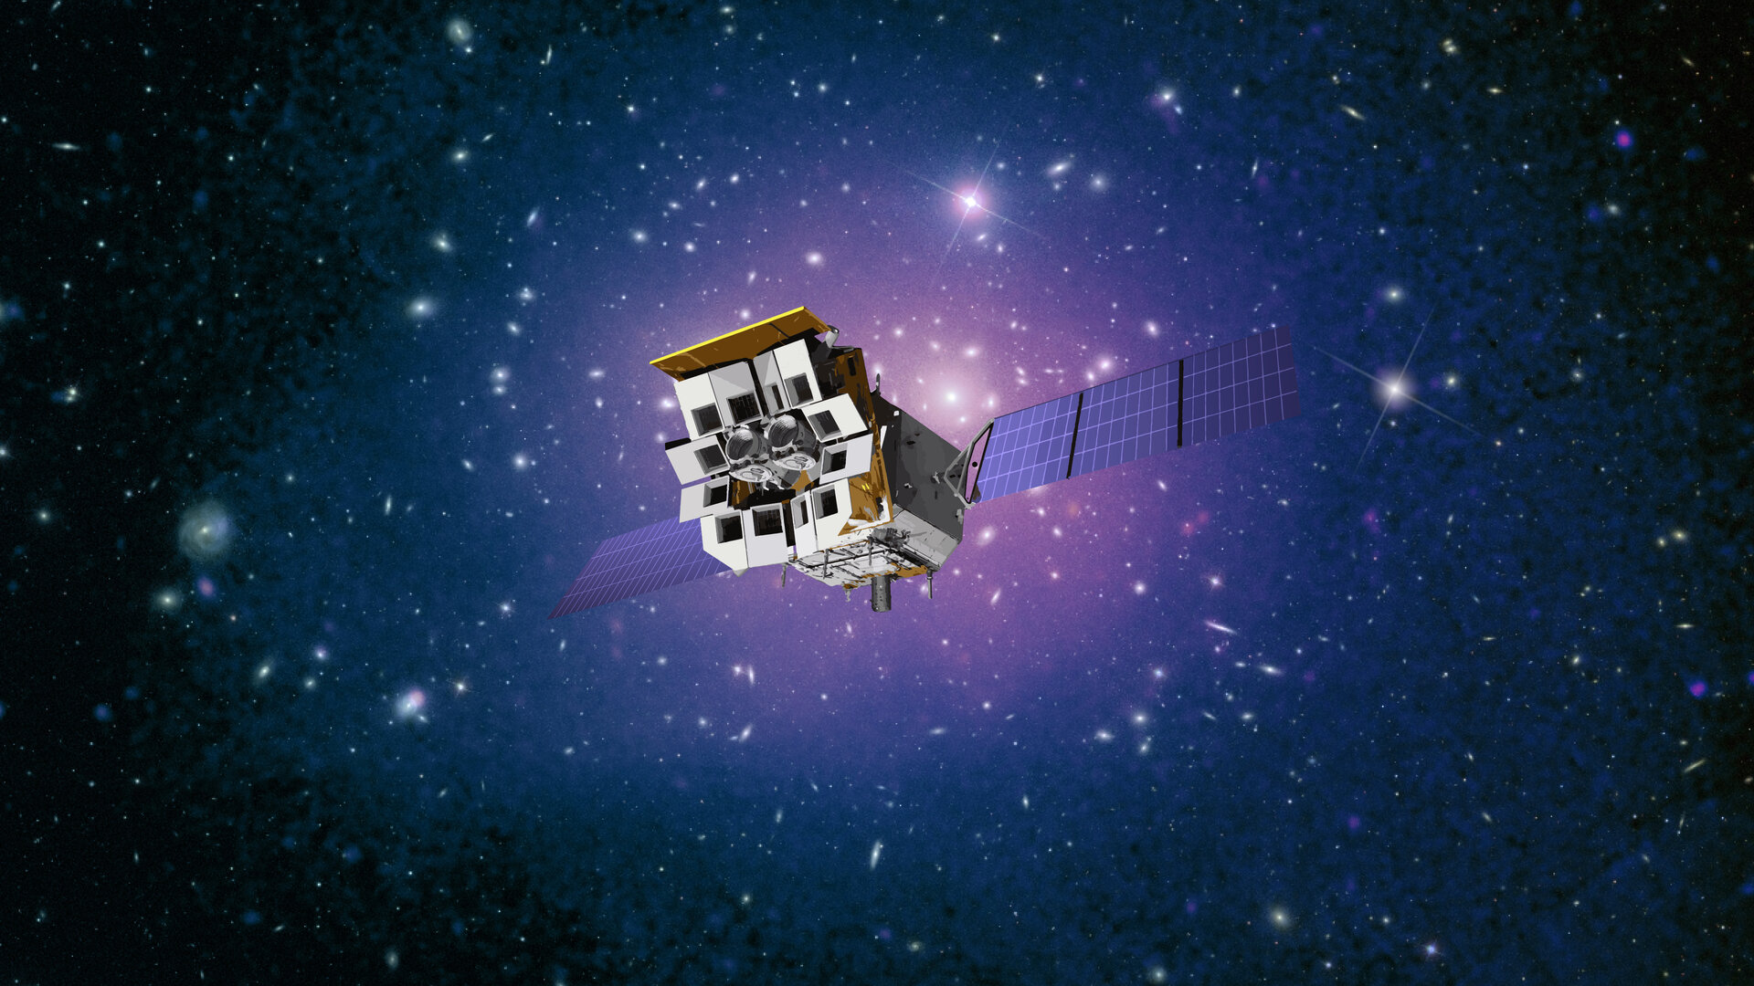



Einstein Probe:
exploring the dynamic X-ray universe
Weimin Yuan
National Astro. Observatories, CAS
on behalf of the Einstein Probe consortium
Image credit CAS/ESA

Slide 2
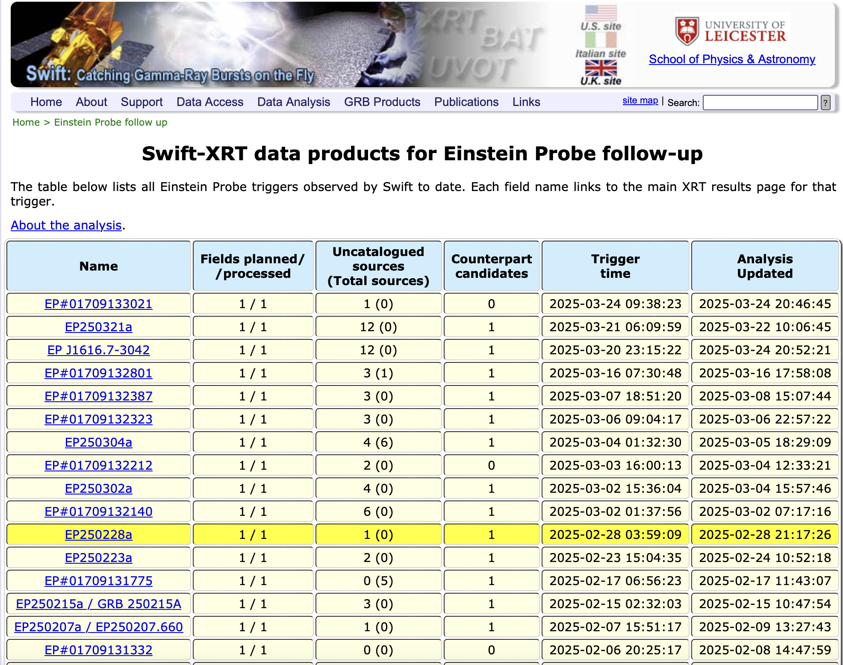
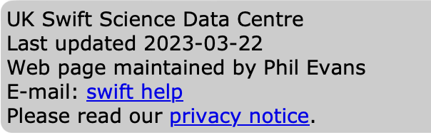
many thanks to
the Swift team!
Notes:
the support to EP from the Swift team can be tranced back to over 10 years ago,
contribution made by Neil

Slide 3
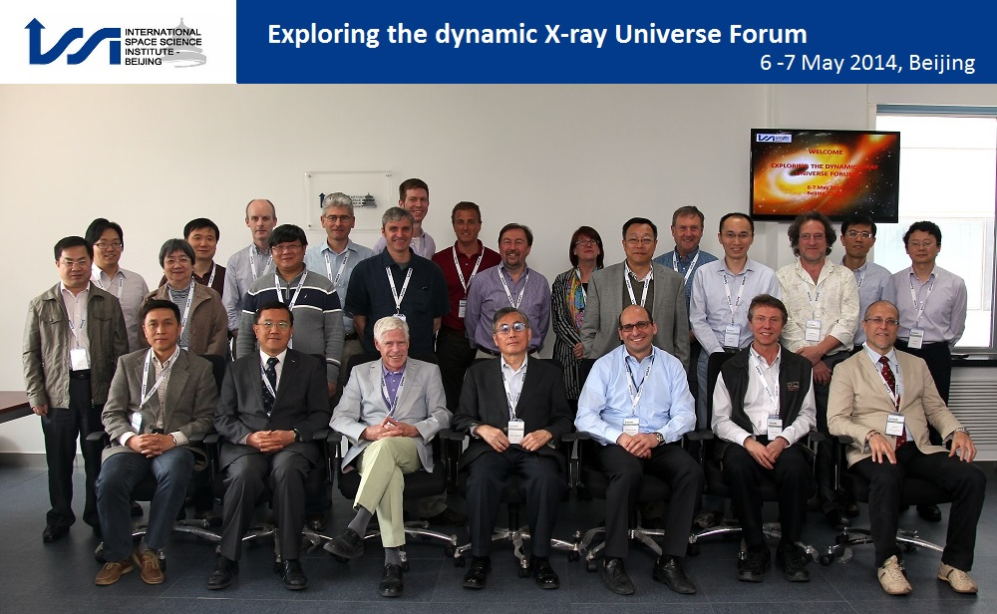
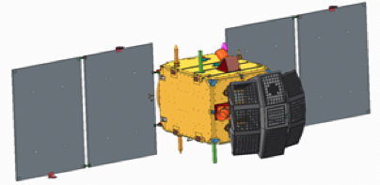

Neil’s contribution to EP
EP in 2013- 2014
2014 at NAO/CAS, Beijing
Neil
2013/01 proposed; 2017/12 Adoption
2024/01/09 launch; 2024/07 delivery

Slide 4
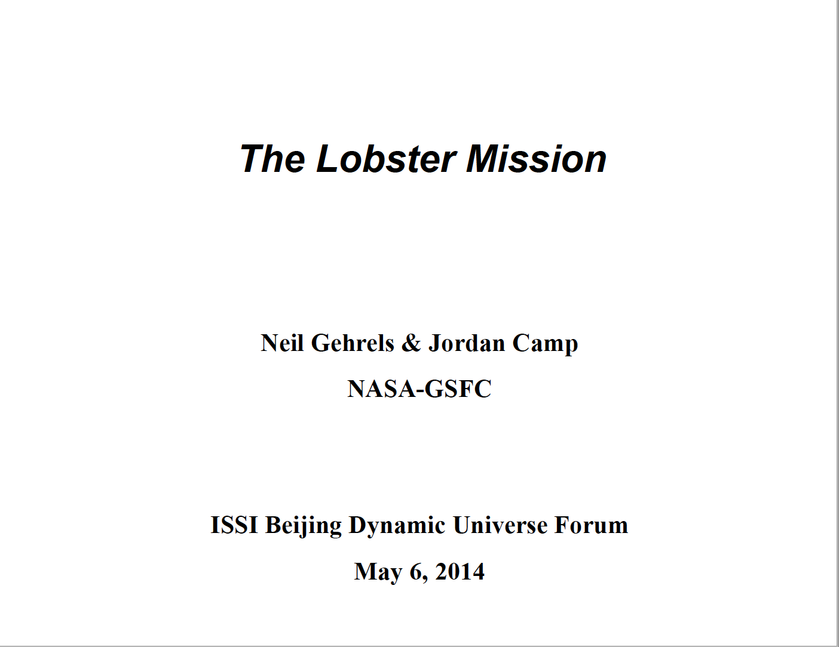
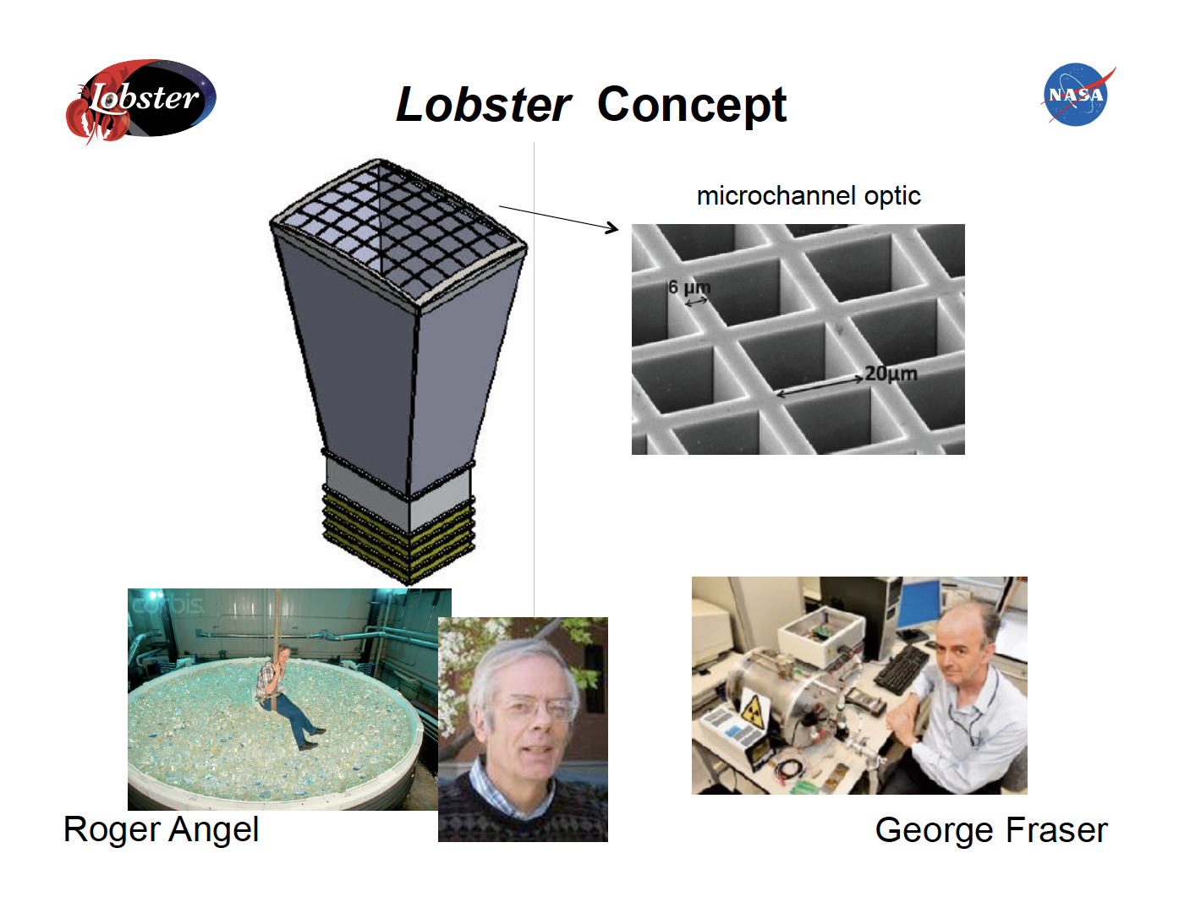
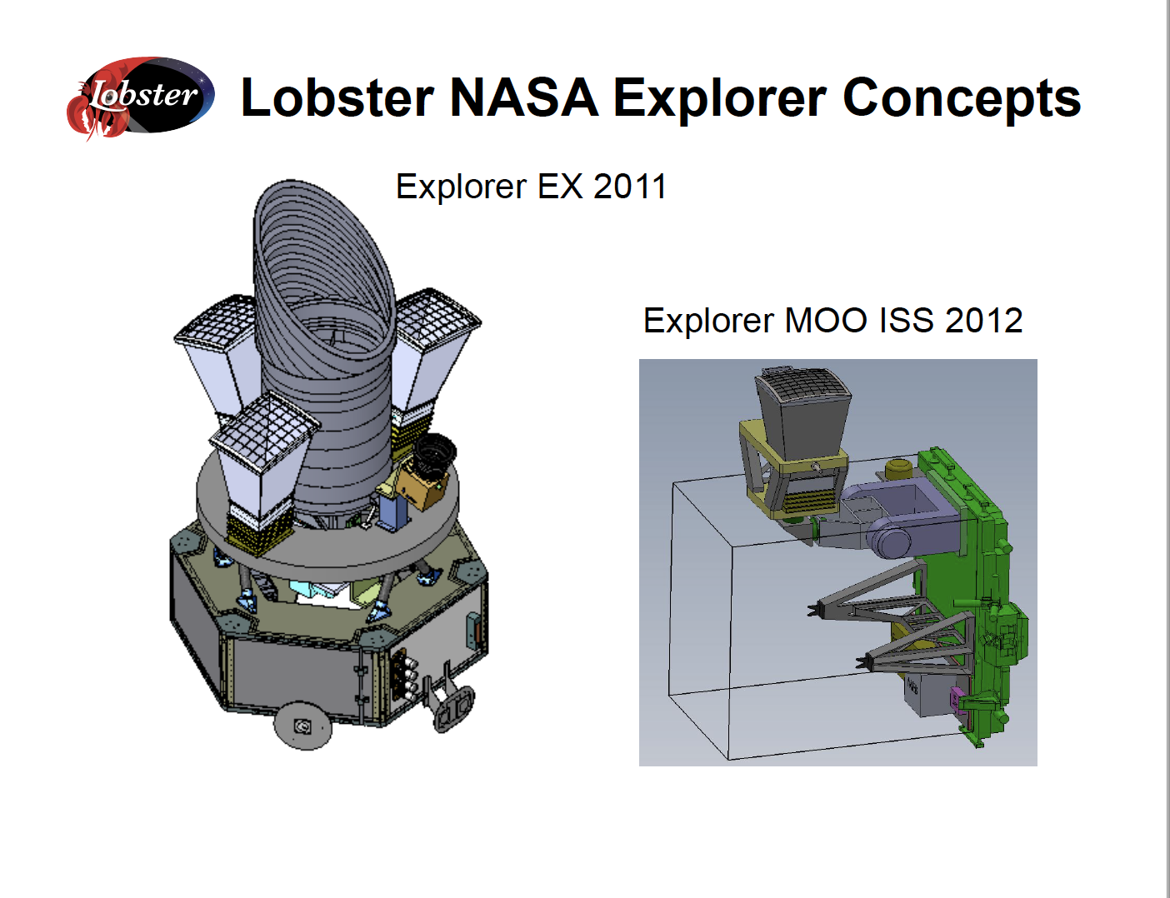
Neil’s presentation at the ISSI-BJ forum on EP
Neil’s presentation
ISSI-BJ forum
2014 May 6
Beijing

Slide 5
we were not alone ……
Paul
Julian
Bertrand
Maurizio
Neil
Luigi

Slide 6
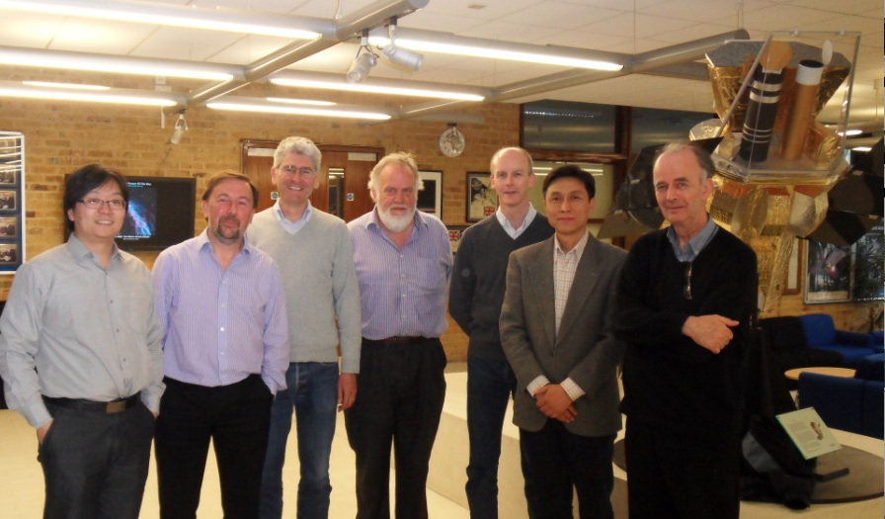
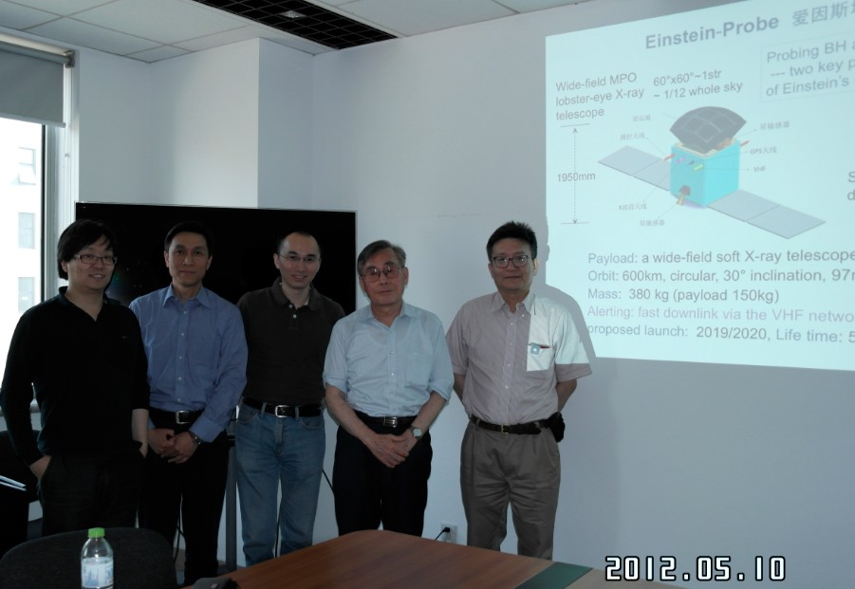
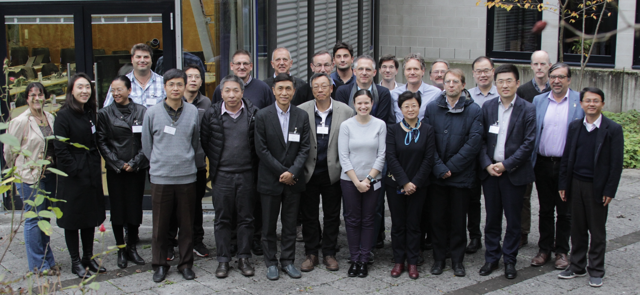
we were not alone ……
Paul
Swift
Dick
Julian
MIke
George
M. Matsuoka
Nobu. Kawai
visit to
Leicester U.
UK 2013
visit of MAXI team
NAOC/CAS
Beijing 2013
EP collaboration meeting at MPE 2019

Slide 7
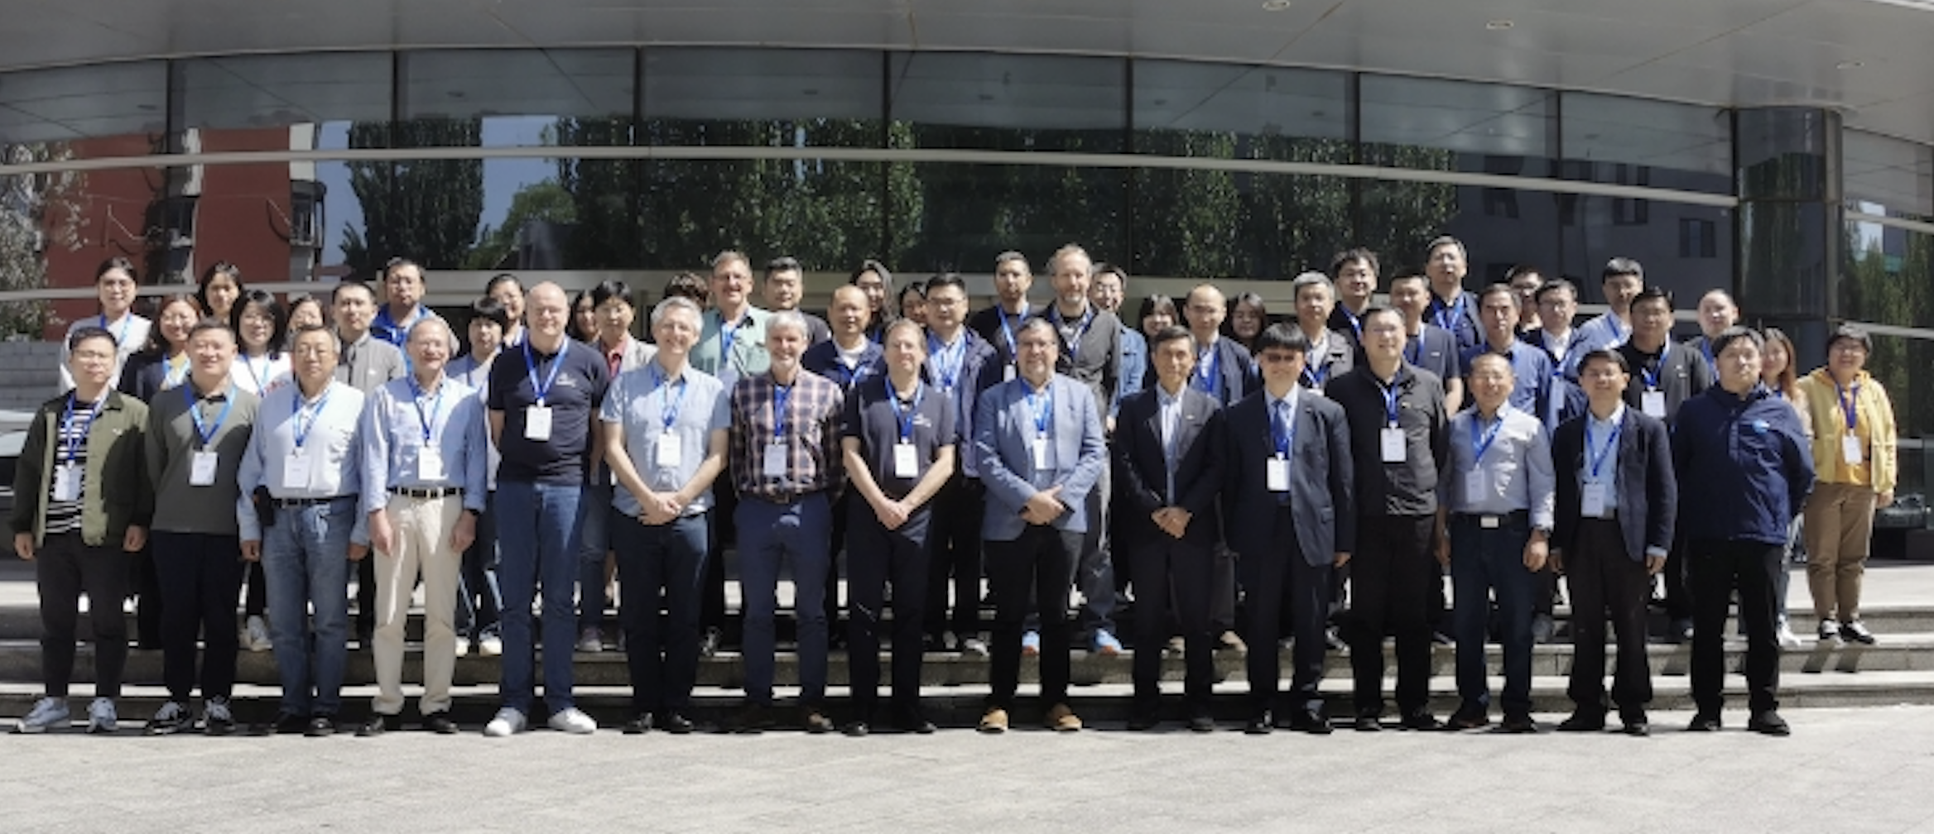
we are not alone ……
Erik Kuulkers
Bertrand
Cordier
2024 Apr NSSC, CAS, Beijing

Slide 8

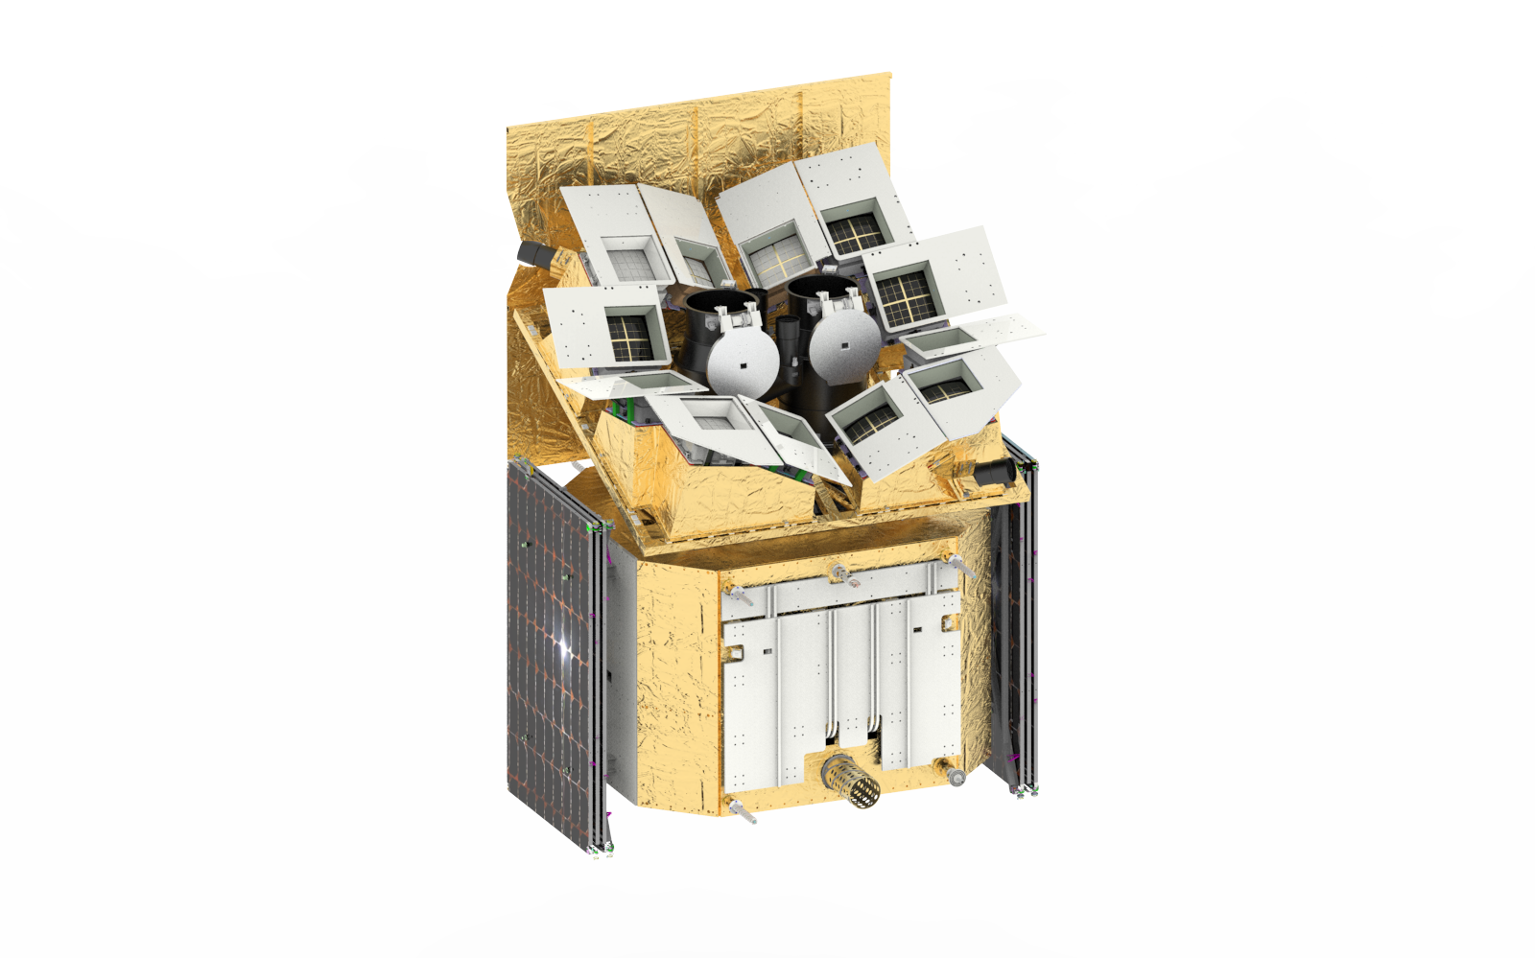

Instruments & spacecraft
Wide-field X-ray Telescope
WXT (12 modules)
Spacecraft
Lobster-eye MPO + CMOS
FoV: ~3,600 sq deg (1.1 sr)
Band: 0.5 – 4 keV
Resolution: ~ 5’ (FWHM)
Sensitivity: ~1mCrab @1ks
On-board data processing
Quick slew & autonomous follow-up
Follow-up X-ray Telescope
FXT (2 units)
Wolter-1 + pn-CCD (eROSITA)
FoV: ~1 deg
Band: 0.3 -10keV
Resolution: 24” (HPD, on-axis)
Effe. area: ~300 cm² @1keV (x 2 units)
Telemetry
X/S-band (several hours)
BD (down/up-link; minutes)
VHF (down-link; minutes)
Yuan, et al. 2022 Handbook of X-ray and Gamma-ray Astrophysics

Slide 9
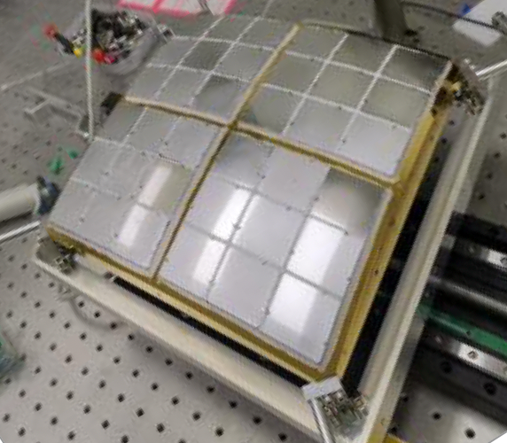
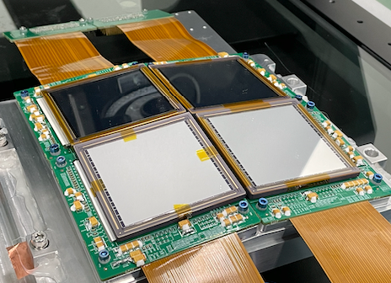


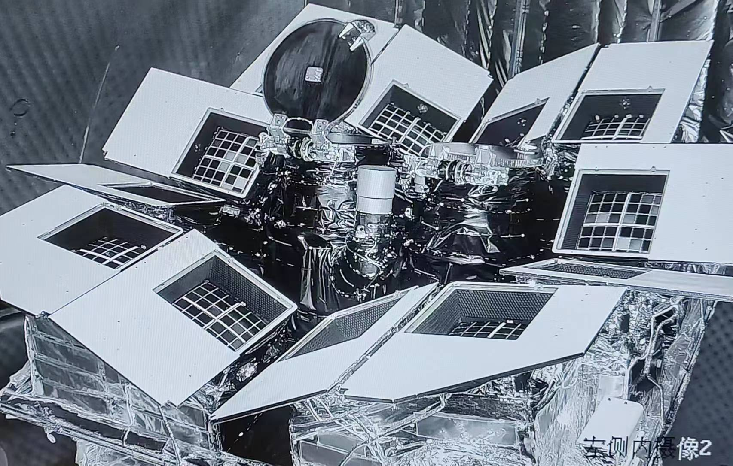
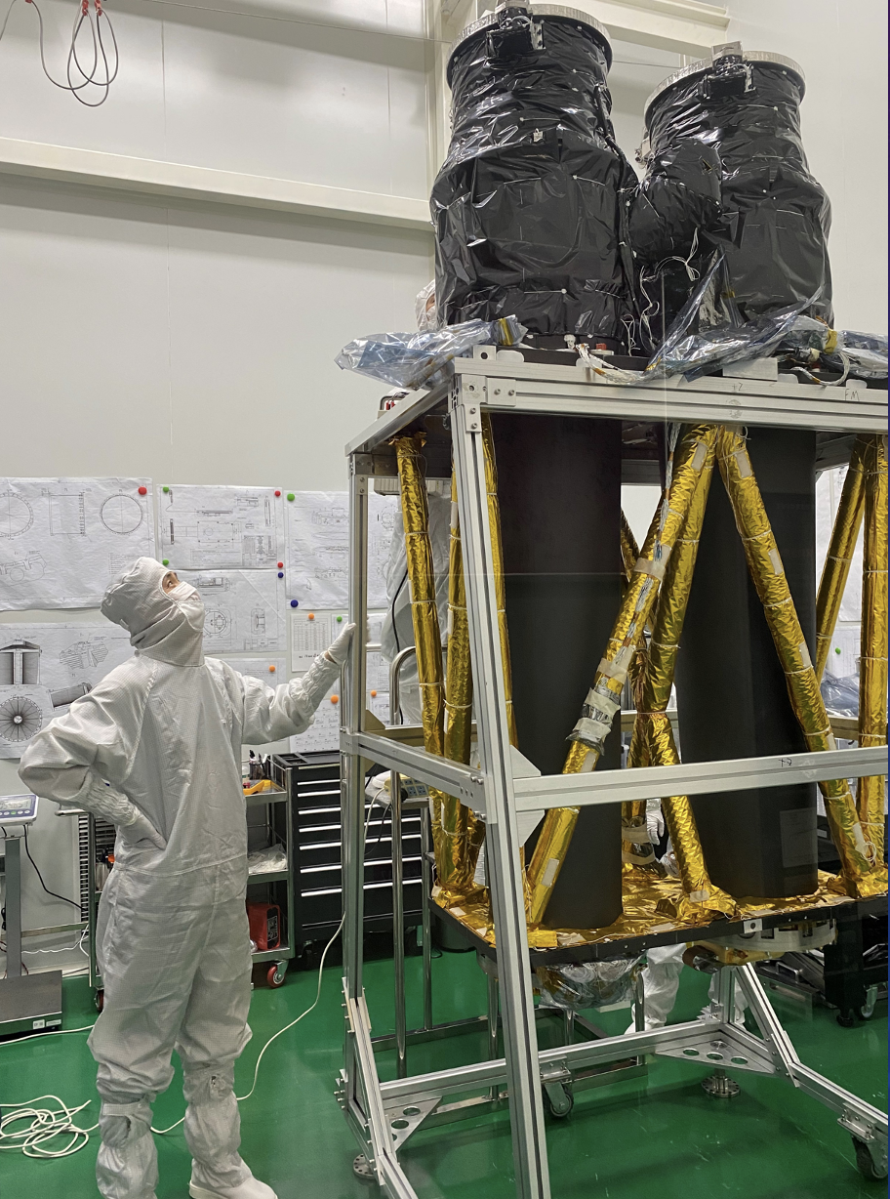

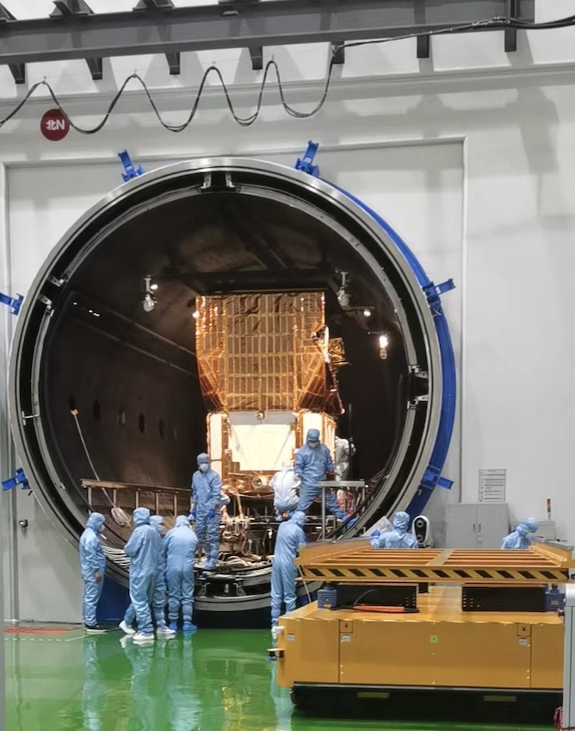
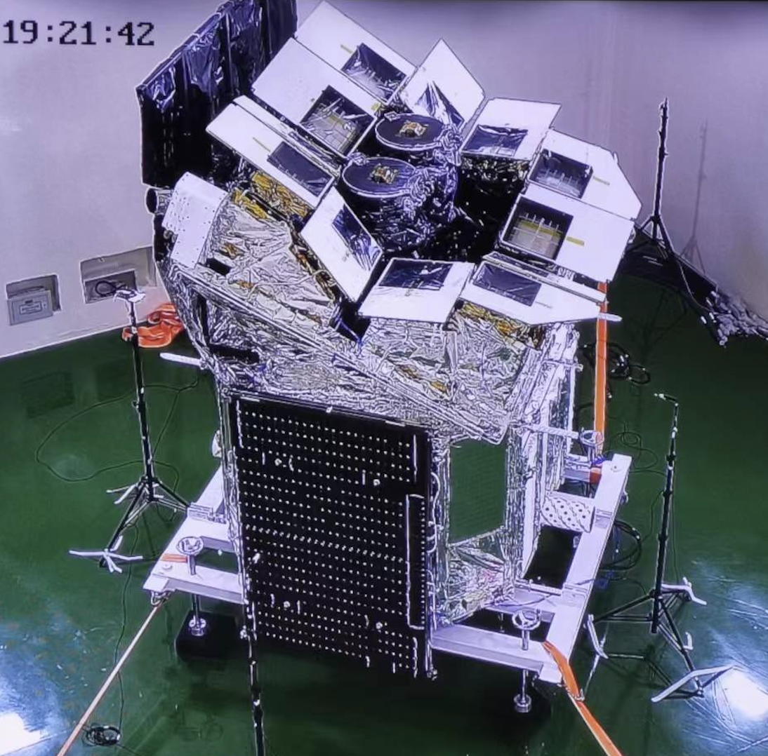
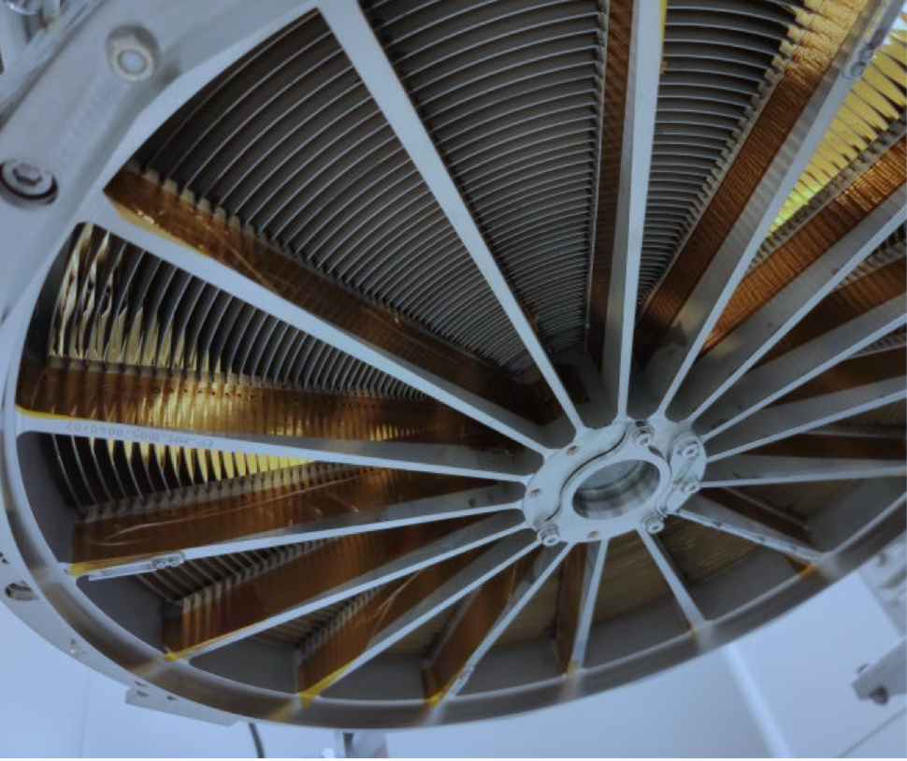
Instruments & spacecraft
WXT chief designer
Xiaojin Sun (SITP/CAS)
Lead of LE mirrors
Chen Zhang (NAO/CAS)
WXT mirror & CMOS detectors (1 module)
PI: Yong Chen
(IHEP/CAS)
FXT mirror assembly FM
(ESA/MediaLario/MPE)
FXT FM built at IHEP/CAS
acoustic test
thermal vacuum tests

Slide 10
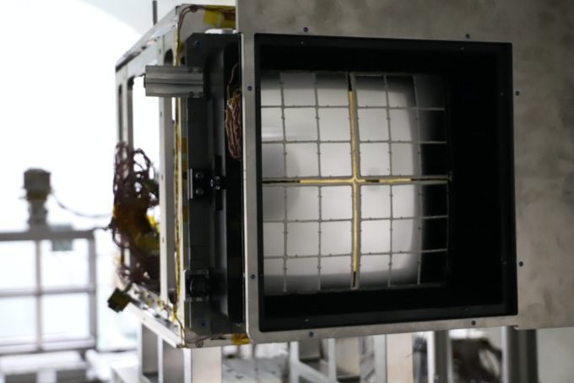
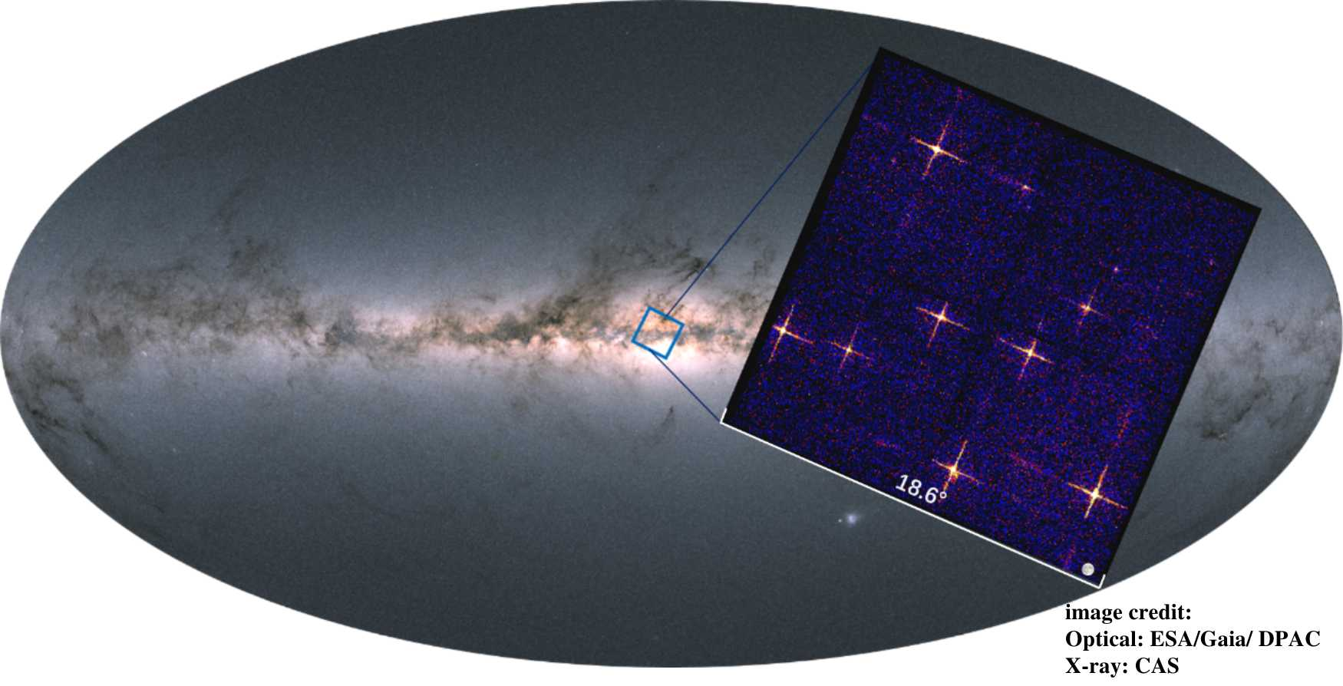
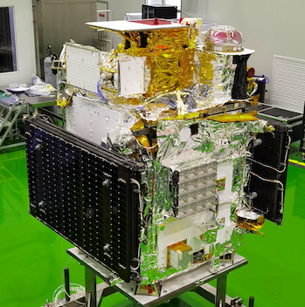
EP-WXT pathfinder LEIA (Lobster Eye Imager for Astronomy)
LEIA first light
August 8-10, 2022
~800s exposure
FoV 340 deg²
LEIA 0.5 – 4 keV
Size of full Moon
in-orbit performance of Lobster-eye MPO & CMOS demonstrated
CAS’s SATech-01 experiment satellite
Launched 2022-07-27
credit: MicroSAT
Frist wide FoV X-ray observations by a lobster-eye focusing X-ray telescope in orbit Zhang et al. 2022 ApJL, 941, L2

Slide 11
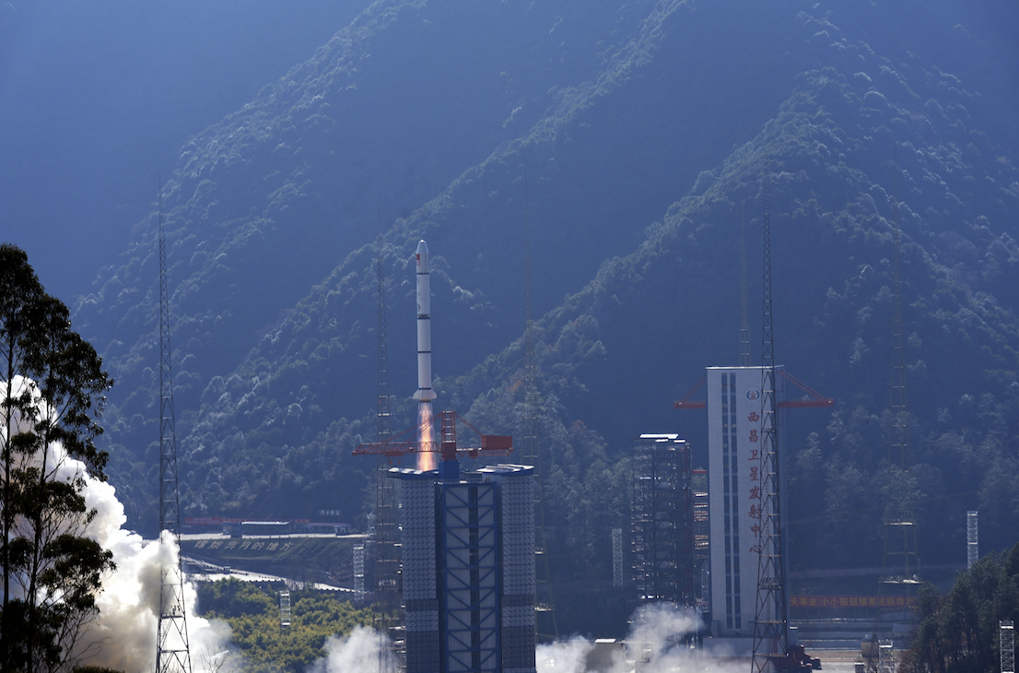
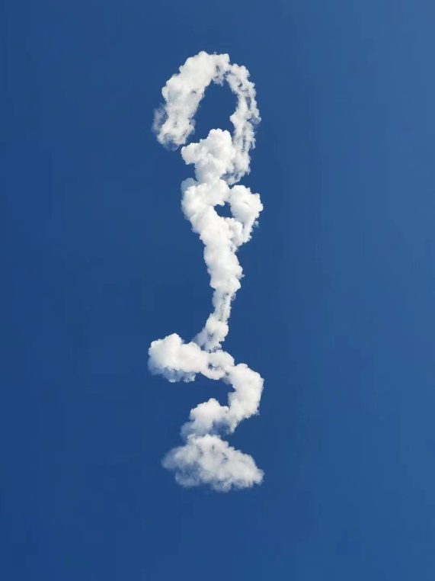
Launch of EP on Jan. 9, 2024
6 yrs after mission adoption
11 yrs after EP proposed
13 yrs after beginning of MPO technology R&D @ NAOC/CAS
LM-2C @Xichang
A loong in Chinese mythology

Slide 12

  S/C-launcher separation
  height 592 km
  orbital period 96min
  inclination angle 29 deg.

Slide 13
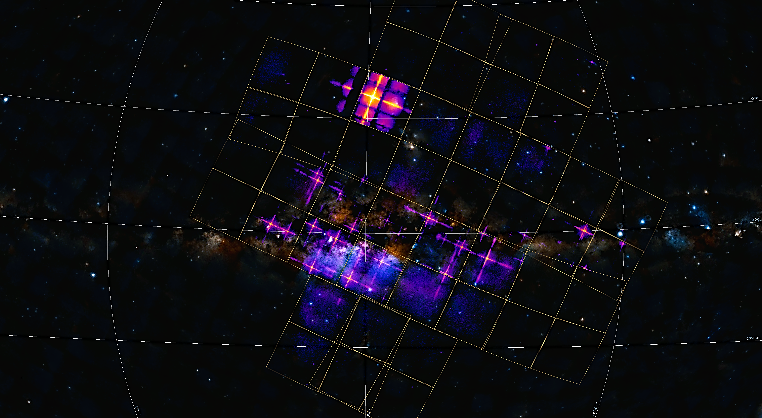
Central region of our Galaxy (purple, red, yellow)
9.3°
WXT FoV 3850 sq. deg.
2
exposure 40 kilo-seconds
9
3
6
4
1: Cir x-1 and Swift J151857.0-572147
2: Sco X-1
3: V2216 Oph
4: V1101 Sco
5: V821 Ara
6: NP Ser
7: V4134 Sgr
8: Sgr X-4
9: Lupus SN
10: SNR RCW 86
1
10
7
5
8
X-ray data credit: EPSC, image credit: Chen Zhang, Huaqing Cheng.

Slide 14
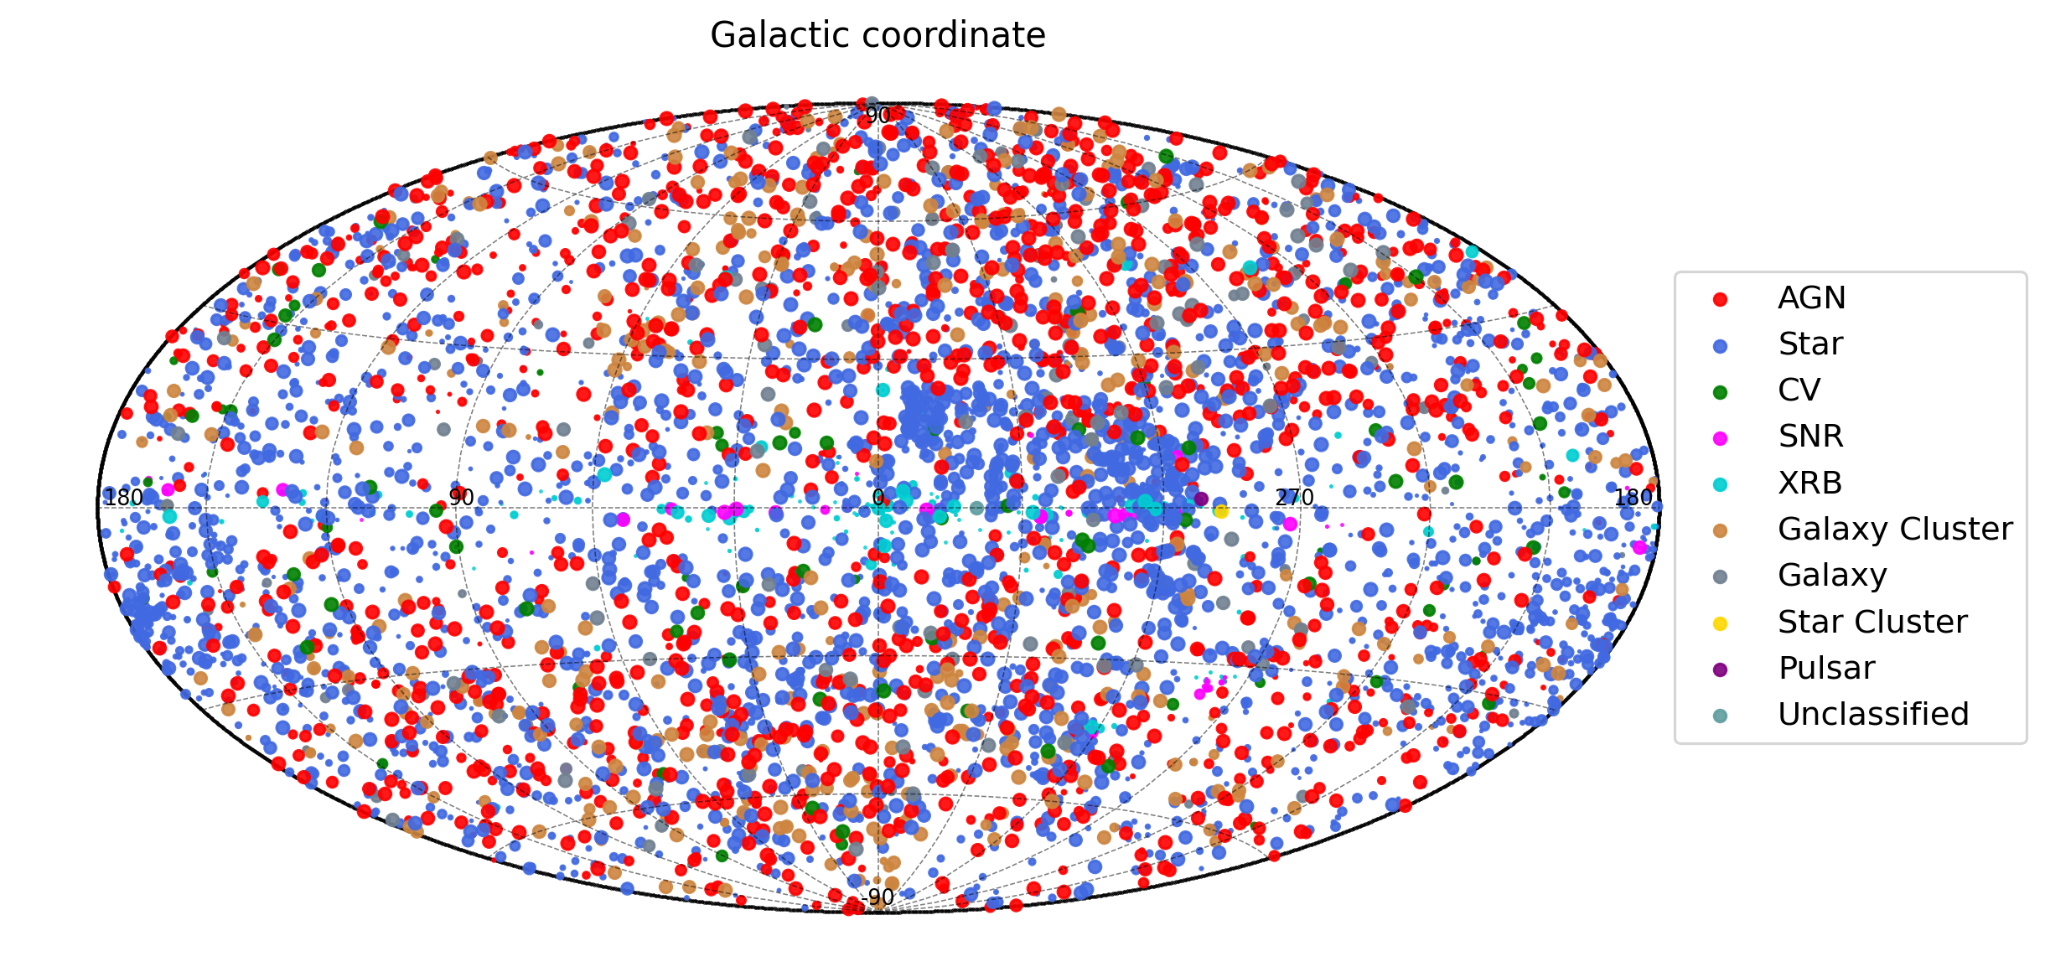
EP-WXT sources （5242）

Slide 15
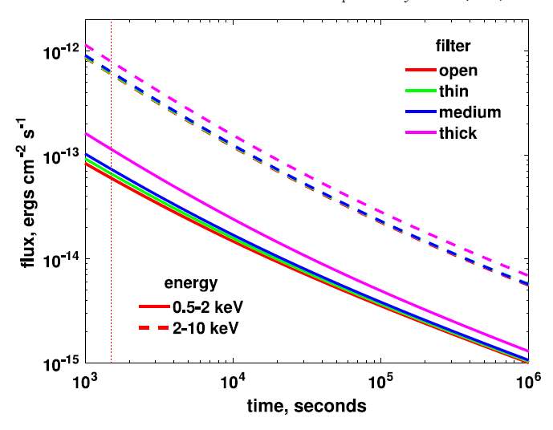
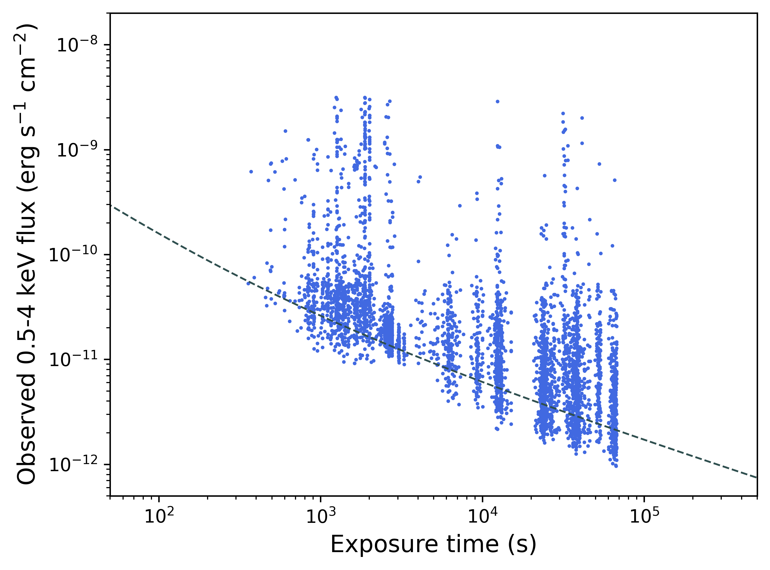
Sensitivity
WXT
FXT (1 unit)
flux vs. exposure for WXT sources

Slide 16
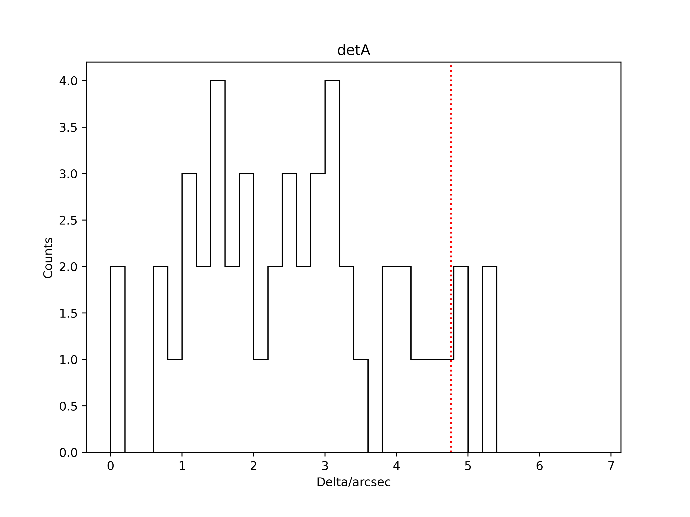
FXT localisation precision for bright sources
90%

Slide 17
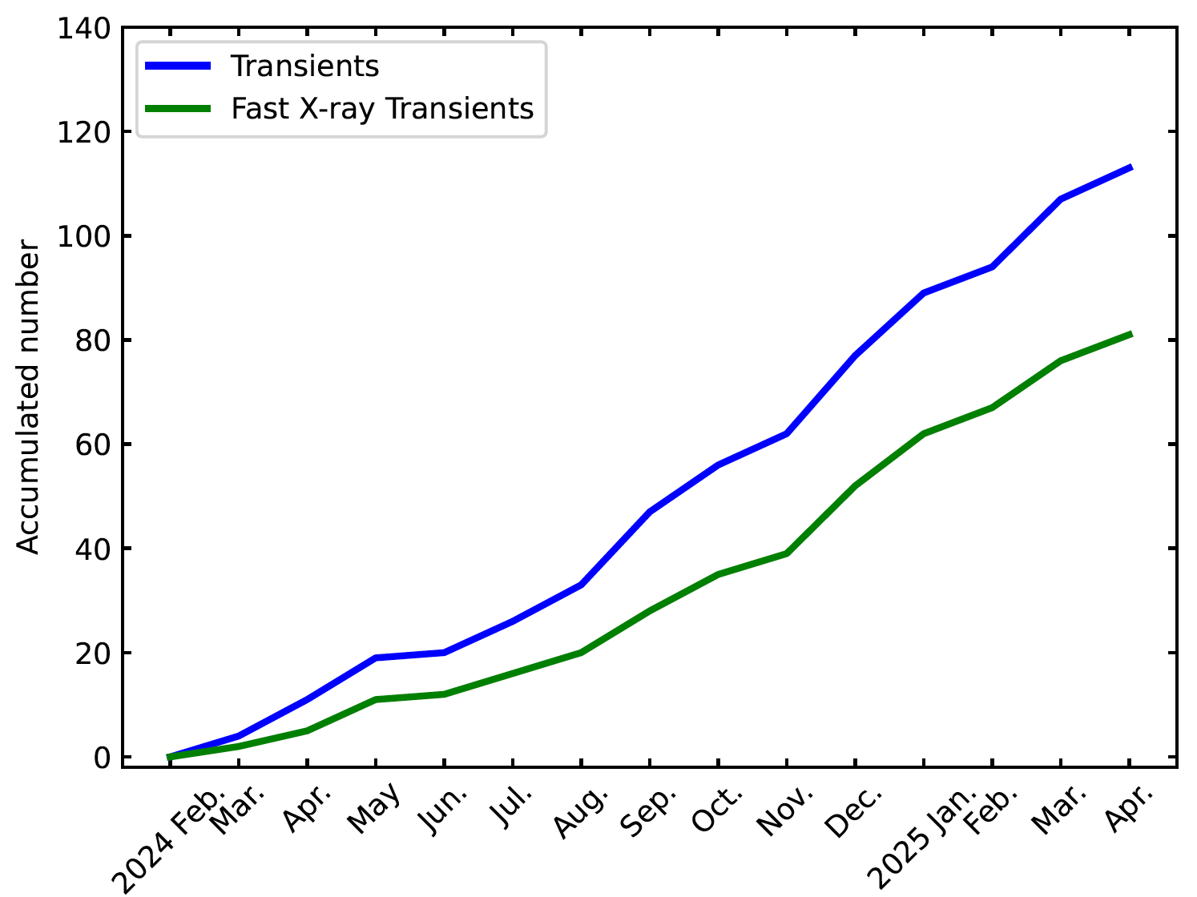
EP X-ray transients since launch
X-ray transients
  WXT:~100 /yr
  all-sky: ~1100/yr
Fast X-ray transients
  WXT: ~ 80 /yr
  all-sky: 880/yr

Slide 18
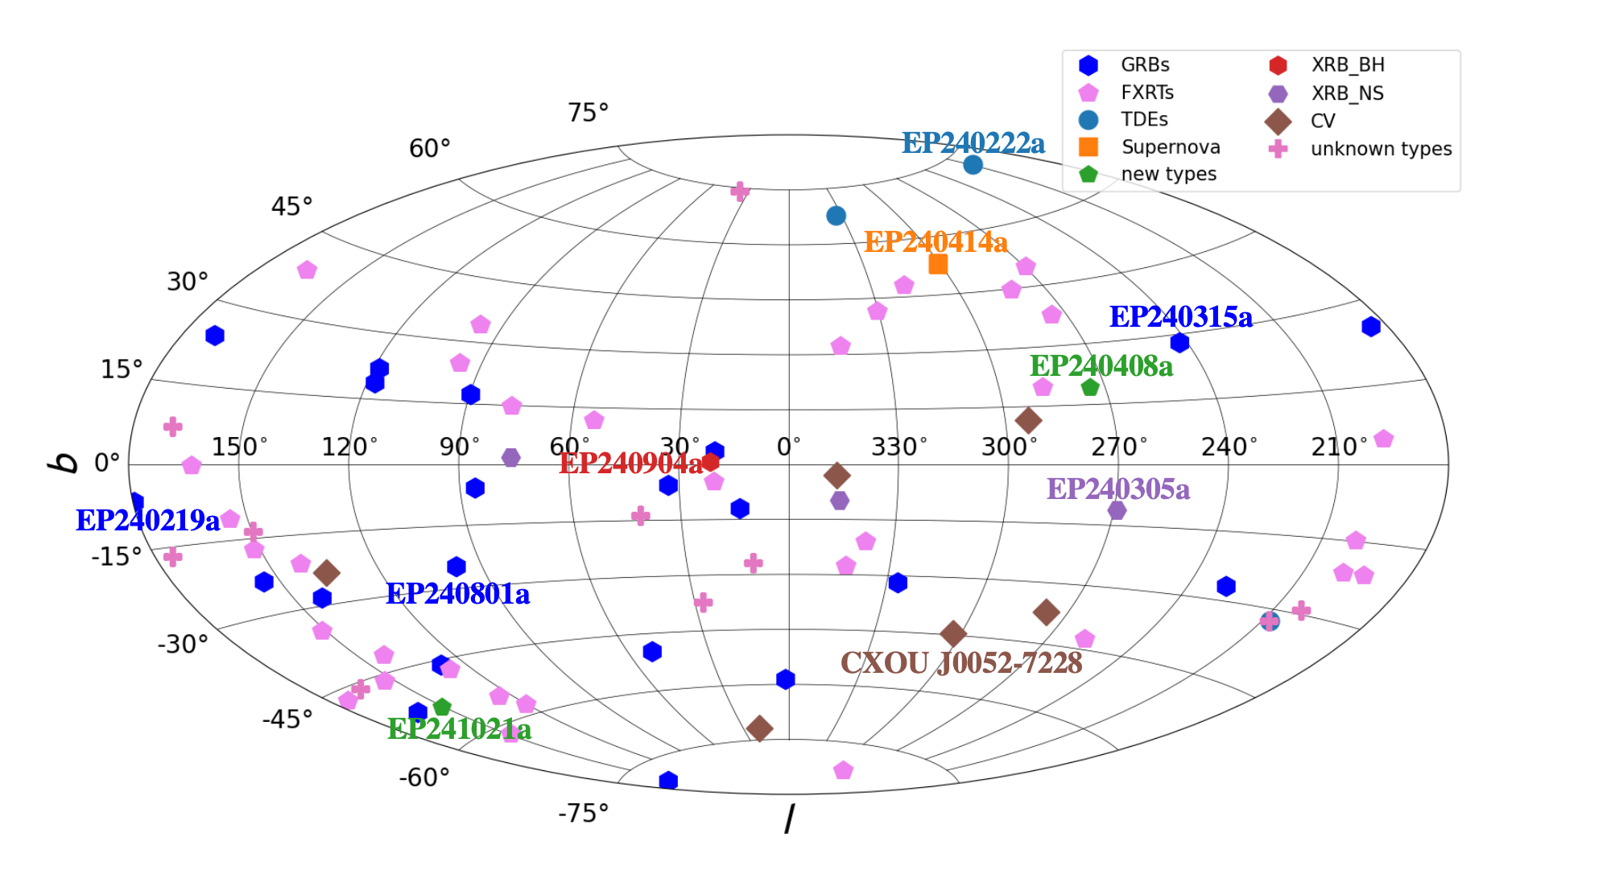
X-ray transients detected by EP-WXT
Hui Sun’s talk
Yuan Liu’s talk
FXTs see Qinyu Wu’s talk

Slide 19
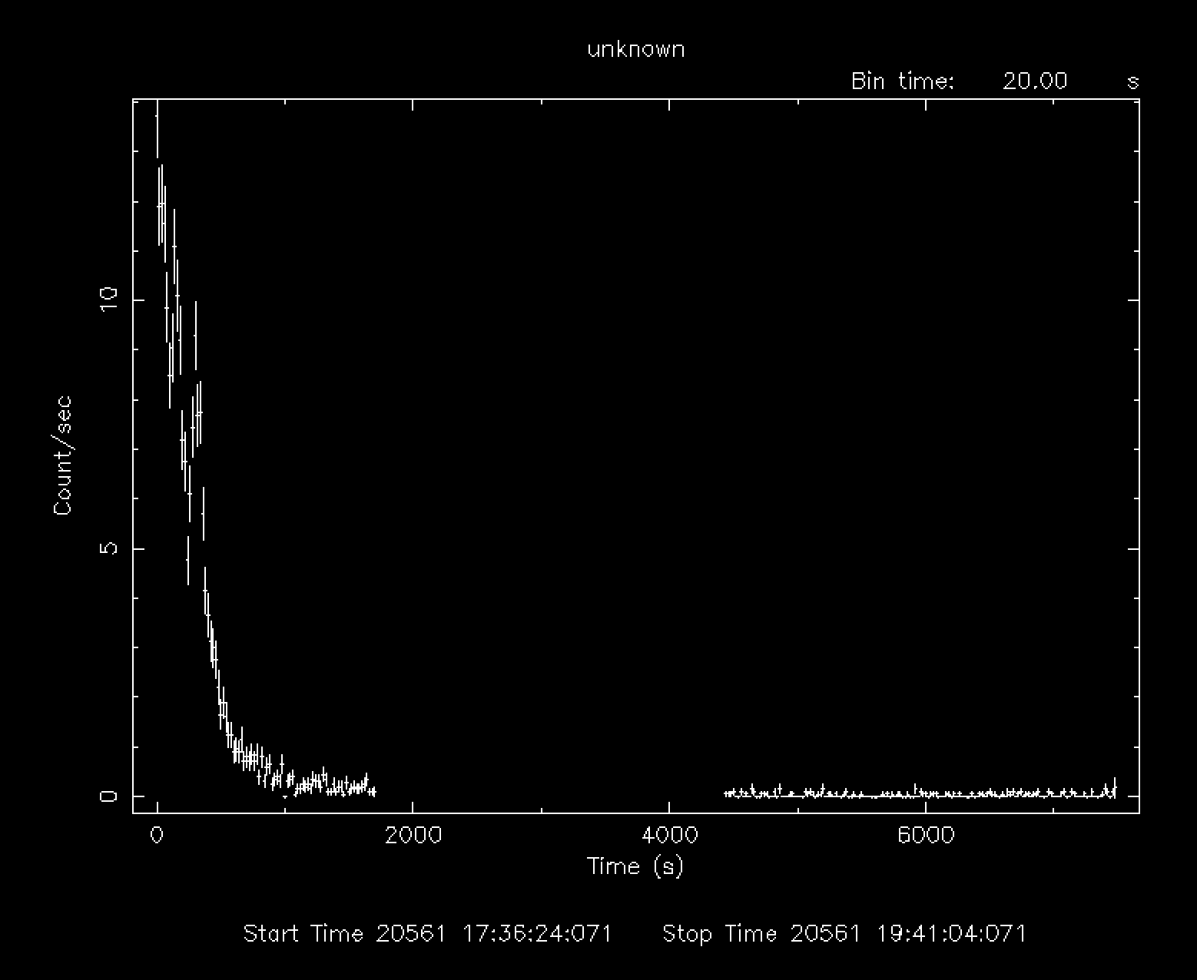
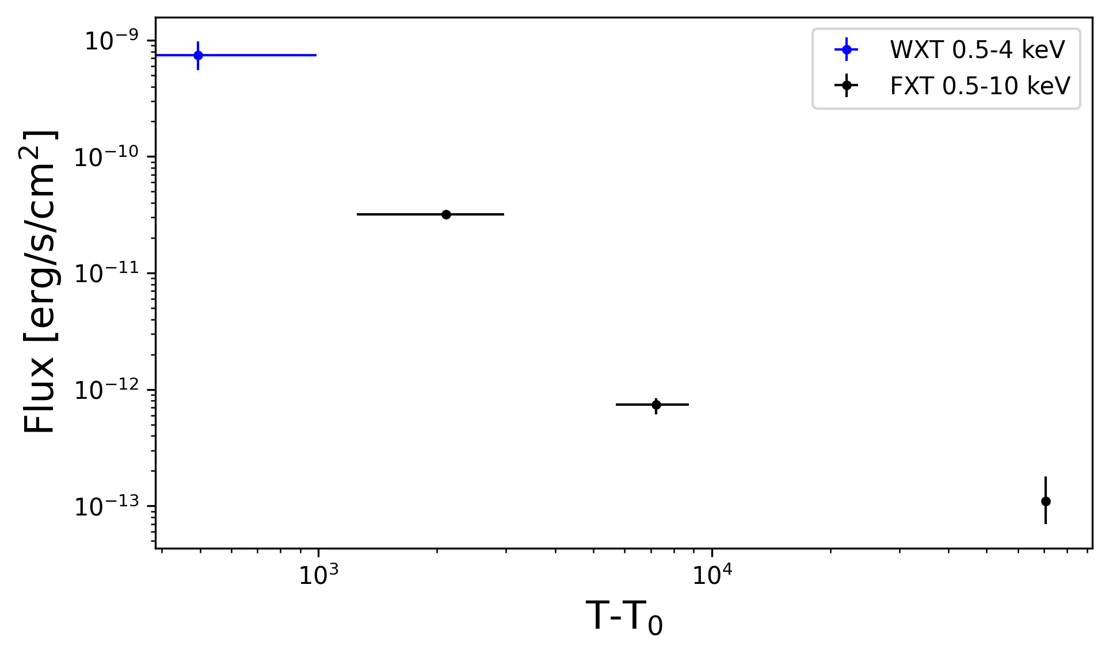
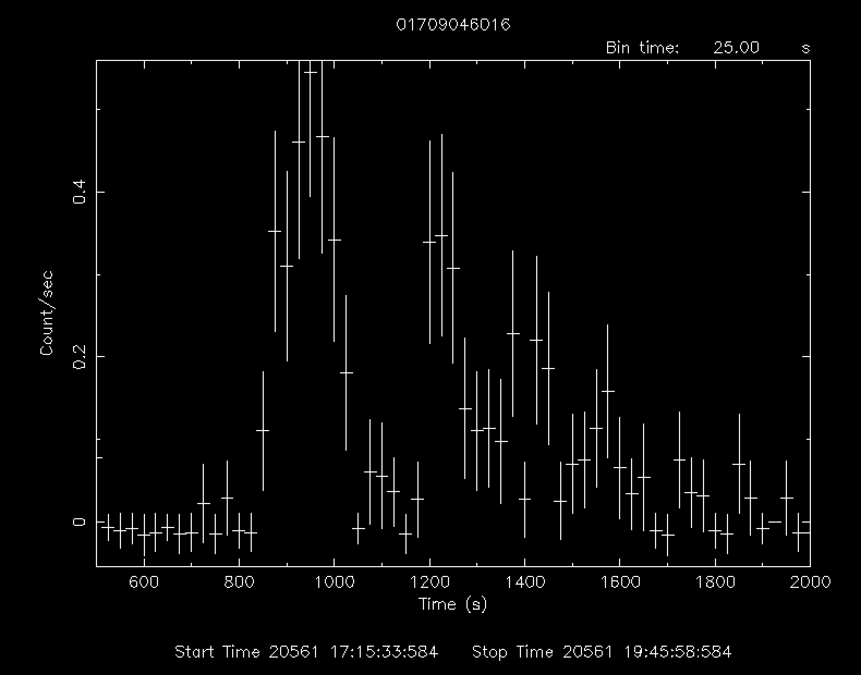
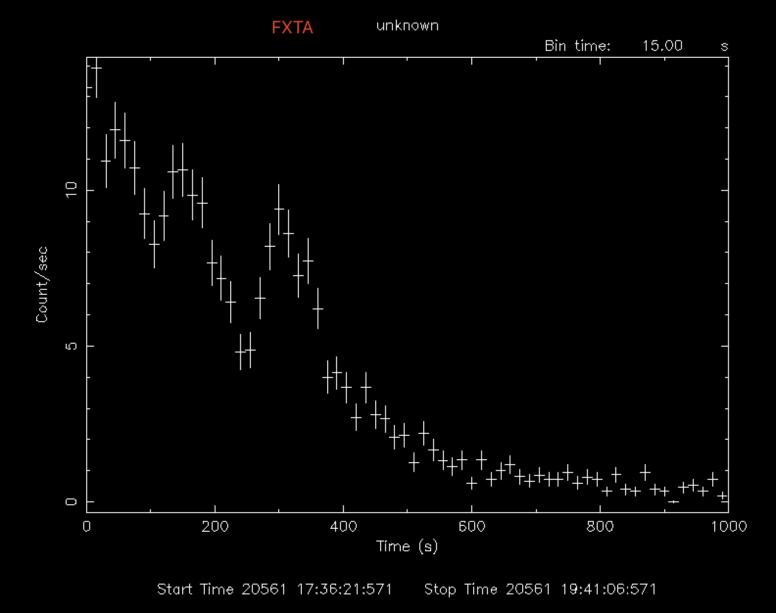
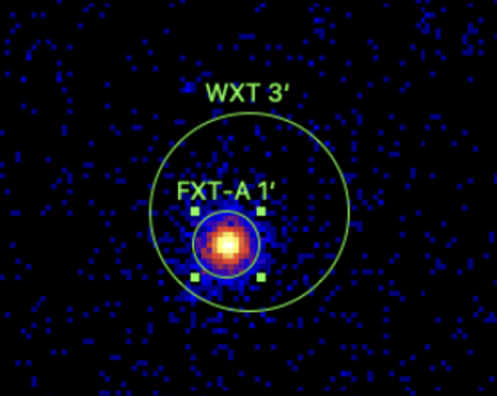
EP240908a: example of quick onboard follow-up
WXT onboard trigger:
  T0=2024-09-08T17:28:27 (UTC)
  peak flux: ~1e-9 erg/s/cm^2
  (EP team et al. GCN 37443)
T0+7min: automated FXT follow-up
  (EP team et al. GCN 37432)
T0+19hrs: FXT ToO
  flux ~1.1x10^(-13) erg/s/cm^2
optical afterglow candidate:
  AB magnitude r ~ 24
  (Quirola-Vasquez et al. GCN 37438)
FXT light curve
no GRB counterpart
WXT light curve
FXT error ~ 5-8arcsec

Slide 20
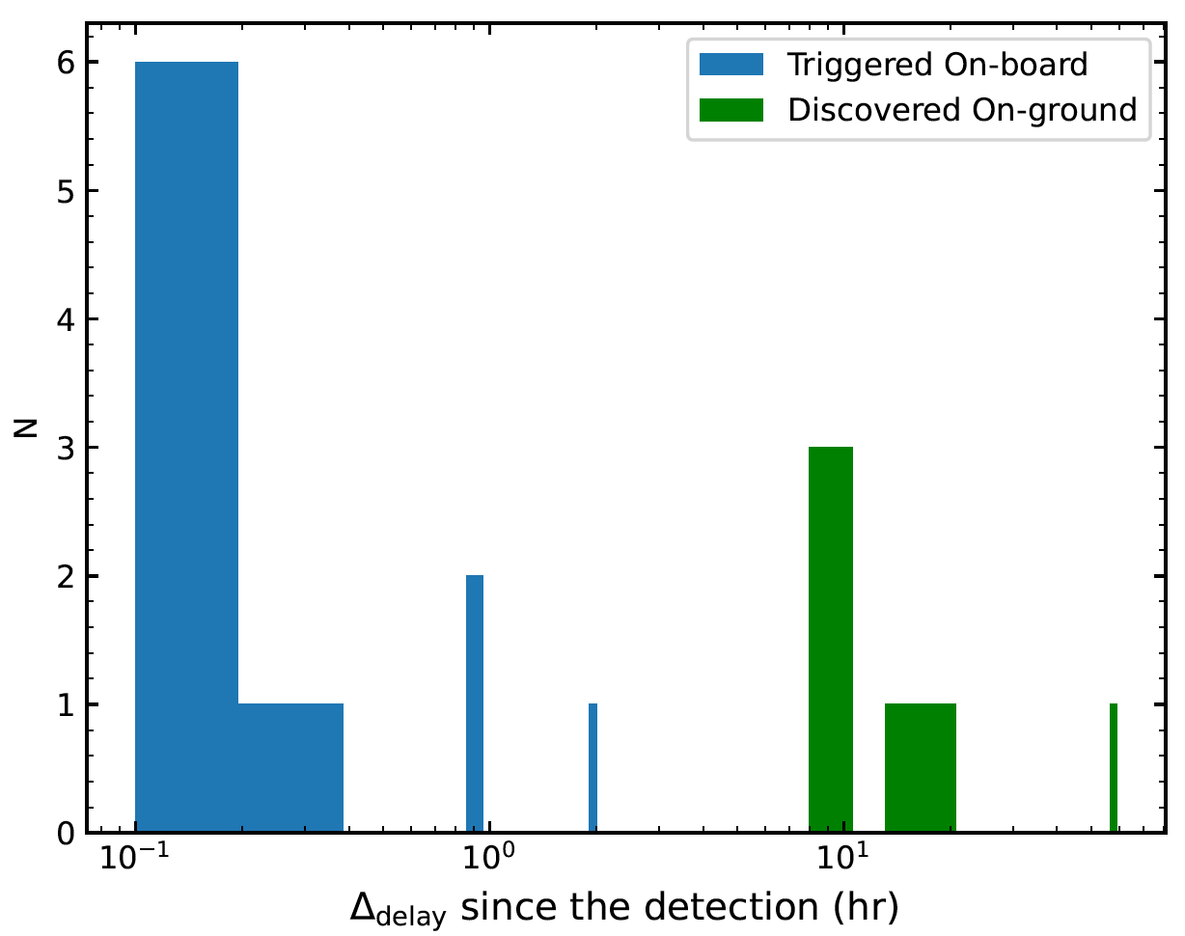
Typical latencies for issuing transient alerts
to be improved

Slide 21
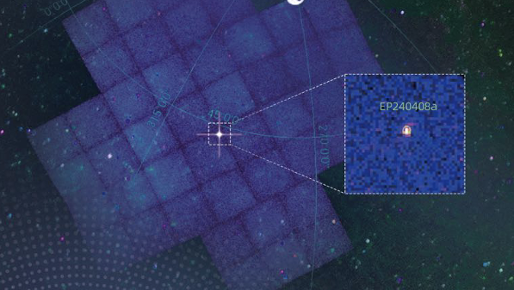
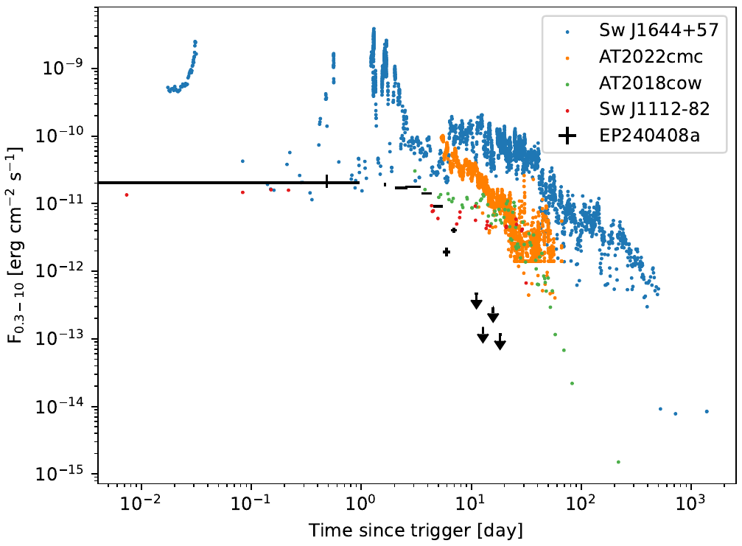
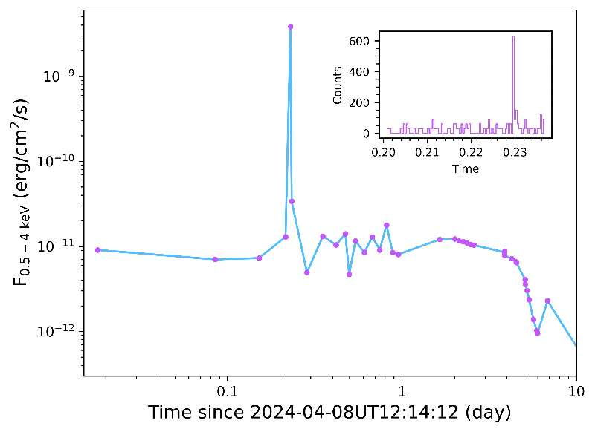
EP240408a: peculiar intermediate-timescale transient
burst of12s duration
Spectral and temporal properties different from known transients;
possibly a new transient type
or IMBH-jetted TDE?
Zhang W., et al. 2025SCPMA..6819511Z
O'Connor B., et al. 2025 ApJL

Slide 22
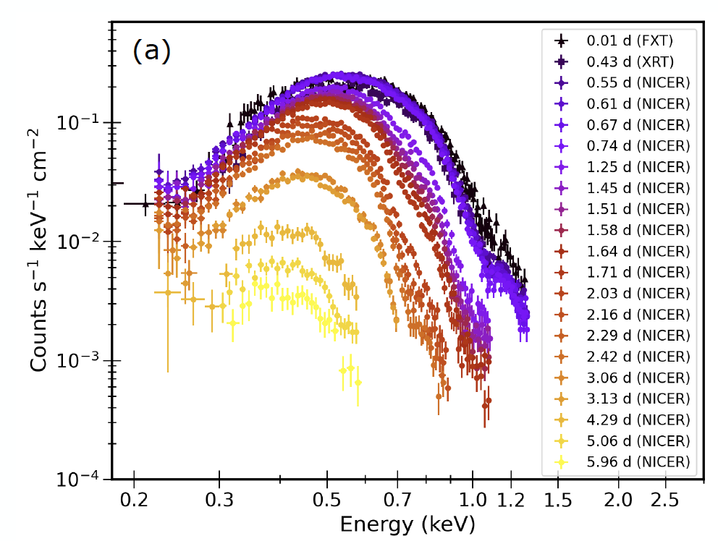
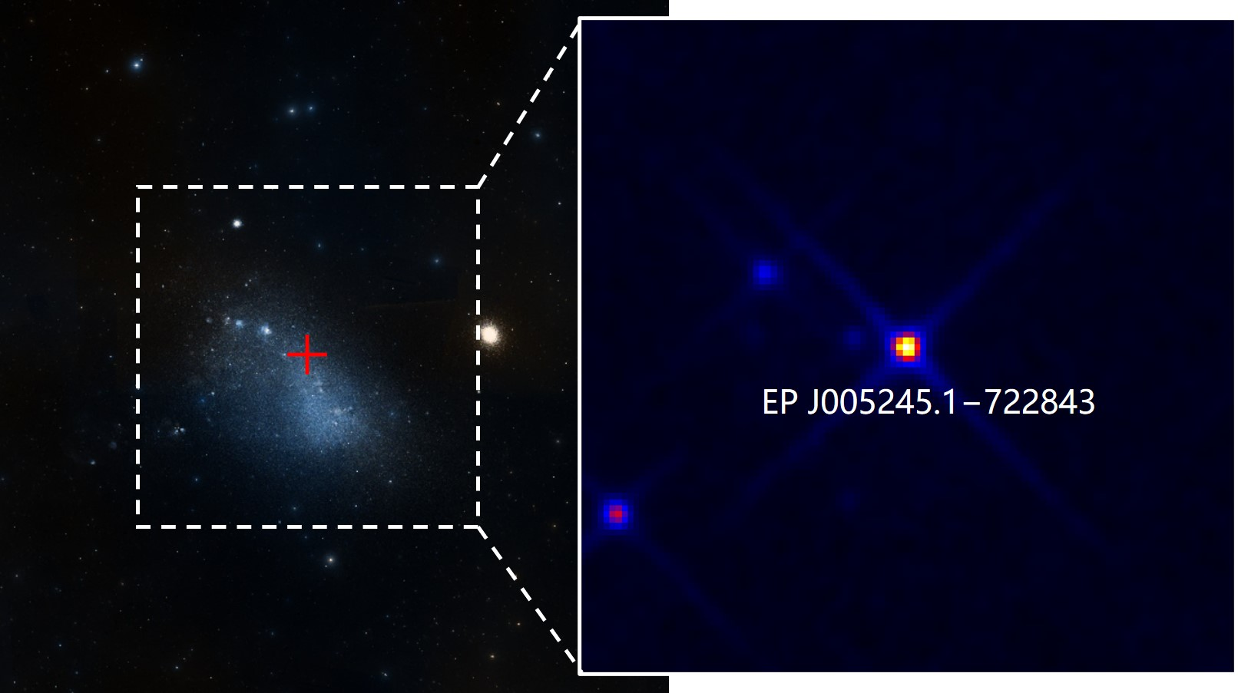
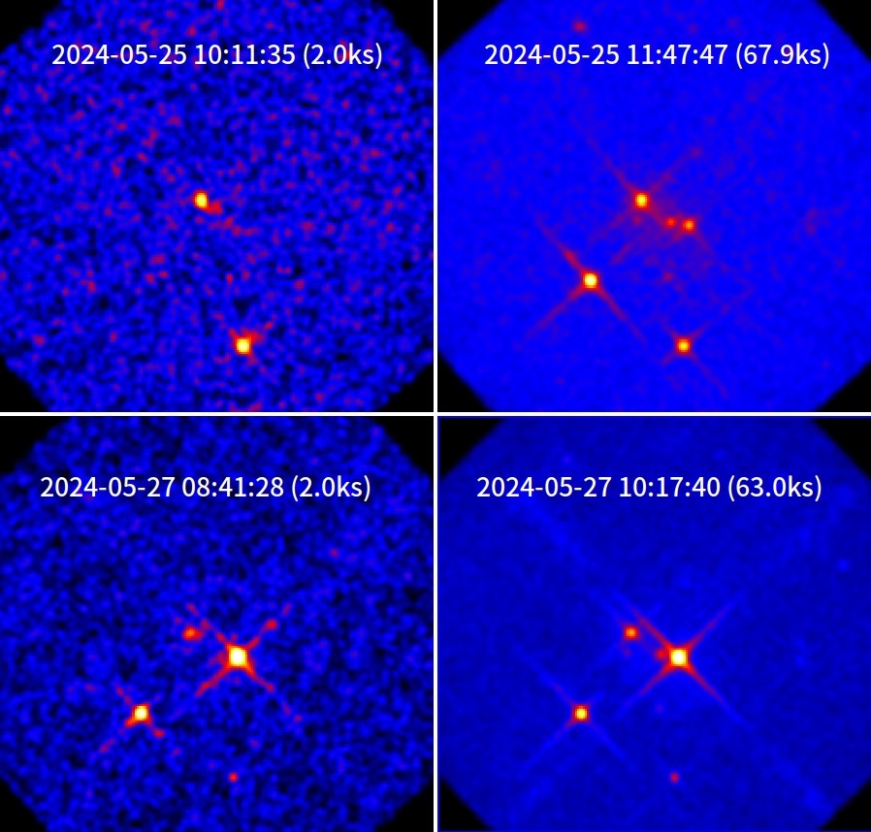
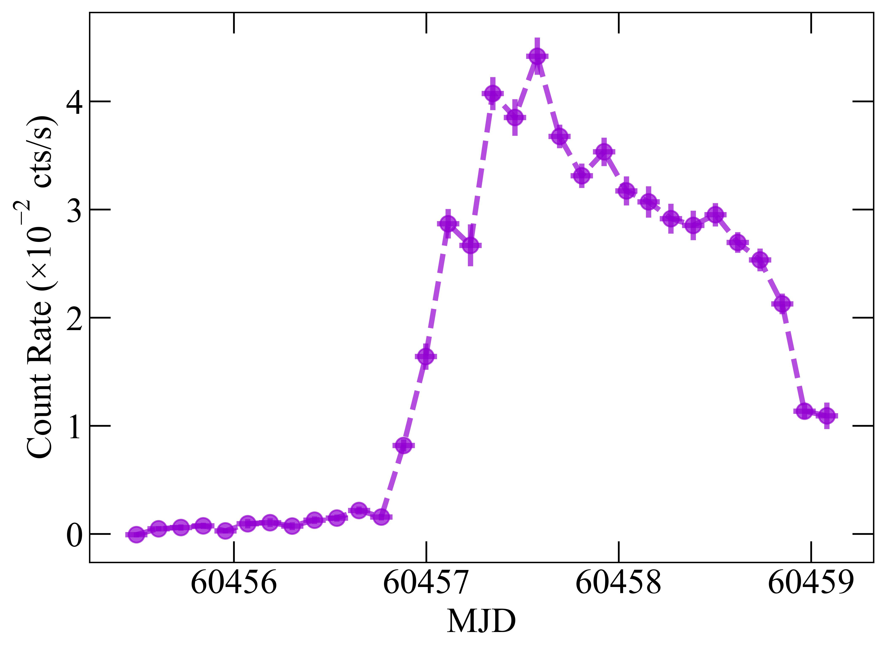
An outburst in Small Magellanic Cloud: Be + WD
thanks to NICER team
WXT lightcurve
0.5-4 keV
CXOU J005245.0-722844 a weak Chandra source
An X-ray outburst detected by EP/WXT (Atel#16631) and Swift/XRT (ATeL# 16633), follow-up by NICER (ATeL# 16636)
very soft X-ray spectrum
a possible Be binary system with a WD
~ 2 days
Gaudin, Coe, Kennea, et al. 2024 MNRAS 534, 1937 (S-CUBED program)
Marino, et al. 2024, ApJL

Slide 23
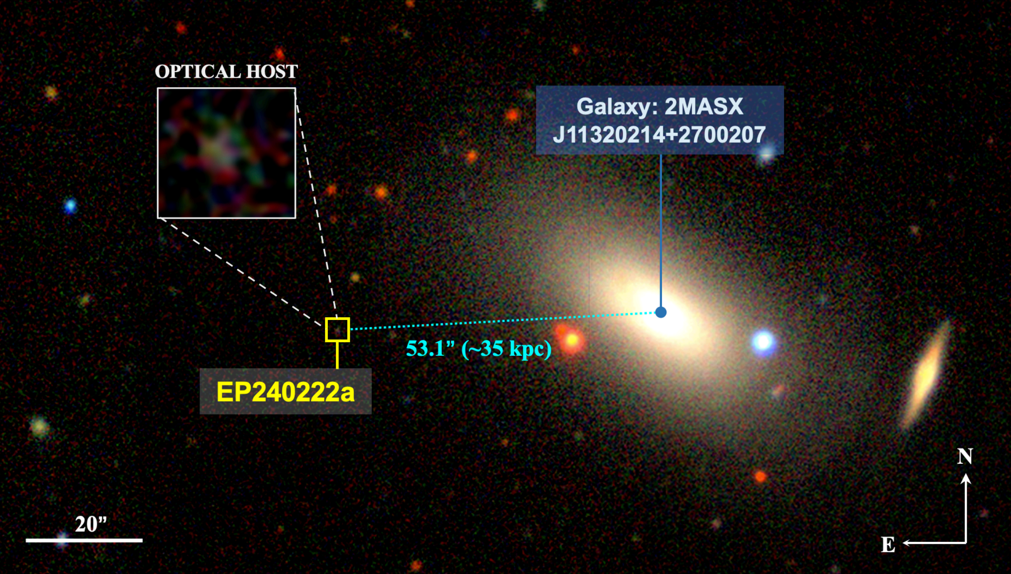
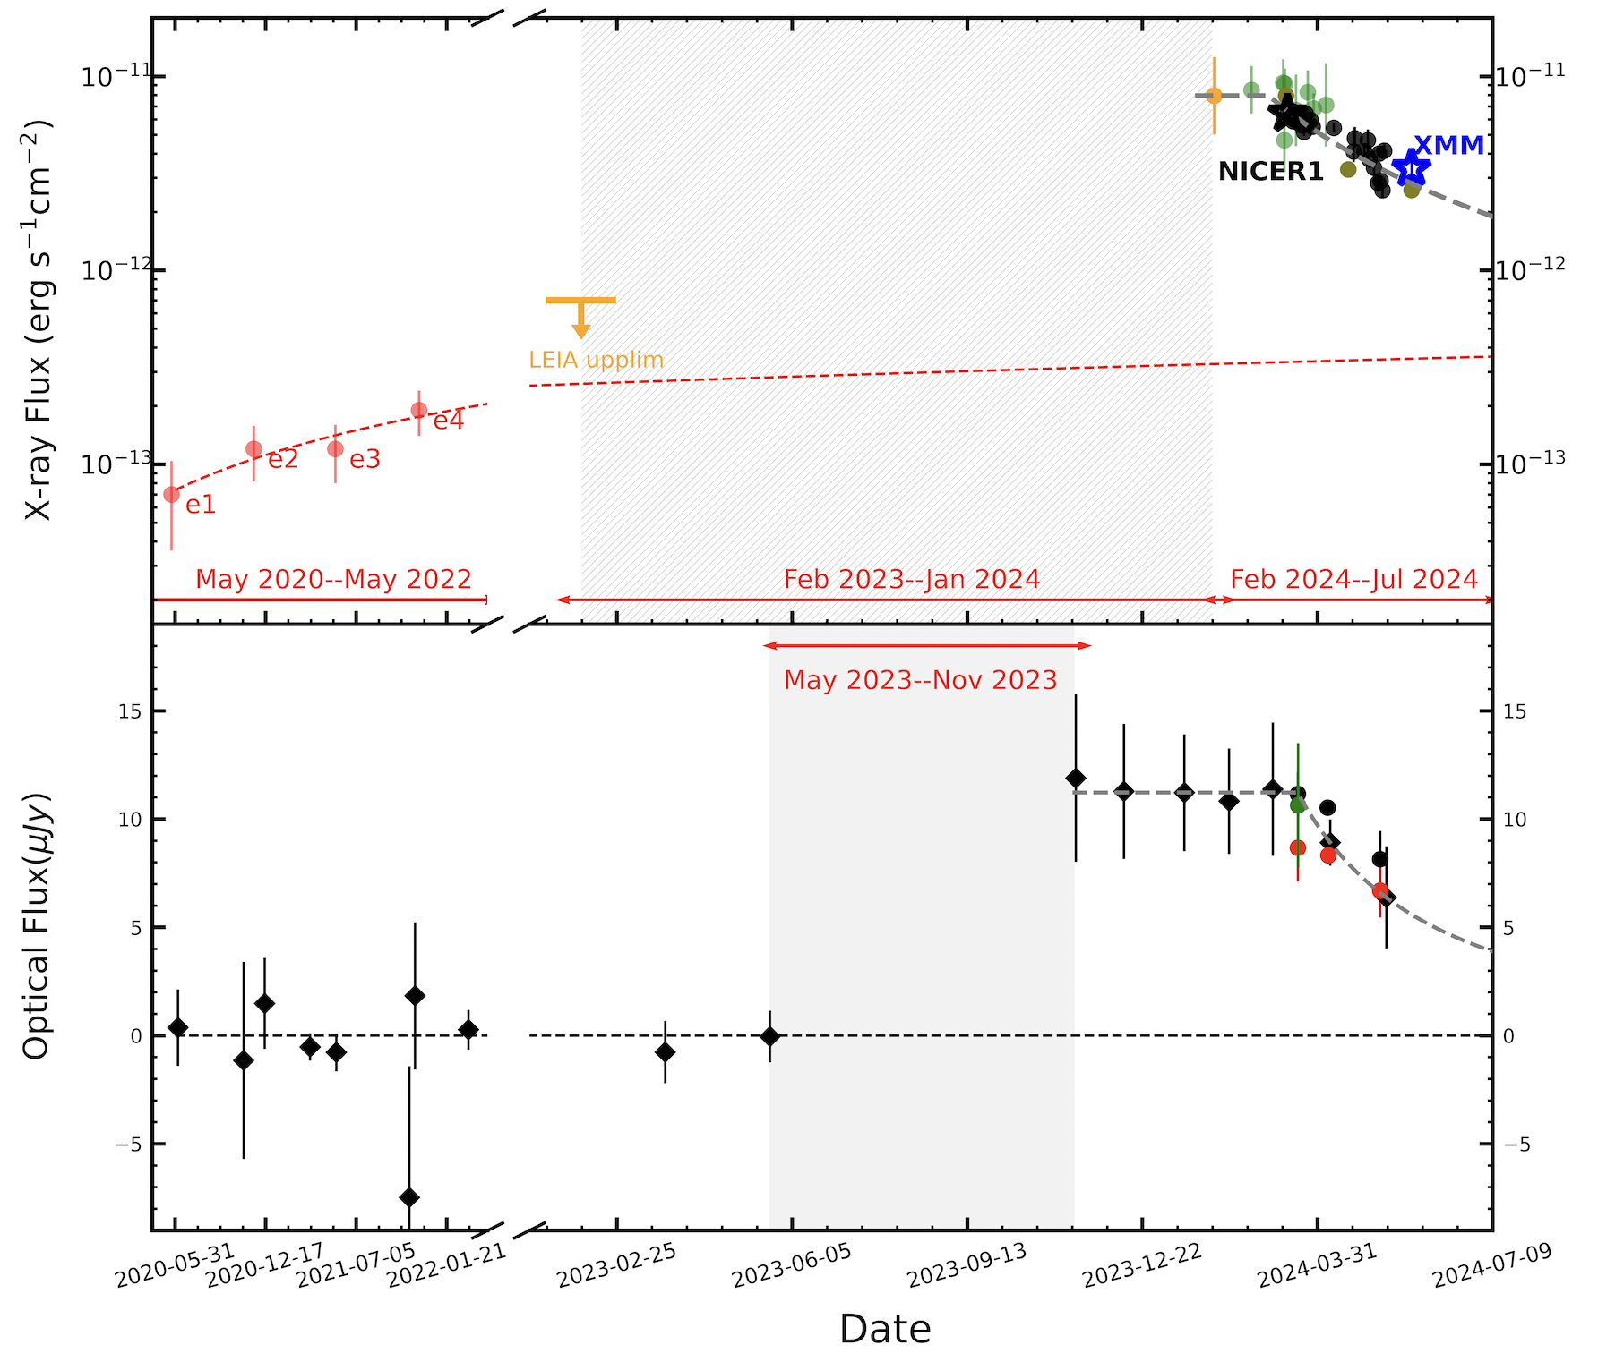
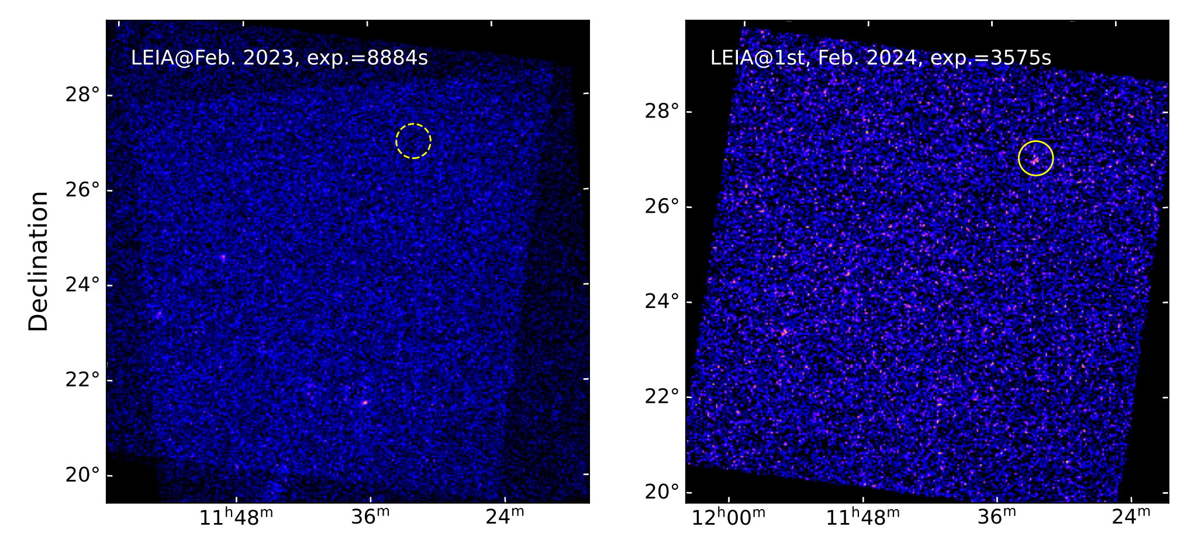
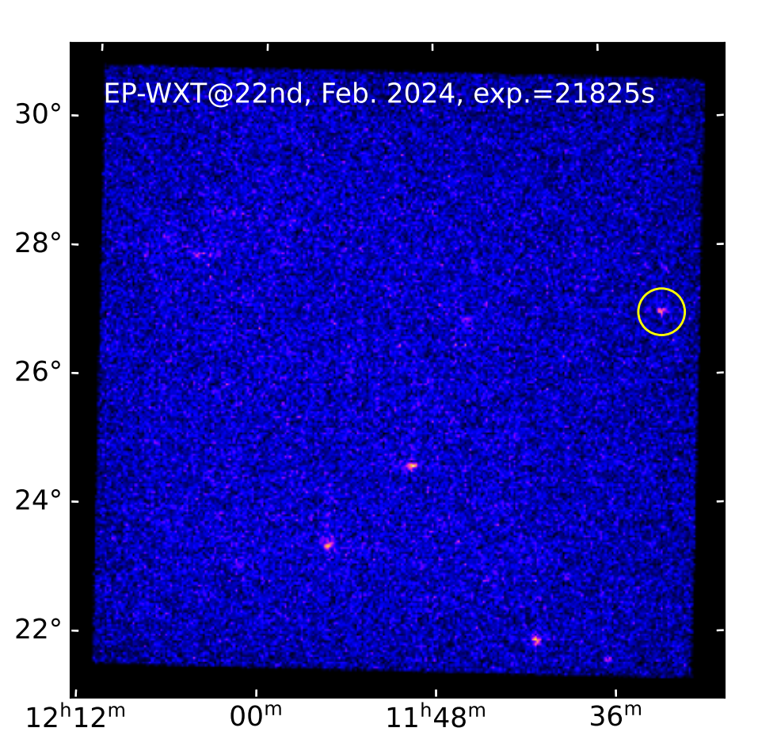
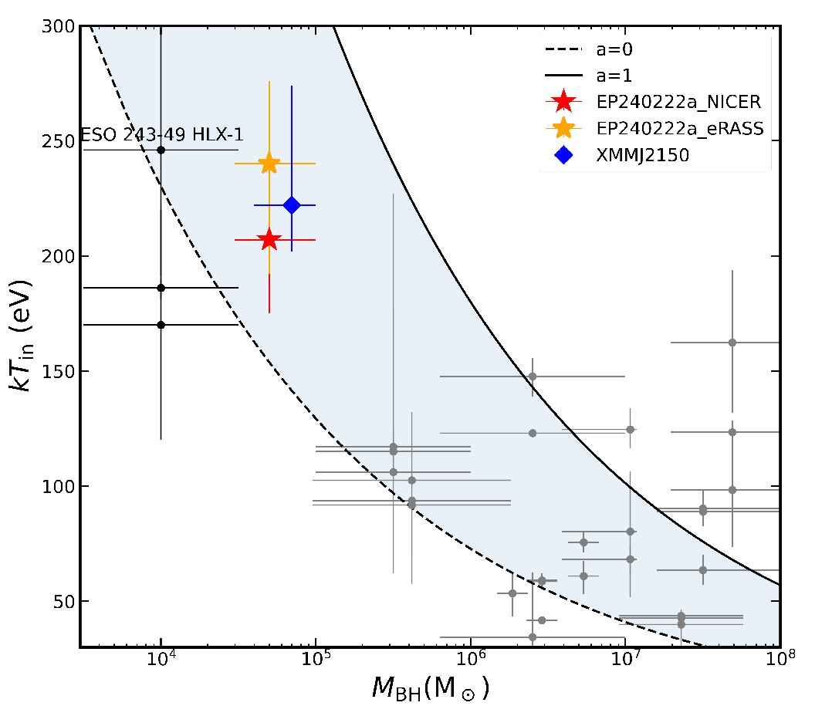
EP240222a: IMBH-TDE
X-ray light curve
optical light curve
Time scale: >4 years
off center: 53”(~35 kpc) away from a massive galaxy
kT: ~ 200 eV
host stellar mass: ~1e7 Msun
Jin et al. submitted
.

Slide 24

EP-WXT monitoring X-ray sources: NS XRB Aql X-1
recent outburst of Aql X-1
0.5-4 keV

Slide 25



Follow-up of GW event: S250206dm
S240422ed: T0=2025-02-06 21:25:30.439 UTC; NSBH (55%), BNS (37%); 373 +/- 104 Mpc; 90% area=547 $\deg^{2}$
EP follow-up observations:
$1^{st}$ round: 2$×$2400s WXT coverage + 100$×$300s FXT targeting galaxies (2025-02-07T02:55:12Z ~ Feb. 8th)
$2^{nd}$ round: 59$×$2000s FXT tiling (from Feb. 11th to 18th)
Search for transient or variable candidates in the FXT data (apparently associated with the galaxies):
found ~20 uncatalogued sources, two of which exhibit significant flux decay.
Detailed information: GCN Circular 39545; https://ep.bao.ac.cn/ep/cms/article/view?id=185
$1^{st}$: WXT covered 302 $\deg^{2}$ within (55% of) the 90% GW area
WXT 0.5-4 keV flux limits: $1×{10}^{−11}$ ${erg s}^{−1}cm^{−2}$
FXT 0.5-10 keV flux limits: $3×{10}^{−13}$ ${erg s}^{−1}cm^{−2}$
$2^{nd}$: FXT covered 34 $\deg^{2}$ within (89% of) the 50% GW area
25
FXT 0.5-10 keV flux limits: $5×{10}^{−14}$ ${erg s}^{−1}cm^{−2}$

Slide 26

Follow-up of neutrino event: IceCube-241127A
2024-11-27T14:11:14.42 Gold event
RA, Dec = 164.09, 5.38 +/- 0. 5 deg (90%)
Two FXT obs
  2024-11-28T01:33:00
  2024-11-28T03:13:00
  Expoure ~ 2800s
~20 sources，no significantly brightening
circle：eROSITA; square：FXT

Slide 27




FRB 20250316A: possible association with EP J120944.2+585060 ?
ATel # 17081, 17086, 17100, 17109, 17114
GCN 39886
D(galaxy) ~ 40Mpc
Lx ~ (2-3)x 10³⁹ erg/s

Slide 28
Summary
Science operations have been started since July 2024
~110 X-ray transients with high/SN detected
A wide range of targets: FXT, GRB, TDE, WD+NS+BH, flaring stars, MMA ……
Monitored the activity of large samples of known sources
Great potential for more discoveries in X-ray time-domain and MM astronomy
http://ep.bao.ac.cn
https://www.esa.int/Science_Exploration/Space_Science/Einstein_Probe_factsheet
Thanks to the Swift team, and other teams incl. NICER, NuSTAR, XMM, Chandra, etc. and ground-based optical and radio telescopes around the world
for supports of follow-up observations
Notes:
stargate

Slide 29


Happy 20th birthday to Swift!
FXT first light image of Puppis A SNR

Slide 30

EP – Swift connection (>10% participants of Swift20yr)

Slide 31
EP data and information flows
EPSC

Slide 32


Observation modes
Circular orbit
  Height 592km, period 96min
  inclination angle 29 deg.
Observation modes
  Survey (primary WXT)
  Autonomous follow-up (FXT)
  ToO (FXT, WXT) – quick response
WXT survey mode
  Pointing to night sky
  3 pointings/orbit, ~20min each
  ~ 1/2 sky covered in 3 orbits (~ 5 hr)
  Whole sky coverage in ½ year
  FXT pointed to pre-selected targets
Equatorial coordinates
Notes:
~ 45 snapshots per day
FXT survey target observation (FSTO)

Slide 33
Alerts of transients, ToO & data
Transient alerts
  Onboard transient search and trigger unit
  Alert information quick downlink： minutes
    VHF (CNES/France)
    BD system (China)
  Alert information: release immediately to the community
    source position, flux, time, spectral parameter
ToO command uplink
  Normal (S-band): < 1 day
  Time critical (BD) < 10 min
Science data
  X-band telemetry: it takes about a few hours to reach EPSC
  Will be made public (community outside EPST) after proprietary periods
  Non-ToO data: one year
  ToO by EP science team: 6 months
  ToO by guest observers: released immediately

