Slide 1




PLANET FORMING DISKS and the interaction with their environment
Elisabetta Rigliaco – Gabriele Columba (PhD) – Raffaele Gratton – Dino Mesa – and all the star&planet formation and exoplanets group
PhD students and postdocs

Slide 2
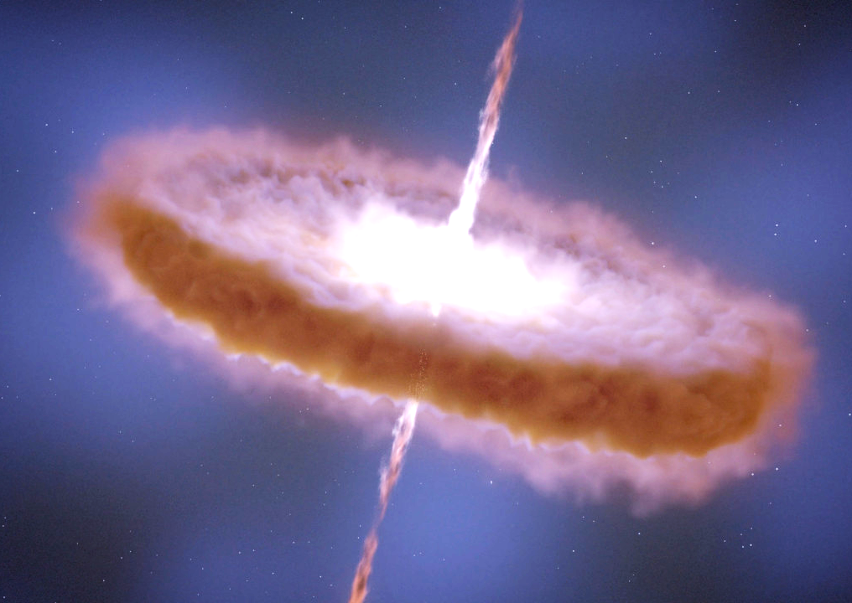
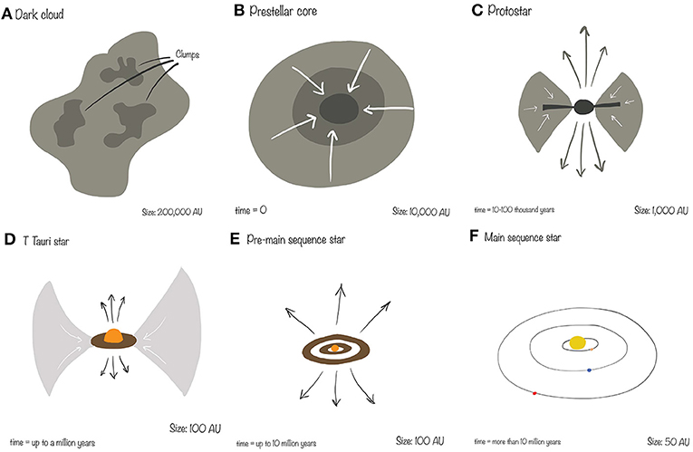
Motivations
Provide insights on the star formation process: disks are a subproduct of the star formation process;
Birthplace of planets: set the initial conditions of planet formation. The diversity of exoplanets might be related to the diversity of the disks’ physical properties;
Dictate the timeframe within which the planetary systems must form
Notes:
Why it is important to study circustellar – planet forming disks?
There are several aspects that make the analysis of these disks very interesting:
Disks are subproduct of the star formation process, hence they provide insight of the star formation process itself.
Dictate the timeframe whithin which the planetary system must form. Once the disk is dissolved we do not have material to form planets
They are the birthplace of planets: set the initial conditions for planet formation. The observed diversity of exoplanets might well be related to the disversity of disks physical properties.

Slide 3
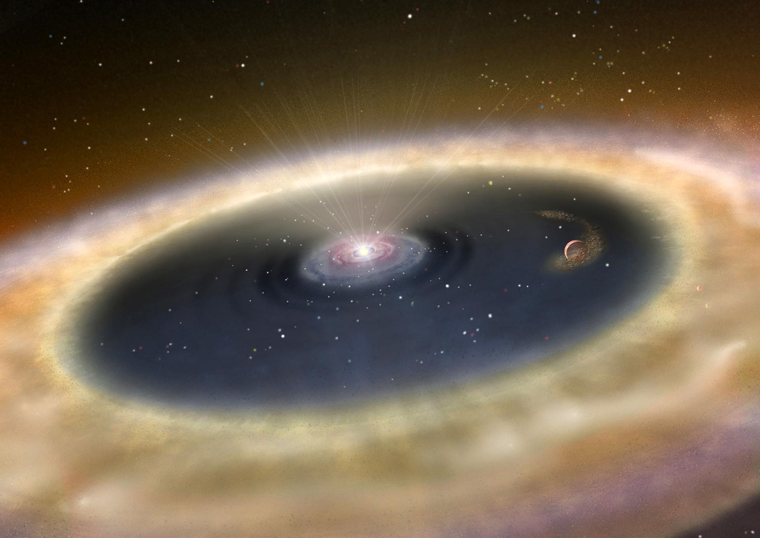
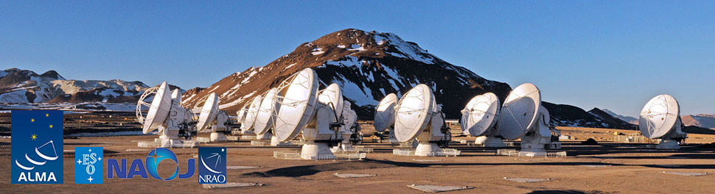
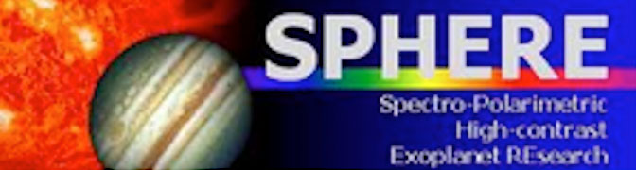


Timeliness
new instrumentation in the near-IR and (sub-)mm regime is allowing us to routiney spatially resolve disks around young stars in nearby associations
ALMA interferometer – spatially resolve thermal emission of cold, large (mm-sized) dust grains and molecules in circumstellar disks
AO assisted instruments - SPHERE (VLT) - SHARK NIR and VIS (LBT) -
eneabled nearly diffraction limited imaging, and scattered light analysis from small dust grains in the disk surface layers
Notes:
Until recently, disk observations were limited in angular resolution and could not provide clear constraints on the physical processes driving their evolution. Modeling of the SED cannot unombigously determine the disk structure and is highly degenerate
The advent of ALMA allowed us to spatially resolve the thermal emission of cold, large (mm-sized) dust grains and molecules in circumstellar disks and associated with circumplanetary disks.
In the optical and near-IR regime, telescopes with extreme adaptiove optics enabled nearly diffraction limited imaging (~4au at 100pc) providing access to both themral from young planets and dust in circumplanetary disks, as well as to the scattered light frokm small (micron-sized) dust grains in the disk surface layers.

Slide 4
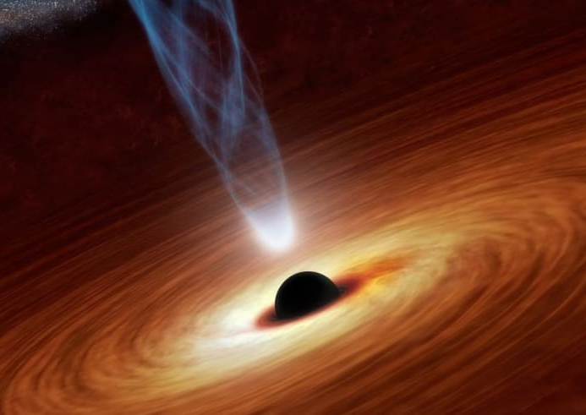
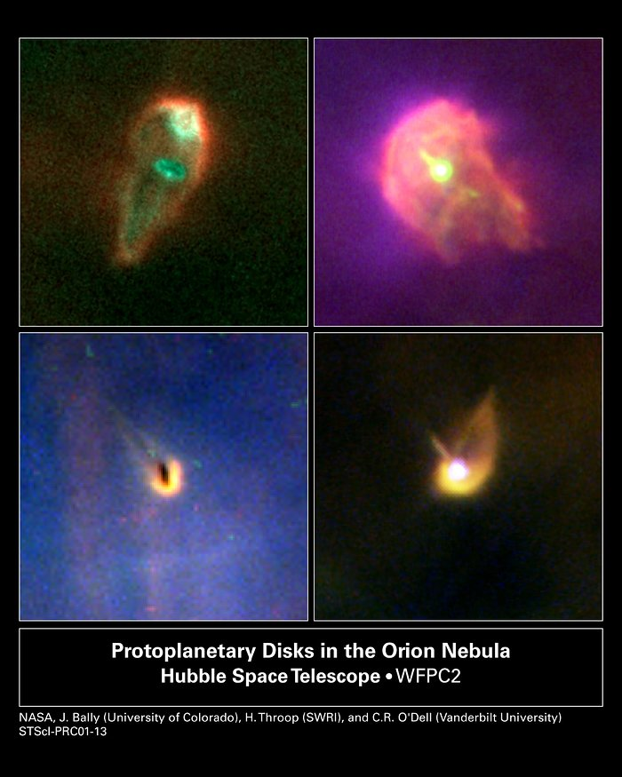
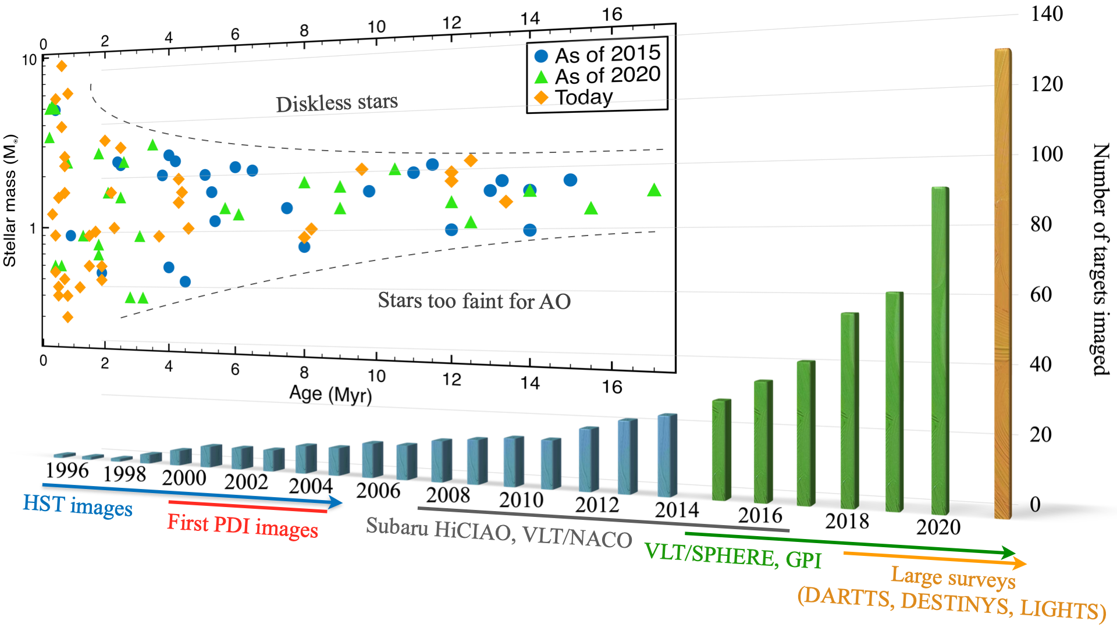
Programs
Demographical studies of disks on large sample of young stellar objects are made possible thanks to systematic programs
Pioneering images of externally illuminated PPD and disks seen in silhouette against the bright background were obtained in the Orion Nebula with HST
Benisty+2022
Notes:
Demographical studies on large sample of young stellar objects are made possible thanks to systematic programs.
Nowadays the vast majority of scattered light images at optical and NIR wavelenghts are acquired with 8-m, AO- and polarimeter equipped telescopes, in particular VLT, Subaru and Gemini.
In the histogram we have the total number of PPDs imaged per year.

Slide 5
Programs
Demographical studies of disks on large sample of young stellar objects are made possible thanks to systematic programs
SEEDS at Sabaru (Hashimoto et al 2012)
GTO program at SPHERE (Beuzit et al. 2019)
DARTTS at SPHERE (Avenhaus et al. 2018)
LIGHTS at GPI ( Laws et al. 2020)
DESTINYS at SPHERE (Ginski et al. 2021)
Transition between space- and ground-based facilities is the main carrier of images of PPDs.
Nowadays scattered light images at the optical and near-IR wavelengths are acquired with 8- m, AO- and polarimeter-equipped, telescopes, in particular with VLT, Subaru, and Gemini in PDI mode
Benisty+2022
Notes:
Demographical studies on large sample of young stellar objects are made possible thanks to systematic programs.
Nowadays the vast majority of scattered light images at optical and NIR wavelenghts are acquired with 8-m, AO- and polarimeter equipped telescopes, in particular VLT, Subaru and Gemini.
In the histogram we have the total number of PPDs imaged per year.

Slide 6
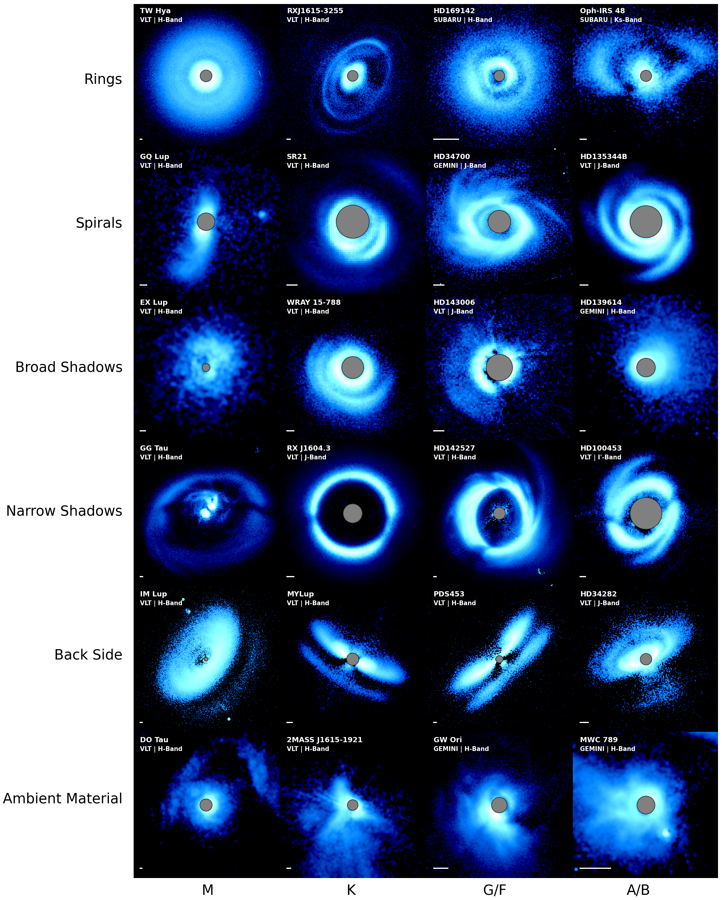
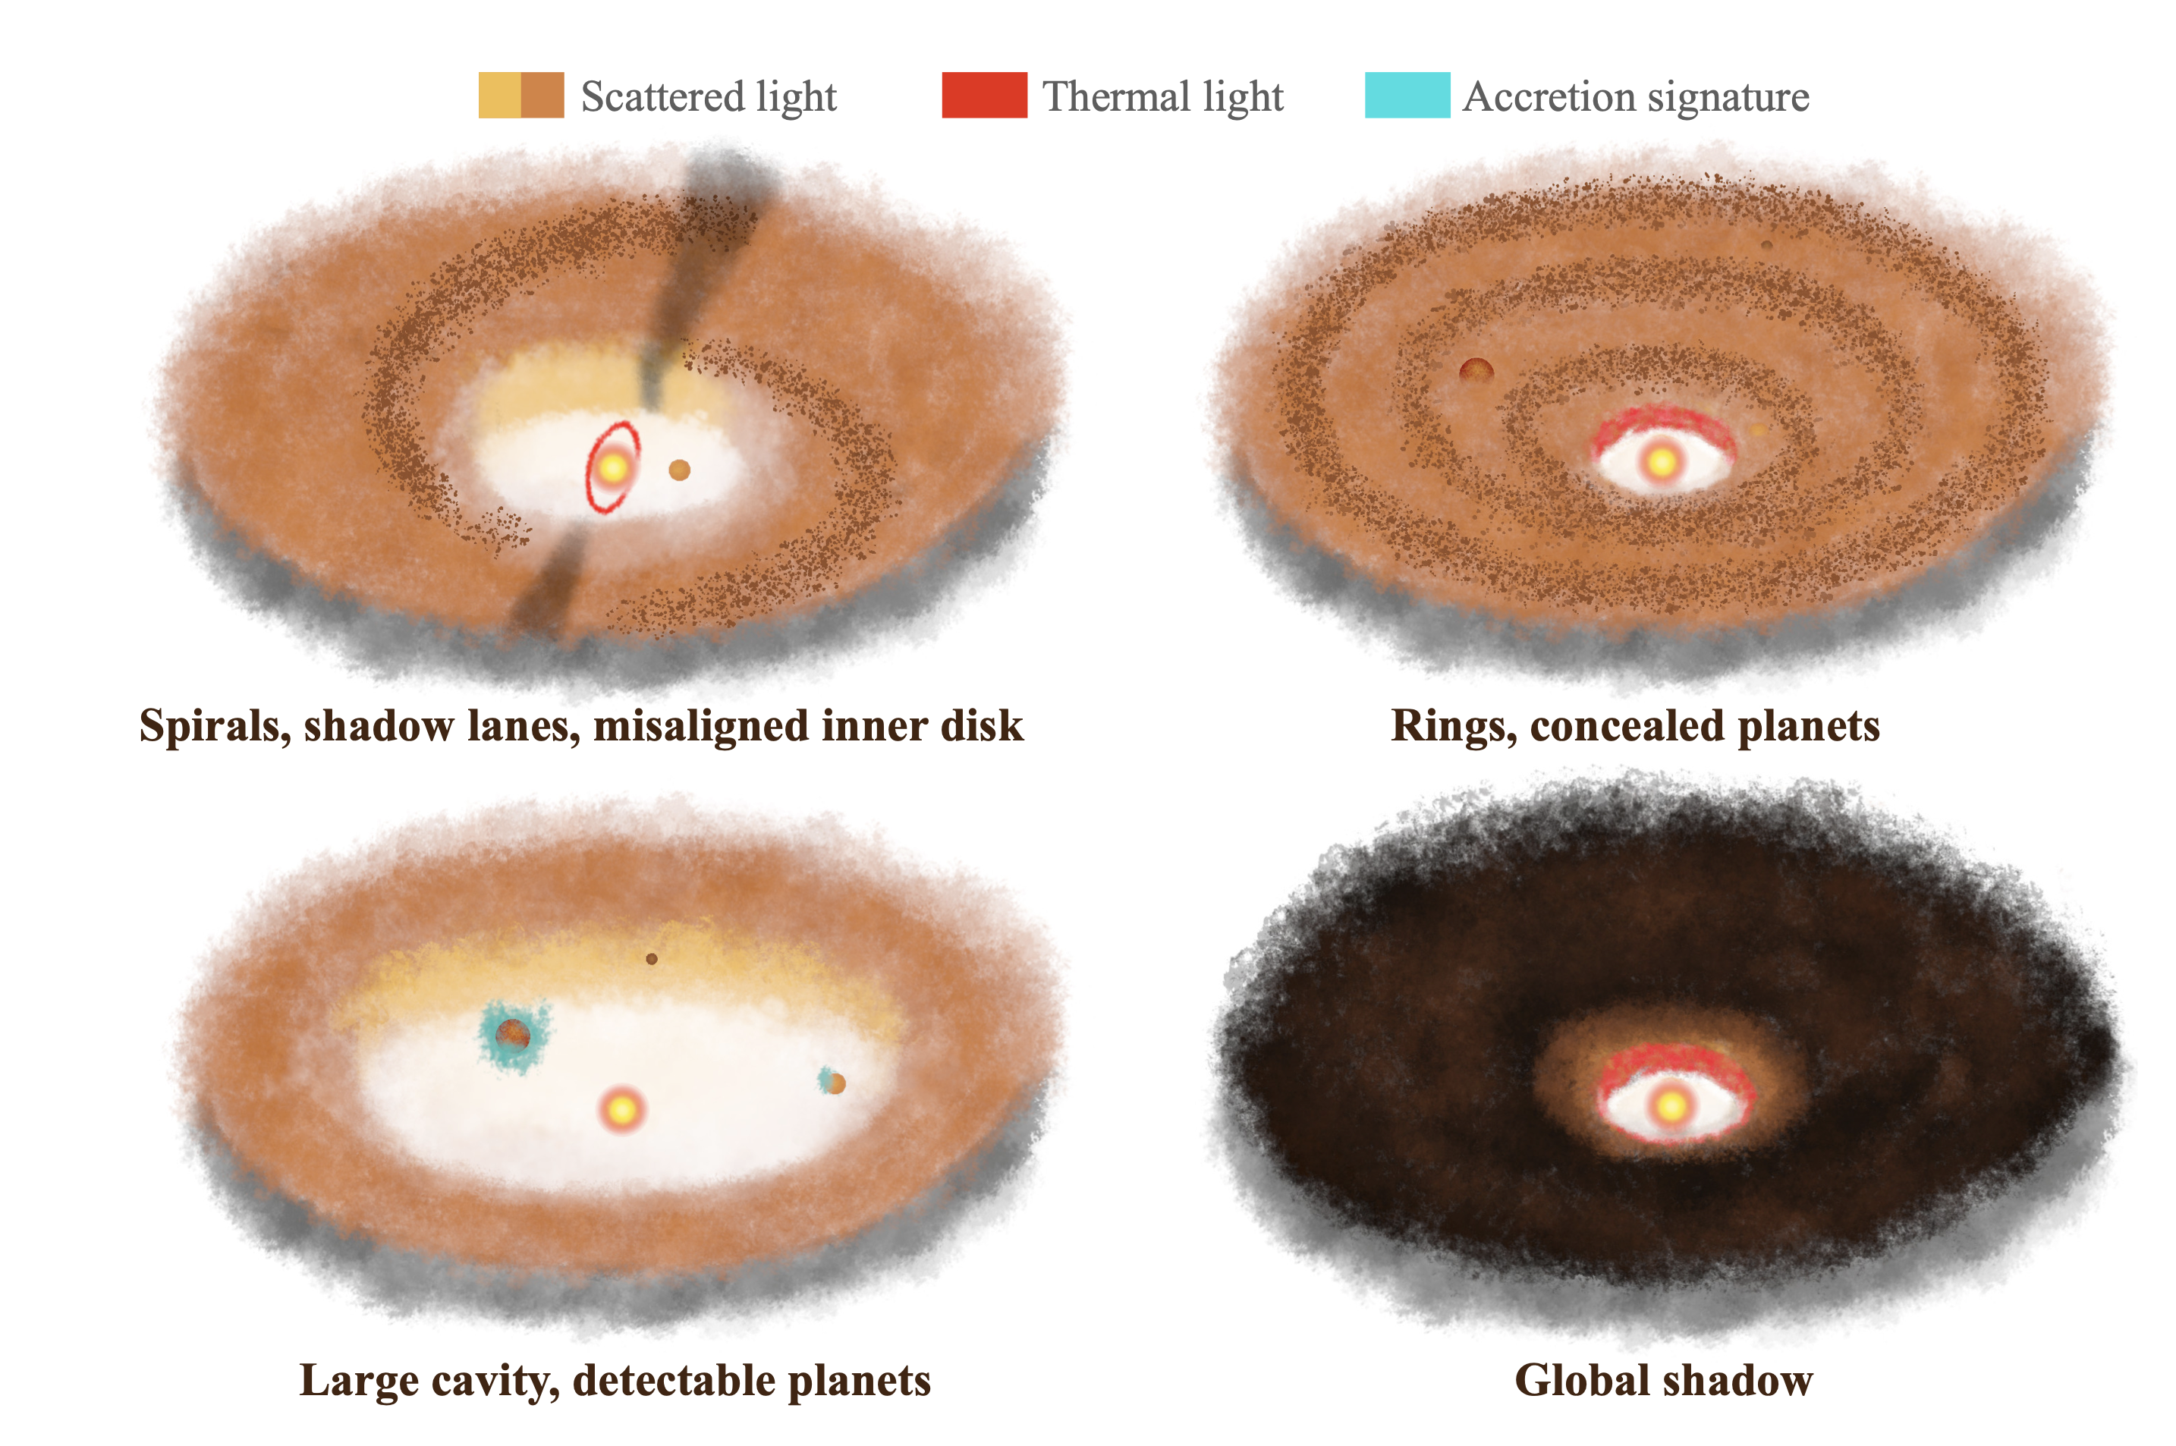
General Results
Benisty+2022
Wide range of morphological features seen in planet-forming disks:
Rings;
Spirals;
Shadows;
Streamers as signpost of interaction with ambient material;
Caused by:
Dynamical evolution of gas and dust in the disk;
Embedded, yet-undetected, protoplanets;
Planet-disk interaction;
Flybys
Notes:
substructures can be created by the dynamical evolution of the gas in the disk, through (magneto- )hydrodynamical instabilities and disk winds (e.g., Riols et al. 2020a). Such processes lead to both symmetric and asymmetric pressure perturbations, which will in turn trap dust grains. On the other hand, substructures may be sign- posts of embedded, yet-undetected, protoplanets. For ex- ample, planets launch spiral density waves at Lindblad res- onances, deplete their orbit of material (Kley et al. 2001) leading to dust and gas depleted gaps (Bae et al. 2017), or even large cavities. The characteristics of these gaps and cavities depend on the planet mass and orbital parame- ters and on the disk viscosity. Planet-disk interactions also often trigger large-scale hydrodynamical instabilities (vor- tices; Meheut et al. 2010) that lead to strong azimuthal asymmetries. Disk substructures can therefore serve as a guide to detect hidden planets (Dong et al. 2019) as well as a local probe of the disk conditions while dynamical inter- actions are ongoing. An extensive study of the prevalence and properties of substructures will allow us to determine the relative importance of the vaious mechanisms driving disk evolution, and can help constraining a yet-undetected population of exoplanets that can then be compared to the demographics of more evolved exoplanetary systems (see Chapter Bae et al.).

Slide 7
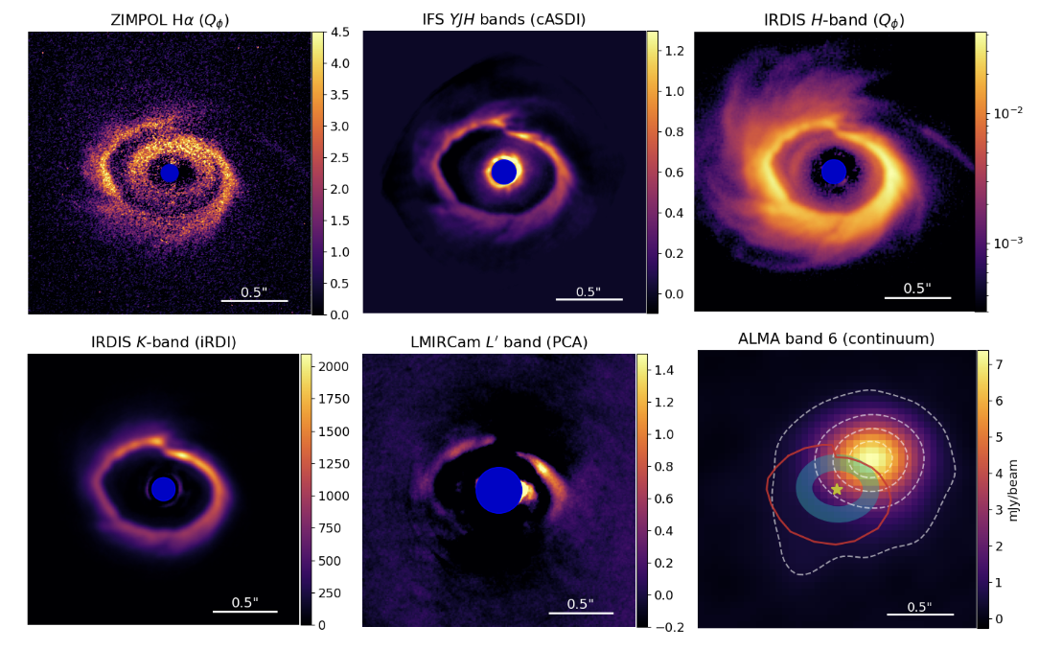
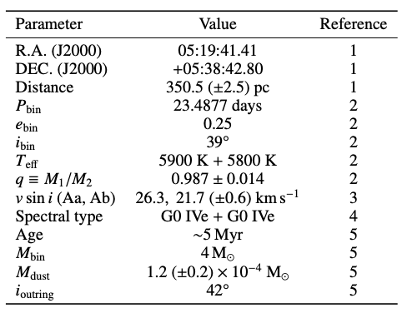
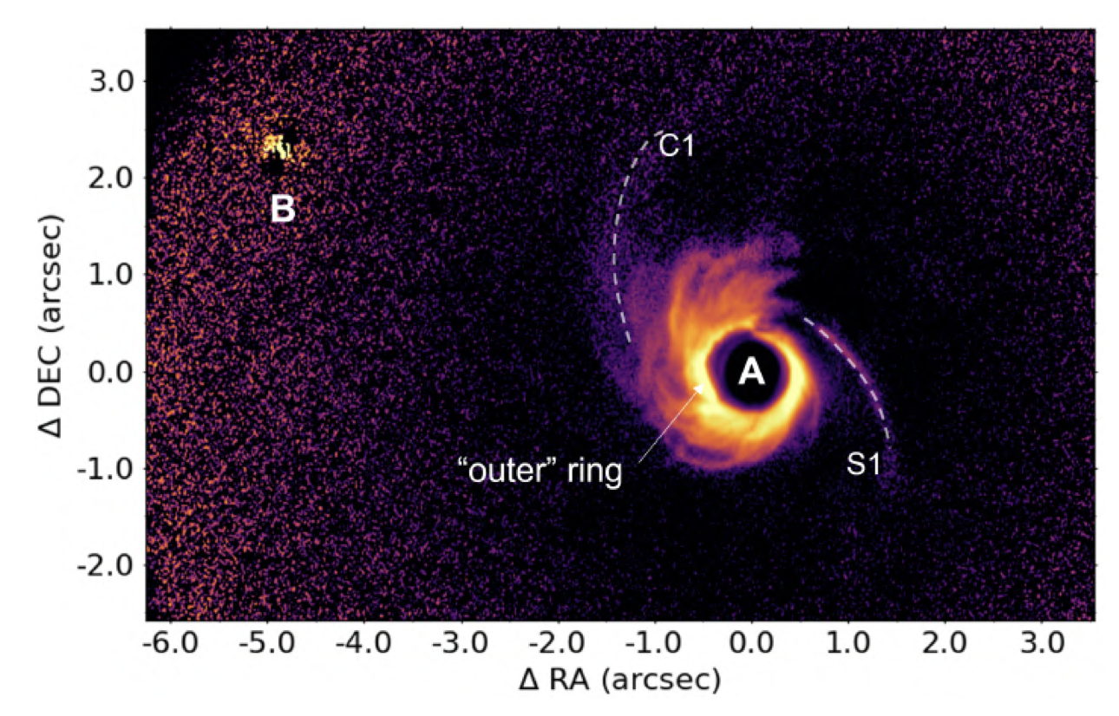
Results: HD34700
Columba+2024
Inner ring detected for the first time in Ha
Inner and outer ring have different physical and geometrical properties
The complexity of the system suggests the existence of one or more disk-shaping physical mechanisms:
presence of a yet undetected planet AND system interaction with the surroundings, by means of gas cloudlet capture or flybys.
Columba+2024
Notes:
Methods. Taking advantage of the high-contrast imaging instruments SPHERE at the VLT, LMIRCam at the LBT, and of ALMA observations,
we analyse this system at multiple wavelengths. We study the morphology of the rings and spiral arms and the scattering properties of the dust.
We discuss the possible causes of all the observed features.
Results. We detect for the first time, in the Hα band, a ring extending from ∼65 au to ∼120 au, inside the ring which is already known from recent
studies. These two have different physical and geometrical properties. Based on the scattering properties, the outer ring may consist of grains with
a typical size of aout ≥ 4 μm, while the inner ring has a smaller typical size of ain ≤ 0.4 μm. Two extended logarithmic spiral arms stem from
opposite sides of the disk. The outer ring appears as a spiral arm itself, with a variable radial distance from the centre and extended substructures.
ALMA data confirm the presence of a millimetric dust substructure centred just outside the outer ring, and detect misaligned gas rotation patterns
for HD 34700 A and B.
Conclusions. The complexity of HD 34700 A, revealed by the variety of observed features, suggests the existence of one or more disk-shaping
physical mechanisms. Our findings are compatible with the presence inside the disk of an as of yet undetected planet of several Jupiter masses and
the system interaction with the surroundings, by means of gas cloudlet capture or flybys. Further observations with JWST/MIRI or ALMA (gas
kinematics) could shed more light on them.

Slide 8
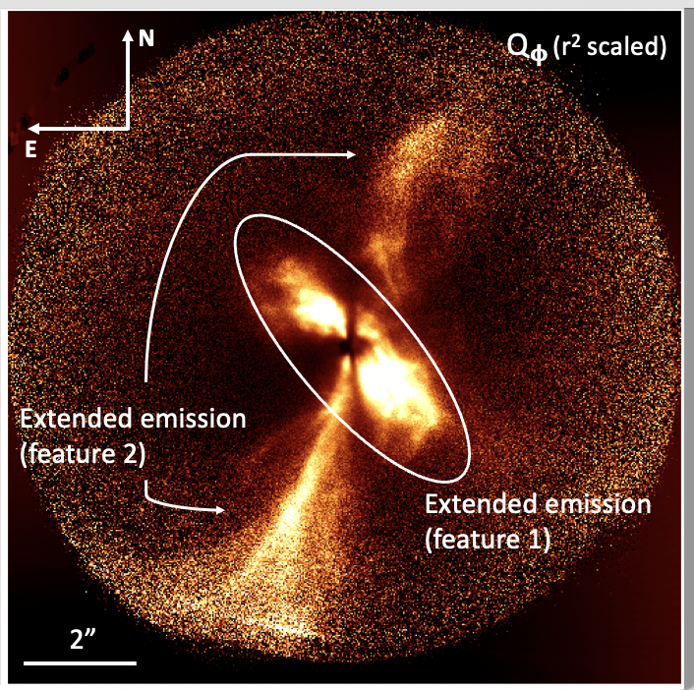
Results: TCrA
The scattered light images reveal the presence of a complex environment around T CrA:
bright, forward- scattering rim of the disk’s surface that is seen at very high inclinations,
dark lane of the disk midplane,
bipolar outflows
streamer features that are likely tracing infalling material from the surrounding birth cloud onto the disk.
Rigliaco+2023
Notes:
Object observed within the DESTINYS Large Program
Context. In recent years, a new hot topic has emerged in the star and planet formation field, namely, the interaction between the cir- cumstellar disk and its birth cloud. The birth environments of young stars leave strong imprints on the star itself and their surroundings. In this context, we present a detailed analysis of the rich circumstellar environment around the young Herbig Ae/Be star T CrA. Aims. Our aim is to understand the nature of the stellar system and the extended circumstellar structures, as seen in scattered light images.
Methods. Weconductedouranalysisonthebasisofasetofcombinedarchivaldataandnewadaptiveopticsimagesatahighcontrast and high resolution.
Results. The scattered light images reveal the presence of a complex environment around T CrA, composed of a bright, forward- scattering rim of the disk’s surface that is seen at very high inclinations, along with a dark lane of the disk midplane, bipolar outflows, and streamer features that are likely tracing infalling material from the surrounding birth cloud onto the disk. The analysis of the light curve suggests that the star is a binary with a period of 29.6 yr, confirming previous assertions based on spectro-astrometry. The comparison of the scattered light images with the ALMA continuum and 12CO (2–1) line emission shows that the disk is in Keplerian rotation and the northern side of the outflowing material is receding, while the southern side is approaching the observer. The overall system lies on different geometrical planes. The orbit of the binary star is perpendicular to the outflows and is seen edge on. The disk is itself seen edge-on, with a position angle of ∼7◦. The direction of the outflows seen in scattered light is in agreement with the direc- tion of the more distant molecular hydrogen emission-line objects (MHOs) associated with the star. Modeling of the spectral energy distribution using a radiative transfer scheme is in good agreement with the proposed configuration, as well as the hydrodynamical simulation performed using a smoothed particle hydrodynamics code.
Conclusions. We find evidence of streamers of accreting material around T CrA. These streamers connect the filament, along which T CrA is forming along with the outer parts of the disk, suggesting that the strong misalignment between the inner and outer disk is due to a change in the direction of the angular momentum of the material accreting on the disk during the late phase of star formation. This impacts the accretion taking place in the components of the binary, favoring the growth of the primary with respect the secondary, in contrast to the case of aligned disks.

Slide 9
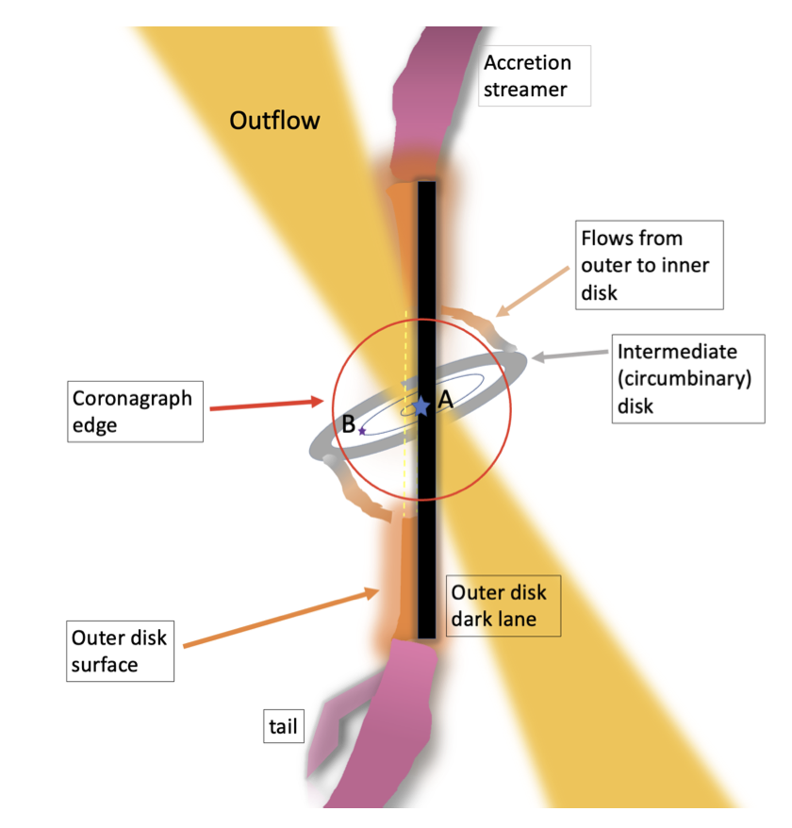
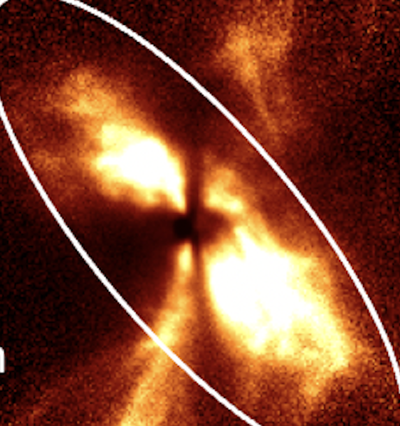
Results: TCrA
The scattered light images reveal the presence of a complex environment around T CrA:
bright, forward- scattering rim of the disk’s surface that is seen at very high inclinations,
dark lane of the disk midplane,
bipolar outflows
streamer features that are likely tracing infalling material from the surrounding birth cloud onto the disk.

Slide 10
Next Challenge
The interaction with the natal environment: Corona Australis
Bresnahan+2018, Herschel map

Slide 11
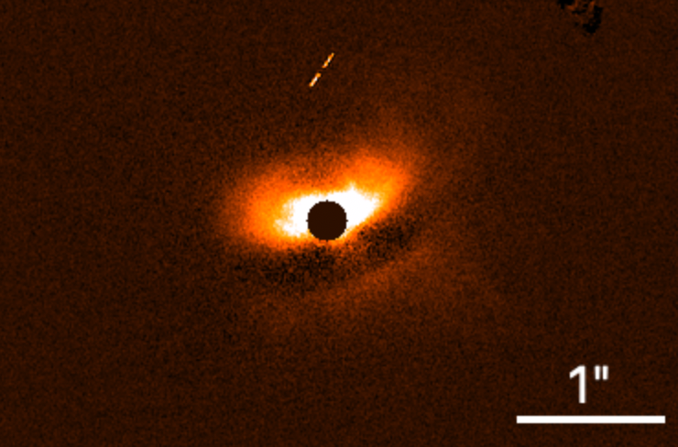
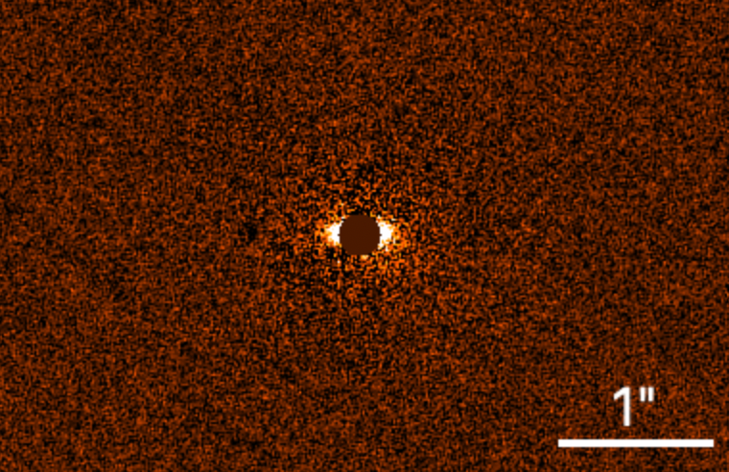
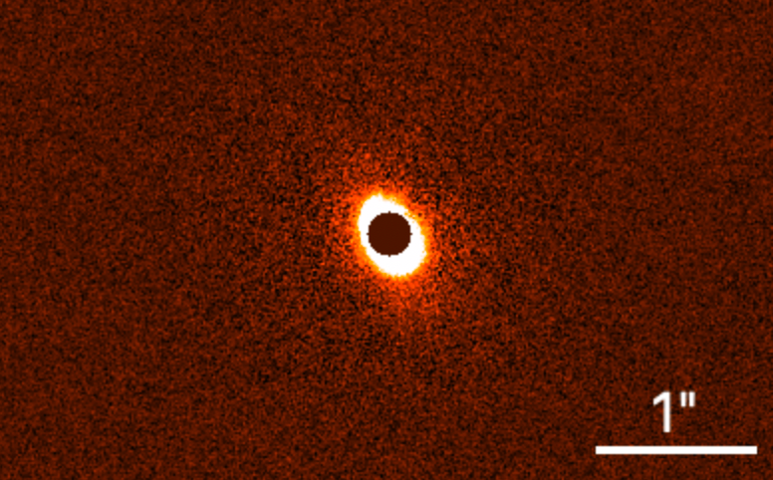
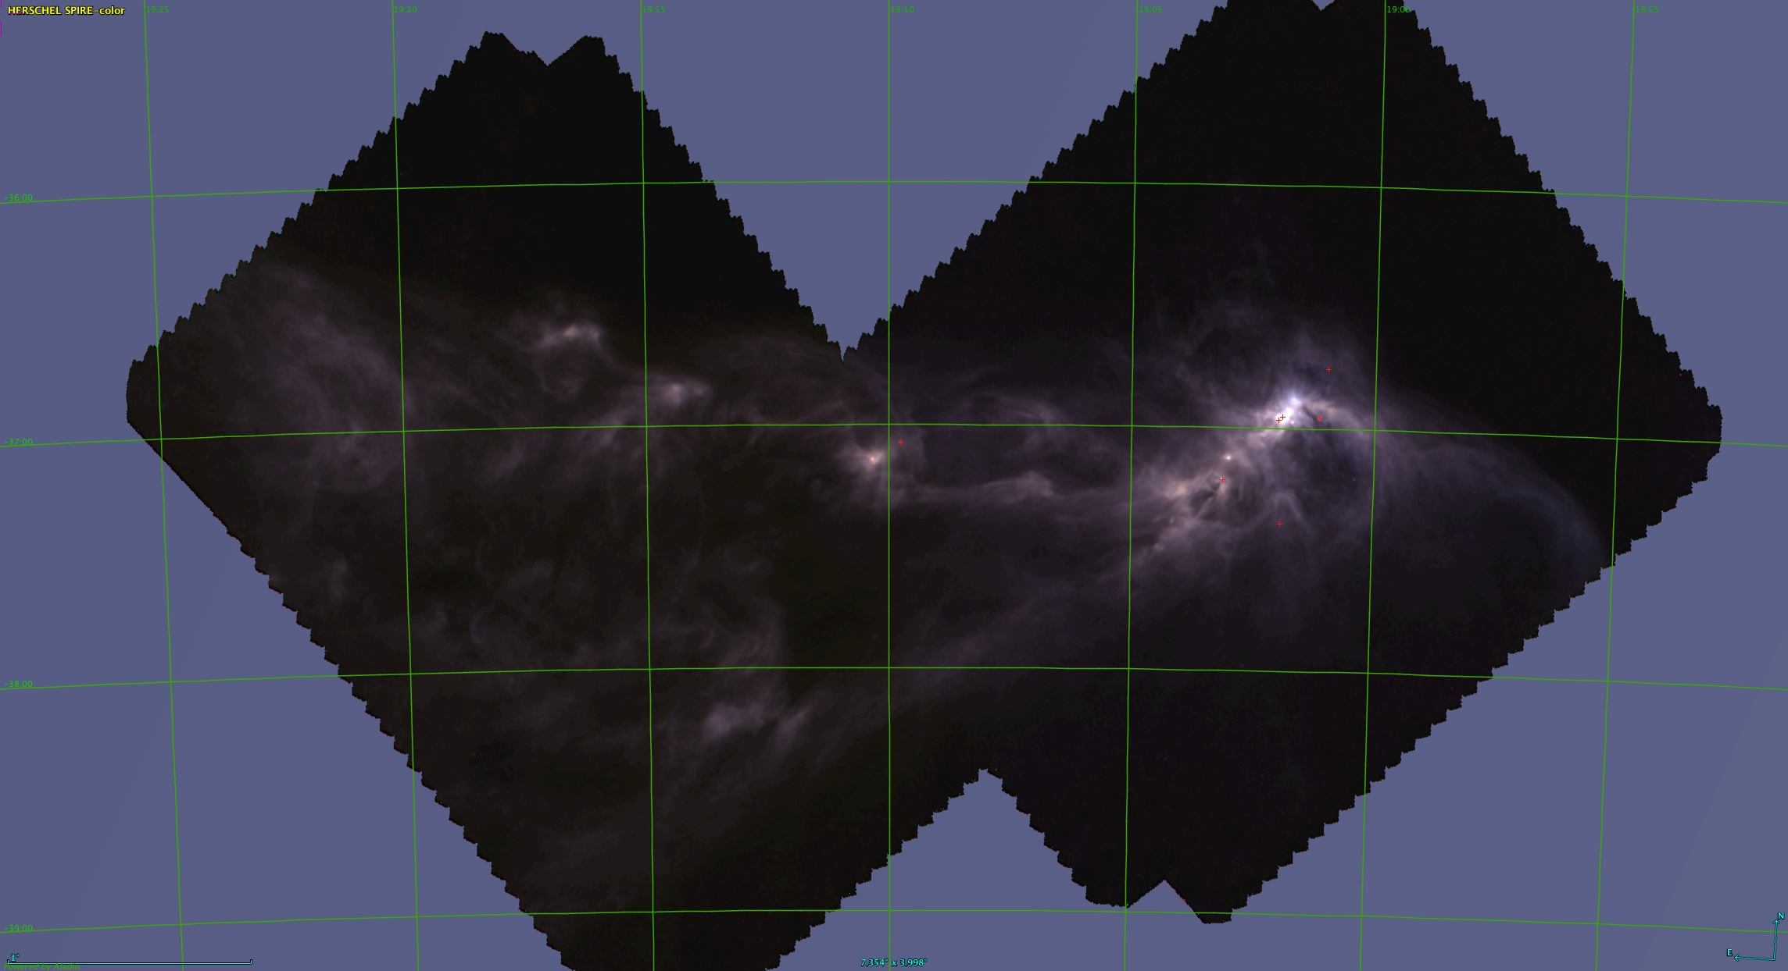
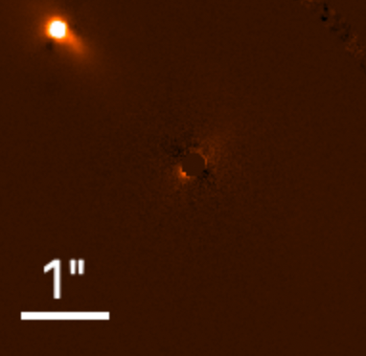
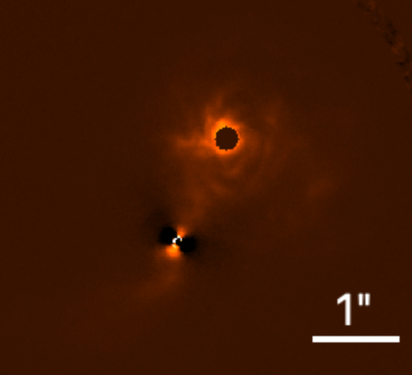
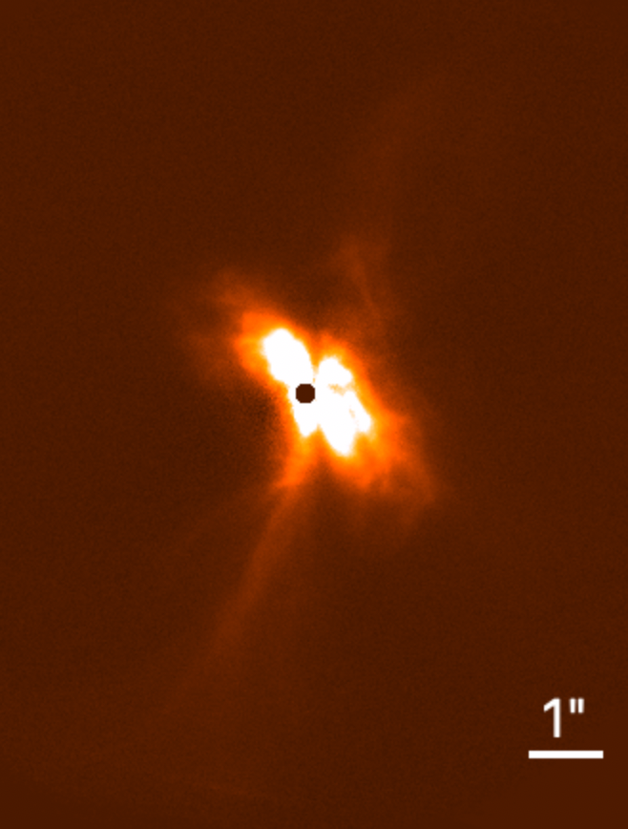
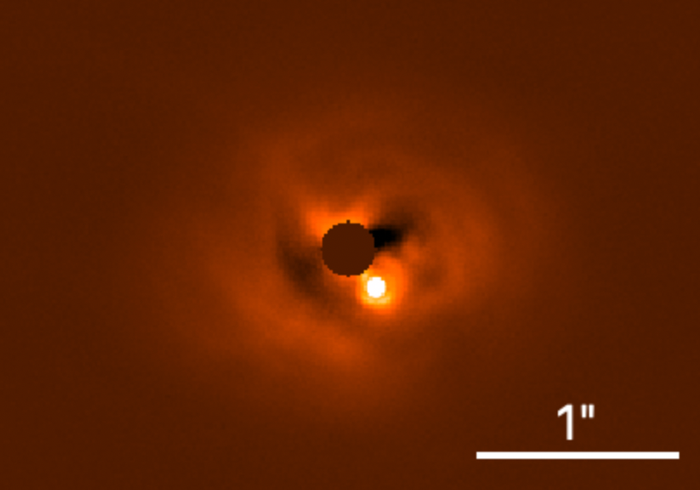
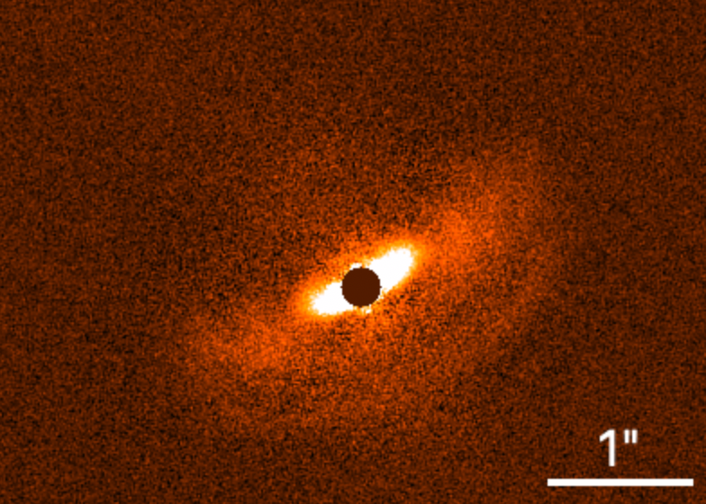






V721 CrA
2MASS J19005804-3645048
RXJ1842-3532
VV CrA
S CrA
$$⭐︎$$
$$⭐︎$$
$$⭐︎$$
$$⭐︎$$
$$⭐︎$$
$$⭐︎$$
DG CrA
BN CrA
T CrA

Slide 12
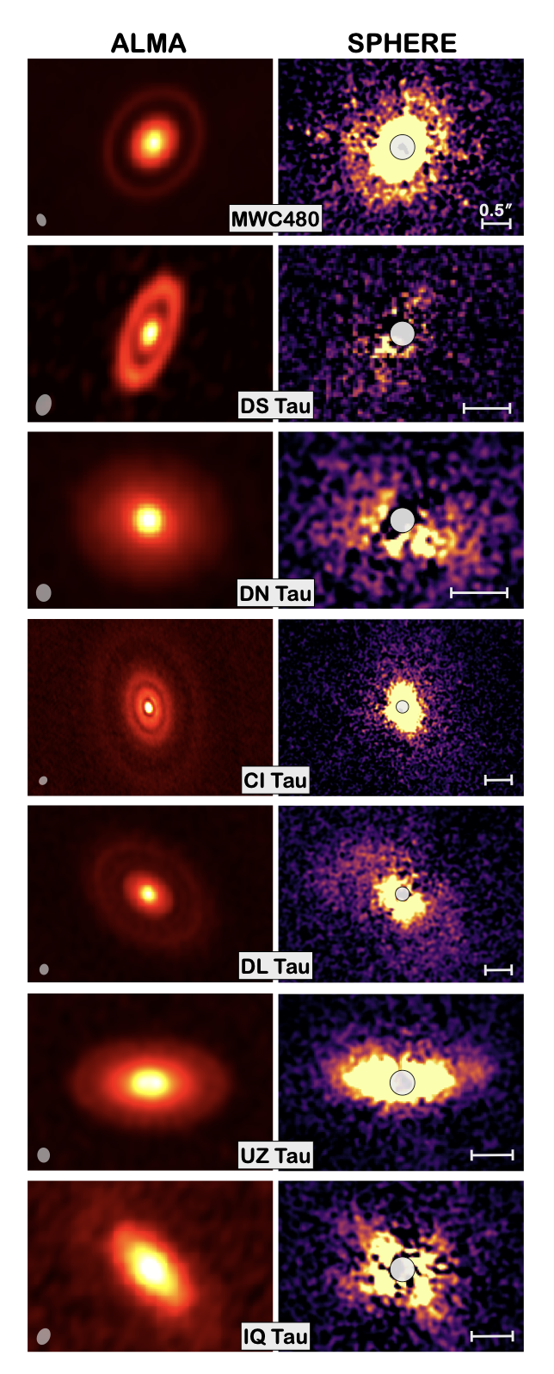
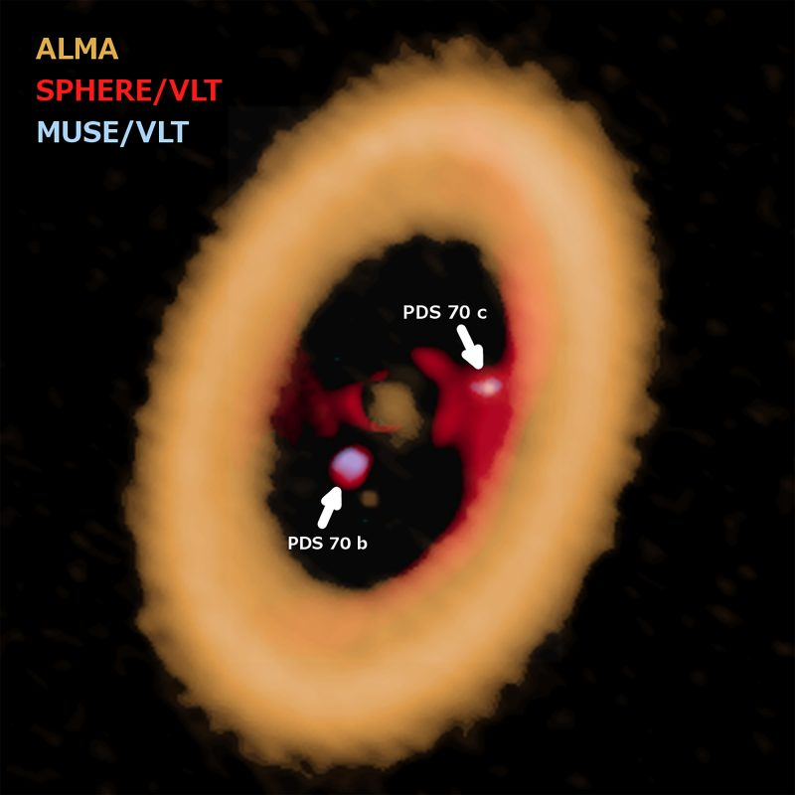
Wrapping up
Circumstellar/Planet-forming/Circumplanetary disks have been living their best life in the past years;
Multi-wavelenghts approach is crucial;
Demographical studies of large sample of young stellar objects are made possible thanks to systematic programs;
Garufi+2024
Next step: demographical analysis of the disk distribution within their natal enviroment
Tight link with:
exoplanets population
star formation
Image via ALMA (ESO/NAOJ/NRAO)/A. Isella/ESO.

