Slide 1
ISTEDDAS: current status Mario Spera
WP1,WP2 Monthly Meeting, June 12, 2024
ICSC Italian Research Center on High-Performance Computing, Big Data and Quantum Computing
Missione 4 • Istruzione e Ricerca

Slide 2
Scientific Rationale: gravitational-wave astrophysics
September 14, 2015 first direct detection of gravitational waves
February 11, 2016 LIGO/Virgo collaboration announces the event GW150914
October 6, 2017 Nobel Prize in Physics - for decisive contributions to the LIGO detector and the observation of gravitational waves.
Today 4th observing run LIGO-Virgo-KAGRA with $≫90$ compact binary coalescences
What’s next Next-gen gravitational-wave interferometers (e.g., Einstein Telescope): compact binary coalescences across cosmic time
Main open astrophysical question - What is the evolutionary history of merging compact-object binaries? - How/When/Where/Why/What/Who
https://www.ligo.caltech.edu/page/what-are-gw
ICSC Italian Research Center on High-Performance Computing, Big Data and Quantum Computing
Missione 4 • Istruzione e Ricerca

Slide 3
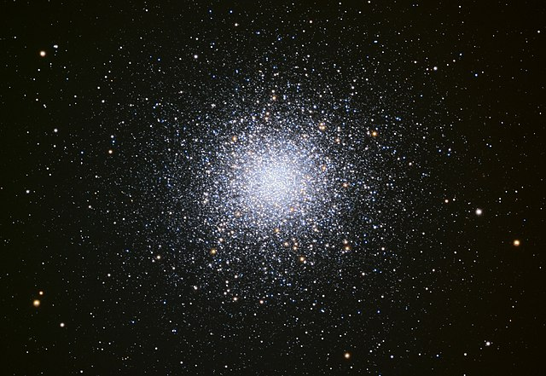
Scientific Rationale
Most stars form in dense stellar environments → star clusters are natural places to look for merging compact-binary coalescences
https://www.youtube.com/watch?v=AKzPCdZKX2I
ICSC Italian Research Center on High-Performance Computing, Big Data and Quantum Computing
Missione 4 • Istruzione e Ricerca

Slide 4
Technical Objectives, Methodologies and Solutions
Main objective: developing a new N-body code (from scratch) with the following native features
high accuracy - for binaries → new algorithms
high performance - $O\left(N^{2}\right)$→ GPU+CPU native exploitation
up-to-date stellar evolution physics – for compact objects → coupling with new stellar evolution codes
high scalability – next-generation supercomputers → MPI exploitation and new parallelization strategies
ICSC Italian Research Center on High-Performance Computing, Big Data and Quantum Computing
Missione 4 • Istruzione e Ricerca

Slide 5
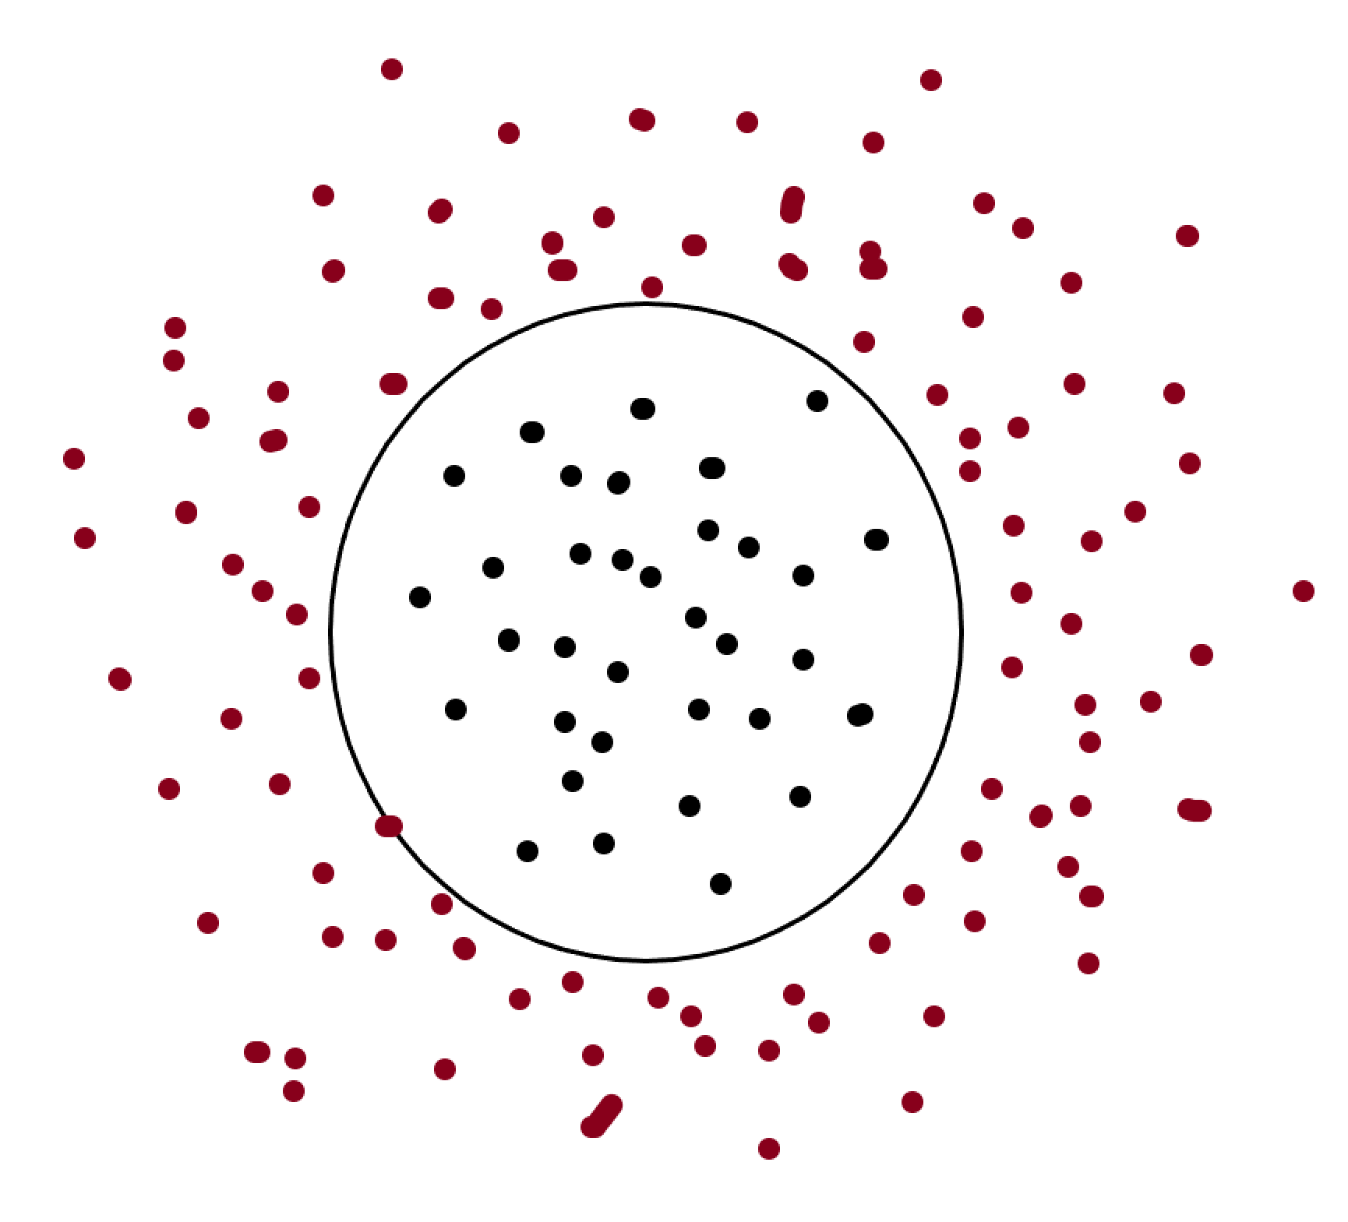
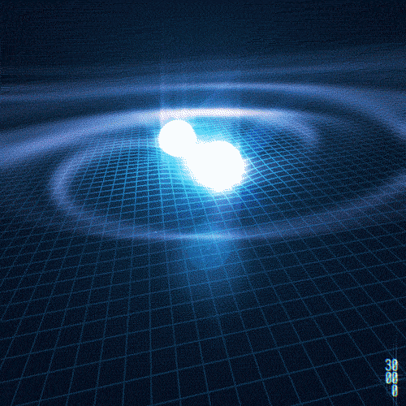
Technical Objectives, Methodologies and Solutions
Brute-force approach is not feasible – not because of $O(N^{2})$ complexity, but mainly for BINARIES
Issues with binaries
Require very small time steps (as small as DAYS) → slow down the evolution of the entire cluster (time scale $\sim 1 Myr$)
Potentially feel the force from al the other stars $O\left(N^{2}\right)$
Doing many numerical steps means accumulating both round-off and truncation errors very fast
ICSC Italian Research Center on High-Performance Computing, Big Data and Quantum Computing
Missione 4 • Istruzione e Ricerca

Slide 6
Technical Objectives, Methodologies and Solutions
Neighbors scheme implemented on GPUs + BINARIES
3-level splitting
Total force on 1 star =
very fast-varying contribution (from the companion star(s)) + fast-varying contribution (from perturbers/neighbours) + slow-varying contribution (from other stars)
Very fast-varying contribution: dedicated high-accuracy algorithm for perturbed binary systems - (regularization: time coordinate transformation)
ISTEDDAS: all binaries are evolved in parallel (complexity $n_{binaries}×O(2)$) while other GPU kernels evolve their centres of mass if binaries evolved on CPUs = asynchronous execution with GPUs
if binaries evolved on GPUs = serial execution (but it might be faster, depending on the number of binaries to evolve)
ICSC Italian Research Center on High-Performance Computing, Big Data and Quantum Computing
Missione 4 • Istruzione e Ricerca

Slide 7
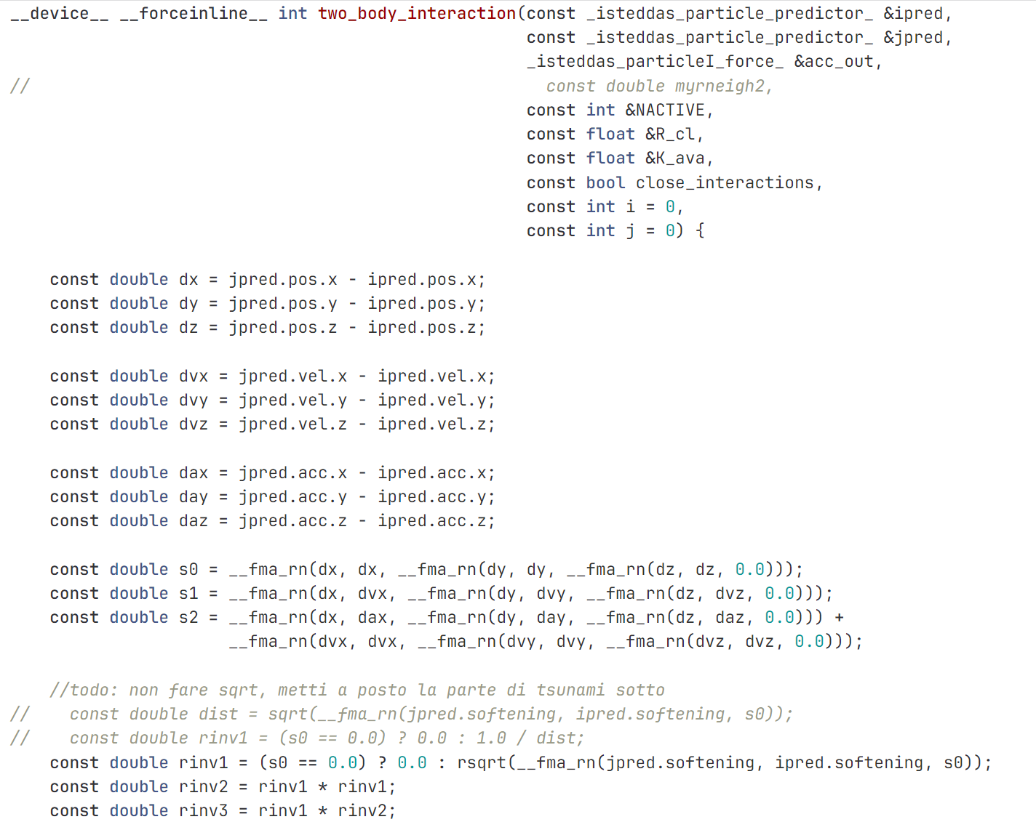
Issues and delays
Using double precision everywhere in the main GPU kernel becomes the real bottleneck.
The Hermite 6th order integrator is unstable if implemented with mixed precision
ICSC Italian Research Center on High-Performance Computing, Big Data and Quantum Computing
Missione 4 • Istruzione e Ricerca

Slide 8
Issues and delays
Using double precision everywhere in the main GPU kernel becomes the real bottleneck.
The Hermite 6th order integrator is unstable if implemented with mixed precision
The 2-level splitting on GPU helps significantly in terms of performance – but this does not help enough if the aim is to simulate large star clusters in a reasonable amount of time (e.g., globular clusters)
ICSC Italian Research Center on High-Performance Computing, Big Data and Quantum Computing
Missione 4 • Istruzione e Ricerca

Slide 9
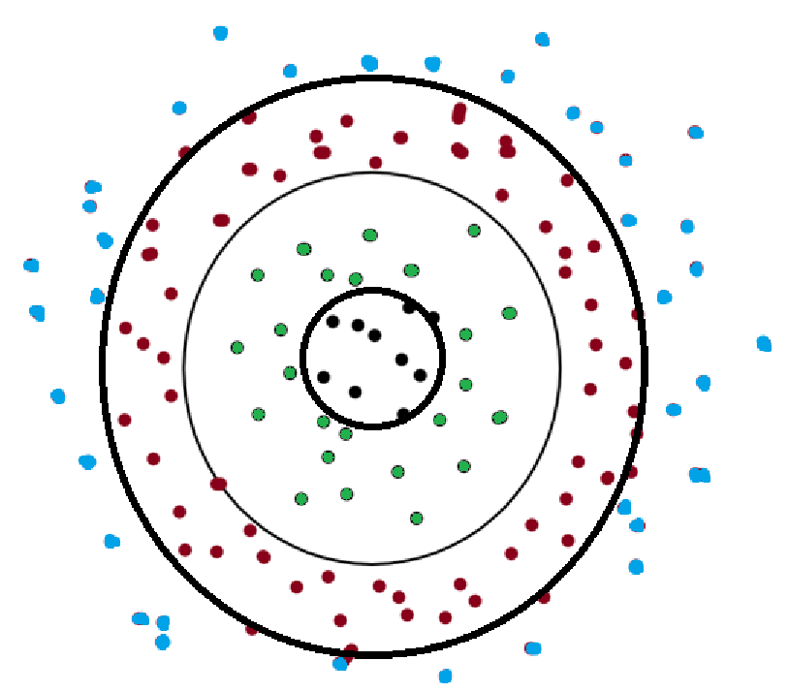
Solutions
multi-level splitting
Total force on 1 star = several contribution from various levels (5+ - depending on the position of the star inside the cluster)
integrator splitting
Integration method
arbitrary order and accuracy for tight few-body systems (e.g., binaries, triples, etc…)
6th order Hermite for neighbor particles – full double precision
4th order for I-level particles – mixed precision
2nd order for other particles – mixed precision
ICSC Italian Research Center on High-Performance Computing, Big Data and Quantum Computing
Missione 4 • Istruzione e Ricerca

Slide 10
Delays and rescheduling
Implementing and debugging the new multi-level scheme will take time (this implementation was not planned at the beginning of the project)
Need to revise KPI/targets for M9 and M10 – work until M8 (included) proceeded as planned
End of project (main goal – 2025/2026): public (final) release of ISTEDDAS
Good (and bad) news: no people hired with PNRR funds to work on this project, and I am the only one working on ISTEDDAS
ICSC Italian Research Center on High-Performance Computing, Big Data and Quantum Computing
Missione 4 • Istruzione e Ricerca

