Slide 1
WP5 – Task 2 Software & algorithm
Review Meeting
Giovedì 12 Settembre - Venerdì 13 Settembre
Radiotelescopi di Medicina
IRA - Bologna
P. Di Lizia, M.F. Montaruli

Slide 2
OUTLINE
01
BIRALES data processing
02
MATER: Catalogued object
Pierluigi Di Lizia
03
MATER: Uncatalogued object
04
Real data processing
05
Current developments
Marco Felice Montaruli
06
Conclusions
Missione 4 • Istruzione e Ricerca
Missione 4 • Istruzione e Ricerca

Slide 3
OUTLINE
01
BIRALES data processing
02
MATER: Catalogued object
Pierluigi Di Lizia
03
MATER: Uncatalogued object
04
Real data processing
05
Current developments
Marco Felice Montaruli
06
Conclusions
Missione 4 • Istruzione e Ricerca
Missione 4 • Istruzione e Ricerca

Slide 4
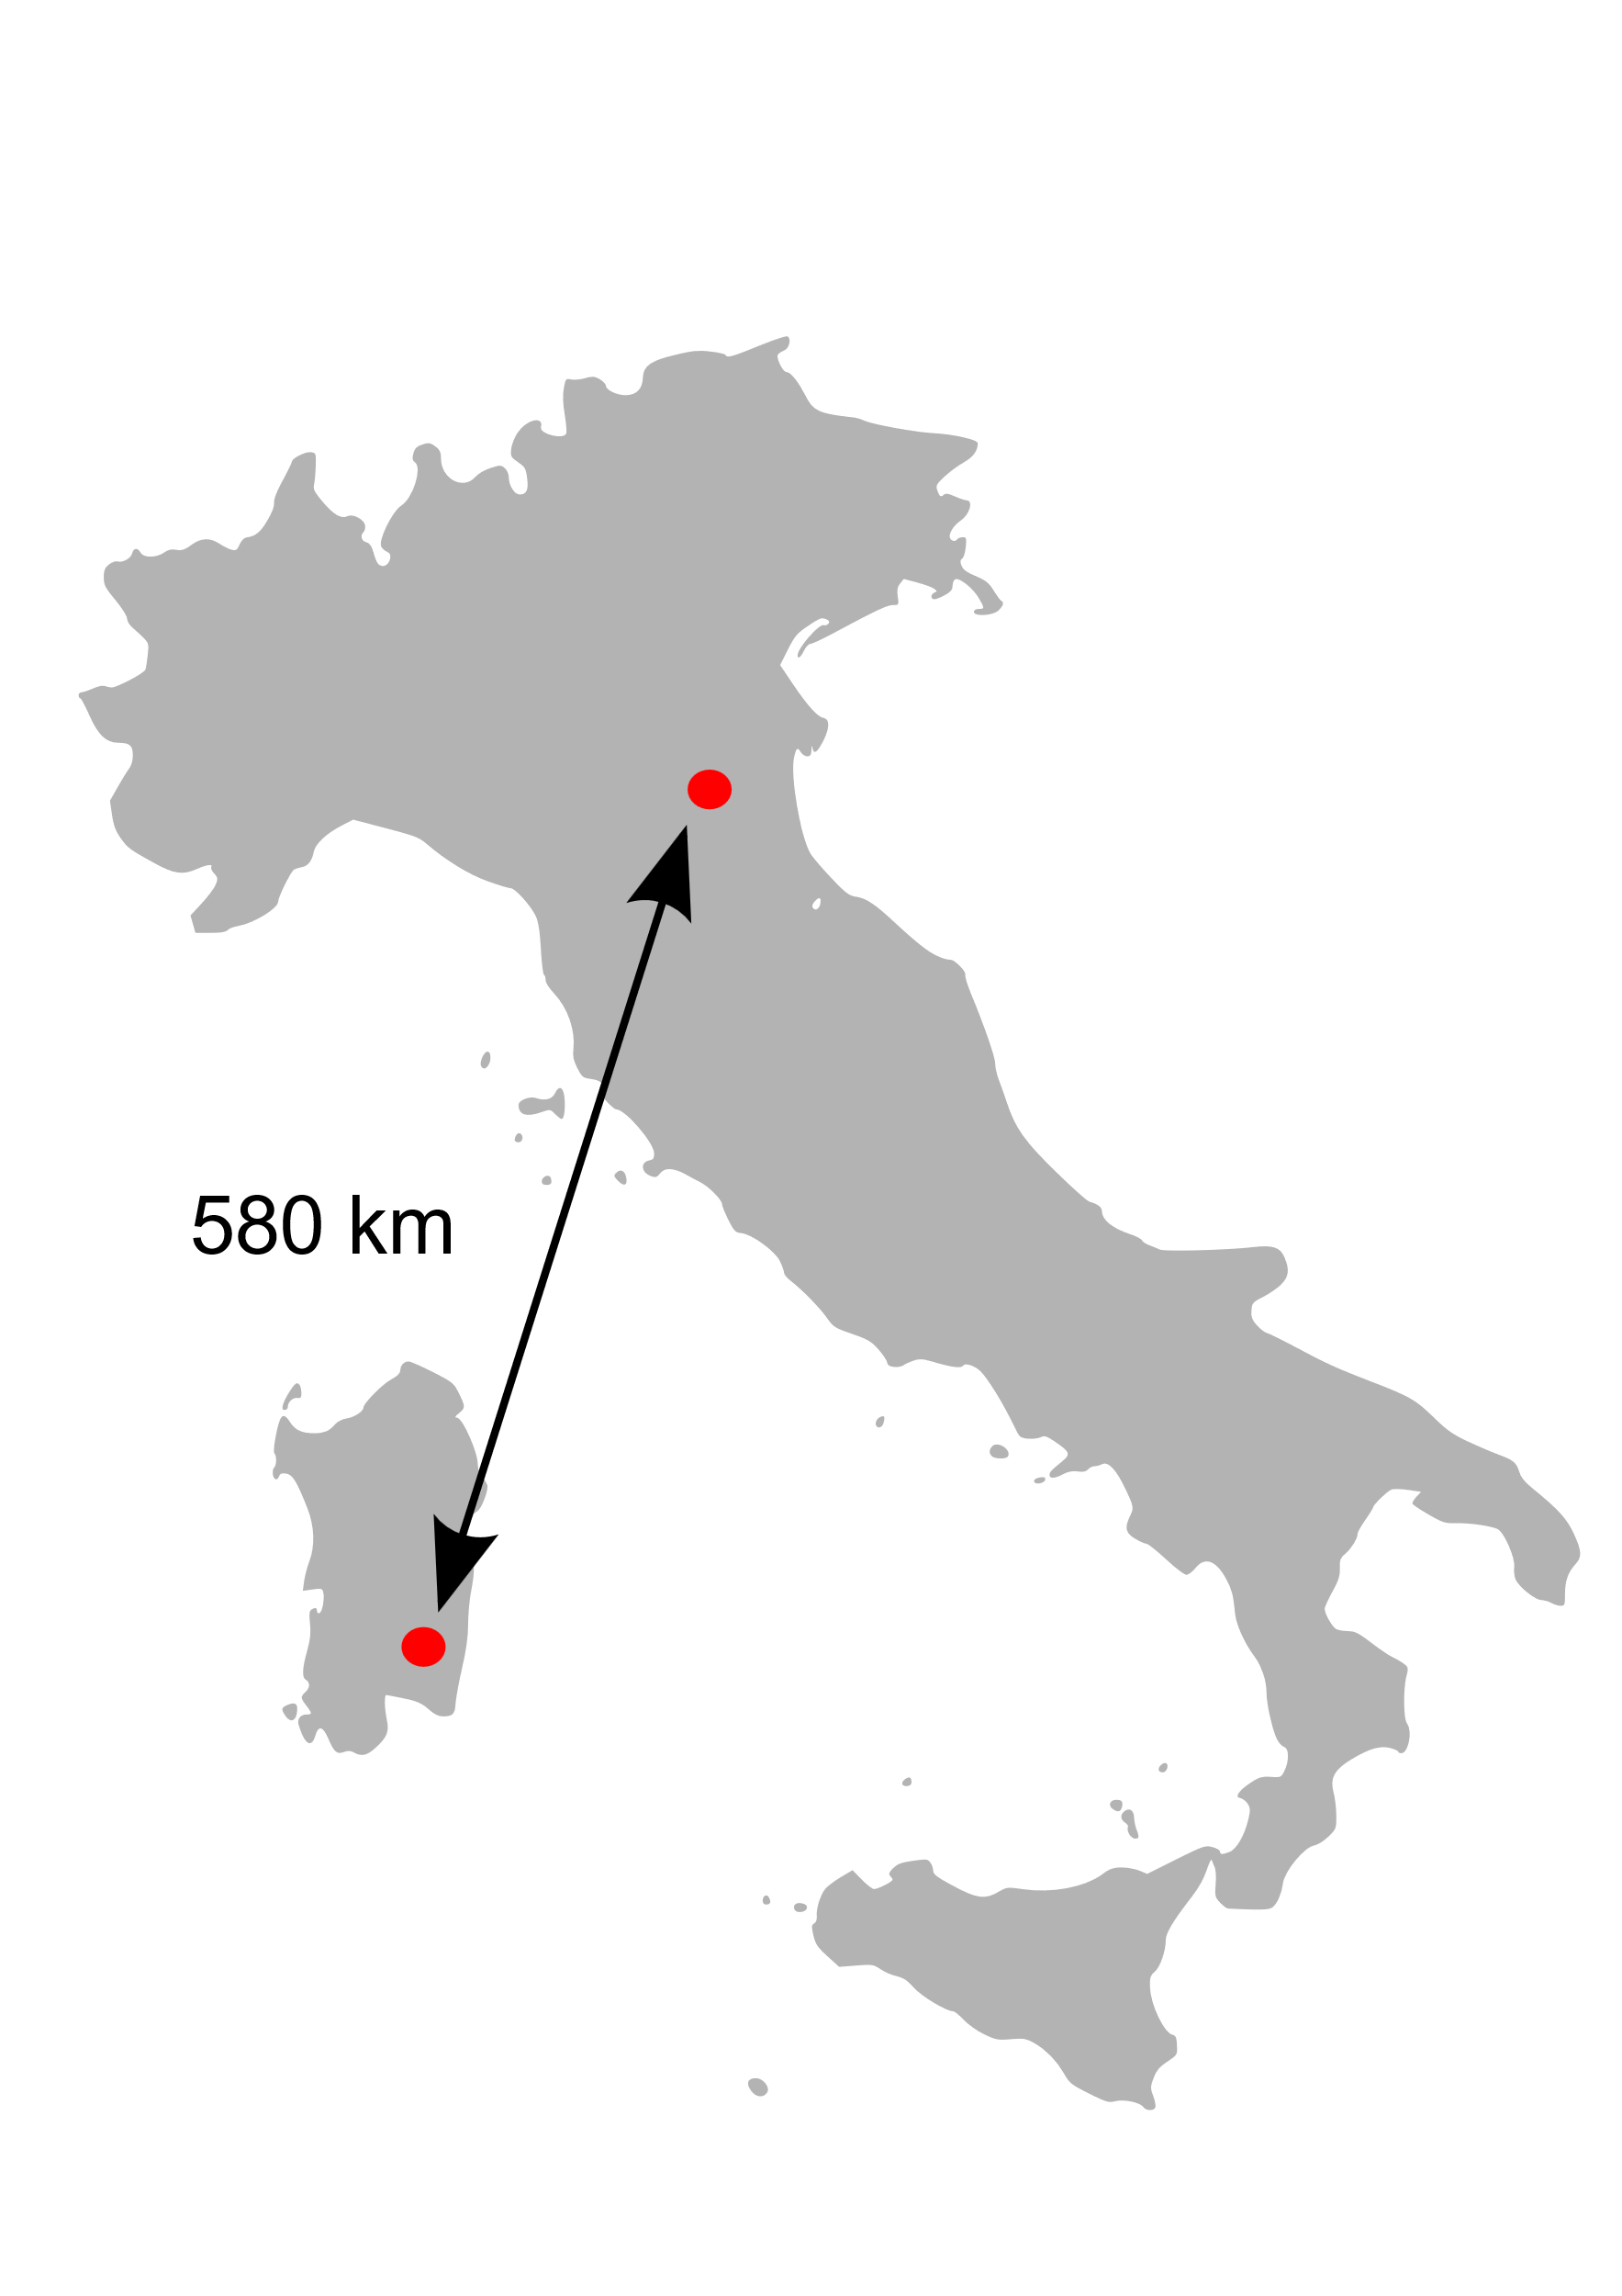
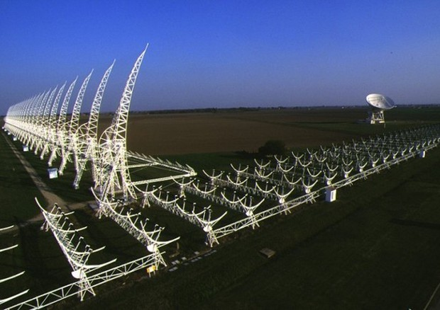
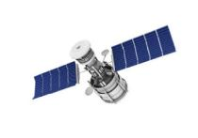
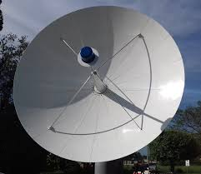
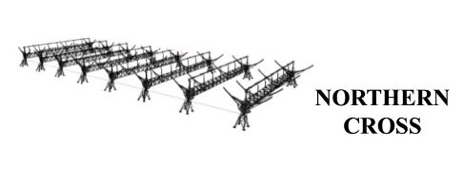
BIstatic Radar for Leo Survey (BIRALES)
Angular profile
Slant Range
Northern Cross
Doppler Shift
RFT
Northern Cross
(Bologna)
RFT
(Sardinia)

Slide 5
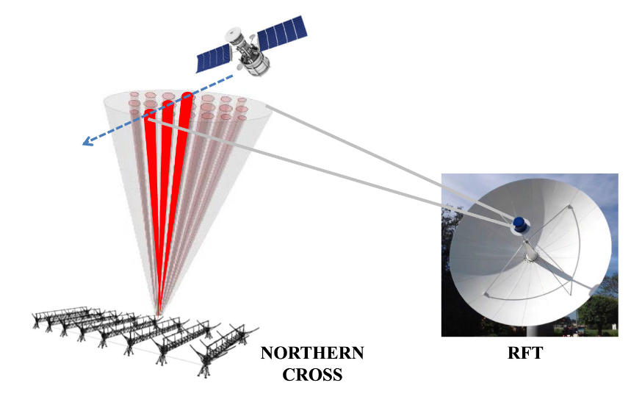
BIRALES: MULTIBEAM APPROACH
Angular profile
Disadvantage: both main lobes and grating lobes appear in sensor FoV
Static beamforming ^{[1]}
Beam 2
Beam 1
Medicina (Bologna)
Salto di Quirra
(Sardinia)
[1] M. Losacco et al., Acta Astronautica, 2020

Slide 6
BIRALES: MULTIBEAM APPROACH
Angular profile
Disadvantage: both main lobes and grating lobes appear in sensor FoV
Static beamforming ^{[1]}
Beam 2
Beam 1
Medicina (Bologna)
Salto di Quirra
(Sardinia)
[1] M. Losacco et al., Acta Astronautica, 2020

Slide 7
BIRALES: MULTIBEAM APPROACH
Angular profile
Disadvantage: both main lobes and grating lobes appear in sensor FoV
Static beamforming ^{[1]}
Beam 2
Beam 1
Medicina (Bologna)
Salto di Quirra
(Sardinia)
[1] M. Losacco et al., Acta Astronautica, 2020

Slide 8
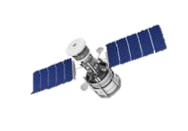
BIRALES: ADAPTIVE BEAMFORMING APPROACH
Adaptive beamforming
Medicina (Bologna)
Salto di Quirra
(Sardinia)

Slide 9
BIRALES: ADAPTIVE BEAMFORMING APPROACH
MUSIC - MUltiple SIgnal Classification ^{[2]}
Raw signal
Covariance matrix
MUSIC ^{[2]}
DOA estimation
[2] R. Schmidt et al., IEEE Transactions on Antennas and Propagation, 1986

Slide 10
BIRALES: ADAPTIVE BEAMFORMING APPROACH
MUSIC - MUltiple SIgnal Classification ^{[2]}
Raw signal
Direction of Arrival (DOA)
Covariance matrix
MUSIC ^{[2]}
DOA estimation
Angular track

Slide 11
DOA AMBIGUITY PROBLEM
DOA solution is unique if distance between antennas is less than
Presence of multiple DOA estimates
Ambiguity solving criteria needed
$$λ/2$$
0.73 m
5.67 m
10 m
Signal DOA

Slide 12
OUTLINE
01
BIRALES data processing
02
MATER: Catalogued object
Prof. Pierluigi Di Lizia
03
MATER: Uncatalogued object
04
Real data processing
05
Current developments
Prof. Marco Felice Montaruli
06
Conclusions
Missione 4 • Istruzione e Ricerca
Missione 4 • Istruzione e Ricerca

Slide 13
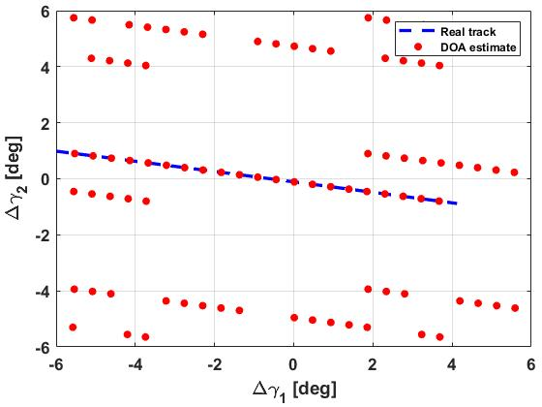
Music Approach for Track Estimate and Refinement (MATER)
Catalogued case
Signal
covariance matrix
Estimate DOAs for each epoch

Slide 14
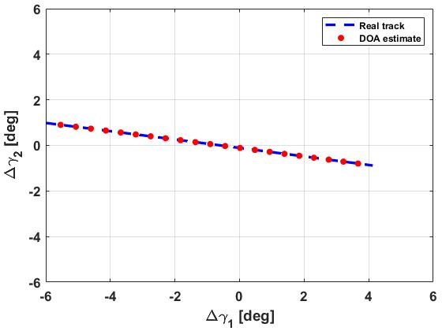
Music Approach for Track Estimate and Refinement (MATER)
Catalogued case
Signal
covariance matrix
Estimate DOAs for each epoch
State prediction

Slide 15
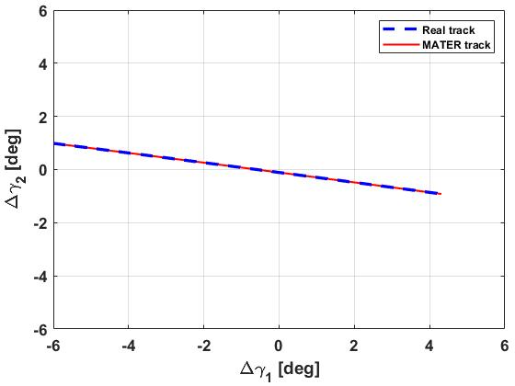
Music Approach for Track Estimate and Refinement (MATER)
Catalogued case
Signal
covariance matrix
Estimate DOAs for each epoch
State prediction
Regression
Final track

Slide 16
OUTLINE
01
BIRALES data processing
02
MATER: Catalogued object
Prof. Pierluigi Di Lizia
03
MATER: Uncatalogued object
04
Real data processing
05
Current developments
Prof. Marco Felice Montaruli
06
Conclusions
Missione 4 • Istruzione e Ricerca
Missione 4 • Istruzione e Ricerca

Slide 17
Music Approach for Track Estimate and Refinement (MATER)
Uncatalogued case
Signal
covariance matrix
Estimate DOAs for each epoch
State prediction

Slide 18
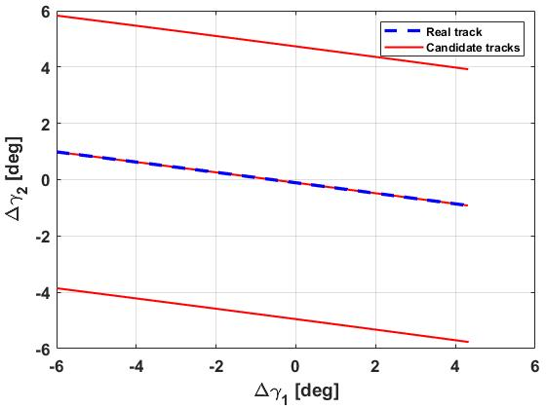
Music Approach for Track Estimate and Refinement (MATER)
Uncatalogued case
Signal
covariance matrix
Estimate DOAs for each epoch
Clustering based on RANSAC

Slide 19
Music Approach for Track Estimate and Refinement (MATER)
Uncatalogued case
Signal
covariance matrix
Estimate DOAs for each epoch
Clustering based on RANSAC
Ambiguity solving criterion

Slide 20
Music Approach for Track Estimate and Refinement (MATER)
Uncatalogued case
First approach:
Signal
covariance matrix
Estimate DOAs for each epoch
For each candidate track, use measured DS and SR to perform an initial orbit determination (IOD)
Clustering based on RANSAC
$$μ,P$$
N candidate tracks
Ambiguity solving criterion
Compute all predicted SNR profiles and compare with measured SNR

Slide 21
Uncatalogued case
For each angular track, if range is available:
Signal
covariance matrix
Estimate DOAs for each epoch
Clustering based on RANSAC
Range
Radar IOD ^{[3]}
Ambiguity solving criterion
Angles
Predicted SNR
profiles
[3] J. Siminski, 6th International Conference on Astrodynamics Tools and Techniques (ICATT), Darmstadt, Germany, 2016, 14-17 March

Slide 22
Uncatalogued case
For each angular track, if only Doppler is available:
Signal
covariance matrix
Estimate DOAs for each epoch
Doppler shift
Clustering based on RANSAC
Range reconstruction^{[4]}
Range
Radar IOD ^{[3]}
Ambiguity solving criterion
Angles
Predicted SNR
profiles
[4] C. Yanez et al, 7th European Conference on Space Debris, 2017

Slide 23
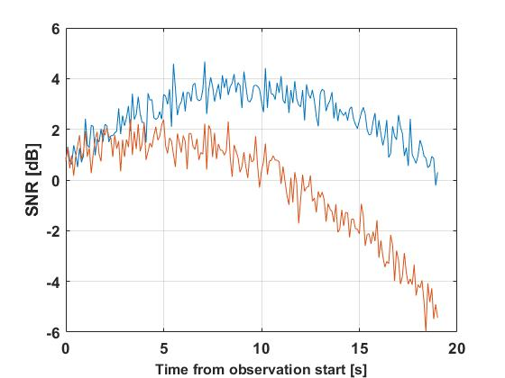
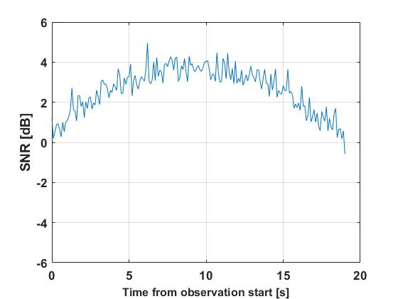
Music Approach for Track Estimate and Refinement (MATER)
Uncatalogued case
Signal
covariance matrix
Estimate DOAs for each epoch
Predicted
Measured
Track 1
Clustering based on RANSAC
Track 2
Ambiguity solving criterion

Slide 24
Music Approach for Track Estimate and Refinement (MATER)
Uncatalogued case
Signal
covariance matrix
Estimate DOAs for each epoch
Final track
Clustering based on RANSAC
Ambiguity solving criterion

Slide 25
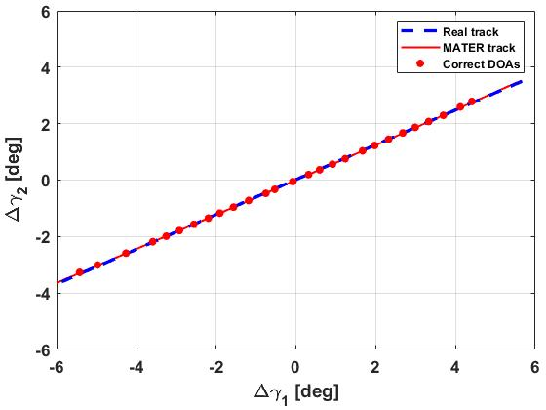
REAL OBSERVATIONS
ISS passage (April 28, 2021)
Accuracy | 1e-02 - 1e-01 deg
MUSIC pattern
Current signal processing chain not suitable:
Still designed for a multibeam logics
Very noisy covariance matrices
Only large objects with small SR

Slide 26
OUTLINE
01
BIRALES data processing
02
MATER: Catalogued object
Pierluigi Di Lizia
03
MATER: Uncatalogued object
04
Real data processing
05
Current developments
Marco Felice Montaruli
06
Conclusions
Missione 4 • Istruzione e Ricerca
Missione 4 • Istruzione e Ricerca

Slide 27
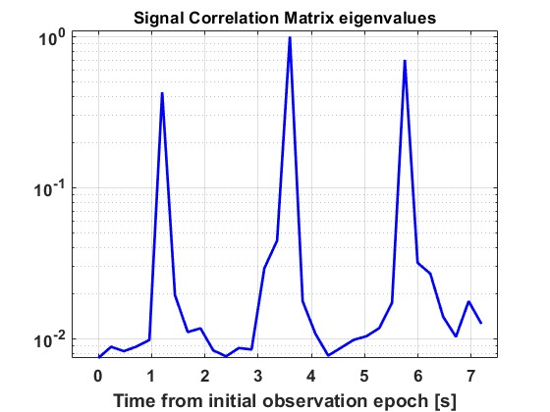
Real data processing
From October 31st to November 4th, 2022
First operational involvement in SST services
3rd Long March re-entry
November 1st, 2022
h. 08:40 UTC
November 2nd, 2022
h. 08:24 UTC
November 4th, 2022
h. 07:29 UTC
Missione 4 • Istruzione e Ricerca
Missione 4 • Istruzione e Ricerca

Slide 28
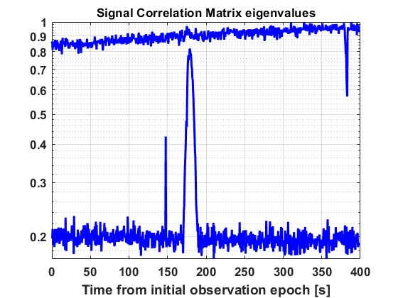
Real data processing - channelisation
December 2°, 2022
Target: SARAL (norad ID 39086)
Radiosource: Cassiopea-A
SARAL transit
Cassiopea-A
SARAL
Missione 4 • Istruzione e Ricerca
Missione 4 • Istruzione e Ricerca

Slide 29
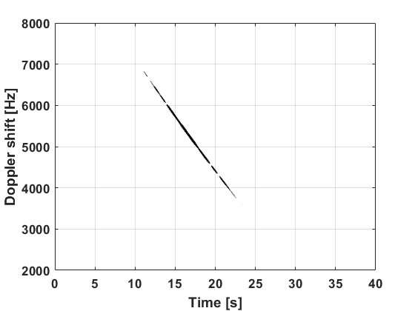
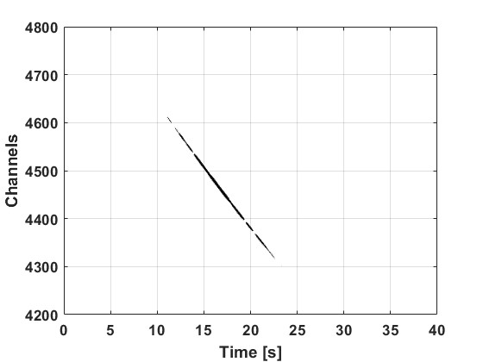
Real data processing - channelisation
8192 channels
Detection block
Channel selected
Correlate
$$BW_{RX} \sim 85000 Hz$$
Angular track accuracy
$$BW_{RX} \sim 10 Hz$$
Detection rate
$$SNR∝\frac{1}{BW_{RX}}$$
Multiple sources scenario
Missione 4 • Istruzione e Ricerca
Missione 4 • Istruzione e Ricerca

Slide 30
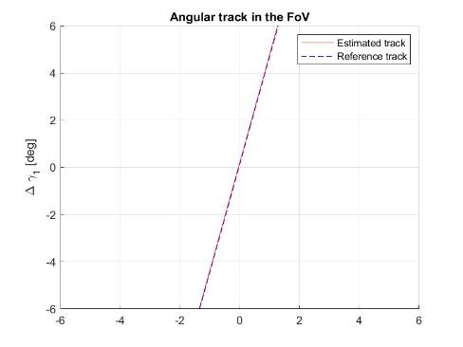
Real data processing - channelisation
July 24°-28°, 2023
The target was maneuvering during the observation
Uncatalogued case
Aeolus re-entry campaign
Missione 4 • Istruzione e Ricerca
Missione 4 • Istruzione e Ricerca

Slide 31
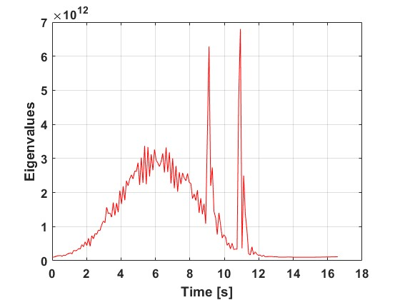
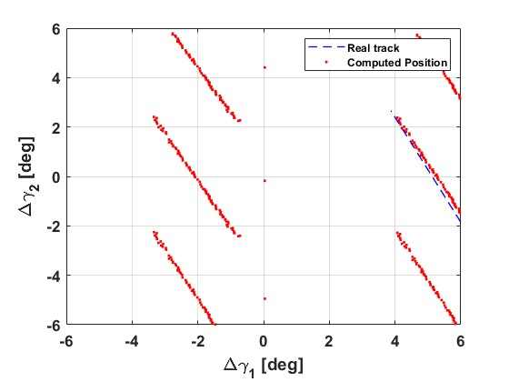
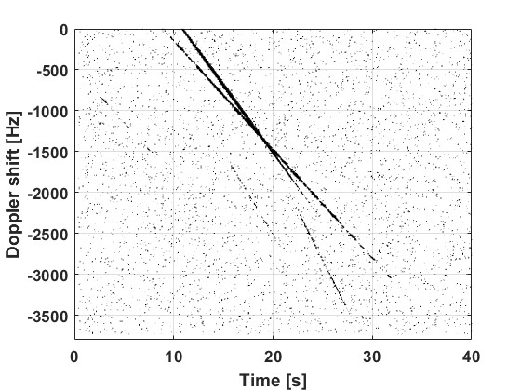
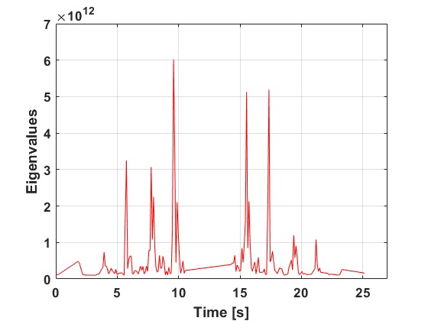
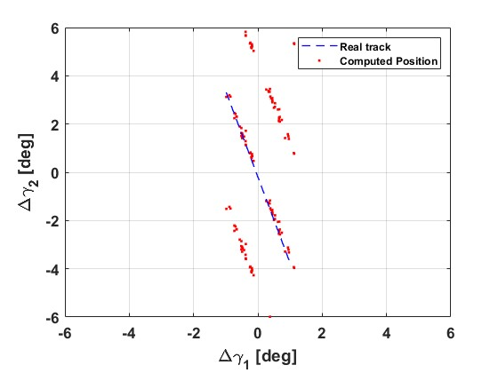
Real data processing - overpopulation
July 24°, 2024
Target: DMSP 5D-2 F8 (norad ID 18123)
DMSP 5D-2 F8 break-up
DMSP 5D-2 F8
Starlink-6051
DMSP 5D-2 F8
Starlink-6051
Disputed region
Additional targets
Unrelated sources overlapping
Satellites constellation problem (starlink)
DMSP 5D-2 F8
Missione 4 • Istruzione e Ricerca
Missione 4 • Istruzione e Ricerca

Slide 32
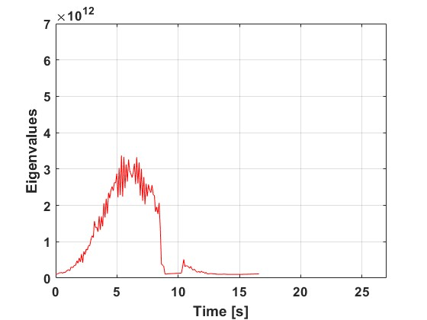
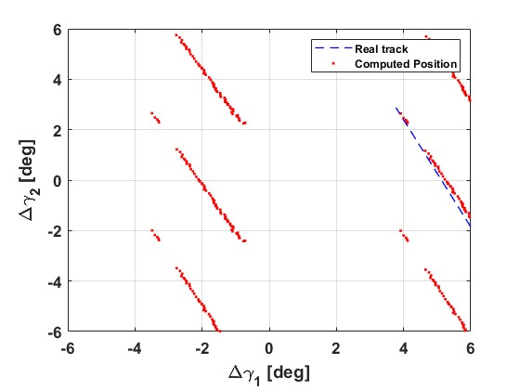
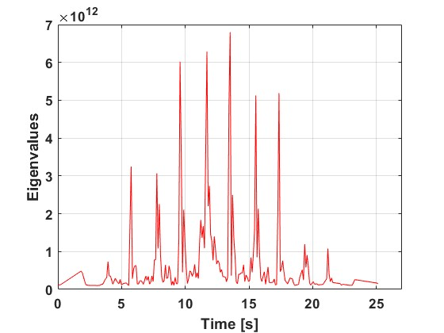
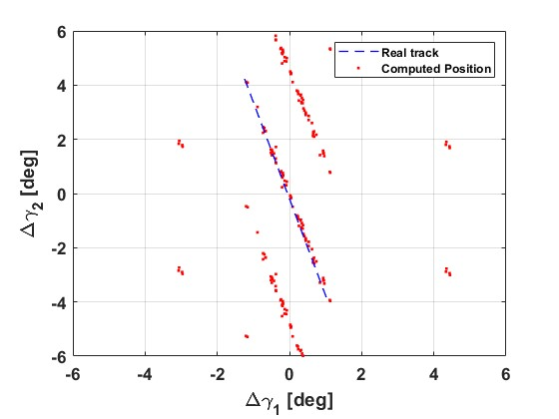
Real data processing - overpopulation
July 24°, 2024
Target: DMSP 5D-2 F8 (norad ID 18123)
DMSP 5D-2 F8 break-up
Starlink-6051
DMSP 5D-2 F8
Starlink-6051
Disputed region
Additional targets
Unrelated sources overlapping
Satellites constellation problem (starlink)
DMSP 5D-2 F8
Starlink-6051
Missione 4 • Istruzione e Ricerca
Missione 4 • Istruzione e Ricerca

Slide 33
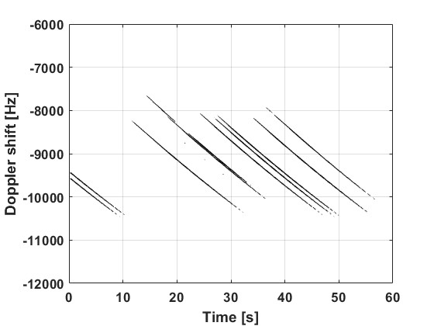
Real data processing - overpopulation
September 3°, 2024
Target: CZ-6A DEB (norad id 60649)
CZ-6A break-up
Critical clustering
Break-up on August 7°, 2024
QIANFAN constellation detected by 1N and 2N
Data associated to two starlinks
No fragments cloud detection
Missione 4 • Istruzione e Ricerca
Missione 4 • Istruzione e Ricerca

Slide 34
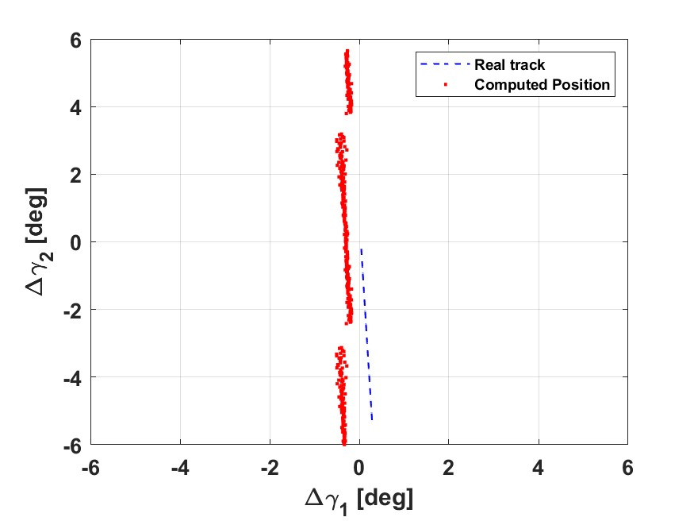
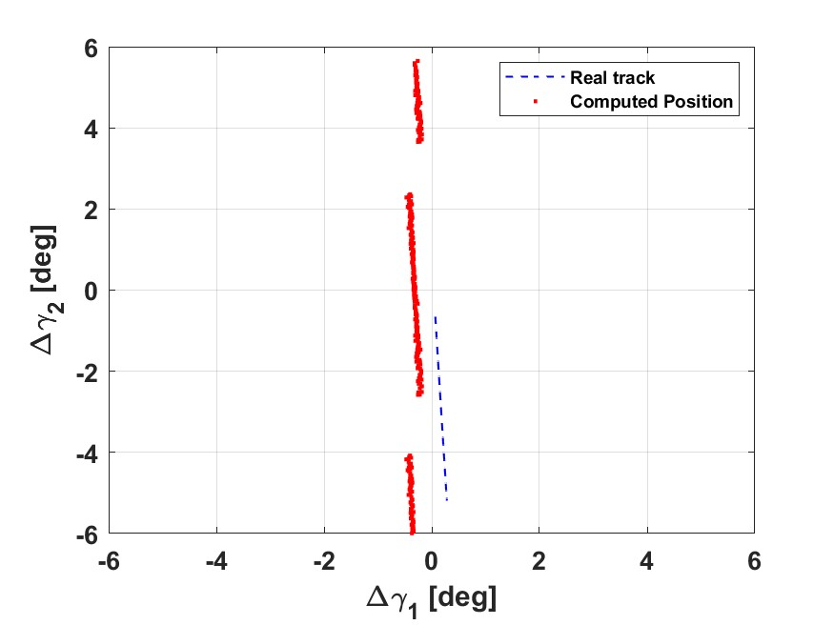
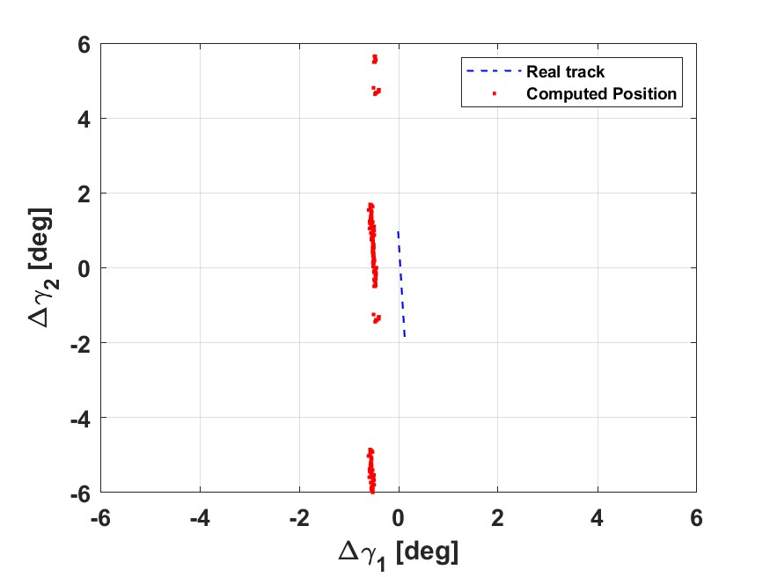
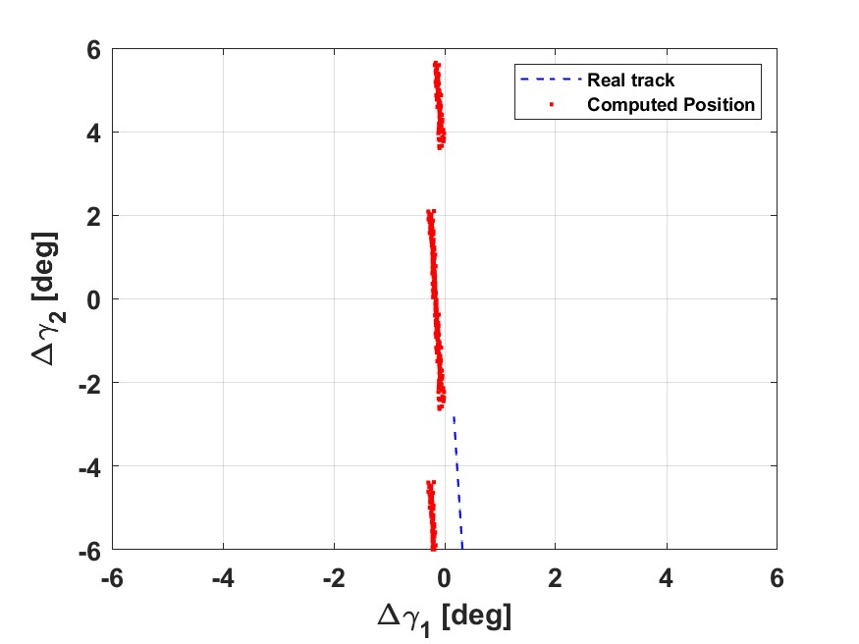
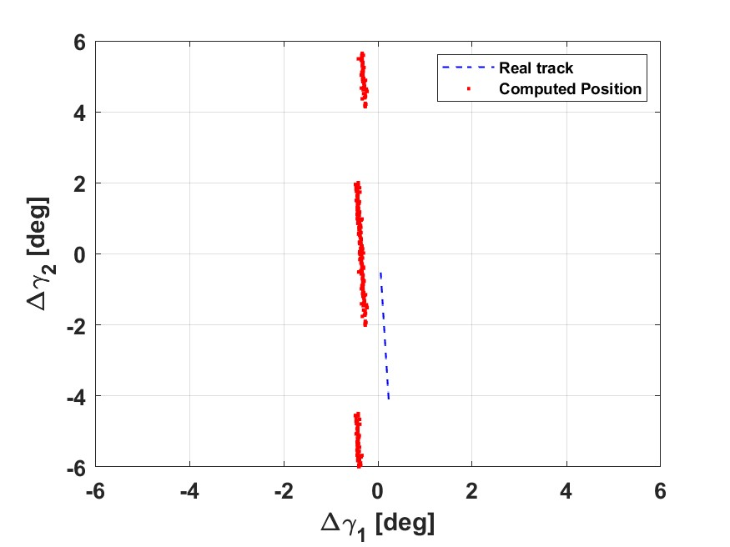
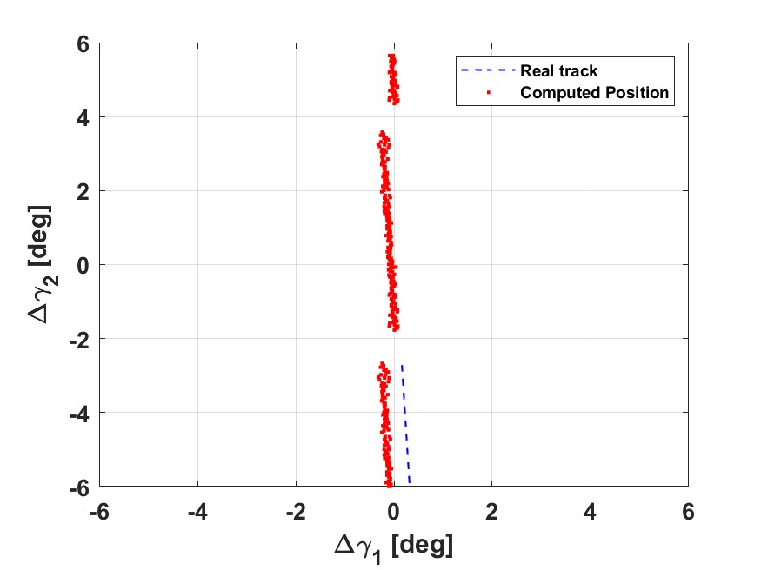
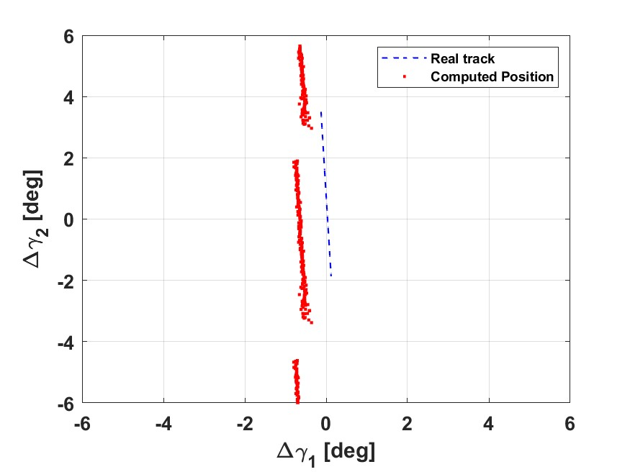
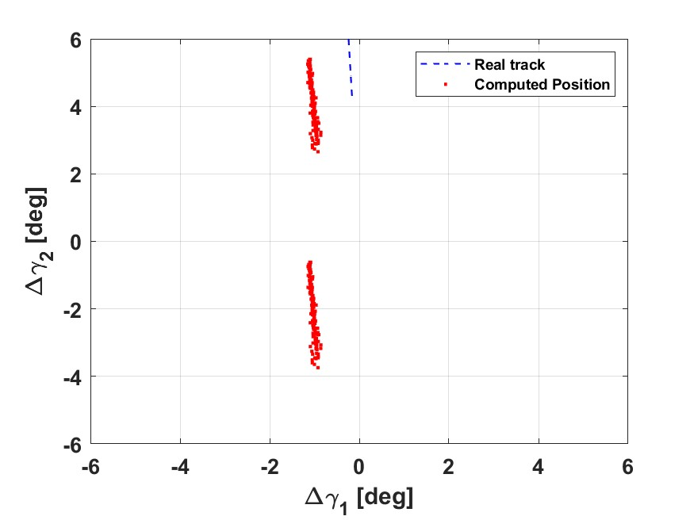
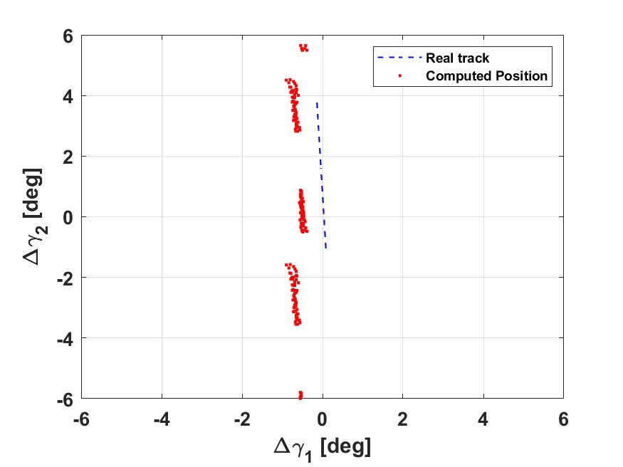
Real data processing - overpopulation
September 3°, 2024
Target: CZ-6A DEB (norad id 60649)
CZ-6A break-up
Which detection associated to the target (if any)?
Missione 4 • Istruzione e Ricerca
Missione 4 • Istruzione e Ricerca

Slide 35
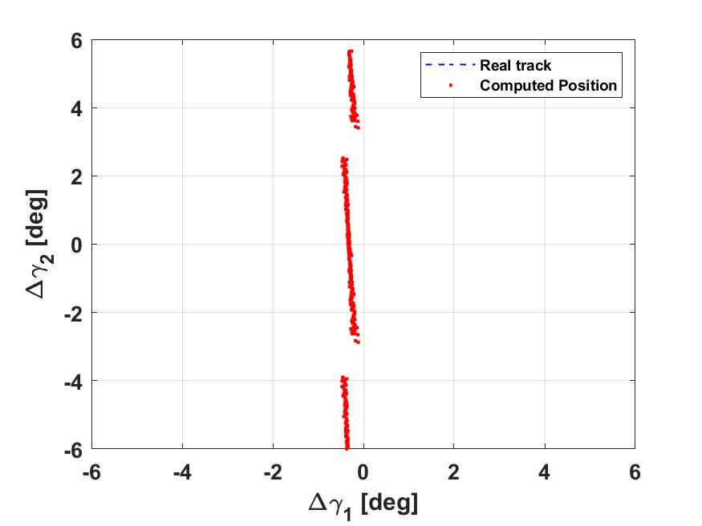
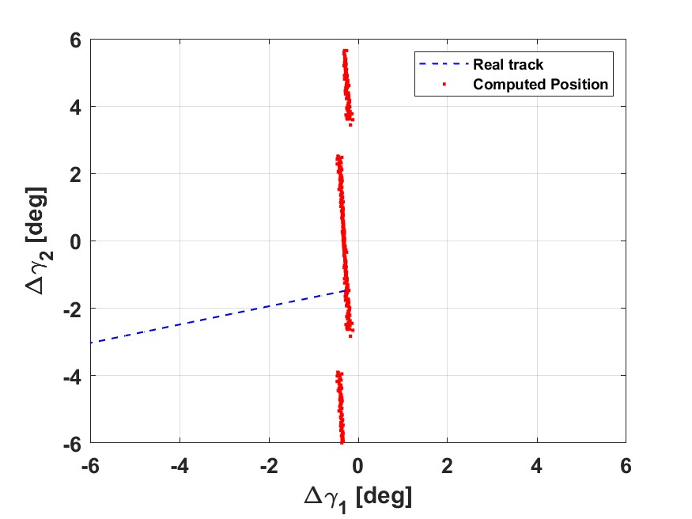
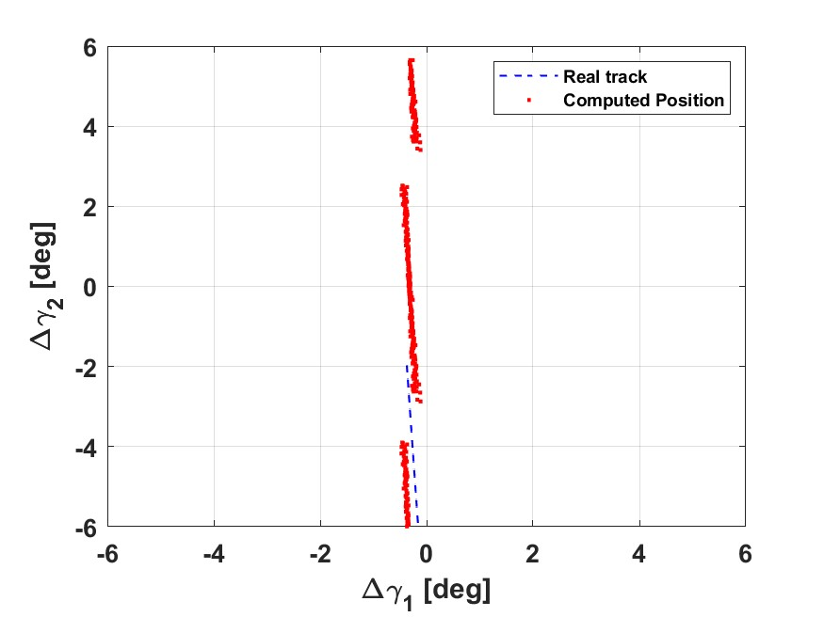
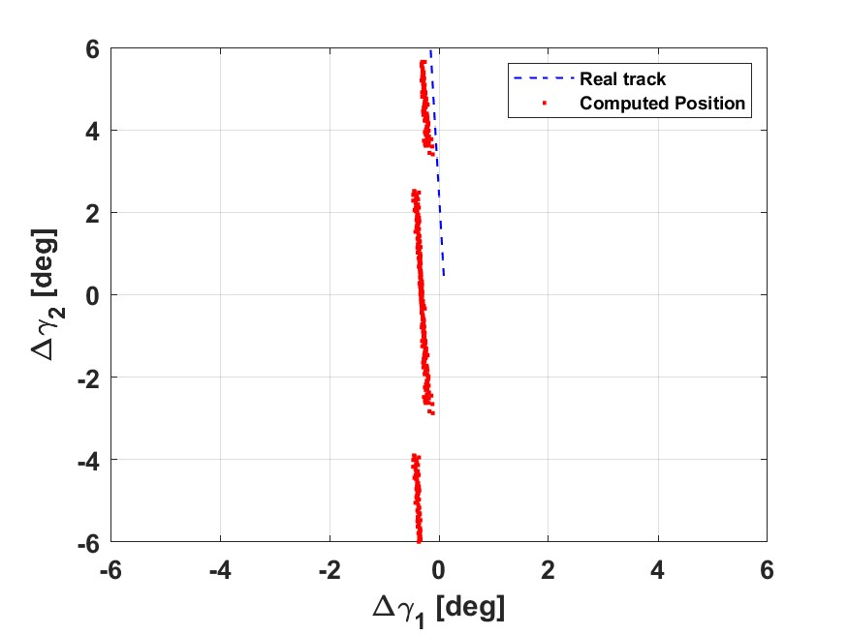
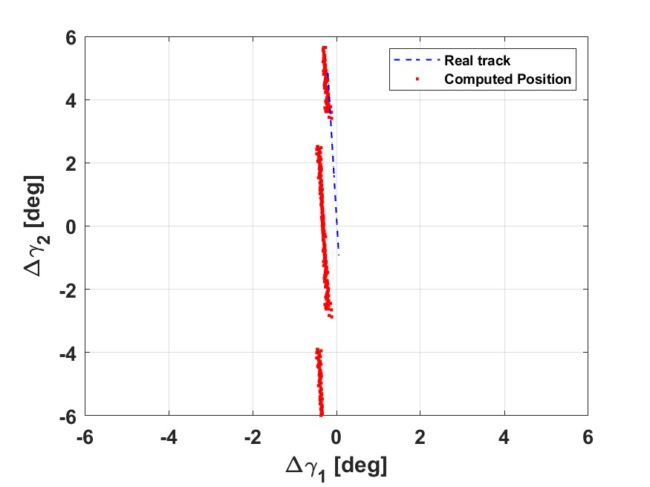
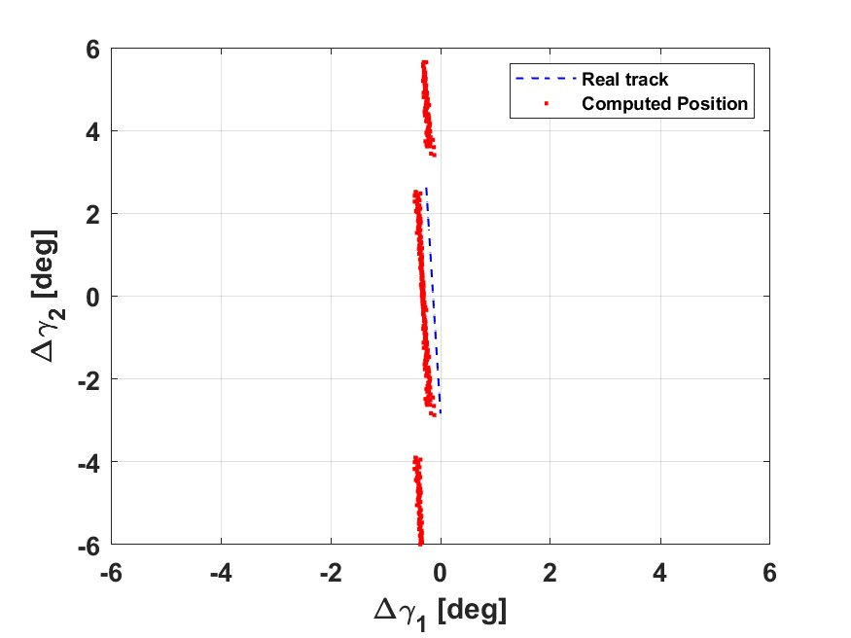
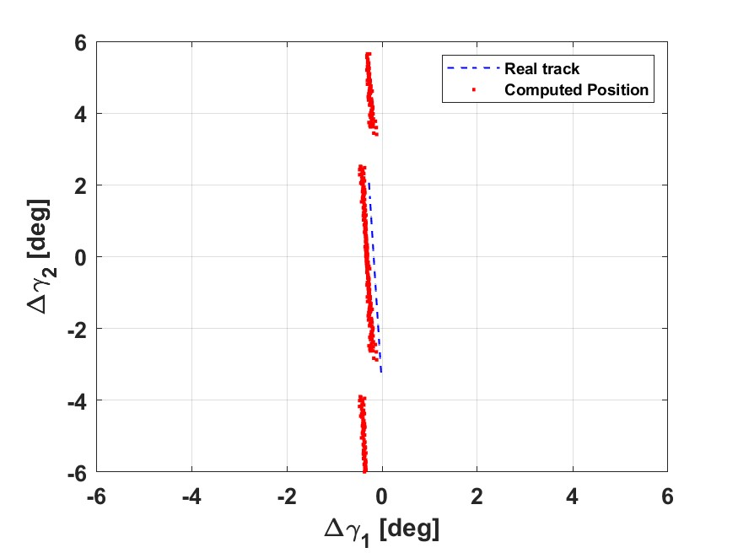
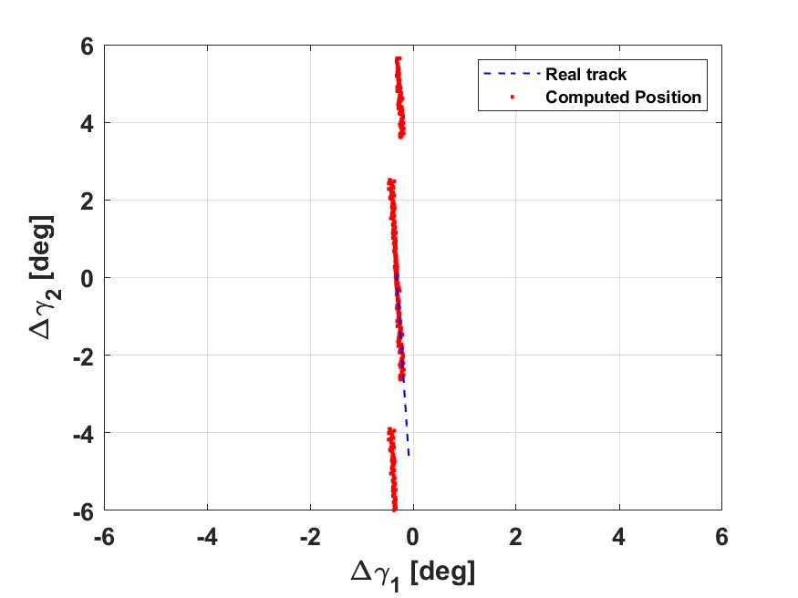
Real data processing - overpopulation
September 3°, 2024
Target: CZ-6A DEB (norad id 60649)
CZ-6A break-up
57118
57885
60379
60383
60384
60385
60386
60387
60389
60649
Which target associated to this detection?
Missione 4 • Istruzione e Ricerca
Missione 4 • Istruzione e Ricerca

Slide 36
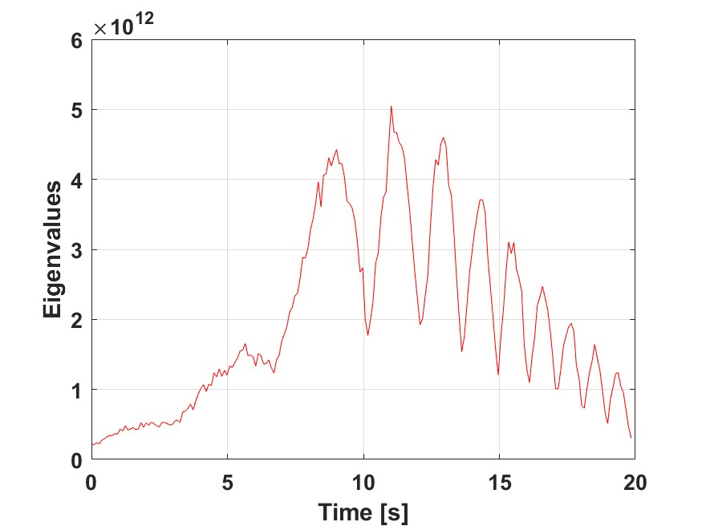
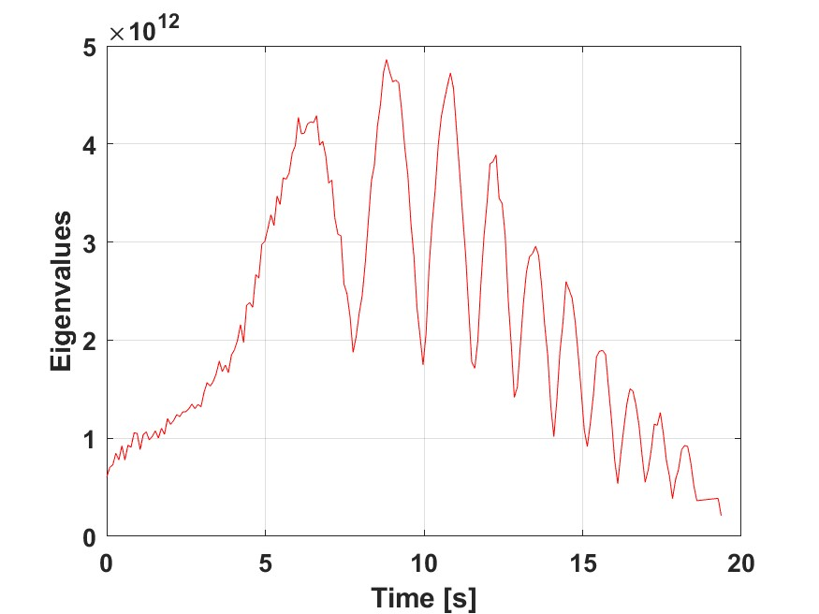
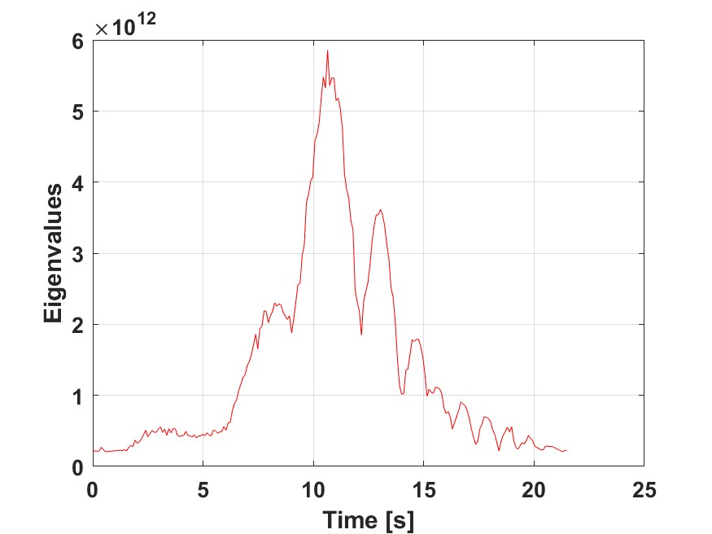
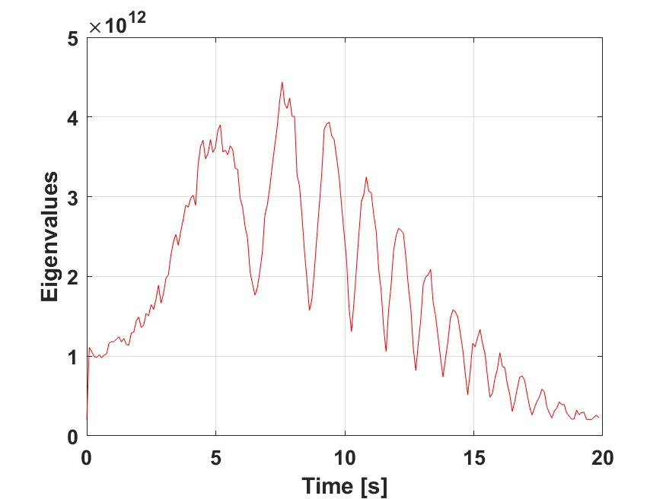
Real data processing - overpopulation
September 3°, 2024
Target: CZ-6A DEB (norad id 60649)
CZ-6A break-up
Tumbling information →Work on SNR reconstruction!
Missione 4 • Istruzione e Ricerca
Missione 4 • Istruzione e Ricerca

Slide 37
OUTLINE
01
BIRALES data processing
02
MATER: Catalogued object
Pierluigi Di Lizia
03
MATER: Uncatalogued object
04
Real data processing
05
Current developments
Marco Felice Montaruli
06
Conclusions
Missione 4 • Istruzione e Ricerca
Missione 4 • Istruzione e Ricerca

Slide 38
Current developments – East-West branch upgrade
Correct
Ambiguous
North-south branch
0.73 m
$$δ_{1}$$
Correct
Ambiguous
$$δ_{1}$$
10 m
5.67 m
5.67 m
10 m
Missione 4 • Istruzione e Ricerca
Missione 4 • Istruzione e Ricerca

Slide 39
Current developments – East-West branch upgrade
Correct
Ambiguous
North-south branch
$$δ_{1}$$
Break the symmetry!
Correct
Ambiguous
$$δ_{2}$$
East-west branch
b
a
10 m
5.67 m
Missione 4 • Istruzione e Ricerca
Missione 4 • Istruzione e Ricerca

Slide 40
Current developments – admissible regions approach
Optical angular track
Range boundaries
Energy boundaries
Constraints
Eccentricity boundary
Admissible region in range and range rate
G. Tommei et al., Orbit determination of space debris: admissible regions, Celestial Mechanics and Dynamical Astronomy, 2007
An accurate angular track is needed
Missione 4 • Istruzione e Ricerca
Missione 4 • Istruzione e Ricerca

Slide 41
Current developments – admissible regions approach
Slant range
To bistatic plane
To bistatic plane
Missione 4 • Istruzione e Ricerca
Missione 4 • Istruzione e Ricerca

Slide 42
Current developments – admissible regions approach
Slant range
Missione 4 • Istruzione e Ricerca
Missione 4 • Istruzione e Ricerca

Slide 43
OUTLINE
01
BIRALES data processing
02
MATER: Catalogued object
Pierluigi Di Lizia
03
MATER: Uncatalogued object
04
Real data processing
05
Current developments
Marco Felice Montaruli
06
Conclusions
Missione 4 • Istruzione e Ricerca
Missione 4 • Istruzione e Ricerca

Slide 44
Conclusions
To recap
Adaptive beamforming approach for BIRALES track reconstruction
Channelisation strategy
Performance improvement
Problems induced by the in-orbit overpopulation
New ways to solve the ambiguity problem
East-west branch upgrade
Admissible region approach
Publications:
M.F. Montaruli, M.A. De Luca, M. Massari, G. Bianchi, A. Magro, Operational Angular Track Reconstruction in Space Surveillance Radars through an Adaptive Beamforming Approach. Aerospace 2024
M.F. Montaruli, P. Di Lizia, S. Tebaldini, G. Bianchi, Adaptive track approach for multiple sources scenarios during radar survey for space surveillance applications, Aerospace Science and Technology, 2024
Missione 4 • Istruzione e Ricerca
Missione 4 • Istruzione e Ricerca

Slide 45
Conclusions
Next steps
New ways to solve the ambiguity problem
Operational pipeline implementation
Work in progress (30%)
Waiting for the automatic detection block
Radar light curves analysis
Operational support from PoliMi
Missione 4 • Istruzione e Ricerca
Missione 4 • Istruzione e Ricerca

Slide 46
GRAZIE
PER L’ATTENZIONE
Next Generation – Croce del Nord
IR0000026
Intervento finanziato nell’ambito del PNRR - Piano Nazionale di Ripresa e Resilienza
M4C2
Missione 4 - Istruzione e Ricerca Componente 2 - Dalla Ricerca alla Impresa
Linea di Investimento 3.1 - Rafforzamento e creazione di Infrastrutture di Ricerca
CUP C53C22000880006
Missione 4 • Istruzione e Ricerca
Missione 4 • Istruzione e Ricerca

