Slide 1
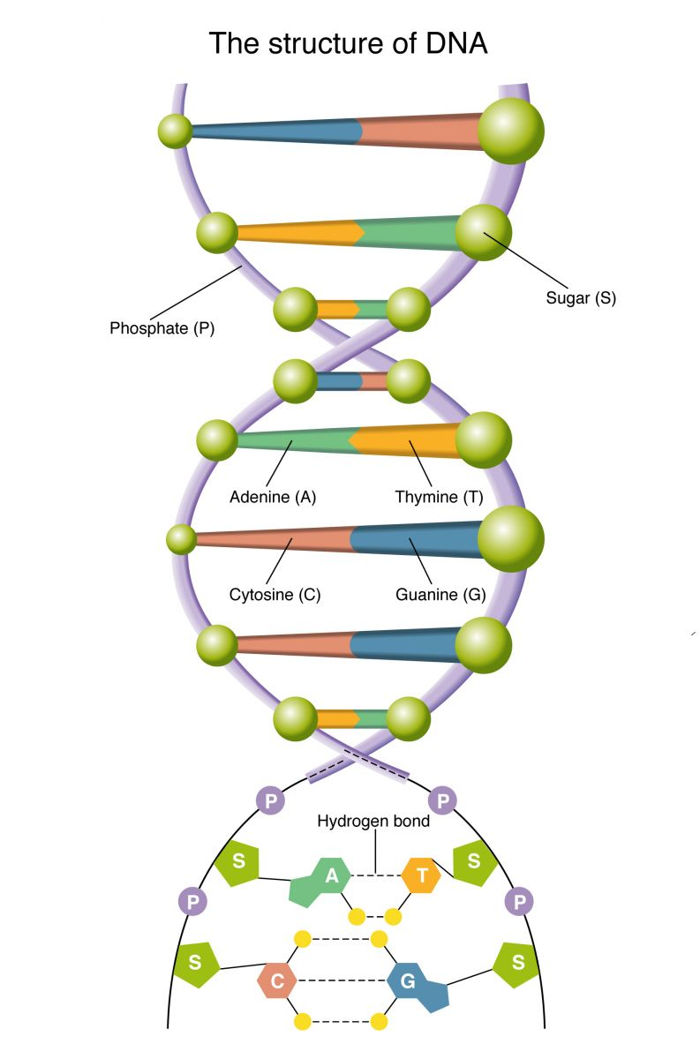
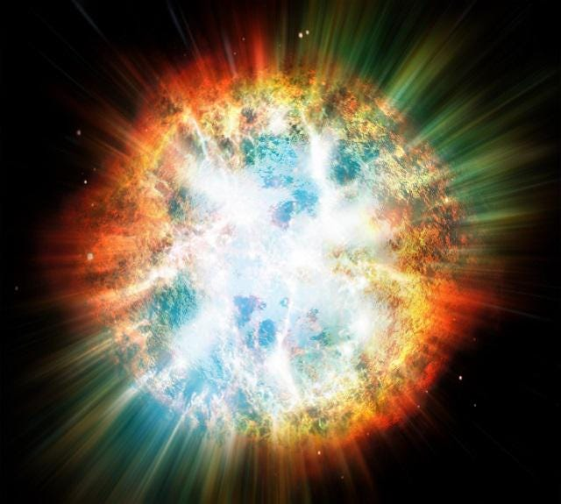
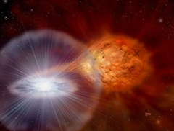
Galactic habitable zone from the perspective of phosphorous enrichment
Takuji Tsujimoto (NAOJ)
Where is the major
production site of P?
P enrichment
in
the solar vicinity
and
the outer Galaxy
Molecules and planets in the outer Galaxy
12-14 Nov. 2024, Fuligno Cenacle

Slide 2
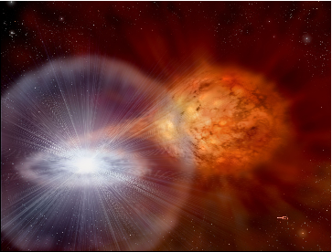
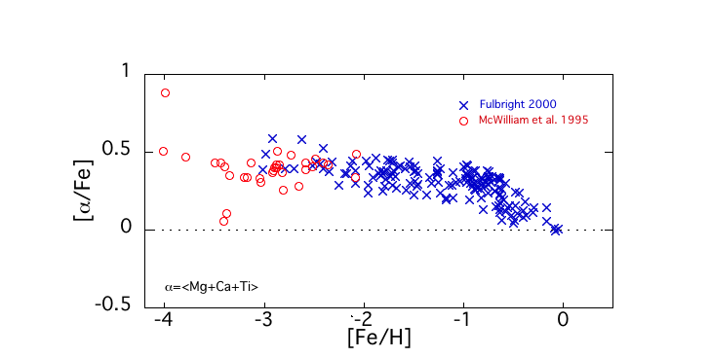
The major production site of P was considered to be
core-collapse supernovae CCSNe)
If so, chemical evolutionary path of P should be
similar to those of α-elements
SNe Ia
(type Ia
supernovae)
CCSNe
fast enrichment
delayed
enrichment of Fe
neighborhood stars
time

Slide 3
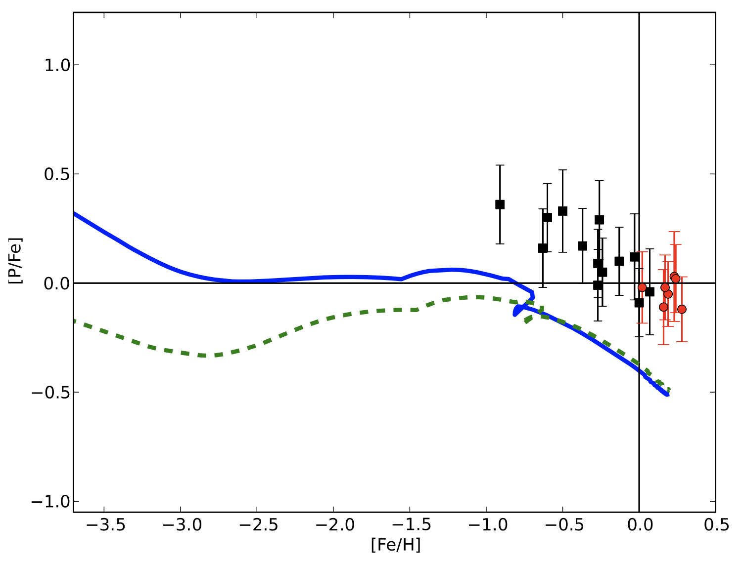
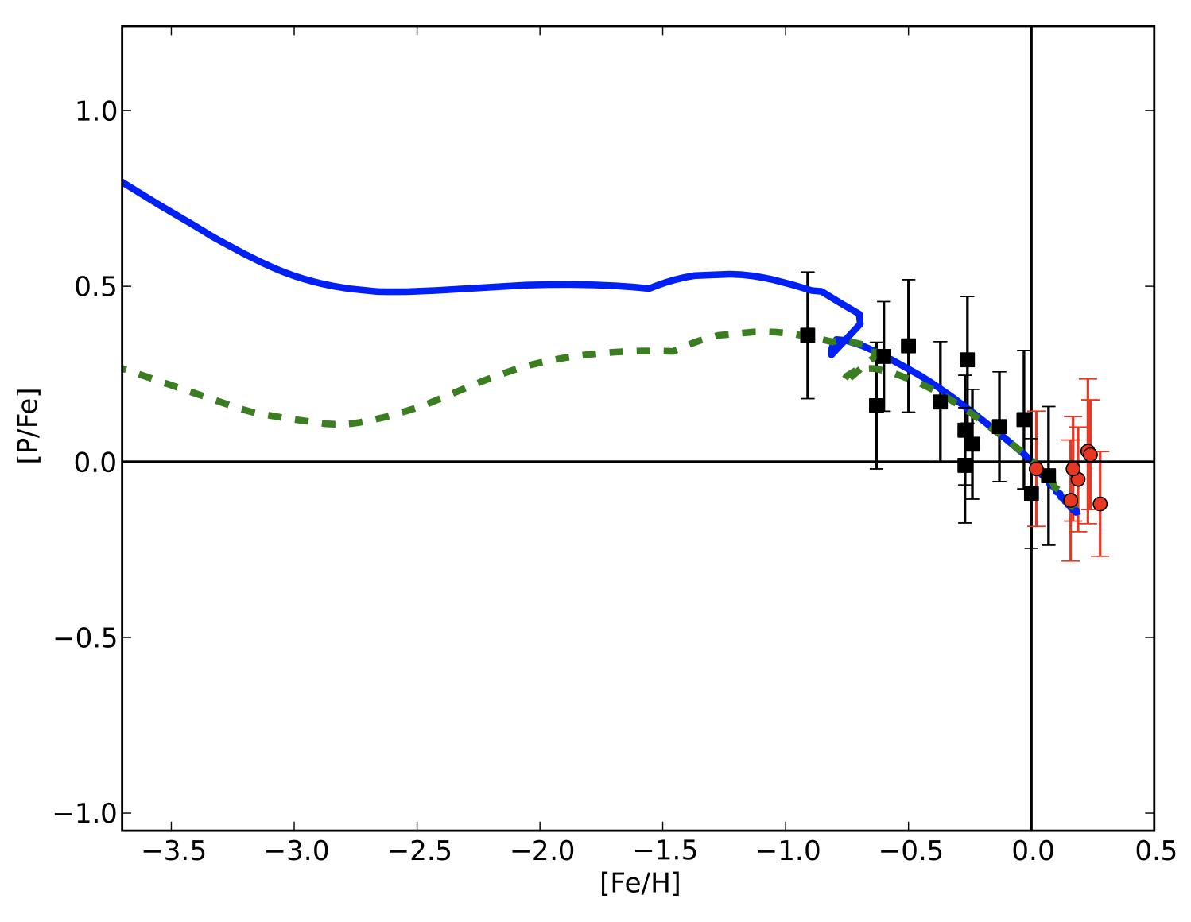
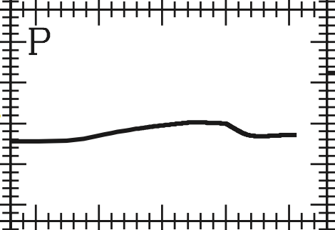
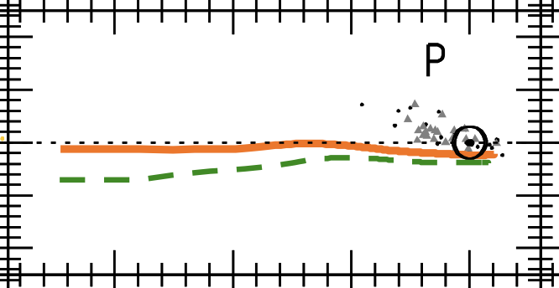
The models with P production by CCSNe fail to
reproduce the observations
(!no physical reason!)
if P yield x 3
Caffau+2011
[P/Fe]
(Cescutti+ 2012)
different CCSN yield
more other works
obs
[P/Fe]
0
[Fe/H]
(Kobayashi+ 2006)
[Fe/H]
(Prantzos+ 2018)

Slide 4
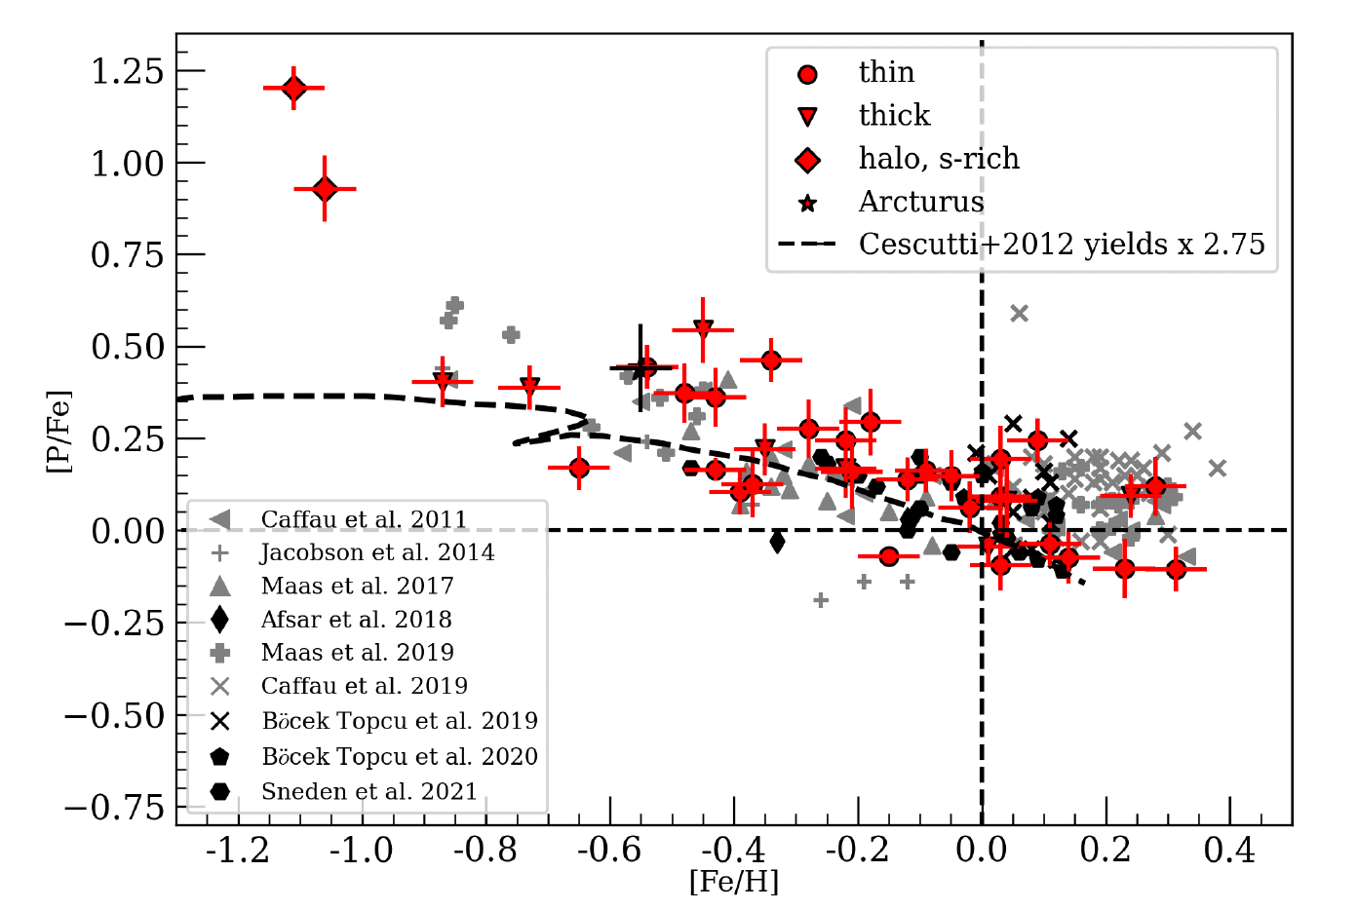

~2014~
yield$×$3 model
Hubble observation
reveals low P/Fe
for low-metallicity
halo stars
~ until recently~
Nevertheless,
general attention has
been given to the observed
trend of disk stars,
in accordance with the
accumulation of data
(Nandakumar+ 2022)

Slide 5
high
This trend is almost established
by the observations so far
up
P/Fe
ディスク星
const.
down
ハロー星
plateau-like feature
low
Fe/H
low P/Fe: reflection of nucleosynthesis in
CCSNe
delayed enrichment, compared to CCSNe, must operate
AGB stars??
But, P yield of AGB is not high… (see Masseron+ 2020)
NOVA??

Slide 6
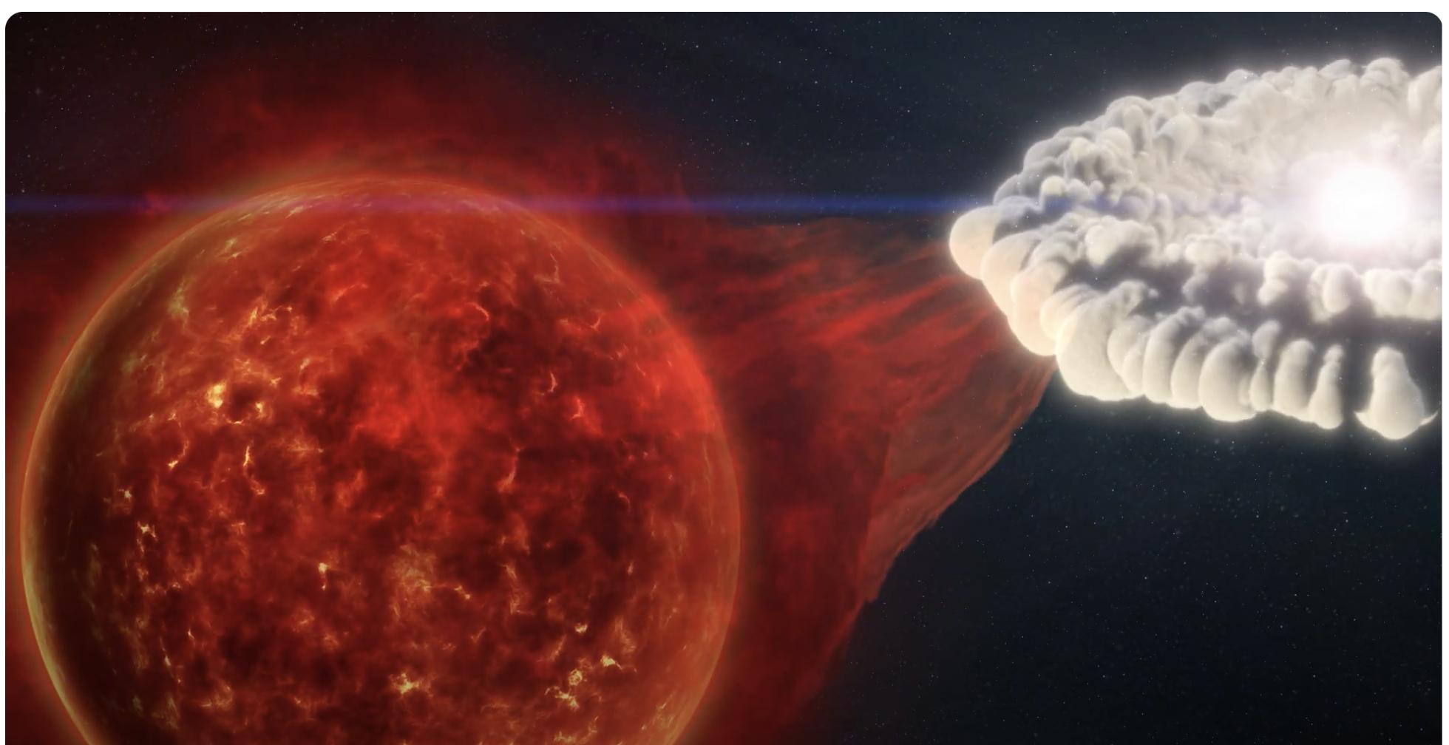
Nova
white dwarf
@MPI
thermonuclear explosions in the H-rich envelopes transferred from
a low-mass stellar companion onto a close white dwarf star
✓nucleosynthetic products up to ⁴⁰Ca
✓two types of nova:
I. CO nova
II.
ONe nova from massive
O-Ne-rich WDs
important for P enrichment

Slide 7
Chemical Enrichment by Nova
✓the ejecta mass is very small
~10⁻³ – 10⁻⁵ M⊙
per a nova
,compared to a thermonuclear supernova ~ 1.4 M⊙
However,
✓the number of outburst (N_{burst}) per a nova system is large
~ 10⁴ times (e.g., Ford 1978…..)
the current nova rate = the formation rate of WDs in binaries $×$ N_{burst}
e.g., R_{MW} ~ 44 yr⁻¹ (De+ 2020)
R_{M31} ~ 65 yr⁻¹ (Darnley+ 2006)
Thus, novae’s contribution must be, in some cases, non-negligible!

Slide 8
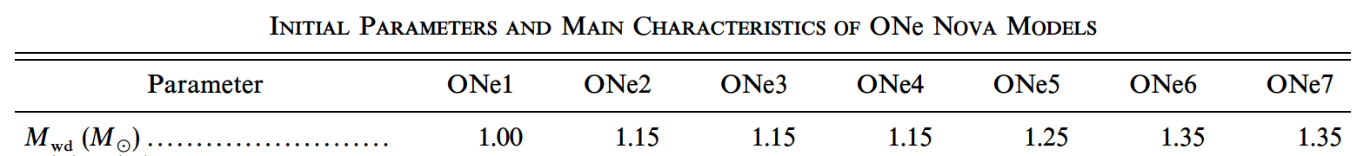
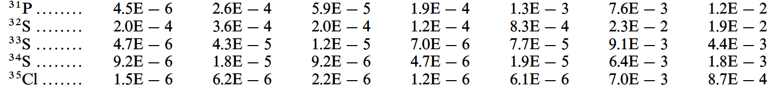
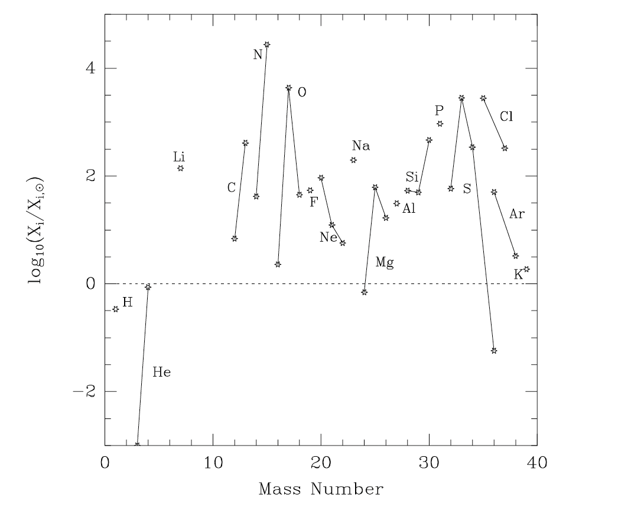
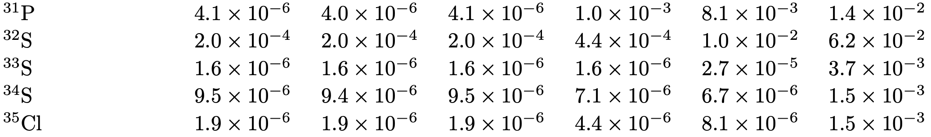
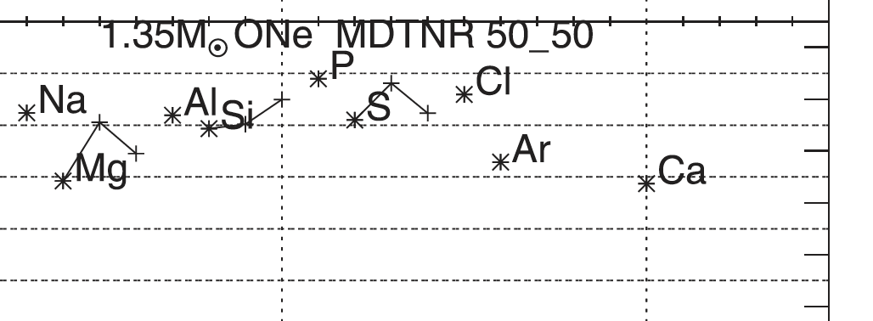
Massive ONe novae generate a very high P production!
1.35 M⦿ ONe nova model
José & Hernanz (1998)
(see also José & Hernanz 2007)
Starrfield+ (2024)
José & Hernanz (1998)

Slide 9
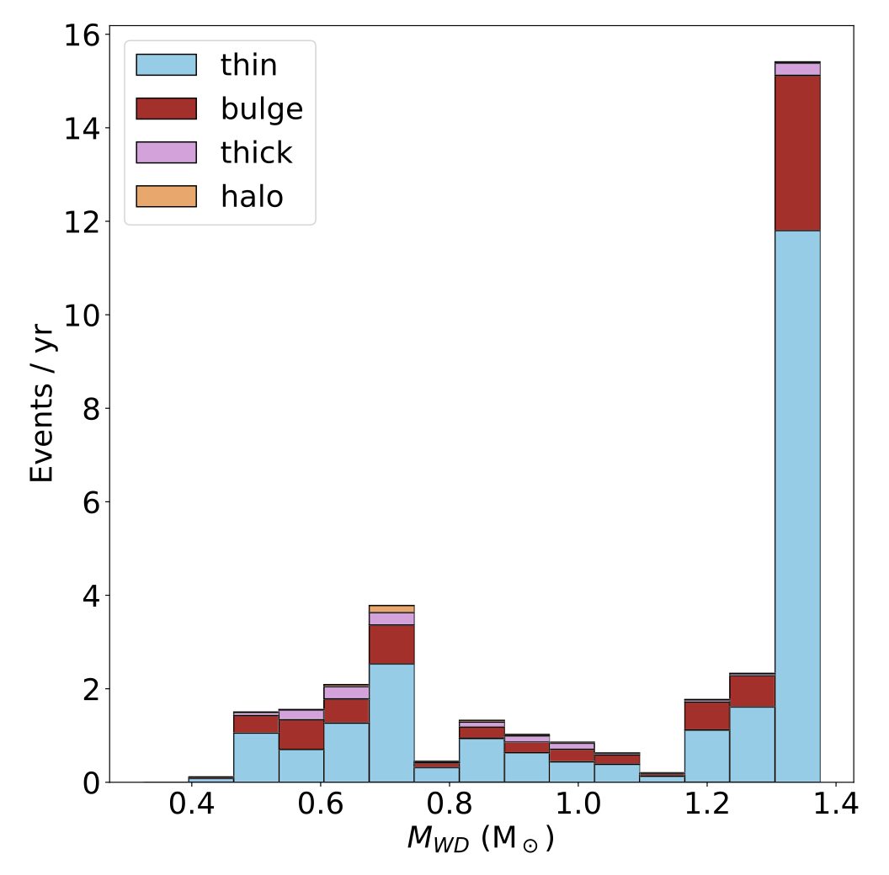
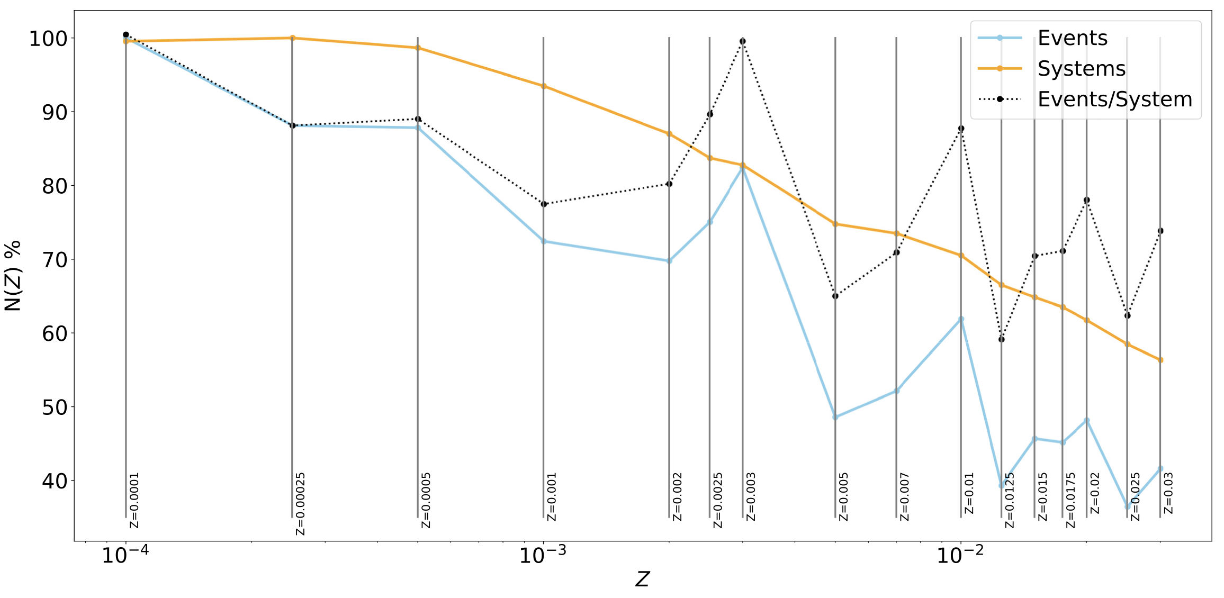
High rate and metallicity-dependence
The rate of massive ONe novae
is predicted to be very high
predicted current rate
in each Galactic
component
The nova rate is predicted to strongly
depend on metallicity
Kemp+ 2022
nova rate
at low Z
reductions in stellar radii
higher remnant masses
metallicity
metallicity

Slide 10
A new grand picture of P chemical evolution
Mass+ (2022)
Caffau+ (2016, 2019)
Nandakumur+ (2022)
Masseron+ (2020)
acquired by HST (i.e., UV obs.)
(Roederer+ 2014, 2016)

Slide 11
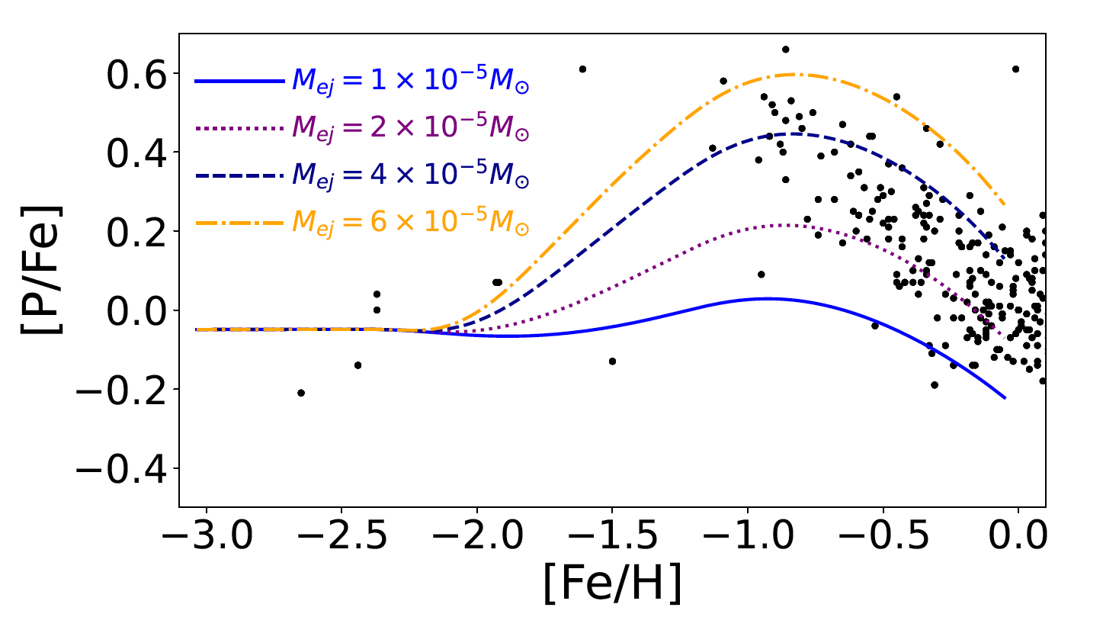

An observed scatter can be explained
by different masses of nova ejecta
higher P abundance relative to Fe at sub-solar metallicity
The model:
(Bekki & TT 2024)
✓ the number of P-rich ONe nova per unit mass = 0.012
(cf. Cescutti+ 2019)
✓ the number of outbursts per nova = 10⁴
(cf. Matteucci+2003;
Cescutti+ 2012)
✓ time delay (t_{delay}): 0.1 < t_{delay}<1 Gyr
(cf. Kemp+ 2022)
✓
,
(Bekki &
TT 2024)

Slide 12
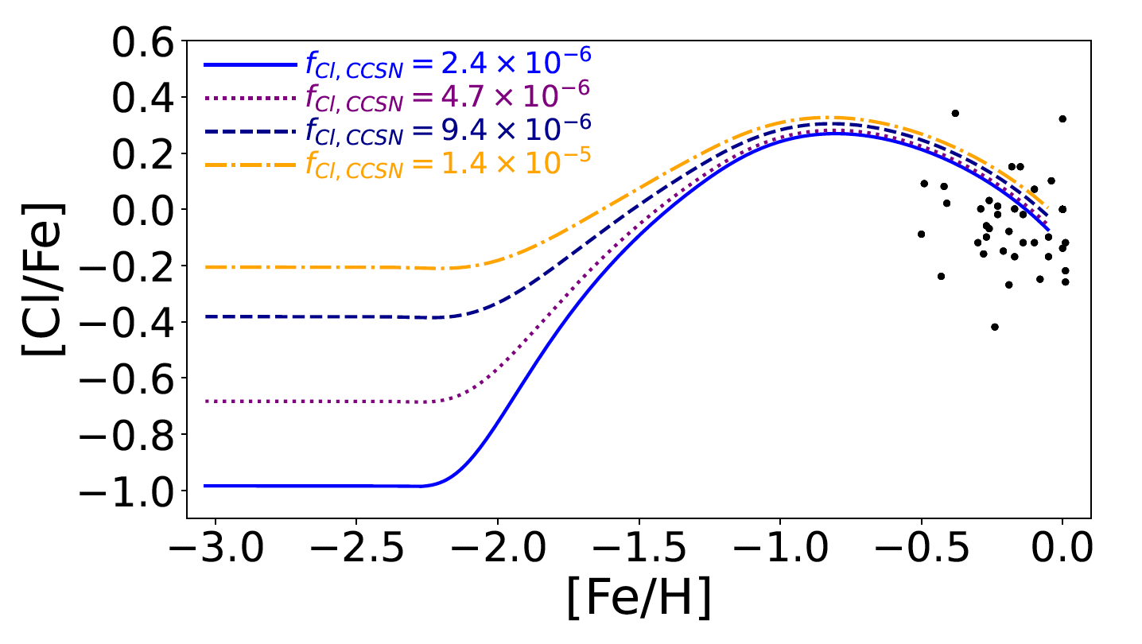
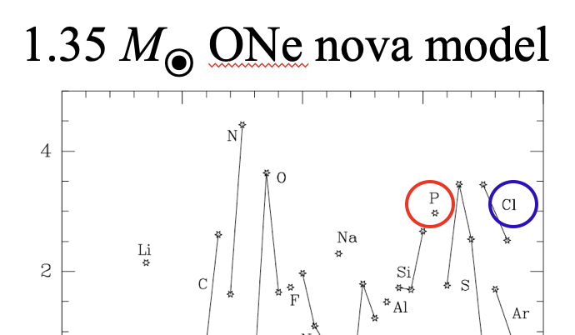
Prediction
[Cl/Fe] should take the same trajectory as [P/Fe]
In the form of chloride ions, chlorine is
necessary to all known species of life.
Cl abundances of stars are deduced from HCl molecular lines
Maas & Pilachowski (2021)
CCSN prediction level

Slide 13
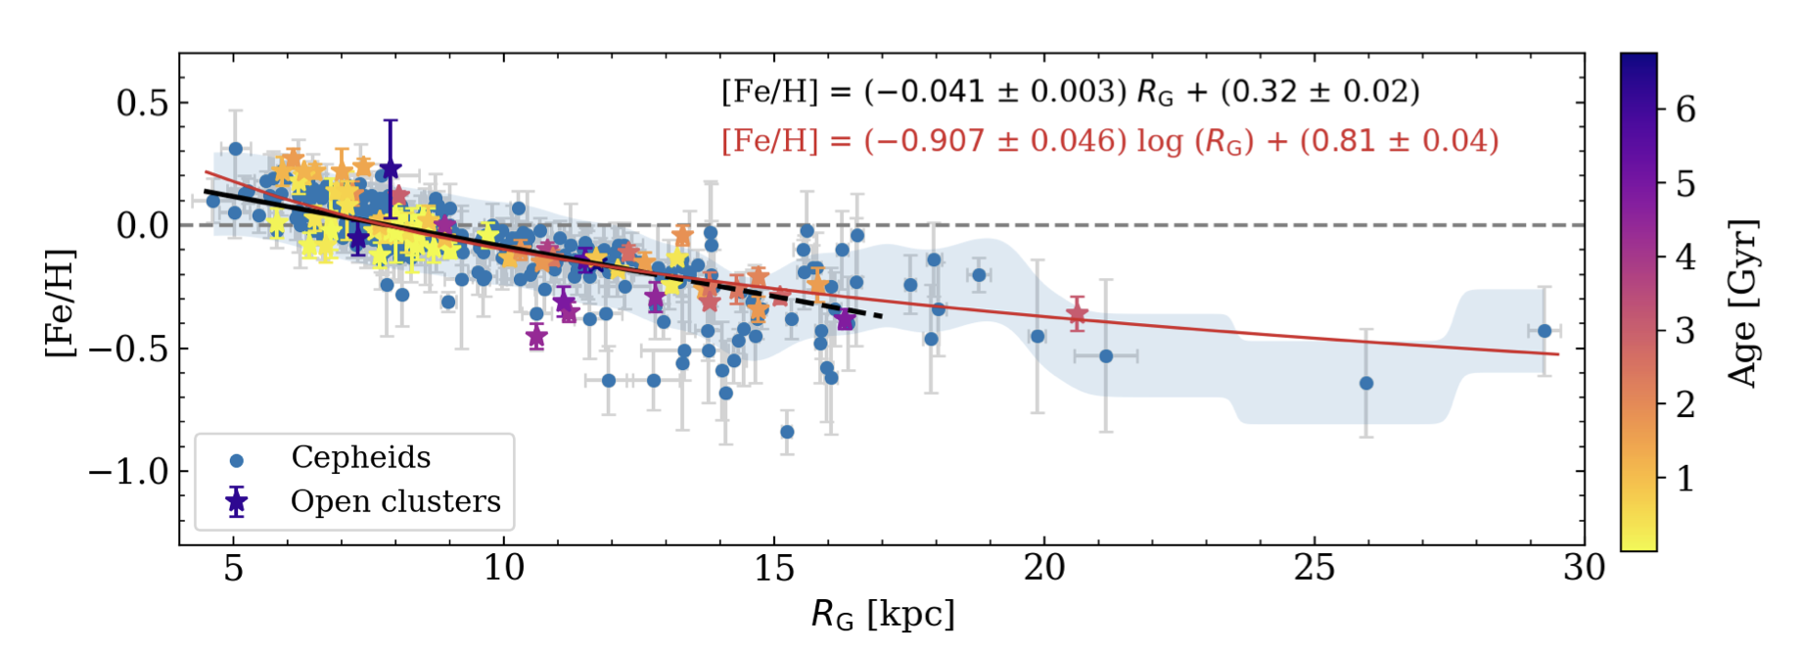
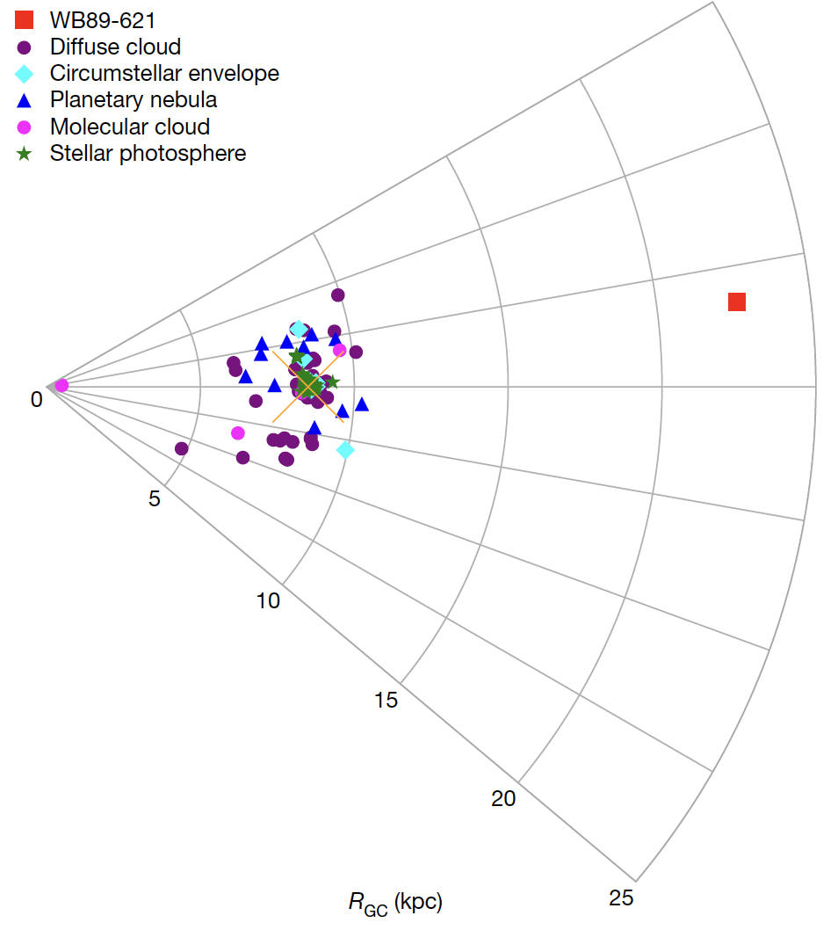
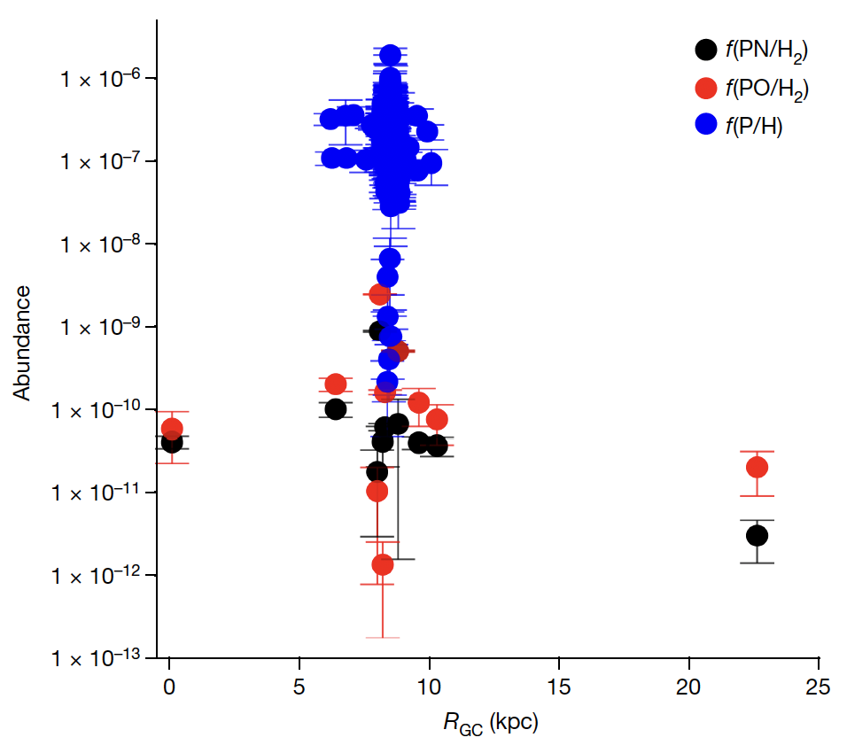
P abundance in the outer disk
Koelemay+ (2023)
da Silva+ (2023)
P measurement from PO and PN molecules
at R_{GC} = 22.6 kpc
a star-forming region
atomic
abundances
WB89-621
little decrease in
the outer disk
R_{GC}
molecular
abundances

Slide 14
At R_{GC} = 22.6 kpc
P abundance decreases by a factor of ~2 (1.5 - 2.3),
compared to the solar vicinity
Koelemay+ (2023)
[P/H] ~ -0.3
[P/Fe] ~ +0.3
On the other hand, [Fe/H] ~ -0.6
solar neighborhood
relatively high
P abundance in
the outer disk
the outer disk
Habitablity will
rise there?

Slide 15



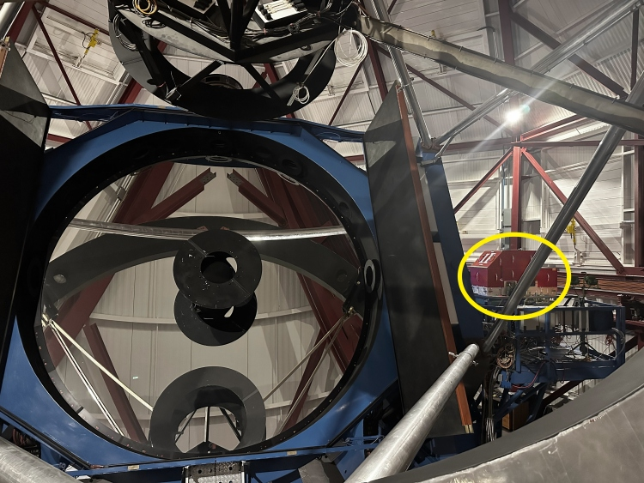
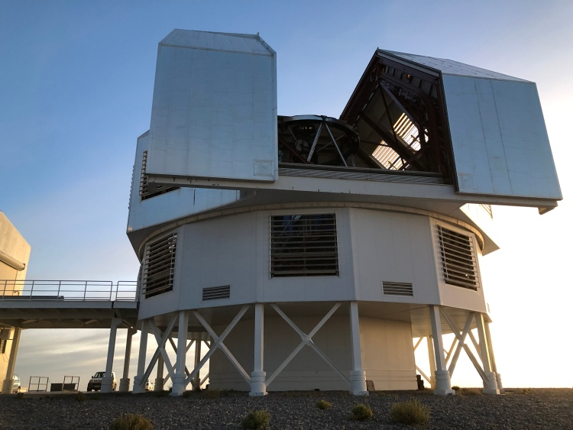
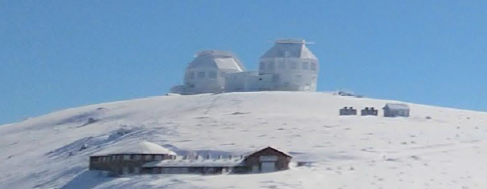
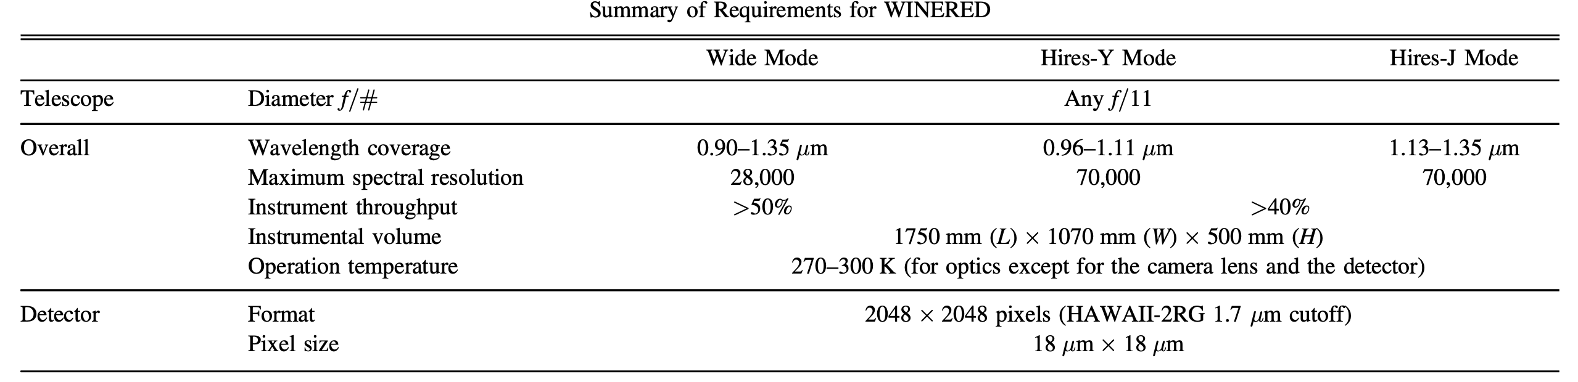
CHIANTI
Italy
the near-infrared high-resolution spectrograph
attached to the Magellan 6.5 m Clay telescope, Las Campanas Observatory
WINERED
Ikeda+ (2022)

Slide 16
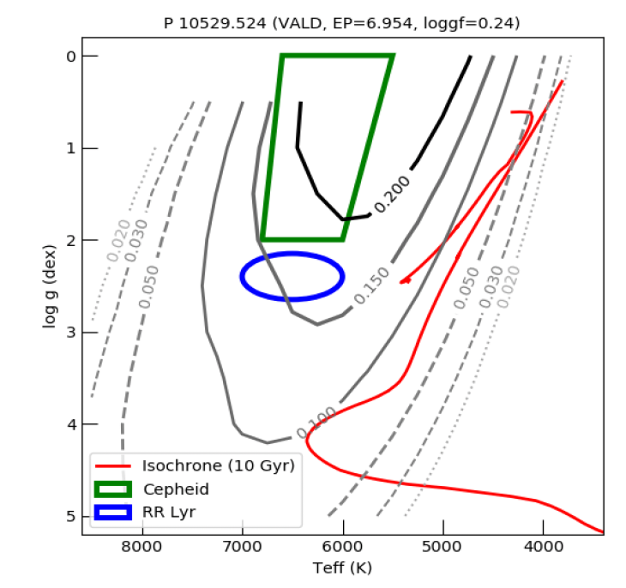
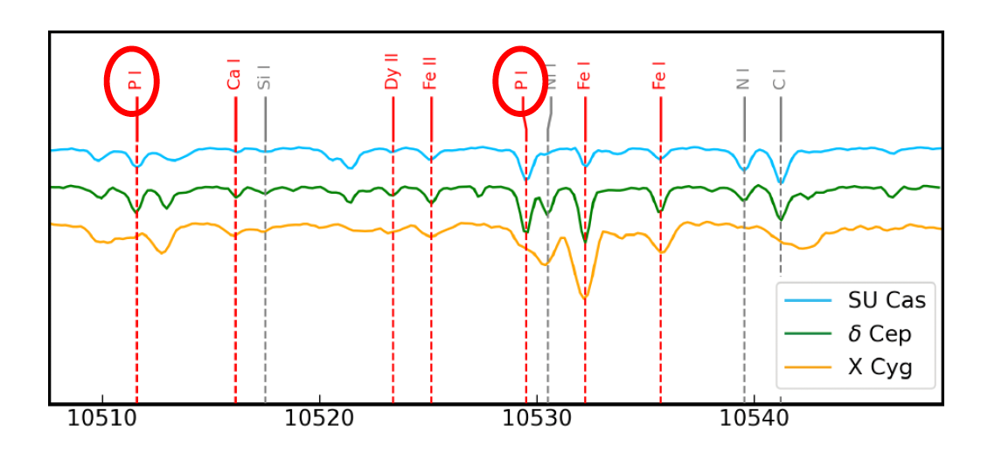
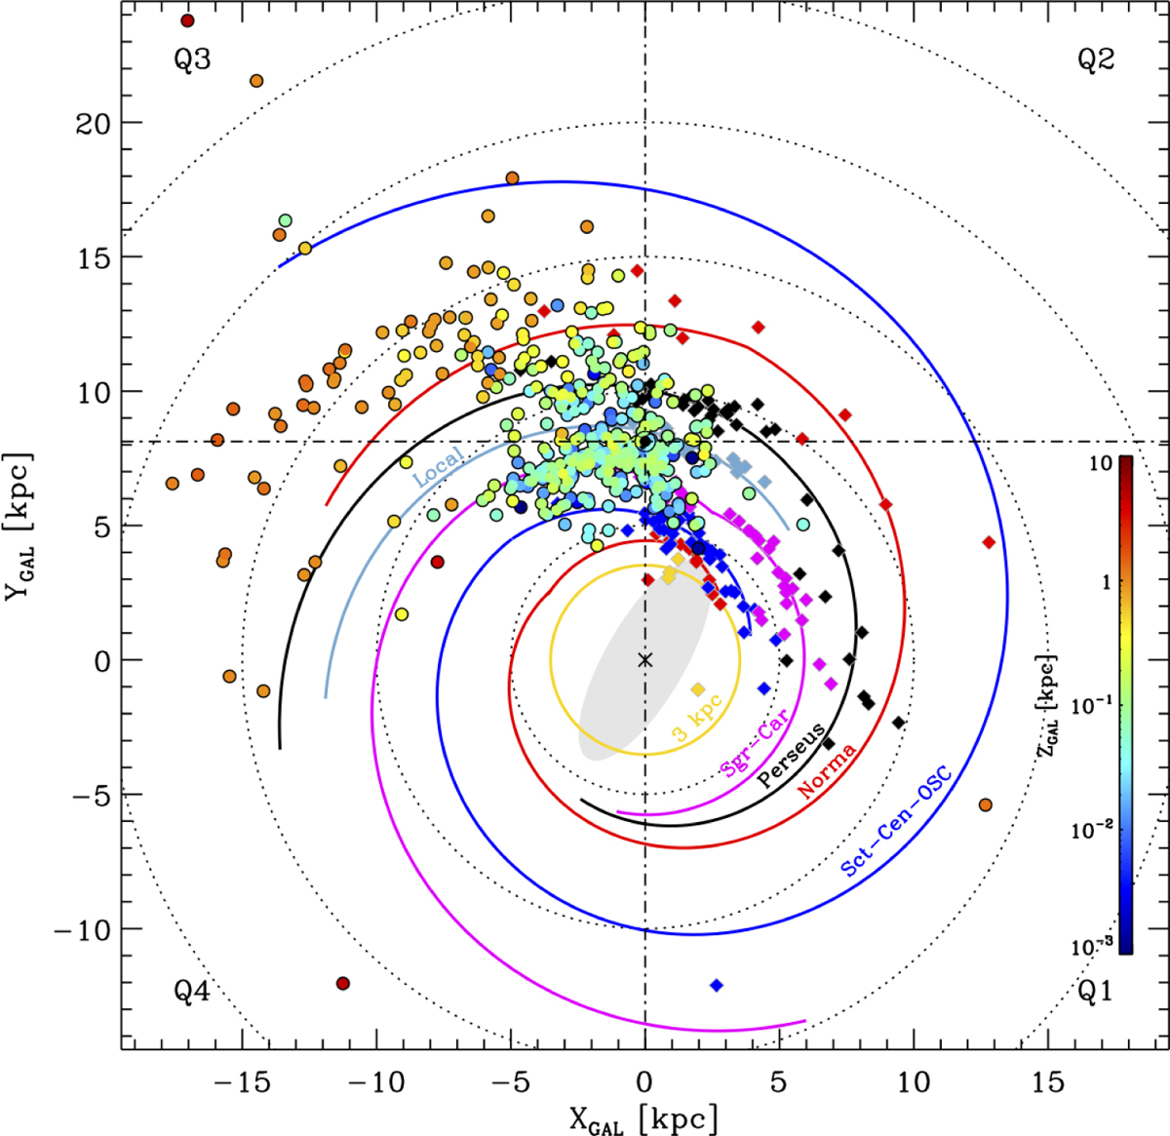
P’s absorption line is strong in variable stars
strength of absorption line at 10529 A
spectrum of Cepheids
Elgueta+ (2024)
Distribution
of
Galactic Cepheids
da Silva+ (2023)
Many Cepheids in the outer
disk exist and can be the targets

Slide 17
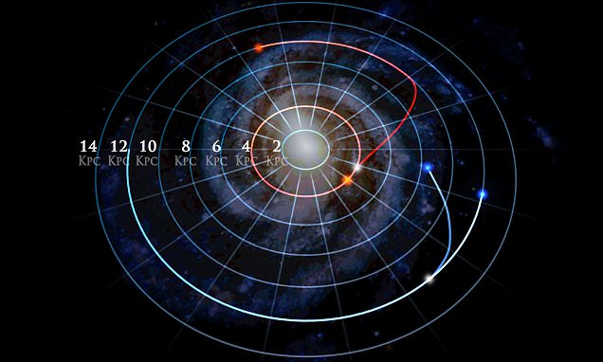
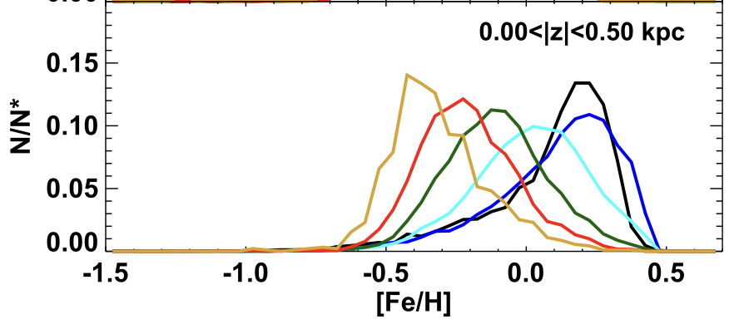
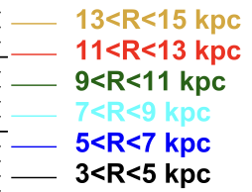
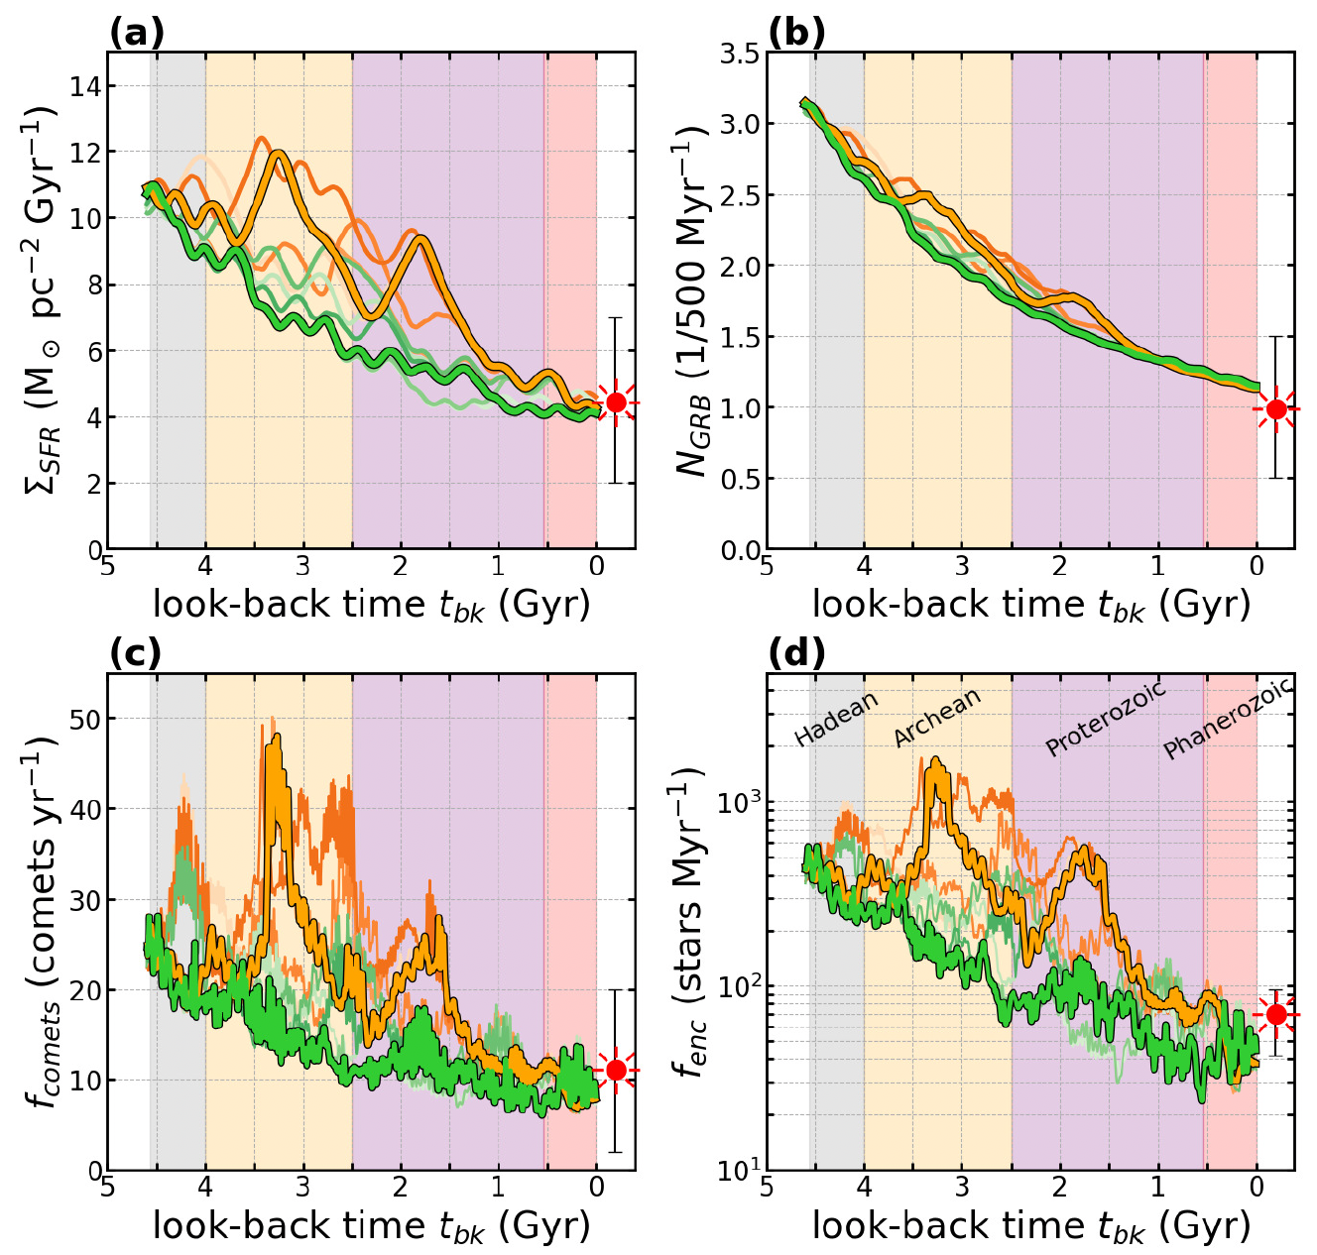
Not closed!
: the outer Galaxy is not a closed system
Evidence for migration of stars from the inner disk
the positive skewness of the
outer disk metallicity distribution
Baba, TT, Saitoh (ApJL: accepted yesterday!)
Hayden+ (2015)
SFR
GRB
skewness
Not static!
:habitable zone is not
static
“Galactic habitable Orbit”
from “zone” to “orbit”
Solar system
migration history
Habitability of planets will change
along their migration pathways
Comets
Encounter
will change via the interaction with the Galactic bar and
spiral arms

Slide 18
Summary
up
down
❐
The evolutionary pathway of P enrichment in the solar vicinity can be reproduced in the framework of ONe nova-P-origin
const.
⦿
❐
Relative abundance of P compared to other elements (e.g., Fe)
is higher at sub-solar metallicity
❐
The outer Galaxy might be ideal for the Galactic habitable zone
in terms of P abundance??
Note, P is essential for life
In addition………..
✓We always keep in mind the effect of radial migration
i.e., A part of outer disk stars was born in the inner disk
✓A new concept “Galactic Habitable Orbit” !

