Slide 1



IMF at low metallicities
Molecules & Planets in the Outer Galaxy
Florence
Nov 13, 2024
Piyush Sharda
Oort Fellow & IAU TGF Fellow
Leiden University
Collaborators:
Shyam Menon, Benjamin Wibking, Mark Krumholz, Michael Grudić, Stella Offner, Volker Bromm, Avishai Dekel, Anish Amarsi, Roman Gerasimov, Michael Zingale, Tommaso Grassi, Amiel Sternberg, Blakesley Burkhart, Serena Viti, Shmuel Bialy, Christoph Federrath
Credits: Wendy Nungarrayi Brown / Yanjirlpirri Jukurrpa (Seven Sisters Dreaming)

Slide 2

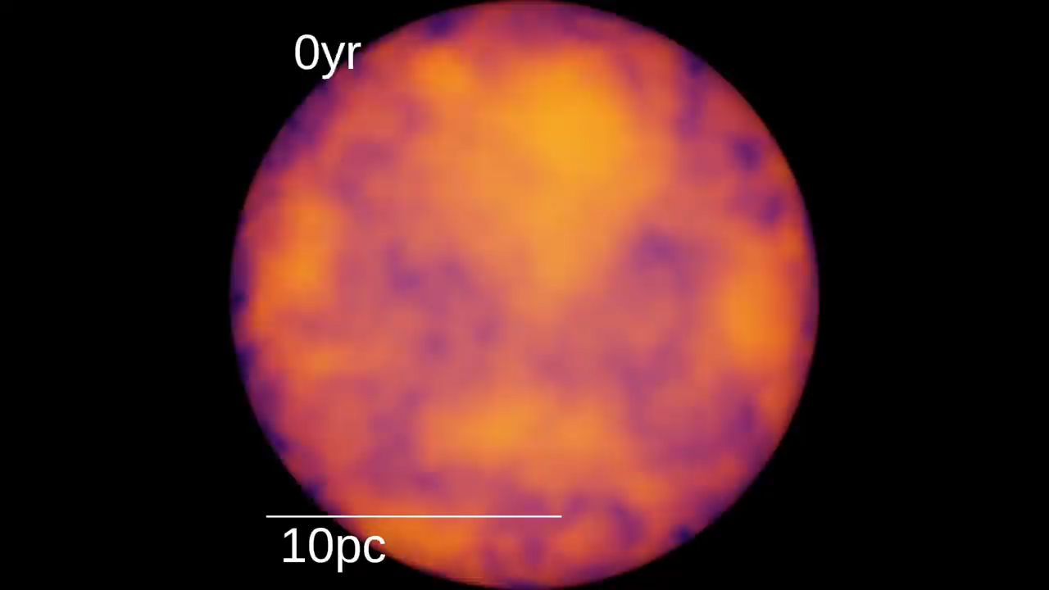

When do stars form?
Molecular clouds collapse when gravity dominates other forces.
Huge dynamic range of ISM physics from the time clouds start collapsing to the time when stars start forming.
Star formation is dictated by chemistry (thermodynamics), turbulence, feedback, magnetic fields, and cosmic rays.
All these processes conspire to yield the number and mass of stars that will form in a given environment.
$$M_{available}> M_{Jeans} ∝ \frac{T^{1.5}}{√ρ}$$
Grudić et al. 2021

Slide 3
“Fundamental arguments suggest that the initial mass function (IMF) should vary with the pressure and temperature of the star forming cloud...”
Kroupa 2001

Slide 4
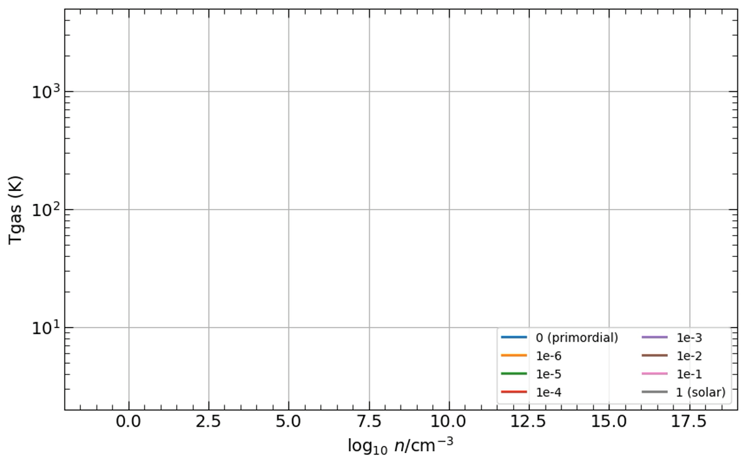

Star formation at different metallicities
Omukai et al. 2005, Sharda et al. in prep.
Cooling is very inefficient in the absence of metals and dust in the ISM. Chemistry is not in a steady state.
Low metallicity ISM chemistry significantly impacts star formation, the IMF, and subsequent metal production.
$$M_{Jeans} ∝ \frac{T^{1.5}}{√ρ}$$
+Talk by Serena
4

Slide 5
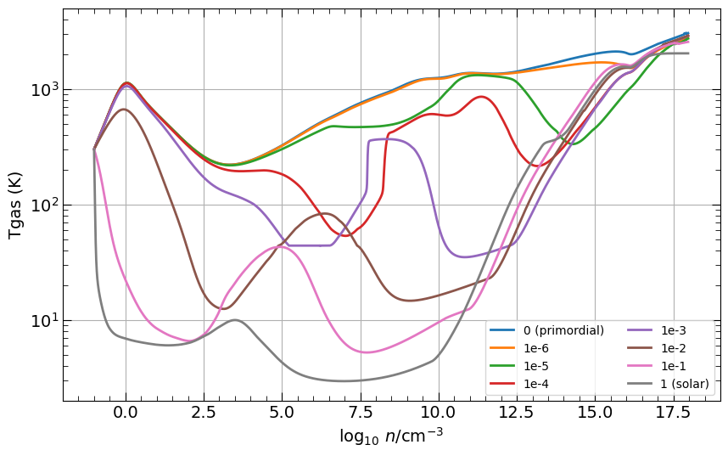
Star formation at different metallicities
Omukai et al. 2005, Sharda et al. in prep.
Cooling is very inefficient in the absence of metals and dust in the ISM. Chemistry is not in a steady state.
Low metallicity ISM chemistry significantly impacts star formation, the IMF, and subsequent metal production.
It is not easy to simulate the entire star formation cascade.
$$M_{Jeans} ∝ \frac{T^{1.5}}{√ρ}$$
+Talk by Serena
Cosmo
Galaxy
5
GMC
Cloud

Slide 6






Variations in the IMF with metallicity
0
10⁻⁴ $Z_{⨀}$
10⁻² $Z_{⨀}$
10^{-1.5} $Z_{⨀}$
10⁻¹ $Z_{⨀}$
$$Z_{⨀}$$
2 $Z_{⨀}$

Slide 7
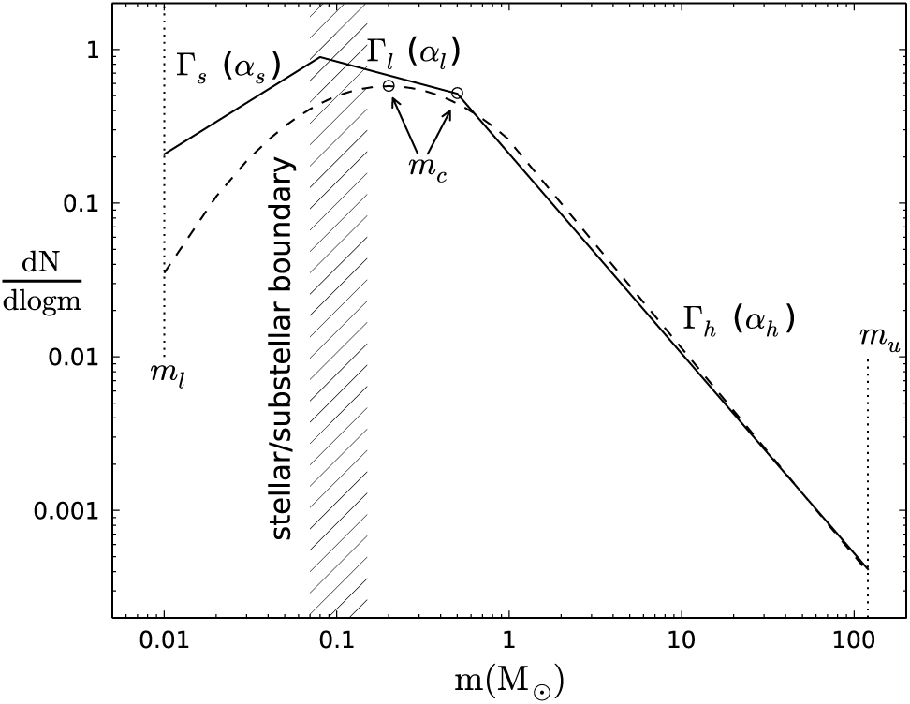
Variations in the IMF with metallicity
0
10⁻⁴ $Z_{⨀}$
10⁻² $Z_{⨀}$
10^{-1.5} $Z_{⨀}$
10⁻¹ $Z_{⨀}$
$$Z_{⨀}$$
2 $Z_{⨀}$
Solar
Negh.
Hopkins 2018

Slide 8
Variations in the IMF with metallicity
0
10⁻⁴ $Z_{⨀}$
10⁻² $Z_{⨀}$
10^{-1.5} $Z_{⨀}$
10⁻¹ $Z_{⨀}$
$$Z_{⨀}$$
2 $Z_{⨀}$
First
stars
Solar
Negh.
Top-heavy
Hopkins 2018

Slide 9
Variations in the IMF with metallicity
0
10⁻⁴ $Z_{⨀}$
10⁻² $Z_{⨀}$
10^{-1.5} $Z_{⨀}$
10⁻¹ $Z_{⨀}$
$$Z_{⨀}$$
2 $Z_{⨀}$
First
stars
Metal-poor stars
Satellite
galaxies
Solar
Negh.
First galaxies/
Ultra-compact
dwarf galaxies
Globular
clusters
Massive Elliptical
Galaxies
Top-heavy
Hopkins 2018

Slide 10
When did the IMF become bottom-heavy?

Slide 11
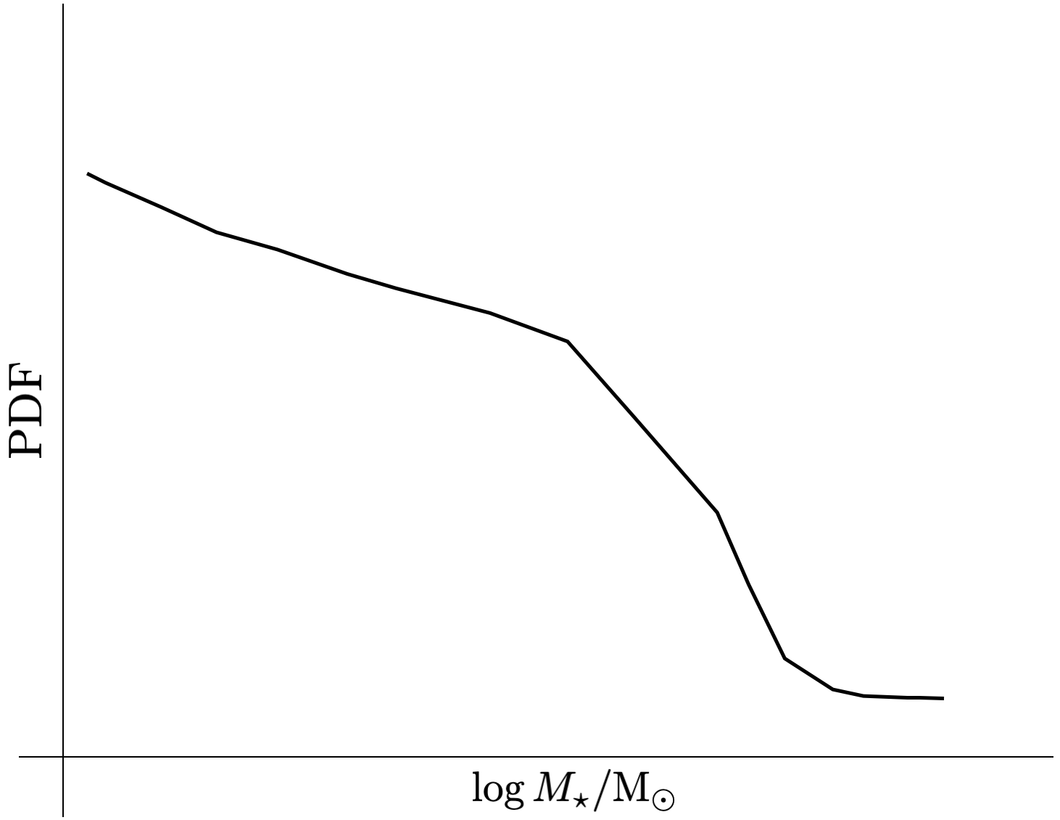
Model for the IMF peak mass
A new model to study gas thermodynamics in molecular clouds at a wide range of metallicities and other ISM properties.
Includes dust-gas coupling in the presence of stellar feedback.
Critical location around an existing protostar where gas becomes marginally unstable to collapse sets the IMF peak mass
(Bate 2005, 2009, Krumholz 2011, Guszejnov et al. 2016, Cunningham et al. 2018, Lee & Hennebelle 2018, Tanvir et al. 2022).

Slide 12
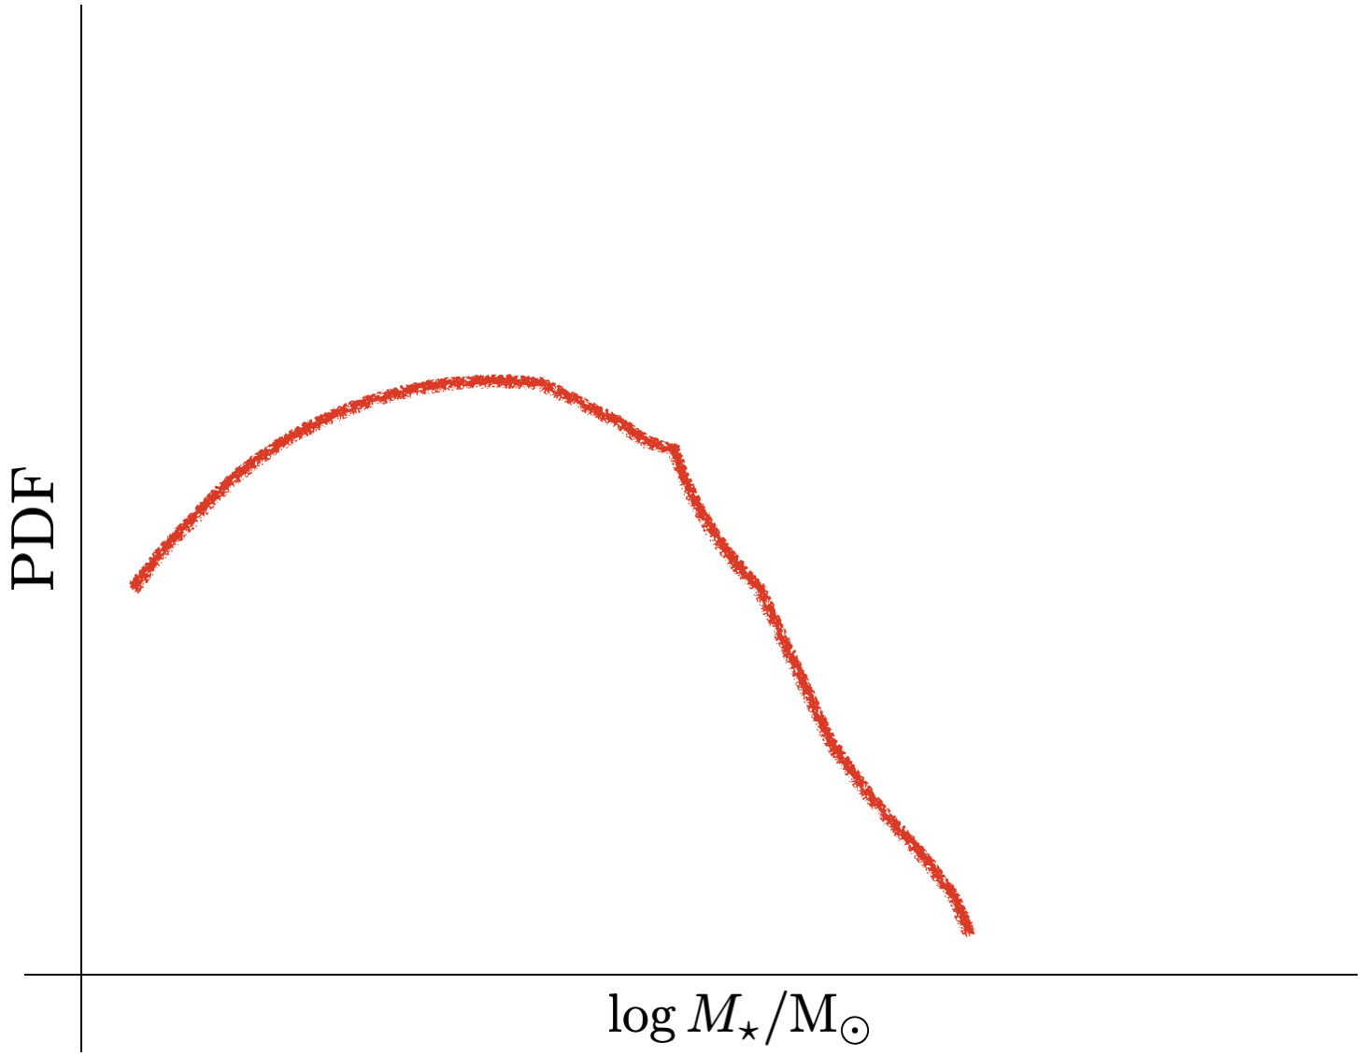
Model for the IMF peak mass
A new model to study gas thermodynamics in molecular clouds at a wide range of metallicities and other ISM properties.
Includes dust-gas coupling in the presence of stellar feedback.
Critical location around an existing protostar where gas becomes marginally unstable to collapse sets the IMF peak mass
(Bate 2005, 2009, Krumholz 2011, Guszejnov et al. 2016, Cunningham et al. 2018, Lee & Hennebelle 2018, Tanvir et al. 2022).

Slide 13
When did the IMF become bottom-heavy?
Distinct chemical regimes exist at different metallicities
H₂ formation
heating
Dust heating
Heating processes
Compressional
heating
HD
cooling
Cooling processes
H₂ cooling
Metal
cooling
Dust
cooling
Sharda & Krumholz 2022

Slide 14
When did the IMF become bottom-heavy?
Low pressure ISM
High pressure ISM
Top-heavy
Bottom-heavy
The IMF became bottom-heavy between ${10}^{−4} Z_{⨀}−{10}^{−2} Z_{⨀}$ in Milky Way-type galaxies.
Sharda & Krumholz 2022

Slide 15
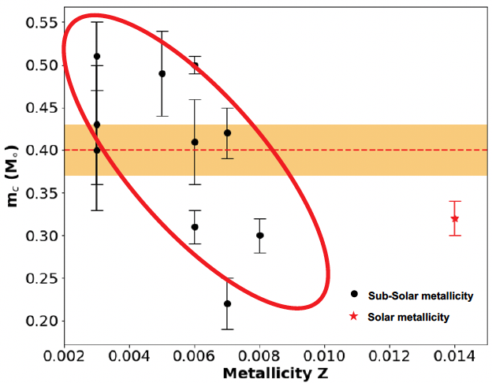
When did the IMF become bottom-heavy?
Low pressure ISM
Sazawal et al. in prep.
Top-heavy
Bottom-heavy
The IMF became bottom-heavy between ${10}^{−4} Z_{⨀}−{10}^{−2} Z_{⨀}$ in Milky Way-type galaxies.
Outer galaxy a suitable environment to test IMF variations?
Sharda & Krumholz 2022

Slide 16
Non Solar-scaled abundances matter!
Factor ~ 7
+Talks by Elisa
and Thomas
Sharda et al. 2023a

Slide 17
These models are a pathway to developing simulations that can address
key open questions in low metallicity star formation.

Slide 18
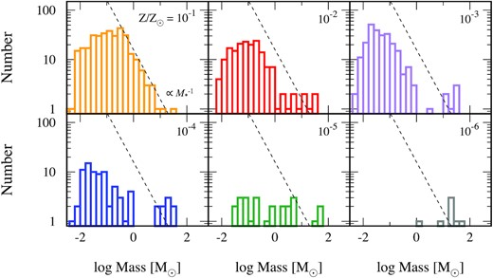
IMFs from hydrodynamic simulations
Chon et al. 2021
IMFs at low metallicity may look nothing like the IMF at Solar metallicity.

Slide 19
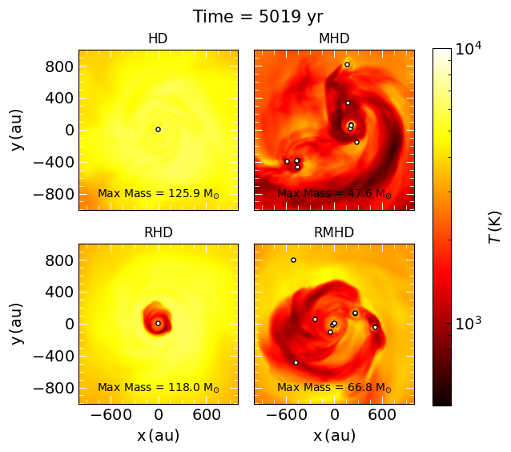
The POPSICLE Project
Co-PIs: Sharda & Menon
POP II/III Simulations Including Chemistry, Luminosity, and Electromagnetism
Only suite of low metallicity simulations that simultaneously include chemistry, radiation feedback, and MHD.
Non-equilibrium chemistry (including cosmic ray chemistry) and cooling (200 reactions, 37 species). Flexible dust composition and sizes.
Non-local second moment VET radiation scheme
(First 3D AMR non-local RHD scheme).
High Jeans resolution to resolve turbulent and mean field dynamo operation.
Generate the IMF at low metallicities with ~au scale resolution.
Sharda et al. 2024a

Slide 20
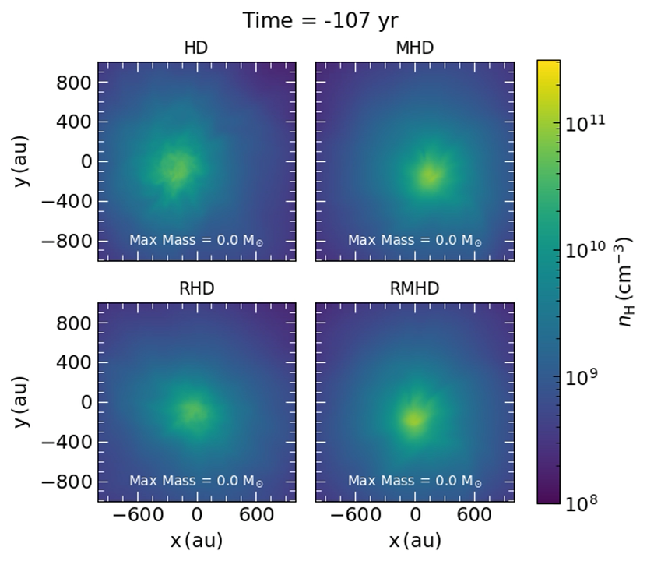
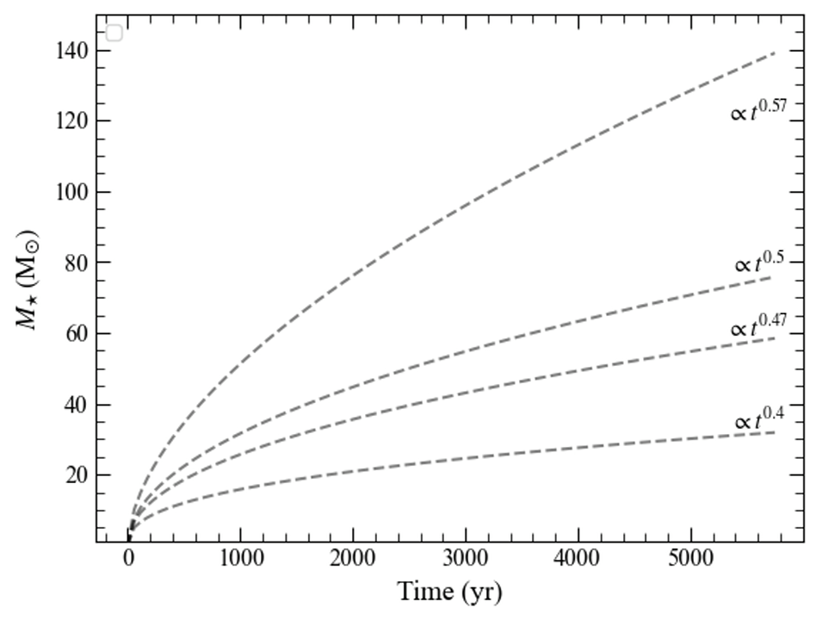
Magnetic fields versus radiation feedback
Pop III
Magnetic fields have more room to be more impactful at low metallicities.
Stellar evolution and star formation physics overlaps at low metallicities.
Sharda et al. in prep.

Slide 21
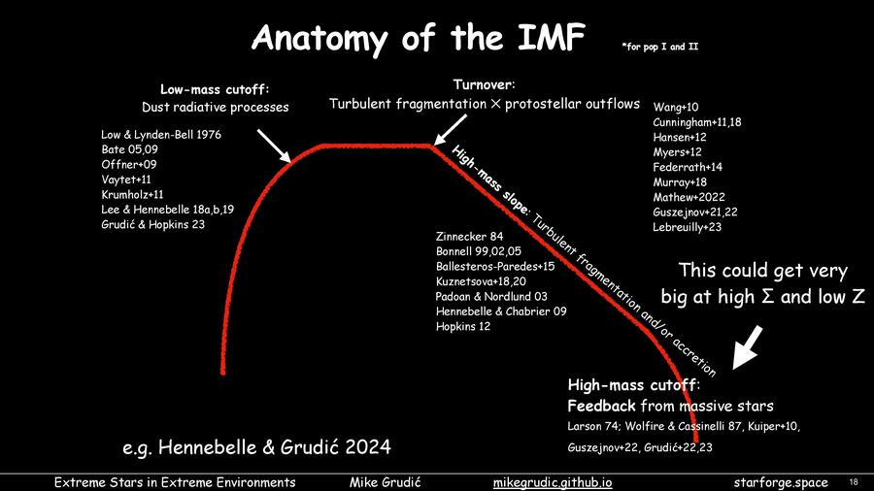
Upper mass cutoff
Upper mass cutoff degenerate with other IMF parameters

Slide 22
Sharda et al. 2020b
Need a large suite of simulations to overcome stochasticity due to
turbulence and fragmentation

Slide 23

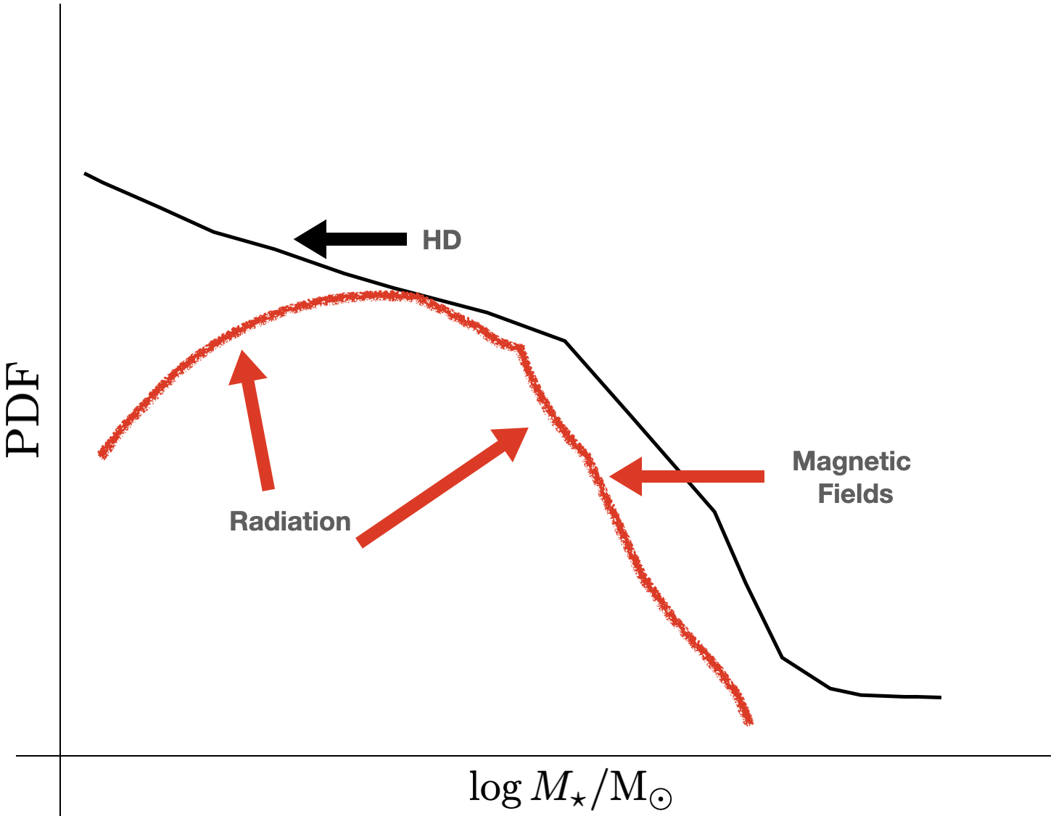
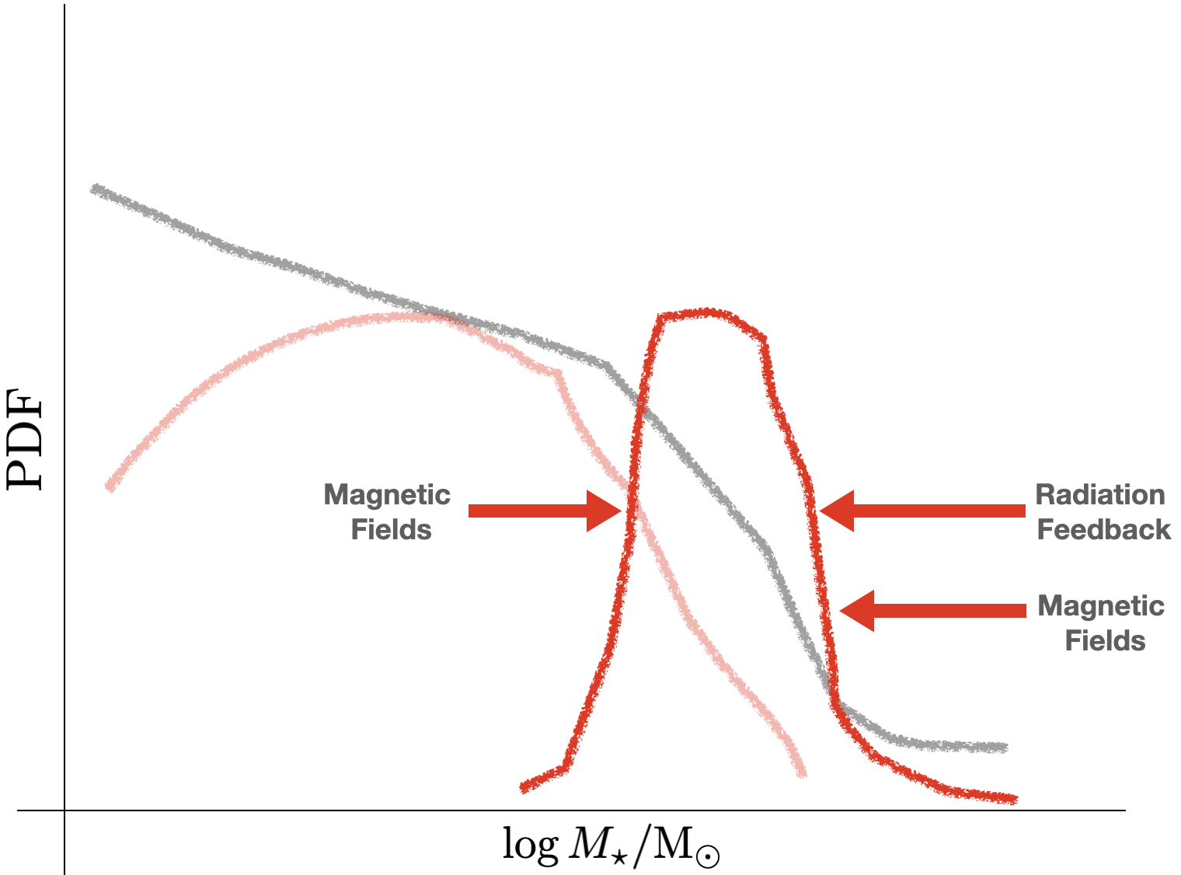
Pop I vs Pop III IMF
Pop I
Pop III
The role of different physical processes in shaping the IMF can be
completely different at low metallicities.

Slide 24
Caveats
Computationally expensive to simulate for long time periods.
Lack of observational constraints: need sub-au resolution for protostellar outflows and H II region expansion.

Slide 25
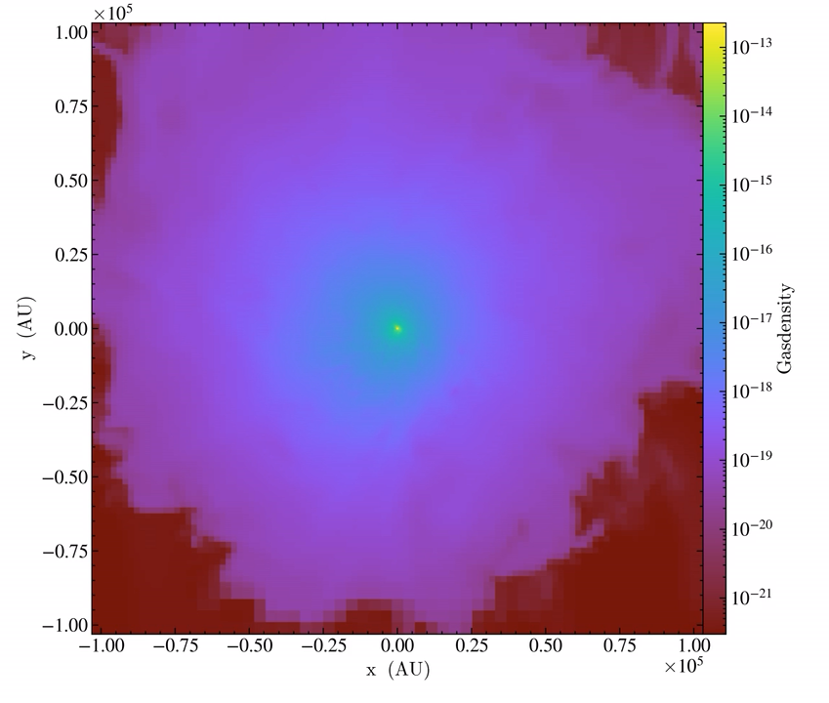
Future: GPU-accelerated hydro simulations
Quokka: new code for GPU-accelerated hydrodynamic simulations with
chemistry and multi-group radiation
Metric | FLASH (CPU) | Quokka (GPU)
Resources | 400 CPUs | 1 GPU
Time | 48 hours | 12 hours
Spatial Resolution | 7 au | 0.004 au (= 1 Solar radius)
Density Coverage | 10³ – 10¹³ cm⁻³ | 10³ – 10¹⁸ cm⁻³
13x performance improvement
from CPU to GPU
Resolve the entire star formation cascade from cloud to stellar scales!
Sharda, Wibking et al. in prep.

Slide 26

Summary
Models suggests that the IMF became bottom-heavy between $Z \sim {10}^{−4} Z_{⨀}$ to ${10}^{−2} Z_{⨀}.$ Exact transition depends on other ISM properties (density, turbulence, dust, elemental abundances). Outer Galaxy could be an ideal location to test IMF variations.
The role of magnetic fields and protostellar radiation feedback can be significantly different in setting the low metallicity IMF, as compared to the IMF in the Solar neighbourhood.
The POPSICLE Project is aiming to produce chemo-radiation-MHD simulations to study the IMF and physics of star formation at low metallicities.
GPU-accelerated simulations can resolve star formation from cloud to stellar scales, with the potential to revolutionize our understanding of how stars form
Lo metallicities, mo problems
Email: sharda@strw.leidenuniv.nl

Slide 28
Significance of statistics
Sharda et al. 2020b, 2021a
Need a large suite of simulations to overcome stochasticity due to
turbulence and fragmentation
+ Wollenberg et al. 2021

Slide 29
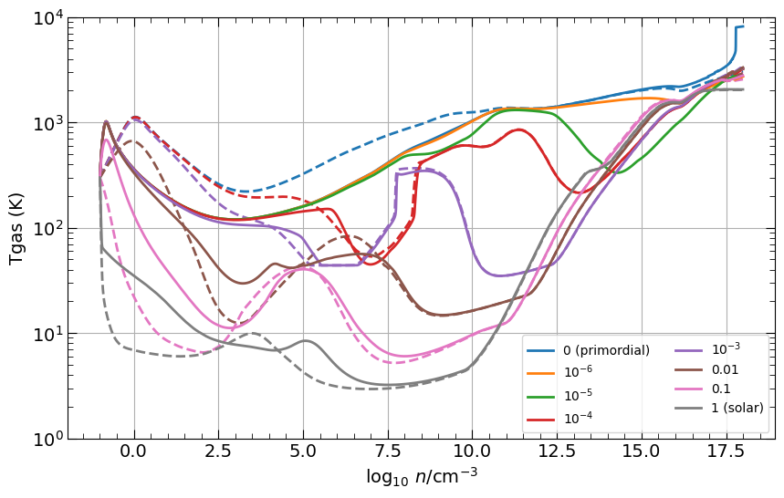
Impact of cosmic rays
Cosmic rays lead to more cooling at sufficiently low metallicities.

Slide 30
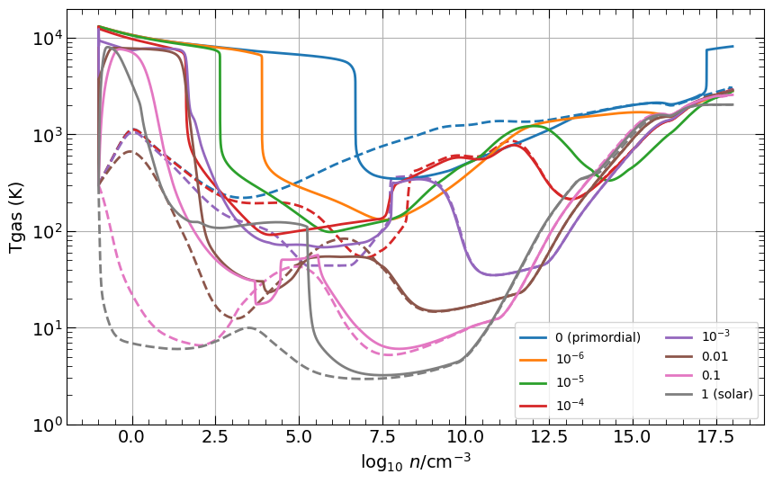
Impact of photochemistry

Slide 31
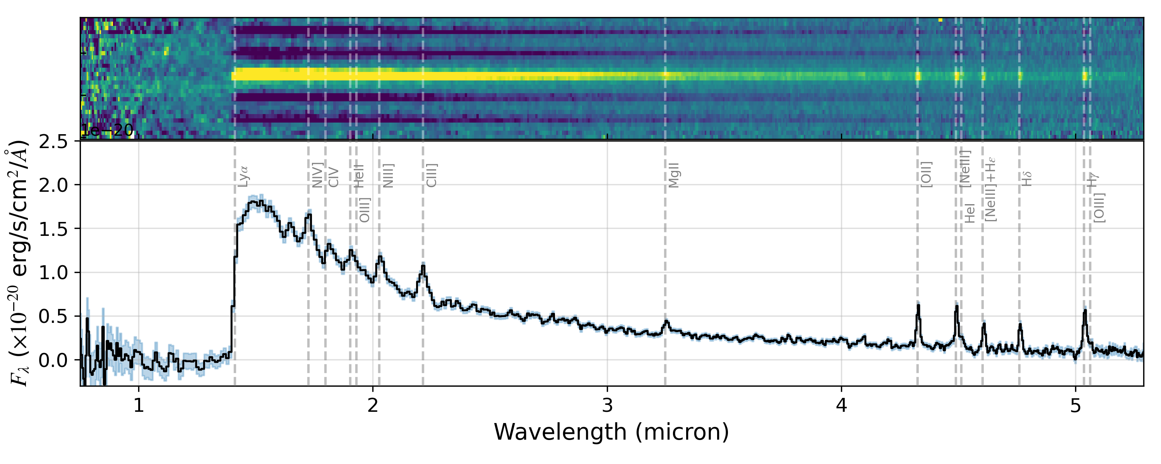
What is JWST telling us about the first galaxies?
Compact sizes (few 10 pc)
High surface densities (10³ Milky Way)
Extreme radiation fields (10⁵ Milky Way)
Normal star formation rates (~ Milky Way)
Little dust
Low metallicity (0 - 1% Solar)
Massive black holes
Bunker et al. 2023 + 100 others
We need to understand star formation in these conditions

Slide 32
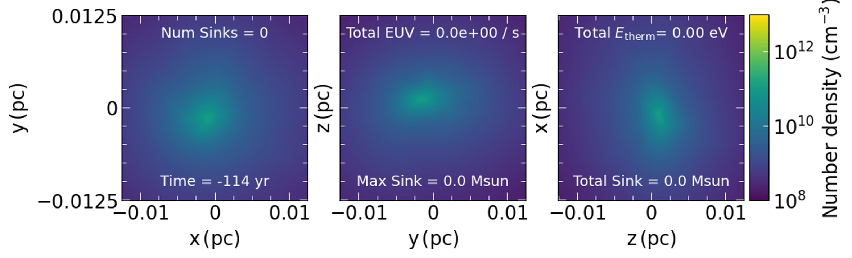
Chemo-Radiation-MHD Simulations
Magnetic fields dominant over (ionizing) radiation feedback.
(Ionizing) radiation feedback unable to halt the growth of massive first stars.
Only chemo-RMHD simulations of PopIII star formation

Slide 33
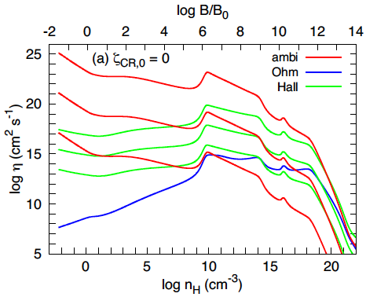
Non-ideal MHD
Ambipolar diffusion is the most significant of the three.
Higher the diffusivity, lower is the field amplification.
Diffusivity due to ambipolar diffusion is almost near the critical value needed for the large-scale dynamo to act.
As the densities increase further, effects of non-ideal MHD drop down.
Small-scale dynamo remains unaffected.
Nakauchi et al. 2019
McKee et al. 2020

Slide 34
Amplification of magnetic fields
Sharda et al. 2021a
Given sufficient resolution, even initially weak field gets exponentially amplified to near saturation values.
This amplification primarily occurs
due to small-scale turbulent dynamo.
Strong magnetic field provides support against gravitational collapse and hinders fragmentation.
Field amplification
Field saturation

