Slide 1
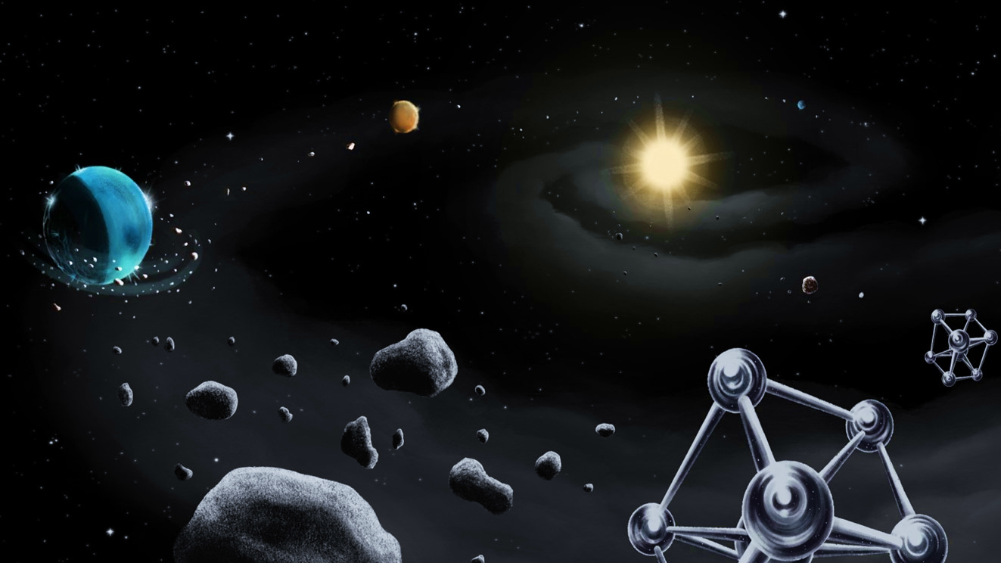
From primordial composition of stars to the present-day composition of their rocky exoplanets
Workshop: “Molecules and planets in the outer Galaxy: is there a boundary of the Galactic Habitable Zone?”
12 – 14 November 2024, Florence, Italy
Bárbara Soares, Vardan Adibekyan and the EXO-Terra Team
Institute of Astrophysics and Space Sciences
University of Porto

Slide 2
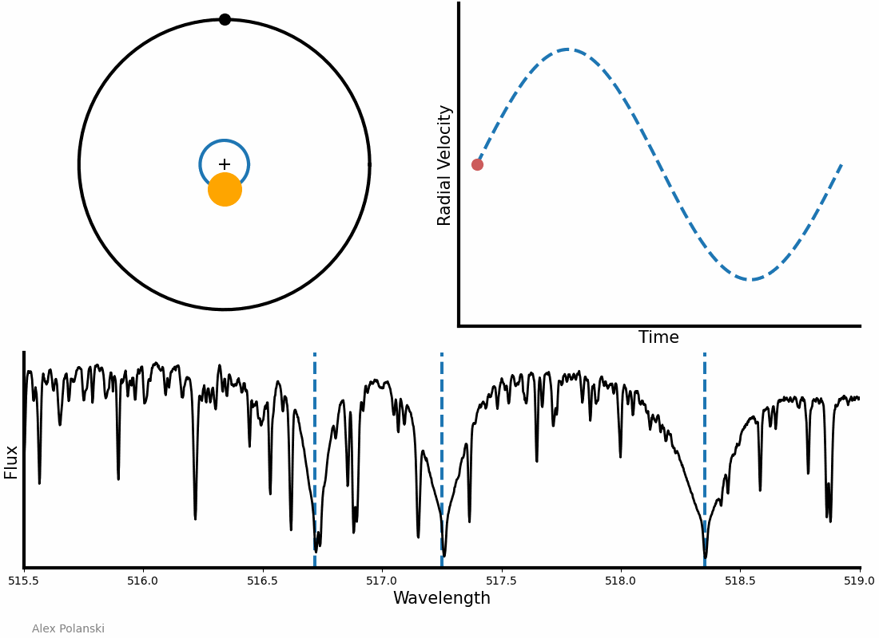
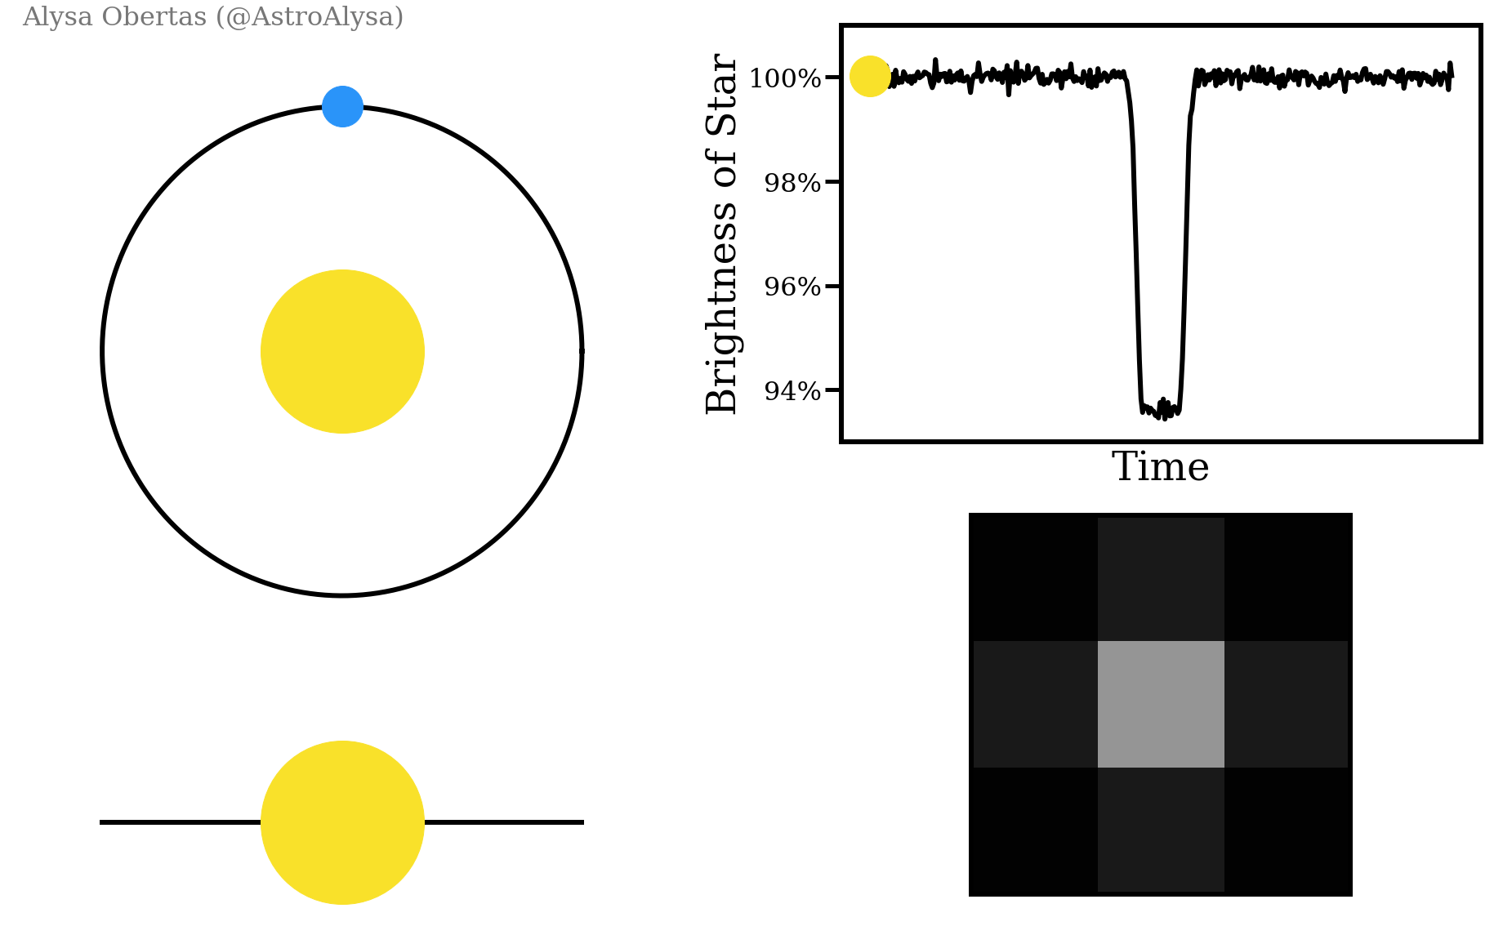
Finding and characterising exoplanets
Radial Velocities method
Transits method
Mass
Radius

Slide 3
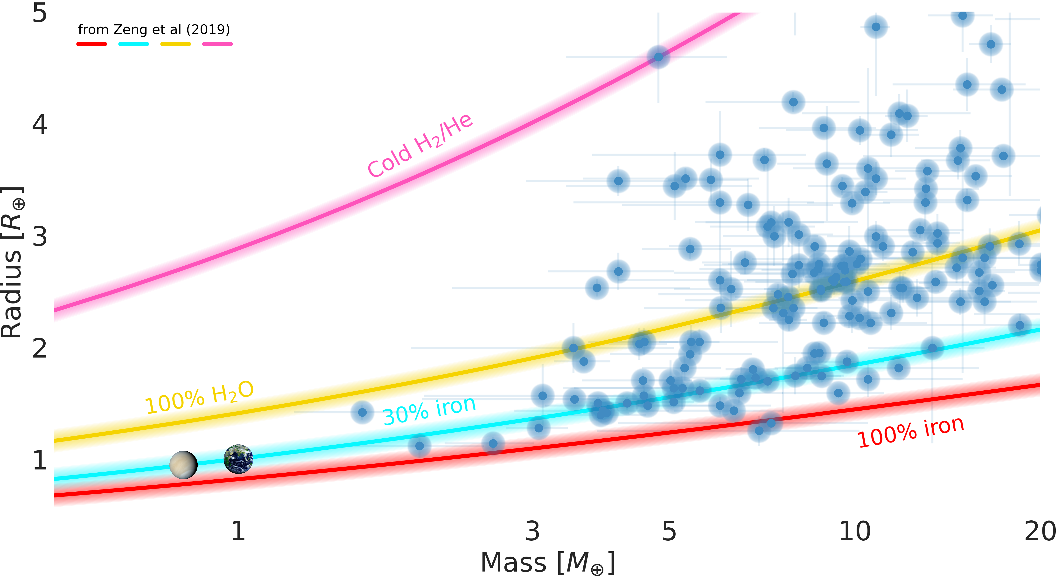
Finding and characterising exoplanets
Recall talk by Elisa Delgado Mena!
Radius
Bulk density
Mass
There is an inherent degeneracy in the planetary compositions
→ Mass and radius are not enough to characterise the interior of rocky exoplanets
Notes:
There is an inherent degeneracy in the planetary compositions that can be inferred only from planet mass and radius measurements:
→ for a specified planet mass, different distributions of material within the planet interior layers can produce identical radii

Slide 4
Breaking the degeneracy
To break this degeneracy, the abundances of the main rocky-forming elements (Mg, Si, and Fe) in the host star are often used.
Ideal: study the protoplanetary disk chemical composition
→ For most of the discovered planet-hosting starts, the disk has already dissipated, since their lifetime is just of a few million years.
Information on the stellar atmospheres → only observational window to provide information on the protoplanetary disks' chemical composition
See tomorrow’s talk by Diego Turrini
4
Notes:
In order to break this degeneracy, the abundances of the main rocky-forming elements (Mg, Si, and Fe) in the host star are often used.
protoplanetary disk composition → disks already dissipated → information on the stellar atmospheres is needed instead

Slide 5
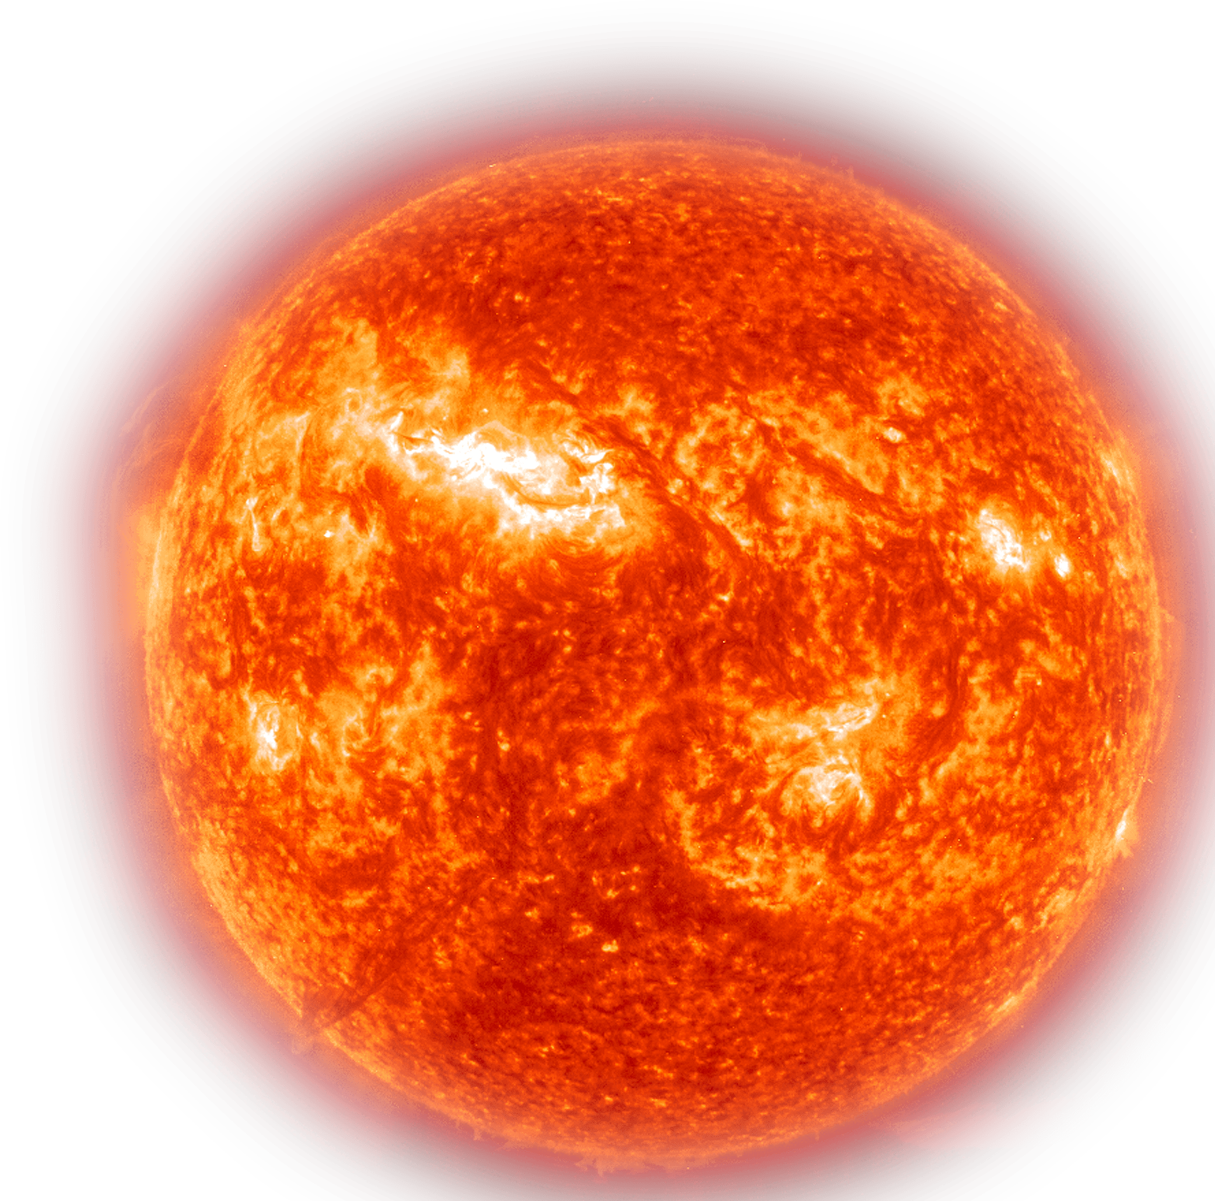
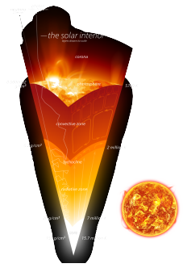
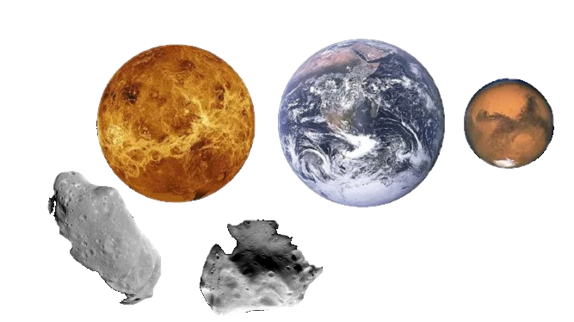
Modelling the interiors of rocky planets
When modelling the interiors of rocky planets, a one-to-one correlation between the composition of the planet and that of its host star is usually assumed.
First order: valid for the case of the Solar System (Earth, Venus, Mars and the Sun).
Similar Mg/Si and Fe/Si
Tc ~ 1300K
5
Notes:
When modelling the interiors of rocky planets, a one-to-one correlation between the composition of the planet and that of its host star is typically assumed. To a 1st order, this assumption appears to be valid for our Solar System, specifically to Earth, Venus, Mars and the Sun. And while it may also be valid for some exoplanets, it is not the case for all systems.

Slide 6
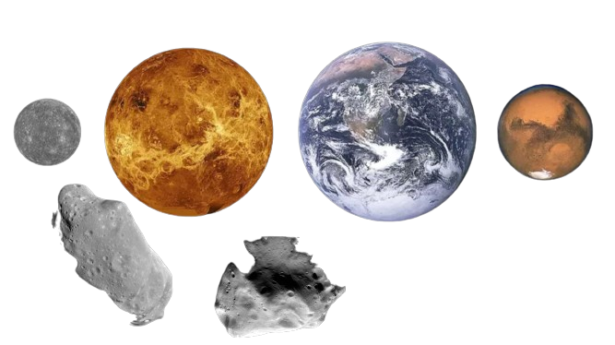
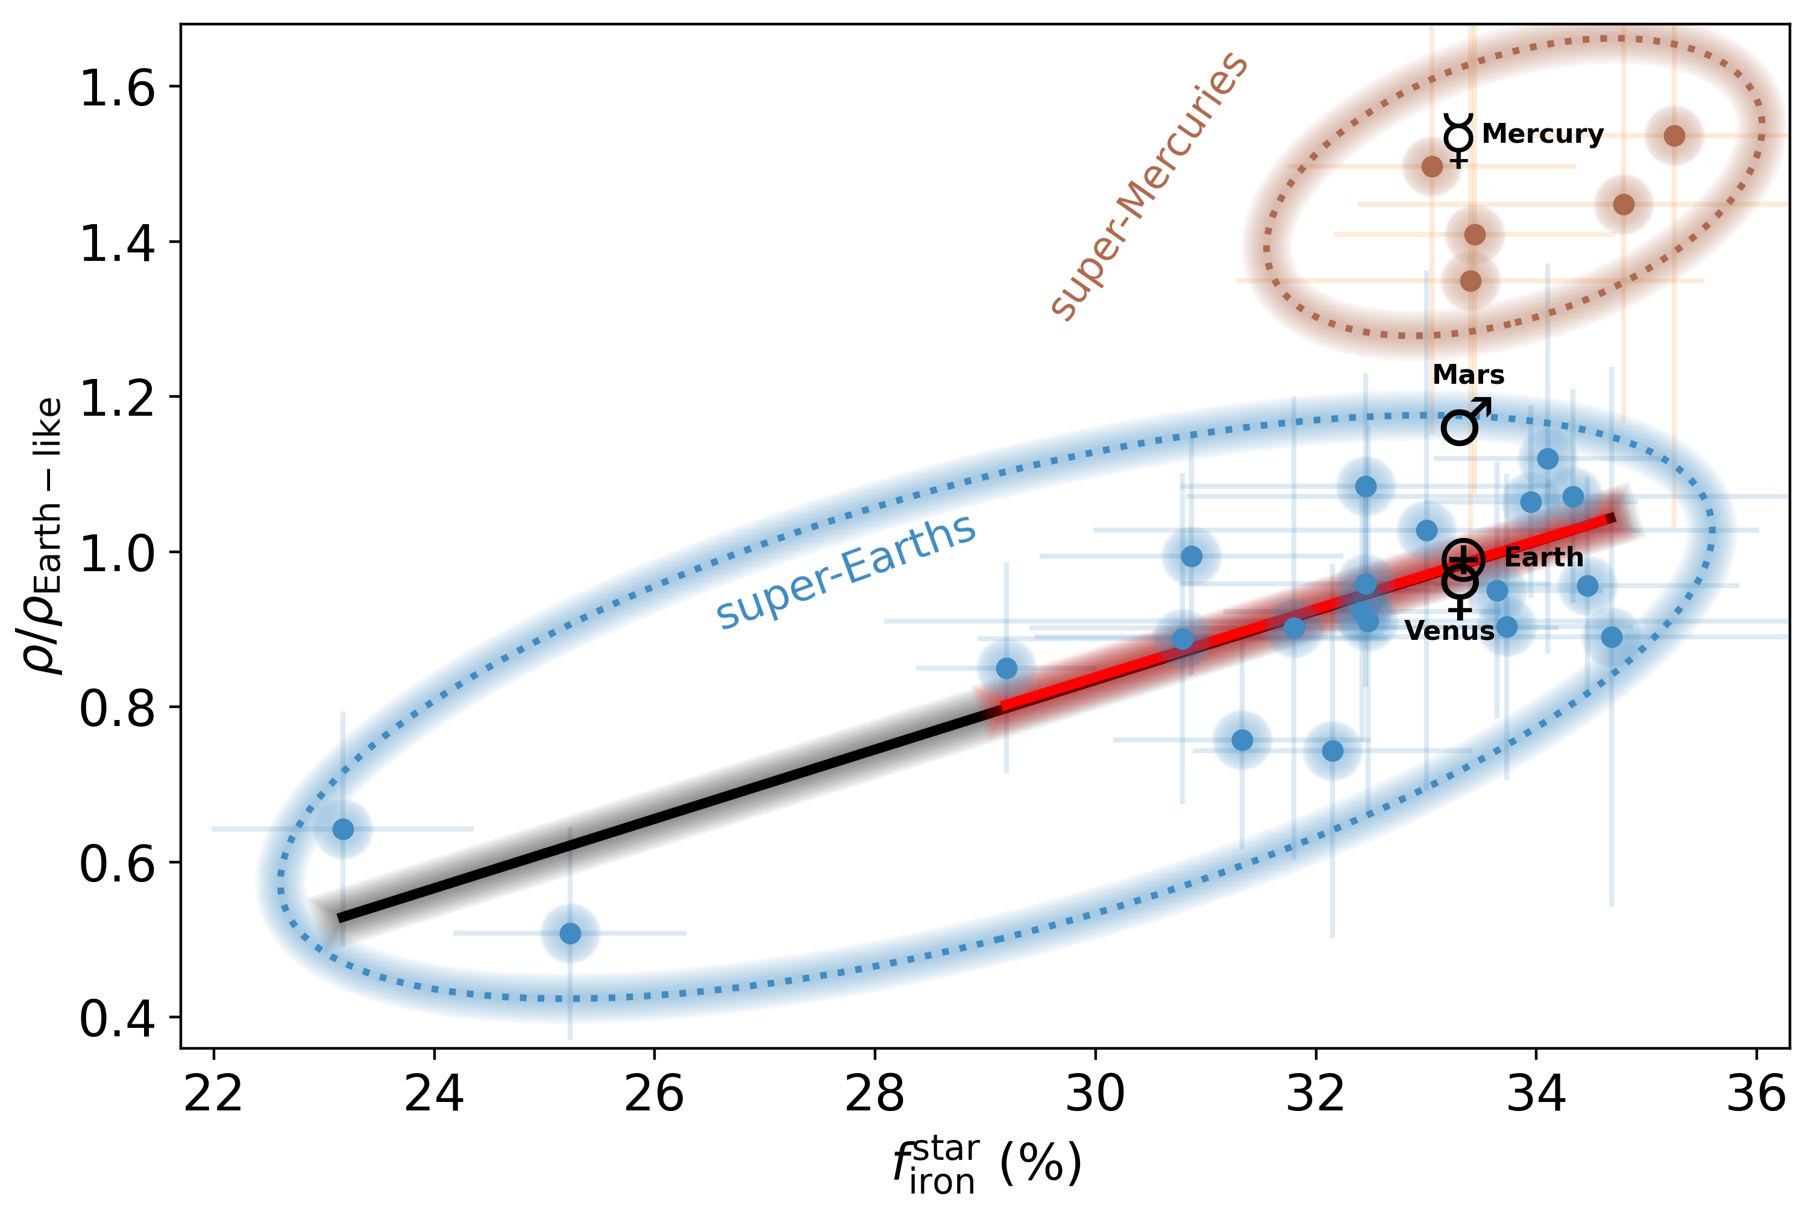
One-to-one compositional correlation?
Good starting point but not enough→ even within the Solar System, it breaks down for the case of Mercury.
Adibekyan et al. (2021) concluded that while there is a correlation between the composition of rocky planets and their host stars, the relationship is not one-to-one.
Super-Earths and super-Mercuries appear to be "distinct" populations
See also:​
Plotnykov & Valencia 2020​; Schulze et al. 2021, Wang et al. 2022​; Unterborn et al. 2023​; Spaargaren et al. 2023​; Schulze et al. 2024​
6
Notes:
Assuming a one-to-one compositional correlation is a reasonable starting point, but it breaks down even within our own Solar System, in the case of Mercury.
Adibekyan et al. (2021a) conducted a statistical comparison of the iron-to-silicate mass fraction in low-mass exoplanets and their host stars, concluding that while there is a correlation between the composition of rocky planets and their host stars, the relationship is not one-to-one.
They also found that super-Earths and super-Mercuries appear to be "distinct" populations.

Slide 7
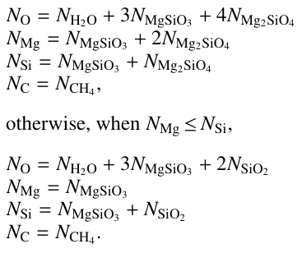
Limitations
Santos et al. (2015, 2017)
Planets’ interior models do not account for volatiles
Present-day stellar abundances were used as a proxy for the primordial protoplanetary disk composition
Astrophysical processes (e.g. atomic diffusion) can affect the surface composition as the star evolves (Deal et al. 2018)
The present-day stellar abundances could differ significantly from their primordial values.
7
Notes:
The planets’ interiors were modeled under the assumption that they consist only of a core and mantle, with no volatiles included;
The present-day stellar abundances were used as a proxy for the primordial proto planetary disk composition
→ Some astrophysical processes, such as atomic diffusion, can alter a star’s surface composition as it evolves (Deal et al. 2018), meaning that the present-day stellar abundances could differ significantly from their primordial values.

Slide 8
EXO-Terra
1) Stellar composition changes over time
2) Planets are not made of only core and mantle
8
Notes:
In this work, we study the star-planet compositional link by addressing these limitations:
We will account for how the stellar composition changes over time
We will also consider that the planets are not made of only core and mantle, but may have other layers, such water layers

Slide 9
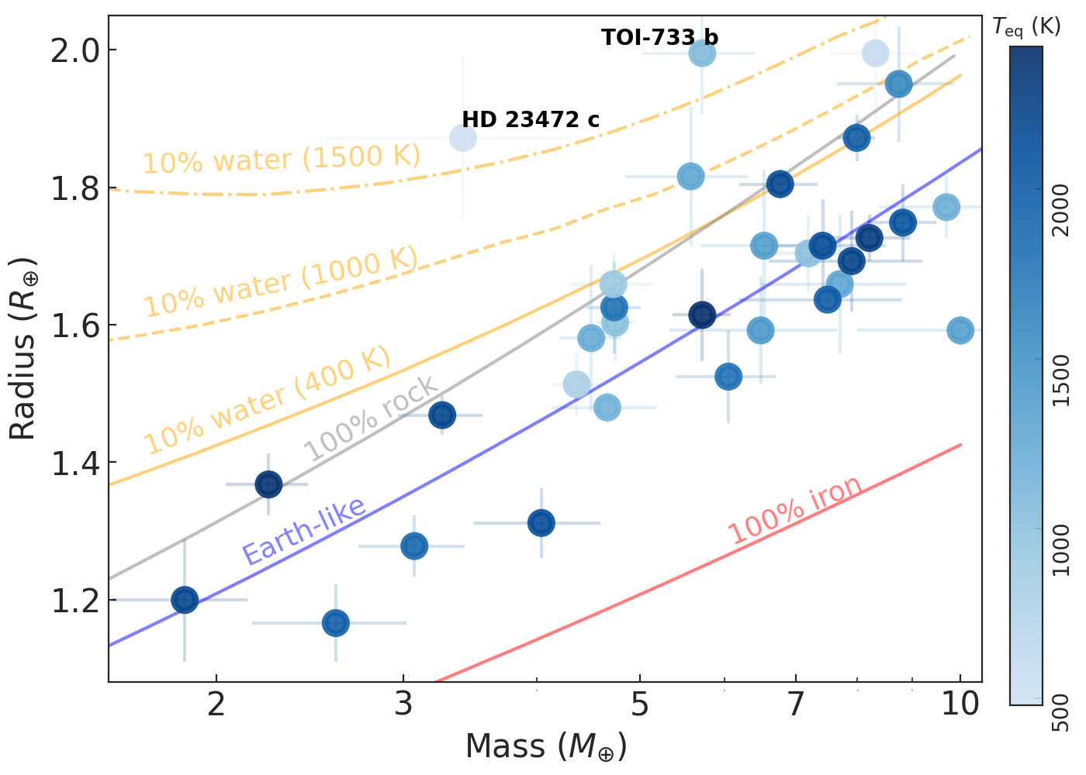
The sample
32 exoplanets ($R<2 R_{⊕}$)
30 FGK stars ($T_{eff}: 4600−6500$ K)
~50% larger than Adibekyan et al. (2021)’s sample
more precise measurements of planetary mass and radius
Masses from RV only
Avoid possible discrepancies in the density distributions of planets with mass determinations via TTV and RV method (e.g. Mills & Mazeh 2017; Leleu et al. 2023; Adibekyan et al. 2024).
9
Notes:
From the PlanetS catalogue, we select planets with radius R<2 R_earth and Teff: 4600-6500 K. This temperature range allows for the precise determination of stellar atmospheric abundances of relevant elements. With this constrains, we get a sample which is ~50% larger than the one from Adibekyan+2021 and with mass and radius measurements more precise. We also select planets with mass determination only using RVs, to avoid discrepancies in the density distributions of planets with mass determinations via TTV and RV method.

Slide 10
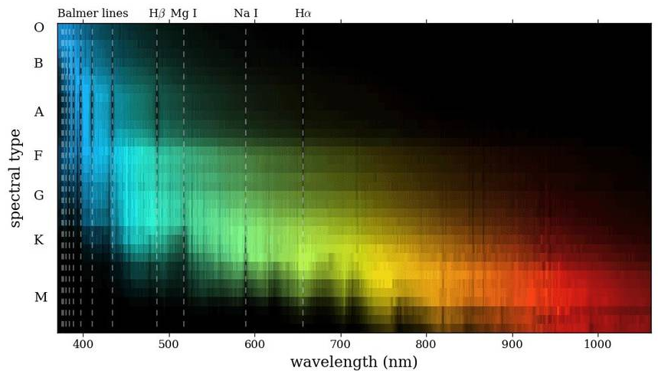
Present-day vs Primordial composition
Through stellar atmospheres, we can only determine the present-day stellar properties.
Properties like atmospheric chemical abundances can change as stars evolve.
Using models from Deal et al. (2020, 2021), we can determine the ages and primordial abundances (C, O, Mg, Si, Fe) of the planet hosting stars.
10
Notes:
Through stellar spectroscopy, we can only determine the present-day stellar properties.
However, certain properties, like the atmospheric chemical abundances, can change as stars age, even while they remain in the main sequence.
Using models from Deal et al. (2020, 2021), we can determine the ages and primordial abundances of the planet hosting stars.
In terms of chemical transport, the model includes atomic diffusion with radiative accelerations, the transport induced by rotation, and an extra turbulent mixing calibrated on the Sun to reproduce its lithium surface abundance.

Slide 11
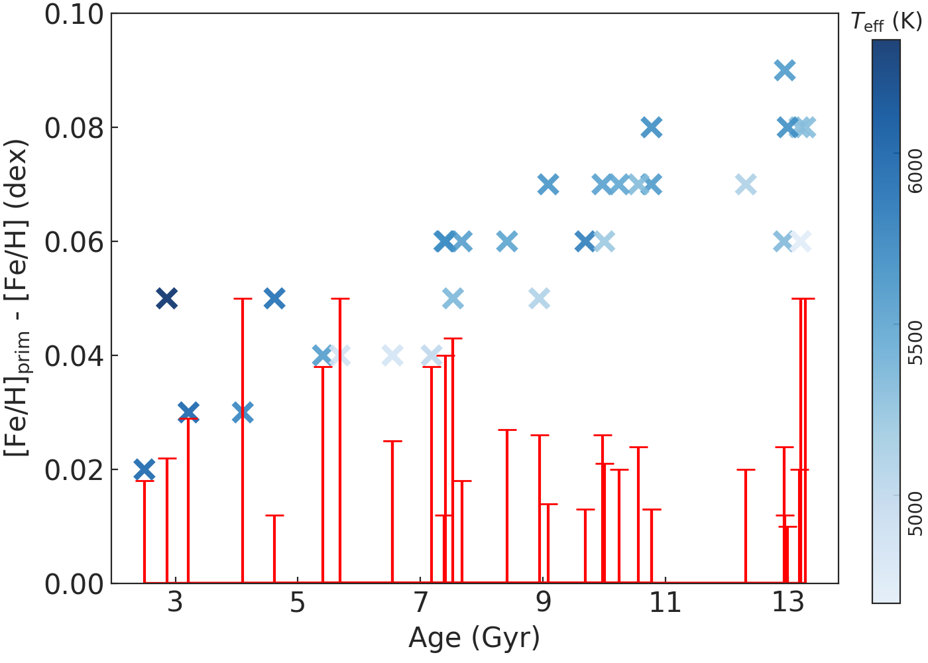
Present-day vs Primordial composition
Amplitude of the iron abundance changing as a function of stellar age and temperature.
Oldest stars experience the most significant reduction in iron abundance.
For a given age, atomic diffusion is more pronounced in hotter stars due to their narrower convective envelopes.
11
Notes:
In the plot, we can see how amplitude of the iron abundance changes as a function of the age and temperature of the stars.
The figure illustrates that the oldest stars experience the most significant reduction in iron abundance and that, for a given age, atomic diffusion is more pronounced in hotter stars due to their narrower convective envelopes.

Slide 12
Present-day vs Primordial composition
The temporal change in metallicity can be several times larger than the uncertainties in the present-day [Fe/H] measurements.
Results consistent for other elements
→ Changes in abundance ratios remain negligible
12
Notes:
Moreover, it is also possible to see how the temporal change in metallicity can be several times larger than the uncertainties in the present-day [Fe/H] measurements. This result is also valid for other elements, which suggest that changes in abundance ratio remain negligible.

Slide 13
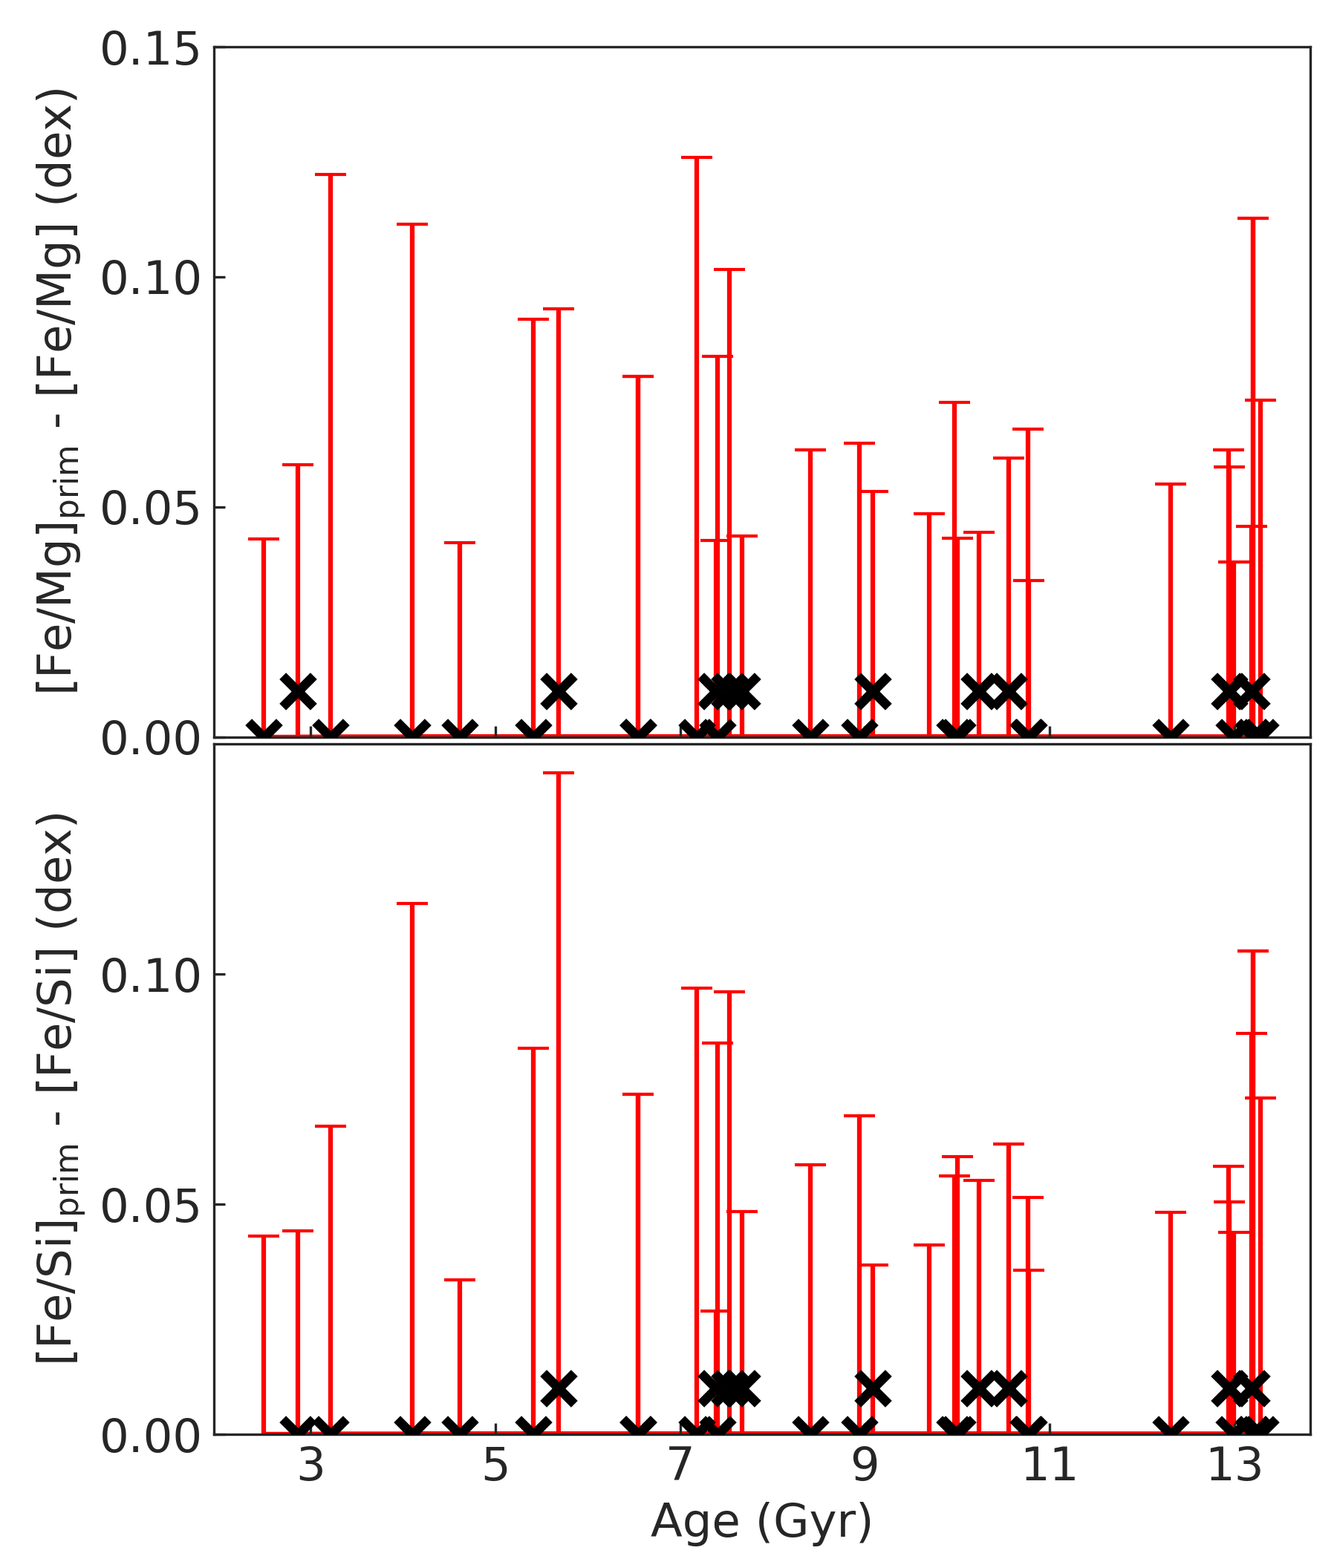
Present-day vs Primordial composition
The temporal change in metallicity can be several times larger than the uncertainties in the present-day [Fe/H] measurements.
Results consistent for other elements
→ Changes in abundance ratios remain negligible
No significant change in abundance ratios!
13
Notes:
Indeed, when checking the difference between primordial and present-day abundance ratios of [Fe/Si] and [Fe/Mg] as a function of age, we find that there is no significant change in abundance ratios.

Slide 14
Composition of planet building blocks
Convert into absolute abundances
Solar reference values from Asplund et al. (2021)
$$f_{iron}^{star}, f_{water}^{star}$$
𝑓_𝑖𝑟𝑜𝑛^𝑠𝑡𝑎𝑟, 𝑓_𝑤𝑎𝑡𝑒𝑟^𝑠𝑡𝑎𝑟
Stoichiometric model from Santos et al. (2015, 2017)
Primordial abundances
Models from Deal et al. (2020, 2021)
Present-day abundances
Spectroscopy
14
Notes:
From the models from Deal et al.(2020, 2021), we determined the primordial atmospheric abundances.
We then converted the derived primordial atmospheric abundances of C, O, Mg, Si, and Fe into absolute abundances using solar reference values from Asplund et al. (2021).
These absolute stellar abundances were then used to estimate the iron-to-silicate mass fraction and the water mass fraction of the protoplanetary disks using the stoichiometric model described in Santos et al. (2015, 2017).
We can do this both for the primordial abundances, but also for their present-day counterpart, to get the compositions of planet building blocks for both cases.

Slide 15
Composition of planet building blocks
Determine composition of protoplanetary disk, $f_{iron}^{star}, f_{water}^{star}$:
present-day stellar abundances
primordial stellar abundances
Negligible differences!
Using present-day stellar abundances to infer the composition of protoplanetary disks is a valid approach, as the key elemental ratios critical for planet formation do not change significantly over time.
15
Notes:
… and then we compare the composition of the planet building blocks (iron-to silicate and water mass fractions) when using both cases We found negligible differences → the abundance ratios of Fe/Mg and Fe/Si remain relatively constant over the evolution of stars in the main sequence.
This consistency suggests that using present-day stellar abundances to infer the composition of protoplanetary disks is a valid approach, as the main elemental ratios critical for planet formation do not change significantly over time.

Slide 16
Interior composition of planets
Three-component interior model (Dorn et al. 2015, Luo et al. 2024):
Core
Mantle
Water (mainly steam)
Water can be present in the core, mantle and surface.
Infer the planetary iron-to-silicate mass fraction ($f_{iron}^{planet}$), the water mass fraction ($f_{water }^{planet}$), and the iron-to-magnesium ratio ($(Fe/M{g)}_{planet}$).
16
Notes:
We use an interior model with 3 components: core, mantle, and water (mainly steam). The model is based on Dorn et al. (2015) with updates from Luo et al. (2024). The water can be present in the core, the mantle, and the surface, depending on the specific thermal state of the planets.
The model is then used to infer the planetary iron-to-silicate mass fraction ($f_{iron}^{planet}$), the water mass fraction ($f_{water,prim}^{star}$), and the iron-to-magnesium ratio ($(Fe/M{g)}_{planet}$).

Slide 17
Star-planet composition link
Notes:
With the present-day and primordial stellar abundances, protoplanetary disk compositions and planet interiors determined, we can now explore the star-planet compositional link.

Slide 18
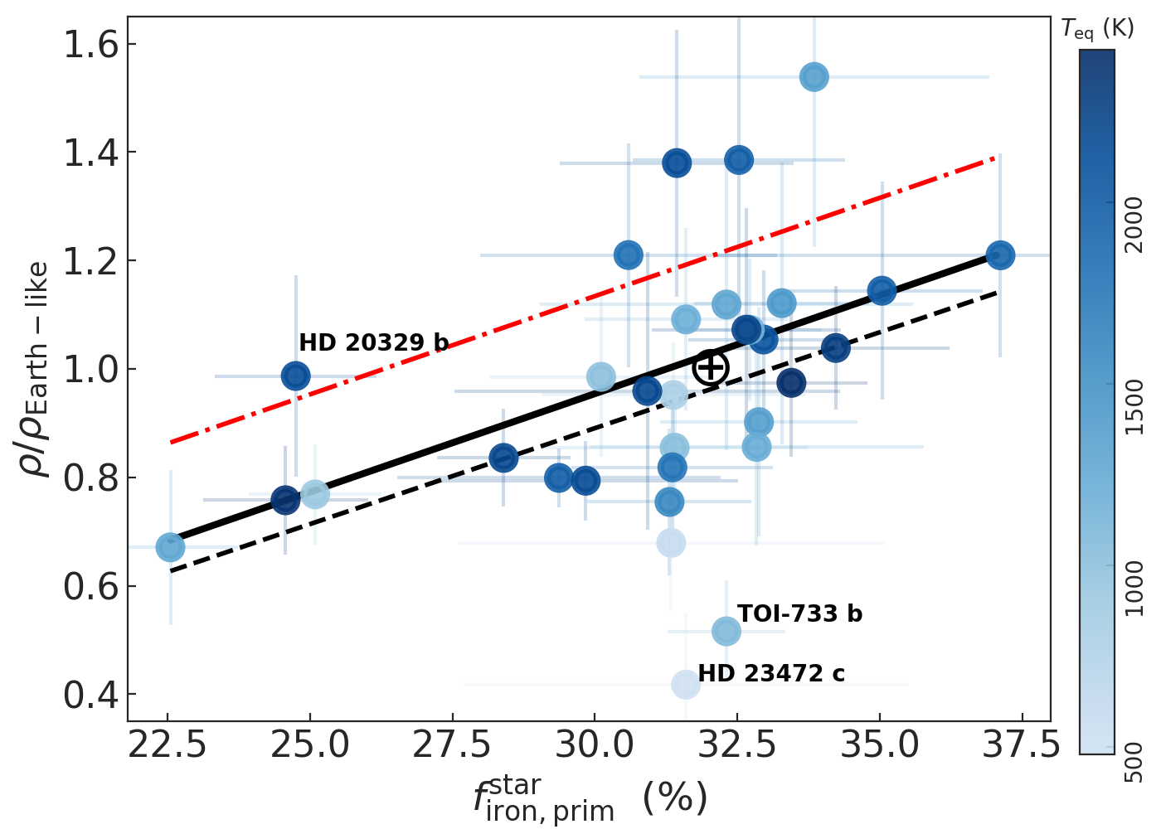
Planets’ scaled density vs $f_{iron,prim}^{star}$
Dependency of scaled densities of planets ($ρ/ρ_{Earth−like}$) on primordial $f_{iron,prim}^{star}$.
Two low-density planets (TOI-733b and HD23472c) orbiting stars with solar $f_{iron,prim}^{star}$
18
Notes:
We analyse how the primordial iron-to-silicate mass fraction impacts the scaled densities of planets (ρ/ρEarth−like). The scaled density is calculated by dividing the bulk density of the planet by the density of a planet with Earth-like composition, for the same planetary mass.
There are two low-density planets (TOI-733b and HD23472c) orbiting stars with solar primordial iron-to-silicate mass fraction.

Slide 19
Planets’ scaled density vs $f_{iron,prim}^{star}$
Dependency of scaled densities of planets ($ρ/ρ_{Earth−like}$) on primordial $f_{iron,prim}^{star}$.
Two low-density planets (TOI-733b and HD23472c) orbiting stars with solar $f_{iron,prim}^{star}$
Farthest from the Earth-like composition curve → significant amount of water (above 10%), potentially in the form of steam.
19
Notes:
If you recall the first plot, these two planets are the farthest from the Earth-like composition curve → our analysis on the interior composition suggests that they contain a significant amount of water (above 10%), potentially in the form of steam.

Slide 20
Planets’ scaled density vs $f_{iron,prim}^{star}$
Dependency of scaled densities of planets ($ρ/ρ_{Earth−like}$) on primordial $f_{iron,prim}^{star}$.
Two low-density planets (TOI-733b and HD23472c) orbiting stars with solar $f_{iron,prim}^{star}$
Farthest from the Earth-like composition curve → significant amount of water (above 10%), potentially in the form of steam.
20
Notes:
Hence, we excluded these two planets from the regression analysis presented in the figure.

Slide 21
Planets’ scaled density vs $f_{iron,prim}^{star}$
Low-density planets are likely formed in protoplanetary disks with a low iron-to-silicate mass fraction.
Statistically significant correlation between scaled density and $f_{iron,prim}^{star}$ (OLS regression p-value of 0.002)
Also noted in Adibekyan et al. (2021)
21
Notes:
Moreover, the plot shows how low-density planets are likely formed in protoplanetary disks with a low iron-to-silicate mass fraction.
An Ordinary Least Squares (OLS) regression p-value of 0.002 suggests a statistically significant correlation between scaled density and primordial iron-to-silicate mass fraction.
This correlation was previously noted in Adibekyan et al. (2021).

Slide 22
Super-Earths and super-Mercuries
Density gap between super-Mercuries and super-Earths appears less pronounced (see also Brinkman et al. 2024; Schulze et al. 2024)
→ Updated mass and radius determinations and stronger precision constraints on these parameters for the sample planets
22
Notes:
Another aspect we can explore is the density gap between super-Mercuries and super-Earths, which appears less pronounced compared to the findings of Adibekyan et al. (2021) → this is in line with the results of some recent studies.
This discrepancy can be attributed to updated mass and radius determinations and stronger precision constraints on these parameters for the sample planets.

Slide 23
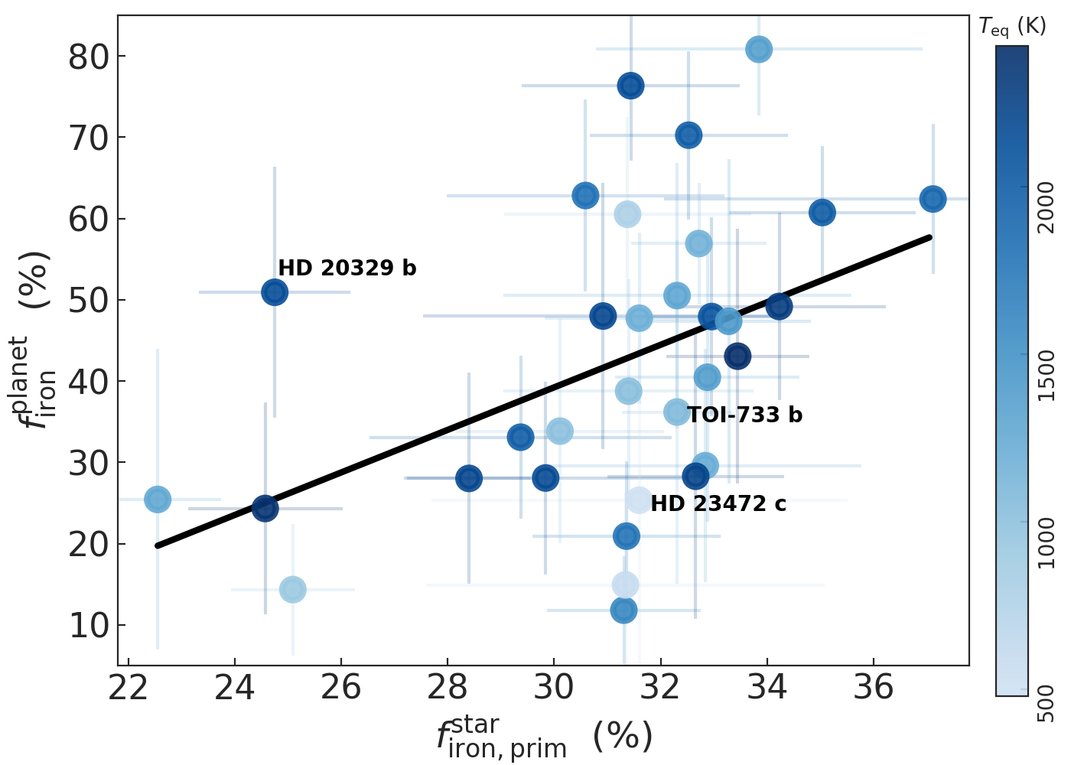
Super-Earths and super-Mercuries
Density gap between super-Mercuries and super-Earths appears less pronounced (see also Brinkman et al. 2024; Schulze et al. 2024)
→ Updated mass and radius determinations and stronger precision constraints on these parameters for the sample planets
HD20329b has $ρ/ρ_{Earth−like}\sim 1$ and orbits a star with a very low $f_{iron,prim}^{star}$ → significantly higher $f_{iron}^{planet}$ → potential super-Mercury
23
Notes:
There is also the curious case of HD20329b that orbits a star with a very low primordial stellar iron-mass fraction and has a scaled density similar to that of Earth. This suggests that HD20329b might have a significantly higher planetary iron-mass fraction than what would be expected from its host star’s protoplanetary disk composition, classifying it as a potential super-Mercury.

Slide 24
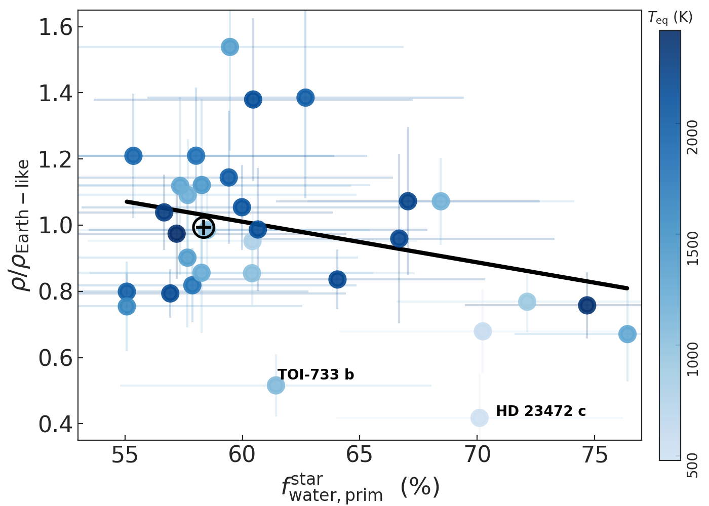
Planets’ scaled density vs $f_{water,prim}^{star}$
Dependency of $ρ/ρ_{Earth−like}$on primordial $f_{water,prim}^{star}$
Trend not statistically significant (p-value = 0.07)
Overall, both low iron content and high water content are probable factors contributing to the low-density of rocky planets.
24
Notes:
When analysing the dependency of scaled-densities on the primordial water-mass fraction, there is a possible negative correlation.
However, this trend is not statistically significant, with a p-value of 0.07.
Overall, both low iron content and high water content are likely factors contributing to the low density of rocky planets.

Slide 25
Planetary and stellar iron-mass fraction
Comparing $f_{iron,prim}^{star}$ with $f_{iron }^{planet}$:
Significant correlation (slope of 2.6±0.9 and p-value = 0.009).
25
Notes:
With information on the stellar and planetary iron-mass fractions, we can now examine the compositional link between solar-type stars and their low-mass planets.
The OLS regression analysis indicates a significant correlation between these two parameters, with a slope of 2.6±0.9 and p-value of 0.009.

Slide 26
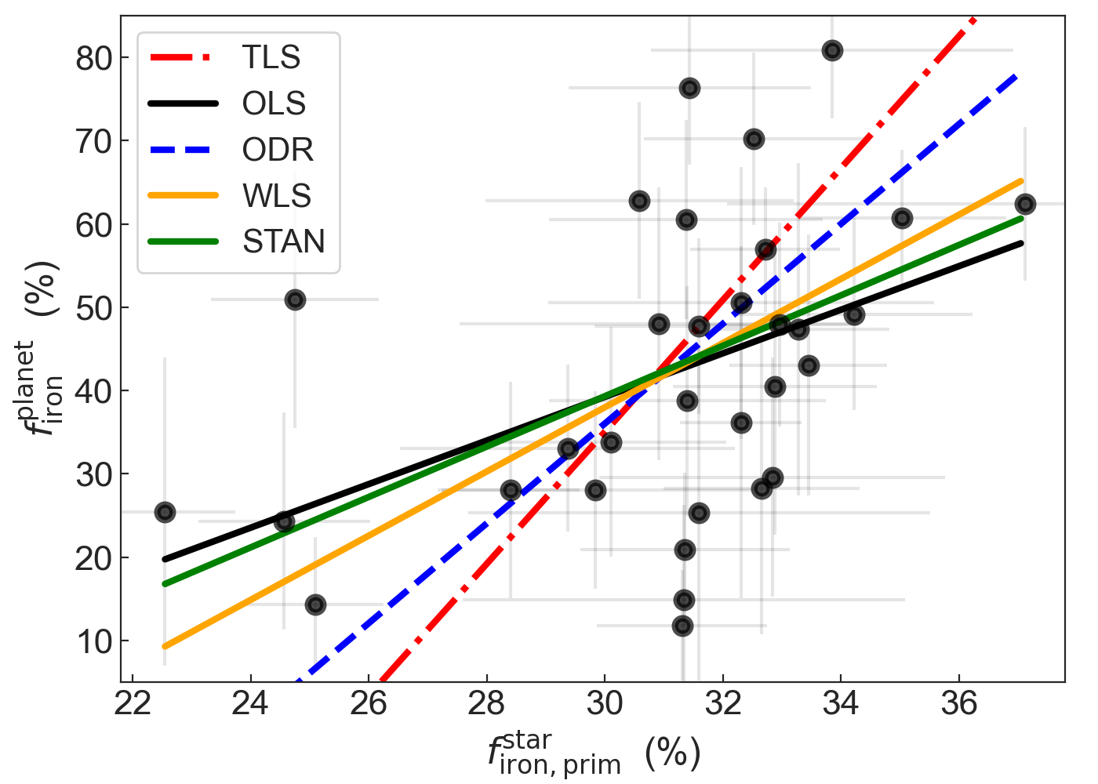
Planetary and stellar iron-mass fraction
Comparing $f_{iron,prim}^{star}$ with $f_{iron }^{planet}$:
Significant correlation (slope of 2.6±0.9 and p-value = 0.009).
To ensure the robustness of this result, we applied different regression methods, accounting for the uncertainties in the parameters.
The presence of a steeper-than-one-to-one correlation remains clear.
26
Notes:
To ensure the robustness of this result, we applied different regression methods, accounting for the uncertainties in the parameters.
While the exact form of the relation varies with the methodology used, the presence of a steeper-than-one-to-one correlation remains evident.

Slide 27
Planetary and stellar iron-mass fraction
Comparing $f_{iron,prim}^{star}$ with $f_{iron }^{planet}$:
Range of $f_{iron }^{planet}$is significantly broader than that of their building blocks (Plotnykov & Valencia 2020; Adibekyan et al. 2021)
Processes during planet formation and evolution can lead to substantial deviations in the iron-to-silicate mass fraction of the resulting planets compared to their original building materials.
27
Notes:
The plot also shows how the range of $f_{iron }^{planet}$is significantly broader than that of their building blocks, confirming previous findings.
This indicates that while the primordial composition of the protoplanetary disk sets a baseline for planetary composition, various processes during planet formation and evolution can lead to substantial deviations in the iron-to-silicate mass fraction of the resulting planets compared to their original building materials.

Slide 28
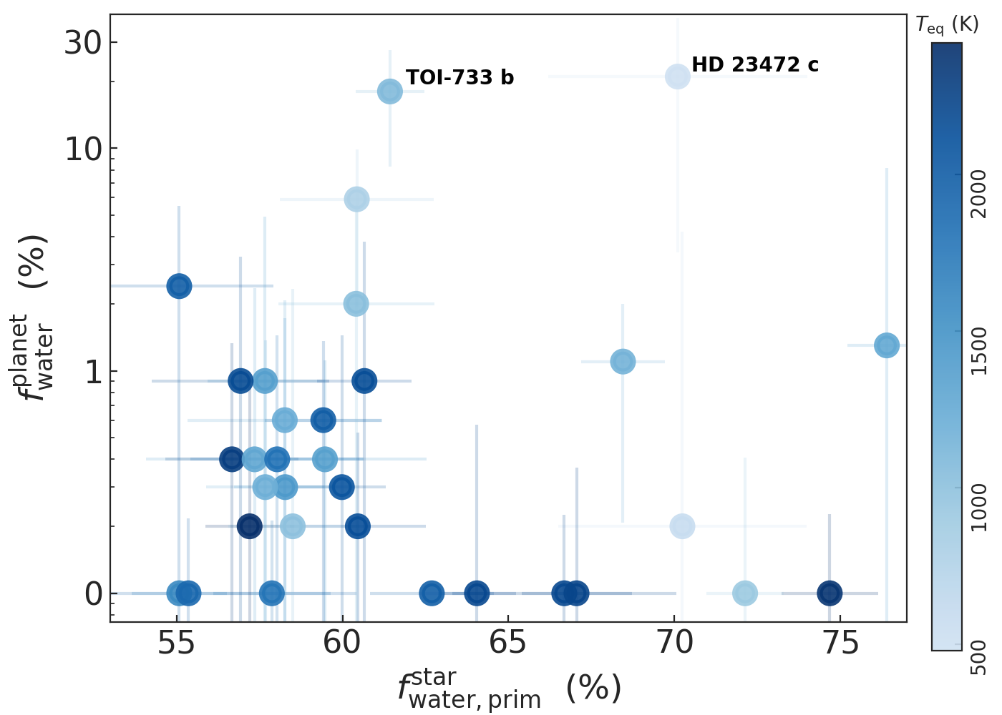
Planetary and stellar water-mass fraction
Comparing $f_{water,prim}^{star}$ with $f_{water }^{planet}$:
Absence of clear correlation
$f_{water,prim}^{star}$is calculated with the assumption that the planet building blocks are located outside the water iceline
Low water content observed in most of the studied planets may suggest that they formed inside the water iceline.
28
Notes:
The same cannot be said of the stellar and planetary water-mass fractions, where there is an absence of correlation.
This may be somewhat expected since the stellar water-mass fraction is calculated with the assumption that the planet building blocks are located outside the water snowline.
The low water content observed in most of the studied planets may imply instead that they formed inside the water snowline.

Slide 29
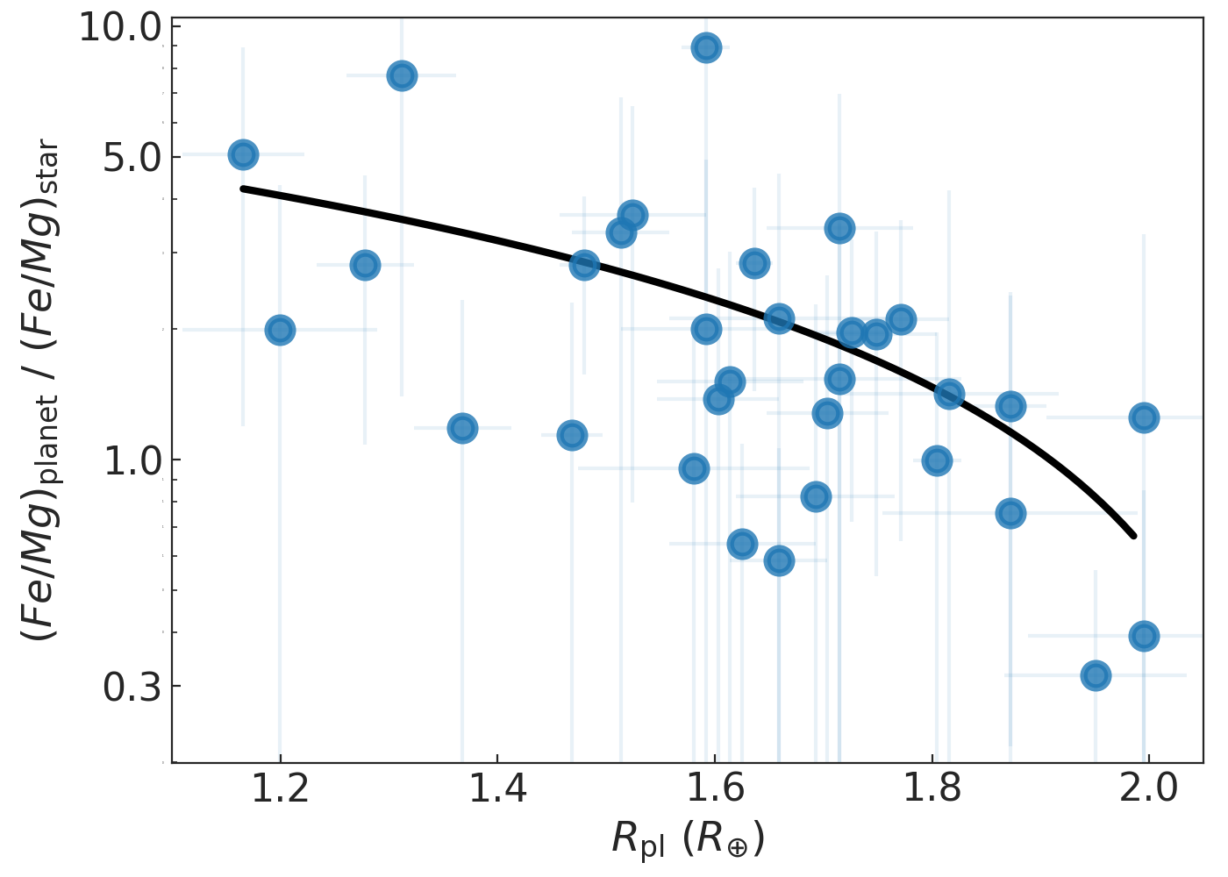
Fe/Mg ratios in planets and their host stars
Planetary interiors are often modeled under the assumption that the Fe/Mg ratio in planets is similar to that of their host stars.
Fe/Mg ratio in planets can be up to 3x lower or up to 10x higher than in their host stars
large variation between the formed planets and the protoplanetary disk
29
Notes:
As planetary interiors are often modeled under the assumption that the Fe/Mg ratio in planets is similar to that of their host stars, we check how the Fe/Mg planet-to-host ratio varies with planetary radius.
The figure reveals that the Fe/Mg ratio in planets can be down to three times lower or up to ten times higher than in their host stars, indicating a large variation between the formed planets and the protoplanetary disk.

Slide 30
Fe/Mg ratios in planets and their host stars
Clear dependence of the $(Fe/M{g)}_{planet} / (Fe/M{g)}_{star}$ratio on planetary radius.
Processes occurring within the protoplanetary disk during planet formation play a significant role in determining the final composition of rocky planets.
30
Notes:
Furthermore, there is a clear dependence of the $(Fe/M{g)}_{planet} / (Fe/M{g)}_{star}$ratio on planetary radius.
Together with the previous result, this further reinforces the possibility that processes within the protoplanetary disk significantly influence the final composition of rocky planets.

Slide 31
Key results
Initial chemical conditions in the portoplanetary disk might be important for the final composition of planets.
Stellar atmospheres provide the only observational window for vestiges of planet-forming disk chemistry, as the disks have long been dissipated around most discovered planet host stars.
Present-day abundances of stars might differ from those at the time of their formation → BUT the temporal changes in stellar abundances do not significantly affect important abundance ratios.
The composition of rocky planets correlates with that of the host star (presumably also with the composition of the portoplanetary disk). However, the relation is not one-to-one.
Abundance ratios within planets might differ significantly from those of their host stars.
31

Slide 32
Thank you!
Bárbara Soares (bsoares@astro.up.pt) Vardan Adibekyan and the EXO-Terra Team
Institute of Astrophysics and Space Sciences
University of Porto

Slide 33
33

Slide 34
Bonus slides

Slide 35
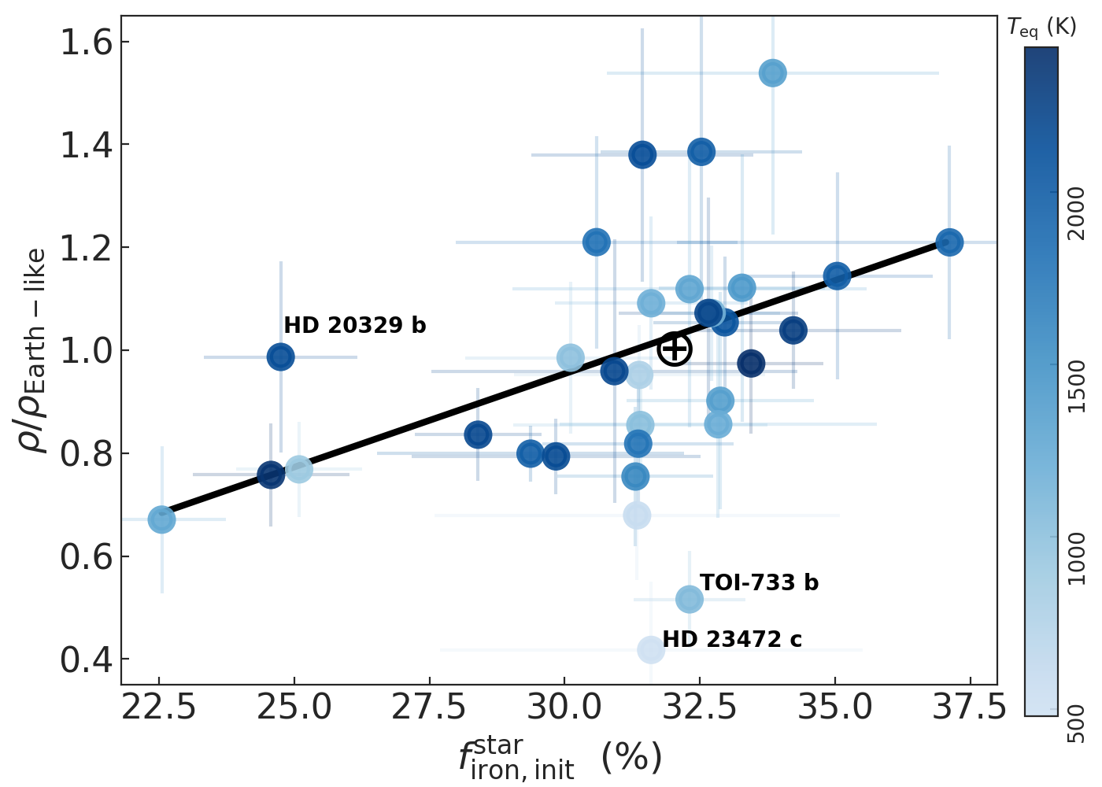
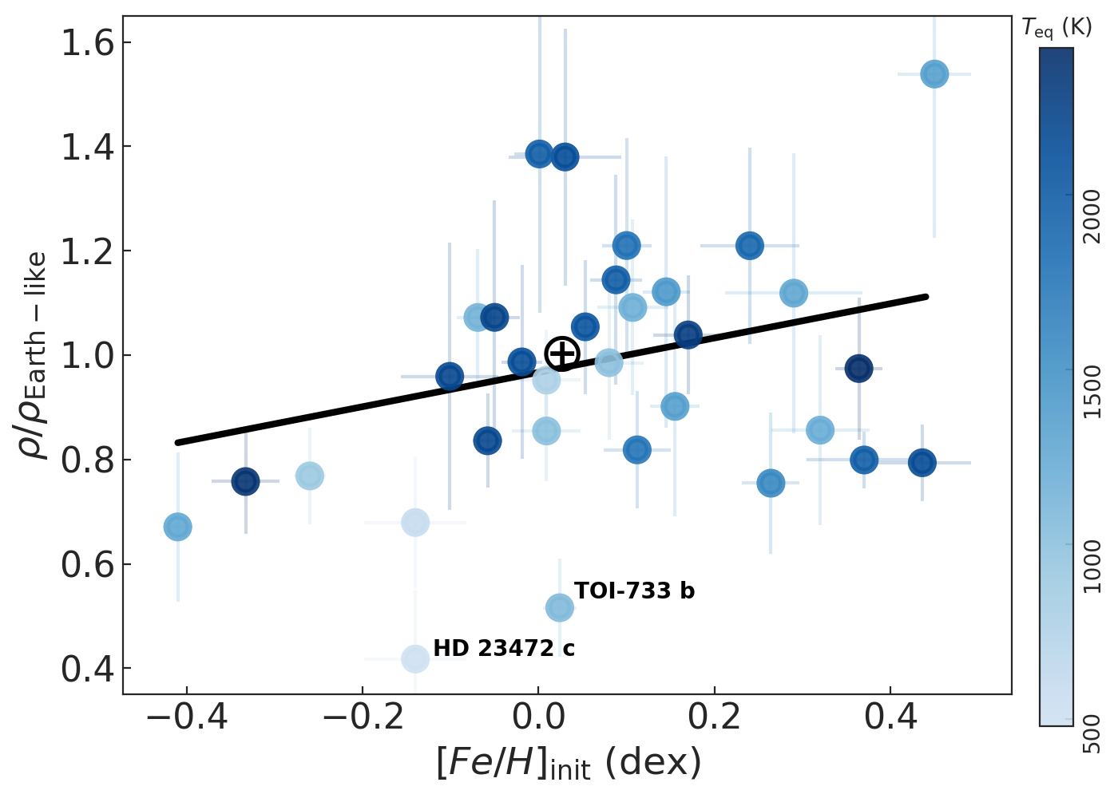
$f_{iron}^{star} ≠$ [Fe/H]
dd
35

Slide 36
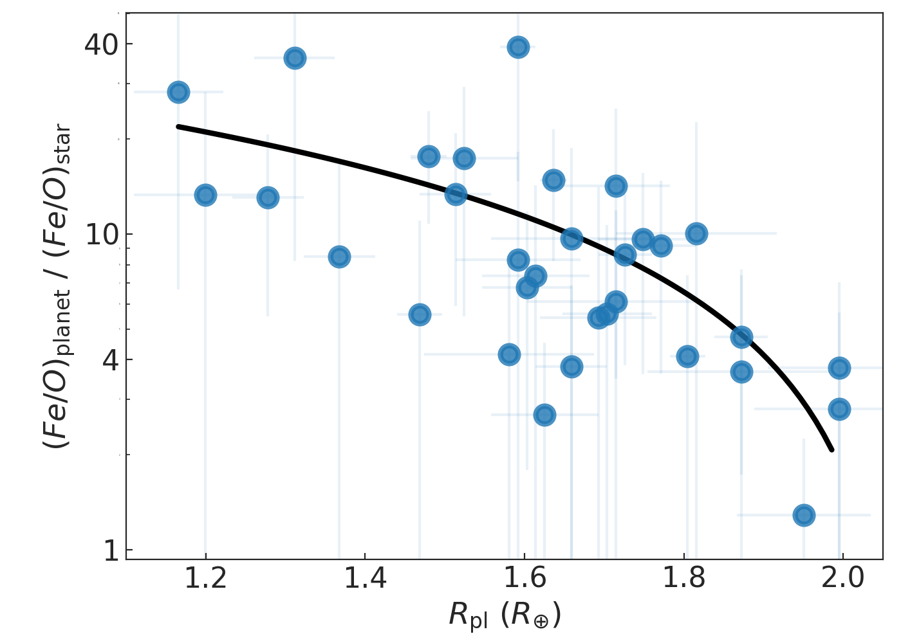
Compositions of stars and planets (other abundance ratios)
36

Slide 37
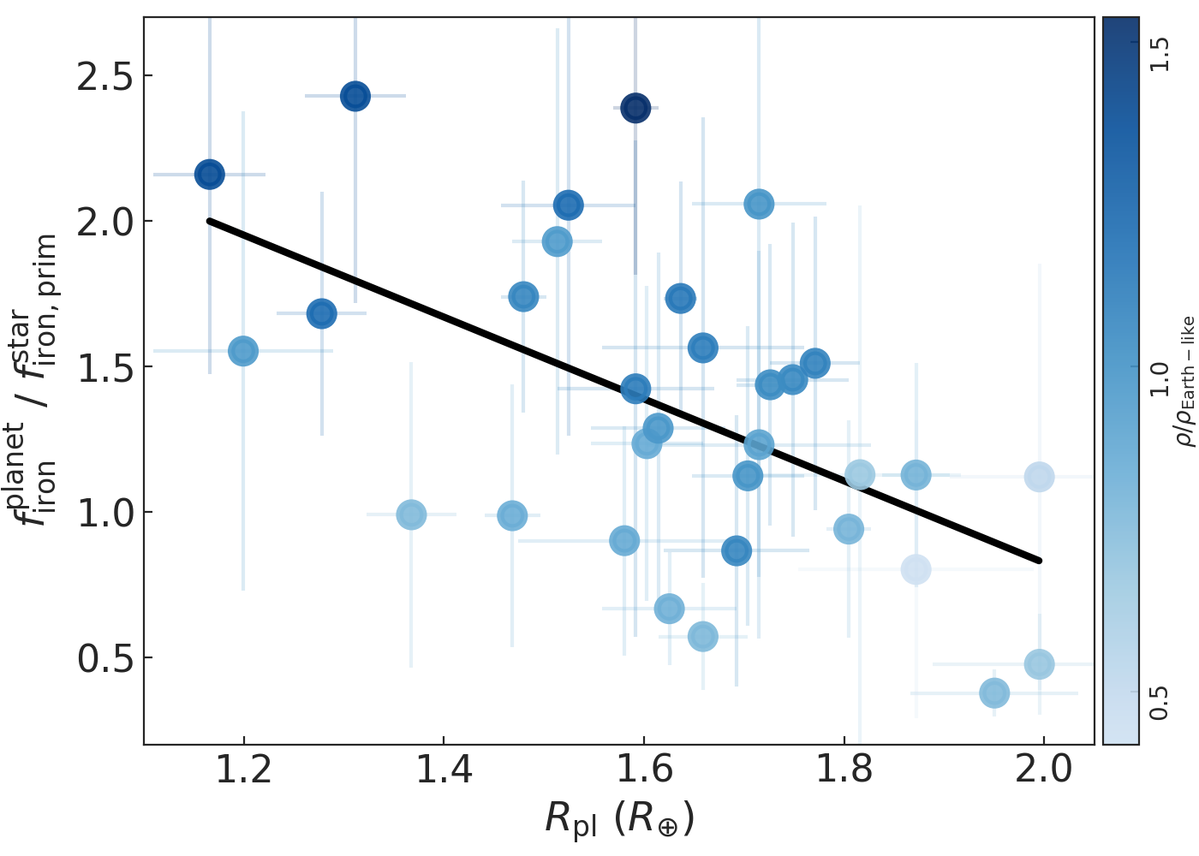
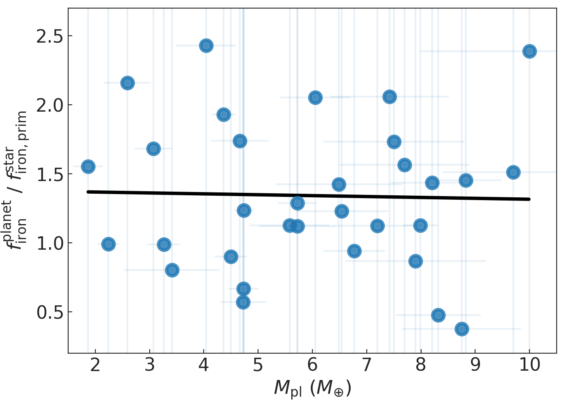
More on the planet-star compositional link…
$f_{iron }^{planet}$/ $f_{iron,prim }^{star}$vs $R_{pl}$, $M_{pl}$
$R_{pl}$: clear correlation (p-value < 0.001)
$M_{pl}$: no correlation (p-value ~ 0.9)
→ Planetary density depends on radius with a cubic relation, while the dependence on mass is only linear.
37
Notes:
We further explore the planet-star compositional link by studying the ratio of planetary and stellar iron-mass fraction as a function of planetary radius and planetary mass.

