Slide 1
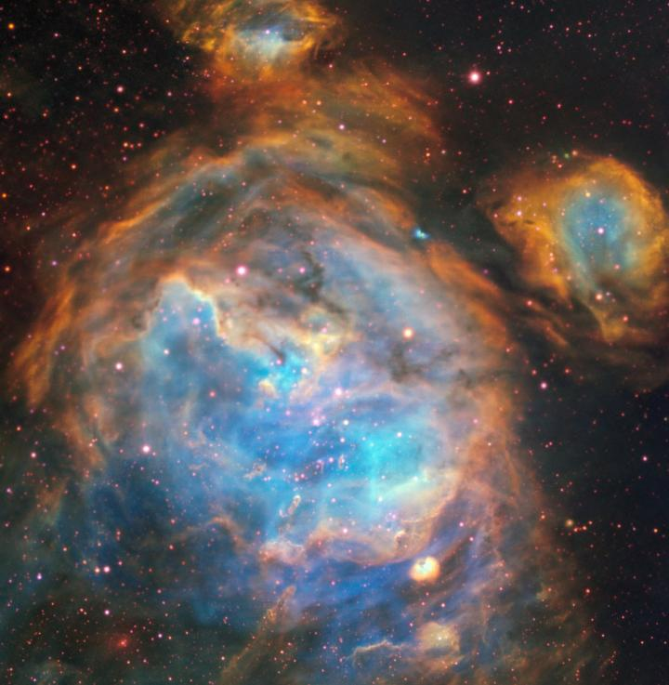



Disks at low metallicities
Anna McLeod
Assoc. Prof.
Durham University
Molecules and Planets in the Outer Galaxy
Firenze, November 12, 2024
Massive

Slide 2
How does this talk fit into this workshop?
We will be honoured if you would accept this invitation to join us, and present a talk on Planets and planet formation at sub-Solar metallicity: observations.
… While metallicity is a topic that I am very involved in, it is more in the context of stellar feedback and massive star formation, and planet formation is not quite my field. I could talk about circumstellar disks at low metallicities, but if that does not quite fit into the workshop please feel free to offer the spot to someone more qualified.
Circumstellar disks at low metallicities is indeed a subject that is going to be included in the workshop!
Great, I’ll be there!
(paraphrased)

Slide 3
Most stars and thus, planets, form under very high external irradiation
Presence of massive stars
High FUV fluxes
Truncated outer disk radii
Shorter disk lifetimes
Disk T, M, lifetime influence planetary systems
Not to mention the effect of supernovae (on planets)! See Riccardo Spinelli’s talk
“At present, external photoevaporation remains an under-studied component of the planet formation puzzle.”
Winter & Haworth, 2022

Slide 4
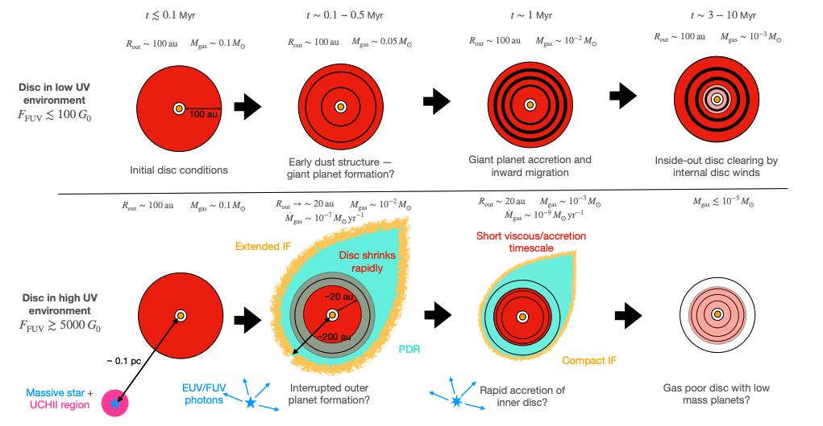
Protoplanetary disks evolve differently under different external irradiation
Photoevaporation becomes more significant with increasing FUV fields, for example, at low metallicities
Winter & Haworth 2022
See also Ramirez-Tannus et al. (incl. McLeod) 2023

Slide 5


Metallicity is a key factor to include in disk evolution studies
Because metallicity changes the quality and impact of internal and external feedback
Lower optical depth in ISM
Higher photon flux from stars
Higher T
Z ~ Z⦿
Z < Z⦿
Lower dust content

Slide 6
Metallicity is a key factor to include in disk evolution studies
Effect of lower metallicity and lower dust content than MW
→ decrease in continuum optical depth
→ higher photon fluxes
→ less efficient cooling
→ higher gas temperatures
=
Stronger thermal pressure feedback
&
Higher photo-evaporation rates
→ star/disk system exposed on shorter timescales
→ stronger internal irradiation stabilizes a hotter disk

Slide 7
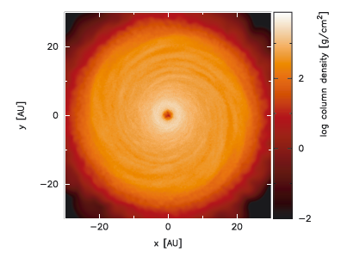
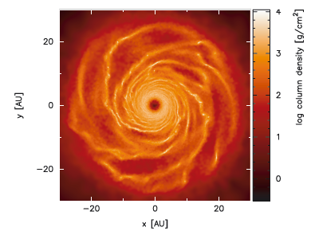
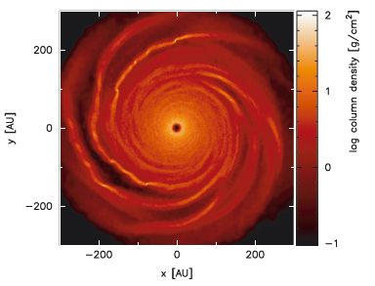
Numerical expectations: varying opacities
Opacity = 1*interstellar
Rosseland
Opacity = 0.01*interstellar
Rosseland
Opacity = 0.1*interstellar
Rosseland
High opacity: less cooling -> no fragmentation
Low opacity: efficient cooling -> fragmentation
Low opacity + large disk: fragmentation at higher opacities
Meru & Bate 2010
Fragmentation is promoted for lower disk opacities because disk cools quickly.
Fragmentation is inhibited by stellar irradiation because the disk is heated.
Question. Low opacities (can) occur at low metallicities, but so does increased stellar irradiation: what dominates?
For planet frequency / metallicity dependence see Maria Tsantaki’s talk

Slide 8
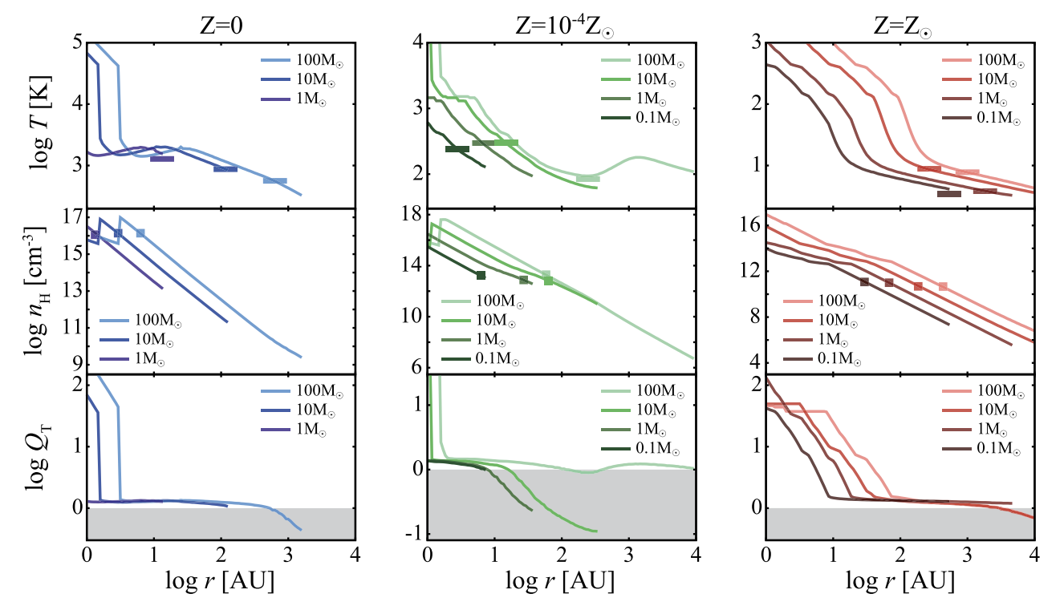


Numerical expectations: varying metallicities
Tanaka+18: disk stability from primordial to Solar metallicity.
Disks get significantly hotter at low metallicities (and have higher $\dot{M}$_{acc} )
Clearly, dust is an important factor as well. Can we quantify this?
Marco Palla’s talk on dust gradients in galaxies
Disks are most unstable at “intermediate” metallicities
$$Q_{T}\sim {\left(\frac{T_{disk}}{T_{env}}\right)}^{3/2}$$
Lower due to efficient dust cooling because density is high
Higher because lower density leads to less efficient dust cooling

Slide 9
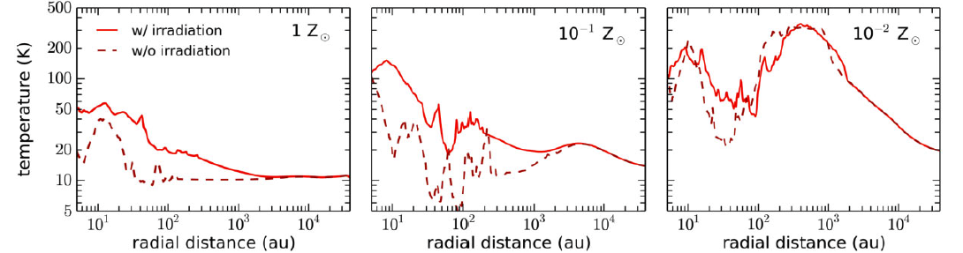
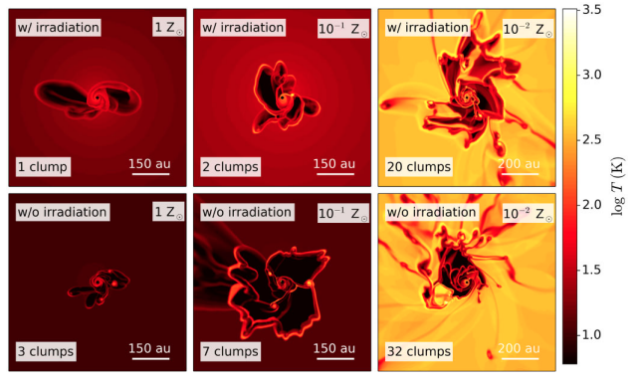
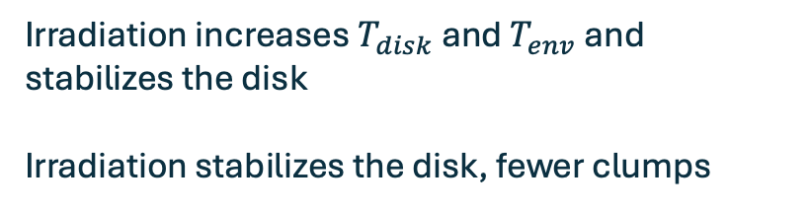
Numerical expectations: varying (internal) irradiation and metallicity
Heating via irradiation is less effective at low metallicities, but the disk is hotter on its own due to less efficient line cooling
Matsukoba+22
Complicated interdependencies of internal vs external irradiation, metallicity, dust opacity, density, etc
Irradiation increases $T_{disk}$ and $T_{env}$ and stabilizes the disk
Irradiation stabilizes the disk, fewer clumps

Slide 10

HH 1177 is the best (and only) extragalactic empirical benchmark
LMC, 0.5 Z ⦿
internally irradiated by optically revealed 15 M ⦿ star
externally irradiated (~13 O stars in SF regions)
(just) resolved Keplerian disk
bipolar jet + molecular outflow
Link with outer parts of MW
due to its birth environment
Link with early Universe due to its mass and lower metallicity
Piyush’s talk on the metallicity dependent IMF

Slide 11
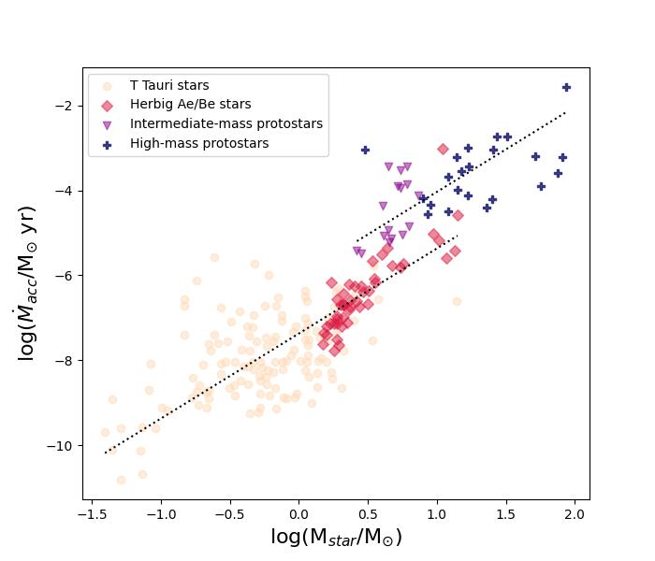
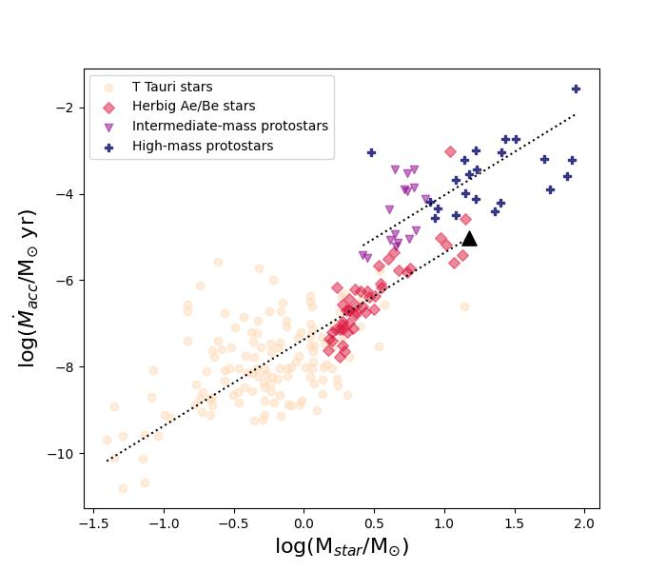
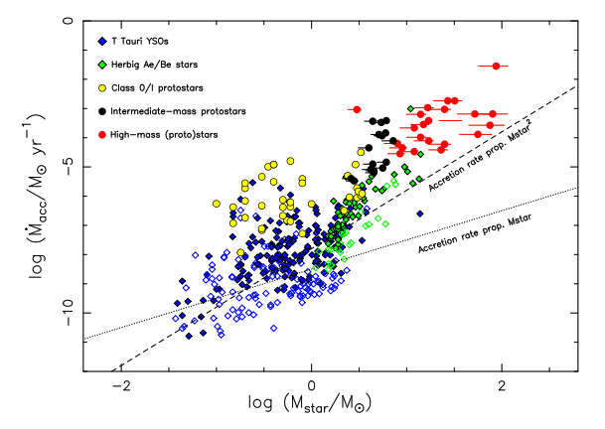


HH 1177 also provides the link between low- and high-mass star formation
Larger $\dot{M}$_{acc} for larger stellar masses
Overall, $\dot{M}$_{acc}∝ $M_{∗}^{2}$
Higher accretion rates in embedded sources
“cannot be tested over the full mass range as, clearly, no optically revealed high-mass stars with primordial disks are known to exist and the area for masses > 10 M⦿ is therefore void.”
Beltrán & de Wit 2016
⚠︎ Stars in different mass and age bins

Slide 12
[SII]
H⍺
[OIII]
McLeod+18,19
LMC N180
Z ~ 0.5 Z⦿
13 O-type stars
64-pointing MUSE mosaic
Notes:
Inset of where in LMC

Slide 13



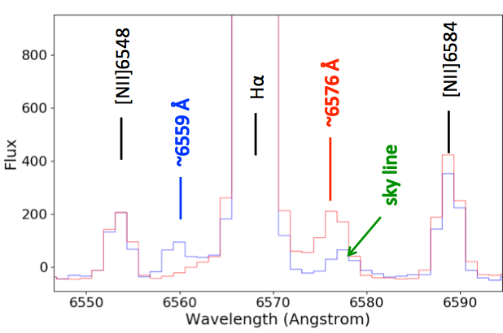
[SII]
H⍺
[OIII]
McLeod+18, Nature

Slide 14
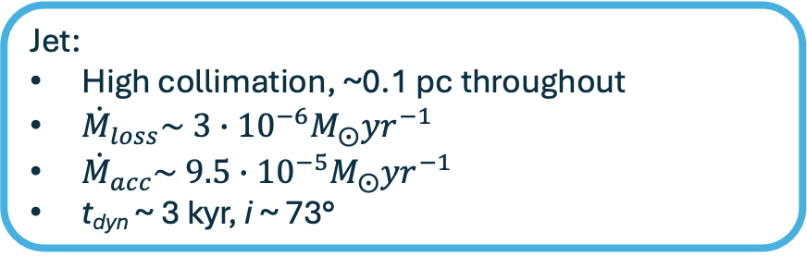
The HH 1177 jet is ~11 pc in length and externally irradiated
HH 1177
Star:
12 M⦿ (Caulet+08, Spitzer SED)
Likely B-type (absence of HeII absorption in MUSE spectrum)
Jet:
High collimation, ~0.1 pc throughout
${\dot{M}}_{loss}\sim 3∙{10}^{−6}M_{⨀}{yr}^{−1}$
${\dot{M}}_{acc}\sim 9.5∙{10}^{−5}M_{⨀}{yr}^{−1}$
t_{dyn} ~ 3 kyr, i ~ 73°
Low metallicity environment → enhanced photoionization → faster cloud dispersal
What’s unusual about HH 1177:
Optically revealed star (!!)
McLeod+18, Nature

Slide 15

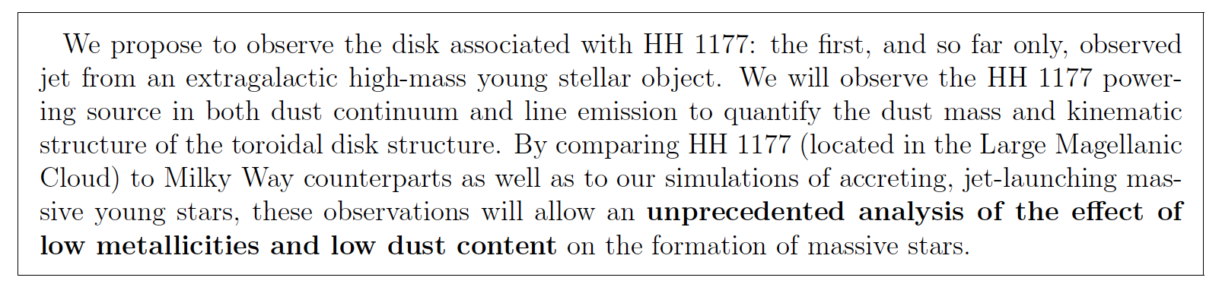
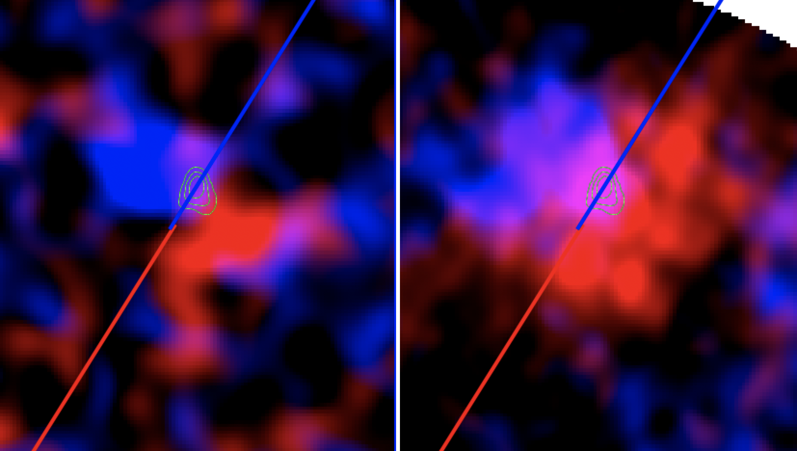
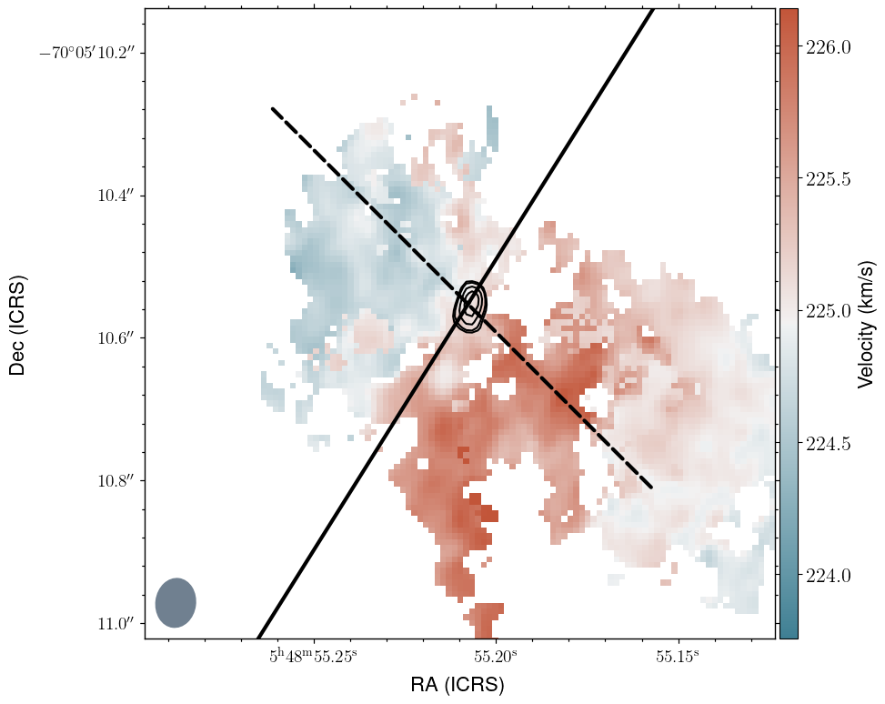
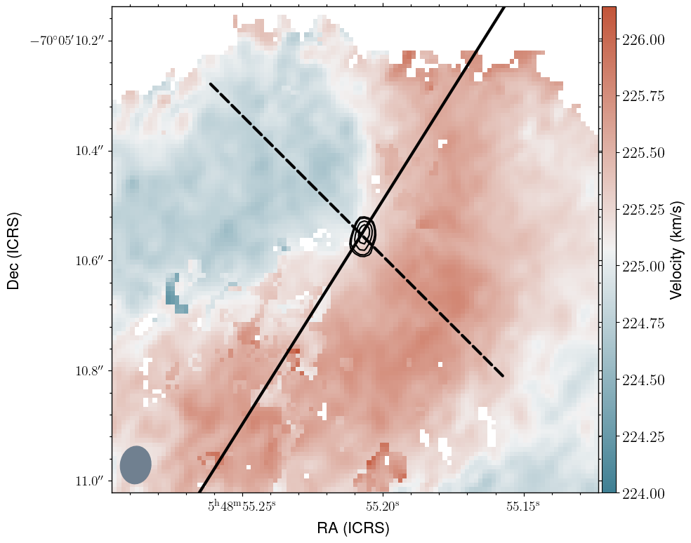
If there is a jet, there is a disk: ALMA cycle 7 proposal
CS
¹³CO
~25000 AU
Anna McLeod, Durham Uni

Slide 16
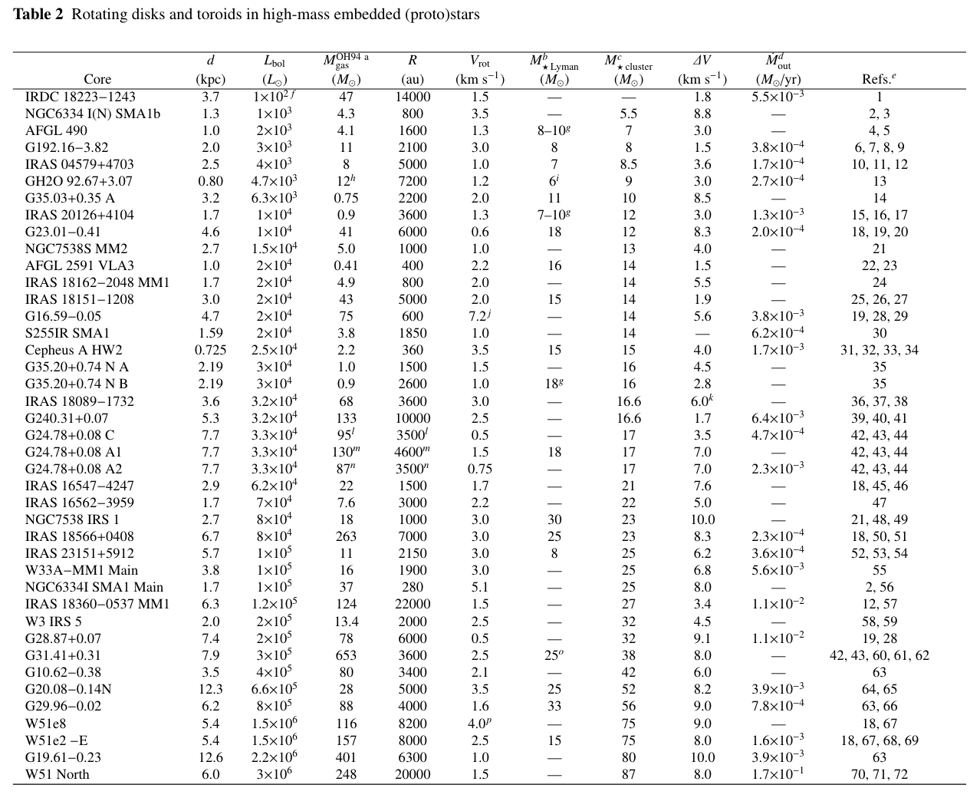
How does the rotating structure around HH 1177 compare?
Most likely Keplerian disks around B-type stars:
R_{disk} 360 – 3600 AU
Surely not 25k AU!
Beltrán & de Wit 2016

Slide 17
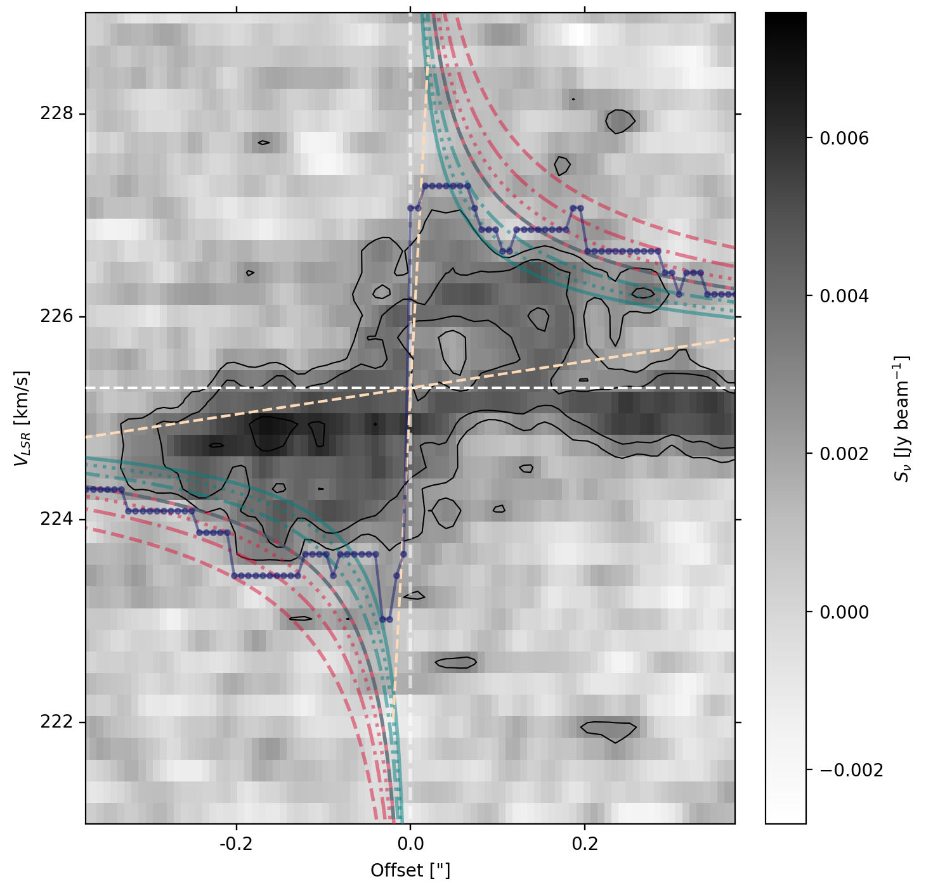
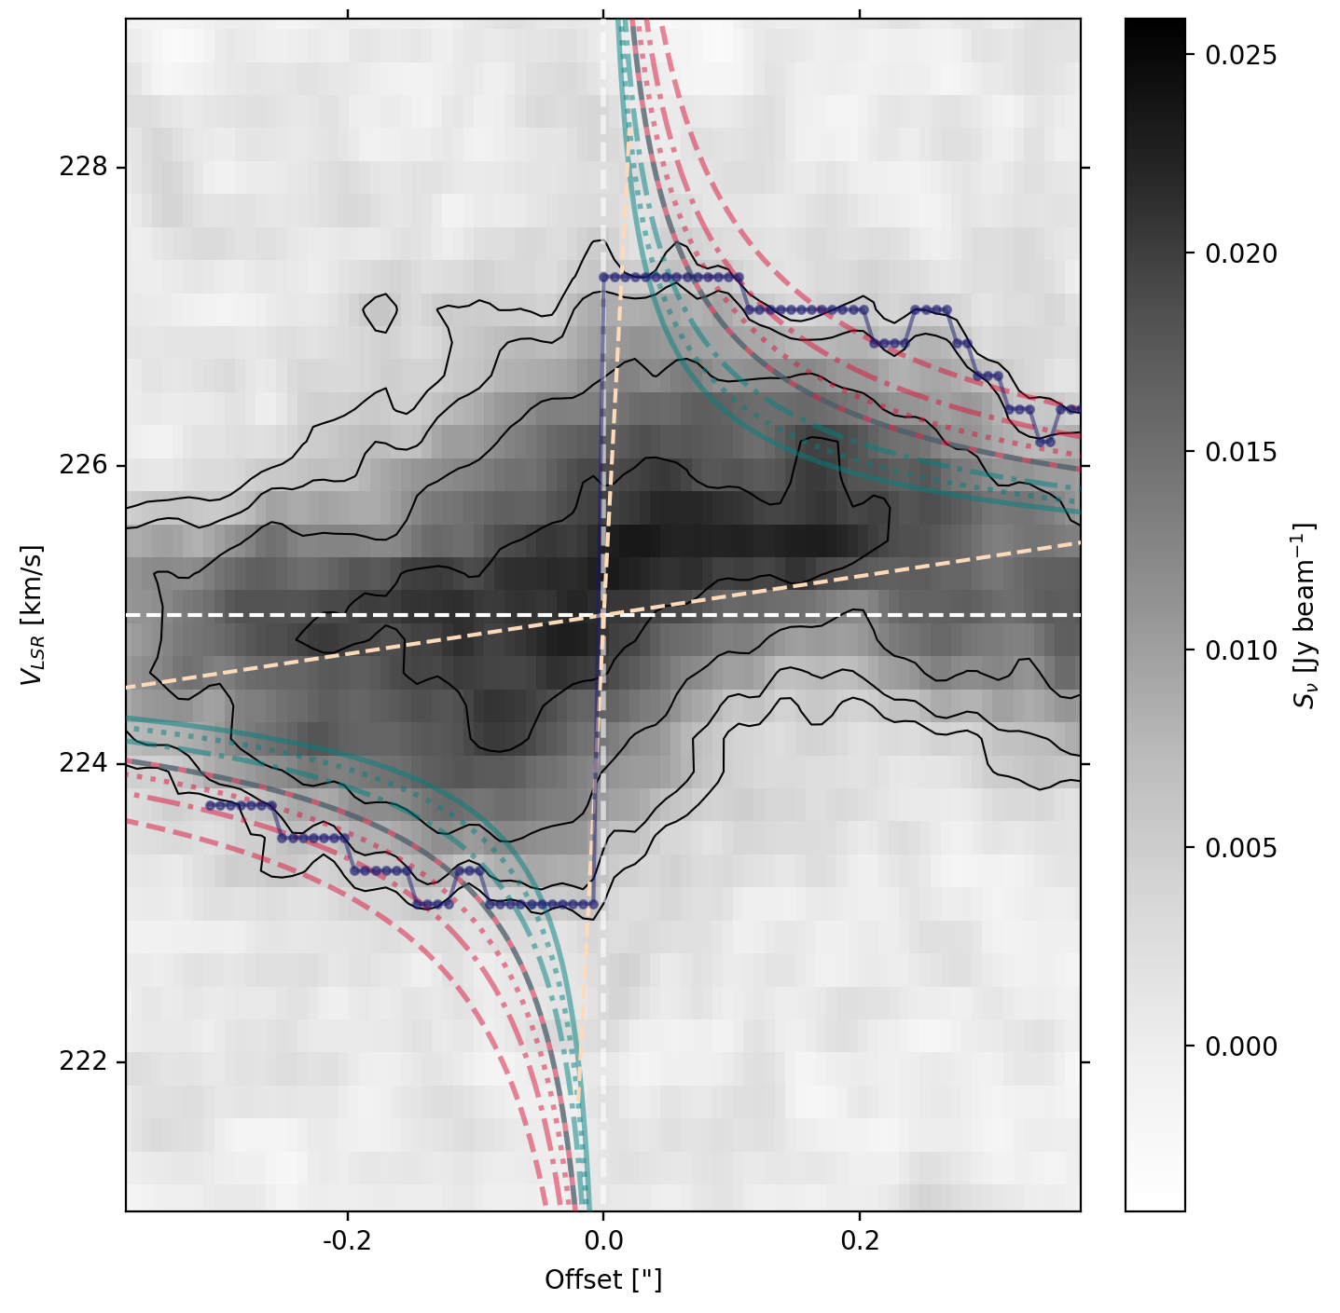
Kinematics broadly consistent with a combination of Keplerian rotation and free-fall
CS
¹³CO
McLeod+24, Nature

Slide 18
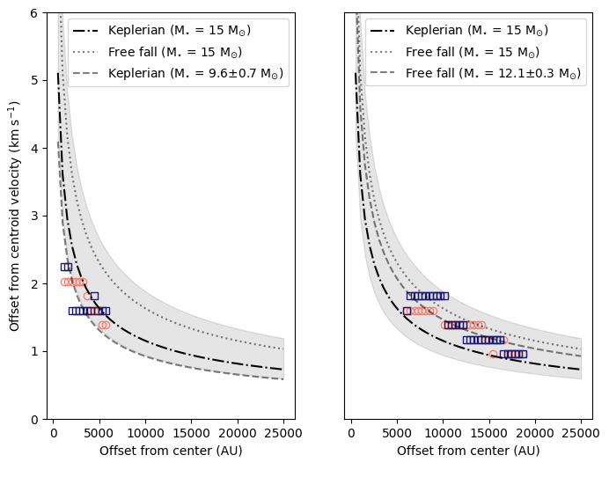
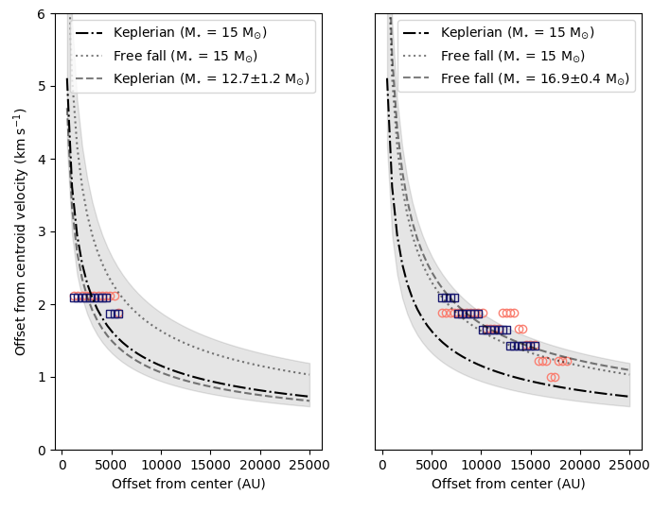
Matter is flowing from larger scales onto “inner” (R<6k AU) disk-like structure
Most likely Keplerian disks around B-type stars: R_{disk} 360 – 3600 AU
~ 6000 AU
CS
McLeod+24, Nature
¹³CO

Slide 19
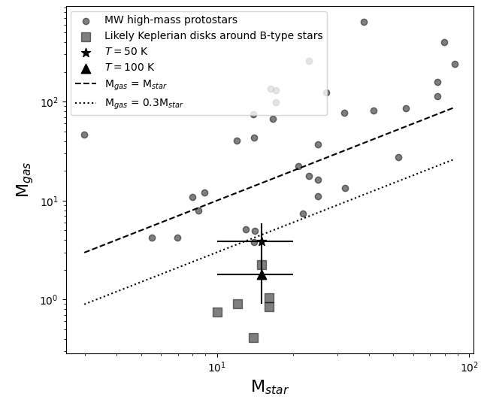
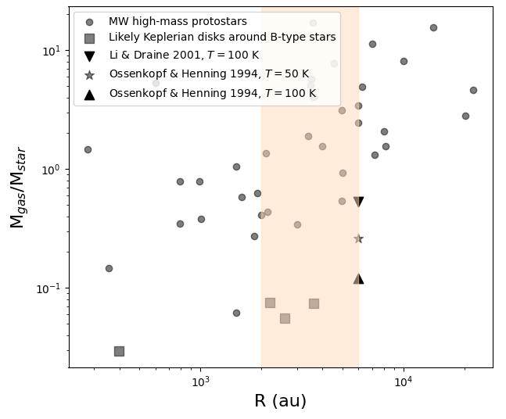
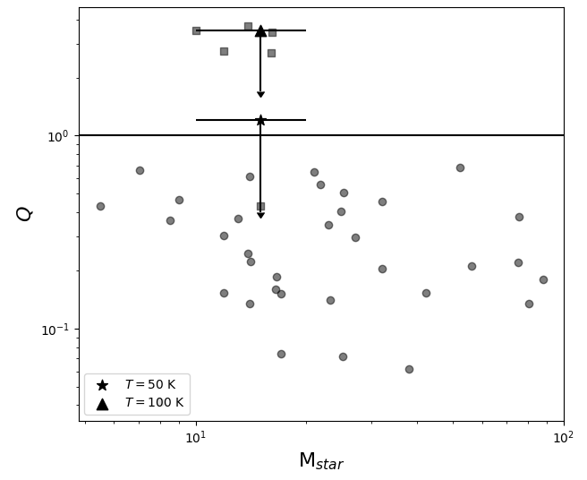
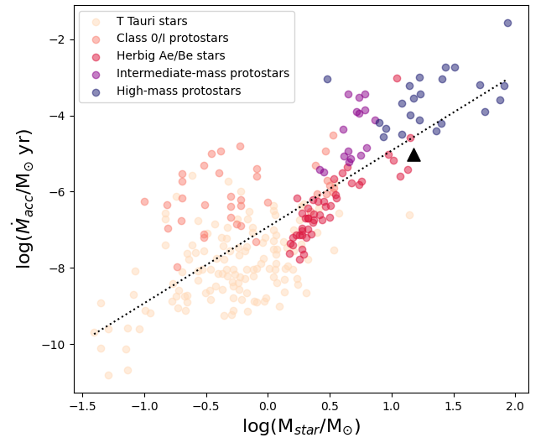
HH 1177 is comparable to MW counterparts in MOST aspects…
…BUT it is optically revealed…
(when we would expect it to be embedded)
“optically revealed accreting MYSOs are not known” (Beltrán & de Wit 2016)
…AND it is surprisingly stable
(when we would expect it to be marginally stable compared to MW counterparts, Tanaka+14, Fukushima+2020)
McLeod+24, Nature
Adapted from Beltrán & de Wit 2016

Slide 20
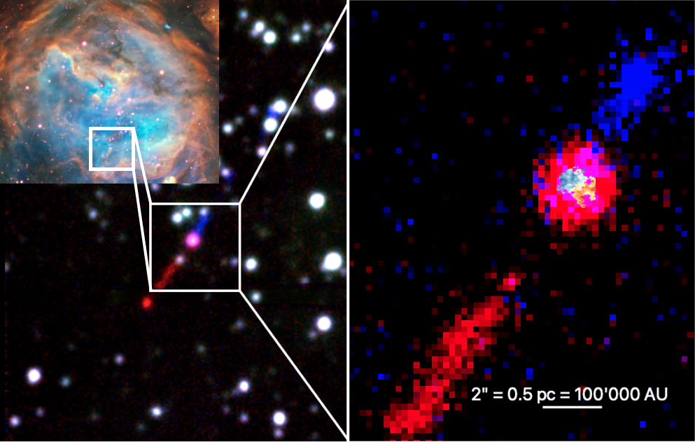
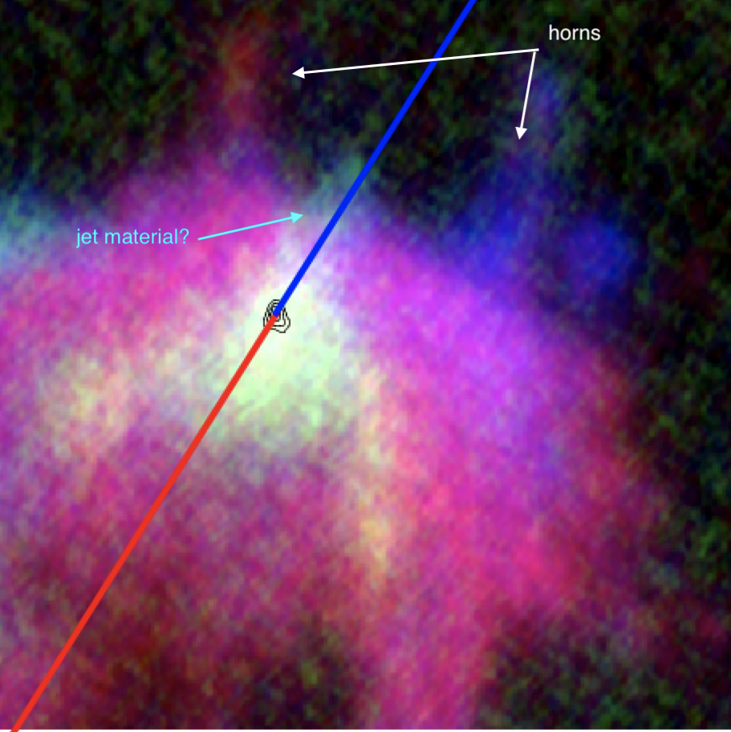
Optical MUSE data
ALMA continuum + lines
Radial flow from larger scales onto central, stable, likely Keplerian disk
Environmental properties matter, how do they affect accretion and YSO growth?
HH 1177 is but the first of many new empirical anchors for massive SF studies
HH 1177 star + jet system in massive LMC HII region
¹²CO traces the outflow and entrained matter (Klaassen+in prep)
Enhanced external + internal feedback exposed the system
and illuminates the jet

Slide 21
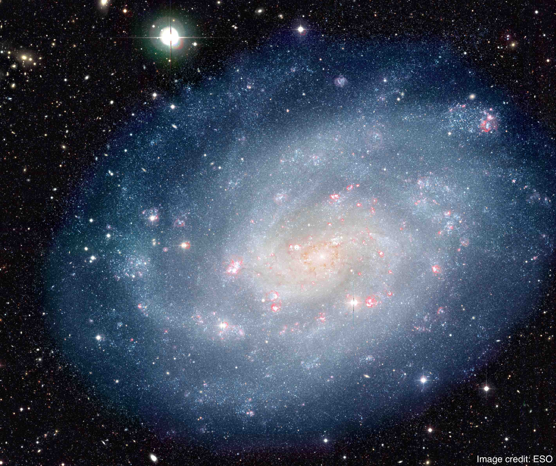
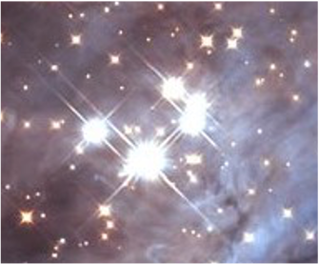
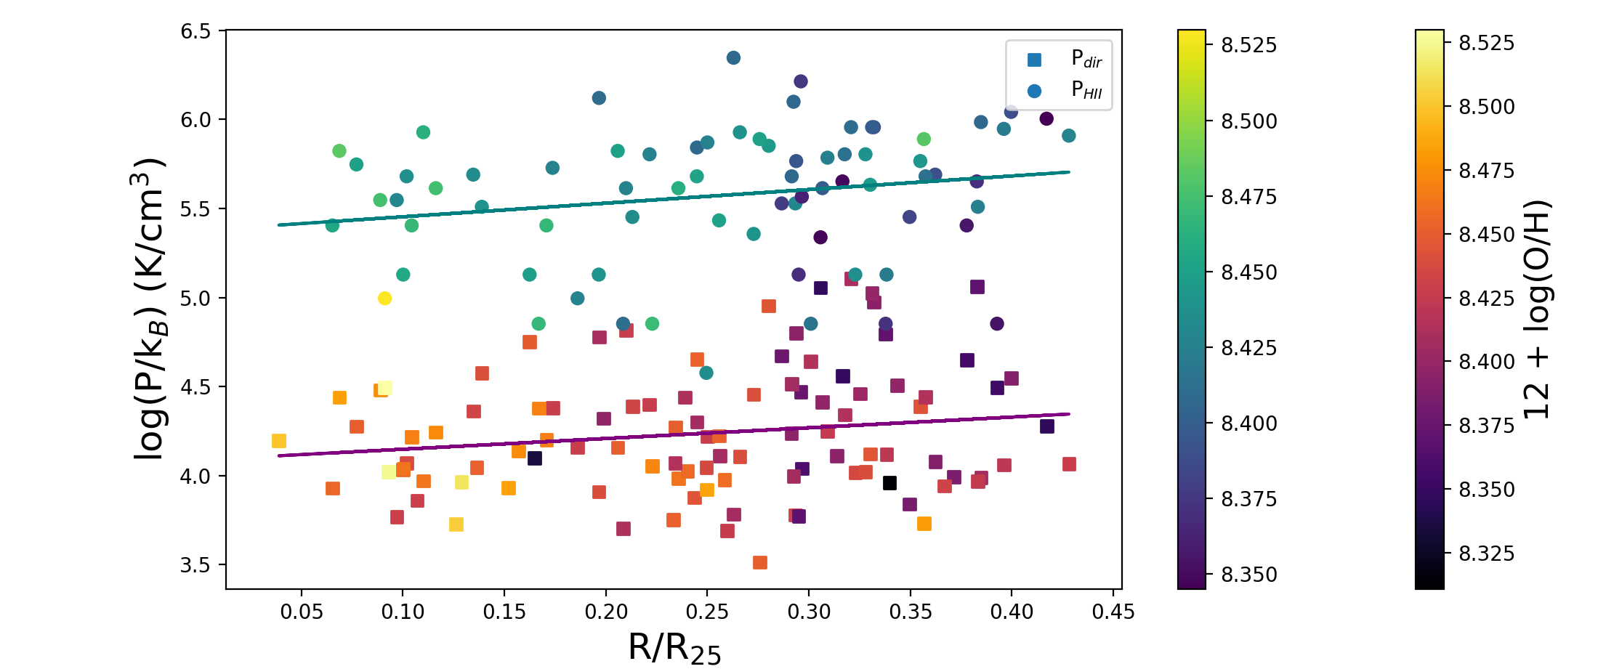
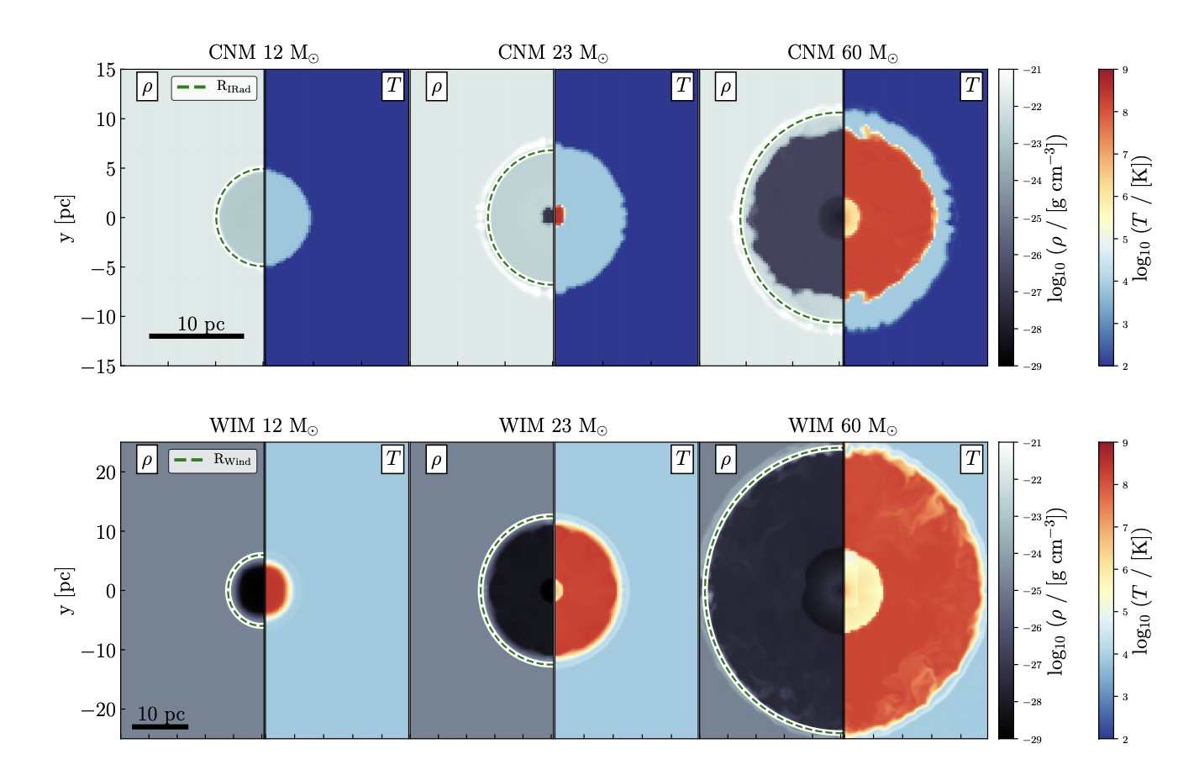
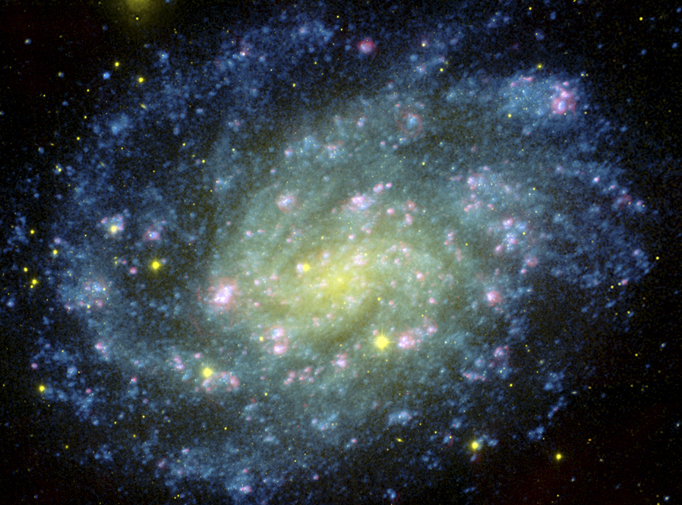
How does the environment affect (massive) star formation and stellar feedback?
↳ e.g., metallicity, dust content, temperature, density, host galaxy properties, etc.
See Marco’s talk about galactic abundance gradients, and Rob’s talk about simulations
few pc
10s-100s pc
kpc
HII regions in NGC 300
McLeod+20,21
Studying (massive) star (and planet) formation outside of the MW is hard
Pressure in HII regions
star in cold neutral medium
Different impact of stellar winds and radiation
star in warm ionized medium
Galactocentric distance
Haid+18

Slide 22
In summary: HH 1177 won’t be the only extragalactic empirical benchmark for long
We are in the era of extragalactic YSO accretion disks, enabling a broader range of environments (e.g., low metallicities)
SINFONI (e.g., Ward+17)
ERIS, JWST
Cores/outflows with ALMA in the LMC/SMC (Tokuda+22, Shimonishi, Hamedani Golshan)
Link with outer parts of MW
Link with early Universe

Slide 24
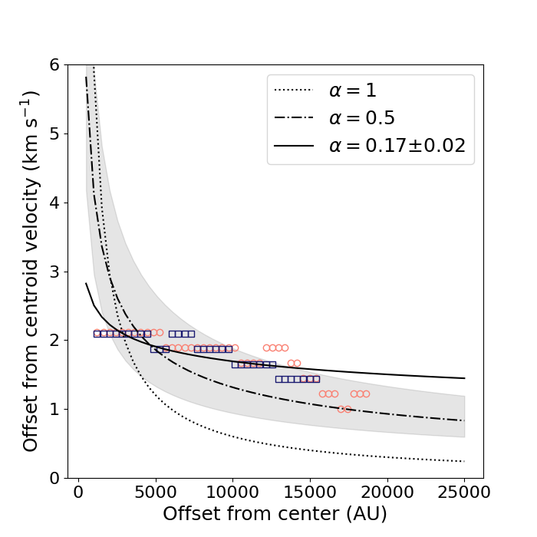
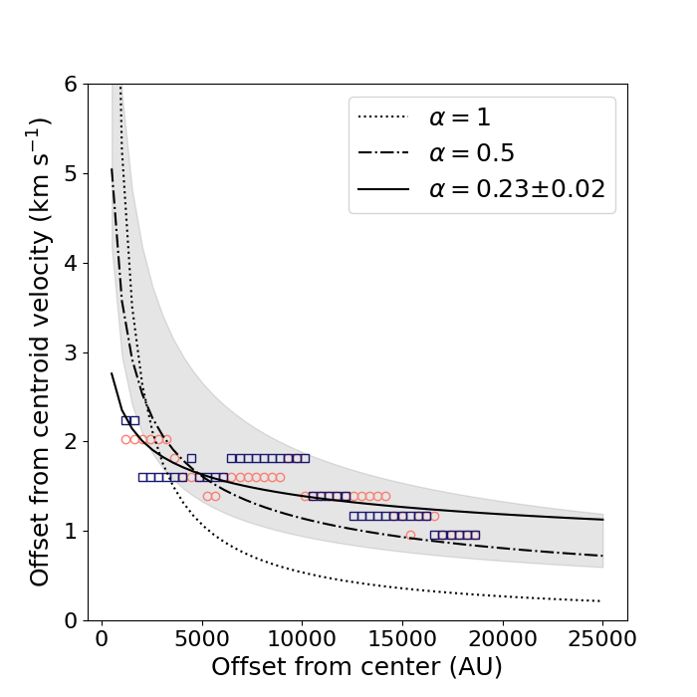
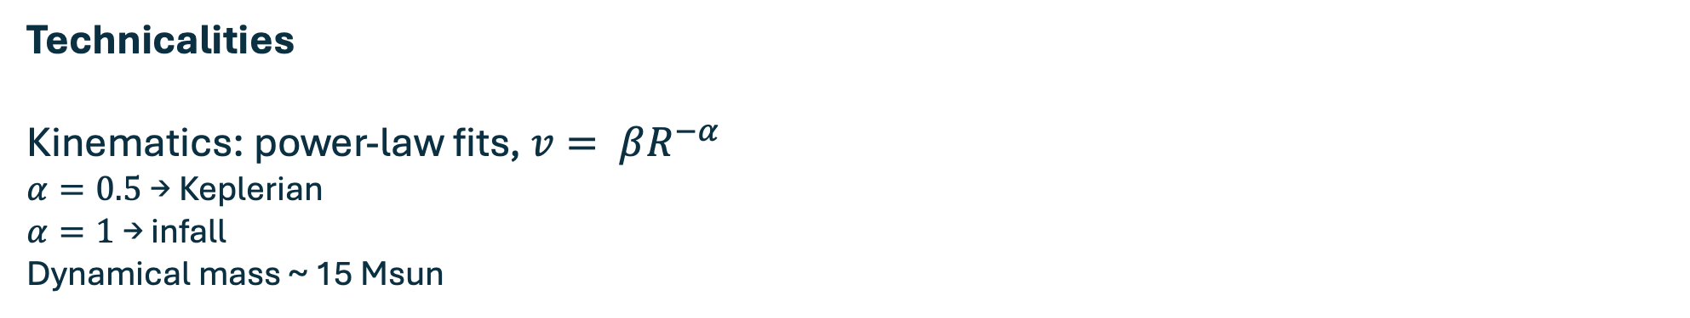
Technicalities
Kinematics: power-law fits, $v= βR^{−α}$
$α=0.5$→ Keplerian
$α=1$ → infall
Dynamical mass ~ 15 Msun

Slide 25
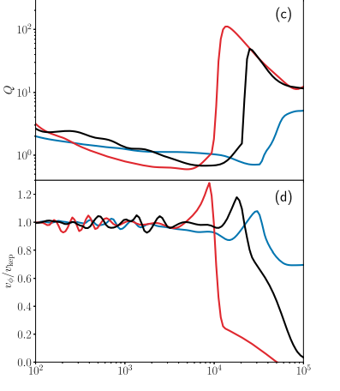
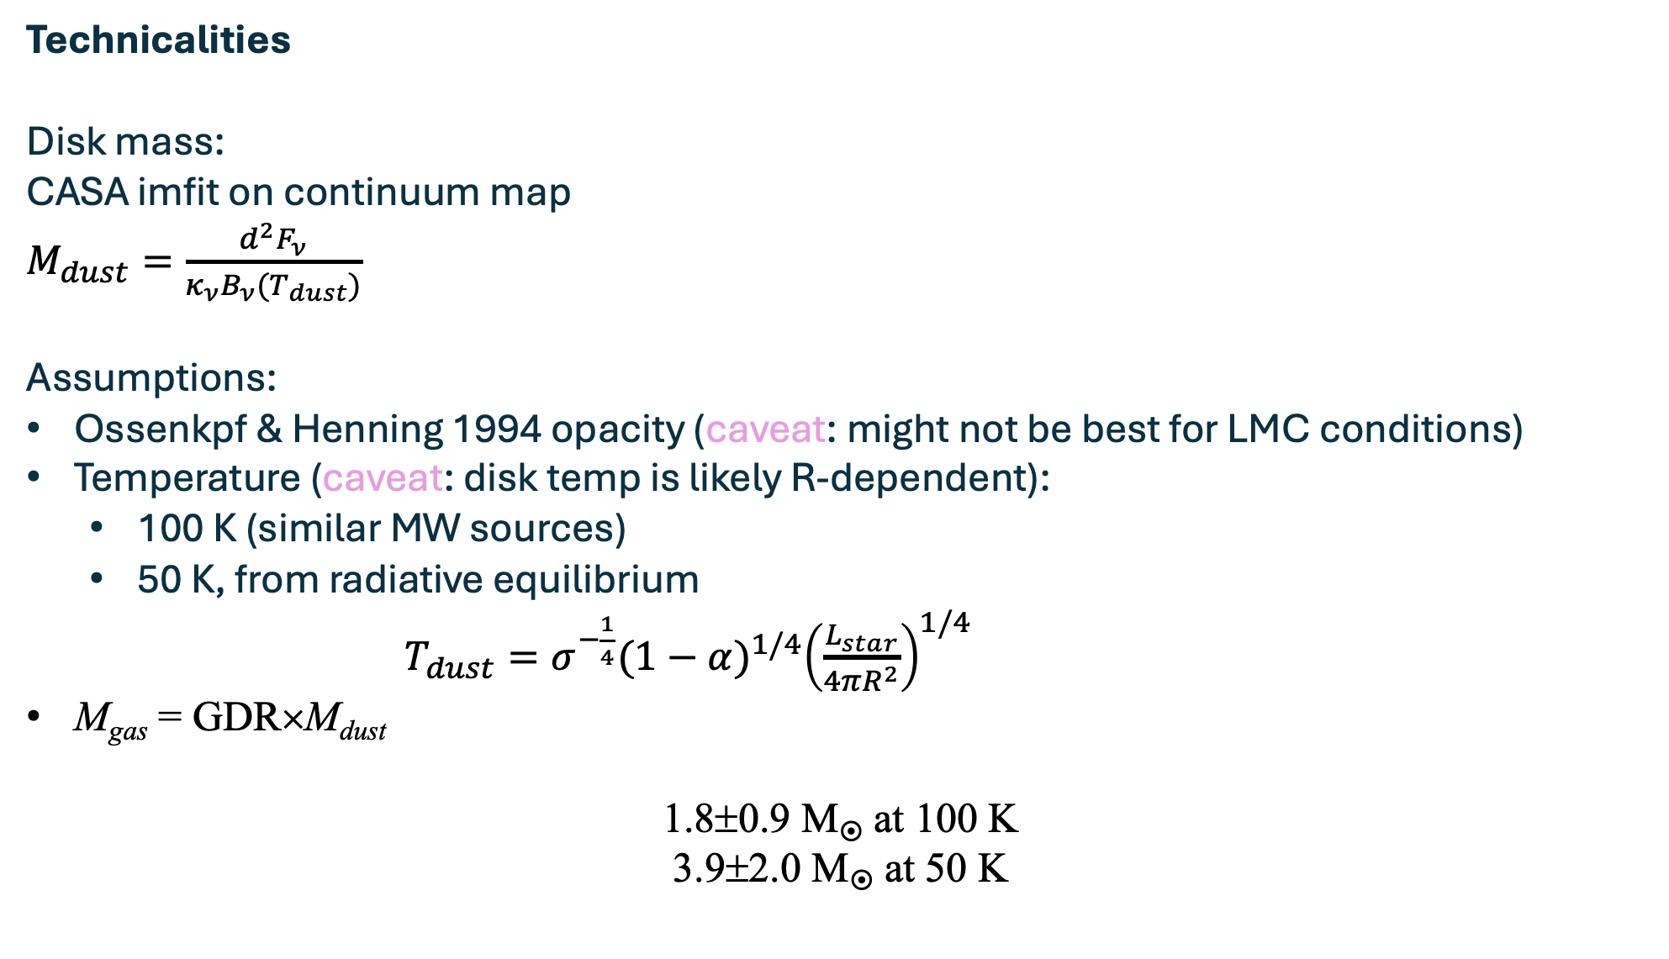
Technicalities
Disk mass:
CASA imfit on continuum map
$M_{dust}=\frac{d^{2}F_{ν}}{κ_{ν}B_{ν}{(T}_{dust})}$
Assumptions:
Ossenkpf & Henning 1994 opacity (caveat: might not be best for LMC conditions)
Temperature (caveat: disk temp is likely R-dependent):
  100 K (similar MW sources)
  50 K, from radiative equilibrium
  $T_{dust}=σ^{−\frac{1}{4}}{(1−α)}^{1/4}{\left(\frac{L_{star}}{4πR^{2}}\right)}^{1/4}$
M_{gas} = GDR×M_{dust}
1.8±0.9 M at 100 K
3.9±2.0 M at 50 K

Slide 26
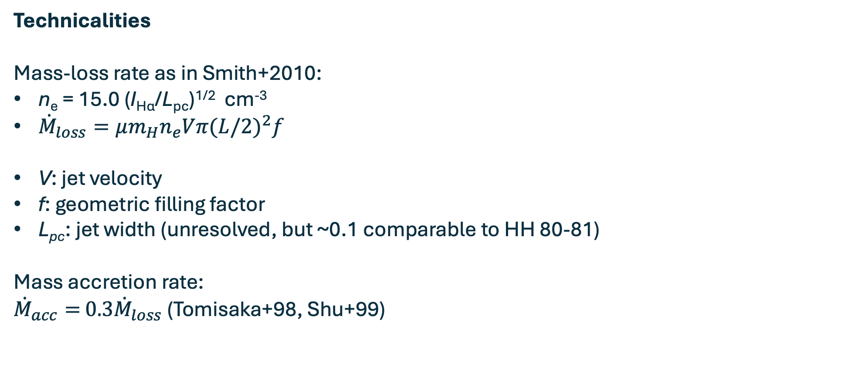
Technicalities
Mass-loss rate as in Smith+2010:
n_{e} = 15.0 (I_{Hα}/L_{pc})^{1/2} cm⁻³
${\dot{M}}_{loss}=μm_{H}n_{e}Vπ{(L/2)}^{2}f$
V: jet velocity
f: geometric filling factor
L_{pc}: jet width (unresolved, but ~0.1 comparable to HH 80-81)
Mass accretion rate:
${\dot{M}}_{acc}=$ ${0.3\dot{M}}_{loss}$ (Tomisaka+98, Shu+99)

Slide 27
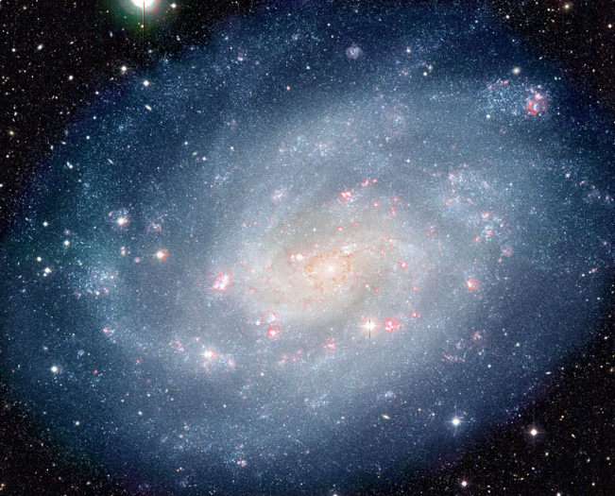
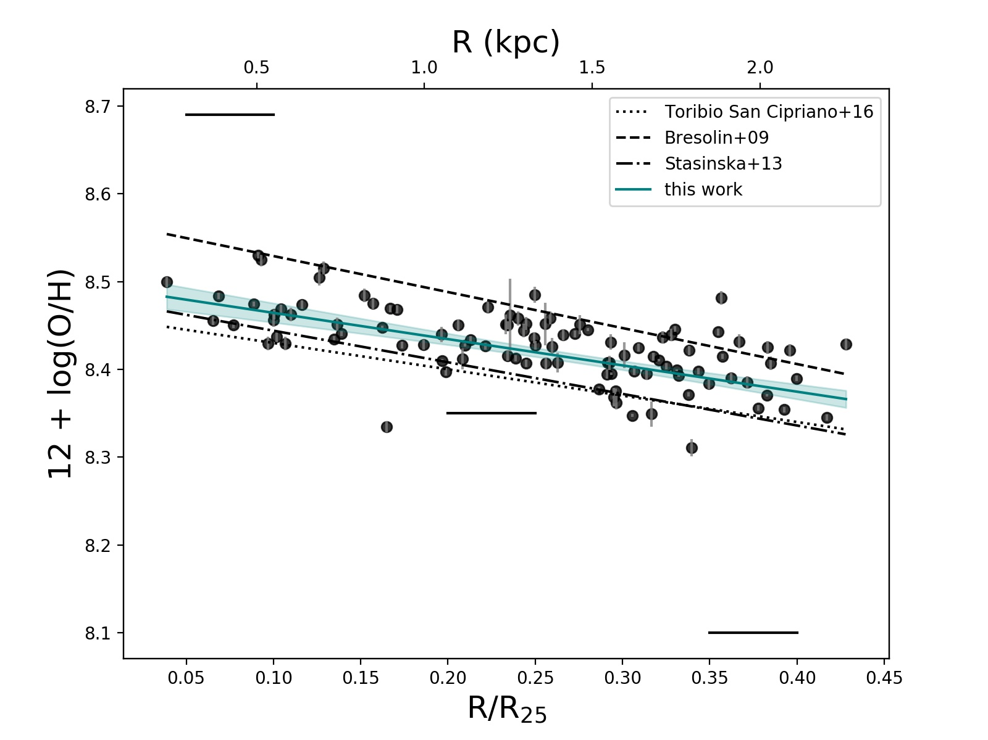
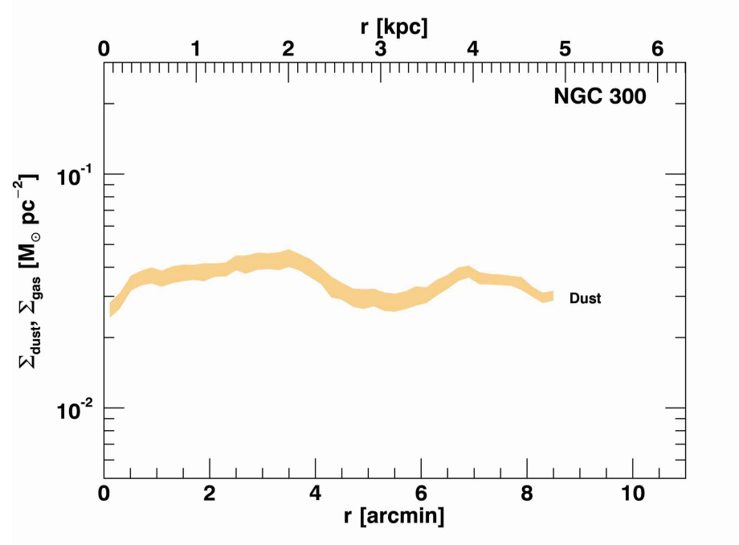
The case of NGC 300: a negative metallicity with a positive dust gradient
NGC 300
MUSE mosaic
~ 0.4 R₂₅
1’ = 550 pc
McLeod+21
Casasola+17
DustPedia
In NGC 300, pre-SN feedback increases with galactocentric distance (increase in the dust mass surface density and higher ionizing photon fluxes) -> environment matters!

Slide 28
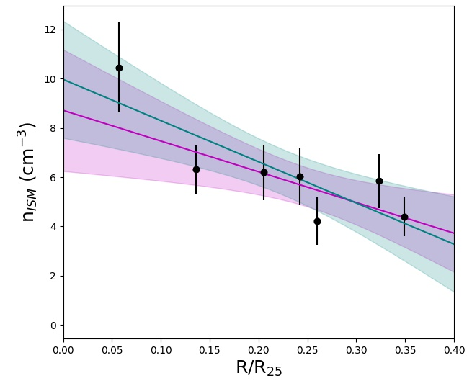
What does this mean in terms of pre- and SN feedback?
Early, pre-SN stellar feedback affects the conditions into which SNe will feed back into
➔ where stellar feedback in enhanced, SNe explode into lower-density environments, changing the overall effect of SNe on galactic scales
➔ in agreement with models (Geen+2015, Lucas+2020)
1’ = 550 pc
McLeod+21

