Slide 1
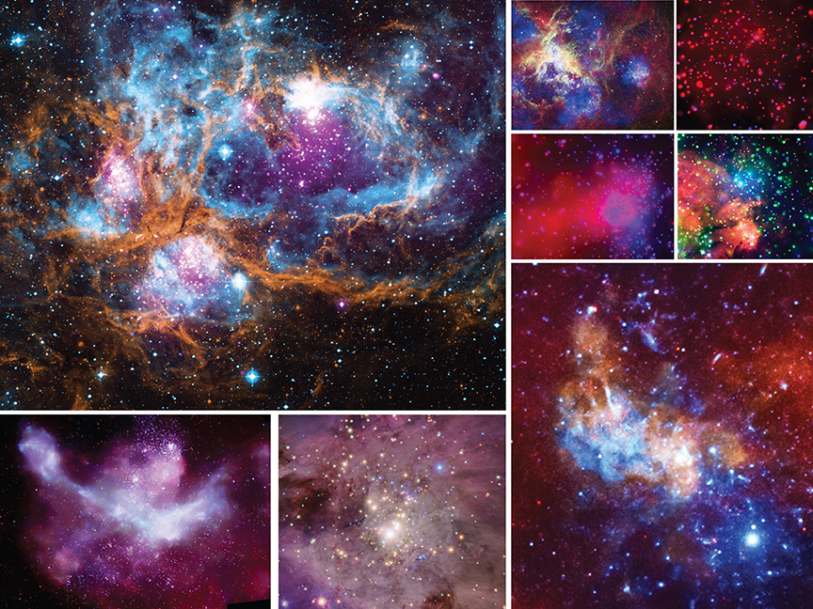
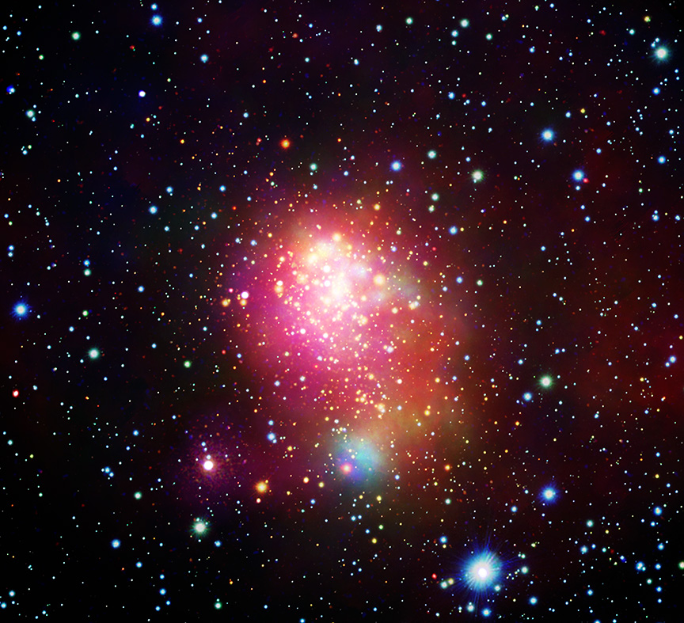
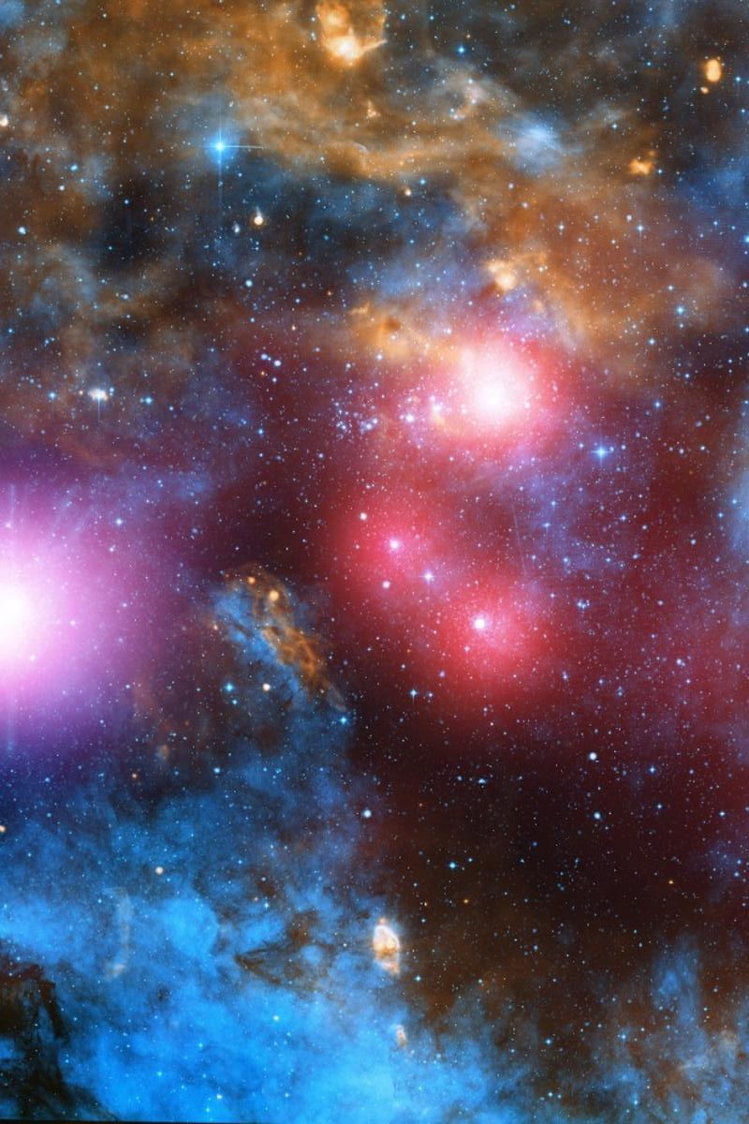
X-ray observations of massive star clusters
Mario Giuseppe Guarcello – INAF Osservatorio Astronomico di Palermo
AND THE EWOCS COLLABORATION

Slide 2
OUTLINE:
X-ray emitters in massive young clusters
Existing X-ray surveys of massive young clusters

Slide 3
What are the X-ray emitters in young massive stars clusters?

Slide 4
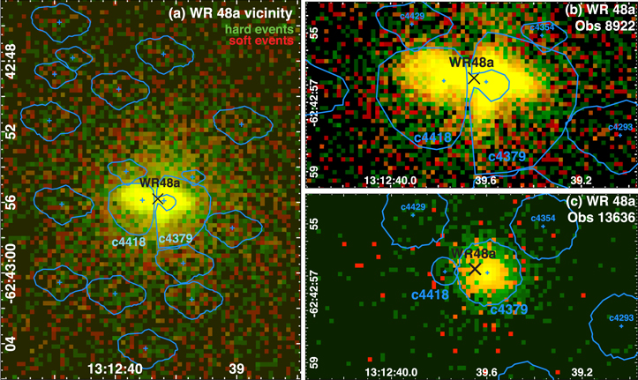
X-rays from massive stars
Single OB stars: L_{x} 10³¹ – 10³³ erg/s
OB+OB, OB+WR: L_{x} 10³² – 10³⁵ erg/s
Mechanisms:
Self-shocked stellar wind
Colliding wind binaries
Magnetically confined wind shock
Chandra/ACIS image of CWB WR 48a (WC8+WN8h, Zhekov+2014). The black cross marks the nominal position of the system (Davies+2012). Sources from Townsley+2019

Slide 5
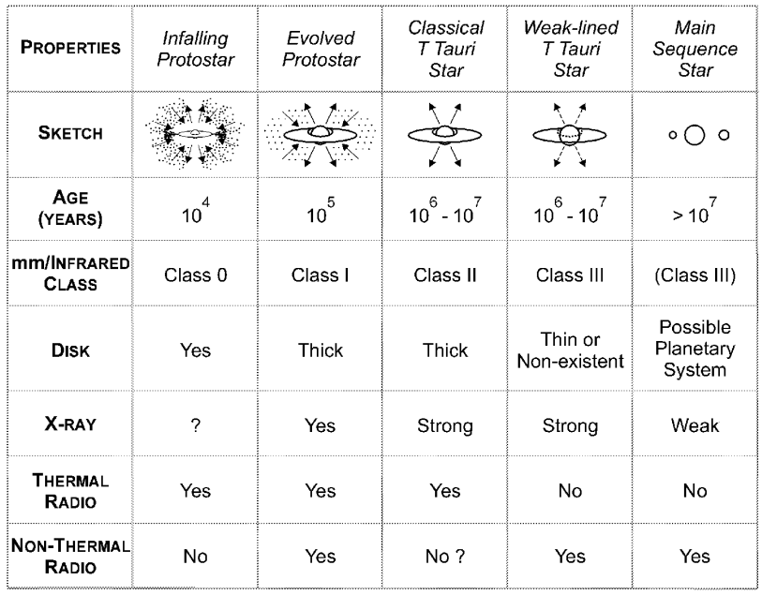
X-rays from low-mass pre-main sequence stars
PMS stars are thousand of times brighter than older stars with similar masses
Only quiescence: 10²⁸ – 10³¹ erg/s
Emission mainly from multi-temperature stellar coronae and solar-type flaring activity (e.g. Montmerle+1991)
Activity sustained by convection-driven dynamo, more efficient in generating strong magnetic fields
Class I protostars detected in X-rays, even with very intense events--e.g. YLW 15 protostar, flare with Lx 10³³-10³⁵ erg/s (Grosso+1997)
Stages of low-mass young stellar evolution
(Feigelson & Montmerle 1999)

Slide 6
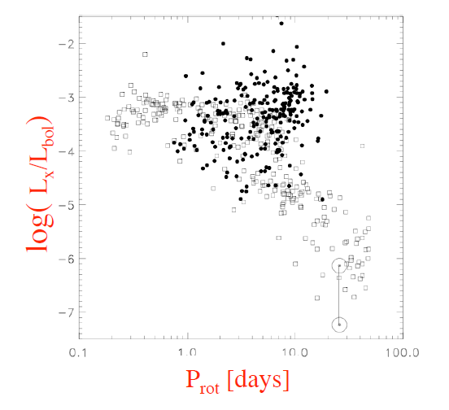
X-ray emission and stellar properties in PMS stars
In PMS stars, L_{X} correlates with stellar mass, Teff, stellar radius, rotation (Getman+2023)
Saturated regime
Lx vs. mass in 16011 PMS (7-25 Myrs) stars. Color coding according to evolutionary stage. Black curves: spline fits to 25%, 50%, 75% quartiles. (Getman+2022)
Lx/Lbol vs. Prot. for ONC PMS stars (solid dots), MS stars (open squares) and the Sun (Preibisch+2005)

Slide 7
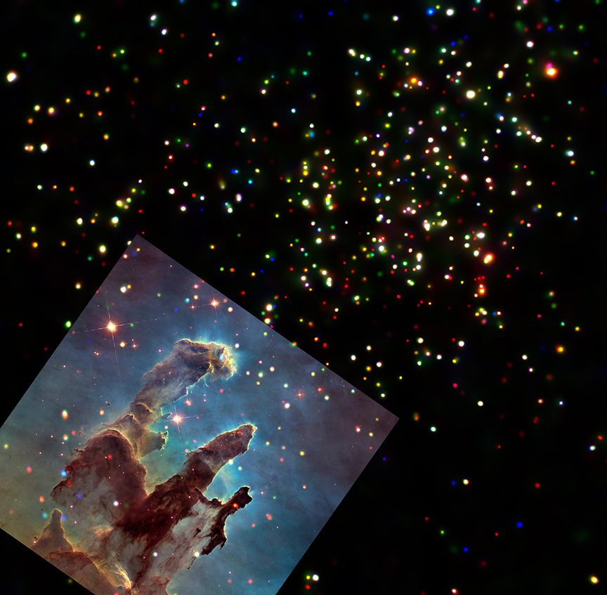
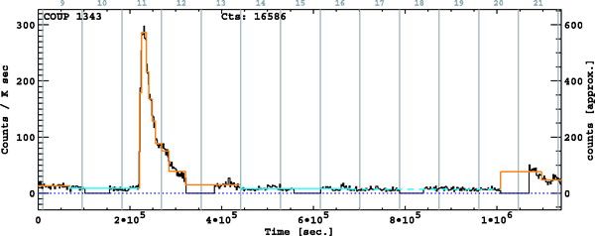
X-ray flaring activity in PMS stars
Episodic large flares are typical of PMS stars
Superflares have peak L_{x}=10³¹—10³³ erg/s and total irradiated energy E_{x}=10³⁴ – 10³⁸ erg/s
(Getman & Feigelson 2021)
A flare with the time evolution of the emitting plasma in a PMS star in Orion (Favata+2005)
X-ray sources in the Eagle Nebula M16 NASA press release; Guarcello+2012

Slide 8
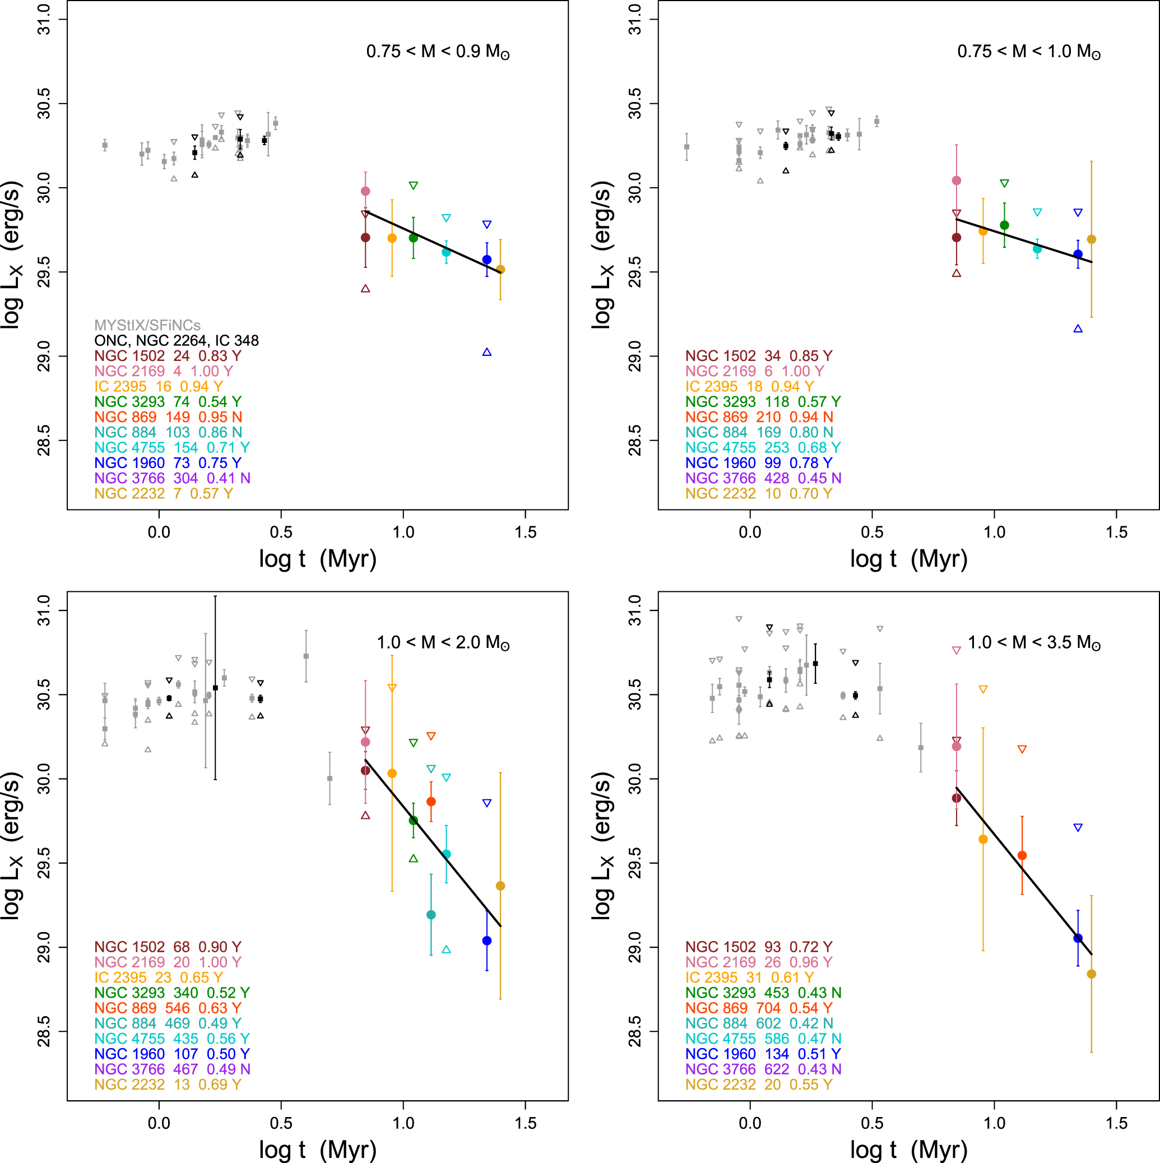
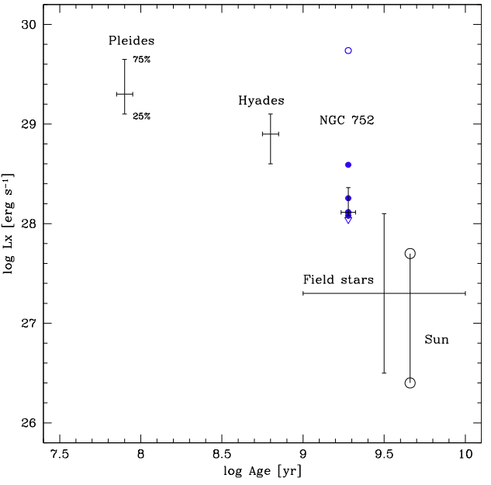
Time evolution of X-ray activity in PMS stars
Lx declines with age, with a rate that depends on stellar mass (Argiroffi+2015, Getman+2022)
Causes: spin down, evolution of internal structure, changes of dynamo…
PMS stars (Getman+2022)
From the Pleiades to the Sun (Giardino+2008)

Slide 9
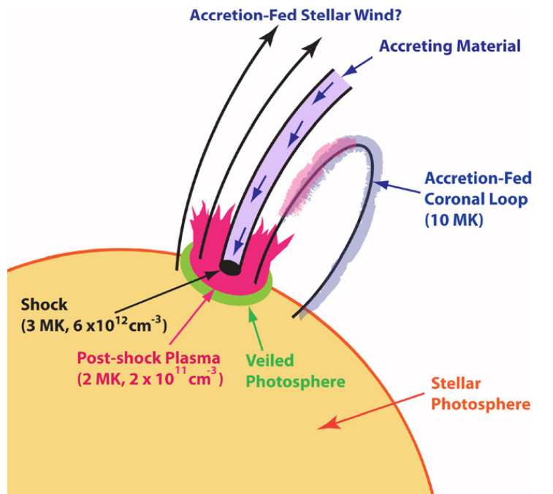
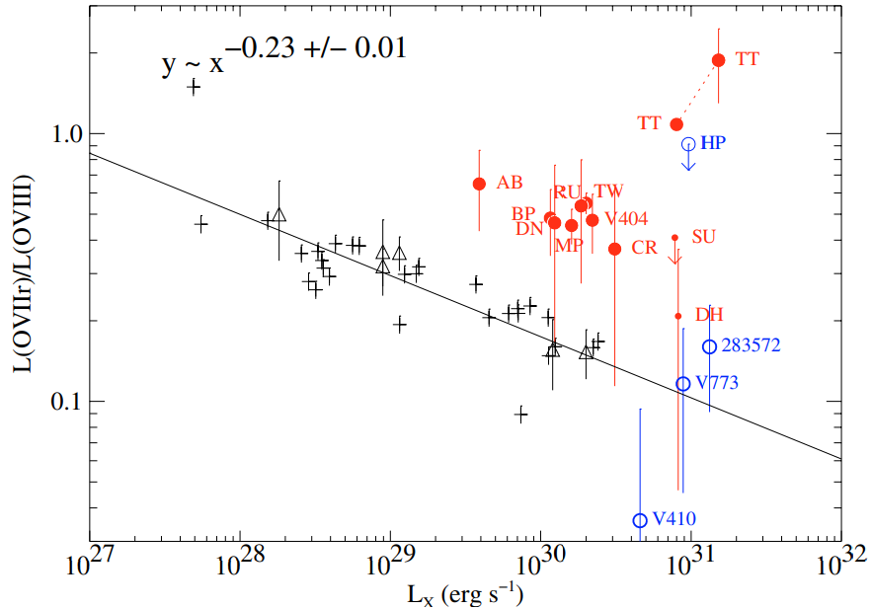
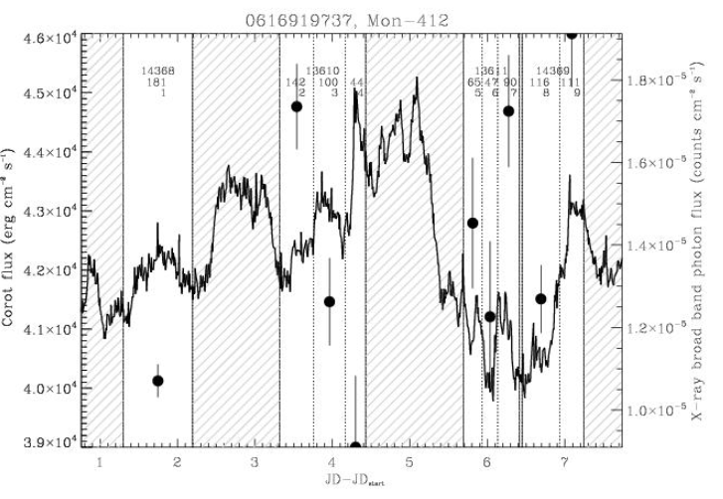
X-rays and protoplanetary discs
(a)
(b)
Accreting PMS stars are more variable than non-accreting, mainly because of time-variable absorption (Flaccomio+2012).
Accretion hot spots in stellar surface produces soft X-ray emission kT<0.5 keV (Gudel+2007)
Magnetic loops connecting star and discs suggested (Favata+2005), but very long loops also observed in disc-less PMS stars (Getman+2021).
Gudel&Telleschi2007
Brickhouse+2010
Guarcello+2017
(a) A model of accretion shock in a PMS star.
(b) Evidence for soft X-ray emission in excess in accreting PMS stars from the O VII/O VIII ratio
(c) Rapid X-ray variability in a PMS star with variable absorption
(c)

Slide 10
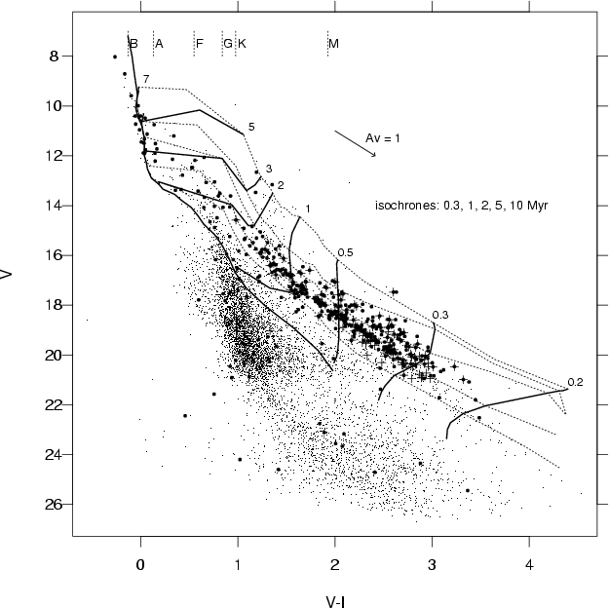
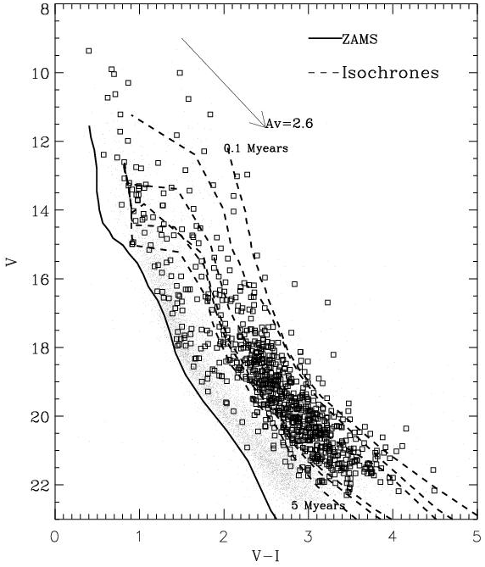
X-ray as membership criterion
The higher level of X-ray emission in PMS stars compared with evolved stars provides an efficient method to select stars associated with young clusters.
This was extremely powerful for cluster science in the pre-Gaia era.
V vs. V-I diagrams of the clusters NGC2363 (left, 5 Myrs) and NGC6611 (right, 1-2 Myrs), with marked the sources with X-ray counterparts (Damiani+2006, Guarcello+2010)

Slide 11
Existing surveys of young massive clusters

Slide 12
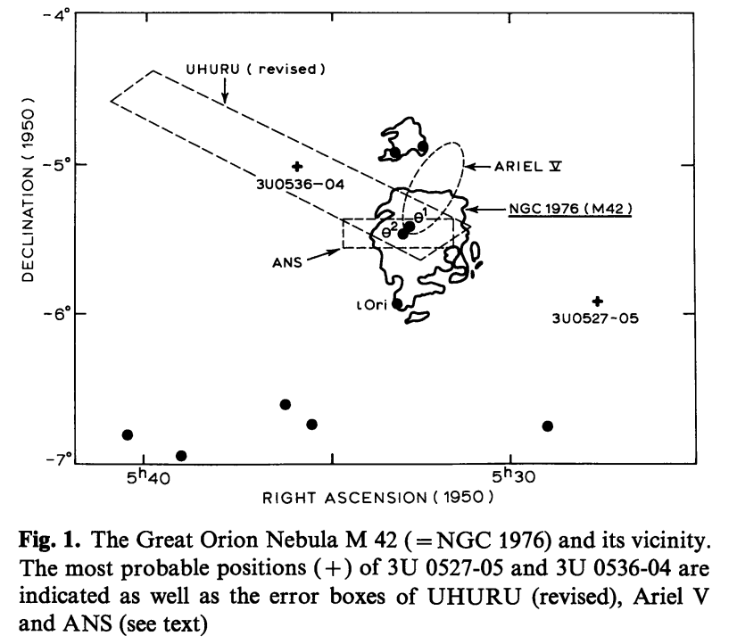
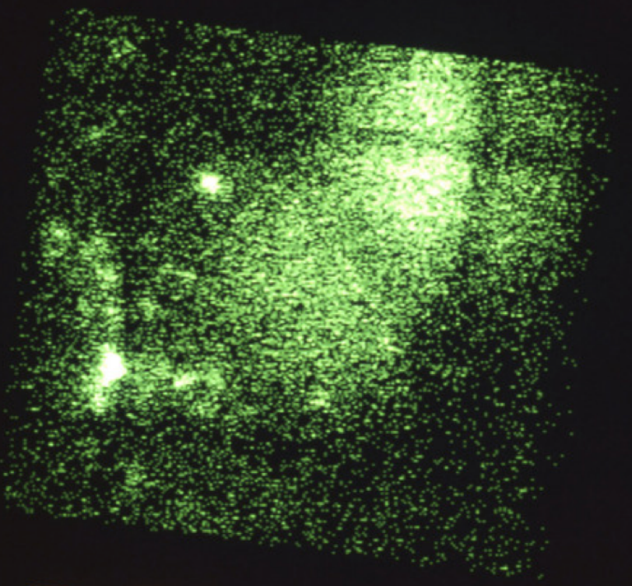
Just a bit of history…
First X-ray observations of the Orion Nebula Cluster by UHURU, ANS, and the Einstein Observatory
First observations of nearby young clusters discovered that PMS are X-ray bright and strongly variable
M42 was recognized as an X-ray source from UHURU (Giacconi & Gursky 1974) and the Astronomical Netherlands Satellite (den Boggende+1978)
Einstein Observatory image of M42. 245 X-ray sources detected with Lx=10³⁰ – 10³² erg/s, among which 10 O6-B5 stars (Gagnè & Caillault 1994)

Slide 13
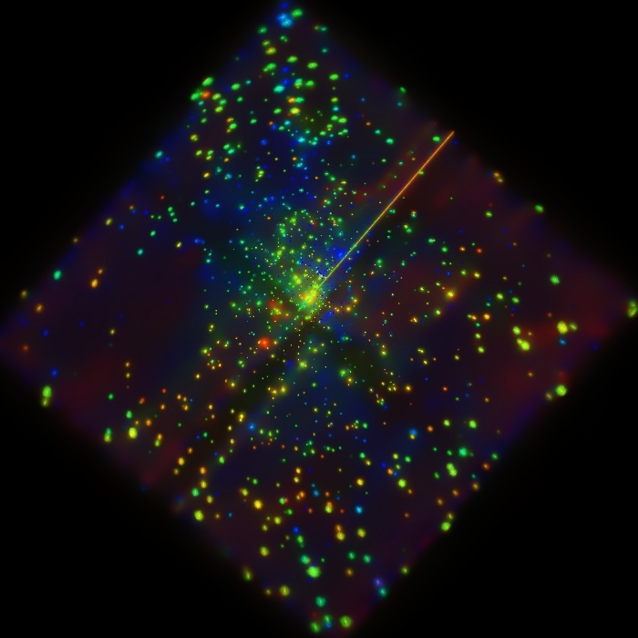
THE CHANDRA ORION ULTRADEEP PROJECT
850 ksec Chandra/ACIS-I observation of the ONC (Jan. 2023).
1616 X-ray sources, 1522 in the broad band, 1315 confirmed ONC members (Getman+2005)
Even 143 proplyds detected (Kastner+2005)
Almost 100% complete! COUP provided a template for all of our following Chandra studies of less well-known and more distant SFRs.
COUP image of the ONC. Red: 0.2-1 keV; green: 1-2 keV; blue: 2—8 keV

Slide 14
TIME VARIABILITY OF COUP SOURCES
Most of COUP source are highly variable. Rotational modulation observed in 23/233 stars supporting not uniform distribution of coronal active regions (Flaccomio+2005)
32 flares modelled with 5-20 Rstar long loops and plasma temperature > 100 MK (Favata+2005)
In general, COUP unveiled most of the connections between X-ray activity and stellar properties

Slide 15
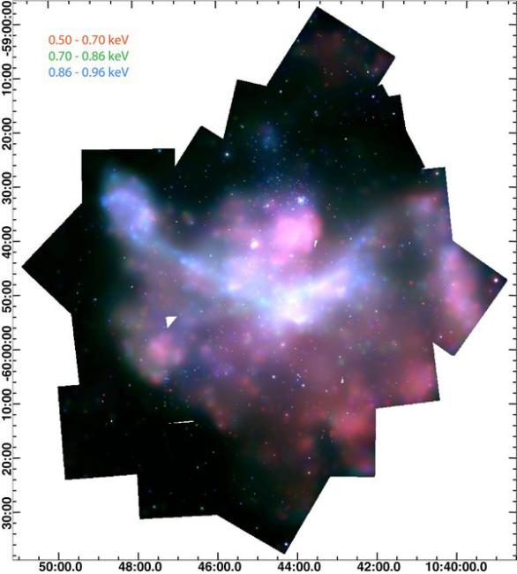
THE CHANDRA CARINA COMPLEX PROJECT
Trumpler15
Motivations: an X-ray survey of the massive star-forming complex of the Carina Nebula (2.3 kpc)
The region hosts a rich and variegate stellar population and compact objects (Hamaguchi+2009)
Carina is one of the closest analogs of Giant Extragalactic H II regions
Survey: 38 Observations (2008), 1.42 square degrees, 1.2Msec observation (Townsley+2011)
Eta Carinae
Trumpler14
WR22
NS
WR25
WR24
Trumpler16
RGB X-ray mosaic of the Carina Nebula.

Slide 16
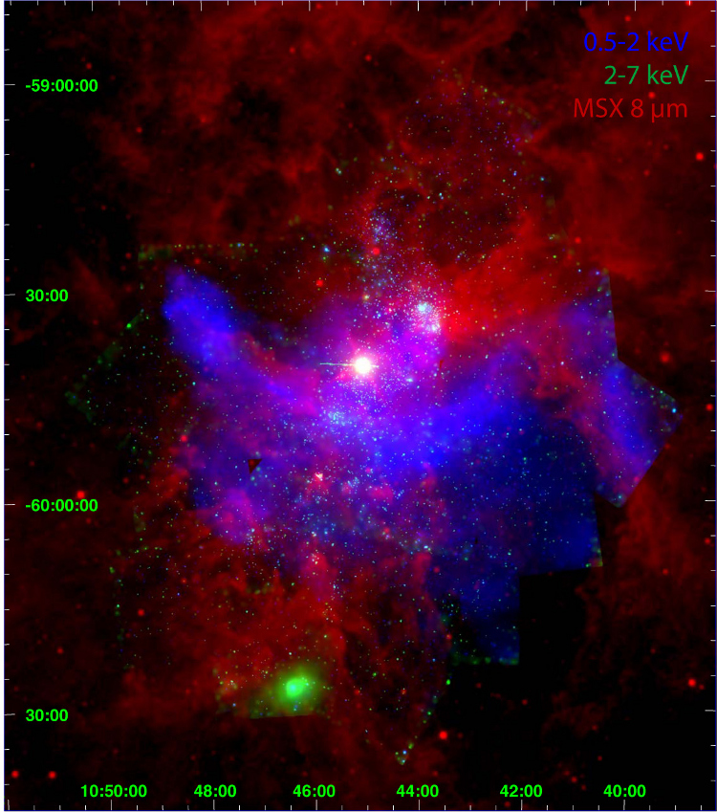
THE CHANDRA CARINA COMPLEX PROJECT
14369 X-ray sources, 10714 Carina members (5457 clusters, 5271 distributed), 10%-20% of the whole population (Broos+2011)
Compact (Tr14), clumpy (Tr16) and sparse (Col228) clusters (Feigelson+2011, Wang+2011, Wolk+2011)
200+ known OB stars, 3 WRs, 1 (+6 ?) NSs (Gagnè+2011, Nazè+2011, Povich+2011)
Soft diffuse emission: produced by stellar winds and SN, filled the dust cavity with 4-7 MK hot plasma. Total Lx=3×10³⁵ erg/s (Townsely+2011)

Slide 17
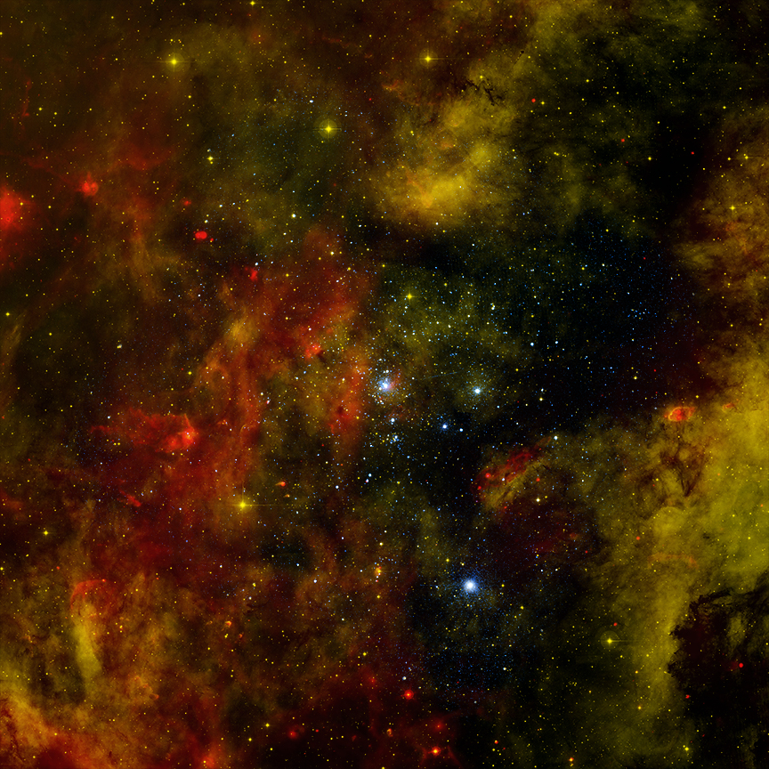
THE CHANDRA CYGNUS OB2 SURVEY
Motivations: an X-ray survey of the closest very massive OB association (1.4 kpc)
Survey: 36 ACIS-I pointings (30 ksec each) designed to provide uniform sensitivity in the central region (Wright+2023). Total 1.08 Msec observation (Drake+2016)
7924 X-ray sources, 6100 members, estimated completeness 90% at 1 solar mass (Wright+2023, Flaccomio+2023, Kashyap+2023)
Bright
rimmed clouds
WR146
CygOB2
Globule2
WR144
DR18
proplyds
Cygnus X3
proplyds
WR145
CygnusOB2; red: [8.0], green: Hα, blue: X-rays

Slide 18
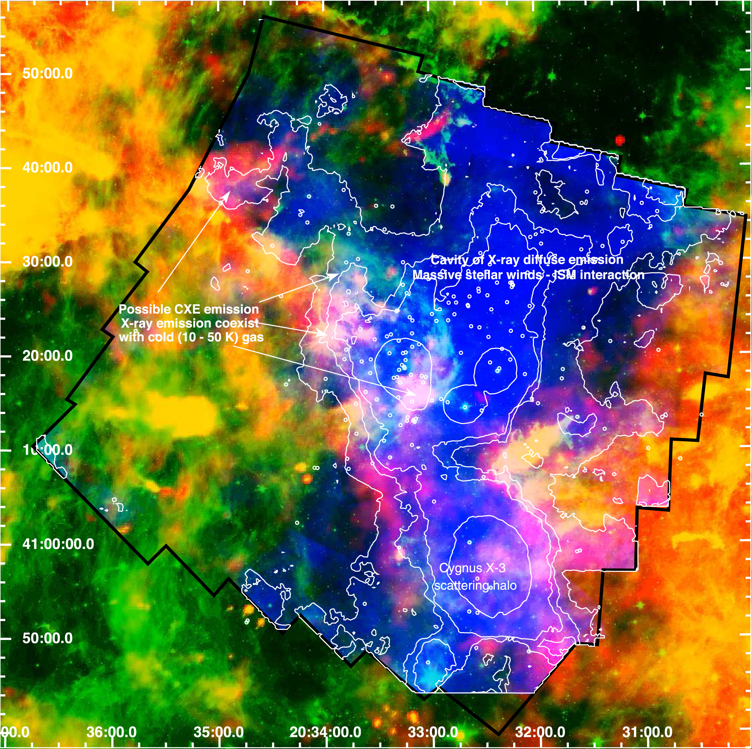
THE CHANDRA CYGNUS OB2 SURVEY
Completeness and uniformity allowed to test the effects of the environment on the dispersal of protoplanetary discs (Guarcello+2023, Winter+2019)
Diffuse emission with Lx=4×10³⁴ erg/s.
Three components with kT=0.11, 0.4, 1.18 keV. Produced by massive stars, shock against ISM.
Possible CXE emission
RGB image. Red: Herschel 500 µm (cold gas), green: [8.0], blue: diffuse X-ray emission.
Arrows indicate possible sites of CXE emission (coexistence of 10 K cold gas and hot diffuse X-rays. (Albacete-Colombo+2023)

Slide 19
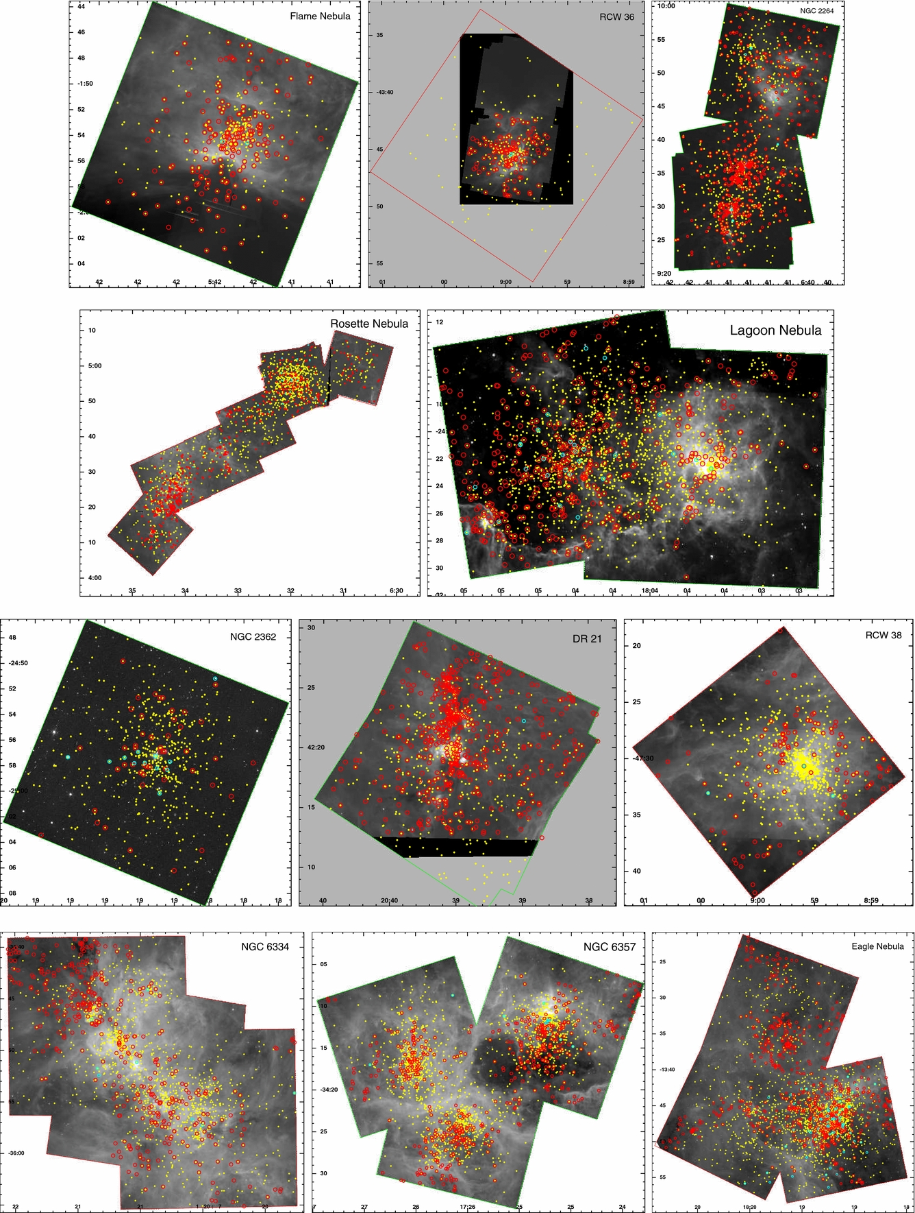
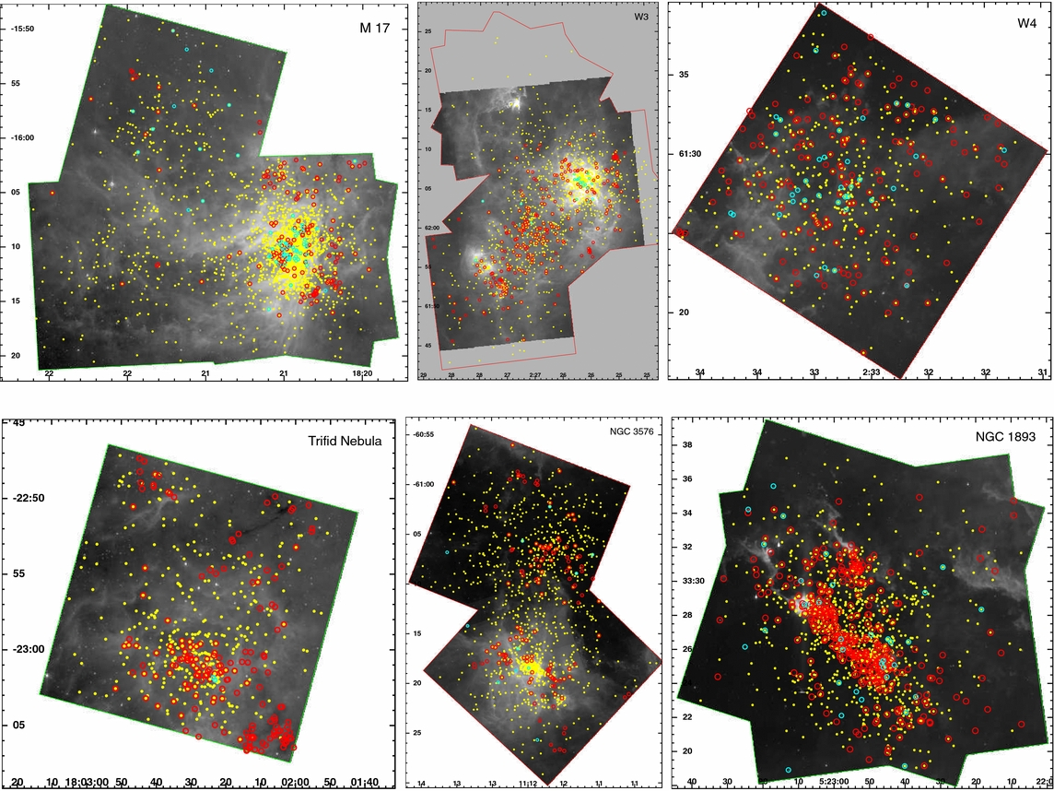
Massive Young Star-Forming Complex Study in Infrared and X-Ray (MYStIX)
Motivations: provide a uniform analysis of existing Chandra observations of 20 massive young clusters < 4kpc (Feigelson+2013)

Slide 20
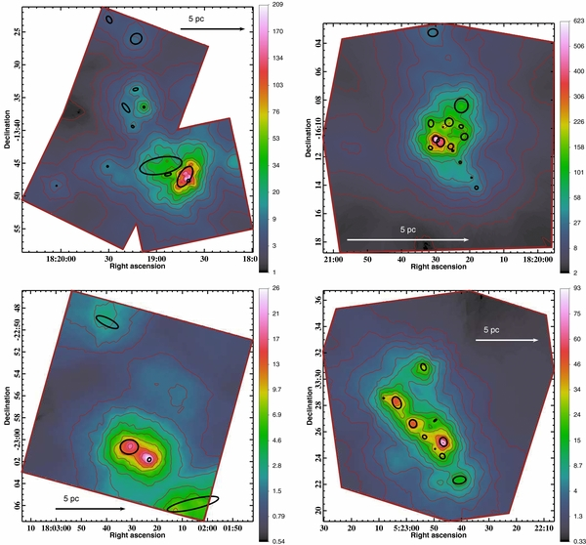
Massive Young Star-Forming Complex Study in Infrared and X-Ray (MYStIX)
Identified 31784 PMS stars in 20 massive SFRs (Broos+2013, Povich+2013, Naylor+2013); 125 candidate X-ray emitting O-early B stars (Povich+2017); 1109 candidate protostars (Romine+2016)
No evidence for feedback from the environment in discs dispersal (Richert+2015)
Structure and subclutering obtained in homogeneous way in 17 massive SFRs.
142 subclusters found (Kuhn+2014), most gravitationally bound (Kuhn+2015)
Large range of stellar density, typical 200-10000 stars/pc². Highest 34000 stars/pc² (RCW38) (Kuhn+2015)
M16
M17
Trifid
NGC1893
Subclusters in four MYSTiX clusters

Slide 21
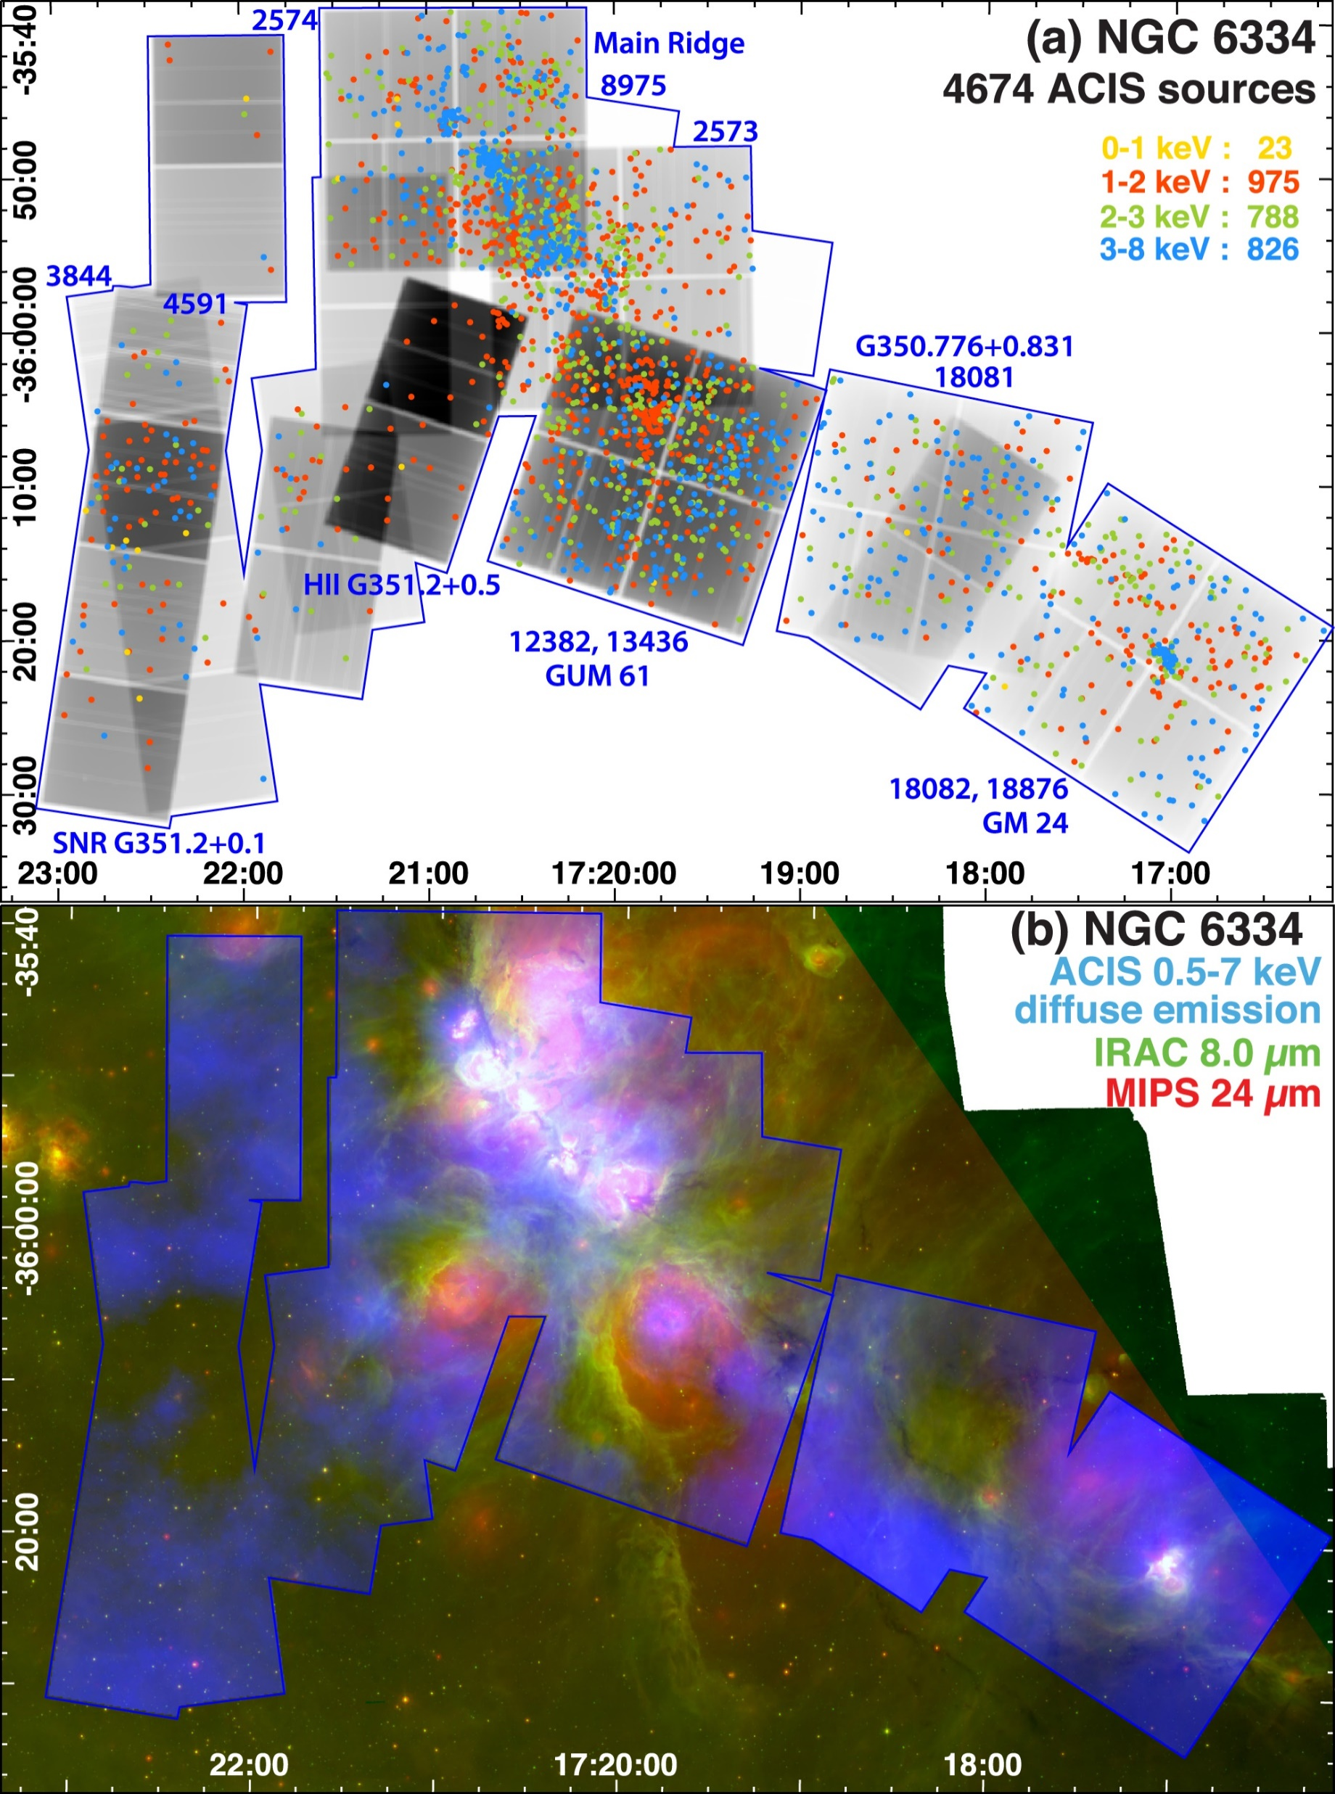
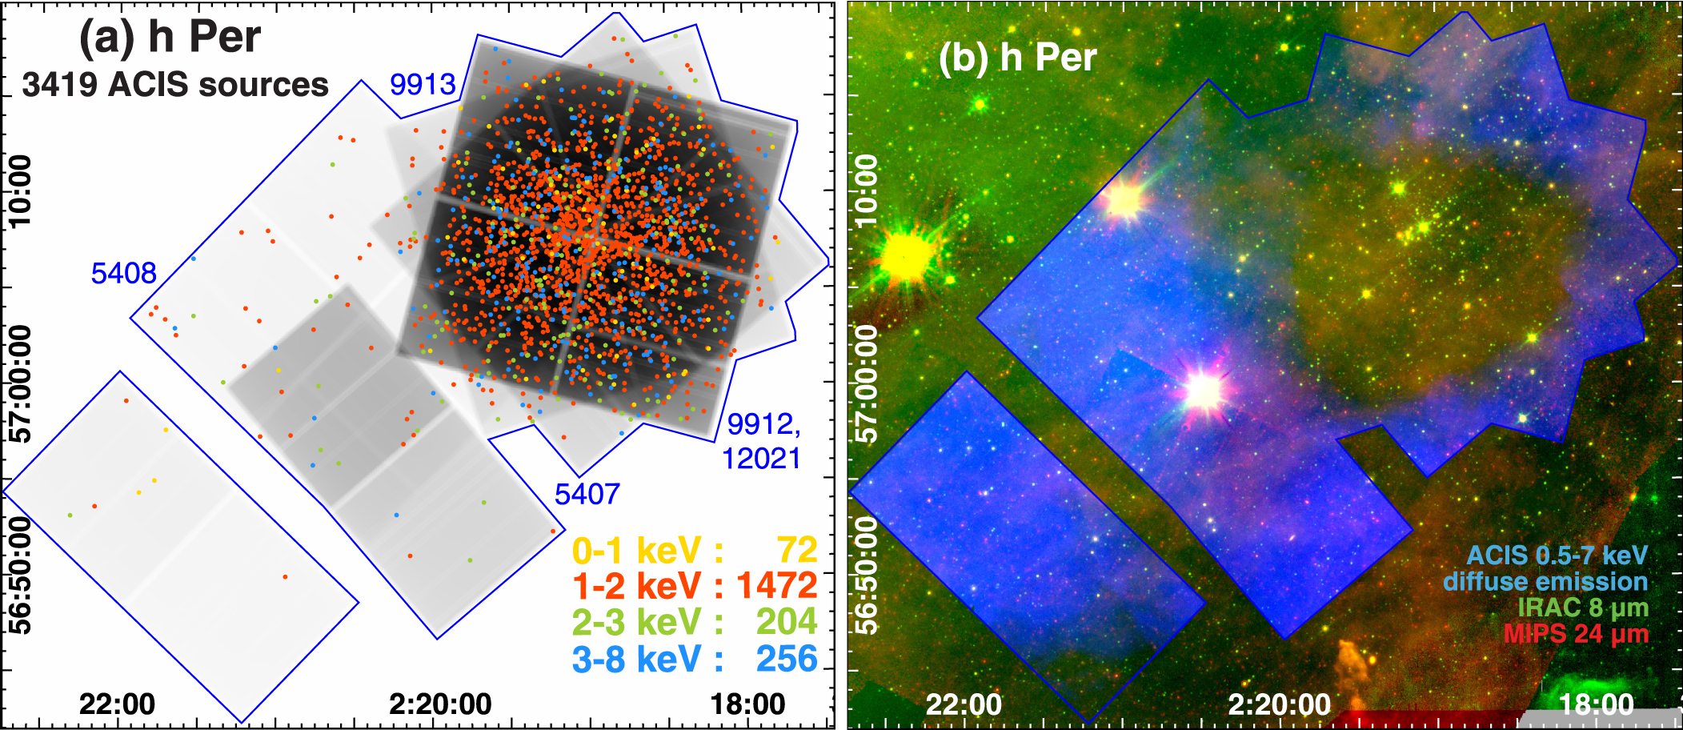
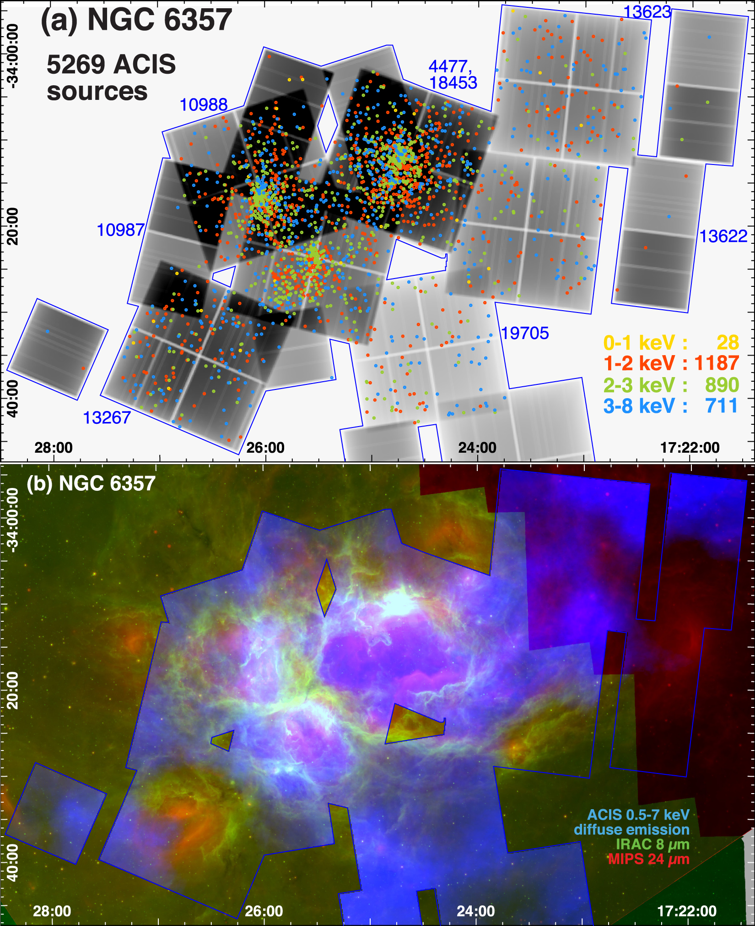
The Massive Star-Forming Regions Omnibus X-Ray Catalog
Extension of MYSTiX to very massive young clusters and SFRs.
Three installments:
MOXC-I: 20623 X-ray sources in 12 MSFRs
with distances ranging from 1.7 kpc to 50 kpc (Townsley+2014)
MOXC-2: 18396 X-ray sources in 16 MSFRs (Townsley+2018)
MOXC-3: 27923 X-ray point sources in 14 Galactic MSFRs (Townsley+2019)
All MSFRs exhibit a variety of masses and morphologies, from monolithic, to clusters-of-clusters to distributed clumps.
All MSFRs have measurable diffuse X-ray emission
Three MOXC clusters:
NGC6334 (top right)
H Persei (top left)
NGC6357 (bottom)

Slide 22
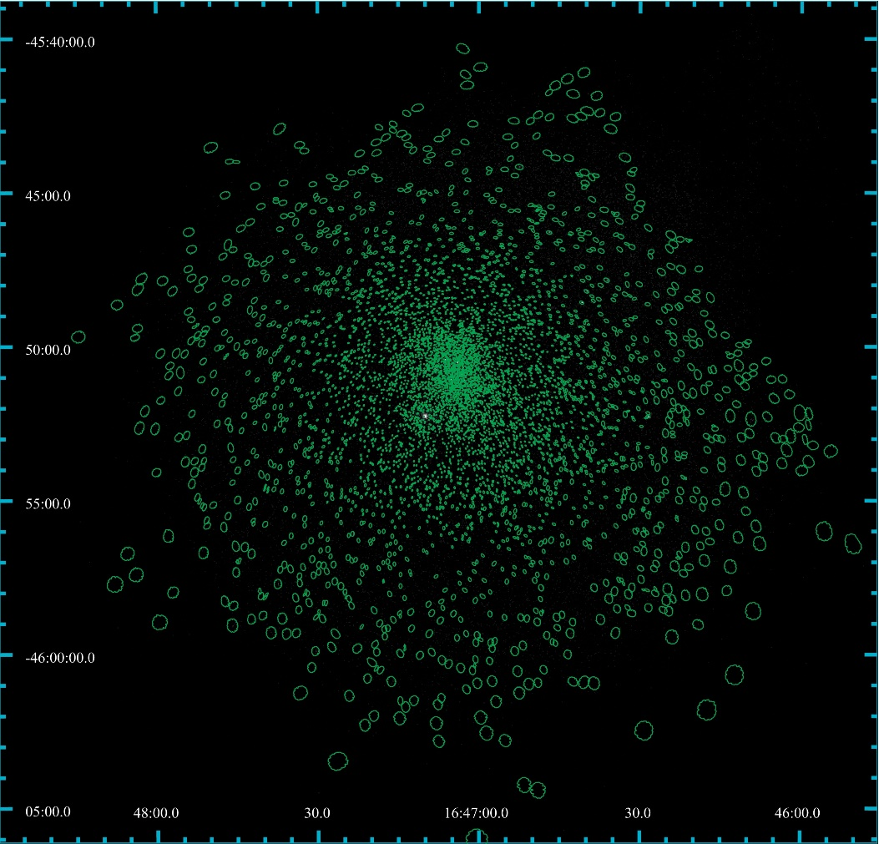
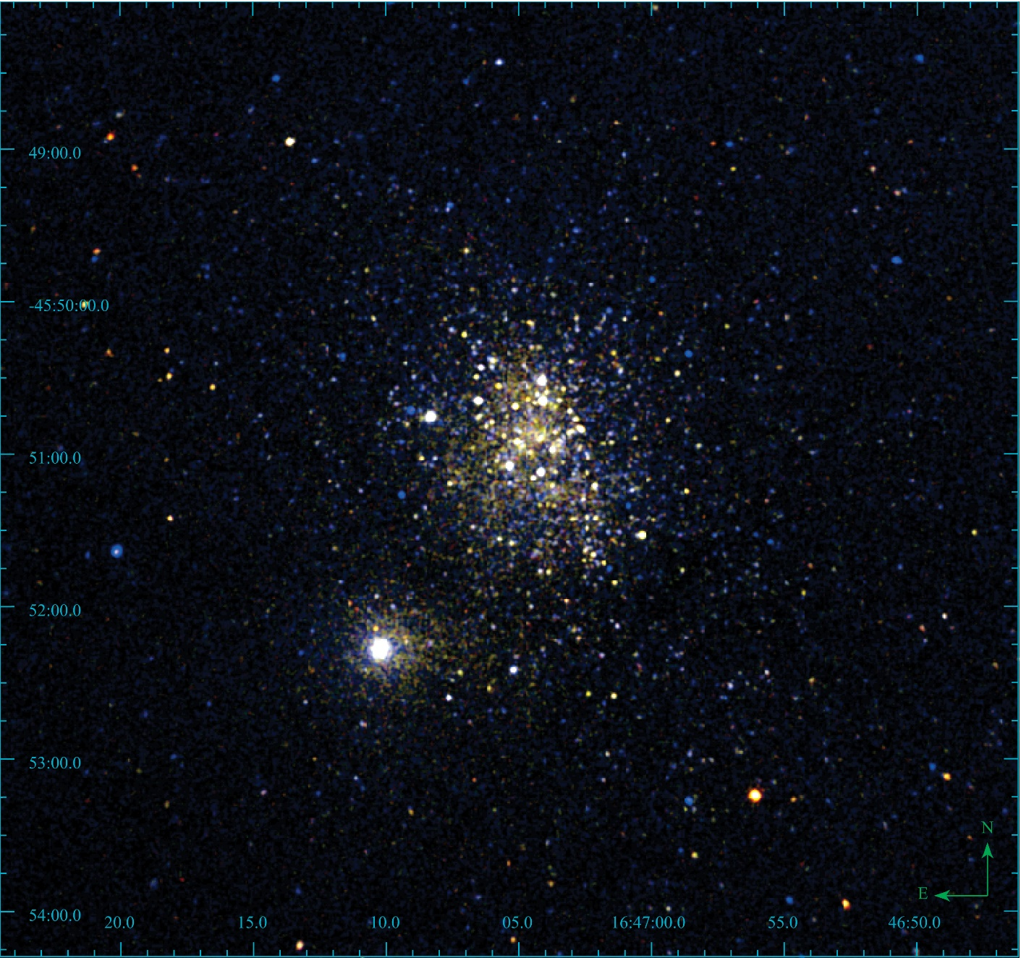
The Extended Westerlund 1 and 2 Open Clusters Survey
Motivations: Extend our knowledge of star formation and early evolution in starburst environment.
44 ACIS observations of Westerlund 1, ~ 1.1MSec
5423 X-ray sources validated
(Guarcello+ 2024).
RGB X-ray Image of Wd1
Soft
Medium
Hard
140 known massive stars (Clark+2020) detected in X-rays, among which 20 WR stars (Anastasopoulou+2024, Ritchie+ in prep).

Slide 23
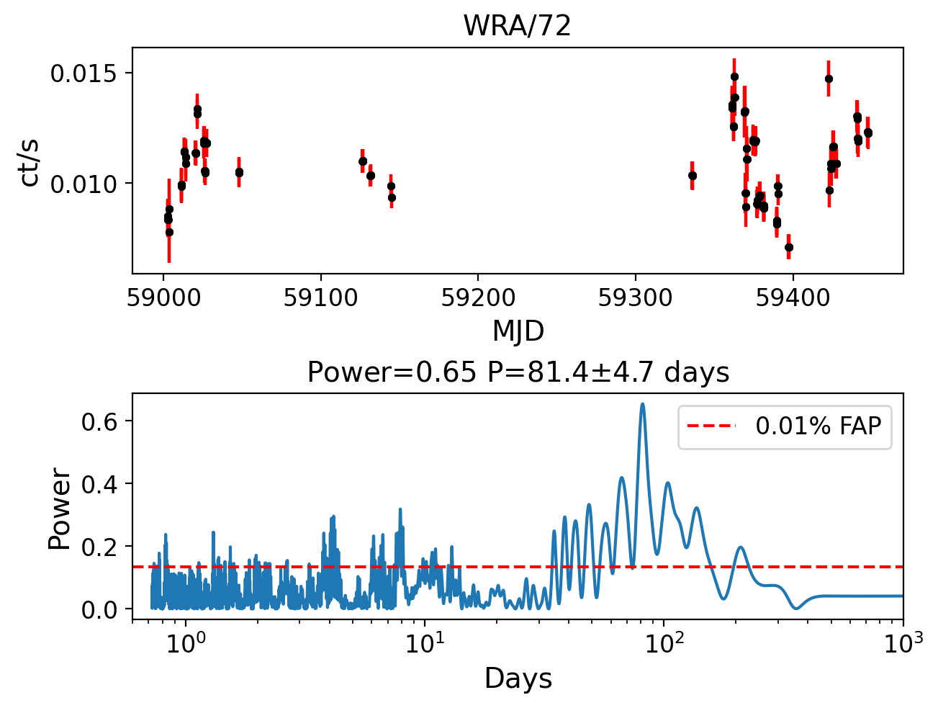
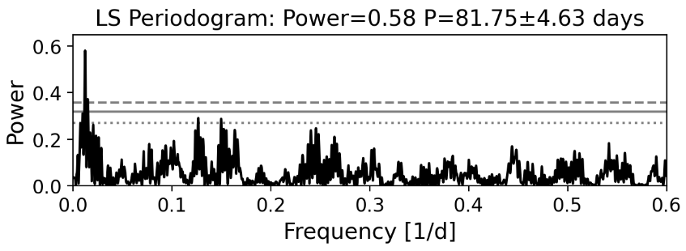
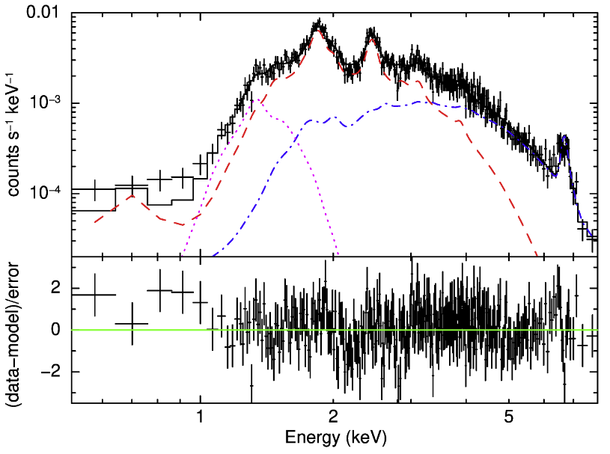
EWOCS view of the Wolf Rayet stars in Westerlund 1
Wd1 hosts 24 Wolf–Rayet stars (Clark+2005; Crowther+2006)
The largest sample of WR stars known in the Milky Way
Time and spectral analysis in X-rays reveal a binarity fraction among the WRs in Wd1 of about 100%
The X-ray spectra of WR stars show evidence for the presence of >10 MK plasma, indicative of colliding winds in binary systems.
All WR stars in Wd1 are in massive binary systems
(Anastasopoulou+2024)
known period
Fe XXV line

Slide 24
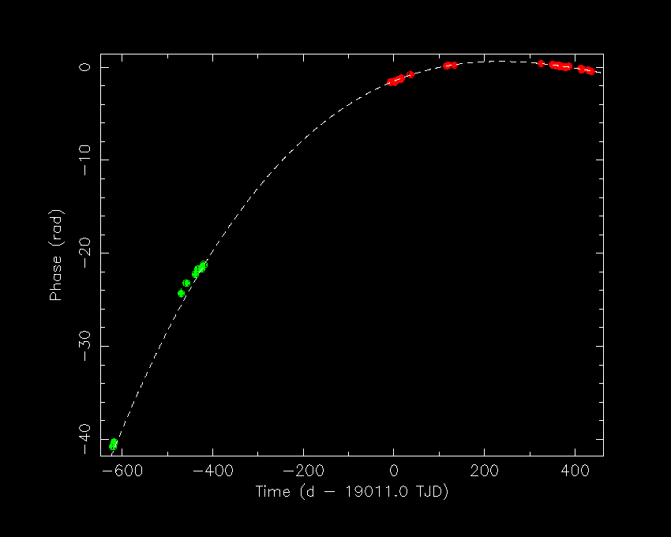
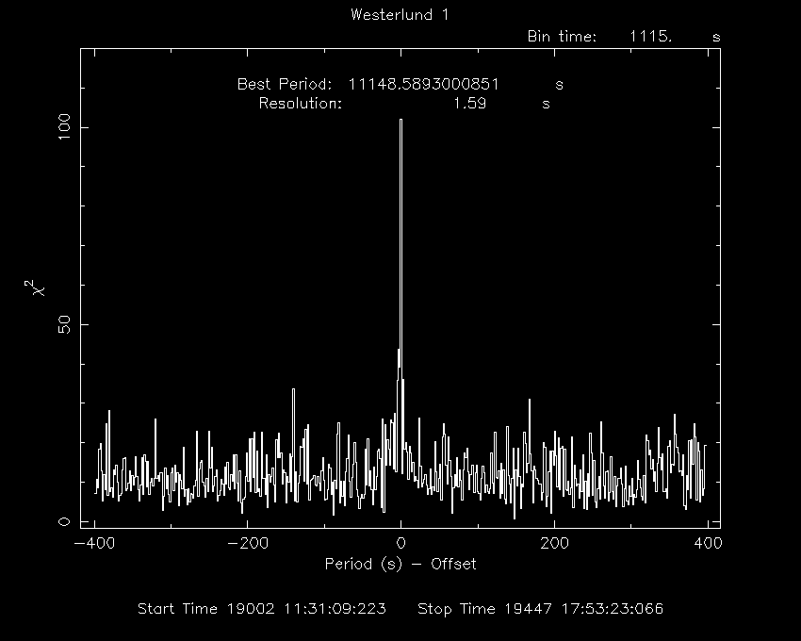
EWOCS view of the compact objects in Westerlund 1
Wd1 hosts the magnetar CXO J164710.2-455216 (Muno+2005), whose quiescent post-outburst state has never been studied (Borghese+ in prep)
Search of new compact objects from timing analysis of bright sources found a candidate low-mass X-ray binary (Israel+ in prep)
New Timing Solution of the pulsar from EWOCS data:
$P=10.61 s$; $\dot{P}=2.5×{10}^{−13}s/s$
$$\ddot{P}=4.9×{10}^{−21}s/s^{2}$$
Results in (An & Archibald 2019):
Bdip ~ 5 × 1013 G; Τ ~ 0.7 Myr
PSD of the new pulsator;
pulsation found at
P=11150s (~3.1h)

Slide 25
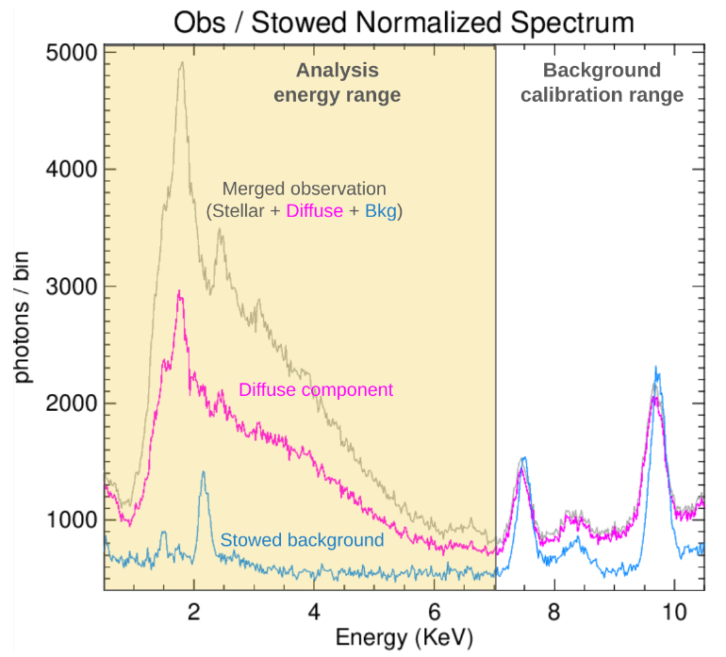
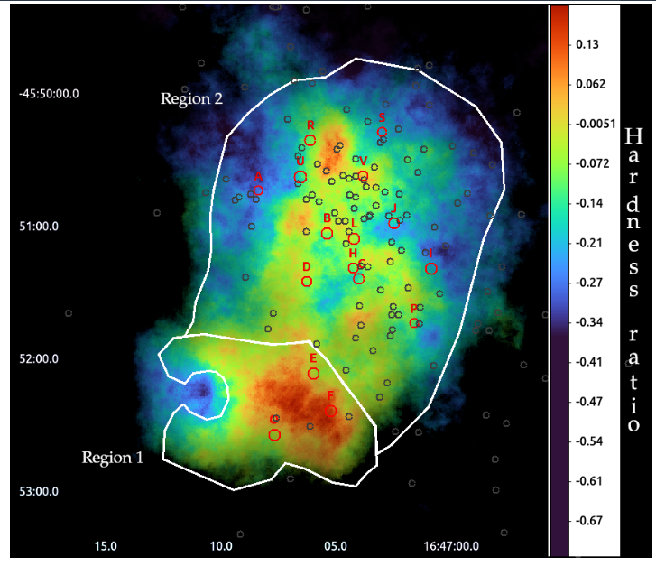
EWOCS view of the diffuse emission in Westerlund 1
OBJECTIVES:
Detect X-ray diffuse emission in Westerlund1; Determine the contribution from hot intracluster gas and stellar winds; Search for non-thermal emission (Albacete-Colombo+ in prep.)
Current estimate of the diffuse emission HR (circles mark massive stars, red: evolved) map and spectrum in the 0.5-7 keV energy band.

Slide 26
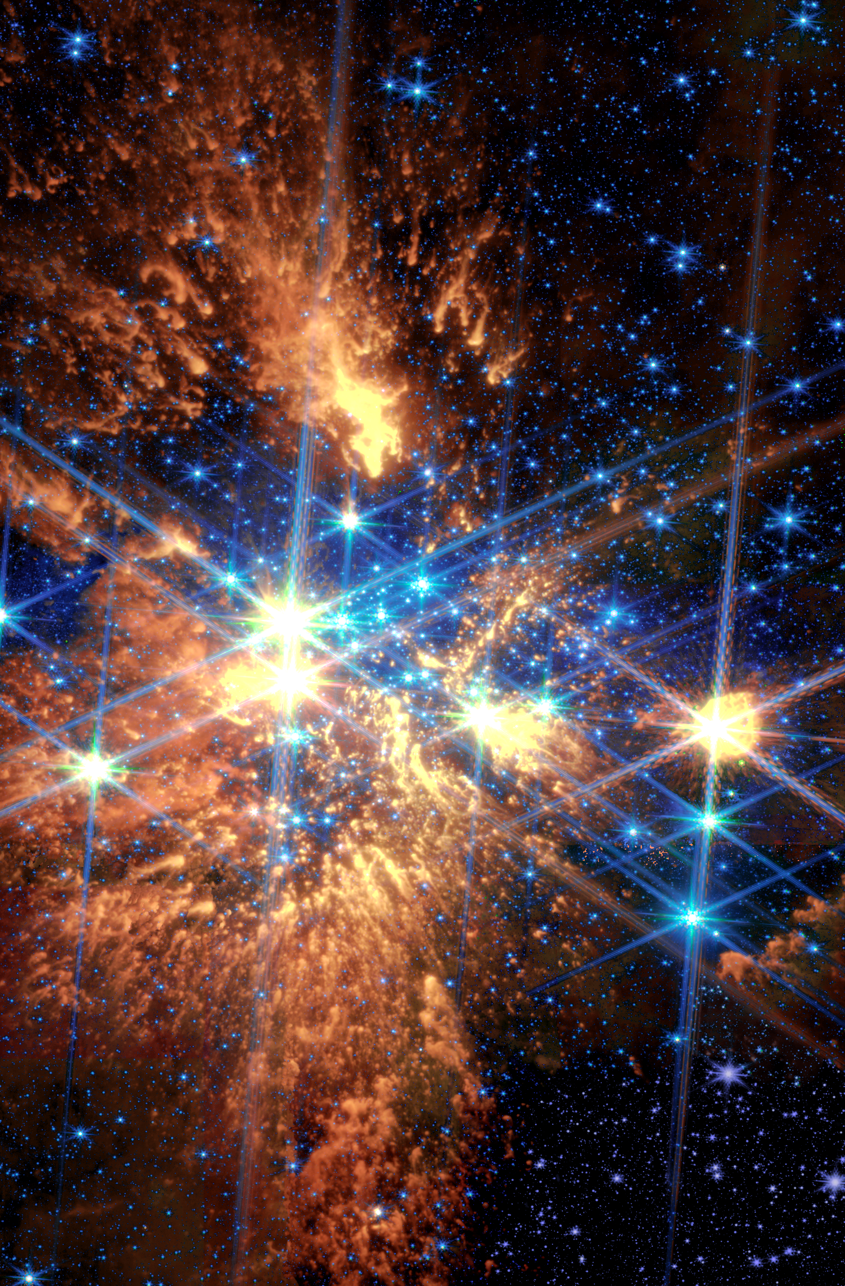
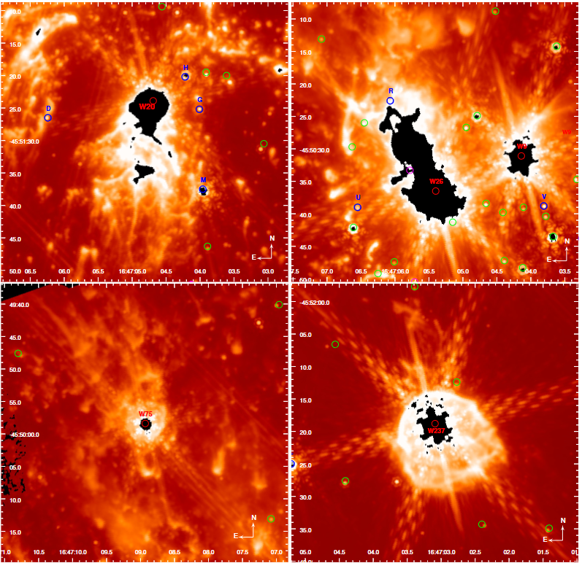
Winds from massive stars in Westerlund 1
JWST/MIRI is unveiling the complex structures of winds from the most massive stars in Westerlund 1
W20 – M5Ia
W26 – M5Ia
W9 – SgB[e]
W75 – M4Ia
W237 – M3Ia
Guarcello+2024
Lovell+ in prep

Slide 27
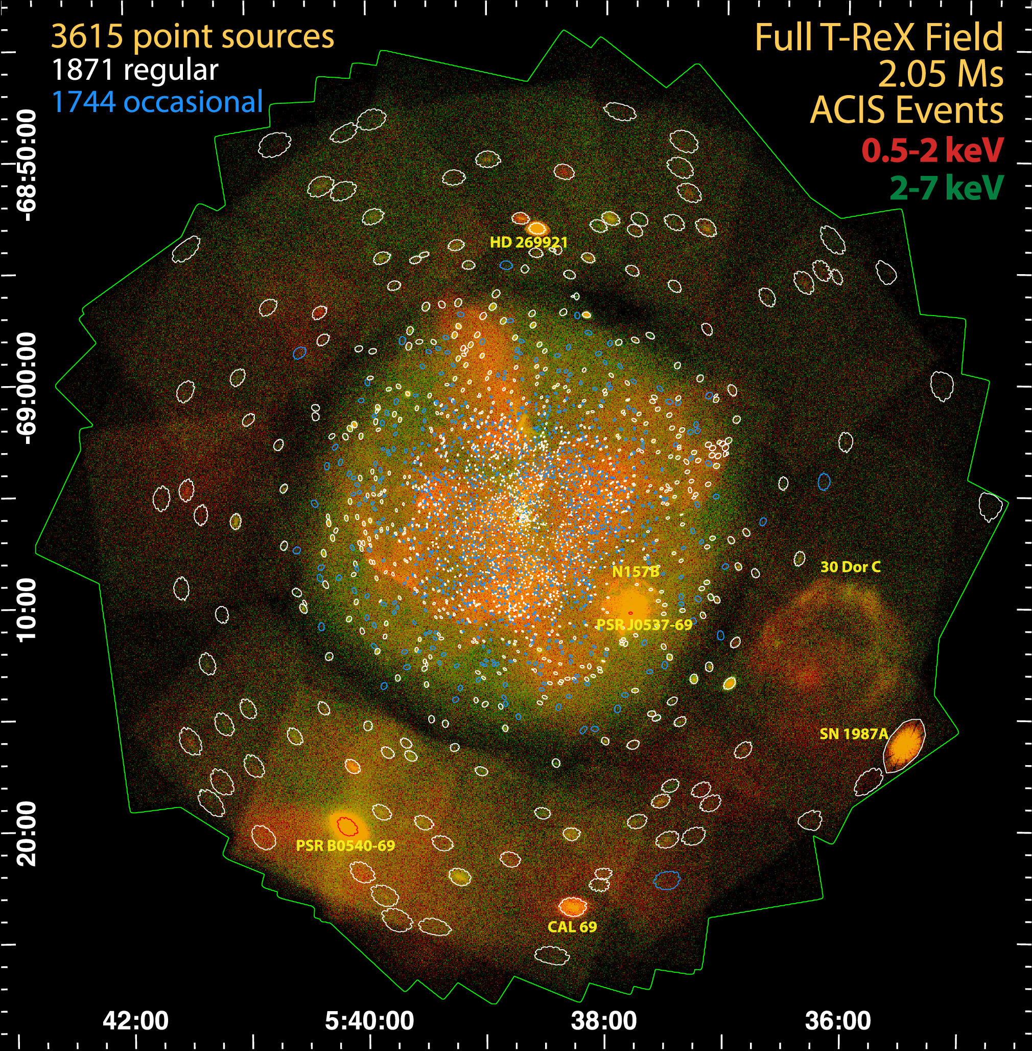
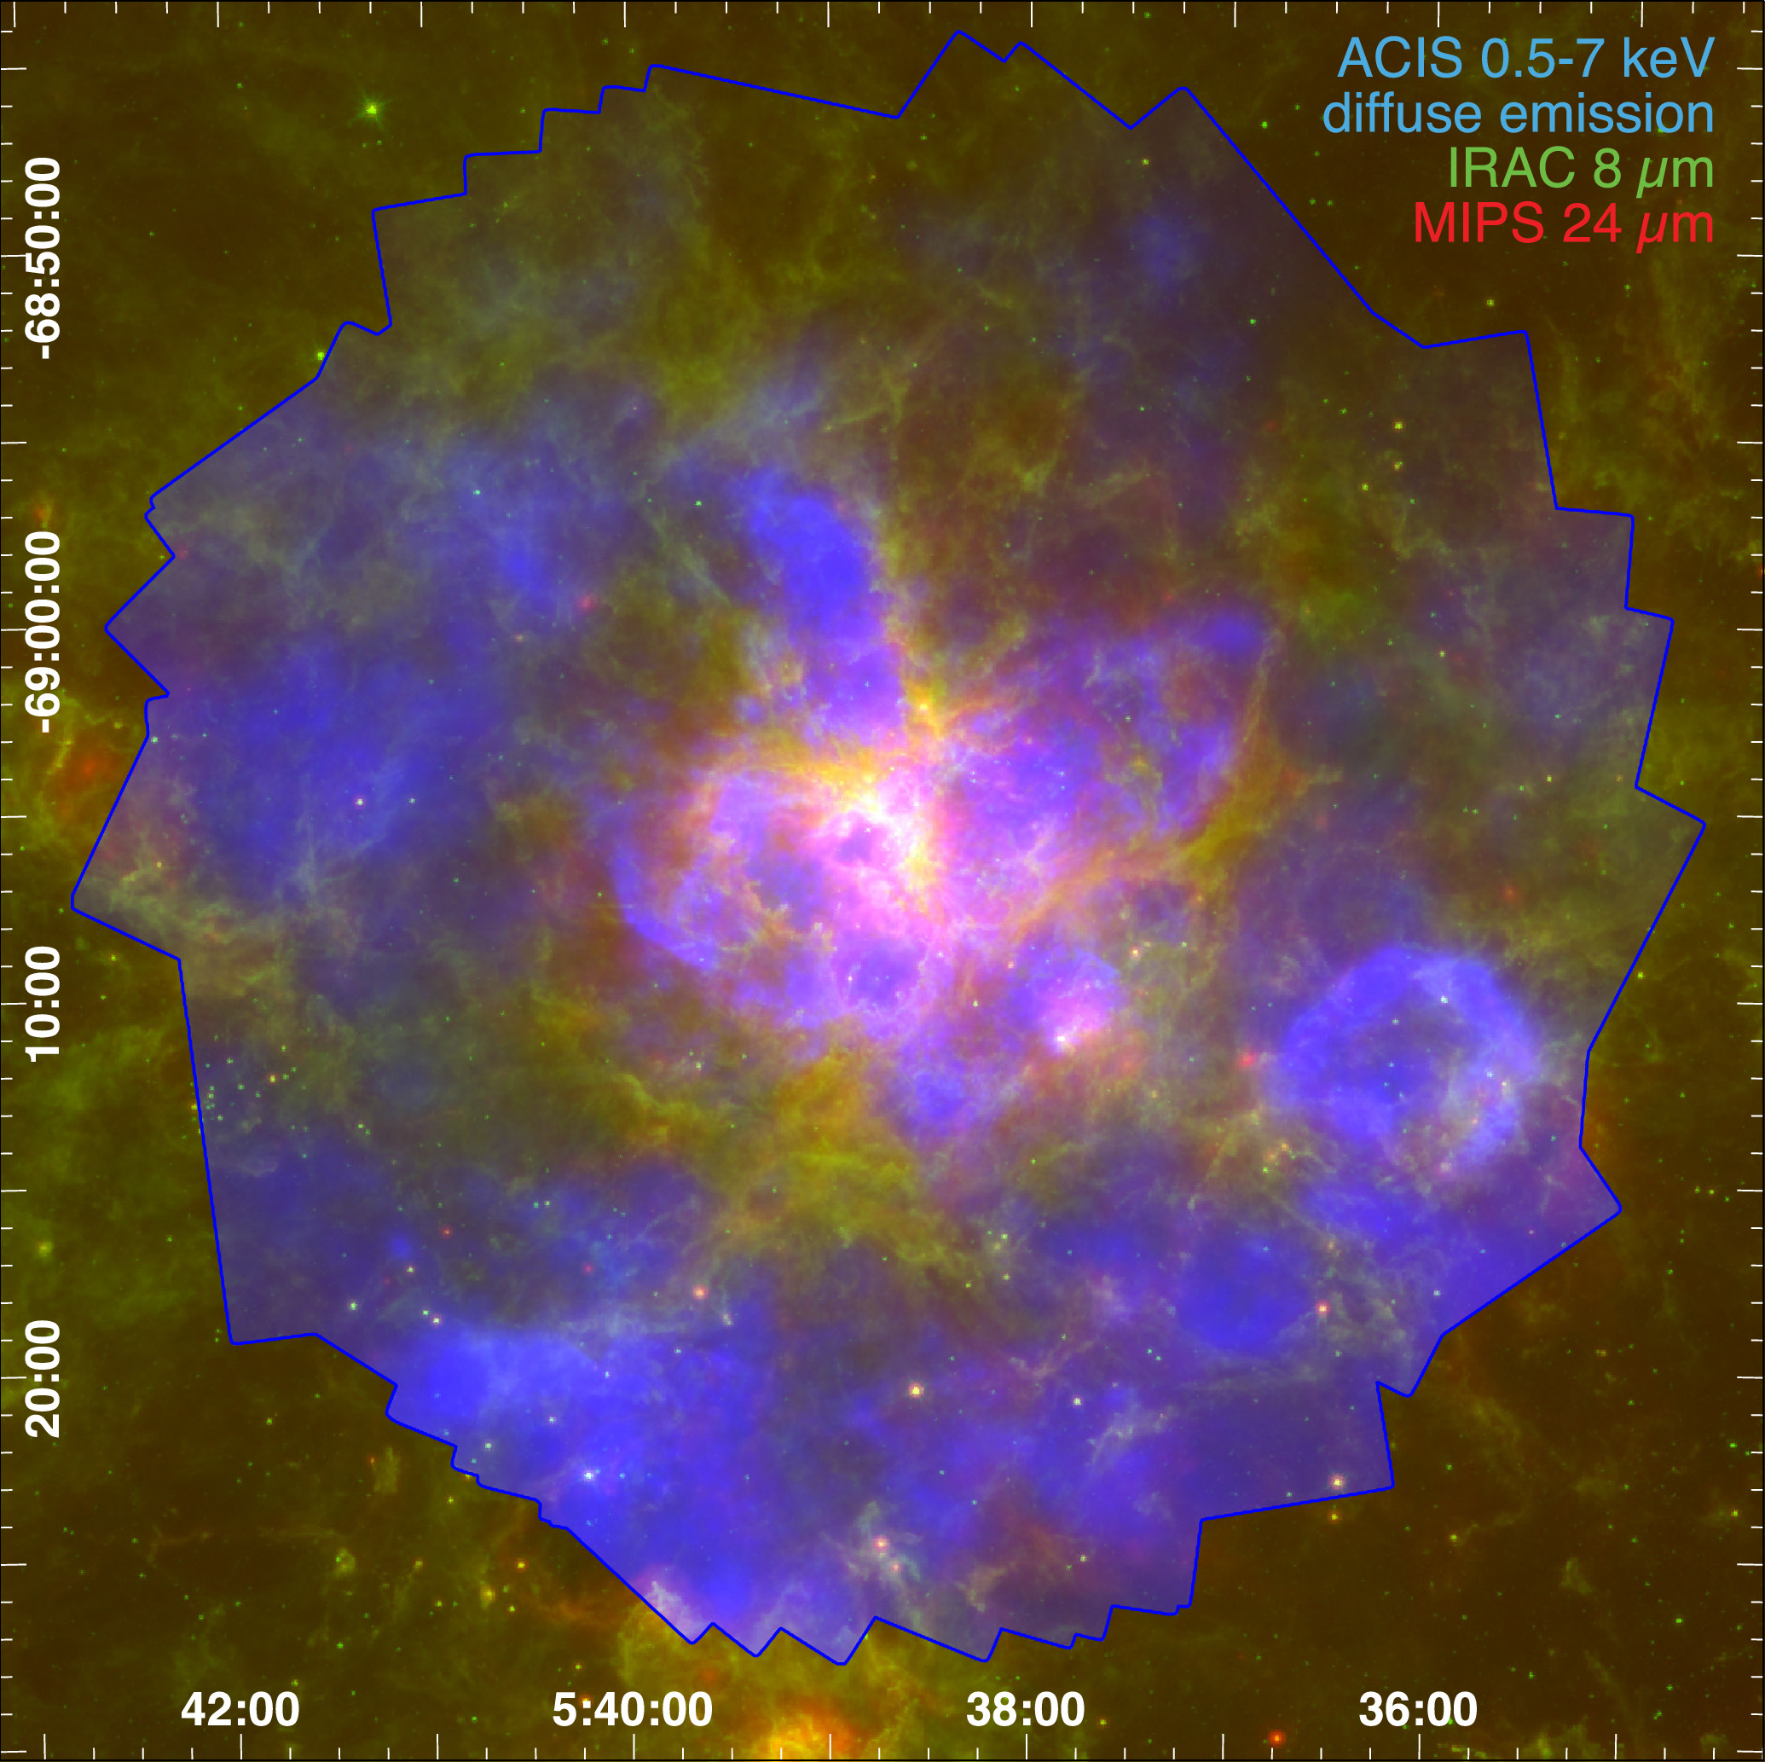
The Tarantula Revealed by X-rays (T-ReX)
48+3 Chandra observations of the Tarantula Nebula. Total exposure 2.05 Ms (Townsley+2024)
3615 X-ray sources (massive stars, compact objects, binaries, some bright PMS stars)
Diffuse emission with Lx=2.1×10³⁷ erg/s
ACIS event data with detected sources
T-ReX diffuse emission over a Spitzer image (Meixner+2006)

Slide 28
Conclusions
1) Massive clusters are bright X-ray objects
2) Low-mass PMS stars significantly contributes to this X-ray emission
3) PMS X-ray emission probes internal structure evolution
4) Several existing X-ray surveys focused on massive SFRs
Notes:
The T-ReX event data for the full T-ReX field. Events are binned by 4 sky pixels (2''). Soft events (0.5–2 keV) are shown in red and hard events (2–7 keV) in green. Regular point sources are outlined by white polygons and "occasional" sources by blue polygons. Red polygons outline sources exhibiting significant pileup. These polygons are examples of event extraction regions, usually based on 90% encircled energy PSF contours. Notable off-axis sources discussed in the text are labeled in yellow.
T-ReX diffuse emission in three soft X-ray bands, smoothed with adaptive kernels to achieve S/N = 15. All 3615 point sources (seen in Figure 2 above) were excised before smoothing. Axes are in celestial (J2000) coordinates.
T-ReX diffuse emission in the Spitzer context. Spitzer images are from the Surveying the Agents of Galaxy Evolution (SAGE) survey (Meixner et al. 2006).

Slide 29
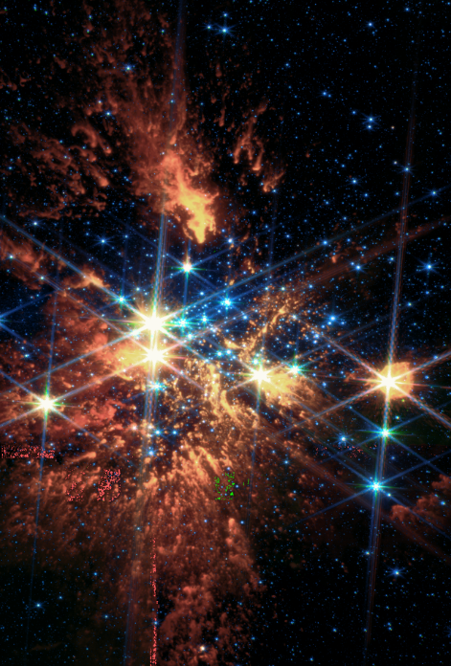
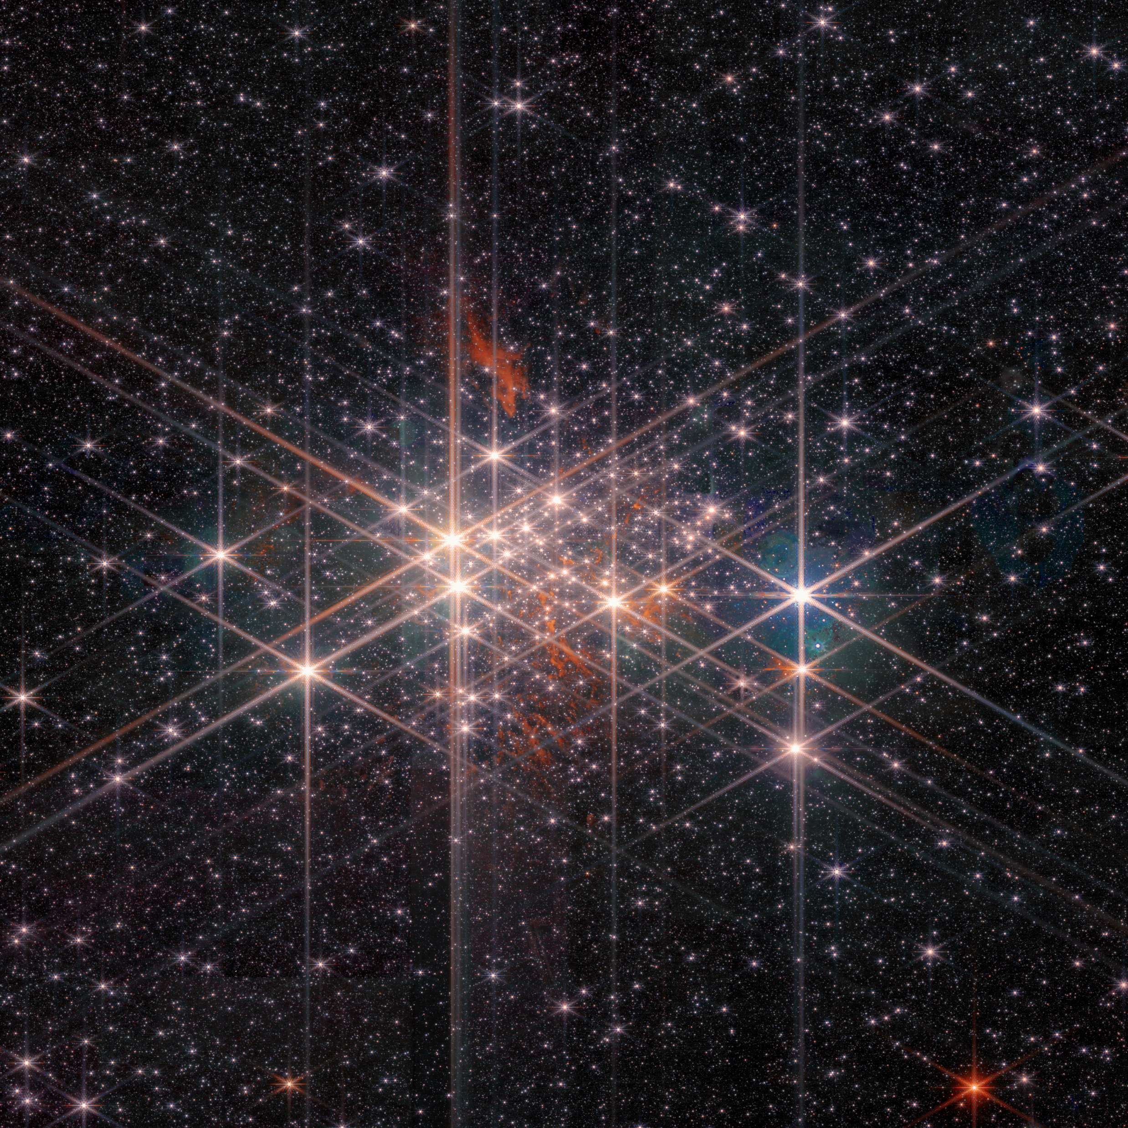
PLEASE UPDATE WESTERLUND 1 IMAGES IN YOUR PRESENTATIONS
JWST/NIRCam
Chandra/ACIS
JWST/MIRI

Slide 31
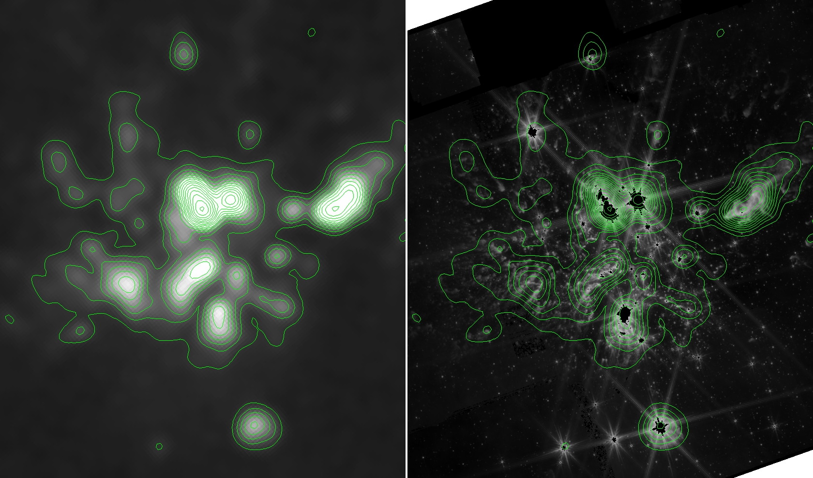
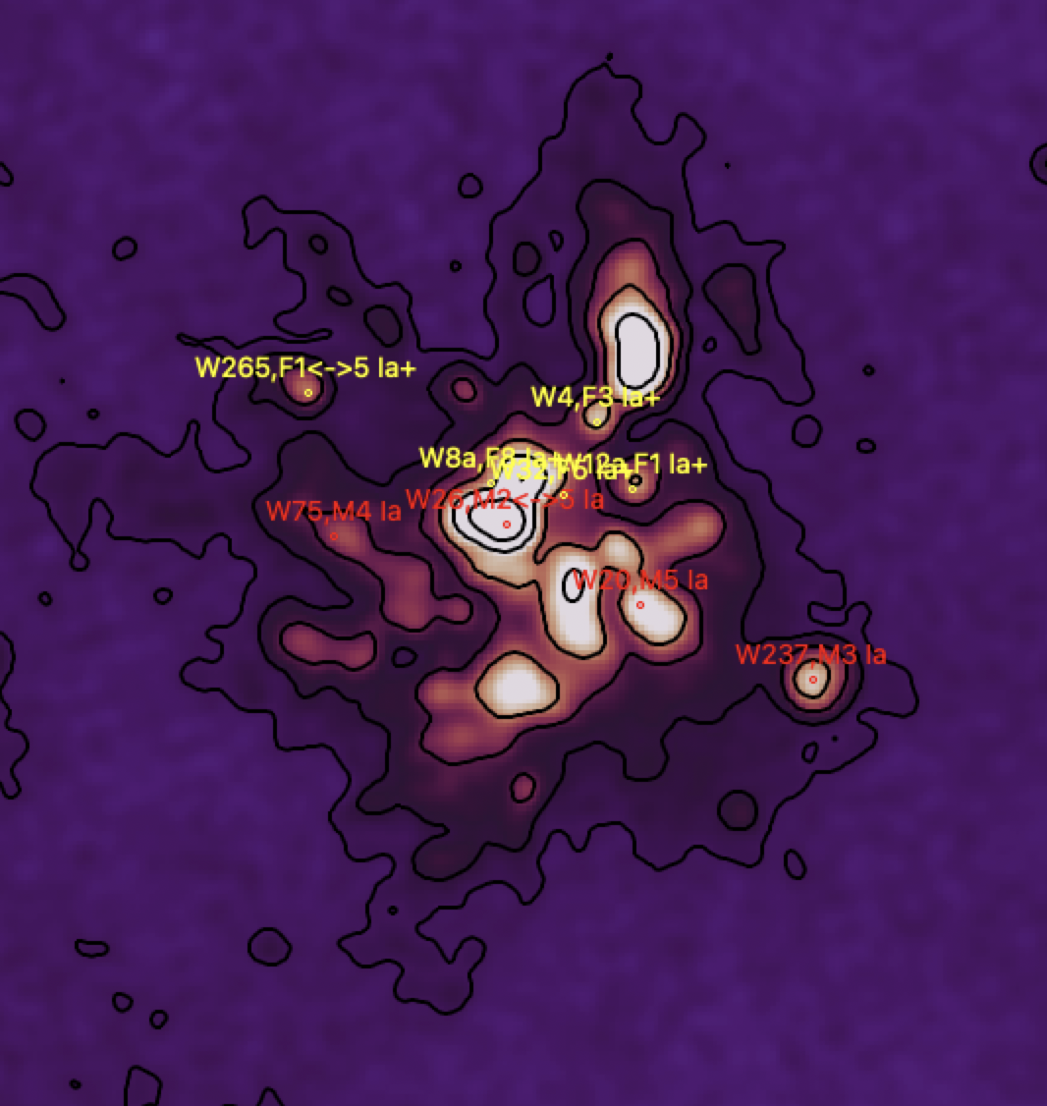
Radio emission from Meerkat (Umana, Trigiglio)
The «Rat» Nebula
The «V-shaped» cloud
The peaks of radio emission clearly correspond to the super- and hypergiants and the nebular structures around Westerlund 1
The south-west droplets

Slide 32
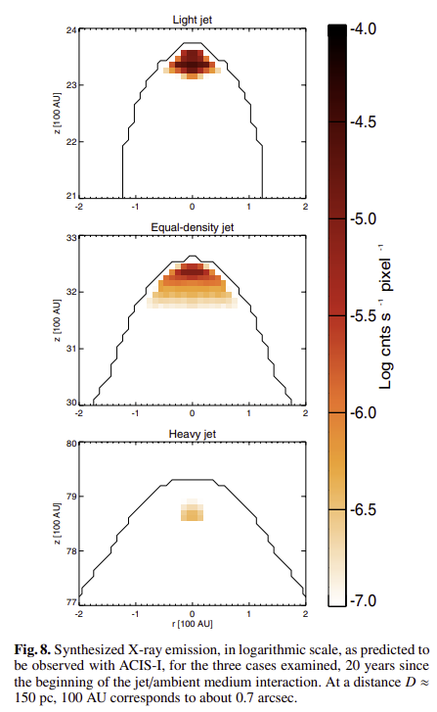
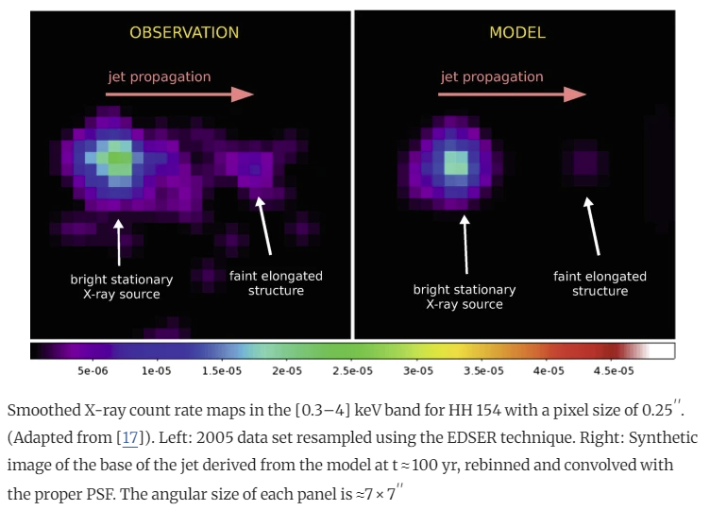
X-rays from protostellar jets
Bonito+2006
S. Ustamujic+2019

Slide 33
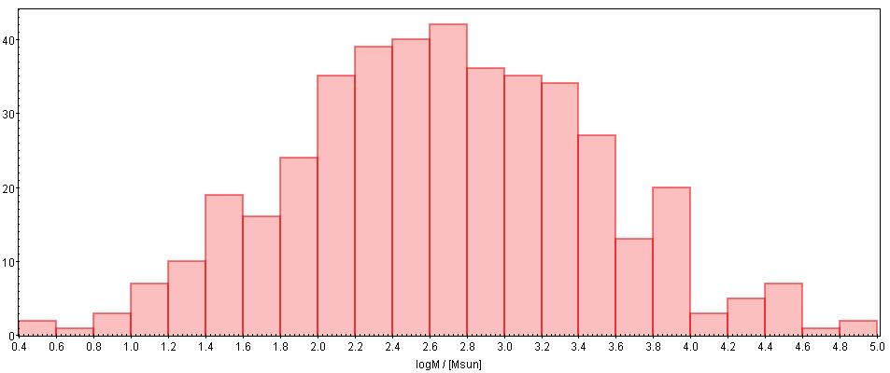
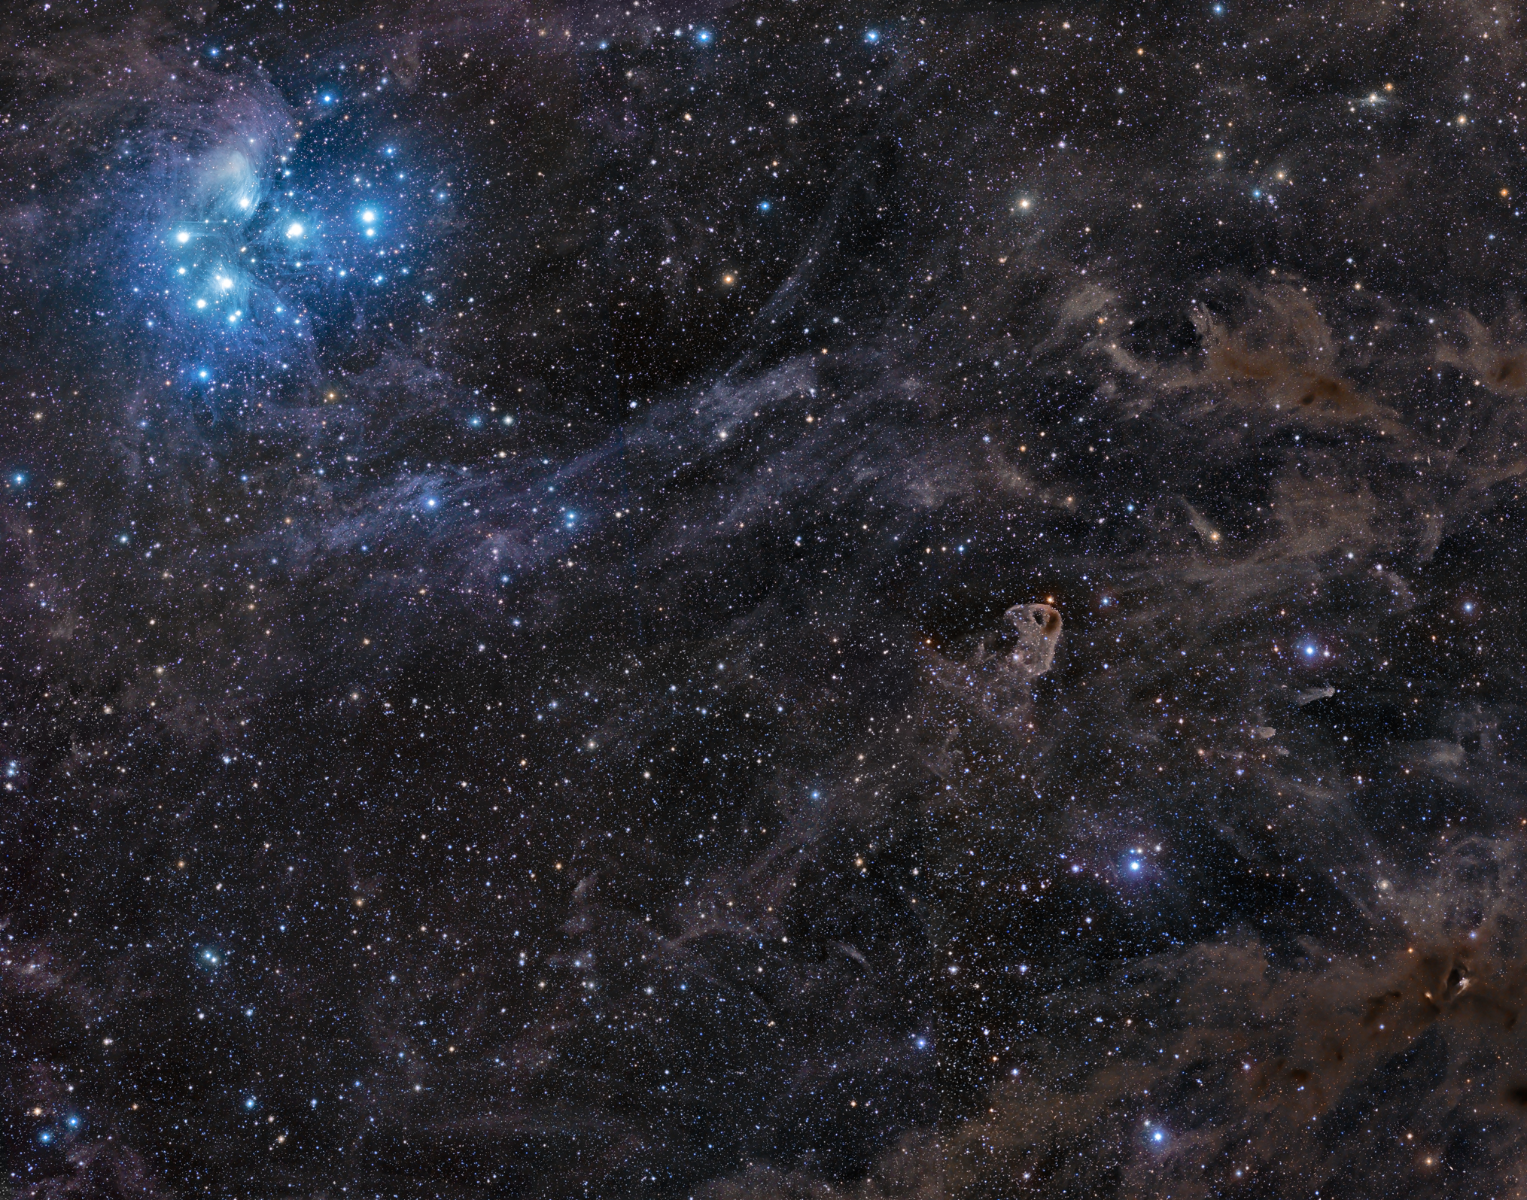
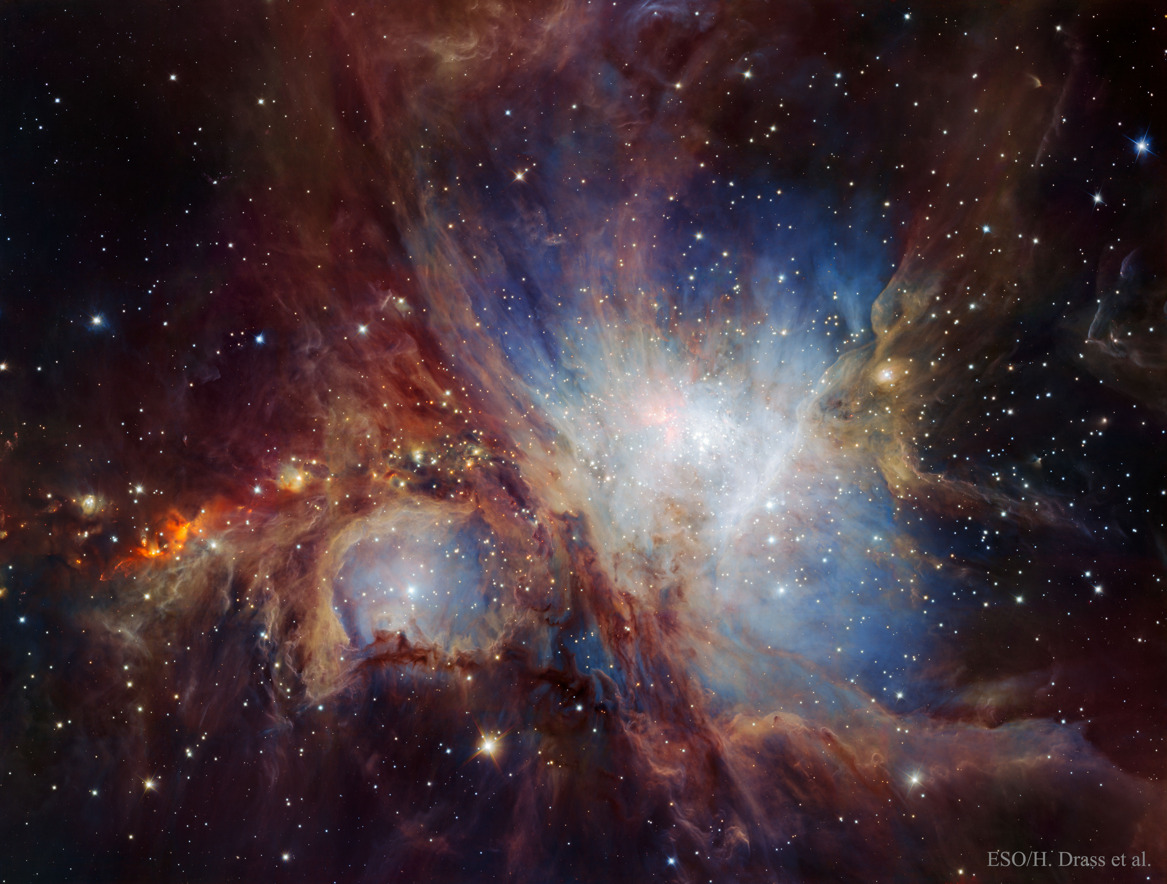
Star clusters across the mass range
Low-mass
Massive
Supermassive
Gozha+2012
TMC
ONC
Lagoon
Westerlund 1

