Slide 1


Stellar Physics and The Chemical Enrichment of the ISM from Massive Stars
Marco Limongi
INAF – Osservatorio Astronomico di Roma, ITALY
Kavli IPMU, University of Tokyo, JAPAN
marco.limongi@oa-roma.inaf.it
in collaboration with
Alessandro Chieffi (INAF-IAPS, Italy)
and
Lorenzo Roberti (Konkoly Obs. Hungary)
Cristiano Ugolini (SISSA, Italy)

Slide 2
Why do we care about Massive Stars?
Massive stars play e fundamental role in the evolution of the Universe
Produce of most of the heavy elements (especially those necessary to life)
Light up regions of stellar birth → induce star formation
Contribute to the production of Neutron Stars and Black Holes
Constitute a natural laboratory for the study of the physics of neutrinos
Are sources of Gravitational Waves (collapse and remnants)
Are the progenitors of long Gamma Ray Bursts
A good knowledge of the evolution of these stars is required in order to shed light on many astrophysical topical subjects

Slide 3
Massive Stars: Distinctive Features
Massive Stars = A star in which the central temperature and density increase in such a way that degeneracy never takes place
High temperatures are achieved that all the nuclear burning, from H to Si, go to completion and eventually a Fe core is formed → production of all the elements with 4<Z<38
Strong neutrino emission from pairs production → dramatic reduction of the nuclear burning lifetimes
Strong Mass Loss
Chaotic evolution of the interior with formation of several and overlapping convective zones
Fe core becomes unstable, collapses to nuclear density, rebounces and launches a shock wave that drives the explosion of the star → Massive stars are the progenitors of Core Collapse Supernovae

Slide 4
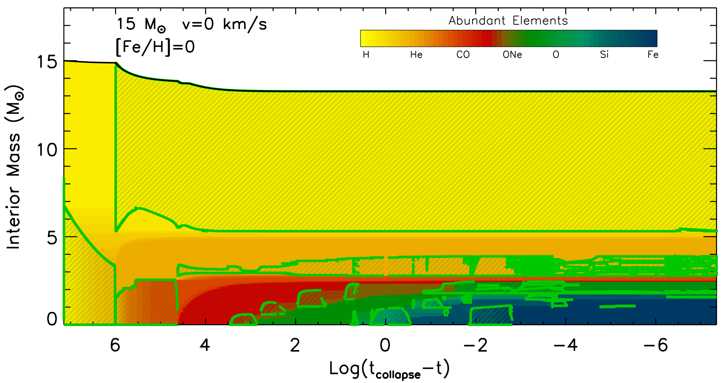
Presupernova Evolution of a Massive Star: Chemical and Convective Hystory
H conv. env.
H-sh.
He
H
C
C
Si
He
C
C
O
O
C
Ne
O
Si
“Fe”
Central burning → formation of a convective core
Central exhaustion → shell burning → convective shell
Local exhaustion → shell burning shifts outward in mass → convective shell

Slide 5
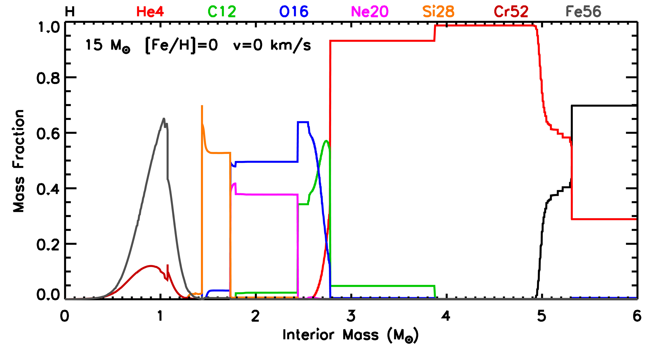
Chemical Stratification @ PreSN Stage
The complex interplay among shell nuclear burning, timing and overlap of the convective zones determines in a direct way the final distribution of the chemical composition
and the physical structure of the star @ presupernova stage
Hes
Hc
Hs
NSE
Sis
Os
Cs
Hec
Fe-peak elements
Nes
²⁸Si
³⁰Si
³²S
³⁴S
²⁰Ne
²³Na
²⁴Mg
²⁷Al
¹²C
¹⁶O
ws
¹²C
weak-s
⁴He
¹⁴N

Slide 6
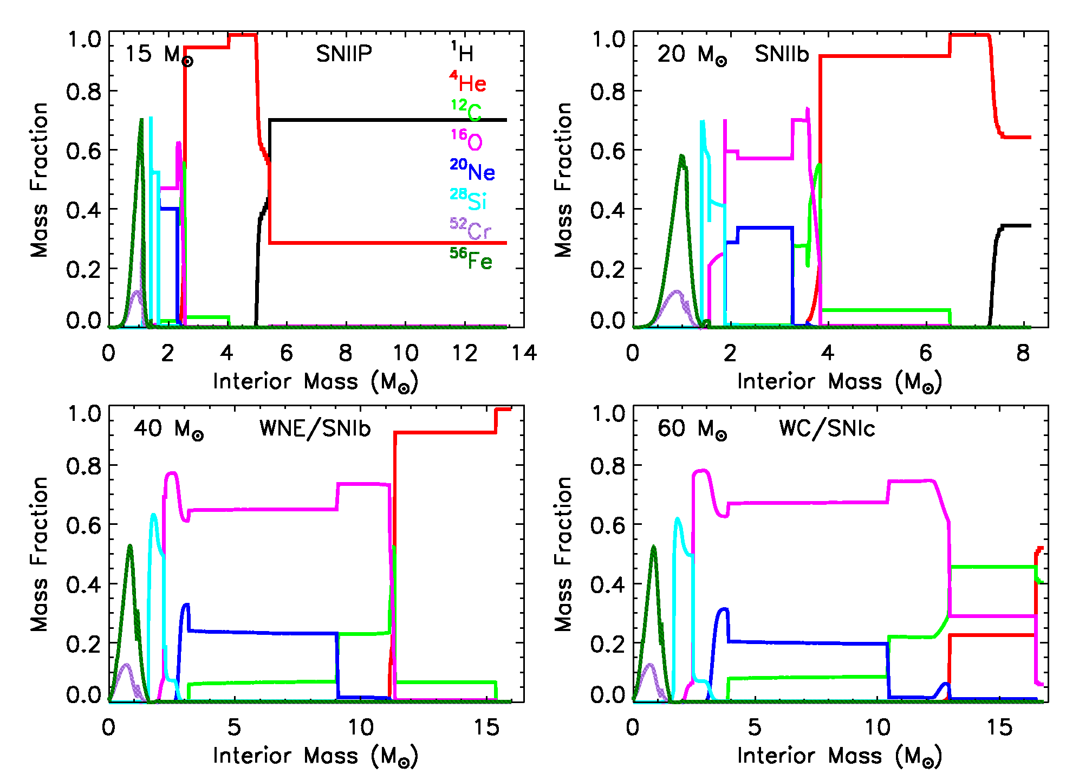
The Presupernova Stars
The complex interplay among the shell nuclear burning and the timing of the convective zones determines in a direct way the final physical and chemical structure
The mass loss history (RSG/WR) determines in a direct way the CCSN type
Models from Limongi and Chieffi (2018)

Slide 7
Core Collapse Supernova Explosion and Nucleosynthesis
The Fe core becomes unstable, collapses to nuclear density, rebounces and through a sequence of events a shock wave is launched that drives the explosion of the star
The propagation of the shock wave through the mantle of the star induces compression and heating → some modification of the chemical composition produced during the hydrostatic burning stages is expected
Such a modification is called Explosive Nucleosynthesis
The modeling of the explosion of the star is mandatory to have information on:
  The chemical composition of the ejected matter (chemical yields)
  The initial mass-remnant mass relation
At present detailed explosive nucleosynthesis calculations for core collapse supernovae are mainly based on artificially induced explosions

Slide 8
Induced Explosion
Piston (Woosley, Weaver and coll.)
Thermal Bomb (Nomoto, Umeda and coll.)
Kinetic Bomb (Chieffi & Limongi)
Calibrated Neutrino Luminosity (Fryer, Janka)
Different ways of inducing the explosion
Shock Wave
Compression and Heating → Explosive Nucleosynthesis
Induced Expansion and Explosion
Matter Falling Back
Matter Ejected into the ISM
E_{kin}/⁵⁶Ni
Mass Cut
Initial Remnant
Initial Remnant
Final Remnant
Fe core

Slide 9
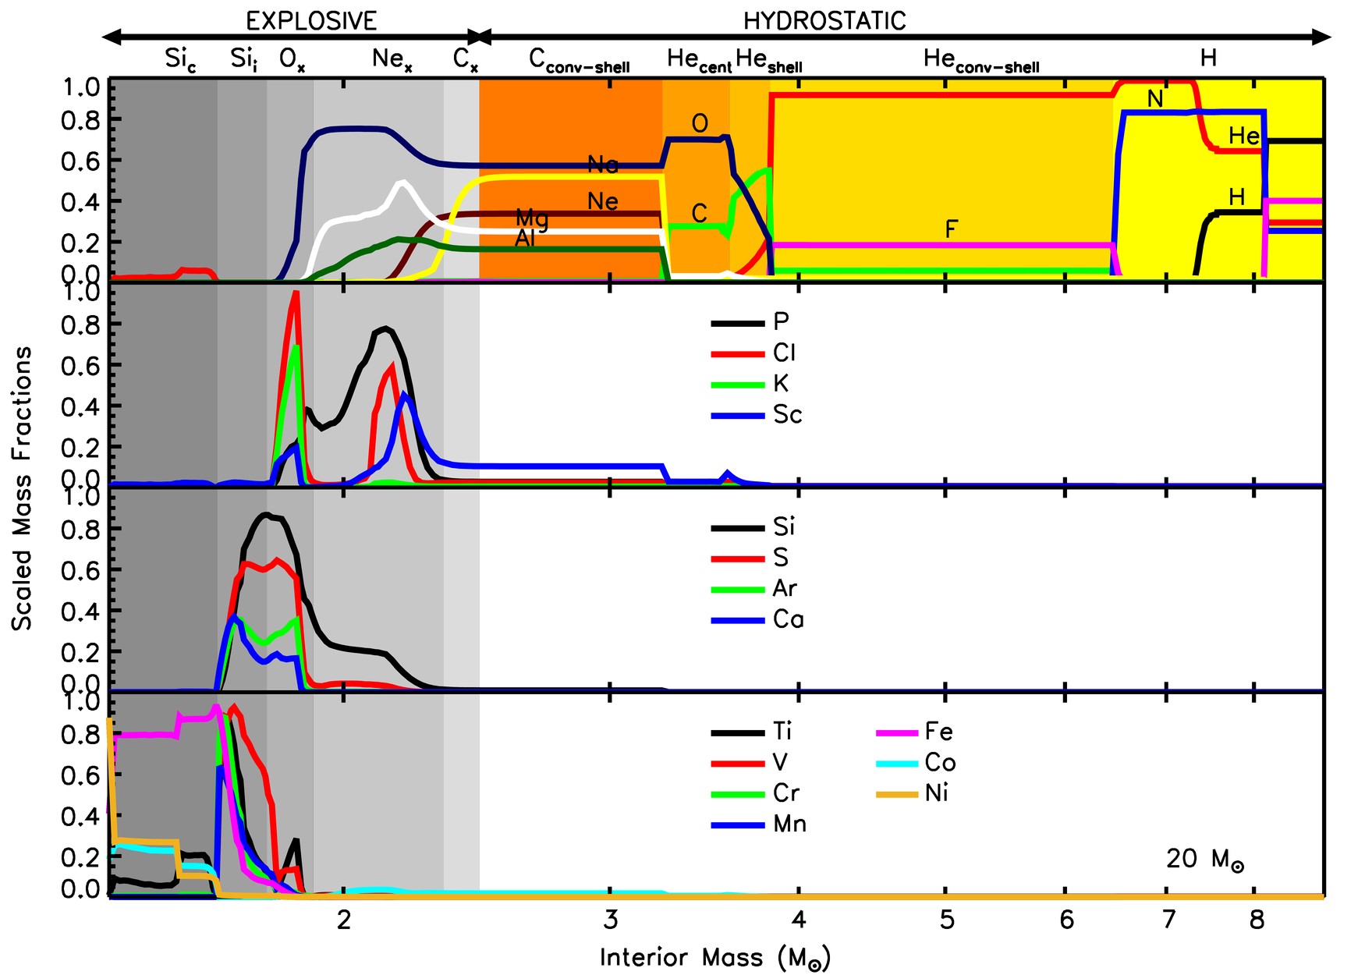
Composition of the Ejecta
Notes:
Summary of where and when the various elements are produced in a massive star

Slide 10
Composition of the Ejecta
Element | Production Site
N (¹⁴N) | Hydrostatic H burning
F (¹⁹F) | Hydrostatic He convective shell
C (¹²C) O (¹⁶O) | Hydrostatic core He burning (¹⁶O partially modified by Cshell and Ne_{x})
Ne (²⁰Ne) Na (²³Na) Mg (²⁴Mg) Al (²⁷Al) | Hydrostatic C convective shell Partially destroyed by C_{x} (²³Na) and Ne_{x} (²⁰Ne) Partially produced by Ne_{x} (²⁴Mg,²⁷Al)
P (³¹P) | Ne_{x}
Cl (³⁵Cl, ³⁷Cl) | Ne_{x}+O_{x}
K (³⁹K) | O_{x}
Sc (⁴⁵Sc) | Hydrostatic C convective shell Ne_{x}+O_{x}
Si (²⁸Si) S (³²S) Ar (³⁶Ar) Ca (⁴⁰Ca) | O_{x}+Si_{i}
V (⁵¹Cr) Cr (⁵²Cr,⁵²Fe) Mn (⁵⁵Mn,⁵⁵Co) | Si_{i}
Ti (⁴⁸Cr) | O_{x}+Si_{i}+Si_{c}
Fe (⁵⁶Ni) Co (⁵⁹Co,⁵⁹Ni) Ni (⁵⁸Ni,⁶⁰Ni) | Si_{c}
Notes:
Summary of where and when the various elements are produced in a massive star

Slide 11
Composition of the Ejecta
Element | Production Site
N (¹⁴N) | Hydrostatic H burning
F (¹⁹F) | Hydrostatic He convective shell
C (¹²C) O (¹⁶O) | Hydrostatic core He burning (¹⁶O partially modified by Cshell and Ne_{x})
Ne (²⁰Ne) Na (²³Na) Mg (²⁴Mg) Al (²⁷Al) | Hydrostatic C convective shell Partially destroyed by C_{x} (²³Na) and Ne_{x} (²⁰Ne) Partially produced by Ne_{x} (²⁴Mg,²⁷Al)
P (³¹P) | Ne_{x}
Cl (³⁵Cl, ³⁷Cl) | Ne_{x}+O_{x}
K (³⁹K) | O_{x}
Sc (⁴⁵Sc) | Hydrostatic C convective shell Ne_{x}+O_{x}
Si (²⁸Si) S (³²S) Ar (³⁶Ar) Ca (⁴⁰Ca) | O_{x}+Si_{i}
V (⁵¹Cr) Cr (⁵²Cr,⁵²Fe) Mn (⁵⁵Mn,⁵⁵Co) | Si_{i}
Ti (⁴⁸Cr) | O_{x}+Si_{i}+Si_{c}
Fe (⁵⁶Ni) Co (⁵⁹Co,⁵⁹Ni) Ni (⁵⁸Ni,⁶⁰Ni) | Si_{c}
The majority of the Elements (Ne-Ni) present in the ejecta are mostly, or partially, produced during the explosion by the explosive nucleosynthesis
Notes:
Summary of where and when the various elements are produced in a massive star

Slide 12
Composition of the Ejecta
Element | Production Site
N (¹⁴N) | Hydrostatic H burning
F (¹⁹F) | Hydrostatic He convective shell
C (¹²C) O (¹⁶O) | Hydrostatic core He burning (¹⁶O partially modified by Cshell and Ne_{x})
Ne (²⁰Ne) Na (²³Na) Mg (²⁴Mg) Al (²⁷Al) | Hydrostatic C convective shell Partially destroyed by C_{x} (²³Na) and Ne_{x} (²⁰Ne) Partially produced by Ne_{x} (²⁴Mg,²⁷Al)
P (³¹P) | Ne_{x}
Cl (³⁵Cl, ³⁷Cl) | Ne_{x}+O_{x}
K (³⁹K) | O_{x}
Sc (⁴⁵Sc) | Hydrostatic C convective shell Ne_{x}+O_{x}
Si (²⁸Si) S (³²S) Ar (³⁶Ar) Ca (⁴⁰Ca) | O_{x}+Si_{i}
V (⁵¹Cr) Cr (⁵²Cr,⁵²Fe) Mn (⁵⁵Mn,⁵⁵Co) | Si_{i}
Ti (⁴⁸Cr) | O_{x}+Si_{i}+Si_{c}
Fe (⁵⁶Ni) Co (⁵⁹Co,⁵⁹Ni) Ni (⁵⁸Ni,⁶⁰Ni) | Si_{c}
Remnant
Ejecta
Iron Peak elements mostly affected by the Fallback (mass cut)
mass cut
Notes:
Summary of where and when the various elements are produced in a massive star

Slide 13
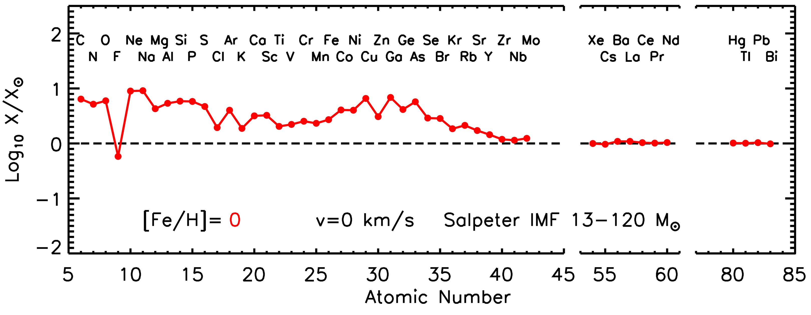
Solar Metallicity non Rotating Models: Composition of the Ejecta
The elements Ne-Ca (synthesized only by massive stars) are coproduced with O. Some of them underproduced by more than a factor of 2 (Cl K) → other sources
The iron peak elements Ti-Ni are underproduced compared to O. SNIa fill the gap
The elements Cu-Zr (weak component, synthesized mainly by massive stars) are coproduced with O. Kr-Rb slightly underproduced → AGB fill the gap
Elements heavier than Zr (main+strong component produced only by AGB stars) not produced

Slide 14
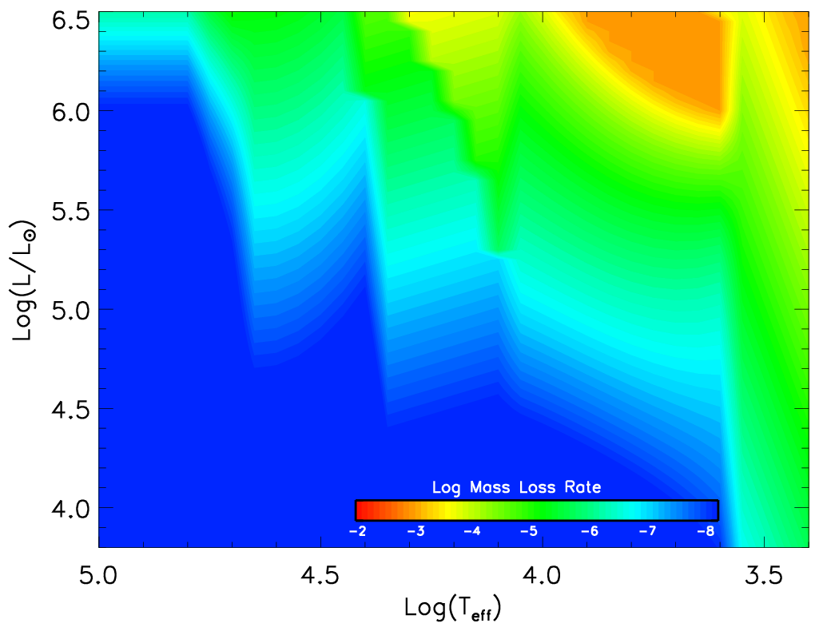
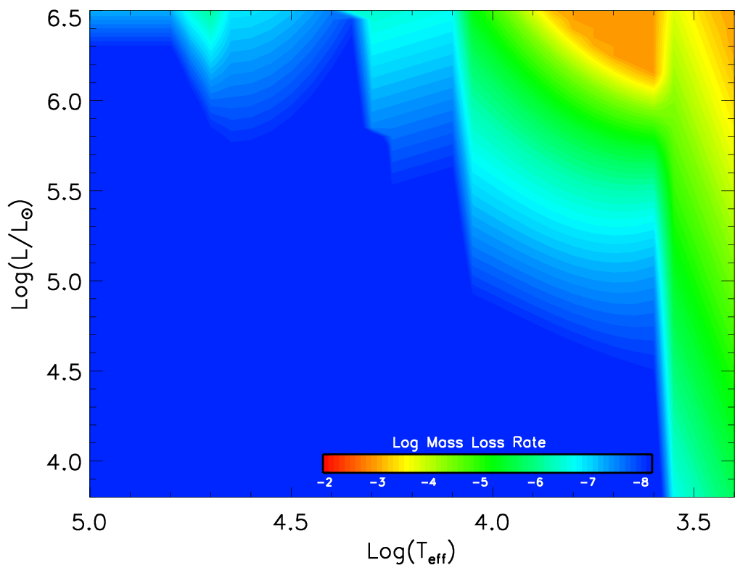
Low Metallicity non Rotating Models: Presupernova Evolution
Mass loss reduces dramatically as the metallicity decreases
[Fe/H]=0
[Fe/H]=-2
Notes:
One crucial ingredient that drives the evolution of a massive star, the mass loss, reduces dramatically as the metallicity decreases.

Slide 15
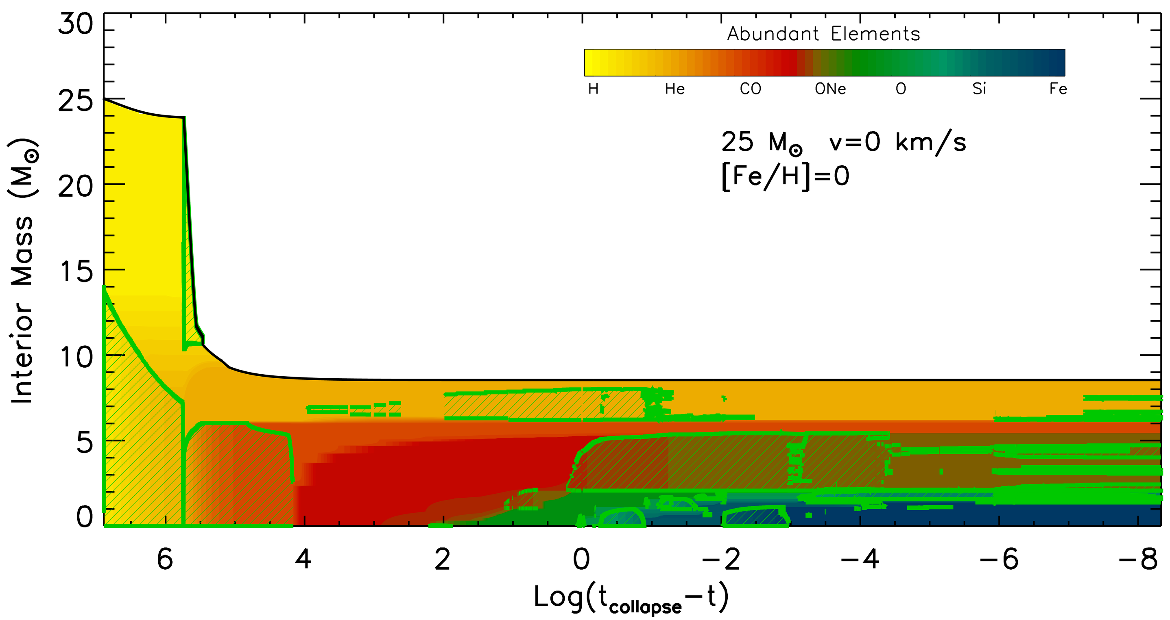
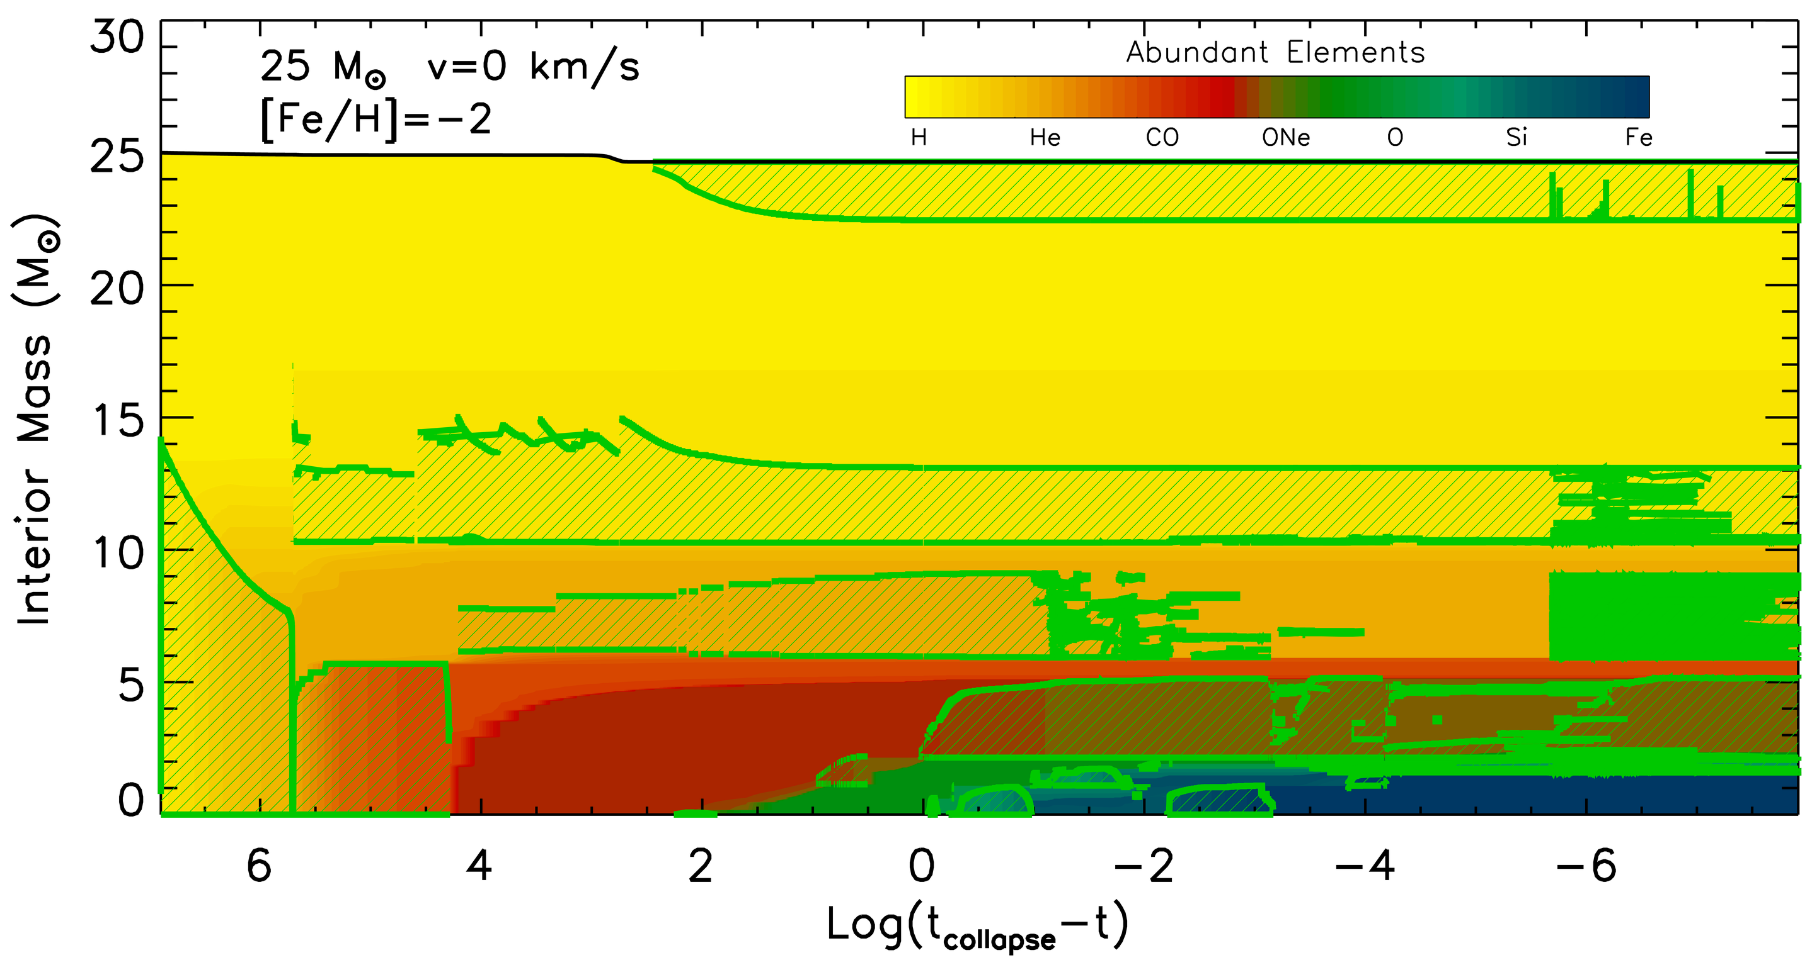
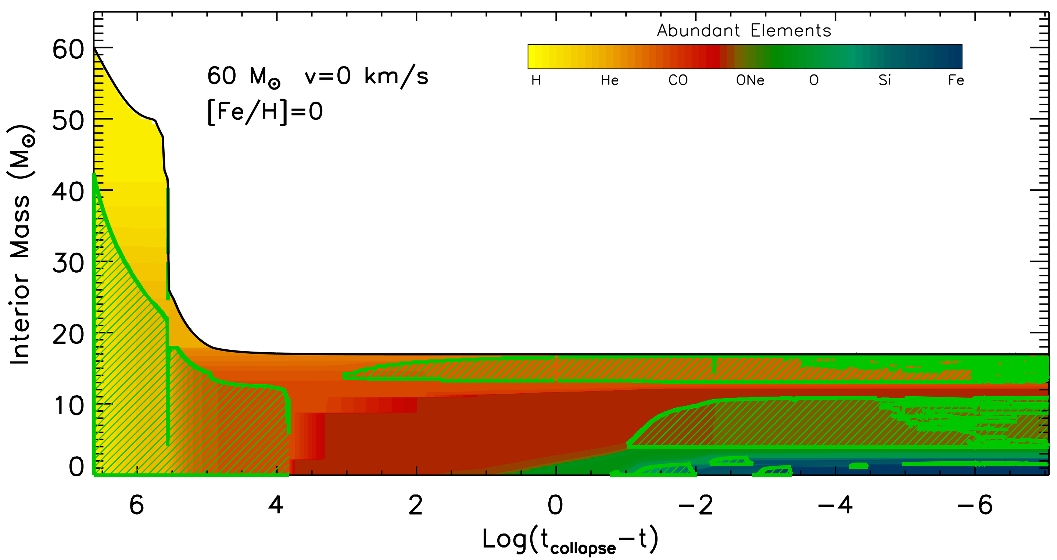
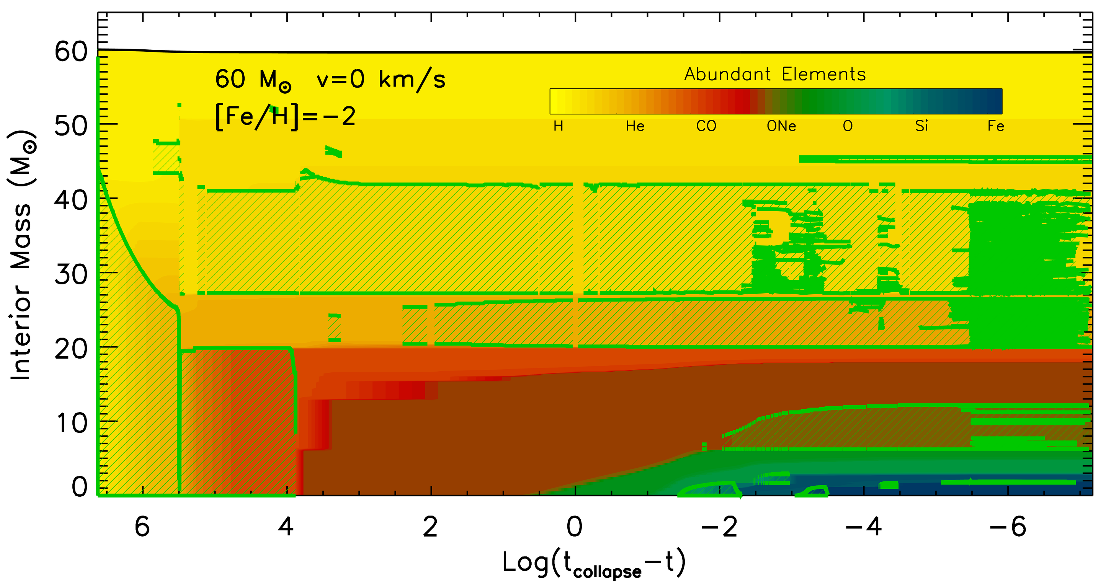
Low Metallicity non Rotating Models: Presupernova Evolution
Dust driven wind
WNL
WNE
Eddington
WNL
WNC
WC
Notes:
Two main information from these plots:
1 - At low metallicities evolution at almost constant mass
2 - Lower mass models the CO core does not depend on the initial metallicity (because at solar metallicity it is not affected by mass loss)
3 - Higher mass models the CO increases substantially at lower metallicities (it is not limited as in the case of the higher metallicities)

Slide 16
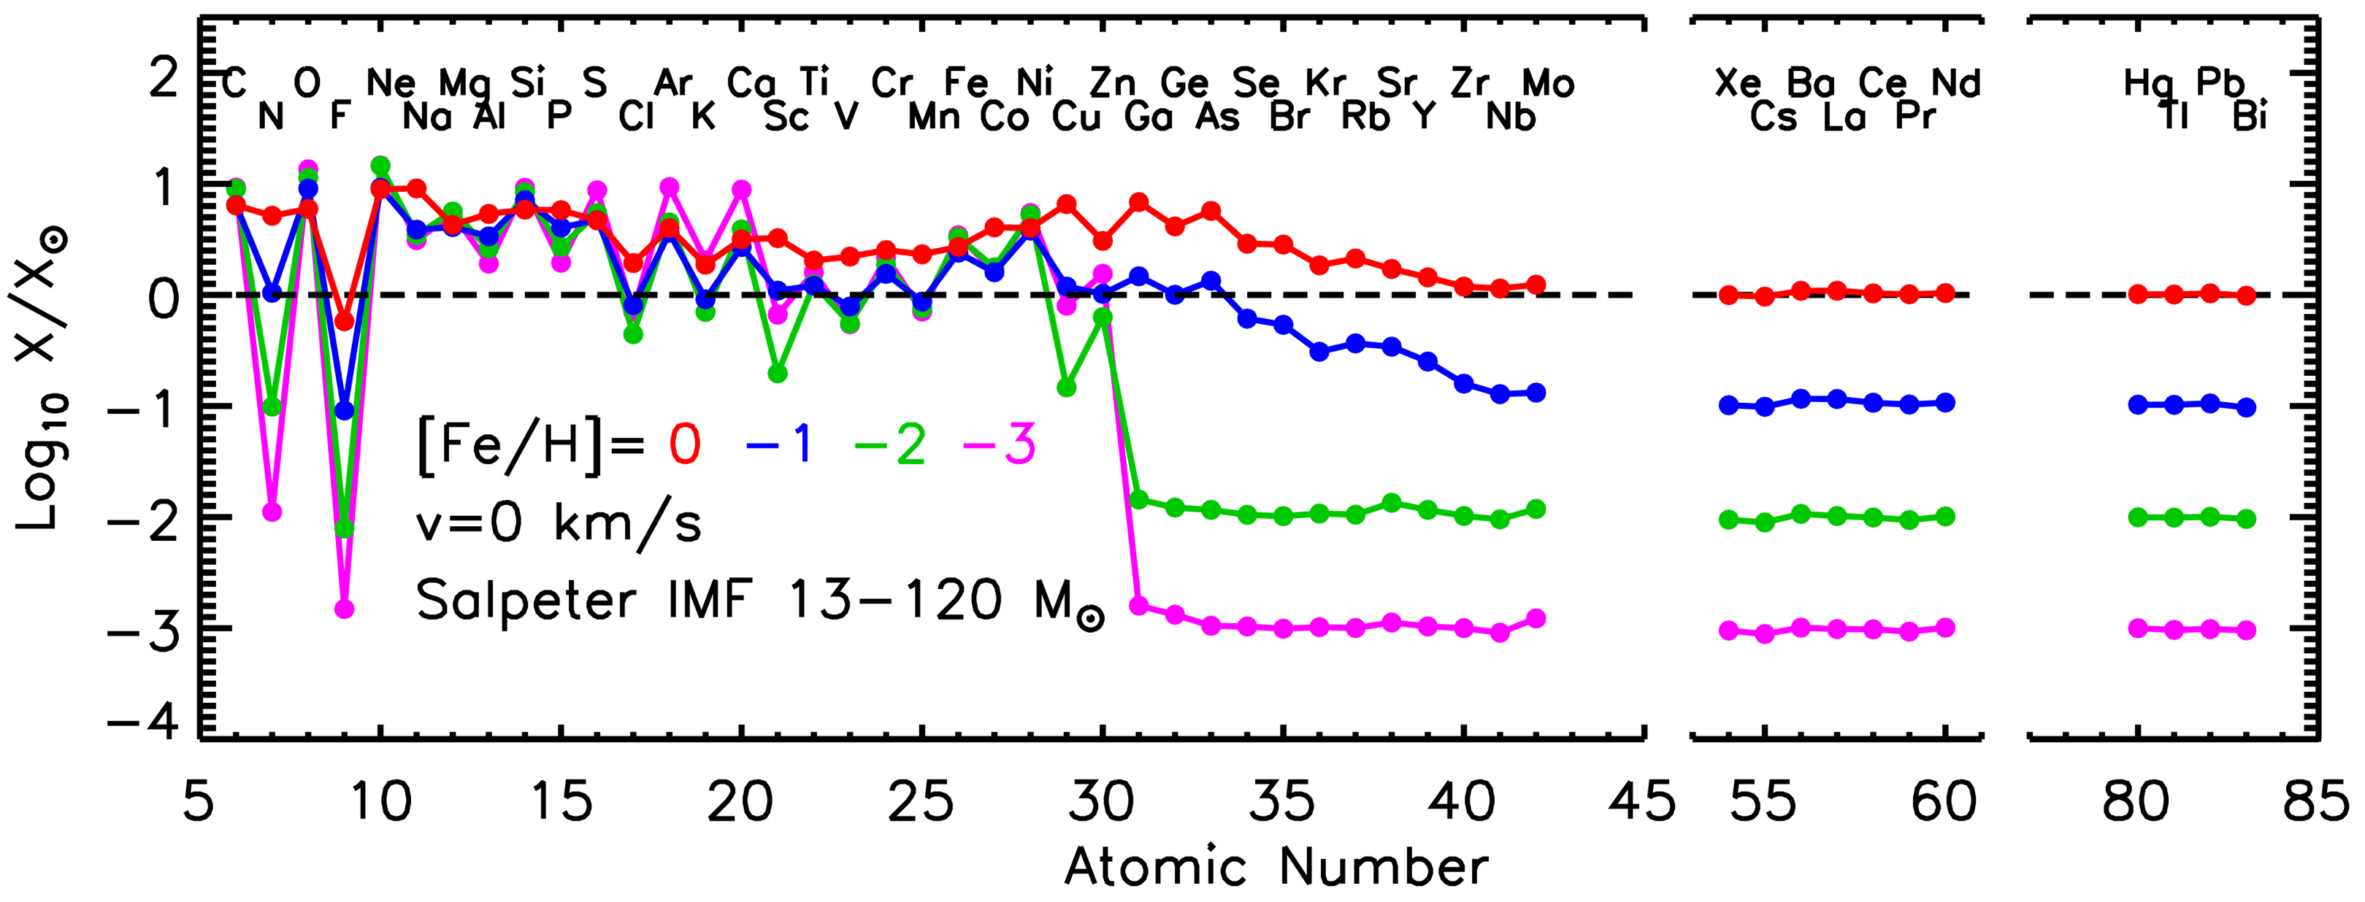
Low Metallicity non Rotating Models: Composition of the Ejecta
Alpha elements show (as expected) the typical behavior of primary nuclei (negligible dependence on the initial metallicity)
The odd elements (from N to Sc), on the contrary, show a typical secondary behavior
All the heavy elements above Fe-peak are produced as secondaries (Zn-Zr start being produced above metallicity [Fe/H]=-1, the others are never produced)

Slide 17
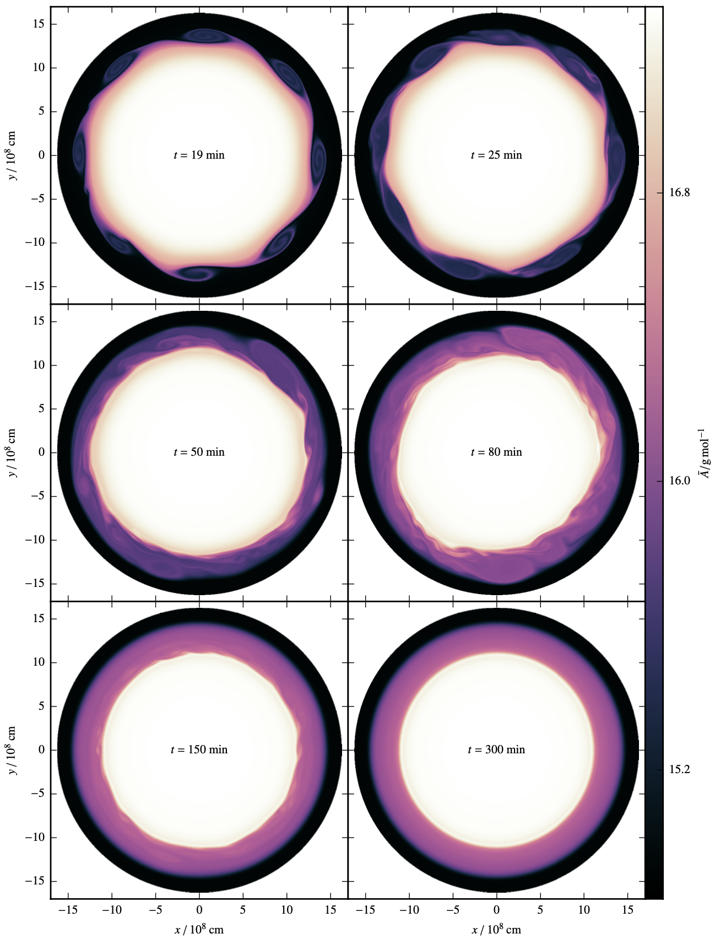
ROTATION DRIVEN INSTABILITIES: TURBULENT SHEAR
Edelmann+2017
Differential rotation induces chemical mixing

Slide 18
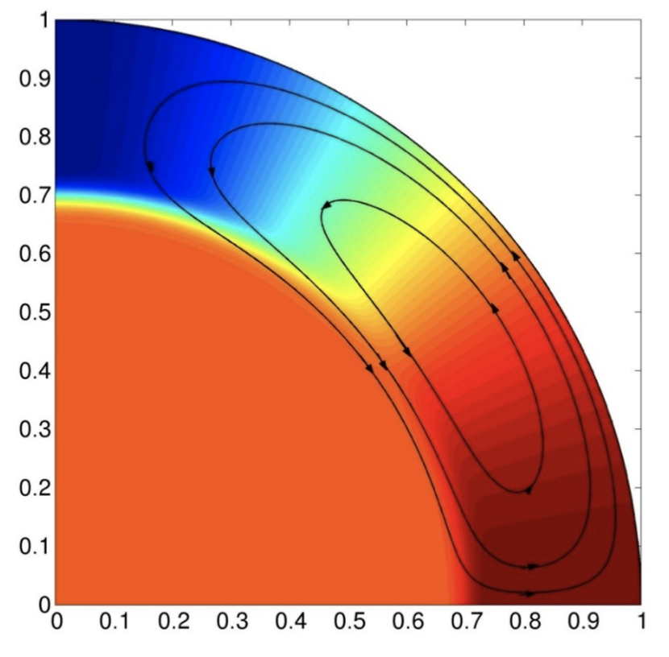
ROTATION DRIVEN INSTABILITIES: MERIDIONAL CIRCULATION
Rotation makes the star oblates
Different heat content between the pole to the equator
HOT
Large-scale MERIDIONAL CIRCULATION develops
Velocity of meridional circulation
COOL
Meridional circulation moves matter through the star and hence it can both transport angular momentum and induce mixing of the chemical composition

Slide 19
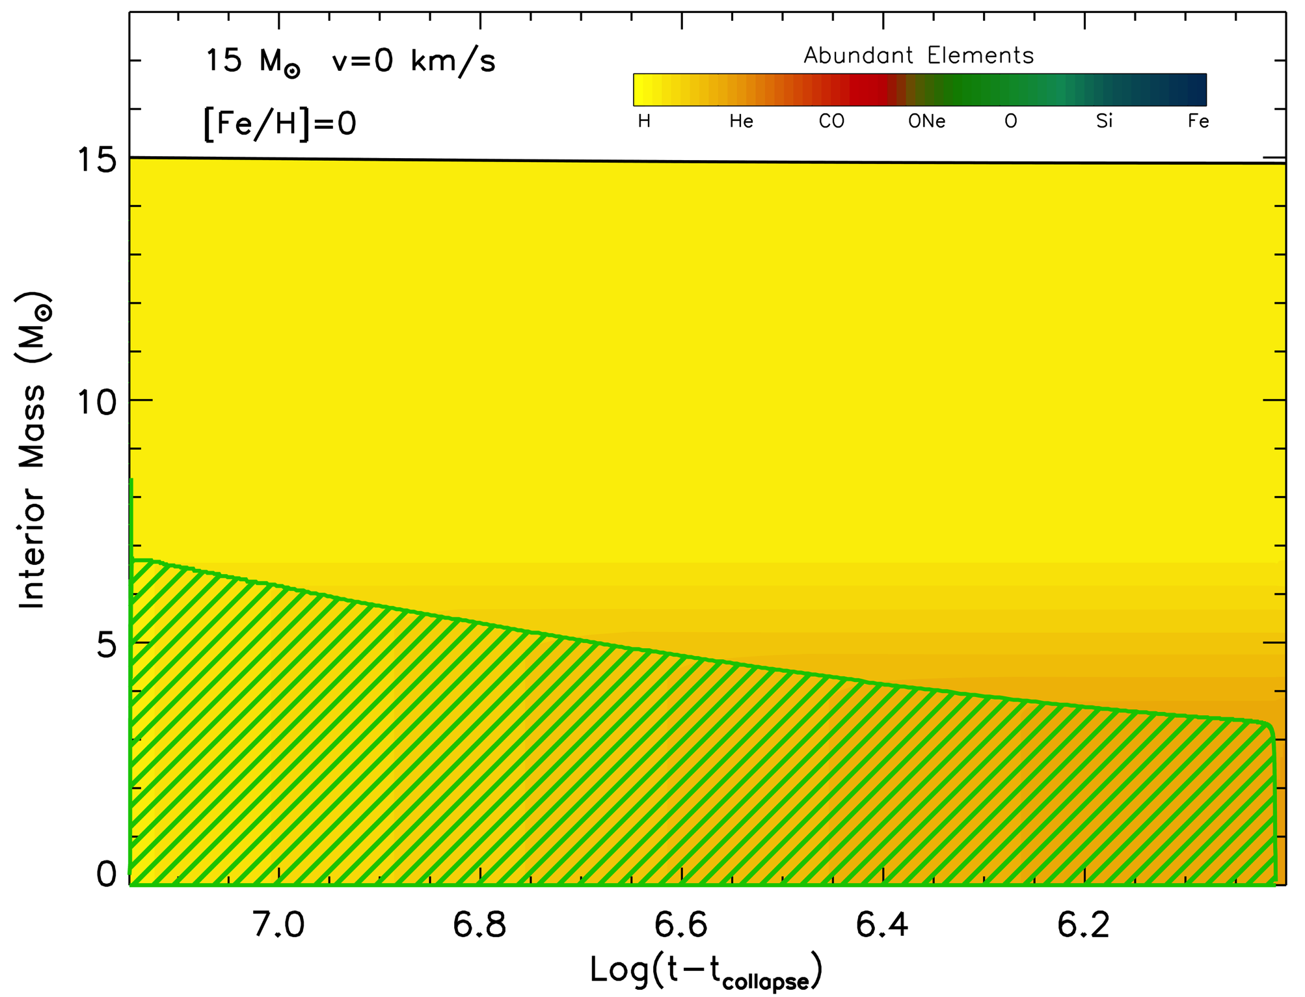
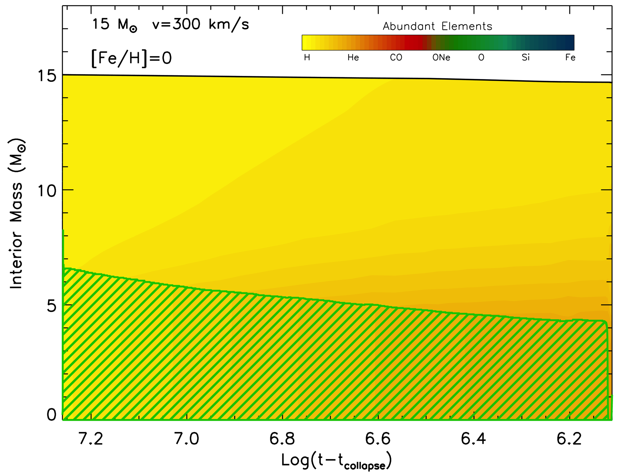
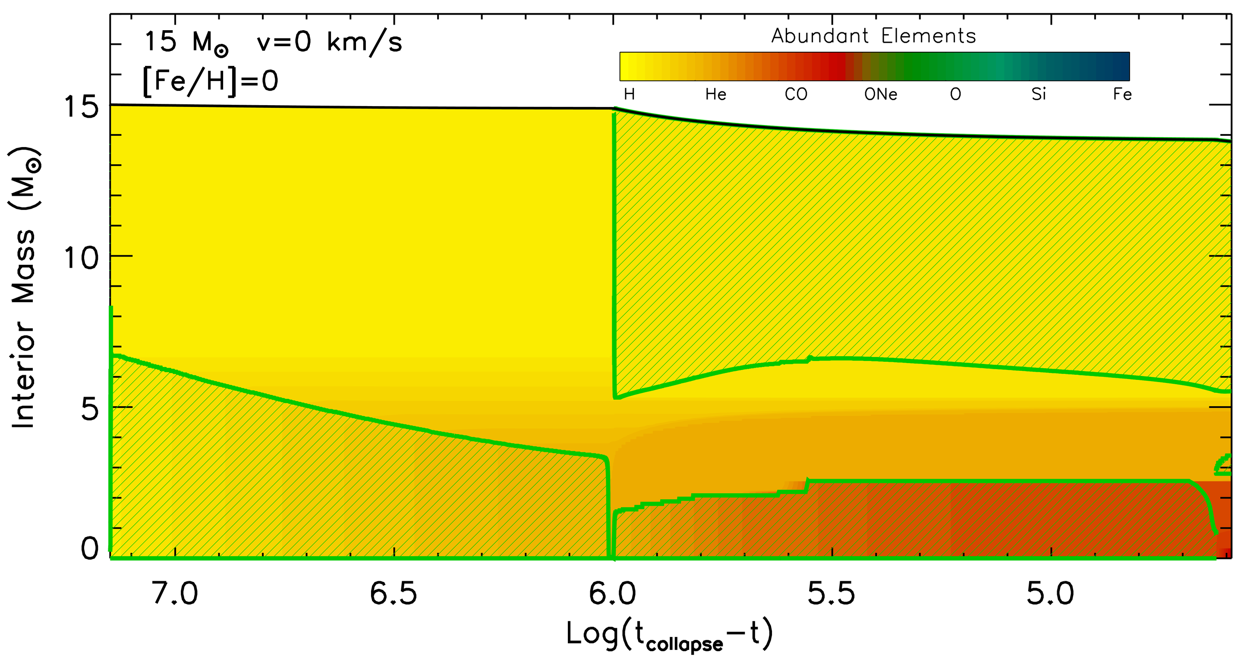
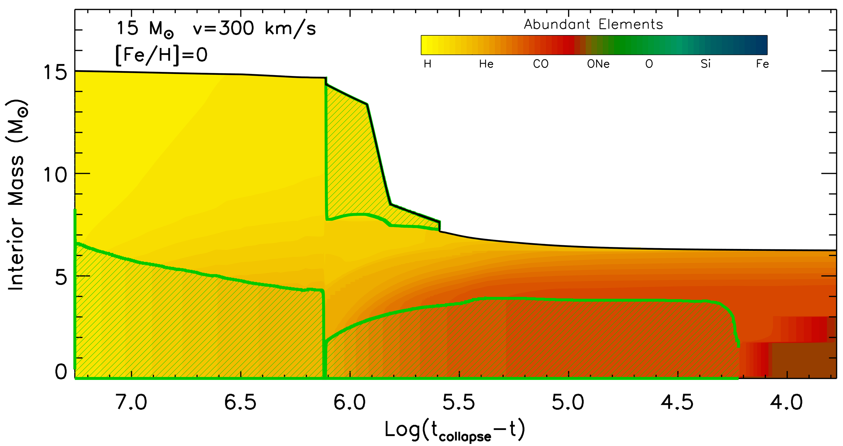
Rotation Driven Mixing in Core H and Core He Burning
Internal evolution: mixing of core H burning products into the H-rich envelope
H burning processed
material
mixed outward
H convective core
H convective core
H convective core
Internal evolution: mixing of core He burning products up to the tail of H-shell
H con. env.
H convective envelope
H conv. core
H conv. core
He conv. core
He conv. core
Notes:
the effect of the rotation induced mixing on the increase of the He core and the chemical surface enrichment is shown here

Slide 20
Production of N, F and s-process Elements in Rotating Massive Stars
¹²C synthesized in the He convective core diffuses up to the tail of the H-burning shell
Rotation induced mixing
¹²C
He convective core
He radiative core
¹²C
p
H-rich radiative zone
⁴He → ¹²C
¹²C
p
¹²C
p

Slide 21
Production of N, F and s-process Elements in Rotating Massive Stars
¹²C synthesized in the He convective core diffuses up to the tail of the H-burning shell
¹²C is converted into CNO nuclei whose abundances are enhanced (the most abundant being ¹⁴N)
Rotation induced mixing
¹²C
He convective core
He radiative core
¹²C
p
H-rich radiative zone
⁴He → ¹²C
¹²C
p
¹²C
p
¹²C+p → CNO (¹⁴N, ¹³C, ¹⁵N, ¹⁷O)

Slide 22
Production of N, F and s-process Elements in Rotating Massive Stars
¹²C synthesized in the He convective core diffuses up to the tail of the H-burning shell
¹²C is converted into CNO nuclei whose abundances are enhanced (the most abundant being ¹⁴N)
The fresh CNO nuclei, and in particular ¹⁴N, plus fresh He, are brought back toward the center.
Rotation induced mixing
¹²C
He convective core
He radiative core
¹²C
p
H-rich radiative zone
⁴He → ¹²C
¹²C
p
¹⁴N
¹²C
p
CNO + ⁴He
¹²C+p → CNO (¹⁴N, ¹³C, ¹⁵N, ¹⁷O)

Slide 23
Production of N, F and s-process Elements in Rotating Massive Stars
¹²C synthesized in the He convective core diffuses up to the tail of the H-burning shell
¹²C is converted into CNO nuclei whose abundances are enhanced (the most abundant being ¹⁴N)
The fresh CNO nuclei, and in particular ¹⁴N, plus fresh He, are brought back toward the center.
The ¹⁴N that diffused back to the center is quickly converted into ²²Ne that becomes an efficient primary neutron source → strong s-process nucleosynthesis activated
Rotation induced mixing
¹²C
He convective core
He radiative core
¹²C
p
H-rich radiative zone
⁴He → ¹²C
¹²C
p
¹⁴N → ²²Ne → neutrons/s-proc
¹²C
p
CNO + ⁴He
¹²C+p → CNO (¹⁴N, ¹³C, ¹⁵N, ¹⁷O)

Slide 24
Production of N, F and s-process Elements in Rotating Massive Stars
¹²C synthesized in the He convective core diffuses up to the tail of the H-burning shell
¹²C is converted into CNO nuclei whose abundances are enhanced (the most abundant being ¹⁴N)
The fresh CNO nuclei, and in particular ¹⁴N, plus fresh He, are brought back toward the center.
The ¹⁴N that diffused back to the center is quickly converted into ²²Ne that becomes an efficient primary neutron source → strong s-process nucleosynthesis activated
Formation of a CNO (¹⁴N, ¹³C, ¹⁵N, ¹⁷O) pocket in the radiative layers of the He core
CO Core
He radiative core
H-rich radiative zone
CNO pocket
(¹⁴N, ¹³C, ¹⁵N, ¹⁷O)

Slide 25
Production of N, F and s-process Elements in Rotating Massive Stars
¹²C synthesized in the He convective core diffuses up to the tail of the H-burning shell
¹²C is converted into CNO nuclei whose abundances are enhanced (the most abundant being ¹⁴N)
The fresh CNO nuclei, and in particular ¹⁴N, plus fresh He, are brought back toward the center.
The ¹⁴N that diffused back to the center is quickly converted into ²²Ne that becomes an efficient primary neutron source → strong s-process nucleosynthesis activated
Formation of a CNO (¹⁴N, ¹³C, ¹⁵N, ¹⁷O) pocket in the radiative layers of the He core
The ¹³C and ¹⁴N engulfed by the He convective shell activate a strong ¹⁹F production
CO Core
He conv. shell
He rad. core
H-rich radiative zone
¹⁴N ¹³C → ¹⁹F
CNO pocket
(¹⁴N, ¹³C, ¹⁵N, ¹⁷O)

Slide 26
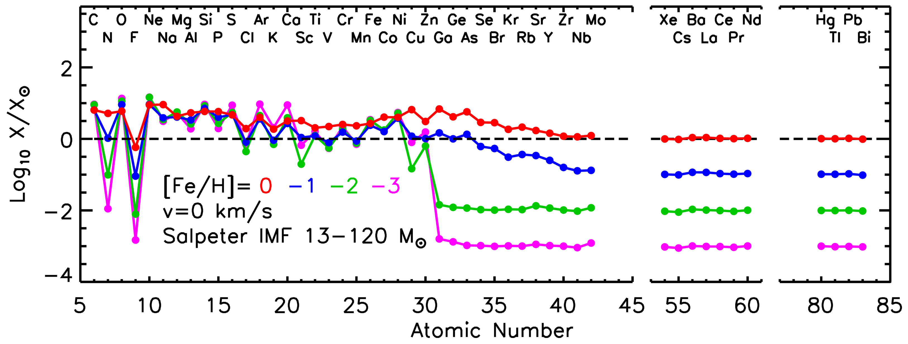
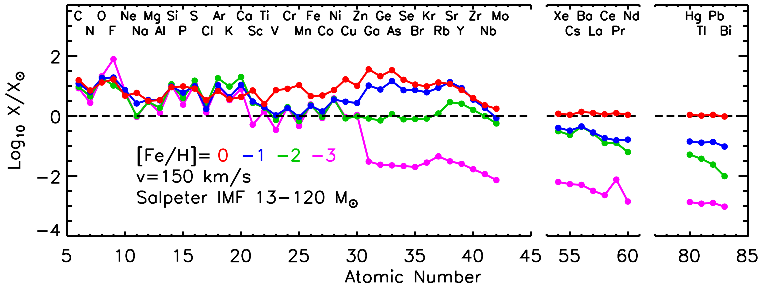
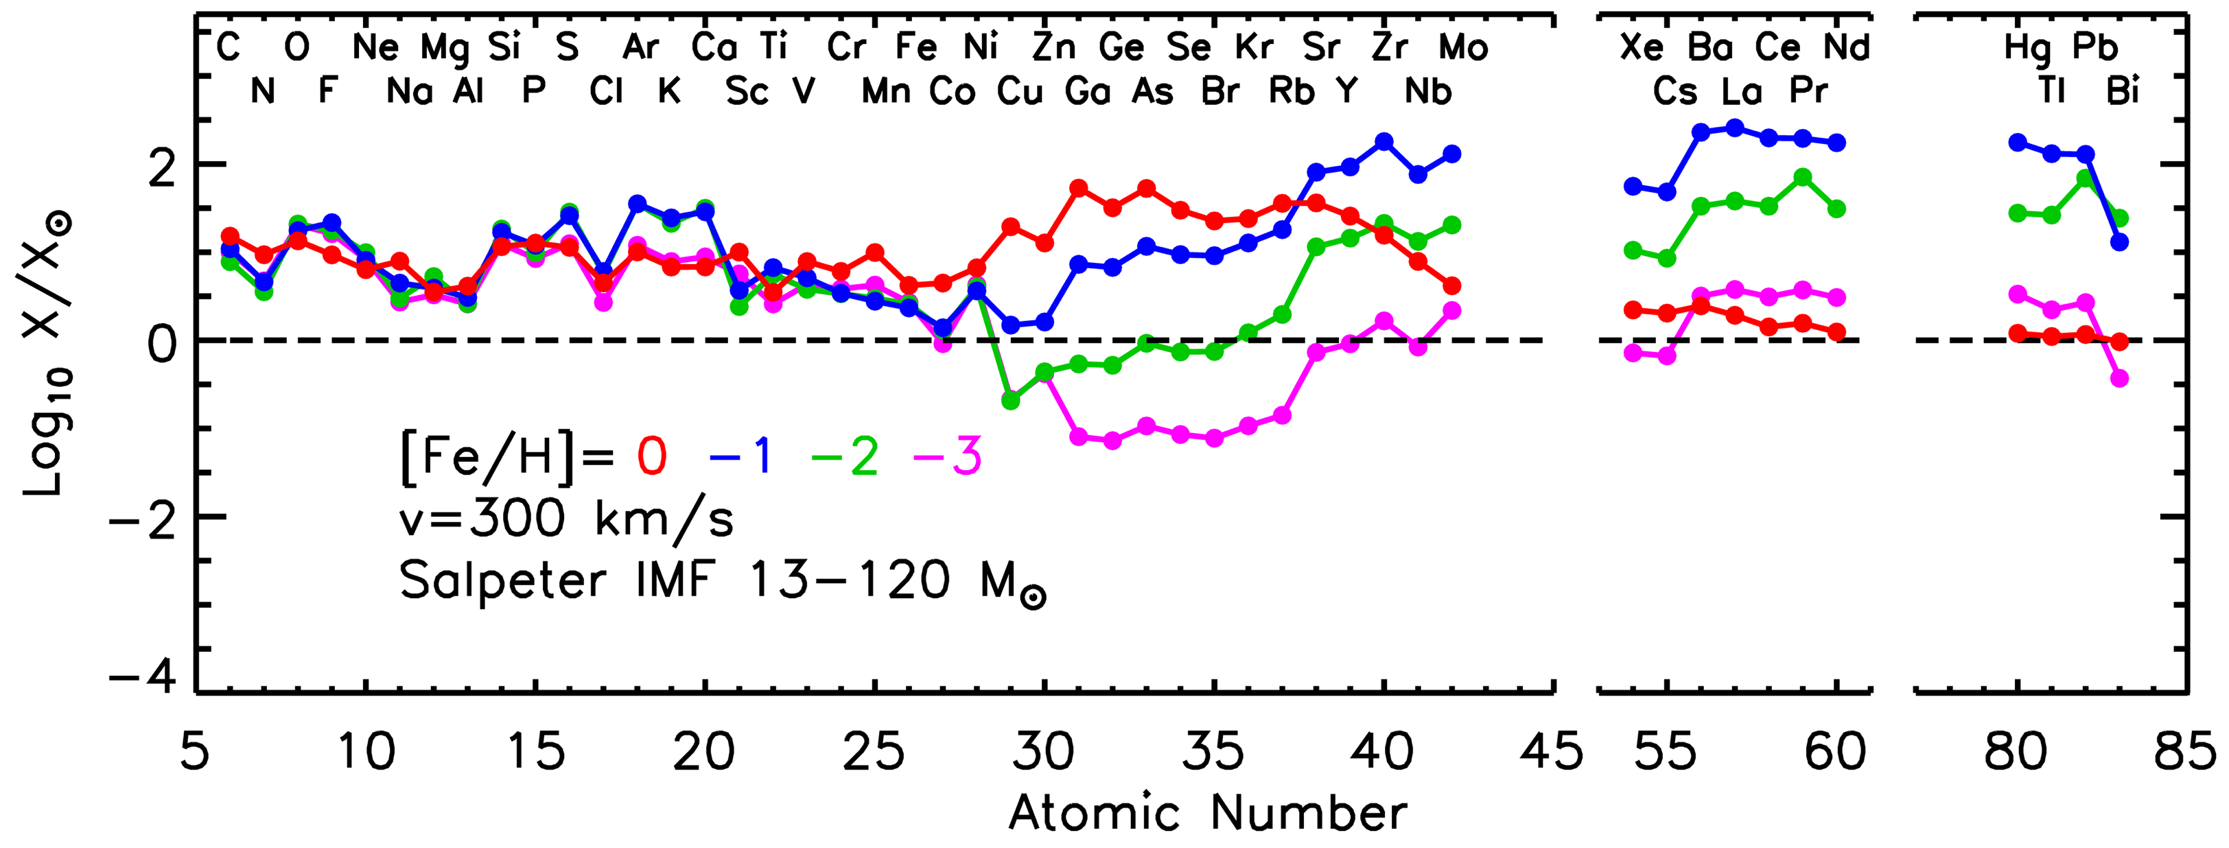
Rotating Models: Composition of the Ejecta
The trends of N and F with the initial metallicity turn from a typical secondary to a typical primary behavior

Slide 27
Rotating Models: Composition of the Ejecta
The trends of N and F with the initial metallicity turn from a typical secondary to a typical primary behavior
The production of s-process elements is substantially enhanced with increasing the initial rotation velocity

Slide 28
Rotating Models: Composition of the Ejecta
The trends of N and F with the initial metallicity turn from a typical secondary to a typical primary behavior
The production of s-process elements is substantially enhanced with increasing the initial rotation velocity
Large overproduction with respect to O (especially the s-only isotopes) at metallicities -2<[Fe/H]<0

Slide 29
Rotating Models: Composition of the Ejecta
The trends of N and F with the initial metallicity turn from a typical secondary to a typical primary behavior
The production of s-process elements is substantially enhanced with increasing the initial rotation velocity
Large overproduction with respect to O (especially the s-only isotopes) at metallicities -2<[Fe/H]<0
OBSERVATIONAL REQUIREMENTS
Primary behavior of N (at the lowest metallicities)
Prevention of an overproduction of the s-only nuclei at metallicities -2<[Fe/H]<-1

Slide 30
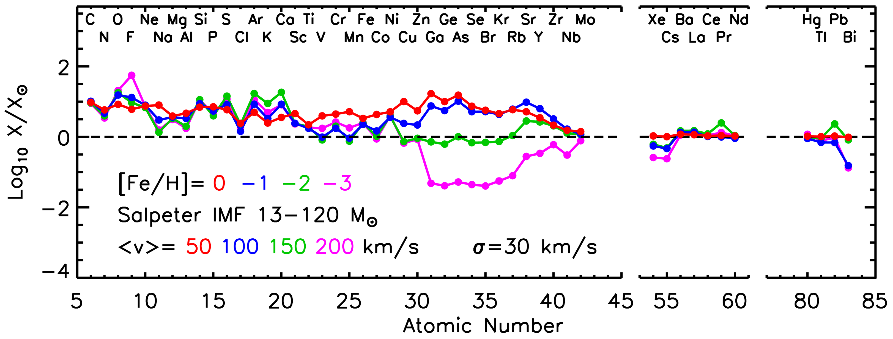
Rotating Models: Composition of the Ejecta
Initial Distribution of Rotation Velocities (IDROV)
Gaussian with and

Slide 31
Rotating Models: Composition of the Ejecta
Initial Distribution of Rotation Velocities (IDROV)
Gaussian with and
Alpha elements behave as primaries

Slide 32
Rotating Models: Composition of the Ejecta
Initial Distribution of Rotation Velocities (IDROV)
Gaussian with and
Alpha elements behave as primaries
N shows a negligible dependence on the initial metallicity (primary)

Slide 33
Rotating Models: Composition of the Ejecta
Initial Distribution of Rotation Velocities (IDROV)
Gaussian with and
Alpha elements behave as primaries
N shows a negligible dependence on the initial metallicity (primary)
Elements between Zn and Zr display a secondary like behavior and always underproduced compared with O. At solar metallicity almost coproduced with O

Slide 34
Rotating Models: Composition of the Ejecta
Initial Distribution of Rotation Velocities (IDROV)
Gaussian with and
Alpha elements behave as primaries
N shows a negligible dependence on the initial metallicity (primary)
Elements between Zn and Zr display a secondary like behavior and always underproduced compared with O. At solar metallicity almost coproduced with O
Elements heavier than Zr behave like primary elements but their overproduction remains always lower than that of O

Slide 35
Summary and Conclusions
In the NON ROTATING case:
Alpha elements show the typical behavior of primary nuclei (negligible dependence on the initial metallicity)
The odd elements (from N to Sc), on the contrary, show a typical secondary behavior
All the heavy elements above Fe-peak are produced as secondaries (Zn-Zr start being produced above metallicity [Fe/H]=-1, the others are never produced)
In the ROTATING case:
The trends of N and F with the initial metallicity turn from a typical secondary to a typical primary behavior
The production of s-process elements is substantially enhanced with increasing the initial rotation velocity
Large overproduction with respect to O (especially the s-only isotopes) at metallicities -2<[Fe/H]<0
The yields of almost all the elements are considerably increased in rotating models due to the larger He cores induced by the rotation driven mixing

