Slide 1
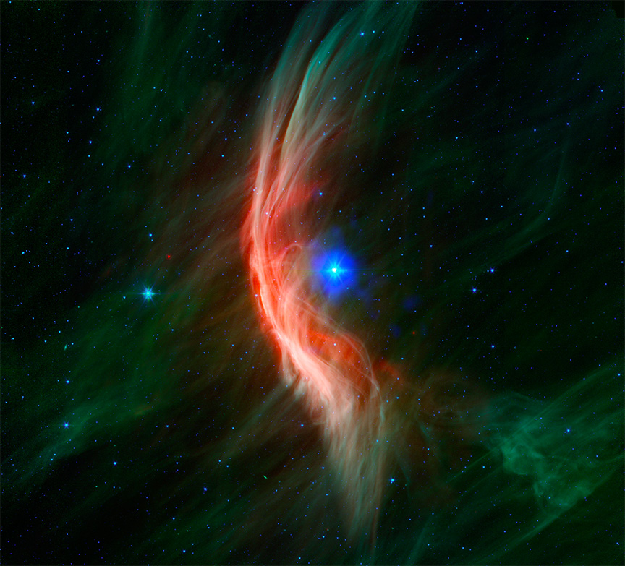
Stellar wind simulations and bow shocks
Jonathan Mackey Dublin Institute for Advanced Studies
Topical Overview on Star Cluster Astrophysics (TOSCA)
Siena, Italy, 30th October 2024
dias.ie
#DIASdiscovers
Notes:
1

Slide 2
Outline
Bow shocks of runaway massive stars
Non-thermal emission
Thermal X-ray emission from Zeta Ophiuchi’s bow shock
Models for X-rays from bow shocks
Multi-ion non-equilibrium solver for ionized plasmas
Description and short advertisement for the solver
Colliding-wind binary systems
Inverse-Compton cooling of thermal plasma

Slide 3
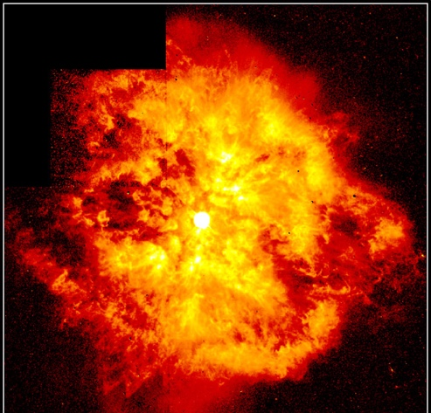
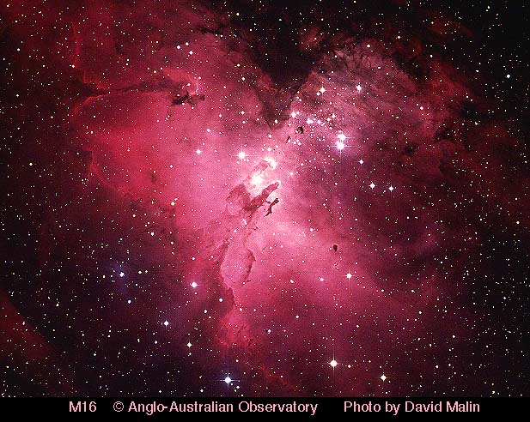
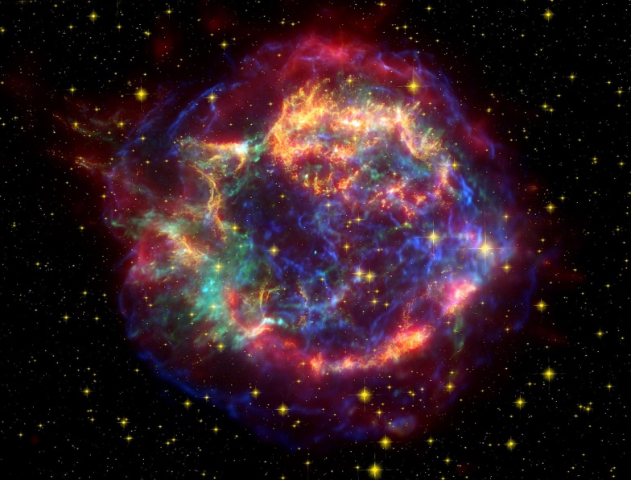
Single Massive Stars
Nebulae due to mass loss
Can contain a few $M_{⊙}$
Born in molecular clouds
Usually with other OB stars
Ejected by grav. dynamics
Stellar wind – ISM interaction produces bow shock
Particle acceleration in wind termination shock (and forward shock)
Supernova explodes into circumstellar matter
Caveat: most single massive stars used to be in a binary/triple system

Slide 4
Bow shocks of hot stars
NGC 7635
Zeta Ophiuchi
BD+43 3654
$v_{∞}=2200$ km/s, $v_{rot}=250$ km/s, $$\dot{M}≈{10}^{−6}M_{⊙}/yr$$
$v_{∞}=1500$ km/s, $v_{rot}=400$ km/s, $$\dot{M}≈{10}^{−8}M_{⊙}/yr$$
$v_{∞}=2300$ km/s, $v_{rot}≤100$ km/s, $$\dot{M}≈{10}^{−5}M_{⊙}/yr$$
Bubble Nebula, driven by BD+60 2522, 40 $M_{⨀}$ star, ~37,500 K, moving with ~30 km/s into dense ISM, $n\sim 50 {\text{cm}}^{−3}$
(HST optical image)
Bow shock of Zeta Ophiuchi, driven by a 20 $M_{⨀}$ star, ~31,000 K, moving with ~30 km/s into ISM $n\sim (3−10) {\text{cm}}^{−3}$
Bow shock of BD+43 3654: 60-70 $M_{⨀}$ supergiant star, ~40,000 K, moving with ~40? km/s in ISM with $n\sim 15 {\text{cm}}^{−3}$, in Cygnus region.
Spitzer Space Telescope IR images from Toala et al. (2016)

Slide 5
Radio observations of bow shocks
Bow shocks of BD+60 2522 (Bubble Nebula, left) and BD+43 3654 (right), M. Moutzouri+(2022), 4-12GHz, VLA
Detect synchrotron emission based on radio spectral index
Moutzouri, Mackey, et al. (2022,A&A,663,A80)
https://arxiv.org/abs/2204.11913

Slide 6
Non-thermal radiation?
Radio synchrotron emission detected from bow shocks (e.g. Benaglia+,2010,2021)
Only upper limits at X-ray (Toala+,2017), GeV (Schulz+,2014), TeV (H.E.S.S. Collaboration, 2018)
Multi-zone model (Del Palacio+,2018) shows that HE/VHE emission may be detected with next-generation facilities.
Radio suveys with ASKAP, MeerKAT show very promising results (e.g. van den Eijnden+,2024).
Wolf-Rayet bubbles have no NTE, so far (except possibly WR102 – Prajapati+,2019)
The bow shock of Zeta Ophiuchi, from Spitzer Space Telescope, with Chandra X-rays overlaid in blue
Need to understand the thermal plasma before the non-thermal can be successfully modelled – magnetic fields, boundary layer processes, cooling
Image credit: X-ray: NASA/CXC/Dublin Inst. Advanced Studies/S. Green et al.; Infrared: NASA/JPL/Spitzer
https://www.nasa.gov/mission_pages/chandra/images/embracing-a-rejected-star.html

Slide 7
Zeta Ophiuchi
Only 135 pc from Earth
Closest O-type star
Closest such bow shock
Gal. lat. +25 deg
Bright IR (van Buren & McCray 1988) and optical emission (Gull & Sofia 1979) detected.
Radio / gamma-ray not detected, but predicted (del Valle & Romero 2012, del Palacio+,2018, Green+2022)
The bow shock of Zeta Ophiuchi, from Spitzer Space Telescope, with Chandra X-rays overlaid in blue
Image credit: X-ray: NASA/CXC/Dublin Inst. Advanced Studies/S. Green et al.; Infrared: NASA/JPL/Spitzer
https://www.nasa.gov/mission_pages/chandra/images/embracing-a-rejected-star.html

Slide 8
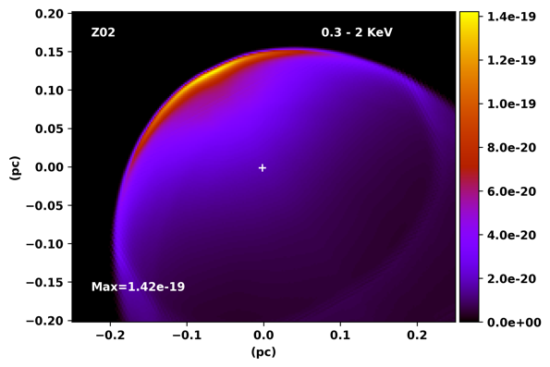
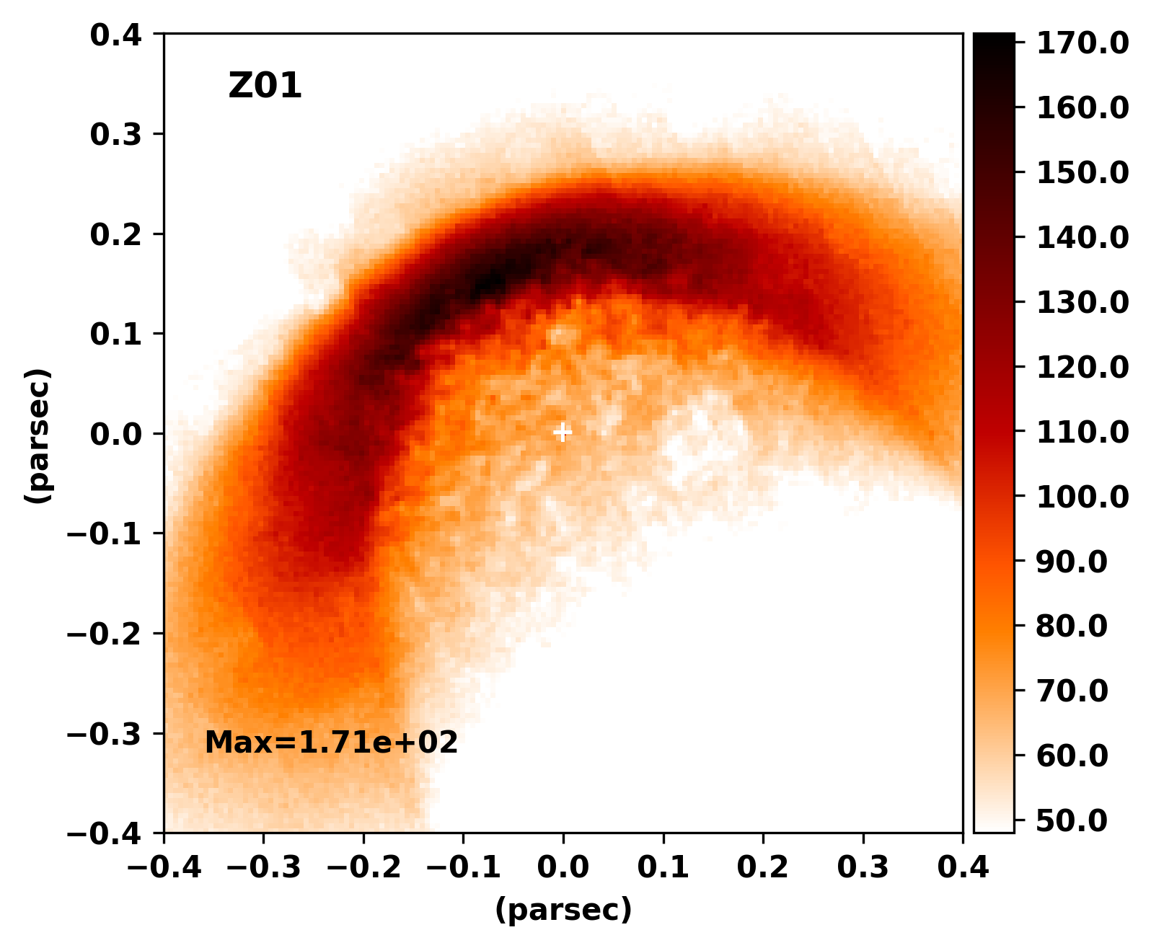
Diffuse X-rays from Zeta Ophiuchi
Toala+(2016) - diffuse X-rays in Chandra data.
Sam Green (PhD 2021) investigated thermal X-ray emission from simulated bow shocks.
In Green+(2022) we re-analysed the observations, confirming the detection
First 3D MHD simulations of the bow shock
Synthetic X-ray and IR images of bow shock.
Toala et al., 2016, Chandra X-ray Observatory

Slide 9
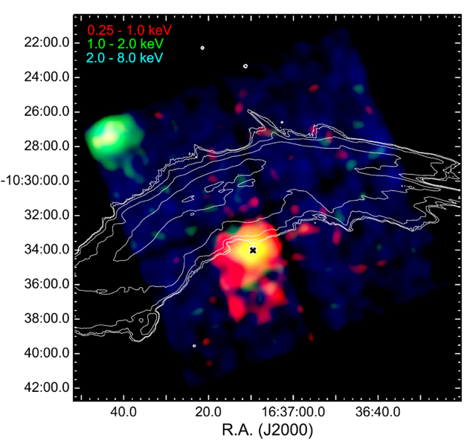
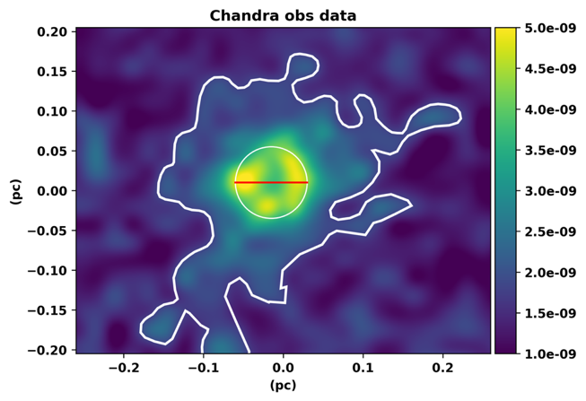
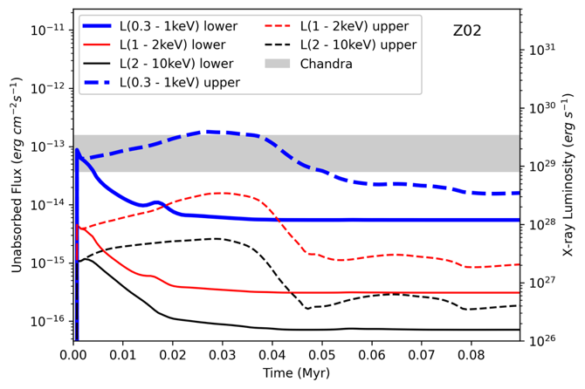
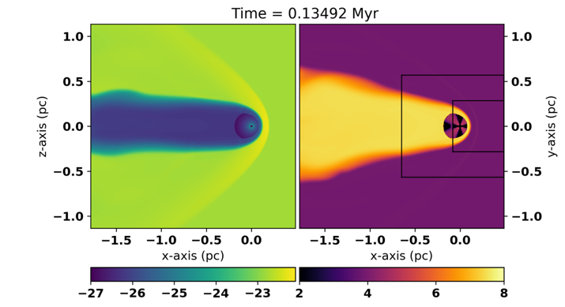
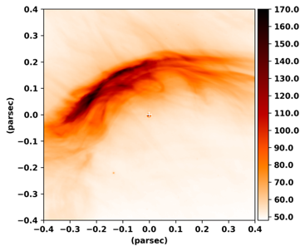
Diffuse X-rays from bow shocks
Toala+(2016) detected diffuse X-rays from around Zeta Ophiuchi with Chandra data.
Emission is weak, contaminated by stellar photons, but it is there
In Green+(2022) we re-analysed the observations, confirming the detection
First 3D MHD simulations of the bow shock
Can match IR emission quite well
X-rays from simulation are too faint
Resolution issue? (not enough turbulence)
#DIASdiscovers

Slide 10
Diffuse X-rays from Zeta Oph – too faint
3D MHD results: simulations vs. observations
matches IR emission quite well
X-rays from simulation are too faint
X-ray morphology also not the same
Resolution / physics?
Green, Mackey, et al. (2022,A&A,665,A35)
https://arxiv.org/abs/2203.06331
Counts/sec/pixel

Slide 11
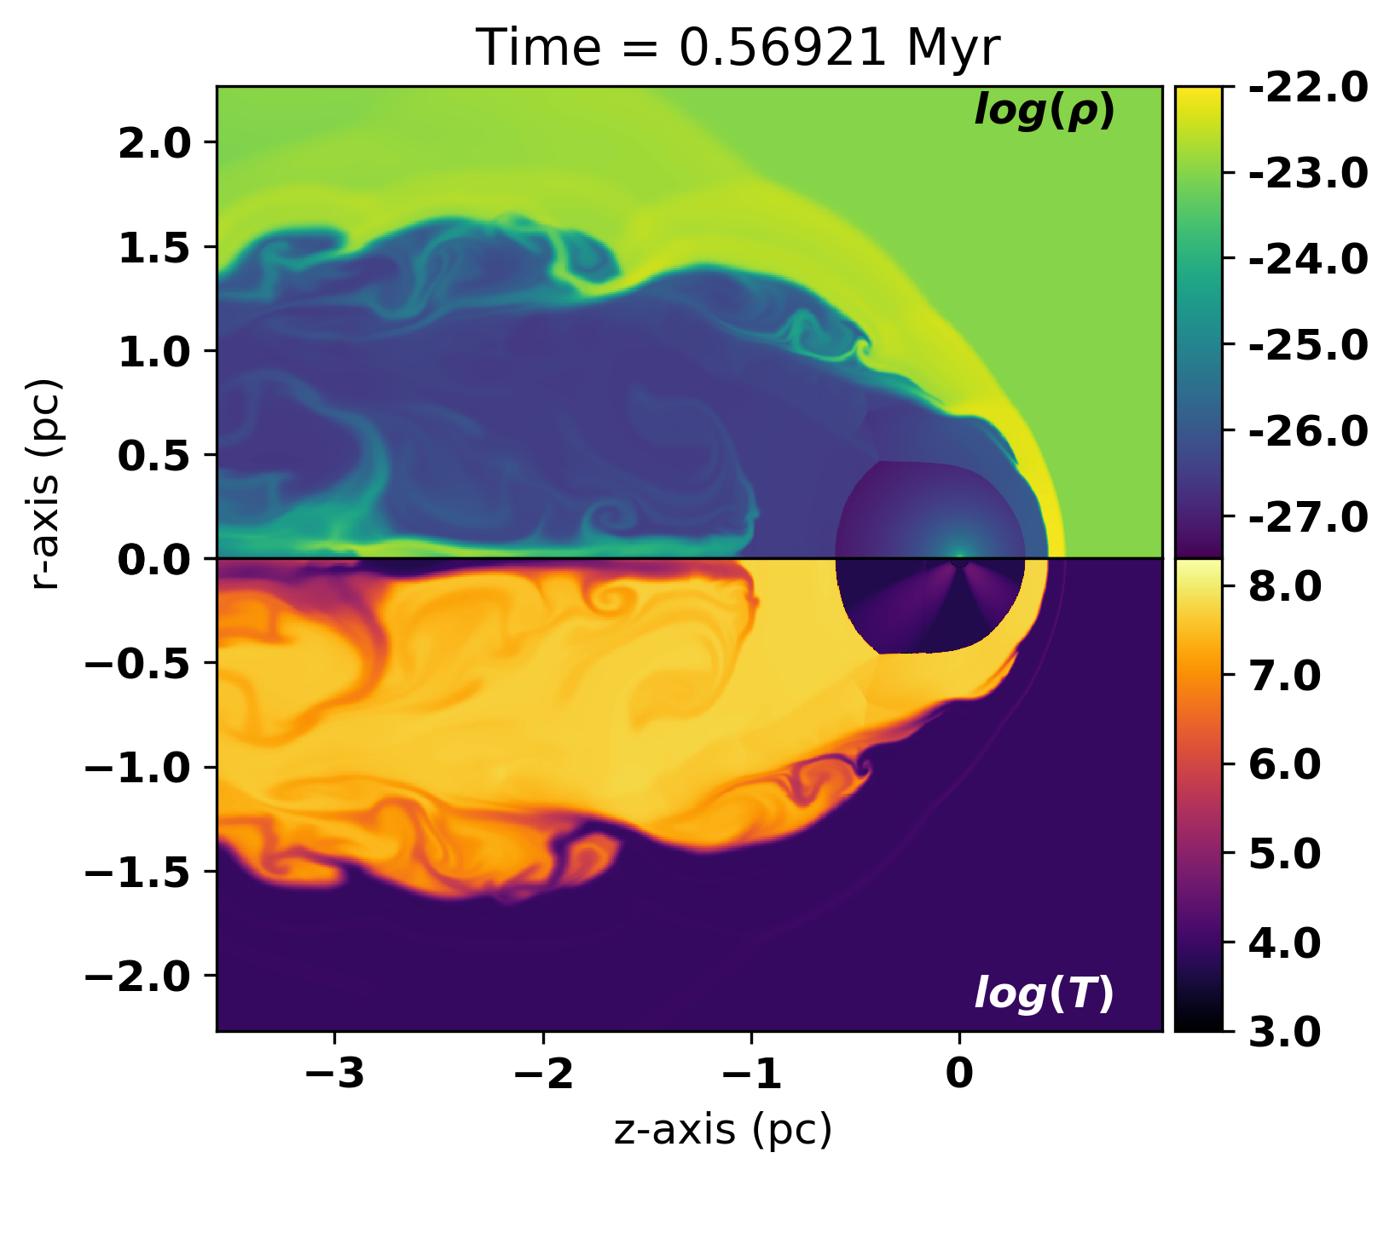
Resolution study of bow shocks
Green+(2022) work used HLL solver (very diffusive at CD)
Upgraded to HLLD/HLL hybrid solver (cf. Mignone+,2012)
2D and 3D MHD simulations with resolutions $128×64$ or ${128}^{3}$ cells, increasing in powers of 2.
Find that X-ray emission is variable, more so with increasing resolution
KH instability at the CD is responsible for this
Interface more stable when $B⊥v_{⋆}$
Convergence looks promising
Left: 256x128 cells Right: 1024x512 cells
2D, 3 levels, HLLD solver
Mackey, et al. (in prep)

Slide 12
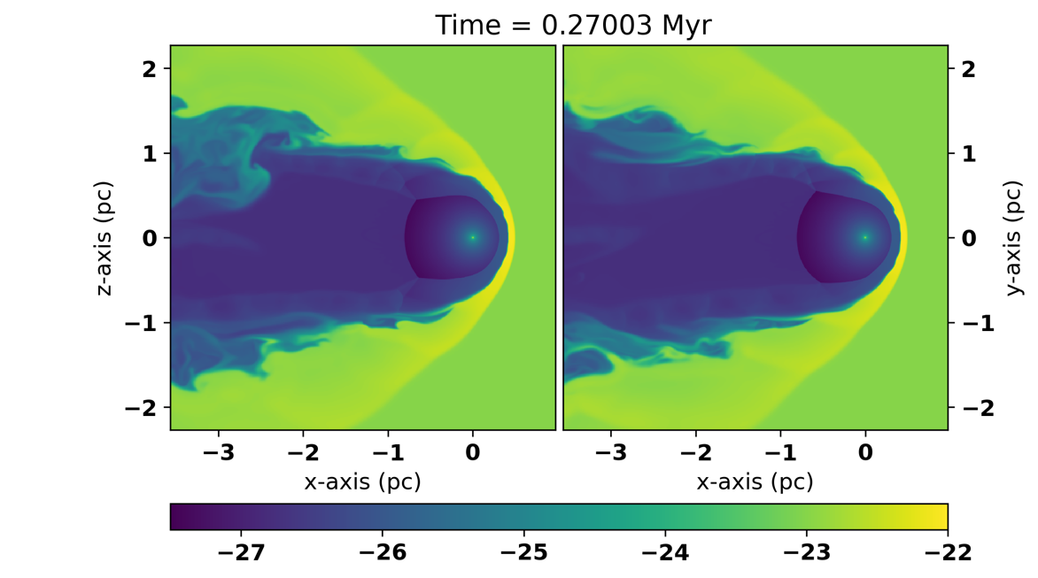
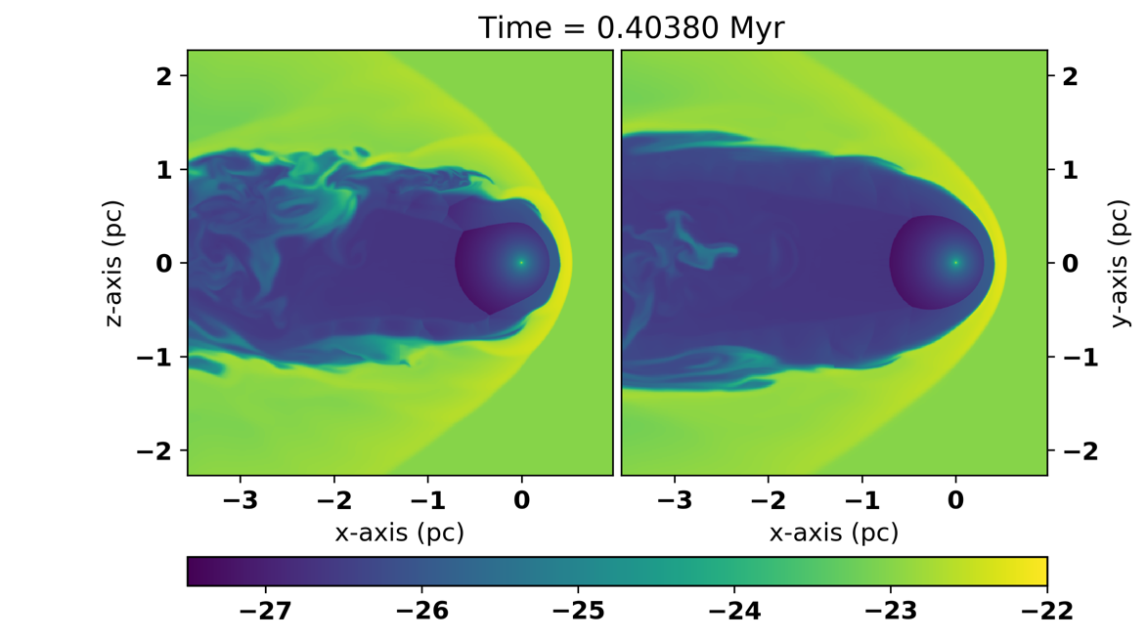
Resolution study of bow shocks
Green+(2022) work used HLL solver (very diffusive at CD)
Upgraded to HLLD/HLL hybrid solver (cf. Mignone+,2012)
2D and 3D MHD simulations with resolutions $128×64$ or ${128}^{3}$ cells, increasing in powers of 2.
Find that X-ray emission is variable, more so with increasing resolution
KH instability at the CD is responsible for this
Interface more stable when $B⊥v_{⋆}$
Convergence looks promising
$B∥v_{⋆}$
${384}^{3}$ cells,
3 levels
HLLD/HLL solver
$B⊥v_{⋆}$

Slide 13
Diffuse X-rays from bow shocks
Toala+(2016) detected diffuse X-rays from around Zeta Ophiuchi with Chandra data.
Emission is weak, contaminated by stellar photons, but it is there
In Green+(2022) we re-analysed the observations, confirming the detection
First 3D MHD simulations of the bow shock
Can match IR emission quite well
X-rays from simulation are too faint
Resolution issue? (not enough turbulence)
#DIASdiscovers

Slide 14
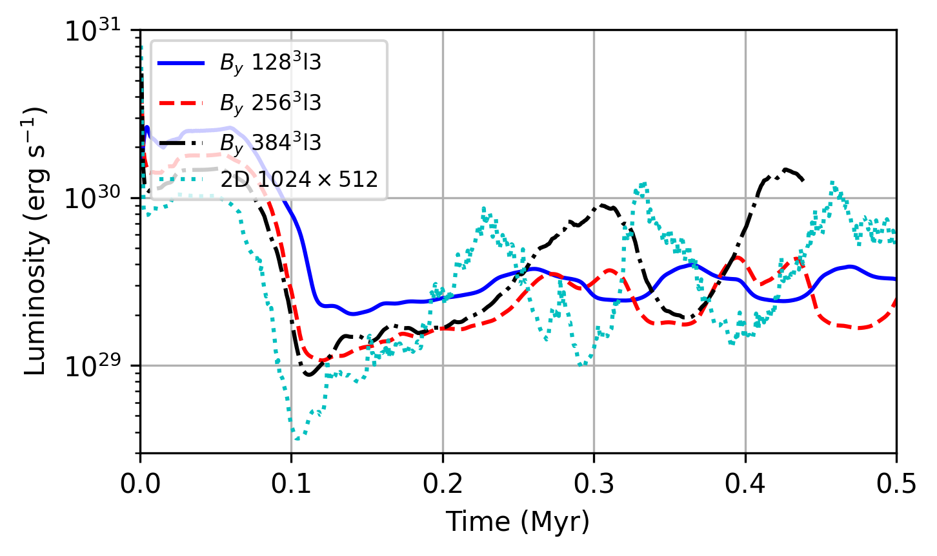
Resolution study of bow shocks
X-rays 0.3-2 keV
Green+(2022) work used HLL solver (very diffusive at CD)
Upgraded to HLLD/HLL hybrid solver (cf. Mignone+,2012)
2D and 3D MHD simulations with resolutions $128×64$ or ${128}^{3}$ cells, increasing in powers of 2.
Find that X-ray emission is variable, more so with increasing resolution
KH instability at the CD is responsible for this
Interface more stable when $B⊥v_{⋆}$
Convergence looks promising
$B∥v_{⋆}$
3D resolution study
X-ray luminosity
$B⊥v_{⋆}$

Slide 15
Higher-resolution simulations
New generation of MHD simulations
Better MHD solver, higher spatial resolution
CD becomes dynamically unstable
Bright and variable X-rays from turbulent wake
Mainly aimed at modelling thermal plasma
Working on synchrotron emission modelling
Mackey, et al. (in prep)

Slide 16
What can we say about wind energy losses?
X-ray emission often used to quantify radiative cooling in wind bubbles.
Does measure hot gas content, but emission varies by 10x over time.
Snapshot measurement of X-rays gives poor constraints on energy dissipation in bow shocks:
Emission is weak, ≤0.1% of input rate of mechanical energy
Dominated by wind-ISM boundary layer, highly variable
Mixing through large-scale eddies at the wind-ISM interface
Most energy is lost at the wind-ISM interface through mixing+UV cooling
Numerical convergence is an issue – simulations are expensive – resolve dynamical instabilities – subgrid model not sufficient for synthetic obs.
Does this apply generally to wind bubbles and superbubbles?
See e.g. Rosen+(2014), Lopez+(2014), Lancaster+(2021,2024)
See Poster by Pandey at this meeting

Slide 17
arXiv:2409.1890

Slide 18
Non-equilibrium module (NEMO) description
Elemental abundances vary in time and space
Track chemical enrichment of ISM
Collisional processes + multi-freq. photoionisation give non-eq. Ionisation state
Elements: H, He, C, N, O, Ne, Si, S, Fe
Species tracked with scalar fields as mass fraction of density field
Elements and ions specified at runtime in parameter file
Written in C++, parallelised with MPI+OpenMP
Implemented in PION MHD code (Mackey+2021)
Integrated with SUNDIALS - CVODE dense linear solver (Gardner et al. 2022)
Rates stored in 2D lookup tables $(n_{e},T)$
Suitable for porting to GPUs (CVODE+MAGMA)
Collisional ionization: Voronov (1997) fits to rates for each ion.
Radiative Recombination: Badnell (2006), Verner & Ferland (1996)
Dielectronic Recombination Zatsarinny+ (2003); Badnell+ (2003)
Charge Exchange Kingdon & Ferland (1996), Butler & Dalgarno (1980)
Photoionization Cross-sections from Werner+(1996), OTS approx.
Radiation Sources ATLAS and POWR model SEDs
Radiative Cooling Used CHIANTIpy (Zanna+,2021) to calculate rates for each ion as function of T and n_e.

Slide 19
2D calculation of WR wind (WC star) sweeping up RSG wind
RSG: $\dot{M}=2×{10}^{−5} M_{⊙}yr^{−1}$, $v_{w}=25 km s^{−1}$
WR: $\dot{M}=3×{10}^{−5} M_{⊙}yr^{−1}$, $v_{w}=1500 km s^{−1}$
Initial 2D test for studying performance and comparison with 1D results
$256×128$ grid cells per level, 5 levels of static mesh refinement centred on the origin
Axisymmetric simulation in $(R,z)$ plane
Slow collisional ionisation in shocked WR wind – swept-up shell also non-eq.

Slide 20
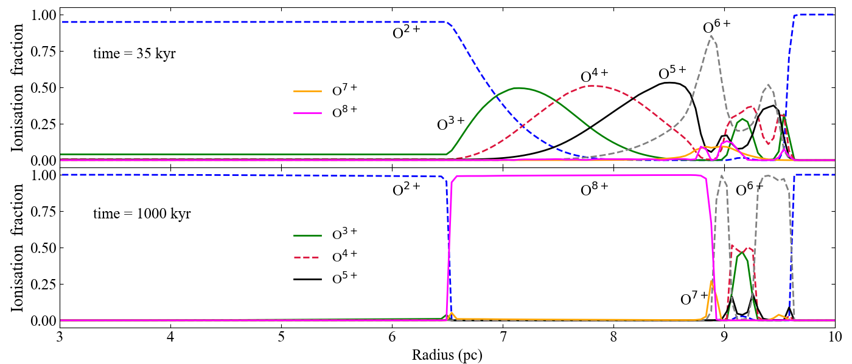
Comparison of NEQ vs. equilibrium calculation
FS
TS
CD

Slide 21
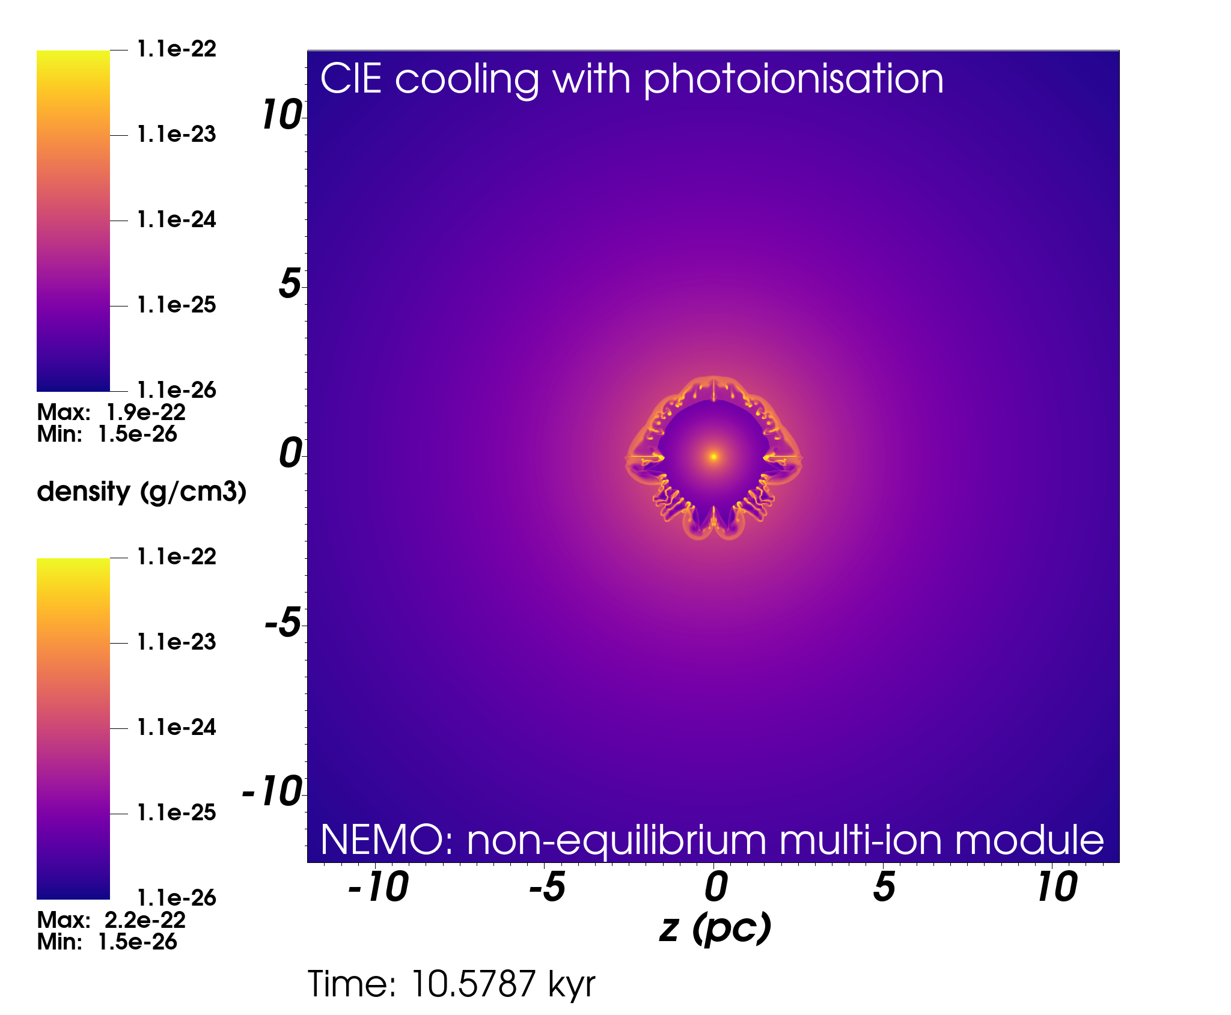
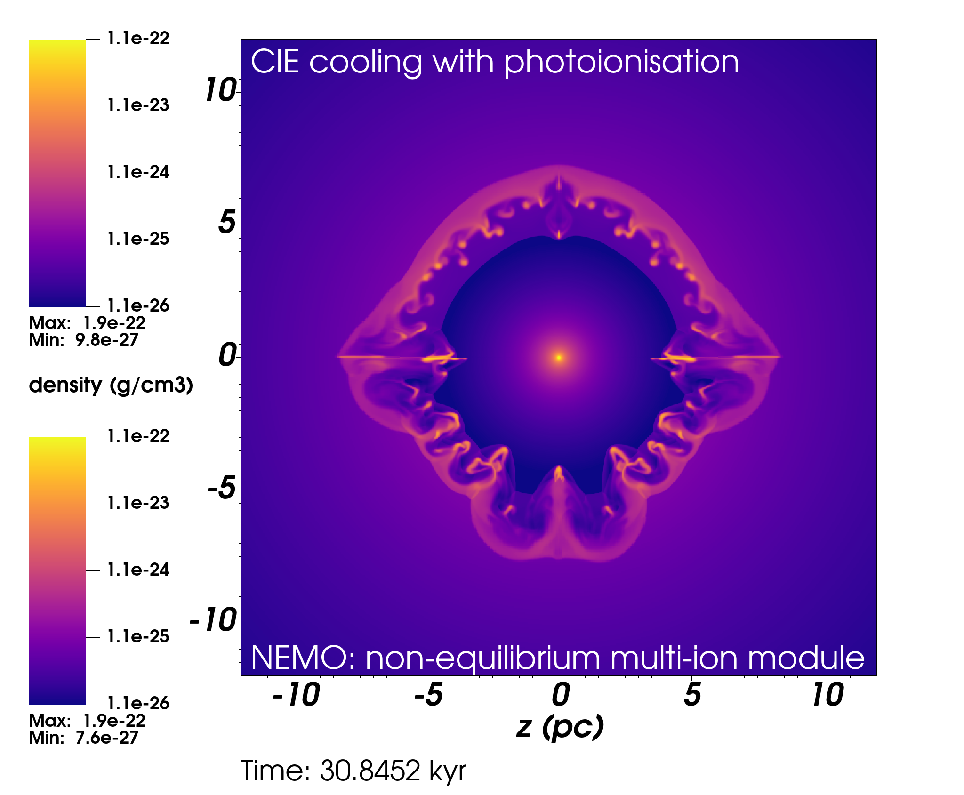
Comparison of CIE vs Non-Eq. cooling
WR wind speed 750 km/s – so that there is radiative cooling in the shocked wind region

Slide 22
Bow Shock modelling
Same model as shown above, but with NEMO microphysics
Can predict e.g. [OIII] 5009AA line, among others
Working on detailed models with synthetic observations in:
Thermal X-ray,
UV lines from wind-ISM interface,
Optical nebular lines,
Thermal IR emission from dust and
Radio continuum(free-free/synch.)
Look out for Mathew+(2025)

Slide 23
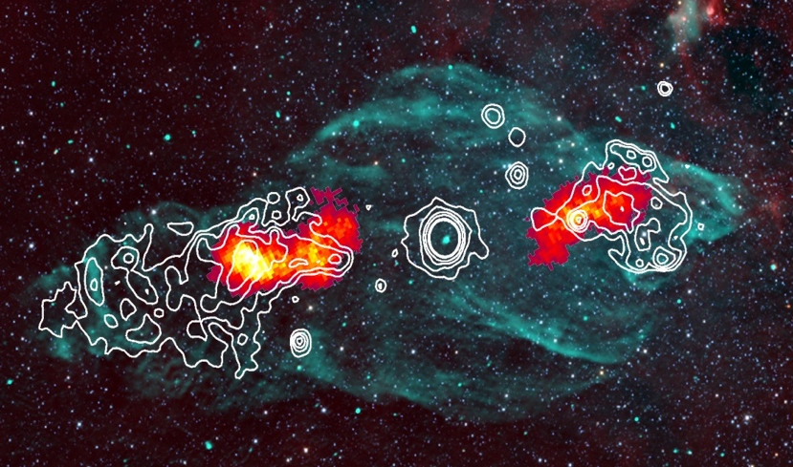
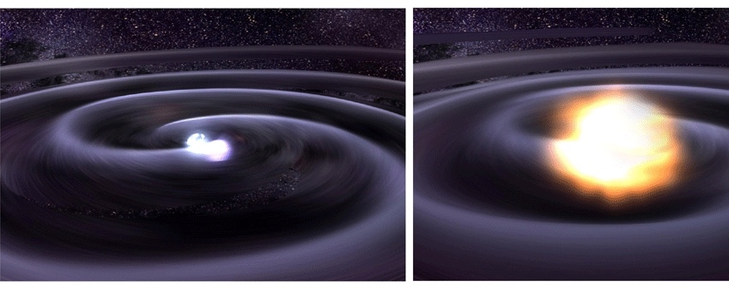
Binary Systems
When one star dies, HMXB may be produced, e.g. microquasar
Almost all massive stars born in binary/triple systems
Live in their star cluster/association
Can be ejected dynamically
Wind-wind interaction has efficient particle acceleration (e.g. Reimer+2006)
Bright radio, optical, UV, X-ray, (+GeV, TeV) sources
Both stars explode, can result in binary BH system
Bright thermal and non-thermal emitters from main-sequence to stellar death.

Slide 24
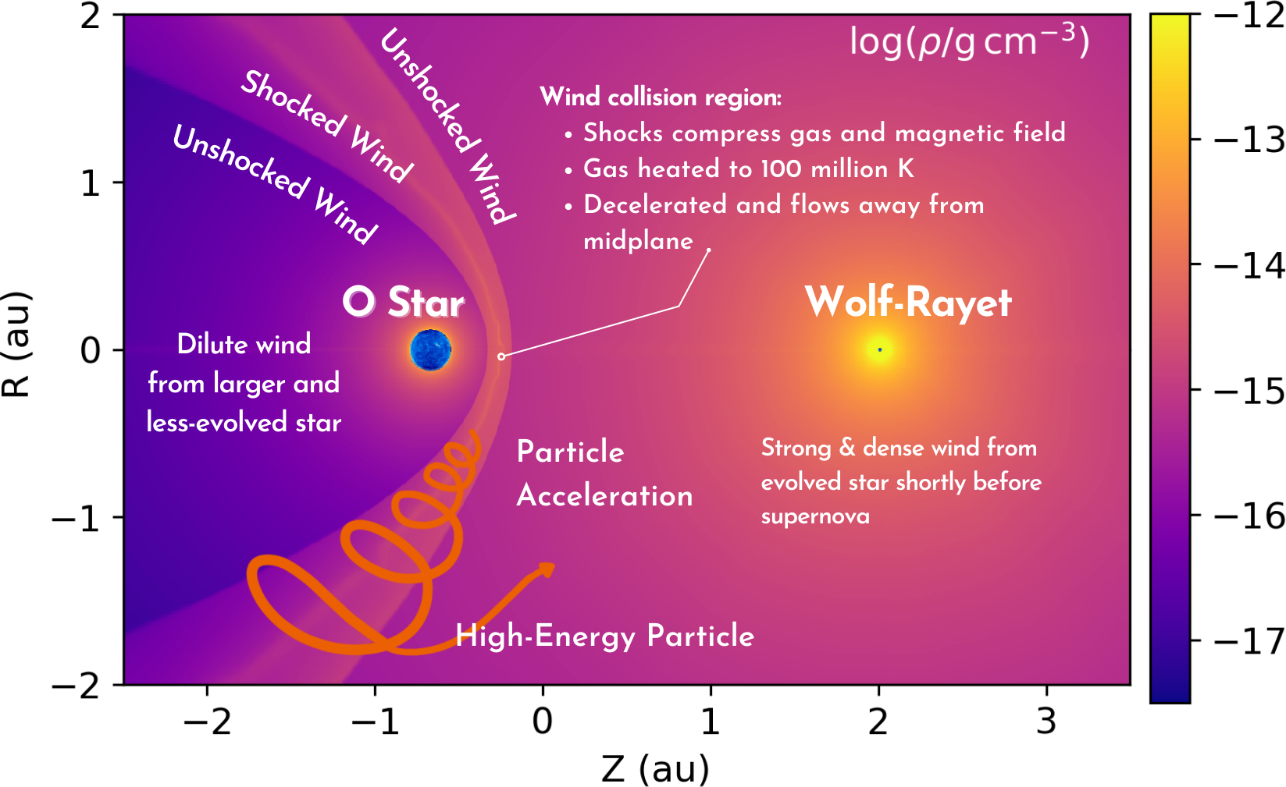

Slide 25
Inverse-Compton Cooling
2D hydrodynamic simulation of WR140 at periastron
of thermal electrons
Relevance for CWBs proposed by Cherepashchuk (1976), also Myasnikov & Zhekov (1993)
Mostly ignored for the past 30 years
IC cooling rate for non-relativistic electrons in radiation field with energy density $U_{γ}$is: ${\dot{E}}_{IC}= \frac{4n_{e}kT}{m_{e}c}σ_{T}U_{γ}$
Cooling time depends only on $U_{γ}$: $τ_{IC}= \frac{3μ_{e}m_{e}c}{8μσ_{T}}U_{γ}^{−1}$
We show this can be the shortest timescale for some CWBs

Slide 26
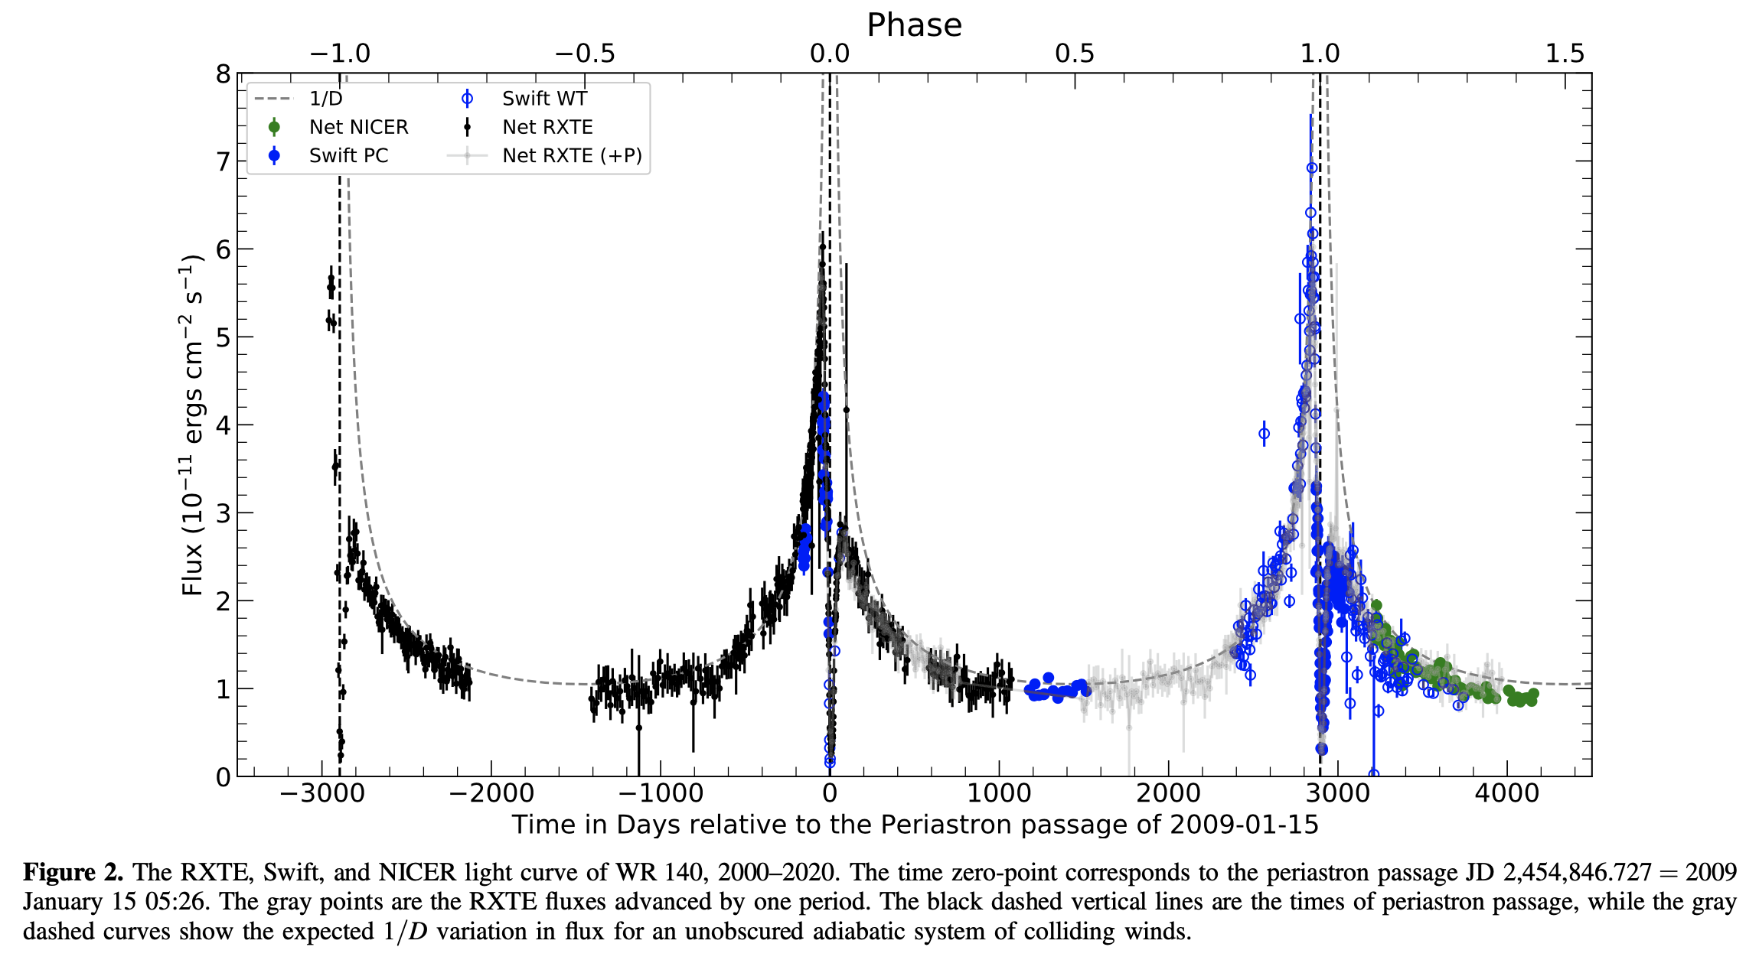
X-ray lightcurve of WR140 (Pollock+,2021)
Dip interpreted as evidence for transition from ~adiabatic to radiative shocks
Creates conditions for dust formation (dense gas that cools below ${10}^{4}$ K)
https://doi.org/10.3847/1538-4357/ac2430

Slide 27
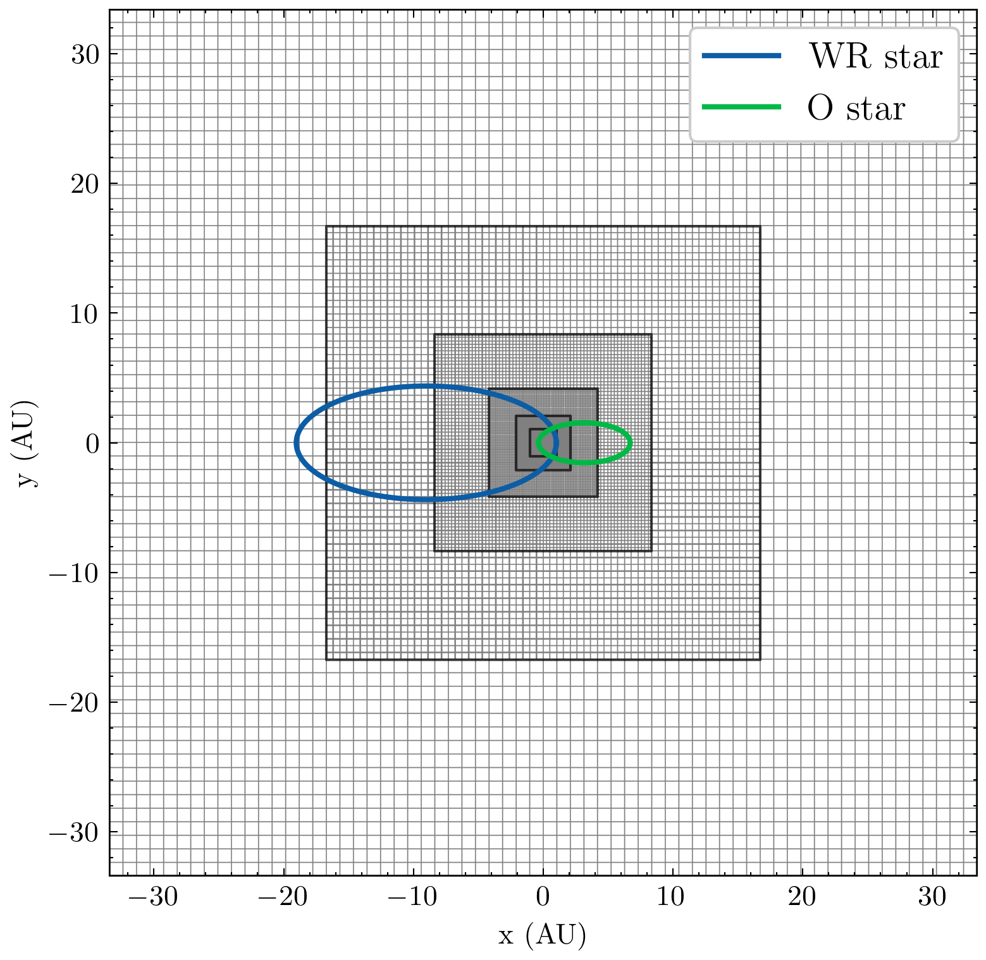
3D simulations of WR140 periastron passage
3D MHD simulations with static mesh-refinement, 256×256×64 cells per level
7 grid levels centred on centre of mass
Both stars on finest level at periastron
First 3D MHD simulations of CWBs with orbital motion, stellar rotation, IC cooling in the literature
Start 140 days before periastron and finish similar time after periastron
Mackey et al. (2023, MNRAS, 526, 3099) https://arxiv.org/abs/2301.13716

Slide 29
2-10 keV X-ray emission from the wind-wind collision
2-10 keV
Synthetic X-ray luminosity calculated from simulation snapshots + XSPEC tables
mhd-1: instantaneous wind acceleration, no IC cooling
mhd-3: wind acceleration, no IC cooling
mhd-2: wind acceleration, IC cooling
RXTE data from Pollock+(2021)
Used mass-loss rates derived from X-ray observations (Sugawara+,2015)
Dip in lightcurve triggered by IC cooling

Slide 30
Magnetic field configuration
Input stellar field field:
O star: 1G surface field, split-monopole
WR star: 100G, split monopole
Field swept into Parker spiral by stellar rotation (at large distance from star)
MHD approximation (no kinetic effects)
What is the B-field configuration at the shocks?
And in the shocked plasma?

Slide 31
Magnetic field configuration
Slice in orbital plane (z=0+) of 3D simulation
Plot of gas density with magnetic field streamlines
WR140 through periastron
O star (secondary): field lines mostly parallel to shock normal.
WR star (primary): first perpendicular and oblique, then all angles possible
Instability makes shock properties strongly variable.
Strong current sheet at CD in wind-collision region

Slide 32
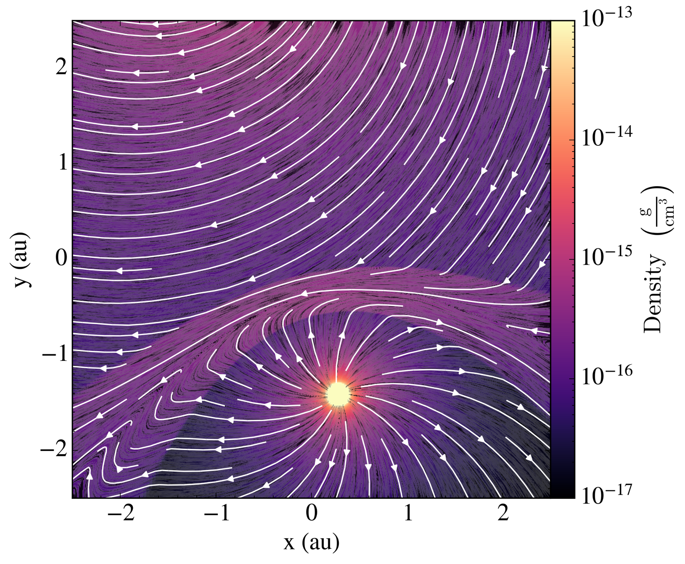
Magnetic field configuration
Slice in orbital plane (z=0+) of 3D simulation

Slide 33
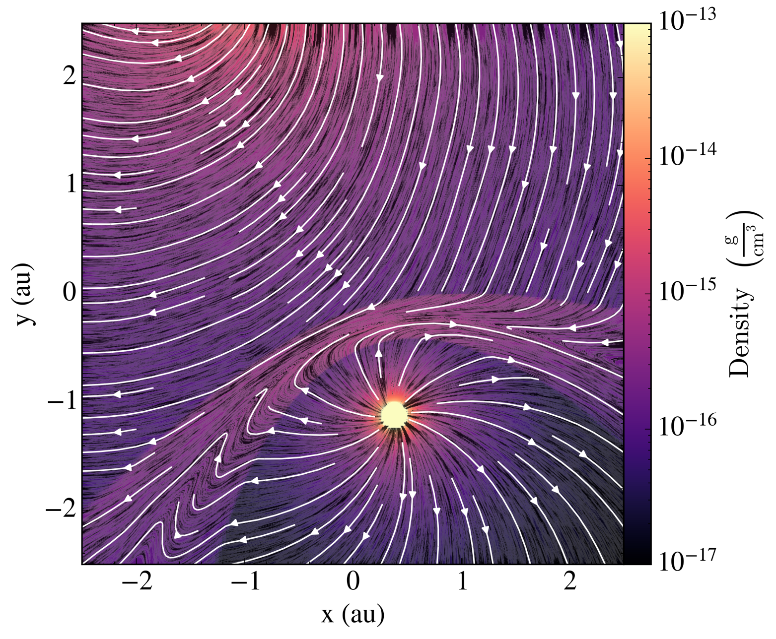
Magnetic field configuration
Slice in orbital plane (z=0+) of 3D simulation

Slide 34
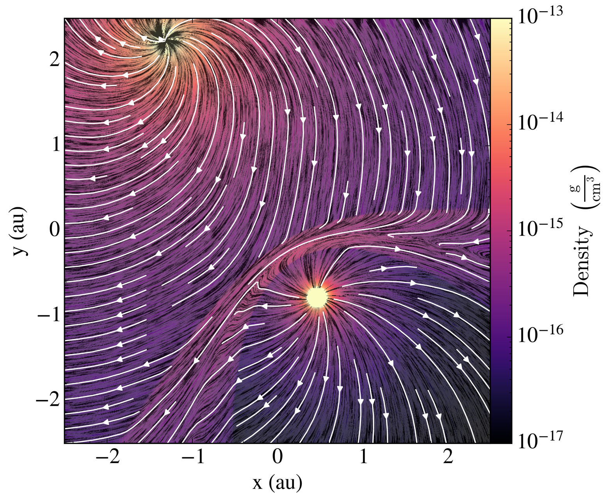
Magnetic field configuration
Slice in orbital plane (z=0+) of 3D simulation

Slide 35
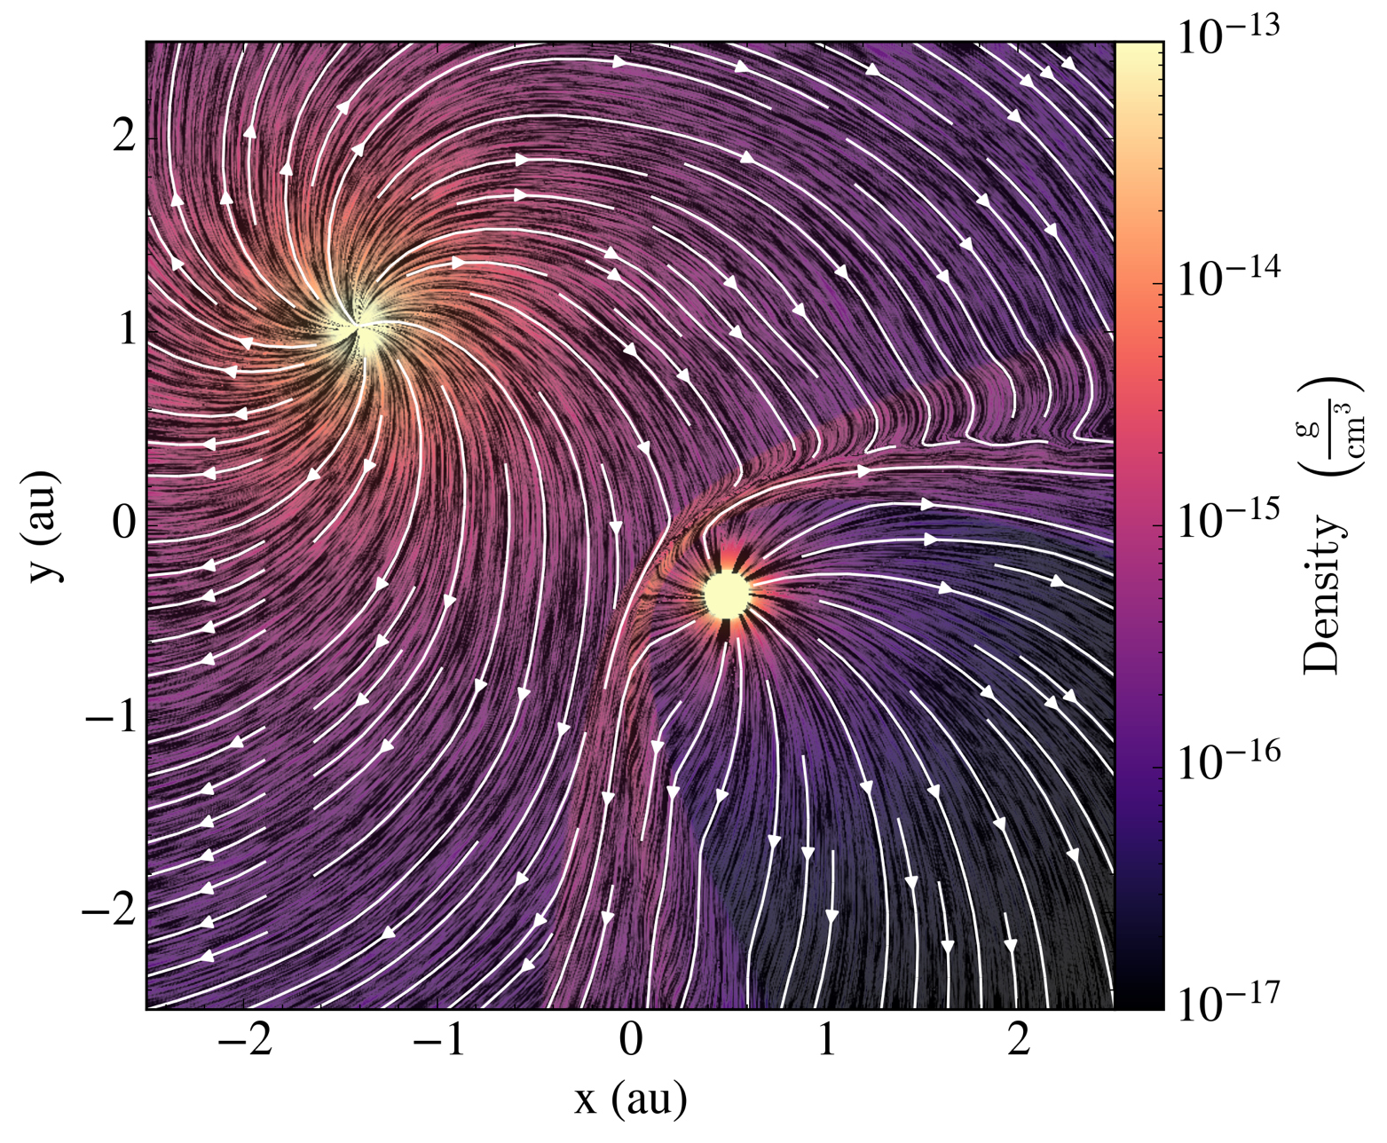
Magnetic field configuration
Slice in orbital plane (z=0+) of 3D simulation

Slide 36
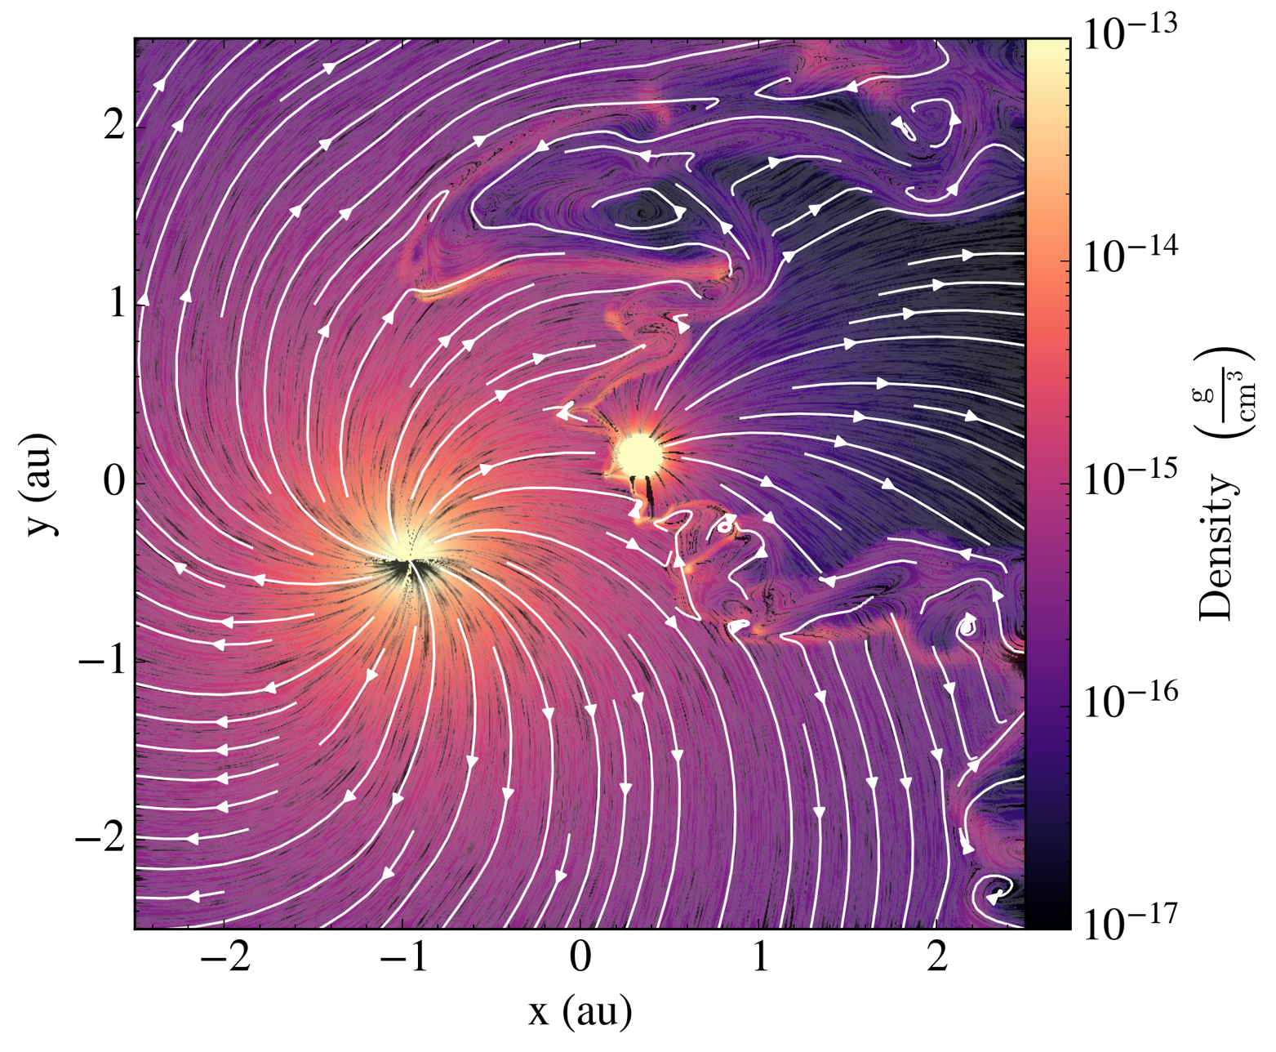
Magnetic field configuration
Slice in orbital plane (z=0+) of 3D simulation

Slide 37
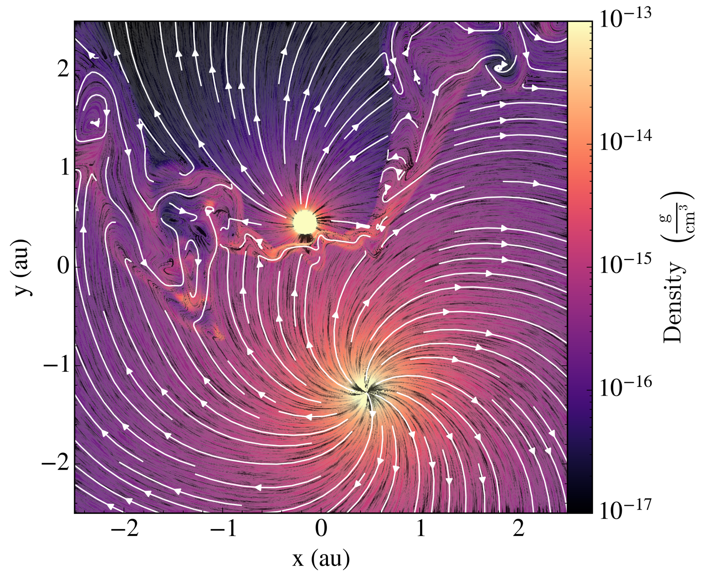
Magnetic field configuration
Slice in orbital plane (z=0+) of 3D simulation

Slide 38
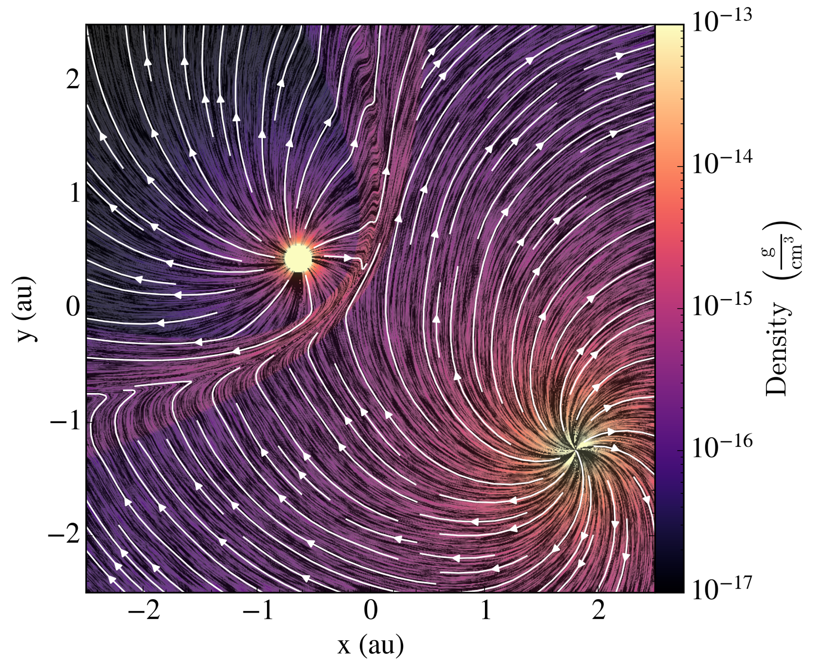
Magnetic field configuration
Slice in orbital plane (z=0+) of 3D simulation

Slide 39
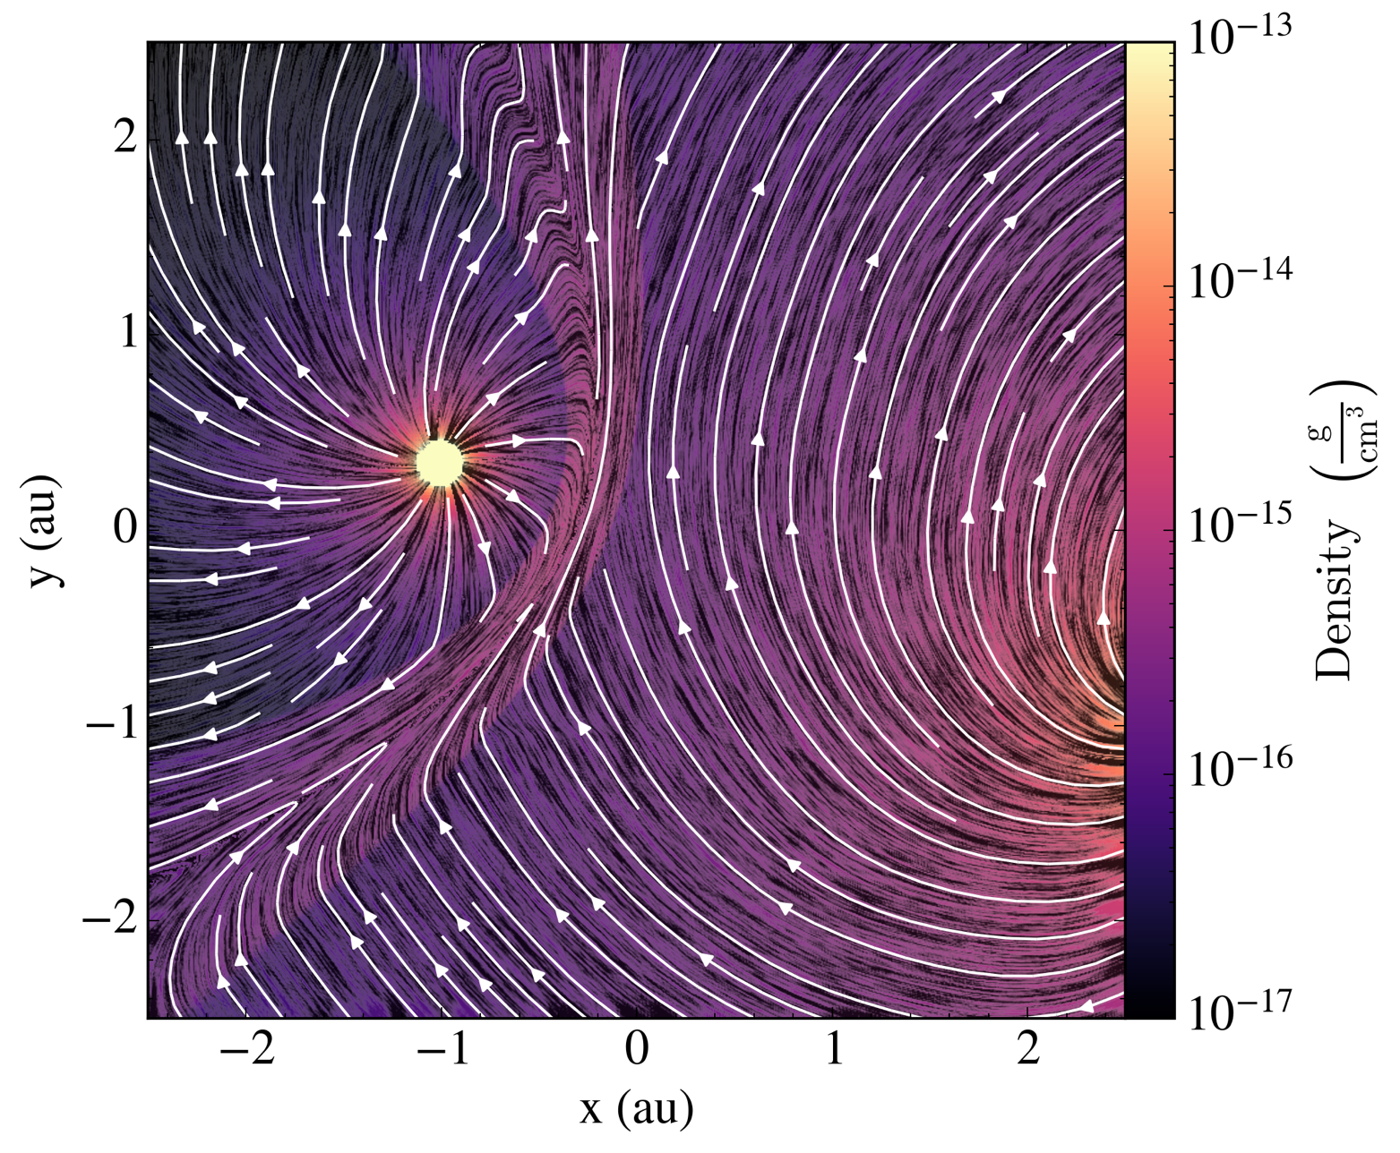
Magnetic field configuration
Slice in orbital plane (z=0+) of 3D simulation

Slide 40
Magnetic field configuration
Slice in orbital plane (z=0+) of 3D simulation
Plot of gas density with magnetic field streamlines
WR140 through periastron
O star (secondary): field lines mostly parallel to shock normal.
WR star (primary): all angles possible
Instability makes shock properties strongly variable.
Work in progress – magnetic properties of shocked plasma in CWBs

Slide 41
Summary
Bow shocks are excellent laboratories for shock physics and the boundary layer between hot and warm ISM phases.
Thermal X-ray emission strongly variable on dynamical timescale of bow shock
Mixing of hot and warm gas may effectively depressurise hot phase
Next-gen telescopes (ATHENA) will measure energy content in hot phase → test models
Non-thermal radio emission can measure particle acceleration in the system
Colliding-wind binaries are brighter but more compact sources
Bright X-ray emitting plasma: detailed simulation ←→ observation comparison TBD
Can measure particle acceleration in time-dependent system
Wind physics is quite uncertain, parameters poorly measured, steady progress ongoing
There is a lot still to be understood about thermal plasma in hot and warm phases in wind-driven bubbles

Slide 42
Projected X-ray emission, $B⊥v_{⋆}$, ${384}^{3}$
x-z plane
x-y plane
ISM B-field mostly along LOS
ISM B-field mostly in plane, vertical

Slide 43
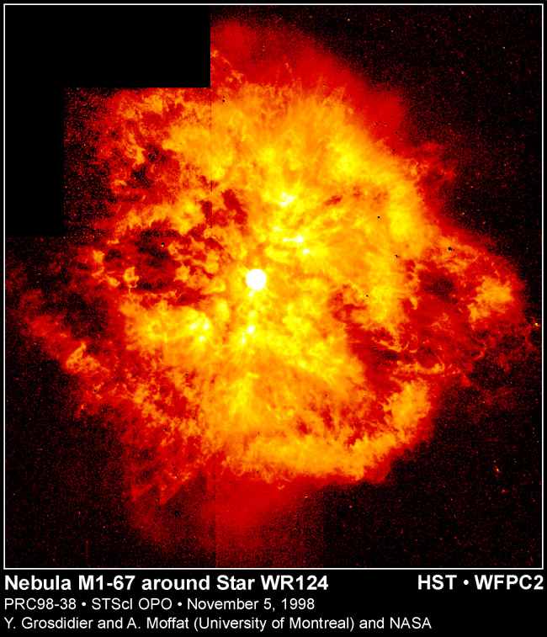
Why a non-equilibrium solver?
Supernova remnants and nebulae around evolved stars have inhomogeneous elemental abundances.
Ionization and recombination timescales often comparable to dynamical timescale in diffuse gas.
Radiative cooling curves assuming CIE cannot be used for spatially varying elemental abundances
If also including photoionization, non-equilibrium (NEQ) is not really more difficult to calculate than ionization equilibrium (IEQ)
Impact on spectral line predictions?
Some previous work: Mellema & Lundqvist (2002 - DORIC), Tesileanu+(2008 - PLUTO)

Slide 44
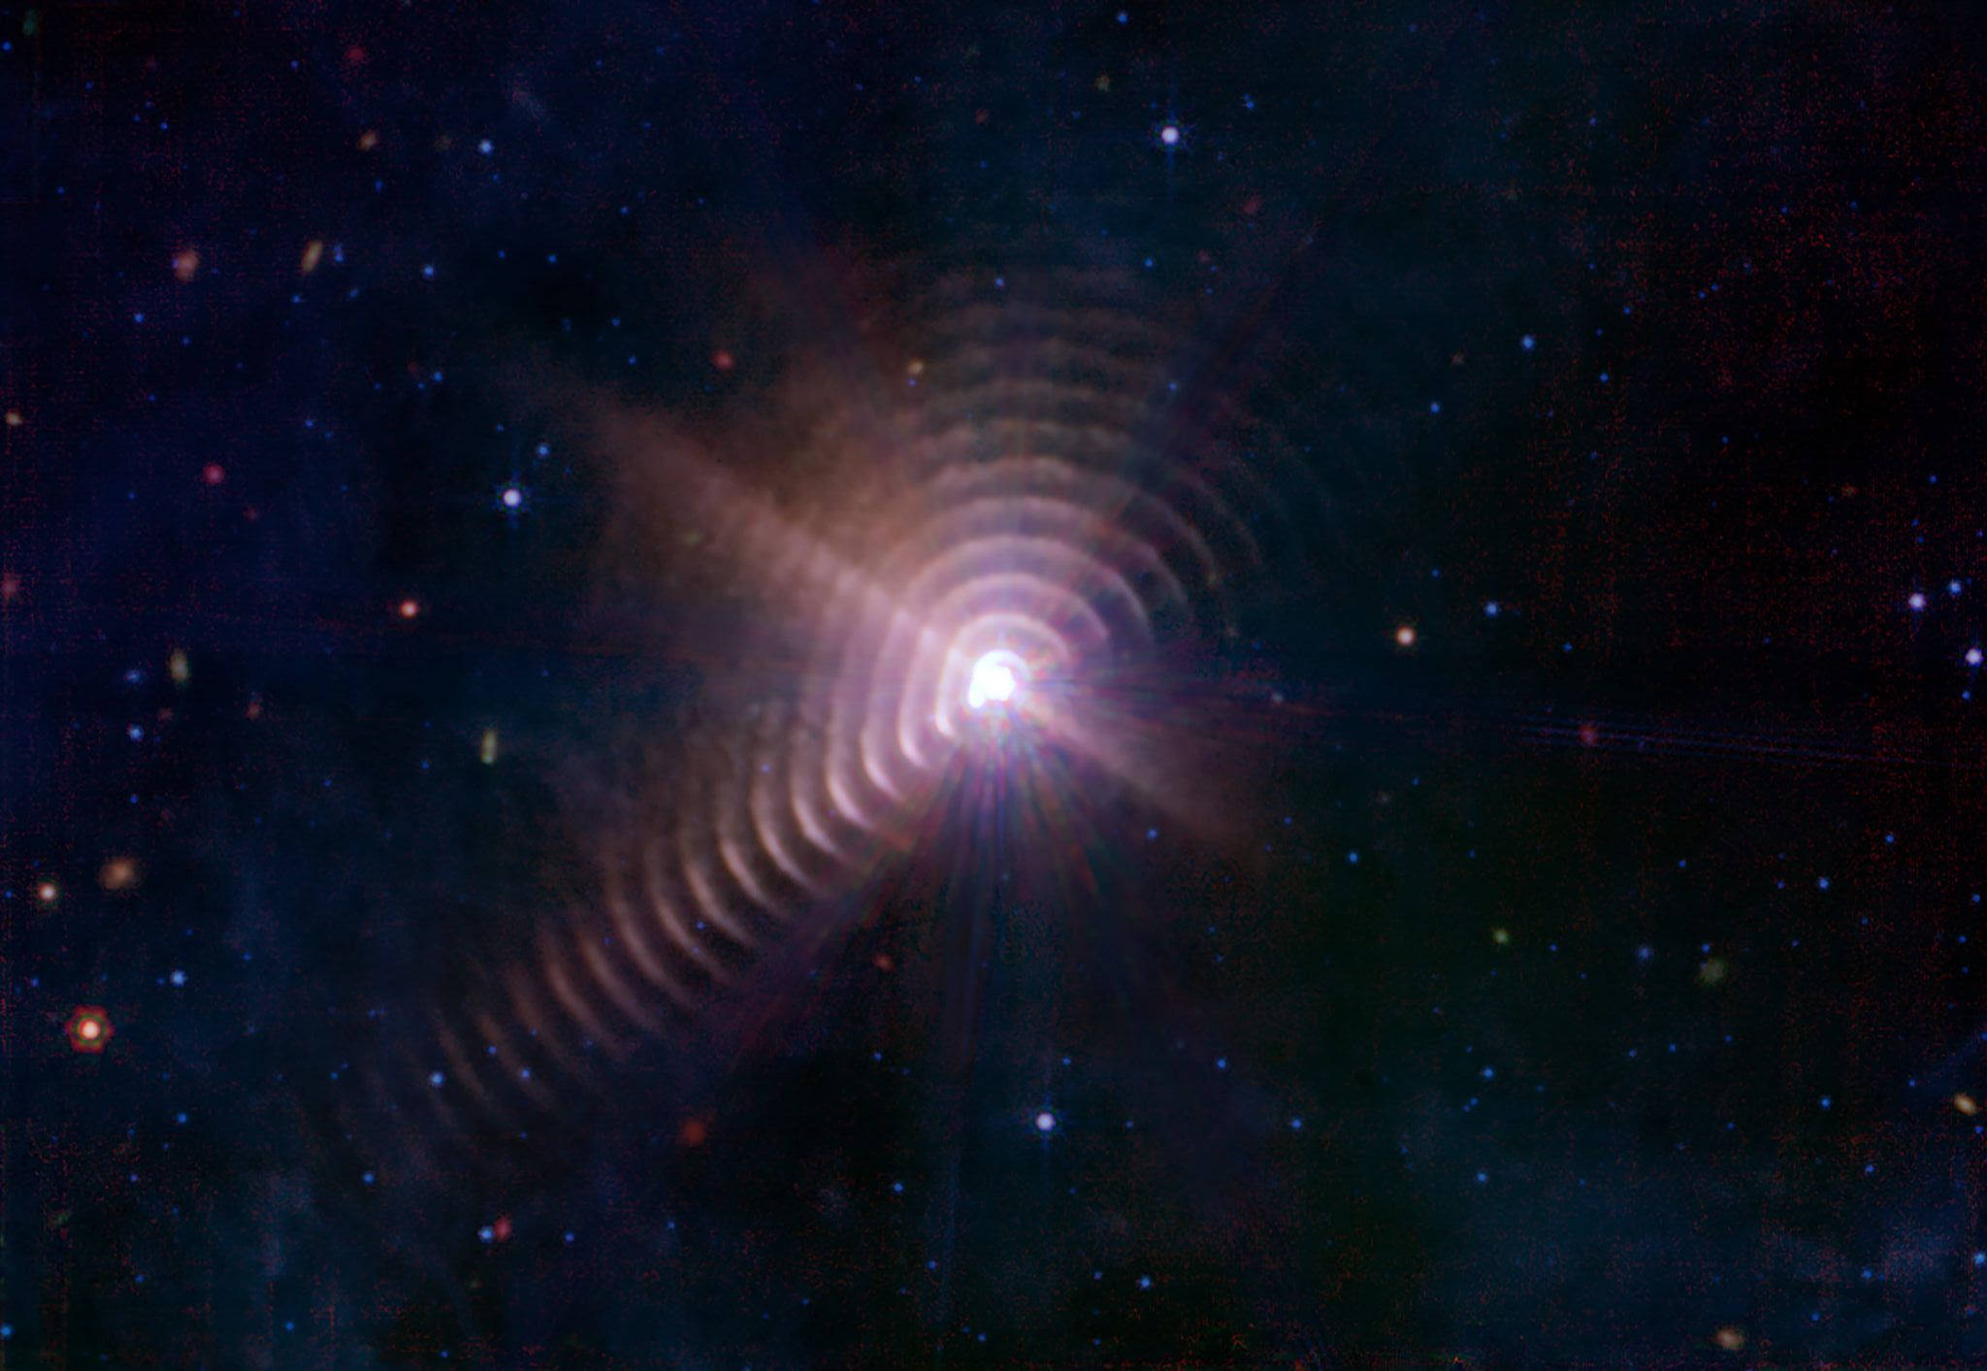
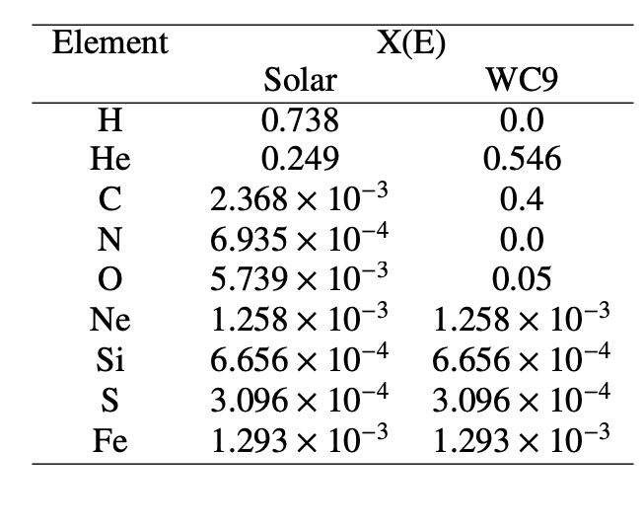
WR140: WC + O binary.
Completely different elemental abundances (e.g. Eatson+,2022)
Dust formation from gas that starts at ${10}^{8} K$
Dust emission from the colliding-wind binary WR140
Credit: NASA, ESA, CSA, STScI, JPL-Caltech, NSF'S NOIRLab

Slide 45
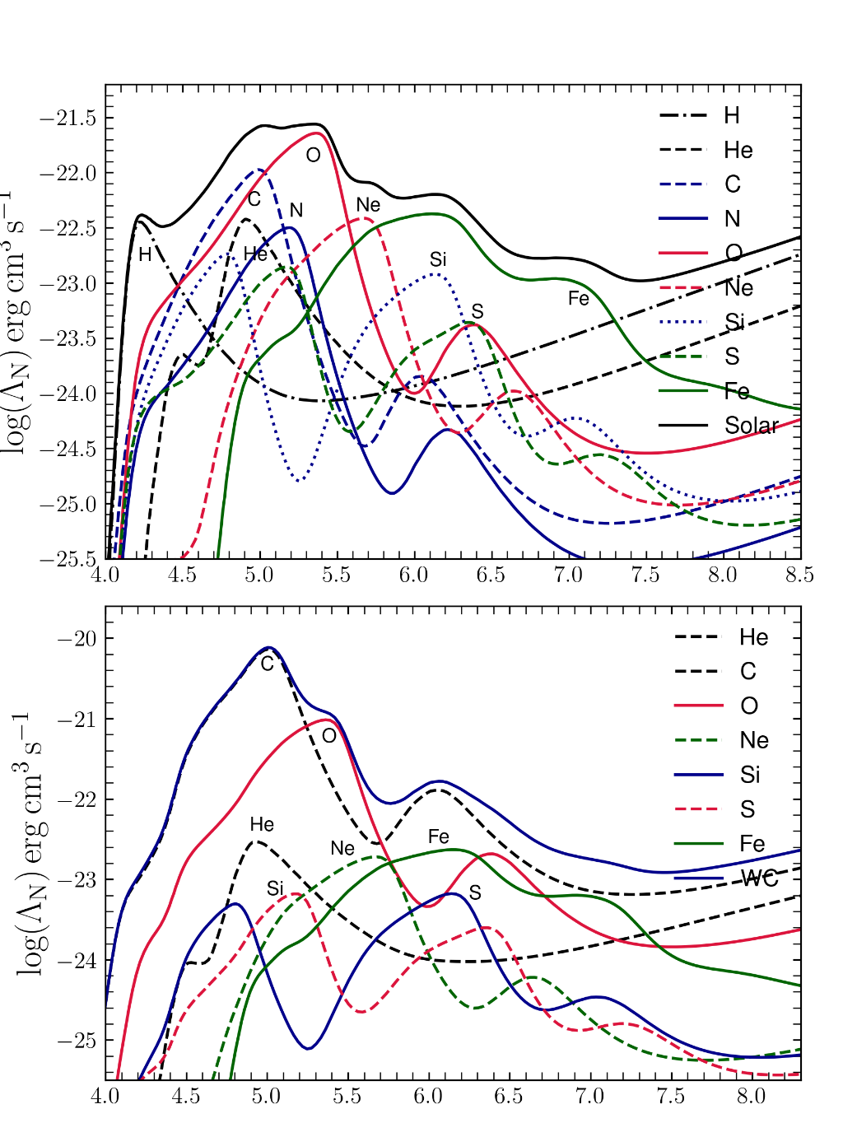
Test Calculations
Solar abundances
Checked that ionization balance in CIE conditions matches literature results
Calculated ion-by-ion cooling at CIE conditions and compare with literature total cooling rates →
WC abundances give strongly enhanced cooling for 4 < logT < 7 (Eatson+,2022)
Performed 1D shock tests following Raymond (1979),
1D HII region photoionization tests (Lexington HII40 benchmark; Ferland,1995).
WC abundances

Slide 46
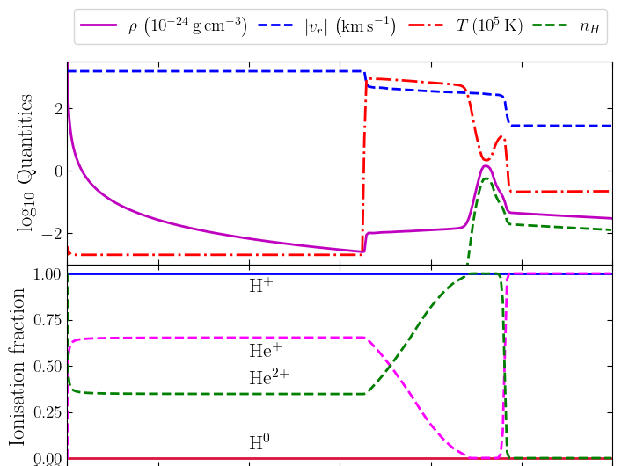
Expansion of WR Nebula
Gas properties at t=35 kyr
Assume star evolves from red supergiant (RSG) to Wolf-Rayet (WR)
Calculation of fast WR wind sweeping up slow RSG wind
Simulation with spherical symmetry (1D)
RSG has ISM abundances
WR has WC abundances (i.e. we skip the WN phase!)
Radiation field of WR star photoionizes nebula (use POWR model)
Lifetime of nebula around 100 kyr
RSG: $\dot{M}=2×{10}^{−5} M_{⊙}yr^{−1}$, $v_{w}=25 km s^{−1}$
WR: $\dot{M}=3×{10}^{−5} M_{⊙}yr^{−1}$, $v_{w}=1500 km s^{−1}$

Slide 47
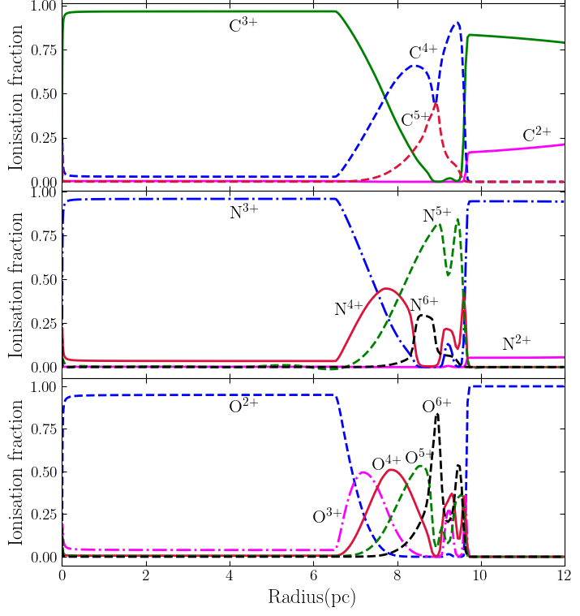
Ionization fractions of CNO elements in the wind

Slide 49
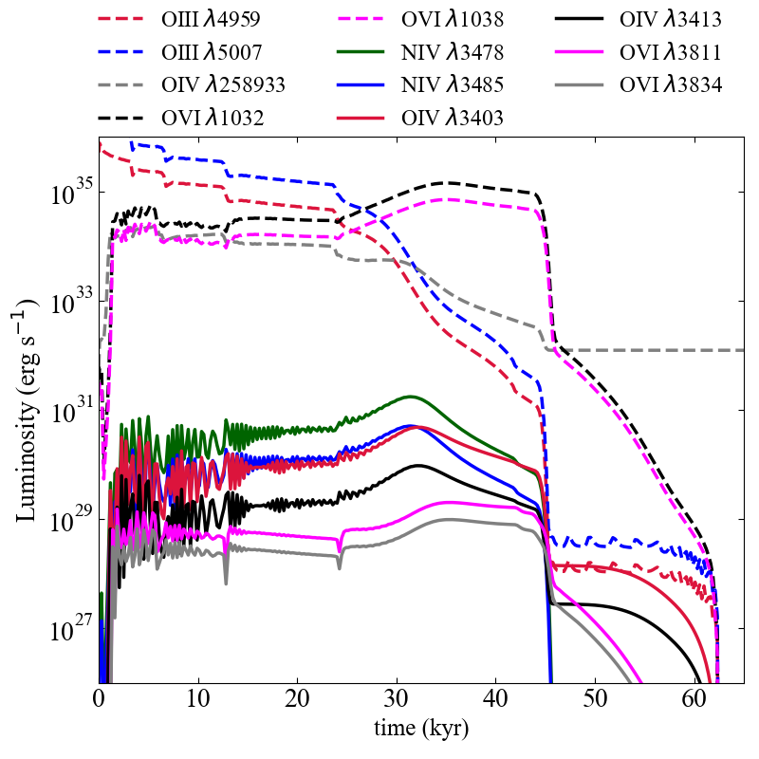
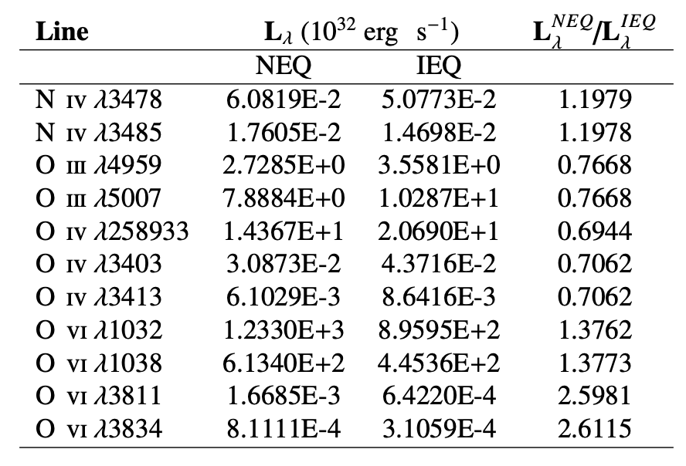
Line luminosity of nebula with time
Selected lines with NEQ module vs. ionization equilibrium, at t=35 kyr

Slide 50
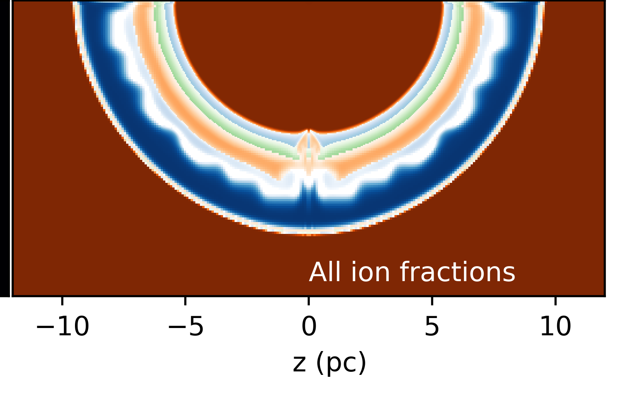
Ionization balance
O3+
O5+
O2+
O4+
O6+

Slide 51
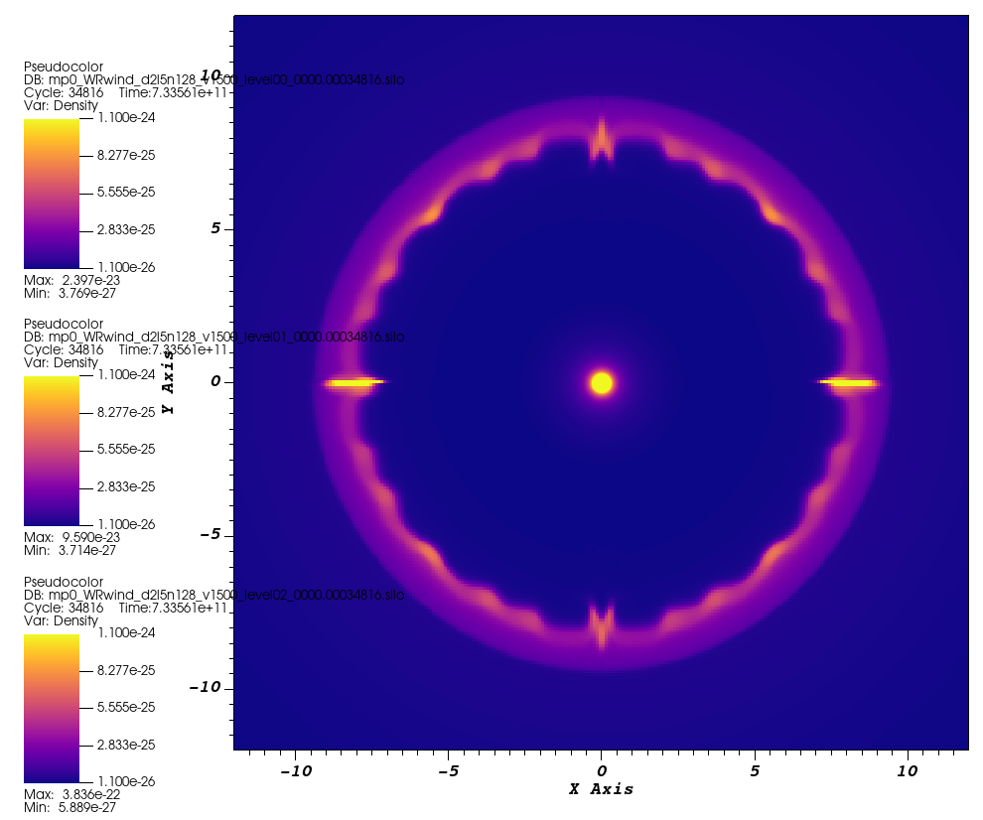
Comparison of CIE vs Non-Eq. cooling
WR wind speed 1500 km/s – no radiative cooling of hot plasma → both modules give similar results
CIE module with photoionisation
Non-equilibrium module

Slide 52
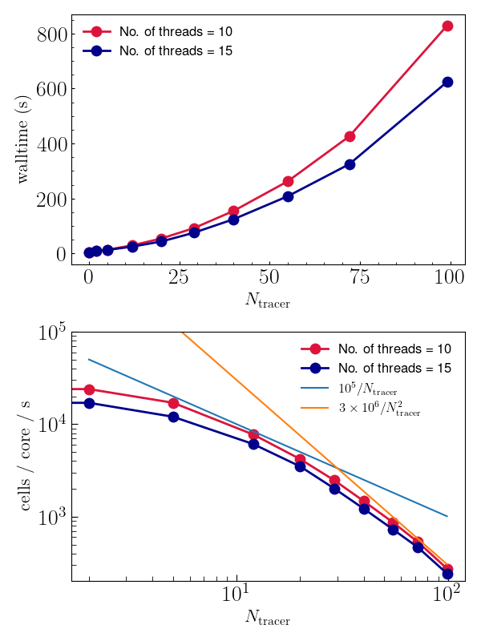
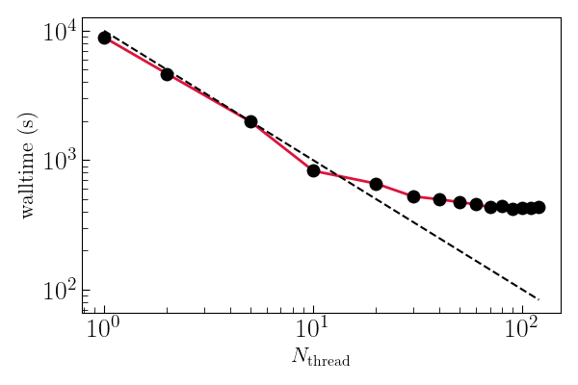
Performance
OpenMP scaling of shock test calculation (only microphysics is multithreaded in 1D)
Performance degrades as # species increases

Slide 53
Summary of multi-ion solver module
We developed a new multi-ion non-equilibrium solver for gas with variable elemental abundances (in time and space)
It’s relatively slow at the moment → suited for 1D and 2D simulations, maybe low-res 3D simulations.
Extensively tested against literature results for IEQ and NEQ solutions
Can predict spectral lines from X-ray to IR, including strong nebular lines in JWST MIRI band (e.g. OIV, NV)
Code will be public with next release of PION v.3.0, in early 2025
Standalone release of module in development
Looking at performance improvements with GPUs
https://arxiv.org/abs/2409.18904 - submitted to A&A

Slide 54
Applications (ideas and discussion welcome)
Nebula of WR102:
Origin of nebula is unclear (insterstellar cloud?)
Optical spectroscopy shows strong C overabundance, but also H-rich gas
Extreme radiation field can photoionise O to O3+ (e.g. OIV 25um line)
Wind-wind mixing and non-equilibrium cooling in colliding wind binaries
Transition from adiabatic to radiative shocks
Dust formation in winds
WO star and nebula WS35 around the candidate super-Chandrasekhar WD system (Gvaramadze+2019)
Nebular modeling with hydrodynamics of wind
Need an evolutionary model/hypothesis to test against
Predict mid-IR lines for JWST (was proposed this year)
Ejecta mixing in young supernova remnants (e.g. Cas A)

Slide 55
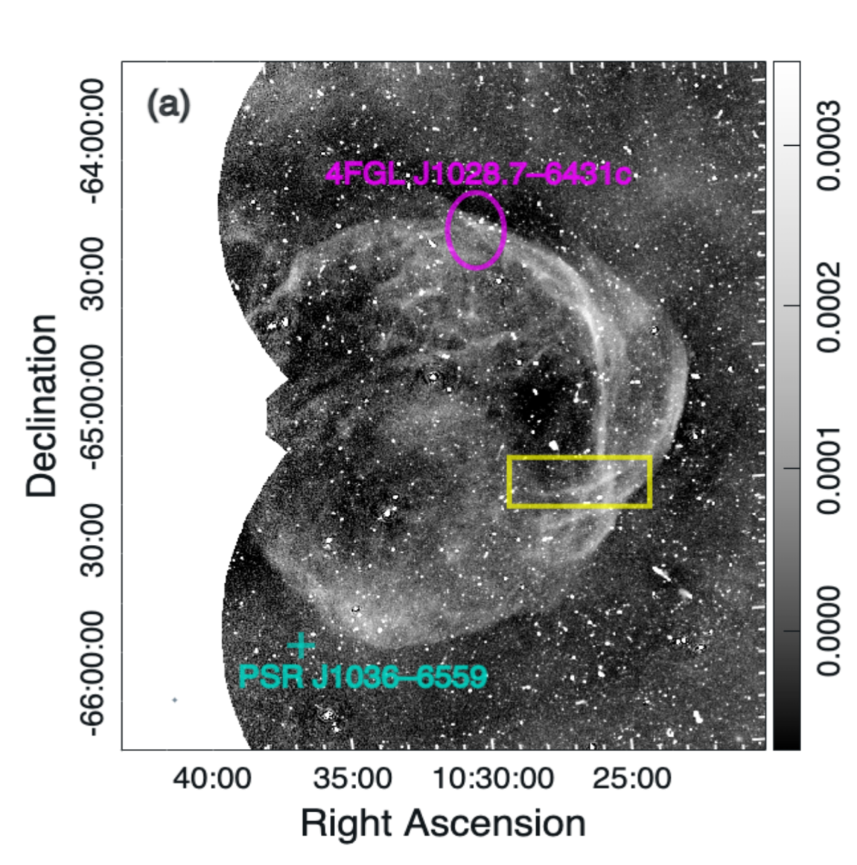
Supernova Remnants
Newly discovered SNR G288.8–6.3 (Filipovic+,2023)
Detected with ASKAP EMU survey
Far from Galactic Plane, low surface brightness
Quite old ($\sim {10}^{4}$yr), still emitting synchrotron
Searched for 𝜸-rays with Fermi-LAT
Detected an extended source →
Similar source size to radio remnant
Soft 𝜸-ray spectrum indicates particle escape
Targeted searches informed by new radio surveys can give new 𝜸-ray discoveries
SNR G288.8-6.3 (Filipovic+,2023)
Burger-Scheidlin et al. (2024, A&A, 684, A150) https://arxiv.org/abs/2310.14431

Slide 56
Supernova Remnants
Newly discovered SNR G288.8–6.3 (Filipovic+,2023)
Detected with ASKAP EMU survey
Far from Galactic Plane, low surface brightness
Quite old ($\sim {10}^{4}$yr), still emitting synchrotron
Searched for 𝜸-rays with Fermi-LAT
Detected an extended source →
Similar source size to radio remnant
Soft 𝜸-ray spectrum indicates particle escape
Targeted searches informed by new radio surveys can give new 𝜸-ray discoveries
Burger-Scheidlin et al. (2024, A&A, 684, A150) https://arxiv.org/abs/2310.14431
Check out Chris’s poster!

Slide 57
𝜸-rays from massive binary systems: η Car
Probably the most extreme binary in the Galaxy
LBV + O/WR system with 5.5 year period
No non-thermal radio detected so far (absorbed?)
Non-thermal and variable X-rays detected (Hamaguchi+2018)
Detected by AGILE and FERMI-LAT (~GeV)
Observed with H.E.S.S. around 2014 and 2020 periastron passages
2020 results presented at ICRC 2023 by Simon Steinmassl (MPIK) for H.E.S.S. Collaboration
Paper coming soon
2020 results consistent with extension of Fermi-LAT spectrum to sub-TeV energies.
Planning another H.E.S.S. campaign in 2025 (as far as possible).
CTA could detect many more CWBs – eta Car is uniquely powerful but it is not unique

Slide 58
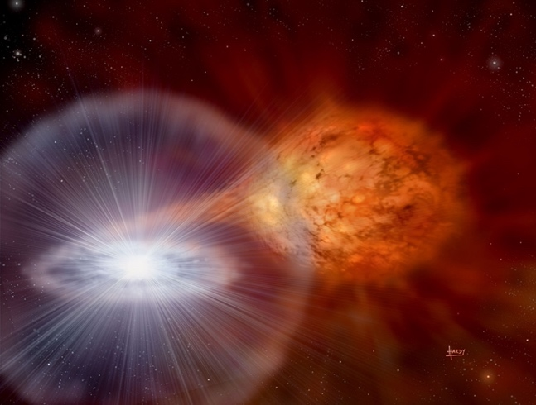
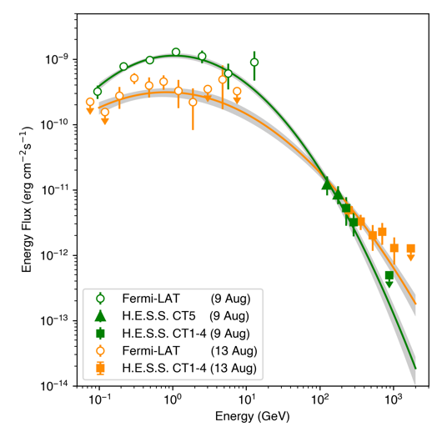
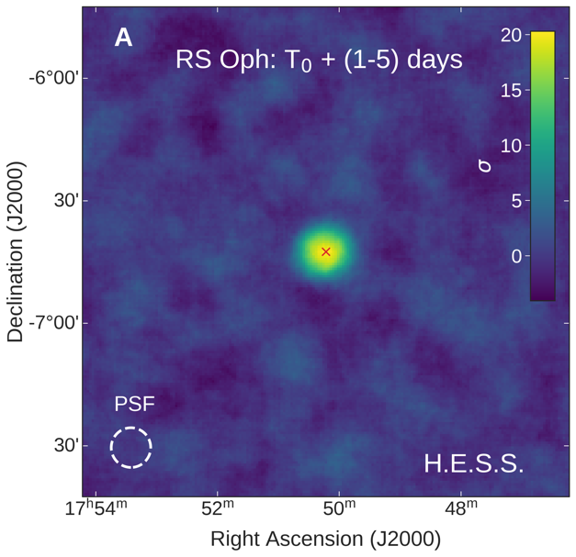
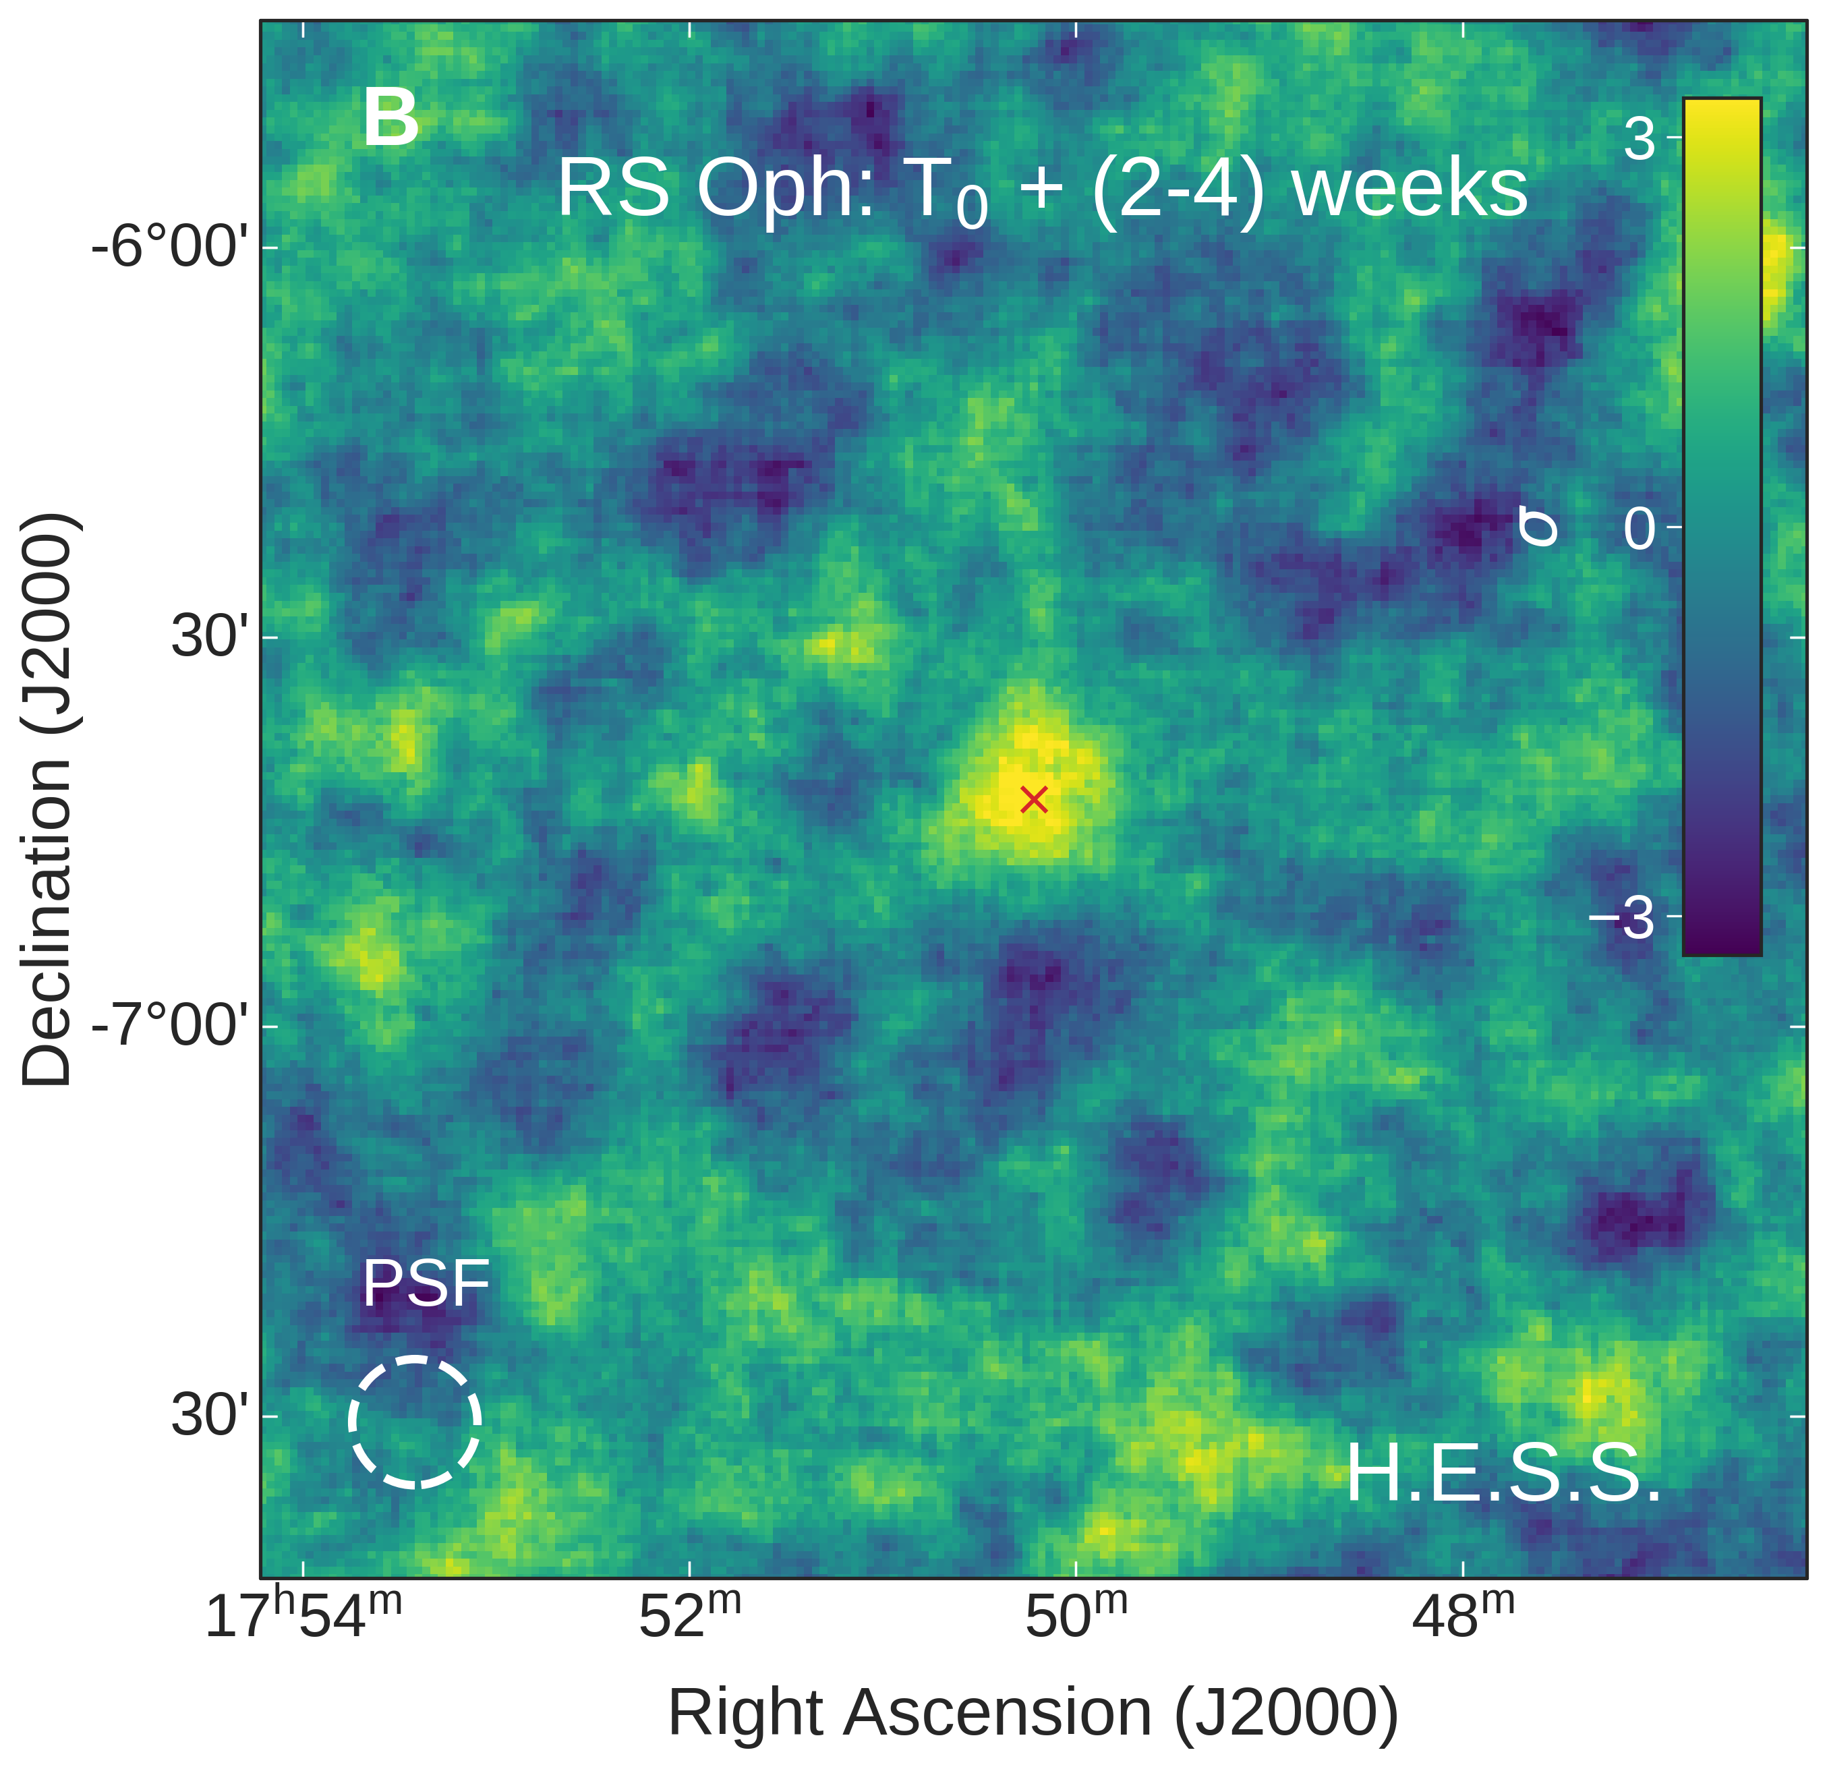
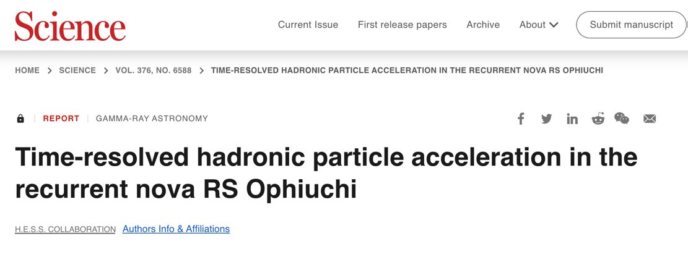
Nova RS Ophiuchi
Recurrent nova from binary system with Red Giant and White Dwarf
WD near Chandrasekhar mass
Eruption 08.08.2021
Detected by HESS on first night after trigger 09.08.2021
Peak TeV flux later than GeV → time-dependent particle acceleration

Slide 59
Nova RS Ophiuchi
HESS Collaboration (2022, Science, 376, 77)
Peak TeV flux later than Gev → time-dependent particle acceleration
Model:
4500 km/s shock expands into wind of Red Giant (RG)
Particle acceleration at forward shock
Hadronic emission from interaction with RG wind
Results sensitive to wind density and magnetic field.
Acceleration efficiency 20-50% required to explain $γ$-ray luminosity

Slide 60
Few thoughts on Microquasars
HESS Collaboration (2024, Science, 383, 402)
Duty cycle? ~ ${10}^{4}$ years – from stellar evolution
Fraction of massive (and low-mass) binaries going through µQSO phase?
70% of massive stars interact with close companion (Sana+2012)
NOT the same as saying 70% have µQSO phase, but…
Kinetic luminosity, acceleration efficiency?
${10}^{39}$ erg/s for ${10}^{4}$ yr → $3×{10}^{50}$ ergs
Can µQSO contribute a lot to Galactic CRs?
At PeV, seems like it
How far up/down in energy do they contribute?
# microquasars (remnants?) vs. # SNRs (at VHE)
Cooling/escape timescales?
There are a lot of uncertainties, especially from stellar evolution and SN modelling, but this is one of the most interesting thing I learned at this workshop.

Slide 61
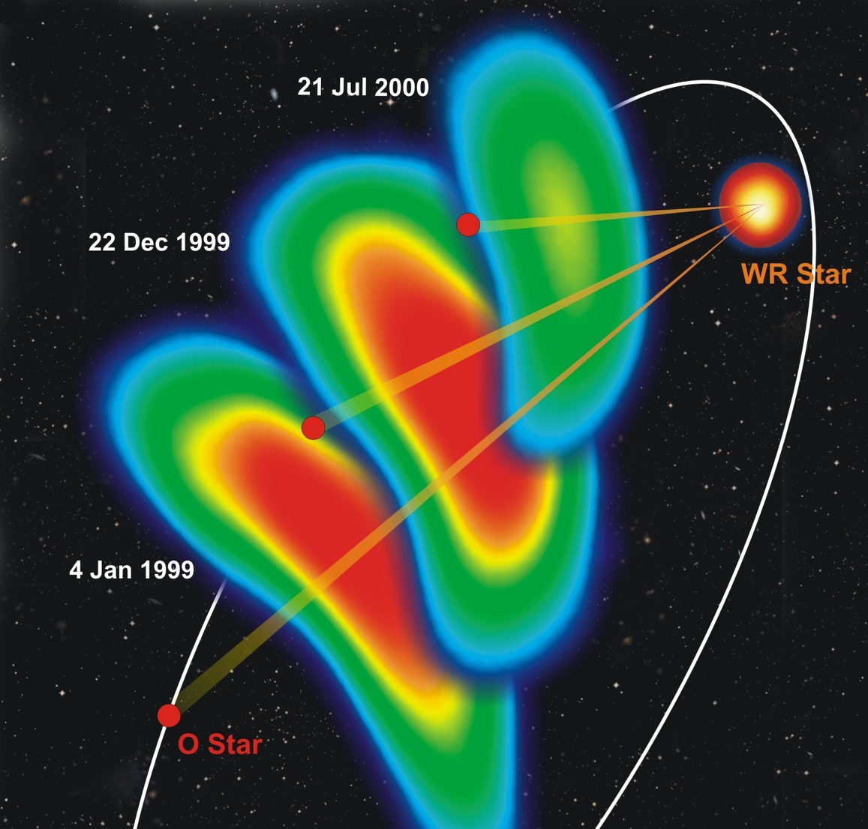
Colliding-wind binaries
CWBs probe winds of both stars:
Eccentric orbits → predictable time-varying shock conditions
Constrain winds of massive stars
Wind clumping, acceleration, mass-loss rates
Final pre-supernova evolutionary stage
Intense dust production
Particle acceleration in shocks
Progenitor systems for NS/NS, NS/BH, BH/BH mergers.
Synchrotron radio observations of WR140
Dougherty et al. (2006)

Slide 62
Colliding-wind binaries
Concentric dust rings in WR 140 from successive periastron passages (JWST, Lau+2022)
CWBs probe winds of both stars:
Eccentric orbits → predictable time-varying shock conditions
Constrain winds of massive stars
Wind clumping, acceleration, mass-loss rates
Final pre-supernova evolutionary stage
Intense dust production
Particle acceleration in shocks
Progenitor systems for NS/NS, NS/BH, BH/BH mergers.

Slide 63
$$\text{erg} \text{c}{\text{m}}^{−2} {\text{s}}^{−1}{arcsec}^{−2}{}$$
Hard X-ray emission maps
Looking down on orbital plane
Absorption not included.

Slide 65
Magnetic field configuration
Slice in orbital plane (z=0+) of 3D simulation
Well before periastron (superior conjunction)
Arrows show B-field strength and orientation
Colour scale shows $\frac{v⋅B}{\left|v\right|\left|B\right|}$
Toroidal field from WR star
Mixed radial/toroidal from larger O star
Mixture of parallel and perpendicular shocks
Strong current sheet at CD

Slide 66
Magnetic field configuration
Slice in orbital plane (z=0+) of 3D simulation
At periastron
Arrows show B-field strength and orientation
Colour scale shows $\frac{v⋅B}{\left|v\right|\left|B\right|}$
Mixture of parallel and perpendicular shocks
Perpendicular at the stagnation point on WR side, parallel on O-star side
Tangled structure in shocked region (instabilities developed)

Slide 67
Magnetic field configuration
Slice in orbital plane (z=0+) of 3D simulation
Shortly after periastron
Plot of plasma beta $β≡\frac{8πP}{B^{2}}$
Log scale clipped at [0.01-100]
Most of shocked plasma strongly thermal-pressure dominated
Small regions with runaway cooling become magnetically dominated (red)
Spatially resolved the max. compression factor in some cases.

Slide 68
2-10 keV X-ray emission from the wind-wind collision
Synthetic X-ray luminosity calculated from simulation snapshots + XSPEC tables
mhd-1: instantaneous wind acceleration, no IC cooling
mhd-3: wind acceleration, no IC cooling
mhd-2: wind acceleration, IC cooling
RXTE data from Pollock+(2021)
Used mass-loss rates derived from X-ray observations (Sugawara+,2015)
Dip in lightcurve triggered by IC cooling in computer model.
2-10 keV

Slide 69
Modifying the wind acceleration – improved models?
Assume now that WR wind is not decelerated by O star radiation field (zero coupling)
Wind-collision region moves even closer to surface of O star.
Shock on O-star side is slower and denser → radiative for longer
Pre-periastron flux now too high (WR wind is not decelerated)
Significant uncertainties:
Mass-loss rates, wind momentum ratio, radiation-wind coupling, beta
Wind clumping, electron-ion $ΔT$
Very difficult to reproduce X-ray light-curve exactly without fine-tuning models. Not clear that this is worthwhile - too many uncertain parameters.

