Slide 1

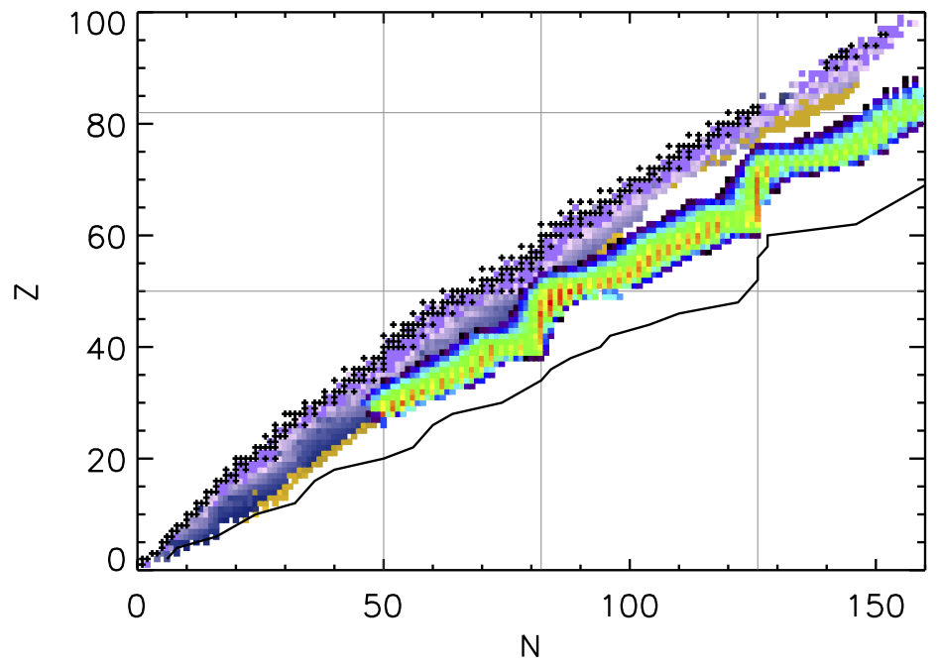



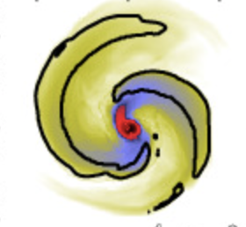
The r process and nuclear masses
Rebecca Surman
University of Notre Dame
sirEN Conference
Giulianova, Italy
12 June 2025
SciDAC ENAF

Slide 2
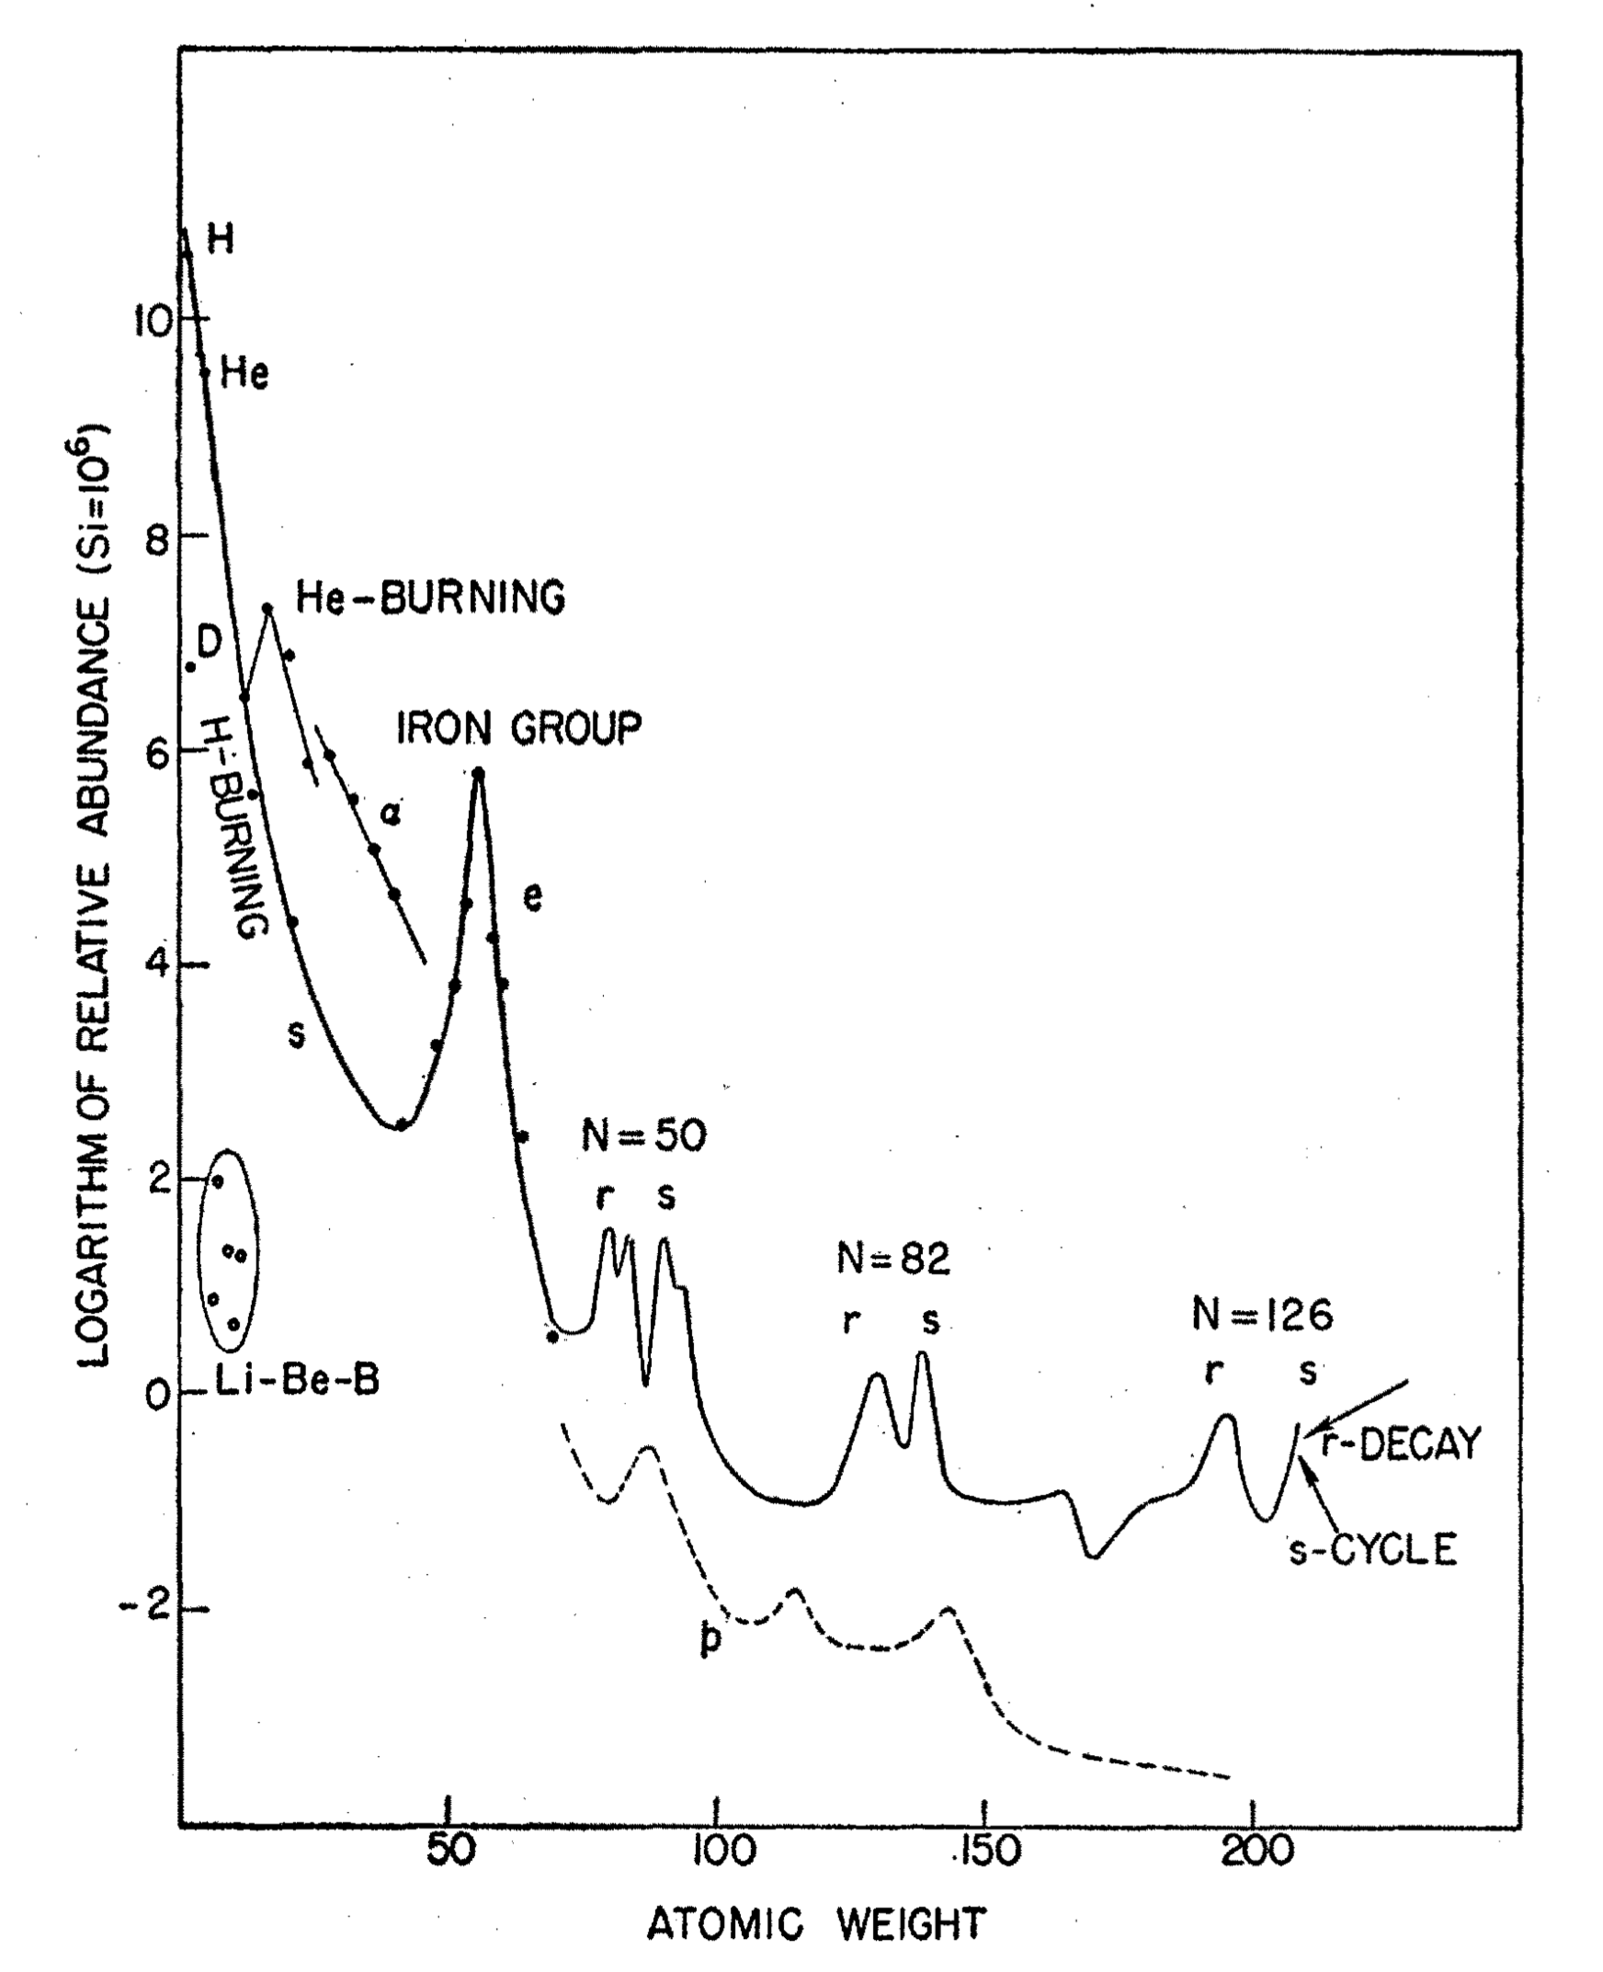
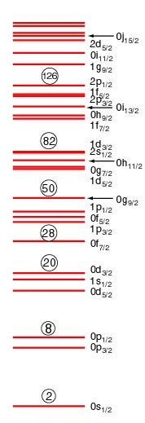
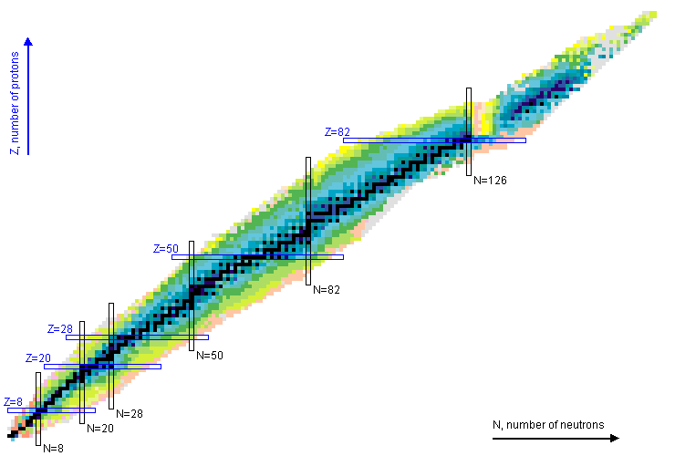
r-process nucleosynthesis: classic picture
B²FH 1957

Slide 3
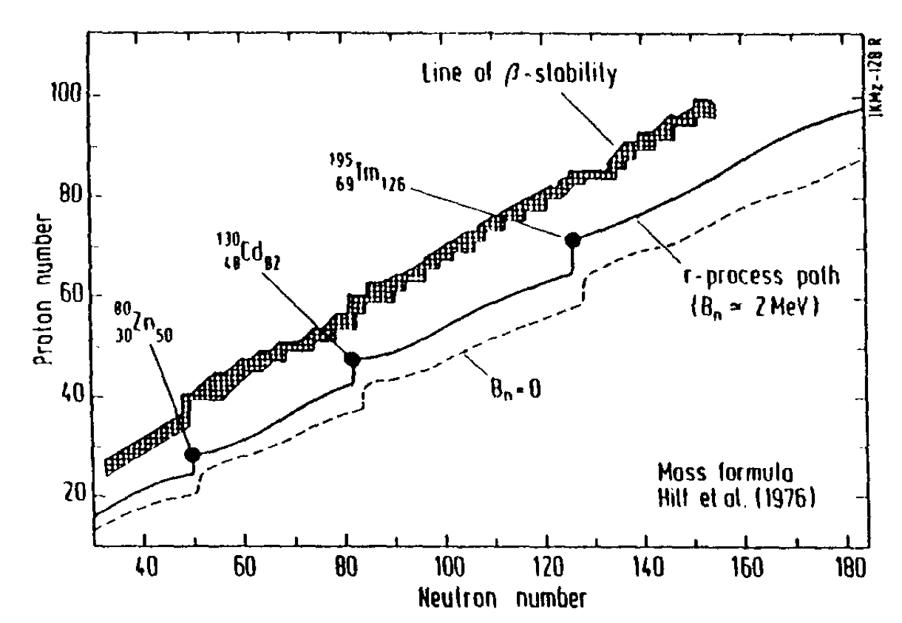
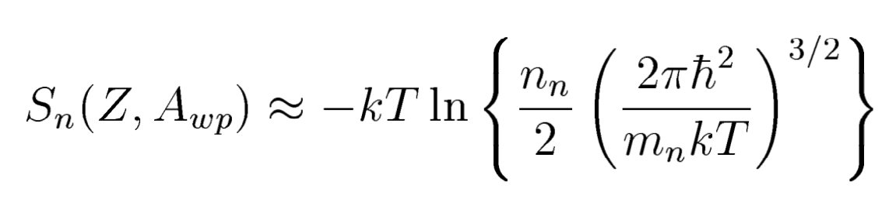
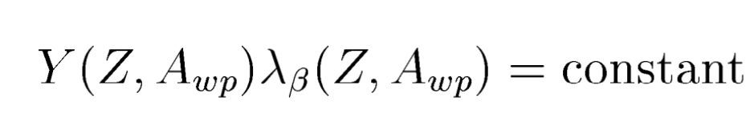
r-process nucleosynthesis: classic picture
(n,γ)-(γ,n) equilibrium:
Steady beta flow:
Cowan, Thielemann, Truran 1991

Slide 4
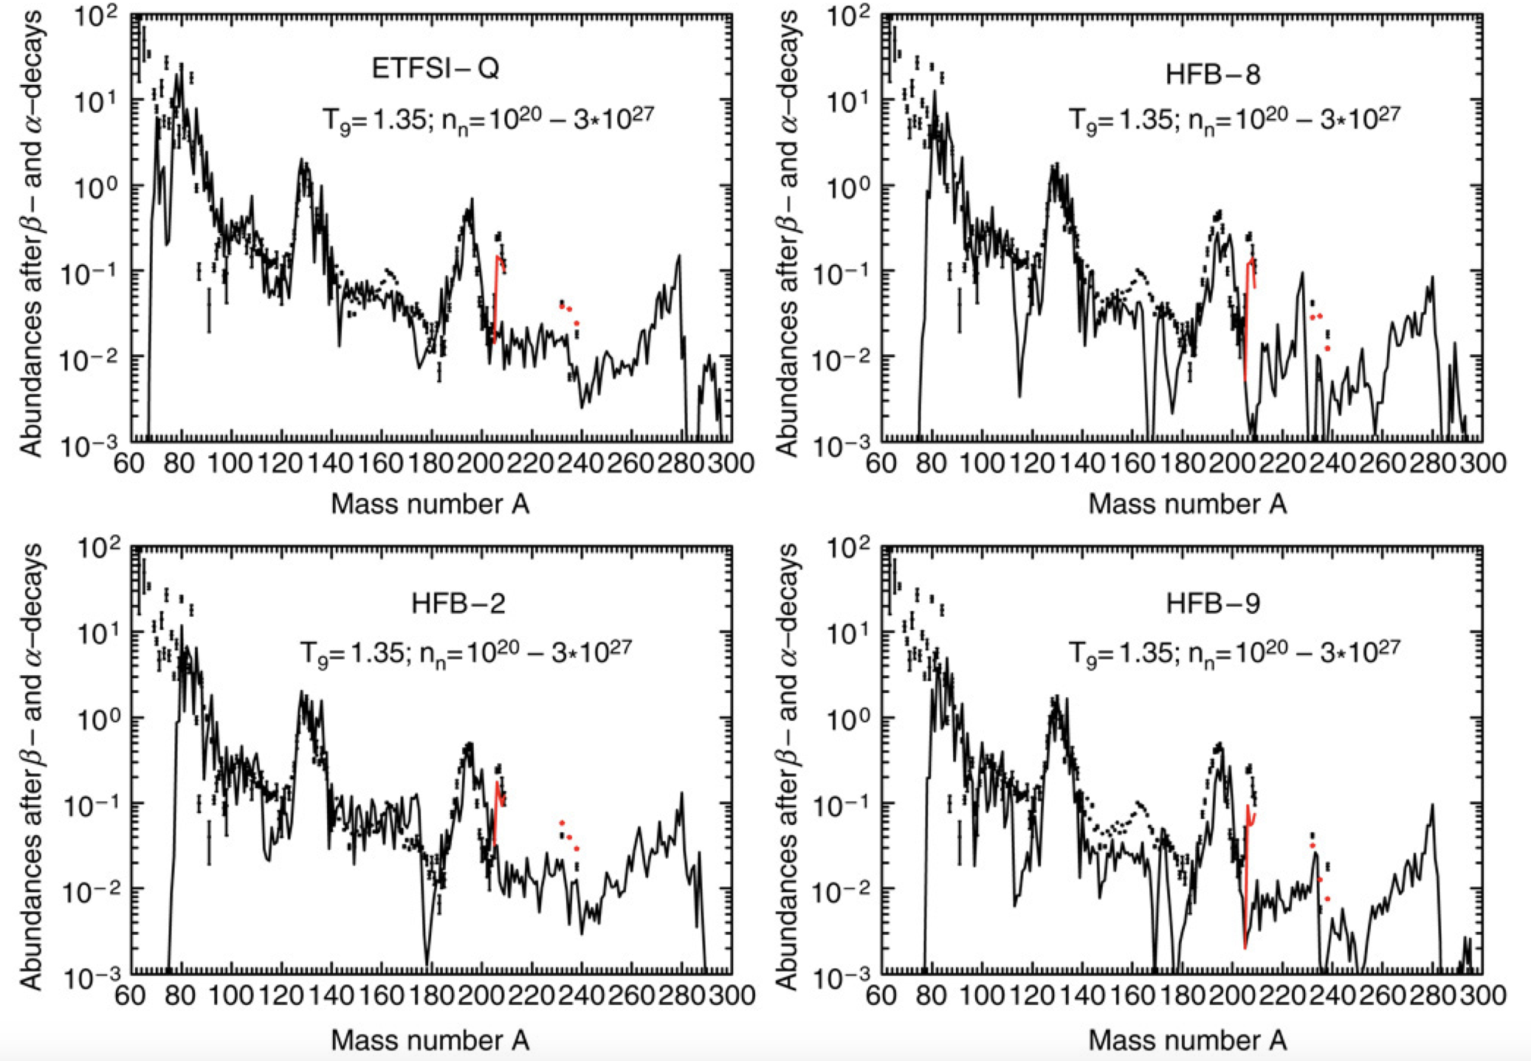
r-process calculations with the waiting point approximation
Kratz, Farouqi, Pfeiffer 2007

Slide 5
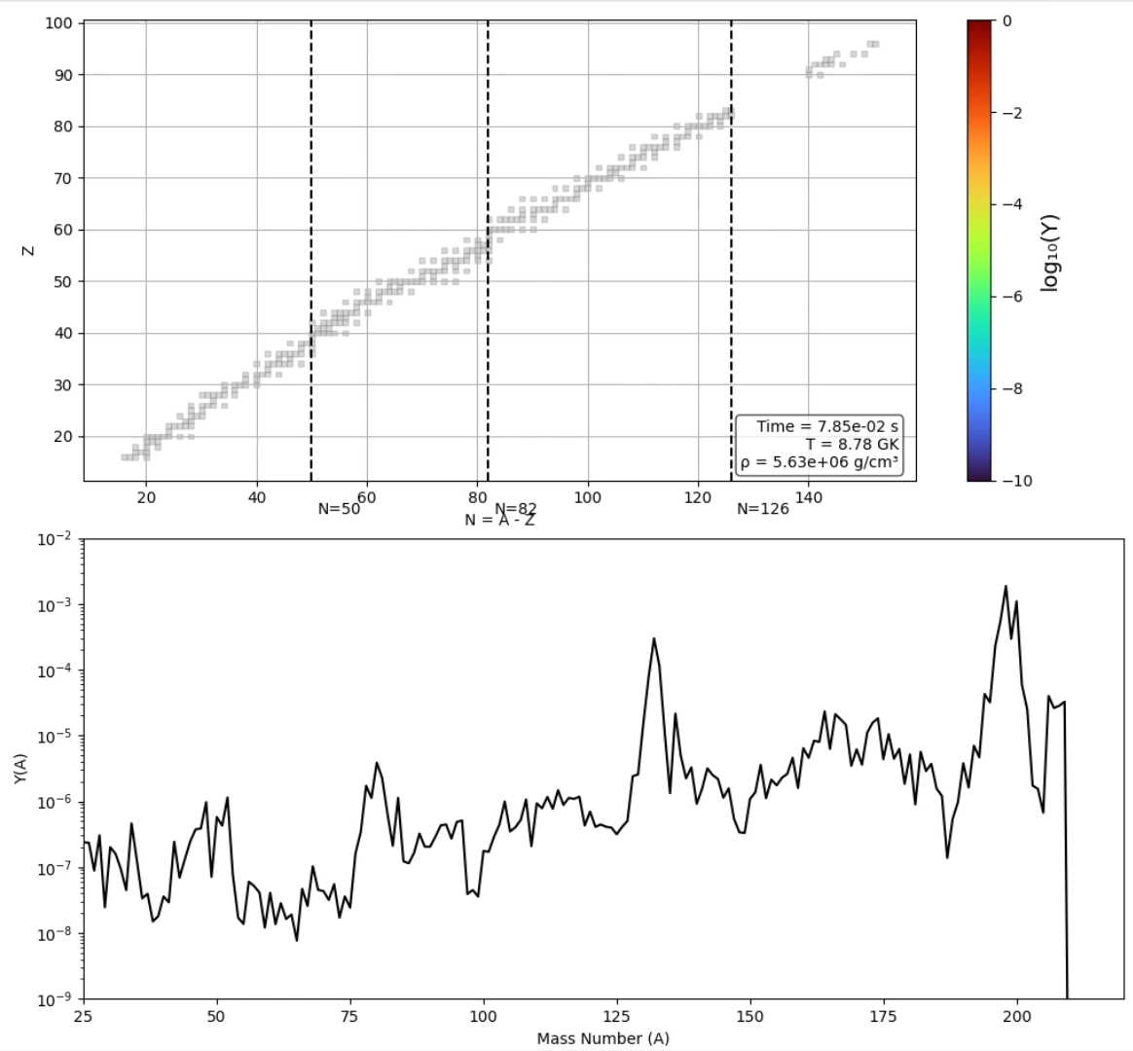
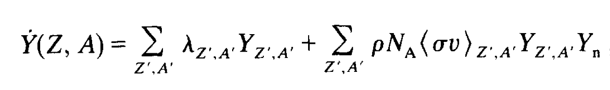

r-process
fully dynamical
calculations
Movie by ND undergrad Rose Hewald using PRISM nuclear network code
Sprouse, Mumpower

Slide 6
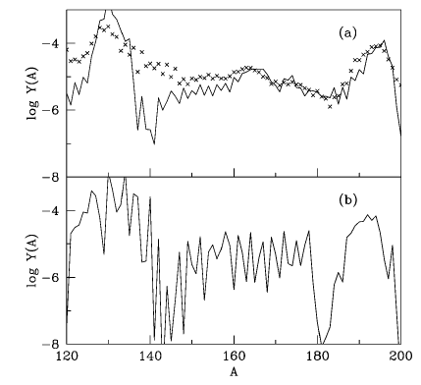
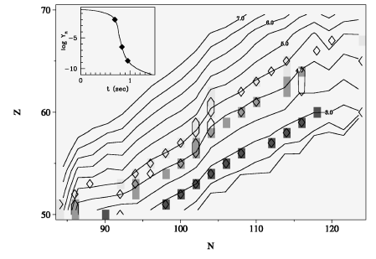
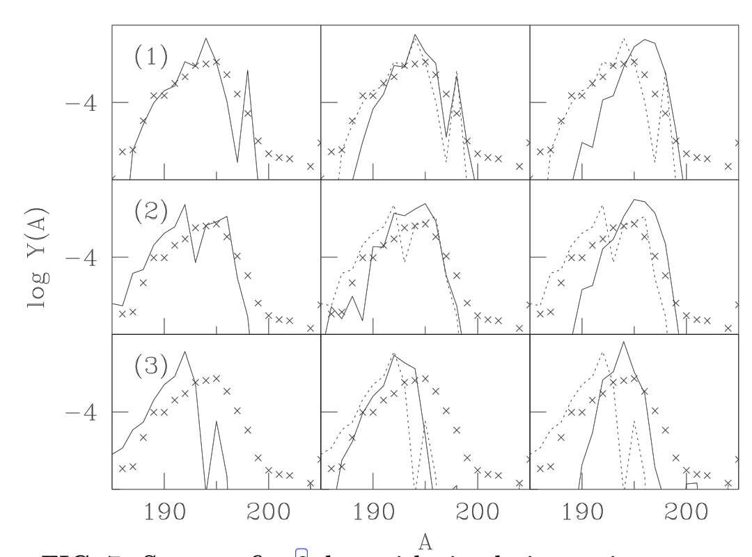
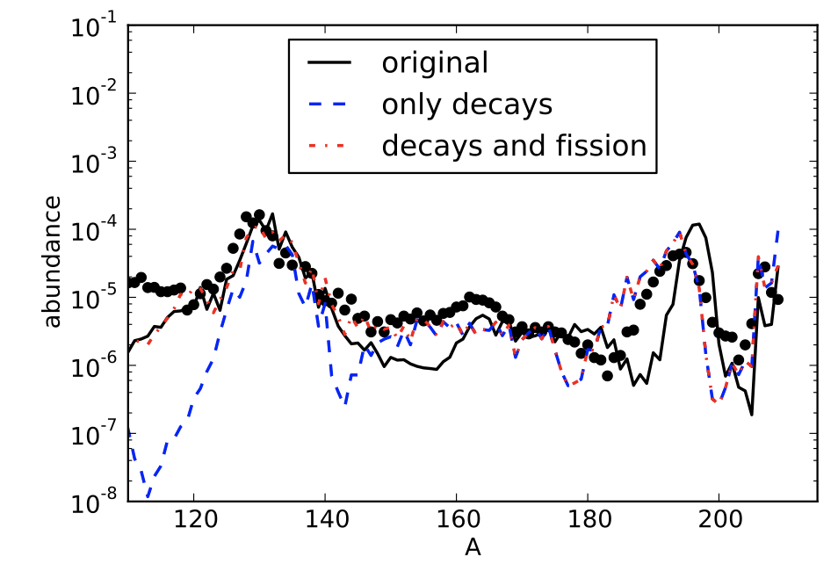
r-process freezeout dynamics
Surman, Engel, Bennett, Meyer 1997
Surman, Engel 2001
Eichler+2015

Slide 7
Nuclear masses for the r-process
masses from the AME
Mumpower, Surman, McLaughlin, Aprahamian 2016

Slide 8
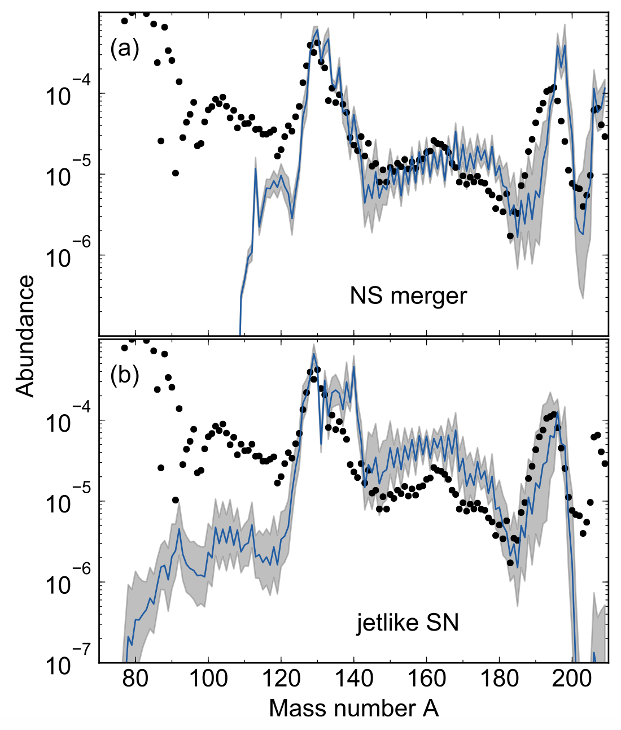
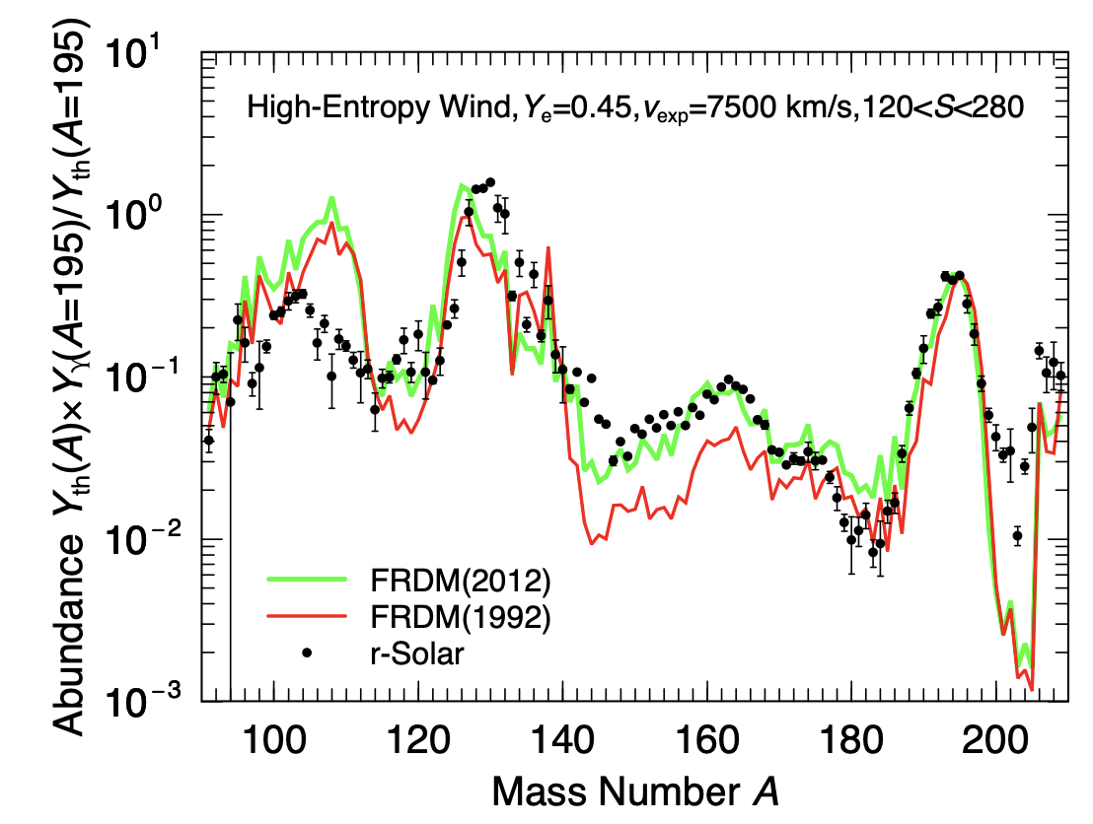
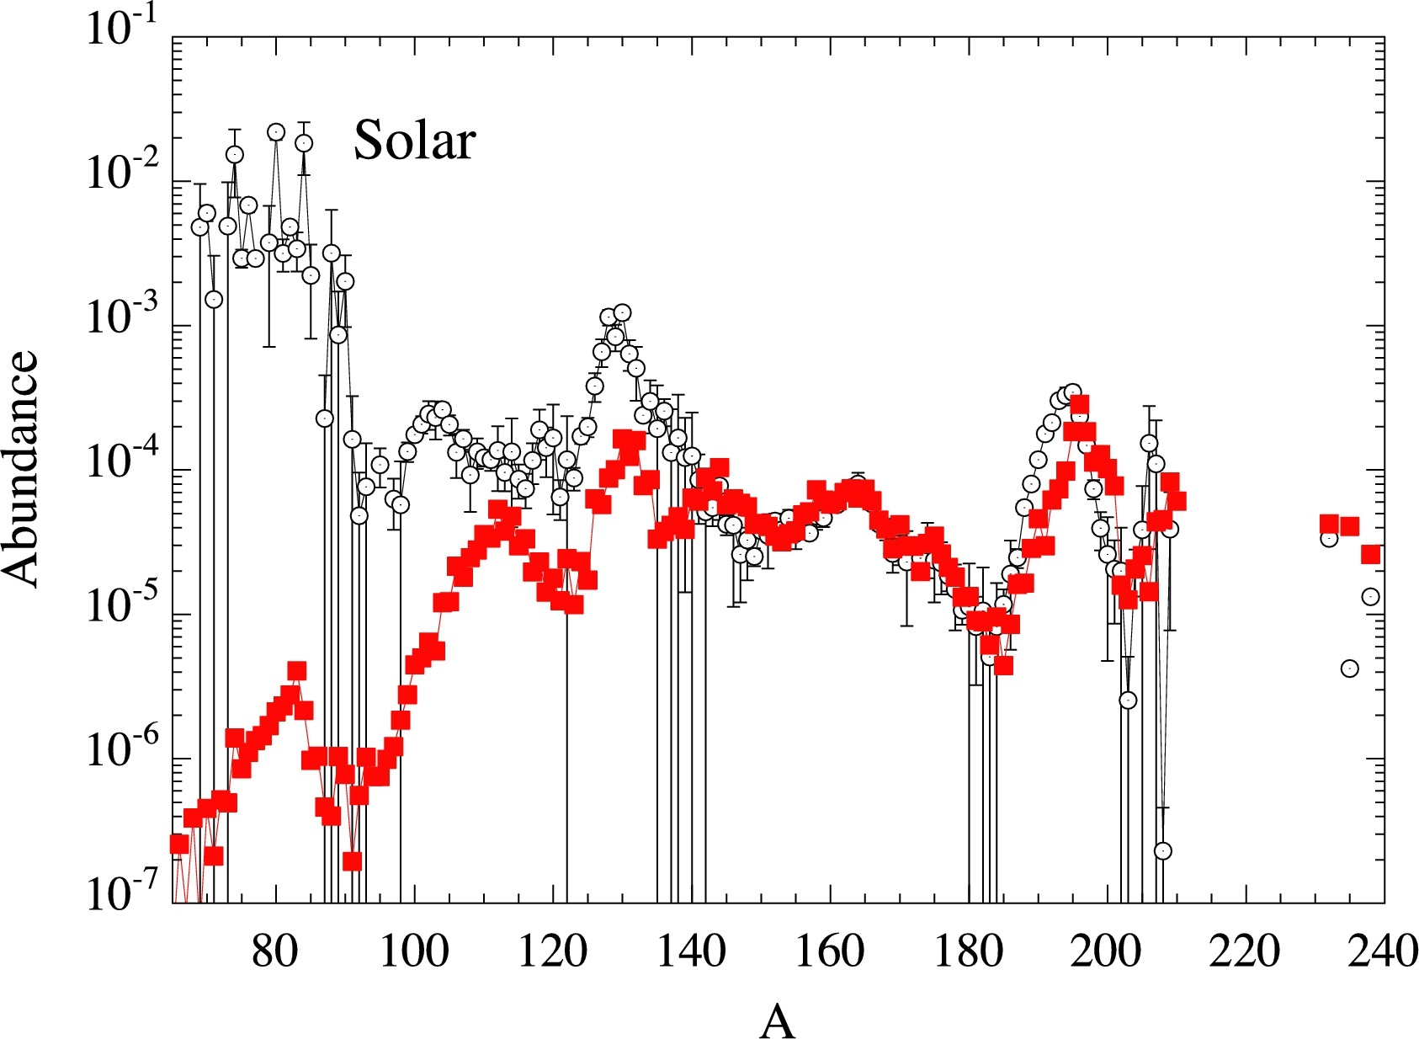
Martin+2016
Nuclear mass model systematics
Kratz+2014
HFB-24
Goriely, Martínez Pinedo 2015
Skyrme EDFs: SkM*, SkP, SLy4, SV-min, UNEDF0, UNEDF1

Slide 9
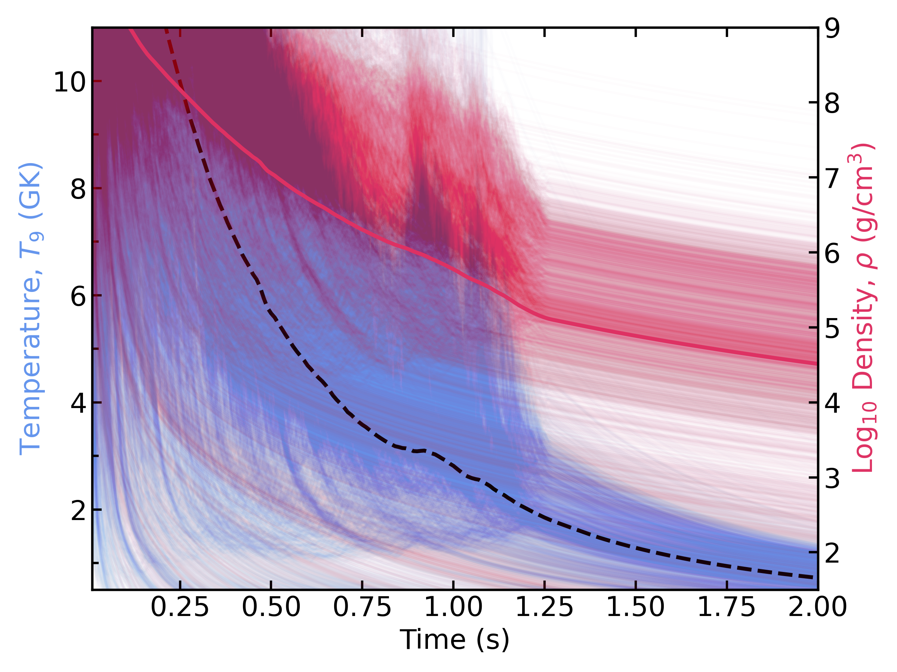
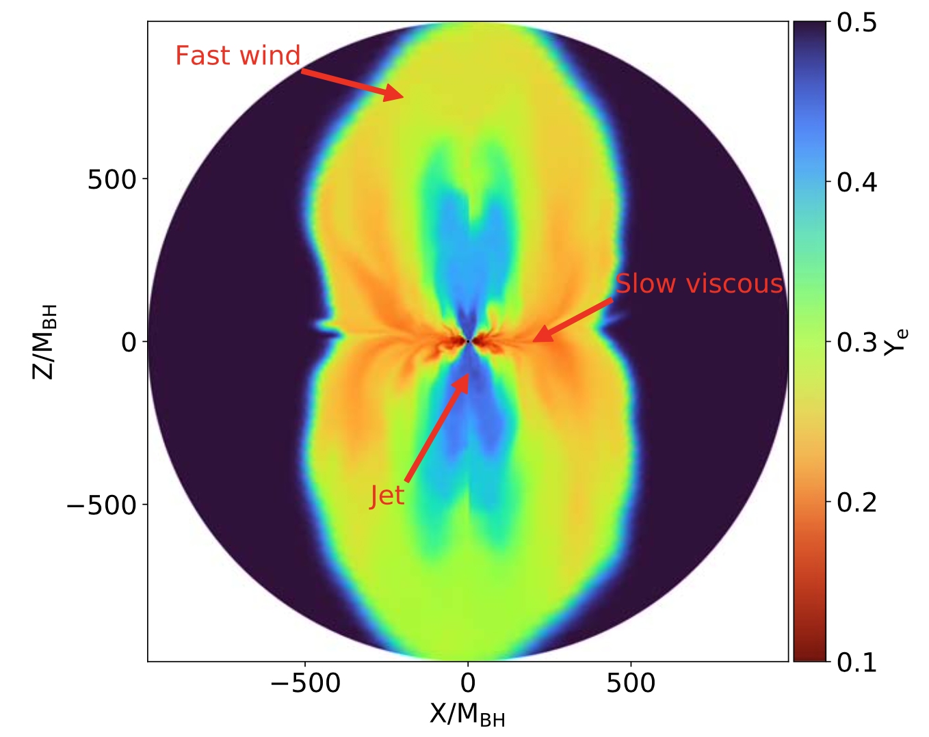
Nuclear uncertainties in the net yields of a NSM event
long-evolution BH accretion disk simulations of Sprouse+2024

Slide 10
Mass models
Mumpower, Sprouse, Miller, Lund, Cabrera Garcia, Vassh, McLaughlin, Surman 2024

Slide 11
Mass models
Mumpower, Sprouse, Miller, Lund, Cabrera Garcia, Vassh, McLaughlin, Surman 2024

Slide 12

Mass models
stronger
weaker
Mumpower, Sprouse, Miller, Lund, Cabrera Garcia, Vassh, McLaughlin, Surman 2024

Slide 13
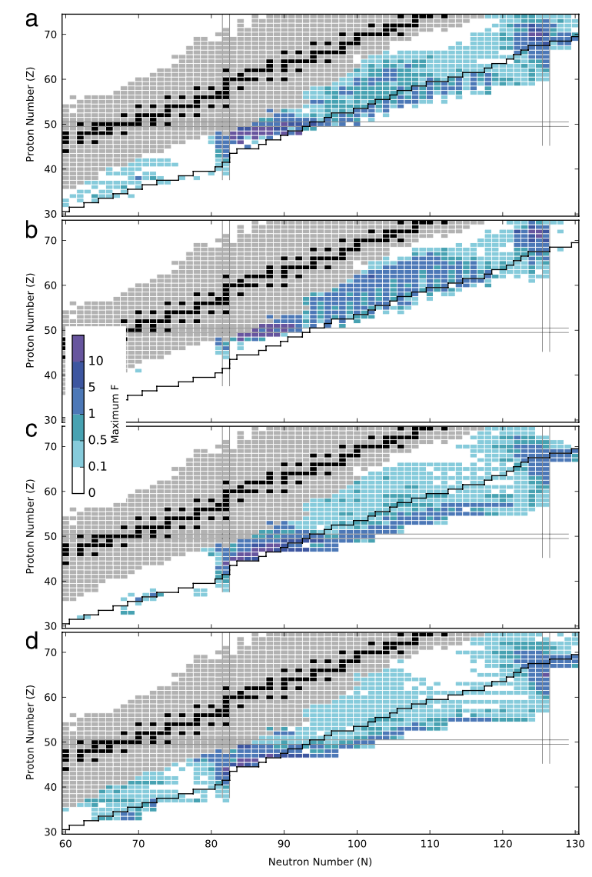
Nuclear mass sensitivity studies
Mumpower, Surman, McLaughlin, Aprahamian 2016
Surman, Mumpower 2018

Slide 14
Nuclear mass sensitivity studies
Mumpower, Surman, McLaughlin, Aprahamian 2016
NSAC LRP document, 2013
Surman, Mumpower 2018

Slide 15

Experimental prospects
AME
FRIB Day 1 reach
FRIB design goal
Surman, Mumpower 2018

Slide 16
Interpreting observables of r-process nucleosynthesis
What observables are currently limited by nuclear uncertainties that could be addressed via nuclear experiment?
Are there distinguishing observables that rise above nuclear uncertainties?
What can we learn about nuclear physics far from stability from r-process observables?

Slide 17
Interpreting observables of r-process nucleosynthesis
What observables are currently limited by nuclear uncertainties that could be addressed via nuclear experiment?
Are there distinguishing observables that rise above nuclear uncertainties?
What can we learn about nuclear physics far from stability from r-process observables?

Slide 18
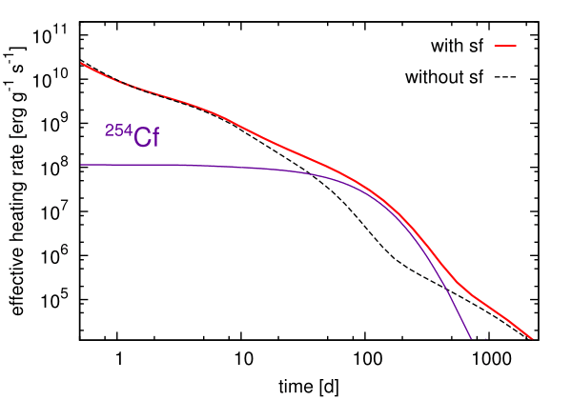
Did the GW170817 merger produce actinides?
excess KN heating at ~100 days
Zhu, Wollaeger, Vassh, Surman, Sprouse, Mumpower, Möller, McLaughlin, Korobkin, Jaffke, Holmbeck, Fryer, Even, Couture, Barnes, ApJL 2018

Slide 19
Did the GW170817 merger produce actinides?
HST observations
Kilpatrick+2021
excess KN heating at ~100 days
Spitzer mid-infrared
Kasliwal+2019
Zhu, Wollaeger, Vassh, Surman, Sprouse, Mumpower, Möller, McLaughlin, Korobkin, Jaffke, Holmbeck, Fryer, Even, Couture, Barnes, ApJL 2018
data at ~100 days matches a GRB afterglow

Slide 20
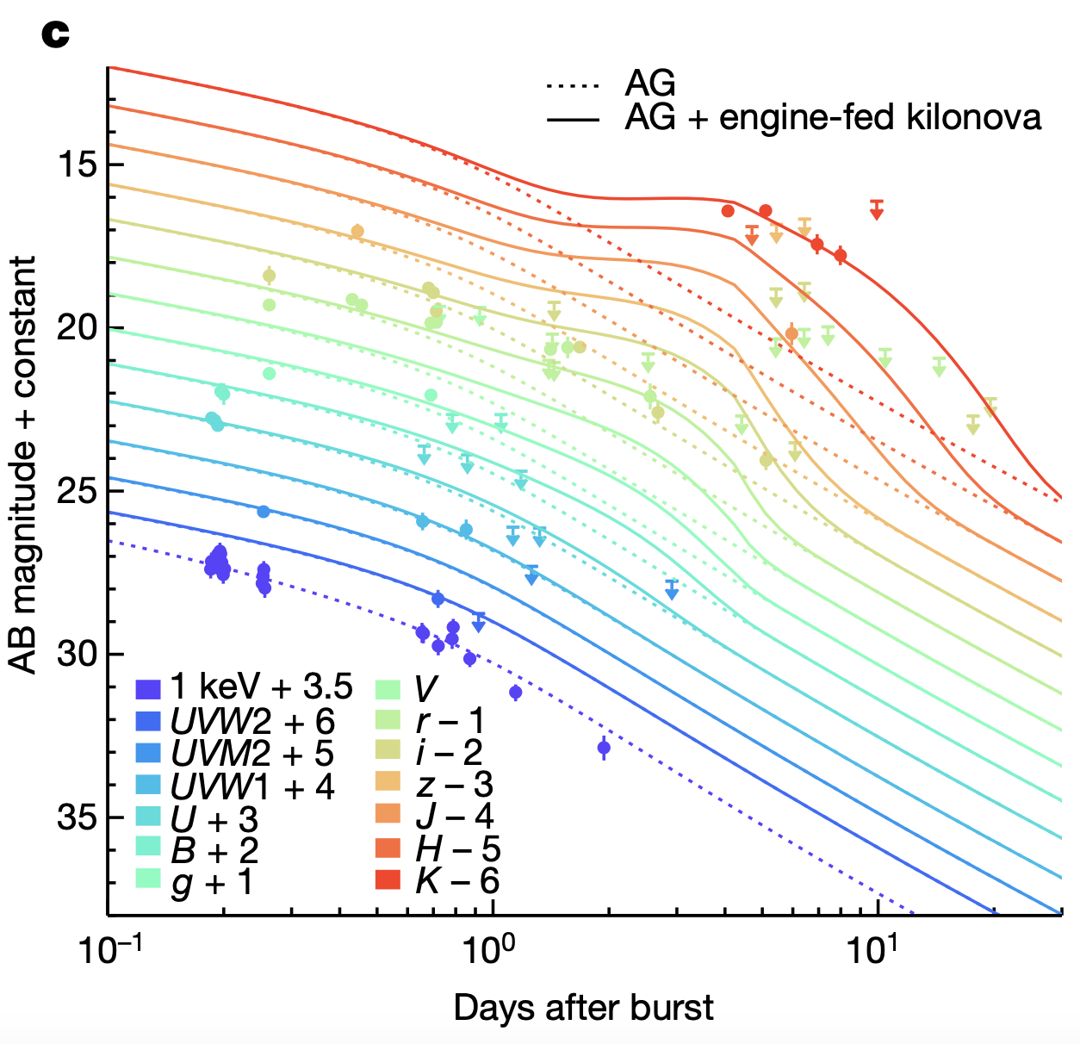
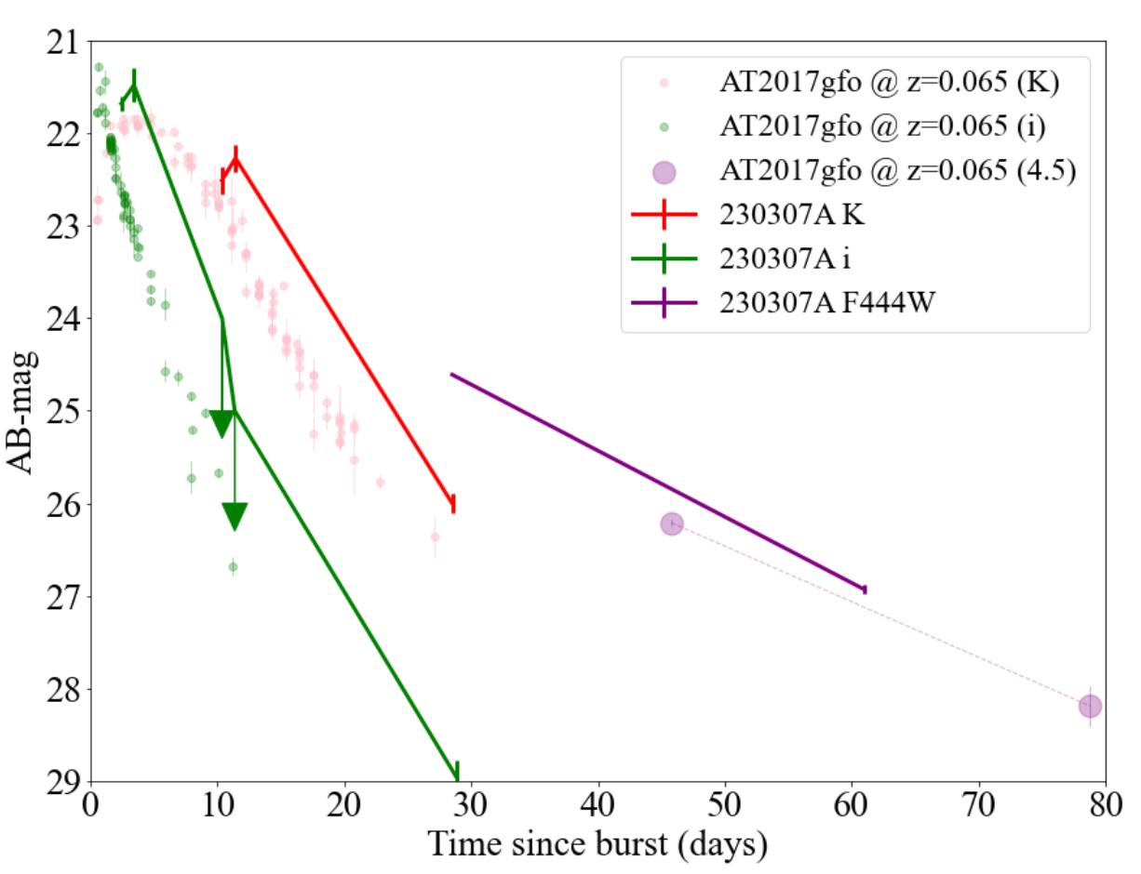
Subsequent KNe show similar late time behavior
GRB 211211A
Yang+22
HST observations
Kilpatrick+2021
GRB 230307A
Levan+23
data at ~100 days matches a GRB afterglow
20

Slide 21
²⁵⁴Cf: dependence on nuclear inputs
²⁵⁴Cf
Vassh, Vogt, Surman, Randrup, Sprouse, Mumpower, Jaffke, Shaw, Holmbeck, Zhu, McLaughlin, 2018
Zhu, Lund, Barnes, Sprouse, Vassh, McLaughlin, Mumpower, Surman 2021

Slide 22
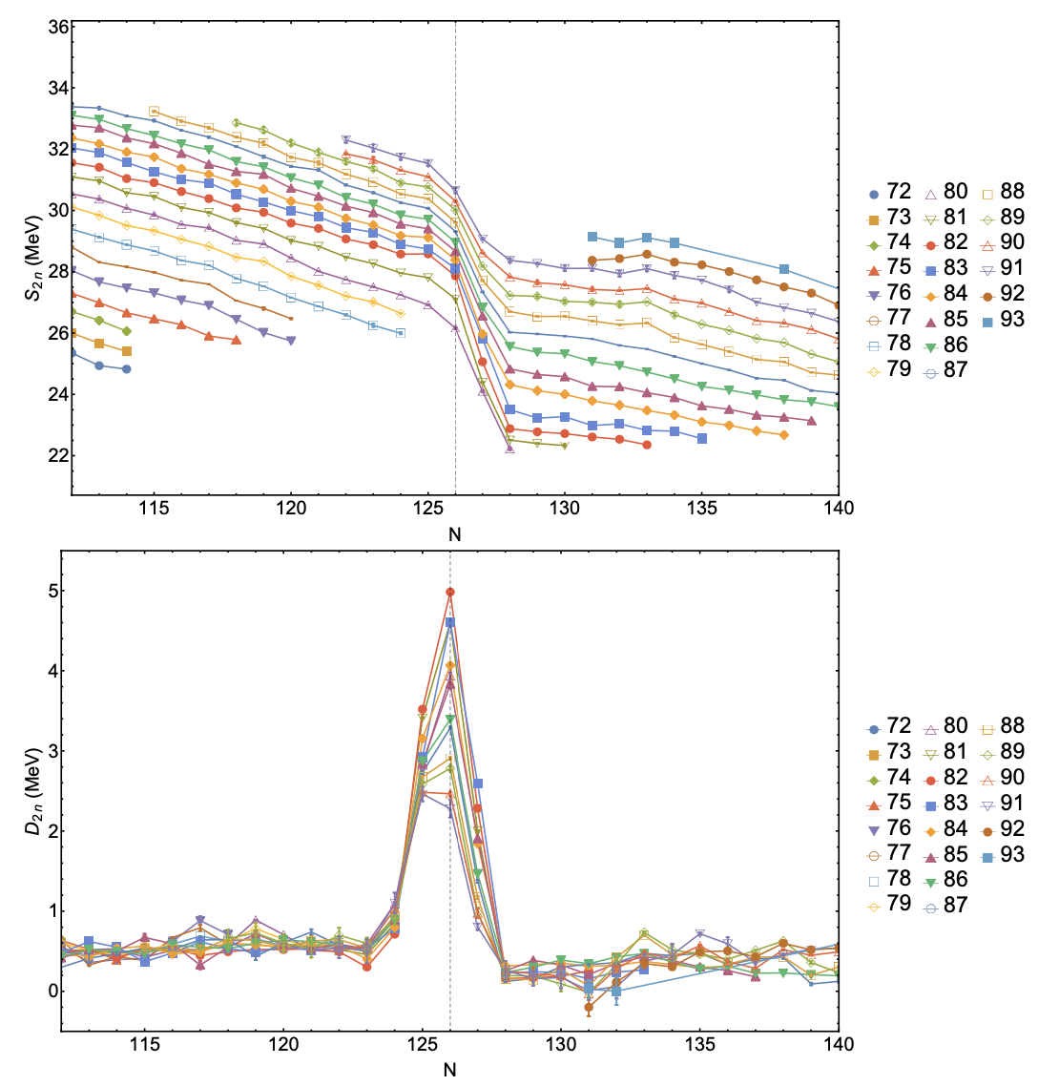
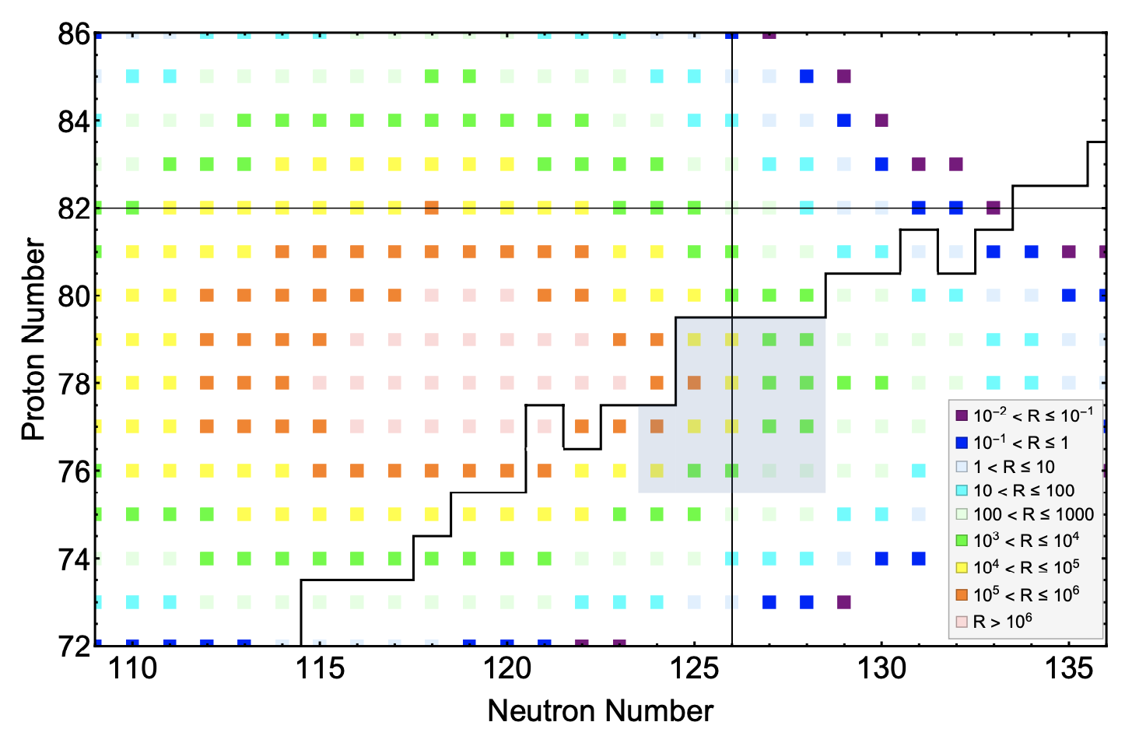

Nuclear masses and actinide production
ANL N = 126 Factory proposal
N = 126 region masses
B Liu+

Slide 23
Interpreting observables of r-process nucleosynthesis
What observables are currently limited by nuclear uncertainties that could be addressed via nuclear experiment?
Are there distinguishing observables that rise above nuclear uncertainties?
What can we learn about nuclear physics far from stability from r-process observables?

Slide 24
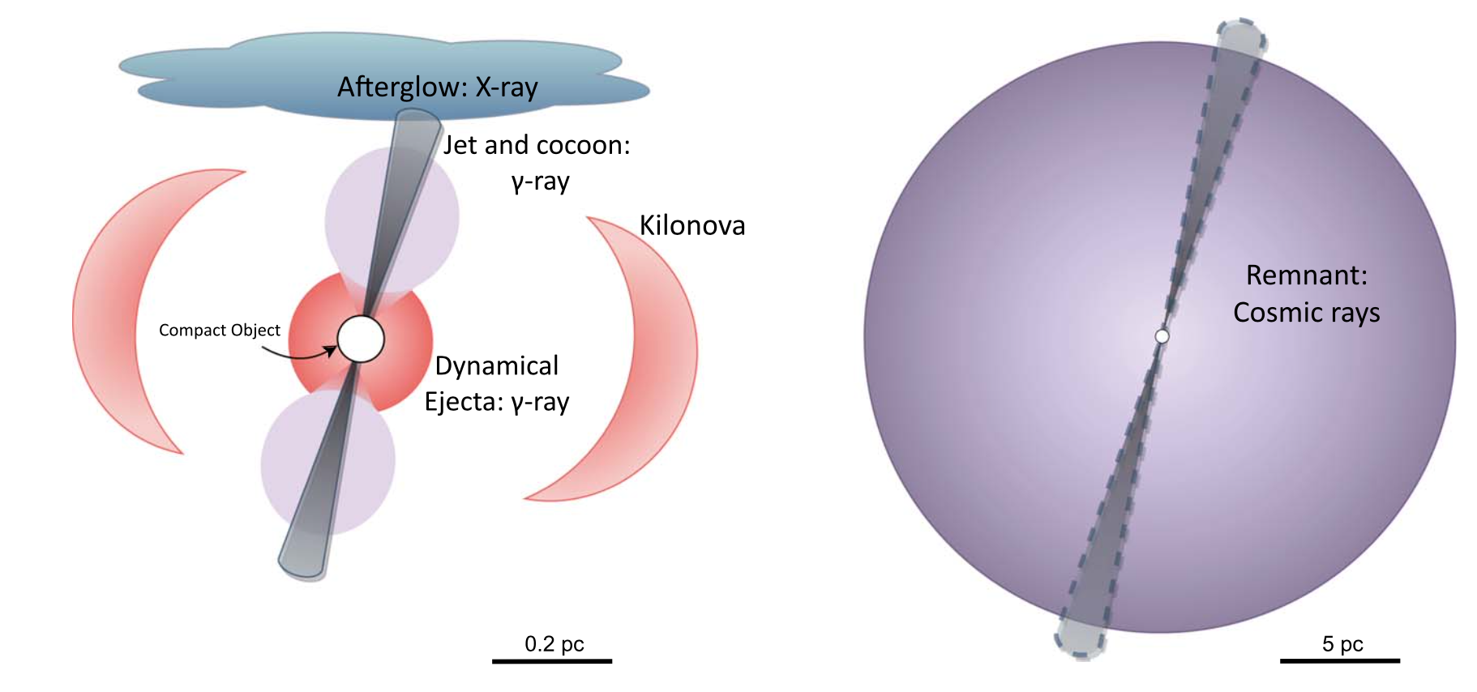
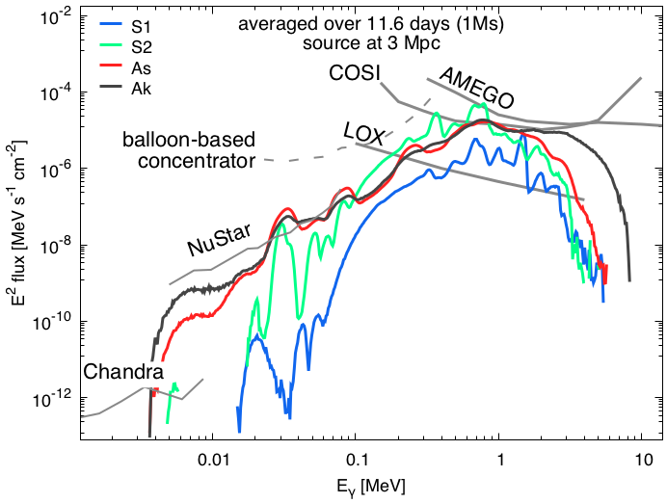
Gamma rays from a nearby event
“Could a Kilonova Kill: a Threat Assessment”
Perkins, Ellis, Fields, Hartmann, Liu, McLaughlin, Surman, Wang 2024
Korobkin, Hungerford, Fryer, Mumpower, Misch, Sprouse, Lippuner, Surman, Couture, Bloser, Shirazi, Evan, Vestrand, Miller 2020
also Hotokezaka+2016; Li 2019; Wu+2019; Ruiz-Lapuente, Korobkin 2020

Slide 25
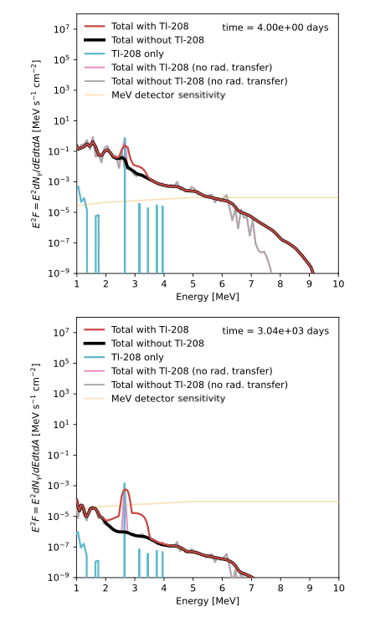
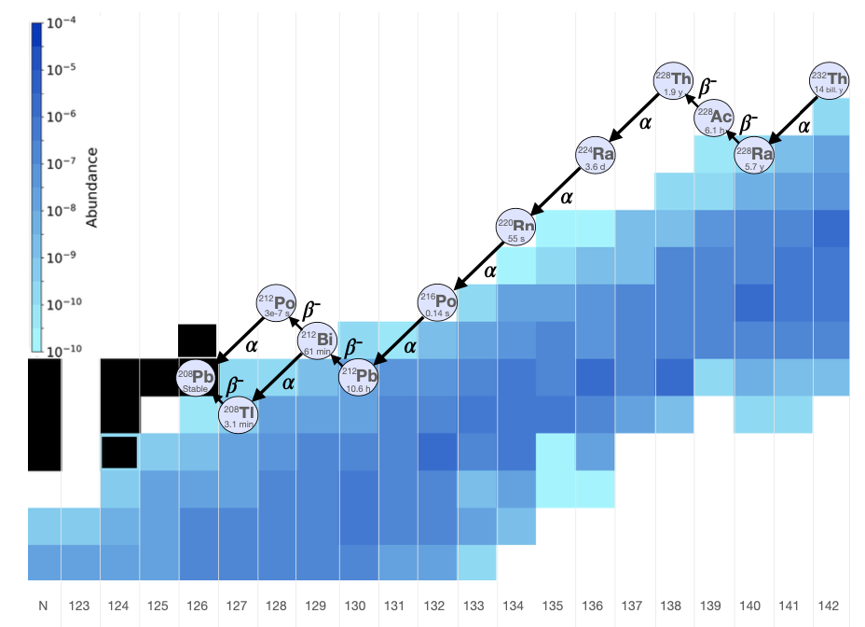
²⁰⁸Tl: a potential actinide signature in gamma rays
Vassh, Wang, Lariviere, Sprouse, Mumpower, Surman, Liu, McLaughlin, Denissenkov, Herwig, PRL 2024
25

Slide 26
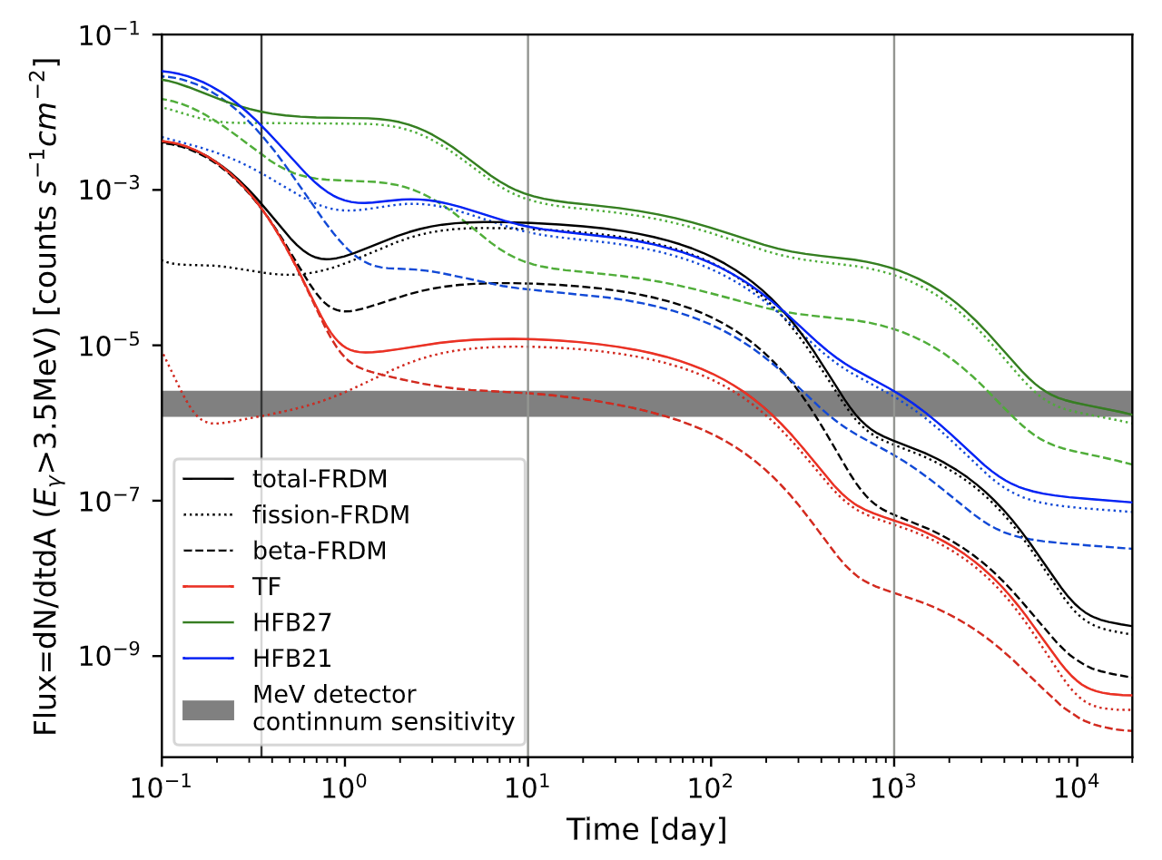
Gamma rays from fission
PRELIMINARY
Wang, Vassh, Sprouse, Mumpower, Vogt, Randrup, Surman, ApJL 2020
Wang, Vassh+ in preparation

Slide 27
Interpreting observables of r-process nucleosynthesis
What observables are currently limited by nuclear uncertainties that could be addressed via nuclear experiment?
Are there distinguishing observables that rise above nuclear uncertainties?
What can we learn about nuclear physics far from stability from r-process observables?

Slide 28
UNEDF1 masses
Sprouse, Navarro Perez, Surman, Mumpower, McLaughlin, Schunck 2020

Slide 29
UNEDF1 masses
Sprouse, Navarro Perez, Surman, Mumpower, McLaughlin, Schunck 2020

Slide 30
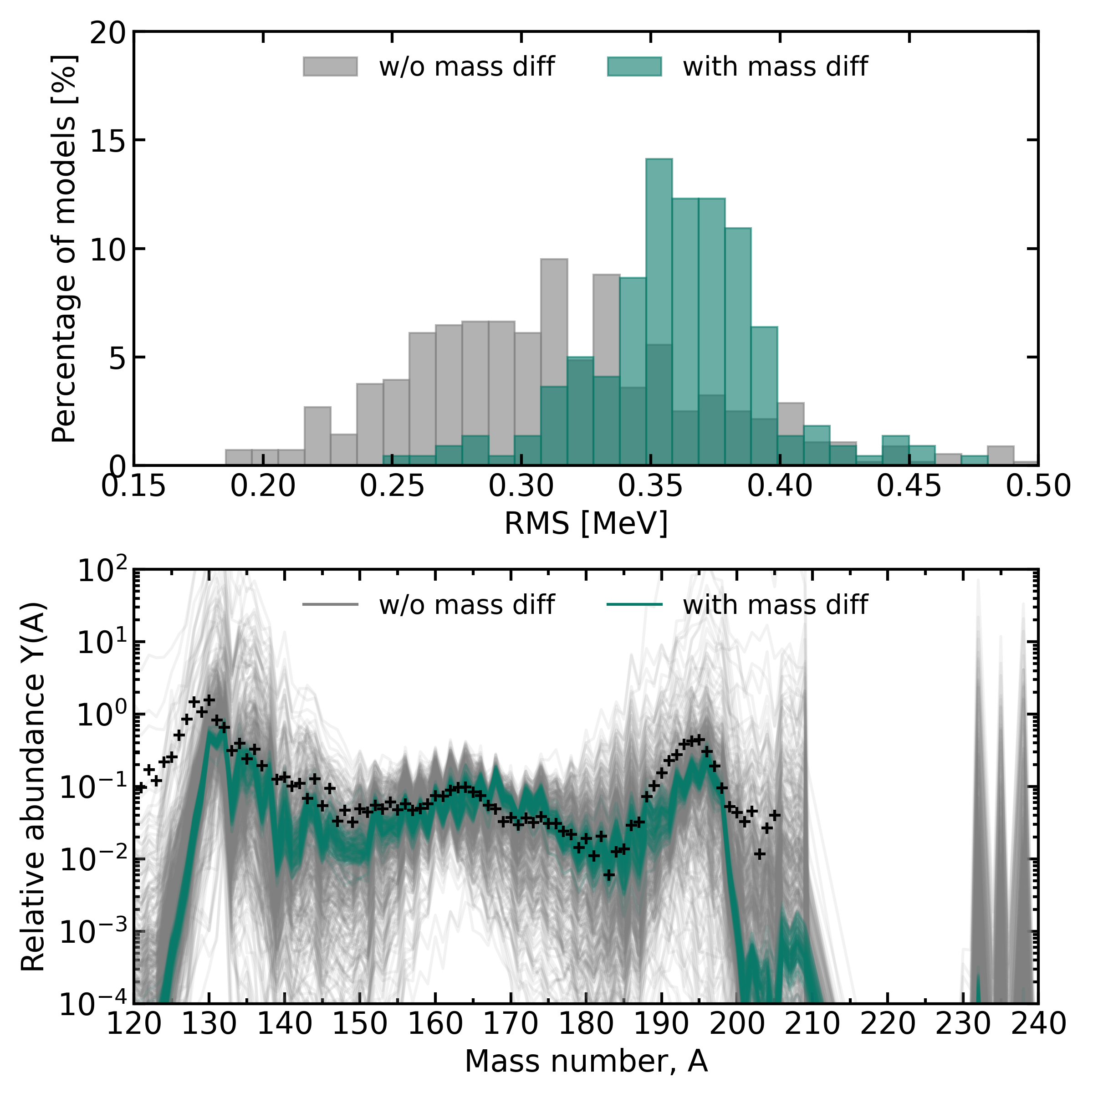
ML mass models
Li, Mumpower, Vassh, Porter, Surman, arxiv:2506.06464

Slide 31
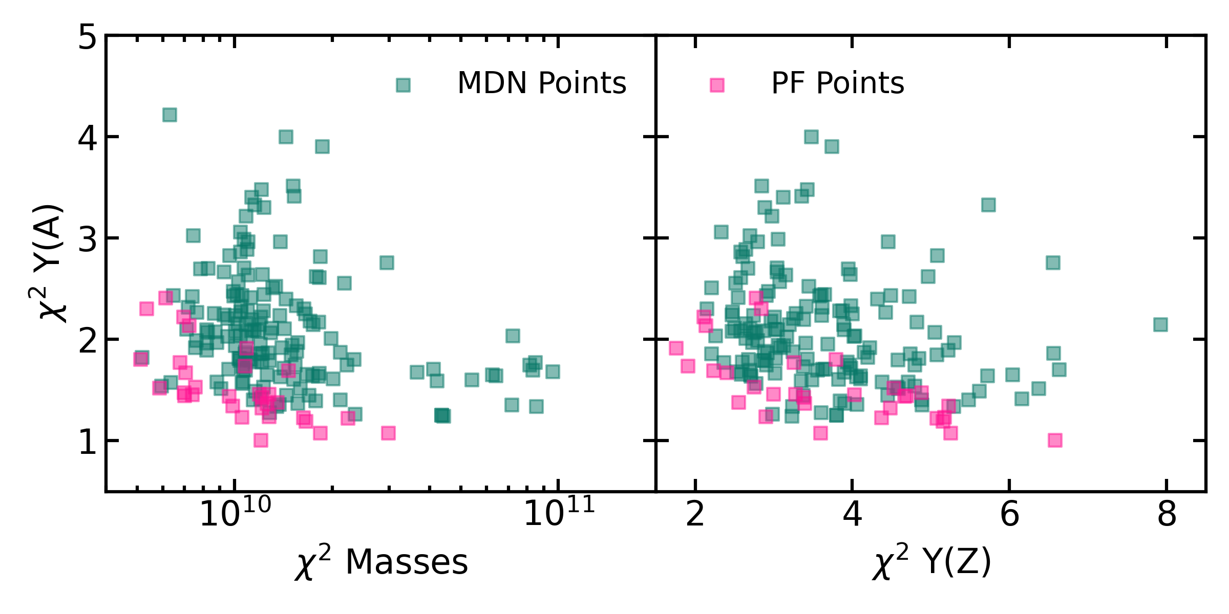
ML mass models: multifactor optimization
Li, Mumpower, Vassh, Porter, Surman, arxiv:2506.06464

Slide 32
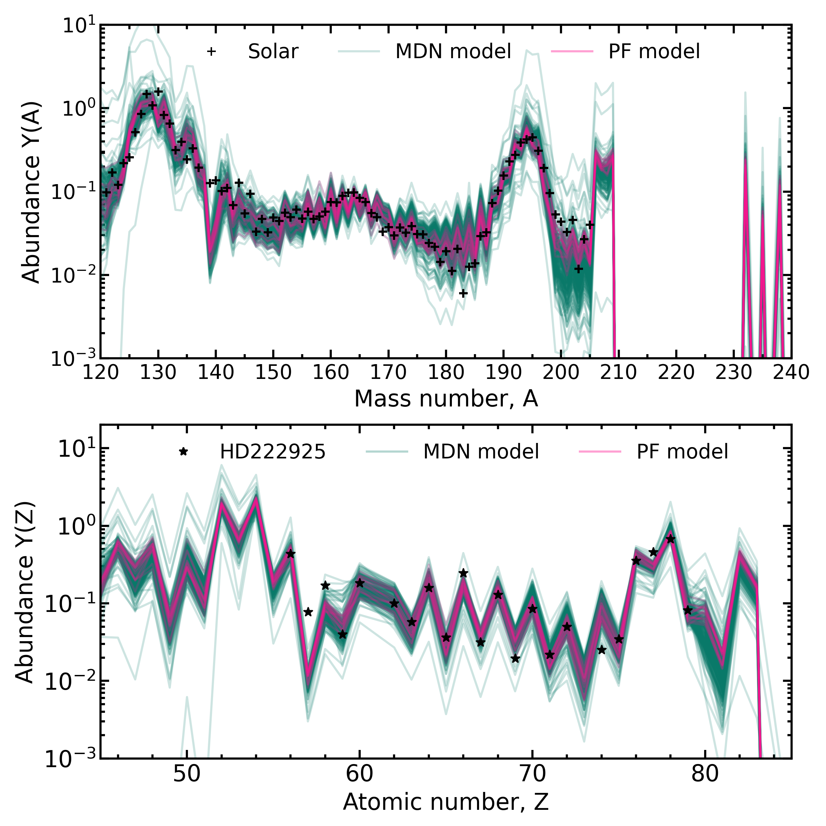
ML mass models: multifactor optimization
Li, Mumpower, Vassh, Porter, Surman, arxiv:2506.06464

Slide 33
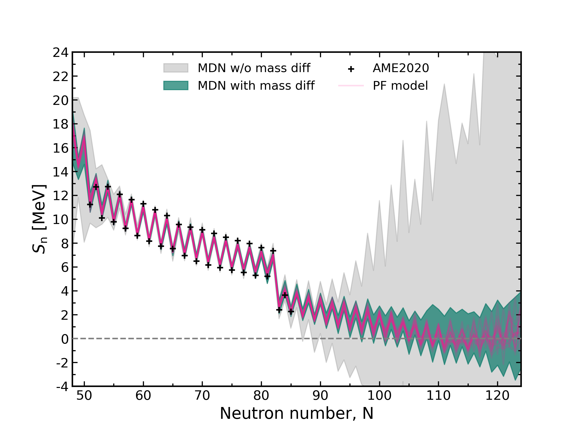
ML mass models: multifactor optimization

Slide 34
Fission yield signatures
Vassh, Mumpower, McLaughlin, Sprouse, Surman 2020
Rh Pd Ag
La Eu
Cowan+2011

Slide 35
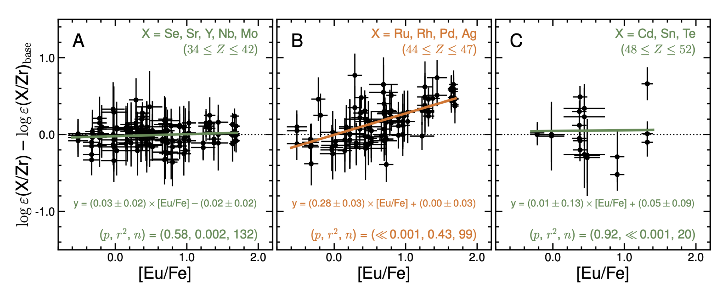
Fission yield signatures
Roederer, Vassh, Holmbeck, Mumpower, Surman, Cowan, Beers, Ezzeddine, Frebel, Hansen, Placco, Sakari, Science 2023

Slide 36
summary
The origin of the heaviest elements in the r-process of nucleosynthesis has been one of the greatest mysteries in nuclear astrophysics for decades.
Despite considerable progress in the past several years, including the first direct detection of an r-process event, the r-process site(s) has not been definitively determined.
The nuclear physics of candidate events remains poorly understood. FRIB, the N=126 factory, ARIEL, and FAIR have the potential to reduce key nuclear uncertainties, facilitating accurate interpretations of r-process observables such as abundance patterns and light curves.
accessible FRIB Day 1
FRIB full reach
Mumpower, Surman, McLaughlin, Aprahamian, JPPNP 2016

Slide 37
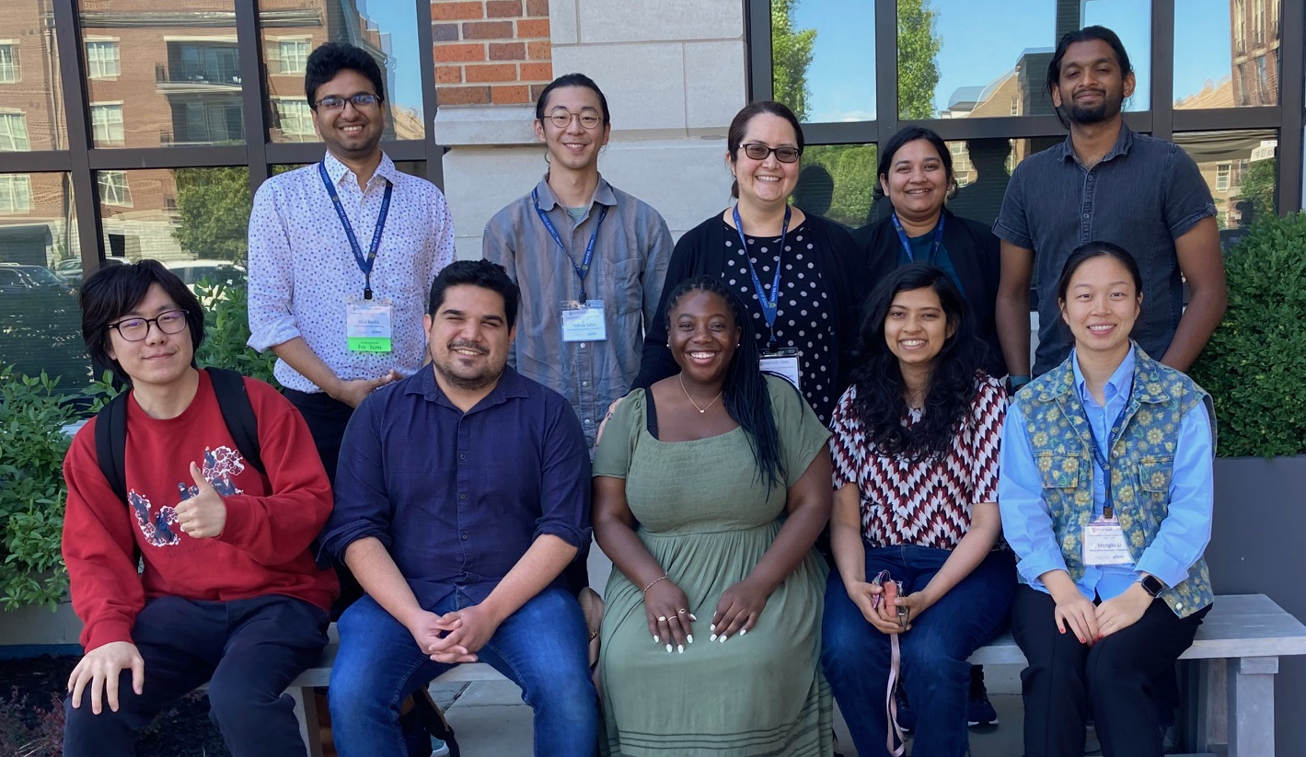


acknowledgements
North Carolina State University
Zhenghai Liu
Kelsey Lund
Atul Kedia
Yonglin Zhu
Gail McLaughlin
Ian Roederer
Los Alamos National Laboratory
Trevor Sprouse
Chris Fryer
Toshihiko Kawano
Matthew Mumpower
University of Notre Dame
Jonathan Cabrera Garcia
Lauren Harewood
Ashabari Majumdar
Pranav Nalamwar
Mengke Li
Yukiya Saito
Ani Aprahamian
Tim Beers
Maxime Brodeur
TRIUMF National Laboratory
Nicole Vassh
Iris Dillmann
Reiner Krucken
Livermore National Laboratory
Erika Holmbeck
Jutta Escher
Nicholas Schunck
Ramona Vogt
University of Tennessee/ORNL
Mitch Allmond
Raph Hix
Robert Grzywacz
Krzysztof Rykaczewski
University of North Carolina
Evan Ney
Jon Engel
MIT
Anna Frebel
Facility for Rare Isotope Beams
Erin Good
Sean Liddick
Artemis Spyrou
Argonne National Laboratory
Jason Clark
Rodney Orford
Guy Savard
IHEP Beijing
Xilu Wang
University of Illinois
Haille Perkins
Brian Fields
King’s College (UK)
John Ellis
students
postdocs

