Slide 1
Nuclear weak-interaction processes in stars
Gabriel Martínez-Pinedo
s, i & r Element Nucleosynthesis (sirEN) conference
Giulianova, Italy, June 10, 2025
ERC AdG KILONOVA

Slide 2
Roberto Gallino, Carlos Abia and myself
(Nuclear Astrophysics 1957–2007: Beyond the First 50 Years, Caltech, Pasadena)

Slide 3
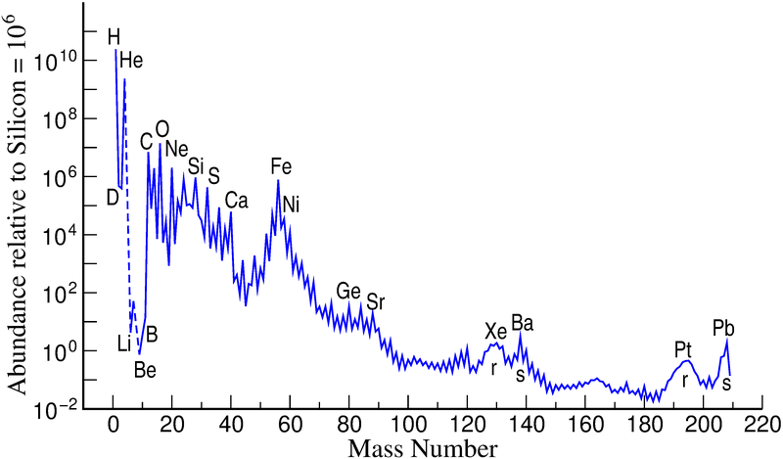
Weak interactions in the Universe
Stellar evolution and explosions
Neutron capture processes:
s process r process
Big bang
Nucleosynthesis in stars operates by converting “protons” into “neutrons” via the weak interaction
This way the Big Bang composition is transformed into the abundances we observe in the solar system

Slide 4
Different regimes
Medium densities and temperatures: material is partially ionized, both bound and continuum processes contribute (bound $β$-decay, atomic $e$-capture, continuum $β$-decay, continuum 𝑒-capture
solar interior, e.g., ⁷Be decay
s-process nucleosynthesis: ²⁰⁵Tl and ²⁰⁵Pb decays
High densities and/or temperatures: material is fully ionized. Produced neutrinos are important energy loss.
URCA processes intermediate mass stars: determined by individual transitions
Core-collapse massive stars: many transitions contribute.
High density regimes ($≳{10}^{12} g cm^{−3}$)
Neutrino absorption and scattering reactions determine opacity.
Sources of neutrinos that affect nucleosynthesis
Explosive nucleosynthesis
Neutrino-nucleus reactions and nucleosynthesis: determine $Y_{e}$, $ν$-process, $νp$-process, $νr$-process
r-process nucleosynthesis: 𝛽-decay neutron-rich nuclei
Notes:
b

Slide 5
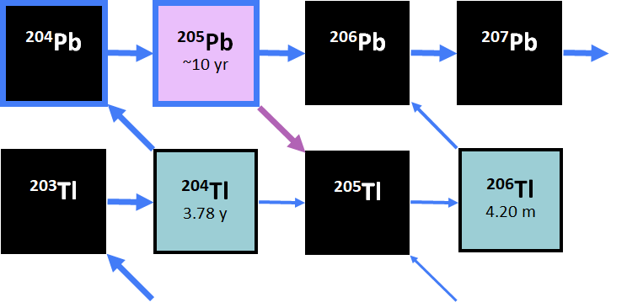
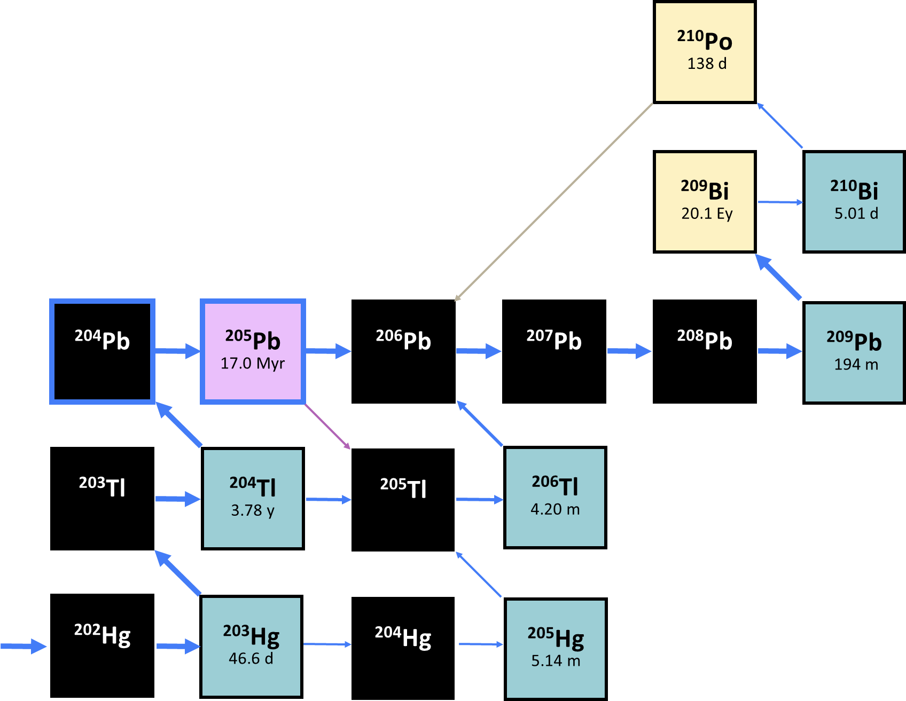
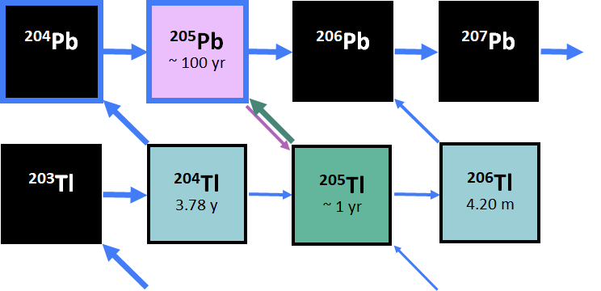
s-process region 205Tl – 205Pb
With a half-life of 17 Myr ²⁰5Pb is a good candidate for a cosmochronometer,
but production is complicated …
at higher temperatures: ²⁰⁵Pb decays by bound 𝑒-capture (excited state)
at low temperatures: ²⁰⁵Pb decays by bound 𝑒-capture (ground state)
at even higher temperatures: ²⁰⁵Tl decays by bound 𝛽-decay

Slide 6
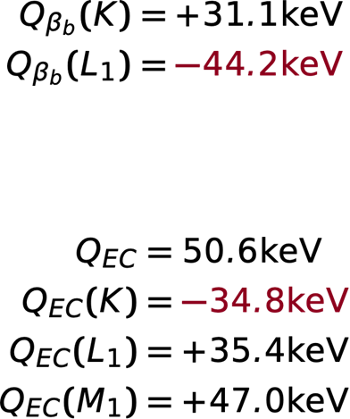
²⁰⁵Tl – ²⁰⁵Pb energetics
electron binding energies on the same scale as Q-value
coulomb corrections in astrophysical plasma are of similar order
only bound 𝛽-decay to K shell possible
no bound 𝑒-capture from K shell possible
Lifetime fully ionized 205Tl measured at GSI: ${291}_{−27}^{+33}$ days
Leckenby et al., Nature 635, 321 (2024)

Slide 7
Energy ion in plasma is modified by presence of background electrons
$$E\left(Q\right)=E_{0}\left(Q\right)+μ_{C}(Q)$$
$E_{0}$ is vacuum energy, $μ_{c}$ interaction background
(Haensel et al. 2007)
Increasing density reduces the number of bound electrons. Ions fully ionized and high T and density
-Qe
+Qe
Pb

Slide 8
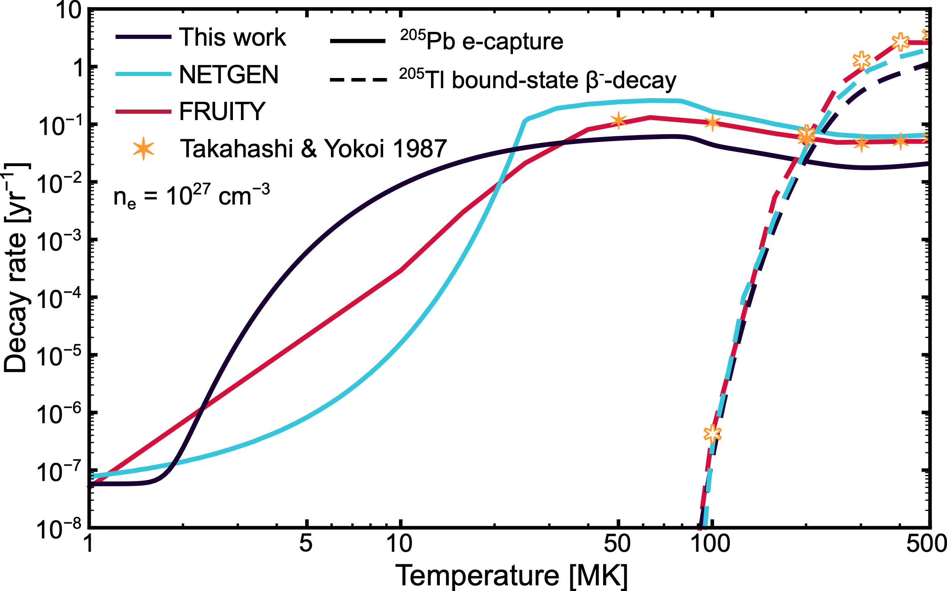
Stellar weak processes
At low T, ²⁰⁵Pb decays by bound e-capture on ground state
Increase in T populates excited state enhancing bound e-capture
With increasing T ionization reduces the number of electrons for capture
Bound $β$-decay becomes possible
Substantial differences with Takahashi & Yokoi results
Leckenby et al., Nature 635, 321 (2024)

Slide 9
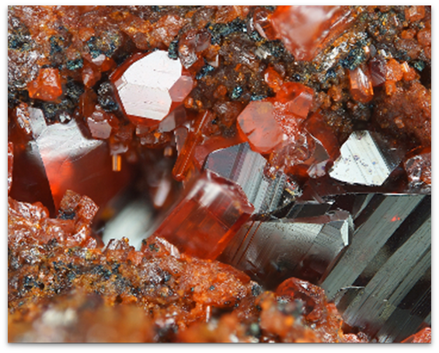
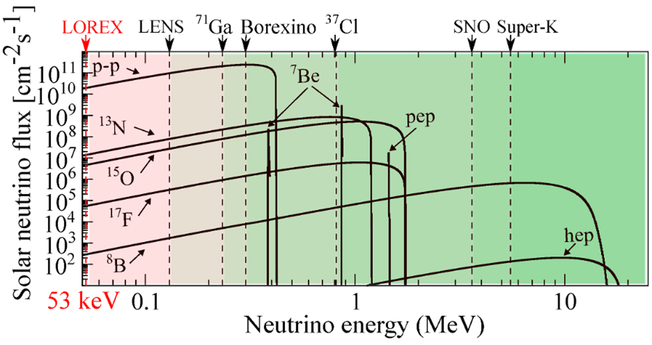
Lorex project
Detect solar neutrinos via reaction $${}_{}^{205}{Tl}+ν_{e}→{}_{}^{205}{Pb}+e^{−}$$
Lowest threshold
Lorandite ore TlAsS2
The LORandite EXperiment (LOREX), proposed in the 1980s, aims at obtaining the long-time averaged solar neutrino flux by utilizing natural deposits of Tl-bearing lorandite ores.

Slide 10
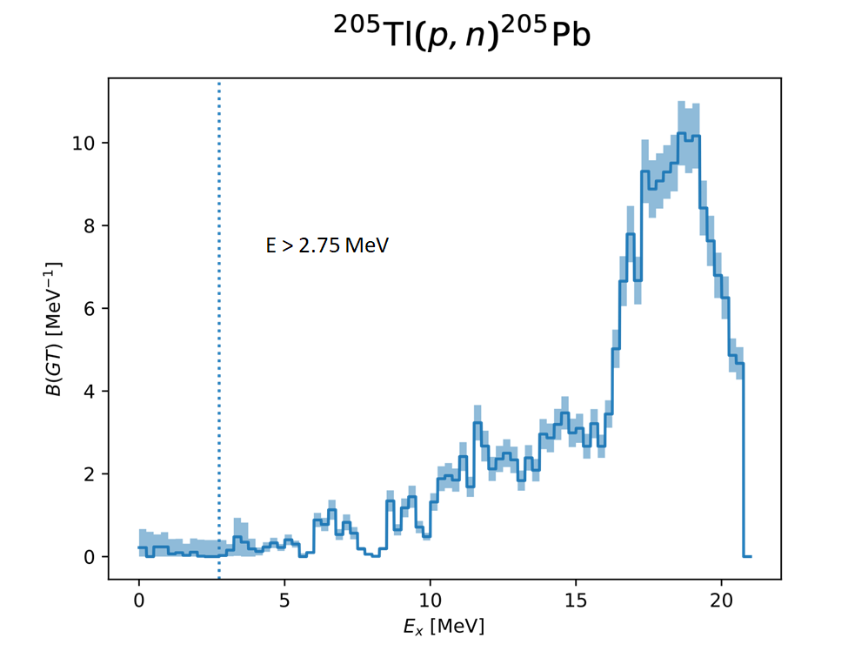
Neutrino capture cross section
Bound-beta decay data plus
Gamow-Teller data from charge-exchange reactions fully
Determines the cross section

Slide 11
Stellar evolution
Late phases of evolution determined by electron capture processes. They remove
electrons from stellar plasma reducing the pressure support and determine the
temperature evolution.

Slide 12
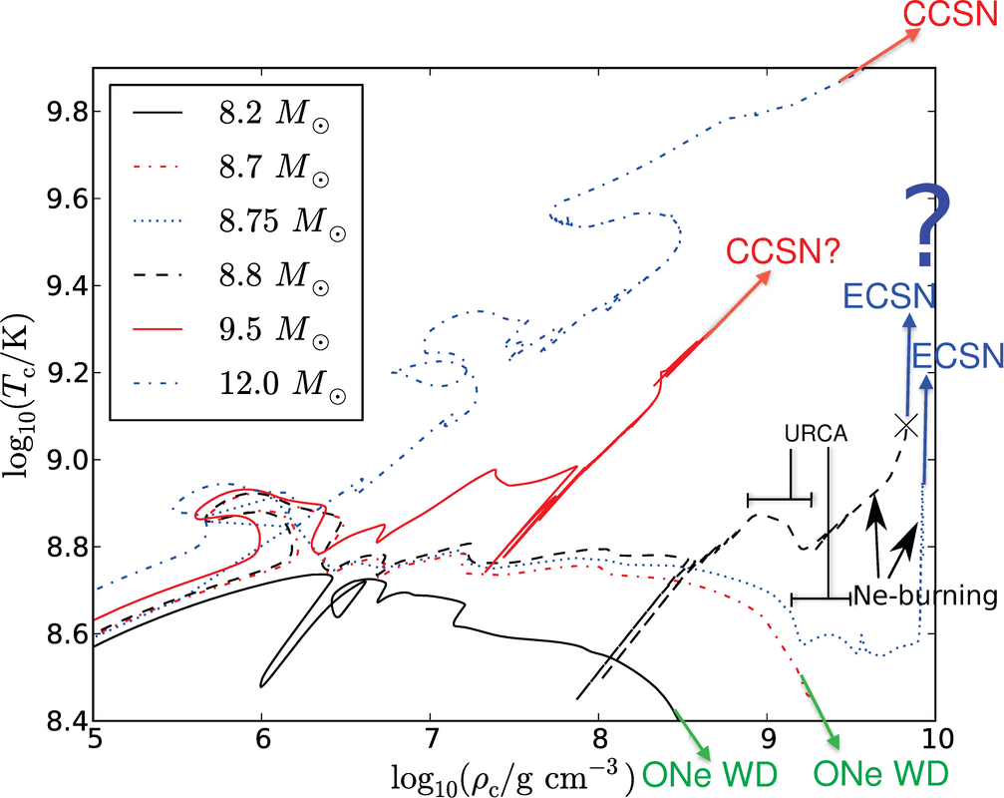
Intermediate mass stars: late time evolution
After the formation of the ONeMg (CONeMg) core, shell burning keeps adding mass to the core. With increasing density electron capture processes become possible.
At some point Oxygen (or Carbon) burning may eventually take place.
There is a critical density such as for lower values burning leads to a thermonuclear supernova while for higher values the end product is a neutron star after core-collapse.
Two main uncertainties: weak processes and convective instabilities.
Jones et al, ApJ 772, 150 (2013)

Slide 13
Urca pairs: cooling vs heating
Figure from Heiko Möller, PhD, 2016

Slide 14
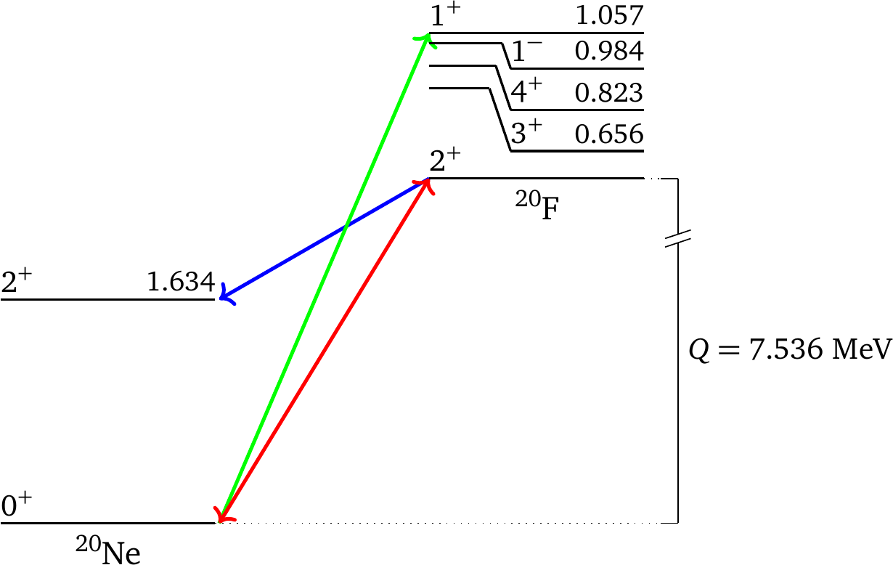
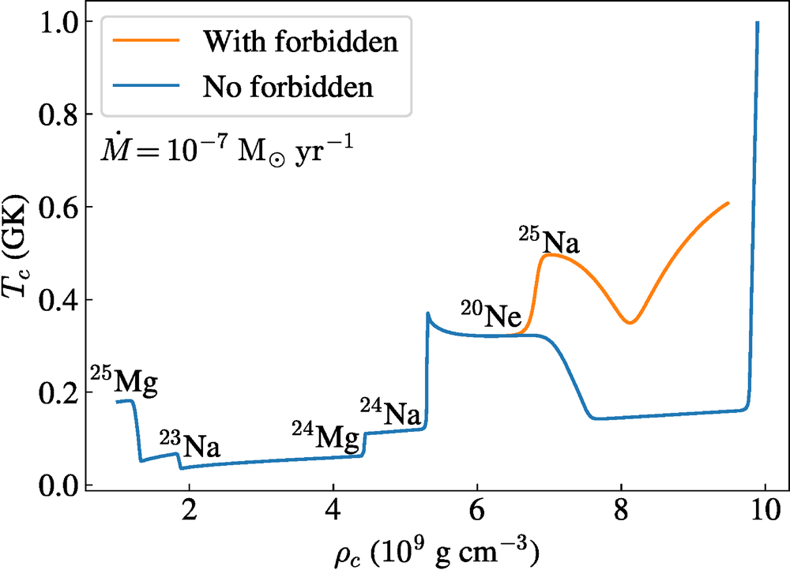
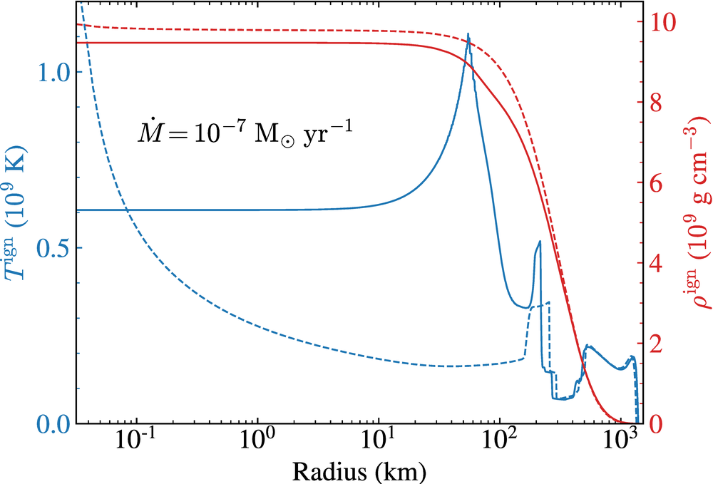
Impact electron capture rate on evolution
Forbidden transition measured at IGISOL/JYFL Jyväskylä [Kirsebom et al, PRL 123, 262701 (2019), PRC 100, 065805 (2019)]
New rate favors off center ignition of Oxygen at lower densities
Favors thermonuclear explosion
Second
forbidden
transition

Slide 15
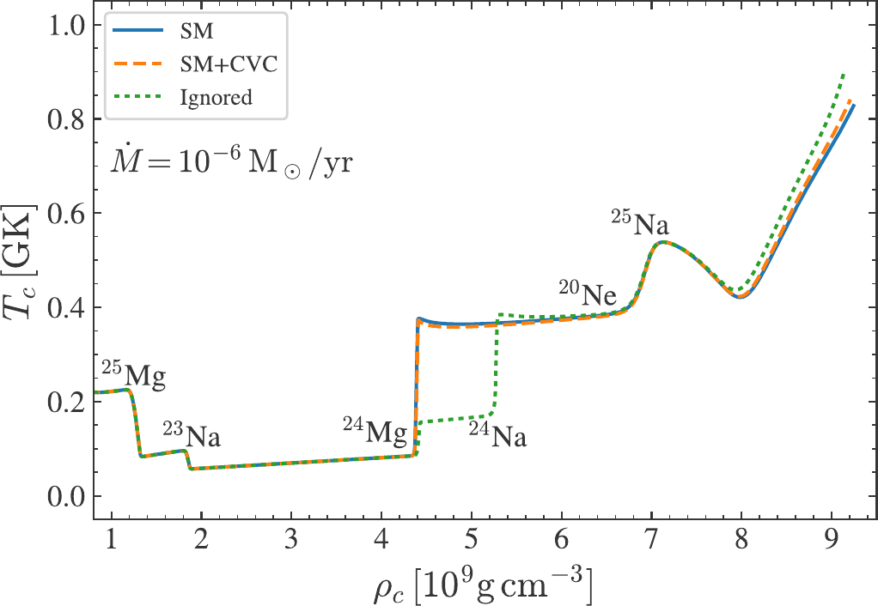
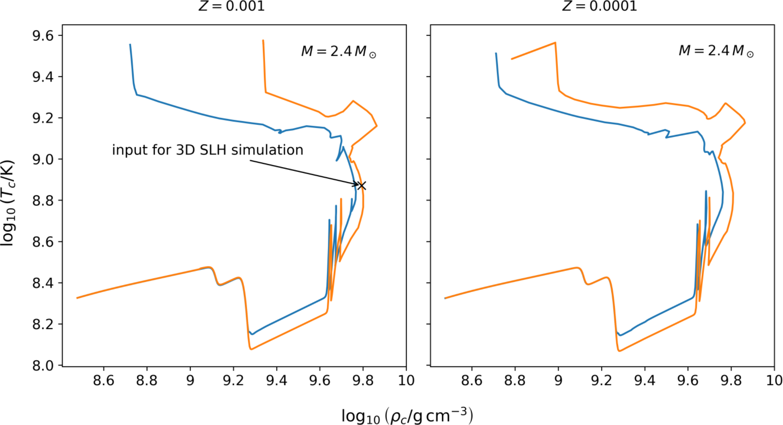
Towards complete description of ignition
Evolution helium stars using MESA setup (Chanlaridis et al. 2022)
Residual Carbon ignited due to electron capture on 24Mg
Goal: 3D model final phases using SLH code (F. Röpke)
P. Christians
Double e-capture24Mg
Forbidden transition from Shell-Model calculation
Strömberg et al., PRC 105, 025803

Slide 16
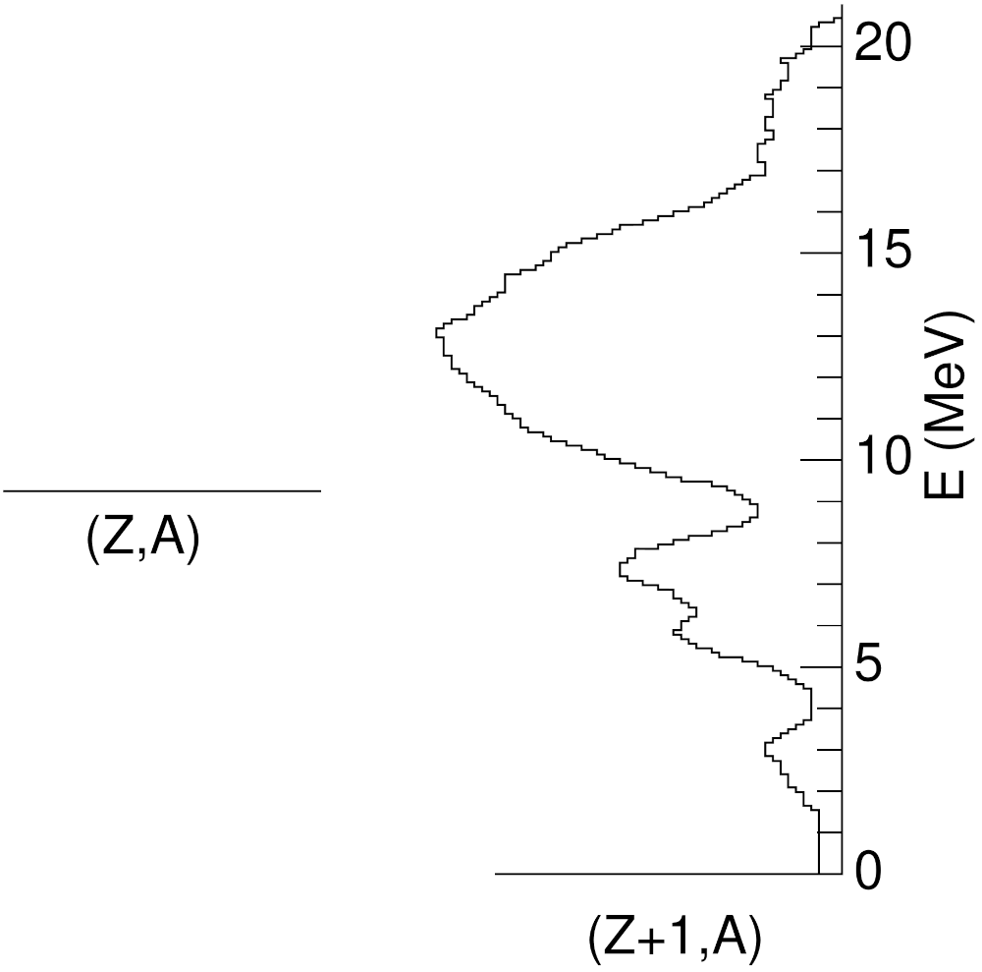
Basics beta-decay
Normally dominated by Gamow-Teller transitions (no angular momentum carried by leptons)
In heavy nuclei Forbidden transitions (L=1) become important.
Competition:
Transition strength: increases with excitation energy
Decay phase space: decreases excitation energy
$$\left(Z,A\right)→\left(Z+1,A\right)+e^{−}+{\overline{ν}}_{e}$$
Strength
$$Q^{5}$$

Slide 17
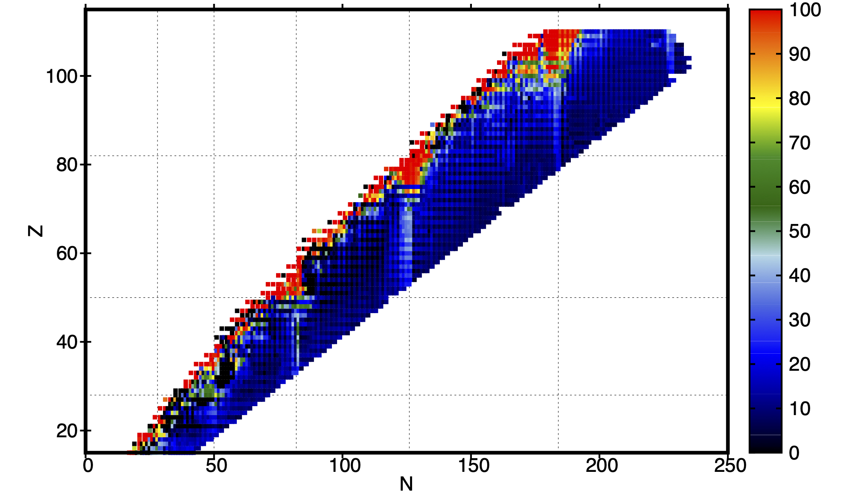
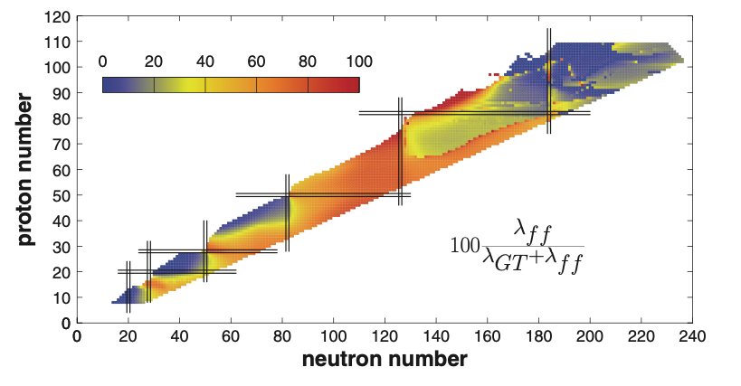
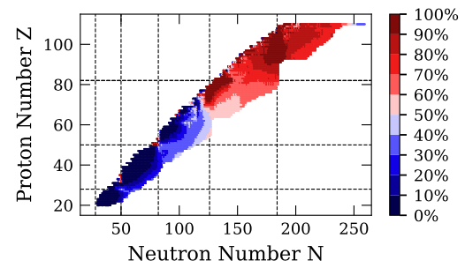
Global calculations of beta-decay rates.
Global calculations are based on quasi-random phase approximation
Address competition Gamow-Teller and
Forbidden transitions
1
QRPA approach based on FRDM for the Gamow-Teller + gross theory for the first-forbidden
FRDM
Moeller, Pfeiffer, Kratz, PRC 67, 055802 (2003)
https://t2.lanl.gov/nis/data/astro/molnix96/tbeta.html
2
Relativistic QRPA based on D3C* functional
Marketin, Huther, Martínez-Pinedo PRC 93, 025805 (2016)
3
Non relativistic QRPA based on Skyrme functional SKO’
1
Ney, Engel, Li, Schunck PRC102, 034326 (2020)
Skyrme SKO’
Relativistic D3C*
2
3

Slide 18
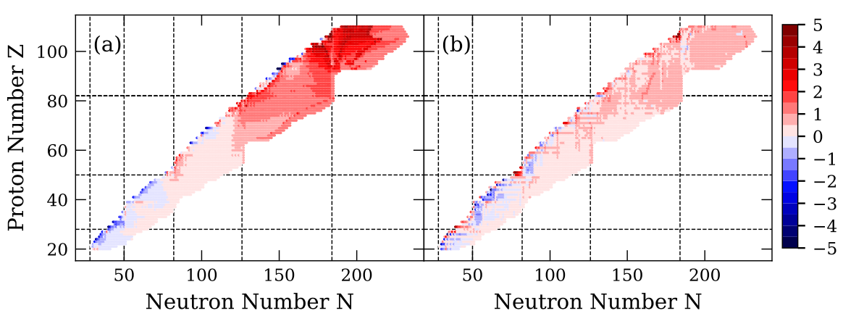
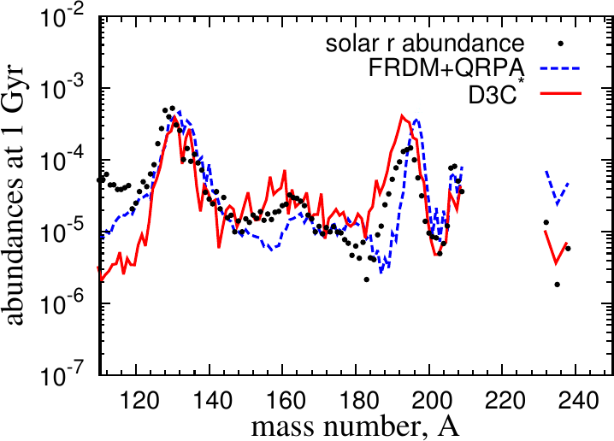
Comparison approaches
Comparison of the total half-lives in different QRPA’s:
Ney et al. PRC 102, 034326 (2020)
~ agreement between the 3 approaches below N<126
Above N>126 the relativistic QRPA predicts considerably shorter half-lives than the other ones
⇒ broadening of the third peak (A~195)
towards lower masses
Strong impact r-process abundances

Slide 19
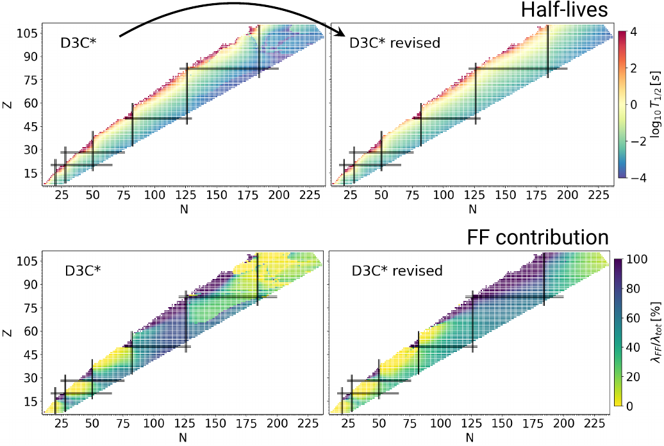
New set of beta-decay rates
Extensive revision of the code
Inclusion of all contribution to proton-neutron residual interaction
Beta-strength combined with statistical model calculations to determine neutron emission probabilities and beta-delayed fission rates
Diana Alvear
Increase in half-lives and forbidden contributions for heavy nuclei

Slide 20
Comparison with BRIKEN data
Recent data for neutron emission probabilities measured by the BRIKEN collaboration for light lanthanides
Statistical model calculations using Talys code based on computed beta-strength function (Max Pallàs, Universitat Politècnica de Catalunya)

Slide 21
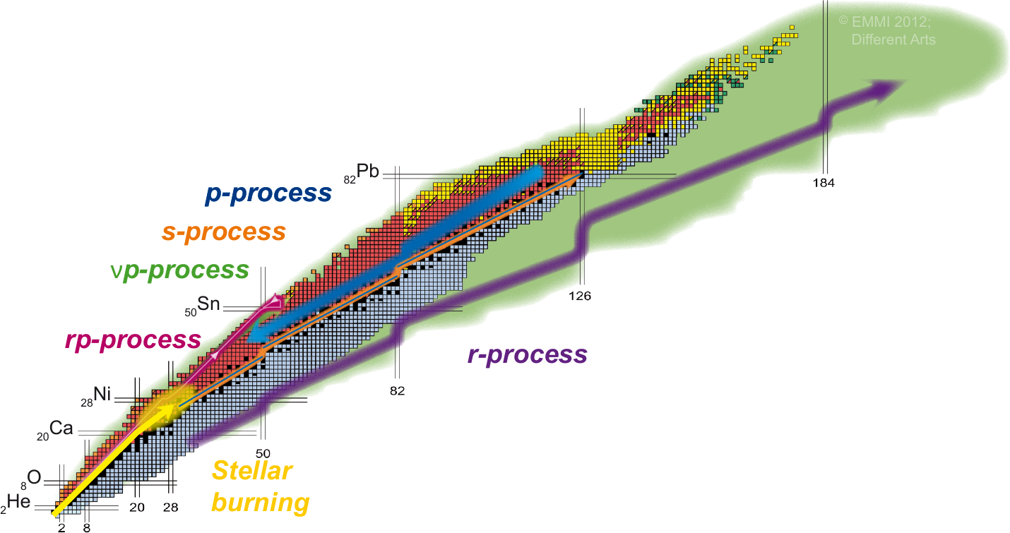
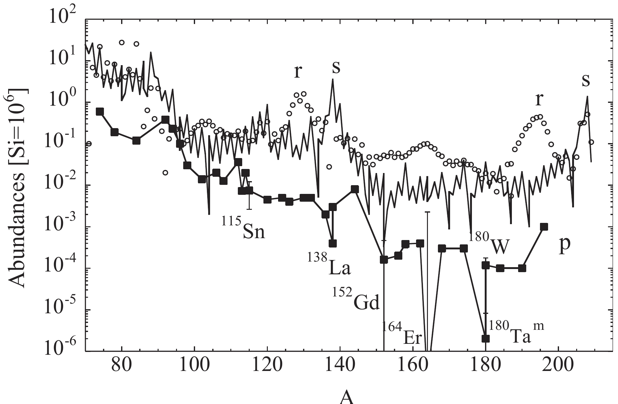
Nucleosynthesis beyond iron
Several processes contribute to the nucleosynthesis beyond Iron: s-process, r-process and p-process (γ-process)
M. Arnould, S. Goriely, Physics Reports 384, 1 (2003)
p-nuclei
Origin p-nuclei unclear
Can neutrino-nucleus reactions help producing p-nuclei?

Slide 22
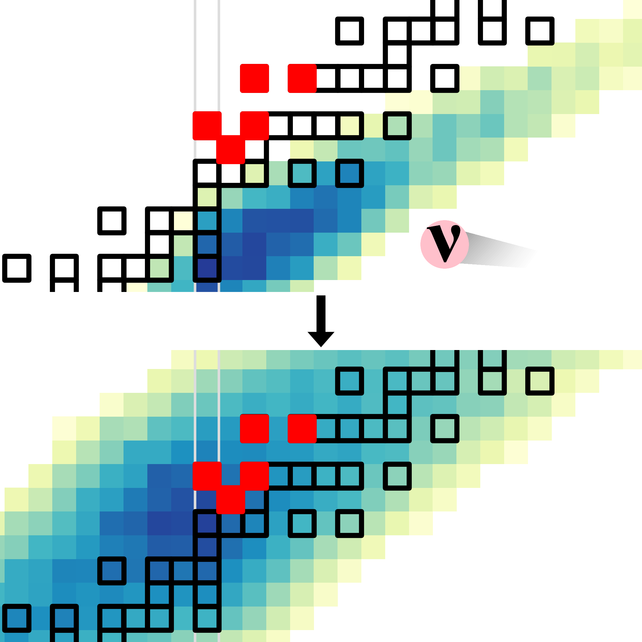
The νr-process: Production of p-nuclei from r-process seeds
Novel nucleosynthesis process that operates under strong neutrino fluxes
Sequence of neutron captures and charged-current neutrino-nucleus reactions.
Production of p-nuclei from neutron-rich nuclei.
May require high magnetic fields as found in magnetars (see Prasanna et al, ApJ 973, 91 2024)
Experimental constraints to neutrino-nucleus cross sections are necessary
Zewei Xiong
GSI
Xiong, Just, GMP, Sieverding PRL132, 192701 (2024)
Gabriel Martínez-Pinedo / Nuclear weak-interaction processes in stars

Slide 23
Summary
Weak interaction plays a fundamental role for nucleosynthesis, stellar evolution, and explosions
K. Langanke and G. Martínez-Pinedo, Nuclear Weak-Interaction Processes in Stars, Rev. Mod. Phys. 75, 819 (2003).
K. G. Balasi, K. Langanke, and G. Martínez-Pinedo, Neutrino–Nucleus Reactions and Their Role for Supernova Dynamics and Nucleosynthesis, Prog. Part. Nucl. Phys. 85, 33 (2015).
K. Langanke, G. Martínez-Pinedo, and R. G. T. Zegers, Electron Capture in Stars, Rep. Prog. Phys. 84, 066301 (2021).
T. Fischer, G. Guo, K. Langanke, G. Martínez-Pinedo, Y.-Z. Qian, and M.-R. Wu, Neutrinos and Nucleosynthesis of Elements, Prog. Part. Nucl. Phys. 137, 104107 (2024).
Further collaborators: D. Alvear-Terrero, P. Christians, O. Just, H. Ko, R. Mancino, T. Neff, F. Nowacki, C. Robin, A. Sieverding, Z. Xiong

