Slide 1

Neutron Capture Nucleosyntheis in AGB Stars
Maurizio M. Busso
National Institute for Nuclear Physics
Department of Physics and Geology, Perugia University.
“It is the stars. The stars above us govern our conditions”,
[W. Shakespeare, King Lear, Act IV, scene III. But also:
Burbidge, Burbidge, Fowler & Hoyle, 1957, (B²FH) Rev. Mod. Phys. 29, 547]
10/06/2025
sirEN WORKSHOP, Giulianova, June 8-13.
1

Slide 2
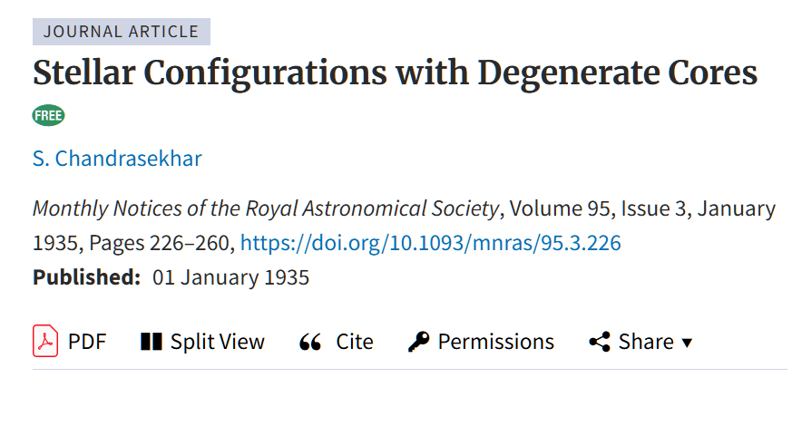
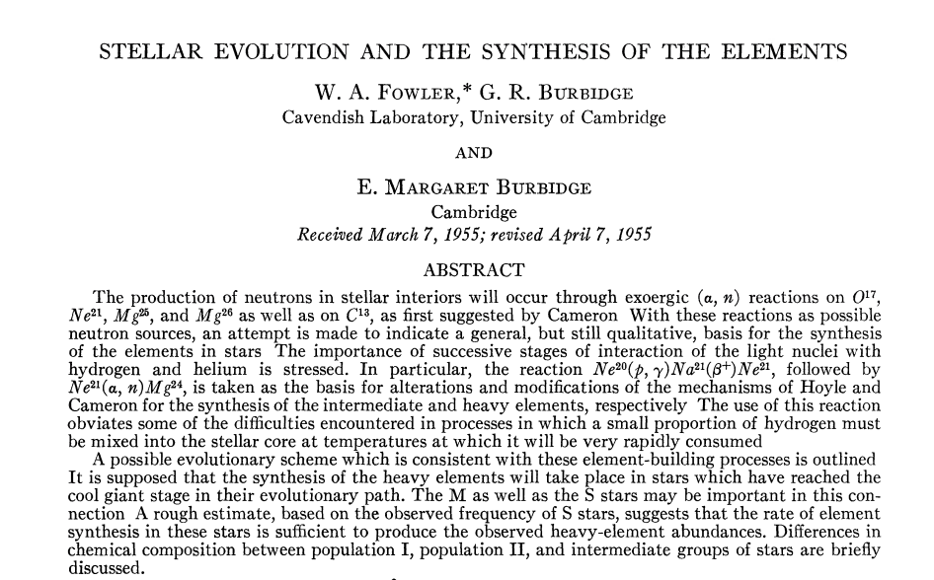
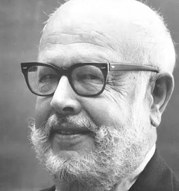
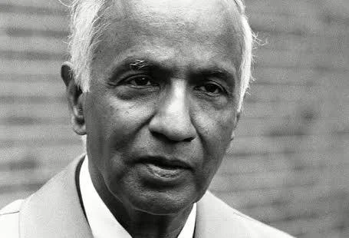
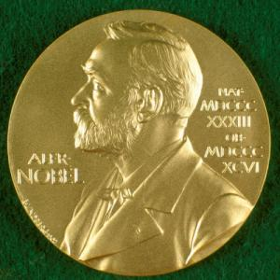


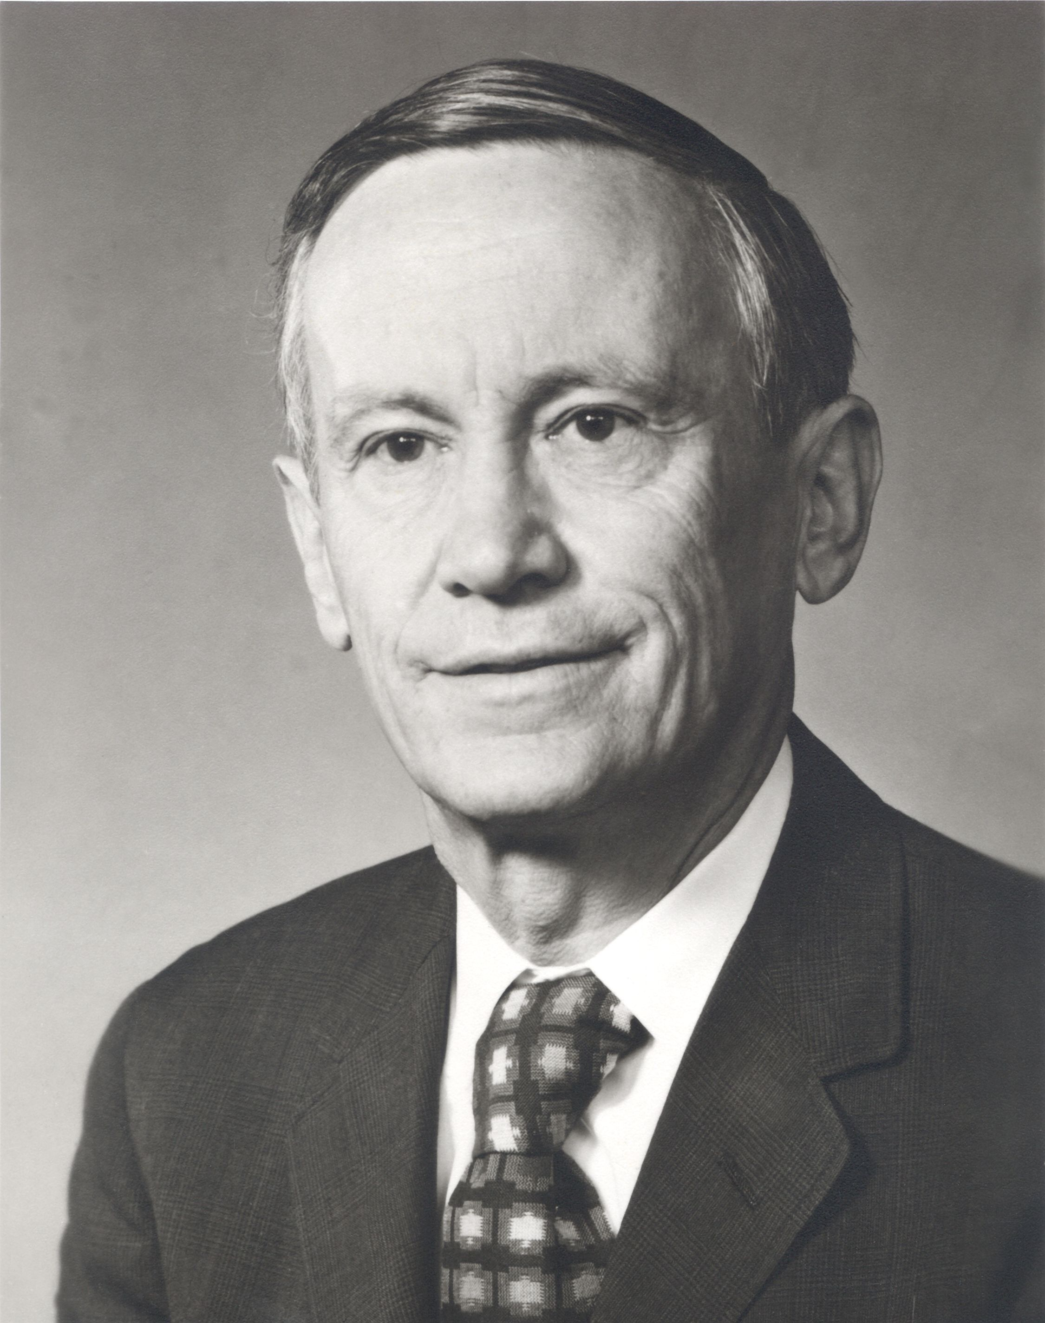
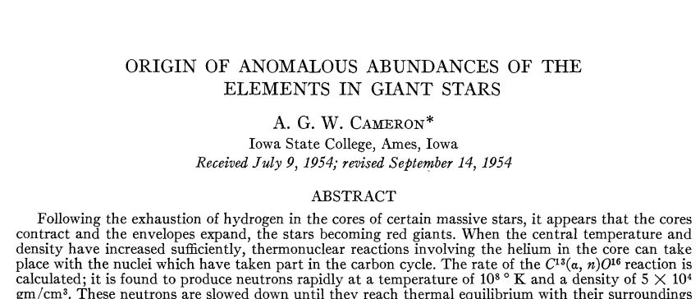
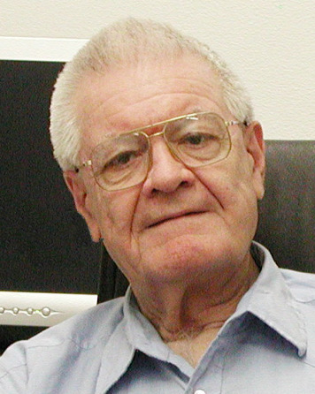
A Premise
This year is 90th, 70th, and 60th anniversary, respectively, of crucial papers for our knowledge of stars with degenerate cores undergoing neutron captures, i.e. AGB stars..
1935
1955
Schwarzshild & Harm (1965)
1955
Seeger et al. (1965)
10/06/2025
sirEN WORKSHOP, Giulianova, June 8-13.
2

Slide 3
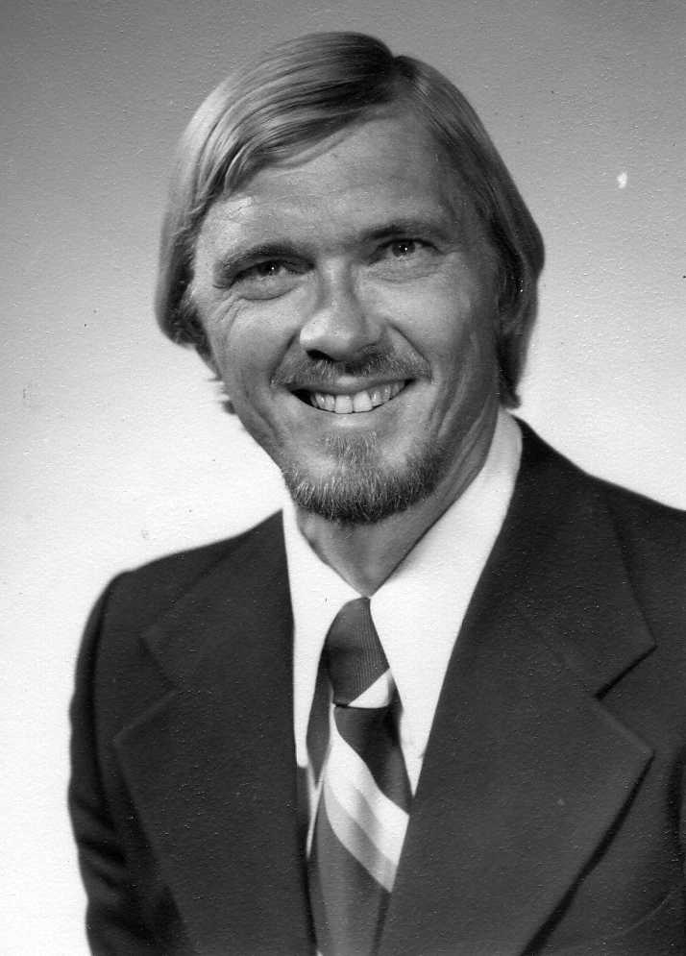
Donald Clayton [1935-2024]’s role in s-processing.
Clayton et al. (1961), Clayton & Rassbach (1967), Clayton & Ward (1974). They clarified that up to three neutron exposures were required by the s-element abundances in the Sun.
Seeger, Fowler and Clayton (1965). They laid down the phenomenological approach, adopting an exponential distribution of neutron exposures and showing an analytically exact solution for it by series.
Ward, Clayton and Newmann (1976), They introduced a treatment for branching reactions.
Ulrich(1973) had in the mean time shown that a sequence of thermal pulses can in priniple account for an exponential distribution of exposures.
Forever thanks, Don(ald)!

Slide 4
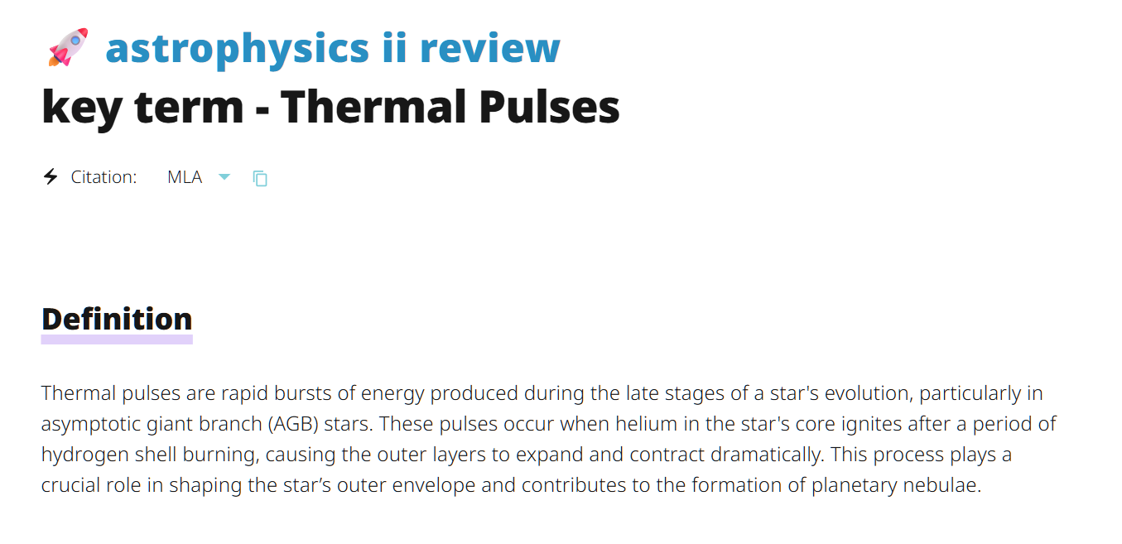
You might infer that the basics of this subject are known from so long a time that discussing them again is useless, both from the nuclear and stellar sides. Brad Meyer (1994) years ago, quoting Confucius (!) said we have “a thread linking together” our ideas on element production. Is that so?
Maybe not from the nuclear side (see e.g. the title of this workshop).
Maybe not even from the stellar side. In the AI era, you can still find things like this:

Slide 5
Hence, I want briefly to mention:
When and by whom was the s process (and its “typical” features) defined;
ii) Where does this interest for “thermal pulses” come from and what kind of role they play today in s- processing;
iii) What is the status of the research in AGB s- processing & mixing (making only one example) in the context of this meeting.
Mine will be only hints to more complete discussions, to be found, e.g., in Iben&Renzini 1982, Meyer 1994, Busso et al. 1999; Herwig 2005; Karakas & Lattanzio 2014; Lugaro et al. 2023; etc…
I shall not discuss overshoot for PIE→ i process. See for that Choplin et al. (2025) and his talk yesterday..

Slide 6
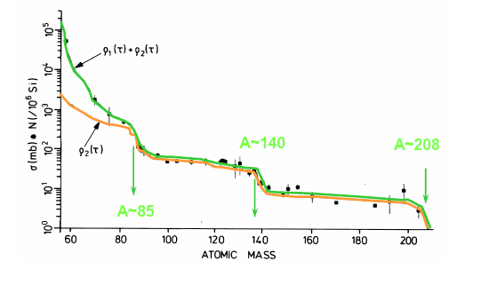
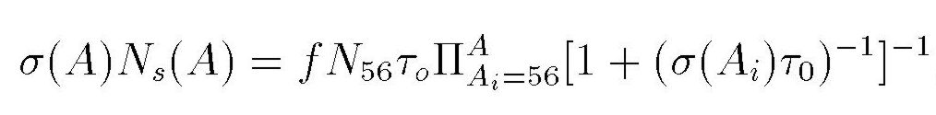
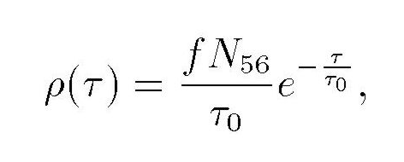
The exponential distribution(s) of exposures
Clayton +,
various
works in
the sixties
AGB STARS
AGB stars provide the MAIN component (A=90-204) and, at low metallicities & the STRONG component (A=204-209), when at low metallicity

Slide 7
(courtesy René Reifarth)
s-only
proton number
⁸⁰Br, t_{1/2}=17 min, 92 % (β⁻), 8 % (β⁺)
Zr
Y
p-process
Sr
(n,γ), n_{n}<10⁷
Rb
Kr
Br
(β⁻)
Se
(β⁺)
p-only
As
⁸⁵Kr, t_{1/2}=11 a
Ge
Ga
⁷⁹Se, t_{1/2}=65 ka
r-only
Zn
r-process
Cu
Ni
Co
⁶⁴Cu, t_{1/2}=12 h, 40 % (β⁻), 60 % (β⁺)
Fe
⁶³Ni, t_{1/2}=100 a
neutron number

Slide 8
The Solar distribution and its nuclear origin
Odd-even effects
and narrow peaks→ s processing
10/06/2025
sirEN WORKSHOP, Giulianova, June 8-13.
8

Slide 9
Up to the nineties: supposed to come from TPs in AGB Stars
(the problem is HERE!)
[it gets very narrow]
What are these thermal pulses? Who discovered them?

Slide 10
Scwarzschild & Härm 1965, ApJ 142, 855
They found an unexpected type of thermal instability in late stages of evolution for a 1 M₈ stellar model, whenever the He-burning shell became sufficiently narrow.
Scwarzschild & Härm 1967, ApJ 150, 961
“[…]The thermal instability previously found to occur in these helium-shell-burning phases […] causes a convective zone to stretch outward […]”
(Treatment below due to Dina Prialnik: you can see that later).
From stellar equilibrium (Lagrangian formulation, P~r⁻⁴):
(1)
Now let the He-shell mass be: Δm=4πρr²l (dl  dr)

Slide 11
Using an equation of state [P = k ρª T^{b}], i.e.:
we get:
Hence thermal stability is guaranteed only if:
Imagine the layer expands. If pressure in the equilibrium external environment drops faster than in the expansion, this last continues and cools the layer. If not, T rises and we get a thermal instability. THERMAL PULSES ARE THIN SHELL INSTABILITIES

Slide 12
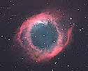
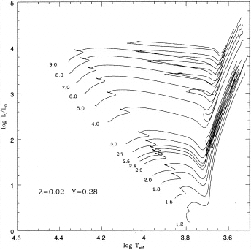
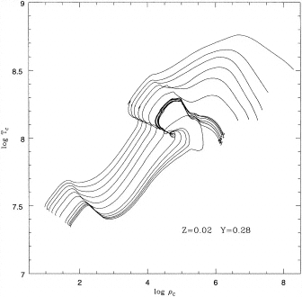
Evolution of (Low &) Intermediate Mass Stars post He-burning
M <8 M₈
C-O White Dwarfs
C-O wd
Degener..
M_{CO} ~ 1.1 M  C ignition M_{MS} = M_{UP} ~ 8 M₈
Becker, Iben 1979-80

Slide 13
Around the end of the eighties the Torino group
(Gallino, Busso, Picchio, Raiteri, Arlandini, Kaeppeler, Renzini) and the Urbana-Chicago group (Iben, Truran, Hollowell, Renzini) reached together the conclusion that
the ¹³C+α reaction had to be active in between thermal pulses and in masses lower than for the ²²Ne one (< 3Mo).
This conclusion was based on:
New cross section measurements
New observations of AGB stars
New measurements of mass-loss rates in IMS
However, ¹³C is almost absent in He layers of AGB stars.
HOW COULD MIXING MECHANISMS GENERATE IT?
(FORMS OF PIE…). NO IDEAS IN THOSE YEARS. VERY DISAPPOINTING!! Nevertheless…

Slide 14
Although s-processing in AGB stars seemed to be an absurd topic (certainly known to come from an unknown, possibly unlikely mixing mechanism), interest in it grew steadily.
Papers related to s-processing in Main Journals,1990.
10 papers, 699 citations
Champagne, A. E. et al. (1990)
Lewis, R.S et al. (1990)
Prantzos, N. et al. (1990)
Kaeppeler, F. et al (1990a,b)
Ott, U.& Begemann, F.(1990)
Smith, V.V. & Lambert, D.L. (1990)
Hollowell, D. & Iben, I. Jr. (1990)
Gallino, R. et al. (1990a,b)
10/06/2025
sirEN WORKSHOP, Giulianova, June 8-13.
14

Slide 15
Papers related to s-processing in Main Journals in 1999 > 22 papers, > 2500 citations:
de Laeter, J. R.; Rosman, K. J. R (1999)
Mashonkina, L.; Gehren, T.; Bikmaev, I. (1999)
Käppeler, F. (1999)
Arlandini et al. (1999)
Busso et al. (1999)
García-Lario, P. et al. (1999)
Nicolussi, G. K. et al. (1999)
Koehler, P. E.; et al. (1999)
Mowlavi, N.; (1999)[s-process & F!]
Kazarnovsky, M. V. et al. (1999)
Rayet, M. & Hashimoto, M. (1999)
Zacs, L. et al. (1999)
Lugaro et al. (1999), etc…
10/06/2025
sirEN WORKSHOP, Giulianova, June 8-13.
15
Notes:
15

Slide 16
Certainly a letter to ApJ in 1995 contributed to awake people who had started to grow bored with inconsistent models. It specified that s-process has a major contribution similar to the classical prediction (n_{n}<10⁷) of the sixties, with just a bit of help for branchings from real Thermal Pulses at higher neutron density. The mixing problem remained.

Slide 17
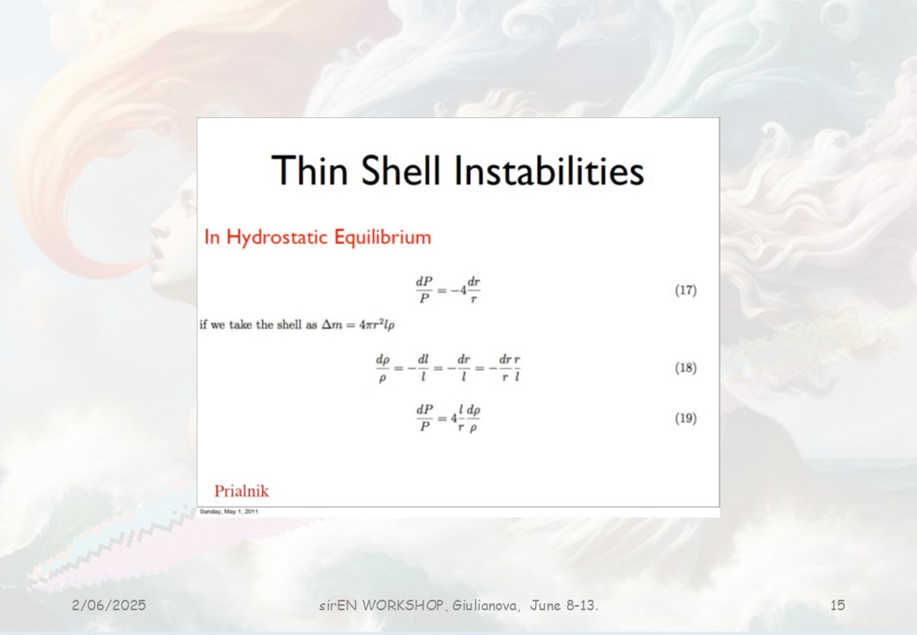
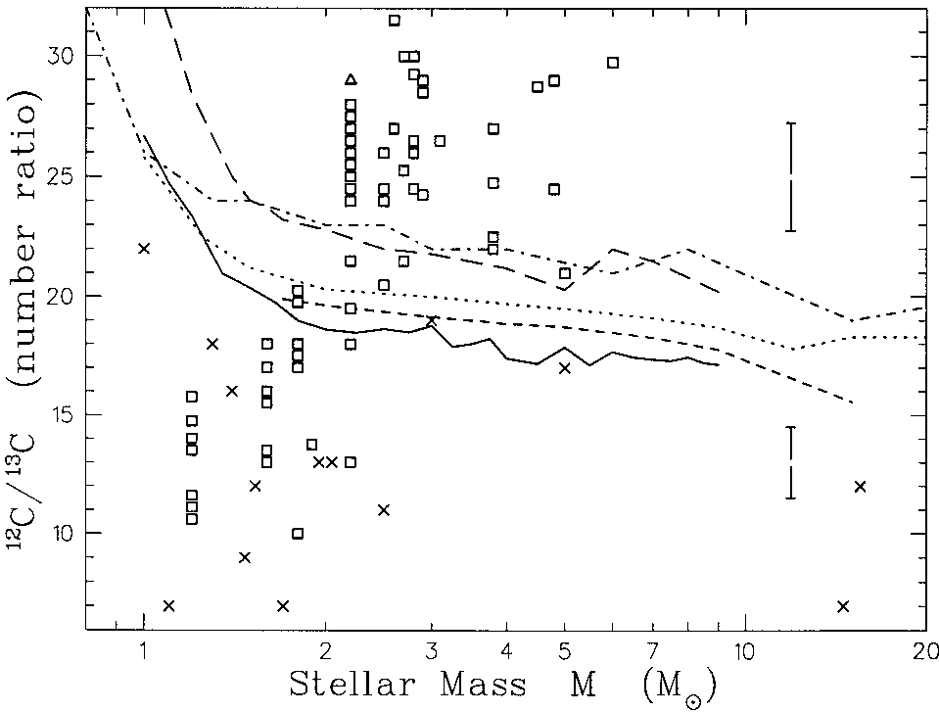
Stellar models do not explain
the ¹²C/¹³C ratio of RGB Stars
Observations
Standard models after first dredge-up
(discrepancy adressed by Gilroy 1989;
Gilroy and Brown 1991; then many others)
However, the need for “something else”
was noted previously (Dearborn et al.
1975 Tomkin et al. 1976).
Palmerini et al. (2013)
Cannot be cured by extending First Dredge-Up. More important in low metallicity stars. Connected with Li production/destruction; for C isotopes slow mixing is needed (see e.g. Charbonnel & DoNascimiento 1998; Charbonnel et al. various papers). HOWEVER, see Blouin etl (2005) submitted.

Slide 18
What kind of mixing?
On the AGB, at TDU, while the star is expanding after an instability, time is very short: (one or few)x10² yr. FAST mixing needed. (No overshoot in our models, PIE only for s-processing. We needed to explore ONE mechanism at a time.)
Choplin et al. (2025).

Slide 19
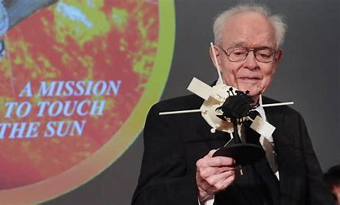
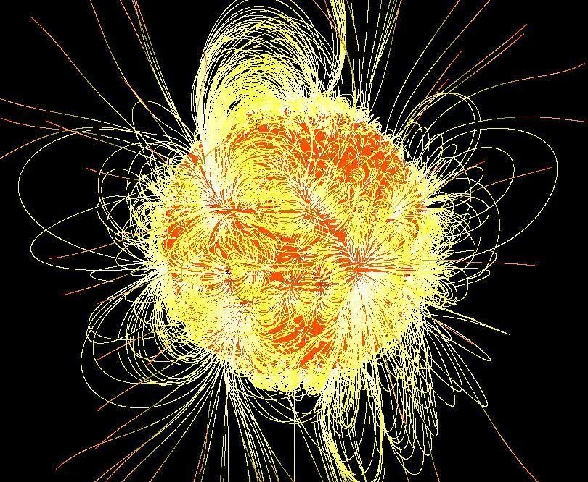
I show here ONE EXAMPLE of a kind of mixing that should occur “on first principles” (as was commonly said years ago) and compare results with r-process calculations in the aim of looking for i-process requiremens.
Other mixing schemes working well exist: see e.g. Battino et al. (2016), (2019)[Gravitation Waves]; Blouin + (2025)?
(see also Lugaro et al. 2223)
Eugene N. Parker, 1927-2022 andx NASA’s probe entitled to him while sill in life.
10/06/2025
sirEN WORKSHOP, Giulianova, June 8-13.
19

Slide 21
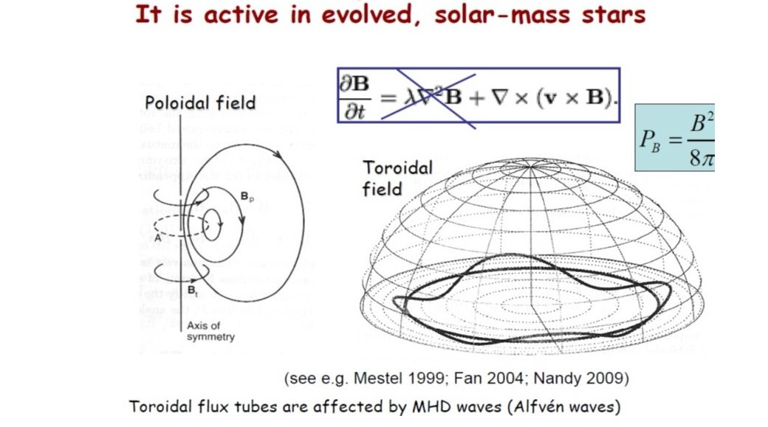
The simplest form of solar synamo
10/06/2025
sirEN WORKSHOP, Giulianova, June 8-13.
21

Slide 22
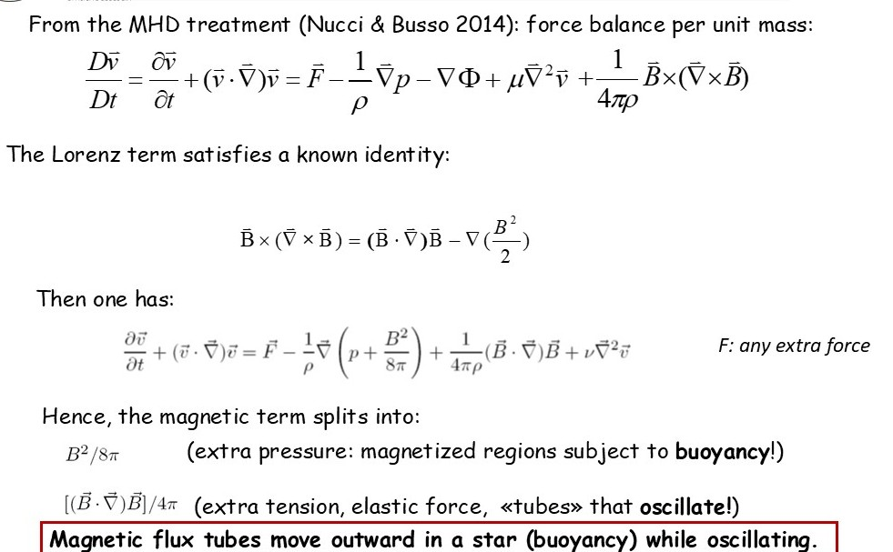
MHD equations are complex and do not have a general solution.
10/06/2025
sirEN WORKSHOP, Giulianova, June 8-13.
22

Slide 23
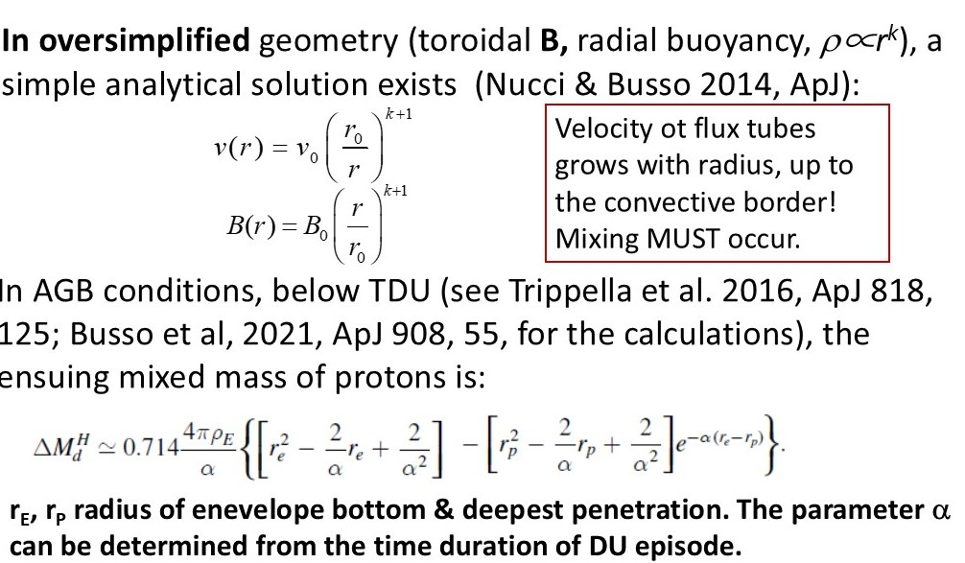
For a pure toroidal geometry
AN ANALYTICAL 3D SOLUTION EXISTS
k negative!
10/06/2025
sirEN WORKSHOP, Giulianova, June 8-13.
23

Slide 24
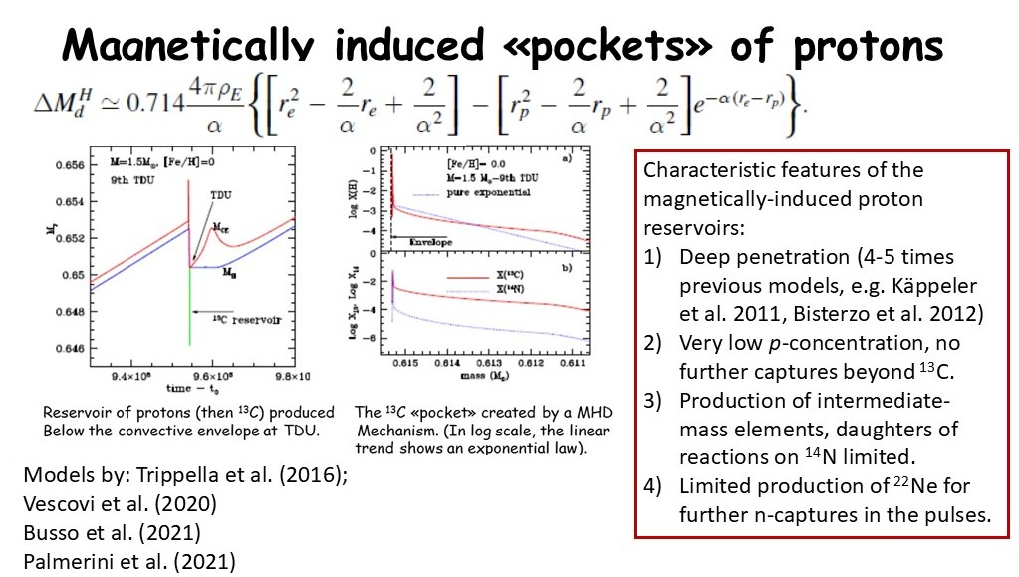
Comparison with r-process
Karl-Ludwig Kratz
10/06/2025
sirEN WORKSHOP, Giulianova, June 8-13.
24

Slide 25
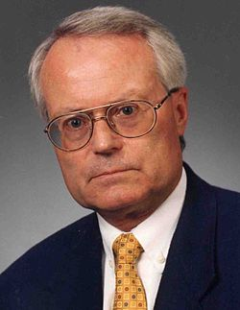

Slide 26
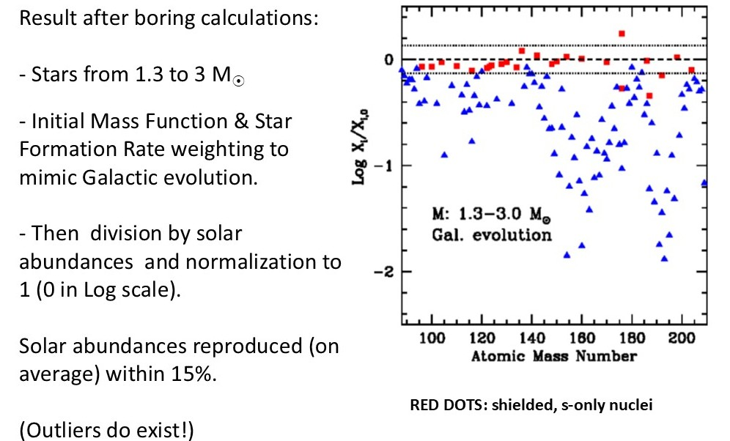
Busso et al. (2022), Palmerini et al. (2021),
Busso, Kratz, Palmerini… (2022)

Slide 27
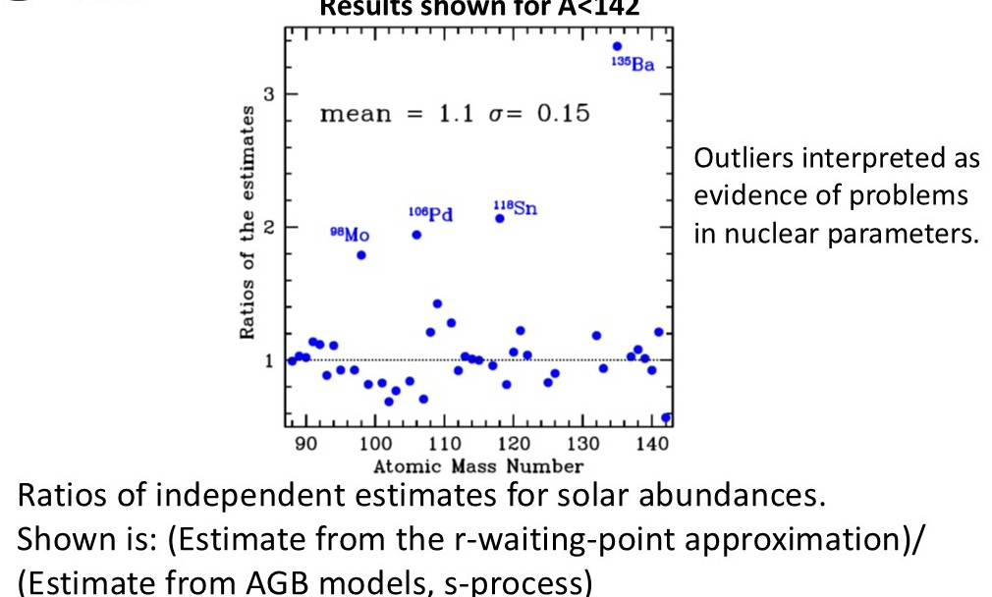
s- and r- comparisons only up to Ce

Slide 28

RECOMMENDATION
Now forget what I said on the details of our results..
Simply look at the formula we got.
It is an exponential «times a surface».
How many mixing mechanisms might be able to produce it?
I guess several! GRAVITY WAVES FOR EXAMPLE?? Plese use the to check the r-process residuals.
Please, try other ways and confirm or deny. Only in this way the idea would turn out to be really useful!
Plasmas cannot work in this special way only!

Slide 29
BACKUPS

Slide 30
AGB stars
Nucleosynthesis 75% of the mass return to the ISM
¹²C & ¹⁴N Life cycles
⁷Li (BBN)
²⁶Al (Early SS)
s-elements main & strong component
(88  A  210)
Pieces of their envelopes  Meteorites
Thermal pulses
3er Dredge-up
Mass Loss
HBB
Mixing process

Slide 31
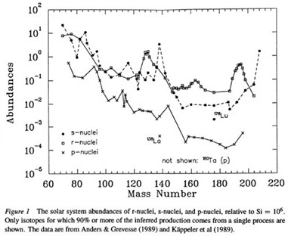
Processes for heavy element production
Originally predicted by B²FH & Cameron (Burbidge et al. 1957, Cameron 1957)
Nuclei produced mostly by the p,
s, & r processes
Figure from Meyer 1994, ARAA 32, 153.
s-captures defined as those so slow to allow decays on their path to occur before proceeding
10/06/2025
sirEN WORKSHOP, Giulianova, June 8-13.
31

