Slide 1
The Stellar Precursors of the Solar System? Constraints from quantitative relations between genetic anomalies and NRLEE ejecta
K.R. Bermingham and B.S. Meyer

Slide 2
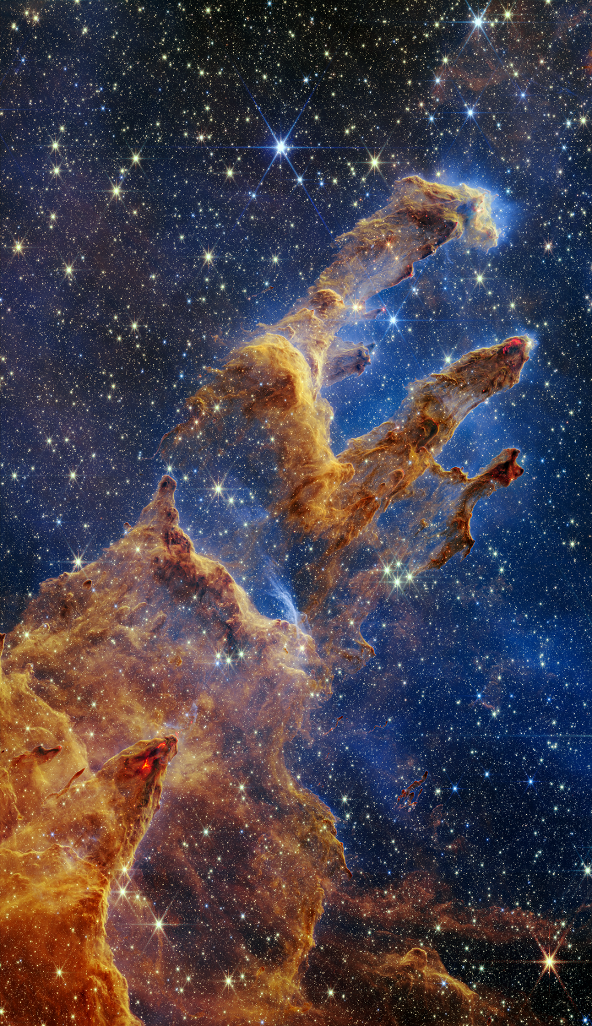
Stellar precursors of the Solar System?
Stellar precursors are the preceding stellar events that defined the composition of the Solar System.
The identity of these stellar precursors remains under investigation.
Knowledge of these would provide important information about how our unique, life-bearing Solar System evolved.

Slide 3
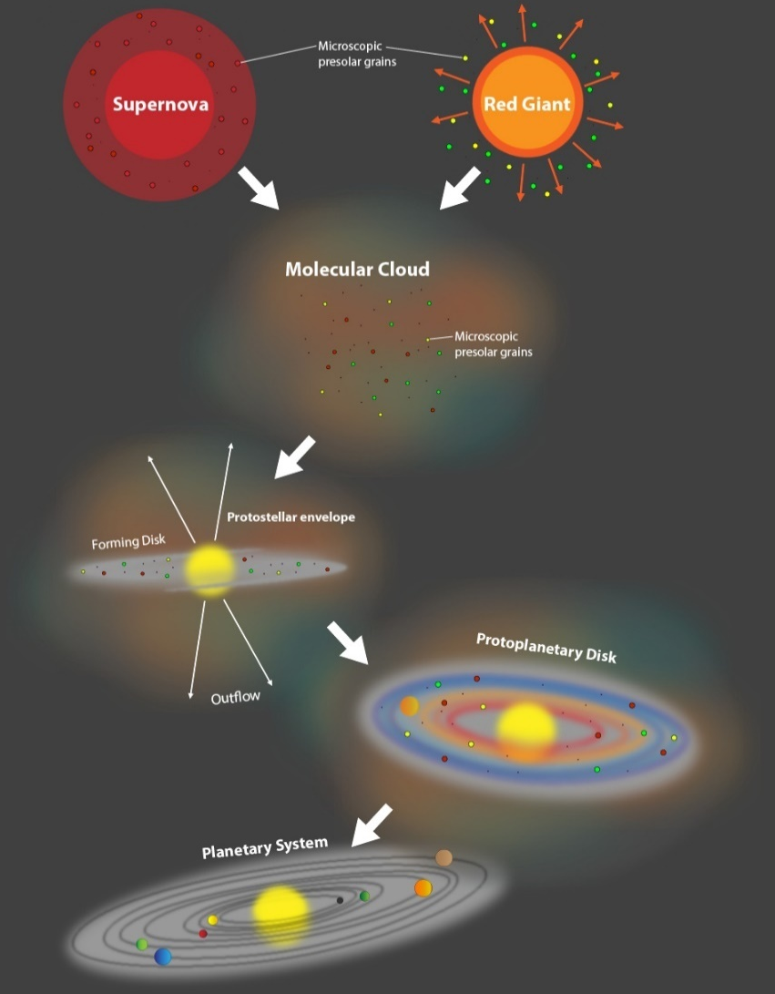
Solar System formation
bone fide
PSG
Evidence for stellar precursors is found in bona fide PSG (isotopically anomalous).
Processed dust (not isotopically anomalous) comprises ~99% of the ~1% dust.
Bona fide PSG comprise ~1% of the ~1% processed dust.
Bona fide PSG form the basis of genetic anomalies (a special type of isotopic variation observed in meteorites).
~99% gas +
~1% solid
(mainly
processed dust)
~1% of ~1%
Bermingham and Meyer (2024)

Slide 4
The sequence of chemistries
CHEM 1
CHEM 2
CHEM 3
CHEM 4
A framework that summarizes the history of isotopes from creation to incorporation into celestial materials over >4.56 Ga.
CHEM 5
Bermingham and Meyer (2024)

Slide 5
Different approaches to understanding the origin of the Solar System
Nuclear
astrophysics
Cosmochemistry
Do we
meet
in the middle?
Bermingham and Meyer (2024)

Slide 6
Recent advancements in cosmochemistry
High precision data (part per million-scale) are now commonplace.
Several-fold increase in the amount of published data.
Consequently, we are discovering isotopic signatures and inter-element isotopic relations that have never been seen before.
New constraints on the distribution of isotopes through space and time.

Slide 7
Linking nuclear astrophysics with genetics
To constrain stellar precursors, can we identify quantitative relations between genetics and stellar nucleosynthesis?
Bulk meteorites are used because they provide an average composition of a region in the disk, which can be coupled with temporal information.
Distinct from presolar grains, which are independent of disk context.

Slide 8
Tools: genetic anomalies
Genetic anomalies are the result of an imperfect mixing of bone-fide PSG grains in the disk.
ppm-scale anomalies.
Mass-independent nucleosynthetic (i.e., “genetic”) isotope anomalies.
An isotopic anomaly is a deviation in the isotopic ratio relative to a terrestrial standard.
The heterogeneous distribution of presolar grains is:
Inherited from the molecular cloud, or
Disk-based processes, or
Addition of material to disk.
µ = (^{l}X_{sample} / ^{k}Y _{sample}) -1 x 10⁶
(^{l}X_{standard} / ^{k}Y _{standard})
ɛ = (^{l}X_{sample} / ^{k}Y _{sample}) -1 x 10⁴
(^{l}X_{standard} / ^{k}Y _{standard})
µ⁹⁷Mo = +ve
µ⁹⁷Mo = 0 = standard
µ⁹⁷Mo = -ve

Slide 9
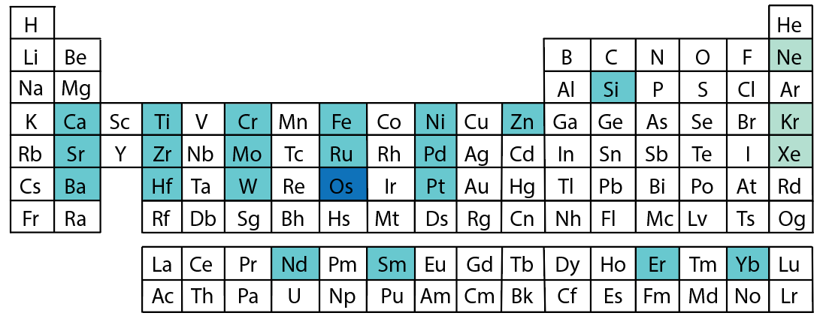
Which elements display genetic anomalies?
Bermingham and Meyer (2024)

Slide 10
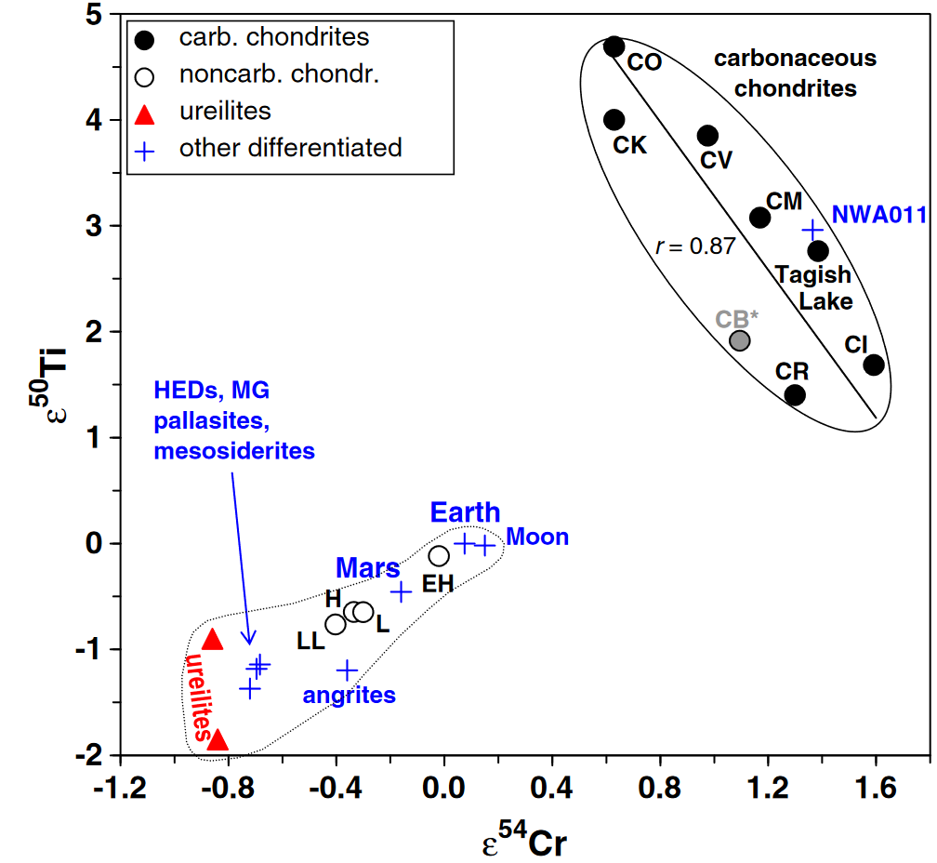
Genetic anomalies and the NC-CC isotopic dichotomy
The disk was initially divided into 2 domains with different genetic compositions.
Non-carbonaceous (NC; inner SS).
Carbonaceous Chondrite (CC; outer SS).
The NC and CC domains were themselves isotopically heterogeneous.
PSG carrier for NRIG nuclides?
CC
GAP
NC
Warren (2011)

Slide 12
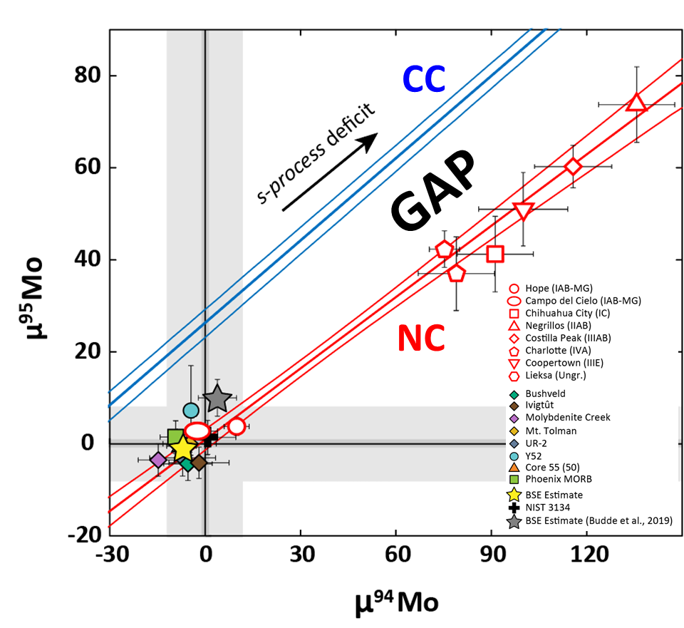
Heavier nuclides with the NC-CC isotopic dichotomy
NC and CC in Mo isotopes are caused by the heterogeneous distribution of s-process grains.
Dauphas et al. (2004); Stephan and Davis (2021).
Offset between NC and CC may be due to the uneven distribution of r-process or s-process.
Budde et al. (2016), Poole et al (2017), Worsham et al. (2017).
Note, Earth is relatively enriched in s-process presolar grains.
s-process enrichment
Bermingham et al. (2025)

Slide 13
Disproportional relationship between NRIG and s-process nuclides
CC is relatively enriched in NRIG nuclides & depleted in s-process nuclides
compared to
NC which is relatively enriched in s-process nuclides & depleted in NRIG nuclides.

Slide 14
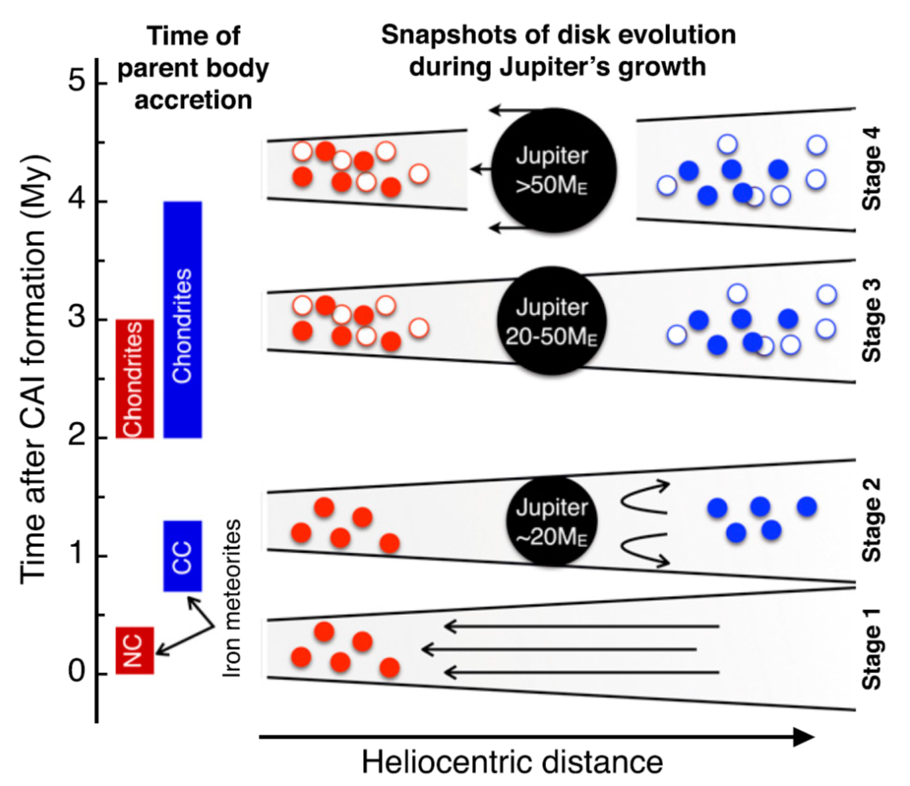
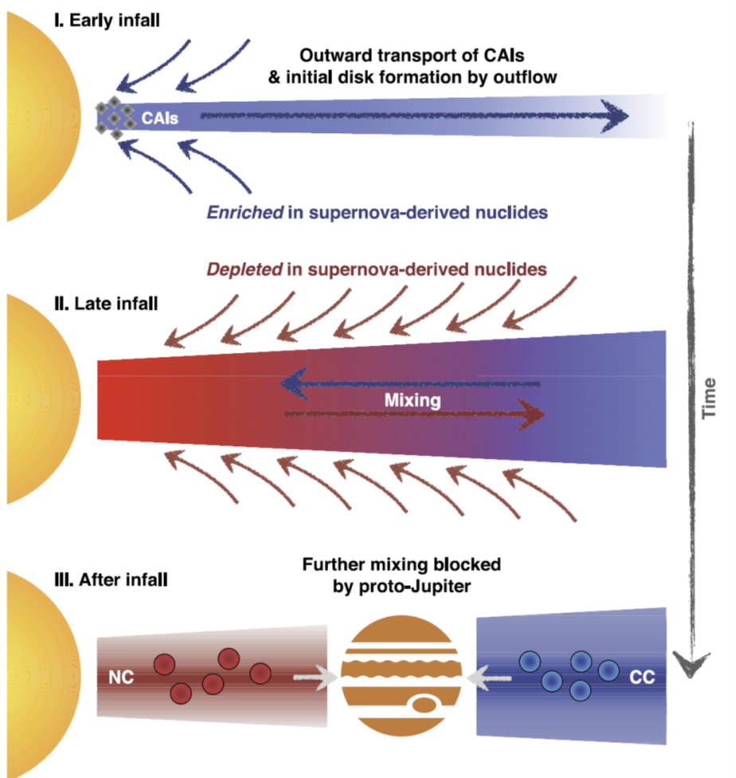
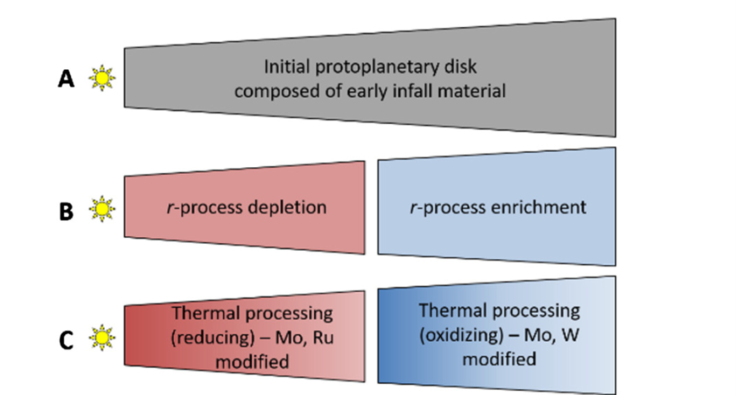
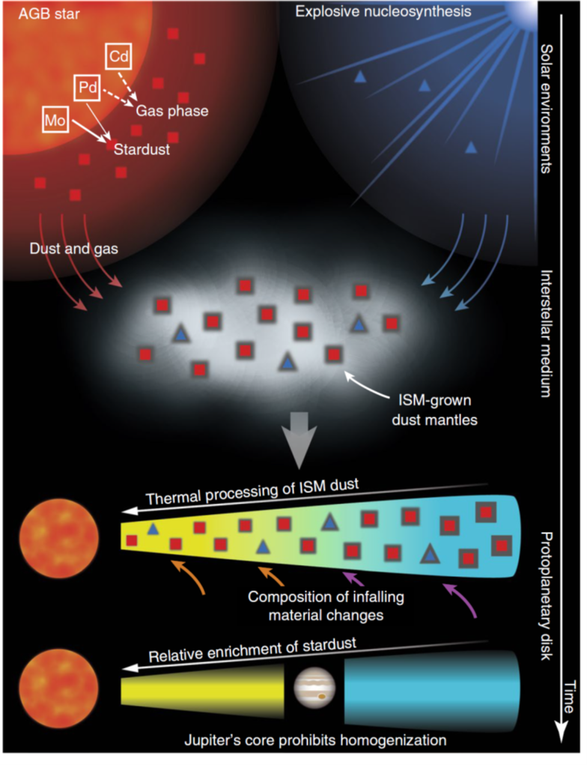
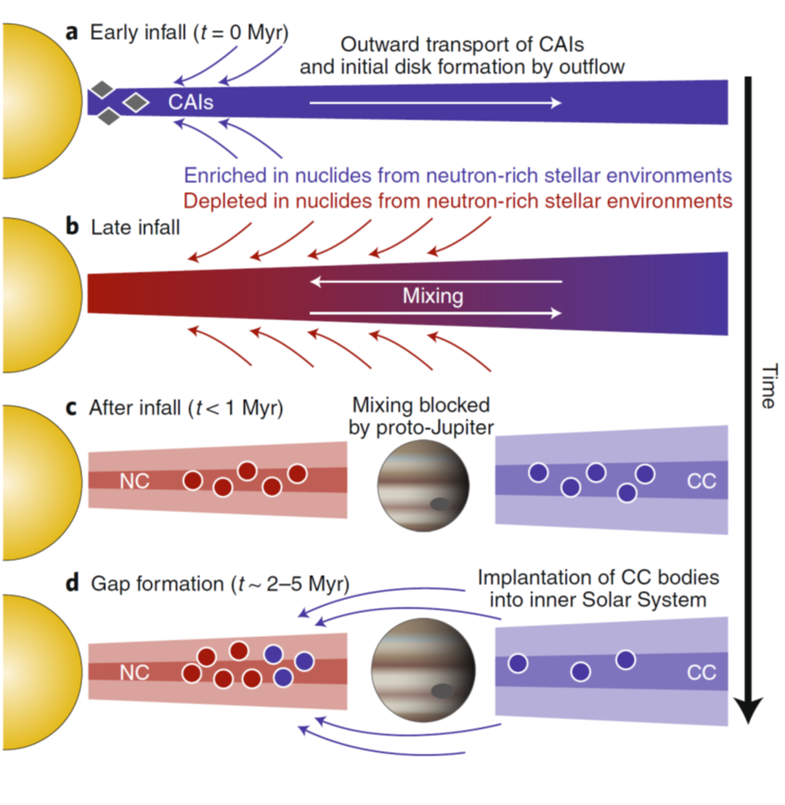
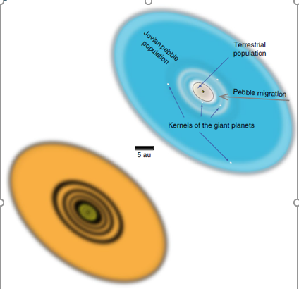
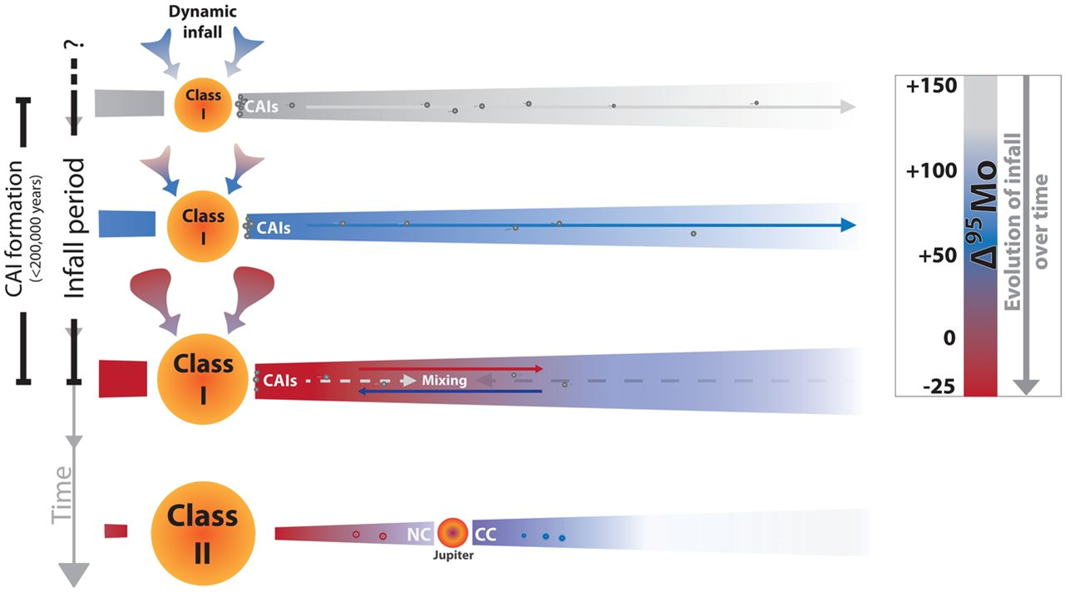
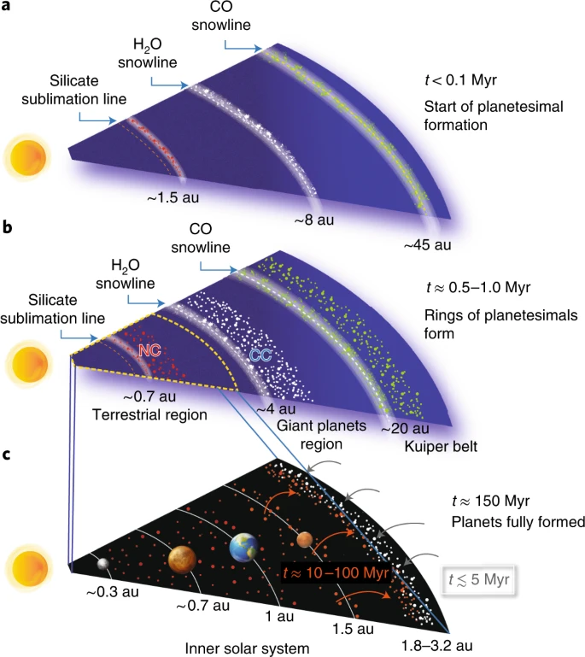
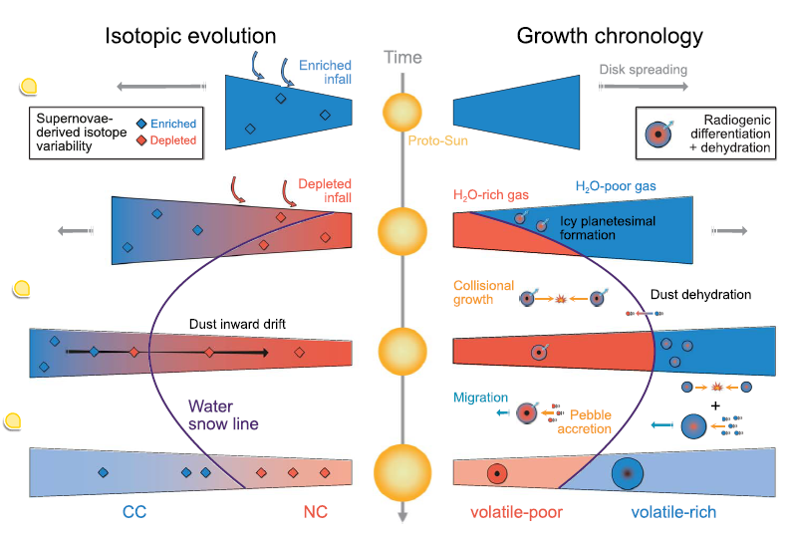
Kruijer et al. (2017)
Kruijer et al. (2017)
Nanne et al. (2019)
Worsham et al. (2019)
Ek et al. (2019)
Kruijer et al. (2020)
Brasser and Mojzsis (2020)
Brennecka et al. (2020)
Izidoro et al (2021)
Lichtenberg et al. (2021)

Slide 15
Stellar precursor for NRIG nuclides?
Isotopic anomalies in ⁵⁰Ti, ⁵⁴Cr, and, especially, ⁴⁸Ca suggest the predominance of dust from rare astrophysical events that ejected neutron-rich, low-entropy matter (Meyer et al., 1996).
Chandrasekhar mass white dwarf star – thermonuclear SN (Woosley, 1997).
Electron capture supernovae – core collapse SN (Wanajo et al., 2013).
Thermonuclear electron capture supernovae of ONeMg – thermonuclear SN (Jones et al., 2019).
Generic term for site production: Neutron-Rich Low-Entropy matter Ejectors (NRLEEs)
Are ⁴⁸Ca, ⁵⁰Ti, and ⁵⁴Cr co-synthesized in NRLEEs?

Slide 16
A possible NRLEE model
A star ejects its envelope and leaves behind a dense white dwarf star.
The white dwarf explodes via a thermonuclear explosion on a short (~1 s) timescale. The yields vary inside the star owing to the different temperatures reached during the explosion.
The explosion proceeds, the star expands and ejects matter into the ISM while a large fraction (~50%) of the matter falls back to create a smaller white dwarf star. Instabilities cause mixing of the different layers in the ejecta.
(Jones et al., 2019; Bermingham and Meyer, 2023)

Slide 17
Nucleosynthetic yields immediately after explosion
NRIG elements (⁴⁸Ca,⁴⁶Ti, ⁵⁰Ti, ⁵⁴Cr) can be co-synthesized in NRLEES.
8 – 10 M☉

Slide 18
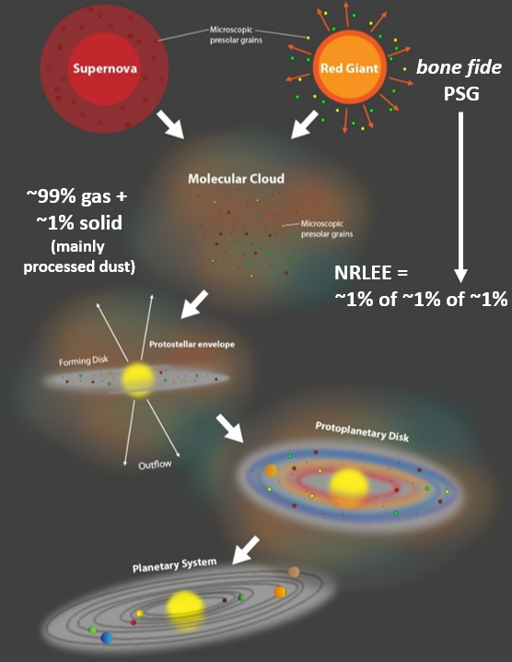
Transit through ISM and abundance in Solar System
Using a new Galactic Chemical Evolution model, the fraction of each dust reservoir’s mass to ISM was calculated.
NRLEE dust is predicted to comprise 1 ppm of the total molecular cloud dust mass (= Solar System composition).
8 – 10 M☉

Slide 19
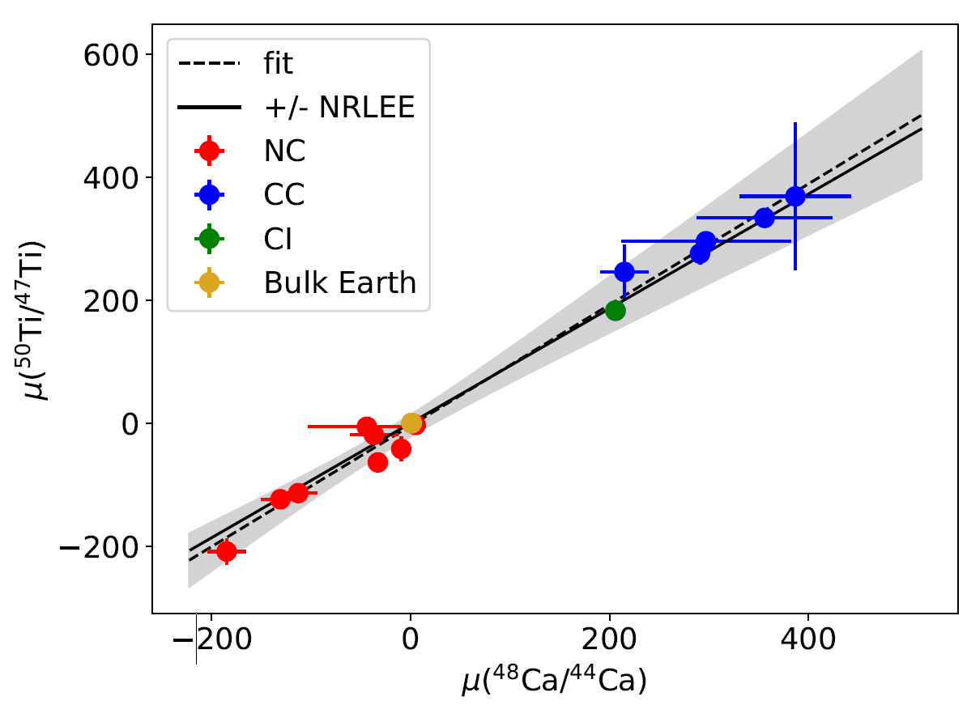
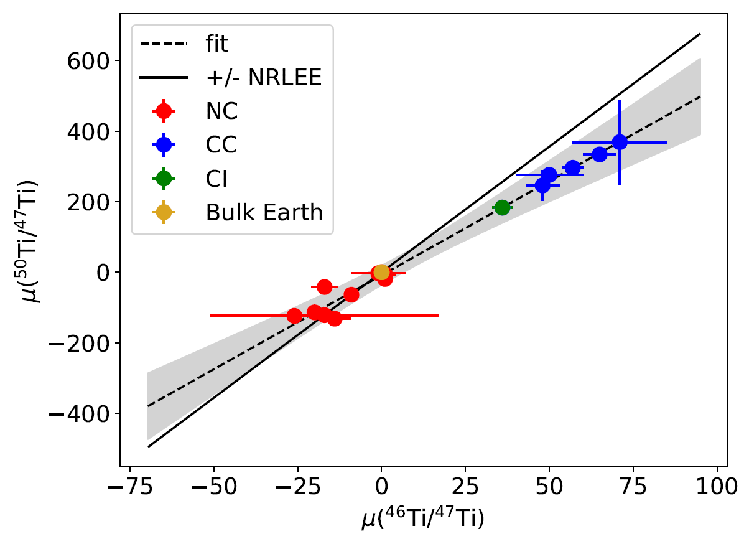
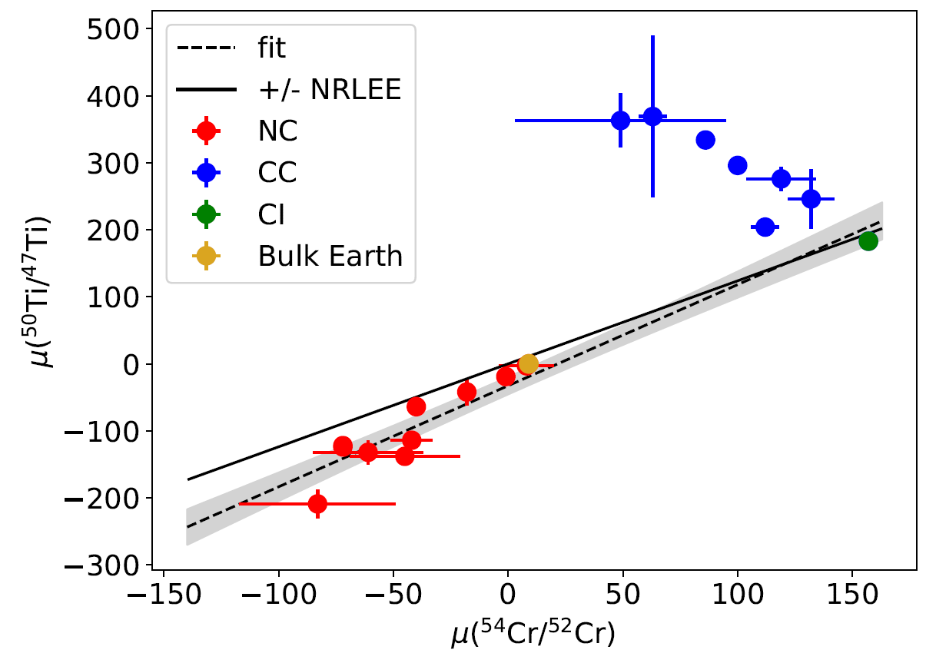
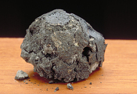
NRLEE material mixed into the Solar System
⁴⁸Ca, ⁵⁰Ti, and ⁵⁴Cr are co-synthesized in NRLEEs; ~ 1 ppm of Solar System
8 – 10 M☉
CI (CC) = bulk Solar System elemental and isotopic compositions.
NRLEE material mixed into CI replicates most NC and CC relations in meteorite samples.

Slide 20
A simplified model for Solar System evolution

Slide 21
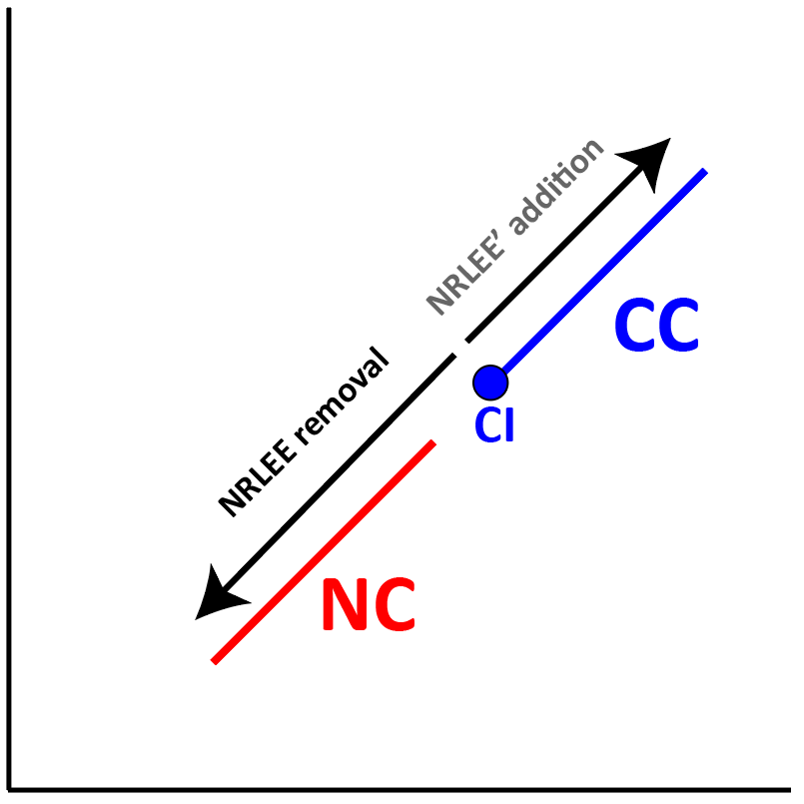
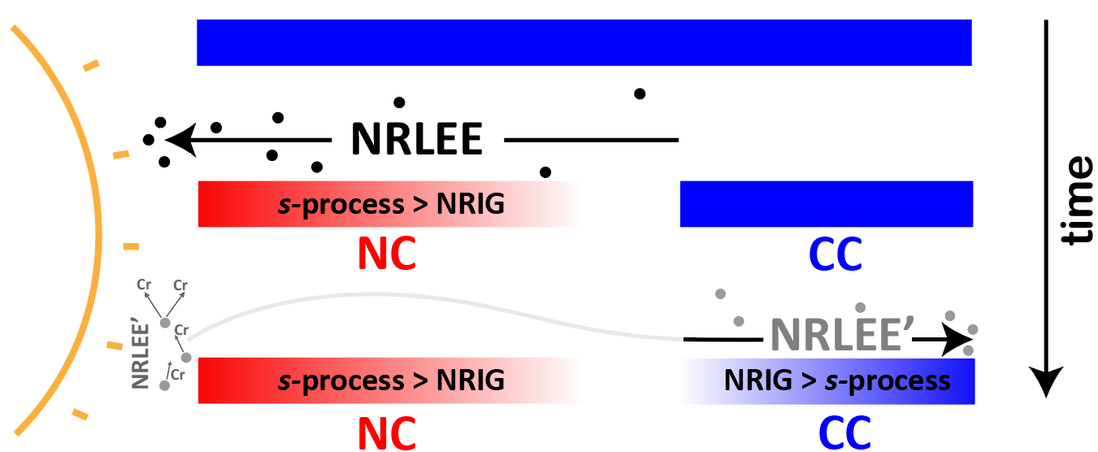
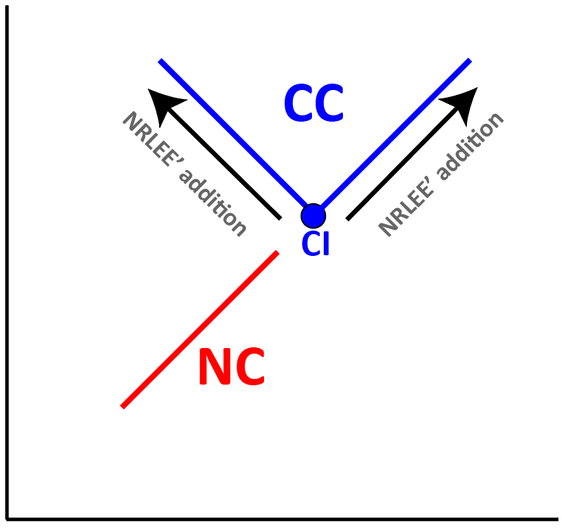
A simplified model for Solar System evolution

Slide 22
Conclusions
The multi-billion-year chemical history of the isotopes can be summarized in the sequence of chemistries.
Meteorite genetics reveal a ubiquitous bimodality in compositions (NC-CC).
Nuclear astrophysics modeling combined with genetic anomalies suggest NRLEEs are a dominant stellar precursor of NRIG nuclides.
A simple model of transit and thermal processing of material in the disk can explain the genetic correlations for NRIG nuclides, and disk evolution.

Slide 24
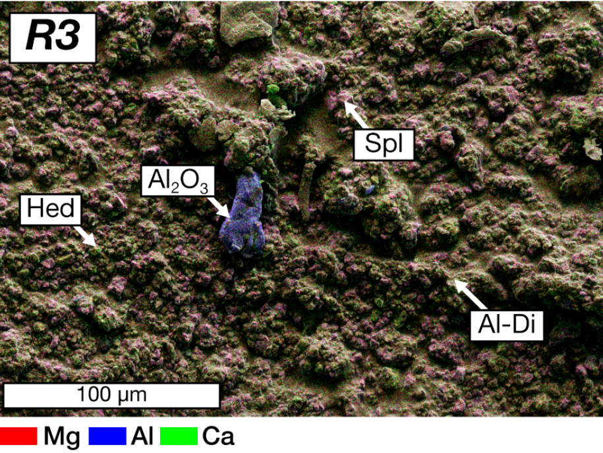
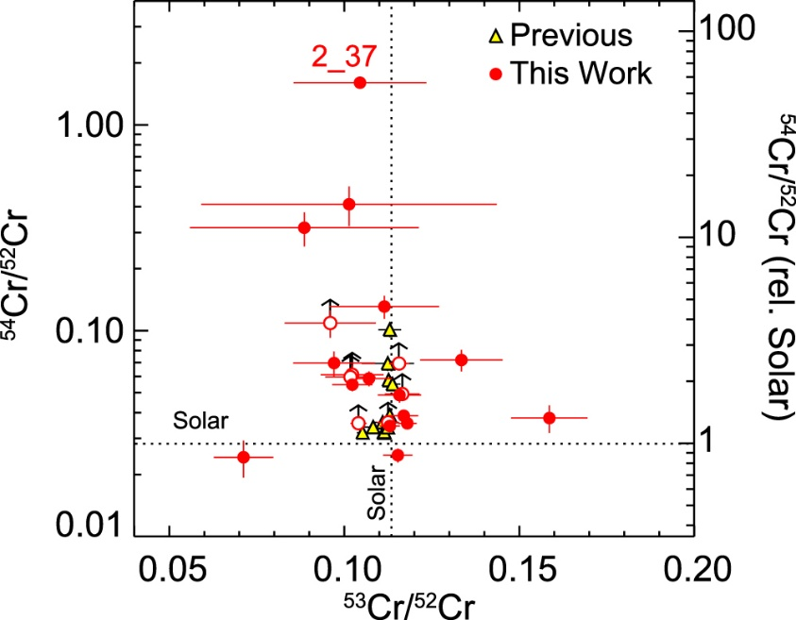
NRLEE condensation chemistry
Perovskite forming in NRLEE ejecta would have strongly coupled excesses in ⁴⁸Ca and ⁵⁰Ti.
Unlikely that hibonite will be a major presolar grain phase because of the low amounts of Al produced in these events.
54Cr- and 50Ti-rich presolar oxide grains in Orgueil (Nittler et al., 2018) and 84Sr-rich grains in Allende CAI residues (Charlier et al., 2021) may be further examples of NRLEE events.
Additional carrier phases enriched in ⁴⁸Ca-⁴⁶Ti-⁵⁰Ti, but not varying in ⁵⁴Cr isotope compositions may be produced.
(Charlier et al., 2021)
(Nittler et al., 2018)

Slide 25
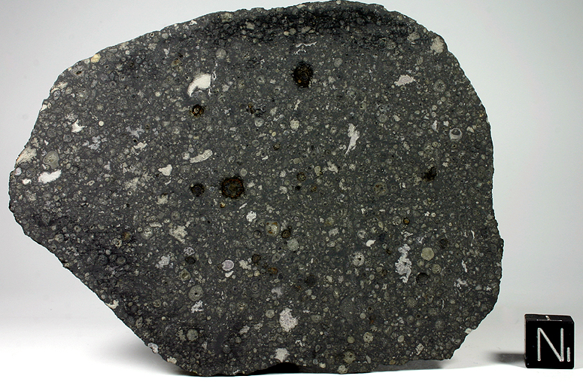
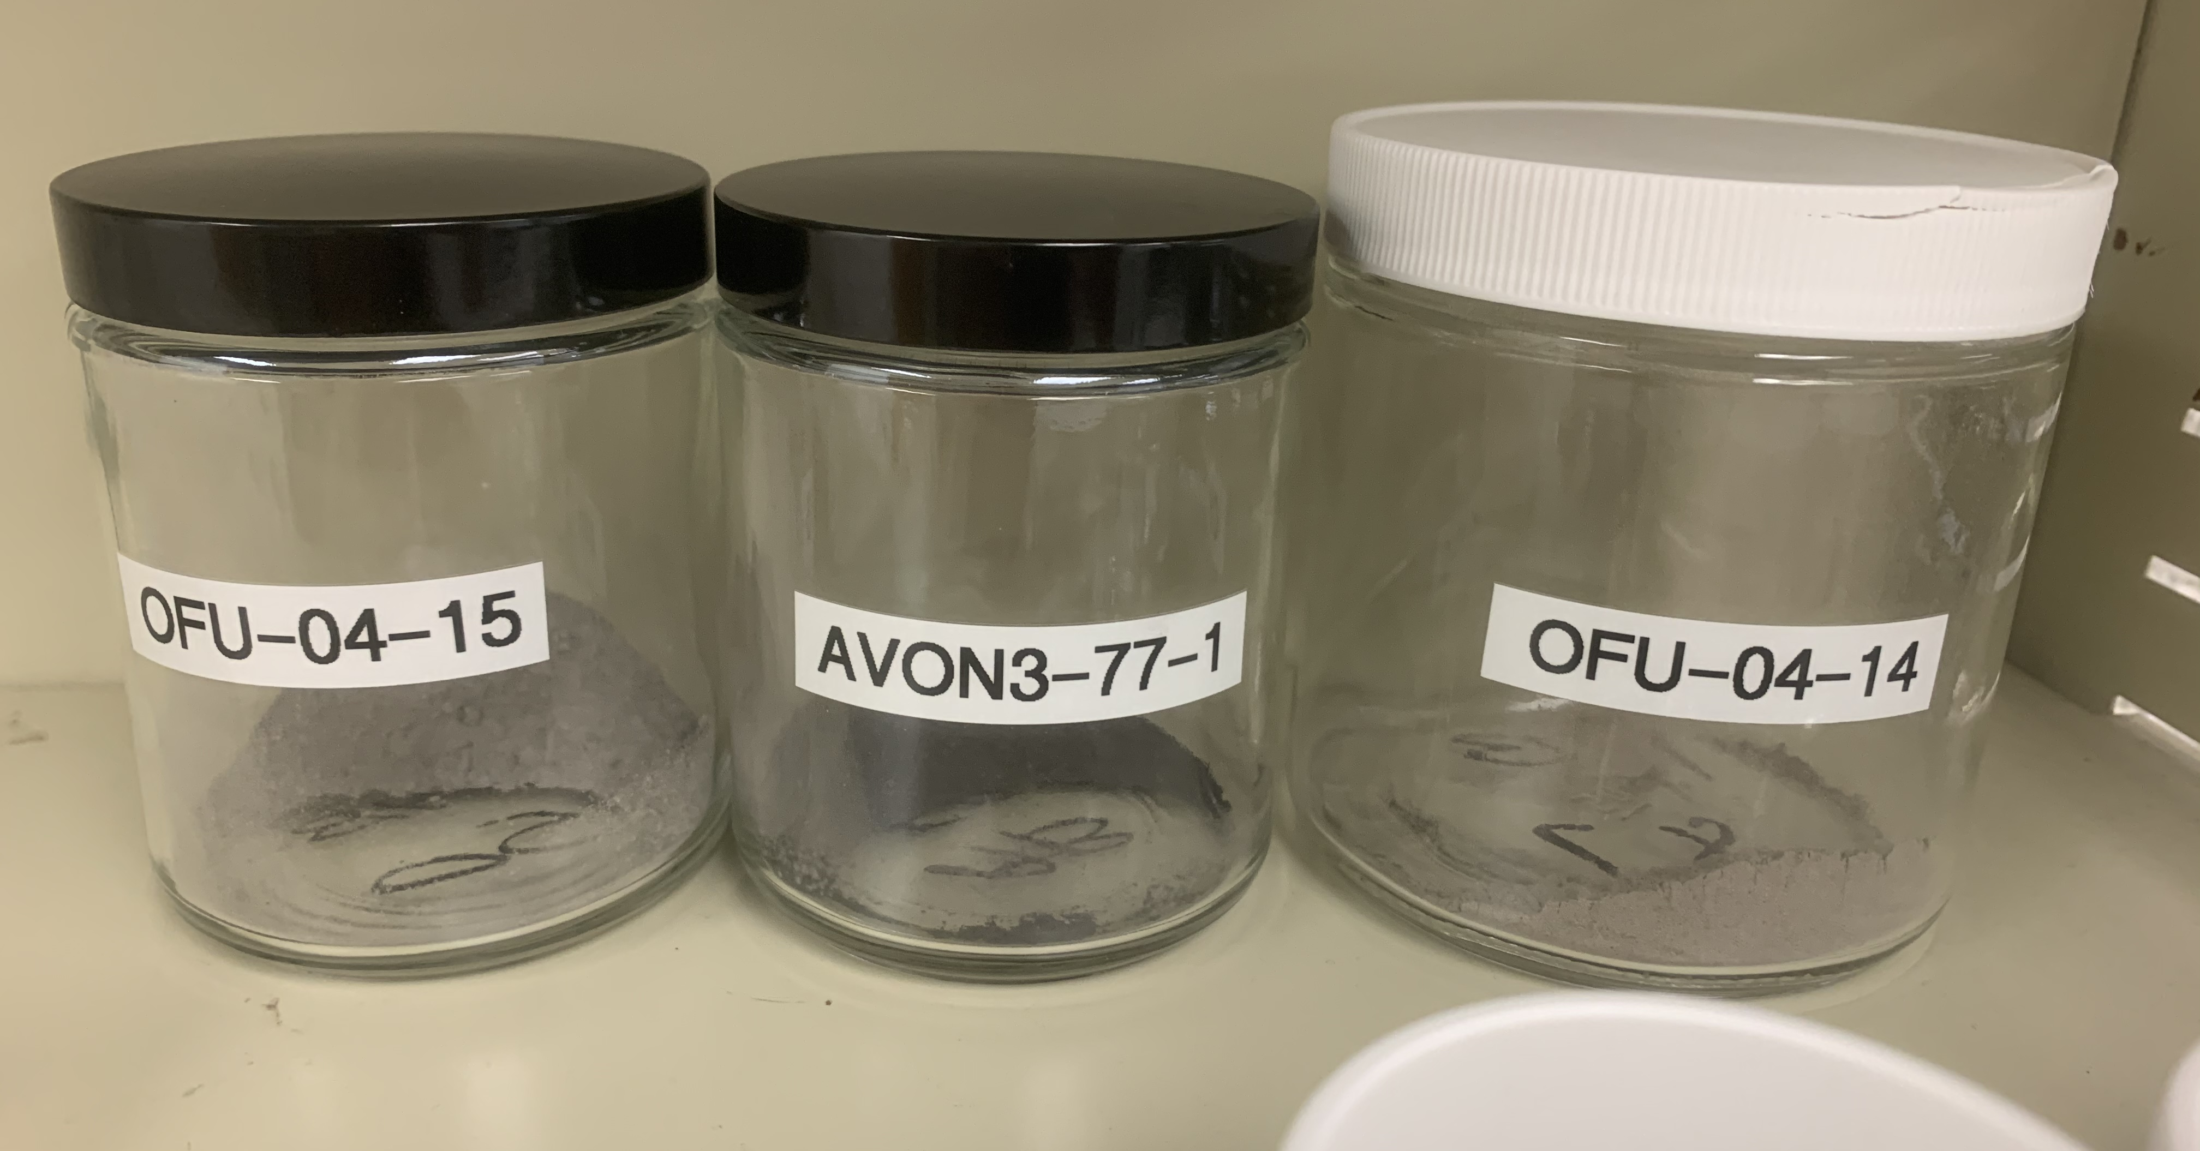
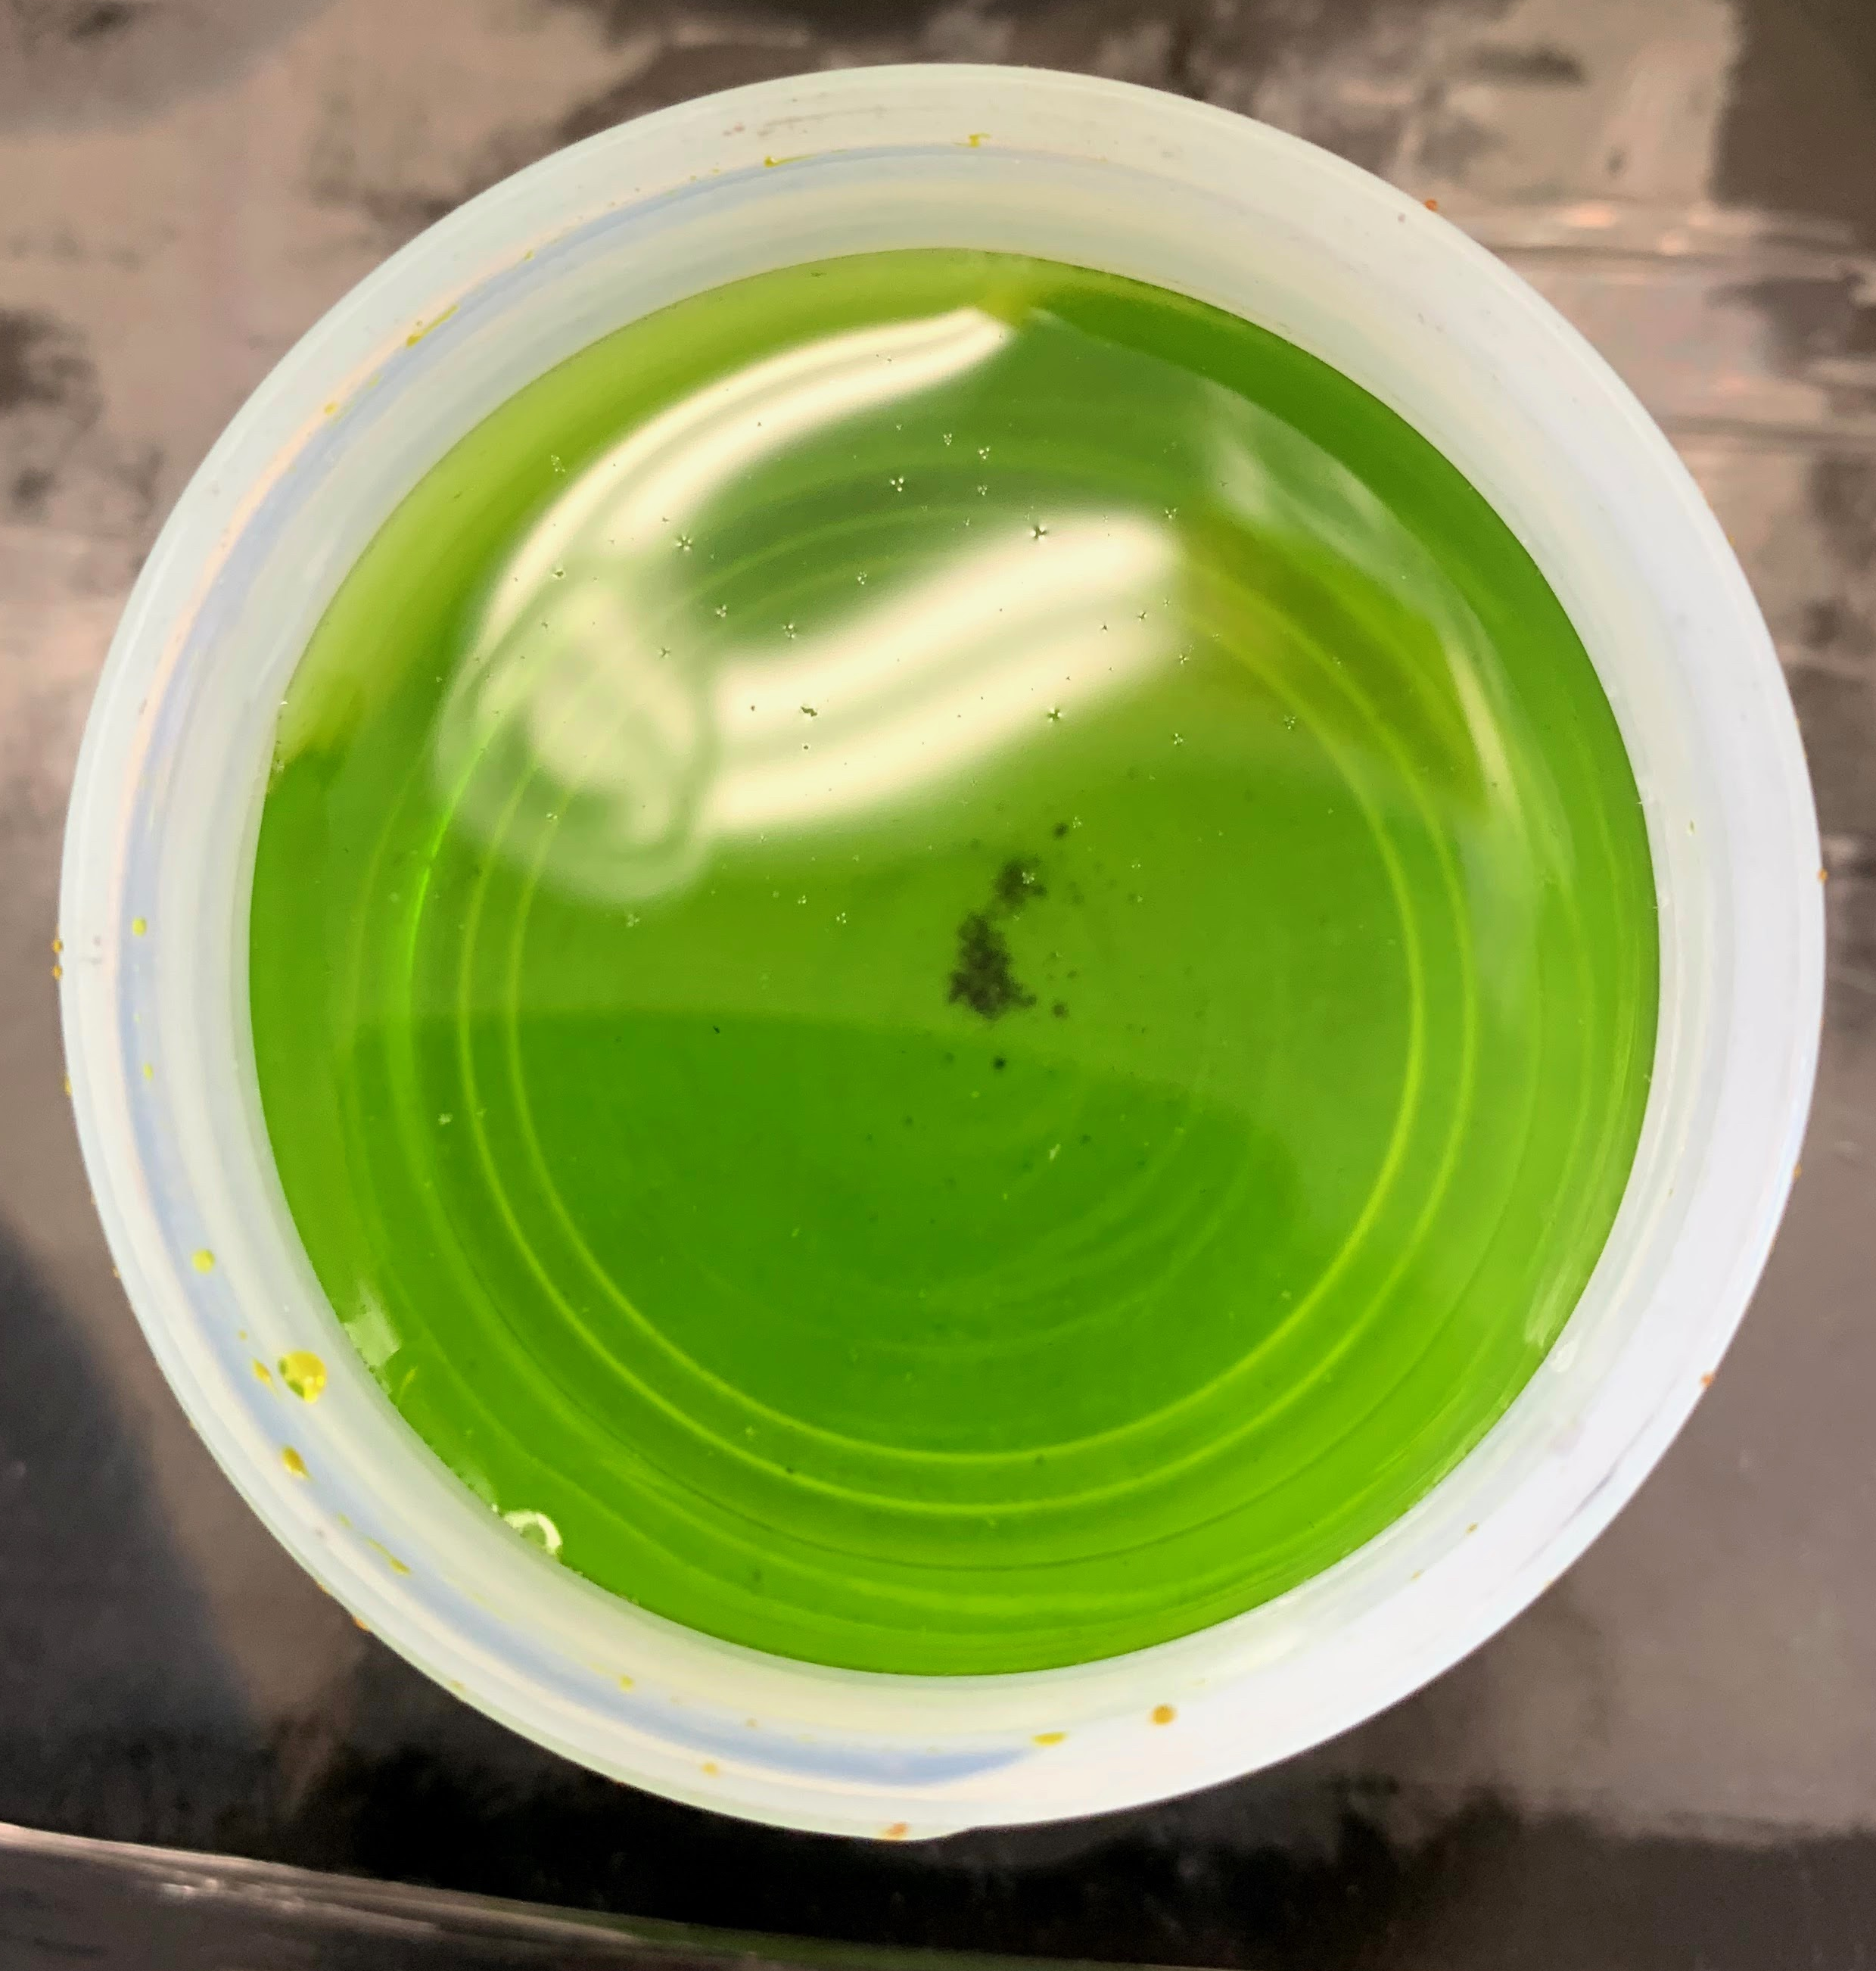
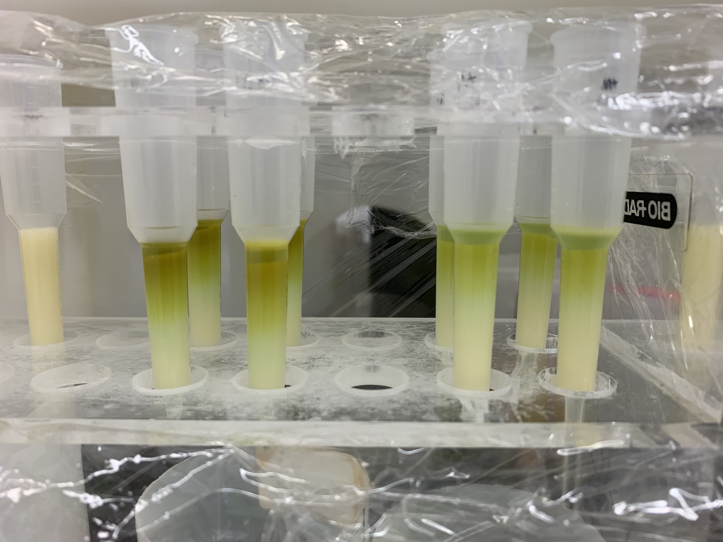
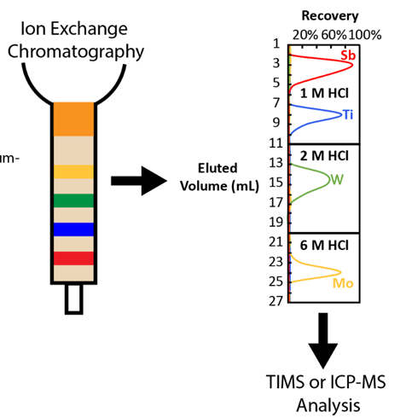
Analytical chemistry

Slide 26
Data collection
TIMS/MC-ICP-MS
Purify sample
Load sample
Ionize sample
Cut sample
Load sample
Sputter
Count ions
Count ions
SIMS

Slide 27
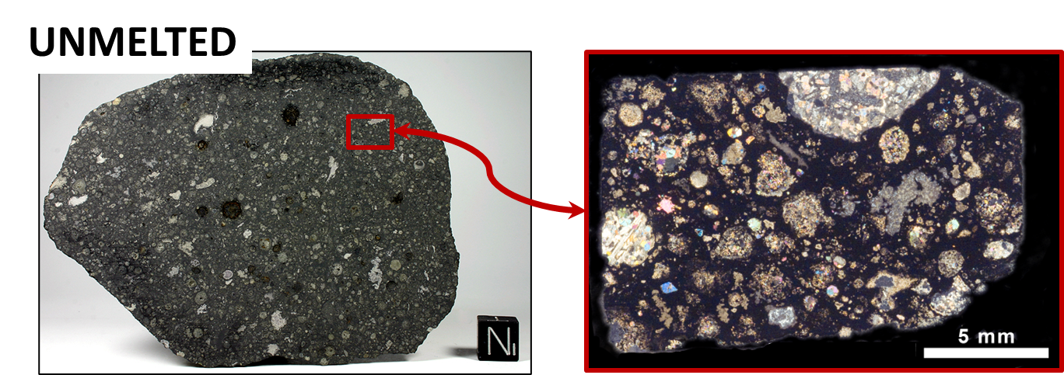
Linking nuclear astrophysics with genetics
To constrain stellar precursors, can we identify quantitative relations between genetics and stellar nucleosynthesis?
Bulk meteorites are used because they provide an average composition of a region in the disk, which can be coupled with temporal information.
Distinct from presolar grains, which are independent of disk context.

