Slide 1



Plasma Induced Modification of β-Decay Rates Relevant for the s-Process
Bharat Mishra, INFN-LNS
for the PANDORA collaboration

Slide 2
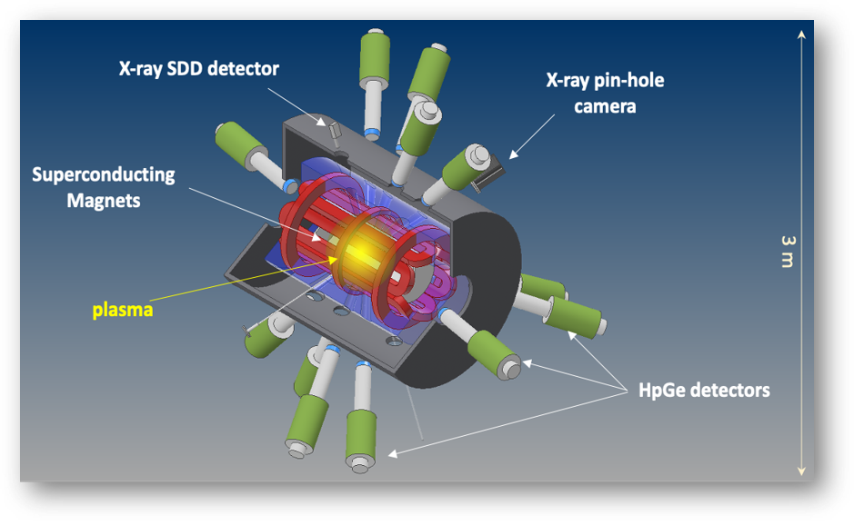
Plasmas for Astrophysics, Nuclear Decay Observations and Radiation for Archaeometry
Nuclear astrophysics in an electron cyclotron resonance (ECR) plasma
n_{e} ~ 10¹¹⁻¹³ cm⁻³
kT_{e} ~ 0.1 - 100 keV
MAIN GOALS:
β-decay rate in plasma for s-process
Plasma opacity for r-process (see talk by A. Pidatella on Thursday)
[1] D. Mascali et al, Universe 8, 80 (2022) [2] D. Mascali et al, EPJ WoC 227, 01013 (2020) [3] A. Pidatella et al, Front. Astron. Space Sci. 931744 (2022)

Slide 3
PANDORA can be a testbench for validating different models of in-plasma β-decay, but models must be adapted to a NLTE ECR plasma [4]
Decay rate for each charge state i and excited level j of the isotope
Updated atomic data taken from HULLAC [5], but can be substituted with other databases as well
Allows studying fundamental atom-nucleus interaction
Customised according to parameter space
FLYCHK [6] for spatially uniform and (mostly) collisional plasmas
PIC-MC codes for laboratory plasmas
Configuration-dependent rates
Plasma model
In-plasma rates
[4] B. Mishra et al, Front. Phys. 932448 (2022) [5] A. Bar-Shalom, M. Klapisch and J. Oreg, J. Quant. Spectrosc. Ra. 71, 169 (2001) [6] H.-K. Chung et al, High Energy Density Phys. 1, 3 (2005)

Slide 4
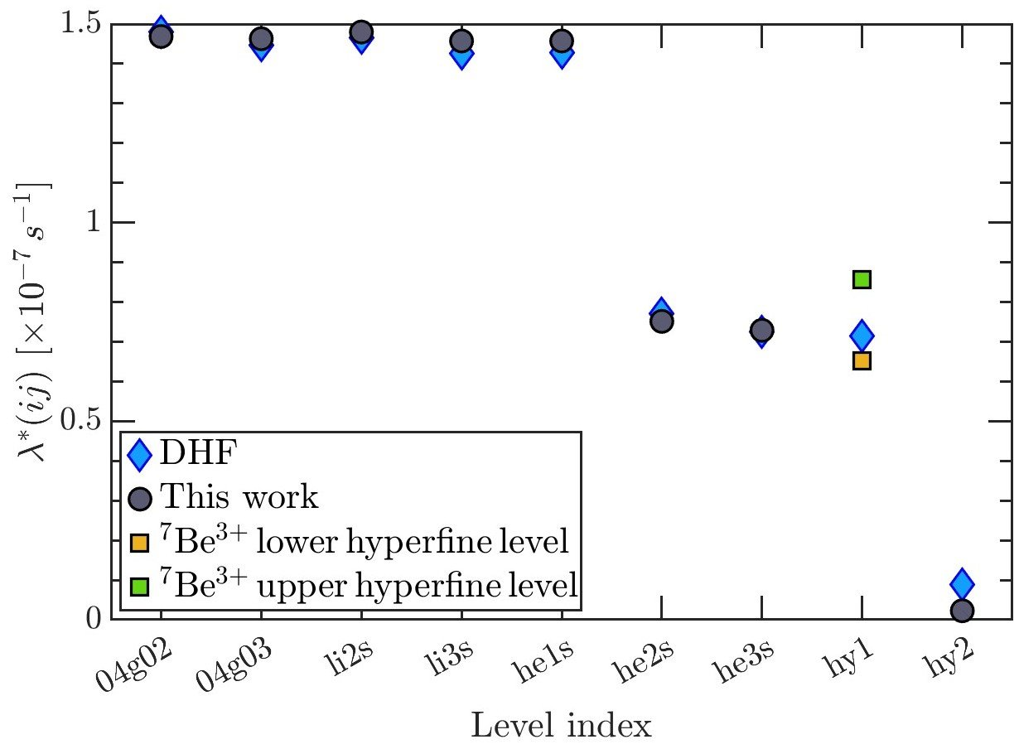
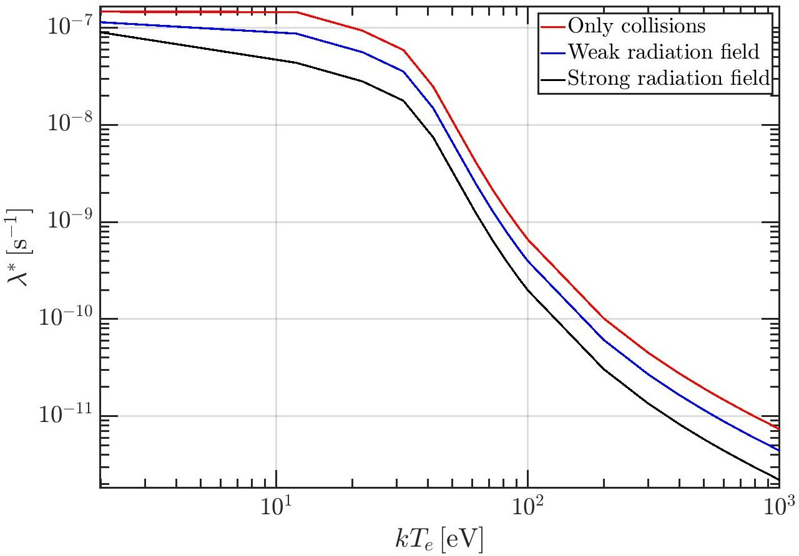
Highlights
Primary model candidate: Takahashi-Yokoi [7]
First isotope studied: ⁷Be (astrophysically relevant and potential first case for PANDORA)
[7] K. Takahashi and K. Yokoi, Nucl. Phys. A 404, 478 (1983)
Configuration-dependent rate
In-plasma rates
Also tested with experimental data from storage rings – ¹⁶³Dy⁶⁶⁺, ¹⁴⁰Pr^{0+,57+,58+} and ¹⁴²Pm^{0+,59+,60+}
Impact of excited bound states (he2ps and hy2) and radiation-mediated equilibrium

Slide 5
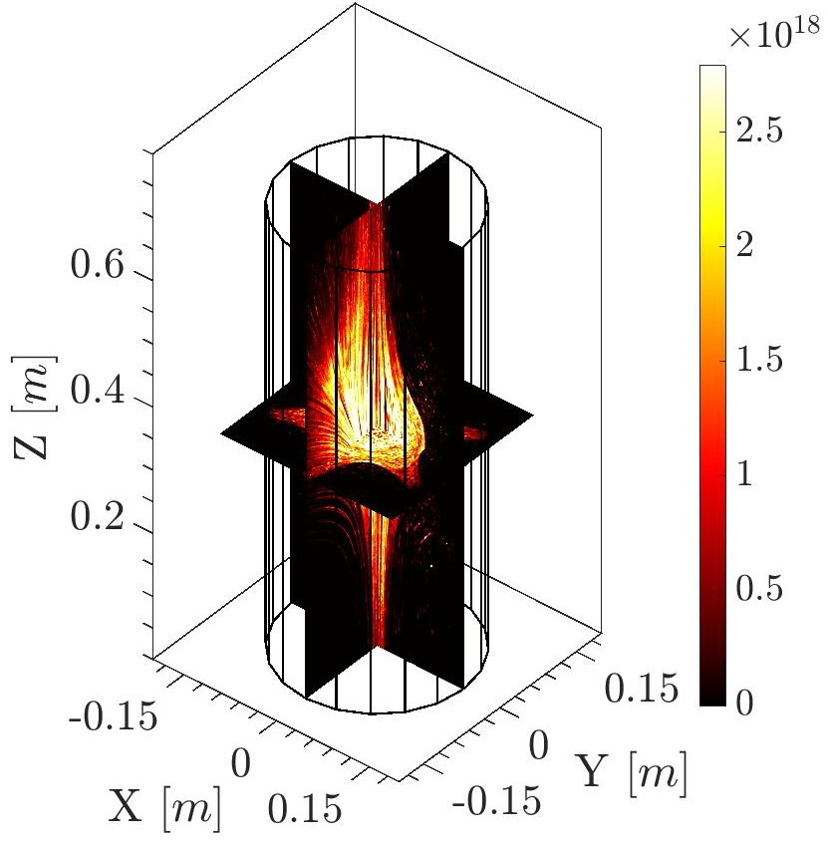
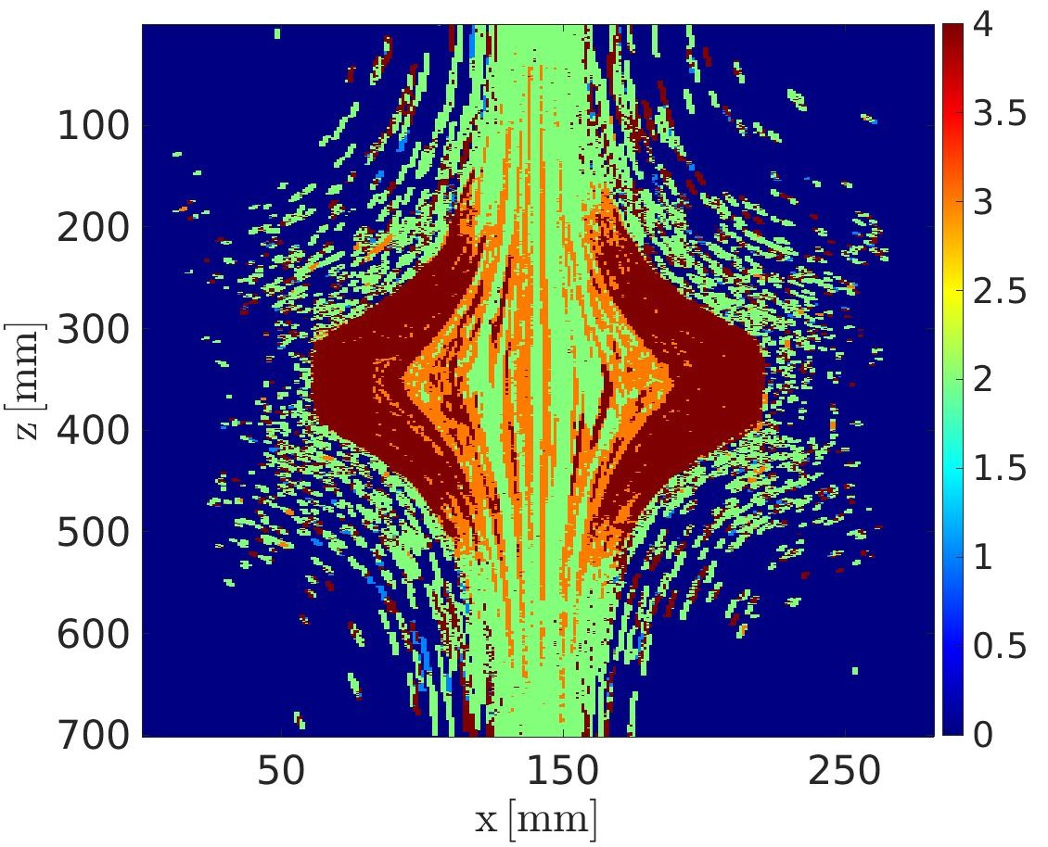
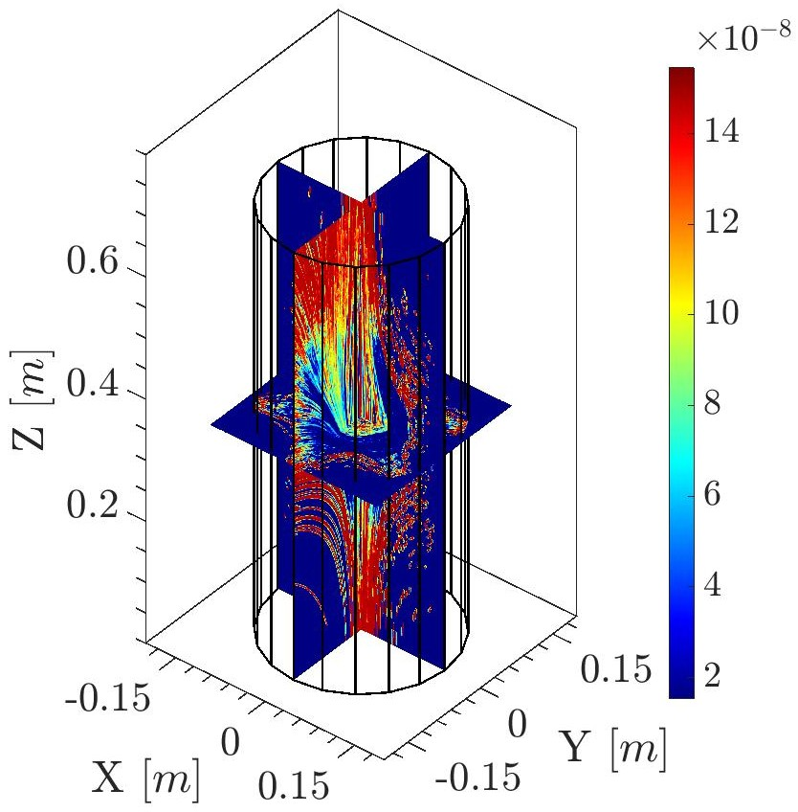
Highlights
PIC simulations carried out to generate 3D maps of electrons in the magnetic trap and combined with the decay model to generate similar maps of λ_{β}
Plasma model
n_{e} [m⁻³]
λ_{β} [s⁻¹]

Slide 6
Conclusions
PANDORA is an upcoming facility at INFN–LNS to study β-decays in a plasma
Configuration-dependent rates
Plasma model
In-plasma rates
Applicable to wider parameter space
Model can be tested in low density laboratory plasma and then applied to s-process nucleosynthesis sites
Uses updated atomic data → HULLAC database and FLYCHK
Model can be extended to light nuclei and include finer effects in multi-electron atoms such as exchange and overlap corrections, influence of excited levels and, hyperfine splitting
Can be coupled to Particle-in-Cell plasma kinetic codes

Slide 7
Thank You

Slide 8
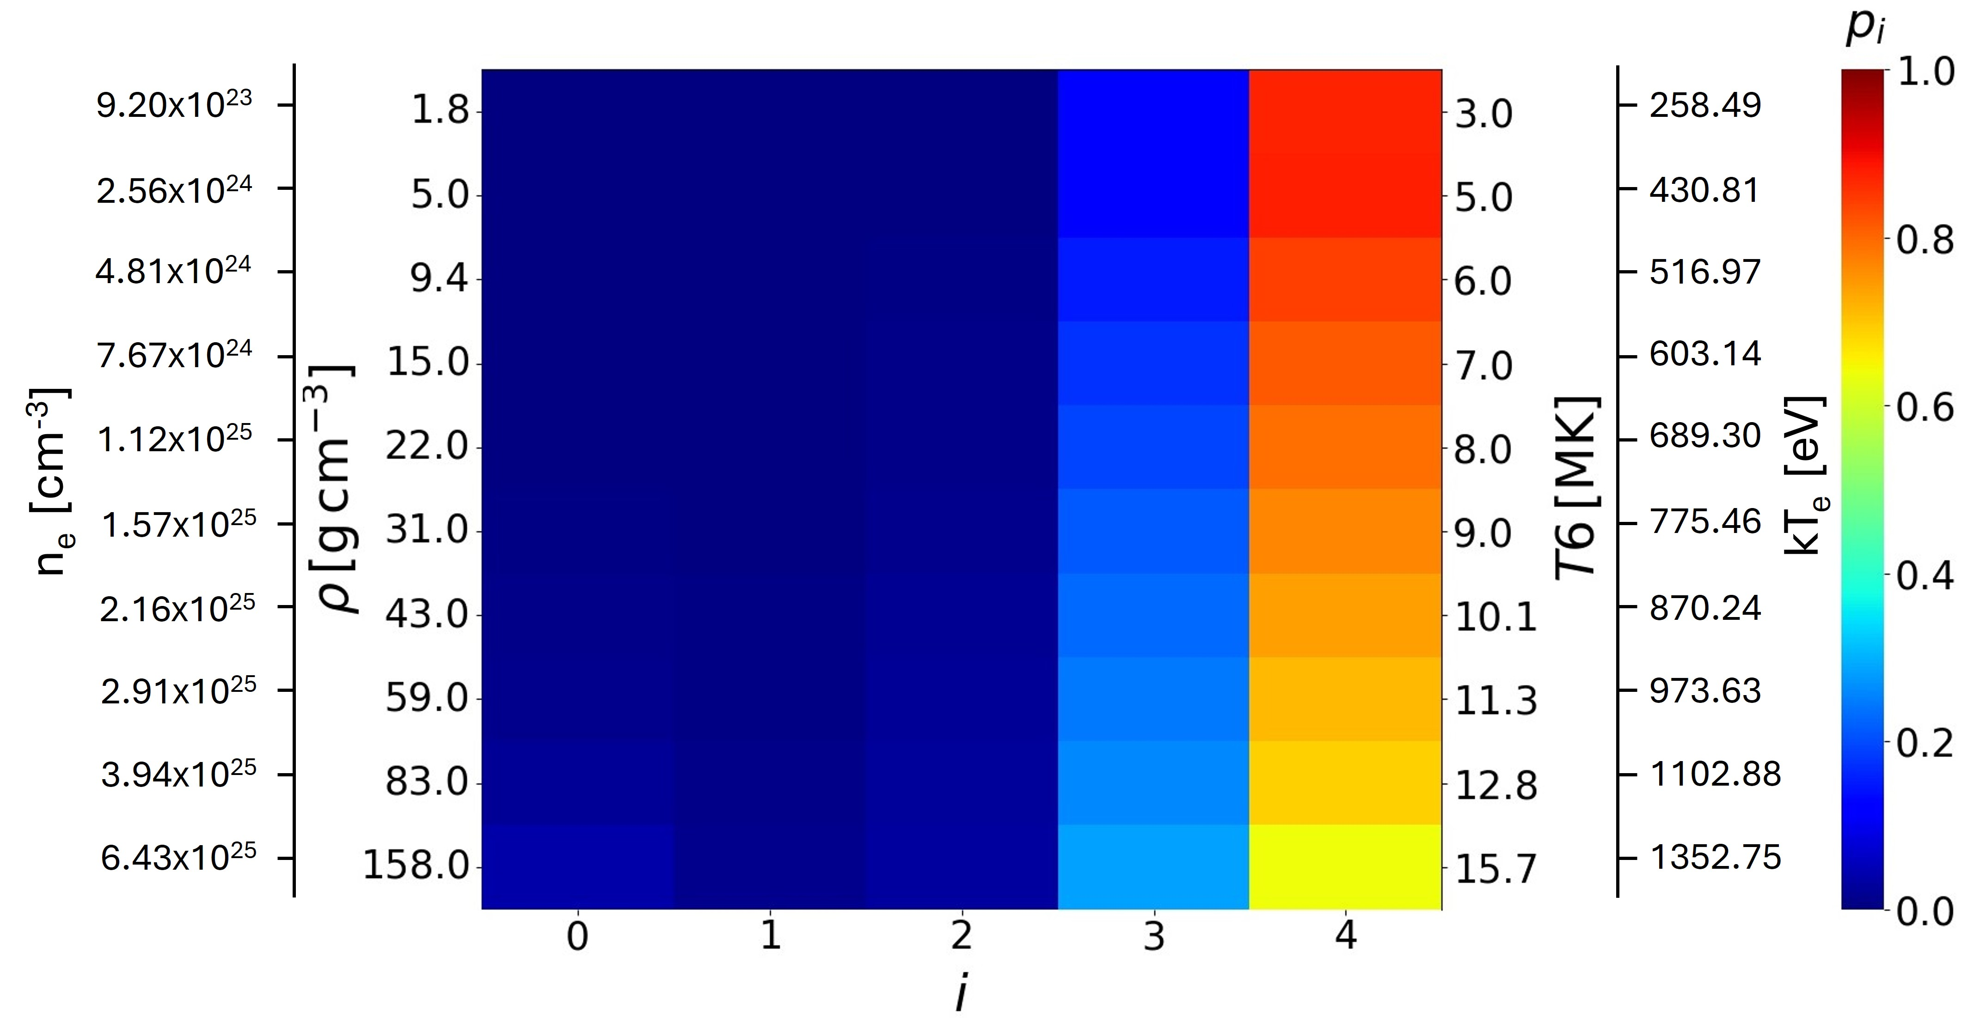
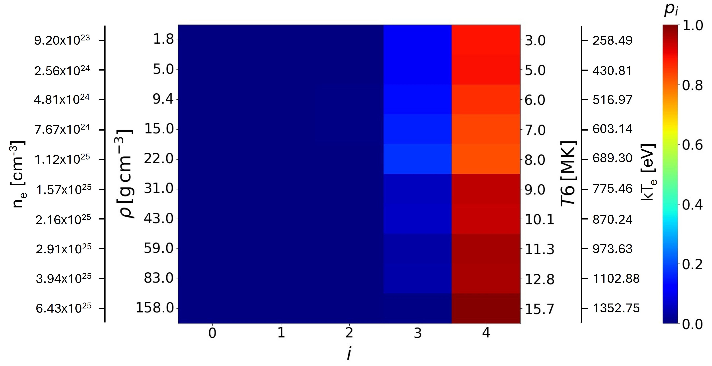
Additional Slides – CSD in solar core
Plasma model
p_{i} of ⁷Be at different depths of solar core as predicted by (left) IPD-model of TY83 and (right) FLYCHK. The rectangles indicate 10% mass fraction radius where a non-zero amount of ⁷Be³⁺ is expected. The IPD model of TY83 is not applicable to light nuclei. Present calculations indicate only a 3% increase in λ_{β} (expected 20%) → analysis ongoing

Slide 9
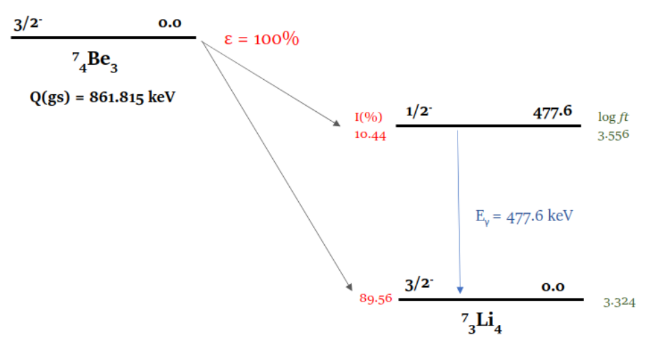

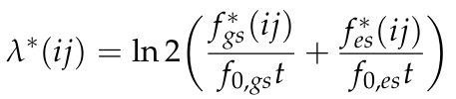

Orbital Electron Capture Decay in ⁷Be
Configuration-Dependent Lepton Phase Volume
Occupancy of orbital contributing to certain decay within relevant ionic configuration
Shape factor describing compatibility between nuclear and lepton wavefunction
Larger of squared radial component of electron wavefunction evaluated on nuclear surface
Q-value of decay when isotope in (i,j) charge state and level configuration
Configuration-Dependent Decay Rate
Plasma-Dependent Decay Rate
⁷Be undergoes EC decay to ⁷Li through 2 channels
Decay scheme taken from ENSDF database
CSD and LPD of radio-isotope ions
12

Slide 10
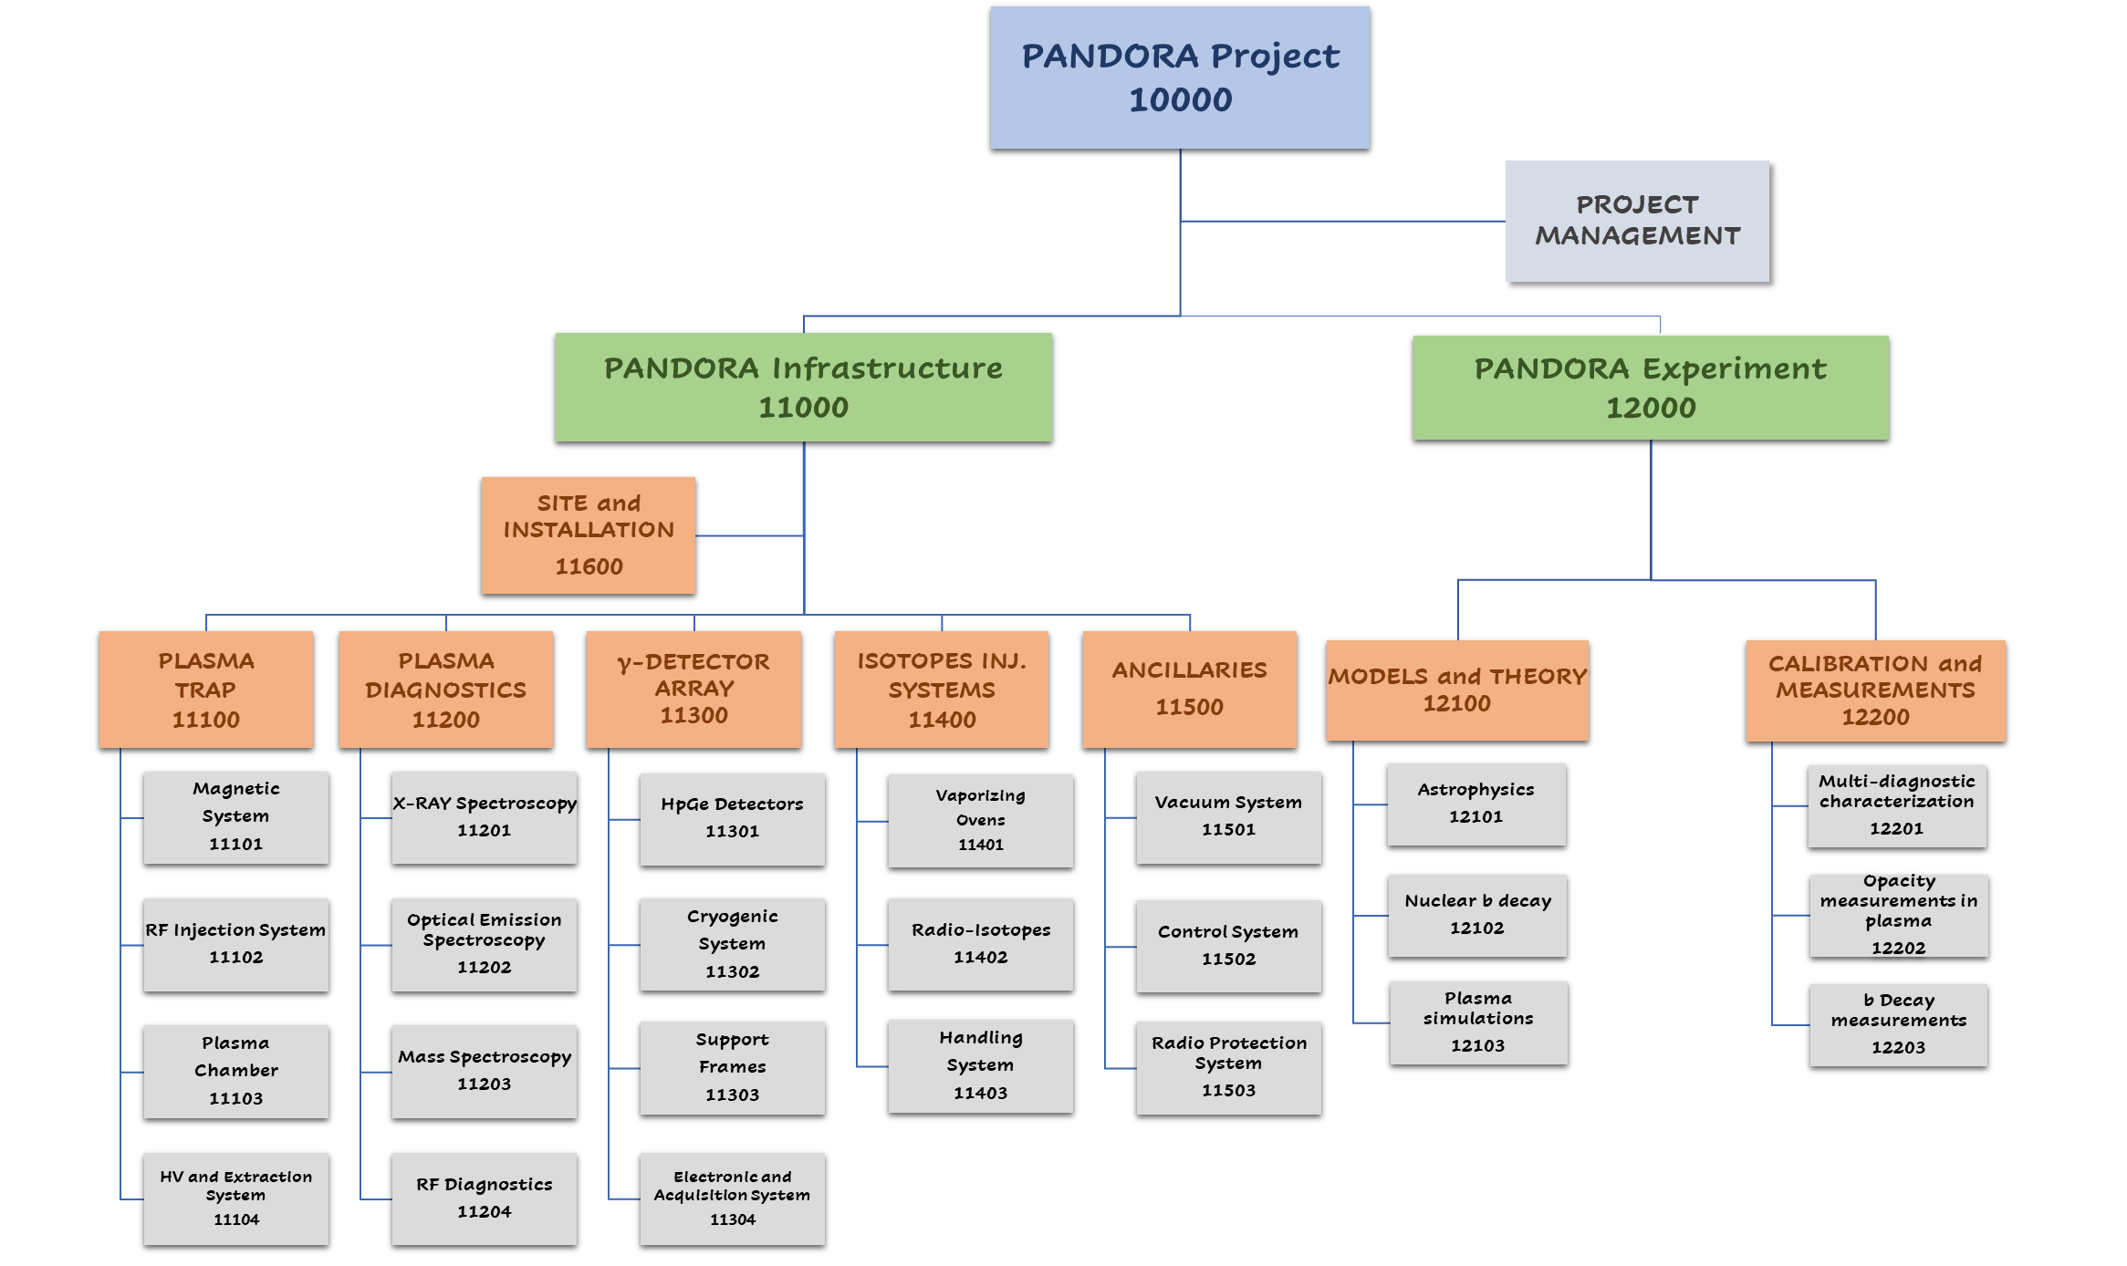
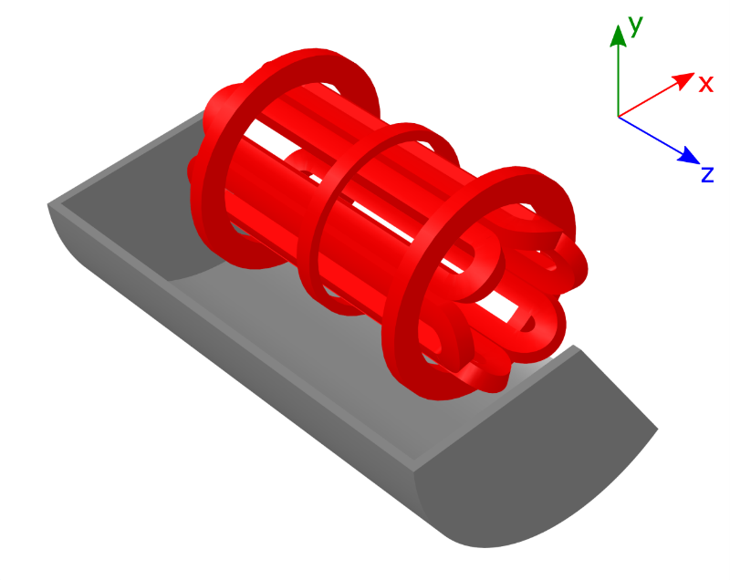
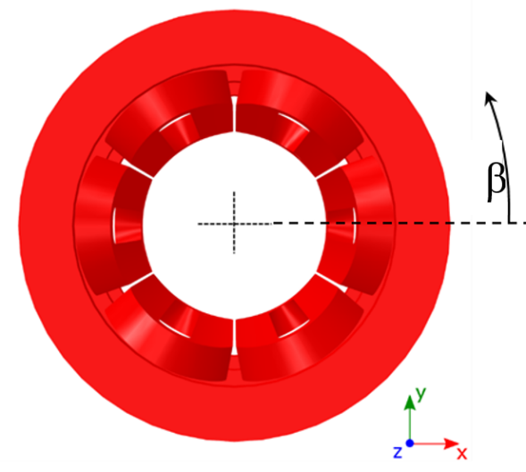
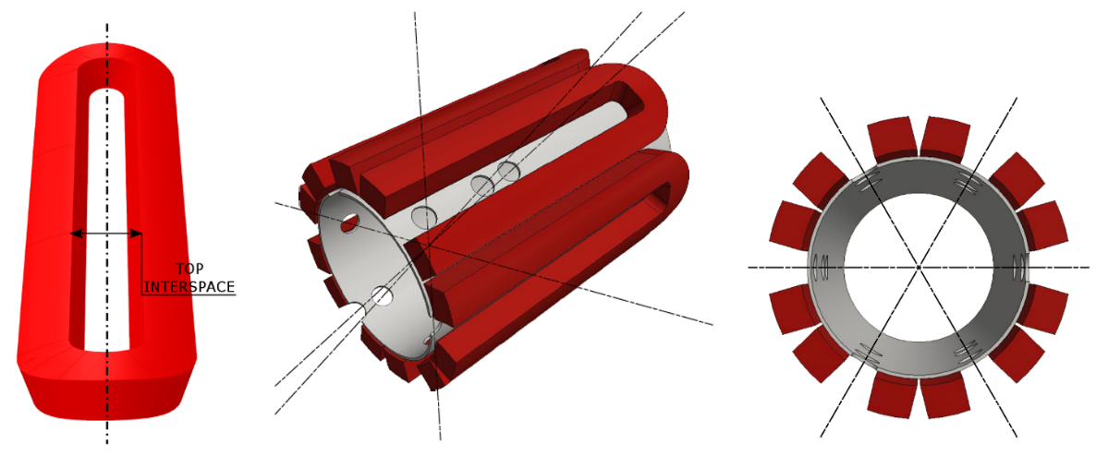
MAIN SUBSYSTEMS UPDATES: Trap procurement
(LNS ACTIVITY)
The magnetic system, fully superconductive, consists of:
#3 axial coils that generates the axial magnetic field;
#6 hexapole coils that generates the radial magnetic field.
It will enclose a plasma chamber with:
inner radius R_{CH_IN} = 140 mm
length L = 700 mm.
MAGNETIC FIELD REQUIREMENTS
B_{inj} max @ z = - 350 mm | 3 T
B_{inj} operative range | 1.7 T – 3 T
B_{ext} max @ z = 350 mm | 3 T
B_{ext} operative range | 1.7 T – 3 T
B_{min} @ z = 0 mm | 0.4 T
B_{hex} @ R_{CH_IN} = 140 mm | 1.6 T
Lhe | Free
Warm Bore radius | 150.5 mm
Distance between mirrors | 700 mm
Stray field (as above specified) | Less than 0.2 T
The PANDORA’s trap has been designed to operate at 18 + 21 GHz.

Slide 11
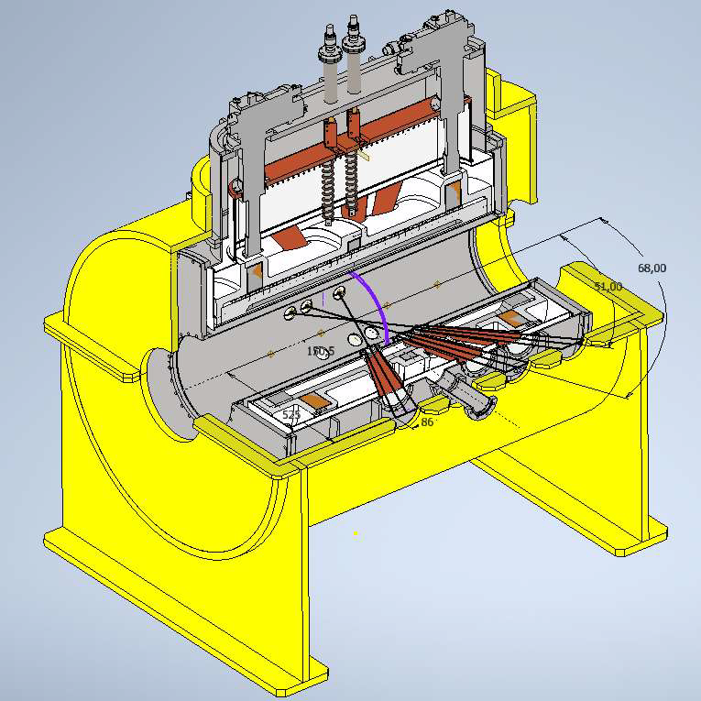
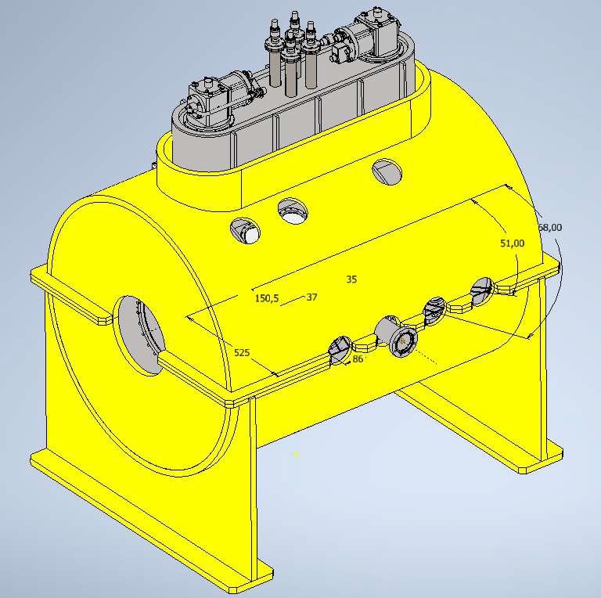
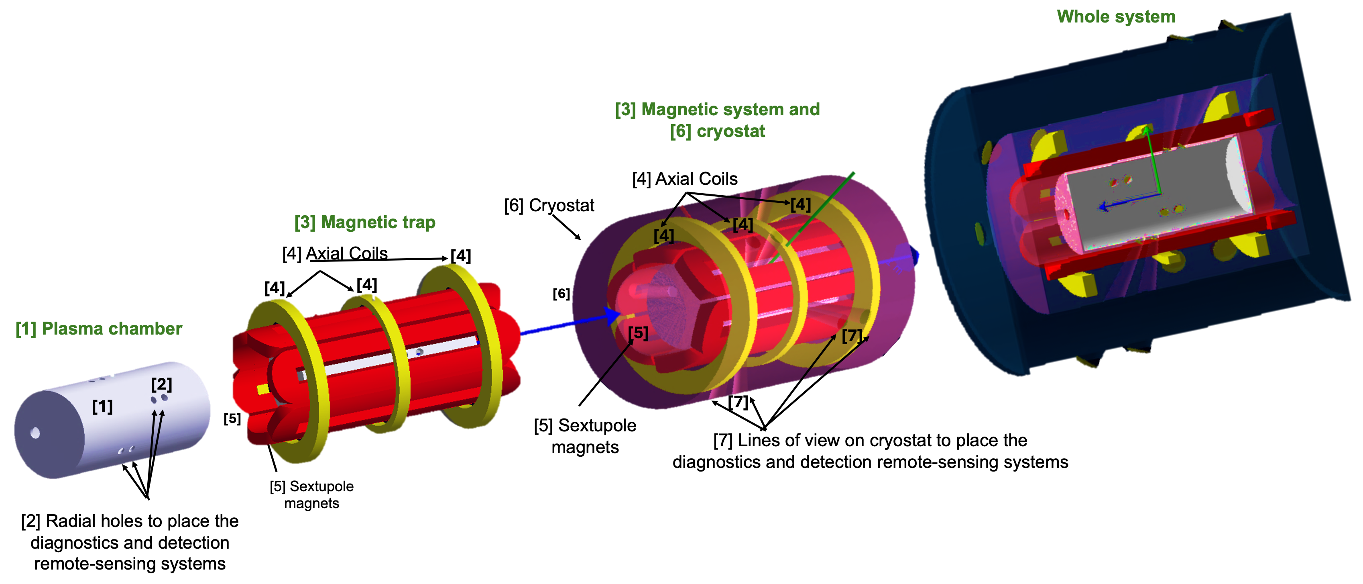
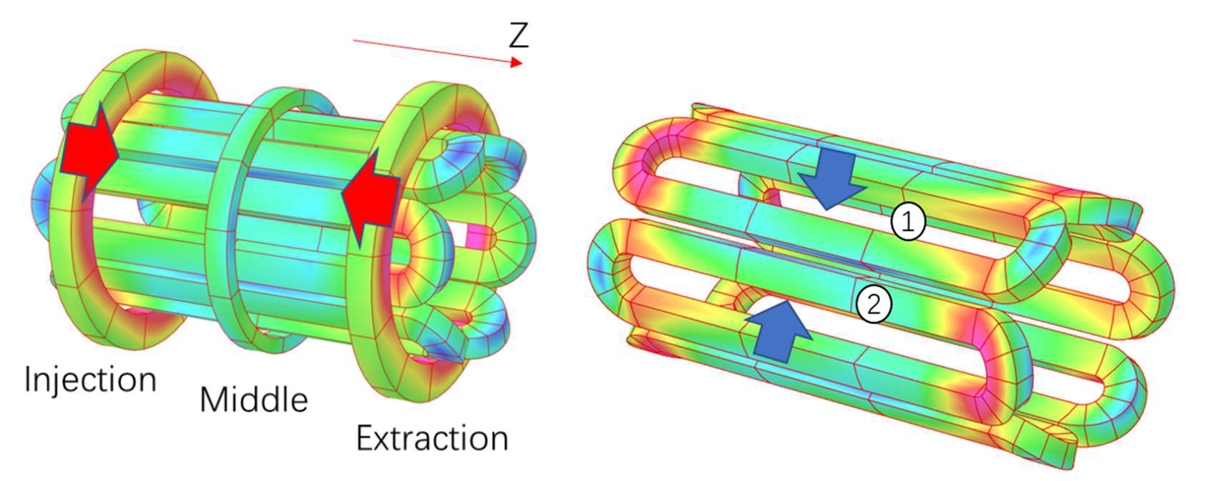
MAIN SUBSYSTEMS UPDATES: Trap procurement
Competitor #1-Executive Design
TENDER IS NOW COMPLETE AND THE COMPANY IS STARTΙΝG MANUFACTURING!!

Slide 12
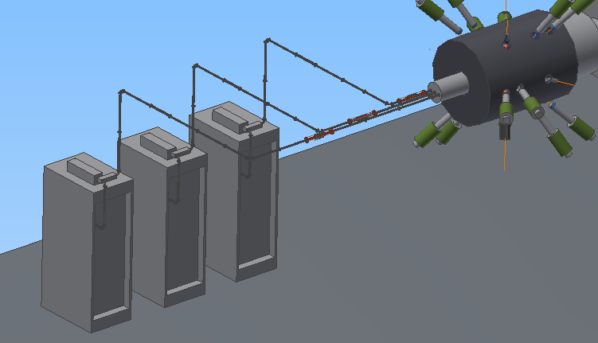
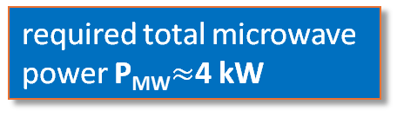
MAIN SUBSYSTEMS UPDATES: RF system
(LNS ACTIVITY)
GREEN: already purchased
YELLOW: planned to be procured in 2024
Silver plated low-losses
Waveguides branching
Target power density of 1.38 kW/l
PANDORA ECR plasmoid
volume ~ 3 l
required total microwave
power P_{MW}$≈$4 kW
Different microwave injection schemes:
“Single-Frequency” mode: only one amplifier is used.
“Two-Frequency Heating” (TFH) and “Two-Close-Frequency Heating” (TCFH) scheme mode, also with the possibility to vary the power ratio between two microwave amplifiers:.
“Three-Frequency-Heating” mode from the three Klystrons
“compliant” with the planned total amount of power delivered by the three klystrons 6 kW
to reach high charge states
Klystron 3
21 GHz
1.4 kW
Klystron 2
17.3-18.1 GHz
2.4 kW
Klystron 1
17.3-18.1 GHz
2.4 kW

Slide 13
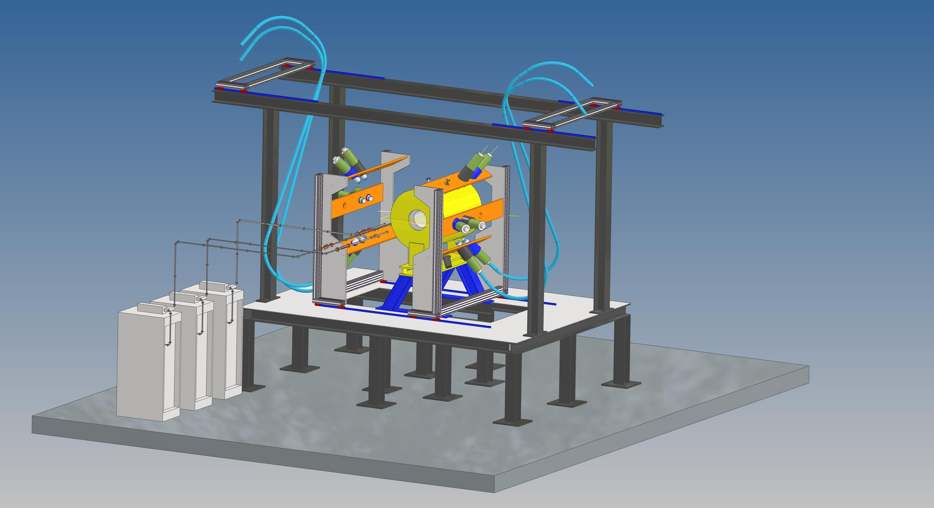

MAIN SUBSYSTEMS UPDATES: HPGE detection system
(LNS+ LNL activity)
PANDORA SETUP Mechanics

Slide 14


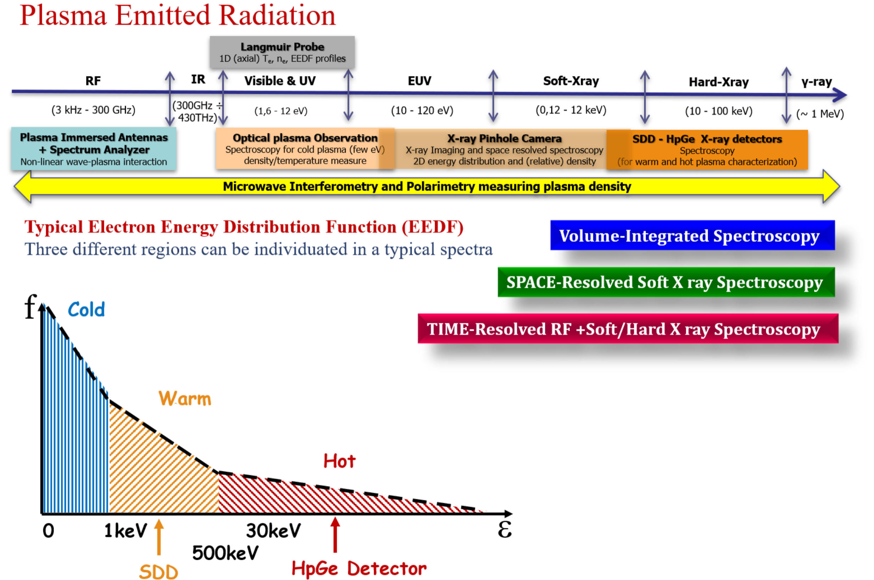



The plasma diagnostics
The PANDORA diagnostics
PANDORA: A New ECRIT – ECR Ion Trap for β-decay measurements in plasmas
Method: ECR plasmas emit radiation from microwave to hard X-rays and this radiation can be used to investigate plasma parameters in different regimes;
→ Similarly to exploring the Universe across the EM spectrum

Slide 15
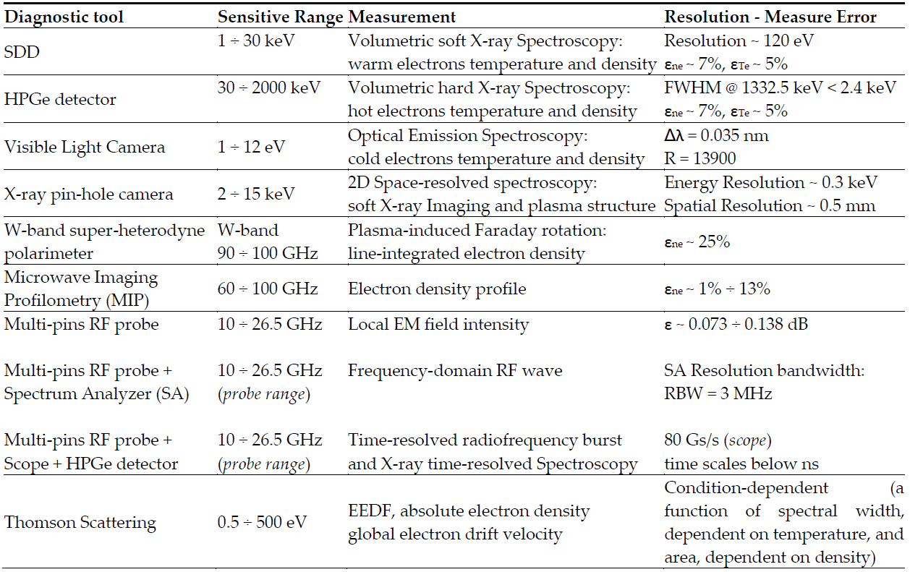
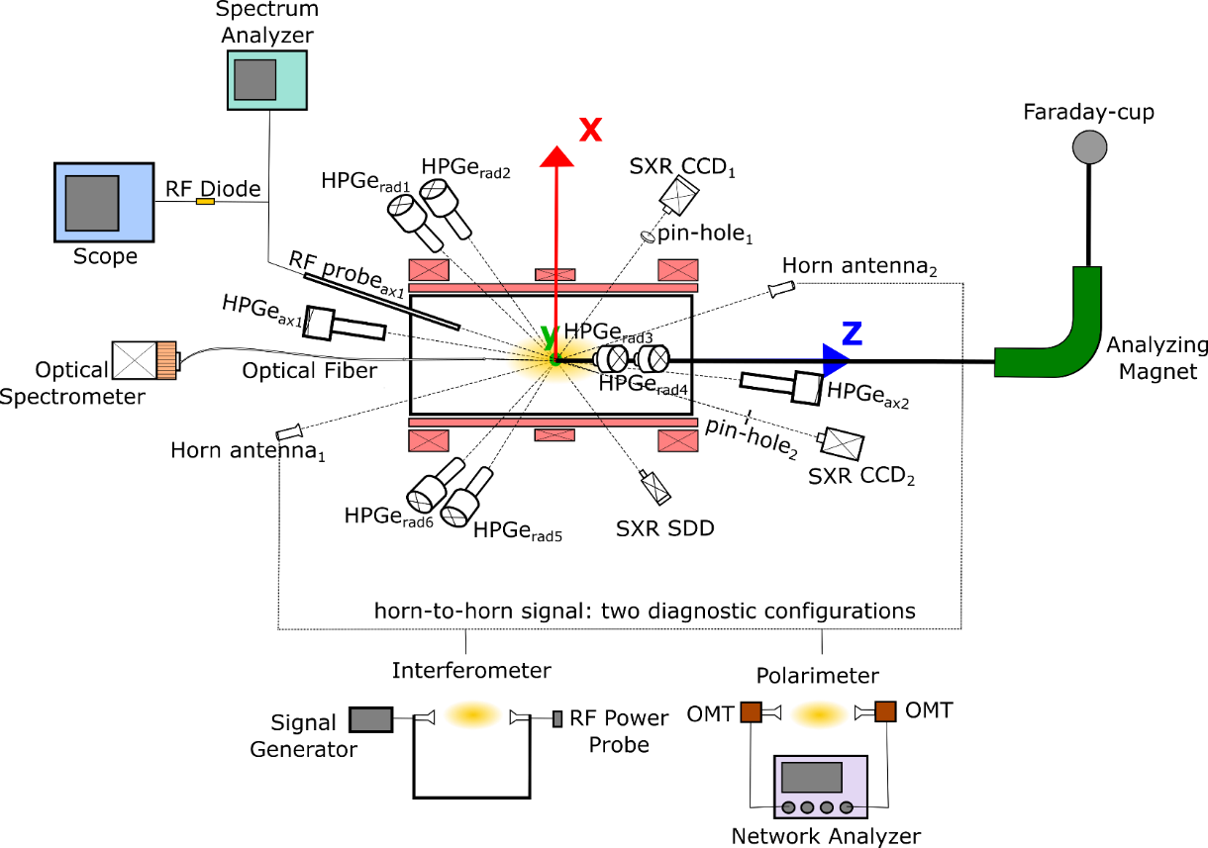
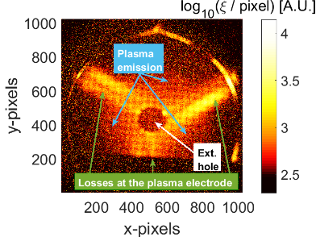
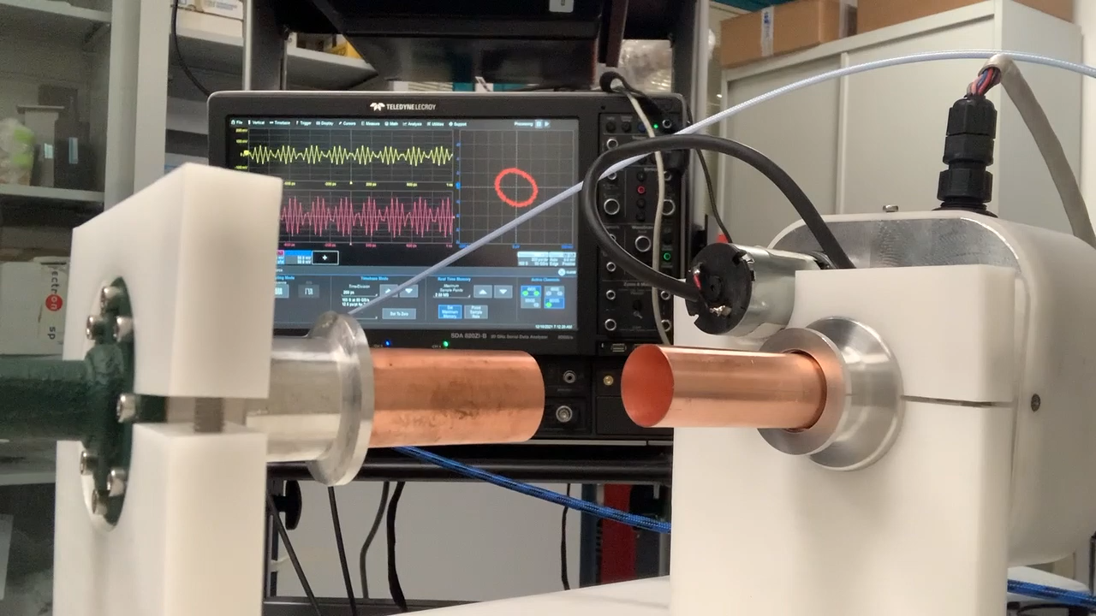

Experimental Setup – Multi-diagnostic System
PANDORA trap as facility for Nuclear Astrophysics studies
Online plasma multidiagnostic
High Resolution
Spectrally-resolved
X-ray Imaging
Polarimeter
E. Naselli et al., Journal of Instrumentation (JINST) 14, 2019, C1008

Slide 16
ECR Plasma Simulations: Pipeline
PIC SIMULATIONS FOR ELECTRONS
3D, steady-state maps of n_{e} and E_{e}
PIC-MC SIMULATIONS FOR PLASMA IONS
PIC-MC SIMULATIONS FOR ISOTOPE IONS
3D, steady-state maps of <Z> and n_{i}
3D, steady-state maps of <Z> and λ*
First level input to all codes and therefore precision needed
Observables: Soft X-ray spectroscopy, interferometry, polarimetry, profilometry, Thomson scattering
Second level input to in-plasma decay code
Observables: Faraday cup, optical emission spectroscopy, X-ray fluorescence
Observables: PANDORA

Slide 17


Particle-in-Cell Simulations
PIC is a technique to simulate plasma.
Self-consistent, steady-state solution
N macroparticles, each representing a certain number of real particles, are initialised and transported according to equations of motion
The simulation domain is divided into a grid, and particle trajectories leaves traces at grid points which leads to an occupation map
Occupation maps are scaled to density maps according to some physical law, and fields are calculated on grid points using FEM/FDM
(i-1,j-1)
(i-1,j)
(i-1,j+1)
(i-1,j-1)
(i-1,j)
(i-1,j+1)
(i-1,j-1)
(i-1,j)
(i-1,j+1)
(i,j-1)
(i,j)
(i,j+1)
(i,j-1)
(i,j)
(i,j+1)
(i,j-1)
(i,j)
(i,j+1)
(i+1,j-1)
(i+1,j)
(i+1,j+1)
(i+1,j-1)
(i+1,j)
(i+1,j+1)
(i+1,j-1)
(i+1,j)
(i+1,j+1)

Slide 18
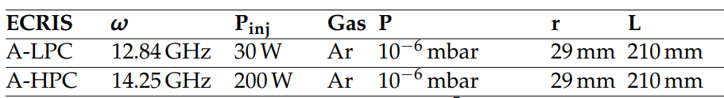
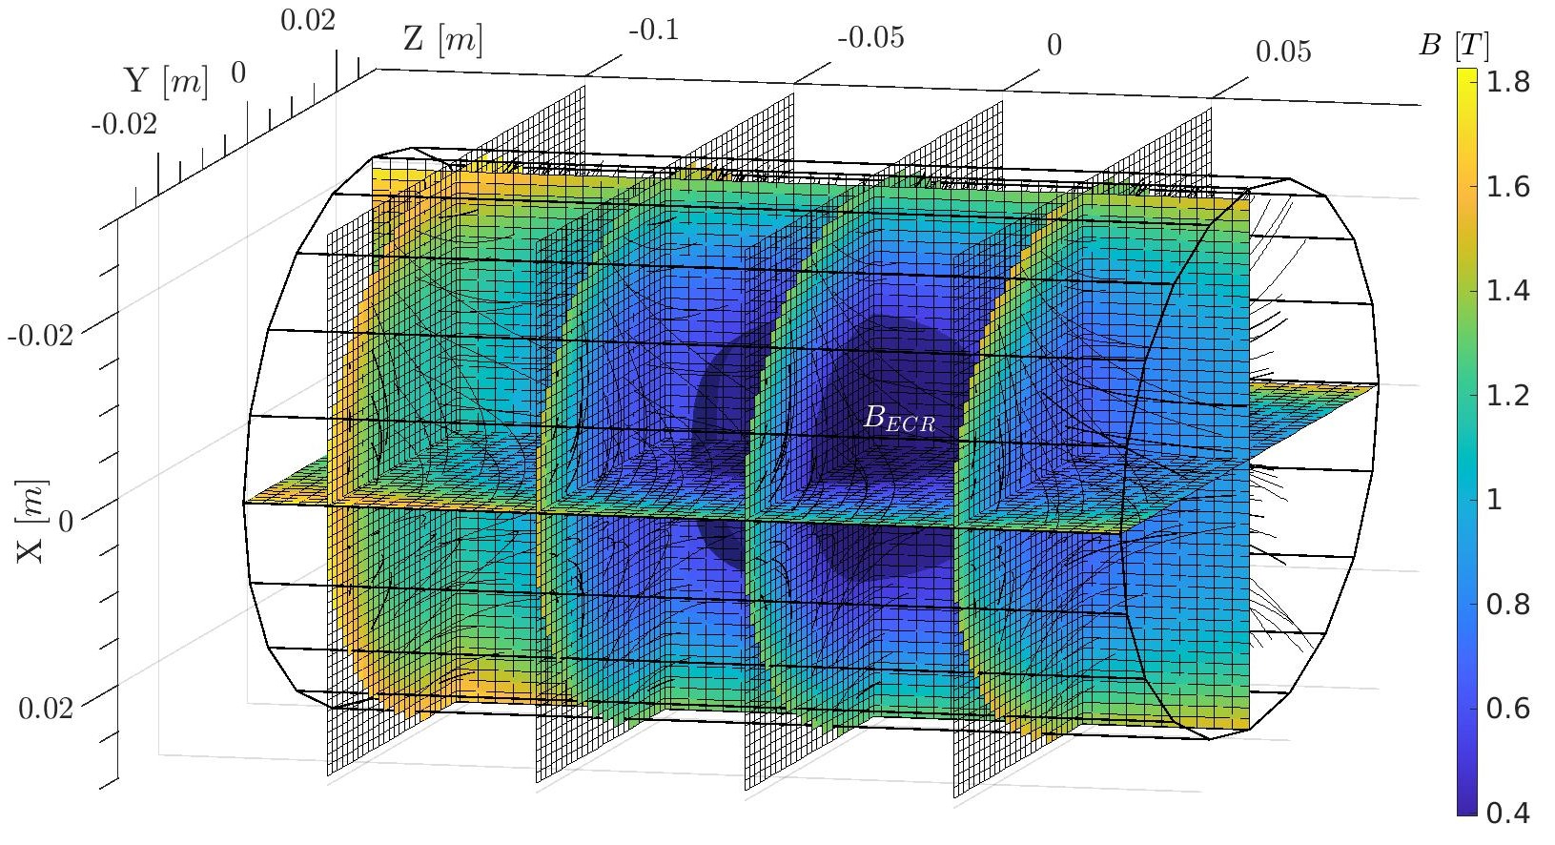
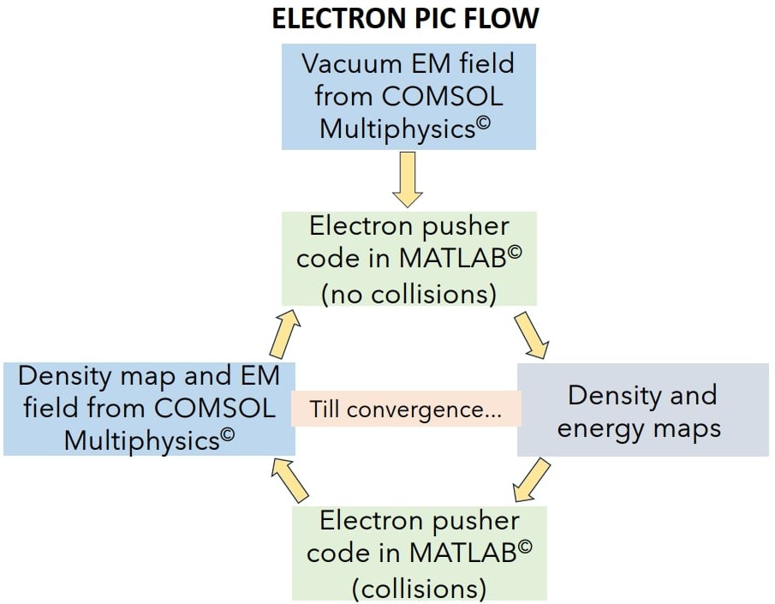
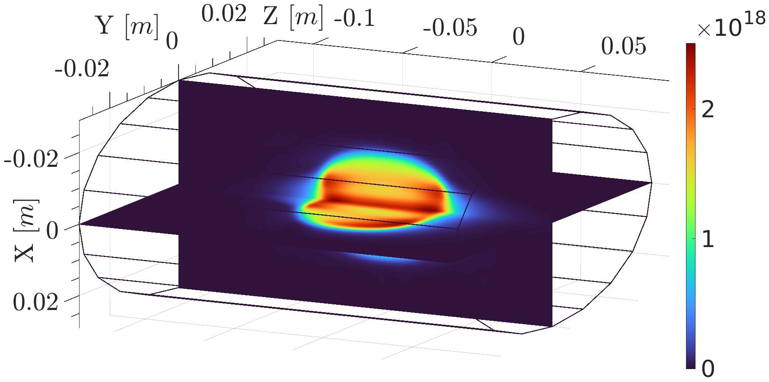
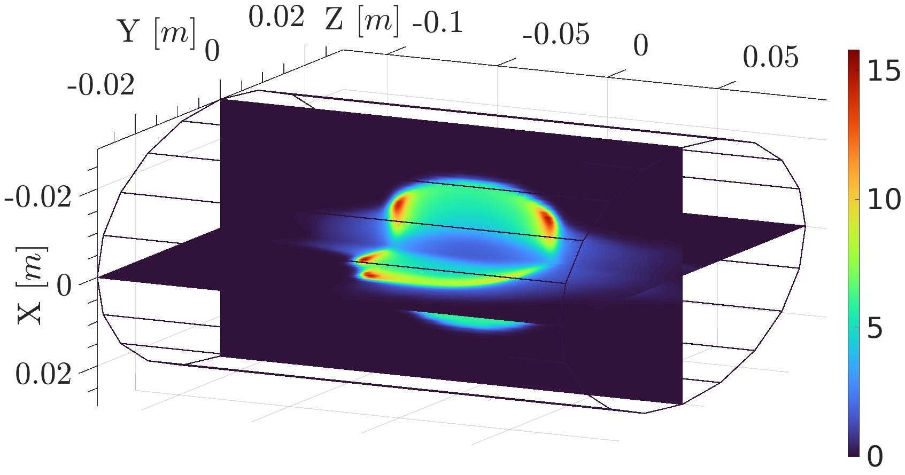
ECR Plasma Electron Simulations
PIC simulation for ECR plasma electrons
Description: Vlasov-Maxwell equation
Scaling: Plasma cutoff density
Self-consistency: Microwave EM field
D. Mascali, G. Torrisi et al , Eur. Phys. J. D. 69, 27 (2015)
G. Torrisi, D. Mascali et al, JEWA 28, 9 (2014)
A. Galatà et al, Front. Phys. 10, 947194 (2022)
R = 29 mm
B-field distribution in A-HPC ion source. The ellipsoidal surface nestled in the middle represents the ECR surface
L = 210 mm
Electron density n_{e} (m⁻³) and mean energy E_{e} (keV) maps for A-HPC obtained from PIC simulations.

Slide 19


ECR Plasma Ion Simulations
PIC simulations for ECR plasma ions:
Description: Vlasov-Maxwell equations + Balance equation
Scaling: Quasineutrality with electron density
Self-consistency: Electron density and energy maps
B. Mishra et al, Front. Phys. 10, 932448 (2022)
B. Mishra, EPJ WoC 275, 02001 (2023)
Ion Transport
Transport in EM fields under Lorentz force
Collisions by Fokker-Planck equation
MC Sampling
3 core modules
Electron impact ionization (EI)
Ion impact charge exchange (CEX)
Density Scaling
Iterative scaling of ion occupation map

Slide 20
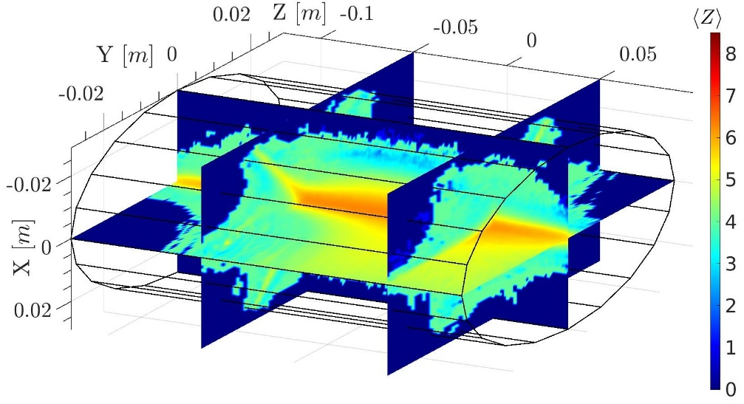
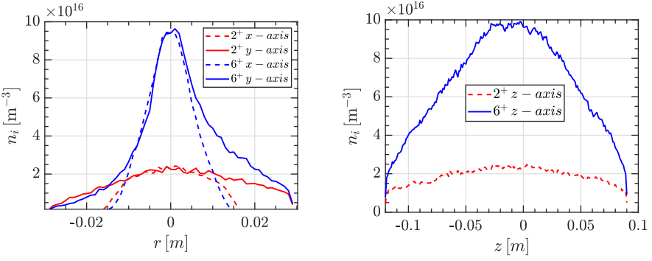
ECR Plasma Ion Simulations
Higher charge states tend to accumulate in the near-axis region
<Z> of argon plasma in A-HPC ECRIS as calculated using PIC-MC code
n_{i} of Ar²⁺ and Ar⁶⁺ in A-HPC ECRIS along the radius and axis in A-HPC

Slide 21



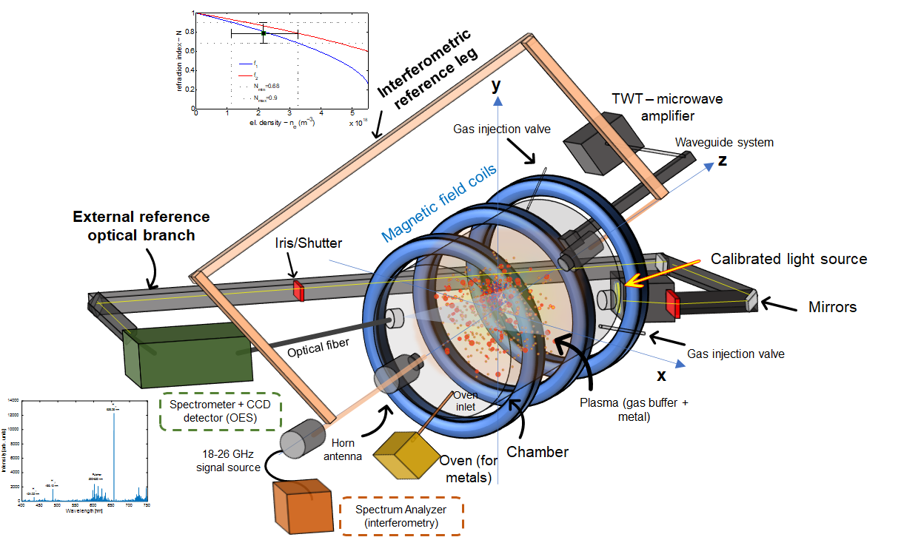






The PANDORA project – concept of spectroscopic plasma analysis
Hydrogen spectrum
Opacity direct measurement: TRANSMITTANCE
  $$H_{α}$$
RF power: from 40 W to 450 W
RF frequency: 3.76, 6.78 GHz
Gas pressure: 1 · 10⁻³ and 1 · 10⁻² mbar
Pidatella, A.,et al. Frontiers in Astronomy and Space Sciences, 10.3389/fspas.2022.931744 (2022)
  $$H_{γ}$$
  $$H_{β}$$
OES diagnostics
Profilometry/Secondary diagnostics
To be measured: independent measurements
Opacity of metal/buffer mixture: strongly dependent on density and temperature profile
angelo.pidatella@lns.infn.it

Slide 22
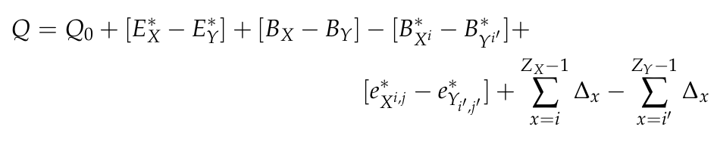

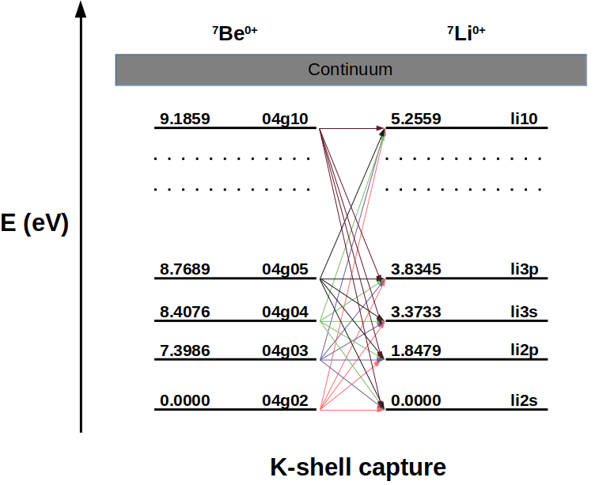
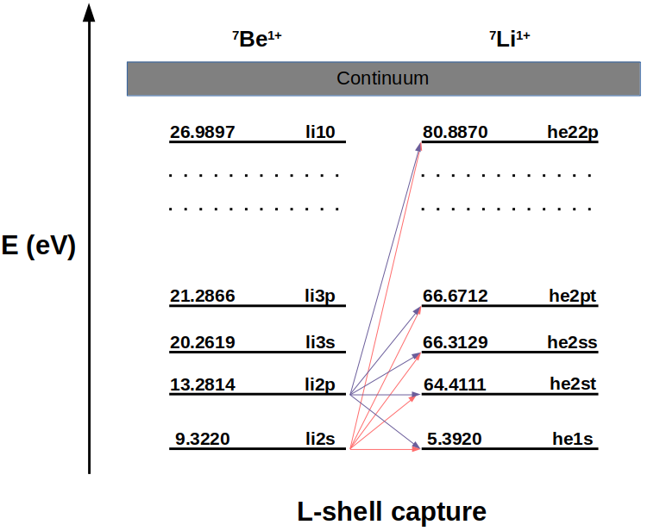
Orbital Electron Capture Decay in ⁷Be
Decay Energy
Average difference in excitation energy between parent and daughter ions
Atomic data (level index, energy and electronic configuration) taken from FLYCHK
H.-K. Chung, M.H. Chen, Y. Ralchenko et al, High Energy Density Phys. 1, 1 (2005)

Slide 23
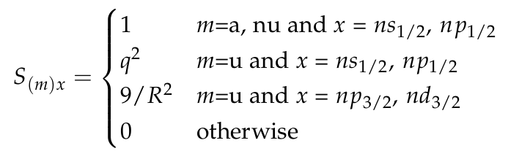
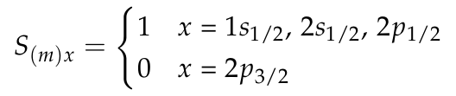

Orbital Electron Capture Decay in ⁷Be
Shape Factor
Shell Occupancy
σ_{x} describes the occupancy of an orbital. In order to capture orbital electrons, the occupancy should be non-zero.
On ionising the atom, the number of electrons available in a shell decreases, and the capture phase volume decreases. Consequently, the EC decay rate goes down. Inversely, bound state decay rates increase because

Slide 24
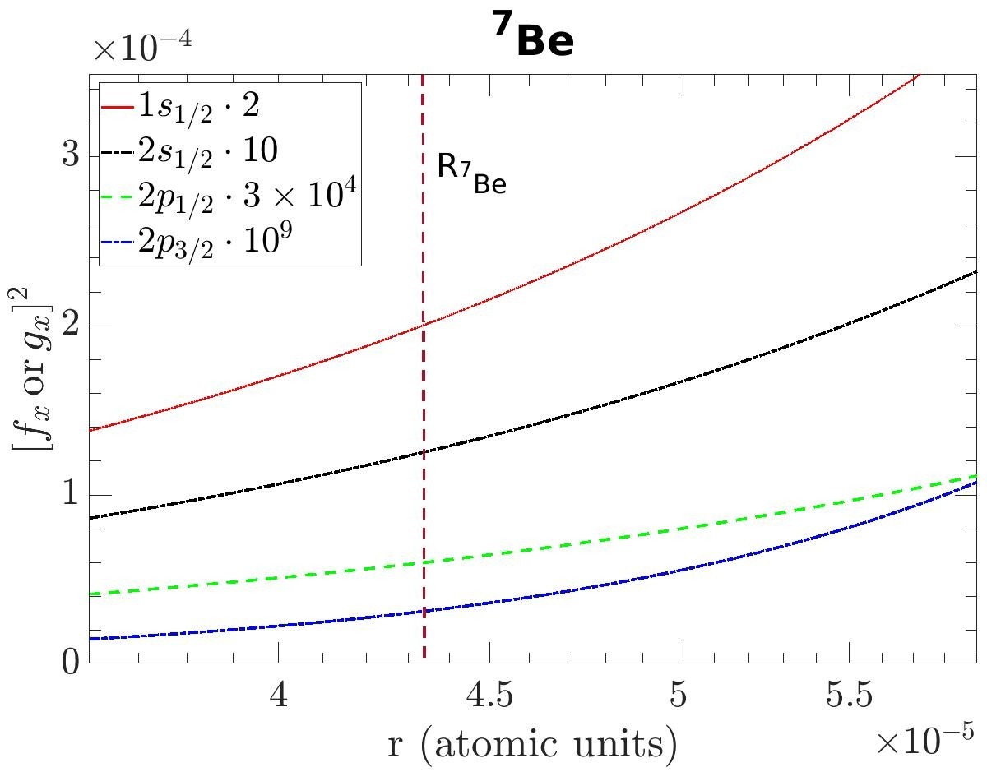
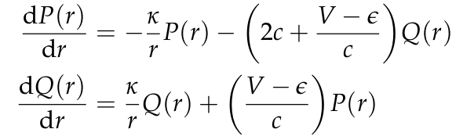
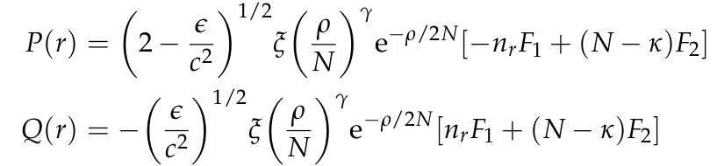
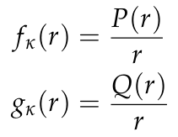
Orbital Electron Capture Decay in ⁷Be
Radial Wavefunctions
The radial wavefunctions describe the degree of overlap between the atomic orbitals and the nuclear surface. The wavefunctions are obtained by solving the Dirac equation in the central Coulomb field
V.M. Burke and I.P Grant, Proc. Phys. Soc.90, 297 (1967)
Electrons from inner orbitals are more likely to be captured as compared to outer orbitals whose contribution decreases rapidly

