Slide 1
Nucleosynthetic Yields from realistic neutrino-driven explosions of 1D core-collapse supernovae
Luca Boccioli^{(*)},
Lorenzo Roberti, Marco Loddo, Sangeeta Kumar,
Evan O’Connor, David Vartanyan, Daniel Kasen, Giacomo Fragione, Marco Limongi, Alessandro Chieffi, Grant Mathews
s, i & r Element Nucleosynthesis
(sirEN) Conference
June 13th 2025
(*) = lbocciol@berkeley.edu

Slide 2
The life cycle of a massive star
Output
Light Curves
Microphysics
(ν interactions)
Nucleosynthesis
Input
Spectra
ZAMS
mass
Supernova
engine
Stellar evolution
Remnant Masses
z
Explosion Energy
binarity
Microphysics
(EOS)
ν signal
rotation
…
B

Slide 3
The life cycle of a massive star
Output
Large uncertainties
Light Curves
Microphysics
(ν interactions)
3D
Nucleosynthesis
Input
Spectra
ZAMS
mass
Supernova
engine
Stellar evolution
Remnant Masses
z
Explosion Energy
binarity
Microphysics
(EOS)
ν signal
rotation
…
B
Small(-ish) uncertainties

Slide 4
The life cycle of a massive star
Output
Large uncertainties
Light Curves
Microphysics
(ν interactions)
3D
Nucleosynthesis
Input
1D
+
Spectra
ZAMS
mass
Supernova
engine
Stellar evolution
Remnant Masses
z
Explosion Energy
binarity
Microphysics
(EOS)
ν signal
rotation
…
B
Large(-ish) uncertainties

Slide 5
The life cycle of a massive star
Output
SkyNet
Light Curves
Microphysics
(ν interactions)
3D
Nucleosynthesis
Input
1D
+
Spectra
ZAMS
mass
Supernova
engine
Stellar evolution
Remnant Masses
z
Explosion Energy
Microphysics
(EOS)
ν signal
In this talk I will be focusing on the Nucleosynthesis and Explosion properties of 3 different sets of progenitors
…

Slide 6
A compromise between 1D and 3D: 1D+ simulations
I will be using a version of STIR (Couch 2020) that was implemented (Boccioli 2021) in GR1D+ ^{(*)}.
STIR adds the turbulent energy ρ$v_{turb}^{2}$ to the overall energy budget.
Calibration
to 3D simulations
Turbulent contributions
(*) https://github.com/evanoconnor/GR1D (O’Connor 2010, 2015)

Slide 7
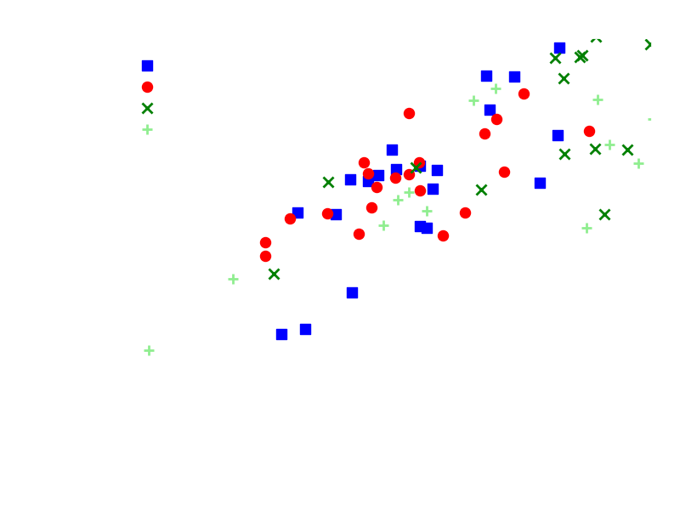
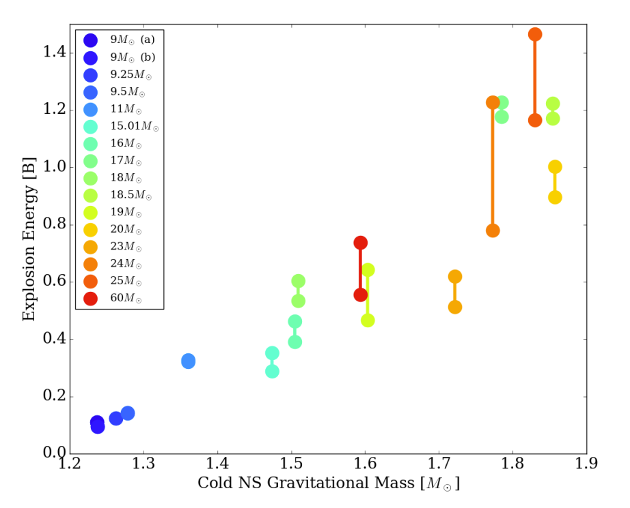
Explosion Energies
Comparison to 3D simulations
Burrows et al. (2024)
3D simulations
KEPLER (Sukhbold 2016,2018)
F23: MESA (Farmer et al. 2023)
LC18: FRANEC (Limongi & Chieffi 2018)
WH07: KEPLER (Woosley & Heger 2007)

Slide 8
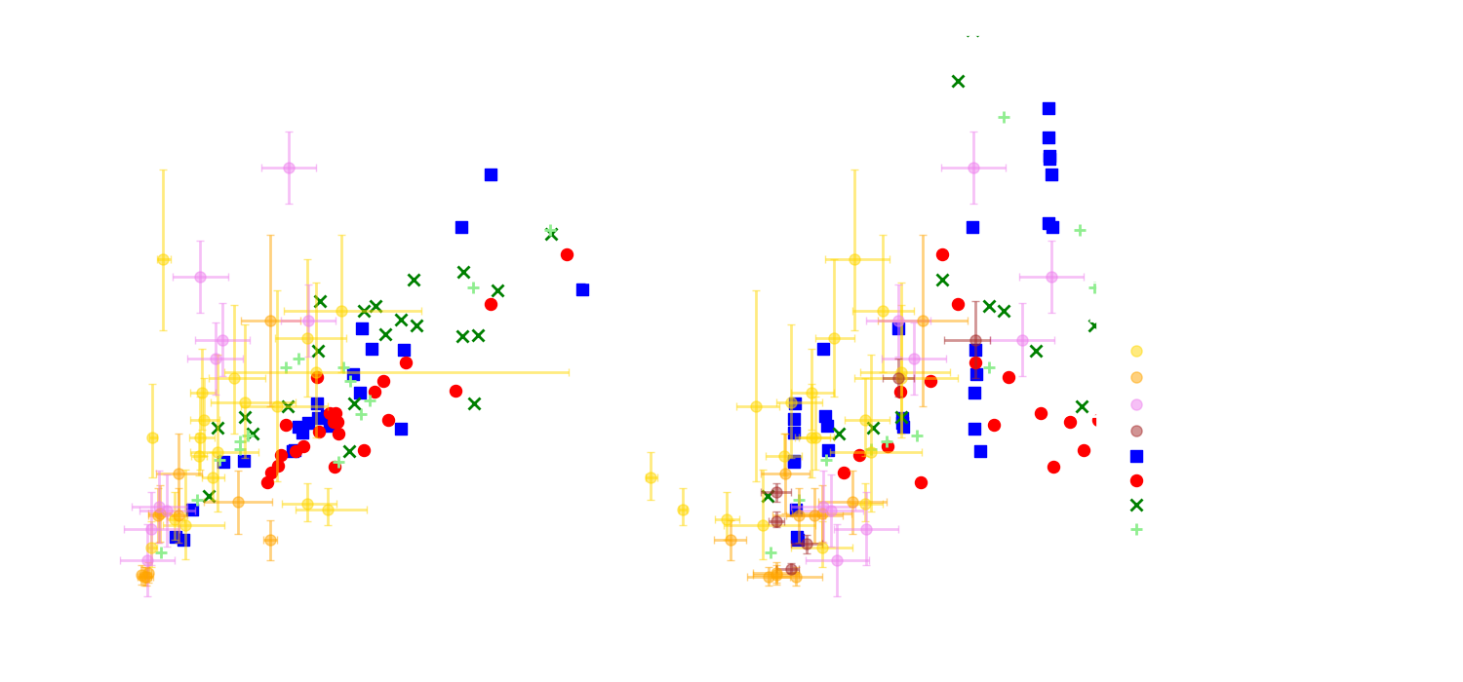
Explosion Energies
Comparison to Observations (kind of!)

Slide 9
Explodability
Impact of Stellar Evolution Uncertainties
KEPLER from Woosley & Heger (2007) solar metallicity,
evolved coupled with 19 isotopes + 128-QSE during Si-burning, post(co)-processed with 1500 isotopes
FRANEC from Limongi & Chieffi (2018),
4 different metallicities, 3 different rotations, evolved with coupled network with 335 isotopes.

Slide 10
Explodability
Impact of Stellar Evolution Uncertainties
MESA from Farmer et al. (2023), solar metallicity,
single and binary-stripped stars evolved coupled with 162 isotopes
Which stars explode and which ones do not directly impacts the population of remnants
and the chemical enrichment of the Interstellar Medium

Slide 11
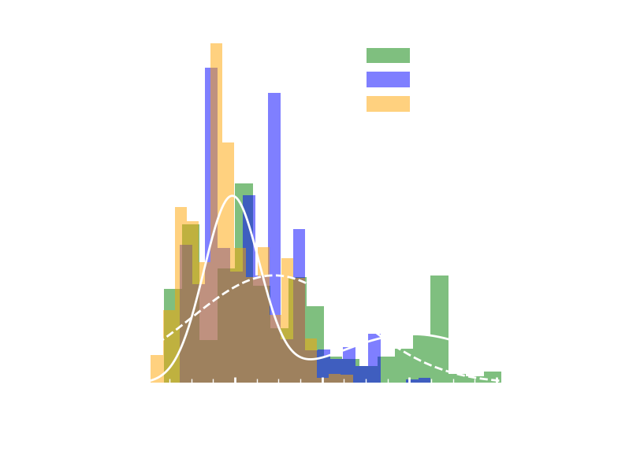
Explodability
How does it affect Remnant Masses?
Neutron Star Birth Mass Distribution
for different explodabilities
(PUSH, S16, and STIR)
Chandrasekhar Mass Distribution
Boccioli & Fragione (2024), but also see Boccioli et al. (2025)

Slide 12
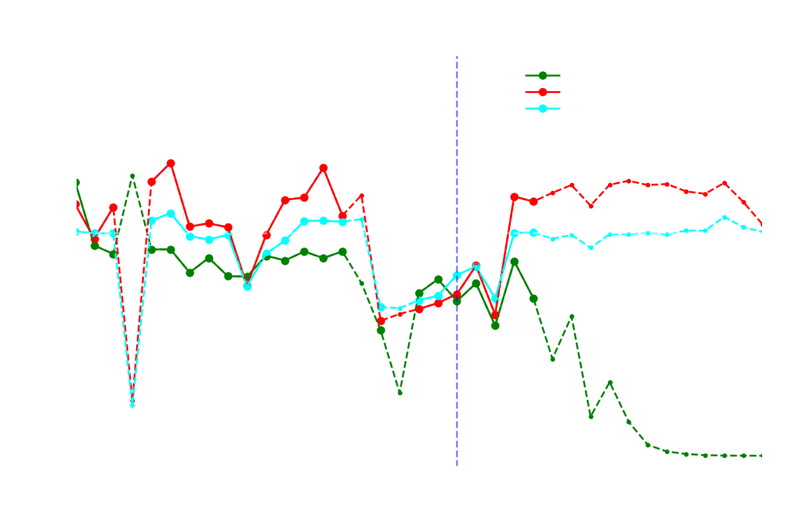
Small Dots/Dashed Lines =
$$Y_{This Work}< {10}^{−7}$$
Nucleosynthesis Yields
Comparison to previous work: KEPLER WH07 (piston) and PUSH (ν-driven), REACLIB
Piston
Different Explodability,
Different Explosion Energy,
Different Mass Cut
Piston + My Explodability
Same Explodability,
Different Explosion Energy,
Different Mass Cut
PUSH
Different Explodability,
Similar Explosion Energy,
Different Mass Cut
Preliminary

Slide 13
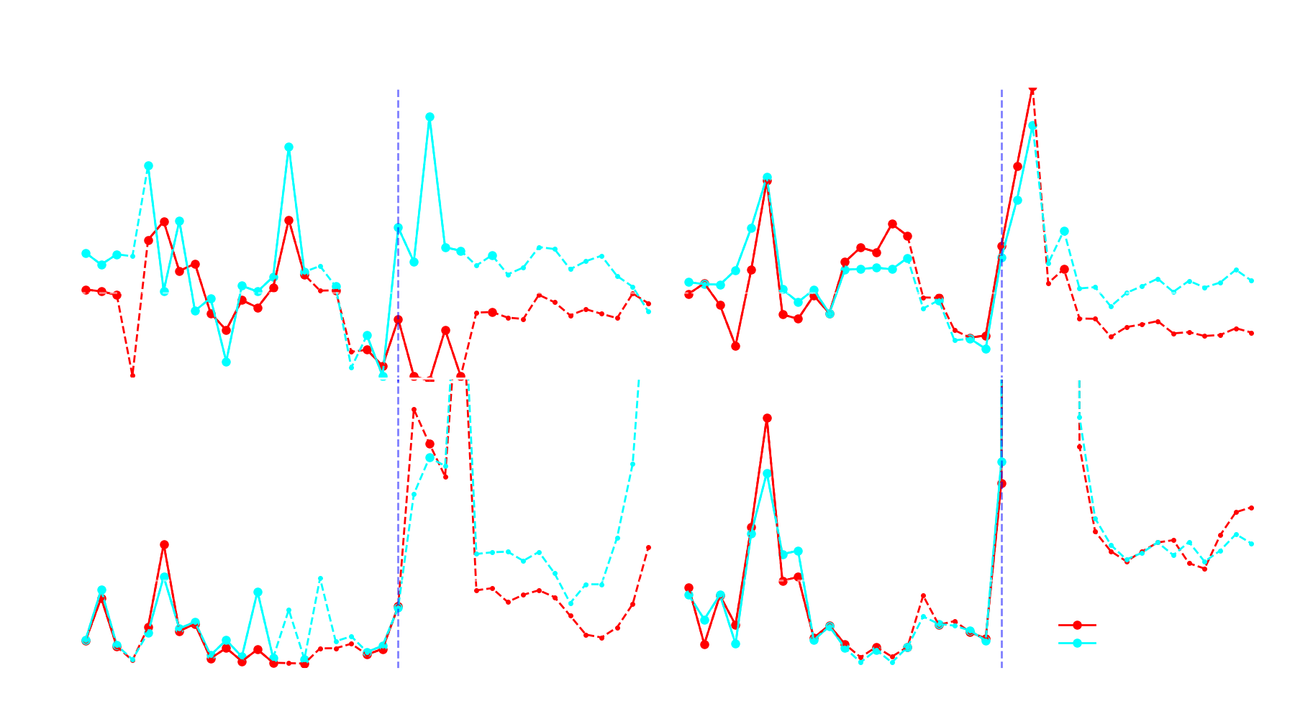
Small Dots/Dashed Lines =
$$Y_{This Work}< {10}^{−7}$$
Nucleosynthesis Yields
Comparison to previous work: FRANEC LC18 (bomb), STARLIB
LC18 force the bomb to eject exactly 0.07 $M_{Ꙩ}$ of Nichel.
Bomb therefore launches a stronger shock at a different mass cut!
Preliminary
Higher temperature
Different
Nucleosynthesis

Slide 14
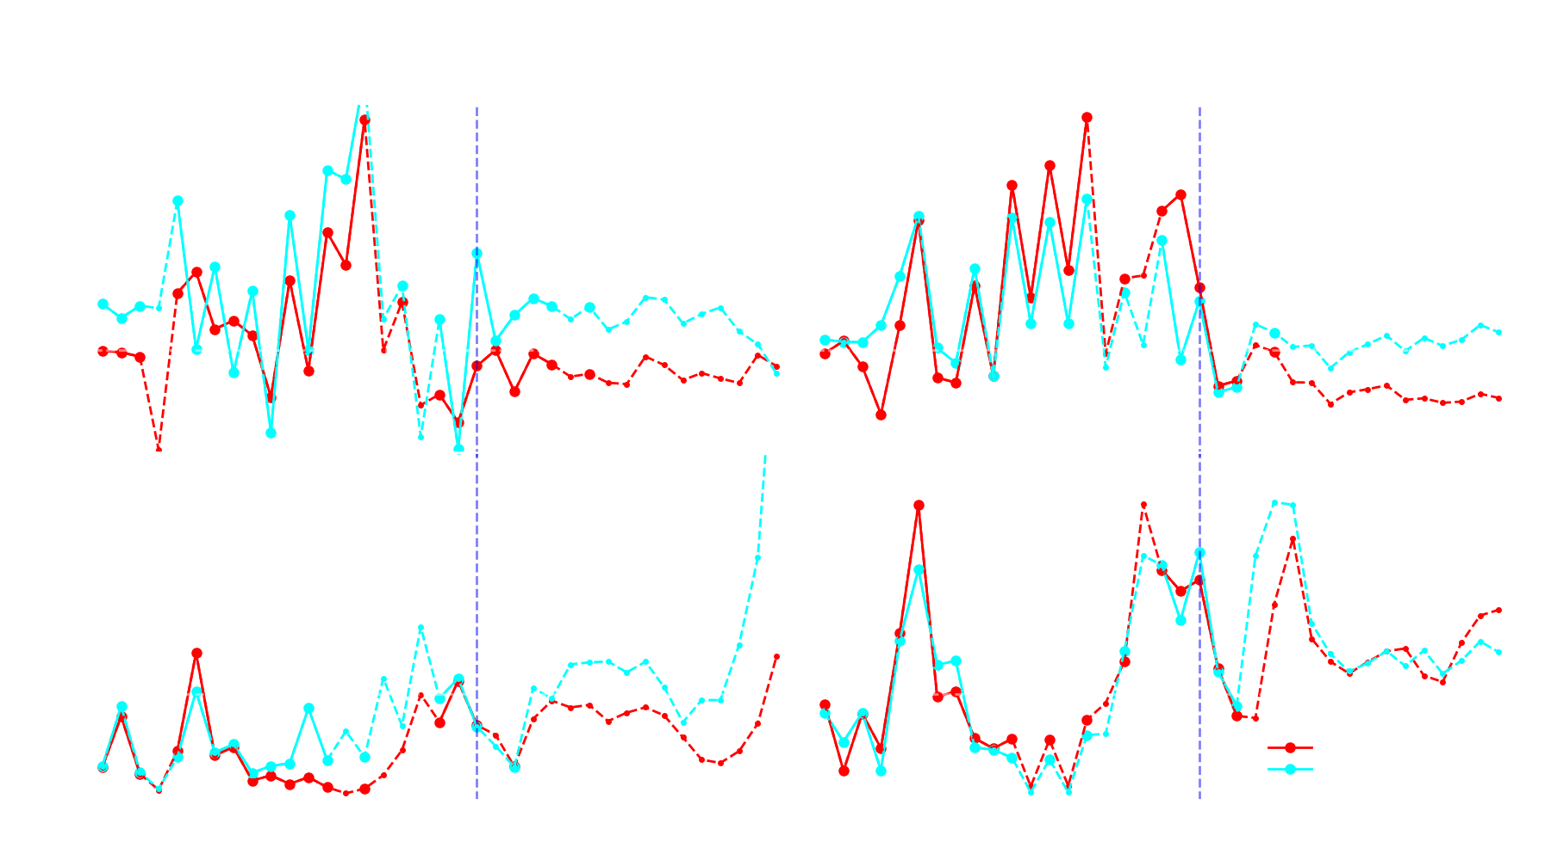
Small Dots/Dashed Lines =
$$Y_{This Work}< {10}^{−7}$$
Nucleosynthesis Yields
Comparison to previous work: FRANEC LC18 (bomb + mixing&fallback), STARLIB
LC18 force the bomb to eject exactly 0.07 $M_{Ꙩ}$ of Nichel.
Bomb therefore launches a stronger shock at a different mass cut!
Preliminary
Higher temperature
Different
Nucleosynthesis

Slide 15
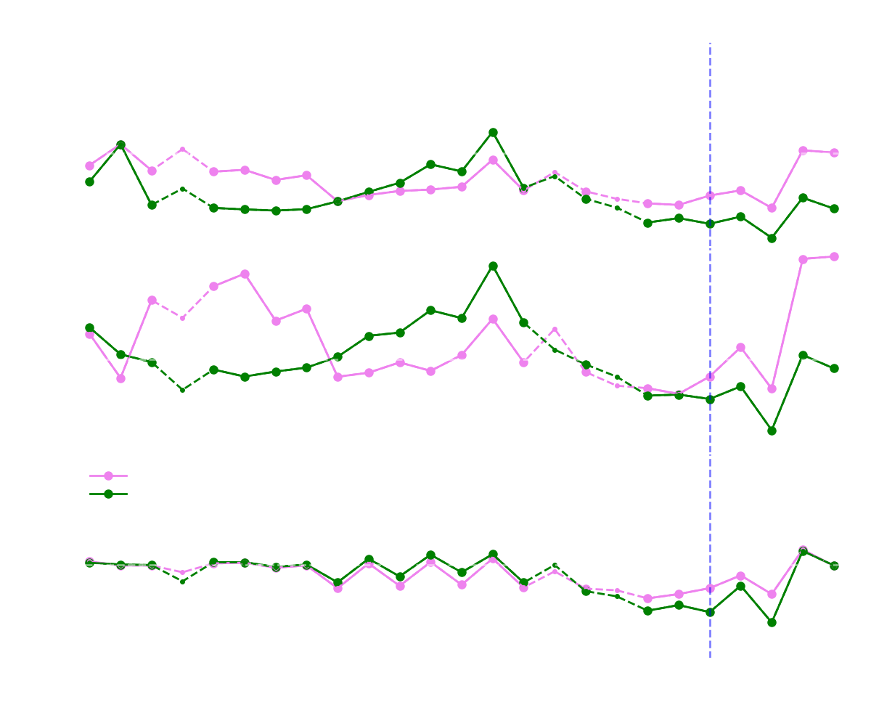
Small Dots/Dashed Lines =
$$Y_{This Work}< {10}^{−7}$$
Nucleosynthesis Yields
Comparison to previous work: MESA F23 (bomb), REACLIB
Everything
Explodes
F23 place a 1 FOE bomb at s = 4
(Si/O interface)
Explodability from
Ertl et al. (2016)
In the last panel, single and binary stars show similar behavior
Because only the Fe-core structure matters for any explosion signature!
Preliminary
Explodability from
Boccioli et al. (2023,2024)

Slide 16
CO-Mergers: a site of titanium production
Stars that experienced a Carbon-Oxygen Shell Merger
CO merger: a few hours before collapse Carbon and Oxygen shells can merge, causing mixing and nuclear burning
In a CO merger, ²⁰Ne is destroyed and ³²S and ⁴⁴Ti are produced

Slide 17
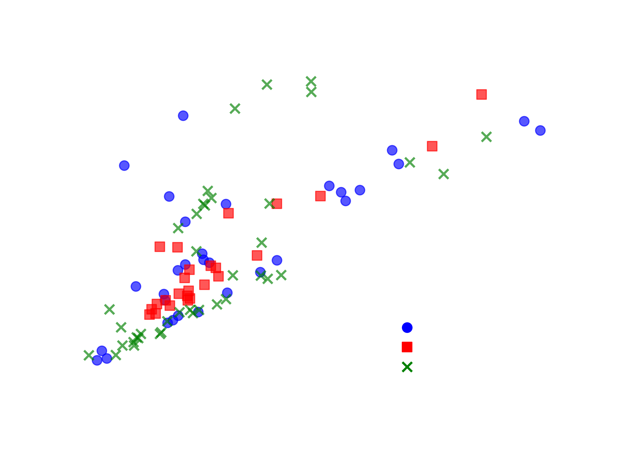
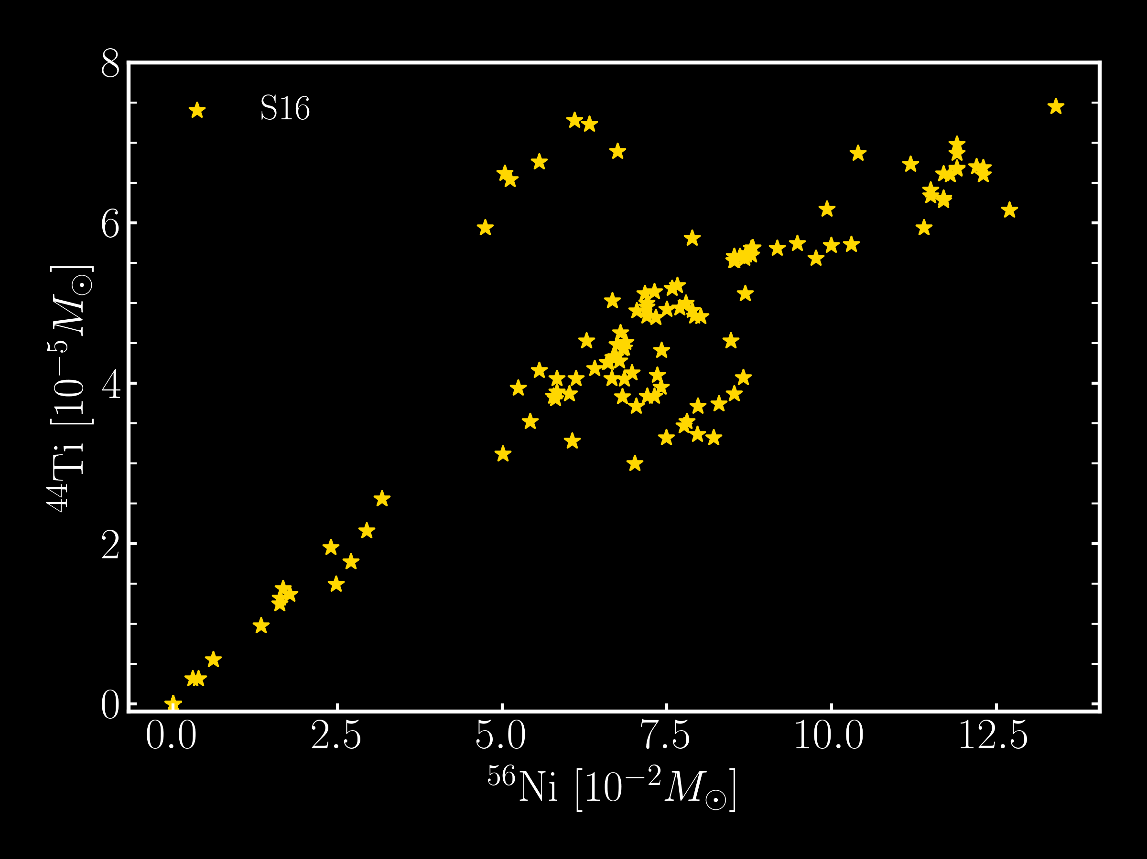
CO-Mergers: a site of titanium production
This work
Sukhbold et al. (2016)
CO-Mergers can produce a significant (factor of 2-3 larger) amount of titanium, and are present in published models!

Slide 18
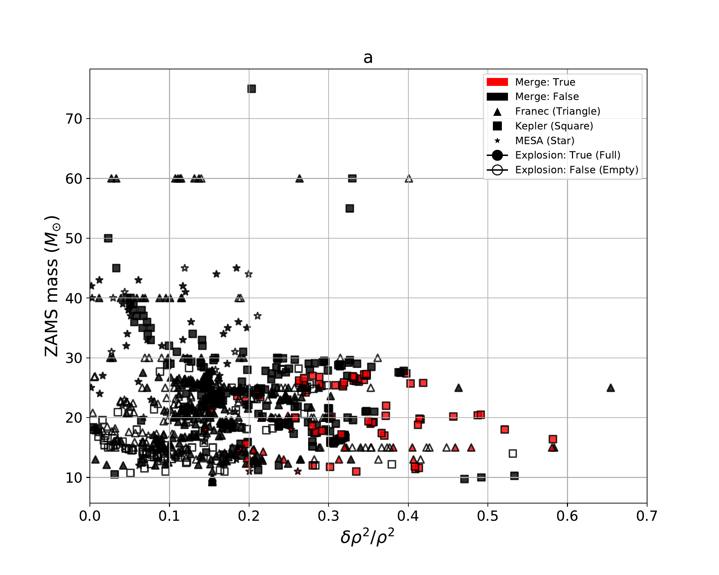
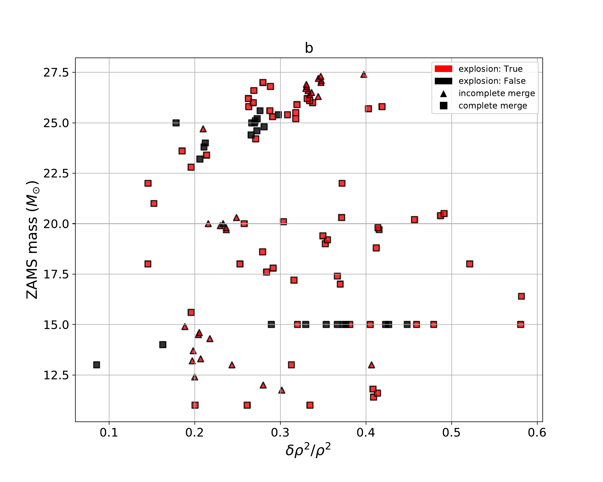
Explodability
Do CO-Merger progenitors explode? (Yes!)
Complete Set of 850 Models
Red = Merger, Black = No Merger
Subset: Only Mergers
Red = Explosion, Black = No Explosion
More Explodable (see Boccioli 2023)
From Marco Loddo’s Master’s Thesis (2025)

Slide 19
Conclusions
Contrary to what one might naively think, 1D+ explosion give explosion energies and Nichel masses comparable to 3D and Observations
Explodability is extremely important to determine observables like Remnant Masses and Nucleosynthesis Yields
Neutrino-driven explosions give moderately to significantly different yields compared to the simpler, more traditional bomb and piston explosions
CO merger have distinct nucleosynthesis signatures. They can produce high amounts of ⁴⁴Ti and odd-Z elements. Therefore, fine mass grids of detailed stellar evolution models are required to fully understand their impact on nucleosynthesis.

Slide 20
Backup Slides

Slide 21
A compromise between 1D and 3D: 1D+ simulations
I will be using a version of STIR (Couch 2020) that was implemented (Boccioli 2021) in GR1D ^{(*)}.
STIR evolves an additional quantity: the turbulent energy ρ$v_{turb}^{2}$
Calibration
to 3D simulations
Buoyancy
Shear
Dissipation
(*) https://github.com/evanoconnor/GR1D (O’Connor 2010, 2015)

Slide 22
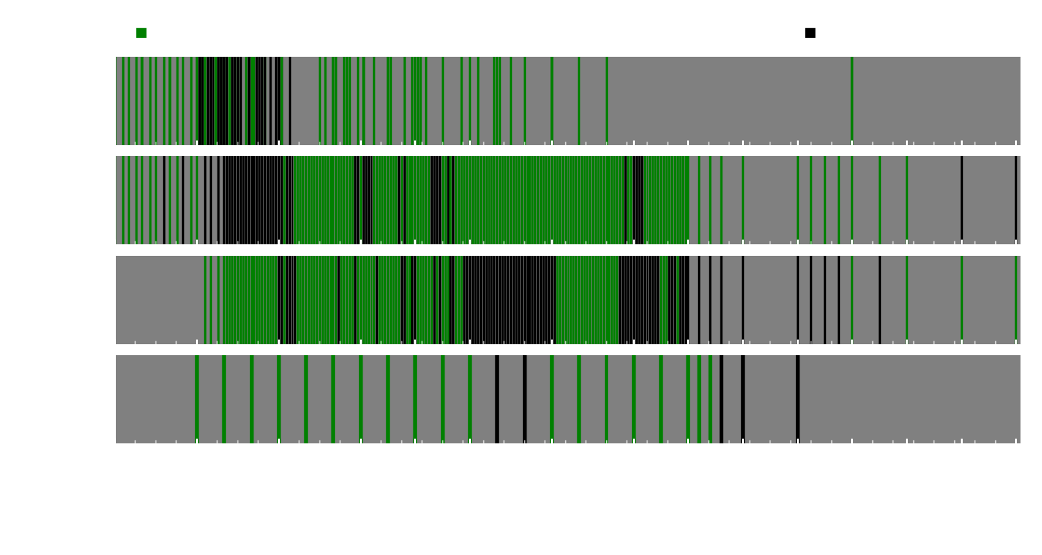
1D vs. 1D+ vs. Multi-D
KEPLER progenitors
= ξ_{2.0} ≥ 0.5
Wang et al. (2022)
Boccioli et al. (2023)
Sukhbold et al. (2016)
Ertl et al. (2016)
Perego (2015)
Ghosh et al. (2022)
Large discrepancies in explodability

Slide 23
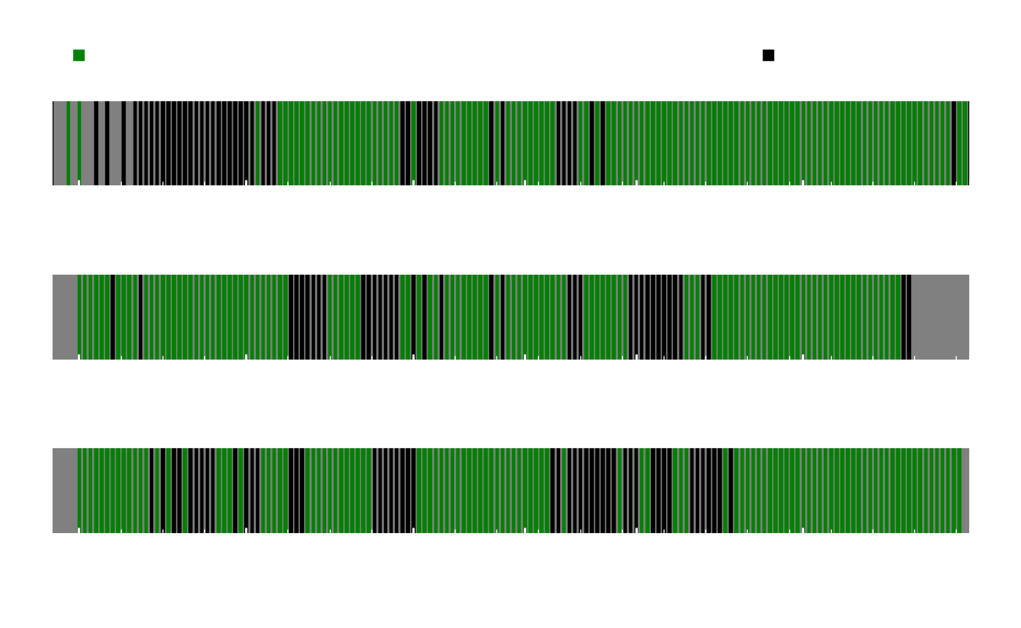
Warning: Uncertainties in Stellar Evolution Propagate!

Slide 24
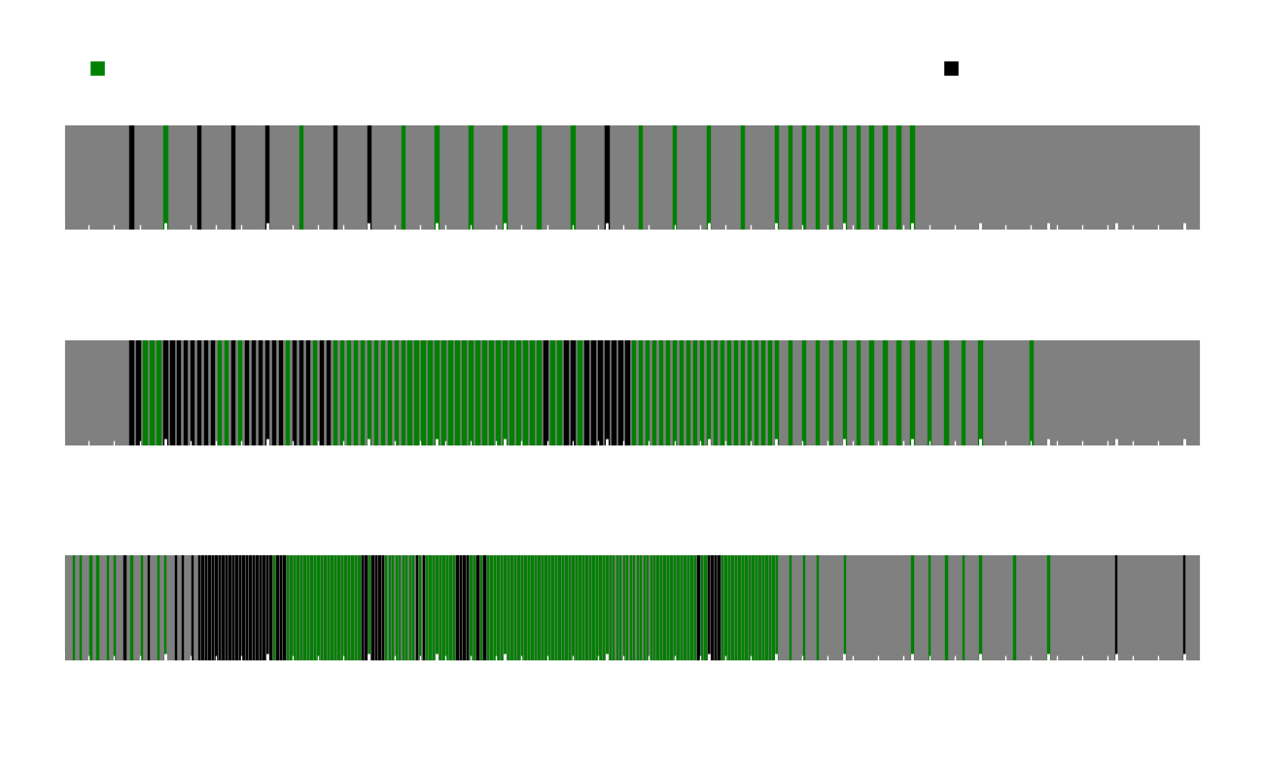
Warning: ZAMS mass is not a good predictor of explosion

Slide 25
How to use 1D+ simulations to predict remnant masses
arXiv: 2404.05927

Slide 26
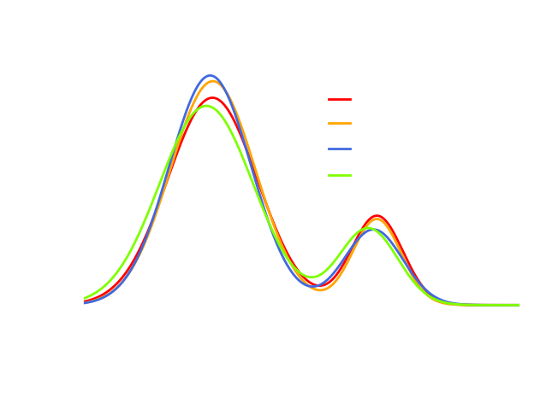
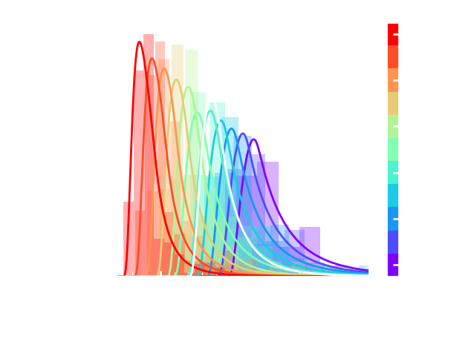
Remnant Mass distributions: 1D+ compared to predictions
Combined Metallicities where IMF $∝$ $M^{−2.35}$
$$M_{BH}=M_{final}−f_{ej}M_{H}$$
Neutron Star Birth Mass Distribution
Black Hole Mass Distribution

Slide 27
Fits for the Neutron Star Mass
Compactness ξ-fit
M_{Si/O}-fit
M_{Ch}-fit
(*) caveat = no good way to treat early and late-time fallback. Conservatively, these are lower-limits for the NS mass, although fallback is estimated to be relatively small (< 0.1 $M_{ꙩ}$)
Boccioli & Fragione (2024)

