Slide 1
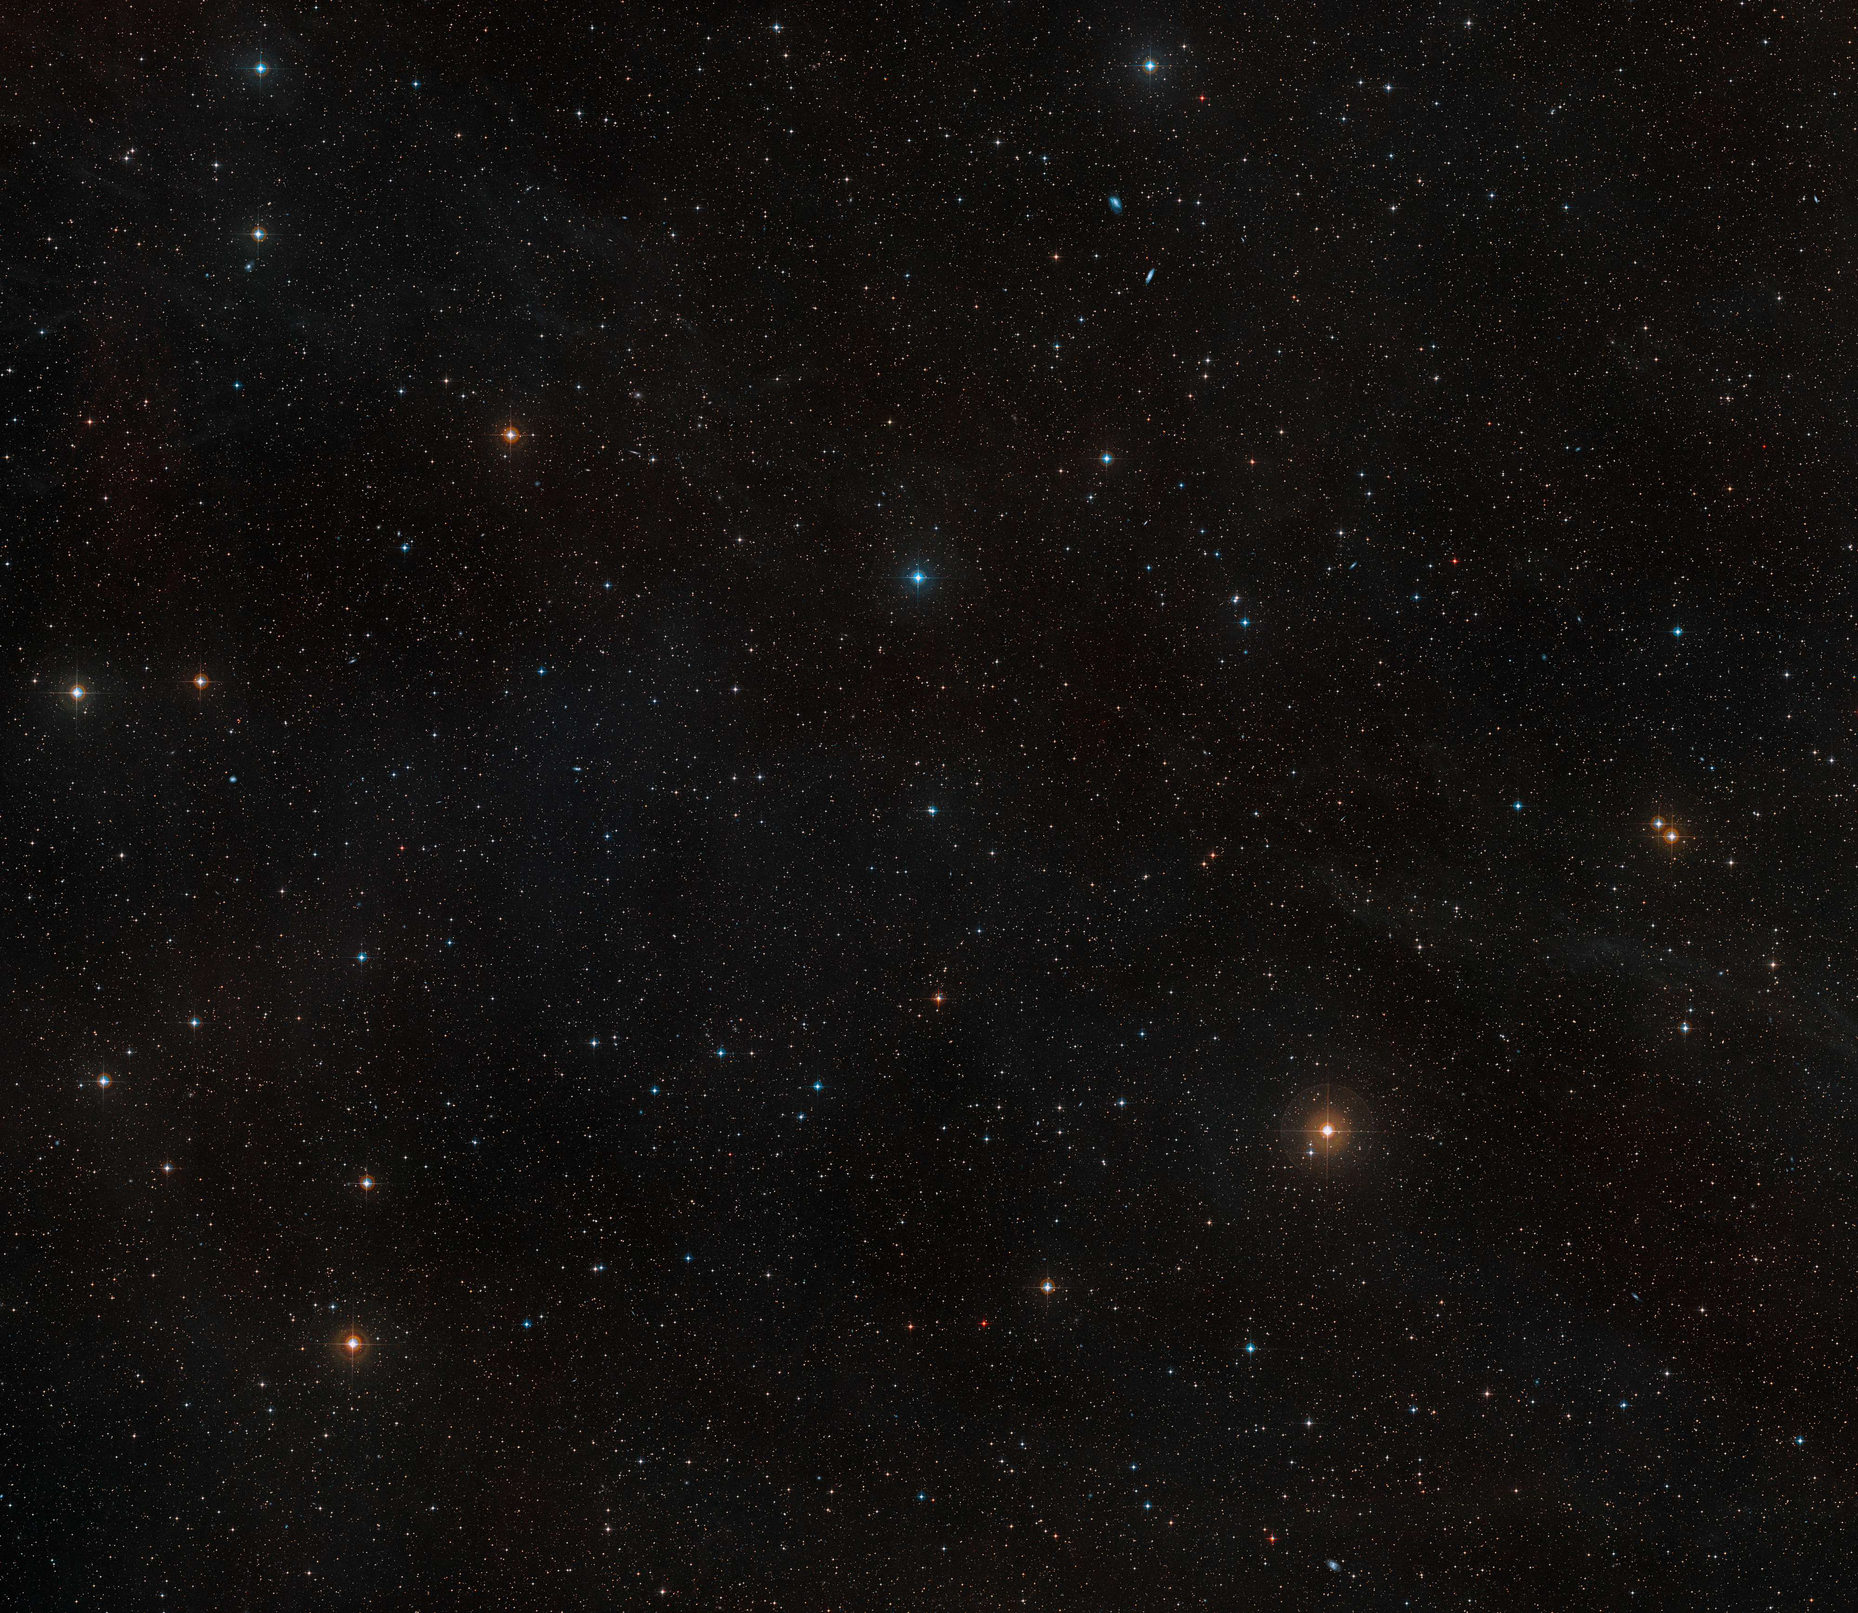
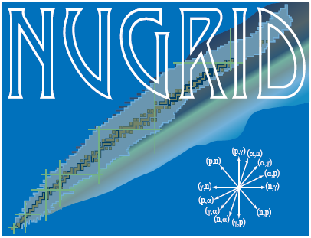




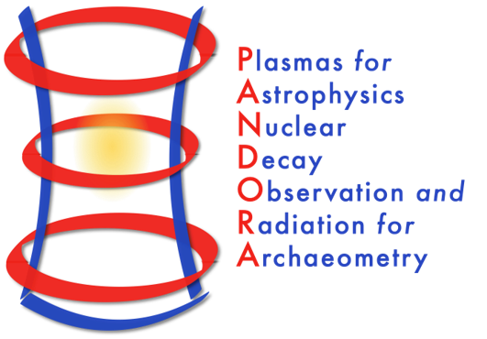
The Role of Carbon-Oxygen Shell Interactions in the Nucleosynthesis and Final Fate of Massive Stars
s, i & r Element Nucleosynthesis (sirEN) Conference
Giulianova, June 18, 2025
Lorenzo Roberti, INFN – Laboratori Nazionali del Sud, Catania, Italy

Slide 2
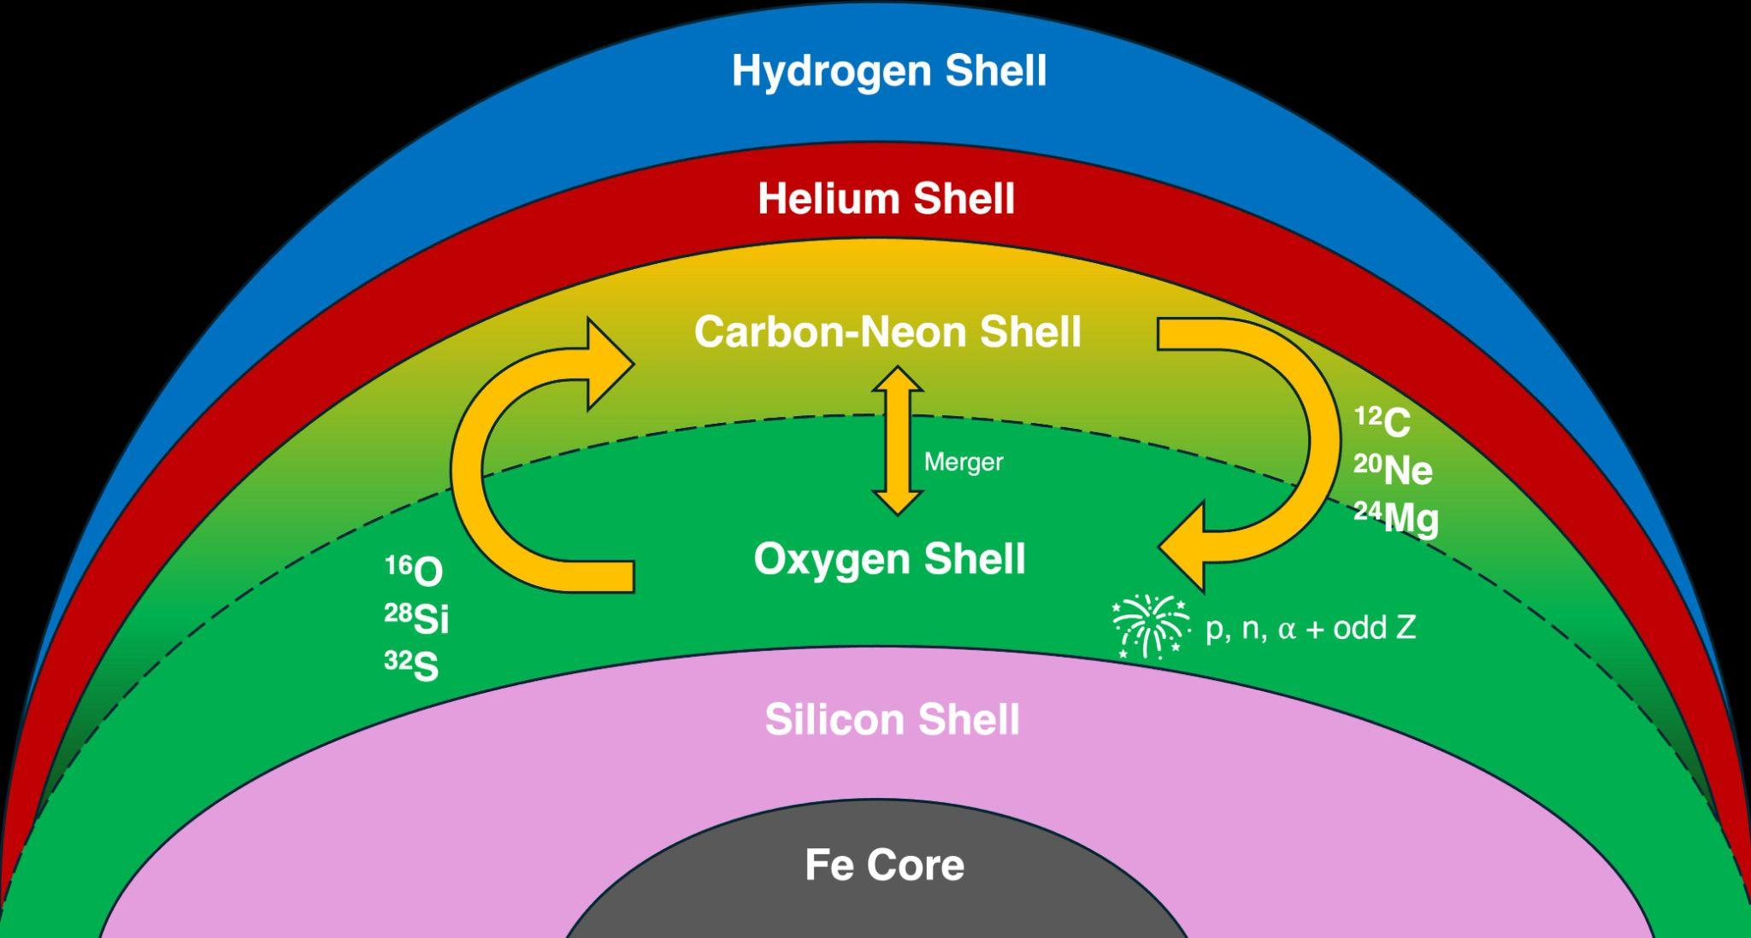

Carbon-oxygen shell mergers in massive stars
Ingestion of some C (and Ne) in the O burning shell during late stages of the evolution;
Formation of an extended (both in mass and radius) mixed convective zone;
Peculiar nucleosynthesis and impact on the explodability;
Found often in 1D stellar models with M_{ini}$≤$25 M$⊙$.

Slide 3
Nucleosynthesis in a C-O shell merger
Enhanced O-burning products and production of odd-Z elements (P, Cl, K, Sc);
Efficient photodisintegration of heavy elements: production of the weak s-process and 𝜸-process nuclei.

Slide 4
Nucleosynthesis in a C-O shell merger
Enhanced O-burning products and production of odd-Z elements (P, Cl, K, Sc);
Efficient photodisintegration of heavy elements: production of the weak s-process and 𝜸-process nuclei.

Slide 5


Stellar models and explosions
Scientific case: 15 $M_{⨀}$ at [Fe/H]=$−5$, with initial equatorial velocity v_{ini}=600 km s⁻¹;
Calculated with the FRANEC (stellar evolution) and HYPERION (ccsn explosion) codes;
Published in Roberti, Limongi, & Chieffi, 2024, ApJS, 270,28 to study the s-process in rotating massive stars at low metallicity.

Slide 6
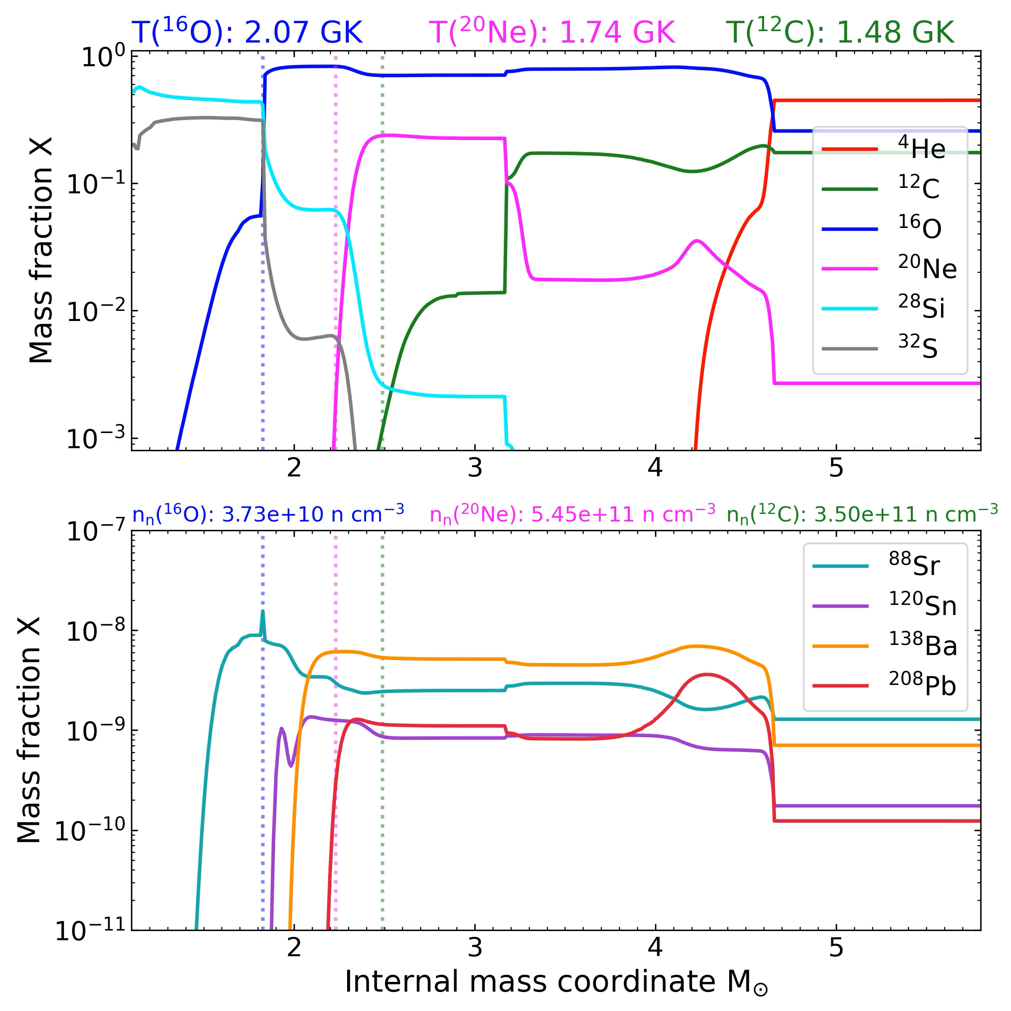
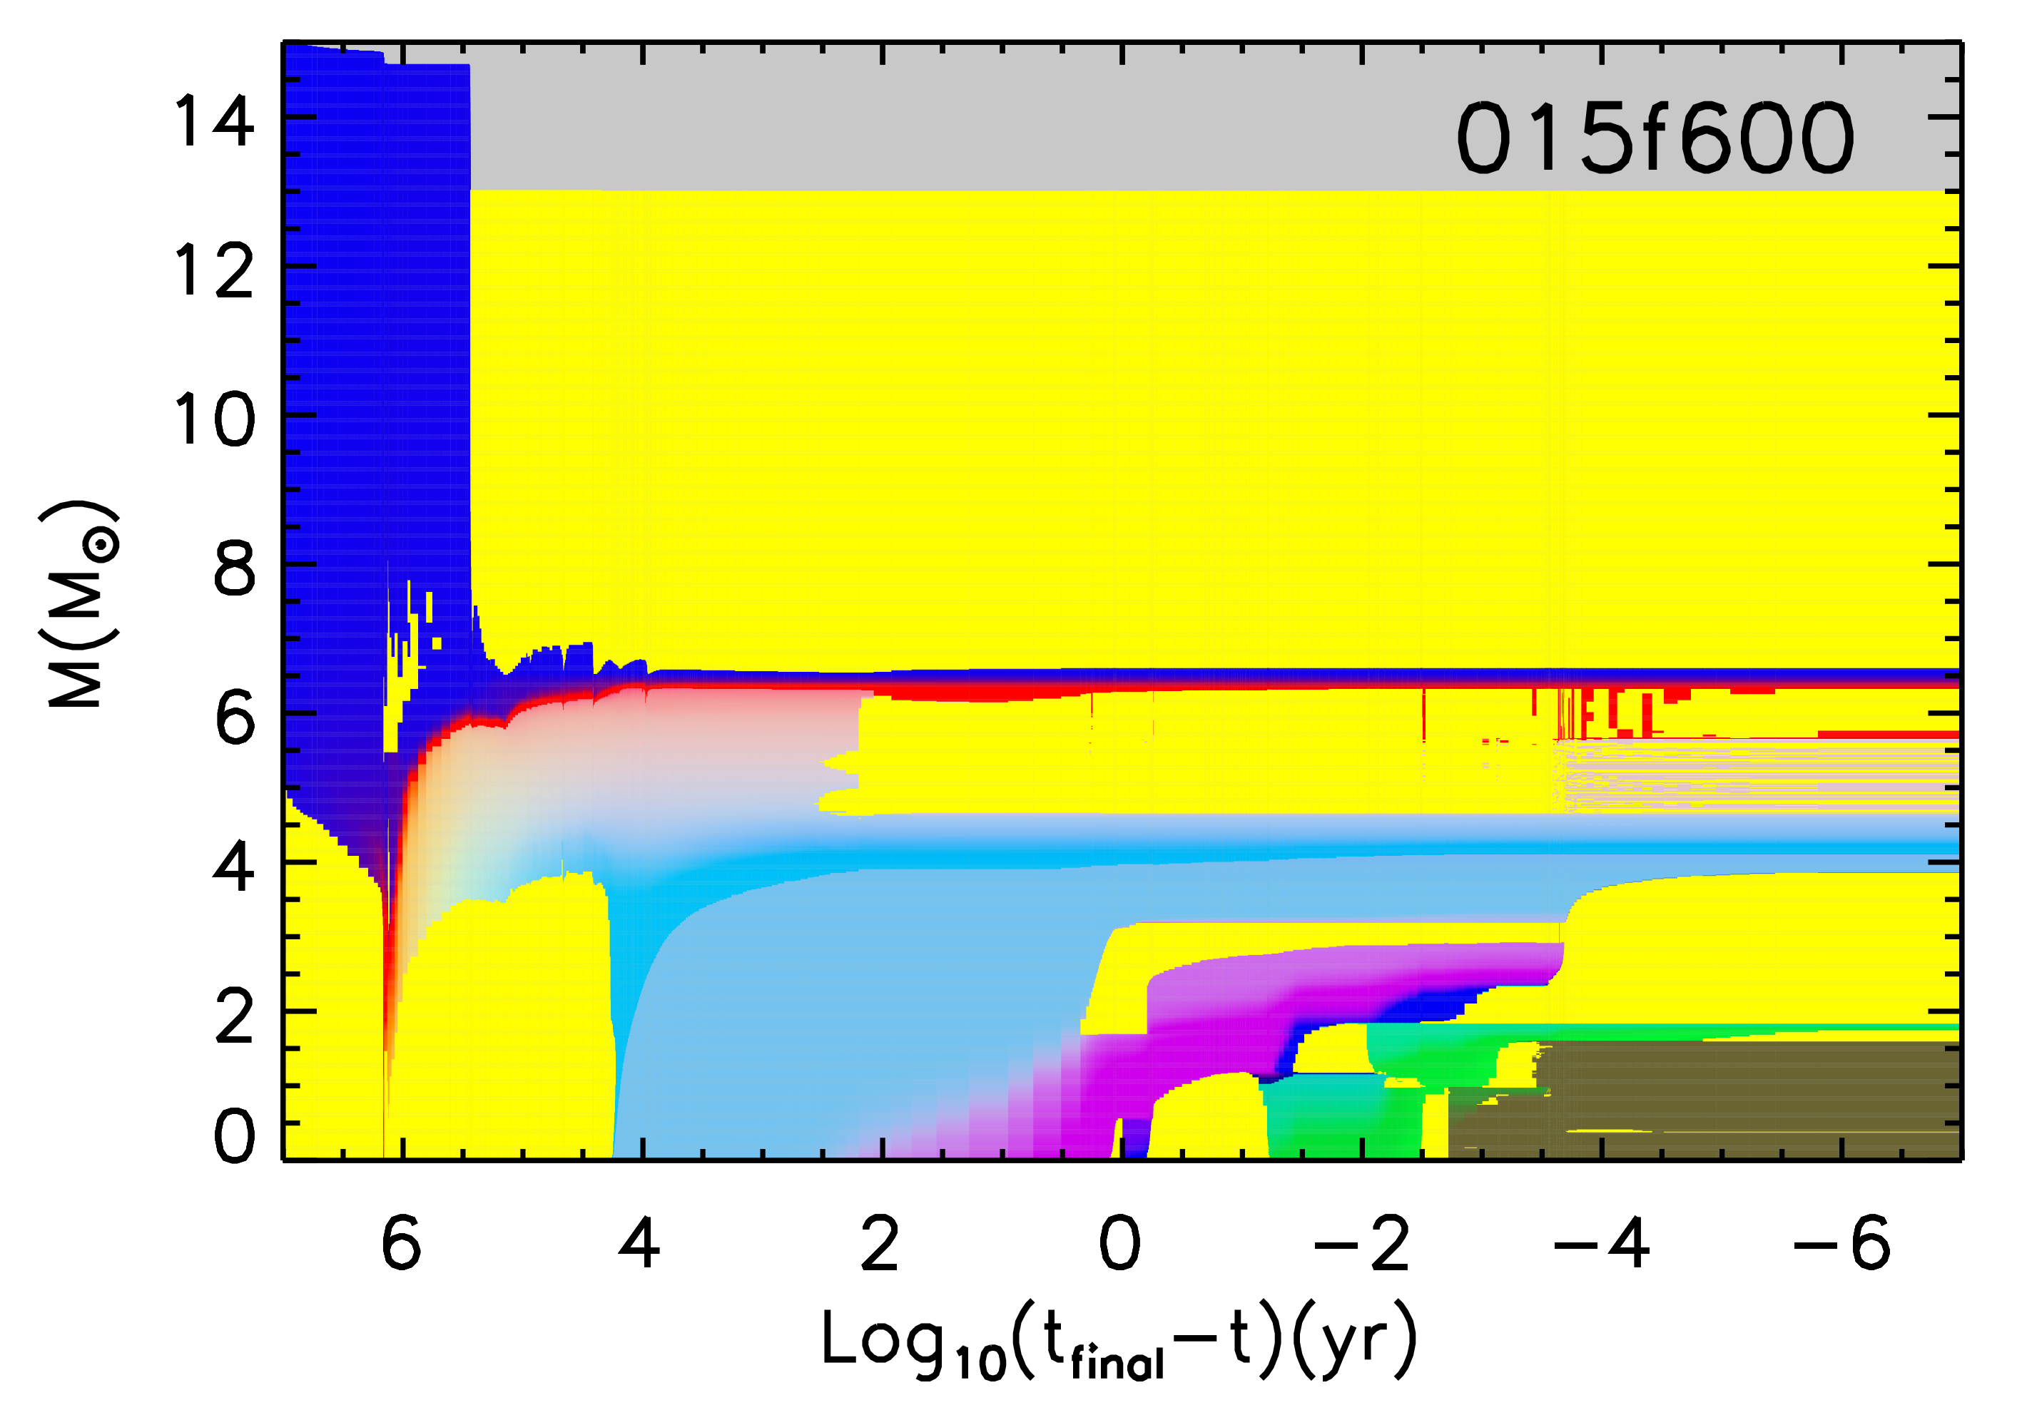
Weak s-process nuclei in a C-O merger
H
Convective envelope
Conv. shell
He
C-O merger
Conv. core
C/O
O/Ne
Si
Fe

Slide 7
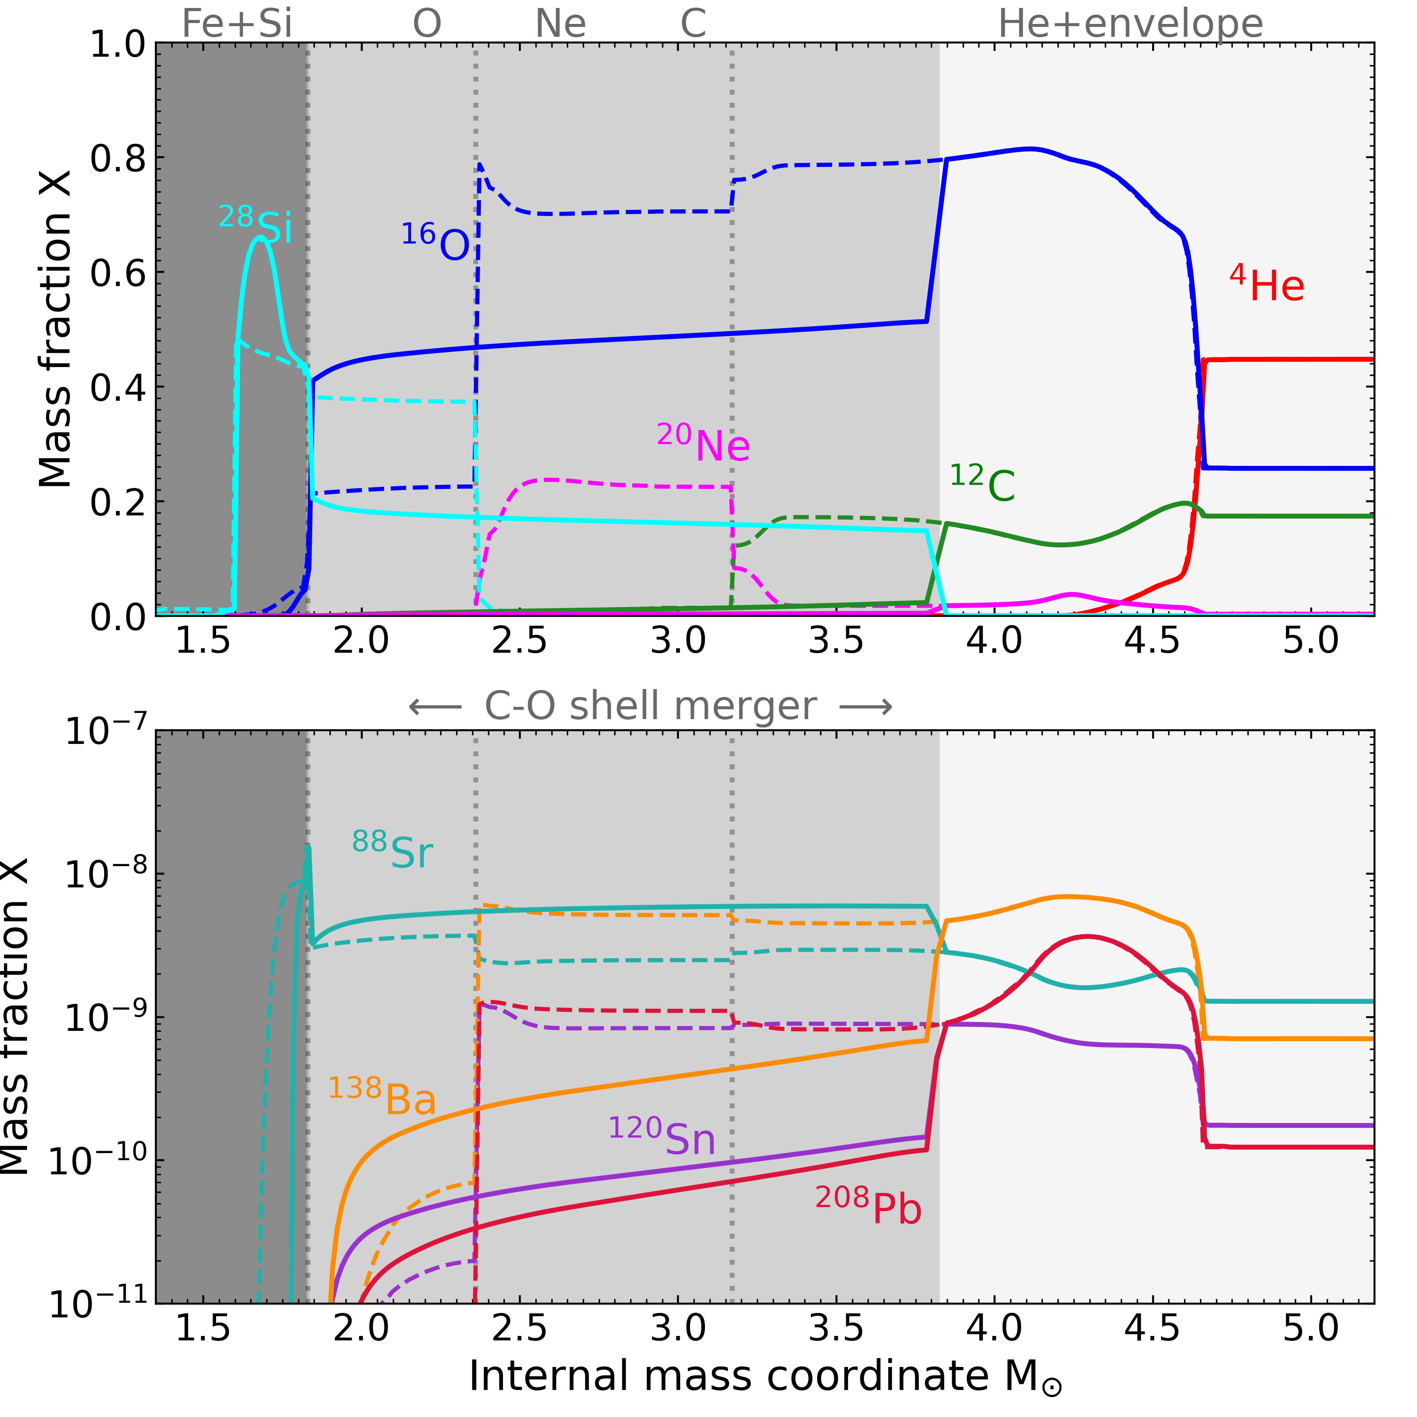
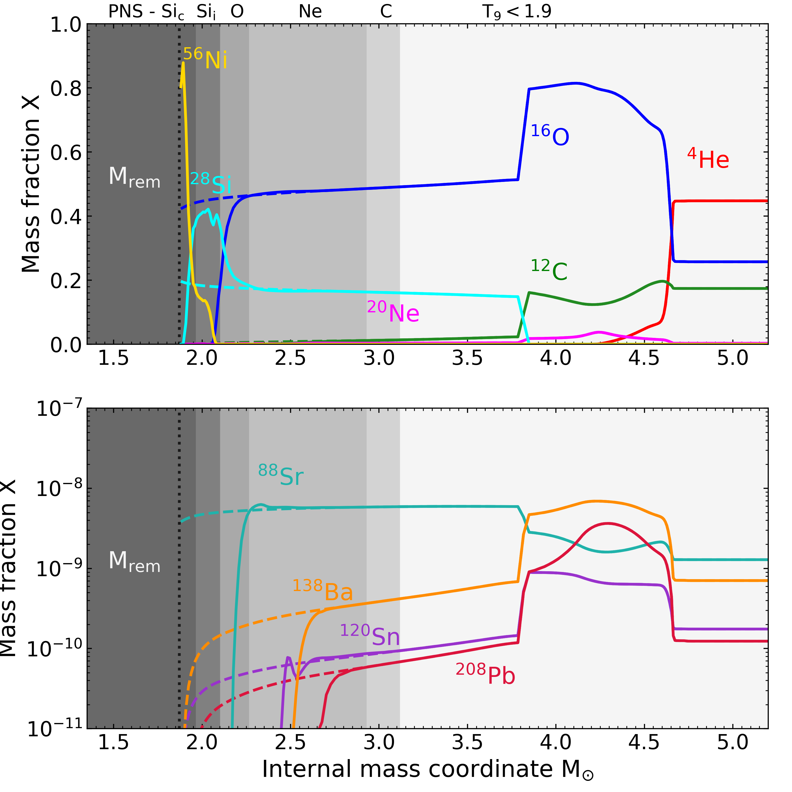
Weak s-process nuclei in a C-O merger (and CCSN)

Slide 8
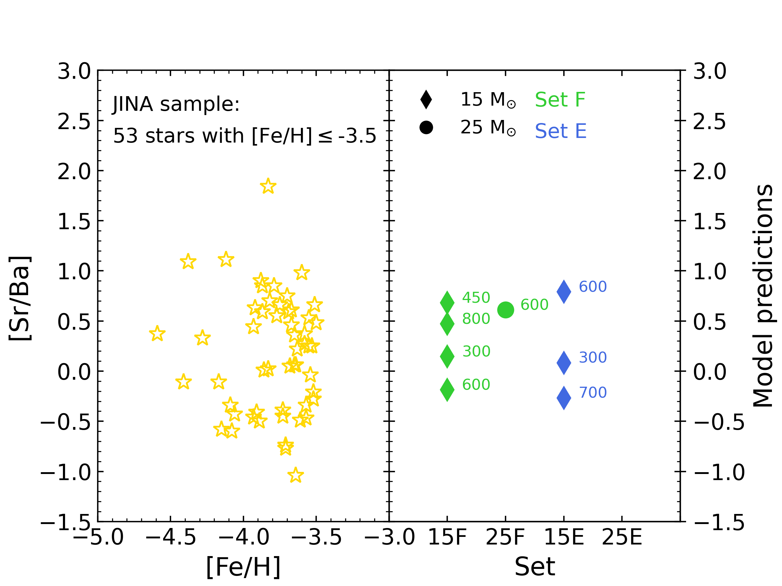
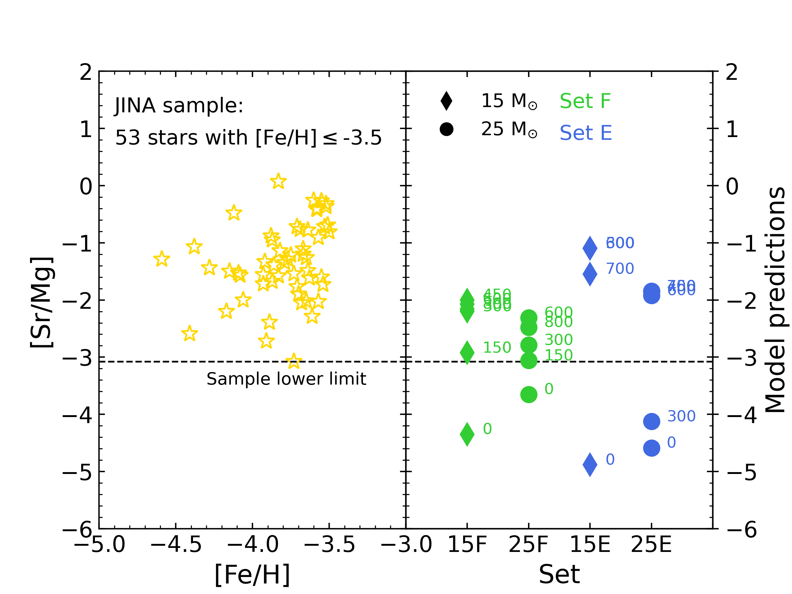
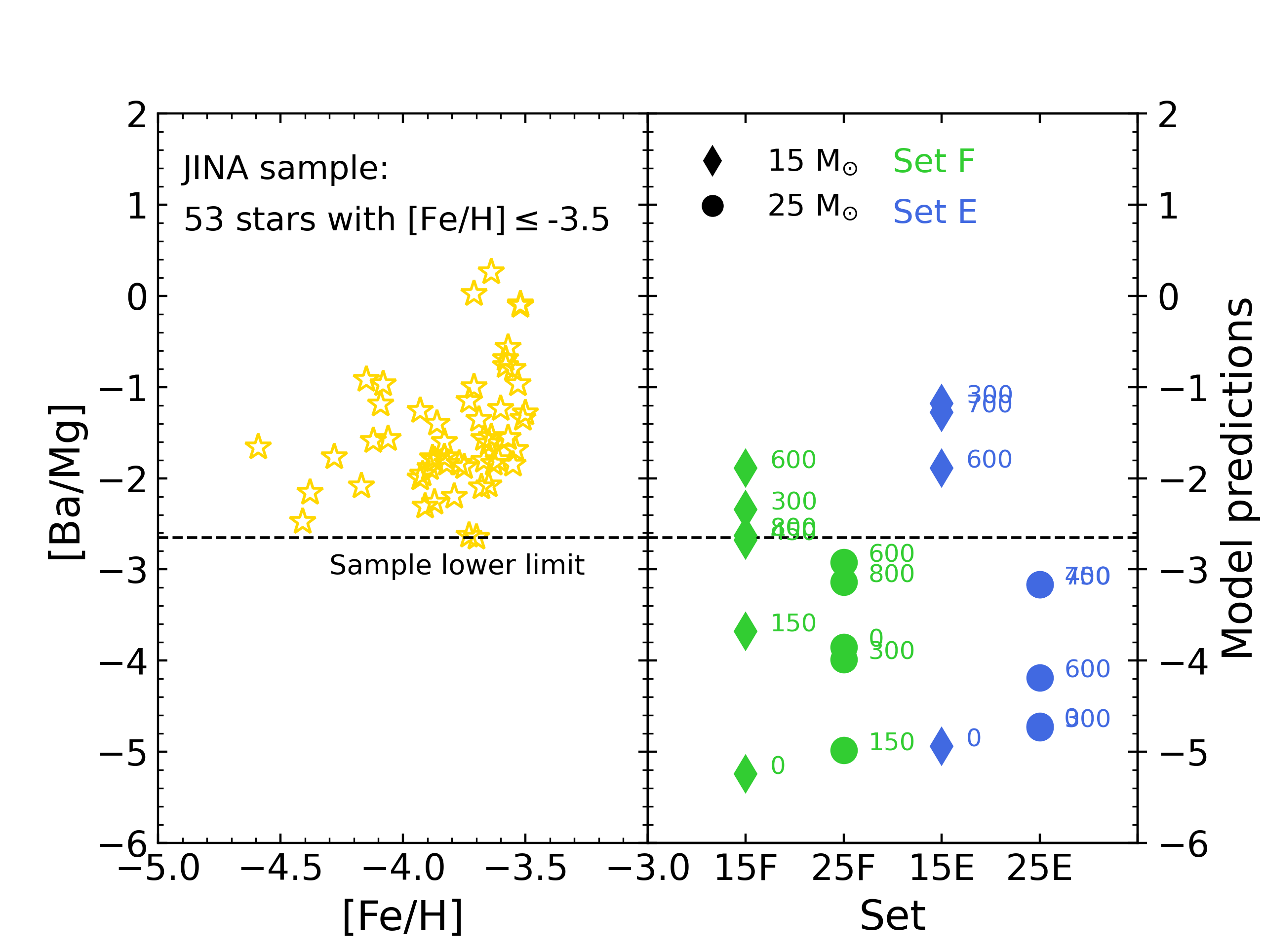
Comparison with observations

Slide 9
Comparison with observations
C-O shell mergers!

Slide 10

Do stars with a C-O merger explode?
Large $δρ$ at the Si/O interface help the CCSN explosion. In particular, ${δϱ2}/{ϱ2}>0.08$ favors the explosion (Boccioli+23).
Stars with C-O shell mergers naturally meet this condition! (Loddo et al., in prep.)

Slide 11
Do stars with a C-O merger explode?
See Luca Boccioli’s talk on Friday 18:50-19:10
(don’t leave! :D)
Large $δρ$ at the Si/O interface help the CCSN explosion. In particular, ${δϱ2}/{ϱ2}>0.08$ favors the explosion (Boccioli+23).
Stars with C-O shell mergers naturally meet this condition! (Loddo et al., in prep.)

Slide 12
Summary and conclusions
Carbon-oxygen (C-O) shell mergers in massive stars have a crucial impact on the nucleosynthesis and on the fate of CCSN progenitors;
In case of (fast) rotating progenitors, the heavy s-process nuclei are destroyed, but the weak component is enhanced;
The explosion slightly reprocess the C-O merger region due to its extended radius;
Production site also for odd-Z elements and p-nuclei;
Questions: frequency? Trend with mass/metallicity/rotation? Nuclear physics?
THANK YOU!

Slide 13
Summary and conclusions
Carbon-oxygen (C-O) shell mergers in massive stars have a crucial impact on the nucleosynthesis and on the fate of CCSN progenitors;
In case of (fast) rotating progenitors, the heavy s-process nuclei are destroyed, but the weak component is enhanced;
The explosion slightly reprocess the C-O merger region due to its extended radius;
Production site also for odd-Z elements and p-nuclei;
Questions: frequency? Trend with mass/metallicity/rotation? Nuclear physics?
THANK YOU!

