Slide 1



Progress on opacity measurements in laboratory plasma trap relevant for Kilonovae signals
Giulianova, June 9-13, 2025
s, i & r Element Nucleosynthesis (sirEN) CONFERENCE
Angelo Pidatella
INFN-LNS
On behalf of the PANDORA collaboration

Slide 2
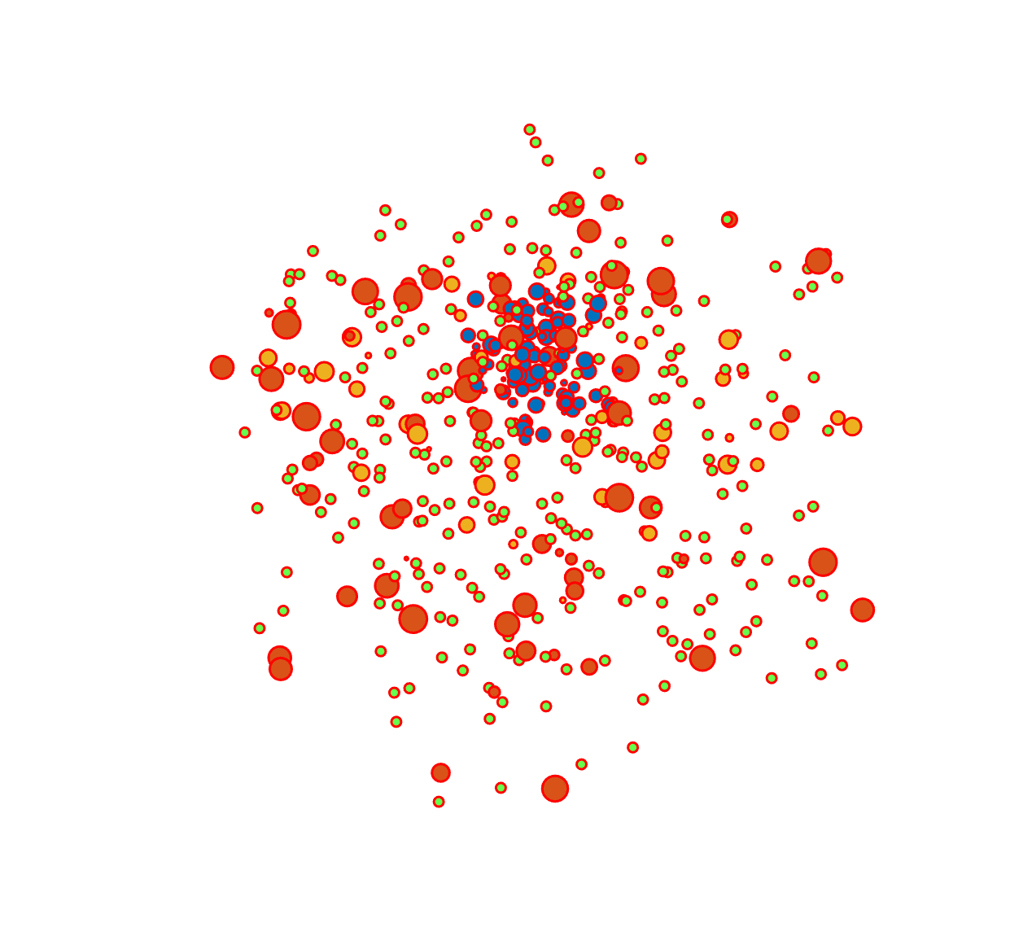

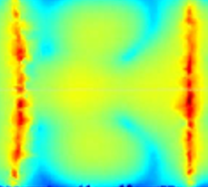
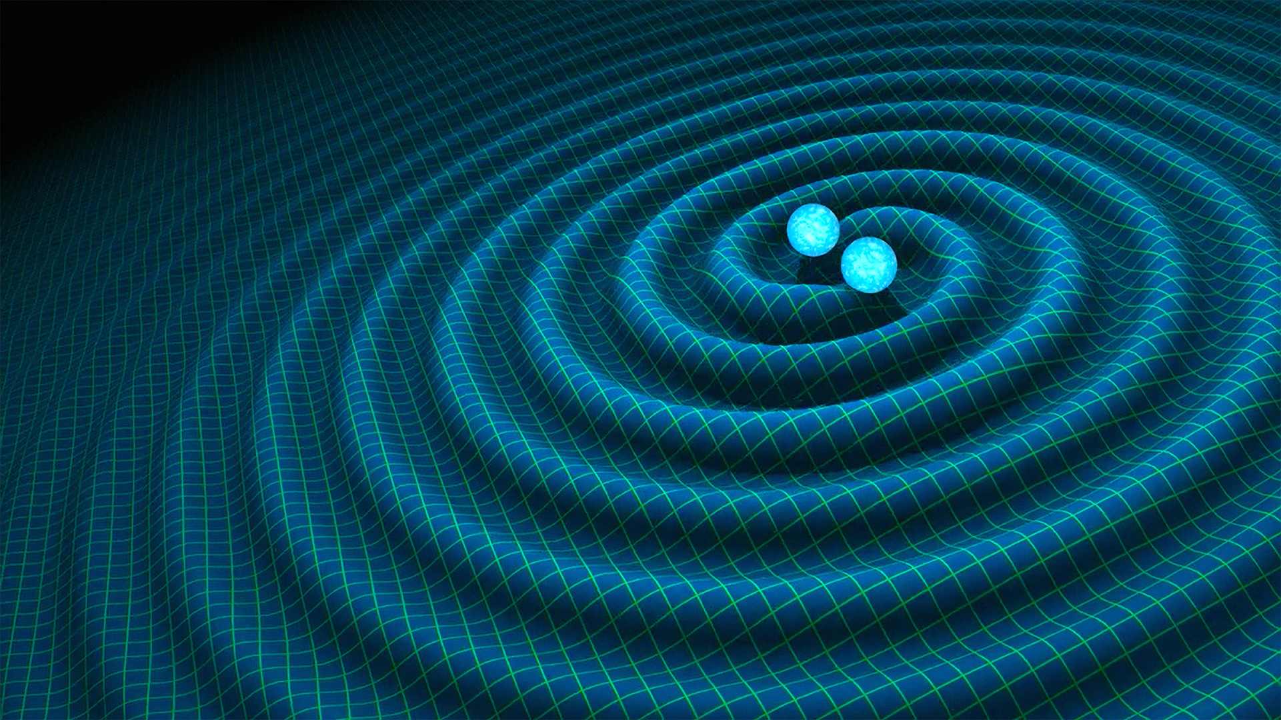
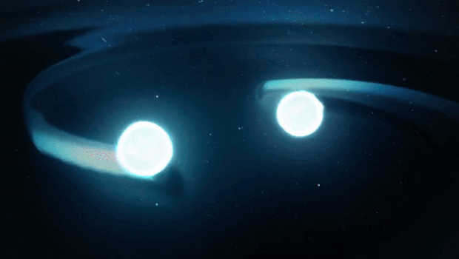
Outline
The kilonova in a nutshell: a recap on the physics case and state of the art
The plasma opacity problem – the PANDORA experiment
  First attempt of reproducing plasma conditions in laboratory
  The opacity experimental design: methods and setup
What’s next?

Slide 3

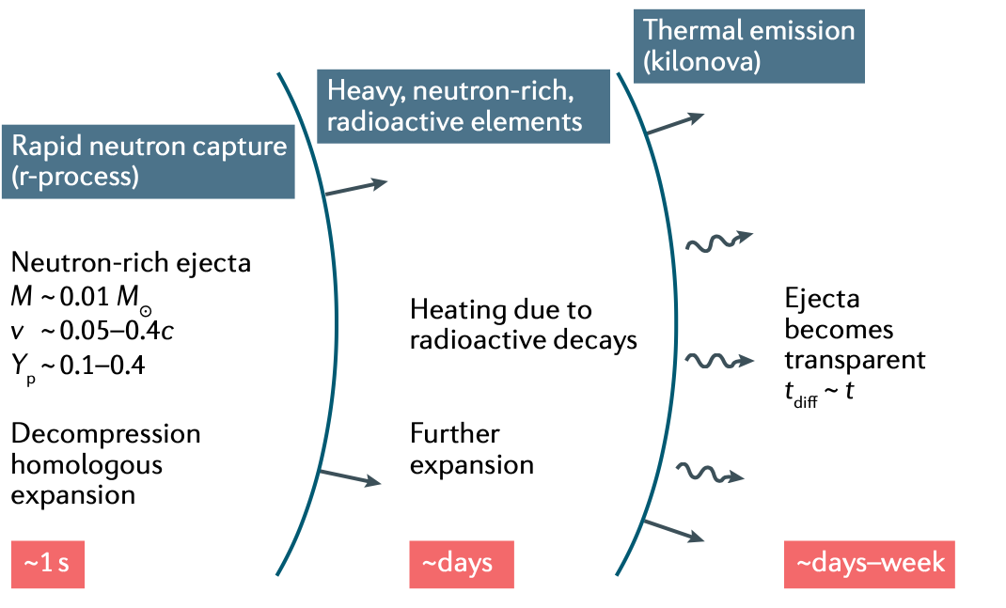
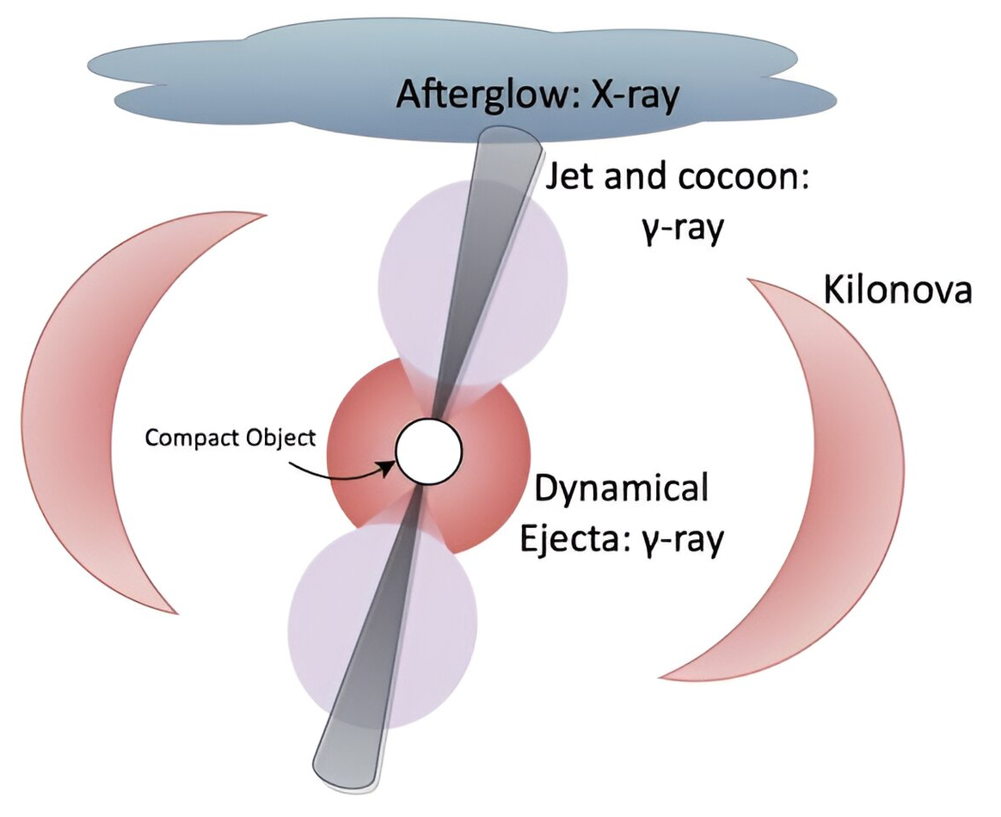
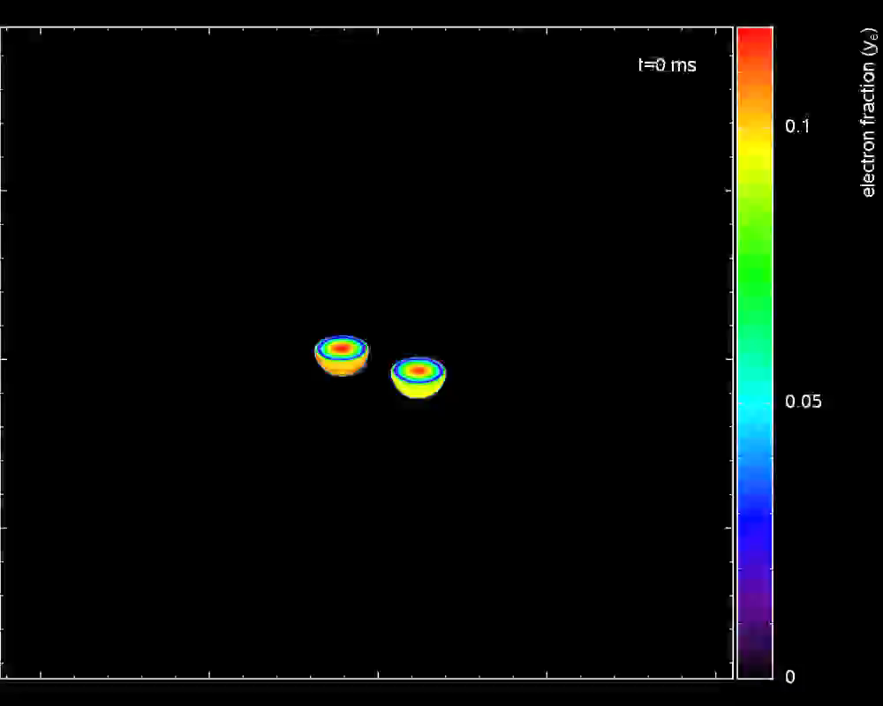
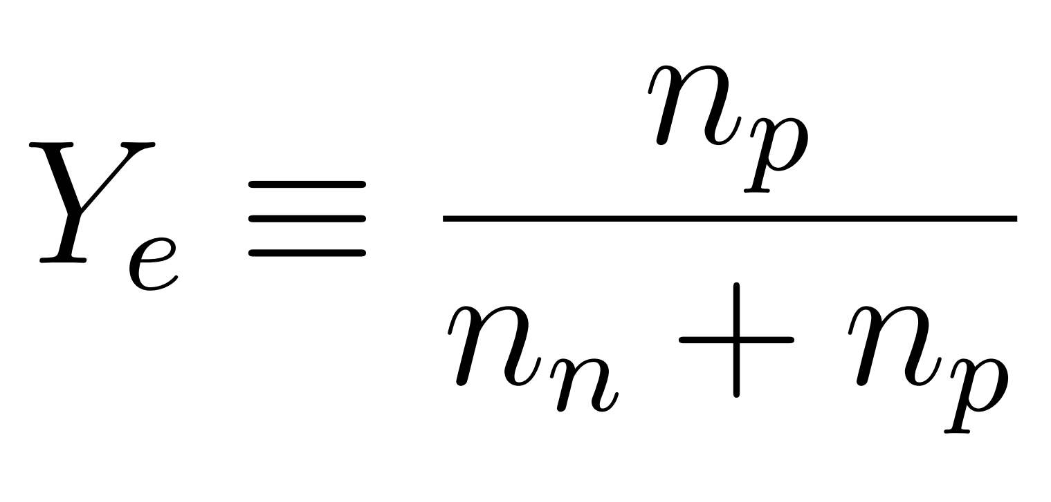



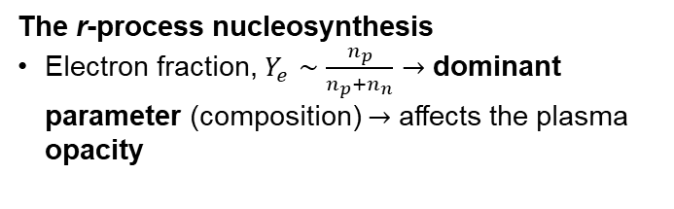
The kilonova in a nutshell: a recap on the physics case and state of the art
Merger of binary neutron stars: ejection of n-rich matter, rapid neutron capture (r-process) nucleosynthesis
Radioactive decay of synthesized r-process nuclei power electromagnetic transient: kilonovae (KN)
I. Arcavi et al. Nature, 551(7678):64,66, (2017)
KN light-curve, 2 fundamental inputs: (1) r-process nucleosynthesis yields (fixing the heating rate) (2) opacity (fixing the exchange of energy between plasma and radiation)
Siegel D. M., Nat. Rev. Phys. 4, 306-318 (2022).
(2)
The r-process nucleosynthesis
Electron fraction, $Y_{e}∼\frac{n_{p}}{n_{p}+n_{n}}→$ dominant parameter (composition) $→$ affects the plasma opacity
(1)
BNS EJECTA OPACITY IS AN OPEN ISSUE TO BE FURTHER EXPLORED
https://compact-merger.astro.su.se/movies.html#rproc

Slide 4
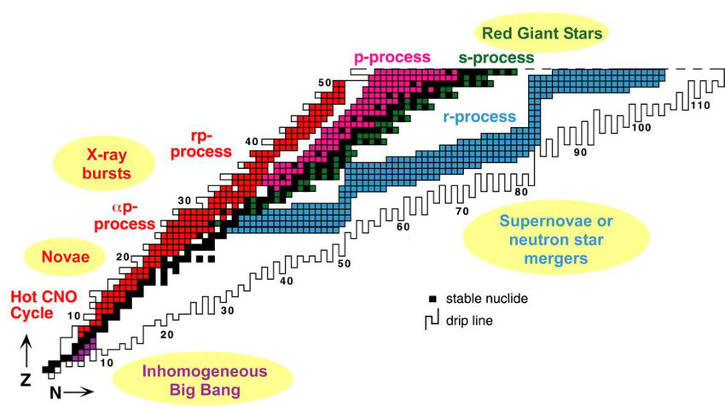
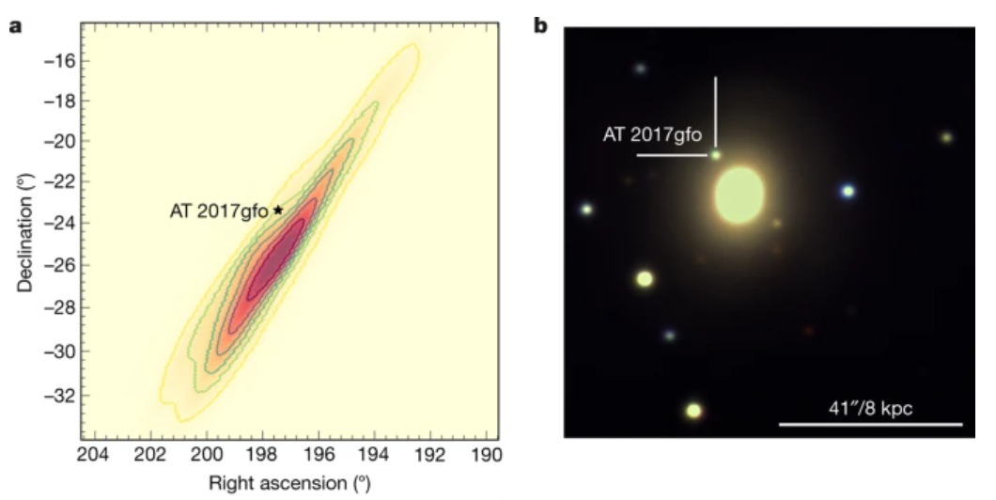
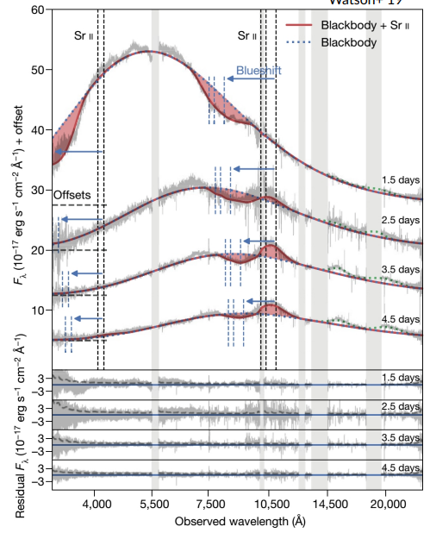
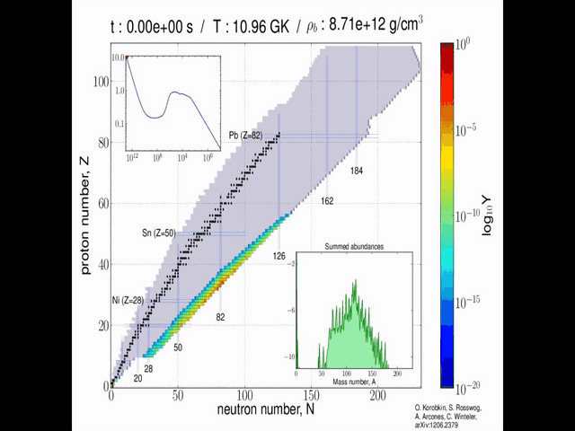
The kilonova in a nutshell: a recap on the physics case and state of the art
EM observations support the theory that neutron star mergers contribute to rapid neutron capture (r-process) nucleosynthesis
The first identification of r-process elements in a neutron star merger was obtained from kilonova (KN) AT2017gfo, from Gravitational Wave event GW170817
The spectra provided first direct evidence of strontium production during a neutron star merger.
Since then, several r-process elements have been identified in the ejecta including yttrium, lanthanum and cerium.
BLACKBODY SPECTRUM VS. OBSERVED KN SPECTRUM
Smartt, S., Chen, TW., Jerkstrand, A. et al. A kilonova as the electromagnetic counterpart to a gravitational-wave source. Nature 551, 75–79 (2017).
Watson, D., et al. Nature 574497-500, (2019)
ABSORPTION SPECTRAL FEATURES

Slide 5
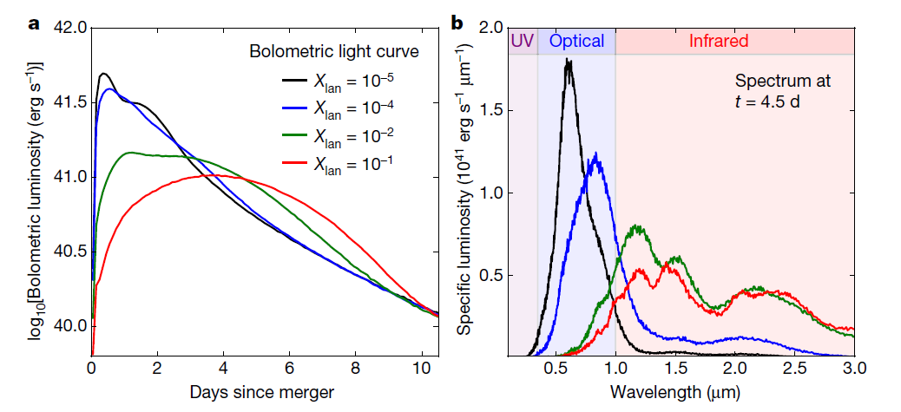
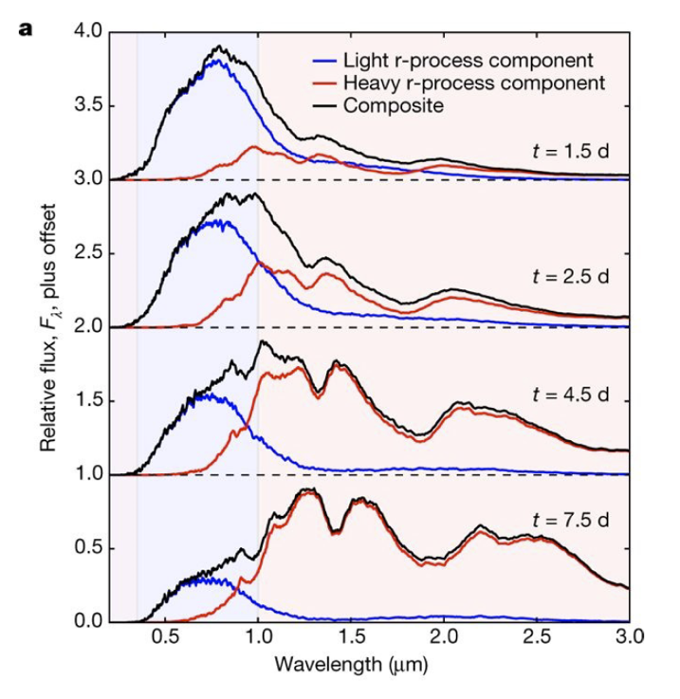
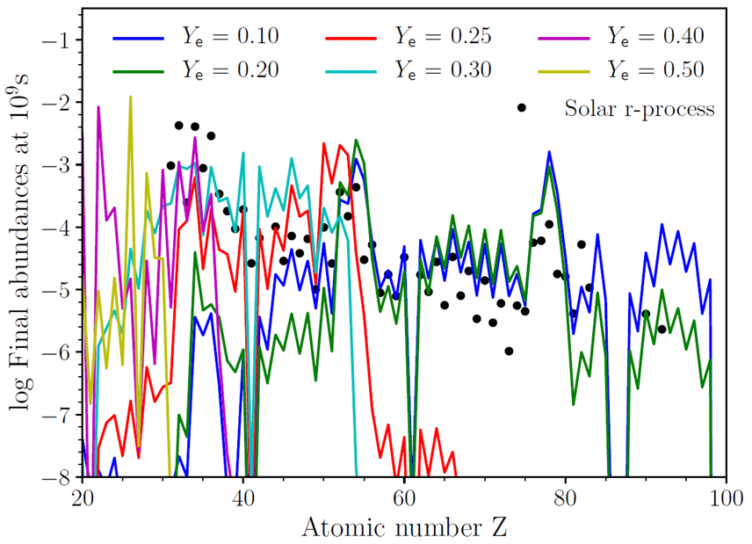


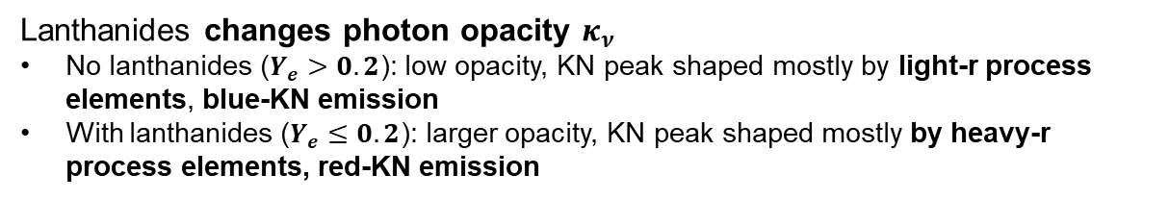
The plasma opacity problem – THE PANDORA EXPERIMENT
D. Kasen et al., Nature 551, 80–84 (2017)
The time-scale dynamics of KN peak, then a KN correct prediction, strongly depends on the opacity
Pidatella, A., et al. Nuovo Cimento 44 C (2021) 65
OPACITY – AMONG MAJOR UNCERTAINTY FOR THE NUCLEOSYNTHESIS – COMPLEX OBSERVABLE TO BE FURTHER EXPLORED !
Lanthanides changes photon opacity $κ_{ν}$
No lanthanides ($Y_{e}>0.2$): low opacity, KN peak shaped mostly by light-r process elements, blue-KN emission
With lanthanides ($Y_{e}≤0.2$): larger opacity, KN peak shaped mostly by heavy-r process elements, red-KN emission

Slide 6
The plasma opacity problem – THE PANDORA EXPERIMENT
Critical OPACITY Challenges Identified (?)
Atomic Data Limitations: Incomplete transition-line databases and uncertain oscillator strengths remain critical bottlenecks.
Ionization State Modeling: Most studies focused on low ionization states (I–IV), while higher states (V–XI) dominate in early-phase ejecta (T > 25,000 K).
Ionization Dynamics: Higher ionization states (V–XI) dominate early phases but are understudied; time-dependent modeling is essential.
Ejecta Composition Heterogeneity: Opacity depends on localized elemental abundances, necessitating multi-element simulations rather than single-element approximations.
NLTE (Non-Local Thermodynamic Equilibrium) effects critically shape kilonova spectra evolution, with their influence growing substantially over time due to the ejecta's rapid expansion and cooling.
Tanaka, M., et al. MNRAS, 496, 2020; Deprince, J. et al, A&A, 696, A32 (2025)
A&A, 685, A91 (2024)
Sneppen A., et al. A&A, 688 (2024) A95
Kato, D. et al., MNRAS 535, 2670–2686 (2024) ;
Banerjee S., et al., ApJ 934 117, 2022
Pognan, Q., A. Jerkstrand, et al. , MNRAS, 513, 4, 2022;
Pognan Q., et al., MNRAS, 526, 4, 2023
Tarumi, Y. et al., arXiv:2302.13061

Slide 7
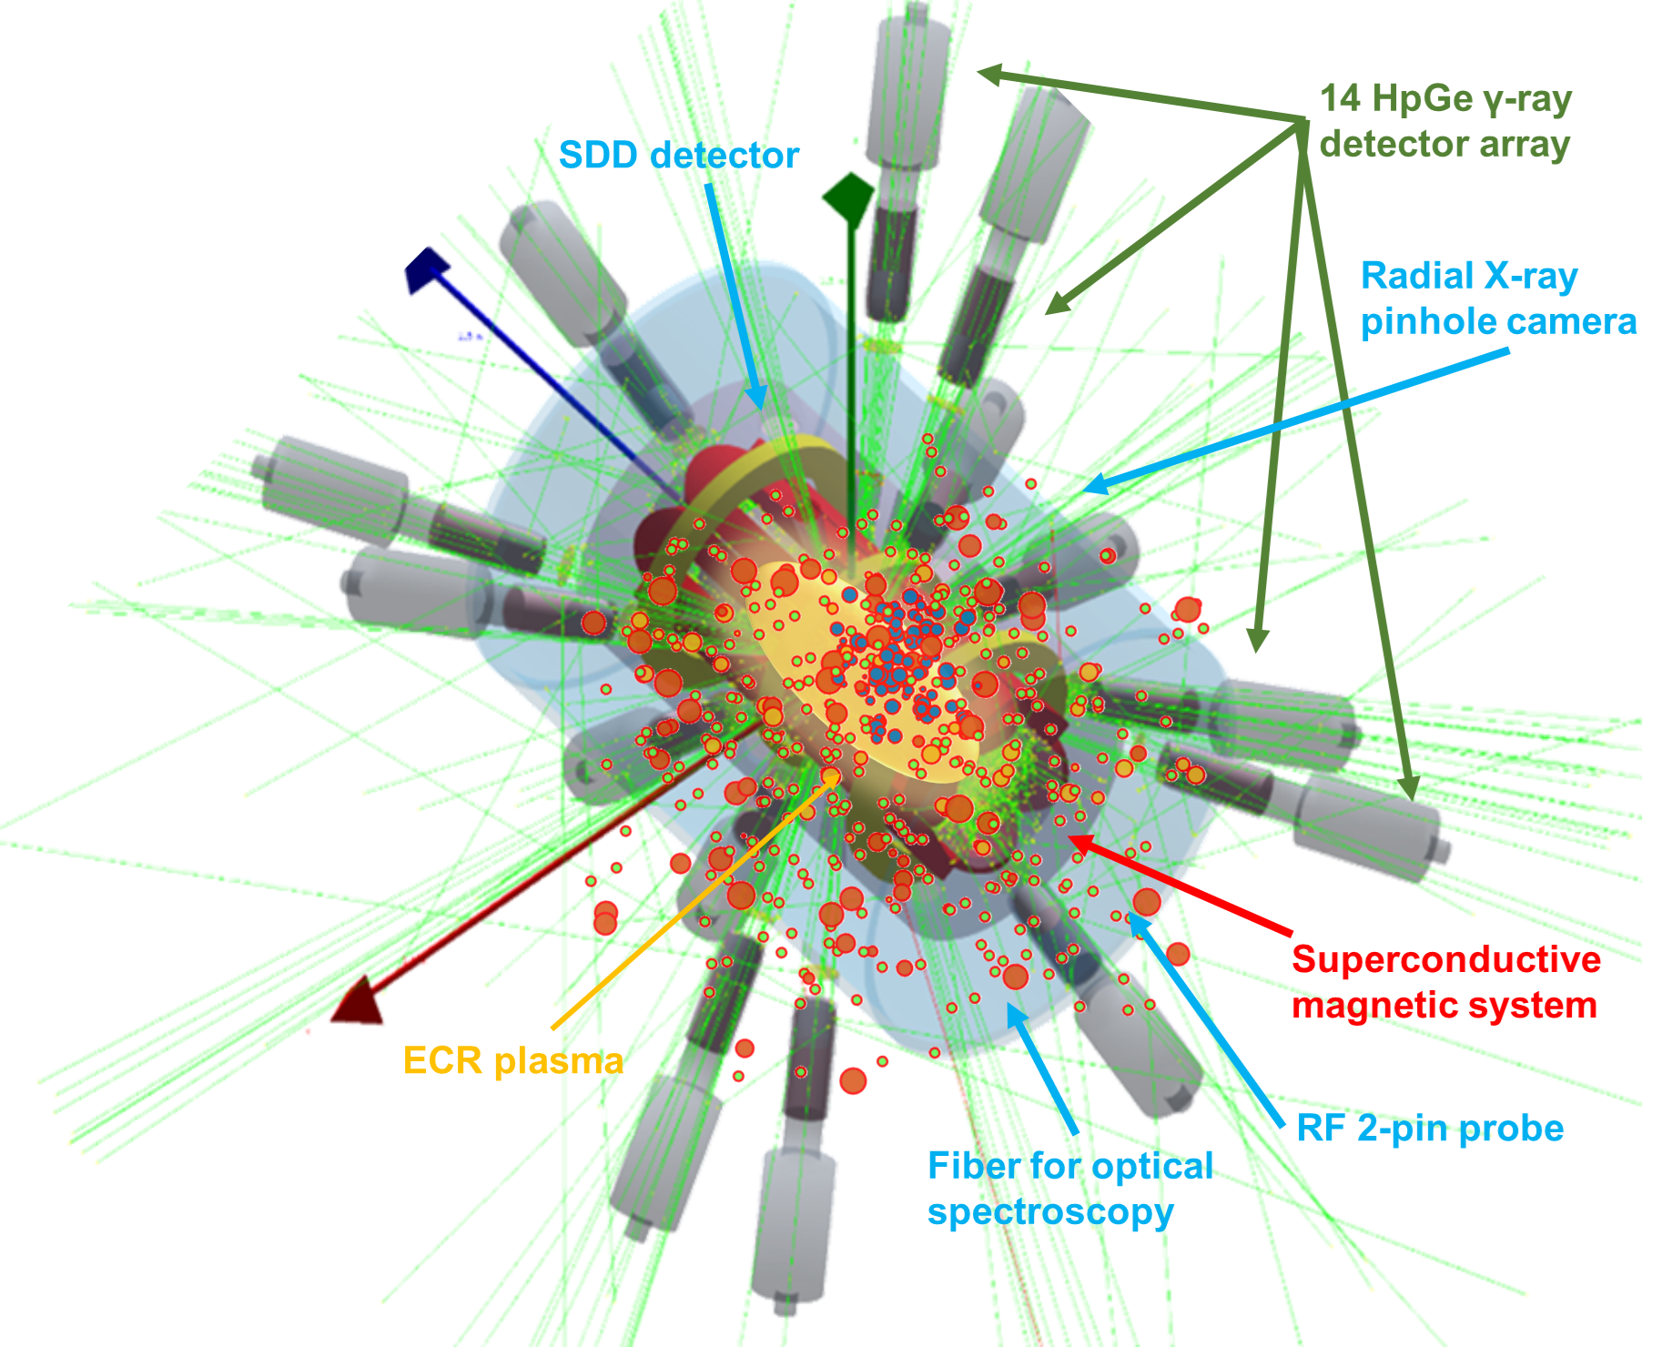
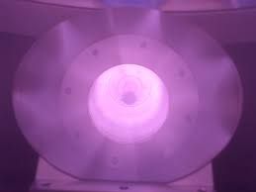
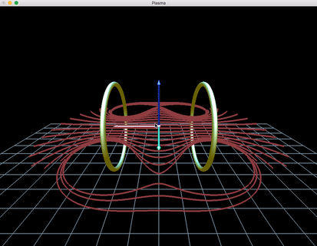
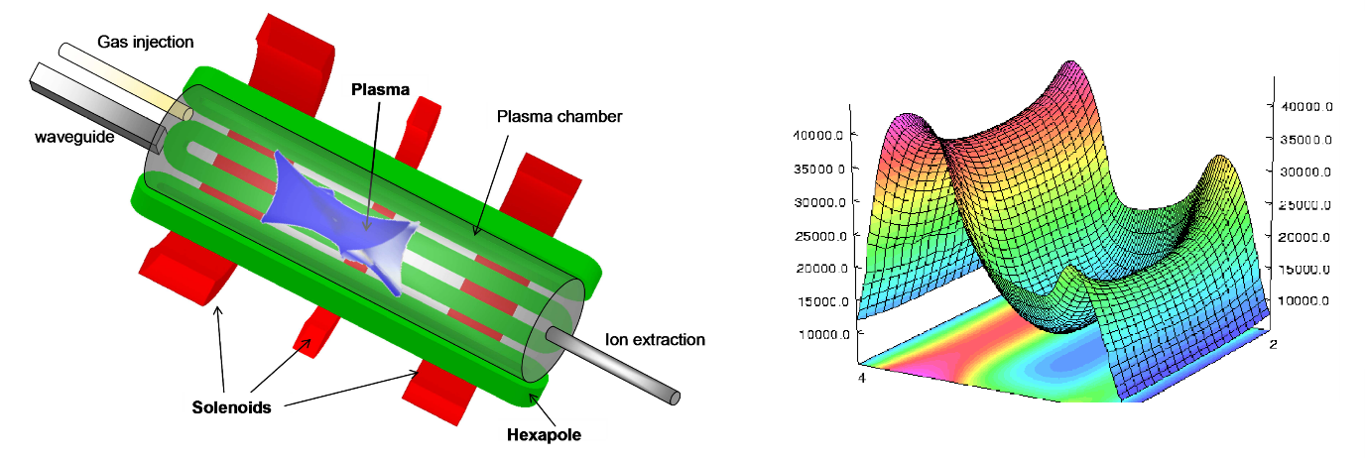

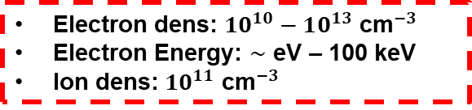
The plasma opacity problem – THE PANDORA EXPERIMENT
From an Electron Cyclotron Resonance (ECR) plasma historically used in particle accelerator as source for multi-charged ion beams to….
Electron dens: $10^{10}−10^{13}$ ${\text{cm}}^{−3}$
Electron Energy: $∼$ eV – 100 keV
Ion dens: $10^{11}$ ${\text{cm}}^{−3}$
…an interdisciplinary ECR plasma facility to perform fundamental studies in nuclear physics and nuclear astrophysics, taking advantage of an advanced multi-diagnostic system
Mascali D., et al, Eur. Phys. J. A (2017) 53: 145
Mascali D., et al, Universe 8 (2), 80 (2022)
PANDORA (Plasmas for Astrophysics Nuclear Decays Observation and Radiation for Archaeometry) plasma trap for inter-disciplinary studies: atomic physics, astrophysics, and nuclear astrophysics
  Nuclear bound-β decay rate in a high-energy content plasma for nuclei relevant in s-process branching
  Magneto-plasma opacity spectroscopic measurements relevant for KN light-curve and r-process nucleosynthesis yields
  Plasma kinetic turbulences and impact on astrophysics
About s-process relevance, see poster by B. Mishra
Pidatella, A. et al., Plasma Phys. Control. Fusion 66 (3), 035016 (2024)
Mishra, B., et al., Front. in Physics, 10, 932448, (2022)
Galatà, A., et al., Front. in Physics, 10, 947194, (2022)
Pidatella, A., et al. Nuovo Cimento 44 C (2021) 65
Pidatella, A., et al. Frontiers in Astronomy and Space Sciences, 10.3389/fspas.2022.931744 (2022)
Mascali D., et al (2022) Plasma Phys. Control. Fusion 64 035020

Slide 8
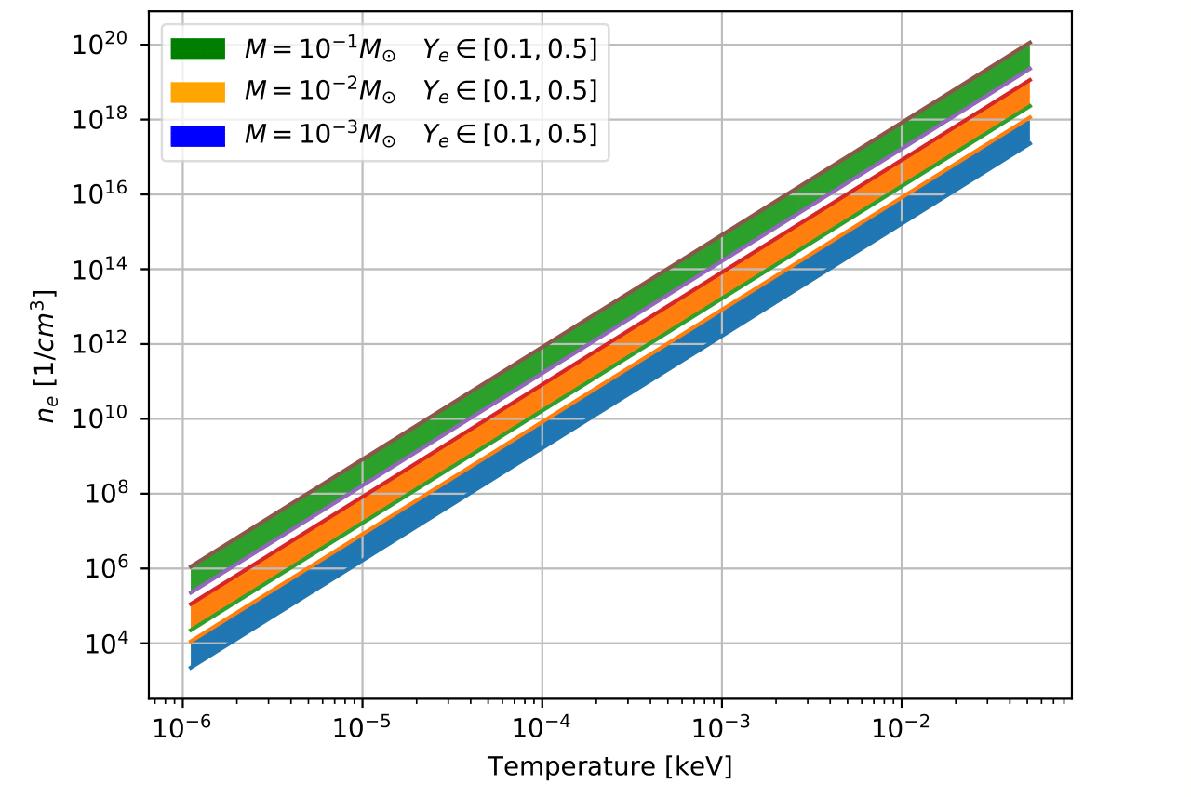
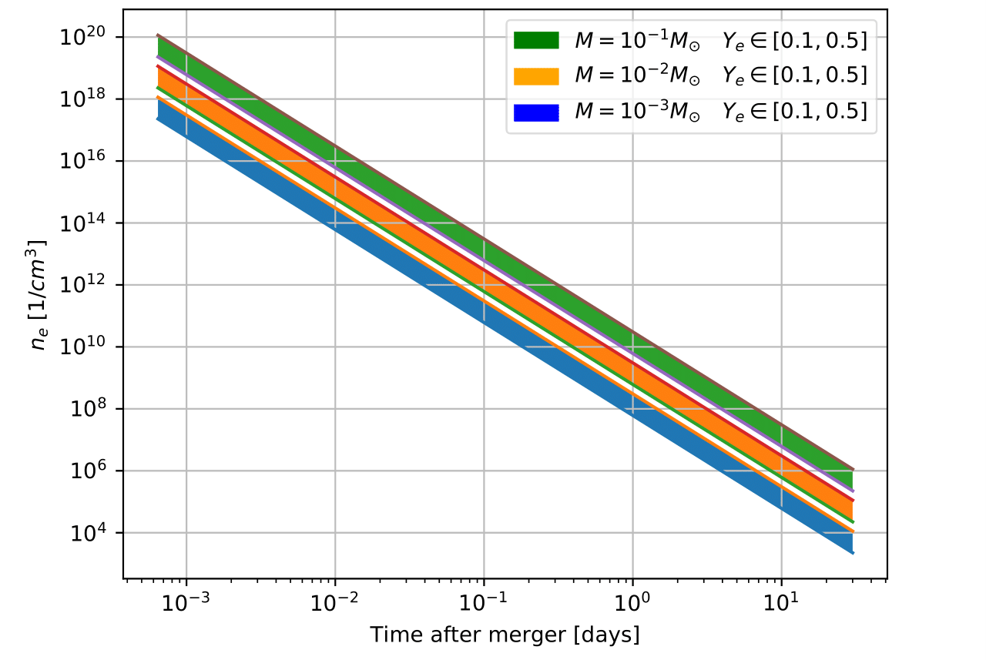
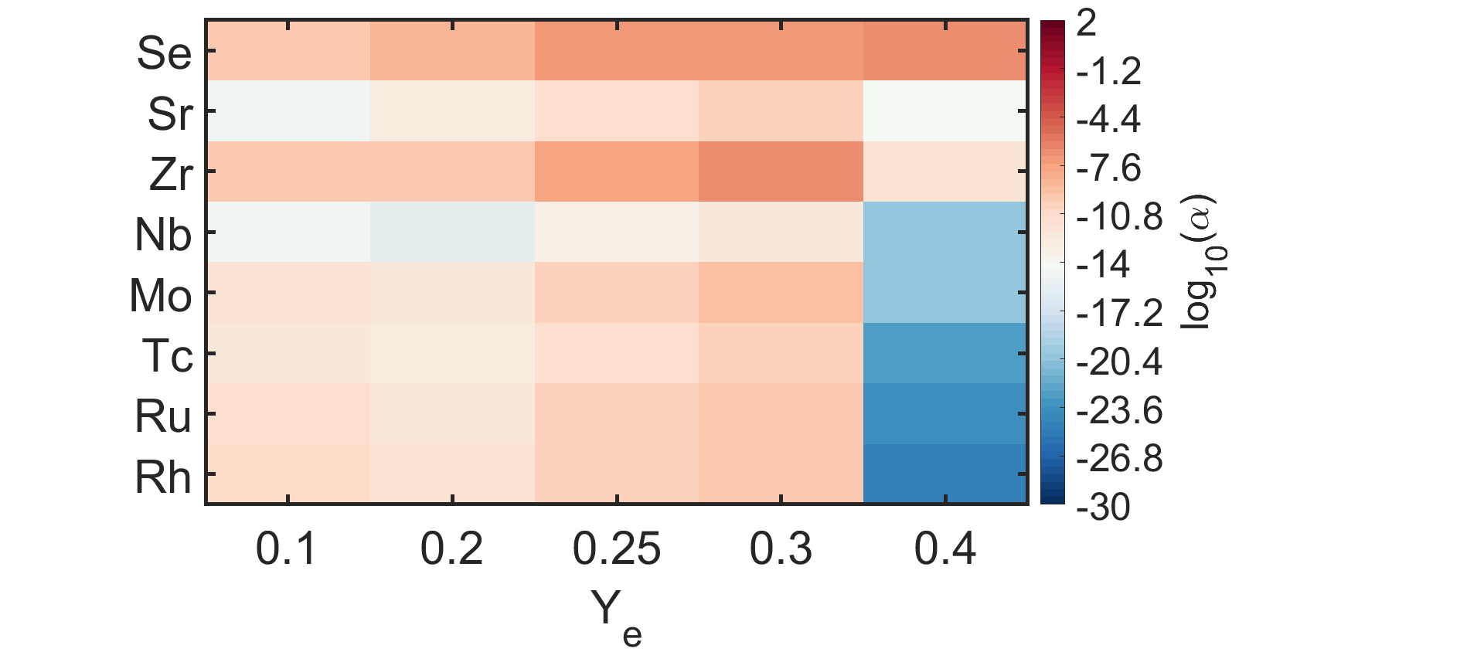
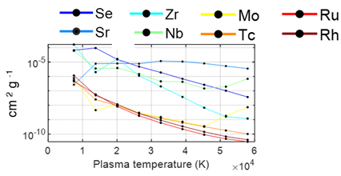

The plasma opacity problem – THE PANDORA EXPERIMENT
Magneto-plasma opacity relevant for kilonova light-curve – feasibility study
MODEL: time-evolving ejecta through homologous expansion of a fluid element under adiabatic conditions (vs. mass M, temperature T, velocity v, and electron fraction $Y_{e}$)
Plasma density in PANDORA: 10¹⁰⁻¹³ cm⁻³
Plasma temperature in PANDORA: few eV
Time after merger: from 10⁻² up to 1 days $→$ blue-KN stage
PHYSICS CASES
Time-dependent r-process elements abundances from SKYNET, with distribution of ejecta properties from astrophysical simulations → LIGHT R-PROCESS ELEMENTS, LOW NEUTRON RICHNESS
MEAN OPACITY vs. T, weighted with abundances from SKYNET: synthetic spectra of opacity from FLYCHK
Pidatella, A., et al. Nuovo Cimento 44 C (2021) 65
Opacity weighted on abundances from SKYNET
O. Korobkin et al., Mon. Not. R. Astron. Soc., 426 (2012) 3-1940:1949
D. Radice et al., Astrophys. J., 869 (2018) 2-130
J. Lippuner et al., Astrophys. J. Supplements, 233 (2017) 18
Chung H.-K. et al., High Energy Density Phys., 1 (2005) 3
Recent supporting work on Zr relevance : L. J. Shingles, et al. ApJL 954 L41, (2023)
Recent supporting work on Se relevance : K., Hotokezaka, M. Tanaka, et al., MNRAS 515, L89–L93 (2022)

Slide 9
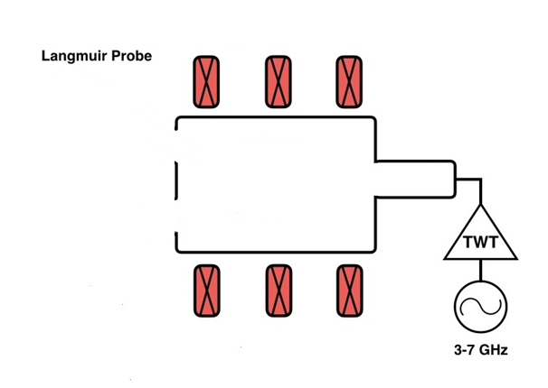
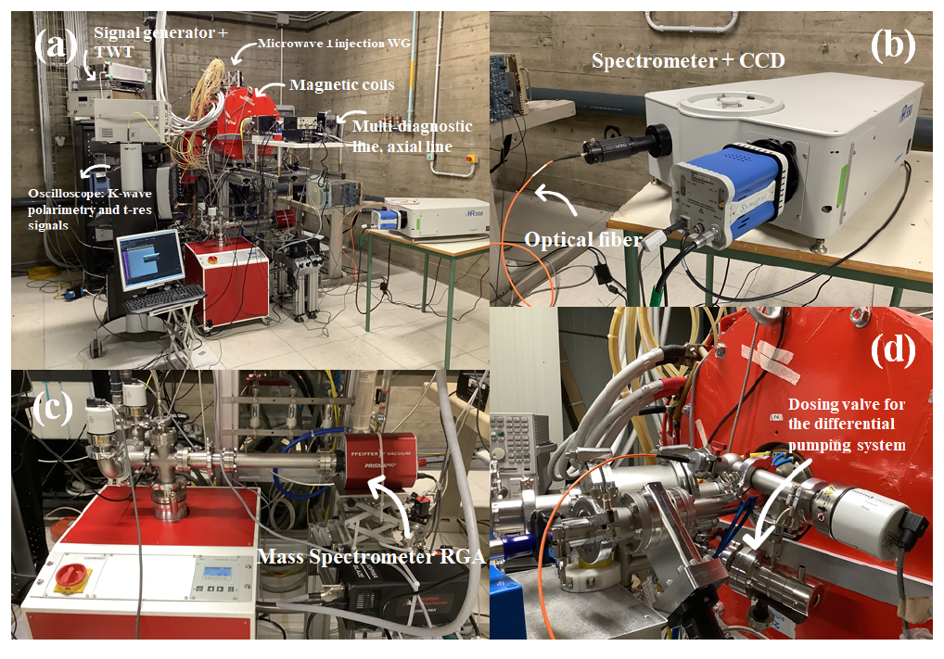
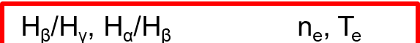



First attempt of reproducing plasma conditions in laboratory
Spectrometer + CCD
Magnetic field coils
PLASMA TRAP CONFIGURATION (FPT vs. PANDORA):
  Simple mirror field, magnetic bottle (min-B field)
  RF power : 50÷450 W (up to 6 kW)
  Heating RF frequency: 3÷4 GHz (18÷21 GHz)
Gas injection (H₂, Ar)
Optical fiber
Plasma
Supplementary diagnostics flange
Experimental H₂/Ar plasma characterization performed on FPT: commissioning with radial injection and high-power
Hydrogen spectrum
The comparison between the theoretical and experimental line ratios allows to evaluate the plasma parameters (electron density and temperature)
  $$H_{α}$$
RF power: from 40 W to 450 W
RF frequency: 3.76, 6.78 GHz
Gas pressure: 1 · 10⁻³ and 1 · 10⁻² mbar
Flexible Plasma Trap @ LNS (setup Feb 2022)
  $$H_{γ}$$
  $$H_{β}$$
Pidatella, A.,et al. Frontiers in Astronomy and Space Sciences
10.3389/fspas.2022.931744 (2022)

Slide 10
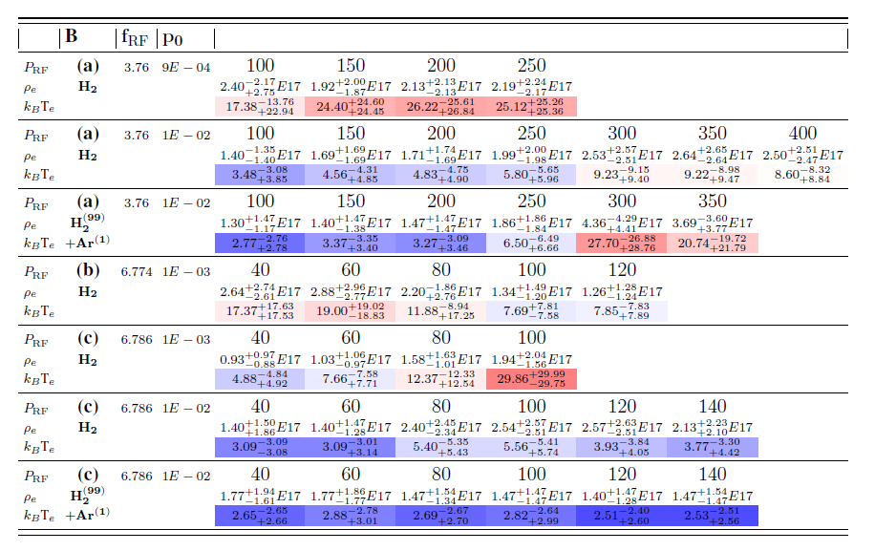
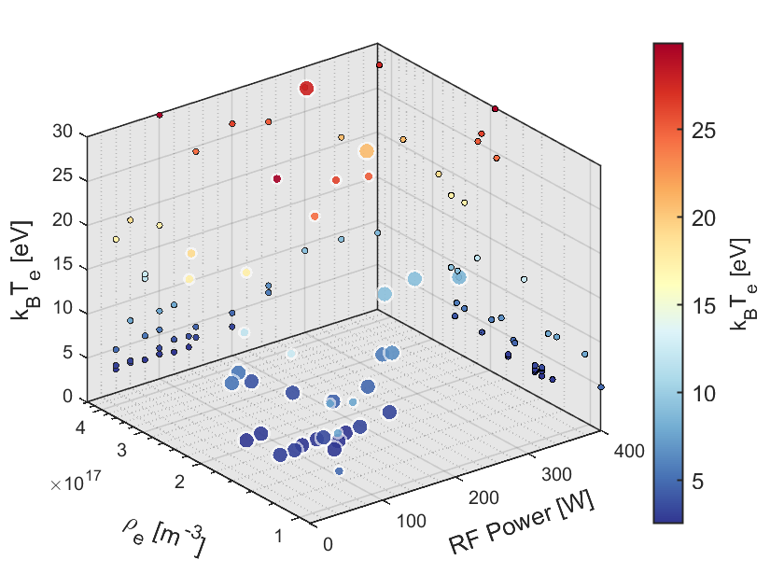

First attempt of reproducing plasma conditions in laboratory
(2022) – First experimental setup and measurement campaign on the Flexible Plasma Trap (FPT@LNS): campaign of OES measurements, closely reproducing KN conditions – few eV, and 10¹¹ cm⁻³
High - T
Plasma power
Density
Temperature
Low - T
Small circle = small gas pressure
Big circle = large gas pressure

Slide 11

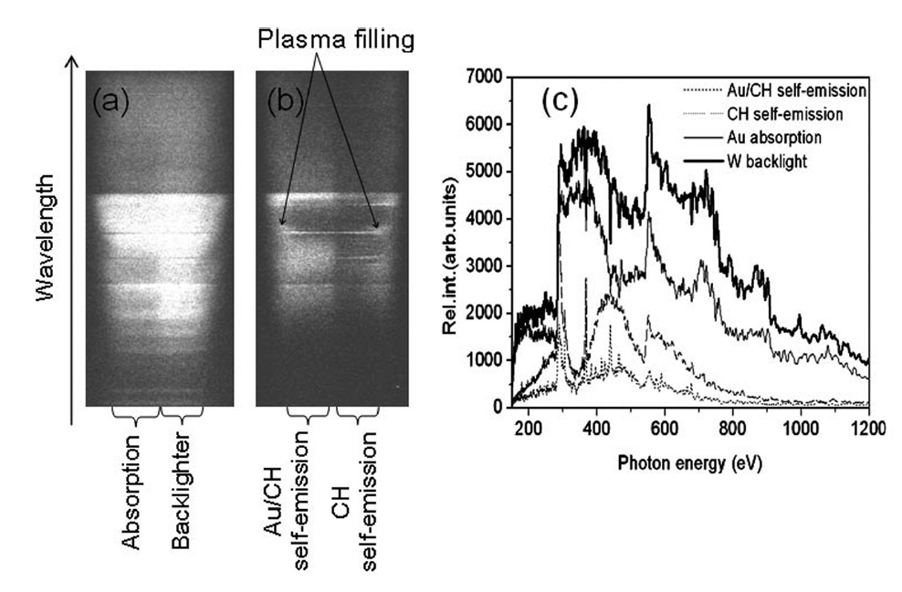
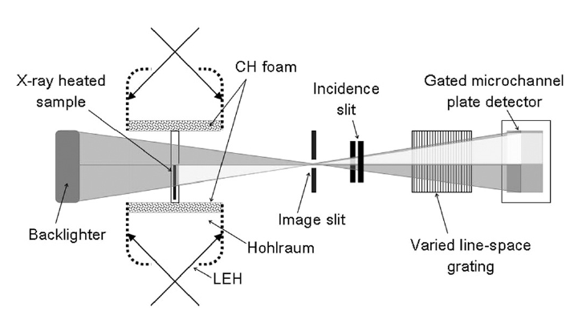
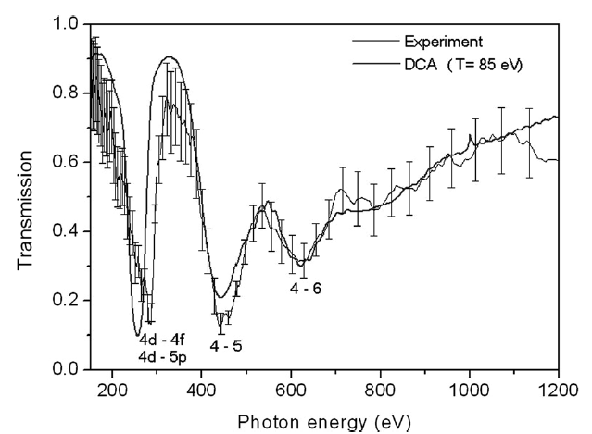
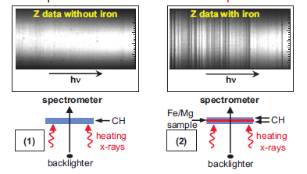
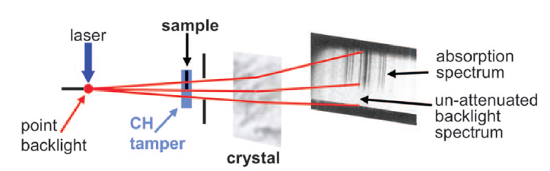
The opacity experimental design: methods and setup
Investigation of opacity models for stellar interior, inertial fusion, and high energy density plasmas
J.Zhang et al., Phys. Plasmas 18, 113301 (2011)
Different plasmas (transient, pulsed, laser & Z plasmas)
Different photon energy (X-Rays)
Opacity of Au plasma @ 85 eV over photon energy range 150 -1200 eV. Gold absorber heated by X-ray radiation from a foam-baffled hohlraum.
Sandia’s Z facility [M. K. Matzen et al., Phys. Plasmas 12, 055503 (2005) ], transmission of a mixed Mg and Fe plasma heated to 156±6 eV.
J.E.Bailey et al., Phys. Plasmas 16, 058101 (2009)

Slide 12
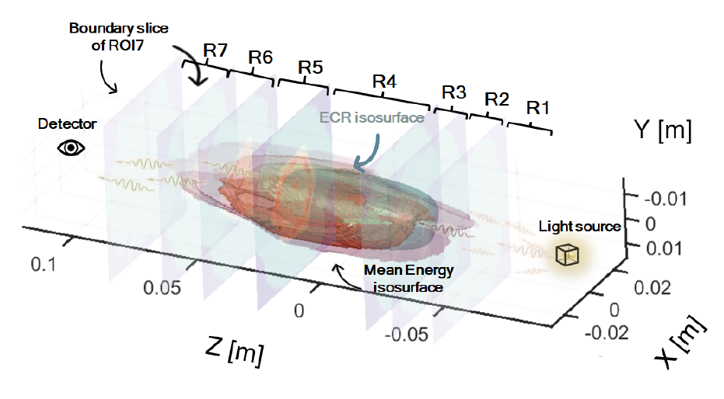
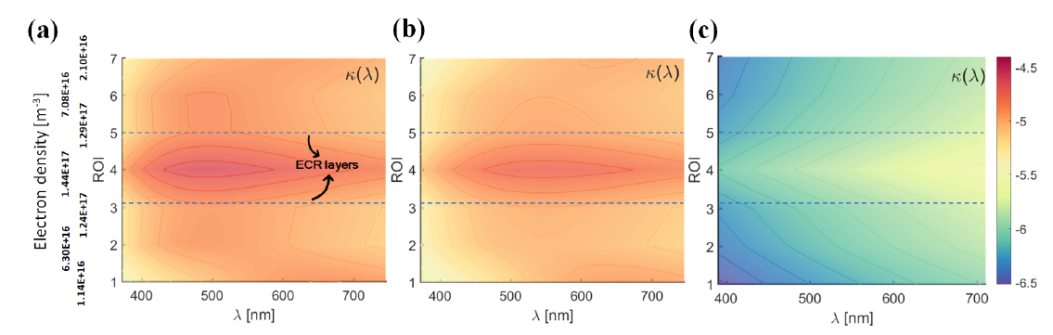

The opacity experimental design: methods and setup
Increasing intensity I(λ) external black-body radiation perturbing the plasma
log₁₀(κ)
Pidatella, A.,et al. Frontiers in Astronomy and Space Sciences, 10.3389/fspas.2022.931744 (2022)
Plasma density and temperature maps from self-consistent particle-in-cell simulations
Bound-bound opacity along one line-of-sight : no radiative perturbation (a), plasma perturbed by an external black-body radiation field [erg m−2 s−1 Hz−1] at 8000 K, with smaller (b) and larger (c) intensities.

Slide 13





The opacity experimental design: methods and setup
REQUIREMENTS
Opacity direct measurement: TRANSMITTANCE
Plasma reproducibility
Accurate transmittance measurements: absolute spectral radiance from OES
Independent plasma diagnostics
Light source: high-quality absolute intensity, broad, featureless spectrum, larger than SE
OES diagnostics
Profilometry/Secondary diagnostics
CHALLENGES & CRITICAL ASPECTS
Transmittance measurements: plasma active medium
Self-emission from plasma + radiation attenuation led by opacity
Spurious contribution: (i) reflection at chamber wall, etc
To be measured: independent measurements
Opacity of metal/buffer mixture: strongly dependent on density and temperature profile
Pidatella, A.,et al. Front. in Astr. Space Sci, 10.3389/fspas.2022.931744 (2022)
Pidatella, A., EPJ Web of Conferences 275, 02012 (2023)
Pidatella, A., Genova University Press, ISBN: 978-88-3618-218-3 (2023)

Slide 14
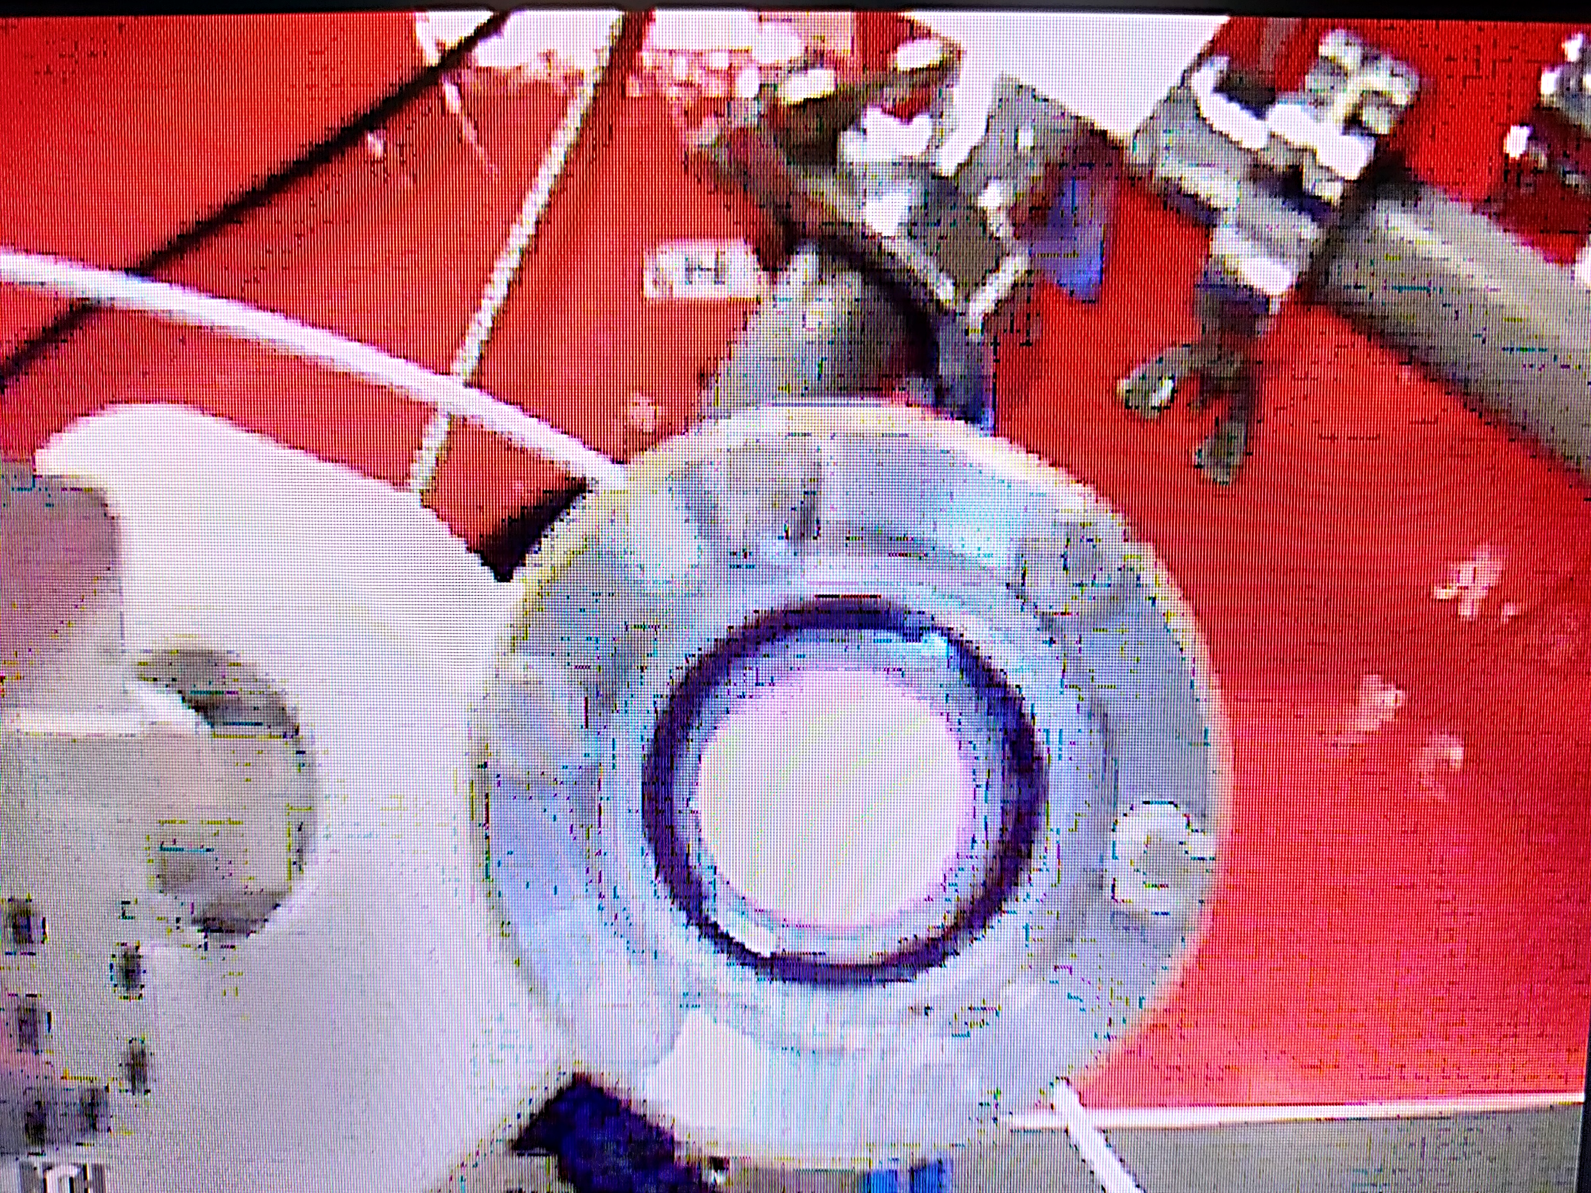




The opacity experimental design: methods and setup
Interferometric branch
y
D. Mascali et al., Review of Scientific Instruments 87, 095109 (2016)
TWT – microwave amplifier
Interferometry: the density determination is based on the phase‐shift induced by the plasma refractive index
Gas injection valve
Waveguide system
z
Magnetic field coils
PLASMA ON
Corrective system for incoming light
VIS spectroscopy system
Optical fiber
Lens system OUT
Lens system IN
Optical fiber
Gas injection valve
x
NIST calibrated halogen lamp + corrective system
Spectrometer + CCD detector (OES)
Oven inlet
Plasma (gas buffer + metal)
Horn antenna
Chamber
18-26 GHz signal source
Oven (for metals)
Spectrum Analyzer (interferometry)

Slide 15
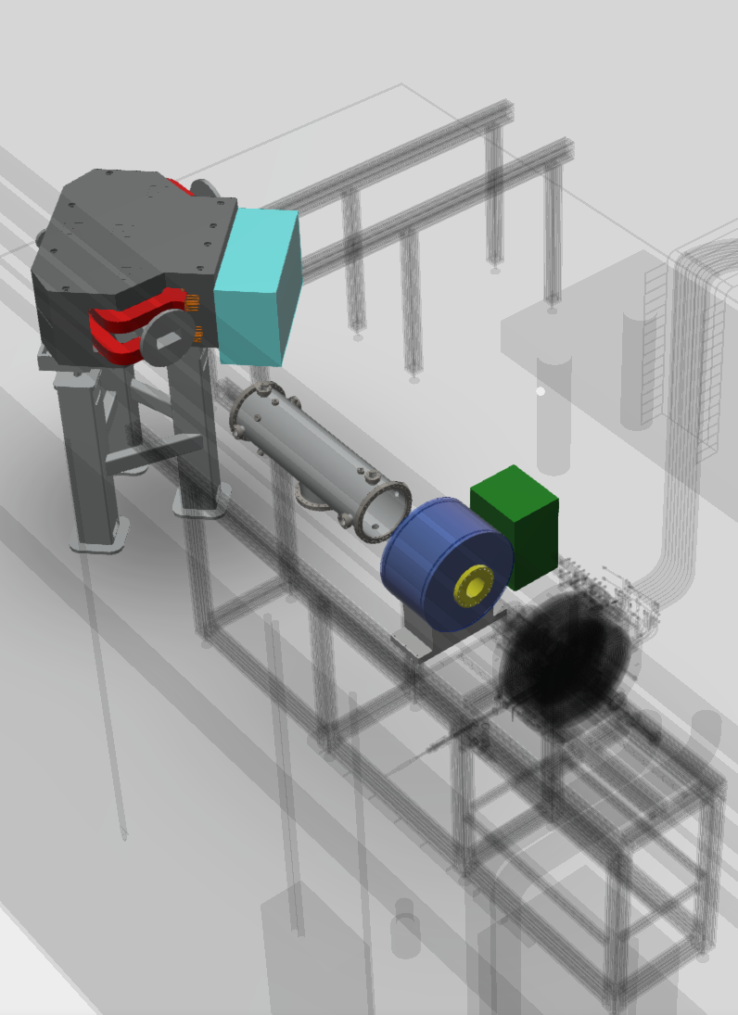
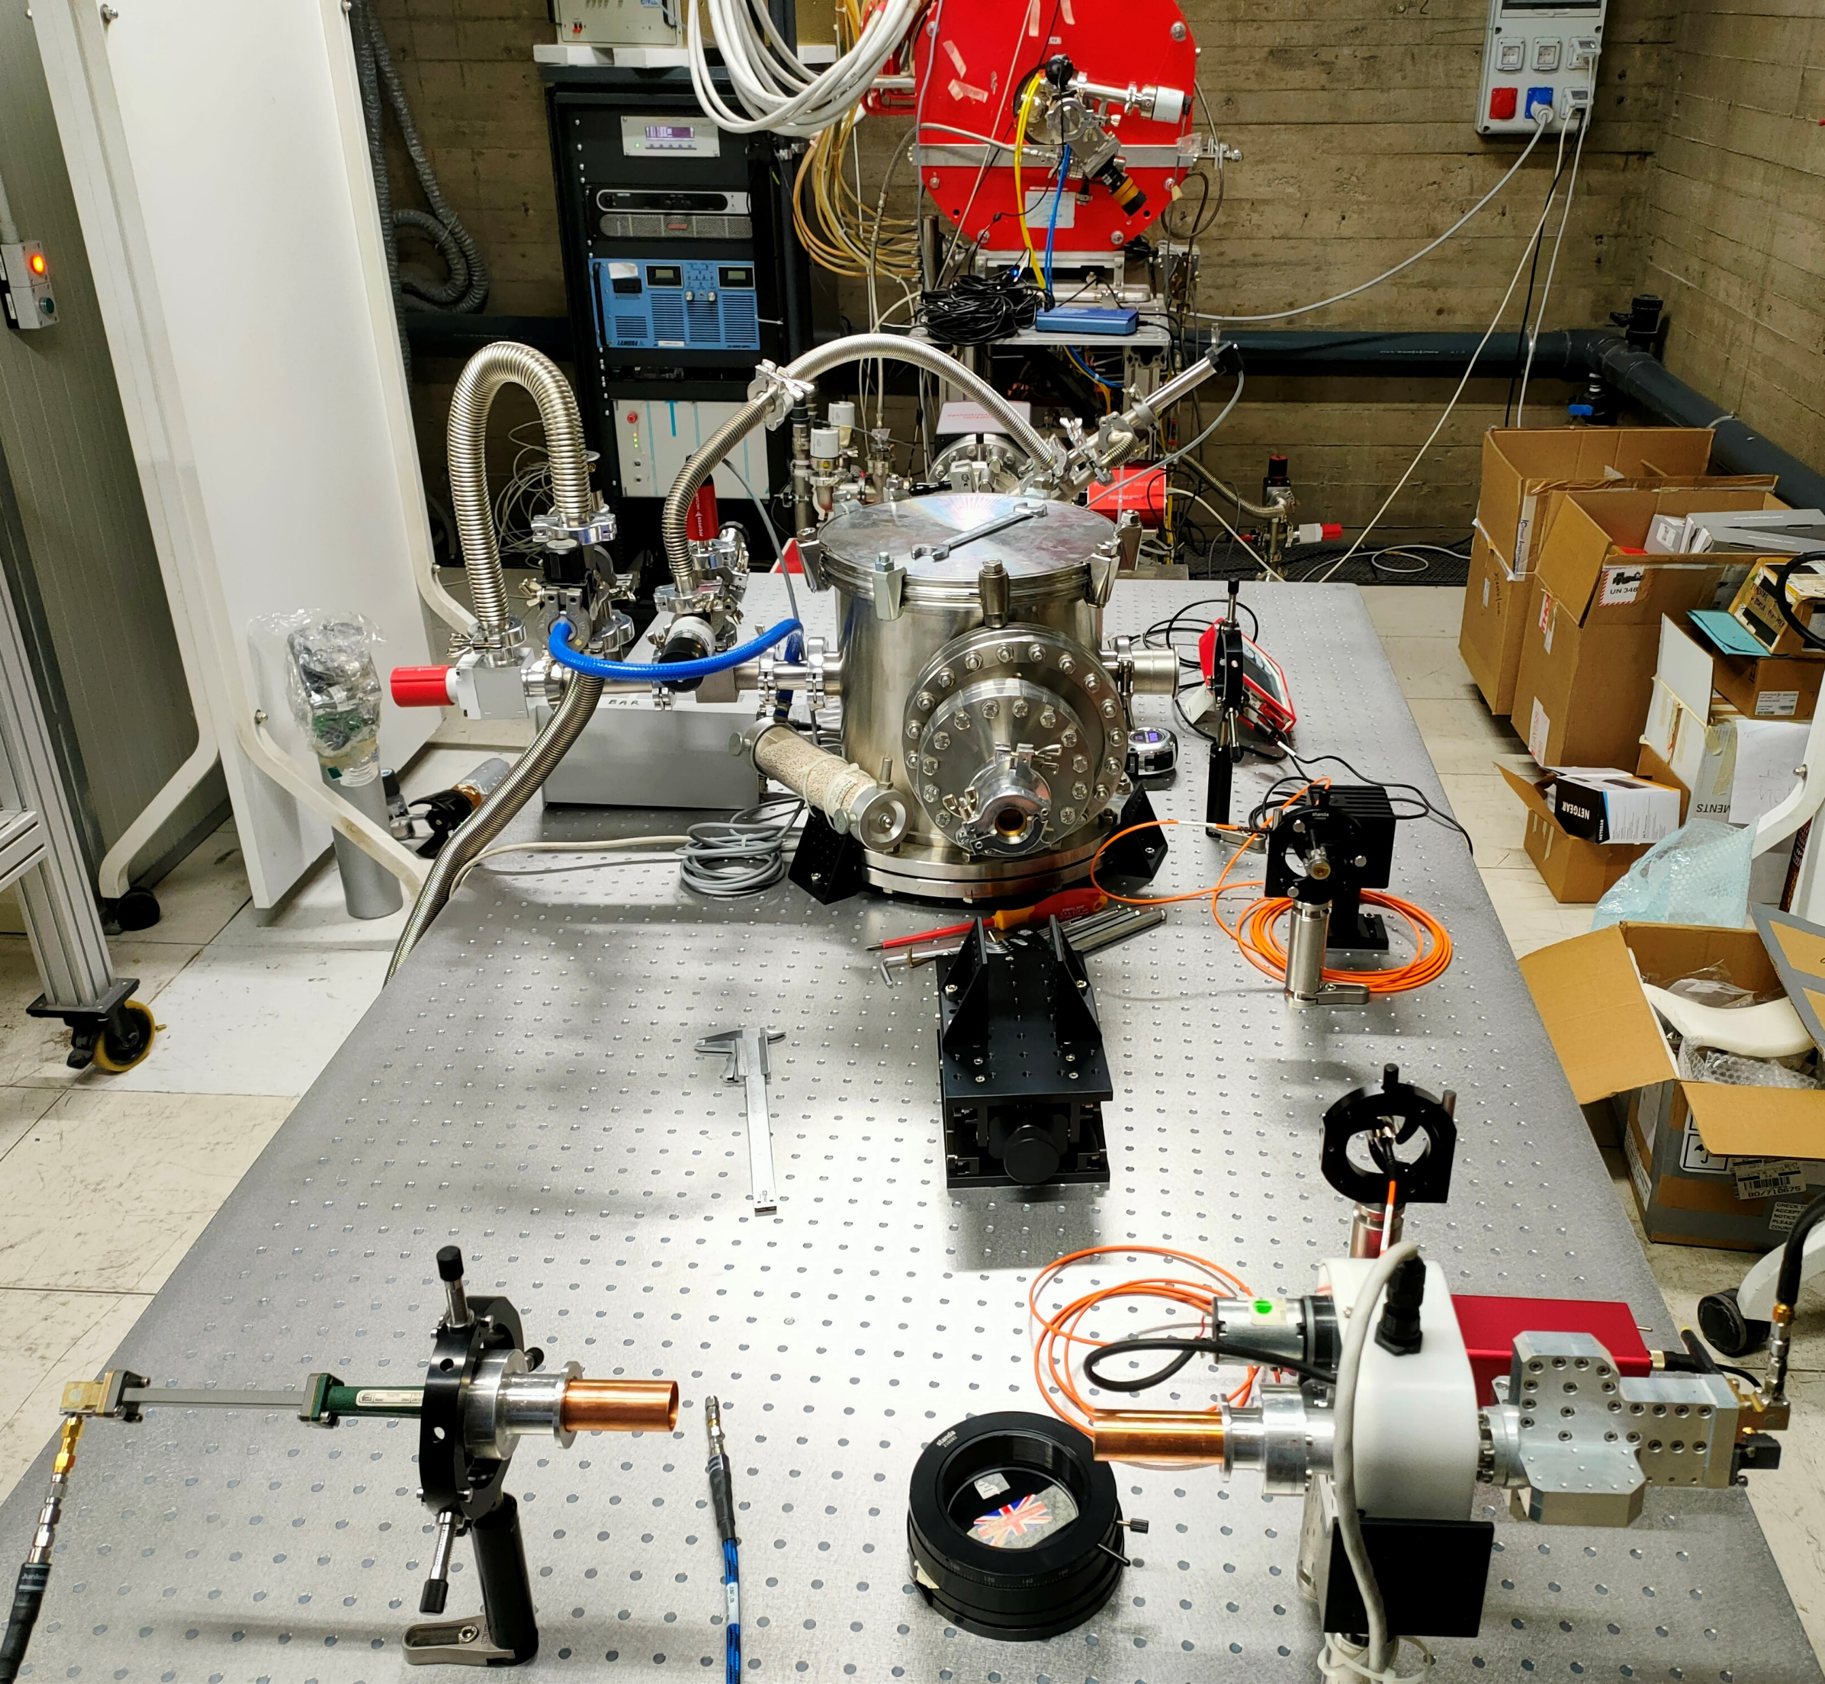
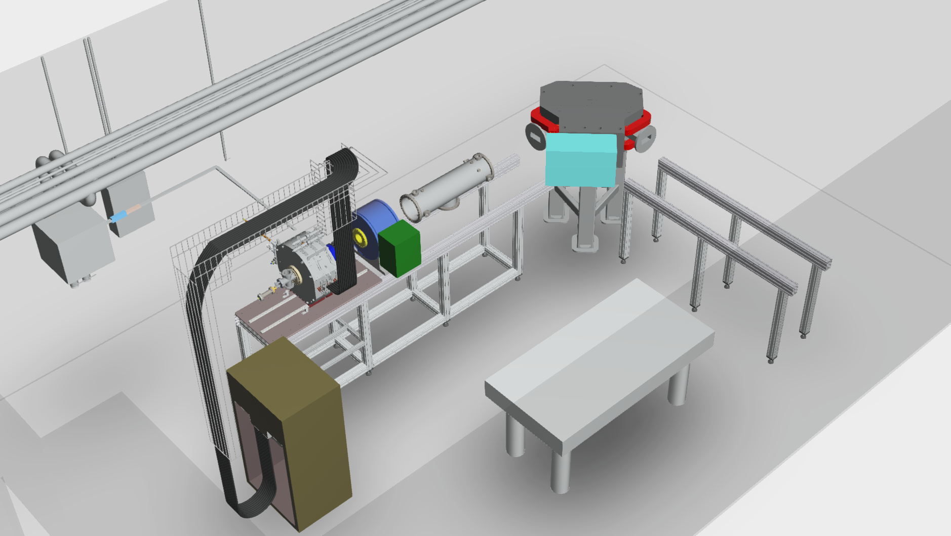
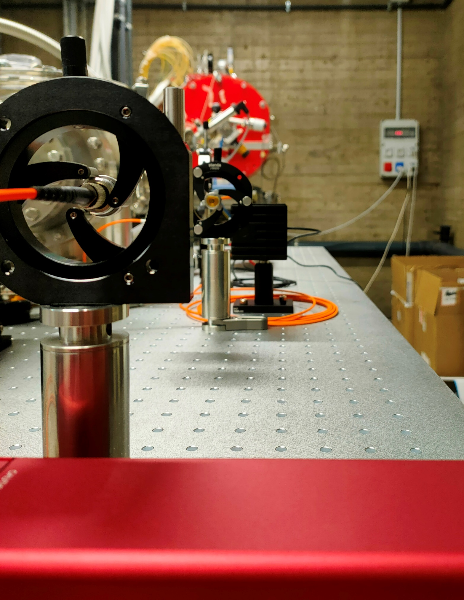
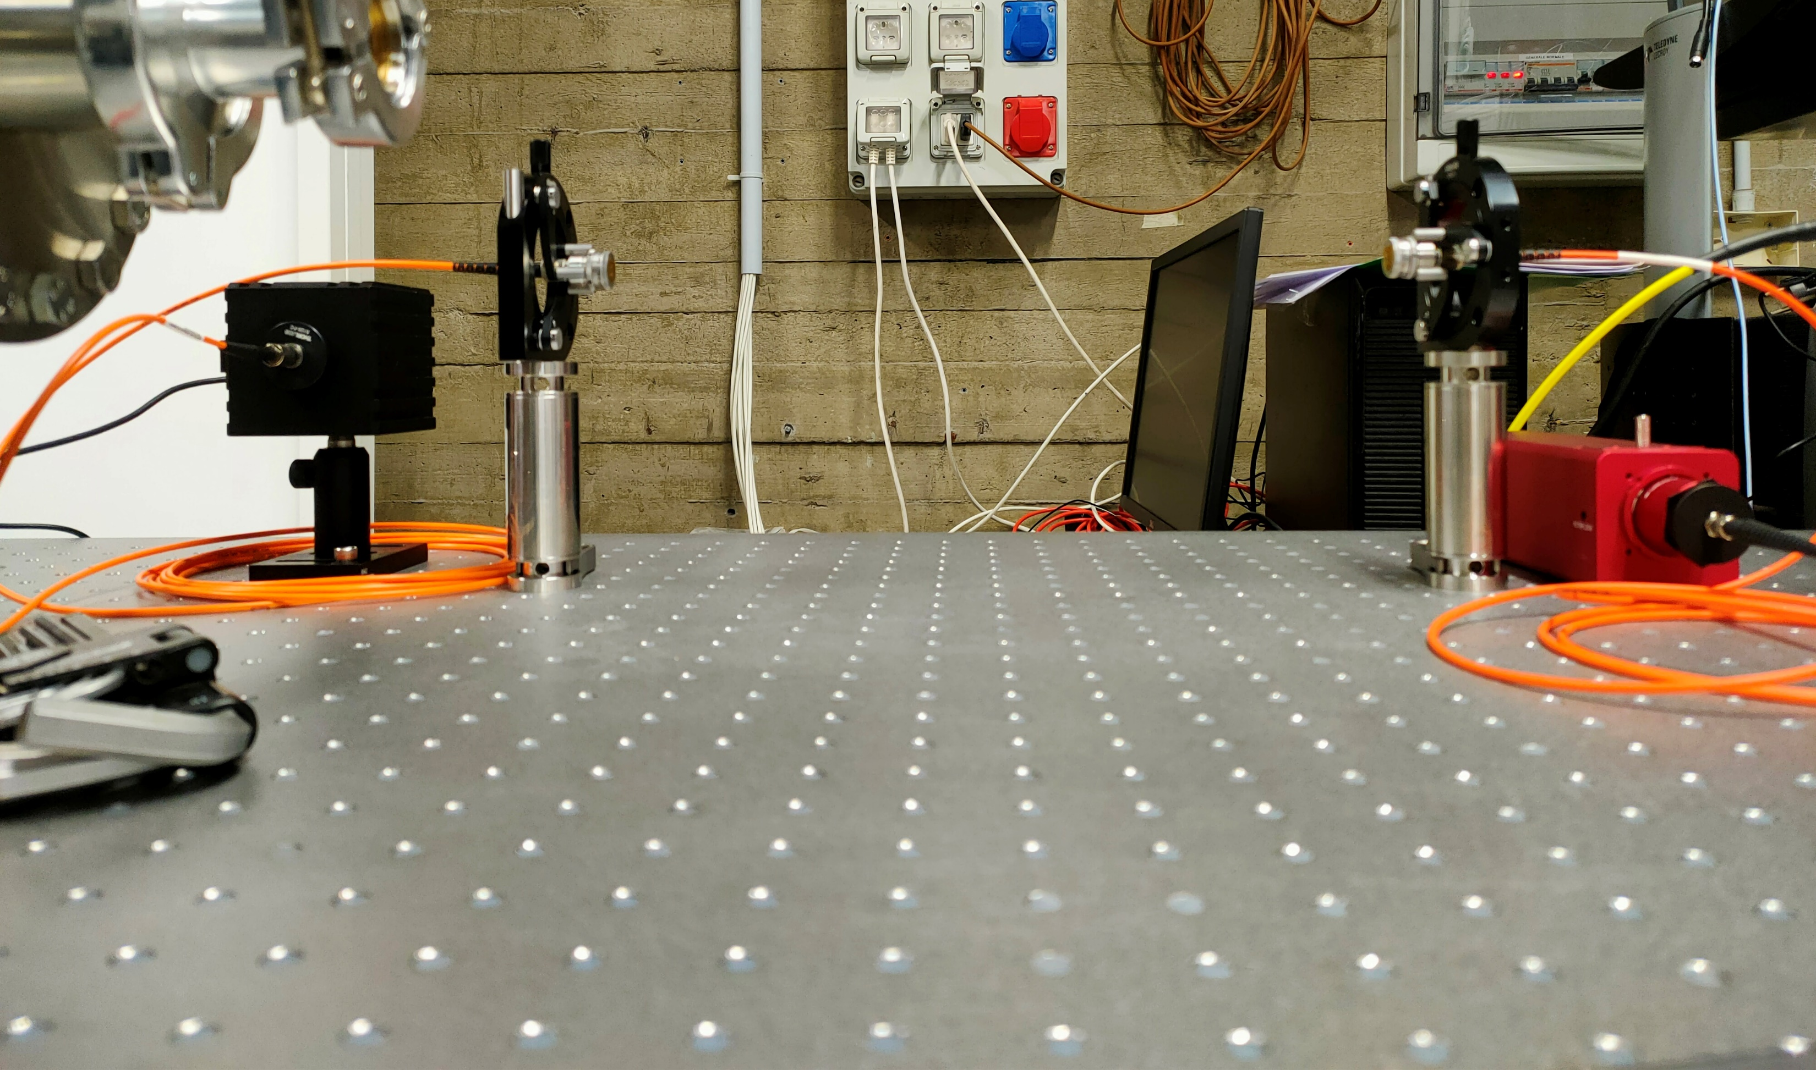
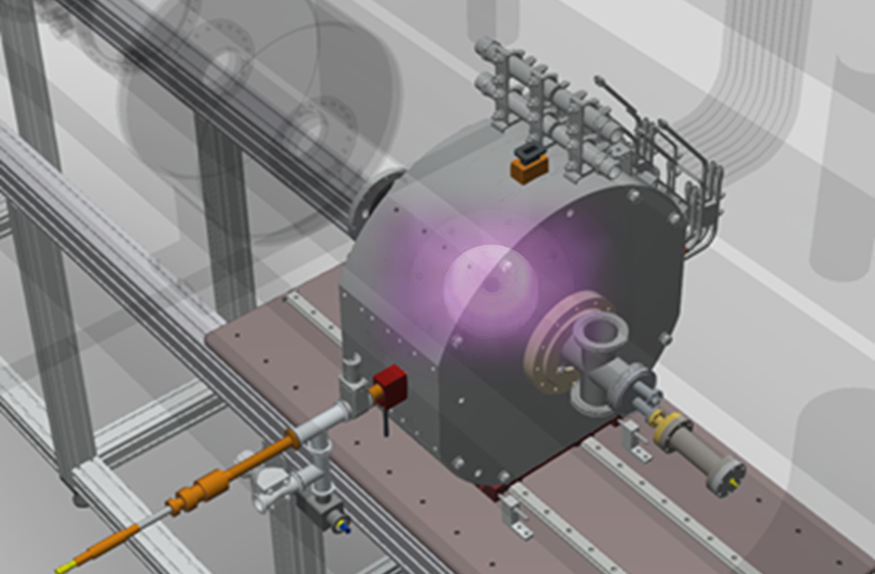
The opacity experimental design: methods and setup
FPT
Mass spectrometer
Beam line
Multi-diagnostic test-bench on the FPT
Lens 1
Lens 2
Lens 2
Lens 1
Plasma trap
Halogen lamp
Calibrated power meter for calibration and alignement
Metallic evaporator
Halogen lamp
Plasma diagnostic box

Slide 16
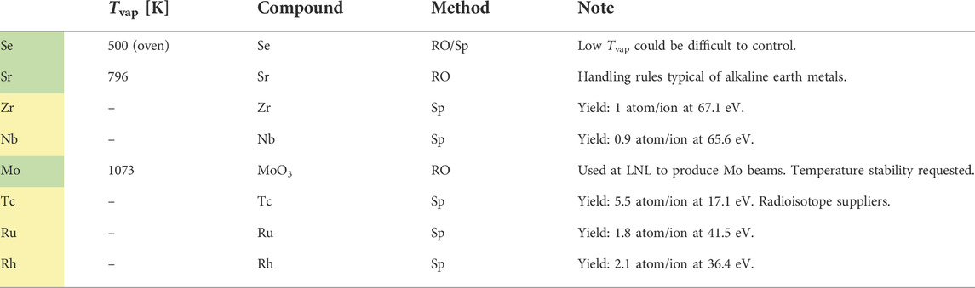

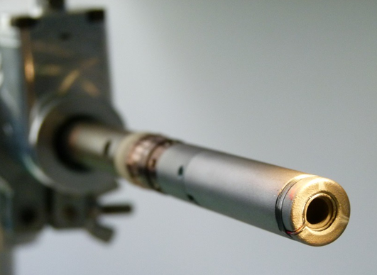
The opacity experimental design: methods and setup
Se
Sr
Wishlist: day-1 measurements
Zr
Nb
Mo
Tc
Ru
Rh
  Why? → Relevant absorption feature in VIS spectrum to be compared with KN observation and theoretical calculations
  How? → Different techniques of metal injection in plasma;
  → Diagnostics of plasma parameters;
  → Diagnostics of relative charge state distribution of metal in the plasma;
  → Detection of VIS-NIR transmittance spectrum
Feasibility
  Two degrees of investigation:
  Single-specie plasma opacity @ KN plasma conditions under NLTE – only light-r process elements!
  Single-specie plasma opacity @≠ KN plasma conditions – both light- and heavy-r process elements – to extrapolate and test (N)LTE opacity models/atomic data at the state-of-the-art

Slide 17
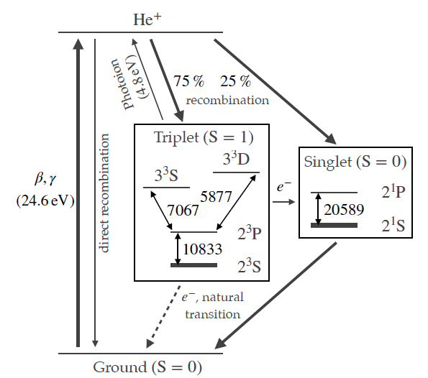
The opacity experimental design: methods and setup
Testing the method and protocol: day-0 measurement
First transmittance measurements @ FPT using He buffer (not mixed), no metallic species
Why He? – relation to the KN scenario
    (2023) Helium 10833 Å line can be an alternative explanation of the feature of P-Cygni profile used to fit AT2017gfo
    Find that 0.2% (in mass) of Helium in the ejecta can reproduce the P-Cygni feature in the observed spectrum at 1.43 -- 4.40 days under non-LTE plasma conditions
    (2024) debated inconsistency of P-Cygni spectrum if using He-I: when NLTE conditions become important?

Slide 18
What’s next? – summary and outlooks
Experimental activities
  VERY SOON! - First transmittance in plasma (Helium): interesting for astrophysical benchmark on speculated He-I absorption line @ 1083 nm in the AT2017gfo KN spectrum
  Opacity measurements of metallic species ( Se, Sr, Zr ) @ FPT, PANDORA at INFN – LNS (Italy)
Simulation activities
  Development of 3D Monte Carlo Collisional Radiative (3D-MCCR) model coupled to self-consistent ECR plasma dynamics (electrons and ions) via PIC simulations
  Atomic calculations: increasing/improving the knowledge on atomic processes
  Radiative transfer calculations for in-laboratory plasmas supporting experimental transmittance measurements – looking forward to blend plasma simulations with possible 1D/3D NLTE models of KN spectra
Talk by M. Bezmalinovich

Slide 19
What’s next? – summary and outlooks
Opacity of NSM ejecta key point to be unraveled for KNe studies and experimental efforts are highly desired. PANDORA could offer the conditions for controlled experiments in laboratory plasmas reproducing blue-KN conditions as well as for testing KN atomic models under NLTE conditions.
PANDORA will be a first-of-its-kind multi-diagnostic facility: designed spectroscopic opacity measurements, coupled to complementary diagnostics for plasma parameters and profiles.
Multiple exciting on-going activities (numerical and experimental) for first-of-its-kind plasma opacity measurements of gaseous and metallic species.

Slide 20







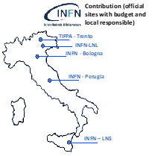










What’s next? – summary and outlooks
Thank you very much for your attention!!
Also collaborating in the nuclear fusion research programme for the Divertor Tokamak Test (DTT) project

Slide 21




BACKUP
To describe the excitation and de-excitation processes which occur in a plasma, population models are needed
Collisional-Radiative (CR) model: intermediate density 1e¹⁶<n_{e}<1e²⁰ m-3, detailed balance of direct-inverse process
Several code suite/tool for CR calculations:
  YACORA - https://www.yacora.de/help
  FLYCHK - https://nlte.nist.gov/FLY/
  CHIANTI - https://www.chiantidatabase.org/cug.html
  TITAN - Collin-Souffrin S., Dumont S., 1986, A&A, 166, 13
  MOCASSIN - https://mocassin.nebulousresearch.org/
  CLOUDY - https://aa.oma.be/cloudy
  and many more…
Used for? Line ratios plasma characterization; spectral analysis with radiation transfer in collisional/photoionised plasmas
Why so many? Collisional vs. photoionised plasma models; different atomic database (NIST; FAC; HULLAC; …); high vs. low- spectral resolution; LTE vs. NLTE; real plasma structure; self-consistent spectral energy distribution; radiative transfer solver; plasma dynamics

Slide 22



BACKUP
Radial X-ray pinhole camera
14 HpGe γ-ray detector array
70 cm
PANDORA
SDD detector
Superconductive magnetic system
28 cm
Gas injection
ECR heating surface
ECR plasma
Microwaves igniting and sustaining plasma, 5 kW and 18-21 GHz
Extraction line - diagnostic
Fiber for optical spectrometry
Min-B field providing MHD-stability and plasma confinment

Slide 23


BACKUP
Volumetric soft and hard X-ray temperature and density
Average density and temperature, line ratios
Line-integrated density
Tomographic info on density and temperature
On-line monitoring of all plasma parameters (density, T, CSD)
Investigation of the plasma properties in all energetic domains
Performing high-resolution spatial and time resolved analysis

Slide 24



BACKUP
Integrated X-ray imaging: volumetric detail, plasma volume
Single-Photon Counting X-ray imaging: space- and spectral-resolved detail
3
2
1
Spatially-Resolved Spectroscopy and Spectrally-Resolved Imaging
D Mascali et al., Plasma Physics and Controlled Fusion 64(3):035020
Jan. 2022, DOI: 10.1088/1361-6587/ac4349
E. Naselli et al 2022 JINST 17 C01009

Slide 25







BACKUP
Hydrogen spectrum
Optical imaging and spectroscopy by Optical Emission spectroscopy
Plasma emitted RF radiation measurements
  $$H_{α}$$
Semi-empirical quantitative characterization of plasma instability strength in different configurations
Studying TCFH as instability damper
Plasma parameters from cold electrons, plasma core volume, confinement dynamics
  $$H_{γ}$$
  $$H_{β}$$
E. Naselli et al., JINST 14, 2019, C1008
S. Biri et al., JINST 16 (2021) 02006
E. Naselli et al 2022 JINST 17 C01009

Slide 26






BACKUP
Plasma modelling: ion dynamics transport → studying CSD in plasma for space-resolved β-decay + detailed atomic physics
  B Mishra, et al., Frontiers in Physics 10, 17, (2022)
  A Galatà, et al., Frontiers in Physics 777, (2022)
Argon buffer gas CSD (left) and plasma density and energy (right)
Metallic species in plasma charge state distribution: via PIC+MC simulations
Preliminary step: 3D collisional ionisation/excitation + spontaneous emission (corona model) - dependency on 3D self-consistent plasma energy and density
Check case: ⁷Be for β–decay modeling
Real plasma structure and dynamics (loss) considered

Slide 27





The opacity experimental design: methods and setup
Numerical opacity vs. FPT experimental plasma parameters vs. external light source flux
SELENIUM
STRONTIUM
ZIRCONIUM
NIOBIUM

Slide 28








The opacity experimental design: methods and setup
Monitoring plasma stability from emission line ratios
Characterizing plasma density and temperature from line ratios
  $$H_{αβ}$$
  $$H_{βγ}$$
7 exp. configurations, different pressures: many spectra per cfg.
  $$H_{α}$$
Lamp-calibrated (relative, not absolute) spectra
  $$H_{γ}$$
  $$H_{β}$$

Slide 29



The opacity experimental design: methods and setup
Monitoring plasma stability from emission line ratios
Characterizing plasma density and temperature from line ratios
ESTIMATES : Average density and temperature proportional to the effective emission coefficients $χ_{λ}$.
Solving non-linear two-variables equation system from two-lines integrated ratios → cross point! Unique solution for $\left\langle ρ\right\rangle ,⟨T⟩$
  $\frac{I_{α}}{I_{β}}=\frac{η_{α}}{η_{β}}\frac{χ_{α}\left(ρ,T\right)}{χ_{β}\left(ρ,T\right)}→\left\langle ρ\right\rangle ,⟨T⟩$
Thanks to the collaboration of colleagues from MPI für Plasmaphysik and UNI-Augsburg
Theory: YACORA CR model line ratios (n,T) isosurface
Collisional Radiative (CR) model
Balance eqs. are solved considering the different mechanisms of population and de-population of atomic levels (Rate eqs.)
Exp: measured line ratios, isoline on theoretical isosurface
Pidatella, A.,et al. Frontiers in Astronomy and Space Sciences
10.3389/fspas.2022.931744 (2022)

Slide 30


The opacity experimental design: methods and setup
OES diagnostic from He? – we need plasma parameters
Plasma diagnostics: OES line ratios
CR model YACORA calculations of NLTE He-I line ratio
Helium theoretical emission line ratios vs. plasma (n, T)

