Slide 1
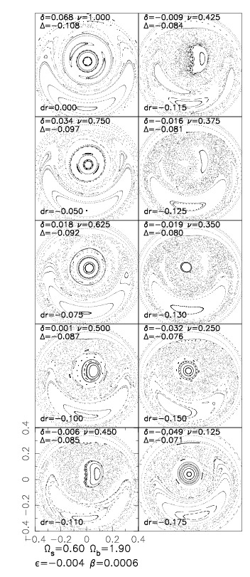
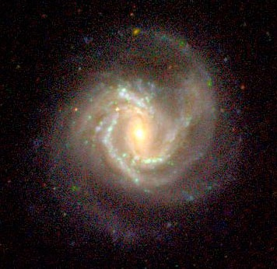
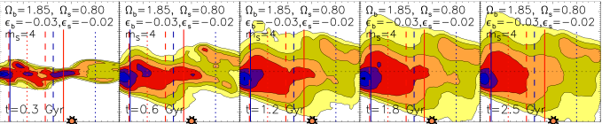

Chemical clocks and their time zones: exploring the cosmic time evolution of [s/Mg] in the Milky Way
Ivan Minchev

Slide 2
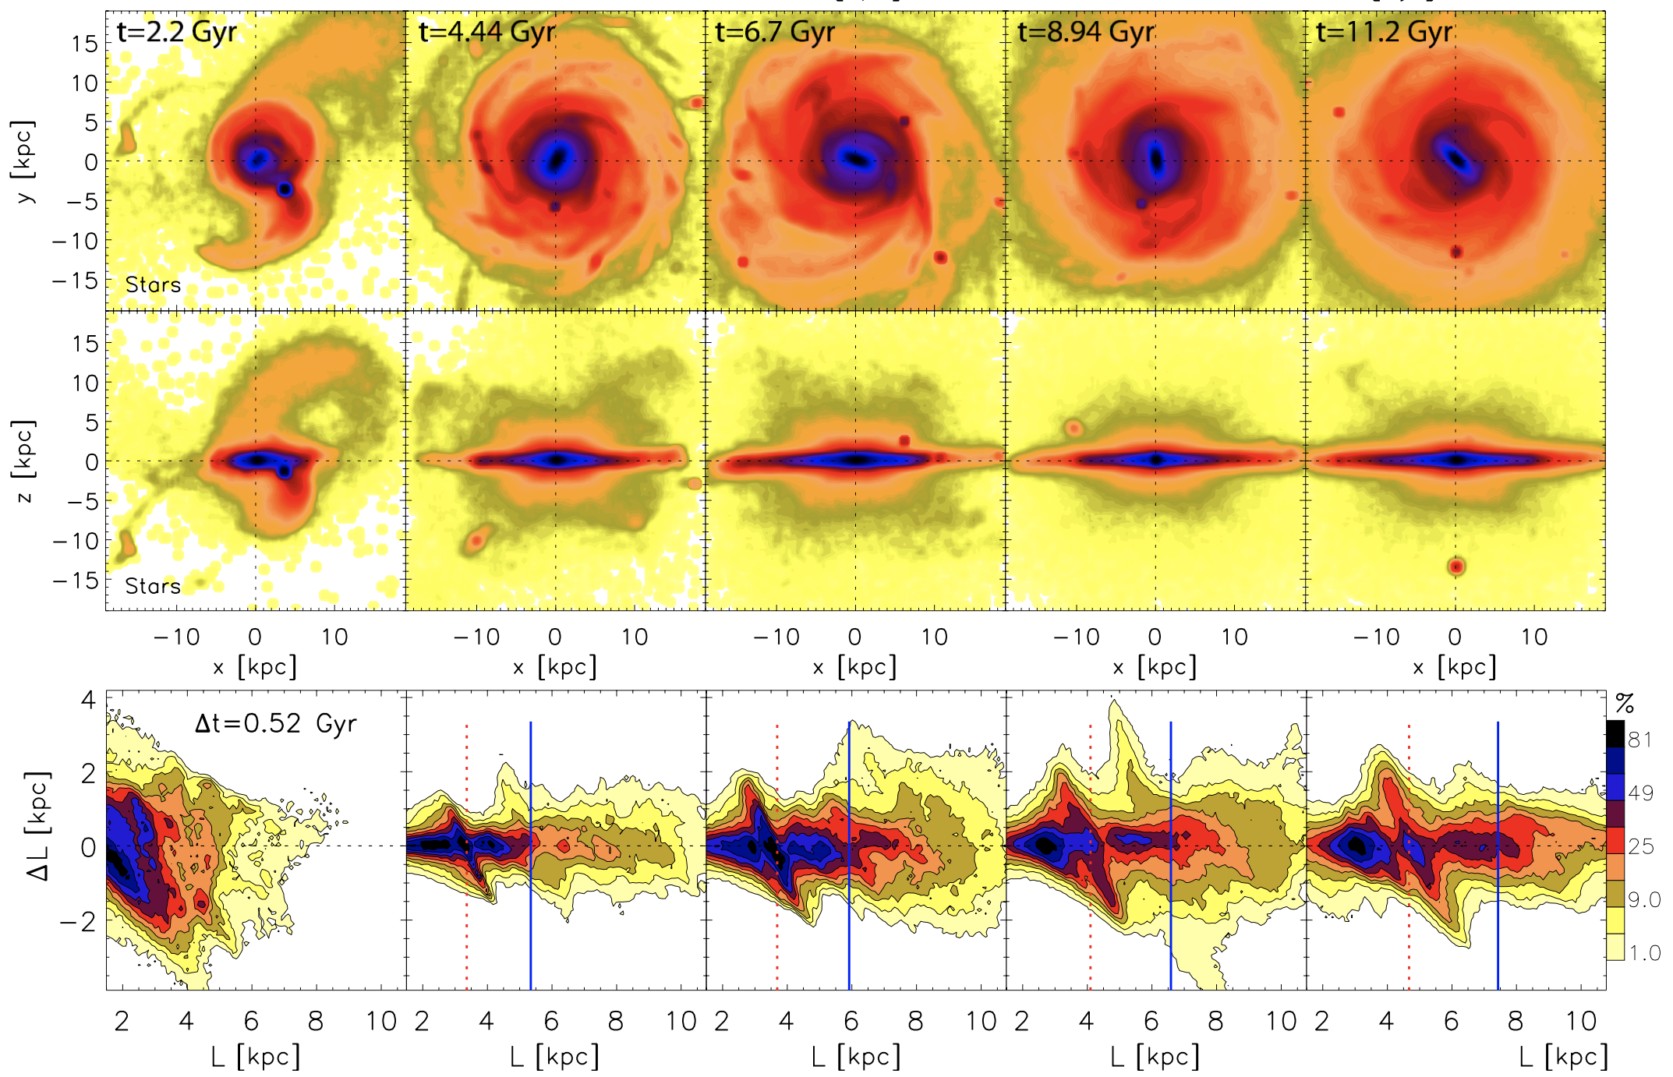

Stellar radial migration throughout the disk evolution
  Minchev + (2013)

Slide 3
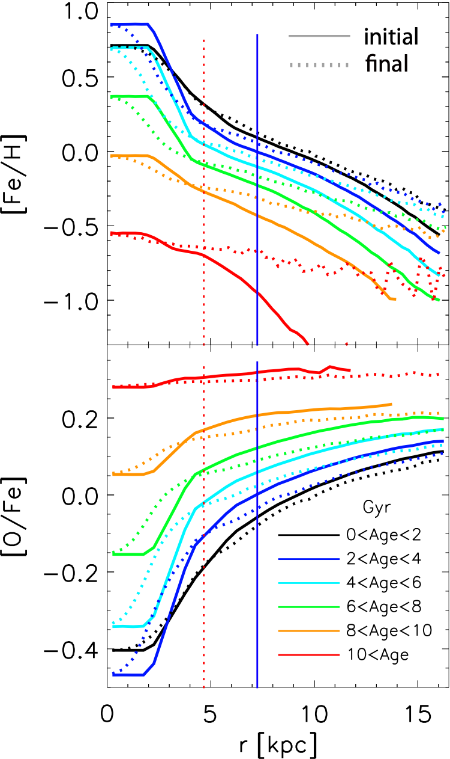


The effect of radial migration on [Fe/H] of mono-age populations
Strong impact on the old stars
young stars
In the last 2 Gyr gradients almost unaffected
old stars
Bar corotation acts as a pivot point
  Minchev + (2013)

Slide 4
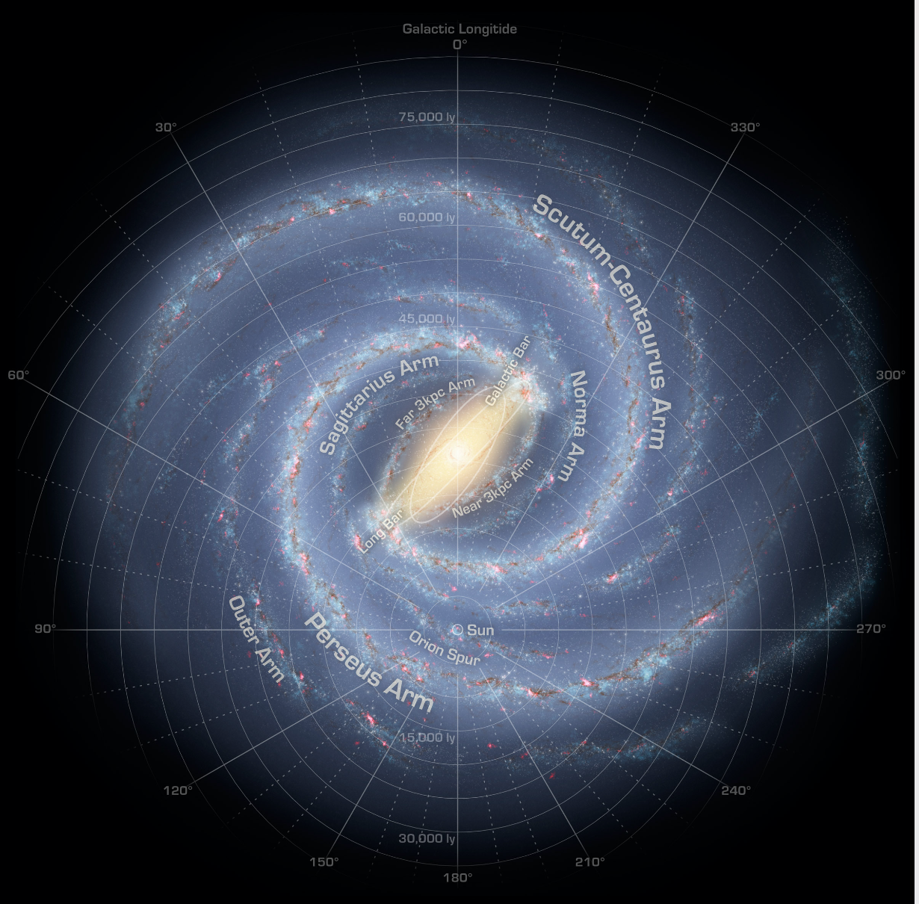
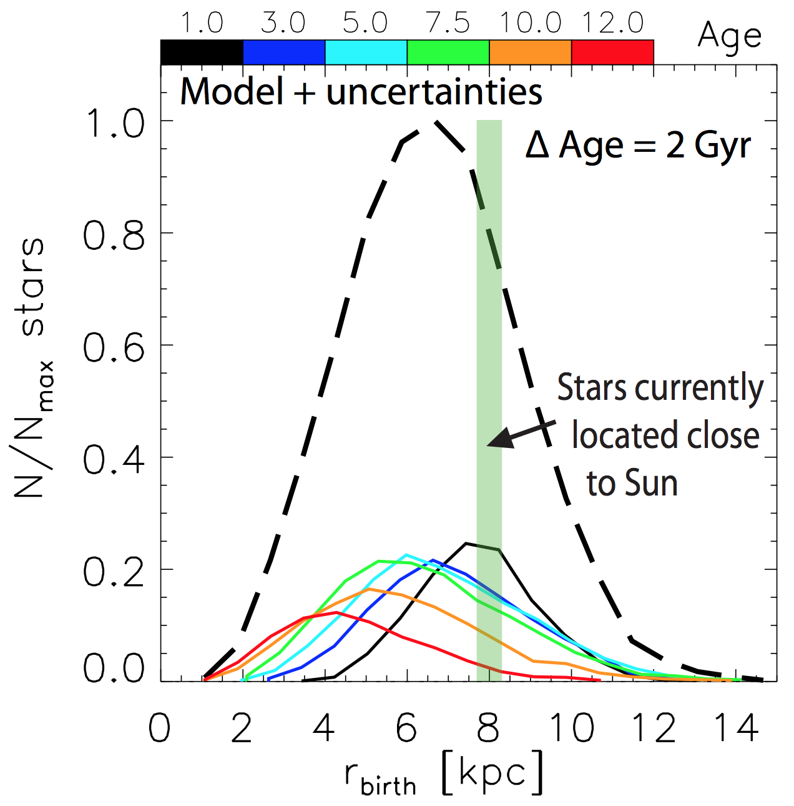
Effect of radial migration on solar neighborhood
Very local sample
does not mean
free of migrators
  Minchev + (2013)

Slide 5
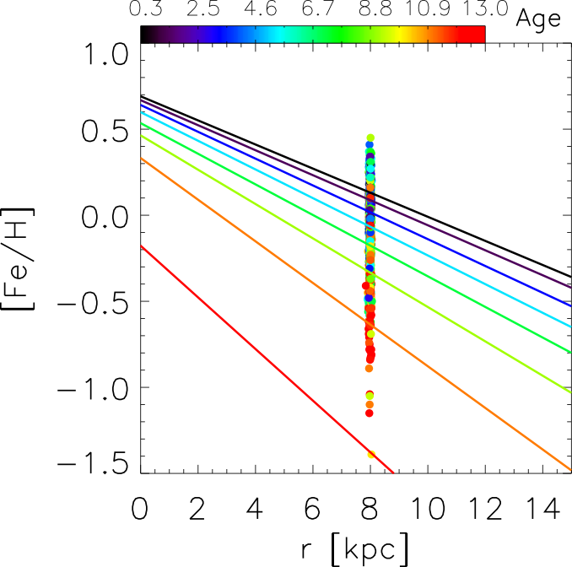
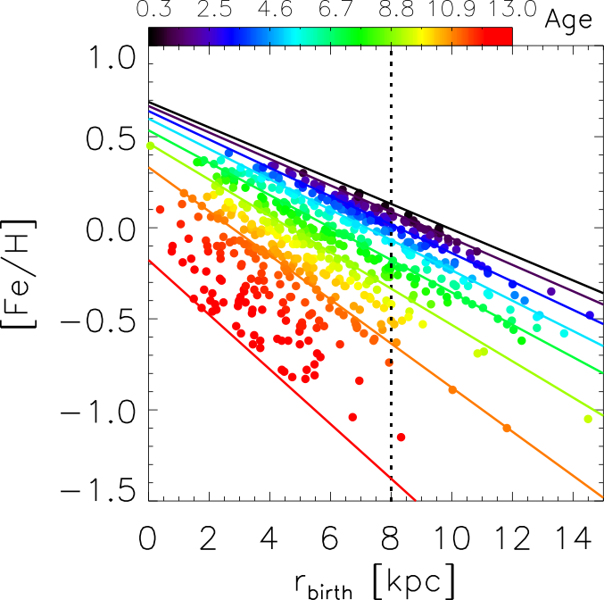
Finding the birth positions of stars
HARPS:AMBRE or HARPS-GTO isochrone ages
Only age and metallicity necessary
Assume ISM metallicity gradient evolving with time
Place stars on the slope by shifting in r according to age and [Fe/H]
HARPS sample
-0.07
?
?
?

Slide 6
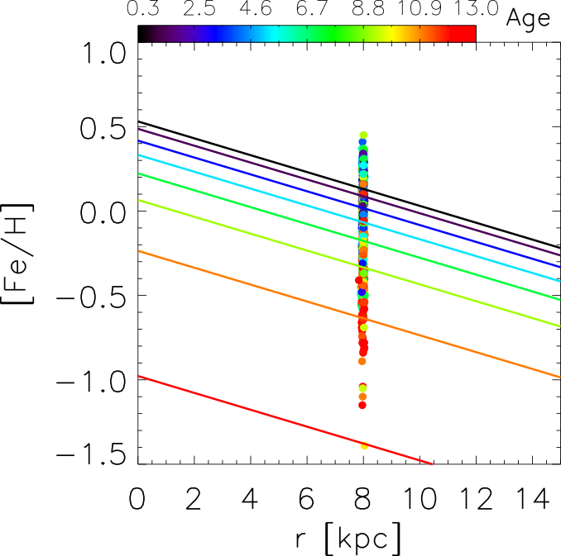
What if gradient was flatter? How flat is too flat?
HARPS:AMBRE or HARPS-GTO isochrone ages
Only age and metallicity necessary
Assume ISM metallicity gradient evolving with time
Place stars on the slope by shifting in r according to age and [Fe/H](r, t)
?
?
?

Slide 7
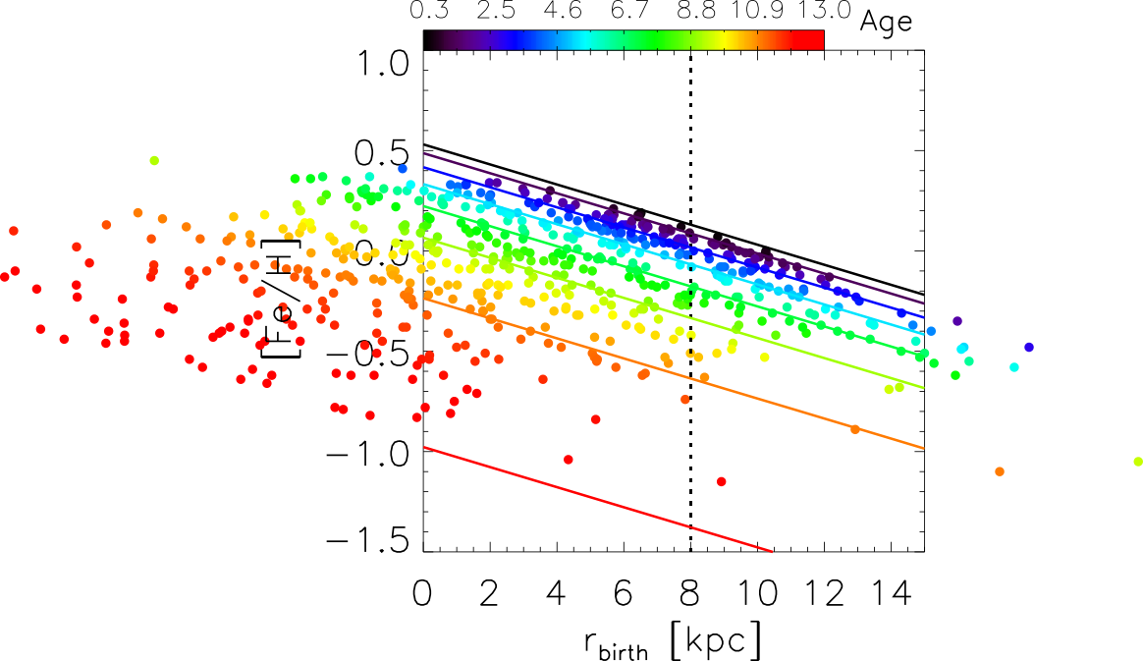
What if gradient was flatter? How flat is too flat?
HARPS:AMBRE or HARPS-GTO isochrone ages
Only age and metallicity necessary
Assume ISM metallicity gradient evolving with time
Place stars on the slope by shifting in r according to age and [Fe/H](r, t)
?
?
?
Same scatter in [Fe/H] gives wider birth radius distributions
When you start getting negative birth radii you know something is wrong

Slide 8
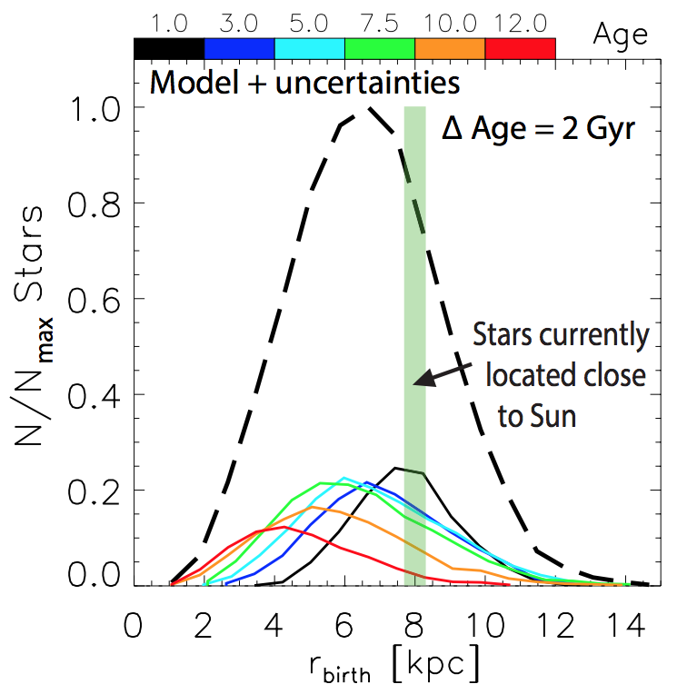
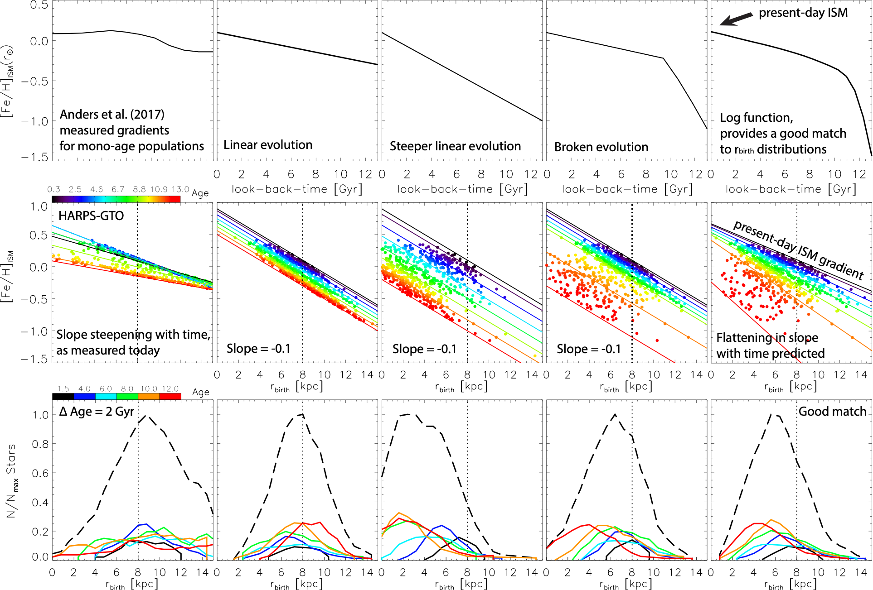
We can try different possibilities for the ISM [Fe/H](r, t)
Time evolution
of [Fe/H] at Rsol
-0.07
Time evolution
of [Fe/H] slope
Starting to look good
Typical Model
Birth radii of mono-age populations

Slide 9
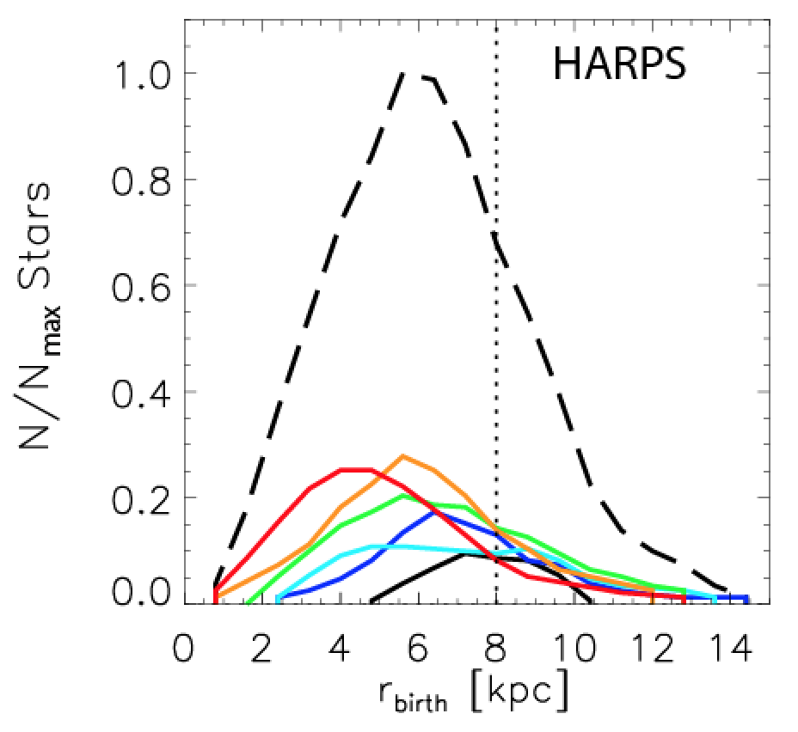
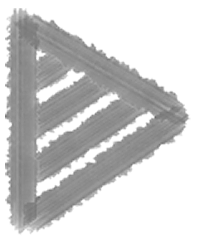
Steep initial ISM metallicity consistent with:
Classical chemical evolution models: Cescutti et al. (2007); Chiappini (2009); Grisoni, Spitoni & Matteucci (2018)
Cosmological sims: Pilkington et al. (2012); Gibson et al. (2013); Vincenzo & Kobayashi (2018)
Hybrid models: MCM13, Kubryk et al. (2015), Prantzos et al. (2023)
Best ISM [Fe/H](r, t) match
A semi-empirical, largely model-independent approach
HARPS data
Model
-0.07
present-day ISM gradient
-0.15
[Fe/H] slope sets the spread of mono-age rbirth distributions
[Fe/H] time evolution at a given r sets the rbirth peak position

Slide 10
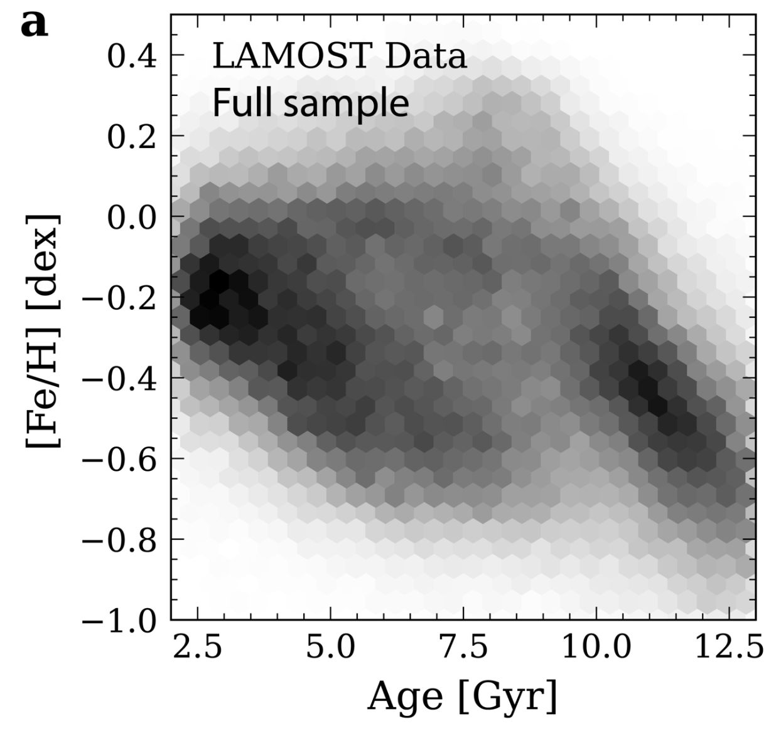
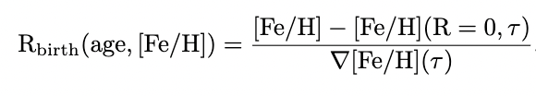
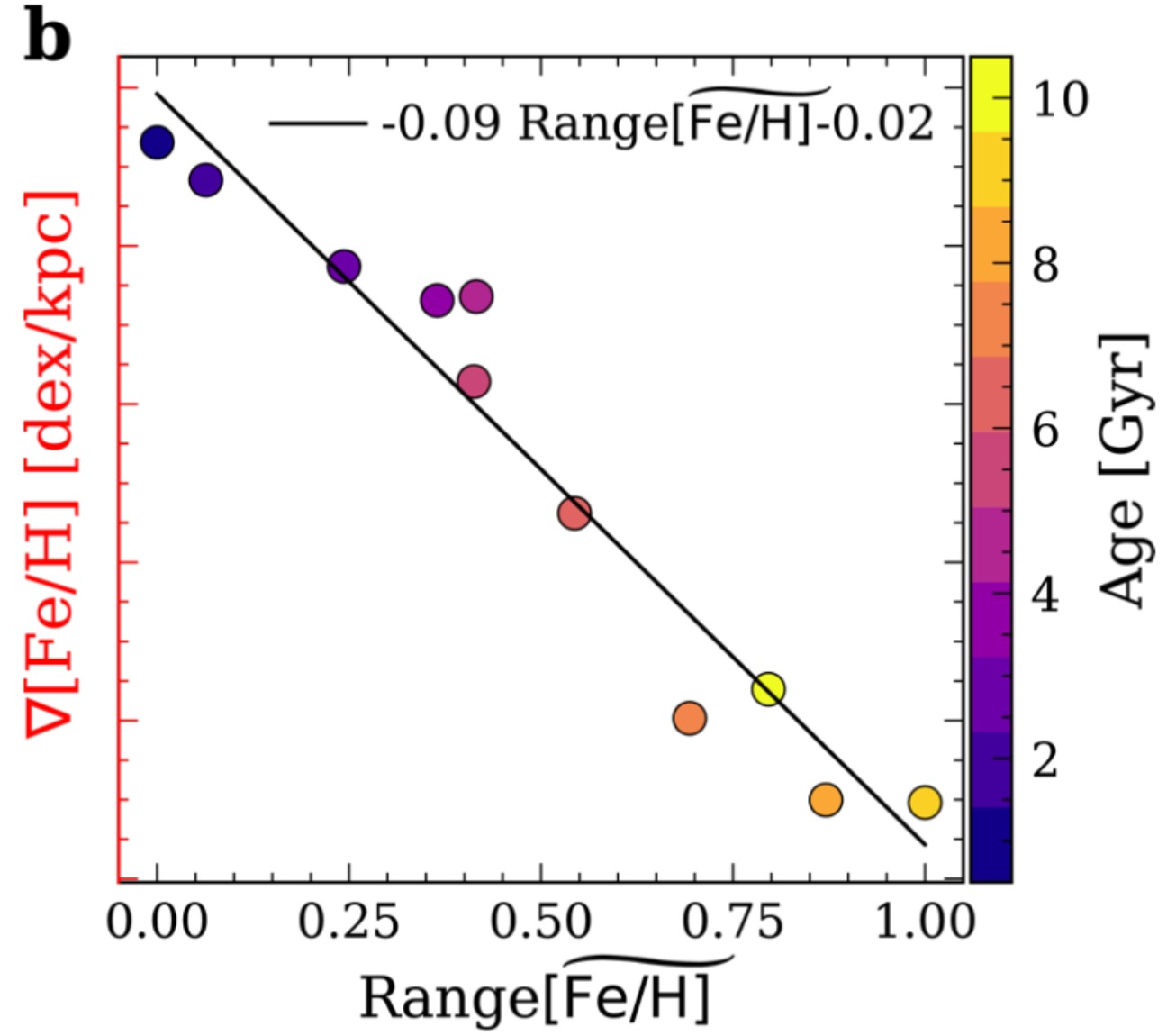
small [Fe/H] range = weak gradient
large [Fe/H] range = steep gradient
weaker
gradient;
small range
[Fe/H]
stronger
gradient;
big range
R_{birth}

Slide 11
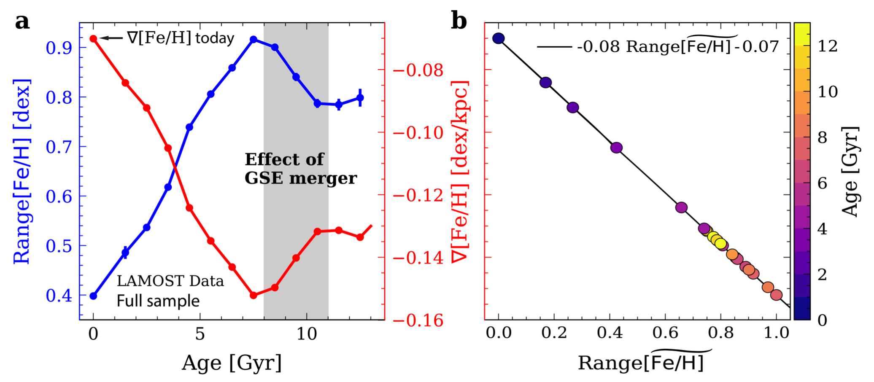
A linear relation between
the [Fe/H] range in AMR and
the [Fe/H] birth gradient
Effect of GSE (Helmi et al. 2018)?
Lu, Minchev et al. (2022)

Slide 12
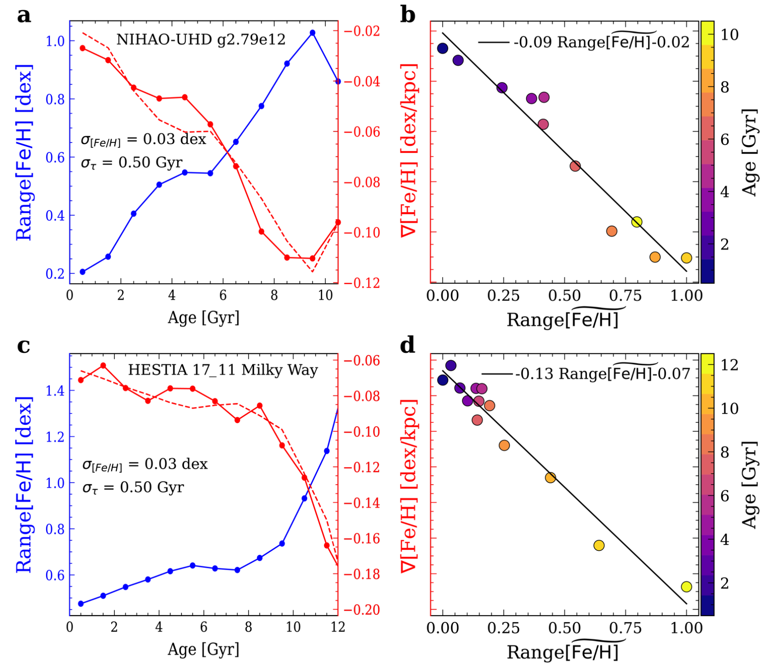
Relation expected from various cosmological simulations
Buck et al. (2019)
err resulting from using a linear model: ~8-10%
Libeskind et al. (2020)
Lu, Minchev et al. (2024)

Slide 13
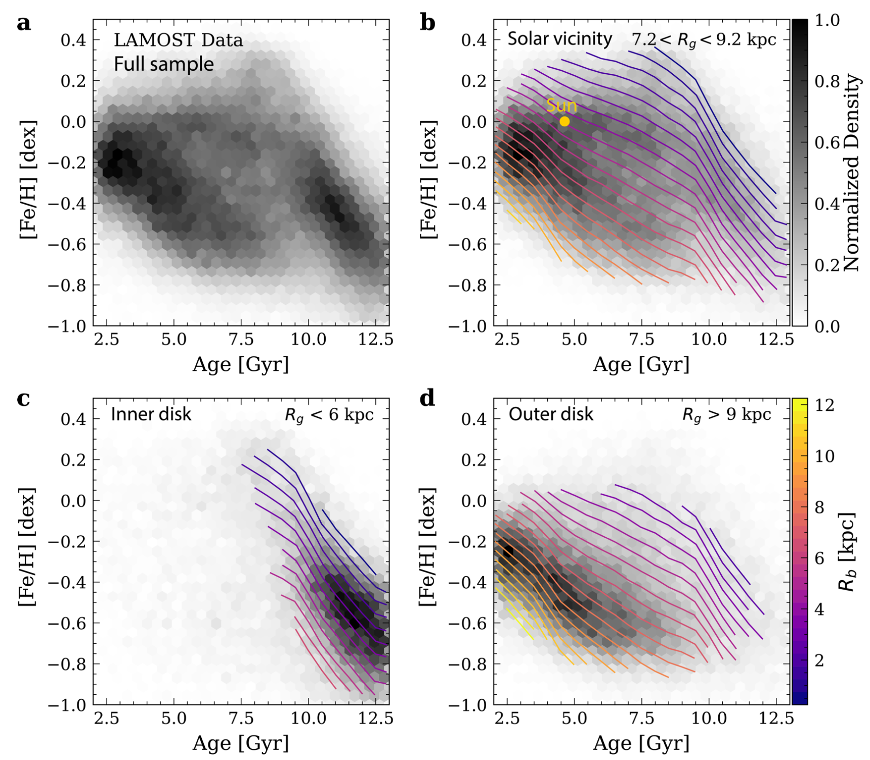
Birth radius tracks in the AMR
Sun born at R = 4.5 ± 0.5
Old ridge belongs to the inner disk and the young one to the outer disk

Slide 14
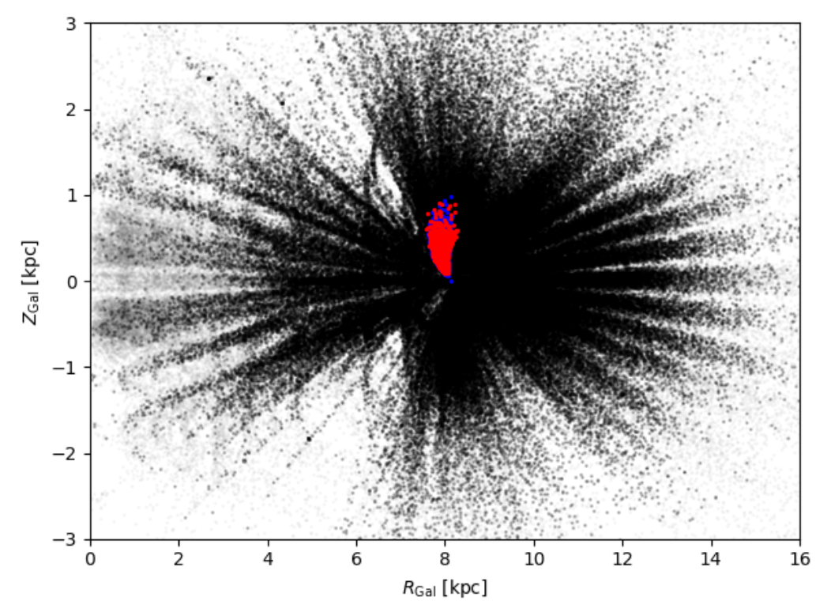
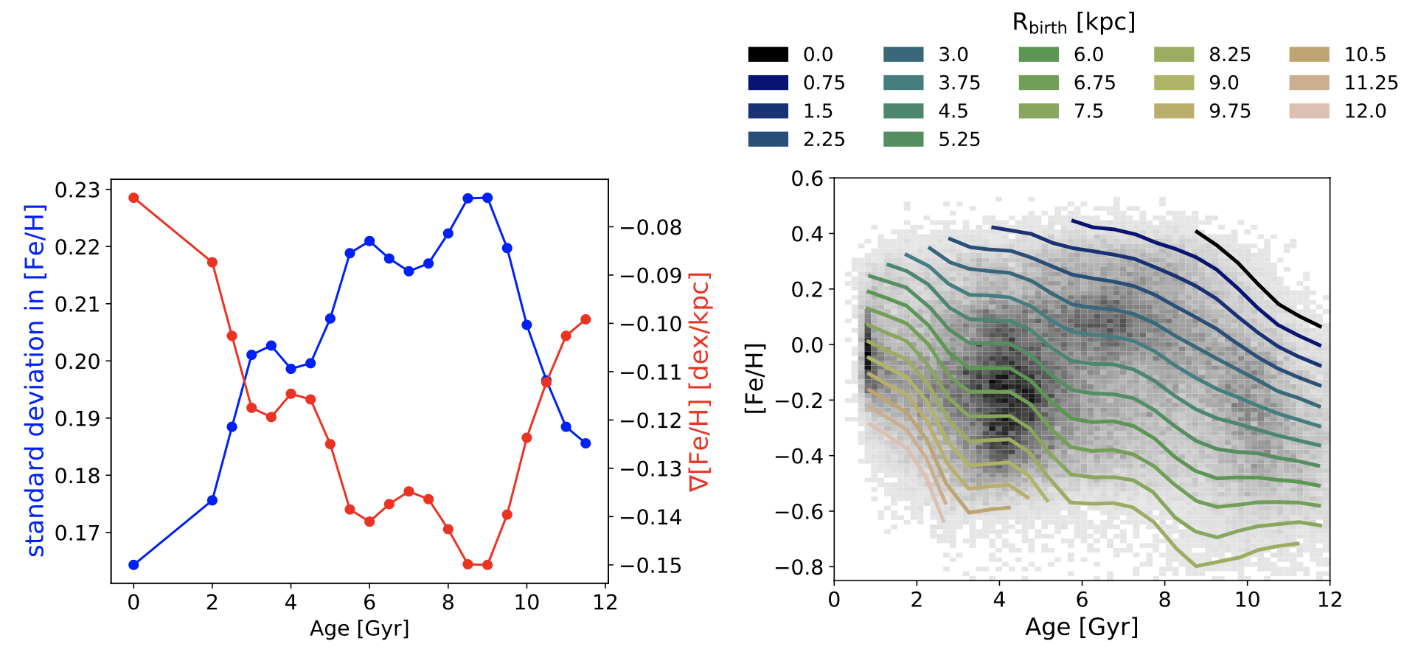
Application to APOGEE DR17 red giants
Spectroscopic ages for ~145K stars, trained on Kepler asteroseismic ages (Anders et al. 2023)
Ratcliffe, Minchev et al. (2024)

Slide 15
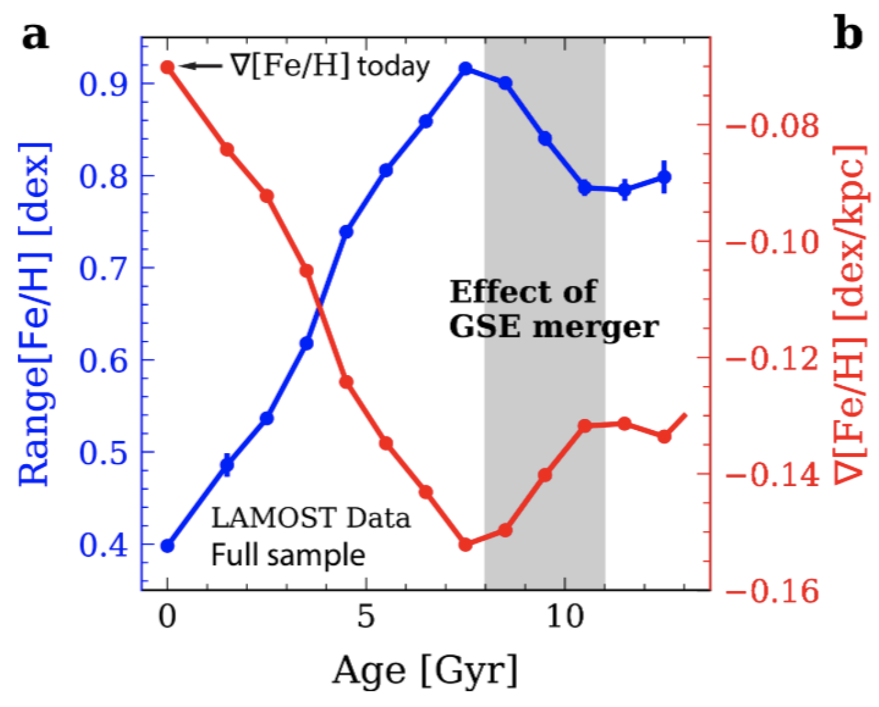
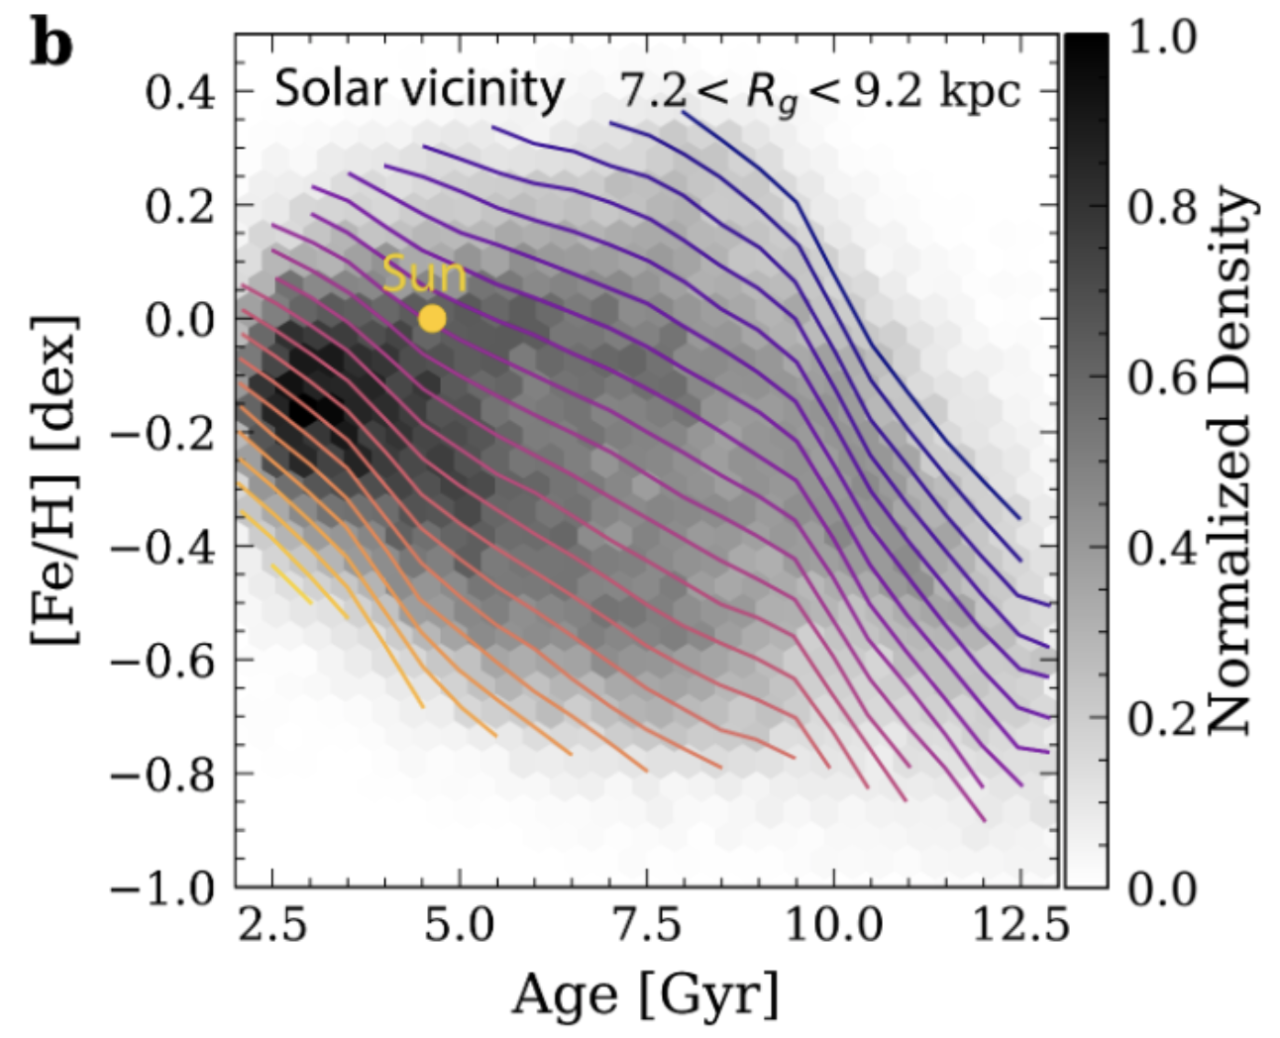
Application to APOGEE DR17 red giants
Spectroscopic ages for ~145K stars, trained on Kepler asteroseismic ages (Anders et al. 2023)
Lu, Minchev et al. (2022)
GSE
Sgr
Ratcliffe, Minchev et al. (2024)

Slide 16
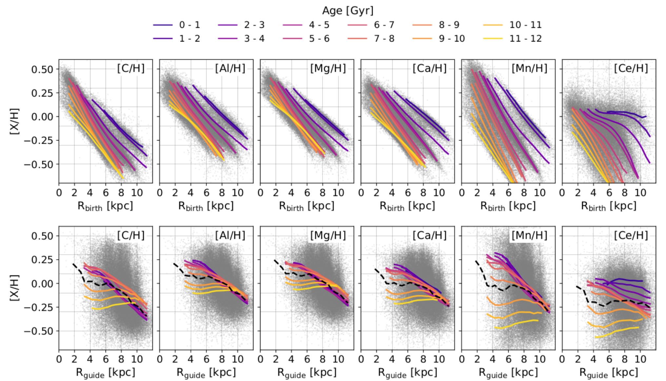
[X/H] evolution with R and cosmic time
Ratcliffe, Minchev et al. (2024)

Slide 17
[X/H] evolution with R and cosmic time
cosmic time
Ratcliffe, Minchev et al. (2024)

Slide 18
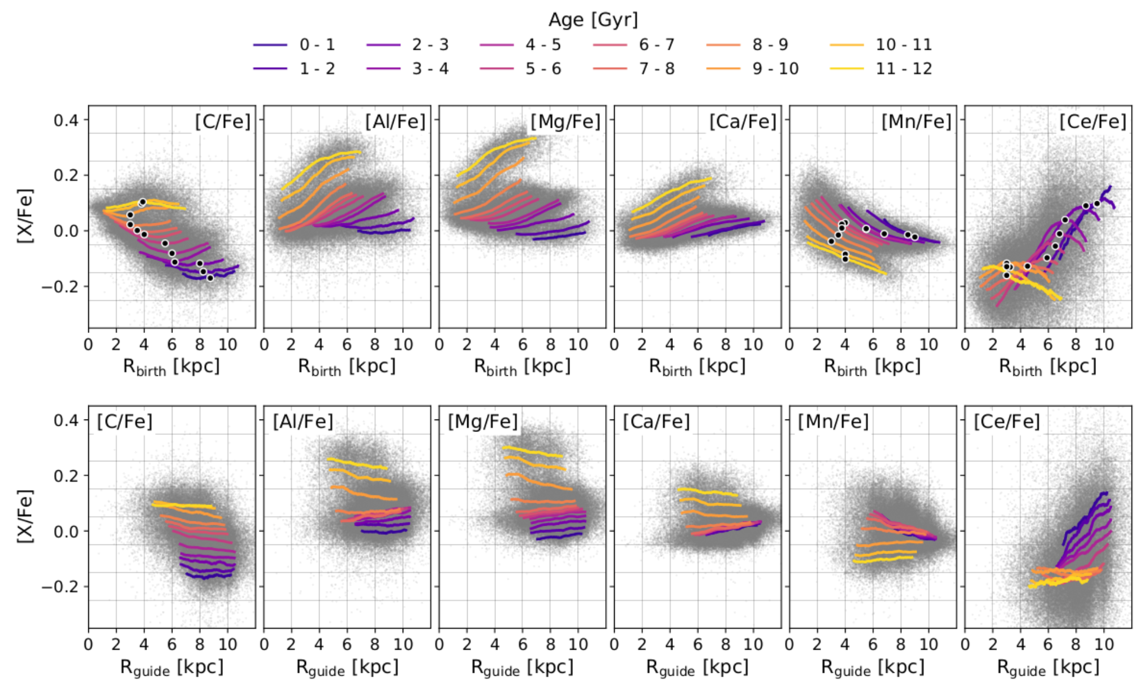
[X/Fe] evolution with R and cosmic time
cosmic time
Ratcliffe, Minchev et al. (2024)

Slide 19
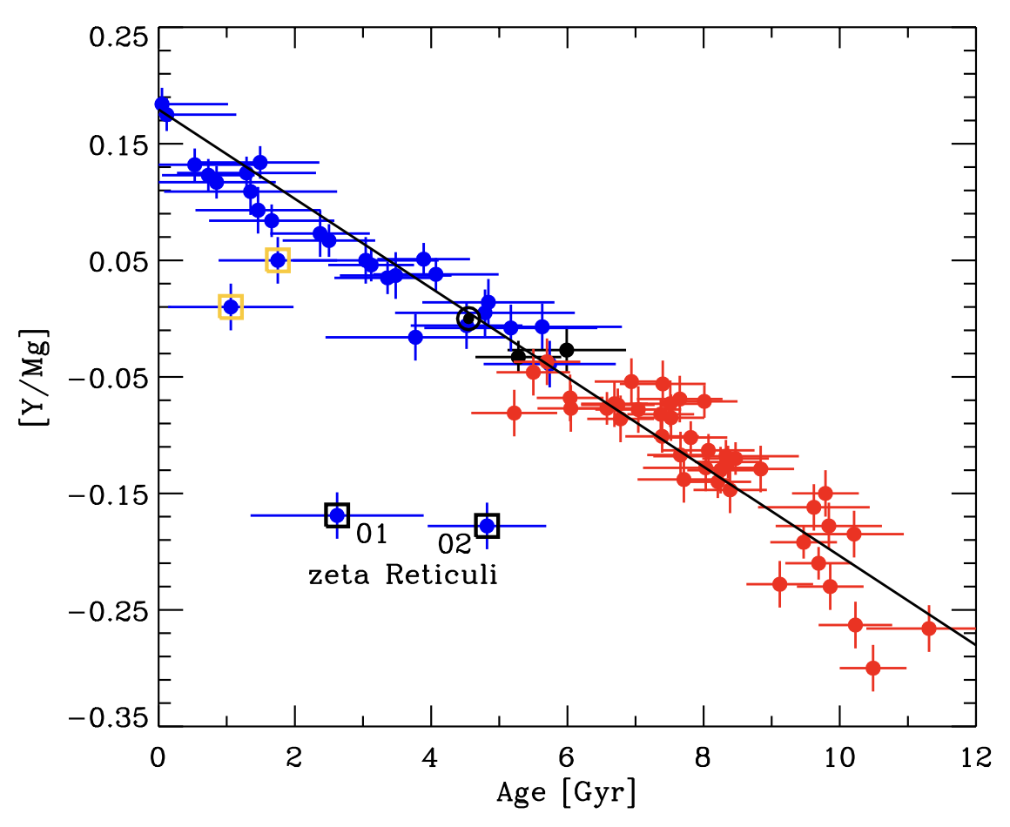
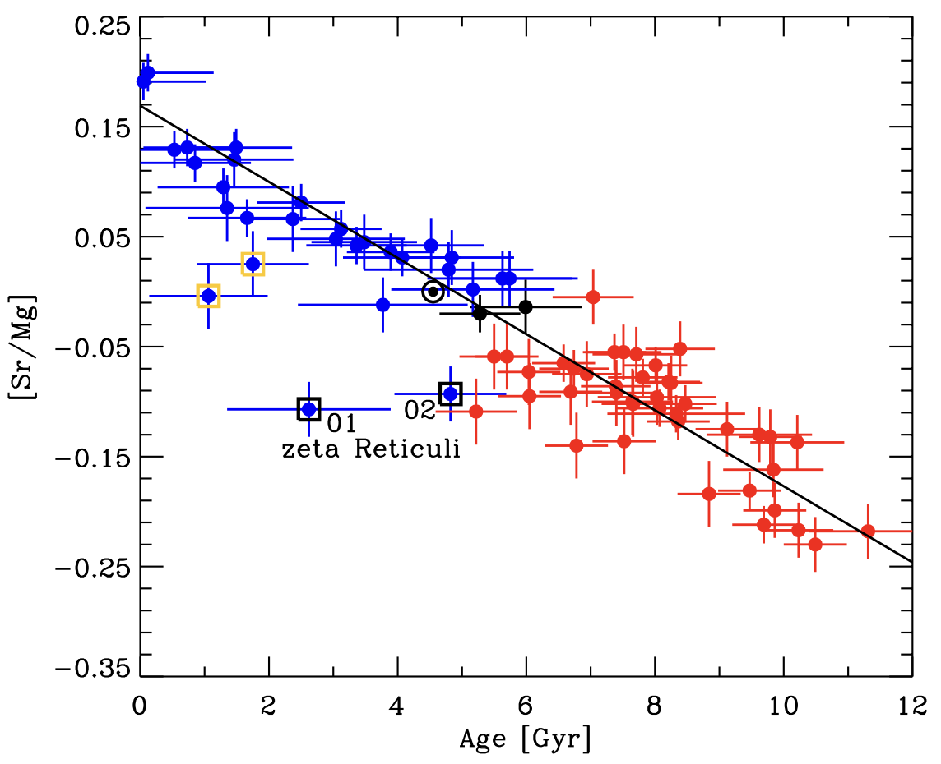
Chemical clocks?
−0.3 < [Fe/H] < +0.3
Linear relation in [Y/Mg] with age, yey!
However, dependent
  on location in the Galaxy (Casali et al. 2020; Casamiquela et al. 2021; Viscasillas Vazquez et al. 2022)
  on metallicity (Delgado Mena et al. 2017; Feltzing et al. 2017; Sales-Silva et al. 2022)
Nissen et al. (2020)

Slide 20
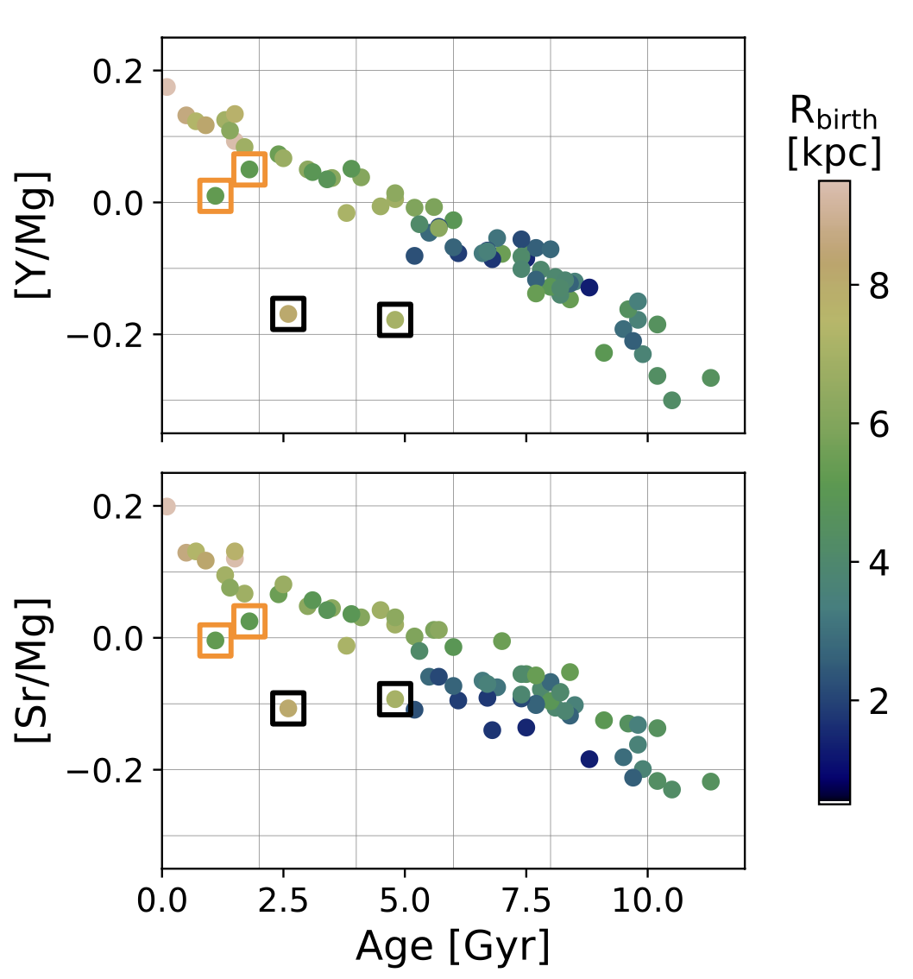
Chemical clocks?
Colored by birth radius
−0.3 < [Fe/H] < +0.3
Nissen et al. (2020)
Ratcliffe, Minchev et al. (2024b)

Slide 21
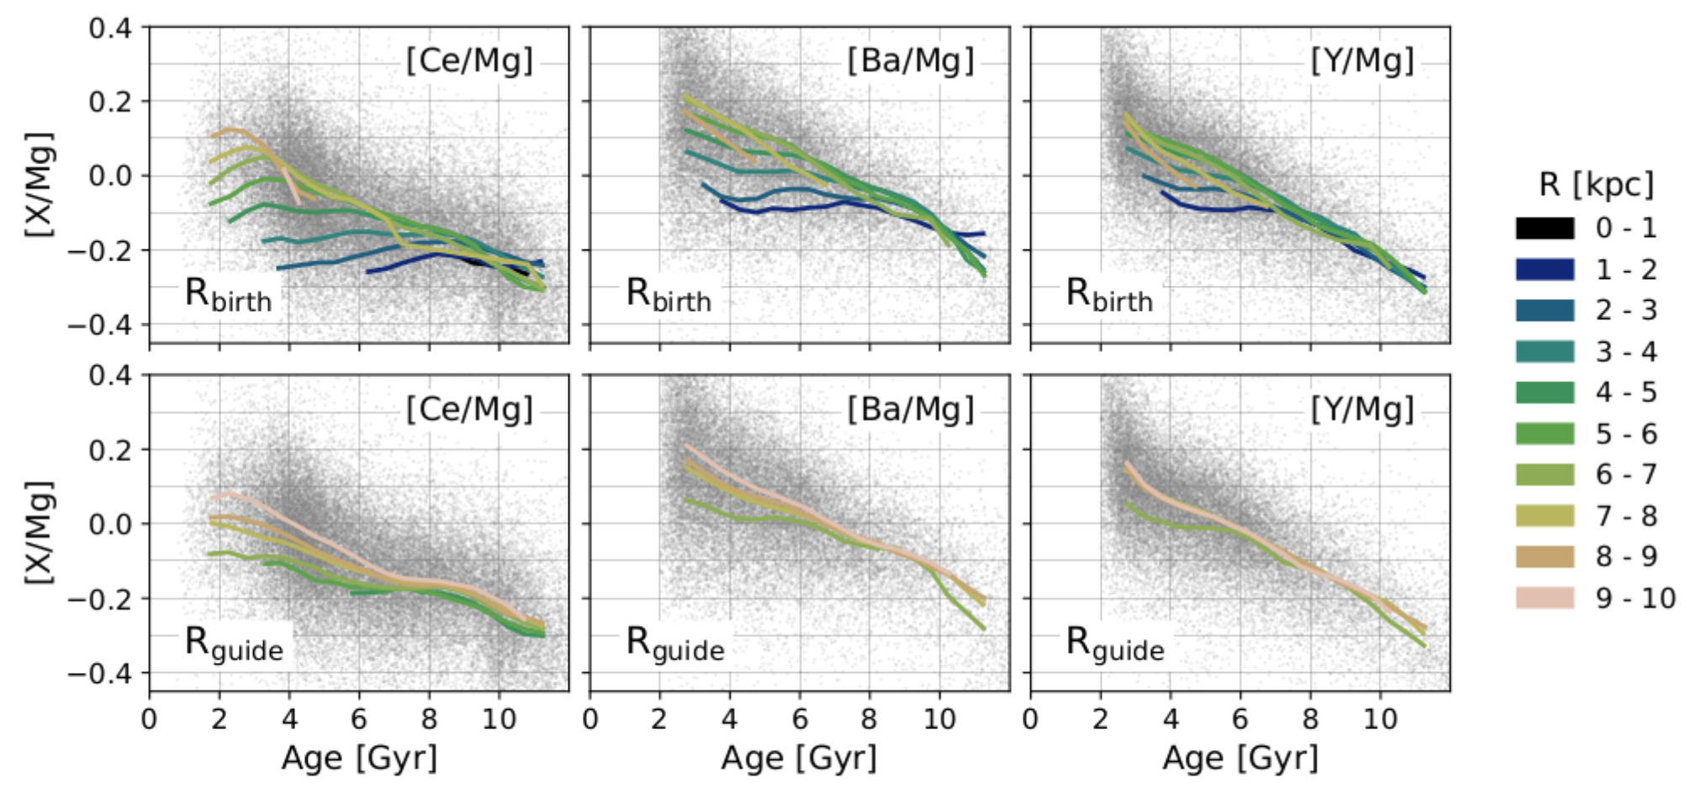
[s/Mg] evolution with time
APOGEE red giants, Anders+ 2023 ages
BAWLAS abundance Hayes+2022
GALAH MSTO+SGB
StarHorse ages (Queiroz+ 2023)
cosmic time
cosmic time
cosmic time
Ratcliffe, Minchev et al. (2024b)

Slide 22
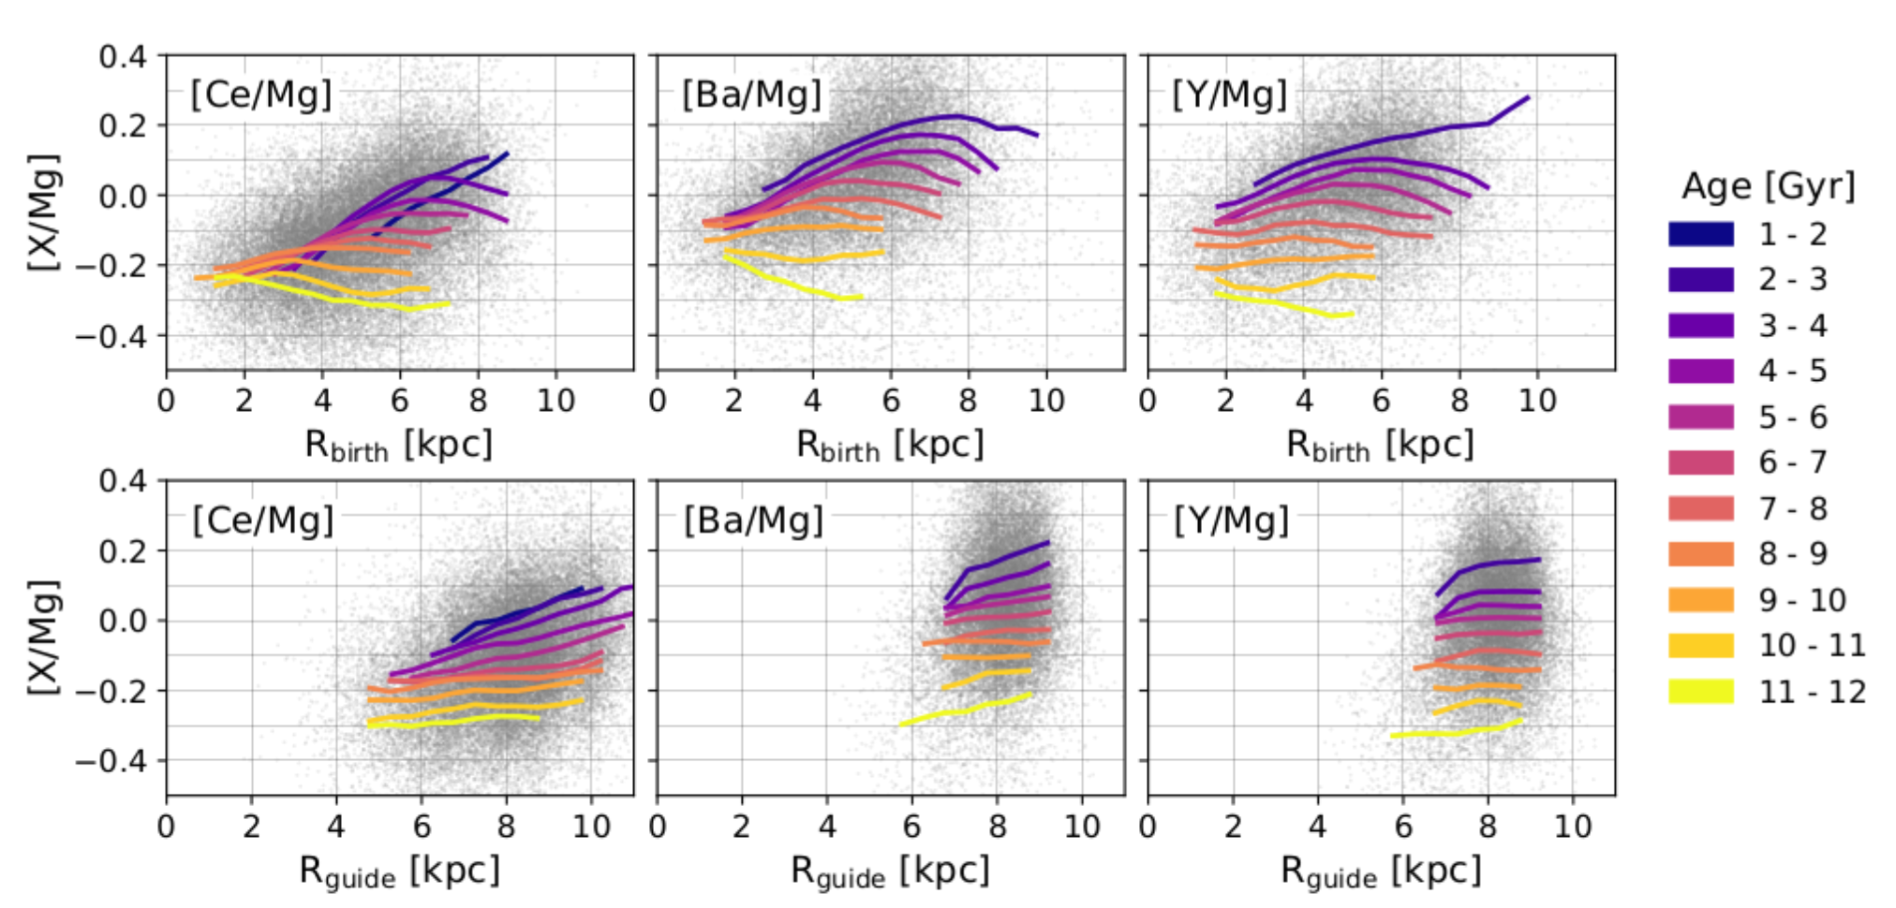
[s/Mg] gradient steepening with time

Slide 23
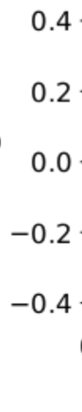
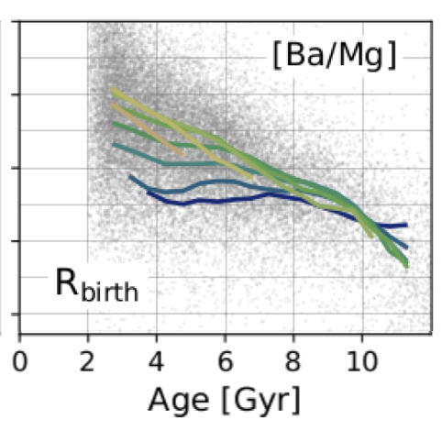
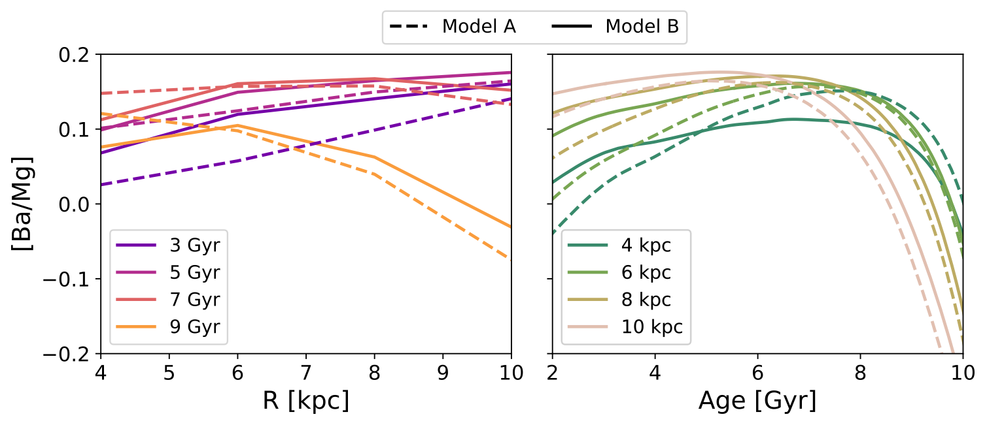
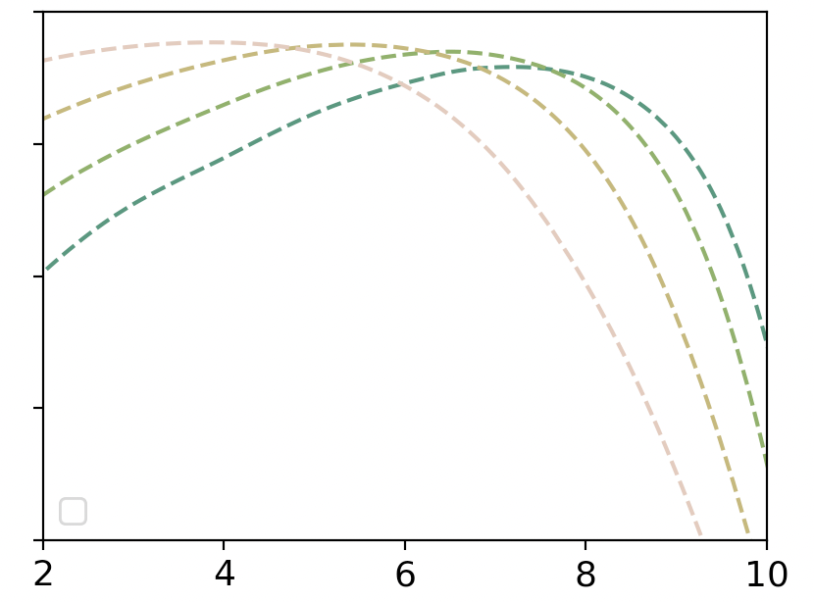
Comparison with a GCE model
Model A: single-infall, model params from Cescutti+ 2007, nucleosynthesis from Van der Swaelmen+ 2023, Ba evolution from Rizzuti+2019, Cristallo+2015 (AGB), Frischkneckt+2016 (massive stars) + simplified migration
  drop in [Ba/Mg] with decreasing age

Slide 24
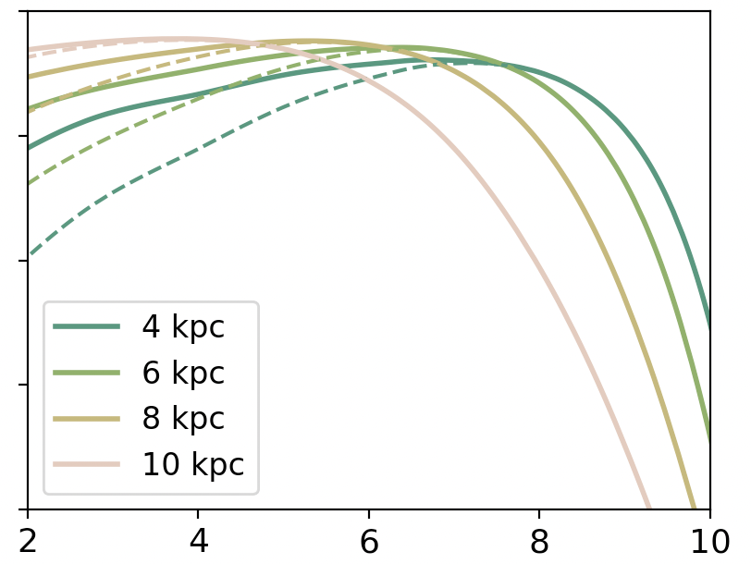
More Ba at higher Z
Model A: single-infall, model params from Cescutti+ 2007, nucleosynthesis from Van der Swaelmen+ 2023, Ba evolution from Rizzuti+2019, Cristallo+2015 (AGB), Frischkneckt+2016 (massive stars) + simplified migration
  drop in [Ba/Mg] with decreasing age
Model B: Model A + modified Ba yields at high Z
  better captures [Ba/Mg]—age—R trends

Slide 25
Conclusions
We can derive the Milky Way's ISM metallicity evolution directly from observational data (given precise age and metallicity measurements) by relying on simple assumptions.
We can consider Rb (birth radius) as a form of dimensionality reduction, condensing age and abundance information into a single parameter.
Migration erases structure in the time evolution of radial gradients—recovering it requires knowledge of Rb.
Chemical clocks become unreliable when populations with different birth radii are mixed.
Further modeling is necessary to fully understand the Galactic disk's [s/Mg] evolution.

Slide 26
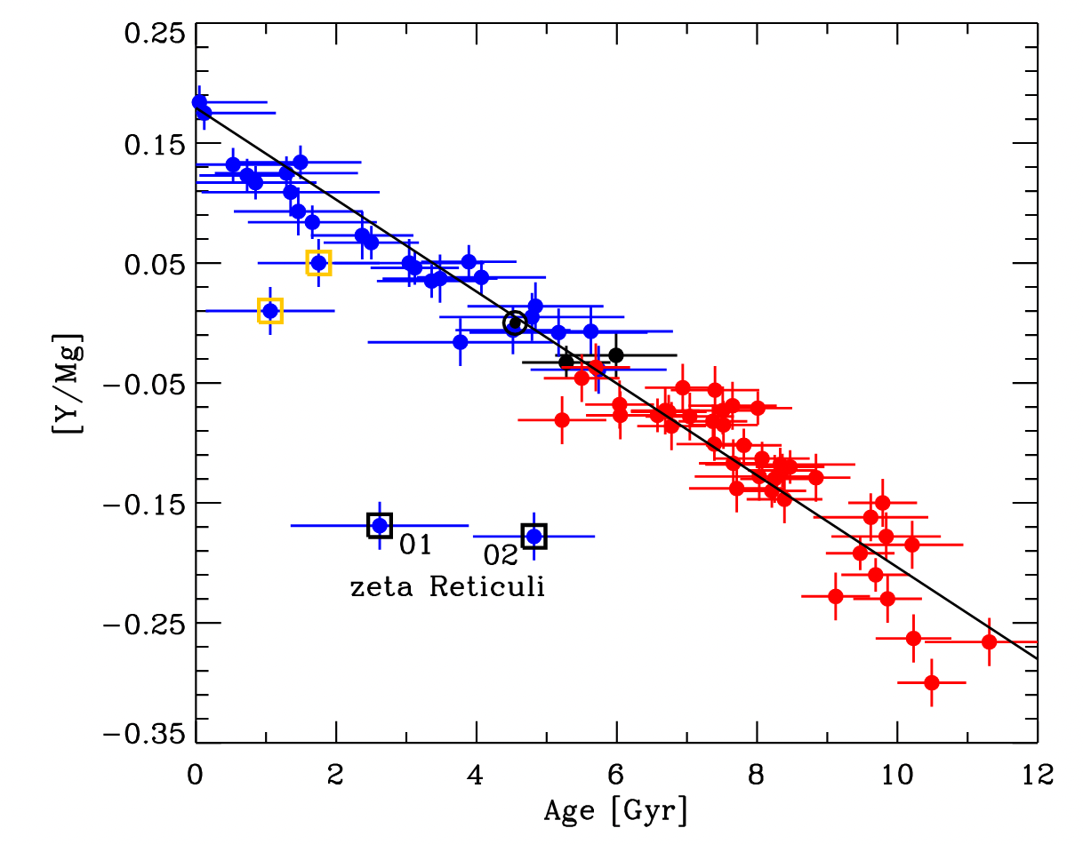
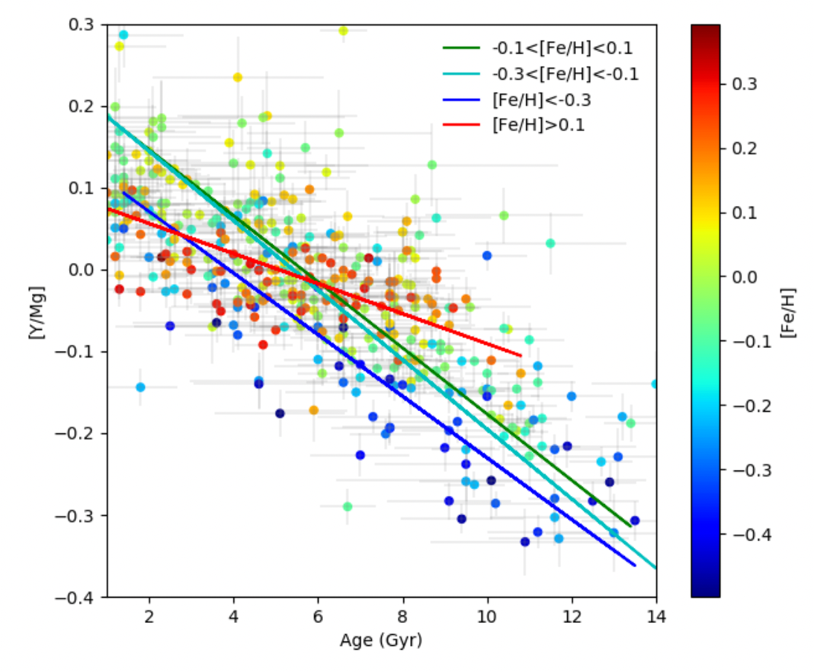

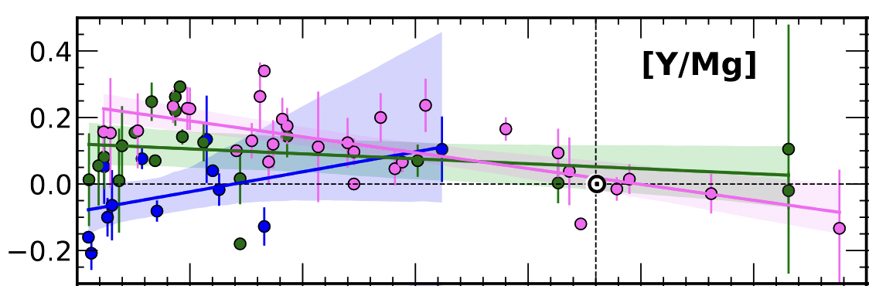
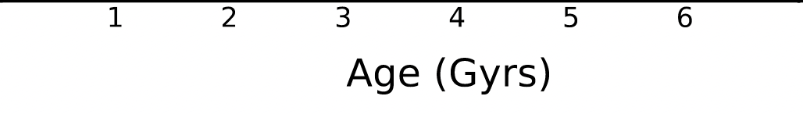
The [s/α]—age relation (chemical clocks)
[s/α] is linearly related to age in solar-twins in solar neighborhood
Depends on current location in Galaxy
…and [Fe/H]
Nissen et al. (2020)
Viscasillas Vázquez et al. (2022)
Casali et al. (2020)

Slide 27
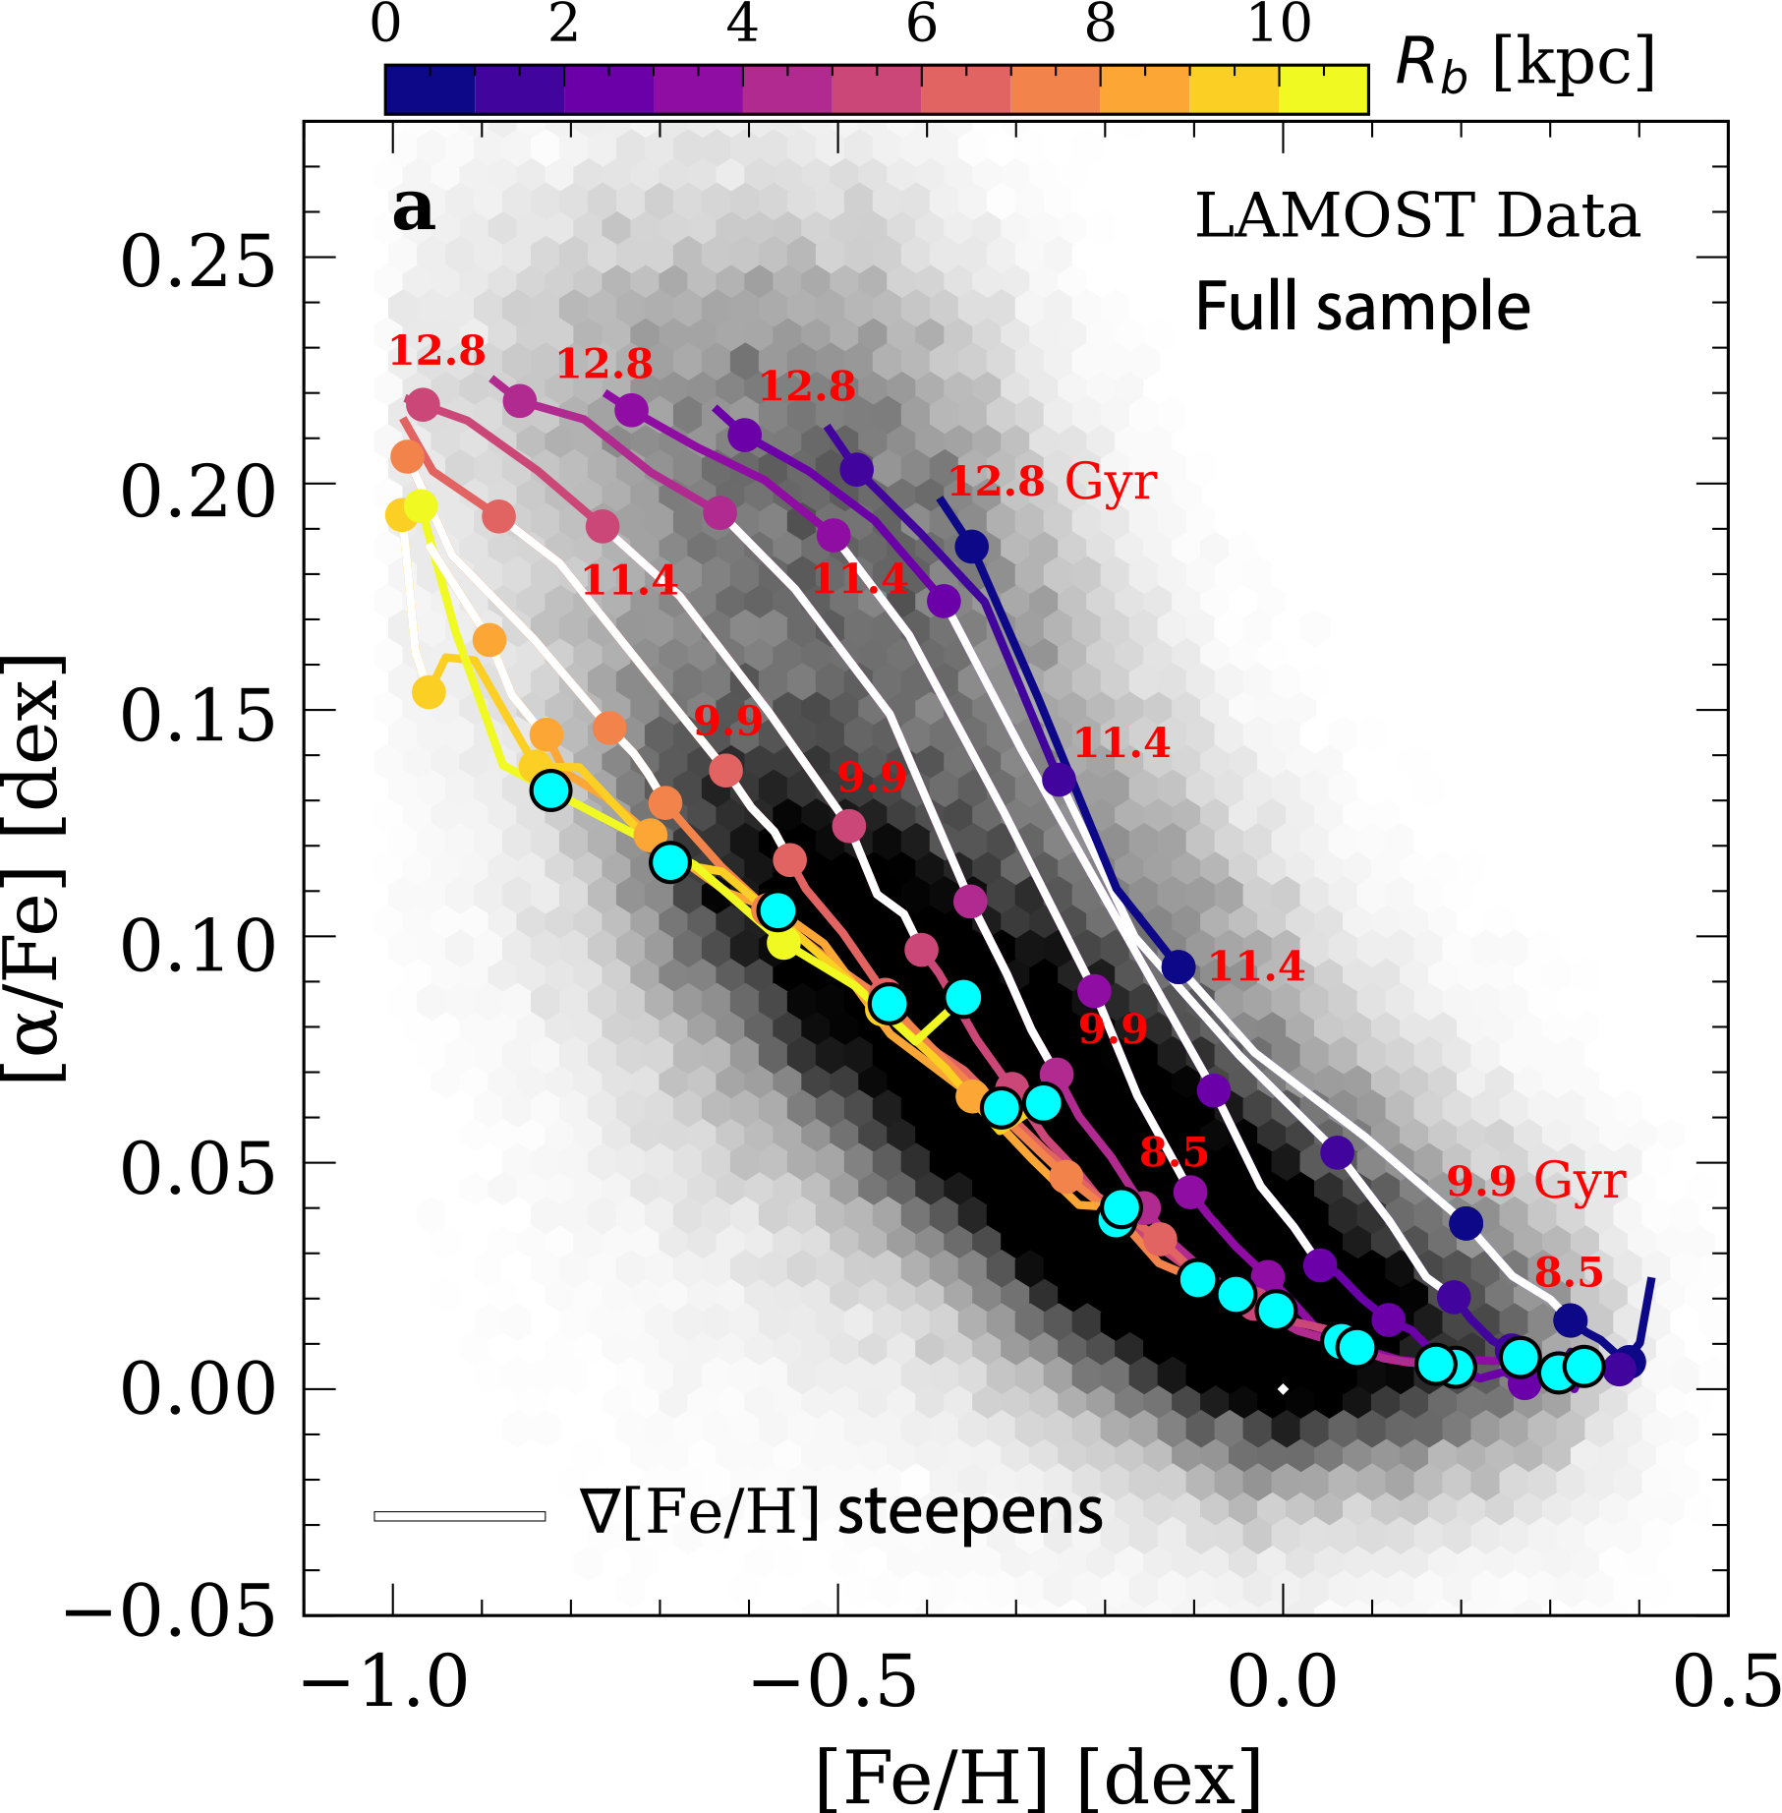
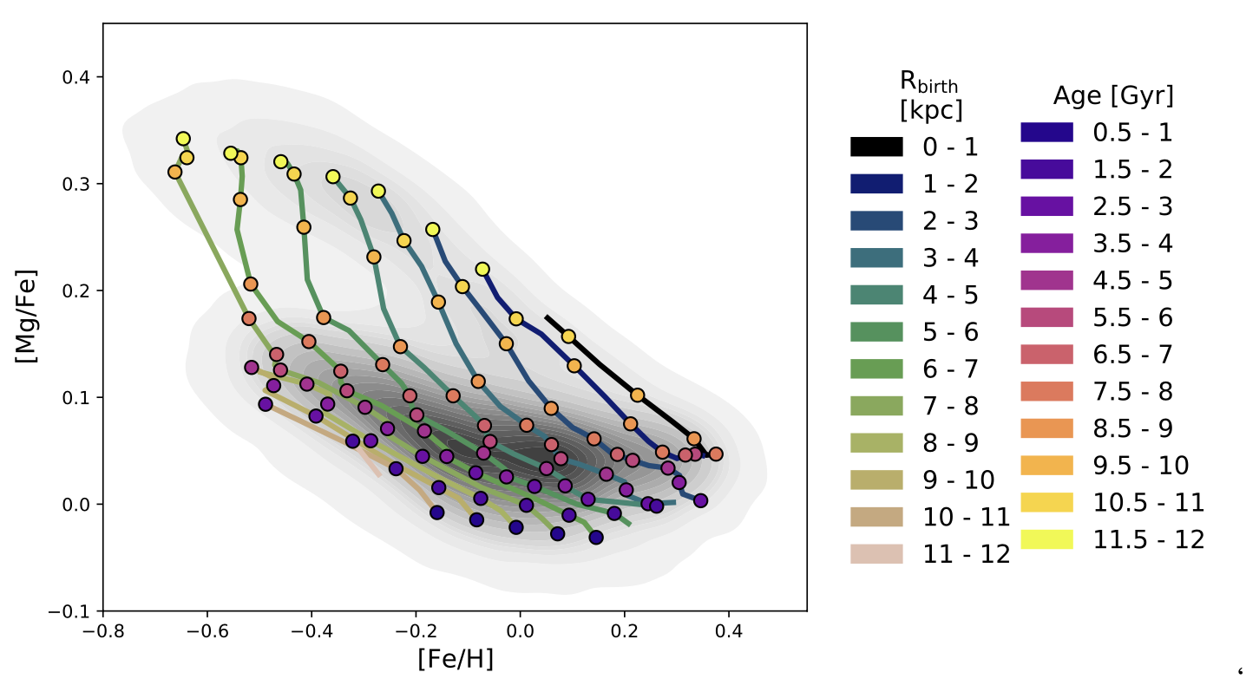
LAMOST Sub giants
APOGEE DR17 red giants

Slide 28
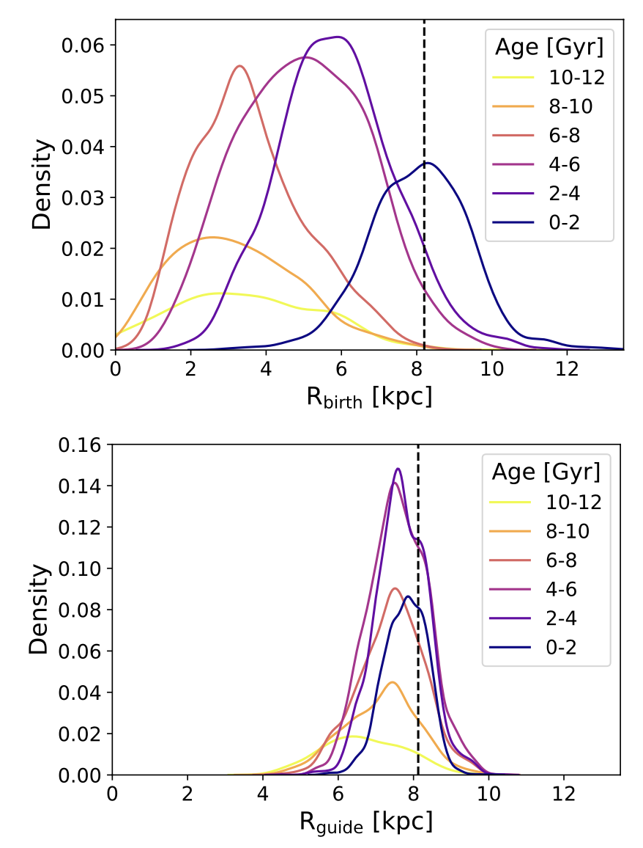
Rbirth distributions shift peaks to inner disk with age naturally
Birth radius
Guiding radius
Ratcliffe, Minchev et al. (2024)

Slide 29
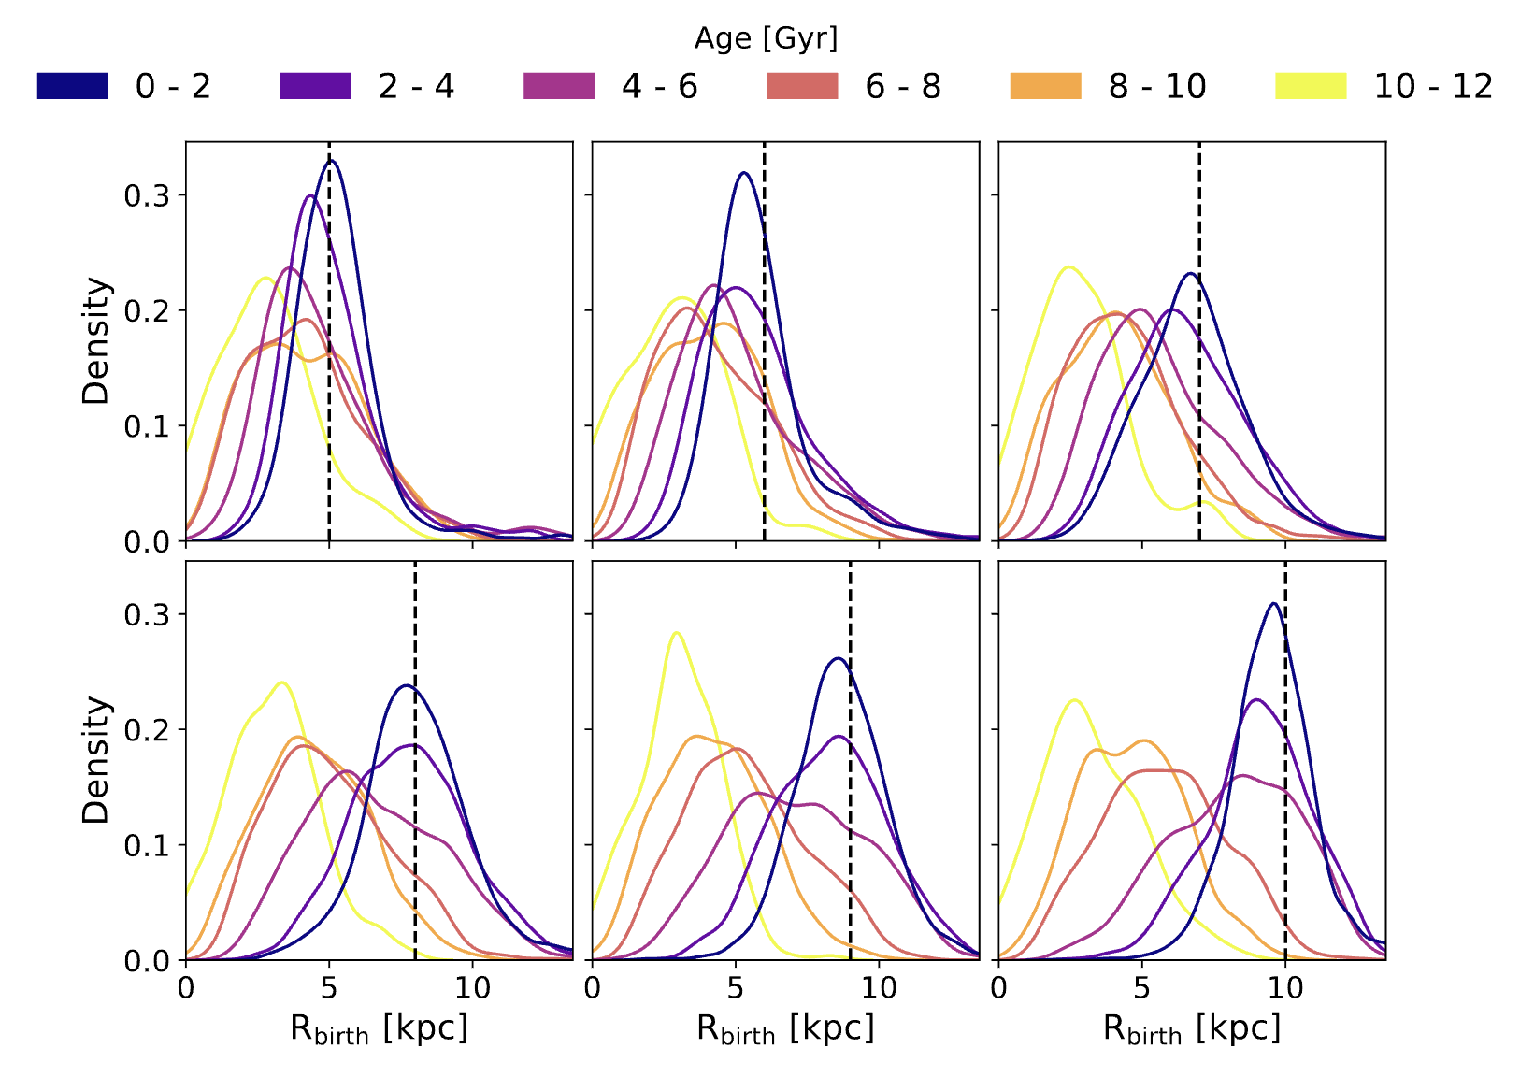
Rbirth distributions shift peaks to inner disk with age naturally at every R

