Slide 1
Dennis Mücher (IKP Cologne)
A. Spyrou, S. Liddick, K. Bosmpotinis, J. Berkman, R. Lubna, S. Uthayakumaar, et. al. (FRIB + MSU)
B. Greaves (UoGuelph)
G. Savard, D. Santiago et. al. (Argonne National Lab.)
S. Goriely (Univ. Brussels)
D. Rochman (PSI, Villingen)
C. Bernards (IKP Cologne)
Neutron Capture Rates for the i and r process
See talk by Artemis Spyrou
Wednesday, 11am!
Institute for Nuclear Physics / University of Cologne | Dennis Mücher | 09.06.25
Notes:
Thank you to the organiziers for the kind invitation. It is very nice to see so many familiar faces. In fact Rod Clark met me the first day saying: Dennis, havnet seen you in ages, where have you been? So I gave him an update and explained that I have been to different conferences because I am not doing so much structure but more astrophysics. And he replied: Oh, I am so sorry for you!

Slide 2
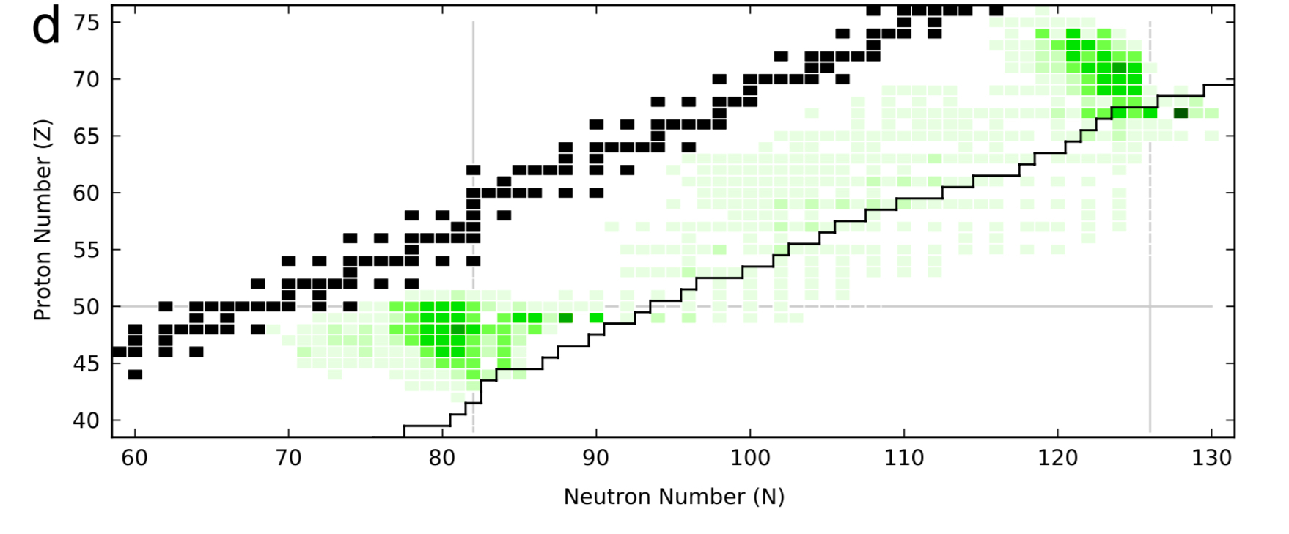
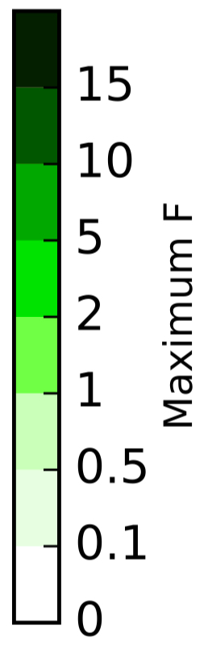
Sorry for being late to this beautiful conference… but this was really important to us…
Adapted from M. Mumpower et al.,
Prog. Part. Nucl. Phys. 86 (2016)
FRIB: 10⁻⁴ pps
ANL, 2022: ¹⁴⁰Cs →¹⁴¹Cs
FRIB, June 2025 (PI: A. Spyrou, DM)
Notes:
Naivly one would think that n-capture rstes are important for the r process, but we have (n,g) (g,n) equillibrium in the early phase
Later: freeze-out; capture rates at closed shells most significant: shown here: NS merger: we don’t have exp information away from stability

Slide 3
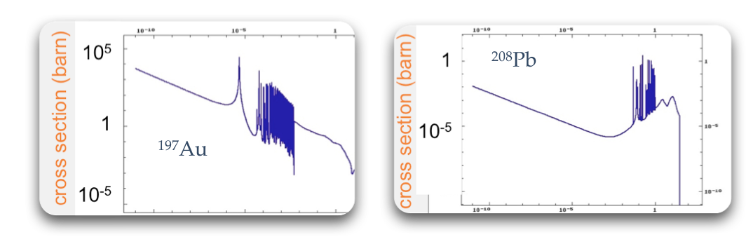
Neutron Capture Rates at Stellar Energies
stellar
stellar
10⁻¹⁰ 10⁻⁵ 1
10⁻¹⁰ 10⁻⁵ 1
neutron energy (MeV)
neutron energy (MeV)
many sharp resonances → statistical
few (broad) resonances → not statistical
Notes:
Why closed shells? Impact of Q-value and structure: note statistical behaviour vs resonant behaviour: resonances difficult to measure with RIB

Slide 4
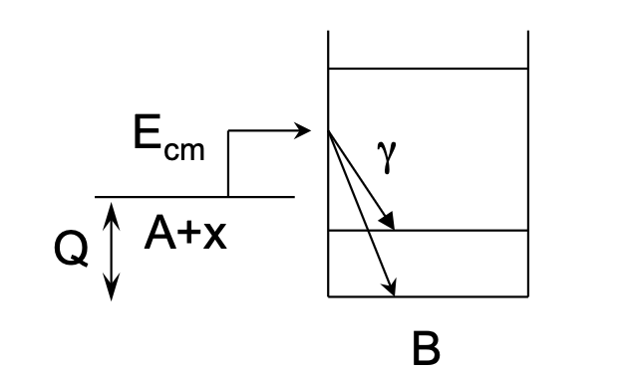
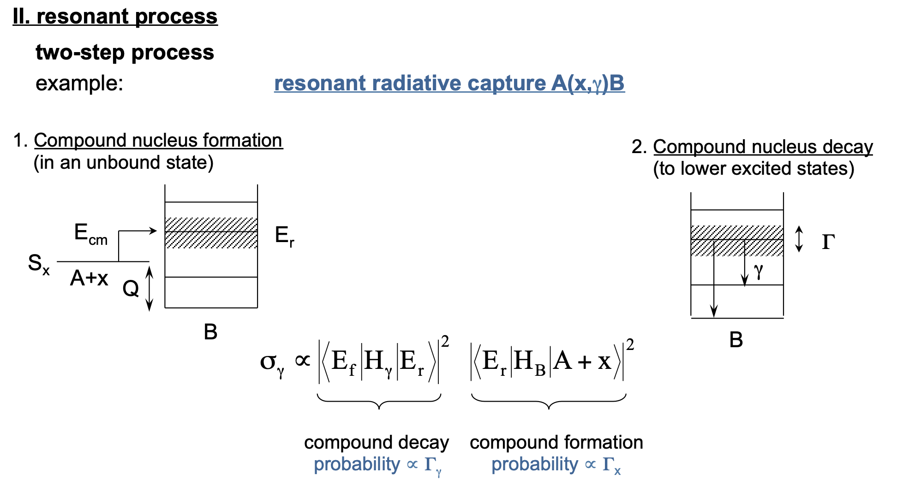
Neutron Captures in a Nutshell: Two Contributions
Direct radiative capture
Resonant capture
Slide adapted from M. Aliotta, Russbach 2014

Slide 5
Hauser-Feshbach: Statistical Approach to Neutron Captures
(n,γ)
A. Spyrou
Required input:
Nuclear Level Density (NLD)
γ-ray strength function (γSF)
Optical model potential
+ Direct capture contributions can play a role
(A-1, Z)
γ
In unstable nuclei the γSF and optical model parameters can in principle be measured or well constrained via inverse kinematics experiment
First method to directly measure the absolute NLD in short-lived nuclei: “Shape method”
A. Spyrou
(A, Z)
Notes:
The topic of my presentation is a new method to constrain n capture rates in unstable nuclei.

Slide 6
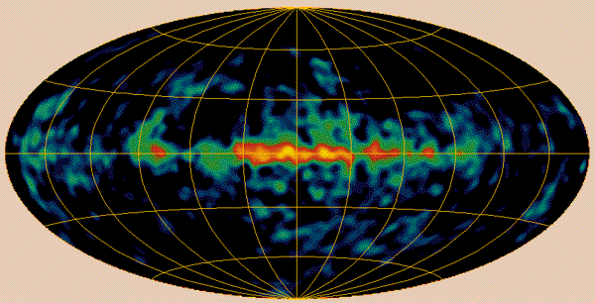
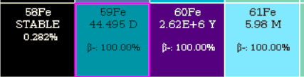
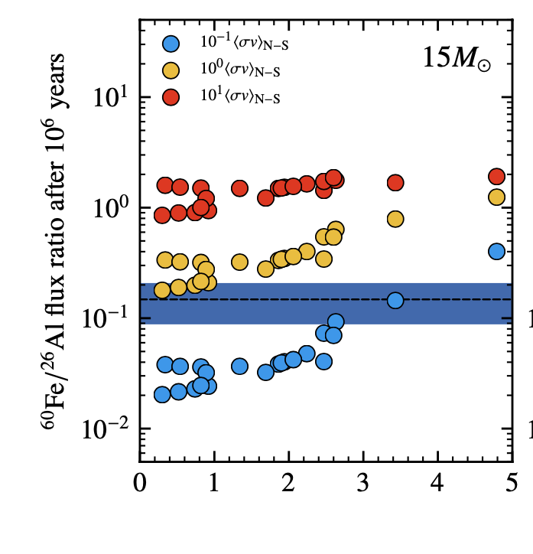
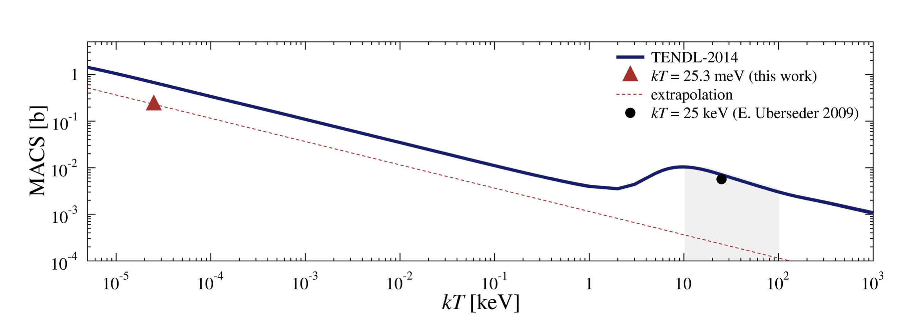
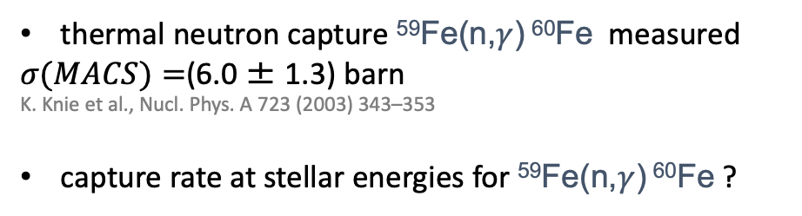

The starting point of heavy nucleosynthesis: ⁵⁹Fe(n,$γ$)⁶⁰Fe
thermal neutron capture ⁵⁹Fe(n,$γ$) ⁶⁰Fe measured
$σ(MACS)=$(6.0 ± 1.3) barn
K. Knie et al., Nucl. Phys. A 723 (2003) 343–353
capture rate at stellar energies for ⁵⁹Fe(n,$γ$) ⁶⁰Fe ?
⁶⁰Fe(n,$γ$)
T. Heftrich et al., Phys. Rev. C 92, 015806 (2015)
Notes:
The topic of my presentation is a new method to constrain n capture rates in unstable nuclei.

Slide 7
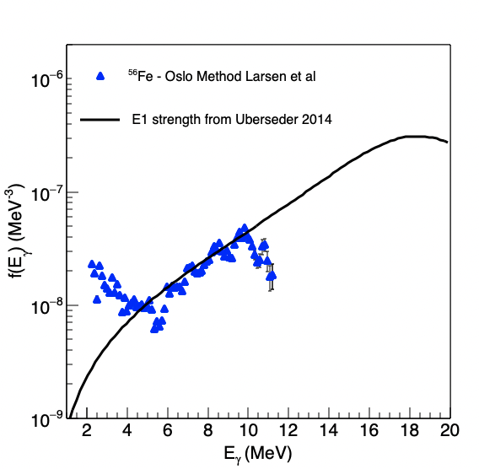
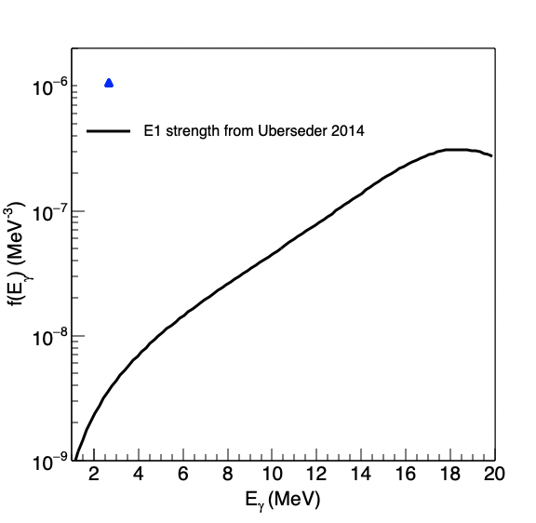
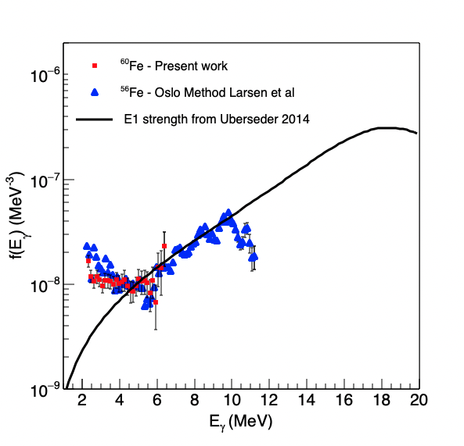
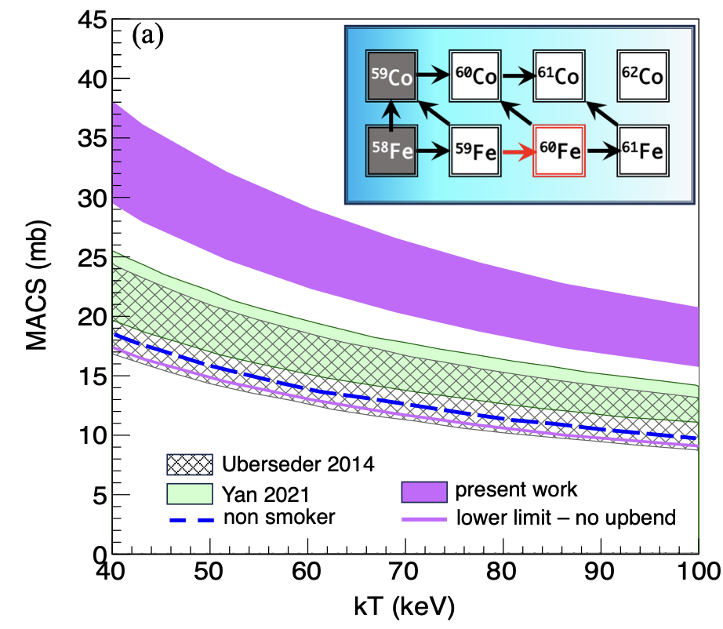
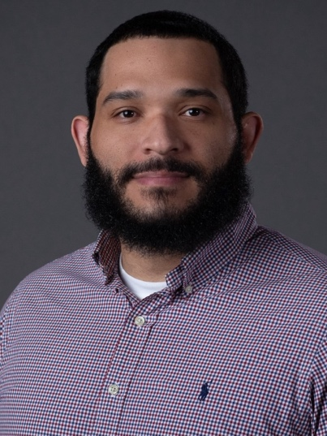
Slide: A. Spyrou
The importance of the upbend in ⁵⁹Fe(n,$γ$)⁶⁰Fe
γ-ray Strength Function
⁵⁹Fe(n,γ)⁶⁰Fe cross section
⁵⁹Fe
⁶⁰Fe
β⁻
(n,γ)
⁶⁰Mn
⁶⁰Fe
⁵⁶Fe
Stellar evolution calculations using MESA by Carl Fields
Spyrou et al. Nature Com. (2024)

Slide 8
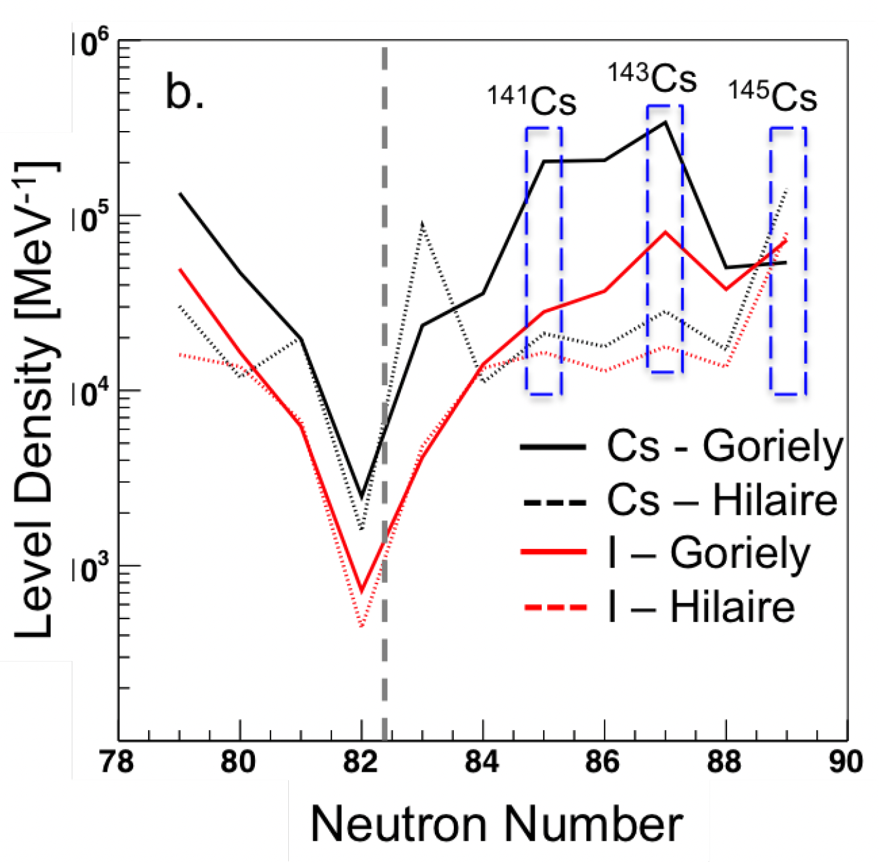
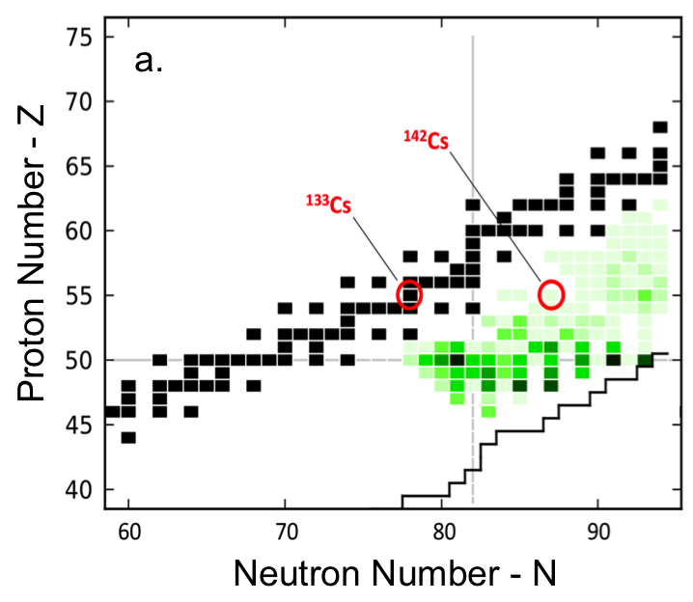
Neutron capture rates in n-rich Cs isotopes (ANL+TRIUMF)
B. Greaves, D. Muecher, A. Spyrou et al, to be submitted to PLB

Slide 9
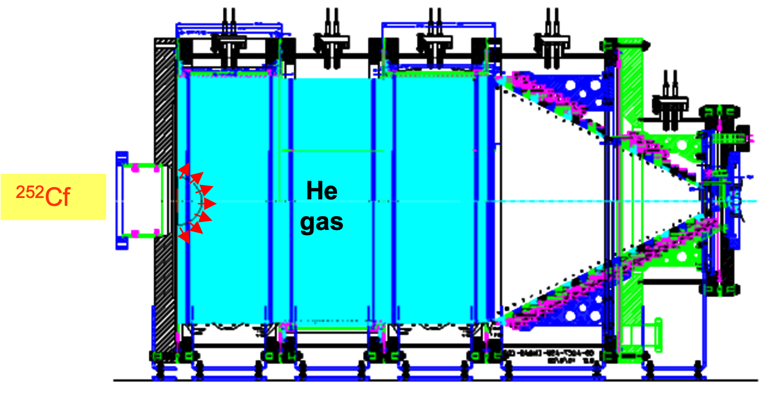

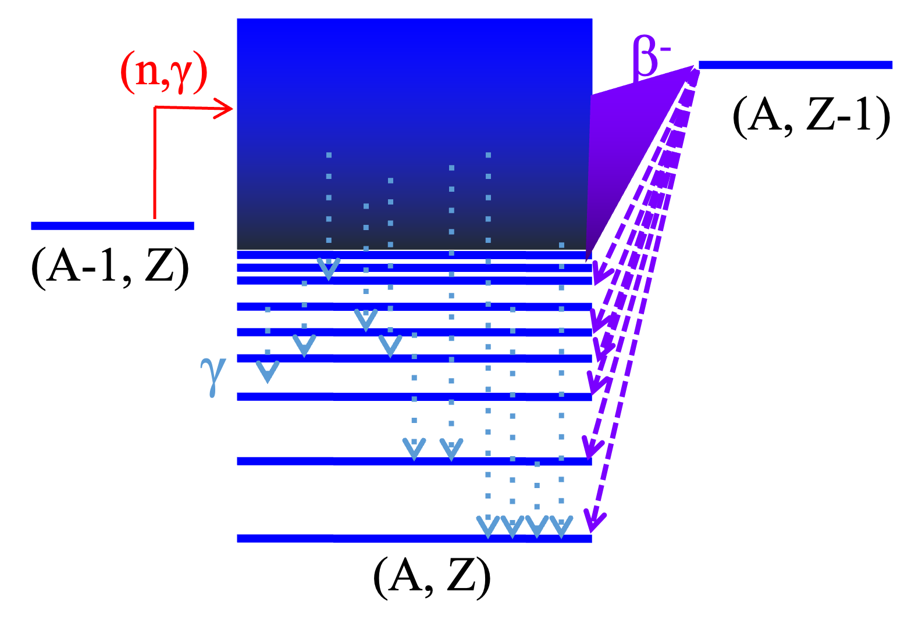
Constraining (n,γ) Rates for Exotic Nuclei
1. RIB Beam delivery
here: 150pps ¹⁴¹Xe
2. population of compound nucleus via β-decay
here: ¹⁴¹Xe→¹⁴¹Cs
A. Spyrou et. al, Phys. Rev. Lett. 113, 232502

Slide 10
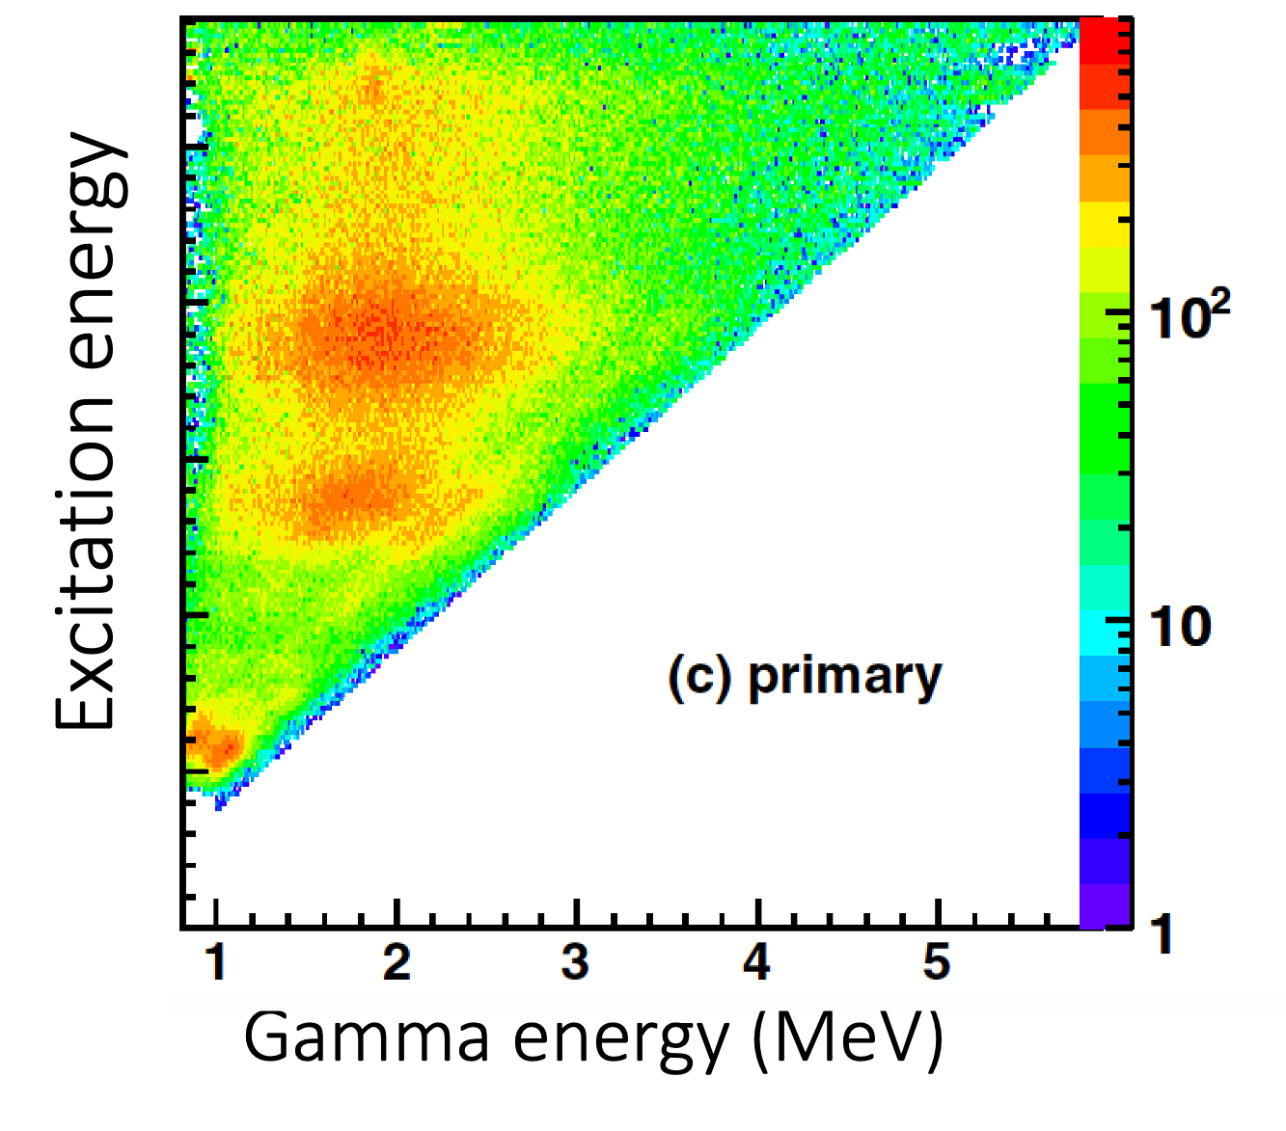
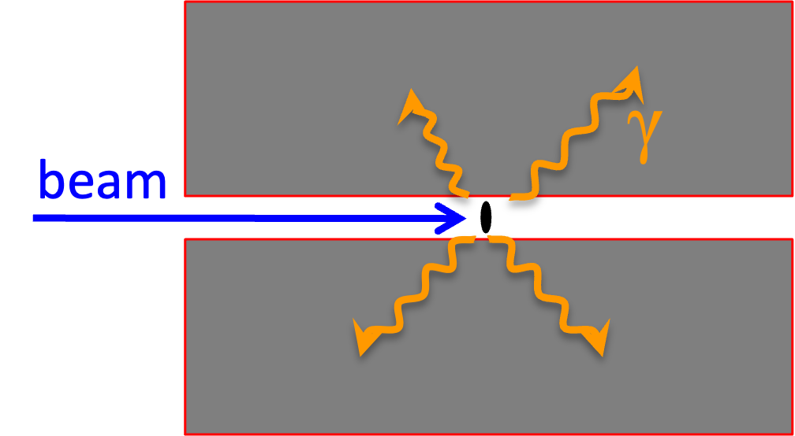
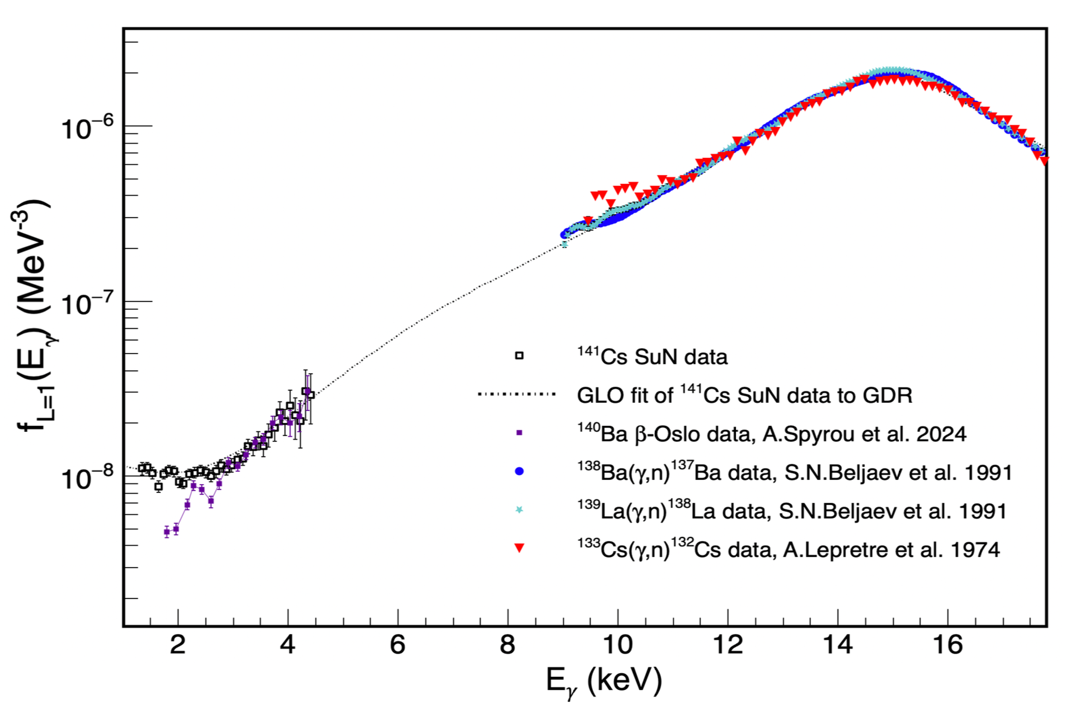
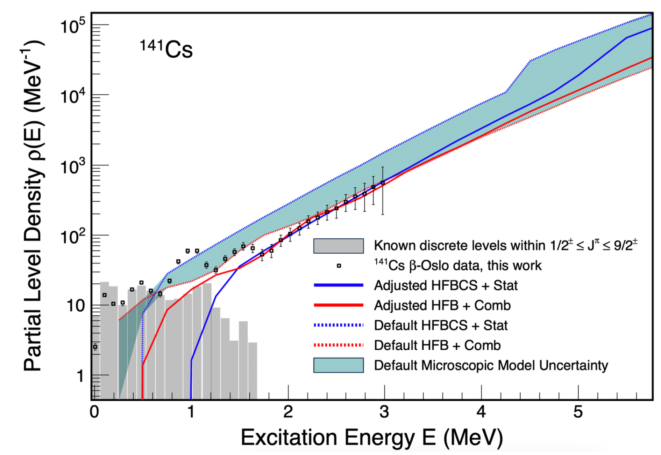
Constraining (n,γ) Rates for Exotic Nuclei
SuN Spectrometer
3. statistical decay of compound
SuN- Total Absorption Spectrometer: A. Simon et al., NIM B 703 (2013) 16-21
E_{x}= E_{γ1} + E_{γ2} + E_{γ3} + E_{γ4} + ...
¹⁴¹Cs
¹⁴¹Cs
4. Extract γSF and NLD

Slide 11
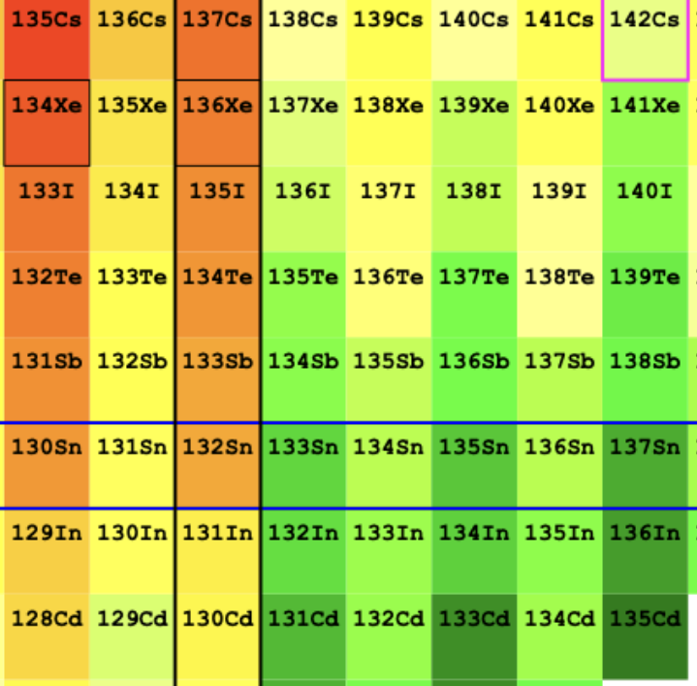
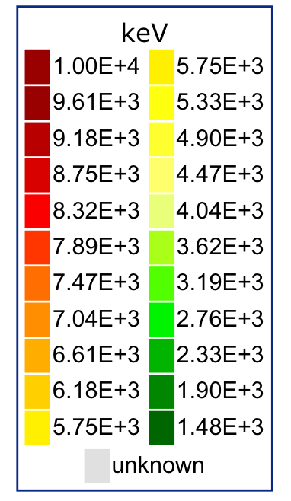
Guiding NLD Models Far Away From Stability
B. Greaves, DM, A. Spyrou et al, to be submitted to Phys. Lett. B
Lower NLD has impact on validity of Hauser-Feshbach model
Our data suggest that NLDs in the A=140 region tend to be smaller than expected by some models

Slide 12
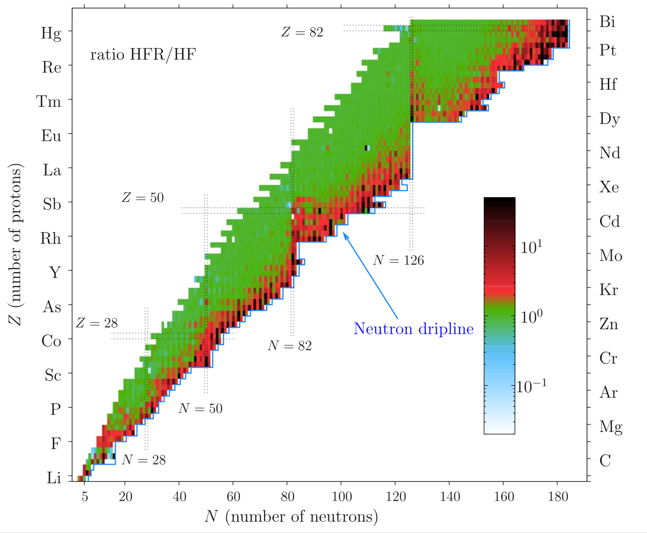
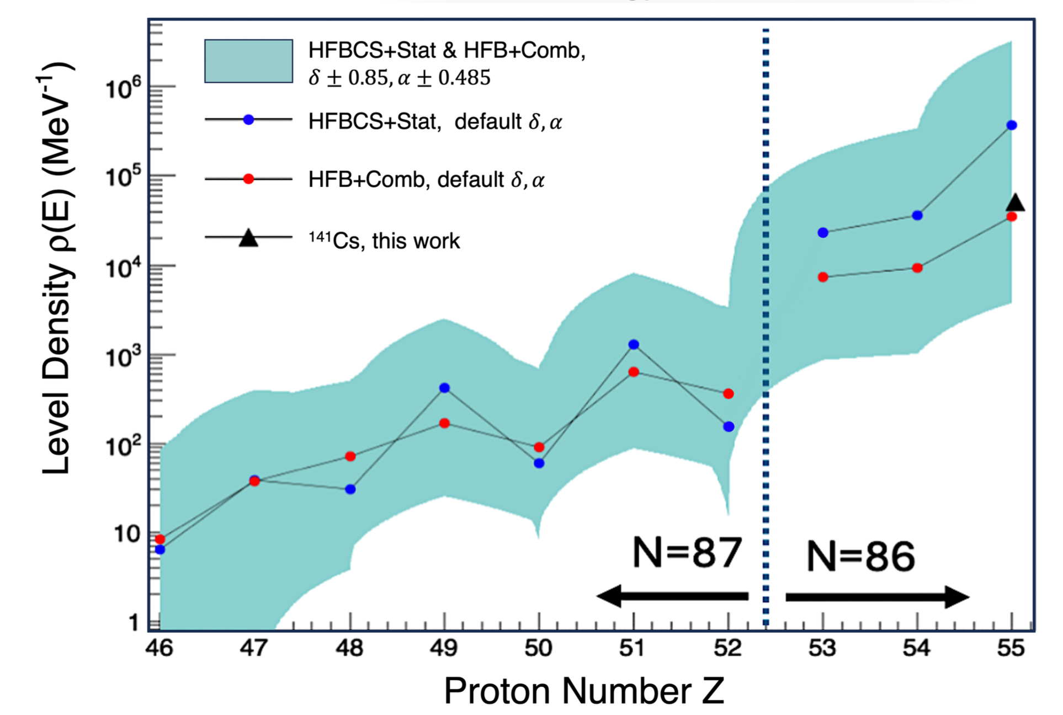
Probing the Limit of the Statistical Regime:
The High-Fidelity Resonance Model
D. Rochman, S. Goriely et al, Physics Letters B 764 (2017)

Slide 13
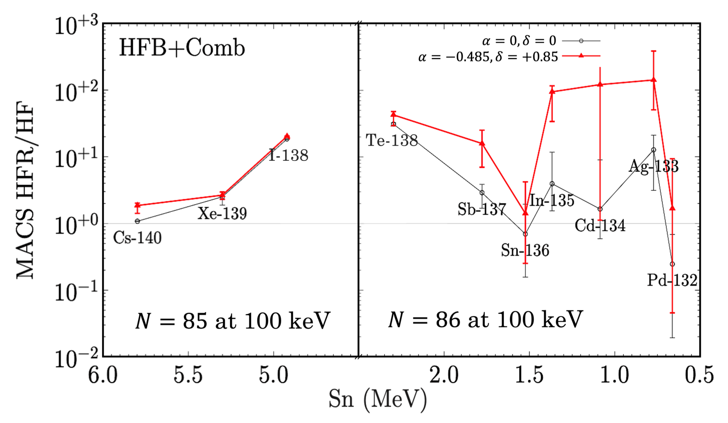
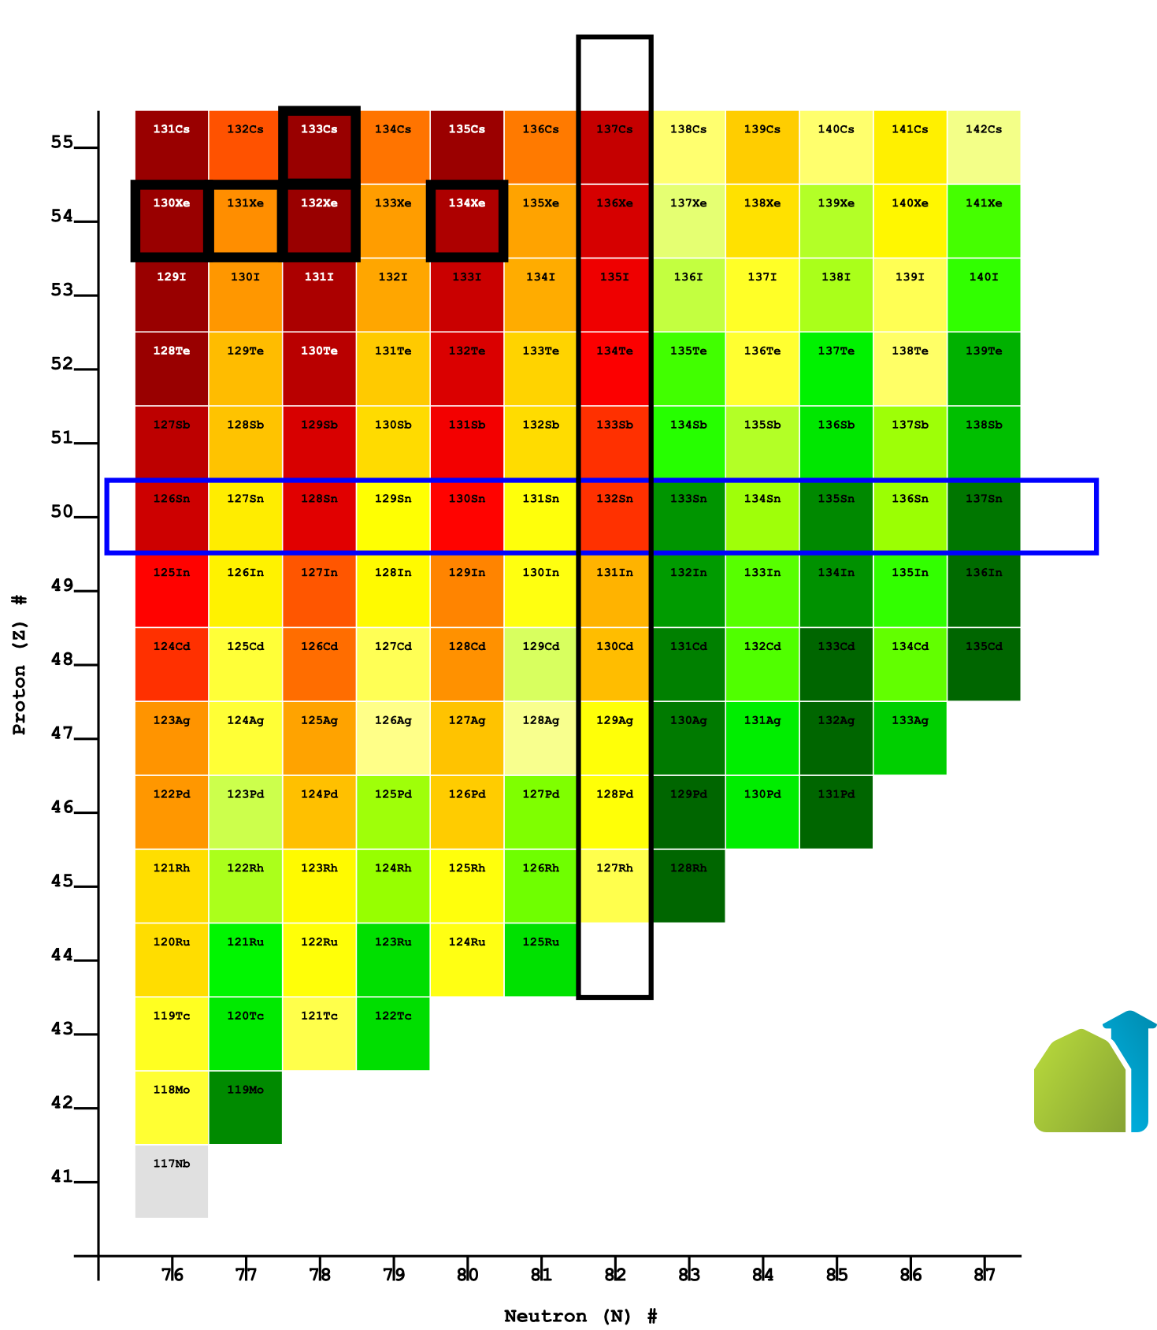
Hauser-Feshbach vs. Individual Resonances
Lower NLD has impact on validity of Hauser-Feshbach model
B. Greaves, DM, A. Spyrou et al, to be submitted to Phys. Lett. B
We have already experimentally reached the limit of the statistical regime
General trend: Hauser-Feshbach unterpredicts (n,γ) rates

Slide 14
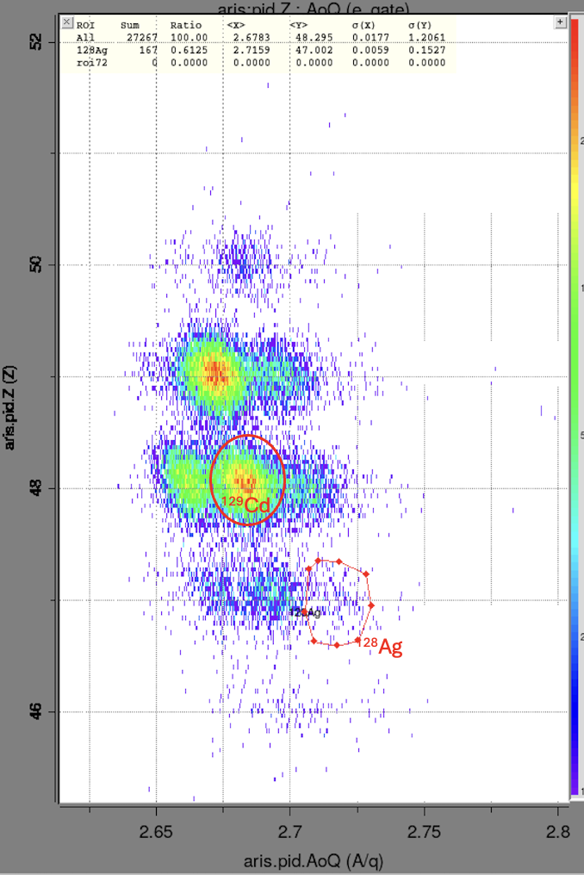
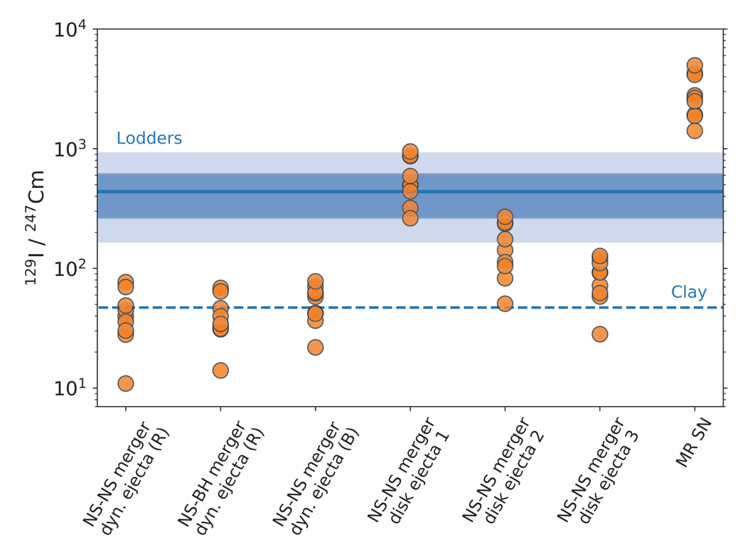
Results from SuN@FRIB, MSU
June 2025
1h of data
50
Sensitivity to r process
49
PRELIMINARY
Z
48
Cote et al, Science 2021
47
46
Sensitivity to ¹²⁹I
2.65 2.7 2.75
A/Q

Slide 15
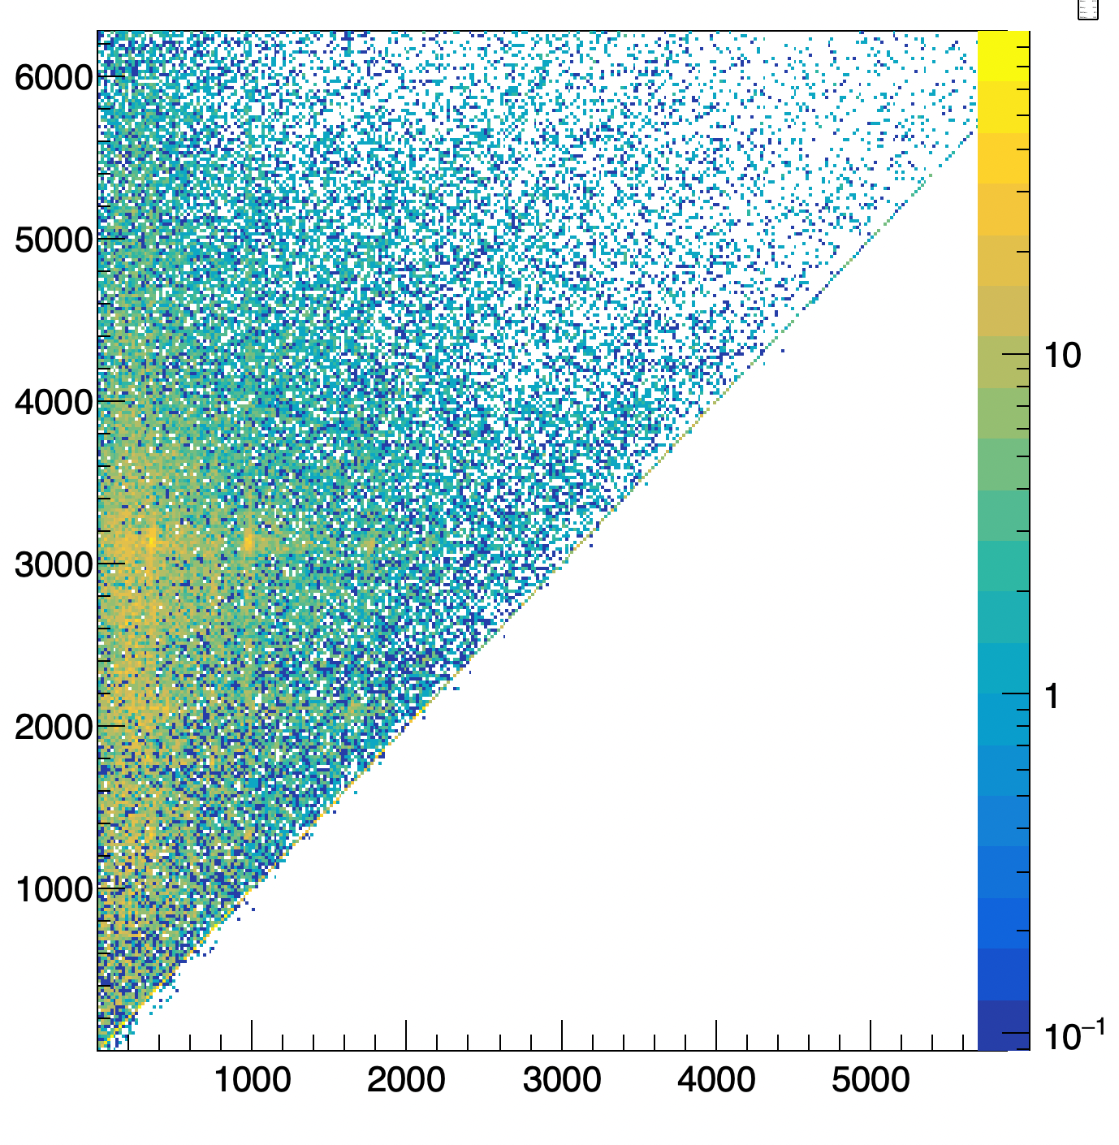
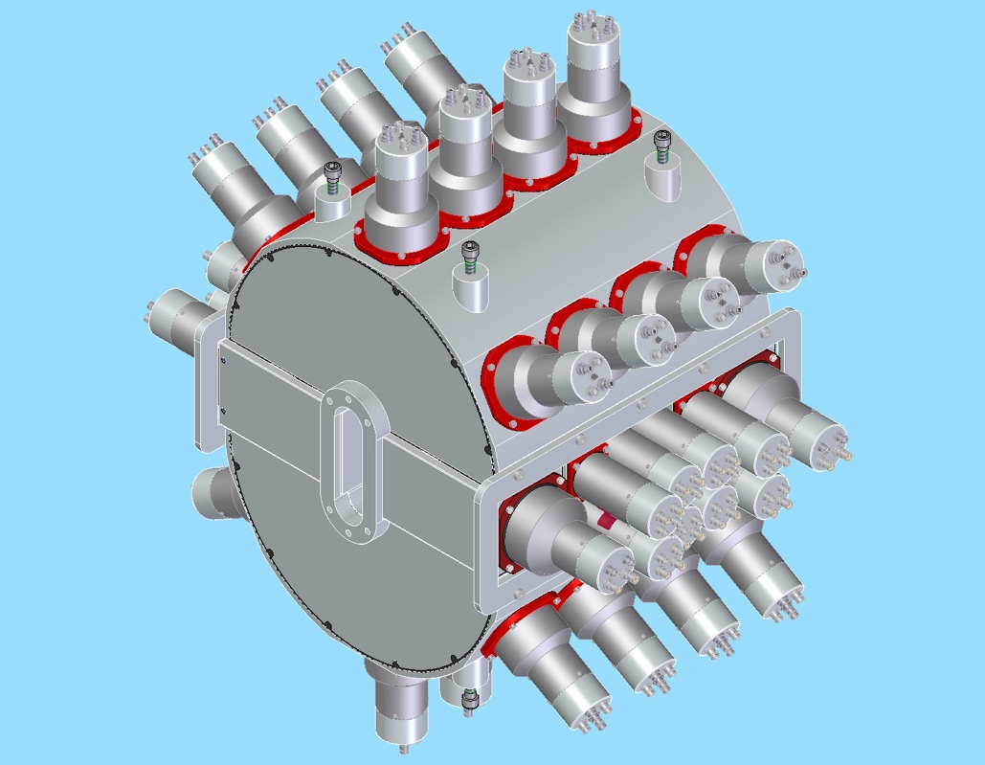
Results from SuN@FRIB, MSU
June 2025
E_{x} (keV)
Sensitivity to r process
PRELIMINARY
¹²⁹Cd →¹²⁹In
10h of data ≈ 80.000 counts
E_{γ} (keV)
SuN++
PIs: A. Spyrou, DM et. al.

Slide 16


Summary + Thank you
β-Oslo: powerful technique for constraining n-capture rates in exotic nuclei
First constraint of the ¹⁴⁰Cs(n,γ)¹⁴¹Cs reaction rate at the limit of statistical behaviour
Successful first experiment for n-capture rates at FRIB below ¹³²Sn
A. Spyrou, S. Liddick, K. Bosmpotinis, J. Berkman, R. Lubna, S. Uthayakumaar, et. al. (FRIB + MSU)
B. Greaves (UoGuelph)
G. Savard, D. Santiago et. al. (Argonne National Lab.)
S. Goriely (Univ. Brussels)
D. Rochman (PSI, Villingen)
C. Bernards (IKP Cologne)

Slide 17
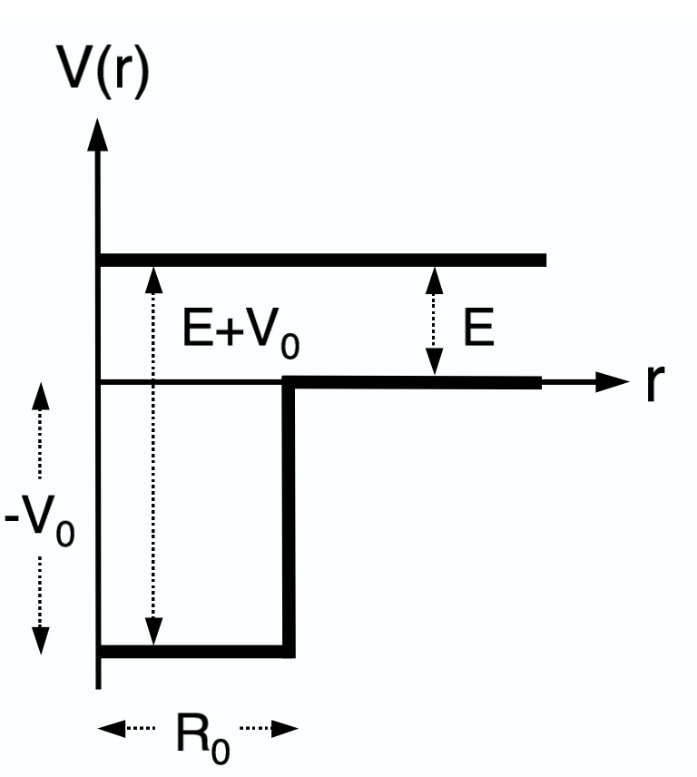
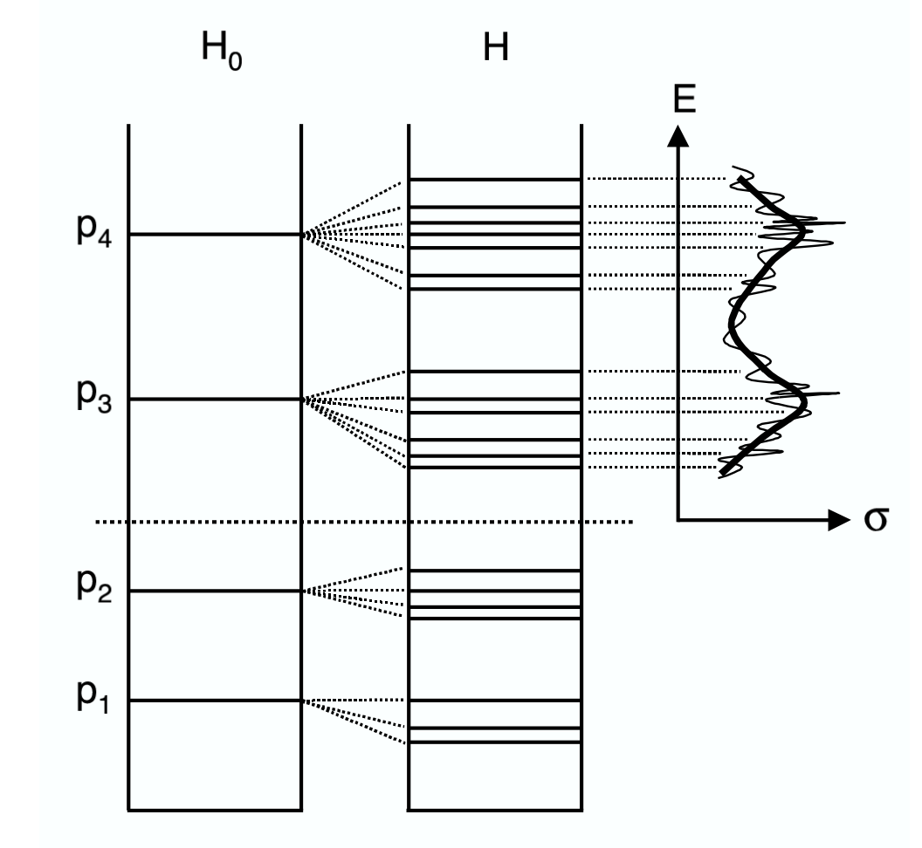
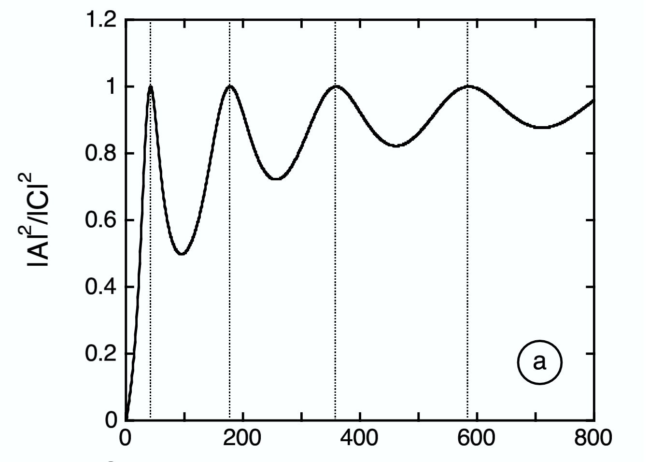
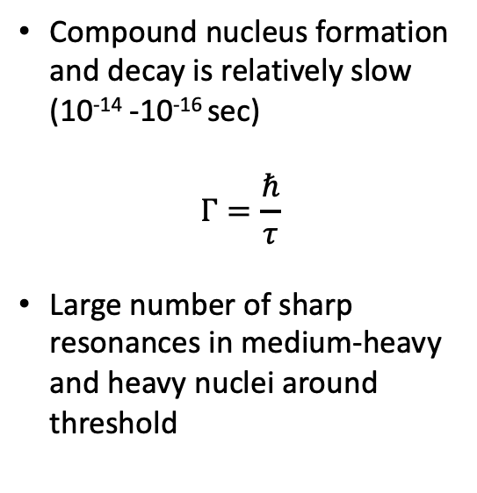
Neutron Captures in a Nutshell: Resonances
Compound nucleus formation and decay is relatively slow (10⁻¹⁴ -10⁻¹⁶ sec)
$$Γ=\frac{ℏ}{τ}$$
Large number of sharp resonances in medium-heavy and heavy nuclei around threshold
E_{neutron}
E_{neutron} (MeV)
Iliadis, Nuclear Physics of Stars

