Slide 1



Proton-rich production of lanthanides:
the νi process
Xilu Wang
wangxl@ihep.ac.cn
Institute of High Energy Physics, Chinese Academy of Sciences
@s, i & r Element Nucleosynthesis (sirEN)
In collaboration with Amol Patwardhan, Yangming Lin, Junbo Zheng, Michael Cervia, Yanwen Deng, Baha Balantekin, Erika Holmbeck, Haining Li, Ian Roederer and Rebecca Surman
Notes:
Collaborator list

Slide 2
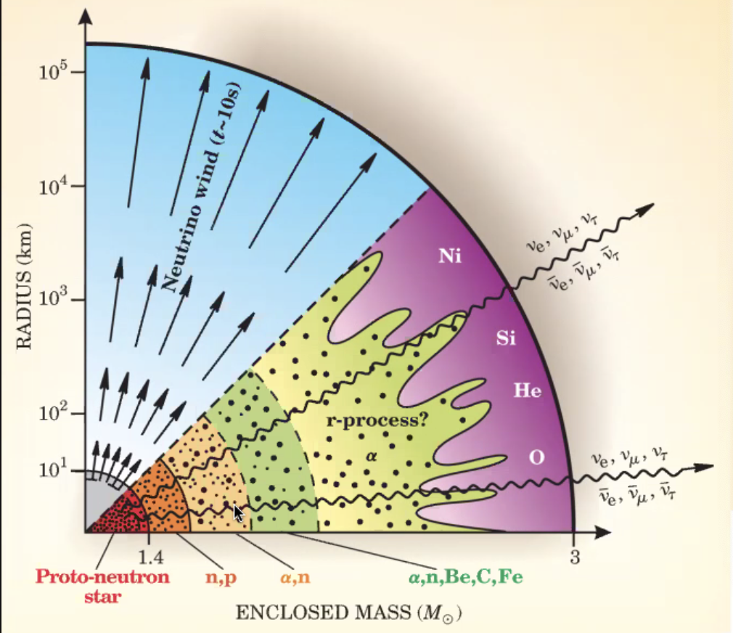
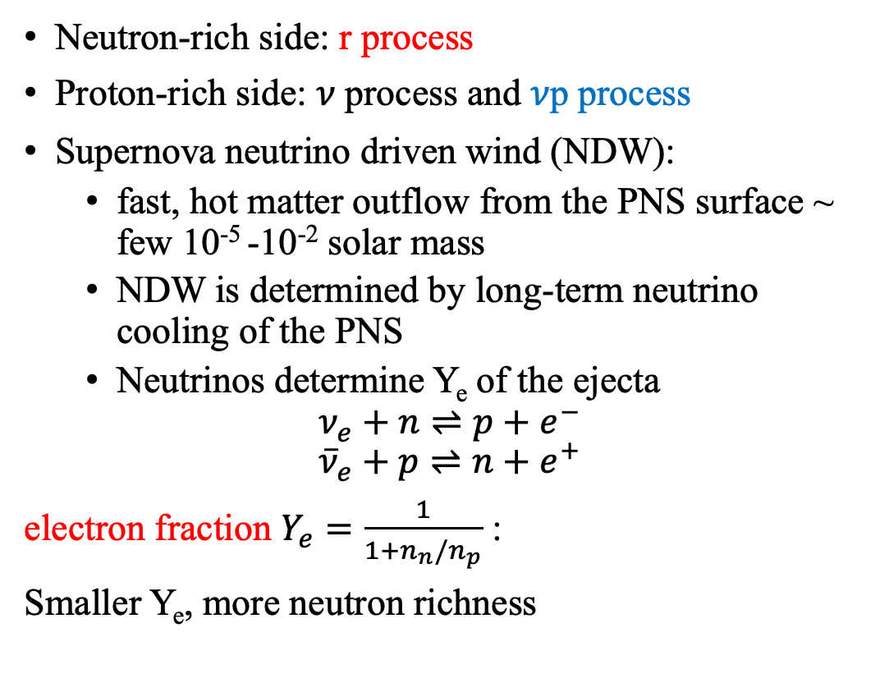
Heavy-element nucleosynthesis affected by neutrinos
Neutron-rich side: r process
Proton-rich side: 𝜈 process and 𝜈p process
Supernova neutrino driven wind (NDW):
  fast, hot matter outflow from the PNS surface ~ few 10⁻⁵ -10⁻² solar mass
  NDW is determined by long-term neutrino cooling of the PNS
  Neutrinos determine Y_{e} of the ejecta
$$ν_{e}+n⇌p+e^{−}$$
$${\overline{ν}}_{e}+p⇌n+e^{+}$$
electron fraction $Y_{e}=\frac{1}{1+n_{n}/n_{p}}$ :
Smaller Y_{e}, more neutron richness
Woosley, Janka 2005
Notes:
There are three nucleosynthesis process that producing heavy elements can be mostly strongly shaped by neutrinos, i.e., . Here our work mainly focus on the r process and vp process that possibly occurring in neutrino driven wind
three nucleosynthesis processes involved in producing heavy nuclei beyond the iron group that are influenced or shaped by neutrino interactions: the ν process, the ν p process and the r process. These processes are all related to explosive events involving compact objects, such as core-collapse su- pernovae and binary neutron star mergers, where an abundant amount of neutrinos are emitted
The neutrino interactions play a vital role in these nucleosynthesis processes though either neutrino-induced spallation reactions with nuclei (ν process) or capture reactions on free nucleons:
These capture reactions shape the electron fractionYe =1/(1+nn/np) that determine what type of nucleosynthesis is possible in the ejecta, and influence the availability of free nucleons to capture as element synthesis proceeds.

Slide 3






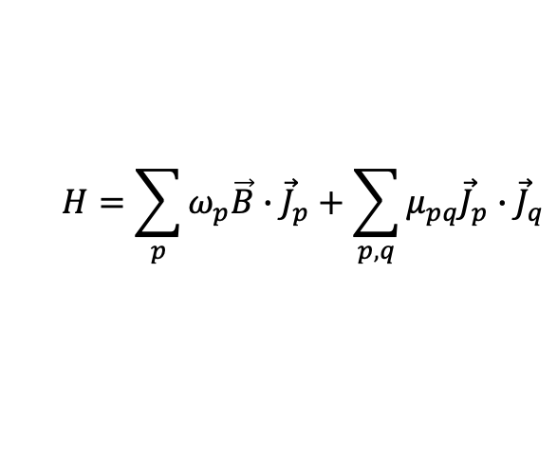
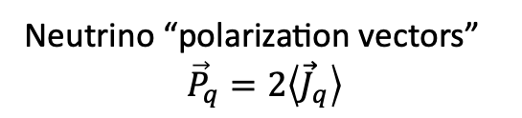
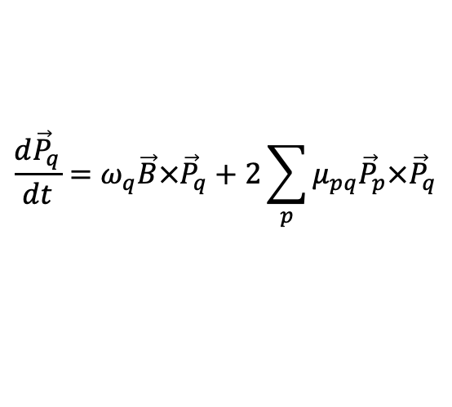
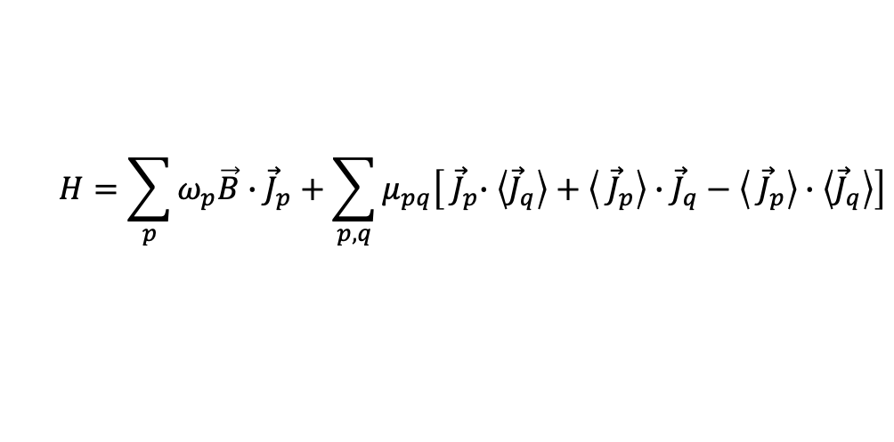

Collective Neutrino Oscillation
Baha Balantekin
Amol Patwardhan
Michael Cervia
Many body:
  a system of N neutrinos with discrete energies quantized in a box of volume V
  two-flavor approximation
Mean field
Neutrino “polarization vectors”
$${\vec{P}}_{q}=2\left\langle {\vec{J}}_{q}\right\rangle$$
$$H=\sum_{p}{ω_{p}\vec{B}∙{\vec{J}}_{p}}+\sum_{p,q}{μ_{pq}{\vec{J}}_{p}∙{\vec{J}}_{q}}$$
$$i\frac{d}{dt}|\left.Ψ\right\rangle =H|\left.Ψ\right\rangle$$
$$H=\sum_{p}{ω_{p}\vec{B}∙{\vec{J}}_{p}}+\sum_{p,q}{μ_{pq}\left[{ \vec{J}}_{p}∙\left\langle {\vec{J}}_{q}\right\rangle +\left\langle { \vec{J}}_{p}\right\rangle ∙{\vec{J}}_{q}−\left\langle { \vec{J}}_{p}\right\rangle ∙\left\langle {\vec{J}}_{q}\right\rangle \right]}$$
$$\frac{d{\vec{P}}_{q}}{dt}=ω_{q}\vec{B}×{\vec{P}}_{q}+2\sum_{p}{μ_{pq}{\vec{P}}_{p}×{\vec{P}}_{q}}$$
Notes:
photo
neutrinos do oscillate, and the collective oscillations can affect the nucleosynthesis in the neutrino driven wind. And we have already learned about the collective neutrino oscillations from the talks by George, Joe, and Huaiyu in the first session, there are different approach to describe or calculate the collective neutrino oscillations.
So next ,we want to explore how any potential changes in neutrino oscillation patterns, due to collective effects in the mean-field and/or beyond, i.e., many body treatment including the quantum entanglement, could impact the heavy element nucleosynthesis in supernovae, by adopting a toy interaction neutrino system.
For a many body system with two flavor approximation, the neutrino hamiltonian can be written as this equation, a sum of vacuum oscillation term and the interaction term, then we can solve the Schrodinger equation to obtain the evolution of the wavefunction in time. We can define the neutrino polarization vectors Pq here, which contain the information about the flavor composition of the neutrino, with Pz component denoting the net lepton number in the flavor or mass basis
%and the Px and Py components representing the coherence between different flavor or mass eigenstates.
Pq can be computed from the evolvement of wavefumction at each timestep
Then for mean-field approximation which neglect nontrivial quantum correlations among neutrinos, the hamiltonian can be then reduced to an effective one-body operator form as this, and we can also obtain the mean-field evolution equation for the neutrino polarization vector Pq here.
With these calculations for Pq, we can then obtain the electron flavor survival probability to calculate the rates of (anti) neutrino capture on neutron (proton), to be implemented into the nuclear reaction network to get the nucleosynthesis yields in supernova neutrino driven wind.
Pαe = (1 + sign(ω) P (f )
z )/2
Two flavor approximation, coherent forward scattering
the reference scale ω0 is defined
in terms of the mass-squared splitting δm2 = 2.44 × 10−3, and a reference energy E0 = 10 MeV

Slide 4
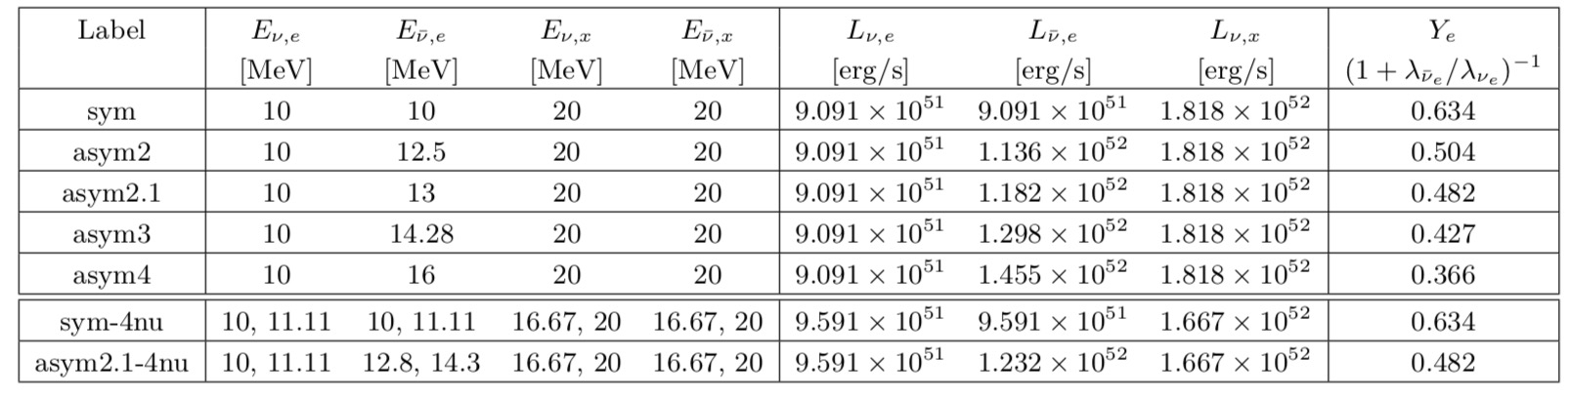
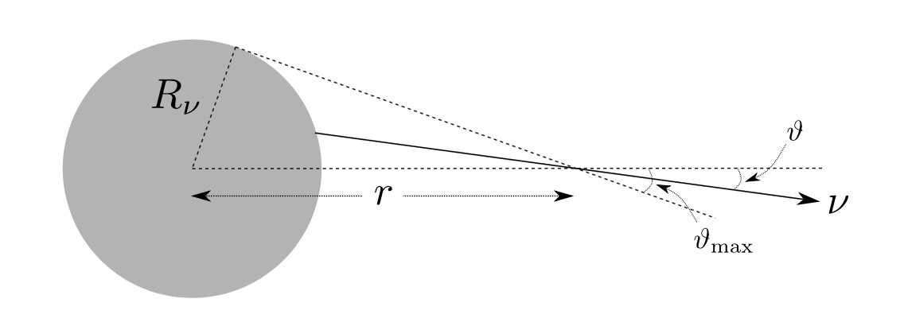
Collective oscillations in supernovae
“neutrino bulb” geometry
--single angle approximation
Balantekin, B.,.., Wang, X., 2024, ApJ 967, 146
Notes:
We adopt Baha’s group’s neutrino calculations for this work, for a toy neutrino interaction system, 4 neutrinos are adopted for the many body calculations.
This table summarized the collective oscillation calculations with various neutrino average energy distributions and the resulting initial electron fraction at equilibrium to be used for the heavy-element nucleosynthesis process. assume a spherically symmetric neutrino source with a sharp decoupling surface and isotropic emission in all outward directions from each point on the surface
For our toy neutrino interaction system, we adopt 4 neutrinos for the many body calculations.
This table summarized the collective oscillation calculations with various neutrino average energy distributions and the resulting initial electron fraction at equilibrium to be used for the heavy-element nucleosynthesis process.
To test the potential effects of neutrino interactions on the nucleosynthesis results, for each set of calculations, we run the nucleosynthesis calculation with four different neutrino treatments: no neutrino involved (nn), no neutrino oscillation (nosc), mean-field collective oscillation calculation (mf) and manybody oscillation calculation (mb), with the same initial composition for each trajectory. And here we don’t include the neutrino-nuclei interactions, as the neutrino flux is noramlly proportional to 1/r^2 in neutrino driven wind, we expect such effect will be small
The neutrino capture rates do still have an implicit time dependence, encoded in the motion r(t) of a fluid element as it travels outward from the proto-neutron star.
$Y_{e}≈\frac{1}{1+λ_{{\overline{ν}}_{e}}/λ_{ν_{e}}}$ at $T\sim 10GK$, when at weak equilibrium stage and undergoes Nuclear Statistical Equilibrium (NSE) nucleosynthesis
10^6 g/cm^3 at T~10GK
v-v interaction strength
To circumvent this
difficulty, a frequently adopted approach involves neglecting any nontrivial quantum correlations among the neutrinos,
thereby enforcing that the neutrino wavefunction forever remain in a product state.

Slide 5
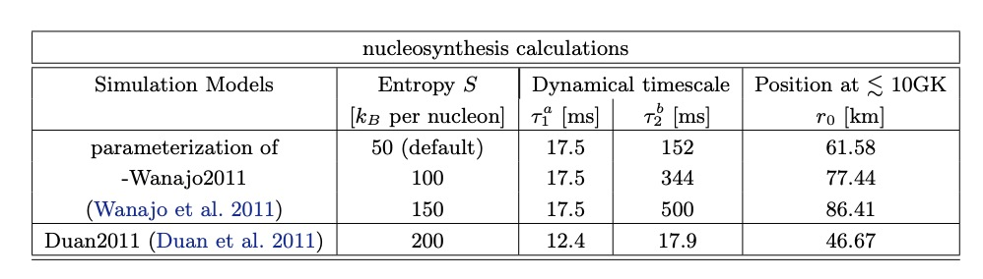

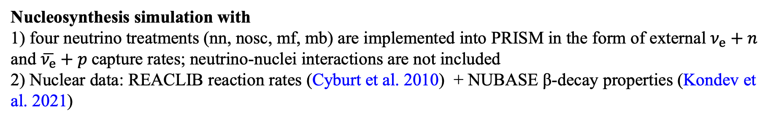
Collective oscillations in supernovae
SN neutrino-driven wind trajectories:
1) parameterized slow NDW trajectory adapted from Wanajo2011 with various entropy values;
2) parameterized high entropy and fast NDW trajectory adapted from Arcones+2007 as in Duan+2011.
Nucleosynthesis simulation with
1) four neutrino treatments (nn, nosc, mf, mb) are implemented into PRISM in the form of external $ν_{e}+n$ and $\overline{ν_{e}}+p$capture rates; neutrino-nuclei interactions are not included
2) Nuclear data: REACLIB reaction rates (Cyburt et al. 2010) + NUBASE β-decay properties (Kondev et al. 2021)
PRISM (Portable Routines for Integrated nucleoSynthesis Modeling): Trevor Sprouse (ND) & Matthew Mumpower (LANL)
Balantekin, B.,.., Wang, X., 2024, ApJ 967, 146
Notes:
We adopt two kinds of sn neutrino driven wind trajectories for nucleosynthesis test, one is the parameterized slow trajectories with various entropy values, which is normally used for vp process, the other one is the parameterized high entropy and fast trajectory which is more favored for r process nucleosynthesis
To test the potential effects of neutrino interactions on the nucleosynthesis results, for each set of calculations, we run the nucleosynthesis calculation with four different neutrino treatments: no neutrino involved (nn), no neutrino oscillation (nosc), mean-field collective oscillation calculation (mf) and manybody oscillation calculation (mb), with the same initial composition for each trajectory. And here we don’t include the neutrino-nuclei interactions, as the neutrino flux is noramlly proportional to 1/r^2 in neutrino driven wind, we expect such effect will be small.
; REACLIB data is supplemented with neutron capture rates, β-decay rates, and fission properties in the actinide region based on the FRDM/FRLDM model (Mumpower et al. 2018)
$Y_{e}≈\frac{1}{1+λ_{{\overline{ν}}_{e}}/λ_{ν_{e}}}$ at $T\sim 10GK$, when at weak equilibrium stage and undergoes Nuclear Statistical Equilibrium (NSE) nucleosynthesis
10^6 g/cm^3 at T~10GK
v-v interaction strength
To circumvent this
difficulty, a frequently adopted approach involves neglecting any nontrivial quantum correlations among the neutrinos,
thereby enforcing that the neutrino wavefunction forever remain in a product state.

Slide 6
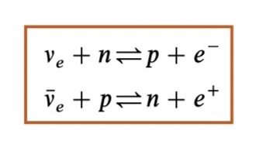
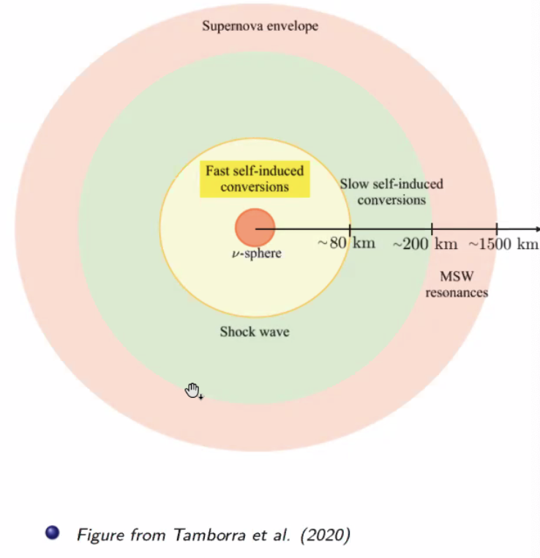
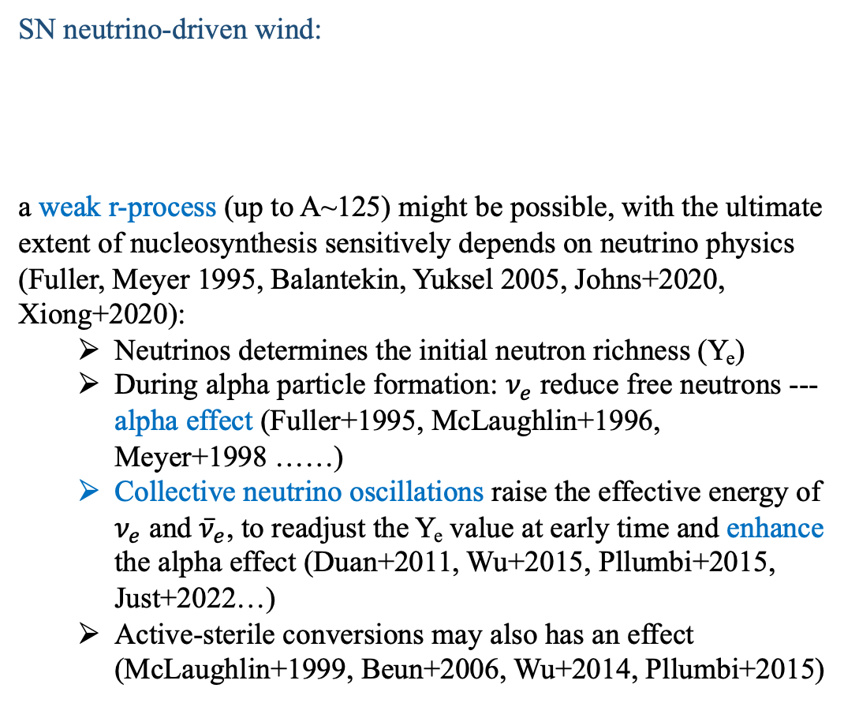
r-process astrophysical sites: supernovae?
SN neutrino-driven wind:
a weak r-process (up to A~125) might be possible, with the ultimate extent of nucleosynthesis sensitively depends on neutrino physics (Fuller, Meyer 1995, Balantekin, Yuksel 2005, Johns+2020, Xiong+2020):
  Neutrinos determines the initial neutron richness (Y_{e})
  During alpha particle formation: $ν_{e}$ reduce free neutrons --- alpha effect (Fuller+1995, McLaughlin+1996, Meyer+1998 ……)
  Collective neutrino oscillations raise the effective energy of $ν_{e}$ and ${\overline{ν}}_{e}$, to readjust the Y_{e} value at early time and enhance the alpha effect (Duan+2011, Wu+2015, Pllumbi+2015, Just+2022…)
  Active-sterile conversions may also has an effect (McLaughlin+1999, Beun+2006, Wu+2014, Pllumbi+2015)
Tamborra+2020
Existence of neutrinos: less robust r-process productions
Notes:
. Still, a weak r process (producing nuclei up to A ∼ 125) might be possible in this environment, with the ultimate extent of the nucleosynthesis in this site sensitively dependent on neutrino physics
(mostly free nucleons),
the electron antineutrino spectrum is hotter than the electron neutrino spectrum,
the rate of electron antineutrino captures will be faster and a composition with more neutrons than protons will be favored
All of the protons (and a corresponding number of neutrons) become locked up in alphas, shutting off the electron antineutrino captures on protons to create neutrons
traditional hierarchy of neutrino energies is assumed, i.e. ⟨Ex ⟩ > ⟨Eν ̄e ⟩ > ⟨Eνe ⟩
Oscillation lead to swap the entire spectra between flavors
Fast oscillation may enhance the r process lanthanide production in the merger remnant (J;ust+2022)

Slide 7
Collective oscillations and r process
asym3
Duan2011
purple: no neutrino (nn)
cyan: no neutrino oscillation (nosc)
blue: many-body calculation of oscillation (mb)
orange: mean-field calculation of oscillation (mf)
asym4
Duan2011
r process: neutrinos hinder the synthesis of heavier nuclei, and mainly affect the 3rd peak and beyond region; many-body treatment has the biggest effect for normal mass hierarchy
for asym3 case with r-process nucleosynthesis barely reach the 3rd peak and beyond:
  Biggest effect of the difference in SN NDW neutrino treatments on the r-process yields: move to weak r-process;
Balantekin, B.,.., Wang, X., 2024, ApJ 967, 146
Notes:
And here are our results for r process test, the left and right plots here show the impact of different neutrino treatments on r process with two different initial ye.
inverted mass hierarchy introduces bigger neutrino effect
$Y_{e}≈\frac{1}{1+λ_{{\overline{ν}}_{e}}/λ_{ν_{e}}}$ at $T\sim 10GK$, when at weak equilibrium stage and undergoes Nuclear Statistical Equilibrium (NSE) nucleosynthesis
10^6 g/cm^3 at T~10GK
Explore the possible effects, on both proton rich and neutron rich side
Not reproduced with modern simulations
Understand particularly for r process, not a favored site
v-v interaction strength
To circumvent this
difficulty, a frequently adopted approach involves neglecting any nontrivial quantum correlations among the neutrinos,
thereby enforcing that the neutrino wavefunction forever remain in a product state.

Slide 8
Collective oscillations and r process
The asym3 case starts with a slightly higher Ye value at equilibrium, producing a lower initial neutron abundance and a faster consumption of neutrons than in the asym4 case.
Neutrino interactions produce an alpha effect of varying strength: nosc, mf, mb enhance the alpha effect, with mb case showing the largest effect. → we observe decreased production of heavier nuclei especially around the third-peak region and beyond, with the smallest A∼ 195 peak produced.
Balantekin, B.,.., Wang, X., 2024, ApJ 967, 146
Notes:
And here shows the evolution of the abundance of neutrons in dashdot line and alpha particles in solid line for the two scenario, where we can see find the neutrino impact

Slide 9
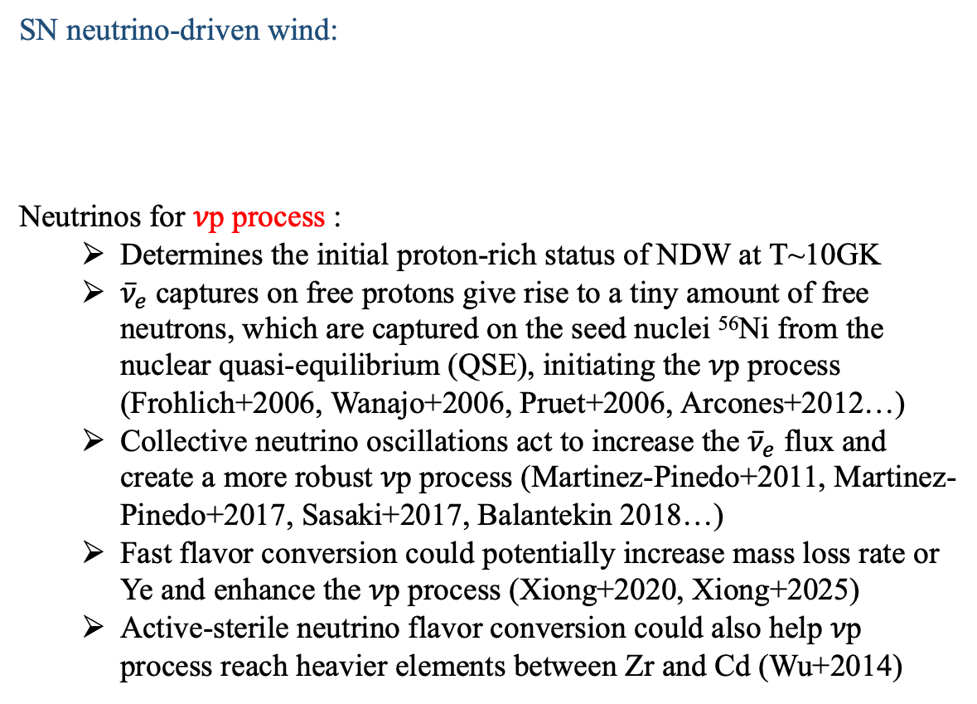
𝜈p-process in supernovae
SN neutrino-driven wind:
Neutrinos for 𝜈p process :
  Determines the initial proton-rich status of NDW at T~10GK
  ${\overline{ν}}_{e}$captures on free protons give rise to a tiny amount of free neutrons, which are captured on the seed nuclei ⁵⁶Ni from the nuclear quasi-equilibrium (QSE), initiating the 𝜈p process (Frohlich+2006, Wanajo+2006, Pruet+2006, Arcones+2012…)
  Collective neutrino oscillations act to increase the ${\overline{ν}}_{e}$ flux and create a more robust 𝜈p process (Martinez-Pinedo+2011, Martinez-Pinedo+2017, Sasaki+2017, Balantekin 2018…)
  Fast flavor conversion could potentially increase mass loss rate or Ye and enhance the 𝜈p process (Xiong+2020, Xiong+2025)
  Active-sterile neutrino flavor conversion could also help 𝜈p process reach heavier elements between Zr and Cd (Wu+2014)
Tamborra+2020
Existence of neutrinos: enhance heavier elements productions in 𝜈p process
Notes:
Then let’s move to the proton rich side. The νp process is a recently-identified nucleosynthesis process (Fro ̈hlich et al. 2006b; Pruet et al. 2006; Wanajo 2006b), discovered in the analysis of hydrodynamical simulations of CCSN neutrino-driven winds where most or all of the ejecta was found to be proton rich with low to moderate entropies
Alpha production rate may hinder the vp process of heavier element synthesis
Not used the updated rate
the electron antineutrino spectrum is hotter than the electron neutrino spectrum,
the rate of electron antineutrino captures will be faster and a composition with more neutrons than protons will be favored
All of the protons (and a corresponding number of neutrons) become locked up in alphas, shutting off the electron antineutrino captures on protons to creat neutrons
traditional hierarchy of neutrino energies is assumed, i.e. ⟨Ex ⟩ > ⟨Eν ̄e ⟩ > ⟨Eνe ⟩
Oscillation lead to swap the entire spectra between flavors

Slide 10
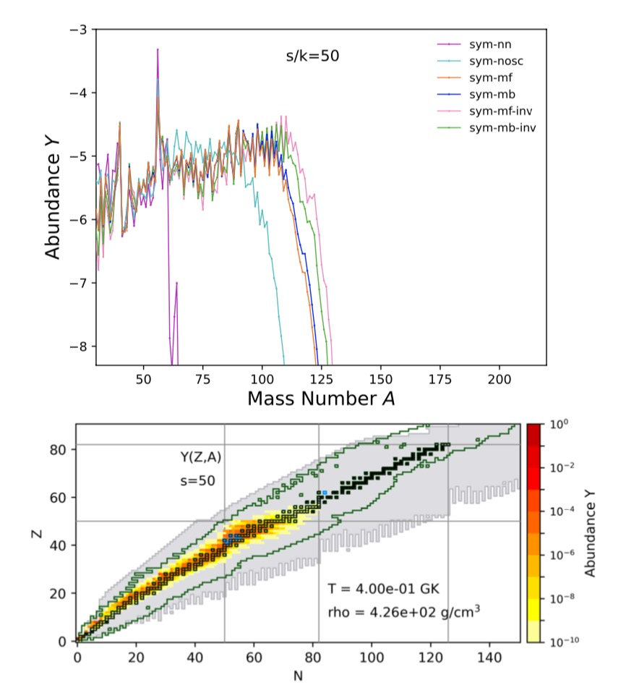
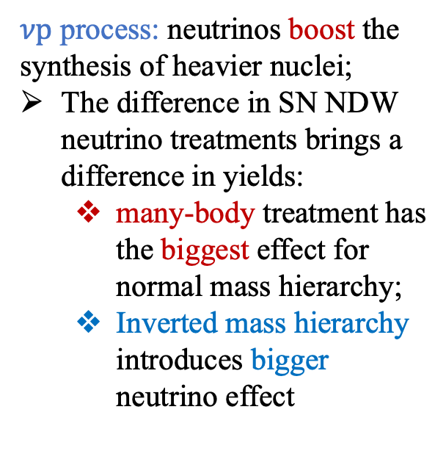
Collective oscillations and 𝜈p process
purple: no neutrino (nn)
cyan: no neutrino oscillation (nosc)
blue: many-body calculation of oscillation (mb)
orange: mean-field calculation of oscillation (mf)
green: inverted mass hierarchy with mb
pink: inverted mass hierarchy with mf
$νp$ process: neutrinos boost the synthesis of heavier nuclei;
The difference in SN NDW neutrino treatments brings a difference in yields:
  many-body treatment has the biggest effect for normal mass hierarchy;
  Inverted mass hierarchy introduces bigger neutrino effect
$νp$ process
Wanajo2011
Balantekin, B.,.., Wang, X., 2024, ApJ 967, 146
Notes:
The mass hierarchy also has an impact on the nucleosynthesis yields—kajino
Here shows the final abundance patterns adopting different neutrino treatments for a vp process calculation with the entropy per nucleon to be 50

Slide 11
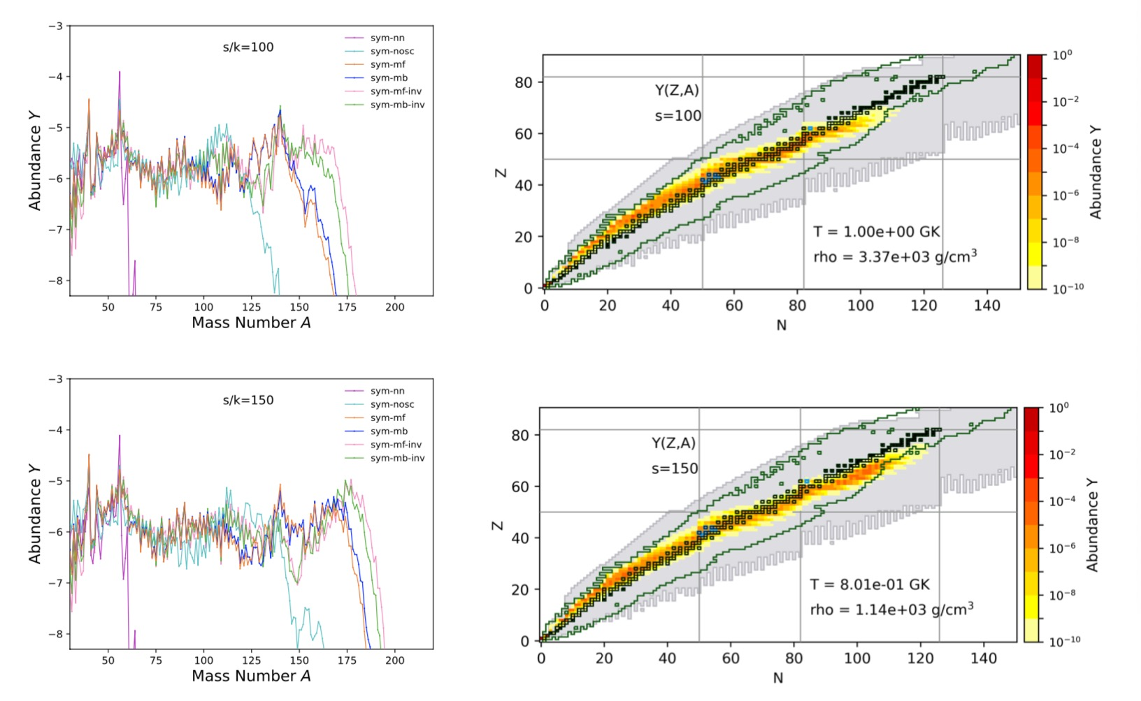
Collective oscillations and 𝜈p process with various entropy
Initial proton-rich condition($νp$ process): with the increased initial entropy, s/k_{B} =50, 100, 150, the collective neutrino oscillation push the synthesis of heavier nuclei, moving towards the neutron-rich region
Special abundance yields for s/k_{B} >~150: light proton-rich nuclei + heavy neutron-rich nuclei
Balantekin, B.,.., Wang, X., 2024, ApJ 967, 146
Notes:
Entropy also plays an important role in the nucleosynthesis, so for we ,
Continue to look at entropy evolution of these trajectories, what we find is indeed, we have a new mechanism popping out,
High entropy—lower mass seed nuclei, more free nucleons
$Y_{e}≈\frac{1}{1+λ_{{\overline{ν}}_{e}}/λ_{ν_{e}}}$ at $T\sim 10GK$, when at weak equilibrium stage and undergoes Nuclear Statistical Equilibrium (NSE) nucleosynthesis
10^6 g/cm^3 at T~10GK
Explore the possible effects, on both proton rich and neutron rich side
Not reproduced with modern simulations
Understand particularly for r process, not a favored site
v-v interaction strength
To circumvent this
difficulty, a frequently adopted approach involves neglecting any nontrivial quantum correlations among the neutrinos,
thereby enforcing that the neutrino wavefunction forever remain in a product state.

Slide 12
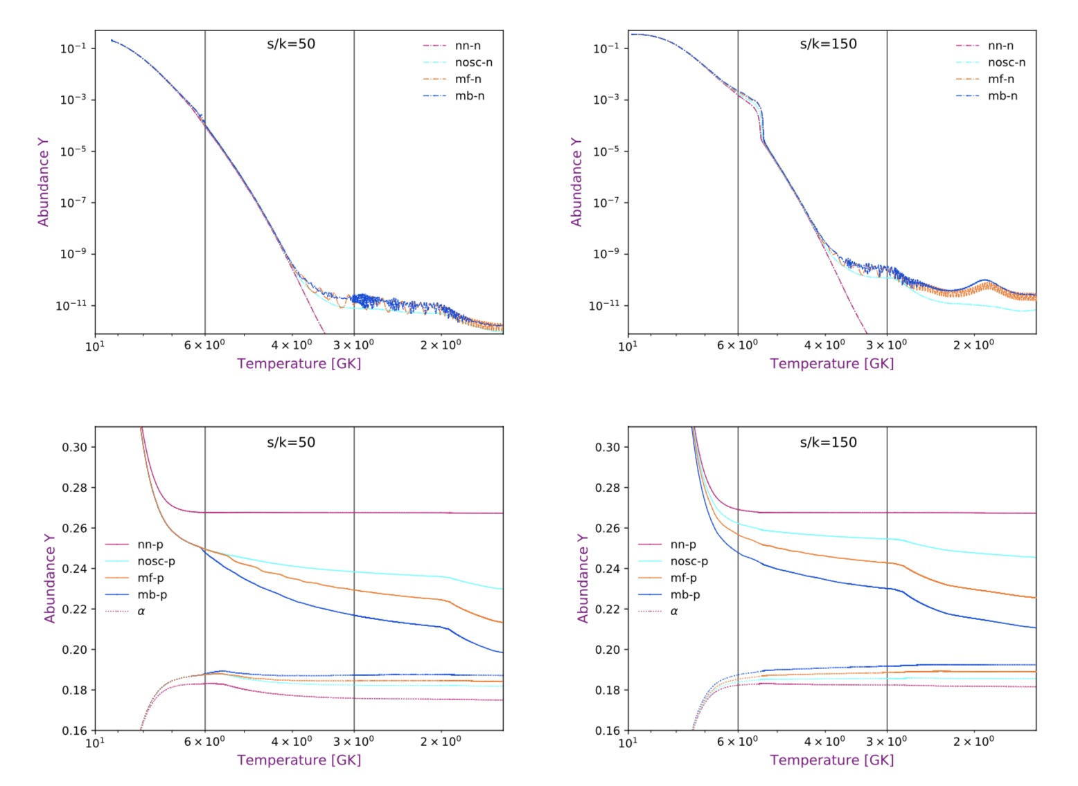
Collective oscillations and 𝜈p process with various entropy
nn: iron group nuclei are synthesized and additional proton capture is blocked by the slow β bottlenecks;
nosc: Y(p) decrease as the T drops, due to conversion of protons to neutrons by neutrinos and the resulting increase in neutron captures to higher A;
mf & mb: Both effects are enhanced by neutrino oscillations, with the sym-mb case showing a larger effect than sym-mf.
→The neutrino effect allows late time, low (T < 1.5 GK) temperature capture of neutrons and reaction flow to heavier, neutron-rich nuclei.
Balantekin, B.,.., Wang, X., 2024, ApJ 967, 146
Notes:
And here shows the evolution of the abundance of neutrons in dashdot line and alpha particles in solid line for the two scenario, to illustrate how different neutrino treatments impact the nucleosynthesis, we can see that
s/k = 150 vs s/k = 50:
the influence of the oscillations happens at an earlier stage for s/k = 150.
the higher entropy ensures that fewer seed nuclei are assembled from the alpha particles, so the free proton-to-seed ratio remains high. The production of neutrons and their subsequent capture is therefore enhanced. This effect allows late time, low (T < 1.5 GK) temperature capture of neutrons and reaction flow to heavier, neutron-rich nuclei.
since we take the onset of oscillations to occur at a fixed radius, which corresponds to a higher temperature for the s/k = 150 outflow
The neutrons produced at T > 6 GK end up bound into alpha particles, with enhanced production of alpha particles for the sym-mb and sym-mf cases.
To understand the mechanism by which this transition to neutron capture nucleosynthesis occurs, we show the
385 temperature evolution of the abundances of neutrons (top panel, log scale) and protons (bottom panel, linear scale) in
386 Fig. 6. Without neutrino interactions on free nucleons, iron group nuclei are synthesized and additional proton capture
387 is blocked by the slow β bottlenecks, shown in the red lines of each of the panels of Fig. 6. When neutrino interactions
388 are included (without oscillations), shown by the cyan lines of Fig. 6, the proton abundance continues to decrease as the
389 temperature drops, due to conversion of protons to neutrons by neutrinos and the resulting increase in proton captures
390 to higher A. Both of these effects are enhanced by neutrino oscillations, with the sym-mb case (blue lines) showing a
391 larger effect than sym-mf (orange lines). Comparing the s/k = 150 examples to s/k = 50, we see the influence of the
392 oscillations at an earlier stage of the nucleosynthesis, since we take the onset of oscillations to occur at a fixed radius,
393 which corresponds to a higher temperature for the s/k = 150 outflow. The neutrons produced at T > 6 GK end up
394 bound into alpha particles, with enhanced production of alpha particles for the sym-mb and sym-mf cases. Still, the
395 higher entropy ensures that fewer seed nuclei are assembled from the alpha particles, so the free proton-to-seed ratio
396 remains high. The production of neutrons and their subsequent capture is therefore enhanced. This effect allows late
397 time, low (T < 1.5 GK) temperature capture of neutrons and reaction flow to heavier, neutron-rich nuclei.

Slide 13
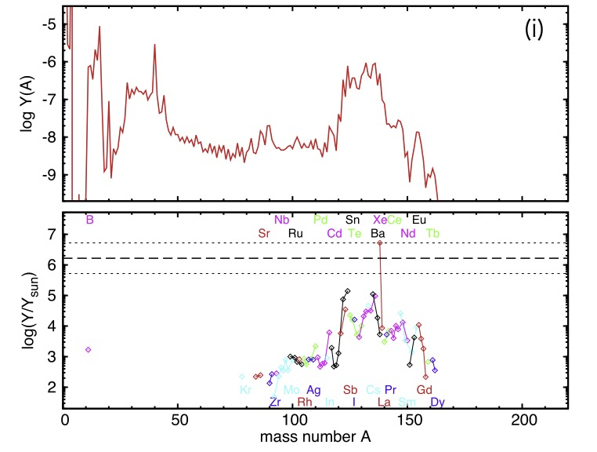
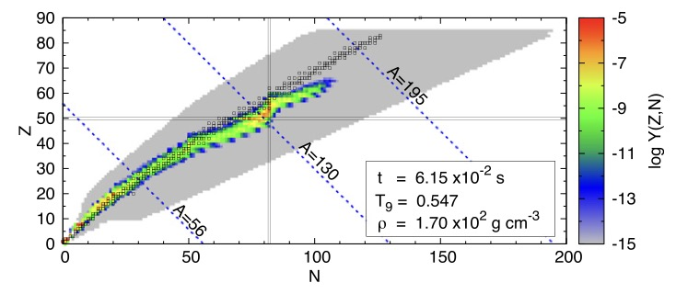
A robust 𝜈p process → neutron rich at late time
First pointed out: Wanajo et al. (2011), Arcones et al. (2012), Nishimura et al. (2019)
Observed in a hypernova neutrino-driven wind with higher (~10x) Lνe∼ 1.65x10⁵³erg s⁻¹ (Fujibayashi et al. 2015):
We find neutrino oscillations amplify the shift from proton-rich to neutron-rich nucleosynthesis
Hypernova wind condition: M_{pns}=3M_{sol} ,E_{𝜈e}=11.0 MeV, Y_{e}=0.587, s/k_{B}=141(Fujibayashi et al. 2015)
Notes:
Indeed, The suggestion that a robust νp process could shift to neutron-rich species at late times was first pointed out in Wanajo et al. (2011), Arcones et al. (2012), and also Nishimura et al. (2019), though the details were not explored. A similar process (with smaller maximum mass number ∼ 160) was also observed in a hypernova neutrino-driven wind with higher neutrino luminosities Lν ∼ 1053 erg/s (Fujibayashi et al. 2015). We find neutrino oscillations amplify the shift from proton-rich to neutron-rich nucleosynthesis

Slide 14
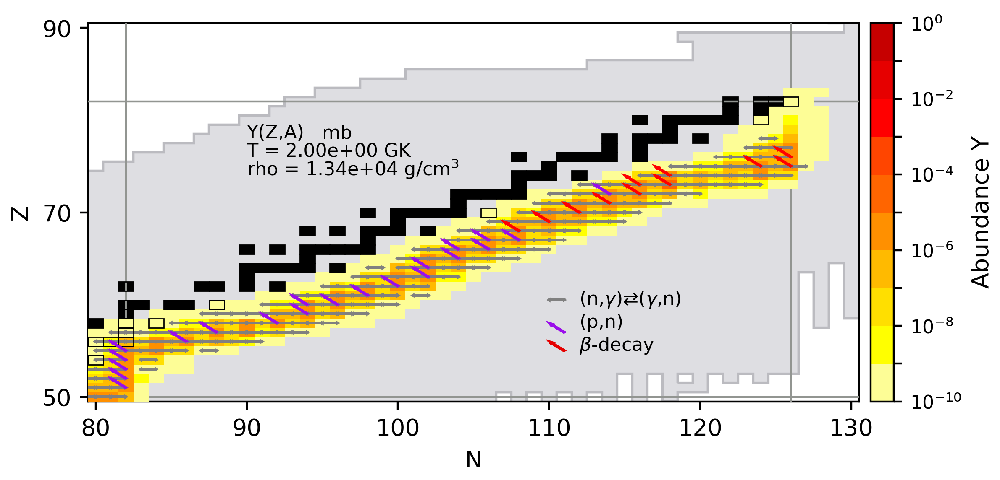
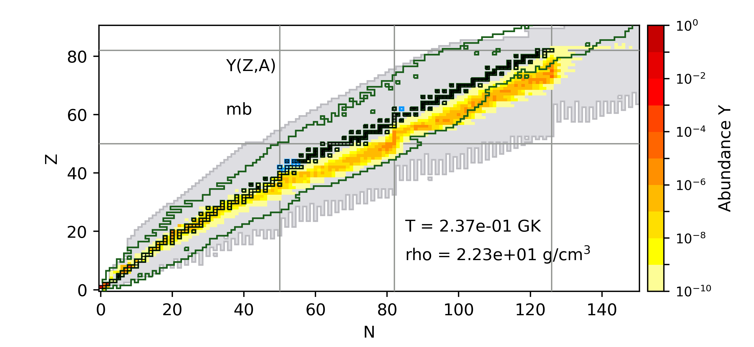
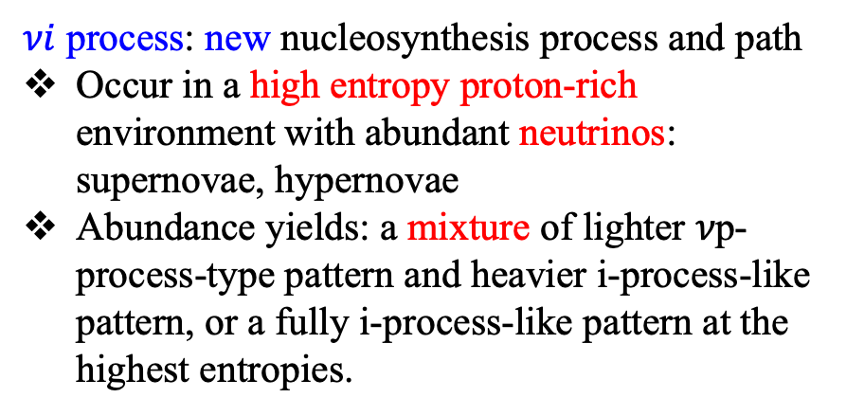
Collective oscillations and 𝜈i process
Duan2011
s/k~200
$νi$ process: new nucleosynthesis process and path
Occur in a high entropy proton-rich environment with abundant neutrinos: supernovae, hypernovae
Abundance yields: a mixture of lighter 𝜈p-process-type pattern and heavier i-process-like pattern, or a fully i-process-like pattern at the highest entropies.
Balantekin, B.,.., Wang, X., 2024, ApJ 967, 146
Notes:
They can get even more extreme, if you have enough protons late time to turn neutrons, then you have really a full i process path.
Then we look at the trajectory with higher entropy values and fast expansion as shown here, we can see that similarly,
The nucleosynthetic pathway is clearly distinct from an i process that occurs in mildly neutron-rich conditions
The nucleosynthesis pathway shows a fully neutron-rich or i-process-like feature, but here the heavy elements are created via neutron capture where the neutrons are a product of neutrino interactions on excess protons in a proton-rich wind. The suggestion that a robust νp process could shift to neutron-rich species at late times was first pointed out in Wanajo et al. (2011), Arcones et al. (2012), and also Nishimura et al. (2019), though the details were not explored. A similar process (with smaller maximum mass number ∼ 160) was also observed in a hypernova neutrino-driven wind with higher neutrino luminosities Lν ∼ 1053 erg/s (Fujibayashi et al. 2015). We find neutrino oscillations amplify the shift from proton-rich to neutron-rich nucleosynthesis and can result in a full intermediate neutron capture process. We dub this novel nucleosynthesis process a “νi process”.
Time scale difference
Inverted mass hierarchy -- the heavy elements are created via neutron capture where the neutrons are a product of neutrino interactions on excess proton
The dominant nuclear reaction flows at T = 2 GK are shown in Figure 10. Similar to a “traditional” i-process, the predominant reaction is neutron capture. Here, the charge-changing interactions include both (p,n) and β decay, with the latter increasing in importance with increasing A.
The process that produces this i-process-like nucleosynthetic pathway here is clearly distinct from an i process that occurs in mildly neutron-rich conditions. Instead, here the heavy elements are created via neutron capture where the neutrons are a product of neutrino interactions on excess protons in a proton-rich wind. The suggestion that a robust νp process could shift to neutron-rich species at late times was first pointed out in Wanajo et al. (2011), Arcones et al. (2012), and also Nishimura et al. (2019), though the details were not explored. A similar process (with smaller maximum mass number ∼ 160) was also observed in a hypernova neutrino-driven wind with higher neutrino luminosities Lν ∼ 1053 erg/s (Fujibayashi et al. 2015). We find neutrino oscillations amplify the shift from proton-rich to neutron-rich nucleosynthesis and can result in a full intermediate neutron capture process. We dub this novel nucleosynthesis process a “νi process”.

Slide 15
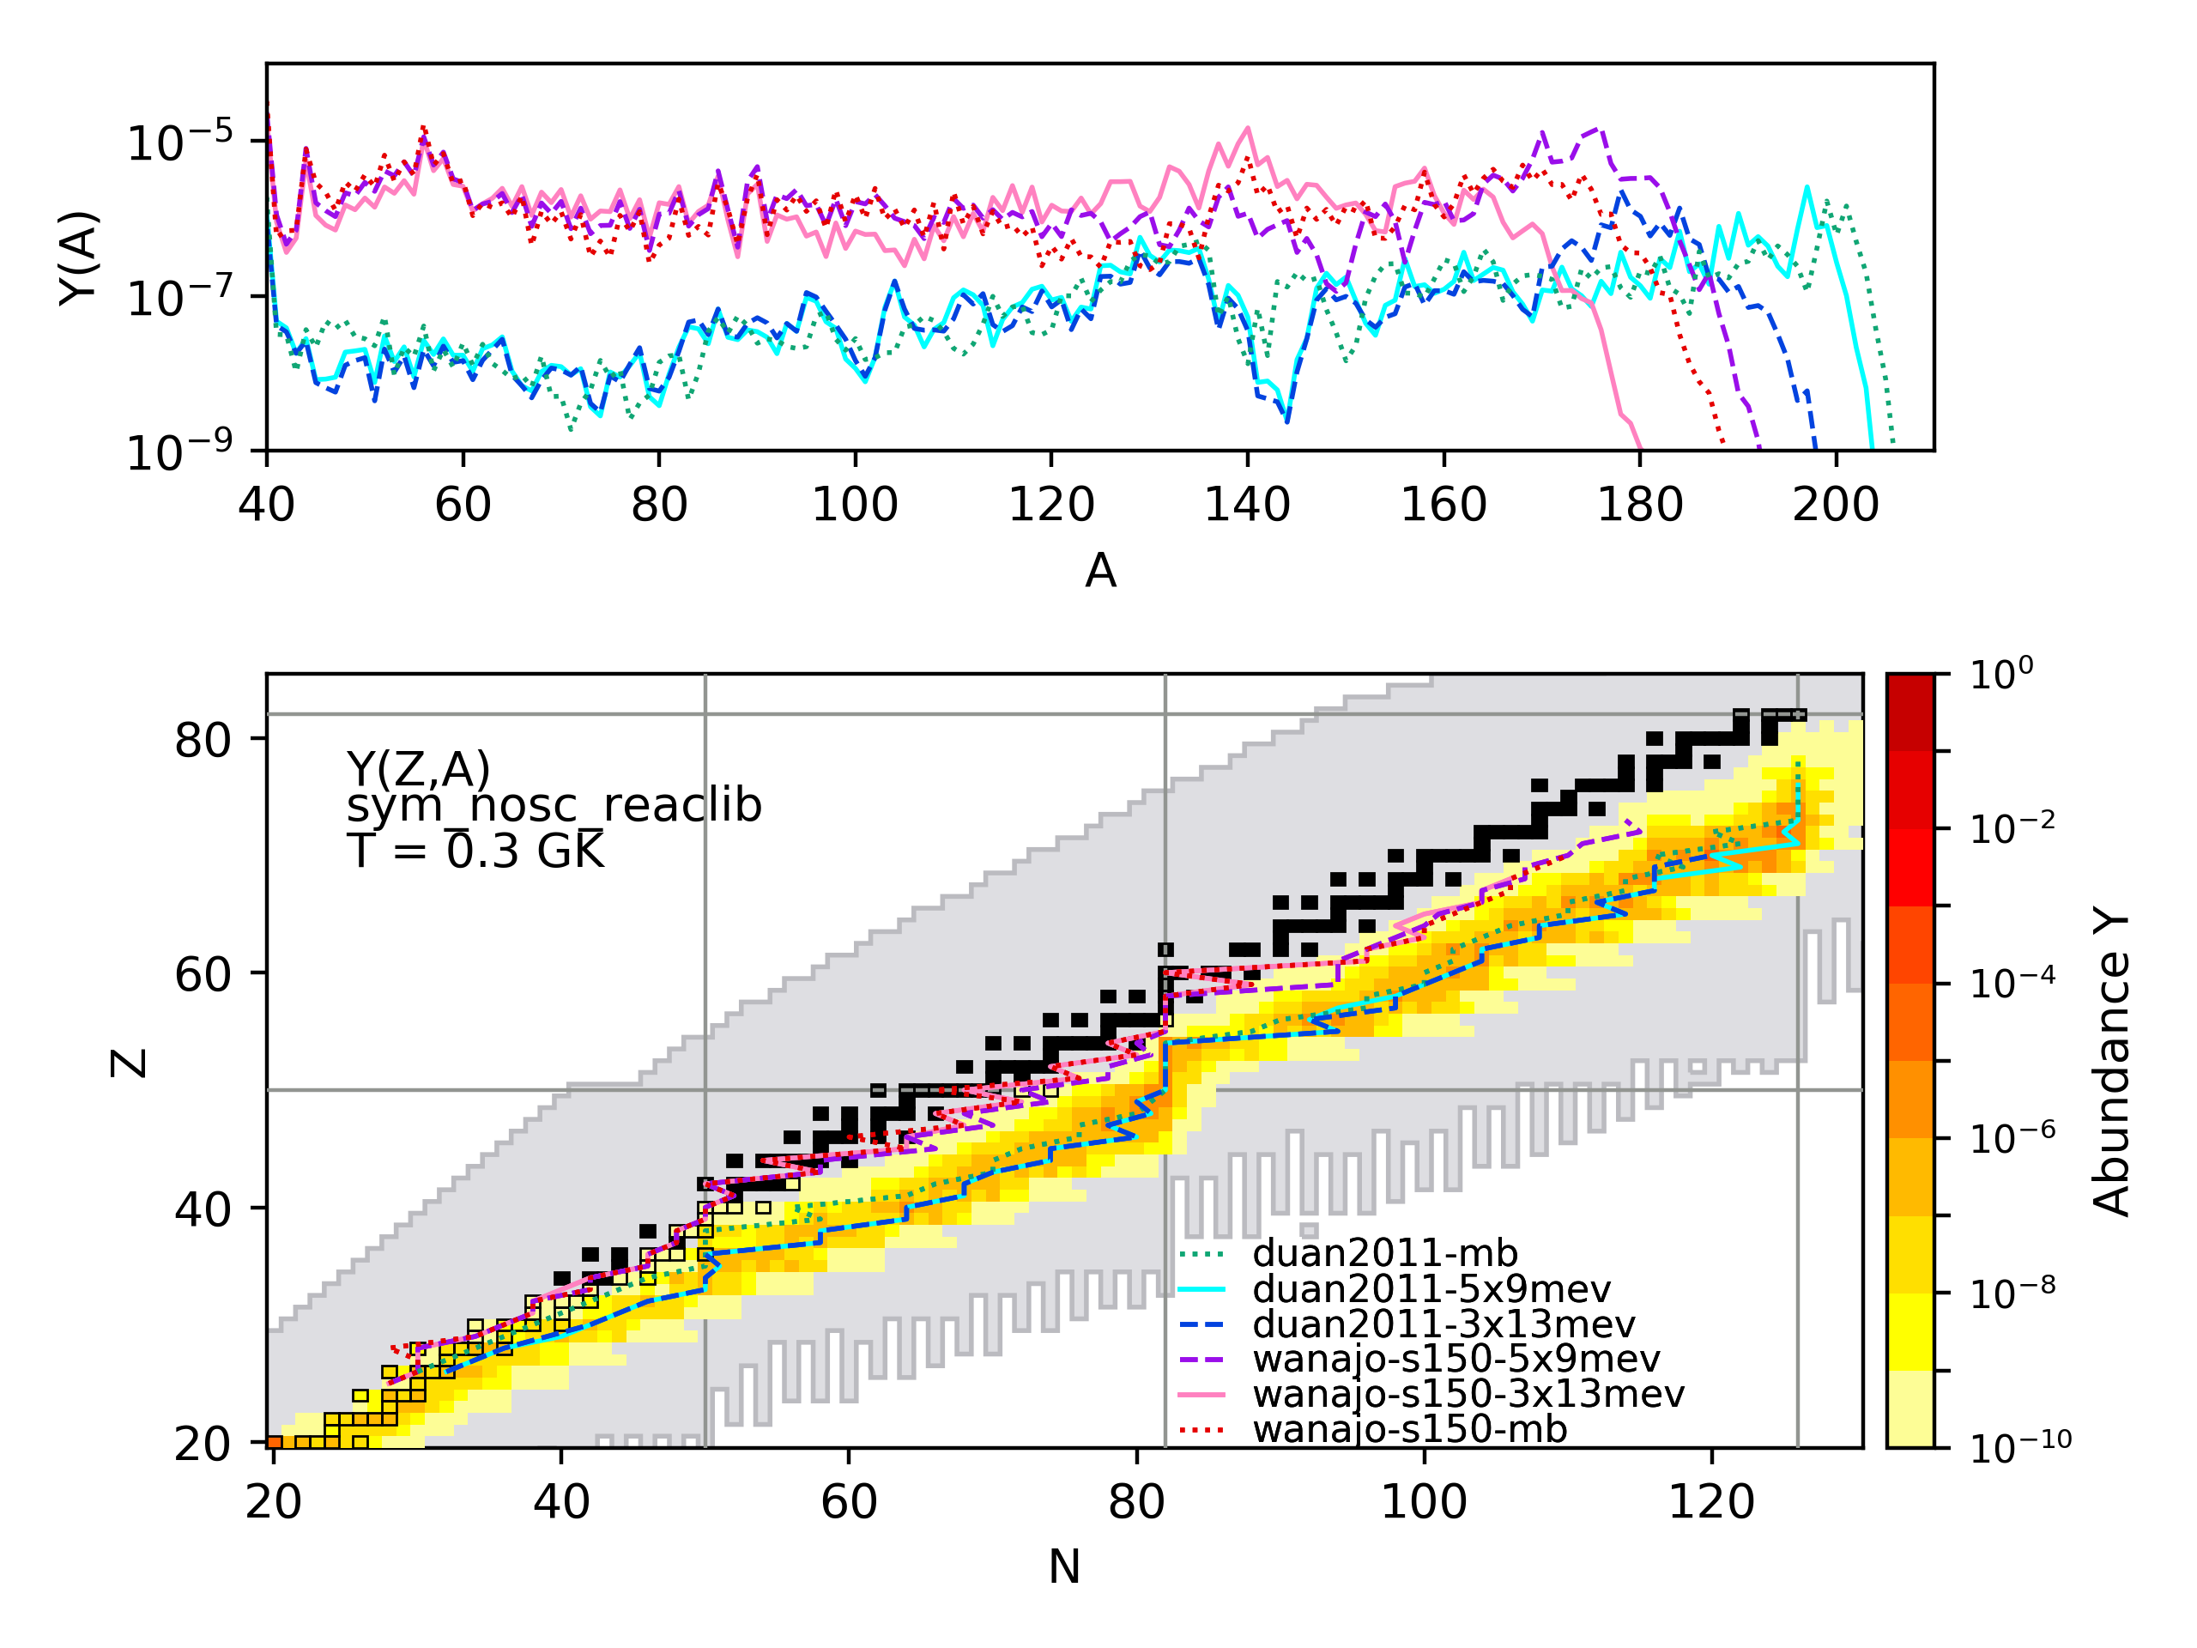
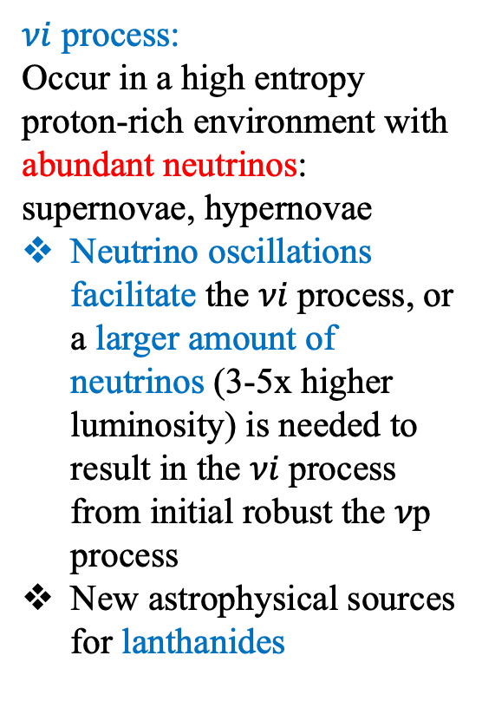
𝜈i process nucleosynthesis
lanthanides
(138<A<179)
$νi$ process:
Occur in a high entropy proton-rich environment with abundant neutrinos: supernovae, hypernovae
Neutrino oscillations facilitate the 𝜈𝑖 process, or a larger amount of neutrinos (3-5x higher luminosity) is needed to result in the 𝜈𝑖 process from initial robust the 𝜈p process
New astrophysical sources for lanthanides
green: duan2011 with neutrinos of many-body (mb) oscillation calculations
cyan: duan2011 with neutrinos of <E_{v}>=9MeV, L_{v}=5xL_{v,0}=5x9x10⁵¹erg/s
blue: duan2011 with neutrinos of <E_{v}>=13MeV, L_{v}=3xL_{v,0}
purple: wanajo-s150 with neutrinos of <E_{v}>=9MeV, L_{v,0}=5xL_{v,0}
pink: wanajo-s150 with neutrinos of <E_{v}>=13MeV, L_{v,0}=3xL_{v,0}
red: wanajo-s150 with neutrinos of mb oscillation calculations
lanthanides
(56<Z<72)
Wang, X., et al., 2025, in preparation
Notes:
Ye=0.585
We can actually get the same thing as with our collective neutrino oscillation, when we have a slightly higher neutrino luminosities, and here we crack up the neutrino luminosities, like the hypernovae conditions that have previously published, indeed, we see, robust production of lanthanides in this proton rich condition, which could have interesting impacts.
As just discussed, we find that the influence of neutrino oscillations grows with the increase of initial entropy, and the ultimate extent and yields of the element synthesis vary from a typical νp-process to an unusual mixture of light proton-rich nuclei and heavy neutron-rich nuclei to a full and robust νi-process.
To examine this trend, the left Fig. shows the comparison of the final abundance yields from the Wanajo2011 trajectories with varying entropy as well as the Duan2011 trajectory, adopting the symmetric many-body (sym-mb) neutrino calculations that result in the greatest influence of the neutrino interactions. Also shown (as points) are the abundances of the proton-rich p nuclei synthesized in each calculation, to highlight the fraction of the material that ultimately shifts neutron-rich. Note the abundance pattern of Wanajo2011 s/k = 50 case follows a typical νp process where p nuclei are dominantly produced, while the abundance patterns resulting from larger initial entropy values shift from a νp process at lower mass to a neutron-rich pattern for heavier nuclei (A ≳ 115 for s/k = 100, A ≳ 100 for s/k = 150, A ≳ 70 for Duan2011).
In addition, we also compare the vi abundance pattern with solar r,
As discussed above, we find that the influence of neutrino oscillations grows with the increase of initial entropy, and the ultimate extent and yields of the element synthesis vary from a typical νp-process to an unusual mixture of light proton-rich nuclei and heavy neutron-rich nuclei to a full and robust νi-process.
To examine this trend, Fig. shows the comparison of the final abundance yields from the Wanajo2011 trajectories with varying entropy as well as the Duan2011 trajectory, adopting the symmetric many-body (sym-mb) neutrino calculations that result in the greatest influence of the neutrino interactions. Also shown (as points) are the abundances of the proton-rich p nuclei synthesized in each calculation, to highlight the fraction of the material that ultimately shifts neutron-rich. Note the abundance pattern of Wanajo2011 s/k = 50 case follows a typical νp process where p nuclei are dominantly produced, while the abundance patterns resulting from larger initial entropy values shift from a νp process at lower mass to a neutron-rich pattern for heavier nuclei (A ≳ 115 for s/k = 100, A ≳ 100 for s/k = 150, A ≳ 70 for Duan2011).

Slide 16


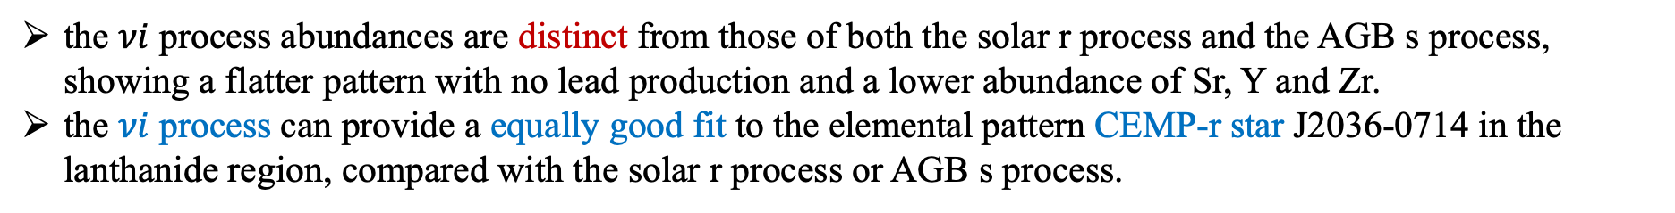
𝜈i process elemental patterns and stellar observations
PRELIMINARY
Yangming Lin
the $νi$ process abundances are distinct from those of both the solar r process and the AGB s process, showing a flatter pattern with no lead production and a lower abundance of Sr, Y and Zr.
the $νi$ process can provide a equally good fit to the elemental pattern CEMP-r star J2036-0714 in the lanthanide region, compared with the solar r process or AGB s process.
Wang, X., et al., 2025, in preparation
Notes:
Carbon-enhanced metal-poor stars (CEMP): stellar descendants of the (primordial) explosive nucleosynthesis events.
We have been talking about
Interpreting the metal poor stars abundances, we are going to add just another ransion of works as in another way we can make lanthanides, and indeed nu-i process, the distinct nature is that it comes with no lead, and lower abundances of Sr, Y, Zr.
The vi process has a relatively flat elemental pattern, and could possibly match some stellar observations of metal poor stars,
Elemental pattern
As discussed above, we find that the influence of neutrino oscillations grows with the increase of initial entropy, and the ultimate extent and yields of the element synthesis vary from a typical νp-process to an unusual mixture of light proton-rich nuclei and heavy neutron-rich nuclei to a full and robust νi-process.
To examine this trend, Fig. shows the comparison of the final abundance yields from the Wanajo2011 trajectories with varying entropy as well as the Duan2011 trajectory, adopting the symmetric many-body (sym-mb) neutrino calculations that result in the greatest influence of the neutrino interactions. Also shown (as points) are the abundances of the proton-rich p nuclei synthesized in each calculation, to highlight the fraction of the material that ultimately shifts neutron-rich. Note the abundance pattern of Wanajo2011 s/k = 50 case follows a typical νp process where p nuclei are dominantly produced, while the abundance patterns resulting from larger initial entropy values shift from a νp process at lower mass to a neutron-rich pattern for heavier nuclei (A ≳ 115 for s/k = 100, A ≳ 100 for s/k = 150, A ≳ 70 for Duan2011).

Slide 17
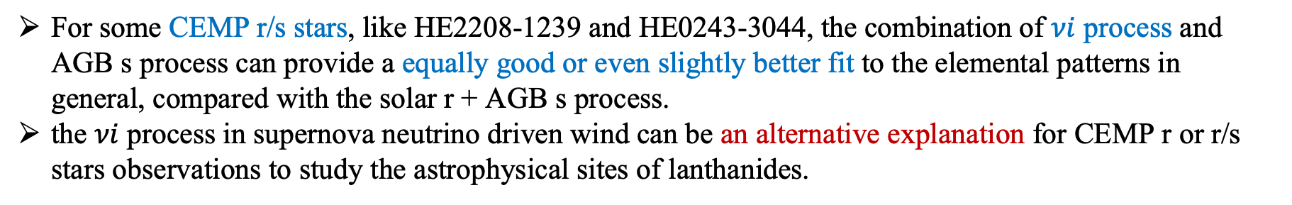
𝜈i process elemental patterns and stellar observations
PRELIMINARY
PRELIMINARY
For some CEMP r/s stars, like HE2208-1239 and HE0243-3044, the combination of $νi$ process and AGB s process can provide a equally good or even slightly better fit to the elemental patterns in general, compared with the solar r + AGB s process.
the $νi$ process in supernova neutrino driven wind can be an alternative explanation for CEMP r or r/s stars observations to study the astrophysical sites of lanthanides.
Wang, X., et al., 2025, in preparation
Notes:
As you see r+s star, could also be nu-i process from supernova.
Vi process elemental pattern compared to r and s
Note that We are not arguing these are vi -process stars, we are just saying there is another potential possibility to interpret these stars.
The vi process has a relatively flat elemental pattern, and could possibly match some stellar observations of metal poor stars,
Elemental pattern
As discussed above, we find that the influence of neutrino oscillations grows with the increase of initial entropy, and the ultimate extent and yields of the element synthesis vary from a typical νp-process to an unusual mixture of light proton-rich nuclei and heavy neutron-rich nuclei to a full and robust νi-process.
To examine this trend, Fig. shows the comparison of the final abundance yields from the Wanajo2011 trajectories with varying entropy as well as the Duan2011 trajectory, adopting the symmetric many-body (sym-mb) neutrino calculations that result in the greatest influence of the neutrino interactions. Also shown (as points) are the abundances of the proton-rich p nuclei synthesized in each calculation, to highlight the fraction of the material that ultimately shifts neutron-rich. Note the abundance pattern of Wanajo2011 s/k = 50 case follows a typical νp process where p nuclei are dominantly produced, while the abundance patterns resulting from larger initial entropy values shift from a νp process at lower mass to a neutron-rich pattern for heavier nuclei (A ≳ 115 for s/k = 100, A ≳ 100 for s/k = 150, A ≳ 70 for Duan2011).

Slide 18
Summary
Neutrinos play a key role in heavy-element nucleosynthesis in supernovae.
However, the neutrino physics in candidate heavy-element nucleosynthesis events remains poorly understood. Different treatments of the collective neutrino oscillations can have a non-negligible impact on the the operation of the νp-process and r-process nucleosynthesis in supernovae.
We found that neutrino interactions, especially when neutrino oscillations are included or a larger amount of neutrinos are emitted, can nudge an initial νp process neutron rich, resulting in a unique combination of proton-rich low-mass nuclei as well as neutron-rich high-mass nuclei. We describe this novel neutrino-induced neutron capture process as the “νi process”.
We also investigate the potential astrophysical observables of νi process and find that νi process can be a possible proton-rich astrophysical site of lanthanides production in the Universe.
  νi process can provide an alternative explanation for the stellar observations of some CEMP stars
In collaboration with Amol Patwardhan, Yangming Lin, Junbo Zheng, Michael Cervia, Yanwen Deng, Baha Balantekin, Erika Holmbeck, Haining Li, Ian Roederer and Rebecca Surman
Notes:
Thanks to Baha and George and other people’s neutrino oscillation studies, we are able to test the effect of neutrino oscillations on nucleosynthesis, help us have a better understanding of the heavy element nucleosynthesis.
Despite considerable progress in the past several years, including the first direct detection of an r-process event, the r-process site(s) has not been definitively determined.
The exact heavy element nucleosynthesis sites or mechanisms remain uncertain.
Future neutrino measurements and better neutrino treatments in supernova simulations
will provide important information for neutrino interactions to help us better understand the heavy-element nucleosynthesis in supernovae.
Test uncertainty of νi due to nuclear physics variation: triple-α rates, neutron capture rates, etc
Astrophysical observables for νi process: metal poor stars (CEMP-r/s or CEMP-i stars); light curves
Alterative astrophysical sites: hypernovae

Slide 19
Thanks for your attention. Questions?

Slide 20
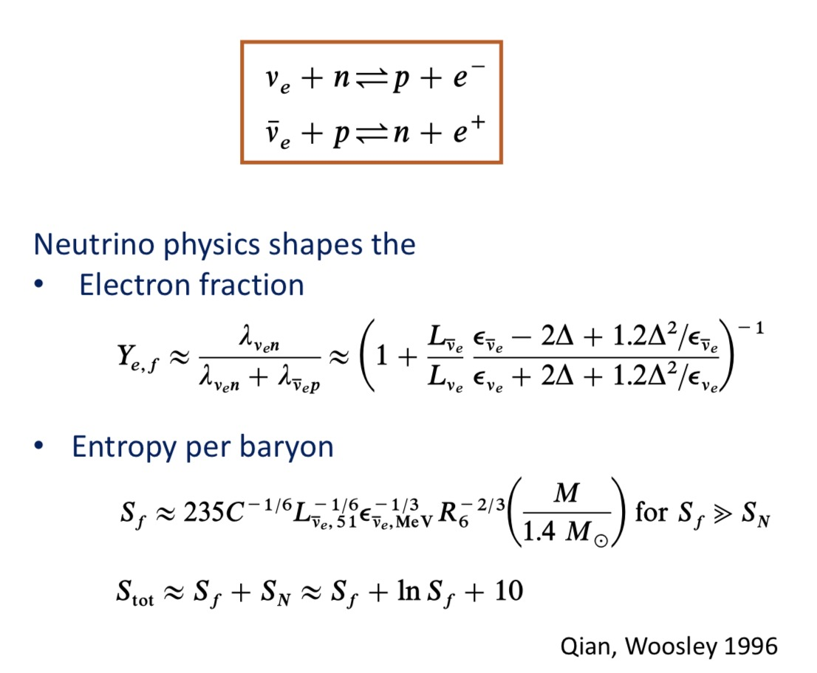
Neutrinos and heavy-element nucleosynthesis in supernovae
Woosley, Janka 2005
Notes:
neutrinos can shape both the electron fraction or neutrino richness of as well as the entropy per baryon for the ejecta, to have impact on the final heavy element nucleosynthesis yields in supernova neutrino driven wind
higher free nucleons to seed ratios
Actually
High entropy and sufficient neutron richness
Final flow entropy S_f at T~0.5MeV~6GK, S_N is the entropy per baryon in non-relativistic nucleons

Slide 21
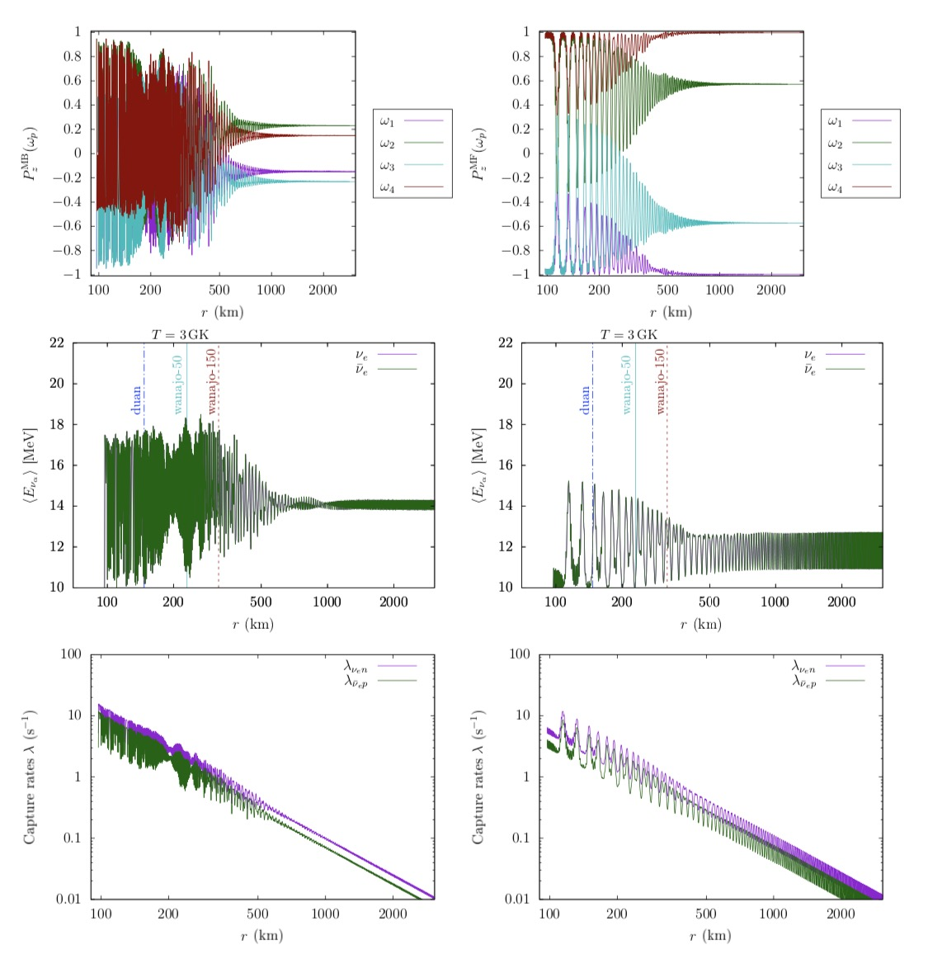
Collective oscillations in supernovae
Balantekin, B.,.., Wang, X., 2024,
ApJ 967, 146, arXiv: 2311.02562
Notes:
Here shows an example comparison between the manybody and meanfield calculations for a four neutrino calculation in the “symm” configuration
The top panels show the evolution of neutrino polarization vector Pz component (ω) vs distance r in the mass basis. W here are the vacuum oscillation frequencies of neutrinos, related the their average every by delta m squared over 2 E. Here w1 and w2 are for antineutrinos, w3 and w4 are for neutrinos.
the bottom panels show the νe and ̄νe capture rates as functions of r.
The two panels on the left show the results for a many-body calculation, whereas the panels on the right show the corresponding mean-field results.
We can see that the oscillations happens earlier for many body case, and the oscillation pattern show different structures for many body and meanfield
Deltam^2/2E mass bases
w1 (electron) w2(x flavor), anti neutrinos, w3(x flavor), w4 (electron) neutrinos
Evolution of mass-basis Pz(ω) (top panels), the average νe and ν ̄e energies (middle panels), and the νe and ν ̄e capture rates (bottom panels) as functions of r for a four-neutrino calculation (2 ν + 2 ν ̄) in the “sym” configuration. The left panels show the results for a many-body calculation, whereas the right panels show the results for the corresponding mean- field calculation. The locations at which three example matter trajectories (summarized in Table 3) reach a temperature of T = 3 GK—the approximate onset of a νp process—are shown by vertical lines in the middle panels. Note that, in the symmetric configuration, the average energies for νe and ν ̄e are the same, but the corresponding capture rates are different due to the difference in Q-values for νen and ν ̄ep reactions.

Slide 22
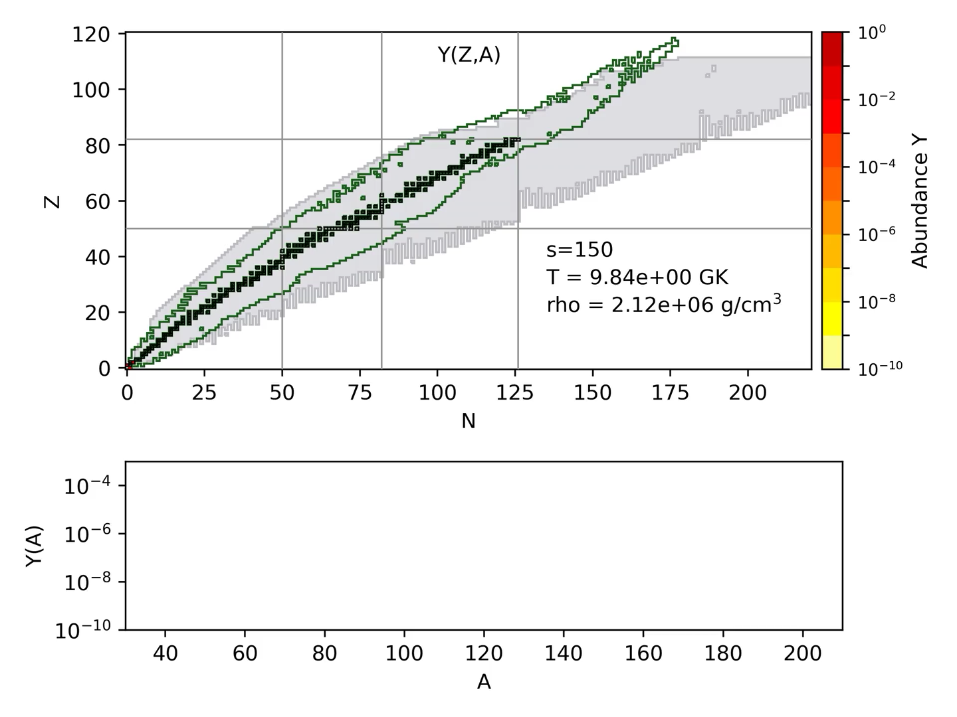
Collective oscillations and 𝜈p process with various entropy
Sym-mb
Special abundance yields for s/k_{B} >~150: light proton-rich nuclei + heavy neutron-rich nuclei
Wanajo2011
Balantekin, B.,.., Wang, X., 2024,
ApJ 967, 146, arXiv: 2311.02562

Slide 23
Collective oscillations and 𝜈p process with various entropy
nn: iron group nuclei are synthesized and additional proton capture is blocked by the slow β bottlenecks;
nosc: Y(p) decrease as the T drops, due to conversion of protons to neutrons by neutrinos and the resulting increase in neutroon captures to higher A;
mf & mb: Both effects are enhanced by neutrino oscillations, with the sym-mb case showing a larger effect than sym-mf.
Balantekin, B.,.., Wang, X., 2024, ApJ 967, 146
Notes:
s/k = 150 vs s/k = 50:
the influence of the oscillations happens at an earlier stage for s/k = 150.
the higher entropy ensures that fewer seed nuclei are assembled from the alpha particles, so the free proton-to-seed ratio remains high. The production of neutrons and their subsequent capture is therefore enhanced. This effect allows late time, low (T < 1.5 GK) temperature capture of neutrons and reaction flow to heavier, neutron-rich nuclei.
since we take the onset of oscillations to occur at a fixed radius, which corresponds to a higher temperature for the s/k = 150 outflow
The neutrons produced at T > 6 GK end up bound into alpha particles, with enhanced production of alpha particles for the sym-mb and sym-mf cases.
To understand the mechanism by which this transition to neutron capture nucleosynthesis occurs, we show the
385 temperature evolution of the abundances of neutrons (top panel, log scale) and protons (bottom panel, linear scale) in
386 Fig. 6. Without neutrino interactions on free nucleons, iron group nuclei are synthesized and additional proton capture
387 is blocked by the slow β bottlenecks, shown in the red lines of each of the panels of Fig. 6. When neutrino interactions
388 are included (without oscillations), shown by the cyan lines of Fig. 6, the proton abundance continues to decrease as the
389 temperature drops, due to conversion of protons to neutrons by neutrinos and the resulting increase in proton captures
390 to higher A. Both of these effects are enhanced by neutrino oscillations, with the sym-mb case (blue lines) showing a
391 larger effect than sym-mf (orange lines). Comparing the s/k = 150 examples to s/k = 50, we see the influence of the
392 oscillations at an earlier stage of the nucleosynthesis, since we take the onset of oscillations to occur at a fixed radius,
393 which corresponds to a higher temperature for the s/k = 150 outflow. The neutrons produced at T > 6 GK end up
394 bound into alpha particles, with enhanced production of alpha particles for the sym-mb and sym-mf cases. Still, the
395 higher entropy ensures that fewer seed nuclei are assembled from the alpha particles, so the free proton-to-seed ratio
396 remains high. The production of neutrons and their subsequent capture is therefore enhanced. This effect allows late
397 time, low (T < 1.5 GK) temperature capture of neutrons and reaction flow to heavier, neutron-rich nuclei.

Slide 24
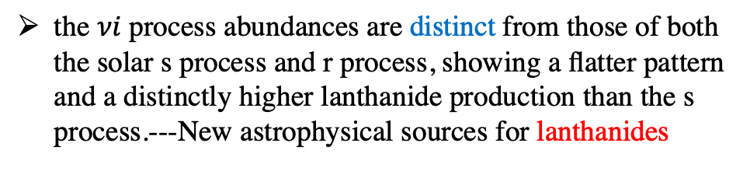
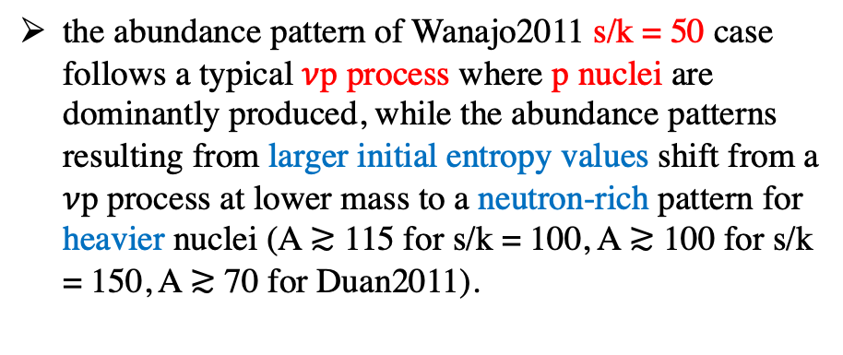
Collective oscillations and 𝜈i process
the abundance pattern of Wanajo2011 s/k = 50 case follows a typical $ν$p process where p nuclei are dominantly produced, while the abundance patterns resulting from larger initial entropy values shift from a $ν$p process at lower mass to a neutron-rich pattern for heavier nuclei (A ≳ 115 for s/k = 100, A ≳ 100 for s/k = 150, A ≳ 70 for Duan2011).
the $νi$ process abundances are distinct from those of both the solar s process and r process, showing a flatter pattern and a distinctly higher lanthanide production than the s process.---New astrophysical sources for lanthanides
Balantekin, B.,.., Wang, X., 2024,
ApJ 967, 146, arXiv: 2311.02562
Notes:
As just discussed, we find that the influence of neutrino oscillations grows with the increase of initial entropy, and the ultimate extent and yields of the element synthesis vary from a typical νp-process to an unusual mixture of light proton-rich nuclei and heavy neutron-rich nuclei to a full and robust νi-process.
To examine this trend, the left Fig. shows the comparison of the final abundance yields from the Wanajo2011 trajectories with varying entropy as well as the Duan2011 trajectory, adopting the symmetric many-body (sym-mb) neutrino calculations that result in the greatest influence of the neutrino interactions. Also shown (as points) are the abundances of the proton-rich p nuclei synthesized in each calculation, to highlight the fraction of the material that ultimately shifts neutron-rich. Note the abundance pattern of Wanajo2011 s/k = 50 case follows a typical νp process where p nuclei are dominantly produced, while the abundance patterns resulting from larger initial entropy values shift from a νp process at lower mass to a neutron-rich pattern for heavier nuclei (A ≳ 115 for s/k = 100, A ≳ 100 for s/k = 150, A ≳ 70 for Duan2011).
In addition, we also compare the vi abundance pattern with solar r,
As discussed above, we find that the influence of neutrino oscillations grows with the increase of initial entropy, and the ultimate extent and yields of the element synthesis vary from a typical νp-process to an unusual mixture of light proton-rich nuclei and heavy neutron-rich nuclei to a full and robust νi-process.
To examine this trend, Fig. shows the comparison of the final abundance yields from the Wanajo2011 trajectories with varying entropy as well as the Duan2011 trajectory, adopting the symmetric many-body (sym-mb) neutrino calculations that result in the greatest influence of the neutrino interactions. Also shown (as points) are the abundances of the proton-rich p nuclei synthesized in each calculation, to highlight the fraction of the material that ultimately shifts neutron-rich. Note the abundance pattern of Wanajo2011 s/k = 50 case follows a typical νp process where p nuclei are dominantly produced, while the abundance patterns resulting from larger initial entropy values shift from a νp process at lower mass to a neutron-rich pattern for heavier nuclei (A ≳ 115 for s/k = 100, A ≳ 100 for s/k = 150, A ≳ 70 for Duan2011).

