Slide 1
June 8 -13, 2025, Giulianova, Italy
s, i & r Element Nucleosynthesis Conference
r, i & s Nucleosynthesis Sites in Multi-messenger Era
of Galactic Chemical Evolution
Coexistence of r-i-s Nucleosynthesis Products in the Collapsar
Zhenyu He
Toshitaka Kajino, M. Kusakabe, S. Zhou, H. Koura, S. Chiba, H. Li, Y. Lin
Beihang University

Slide 2
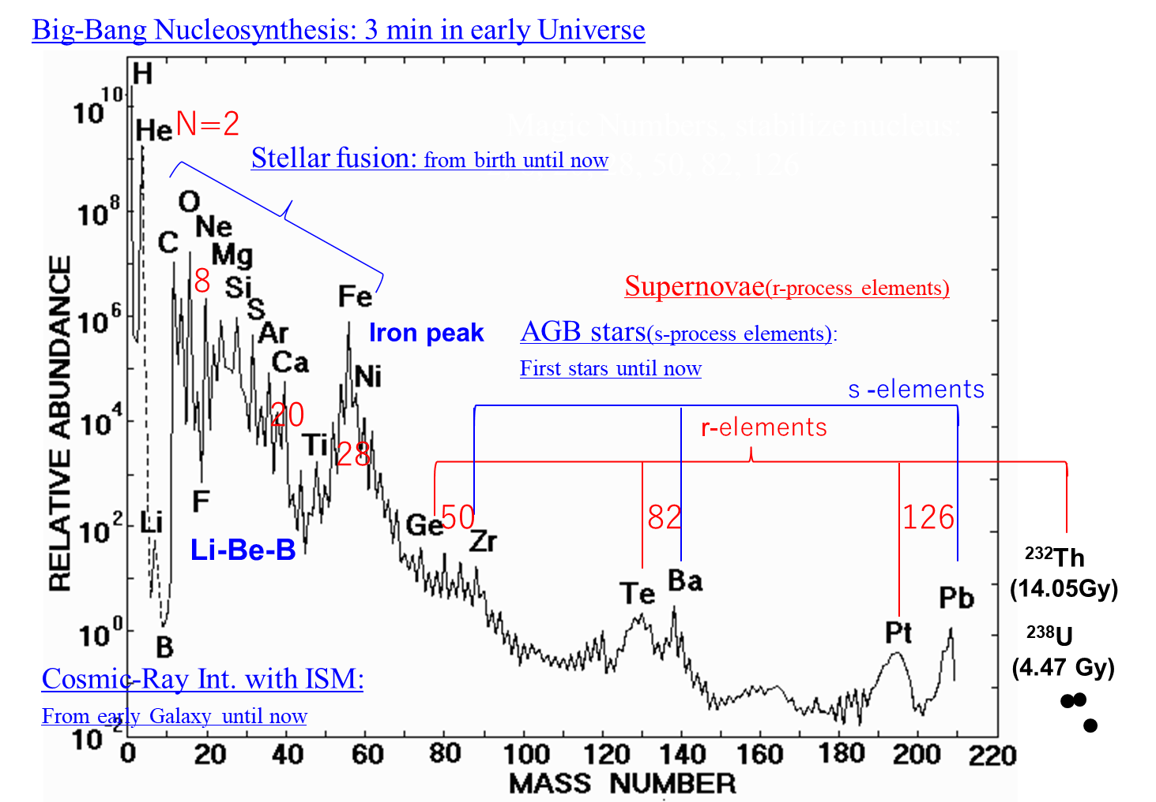
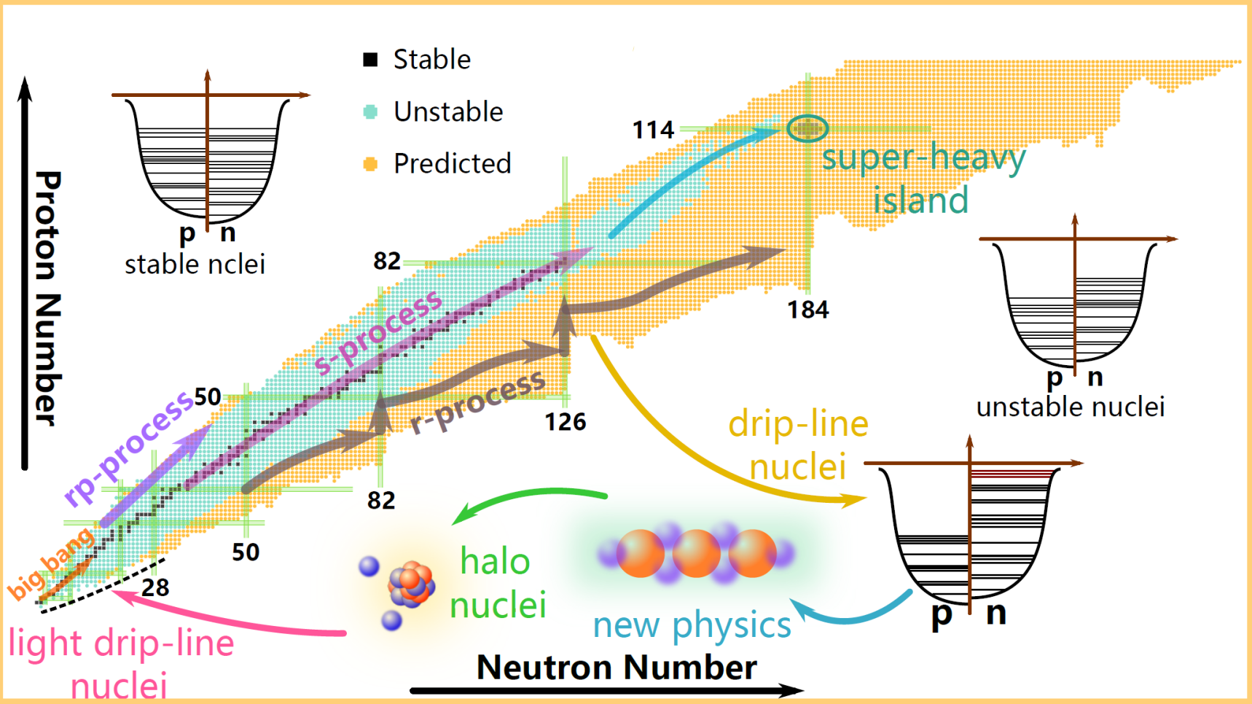
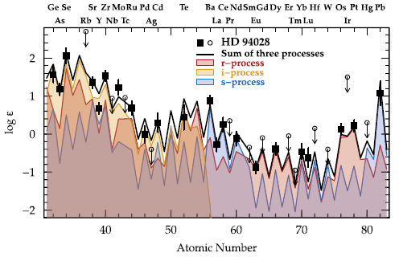
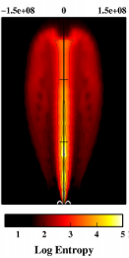
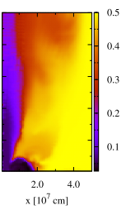
Element genesis in the solar system
i-process
stable nuclei
CEMP r/s stars
Collapsar: a promising r-process site
r-process
N_{n} > 10²⁰ cm⁻³
Ye
i-process
N_{n} ≈ 10¹² ~ 10¹⁶ cm⁻³
s-process
N_{n} ≈ 10⁶ ~ 10¹⁰ cm⁻³
Roederer et al. (2016)
Nakamura et al. (2015)

Slide 3
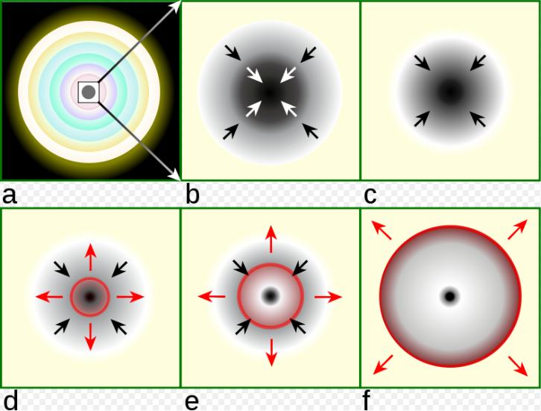
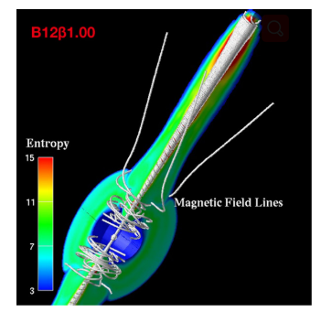
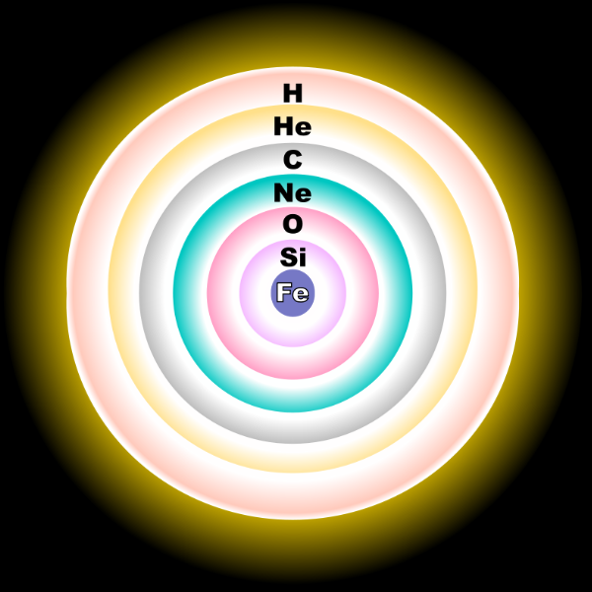
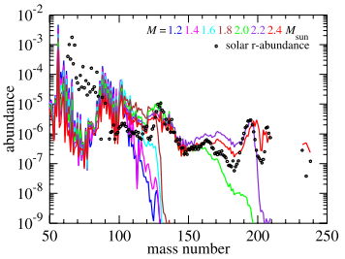
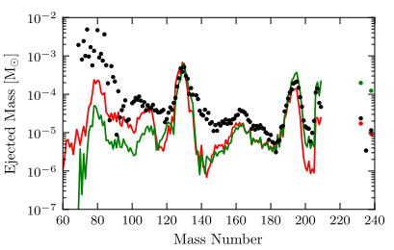
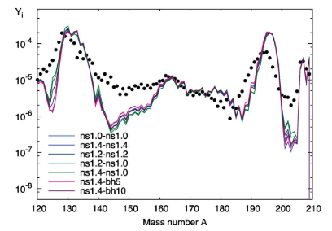
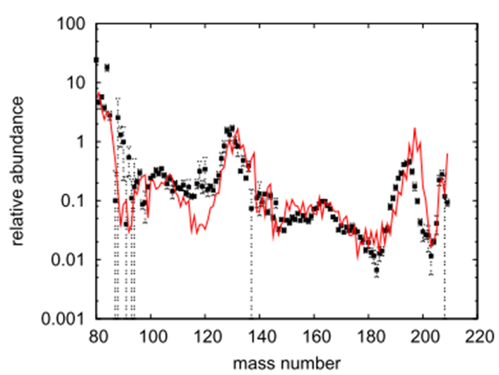
Candidates of the r-process sites
Weak r-process
Main r-process
Neutrino-driven wind
from CCSNe
Magneto-hydrodynamic jet (MHDJ) supernovae
Neutron star mergers (NSMs)
Collapsar
(Ye ~ 0.5)
(Ye = 0.2 ~ 0.4)
(Ye ~ 0.1)
(Ye < 0.2)
Confirmed observationally!
(Nishimura et al. 2015)
(Korobkin et al. 2012)
(Nakamura et al. 2015)
(Winteler et al. 2012)
(Wanajo 2013)
3
3

Slide 4
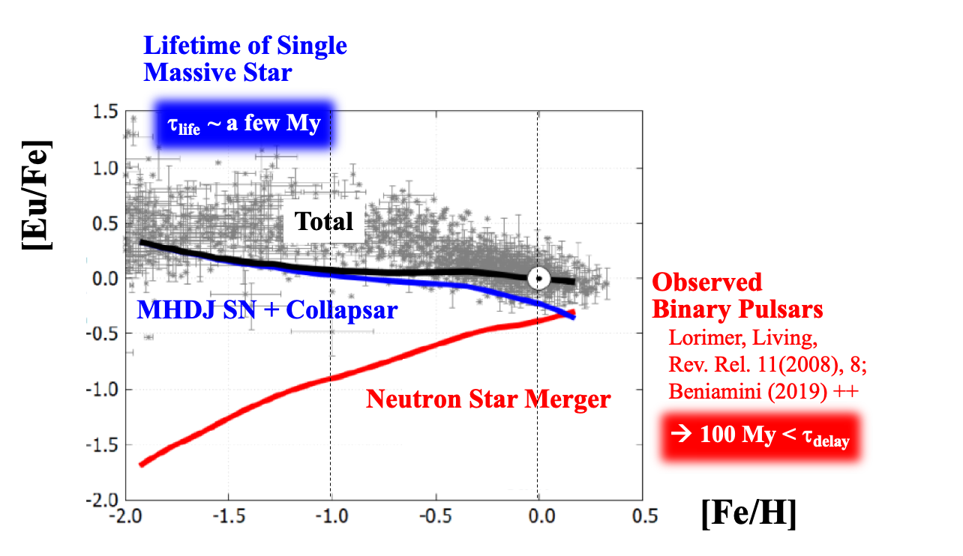
Cosmic & Galactic Evolution : CCSNe, NSMs, Collapsars
ν-Wind SN
MHD-Jet SN + Collapsar
Neutron Star Merger
★ Early Galaxy was dominated by
single massive SN & Collapsar.
★ Neutron Star Merger has arrived later in cosmic evolution.
t = 0.5 ~ 1 Gy
Coalescence Time Delay of Neutron Star Merger
Mass A
Yamazaki, He, Kajino, Mathews, Famiano, Tang, Shi, ApJ 933 (2022), 112.
4

Slide 5
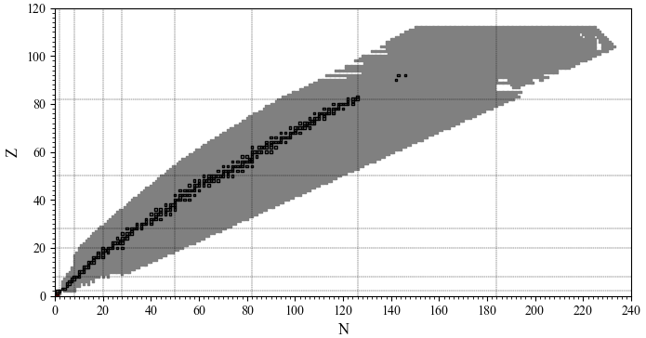
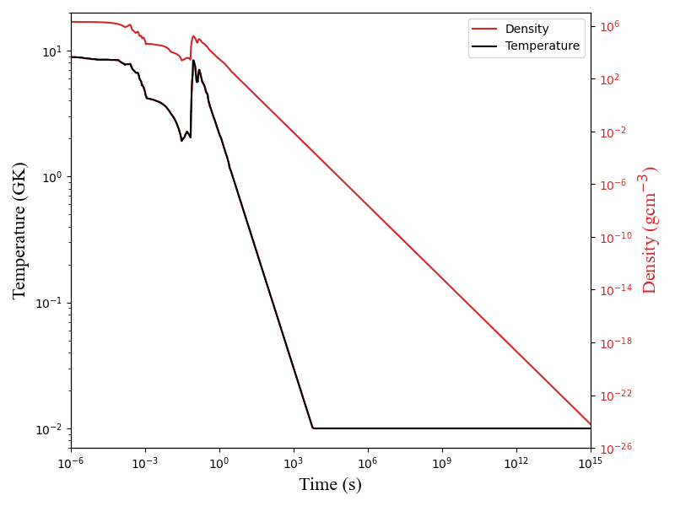
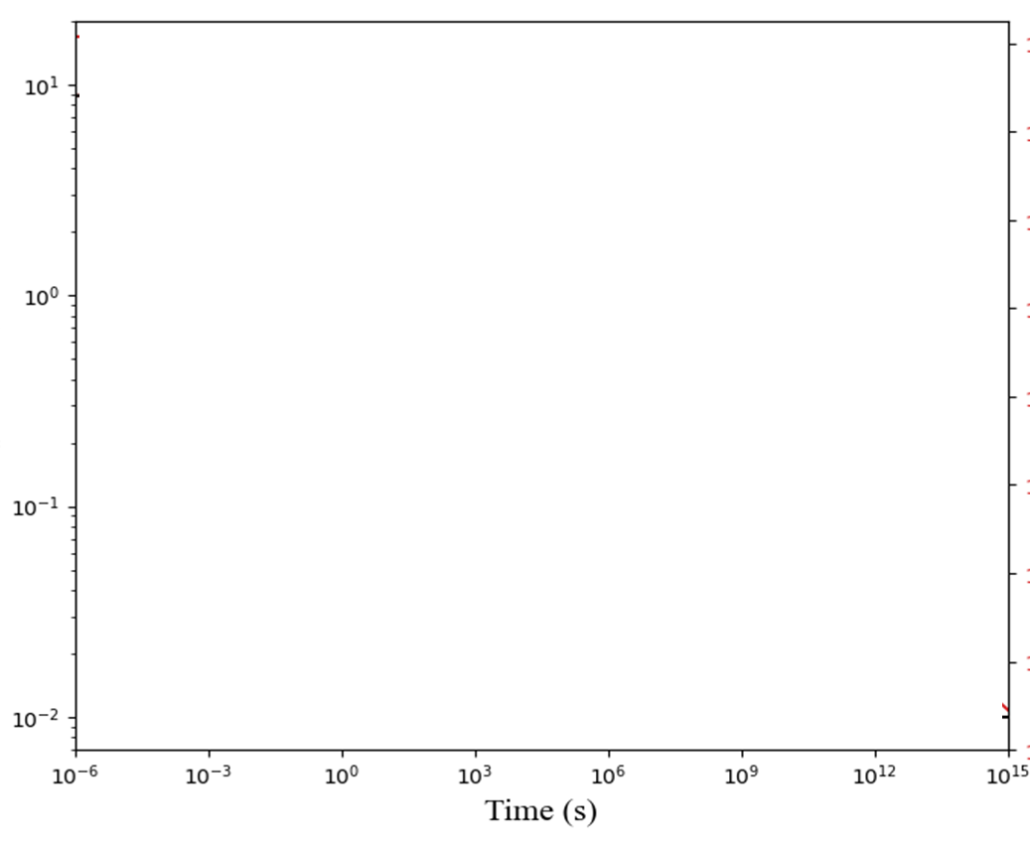
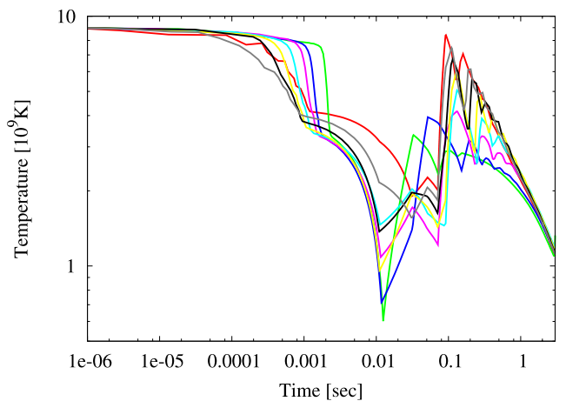
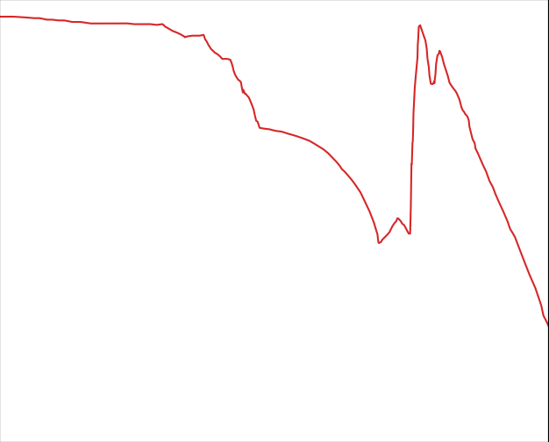
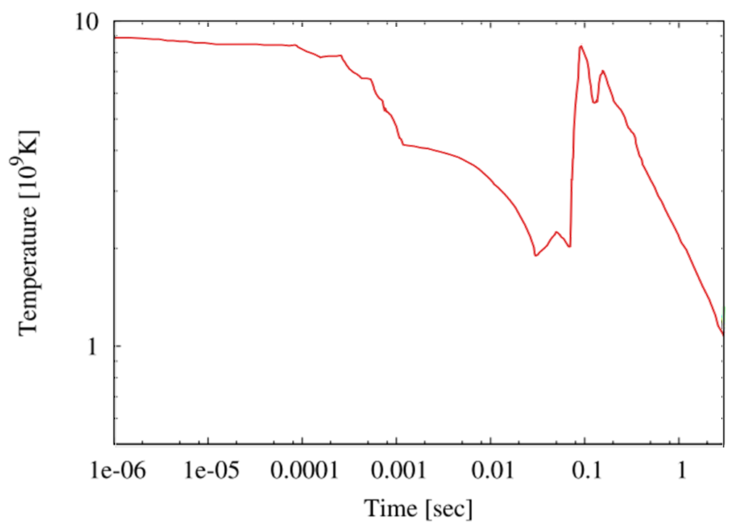
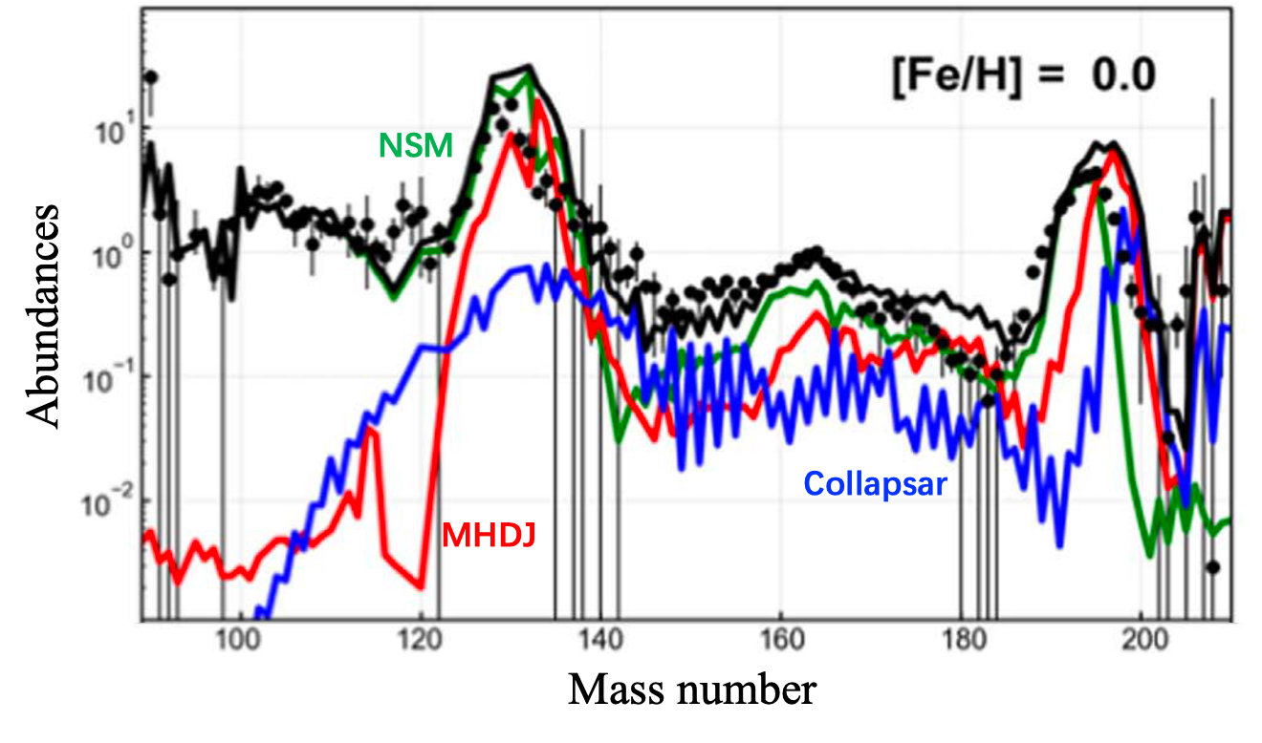
Nucleosynthesis in the collapsar
Nuclear reaction network
Extrapolation for the jet propagation
NucNet Tools (Meyer 2012)
7851 nuclei (Z <= 111) linked by 48965 nuclear reactions
(JINA Reaclib)
Update half-lives of fission and alpha-decay based on KTUY05 nuclear mass formula.
Koura et al. (2005,2012)
Chiba et al. (2008)
(Nakamura et al. 2013)
site
Ye
𝜏_{dyn}
MHDJ
0.2 – 0.4
slow
Collapsar/MHDJ: decelerated propagation (𝛼 < 1)
NSM
~ 0.1
fast
NSM: free expansion (𝛼 ≈ 1)
Collapsar
< 0.2
slow
Heger et al. (2003), Liu et al. (2017), Rosswog et al. (2014), Hamidani et al. (2020)
Yamazaki, He et al. (2022)
5

Slide 6
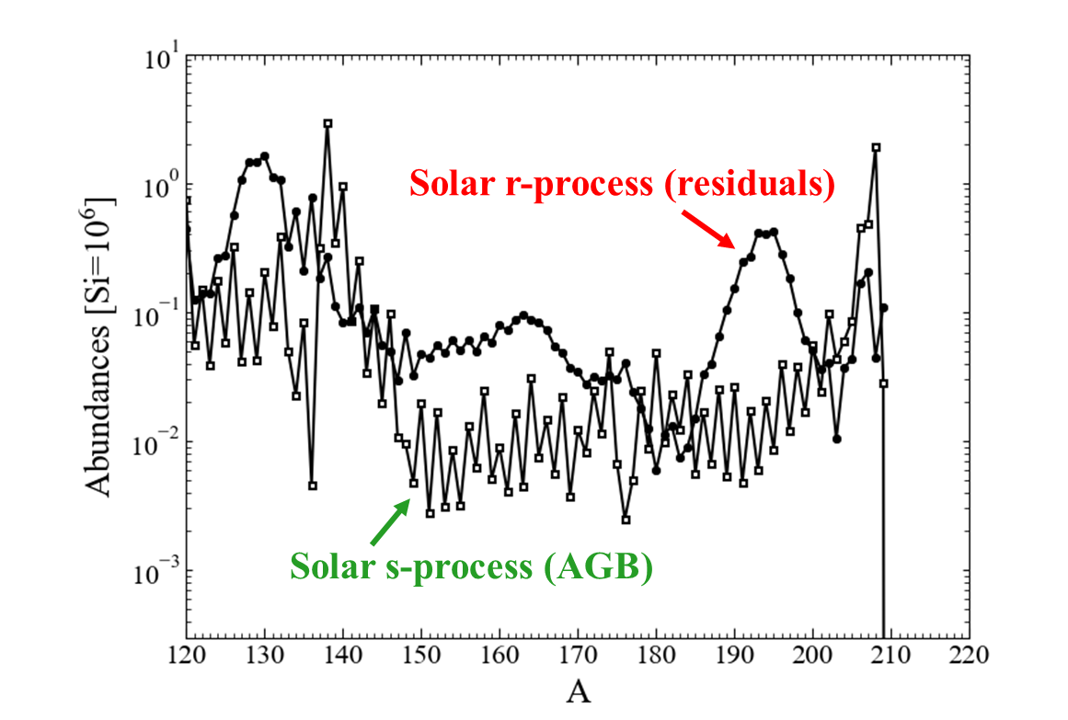
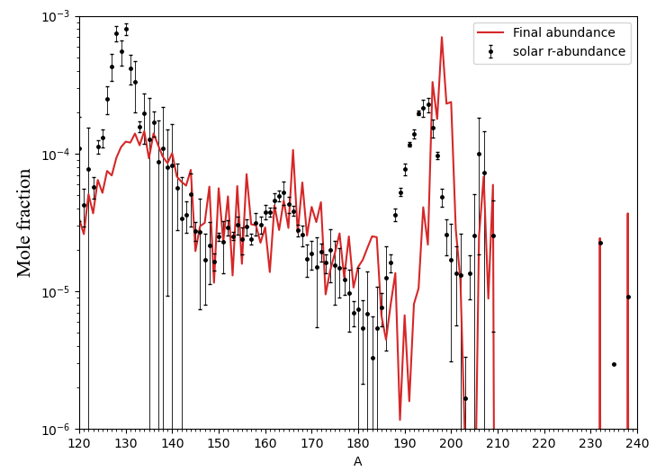
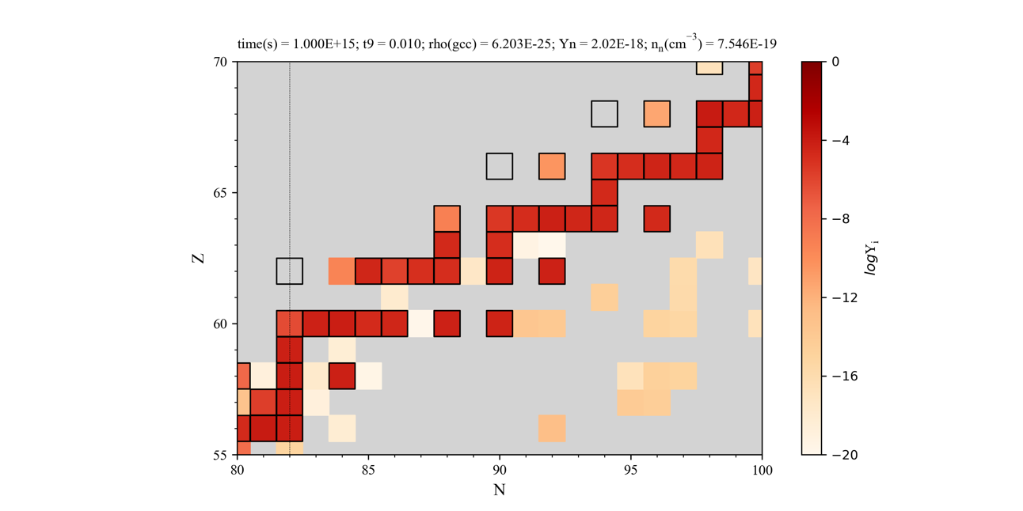
Nucleosynthesis in the collapsar
Why significant odd-even effect emerges?
¹⁶⁰Dy
¹⁵⁴Gd
Universality!
¹⁴⁸Sm
¹⁵⁰Sm
Similar to s-process pattern?
¹⁴²Nd
Goriely. (1999); Roederer et al. (2012)
A pronounced odd-even effect near the rare earth hill in Yi-A pattern
Several s-only nuclei (eg: ¹⁴²Nd, ^{148, 150}Sm, ¹⁵⁴Gd, and ¹⁶⁰Dy) gain final abundances at a high level.
Notes:
the s-only and r-only isotopes, which are shielded by stable isobars against the r-process region or lie outside the s-process path, respectively. (Reifarth et al 2014)

Slide 7
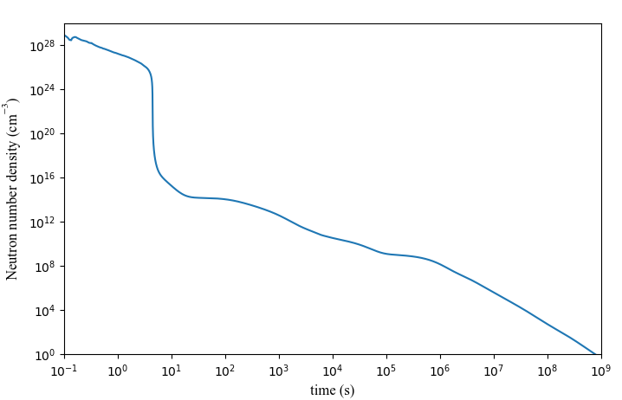
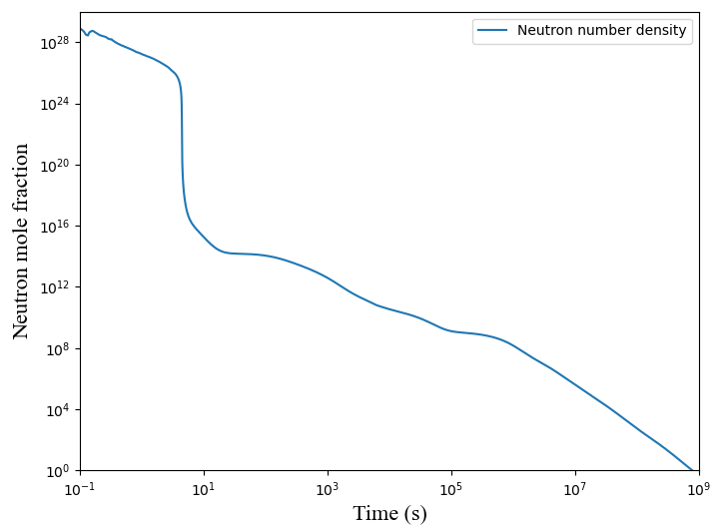
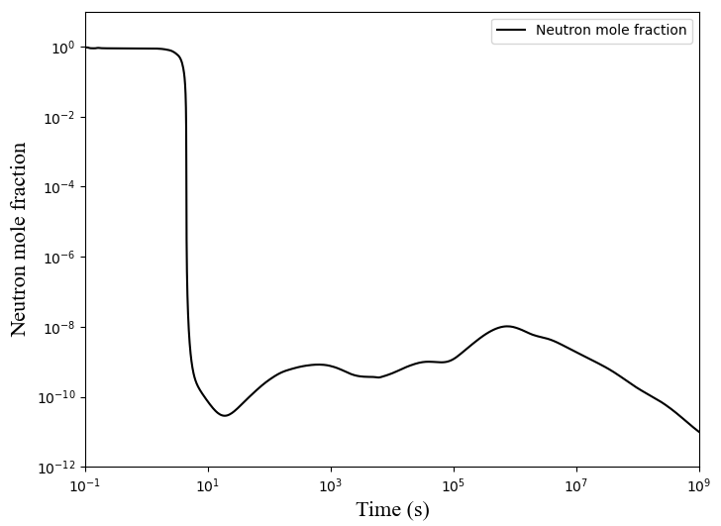
Late-time neutron emission and the secondary neutron-capture processes
the collapsar jet
r-process:
>10²⁰
i-process:
10¹² ~10¹⁶
s-process:
10⁶ ~10¹⁰
Fission neutrons
Neutrons emitted by fission form plateaus in the neutron density curve, and thus make (n,γ) possible after neutron exhaustion for r-process at ~ 5s.

Slide 8
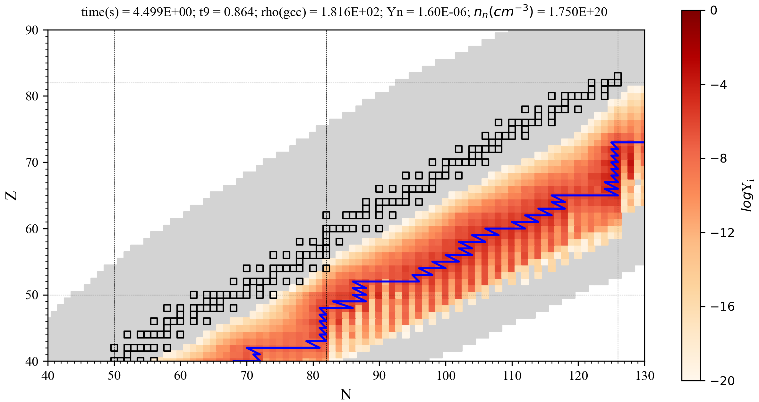
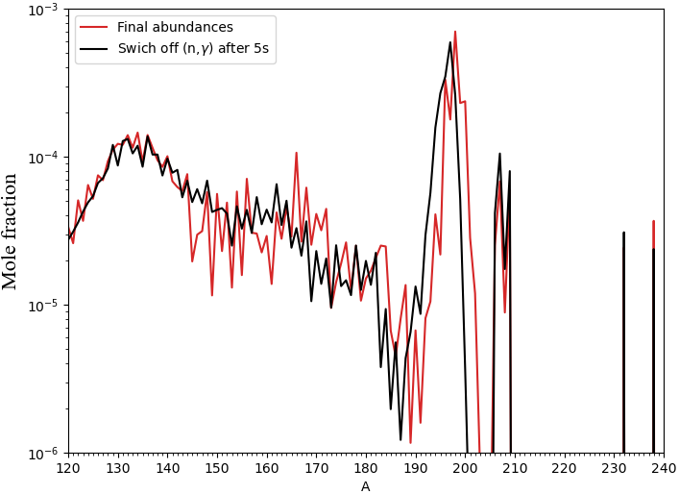
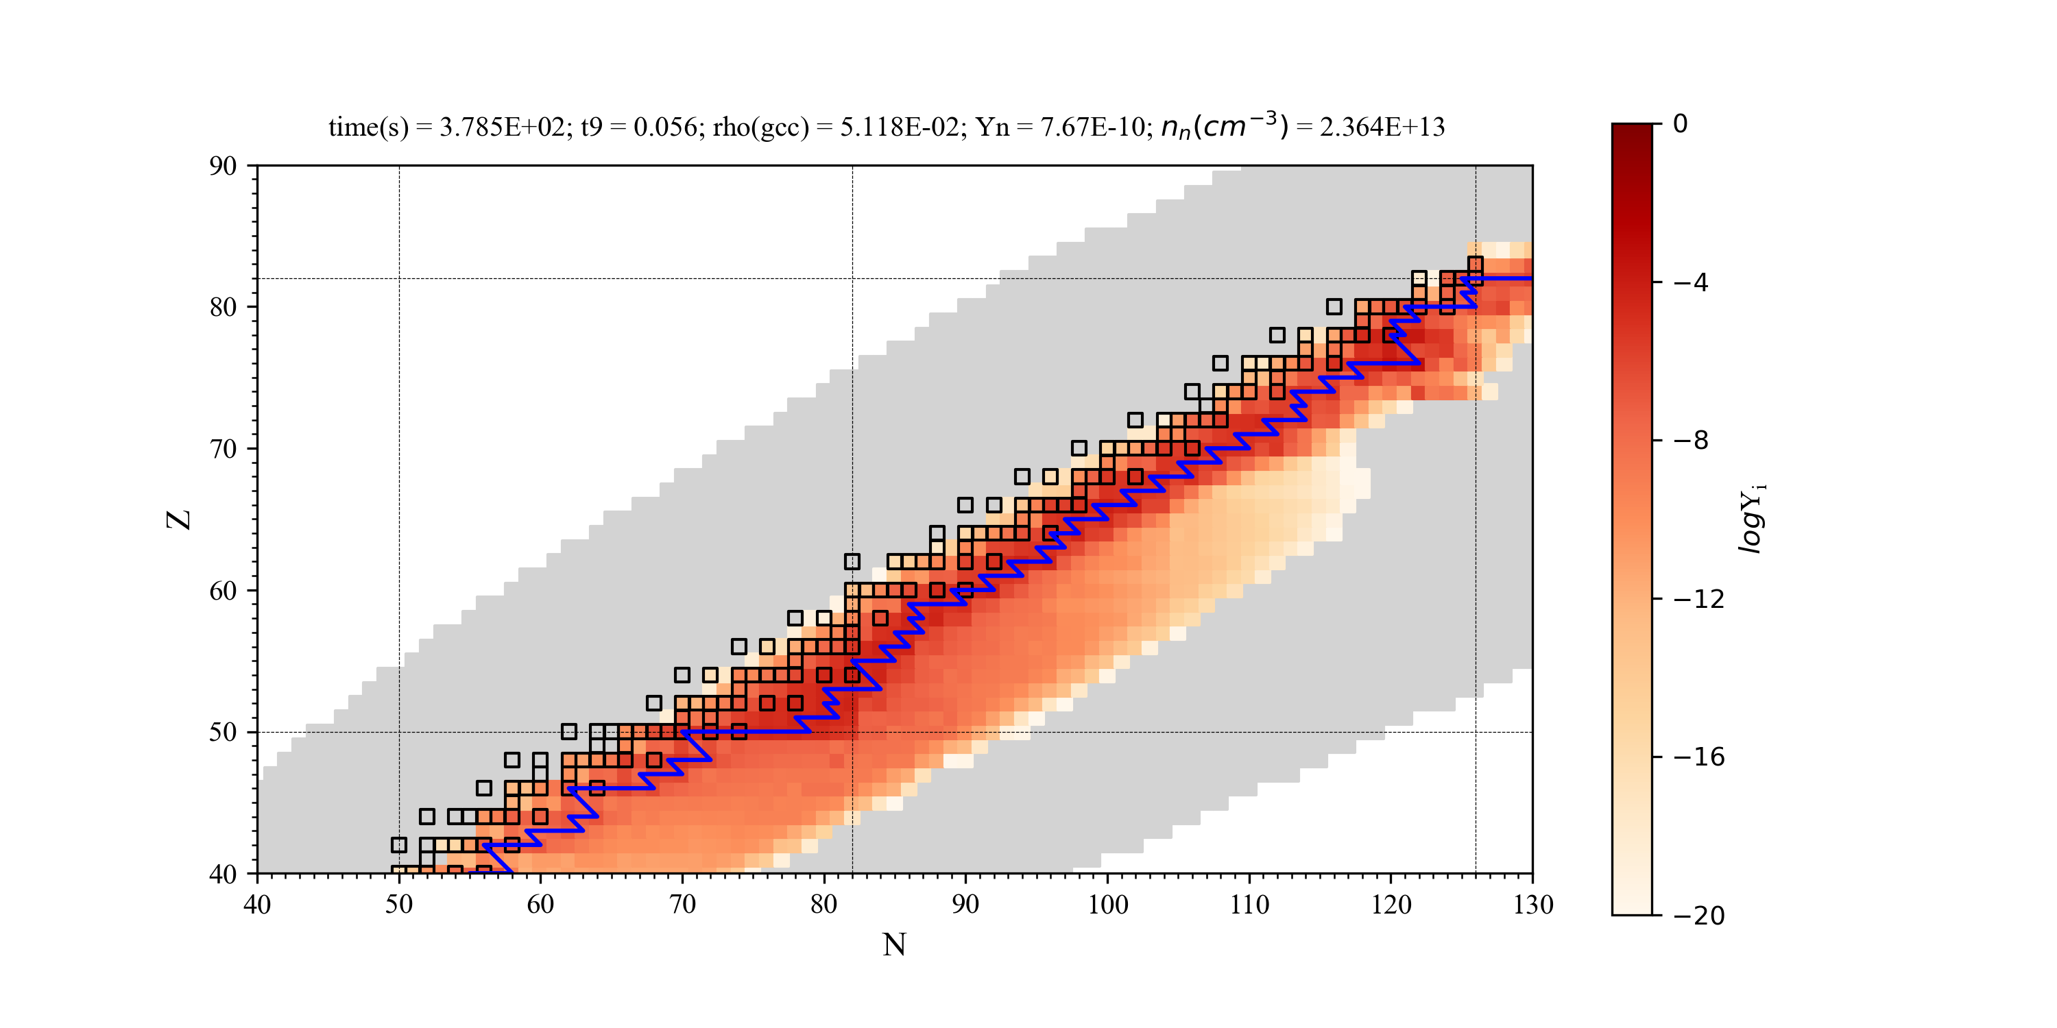
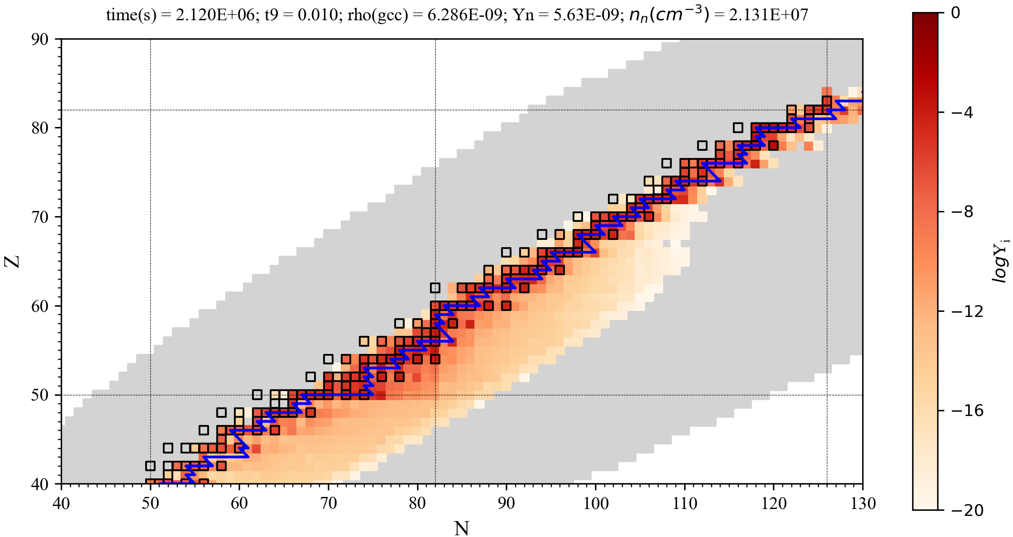
Late-time neutron emission and the secondary neutron-capture processes
He et al. (2024) ApJL, 966, L37
the collapsar jet
time(s) = 4.5; T₉ = 0.86; ρ(gcc) = 1.8×10²; Y_{n} = 1.6×10⁻⁶; N_{n}(cm⁻³) = 1.8×10²⁰
r-process
r-process
i-process
s-process
Final abundances
Switch off (n,𝛾) after 5s
time(s) = 3.8×10²; T₉ = 0.056; ρ(gcc) = 5.1×10⁻²; Y_{n} = 7.7×10⁻¹⁰; N_{n}(cm⁻³) = 2.4×10¹³
time(s) = 2.1×10⁶; T₉ = 0.01; ρ(gcc) = 6.3×10⁻⁹; Y_{n} = 5.6×10⁻⁹; N_{n}(cm⁻³) = 2.1×10⁷
i-process
s-process
The r-process yields serve as seed nuclei for the secondary i- and s-processes.

Slide 9
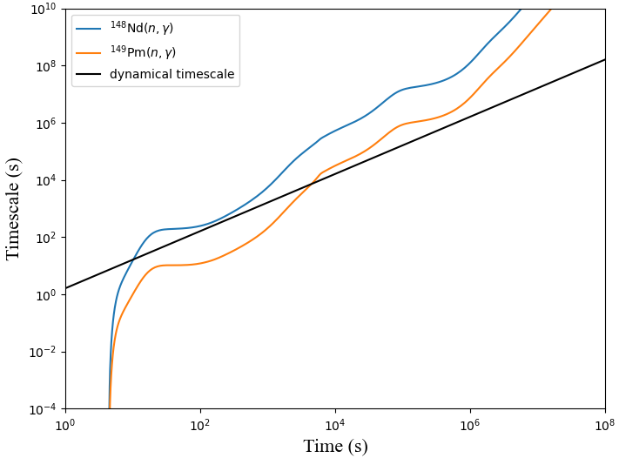
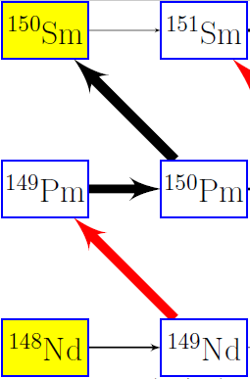
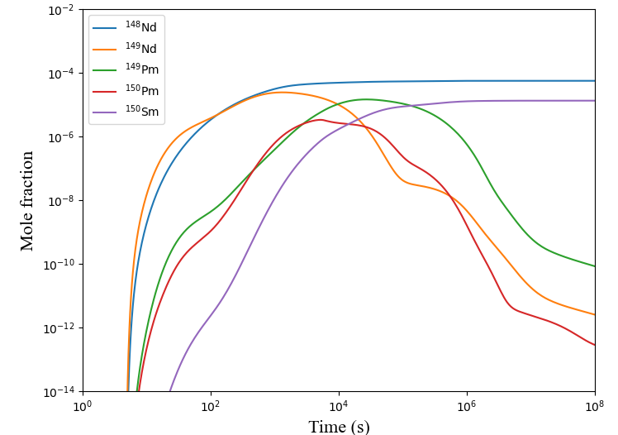
Late-time neutron emission and the secondary neutron-capture processes
He et al. (2024) ApJL, 966, L37
timescale of (n,γ) reactions:
¹⁴⁸Nd(n,γ) ¹⁴⁹Nd
dynamical timescale:
(s-only)
¹⁴⁹Pm(n,γ) ¹⁵⁰Pm
¹⁴⁸Nd
¹⁵⁰Sm
¹⁴⁹Pm
During 10 -10⁴ s, τ_{dyn} ≈ τ_{(n,γ)} (¹⁴⁸Nd), τ_{(n,γ)} (¹⁴⁹Pm)
(n,γ) reactions are operative.
¹⁴⁹Nd
¹⁵⁰Pm
figure indicates the route to produce ¹⁵⁰Sm
¹⁴⁸Nd(n,γ) ¹⁴⁹Nd(β-)¹⁴⁹Pm(n,γ) ¹⁵⁰Pm (β-) ¹⁵⁰Sm

Slide 10
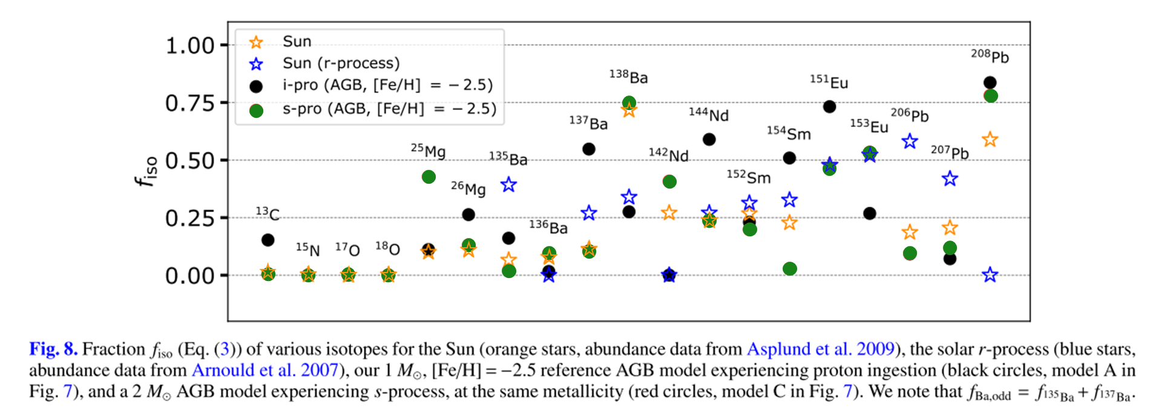
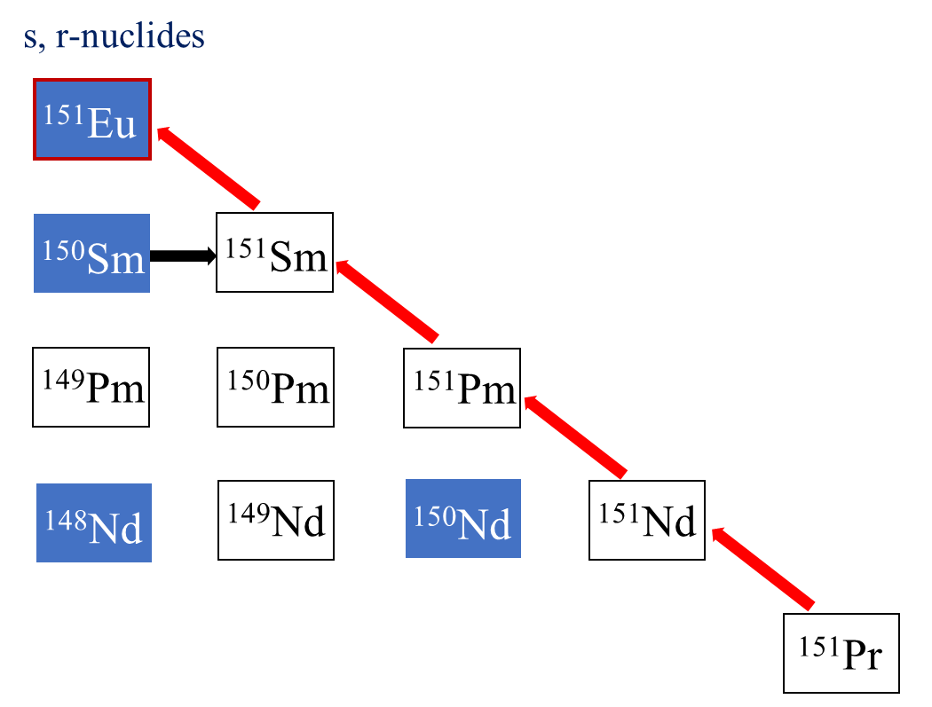
Late-time neutron emission and the secondary neutron-capture processes
Choplin, A., Siess, L., & Goriely, S. (2021) A&A, 648, 119
Collapsar (this study)
2.698 h
1.728 h
s-process: low N_{n}
¹⁴⁹Nd(n,γ)¹⁵⁰Nd (×)
(short-lived)
¹⁵⁰Pm(n,γ)¹⁵¹Pm (×)
i-process: higher N_{n}
¹⁴⁹Nd(n,γ)¹⁵⁰Nd (n,γ)¹⁵¹Nd (○)
¹⁵⁰Pm(n,γ)¹⁵¹Pm (○)

Slide 11
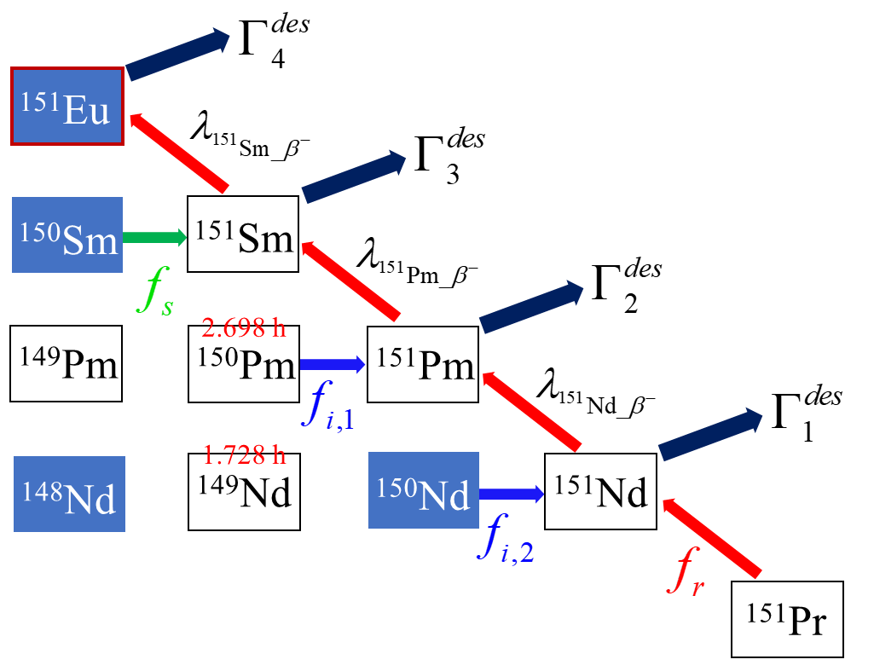
Separate the contributions of r-, i-, and s-processes
He et al. (2024) ApJL, 966, L37
i-process: 86.8%!
We formulate and quantitatively identify the contribution of r-, i-, and s-processes.
where,

Slide 12
Separate the contributions of r-, i-, and s-processes
where,
Generalization
n = 3
n = 4
It can be applied to any given nuclide.

Slide 13
Separate the contributions of r-, i-, and s-processes
Systematically investigate 28 isotopes near the rare earth peak
Secondary i- and s-processes play important roles in collapsars;
18 of 28 isotopes are mainly produced from the secondary i- and s-processes
Identify 38 relevant (n,𝛾) reactions and conduct sensitivity study
rates ×10, ×0.1
He, Kajino et al. (2025), submitted

Slide 14
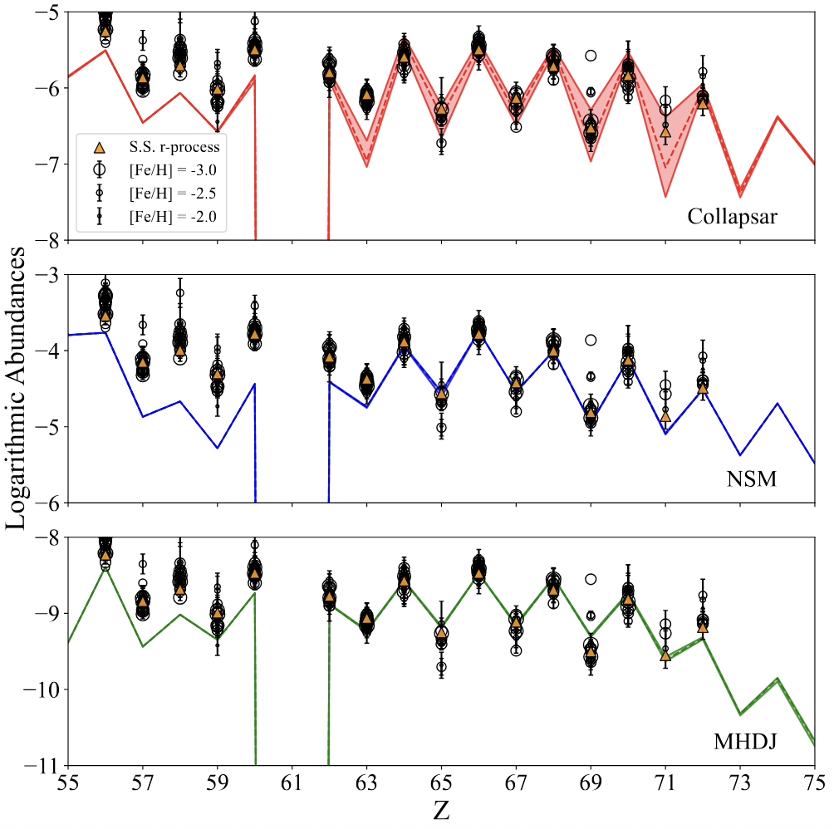
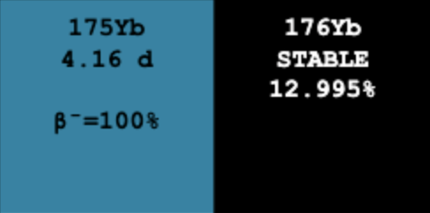
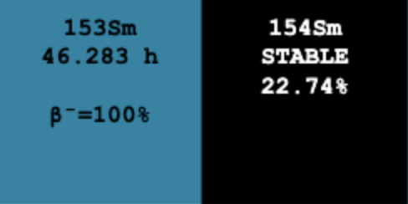
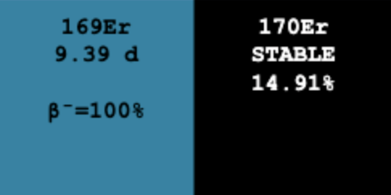
Sensitivity study on key (n,𝛾) reactions in secondary i-process
Quantitatively analyze the sensitivity:
Z = 69 or 71
Top 10 important (n,𝛾) reactions for Tm:
¹⁷⁵Yb(n,𝛾)¹⁷⁶Yb, ¹⁵³Sm(n,𝛾)¹⁵⁴Sm, ¹⁵¹Pm(n,𝛾)¹⁵²Pm, ¹⁷²Er(n,𝛾) ¹⁷³Er, ¹⁷⁵Tm(n,𝛾) ¹⁷⁶Tm, ¹⁶⁶Ho(n,𝛾) ¹⁶⁷Ho, ¹⁵¹Nd(n,𝛾)¹⁵²Nd, ¹⁵²Pm(n,𝛾)¹⁵³Pm, ¹⁴⁹Nd(n,𝛾) ¹⁵⁰Nd, ¹⁴⁷Nd(n,𝛾) ¹⁴⁸Nd
¹⁷⁵Yb(n,𝛾)¹⁷⁶Yb, ¹⁵³Sm(n,𝛾)¹⁵⁴Sm, ¹⁵¹Pm(n,𝛾)¹⁵²Pm, ¹⁷²Er(n,𝛾) ¹⁷³Er, ¹⁷⁵Tm(n,𝛾) ¹⁷⁶Tm, ¹⁶⁶Ho(n,𝛾) ¹⁶⁷Ho, ¹⁵¹Nd(n,𝛾)¹⁵²Nd, ¹⁵²Pm(n,𝛾)¹⁵³Pm, ¹⁴⁹Nd(n,𝛾) ¹⁵⁰Nd, ¹⁴⁷Nd(n,𝛾) ¹⁴⁸Nd
Top 10 important (n,𝛾) reactions for Lu:
¹⁶⁹Er(n,𝛾) ¹⁷⁰Er, ¹⁵³Sm(n,𝛾)¹⁵⁴Sm, ¹⁶⁶Dy(n,𝛾)¹⁶⁷Dy, ¹⁵¹Pm(n,𝛾)¹⁵²Pm, ¹⁶⁸Ho(n,𝛾) ¹⁶⁹Ho, ¹⁷⁴Tm(n,𝛾) ¹⁷⁵Tm, ¹⁵¹Nd(n,𝛾)¹⁵²Nd, ¹⁵²Pm(n,𝛾)¹⁵³Pm, ¹⁴⁹Nd(n,𝛾)¹⁵⁰Nd, ¹⁴⁷Nd(n,𝛾)¹⁴⁸Nd
¹⁶⁹Er(n,𝛾) ¹⁷⁰Er, ¹⁵³Sm(n,𝛾)¹⁵⁴Sm, ¹⁶⁶Dy(n,𝛾)¹⁶⁷Dy, ¹⁵¹Pm(n,𝛾)¹⁵²Pm, ¹⁶⁸Ho(n,𝛾) ¹⁶⁹Ho, ¹⁷⁴Tm(n,𝛾) ¹⁷⁵Tm, ¹⁵¹Nd(n,𝛾)¹⁵²Nd, ¹⁵²Pm(n,𝛾)¹⁵³Pm, ¹⁴⁹Nd(n,𝛾)¹⁵⁰Nd, ¹⁴⁷Nd(n,𝛾)¹⁴⁸Nd
1. New theoretical predictions for these (n,𝛾) reactions.
Low-energy enhancement in the γSF
(SAGA database)
2. Experimental measurements on these (n,𝛾) reactions.
Universality of the r-process
Sensitivity in collapsar, especially Tm (Z = 69) and Lu (Z = 71)
He, Kajino et al. (2025), submitted

Slide 15
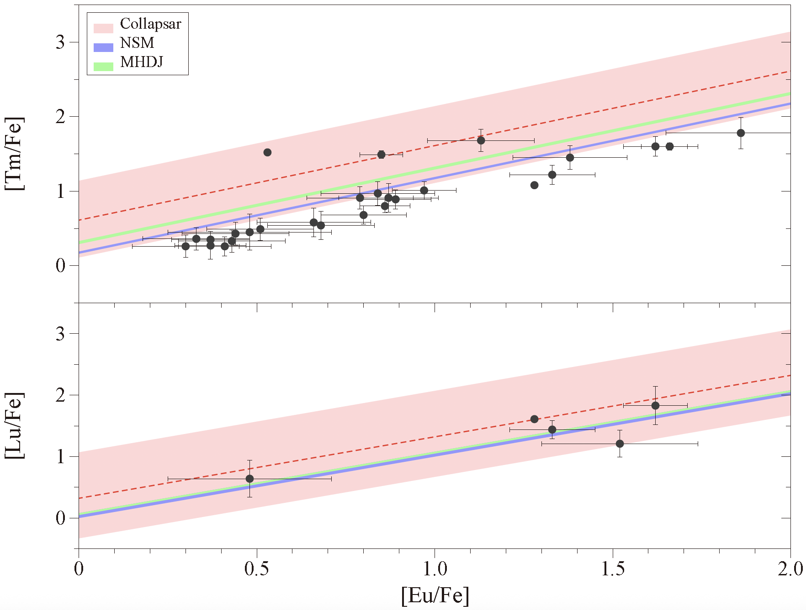
Sensitivity study on key (n,𝛾) reactions in secondary i-process
[X/Fe] = log(N_{X}/N_{Fe})★ - log(N_{X}/N_{Fe})⊙
(SAGA database)
Correlations between Tm and Eu, Lu and Eu indicate the same origin of these elements.
(SAGA database)
Universality of the r-process
Precise measurements of relevant (n,𝛾) reactions
Sensitivity in collapsar, especially Tm (Z = 69) and Lu (Z = 71)
Reduction of uncertainties
Possible observational indication for collapsar events
Large values of [Tm/Eu] or [Lu/Eu]

Slide 16
Summary
1. Coexistence of nucleosynthesis products from the r-, i- or s-processes in collapsar jets, which does not occur in MHDJ or NSM.
The secondary i- and s-processes can be the major source for some rare-earth isotopes in collapsars, such as ^{150,154}Sm, ¹⁶⁰Gd, ¹⁷⁰Er, and ¹⁷⁶Yb.
2. The secondary i- and s-processes could provide observational hint of the collapsar event.
New estimation of cross section for important (n,𝛾) reactions are required.
Large values of [Tm/Eu] or [Lu/Eu]; More observational data are needed.
3. Influence the conventional interpretation of the solar r-process abundances.
Nucleosynthesis in collapsar jets can also produce s-only nuclei.

Slide 17
June 8 -13, 2025, Giulianova, Italy
s, i & r Element Nucleosynthesis Conference
Thanks for your attention!

