Slide 1
Trans-Fe elements from Type Ia Supernovae
Umberto Battino (University of Naples “Federico II”, INAF, NuGrid Collaboration)
Collaborators: J.D. Keegans, M. Allen, F. K. Röpke, F. Herwig, A. Best, L. Piersanti, O. Straniero, S. A. Sim, C. Travaglio, R. Hirschi, P. A. Denissenkov
13 June 2025; Giulianova

Slide 2
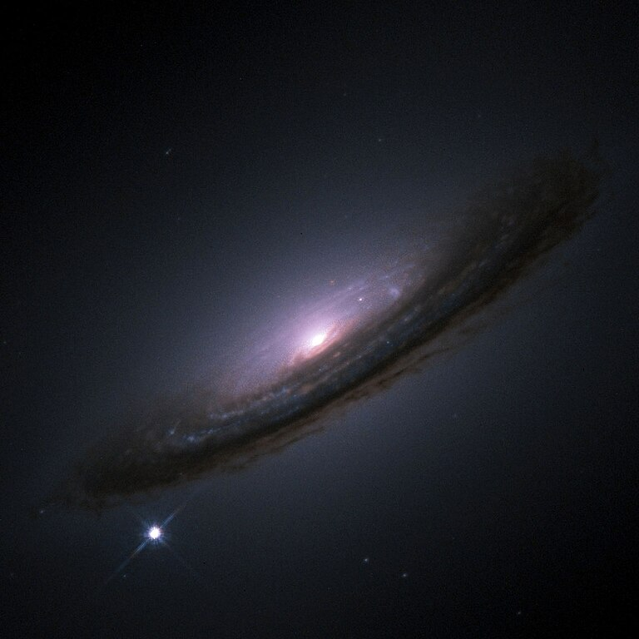
Type Ia Supernova and (Astro)physics
2/3 of the iron content in the Milky Way was produced by the explosion of white dwarfs in binary systems as type Ia supernovae.
And maybe also a fraction of the p-nuclei! (see e.g. Howard & Meyer 1993, Travaglio et al. 2011, Battino et al. 2020)
Iron is a crucial ingredient for planetary magnetic-field generation, the formation of proteins and enzyme systems (Wade et al. 2021) → central role played in the emergence of life as we know it on Earth.
Additionally, due to their characteristic lightcurves, SNe Ia are standardizable candles for cosmic-distance measurements → evidence for the accelerated expansion of the Universe (Nobel Prize Physics, 2011)
NASA/ESA, The Hubble Key Project Team The High-Z Supernova Search Team
1

Slide 3
Type Ia Supernova and (Astro)physics
2/3 of the iron content in the Milky Way was produced by the explosion of white dwarfs in binary systems as type Ia supernovae.
And maybe also a fraction of the p-nuclei! (see e.g. Howard & Meyer 1993, Travaglio et al. 2011, Battino et al. 2020)
Iron is a crucial ingredient for planetary magnetic-field generation, the formation of proteins and enzyme systems (Wade et al. 2021) → central role played in the emergence of life as we know it on Earth.
Additionally, due to their characteristic lightcurves, SNe Ia are standardizable candles for cosmic-distance measurements → evidence for the accelerated expansion of the Universe (Nobel Prize Physics, 2011)
…and yet the nature of SNIa progenitors is still a matter of debate!
NASA/ESA, The Hubble Key Project Team The High-Z Supernova Search Team
1

Slide 4
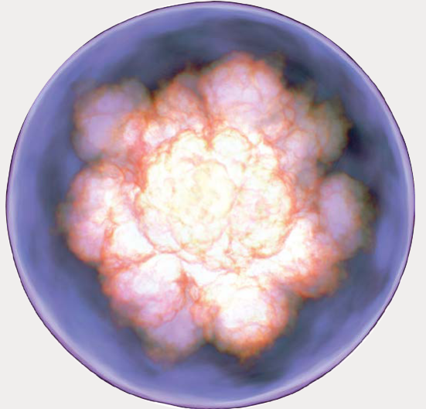
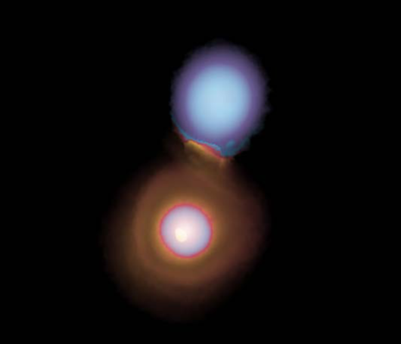
SNe Ia progenitors
Near-Chandrasekhar mass events
Deflagration of Deflagration+Detonation
H-accretor → But only ~6% of SN Ia from there
(see e.g. Johansson et al. (2016))
Slow WD merger → Accretion disk formation → Final outcome depends on accretion rate and WD mass ratio (see e.g. Piersanti+2003)
Sub-Chandrasekhar mass events
He-accretor → Double-detonation
(see Fink+2010; Magee+2021)
Major channel (~70%), but we still need ~30% near-Ch (Lach+2020, Collins+2022)
Violent merger → Prompt detonation during the merger process (if mass ratio q > ~0.8 or at least ~0.01 M_{sun} He present; see Pakmor et al. 2010, 2011, 2012, 2013)
2

Slide 5
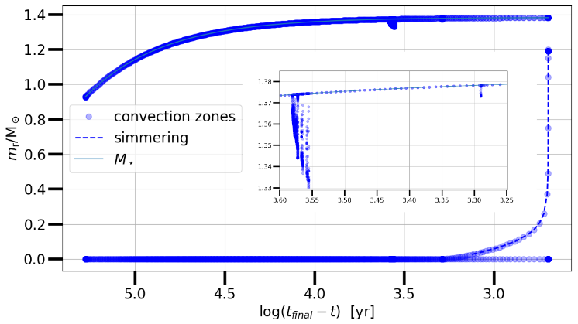
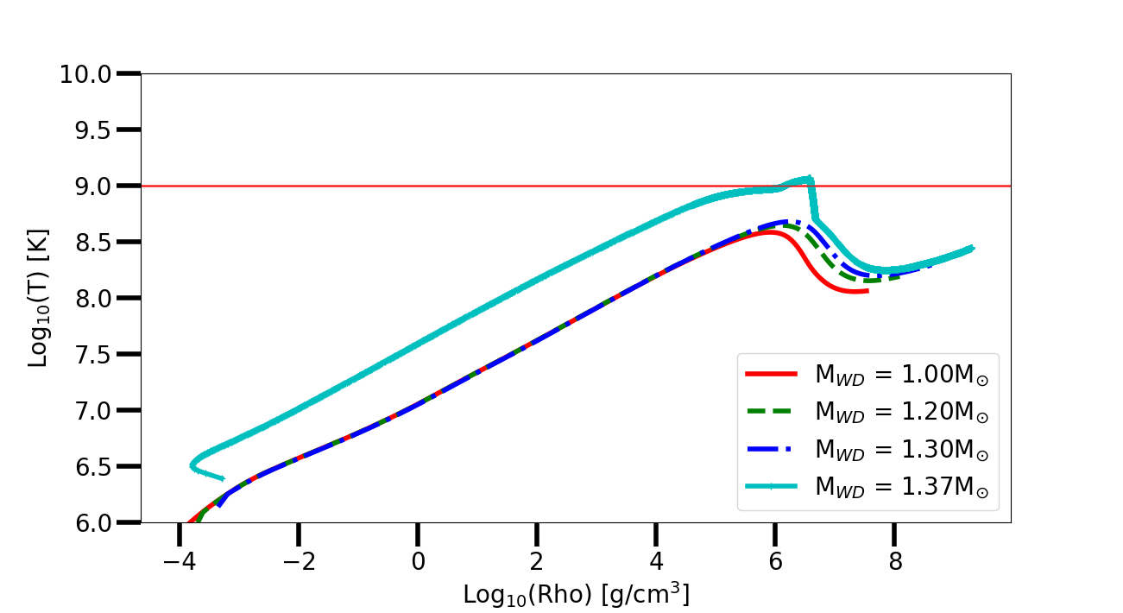
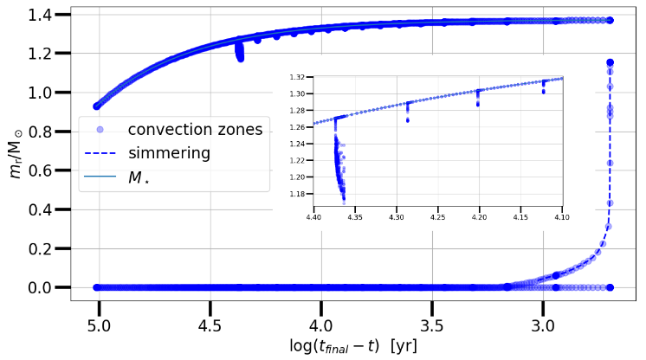
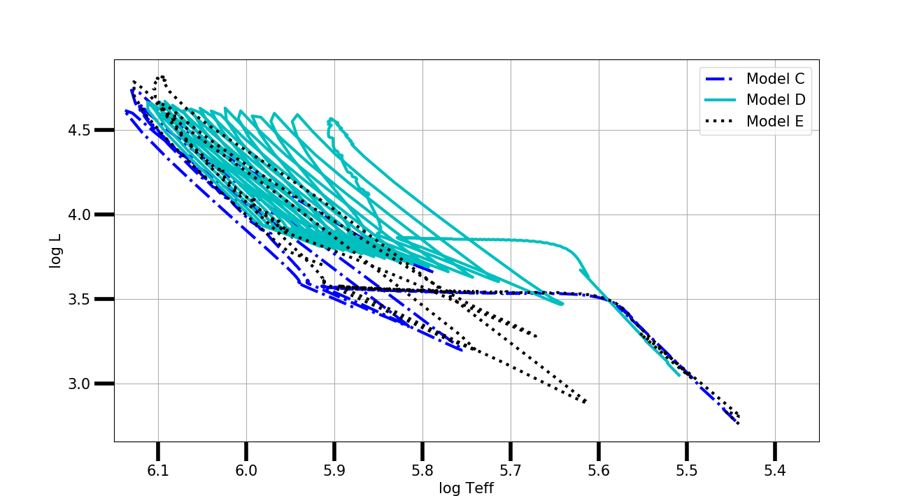
Slow WD mergers
C-flashes
10
IF mass acc rate > 2 10⁻⁶ M_{sun}/yr…
¹²C(¹²C,a) ²⁰Ne
²²Ne(a,n) ²⁵Mg
3

Slide 6
Trans-Fe element nucleosynthesis
11
¹²C(¹²C,a) ²⁰Ne
²²Ne(a,n) ²⁵Mg
5

Slide 7
C-burning flame propagation
4

Slide 8
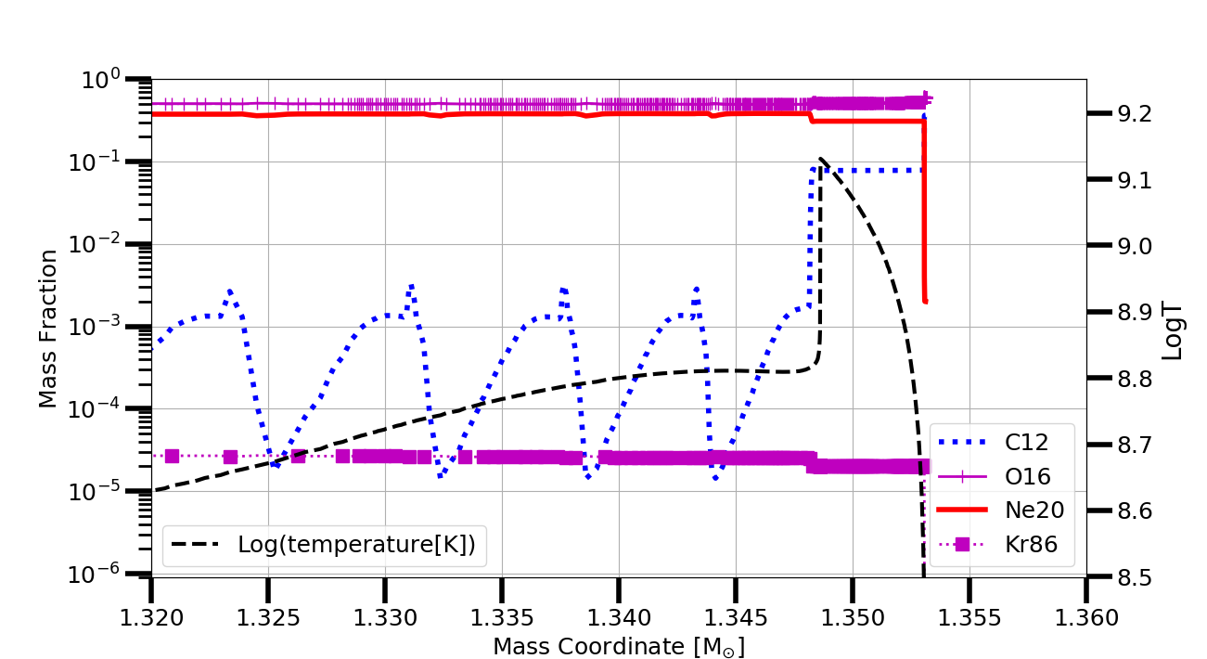
Impact of the ²²Ne(a,n)²⁵Mg
New direct measurement currently underway at the INFN Gran Sasso National laboratory (ERC starting grant SHADES; PI: A. Best). See also posters and talks by T. Chillery, D. Rapagnani, and D. Mercogliano.
6

Slide 9
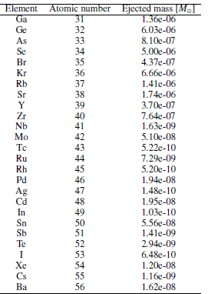
Explosive Yields
PRE-SUPERNOVA TRANS-FE ABUNDANCES
Explosive model: 1.4 M_{sun} def-to-det model (Townsley et al. 2016 T1.4),
New observable ‘smoking gun’ of a Chandrasekhar explosion? (~10⁻⁵ M_{sun} of Sr successfully detected in the AT2017gfo kilonova, see Watson et al. 2019)
7

Slide 10
Explosive Yields
PRE-SUPERNOVA TRANS-FE ABUNDANCES
Explosive model: 1.4 M_{sun} def-to-det model (Townsley et al. 2016 T1.4),
⁶⁰Fe increased by ∼20 times compared to cases without pre-SN trans-Fe element enrichment.
Next-generation gamma-ray telescopes will have the potential to detect a single SNR directly!
New observable ‘smoking gun’ of a Chandrasekhar explosion? (~10⁻⁵ M_{sun} of Sr successfully detected in the AT2017gfo kilonova, see Watson et al. 2019)
7

Slide 11
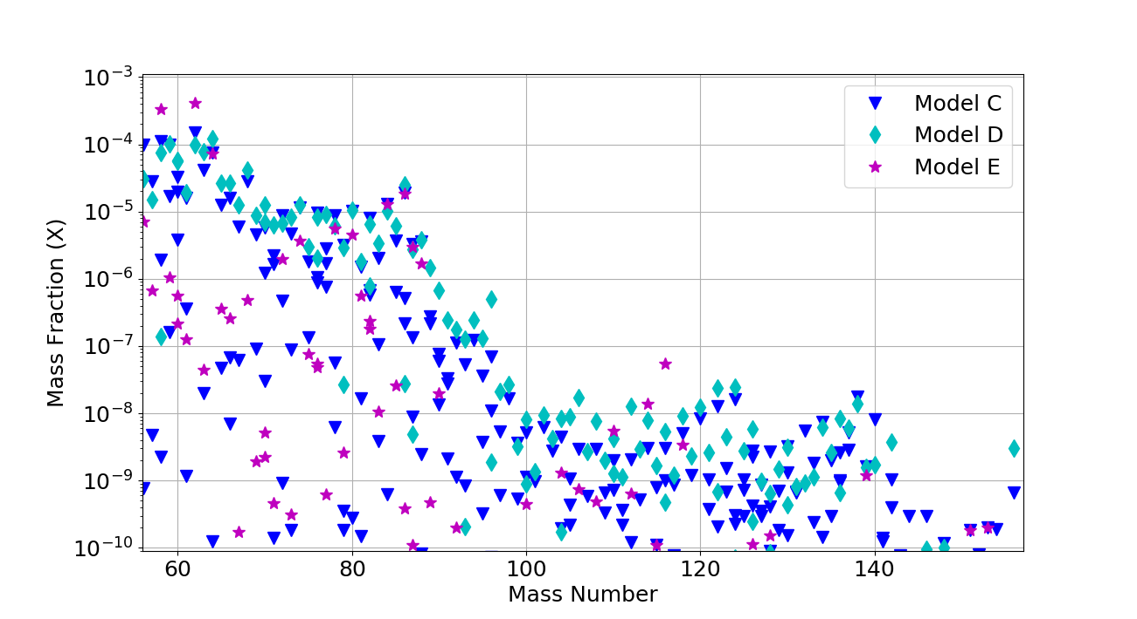
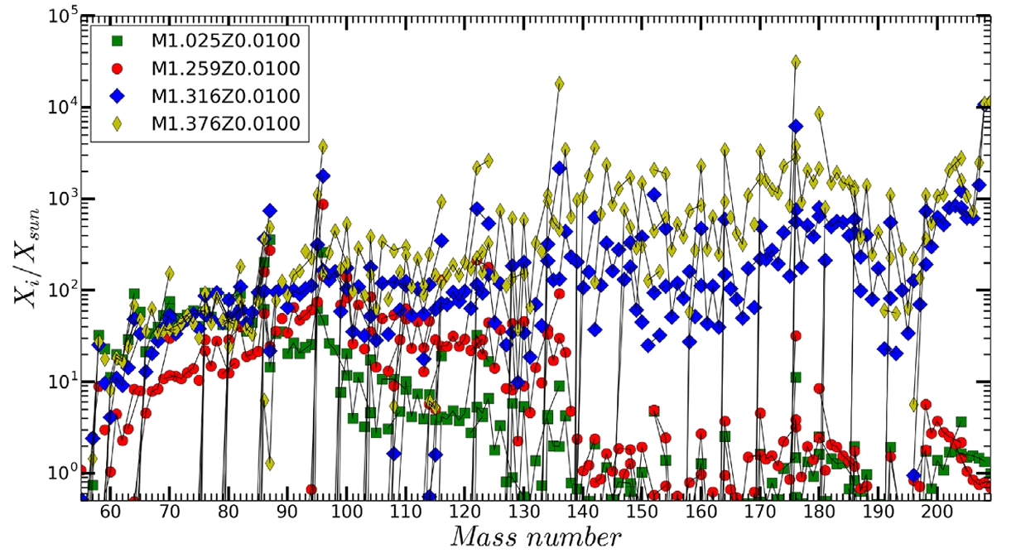
Explosive Yields
PRE-SUPERNOVA TRANS-FE ABUNDANCES
Battino et al. 2025
(Near-Ch from CO-WD mergers)
Explosive model: 1.4 M_{sun} def-to-det model (Townsley et al. 2016 T1.4),
Battino et al. 2020
(Near-Ch from H-accretion)
New observable ‘smoking gun’ of a Chandrasekhar explosion? (~10⁻⁵ M_{sun} of Sr successfully detected in the AT2017gfo kilonova, see Watson et al. 2019)
7
7

Slide 12
Summary and future perspectives
As our slowly merging CO WDs models approach the Chandrasekhar mass, C-burning ignites on the surface before it does in the center → ¹²C(¹²C,α)²⁰Ne → ²²Ne(α,n)²⁵Mg.
Large production of trans-Fe elements in the outermost ∼0.04M⊙ to ∼0.11M⊙. Something similar happens also in the case of in near-Ch WD from H-accreting systems (see Battino+2020).
Kr, Rb and Sr overproduced by up to ~1000 times compared to solar, Ga, Ge, Se, Kr, Rb, and Sr are all ejected in high amounts (>10⁻⁶ M⊙) during the explosion.
A new observable ‘smoking gun’ of a Chandrasekhar explosion? It’s highly possible trans-Fe elements from SNIa can only be produced by near-Chandrasekhar events → New way to constrain the progenitors? (Synthetic spectra from radiative transfer needed)
Can we see this? Great deep and all-sky surveys are about to start! (LSST, 4MOST-TiDES)
⁶⁰Fe increased by a factor of ∼20 compared to what is obtained from models without the inclusion of pre-SN trans-Fe element enrichment → Potential good case for Next-generation gamma-ray telescopes
8

Slide 13
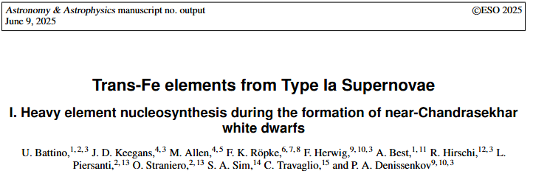
Summary and future perspectives
As our slowly merging CO WDs models approach the Chandrasekhar mass, C-burning ignites on the surface before it does in the center → ¹²C(¹²C,α)²⁰Ne → ²²Ne(α,n)²⁵Mg.
Large production of trans-Fe elements in the outermost ∼0.04M⊙ to ∼0.11M⊙. Something similar happens also in the case of in near-Ch WD from H-accreting systems (see Battino+2020).
Kr, Rb and Sr overproduced by up to ~1000 times compared to solar, Ga, Ge, Se, Kr, Rb, and Sr are all ejected in high amounts (>10⁻⁶ M⊙) during the explosion.
A new observable ‘smoking gun’ of a Chandrasekhar explosion? It’s highly possible trans-Fe elements from SNIa can only be produced by near-Chandrasekhar events → New way to constrain the progenitors? (Synthetic spectra from radiative transfer needed)
Can we see this? Great deep and all-sky surveys are about to start! (LSST, 4MOST-TiDES)
⁶⁰Fe increased by a factor of ∼20 compared to what is obtained from models without the inclusion of pre-SN trans-Fe element enrichment → Potential good case for Next-generation gamma-ray telescopes
Full results in Battino et al. 2025 (Submitted to A&A)
8

Slide 14
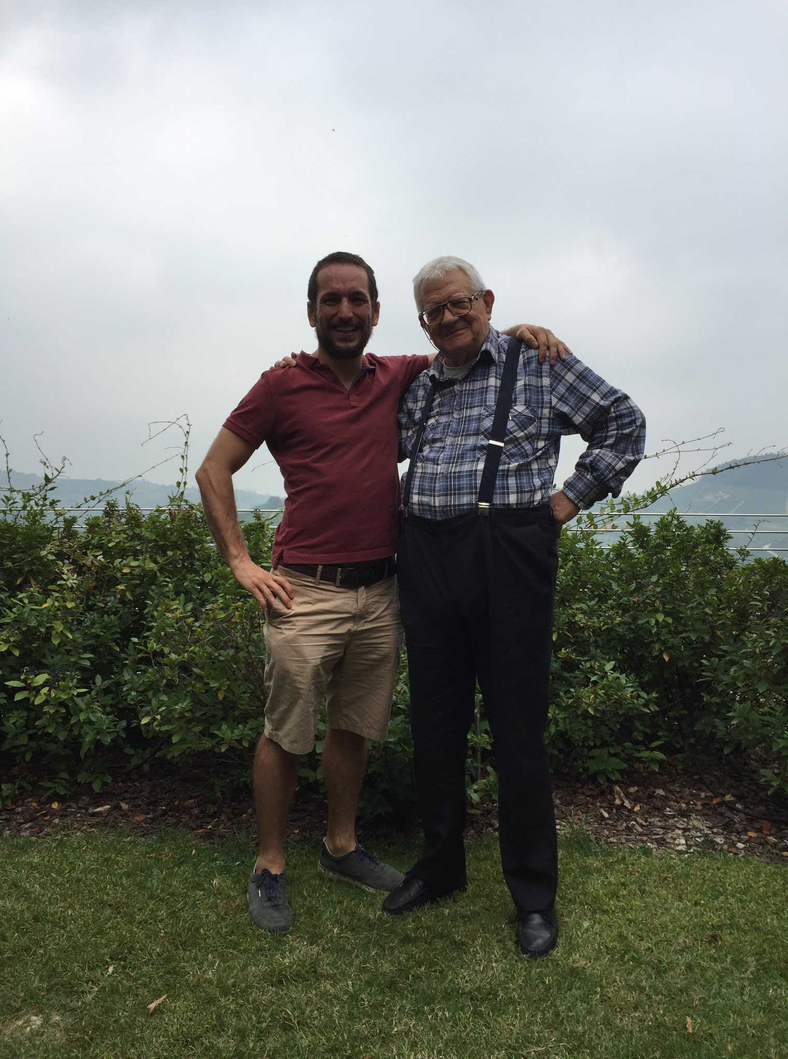
Grazie!
Thank you!!

