Slide 1
The Principal Components of Metal-poor Stars
Erika M. Holmbeck
sirEN | 11 June 2025

Slide 2
Rapid neutron capture nucleosynthesis in action
Unknown
Known nuclei
Stable nuclei
(Sprouse & Mumpower)

Slide 3
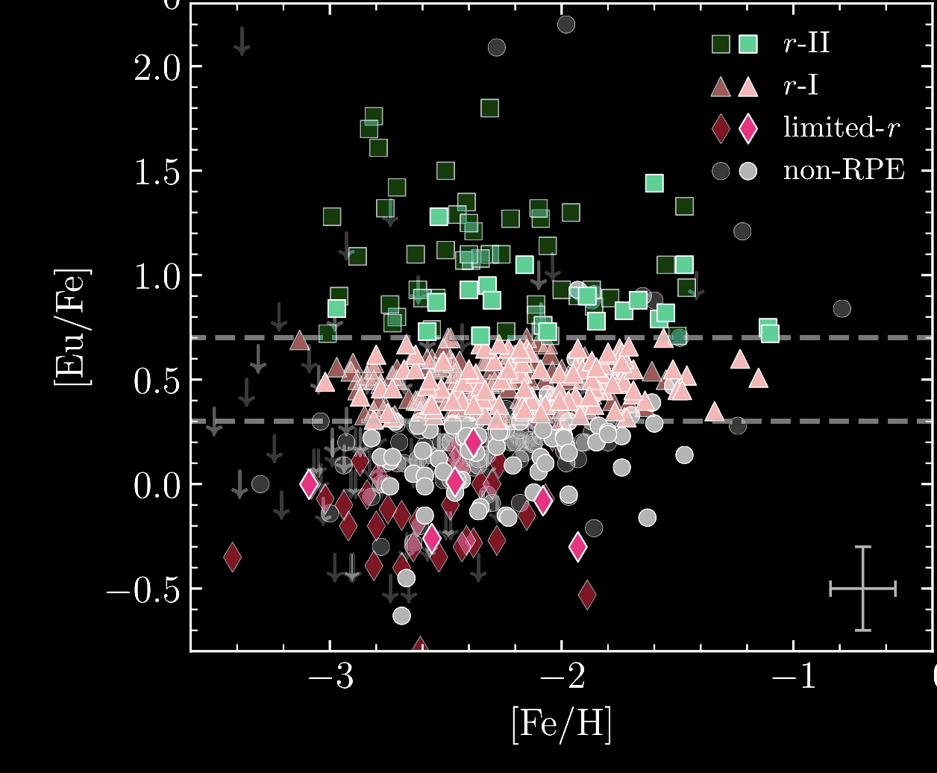
The oldest, most r-process enhanced are considered “single-origin”
more r-process rich →
← chemically simple (“older“)
RPA DR4: Holmbeck+ (2020)

Slide 4
The oldest, most r-process enhanced are considered “single-origin”
more r-process rich →
← chemically simple (“older“)
RPA DR4: Holmbeck+ (2020)

Slide 5
Mergers, collapsars, magnetars, oh my!
more r-process rich →
← chemically simple (“older“)
RPA DR4: Holmbeck+ (2020)

Slide 6
Mergers, collapsars, magnetars, oh my!
more r-process rich →
← chemically simple (“older“)
RPA DR4: Holmbeck+ (2020)

Slide 7
Mergers, collapsars, magnetars, oh my!
more r-process rich →
← chemically simple (“older“)
RPA DR4: Holmbeck+ (2020)

Slide 8
Mergers, collapsars, magnetars, oh my!
more r-process rich →
← chemically simple (“older“)
RPA DR4: Holmbeck+ (2020)

Slide 9
Mergers, collapsars, magnetars, oh my!
more r-process rich →
← chemically simple (“older“)
RPA DR4: Holmbeck+ (2020)

Slide 10
“It can clearly be seen that the abundance pattern for this star is reproduced by my favorite r-process site”
Holmbeck+ (in prep.)

Slide 11
The inconvenient truth: stars were likely enriched from multiple r-process sites…yes, even the metal-poor ones
Holmbeck+ (in prep.)

Slide 12
We have an observed case for this!
The inconvenient truth: stars were likely enriched from multiple r-process sites…yes, even the metal-poor ones
Holmbeck+ (in prep.)

Slide 13
We have a sample of 42 stars that appear to be described by a baseline pattern plus a fission pattern
Roederer+ (2023)

Slide 14
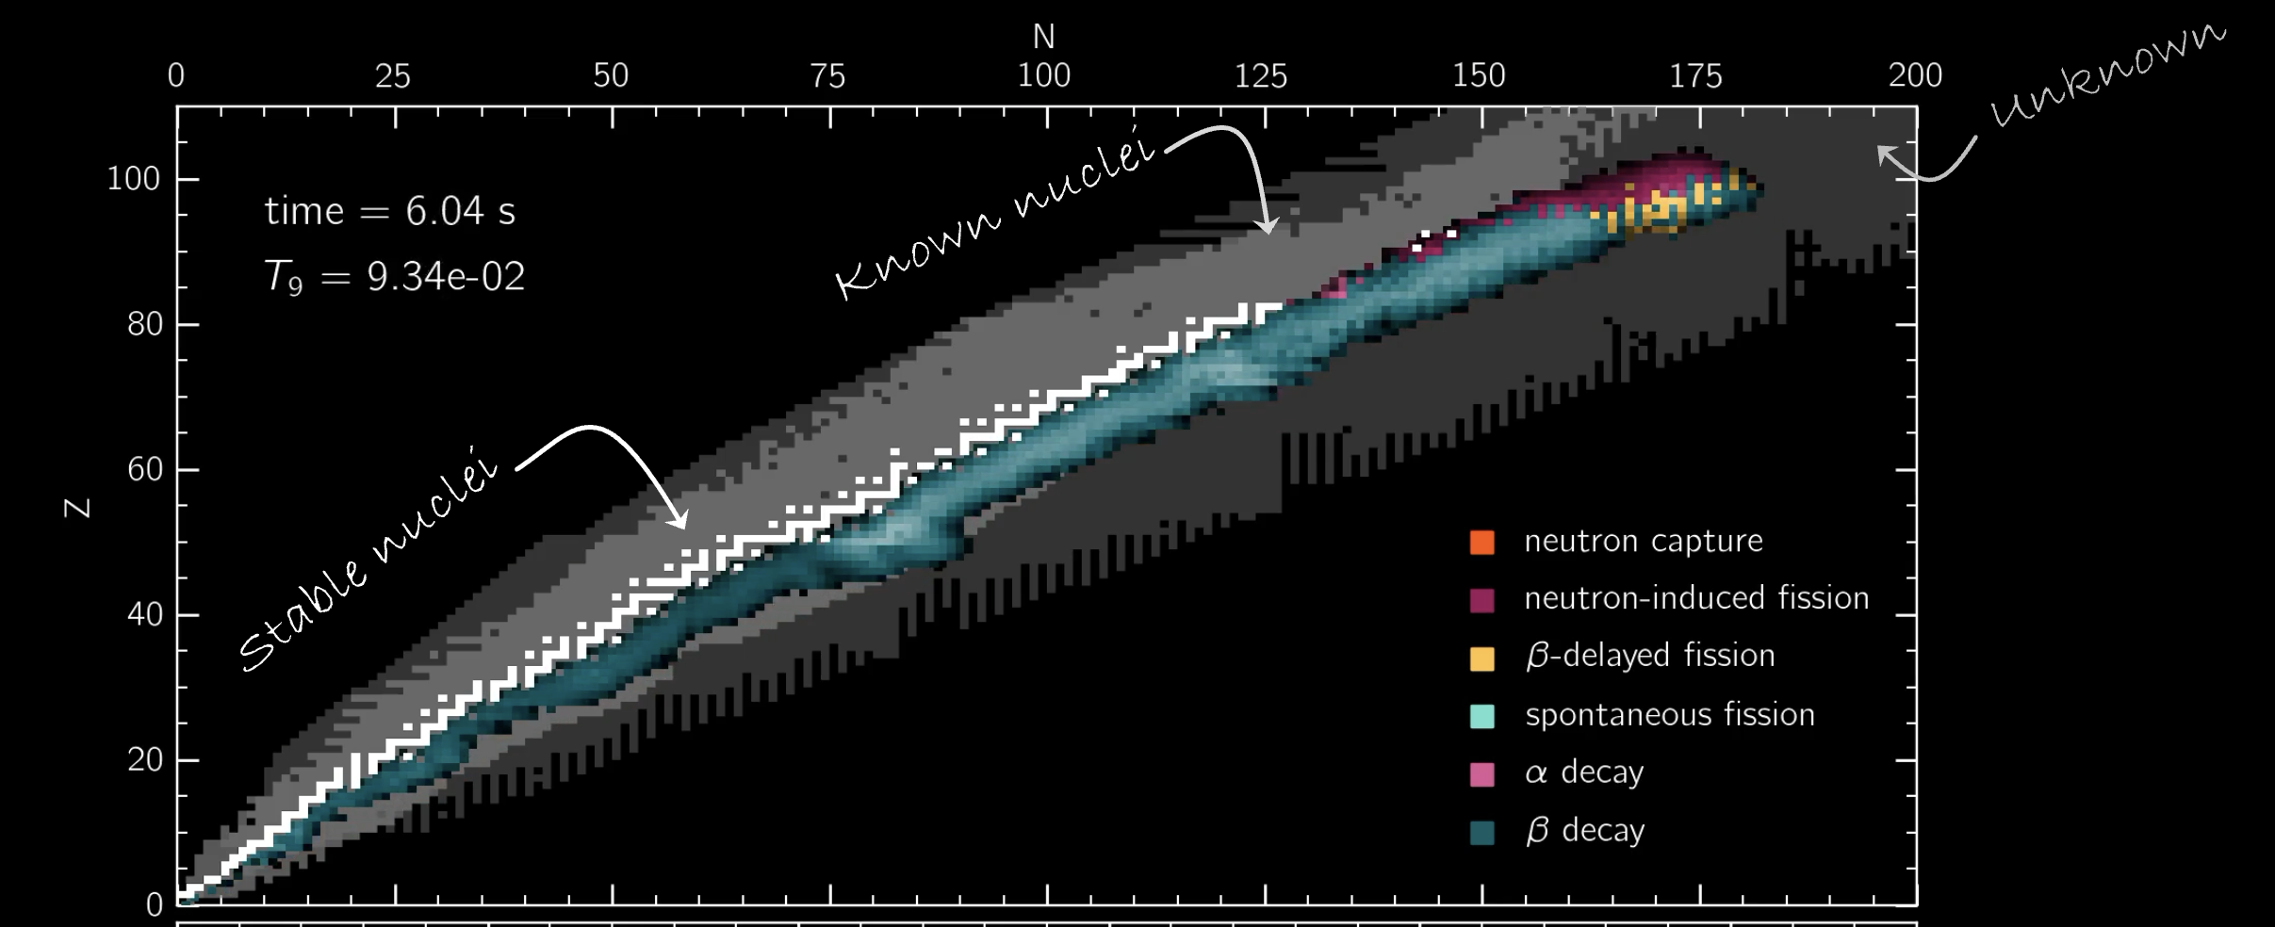
In favorable site conditions, nuclei fission and deposit material at lower masses, producing an abundance excess

Slide 15
In some conditions, nuclei fission and deposit material at lower masses, producing an abundance excess

Slide 16
We have a sample of 42 stars that appear to be described by a baseline pattern plus a fission pattern
Roederer+ (2023)

Slide 17
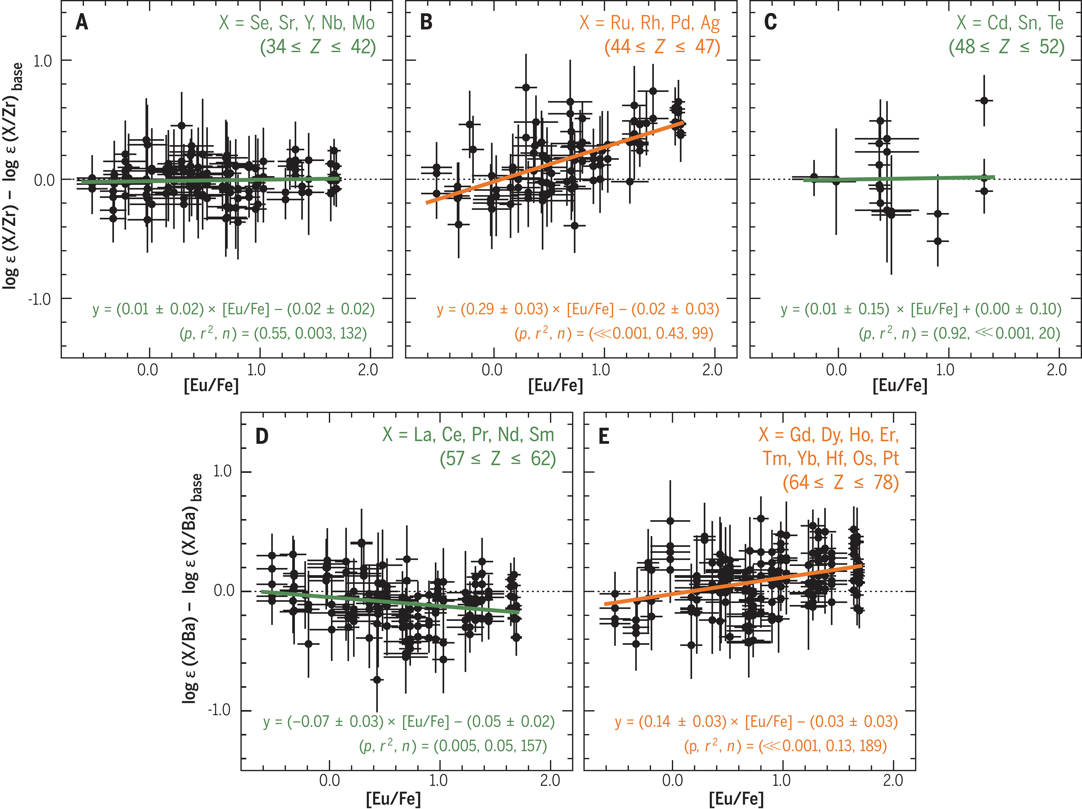
The abundance excess increases with [Eu/Fe] (r-process enrichment)
Roederer+ (2023)

Slide 18
Does this equate to each star being a combination of fission-capable r-processes and non-fission achieving sites?
Roederer+ (2023)

Slide 19
These stars show at least two distinct patterns
Can we use their patterns to quantify r-process site/type contribution in stars?
Does this equate to each star being a combination of fission-capable r-processes and non-fission achieving sites?
Roederer+ (2023)

Slide 20
The method: treat each of the 42 abundance patterns as a linear combination of a basis set of abundance patterns
$$Λ$$
$$⋮$$

Slide 21
Basis: (1) limited/weak r-process pattern, (2) a main/robust r-process pattern, and (3) the entire pattern
limited r-process
main r-process
whole pattern
$$Λ$$
(1) and (2) motivated by the separate universality between the limited and main r-processes
(3) potential fission signature covers both limited and main r-process regions

Slide 22
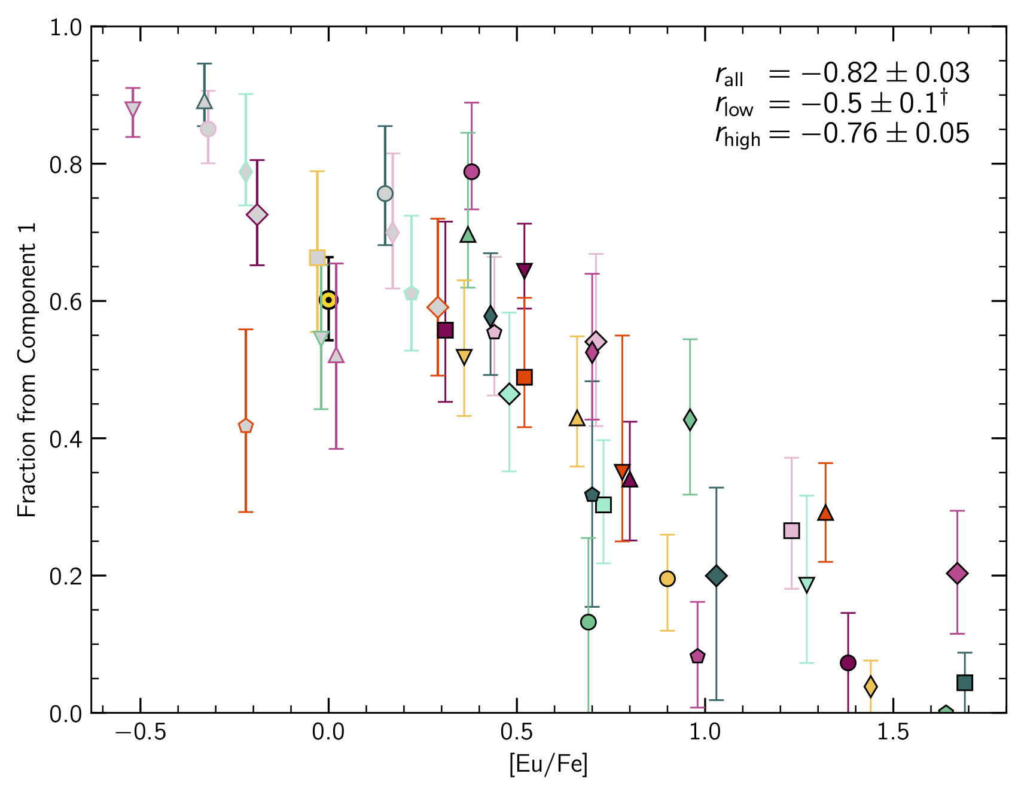
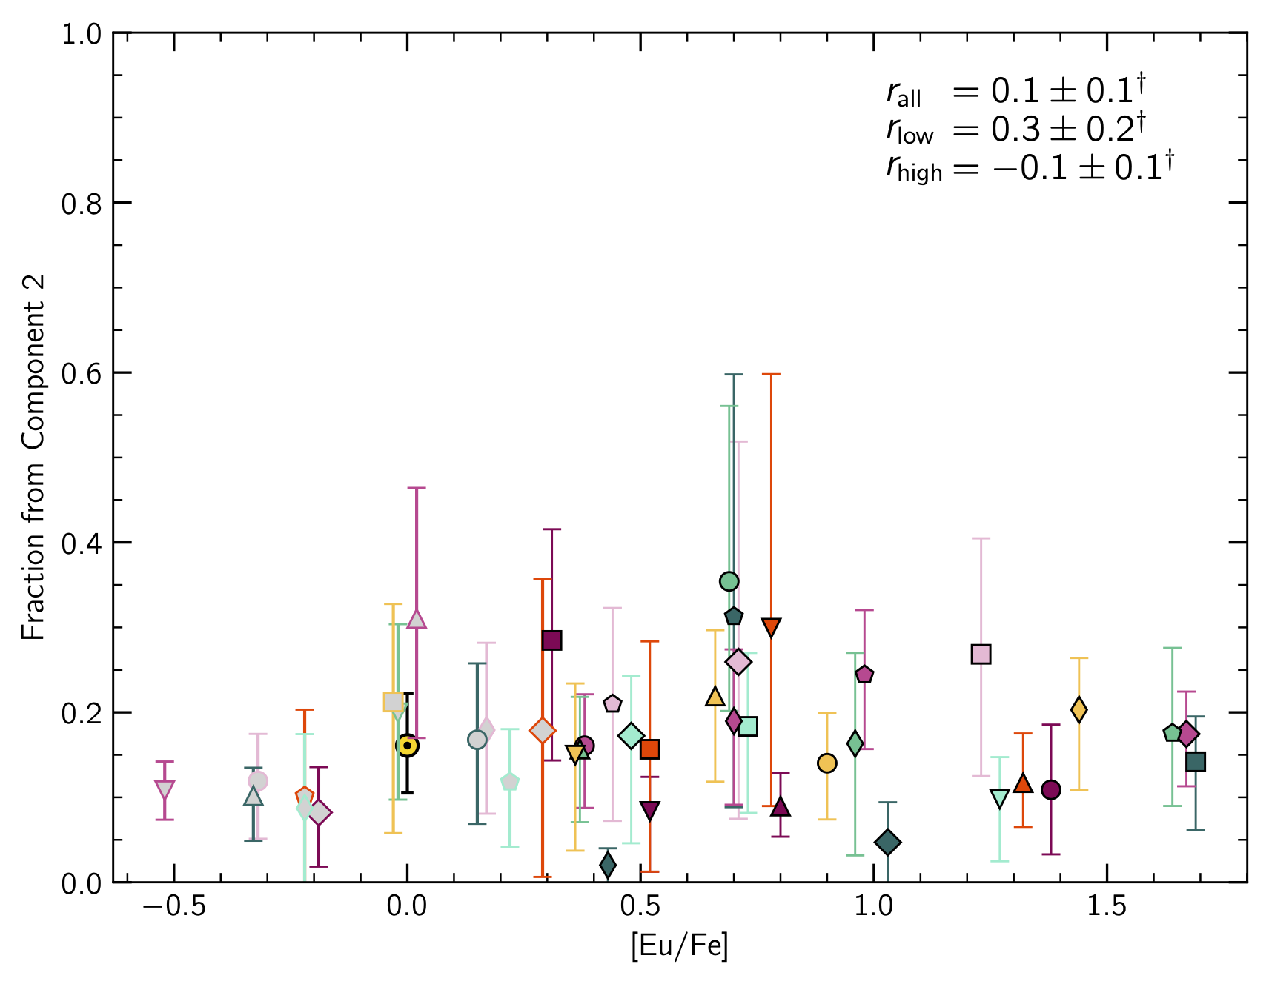
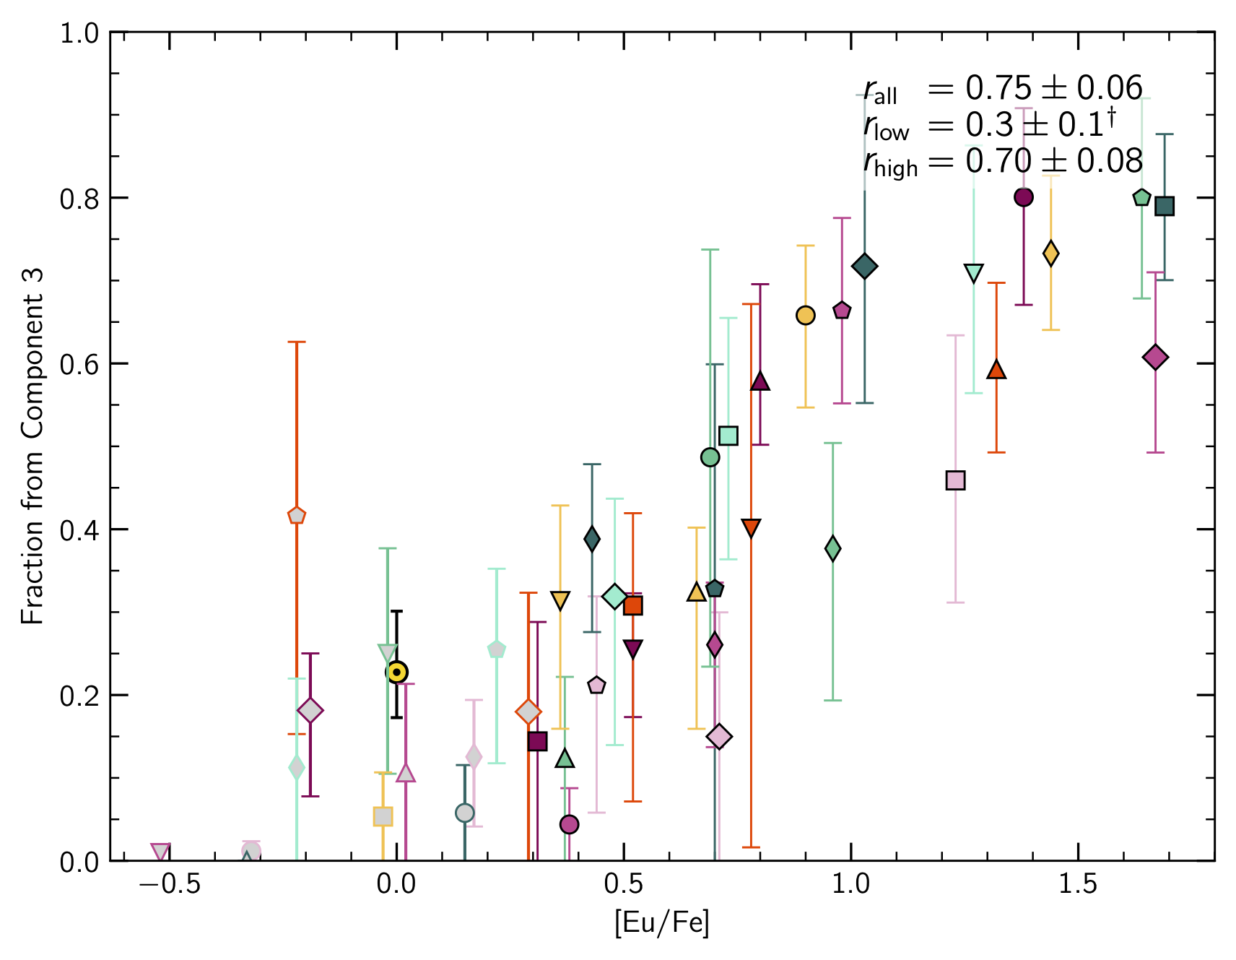
How much each component contributes to each star as a function of its [Eu/Fe]
Component 1:
Light/limited r-process that decreases with [Eu/Fe]—agrees with observation
Component 2:
A main r-process that is constant(?) over [Eu/Fe]
Component 3:
A full r-process pattern that increases with [Eu/Fe] —agrees with observations
Holmbeck+ (in prep.)

Slide 23
How much each component contributes to each star as a function of its [Eu/Fe]
Baseline limited-r?
Baseline main r-process?
Fission?
Component 1:
Light/limited r-process that decreases with [Eu/Fe]—agrees with observation
Component 2:
A main r-process that is constant(?) over [Eu/Fe]
Component 3:
A full r-process pattern that increases with [Eu/Fe] —agrees with observations
Holmbeck+ (in prep.)

Slide 24
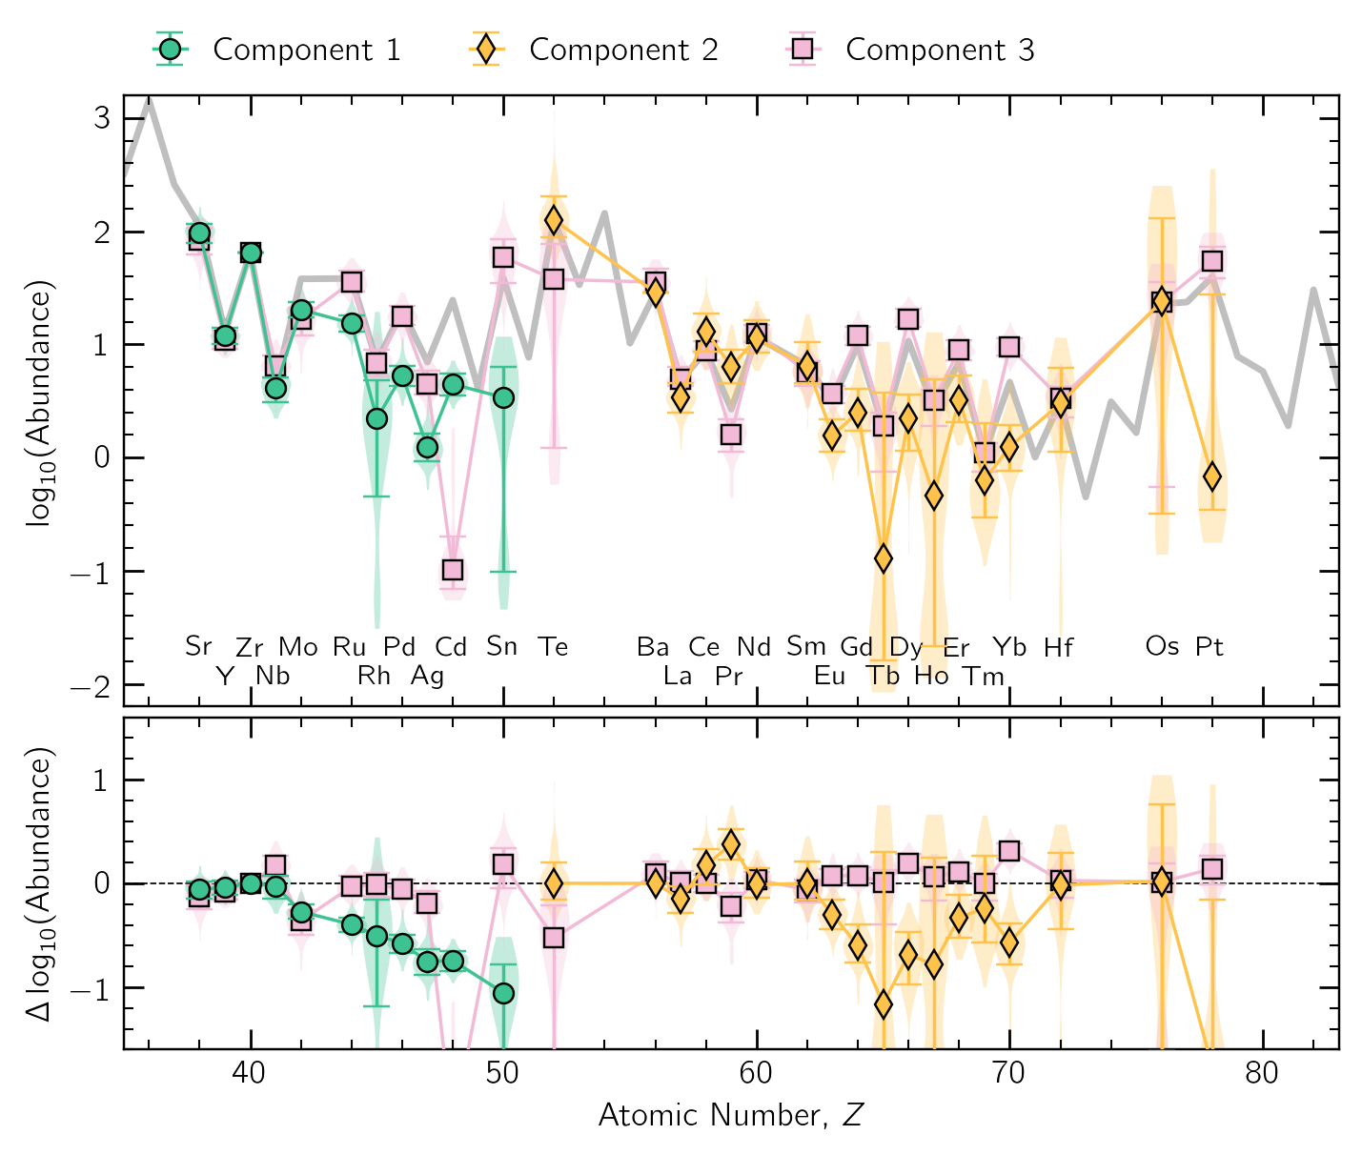
So what?
Nucleosynthesis theorists
Nuclear experimentalists
GCE theorists
Your-favorite-stellar-population observers
can use these basis patterns as the true observed r-process signature for individual sites
can trust their nucleosynthesis friends even more :)
can use the frequency with which each basis pattern occurs as a measure of r-process site frequencies
can quantify the nucleosynthetic history of an observed population
Holmbeck+ (in prep.)

Slide 25
In Summary
It is convenient to treat the abundance patterns of very metal-poor stars as the individual children of single r-process-hosting events
We can start addressing r-process abundance patterns statistically: is each r-II star actually only enriched by one event?
This work shows the result a method in which the abundance patterns of 42 stars can be described robustly with as a few as three common abundance patterns
One of these common patterns could be the signature of a “pure” fission cycling r-process, which can/should be used to compare to r-process models
This method can be applied to other populations over time/metallicity to quantify r-process site contribution over time

Slide 26
Thanks!
Collaborators & Students
Jessica Agnos (SFSU)
Carlos Allende Prieto (IAC Tenerife, Spain)
Avrajit Bandyopadhyay (UFlorida)
John Cowan (Oklahoma)
Elizabeth Den Hartog (Wisconsin)
Peter Haramis (SFSU)
Dimitrii Gudin (Notre Dame)
Kohei Hattori (NAOJ, Japan)
Yutaka Hirai (Notre Dame/Tohoku U, Japan)
Alexander Ji (UChicago)
James Lawler (Wisconsin)
Young Sun Lee (Chungnam Natl U, Korea)
Mohammad Mardini (Zarqa U, Jordan)
Jennifer Marshall (Texas A&M)
Mila Racca (Stockholm U, Sweden)
Shivani Shah (UFlorida)
Derek Shank (Notre Dame)
Chris Sneden (UTexas)
Nicole Vassh (TRIUMF, Canada)
Teodora Xylakis-Dornbusch (Heidelberg, Germany)
Funding & Telescopes
Hubble Space Telescope
Magellan Telescope,
McDonald Observatory
Apache Point Observatory
Gran Telescopio Canarias
NSF grant AST 2205847
NSF grant AST 2206263
NSF grant AST-2307436
NSF grant PHY 14-30152 “Physics Frontier Center/JINA Center for the Evolution of the Elements” (JINA-CEE)
NSF grant OISE1927130 “The International Research Network for Nuclear Astrophysics” (IReNA)
NSF: NOIRLab, managed by Association of Universities for Research in Astronomy
NASA Astrophysics Theory Program grant 80NSSC24K089
NASA Astrophysics Data Analysis Program grant 80NSSC21K0627
DOE Contract DE-AC52-07NA27344
Swedish Research Council: VR 2021-05556
Disclaimer
This document was prepared as an account of work sponsored by an agency of the United States government. Neither the United States government nor Lawrence Livermore National Security, LLC, nor any of their employees makes any warranty, expressed or implied, or assumes any legal liability or responsibility for the accuracy, completeness, or usefulness of any information, apparatus, product, or process disclosed, or represents that its use would not infringe privately owned rights. Reference herein to any specific commercial product, process, or service by trade name, trademark, manufacturer, or otherwise does not necessarily constitute or imply its endorsement, recommendation, or favoring by the United States government or Lawrence Livermore National Security, LLC. The views and opinions of authors expressed herein do not necessarily state or reflect those of the United States government or Lawrence Livermore National Security, LLC, and shall not be used for advertising or product endorsement purposes.

Slide 27
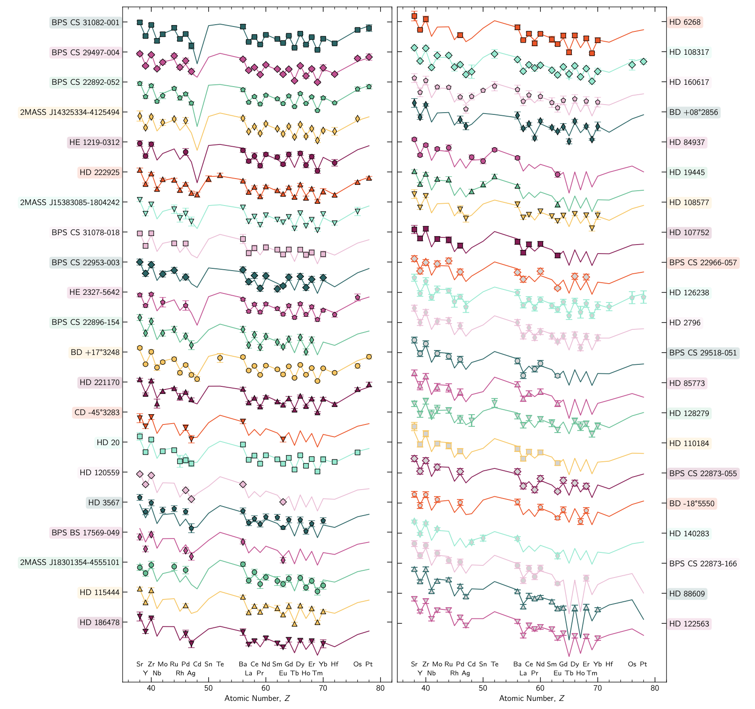
Holmbeck+ (in prep.)

