Slide 1
Spectral analysis and plasma ejecta opacity of the early-stage kilonova
Speaker: Ph.D. Student Matteo Bezmalinovich Co-authors: M. Bulla, D. Vescovi and S. Cristallo

Slide 2
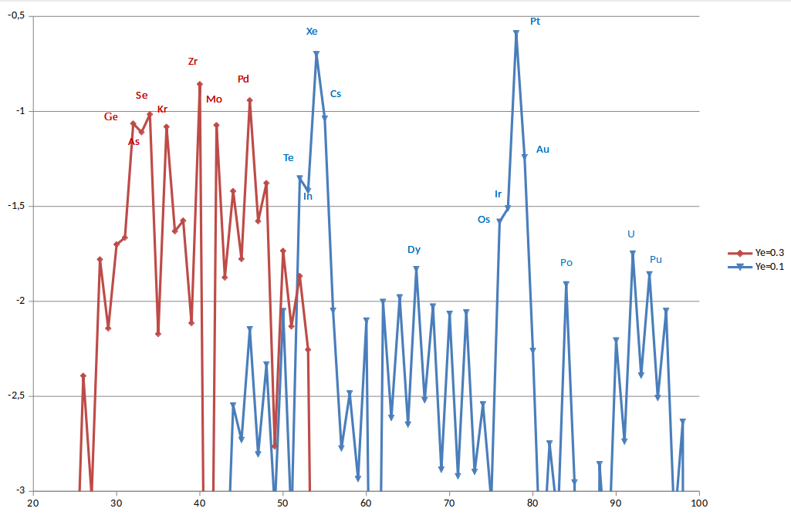
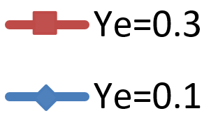
Why Selenium?
Abundances
Z (Atomic number)

Slide 3
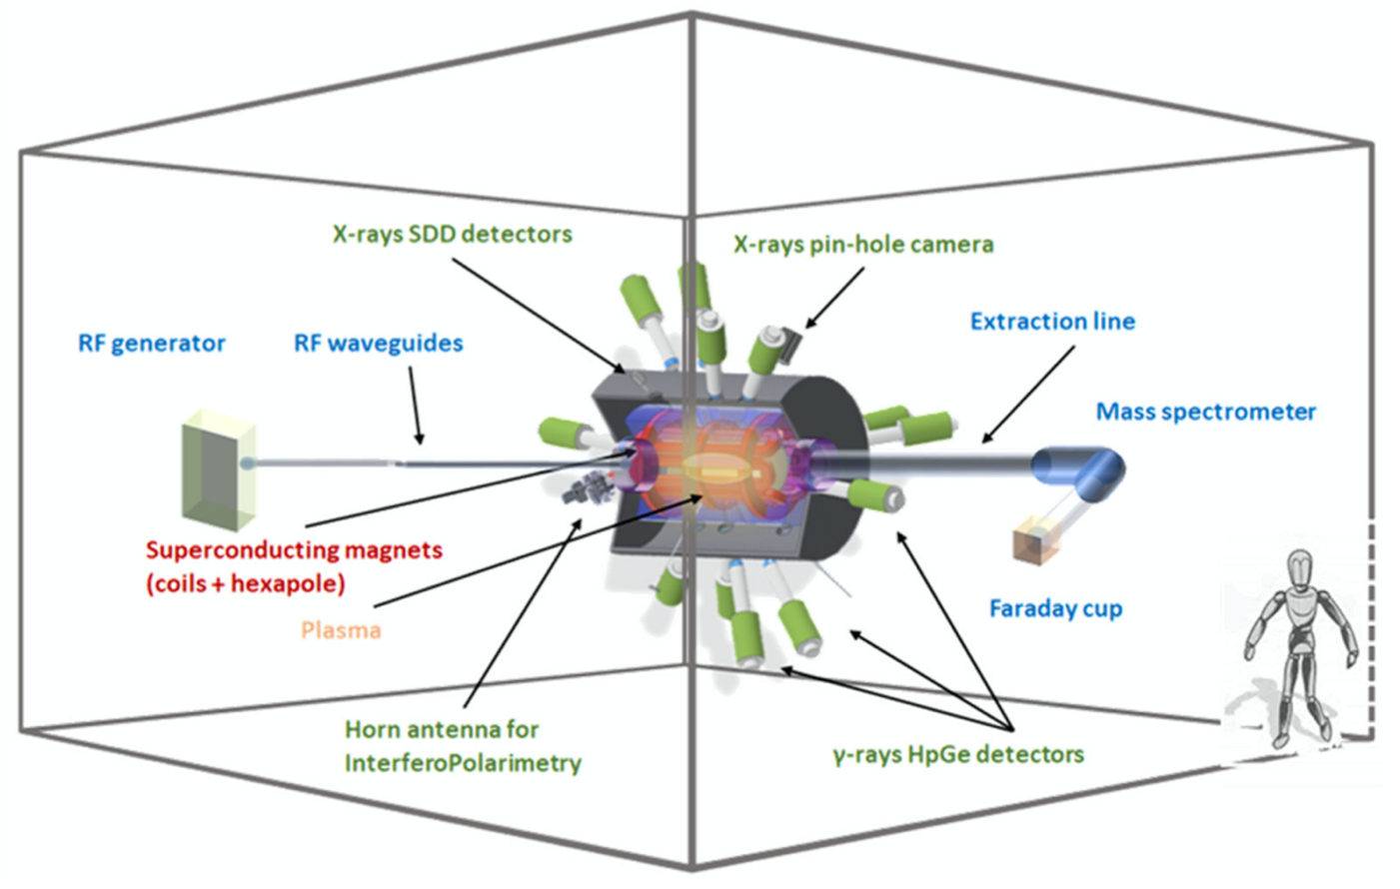
Why Selenium?
Abundances
Z (Atomic number)
D. Mascali et al., Universe 8, 80 (2022).

Slide 4
The KN light curve model
POSSIS (KN light curve model)
Bulla M., MNRAS, 2019
KN 3D model light curve angular dependent

Slide 5
The KN light curve model
POSSIS (KN light curve model)
Bulla M., MNRAS, 2019
KN 3D model light curve angular dependent
KN abundances
RTE equation
Opacity

Slide 6
The KN light curve model
POSSIS (KN light curve model)
Bulla M., MNRAS, 2019
KN 3D model light curve angular dependent
KN abundances
RTE equation
Opacity
Input

Slide 7
The KN light curve model
POSSIS (KN light curve model)
Bulla M., MNRAS, 2019
KN 3D model light curve angular dependent
Preliminary works: Numerical simulation of opacity (Se,Sr,Zr,Nd - Pidatella+, Frontiers 2022) (Ar - Bezmalinovich+, Il Nuovo Cimento,2024)
KN abundances
RTE equation
Opacity
Input
Ph.D. Goal Se opacity and KN spectra analysis (Bezmalinovich M. et al., in prep., 2025)

Slide 8
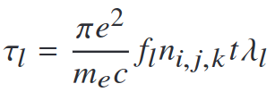
The Expansion Opacity
POSSIS code
Outcomes:
KN 3D model light-curve angular dependent
Requirements
Expansion opacity
Nucleosynthesis trace (input Ye for the spherical grid)
Homologous expansion t=dr/dv
Initial density and temperature correlated to the input trace
Expansion opacity as input
with Sobolev optical depth
Priority task: atomic calculations to estimate the expansion opacity
How?
GRASP2018
(General Relativistic Atomic Structure Package)

Slide 9
Well, let’s put it into practice…
Atomic and opacity results

Slide 10
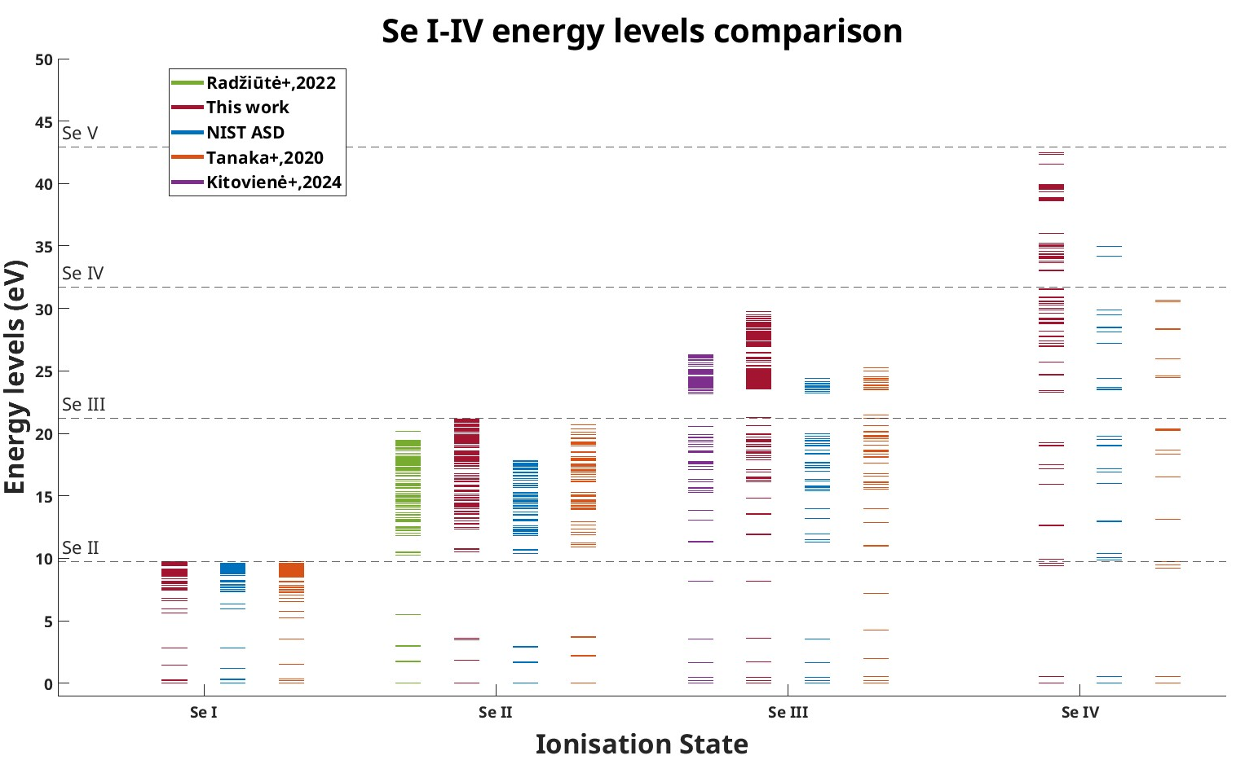
Se I-IV Energy Levels

Slide 11
Se I-IV Energy Levels
The results presented by our grasp2018 calculations in red will be soon available in the paper Bezmalinovich M. et.al, in prep. 2025

Slide 12
Se I-IV Energy Levels - results
Mean absolute differences
Mean relative differences (%)
N = # total levels (in common) compared for each ionisation state

Slide 13
Se I-IV Energy Levels - results
Mean absolute differences
Mean relative differences (%)
N = # total levels (in common) compared for each ionisation state

Slide 14
Se I-IV Energy Levels - results
Mean absolute differences
Mean relative differences (%)
N = # total levels (in common) compared for each ionisation state

Slide 15
Se I-IV Energy Levels - results
Mean absolute differences
Mean relative differences (%)
N = # total levels (in common) compared for each ionisation state
Combine data with major accuracy
MODEL I = our (Se I + Se IV) +
Se II +
Se III

Slide 16
Se expansion opacity

Slide 17
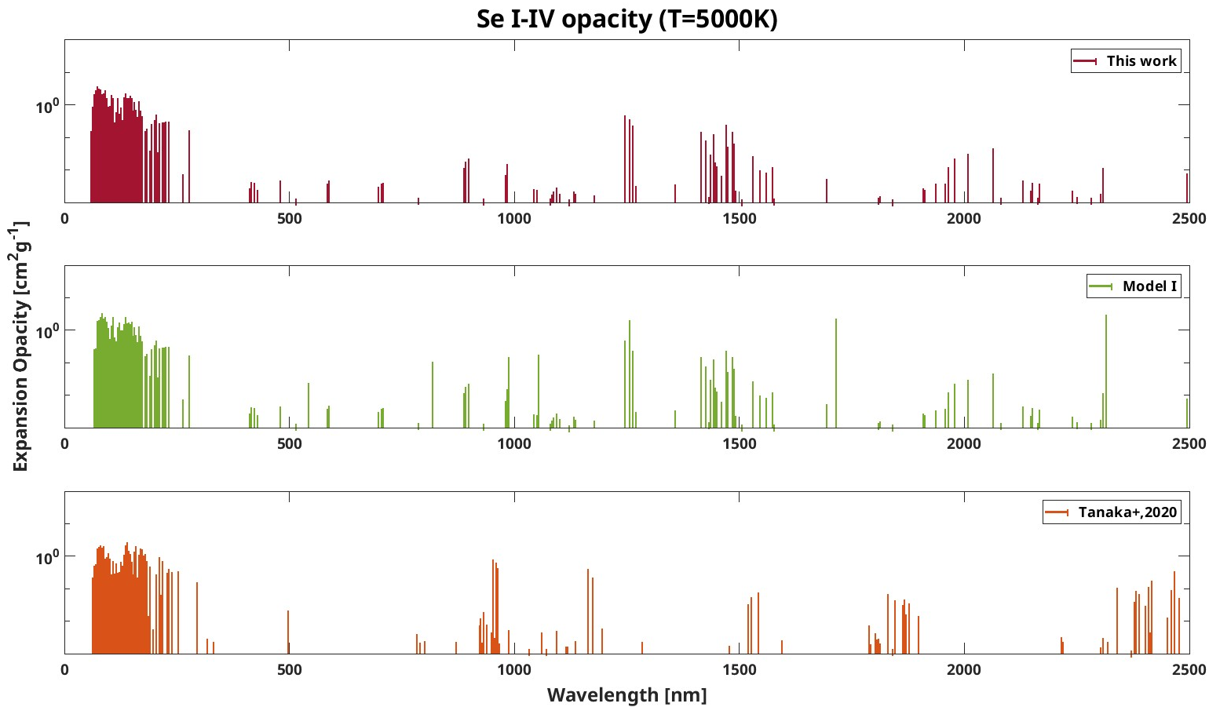
Se I-IV Expansion Opacity
E1 transitions (only)

Slide 18
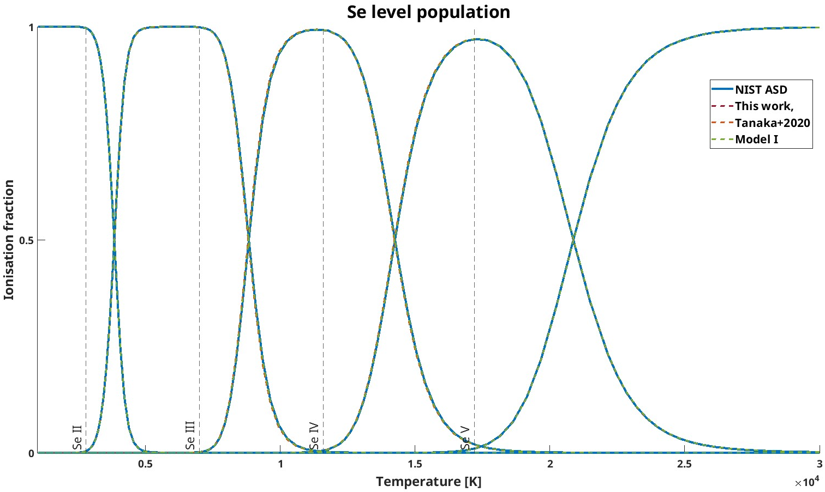
Selenium Level Population

Slide 19
Selenium Level Population
KN early-stage (blue emission)

Slide 20
Early-stage KN → Push beyond Se IV

Slide 21
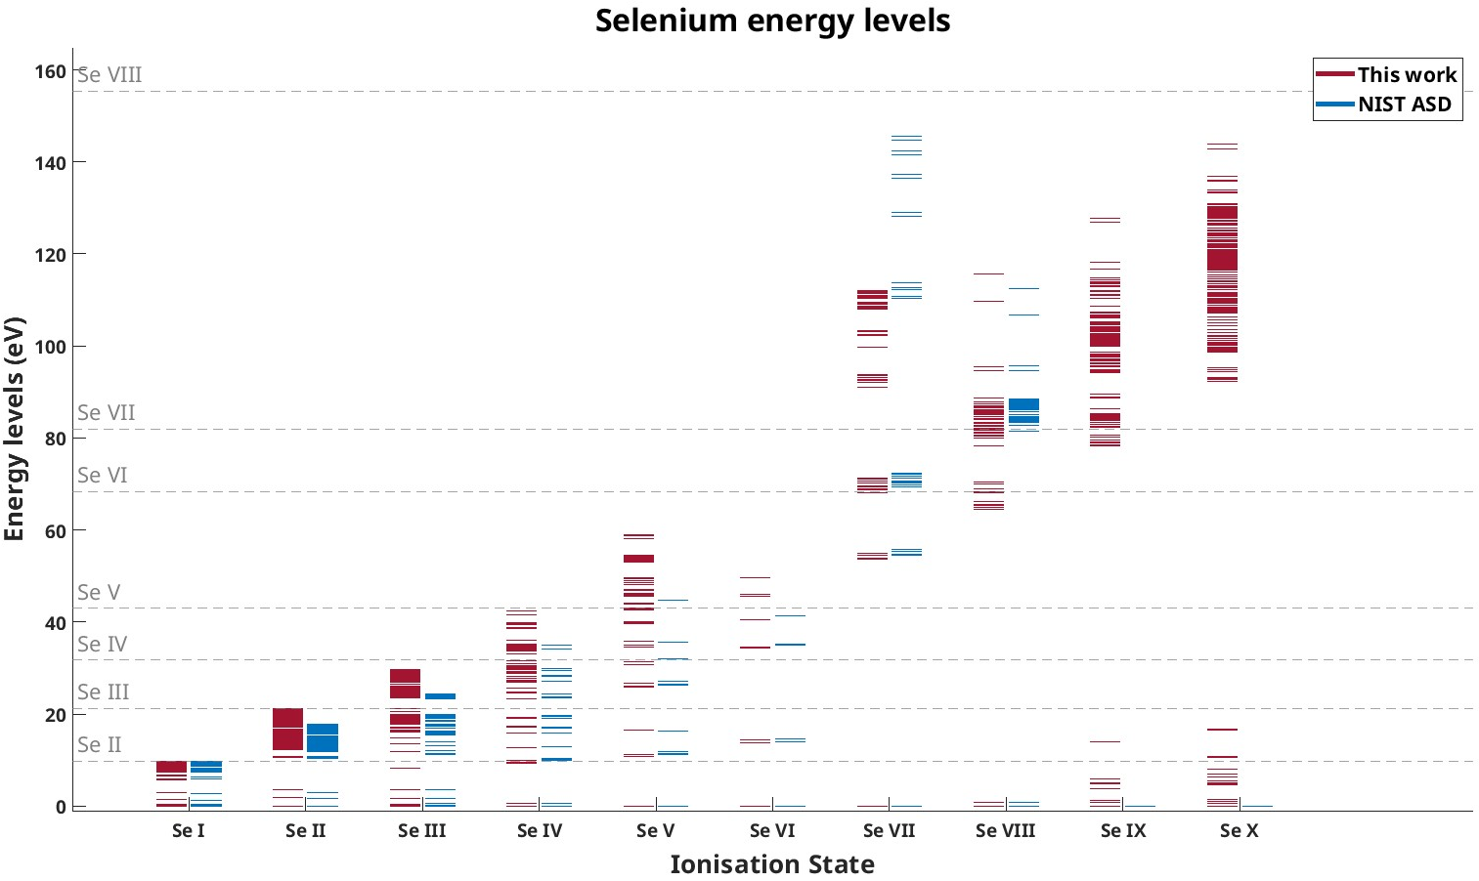
Se I-X Energy Levels

Slide 22
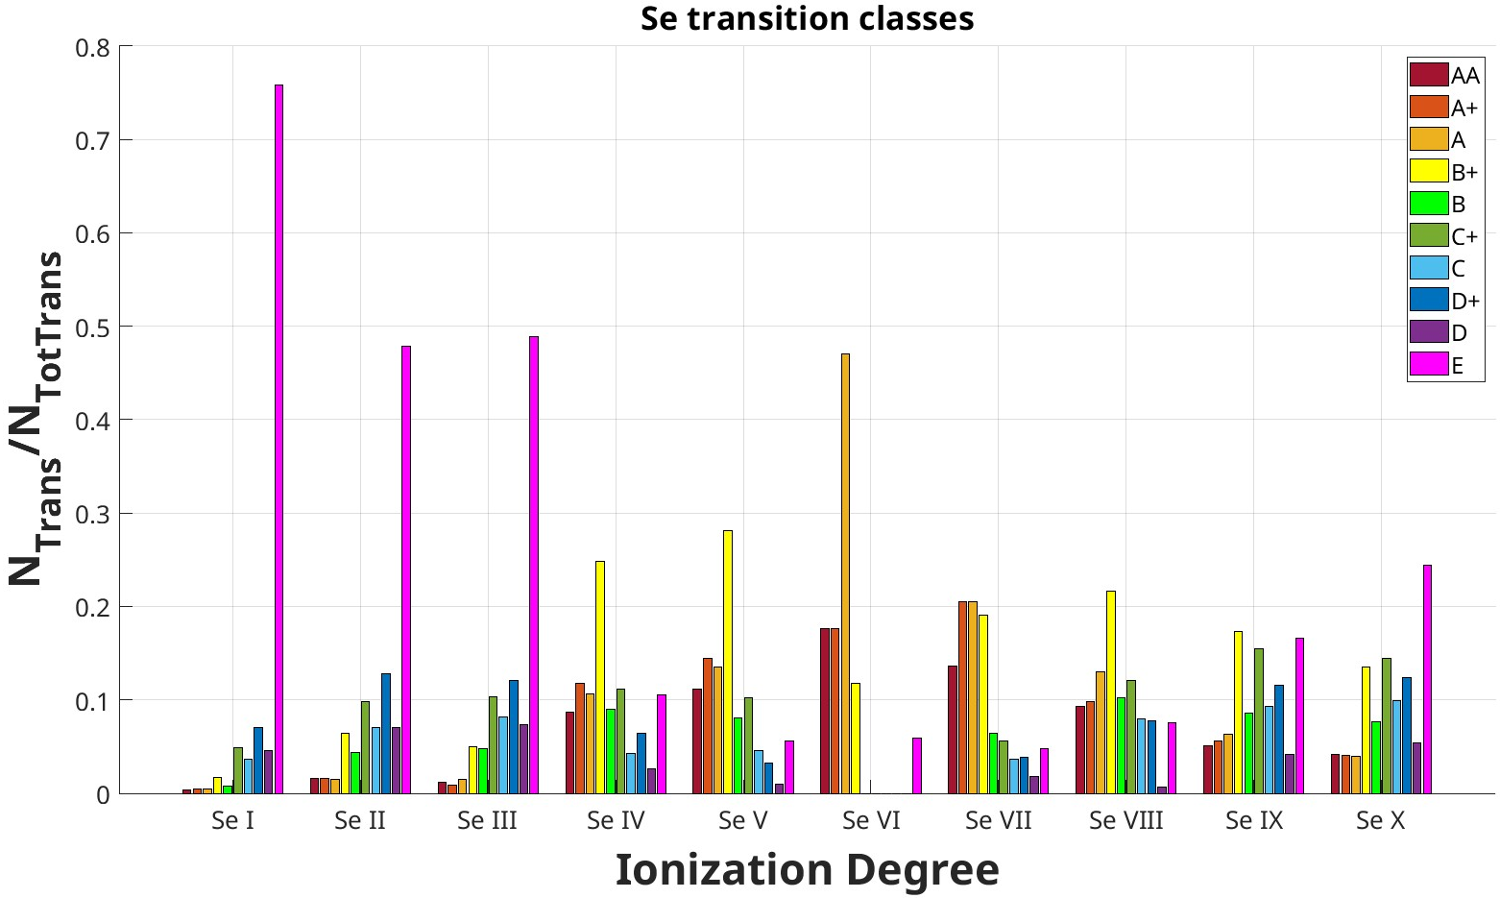
Se I-X transitions
1218
# transitions
Thanks to the cooperation with G. Gaigalas
3099
17
4463
no NIST ASD data available
520
1255
604
7620
440
2508

Slide 23
Assuming Se I-X…
… what happens to the opacity if we go beyond T=5000K?

Slide 24
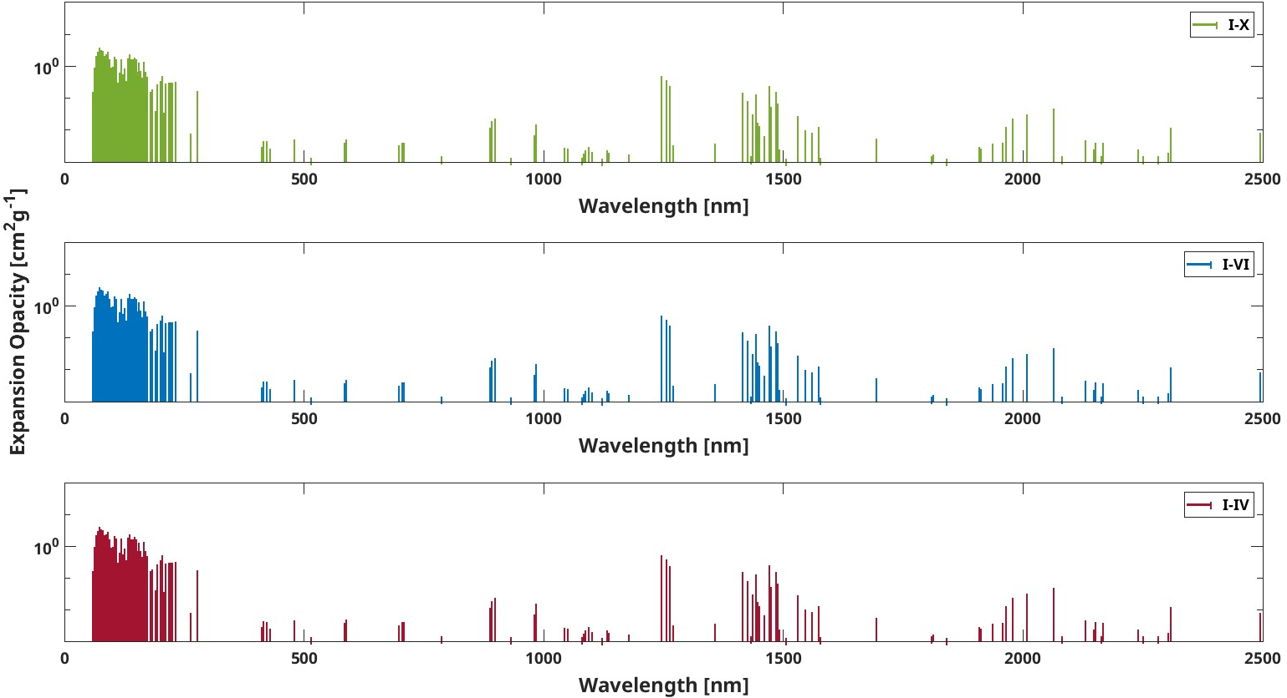
Se I-X - T=5000K
ALL IDENTICAL

Slide 25
Se I-X - T=20000K

Slide 26
Se I-X - T=20000K

Slide 27
Se I-X - T=20000K
IDENTICAL

Slide 28
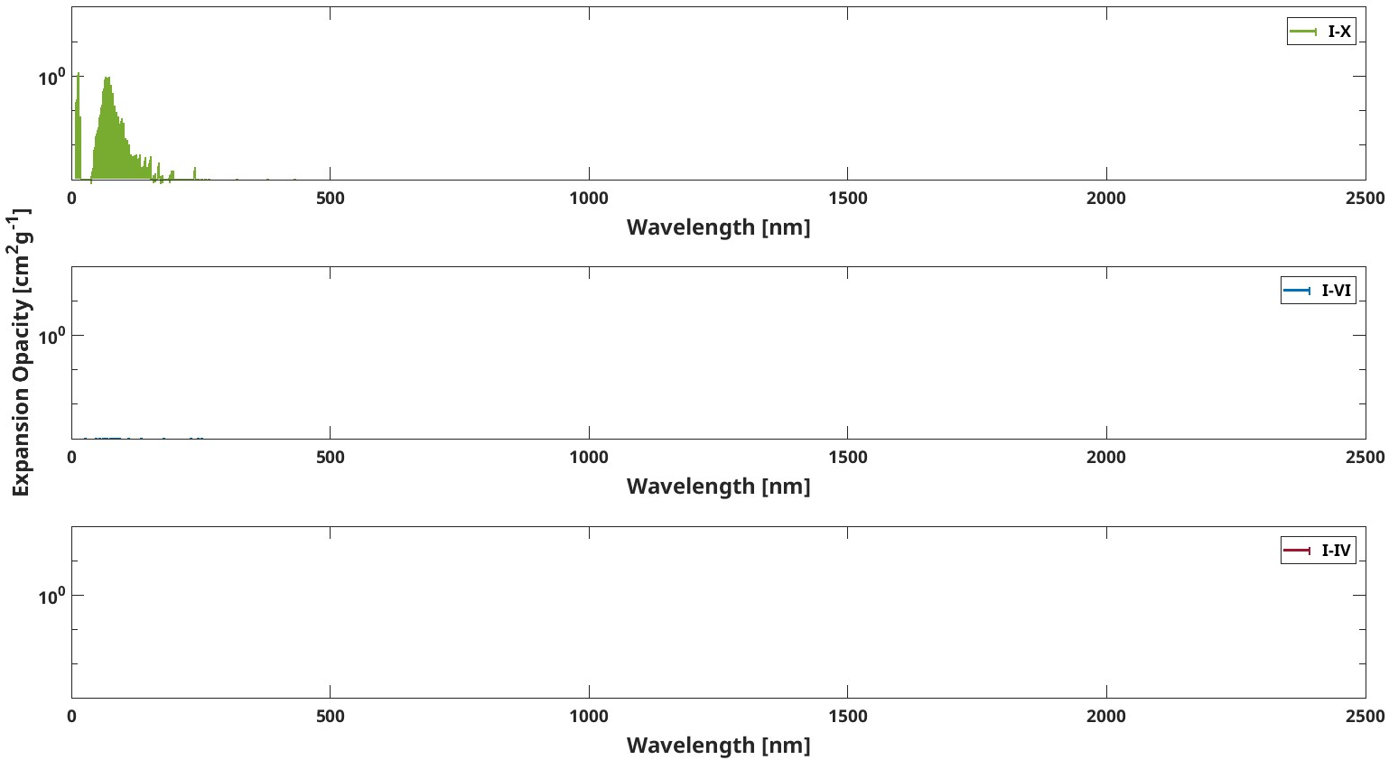
Se I-X - T=100000K

Slide 29
What about KN spectrum?

Slide 30
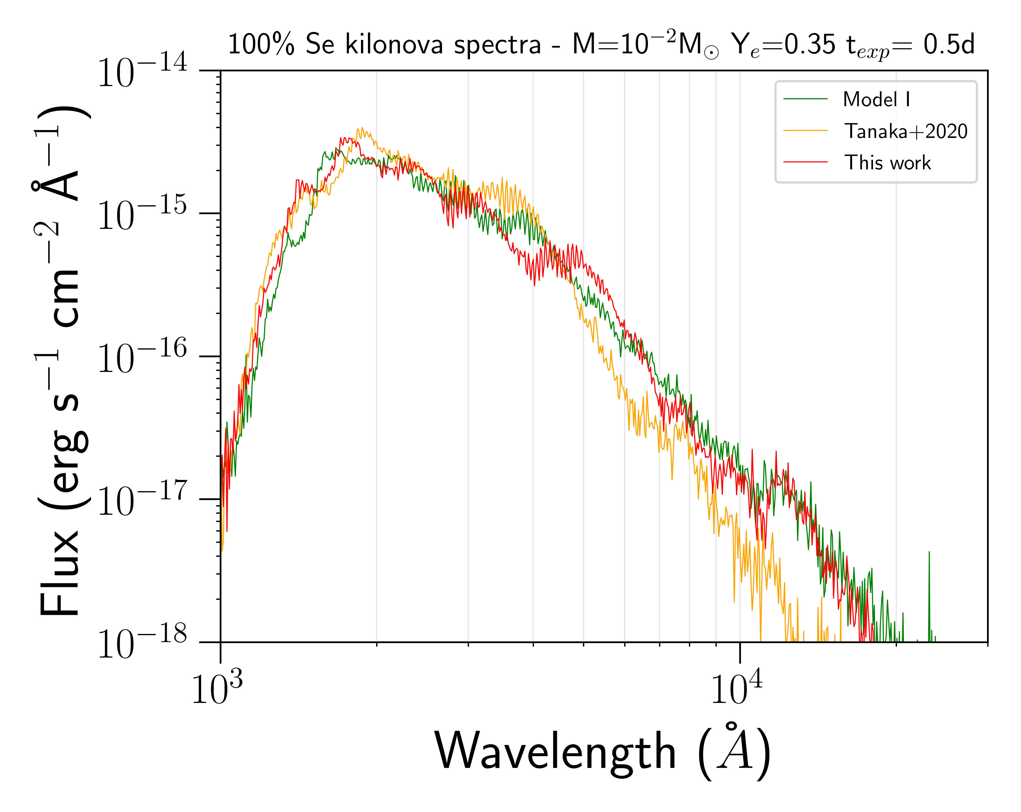
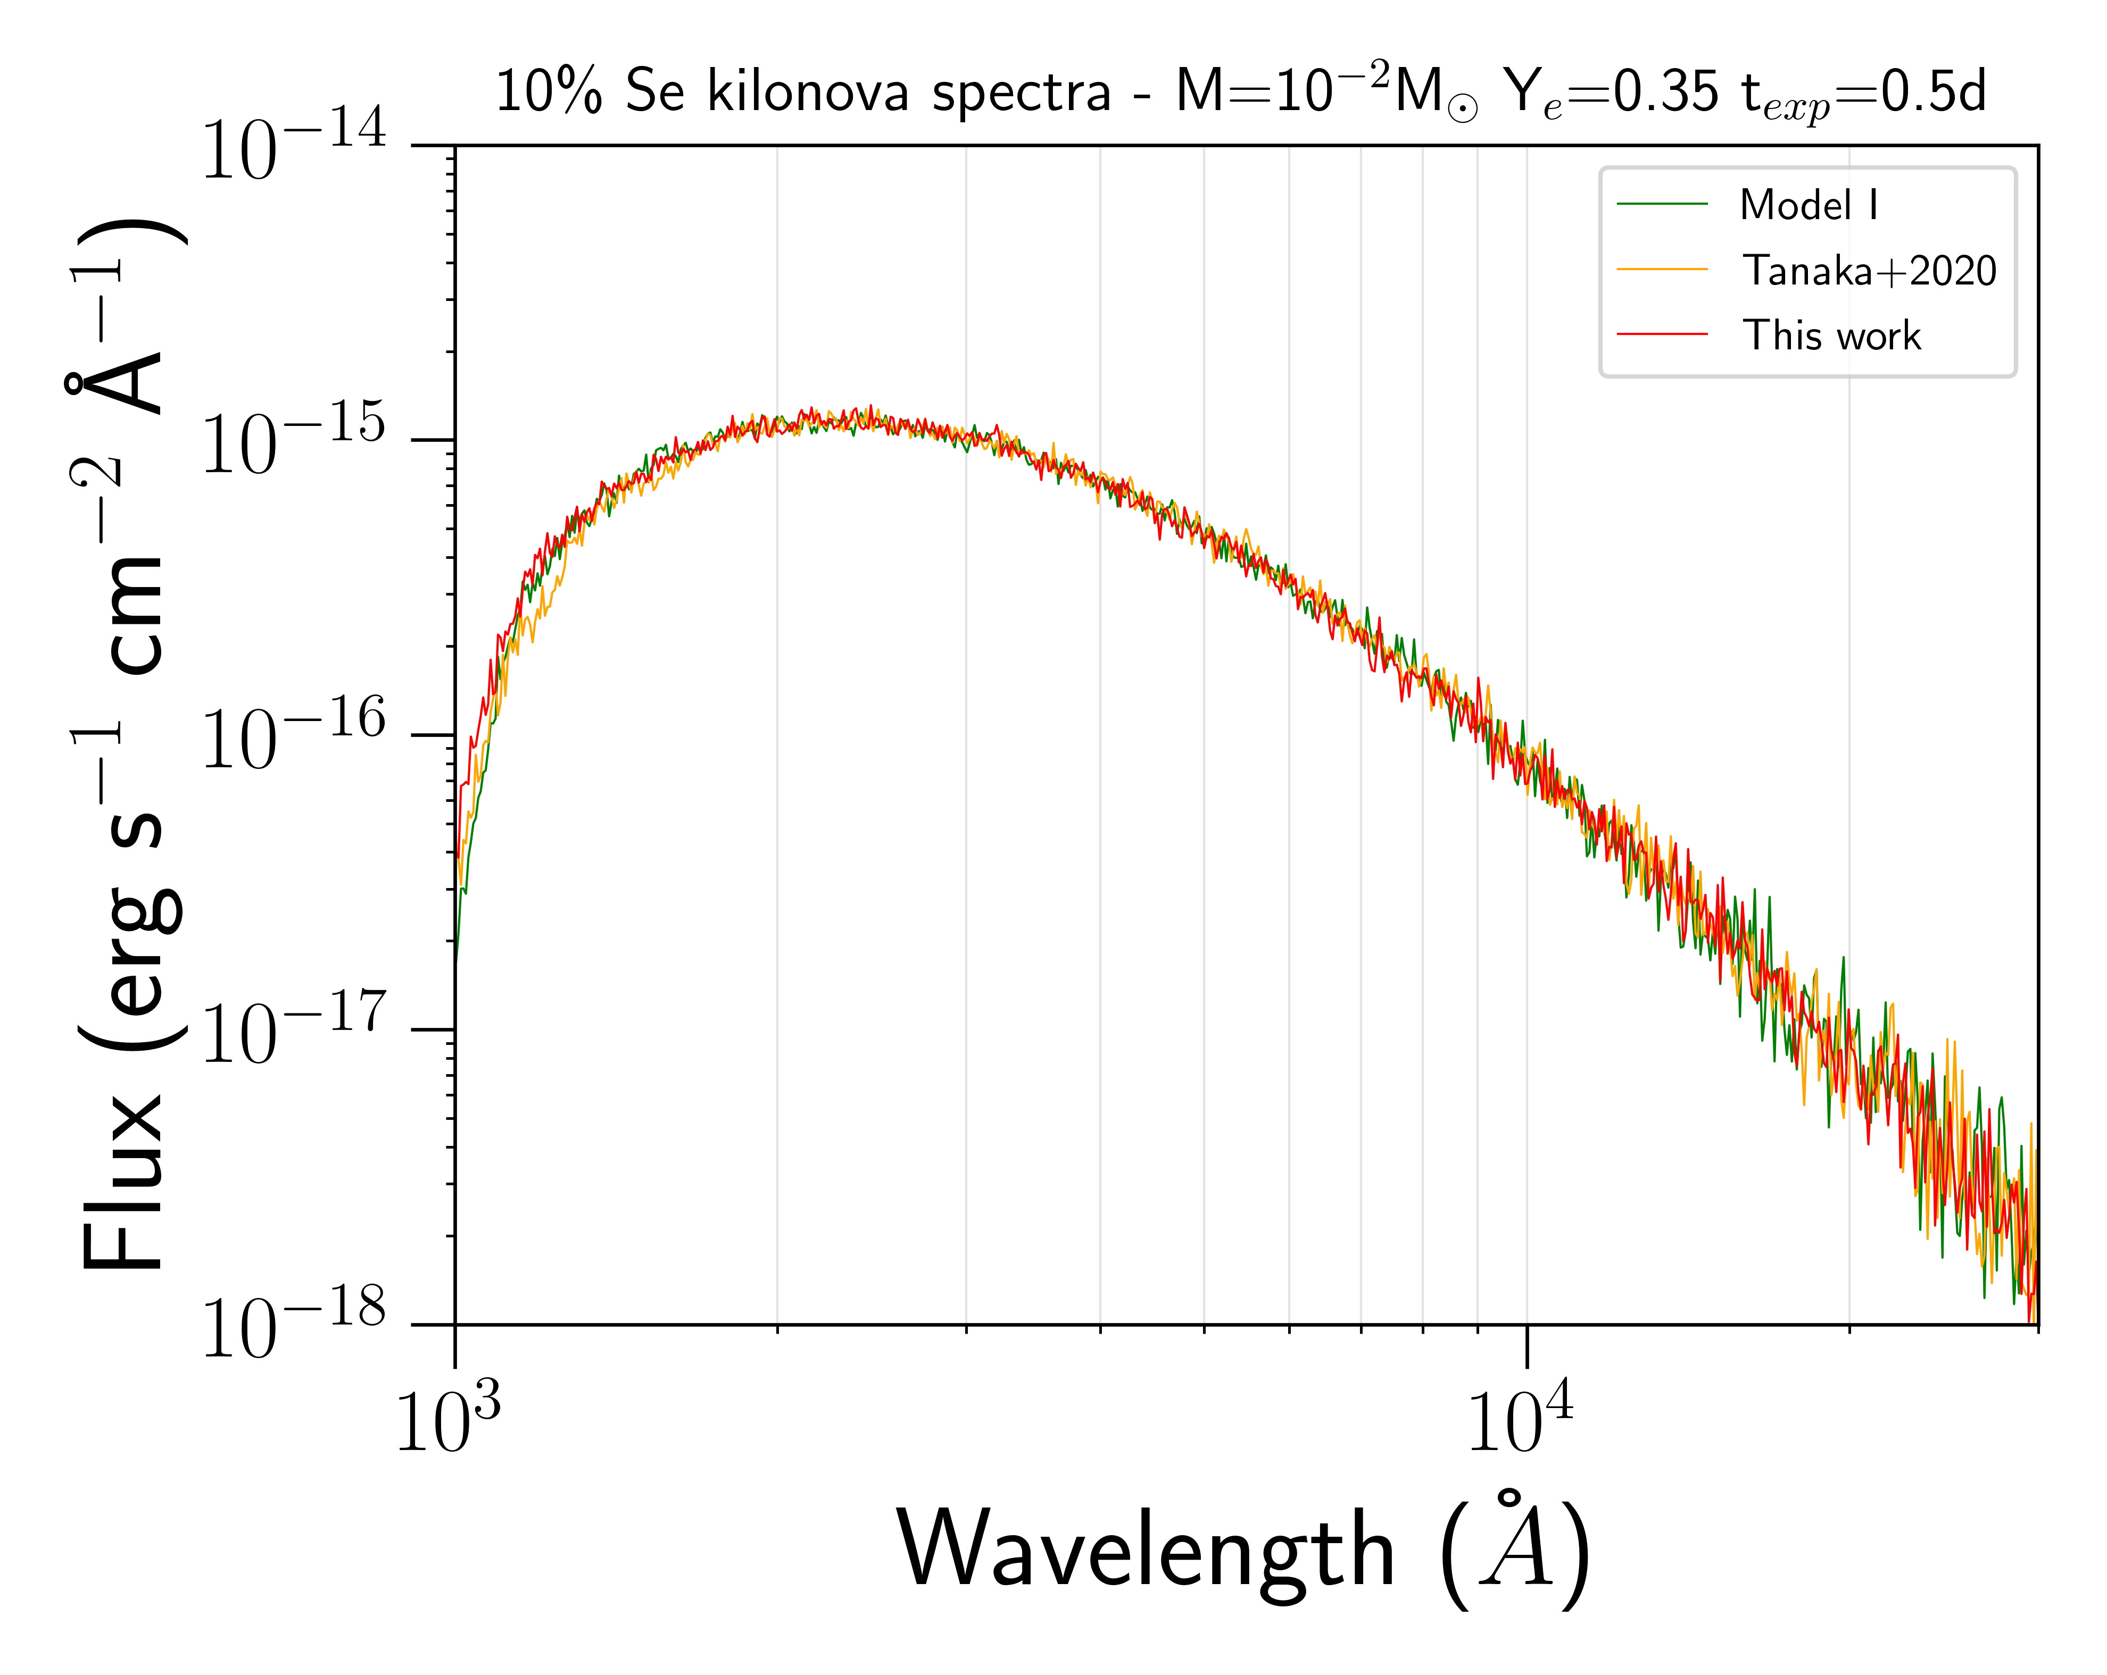
KN spectrum analysis - t = 0.5d
The results presented in red will be soon available in the paper Bezmalinovich M. et.al, in prep. 2025

Slide 31
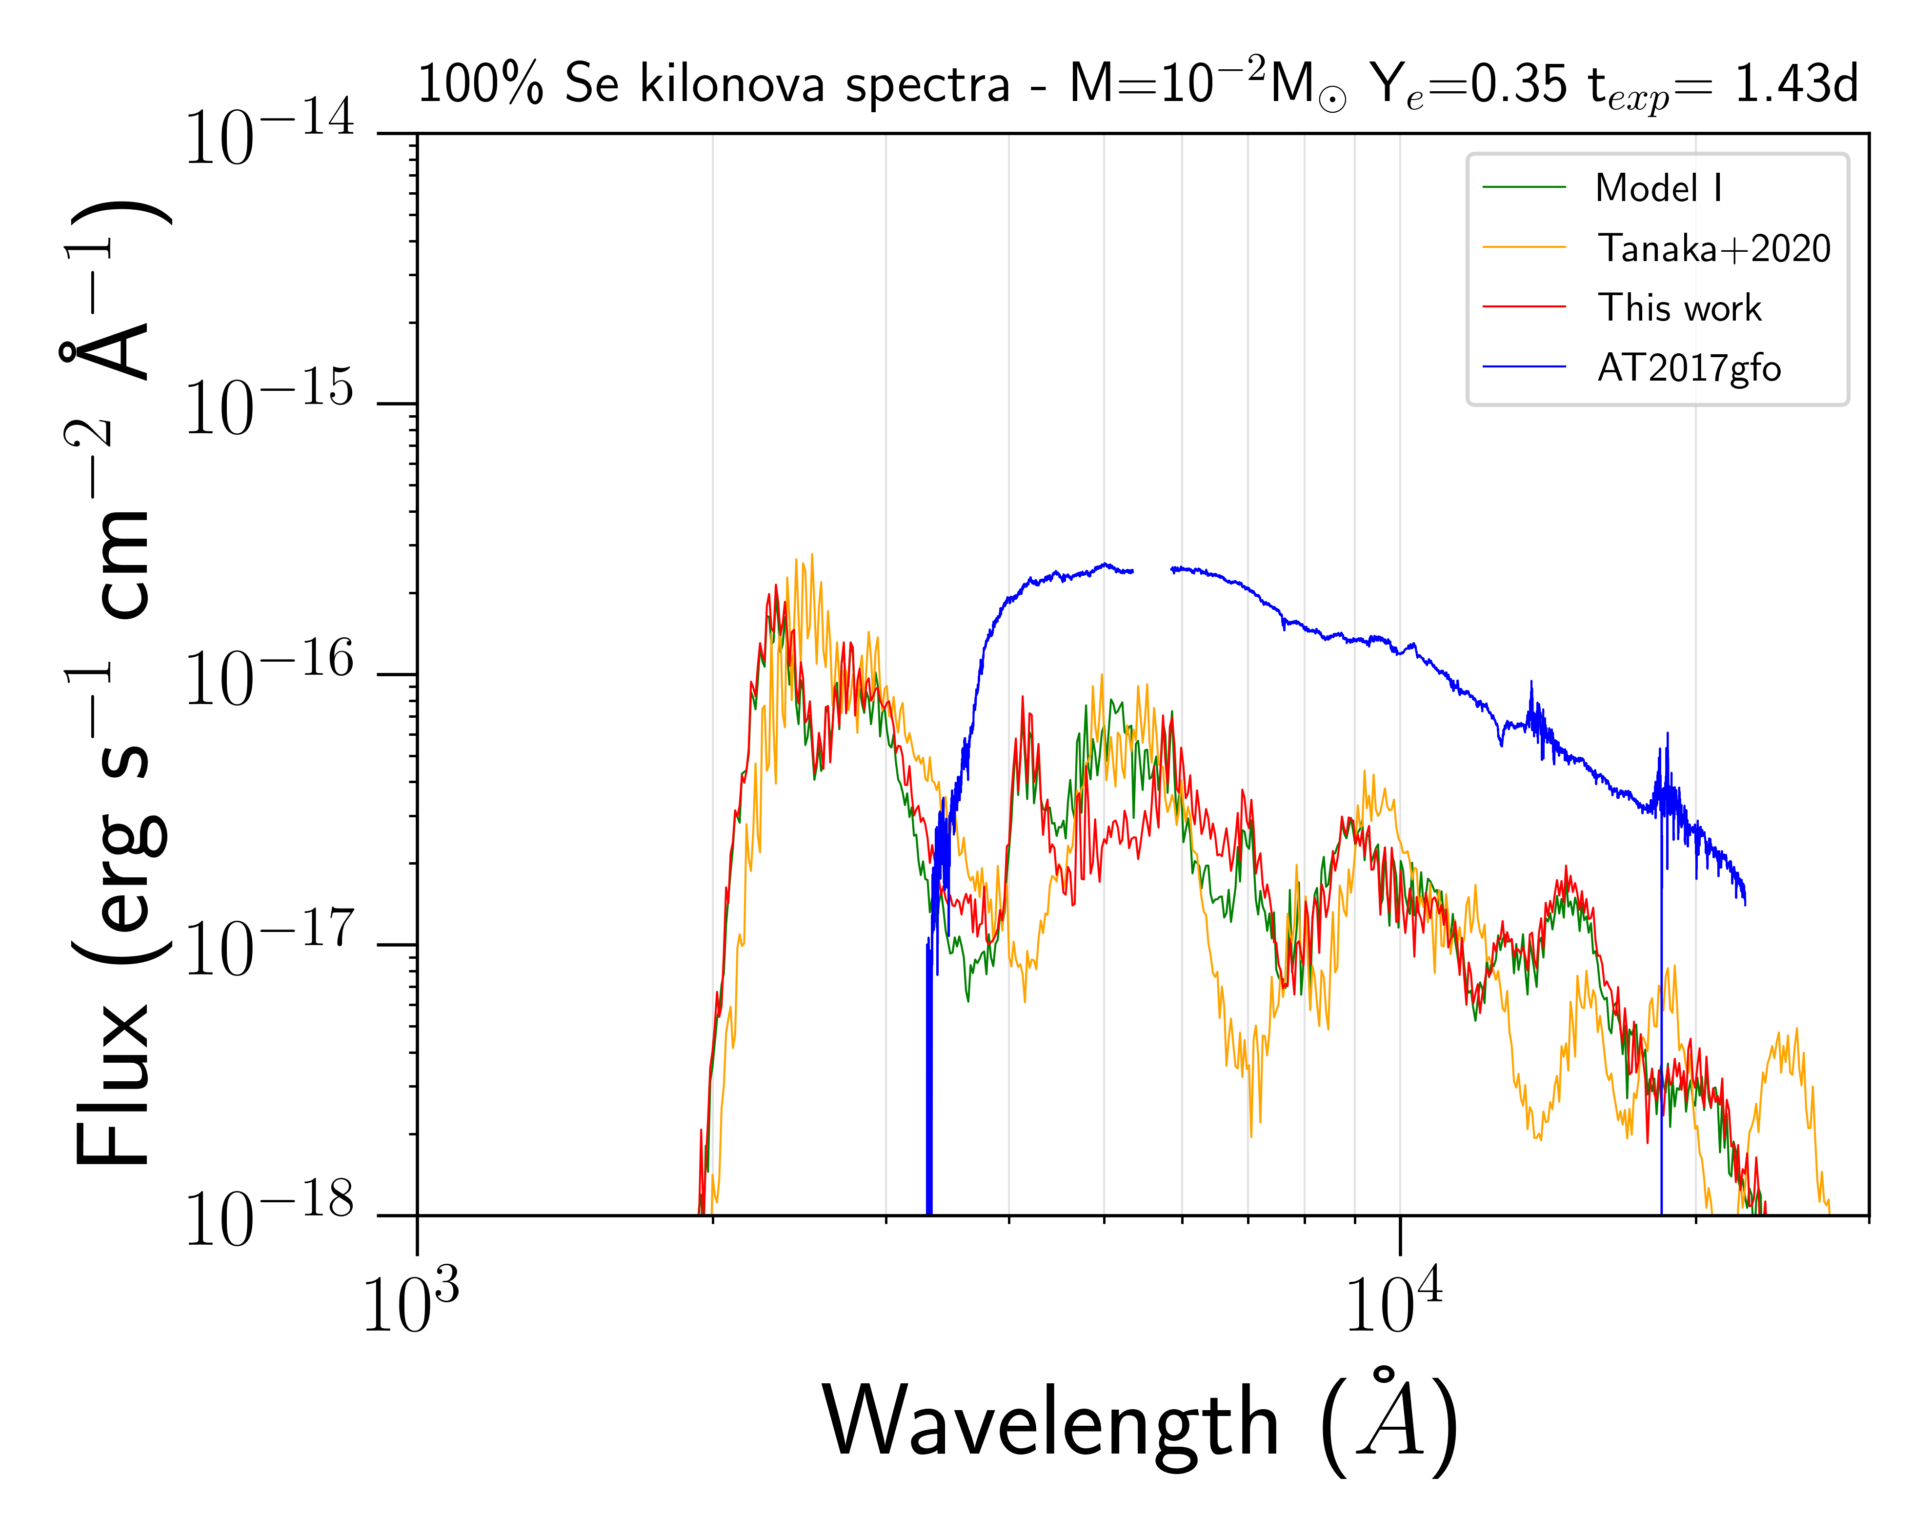
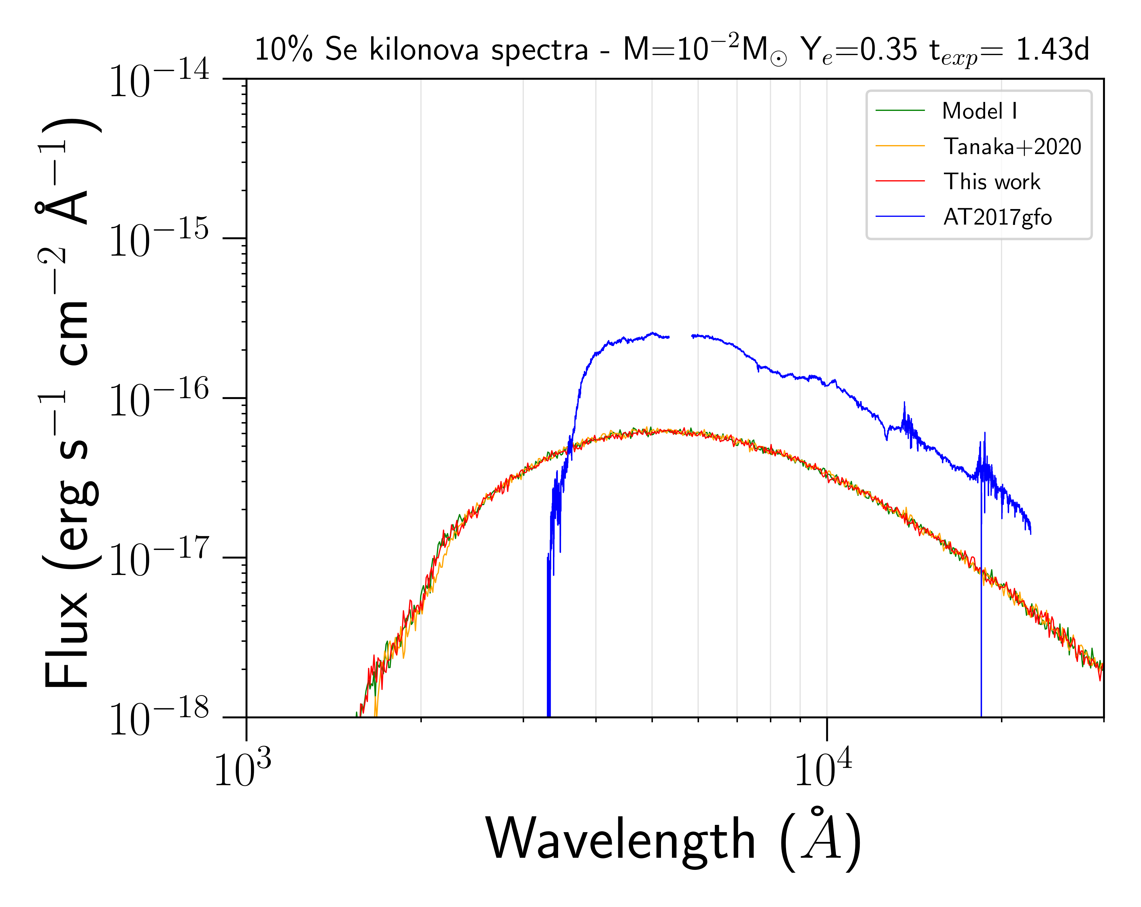
KN spectrum analysis - t = 1.43d
The results presented in red will be soon available in the paper Bezmalinovich M. et.al, in prep. 2025

Slide 32
The MARTINI platform

Slide 33
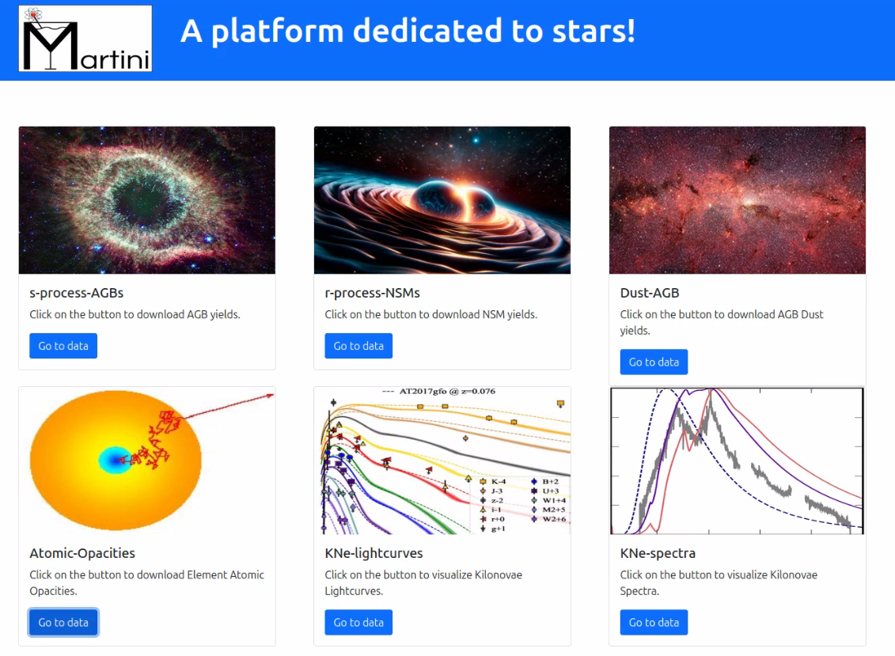
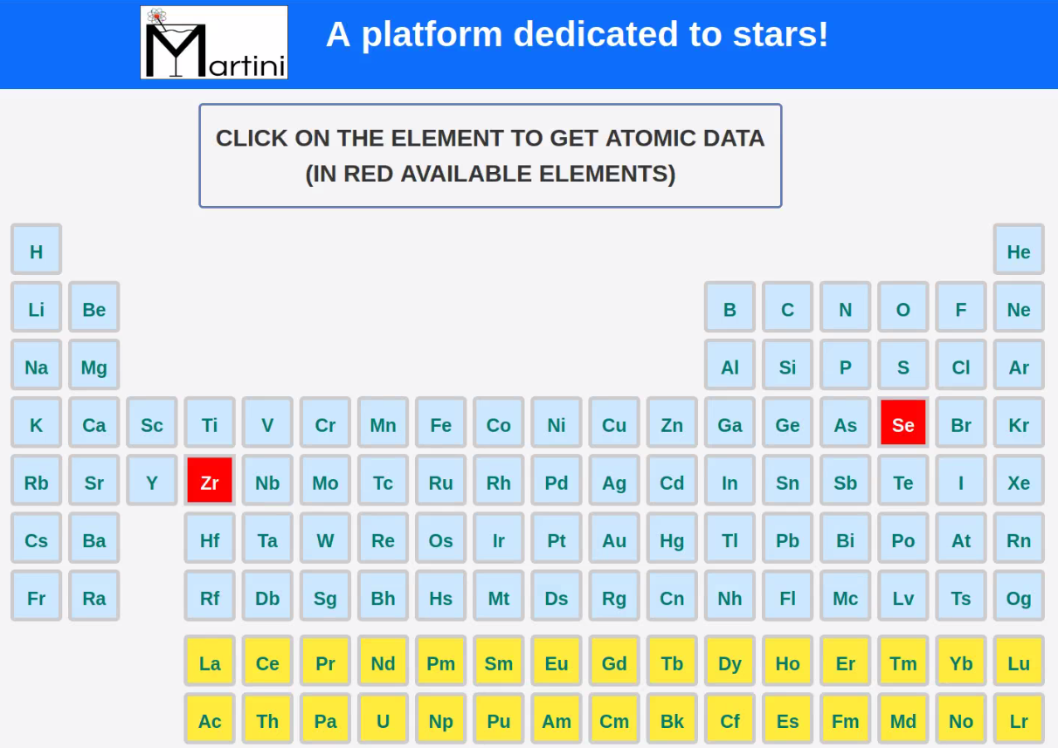
The MARTINI platform
Every quantity, from atomic data to spectra will be reported inside the database
Select the astrophysical content of interest

Slide 34
The MARTINI platform
Every quantity, from atomic data to spectra will be reported inside the database
Select the astrophysical content of interest

Slide 35
The MARTINI platform - Se details

Slide 36
Conclusions
General overview
- A platform where store all our astrophysics data (Open Access)
- We developed the framework and the tools to calculate atomic data and expansion opacity
- Modelling the KN spectra and the light curves

Slide 37
Conclusions
General overview
- A platform where store all our data
- We developed the framework and the tools to calculate atomic data and expansion opacity
- Modelling the KN spectra and the light curves
Selenium case
- Improved Se atomic data from Se IV to Se X
- Accurate Se opacity and KN spectra
- No evident Se spectral features can be observed in a AT2017gfo-like KN

Slide 38
Future Perspectives
Analysis of the next early-stage peak elements starting from Zr (in progress)

Slide 39
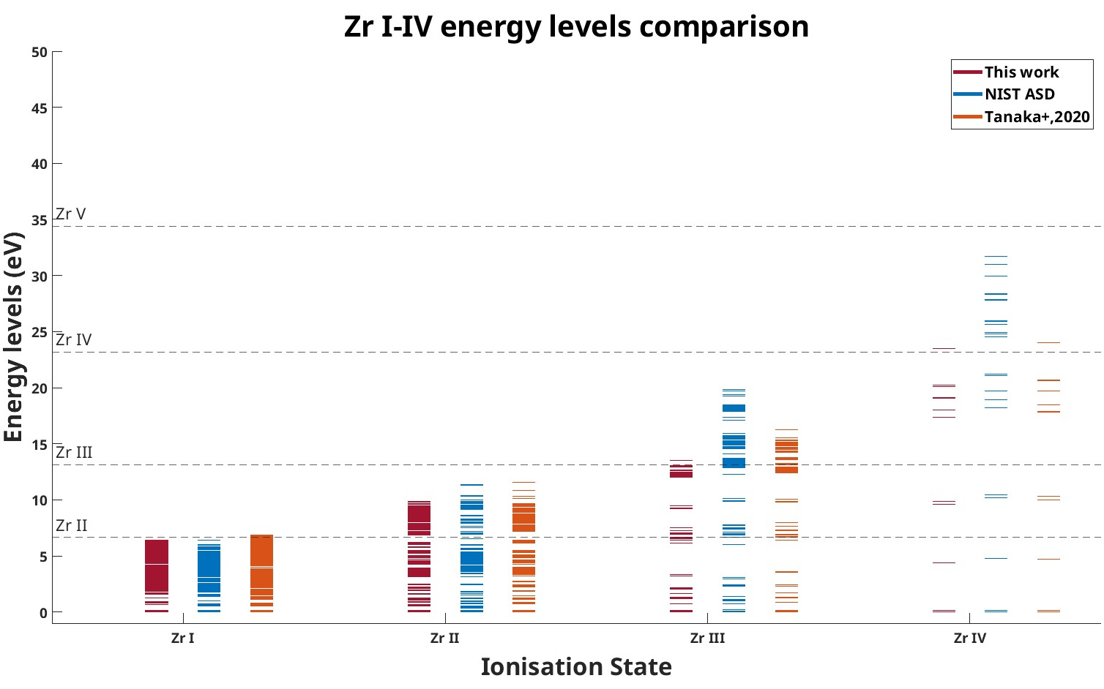
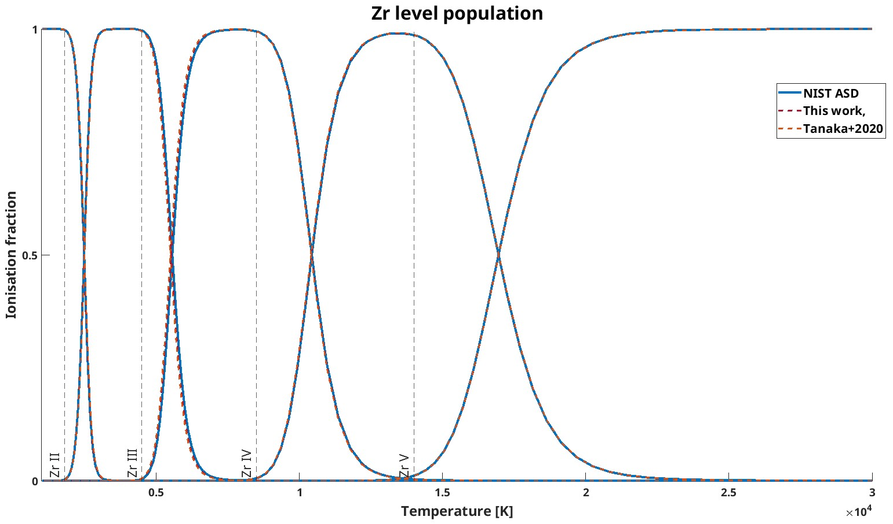
Future Perspectives
Analyse next early-stage peaks’ elements starting from Zr (in progress)

Slide 40
Extra contents

Slide 41
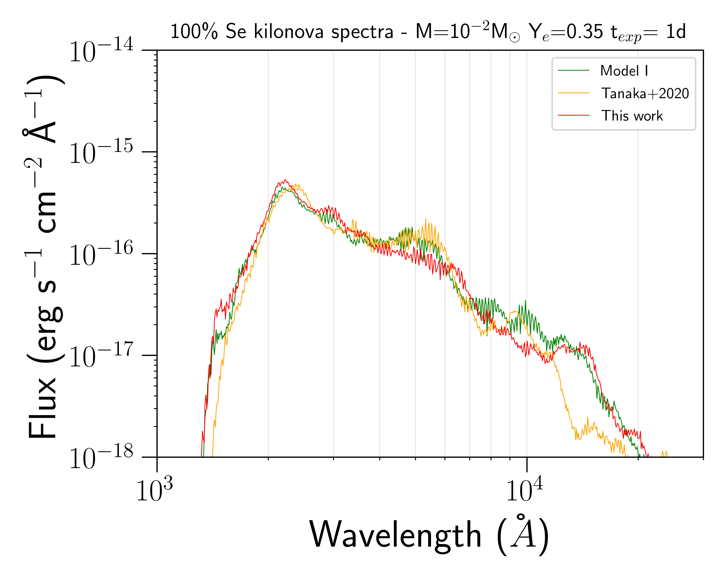
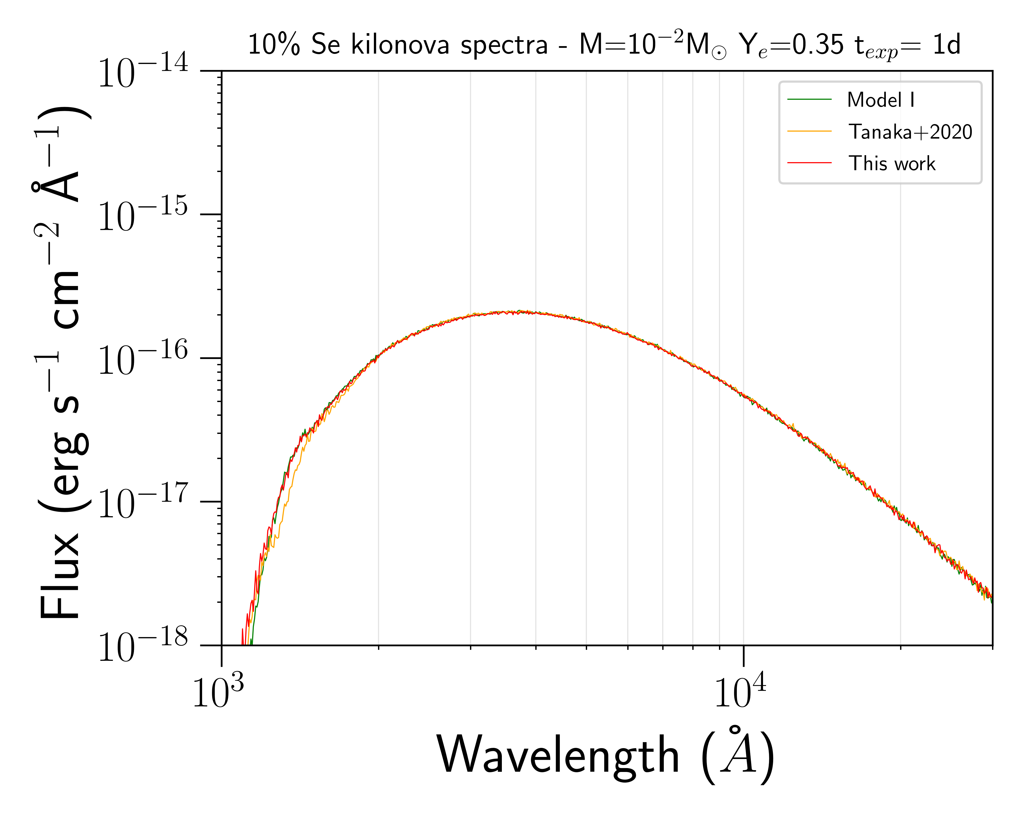
EXTRA - KN spectrum analysis - t = 1d
The results presented in red will be soon available in the paper Bezmalinovich M. et.al, in prep. 2025

Slide 42
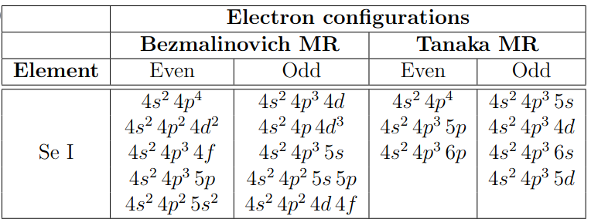
Extra - Se Electron Configurations
+2020
+2020
All the sets of electron configuratations respect the same symmetry
{5s,5p,4d,4f}

Slide 43
EXTRA – Atomic calculation strategy
Even and odd wave functions have been optimised separately
MR layer = {5s,5p,4d,4f} for all ionisation degree (both even and odd parity)
RCI
L1 = {6s,6p,5d,5f}
RCI strategy
L2 = {7s,7p,6d,6f}
L3 = {8s,8p,7d,7f}
RCI final layer = {8s,8p,7d,7f}

Slide 44
EXTRA – Atomic calculation strategy
Real case
Same n but different electron configuration
Different n
Standard case
Multi-configuration
4s²4p³6s¹
Excited state
n=6
4s²4p³5s¹
4s²4p³4d¹
4s²4p²4d²
n=5
4s²4p³4d¹
Transition
Excitation n-quantum number
Complex wave functions
n=4
n=4
Ground level
[Ar] 3d¹⁰4s²4p⁴
[Ar] 3d¹⁰4s²4p⁴
Dirac–Coulomb Hamiltonian
Selenium (Se) example
State wave function
Large expansion set of electron configurations (ECs) The final state will be a linear combination of the all possible lower/upper states of the transitions
Multi-configuration

