Slide 1
Control Software for Space instrumentation:
the INAF contribution
Anna Maria Di Giorgio
INAF IAPS

Slide 2



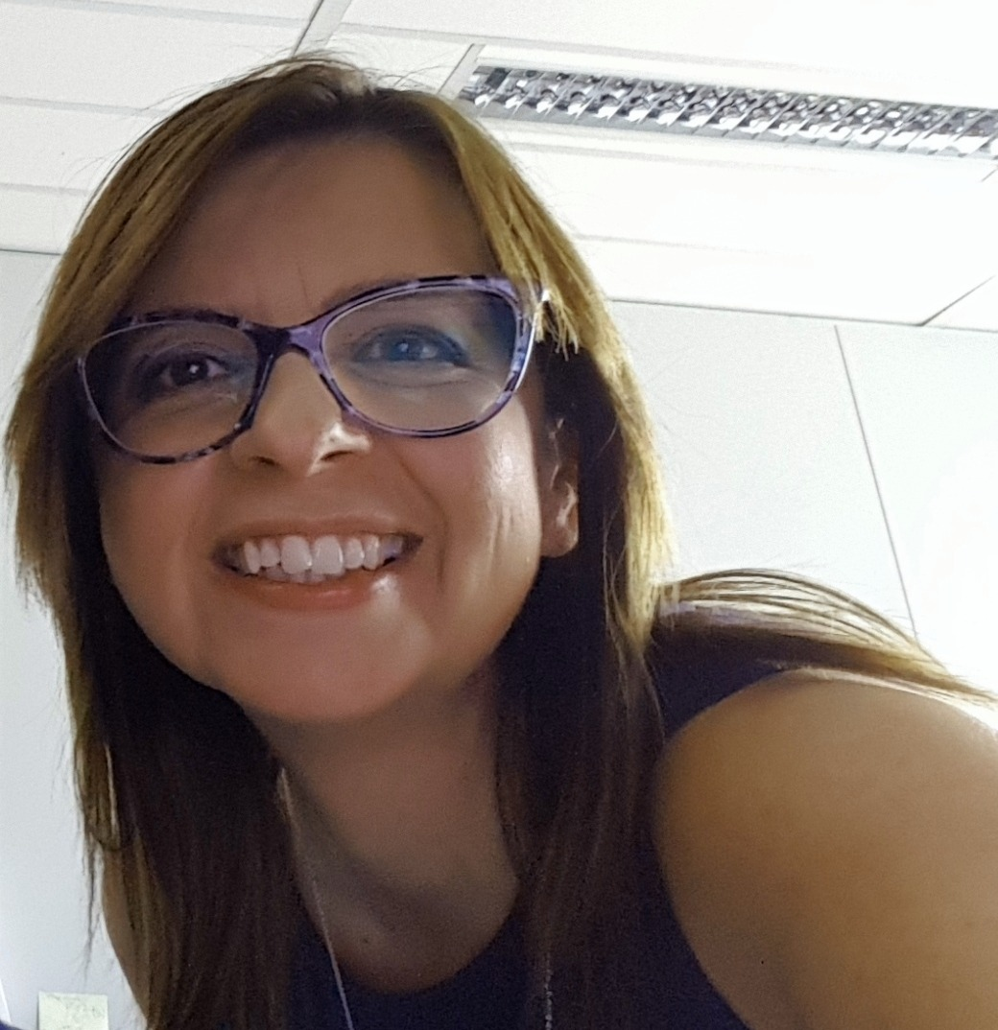



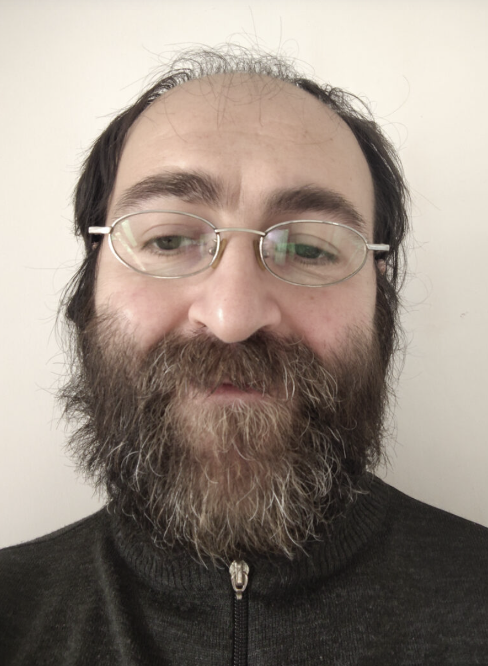
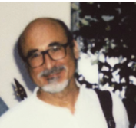

Control Software for Space instrumentation – key personnel
Giovanni Giusi
Maria Farina
J. Scige Liu
Vito Capobianco (TD)
Andrea Russi (TD)
Anna Maria Di Giorgio
Sebastiano Ligori
Eduardo Medinaceli
Donata Bonino
Leonardo Corcione

Slide 3
Space missions payload control SW: ASI and INAF
At payload instruments level, in the past decade ASI put a particular effort in supporting the production of instrument control systems, thus allowing Italy to gain a leading role in this field → The involved Italian industries acquired an expertise that today allows them to compete at the same level of all the other major European companies.
Analogously, within the European Research Institutes Consortia providing payload instrumentation, the Italian Research Institutes can today be considered as the reference partners for the production of the payload control and data handling software.

Slide 4
Space instrument control systems - characteristics
Rad Hard
Low power consumption
Small volume
Low mass
Real time operative systems
Deterministic
Capability to operate autonomously
ESA SW development standards (on items and processes)

Slide 5
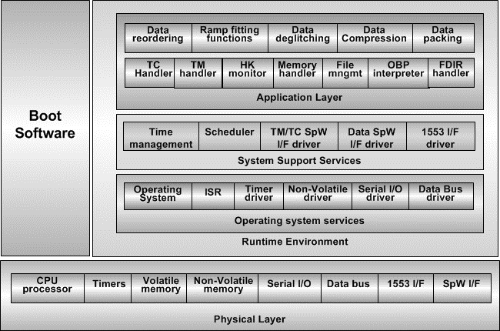
Space Control Systems Components
Experience with the main flight qualified fault tolerant processors:
                DSP21020 (Herschel), LEON (Euclid, PLATO, ARIEL, Athena), PowerPC 750FX (Euclid), ARM Cortex-A.
Experience with the MIL 1553 STD B avionic standard for the TM/TC I/F (Herschel and Euclid)
Experience with SpaceWire networks (Euclid, PLATO, ARIEL)
Experience with CAN bus and RS422 (Herschel, CSES)

Slide 6
Space Control Systems Components
Processor | Clock frequency | MFLOPS | MIPS | Power dissipation
DSP 21020 | 20MHz | 40 | 20 | 4
LEON3FT | 25MHz | 4 | 20 | 0.5W
SCS750 (PPC) | 400-800MHz |  | 200-1800 | 7 - 30W
GR740 quad core | 250 MHz | 1GFLOP | 1000 | <5W
Experience with the main flight qualified fault tolerant processors:
                DSP21020 (Herschel), LEON (Euclid, PLATO, ARIEL), PowerPC 750FX (Euclid), ARM Cortex-A.
Experience with the MIL 1553 STD B avionic standard for the TM/TC I/F (Herschel and Euclid)
Experience with SpaceWire
networks (Euclid, PLATO, ARIEL)
Experience with CAN bus and RS422
(Herschel, CSES)

Slide 7
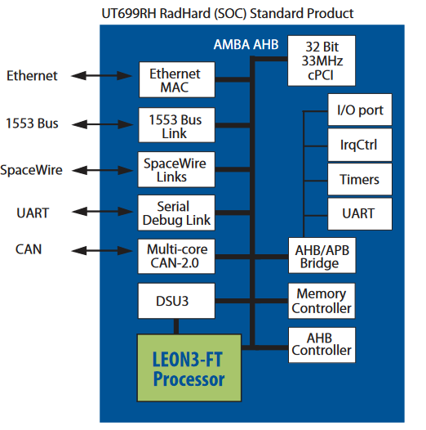
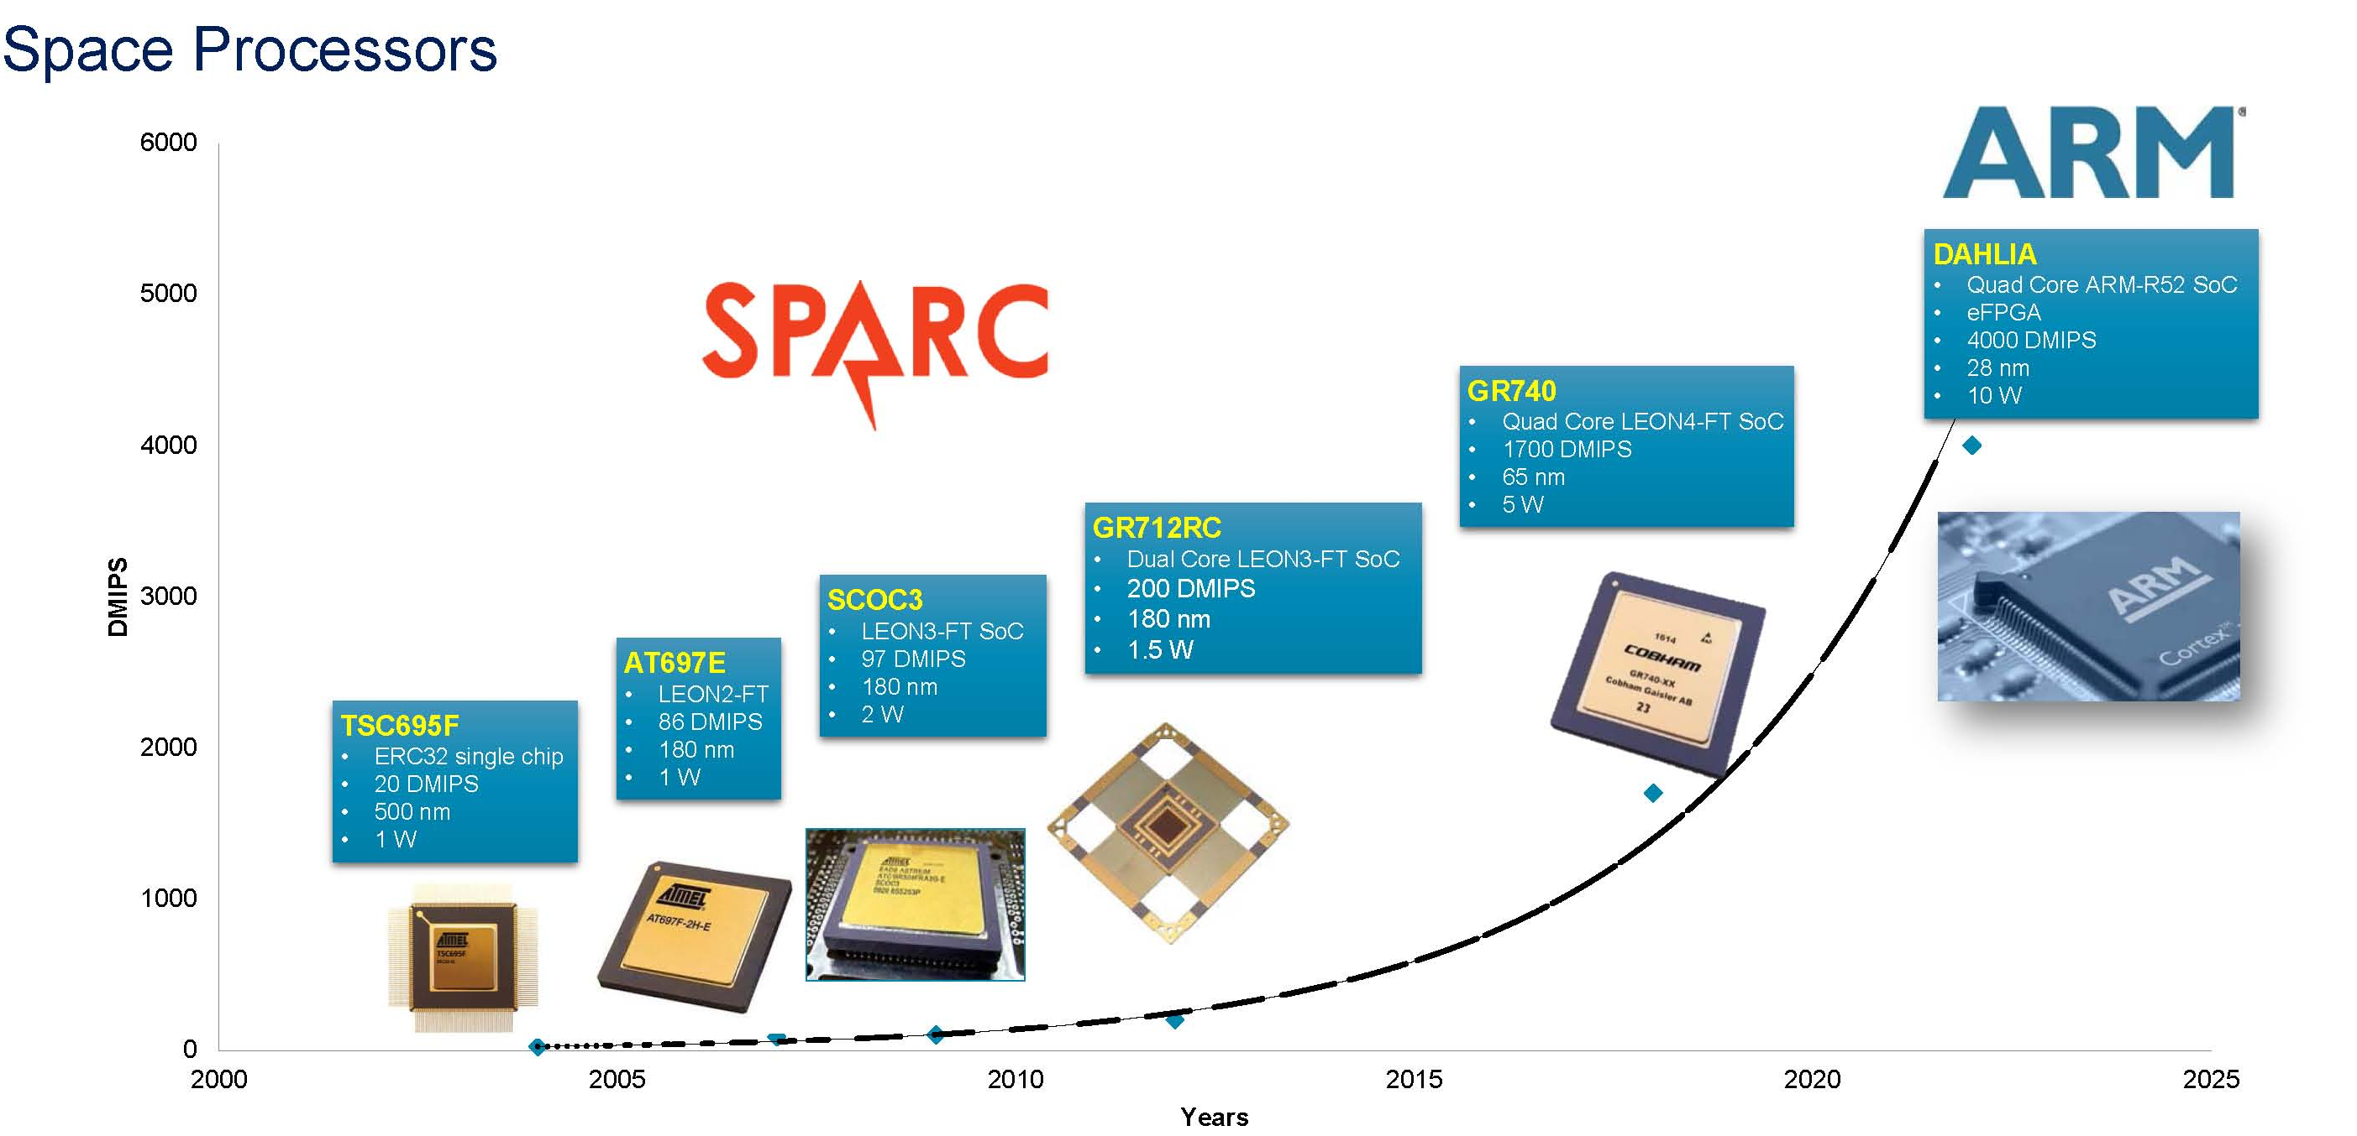
Space Processors - LEON
SPARC V8 processor developed by Gaisler Research: it is a synthesizable processor core for embedded applications.
The LEON3 processor is part of the GRLIB package that is under continuous growth. On Board processor for many ESA missions in study phase (PLATO, ARIEL, ATHENA )

Slide 8
Space Processors - LEON
4 x LEON4 fault tolerant CPU:s16 KiB L1 instruction cache
16 KiB L1 data cache
Memory Management Unit (MMU)
IEEE-754 Floating Point Unit (FPU)
Integer multiply and divide unit.
MiBLevel-2 cache shared between the 4 LEON4 cores
System clock (CPU:s, L2Cache, on-chip buses)
Nominal frequency is 250 MHz, generated by PLL from external 50 MHz clock
Full temp range (-40 to +125 )
4 CPUs - 250 MHz - 1000DMIPS
Communication Interfaces:
8-port Spacewirerouter with on-chip LVDS
2 x 1Gbit/100Mbit Ethernet MAC
PCI master/target with DMA, 33 MHz
Dual-redundant CAN
MIL-STD-1553B interface (bus A/B)
2 x UART
16 x GPIO
SPARC V8 processor developed by Gaisler Research: it is a synthesizable processor core for embedded applications.
The LEON3 processor is part of the GRLIB package that is under continuous growth. On Board processor for many ESA missions in study phase (PLATO, ARIEL, ATHENA )

Slide 9
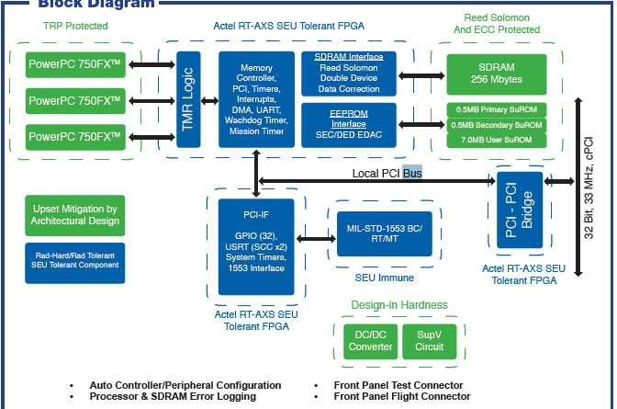
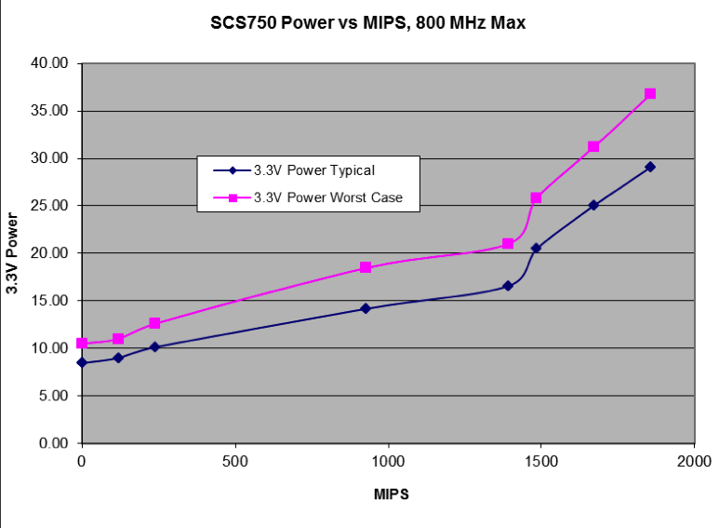
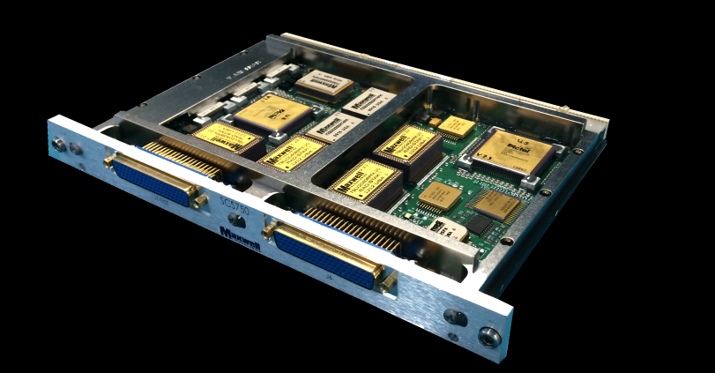
Space Processors – SCS750 (rad-hard PowerPC)
3 FULLY TMR PROTECTED PROCESSORS PowerPC 750FXTM
• > 1800 Dhrystone MIPS @ 800MHz
• 400 to 800MHz - Software selectable core clock rate
• 256 MByte SDRAM
• 8 MByte EEPROM - ECC protected
  7.0 MByte EEPROM available to user
  0.5 MByte Primary SuROM –
  0.5 MByte Secondary SuROM
Extremely expensive
ITAR protected
Used on GAIA, Euclid

Slide 10
Space Control Systems Components
Experience with the main flight qualified fault tolerant processors:
                DSP21020 (Herschel), LEON (Euclid, PLATO, ARIEL), PowerPC 750FX (Euclid), ARM Cortex-A.
Experience with the MIL 1553 STD B avionic standard for the TM/TC I/F (Herschel and Euclid)
Experience with SpaceWire
networks (Euclid, PLATO, ARIEL)
Experience with CAN bus and RS422
(Herschel, CSES)

Slide 11
Interfaces - SpaceWire Standard
The standard ECSS-E-ST-0-12C (first definition Jan 2003) can be downloaded from http://spacewire.esa.int
Based on LVDS the standard provides prescriptions for :
Physical Level provides connectors, cables and EMC specifications
Signal Level defines signal encoding, voltage levels, noise margins and data rates
Character Level specifies the data and control characters used to manage the data flow
Exchange Level covers the protocol for link initialization, flow control, fault detection and link restart
Packet Level details how a message is delivered from a source node to a destination node
SpaceWire for Space
SpaceWire is supported by several radiation tolerant ASICs designed for ESA, NASA and JAXA. Current radiation tolerant devices are capable of up to 200 Mbits/s data signalling rate with a data-rate of 160 Mbits/s per link or 152 Mbits/s bi-directional per link.
New Standard High Level Protocols under study to allow for a “deterministic” use of SpaceWire Networks
Presently used in SOLO, Euclid (link to MMU and data transfer inside the DPU), PLATO, Bepi Colombo (S/C network), ARIEL, ATHENA

Slide 12
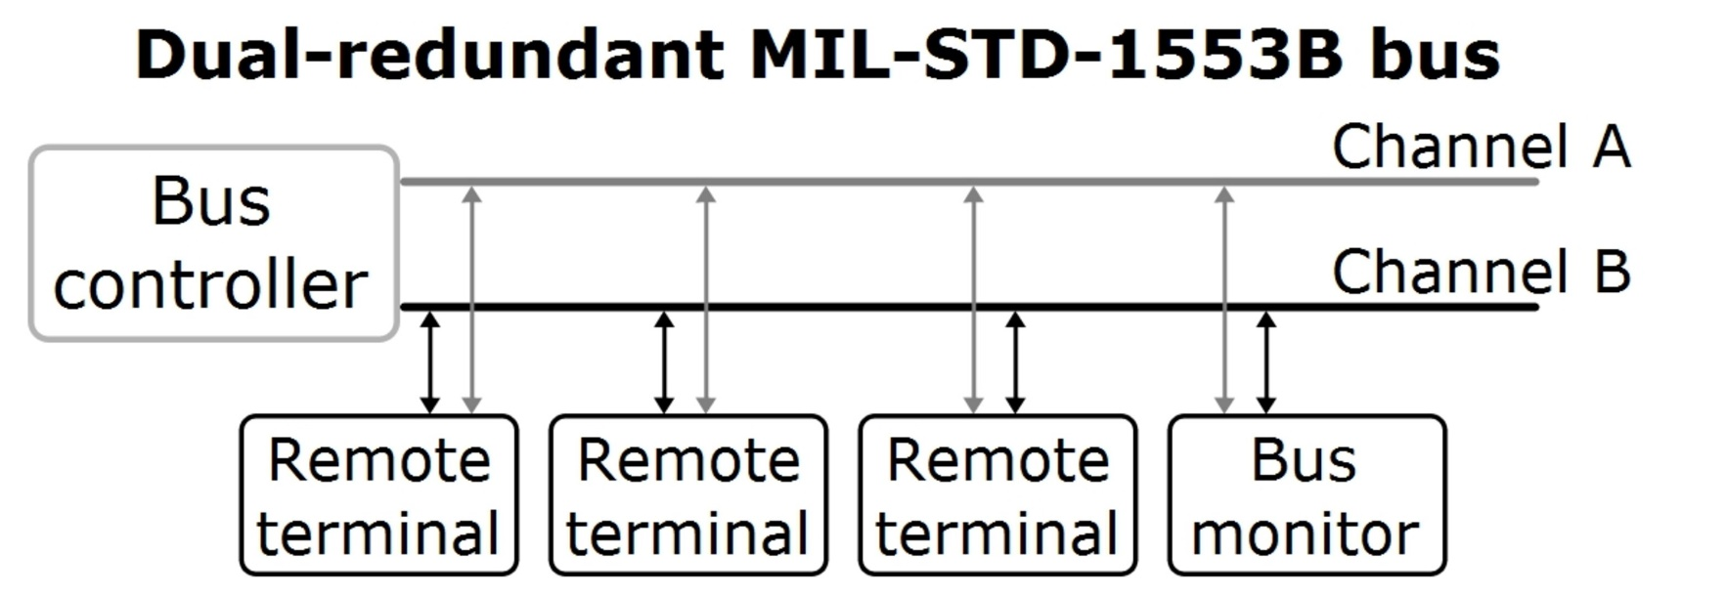
Interfaces – MIL-STD-1553 Standard
- First standard draft published by SAE in 1968
Mil-Std-1553A released in 1975 and the B version adopted in 1978.
military and aerospace applications (US Force, NATO, MoD, NASA ESA, etc).
the Bus is a terminated transmission line based on a twisted and shielded pair cable, Bus controller and the Remote terminals are connected to the line through stubs and couplers
Bus data rate: 1 Mbits/s
dual standby redundant architecture.
MIL-STD-1553 defines three types of bus users, called terminals: Bus Controller (BC), Remote Terminal (RT) and Bus Monitor (BM). The transaction on the bus is of type Command/Response. The BC acts as the master and initiates all the transactions. The RTs, commanded by the BC, provide the interface between 1553 bus and the relevant unit/sub-system. The BM is passive and record the bus traffic.
Currently used on the International Space Station (ISS) and in many other European and ESA spacecraft like Ariane 5, VEGA, Sentinels, IXV, Bepi Colombo, GAIA, Gallileo, SmallGeo, ATV, Euclid, etc.
ESA issued the ECSS-E-50-13C standard

Slide 13
Space Control Systems Components
Experience with space qualified RTOS (Virtuoso, VxWorks, RTEMS, FreeRTOS)

Slide 14
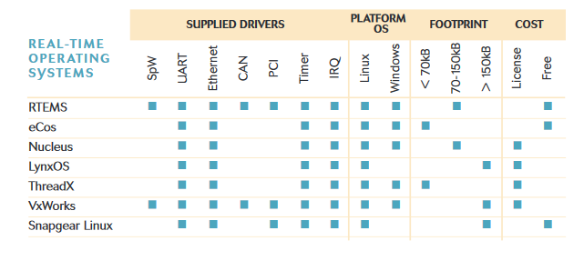
Space Control Systems Components
Experience with space qualified RTOS (Virtuoso, VxWorks, RTEMS, FreeRTOS)

Slide 15
Space Control Systems Components
Real Time SW design and development
Experience with space qualified RTOS (Virtuoso, VxWorks, RTEMS)
  UML standard for software modeling
  Expertise in C, C++, Java, Python programming
  MISRA coding standards (Euclid, PLATO, ARIEL)
Deep Knowledge of ESA ECSS standards and procedures
Experience with CCSDS standard lossless compression algorithms implementation and optimisation (Euclid)

Slide 16
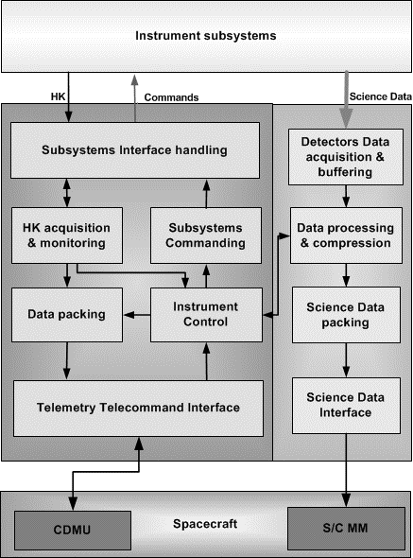
Space Instruments Control Software
Acceptance of instrument commands from CDMU;
Execution of predefined instrument command sequences;
Instrument health/status monitoring;
Implementation of pre-defined procedures on detection of instrument anomalies.
HK data acquisition and packetisation;
Science data acquisition, compression and packetisation;
Transmission of data (HK, events and TC verification) from the instrument to S/C CDMS;
Transmission of science data to the S/C MM.
Capability to load, via TCs, replacement and/or additional SW (patches, tables, ICSs, TBC);
Self test and SW verification facilities;
Possibility to load and dump part of CDPU memory;
Possibility to write and check EEPROM: possibility to inhibit these functions during flight operations

Slide 17
Space Instruments Control Software
Acceptance of instrument commands from CDMU;
Execution of predefined instrument command sequences;
Instrument health/status monitoring;
Implementation of pre-defined procedures on detection of instrument anomalies.
HK data acquisition and packetisation;
Science data acquisition, compression and packetisation;
Transmission of data (HK, events and TC verification) from the instrument to S/C CDMS;
Transmission of science data to the S/C MM.
Capability to load, via TCs, replacement and/or additional SW (patches, tables, ICSs, TBC);
Self test and SW verification facilities;
Possibility to load and dump part of CDPU memory;
Possibility to write and check EEPROM: possibility to inhibit these functions during flight operations
ESA Packets Utilization Standard - ECSS-E-ST-70-41C

Slide 18
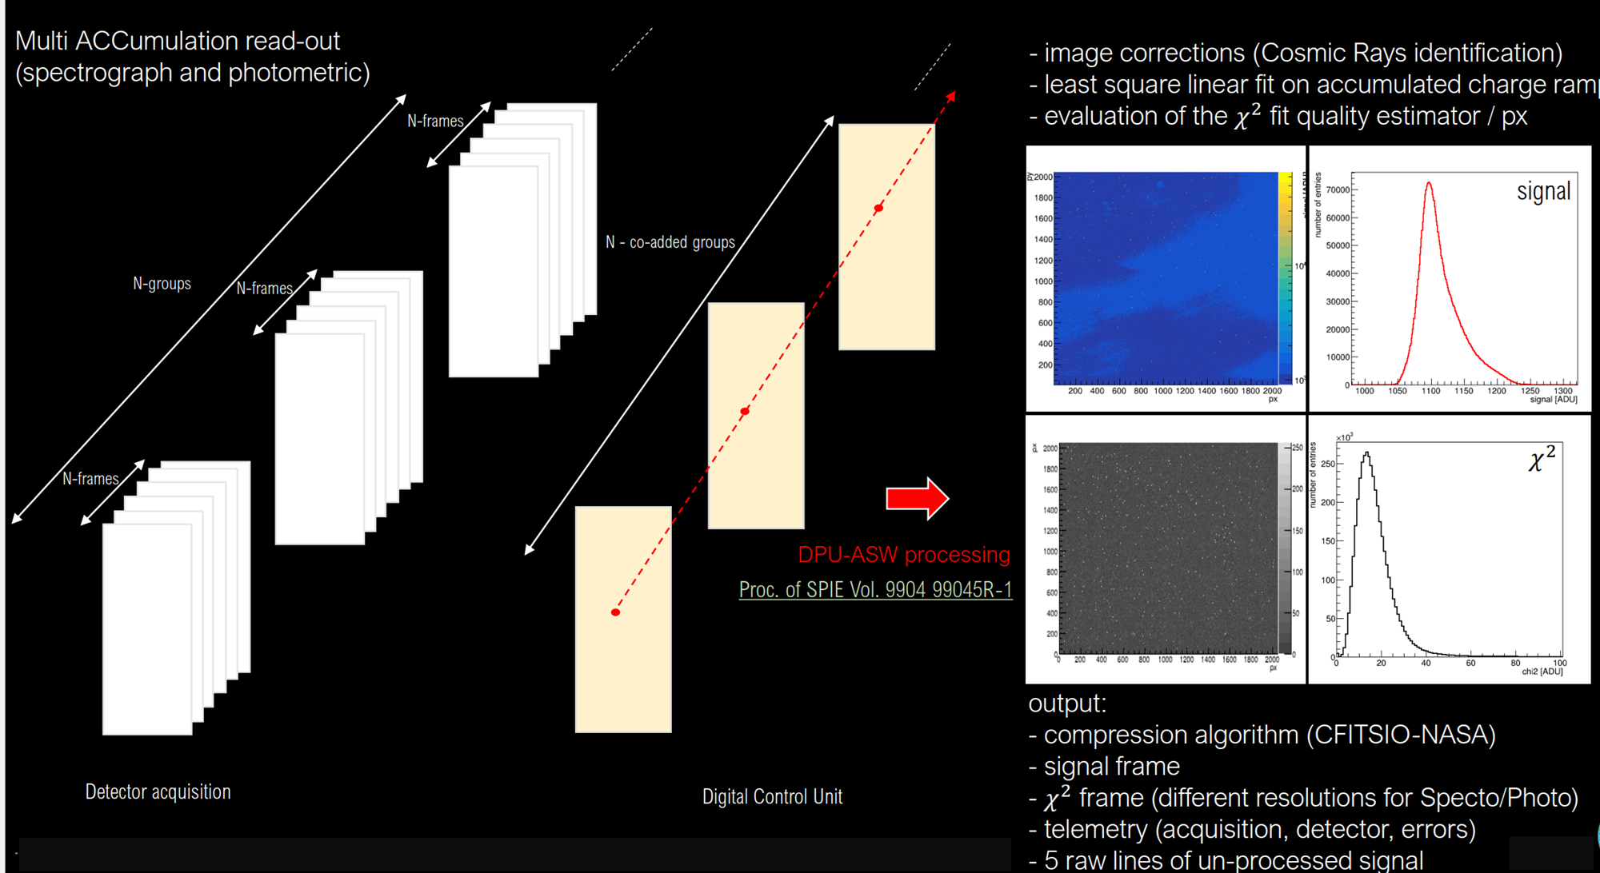
On-board data processing: the Euclid NISP DPU example

Slide 19
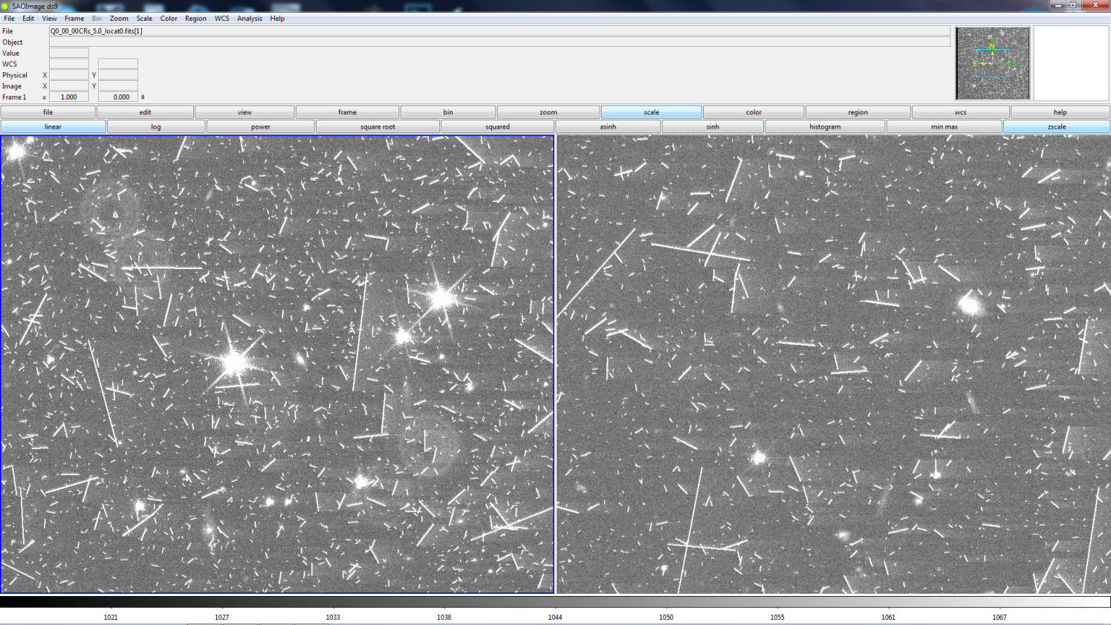
On-board data compression: the Euclid VIS CDPU example
Space qualified lossless compression algorithm: CCSDS121 (rice algorithm) that scans the image using a 1D-default prediction in the horizontal direction.
The algorithm has been slightly modified at IAPS to
Use in input a "box" of 4x4 pixels which allows to better exploit the two-dimensional correlations intrinsic to the considered images.
High Cosmic Ray High Star Density (left) and Low Cosmic Ray Low Star Density (right) simulated image quadrants
The implemented lossless compression allows to compress a 600Mpixel image in <300sec reaching an average compression ratio = 3

Slide 20
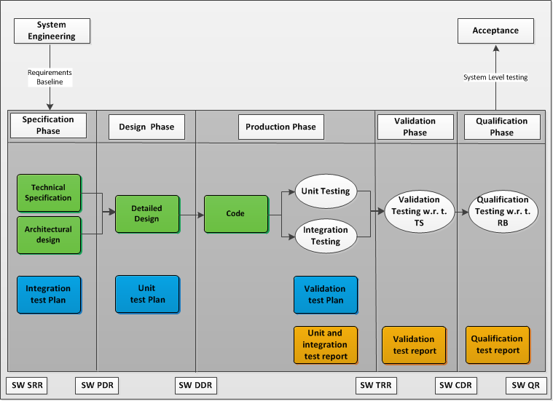
Incremental Life Cycle Model

Slide 21
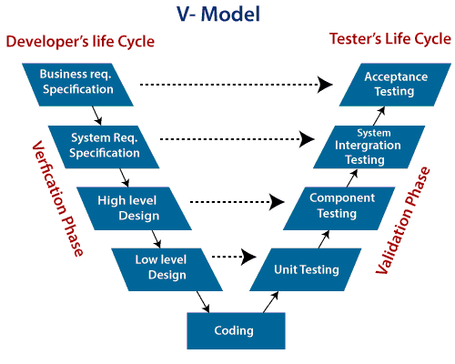
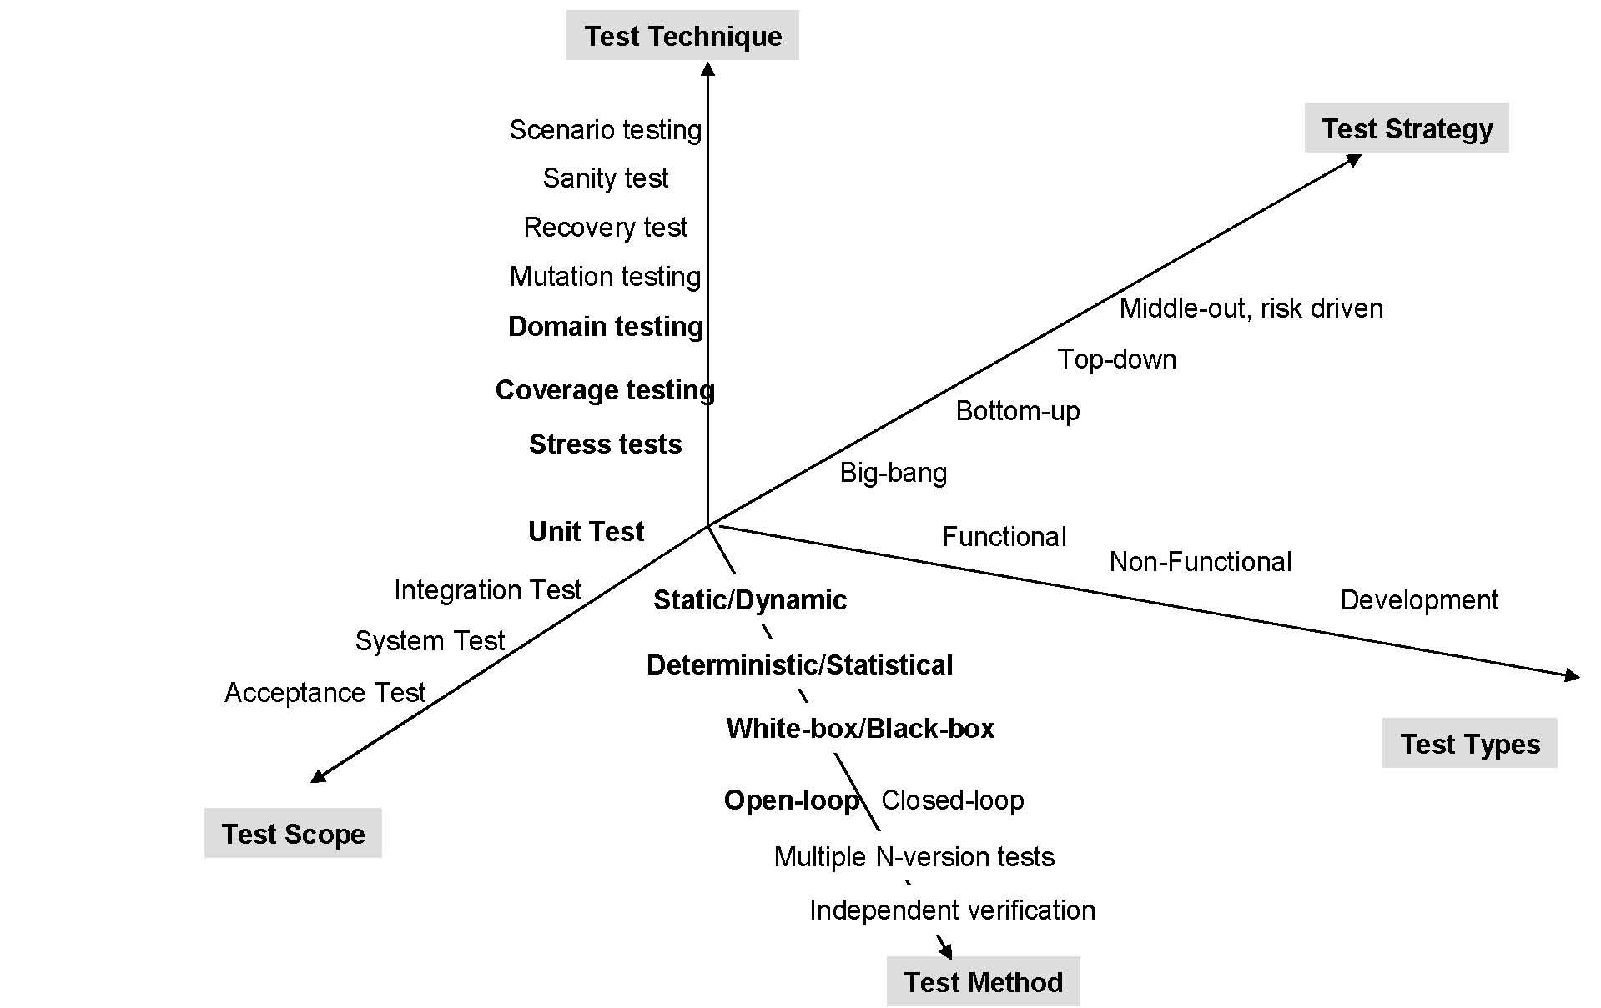
Space Control Systems Testing
Major Effort
Possible Collaborations

Slide 22
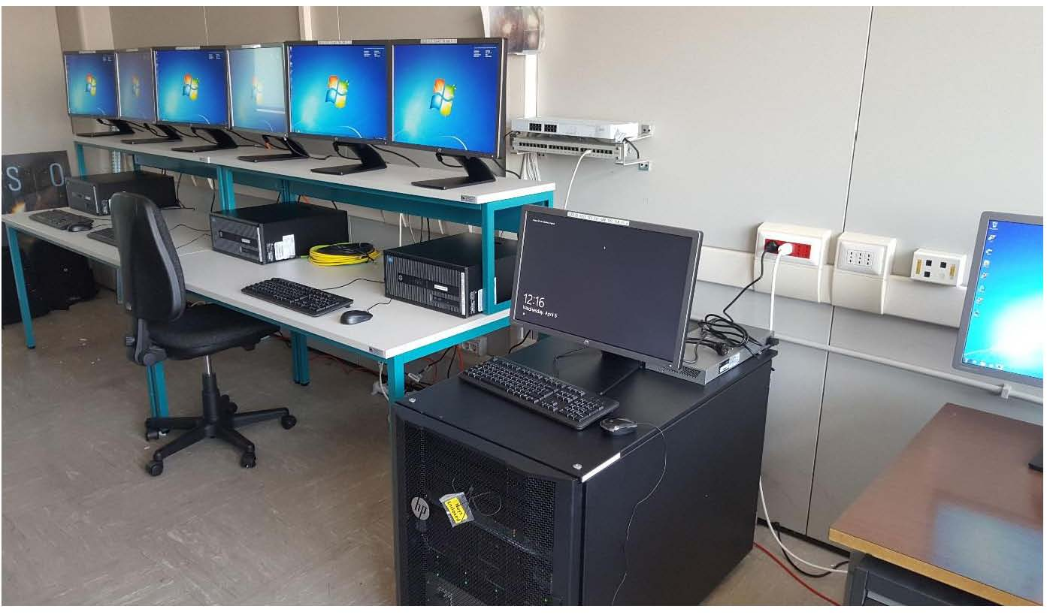

Space Instruments Control Software Validation and Testing – EGSE and CCS
EGSE
Instrument Control Electronics
Test Environment
S/C simulator
A/D signals
Data (SpW, 1553….)
Front End
CCS
CCS
Front End Controller
Procedures
MMI
Data Handler
LAN
TC/TM DB
Telemetry Telecommand packets Database
SCOS2000
Sci Data
MMI
TC/TM Log
Operator
Test Conductor
Observers
Analysts

Slide 23
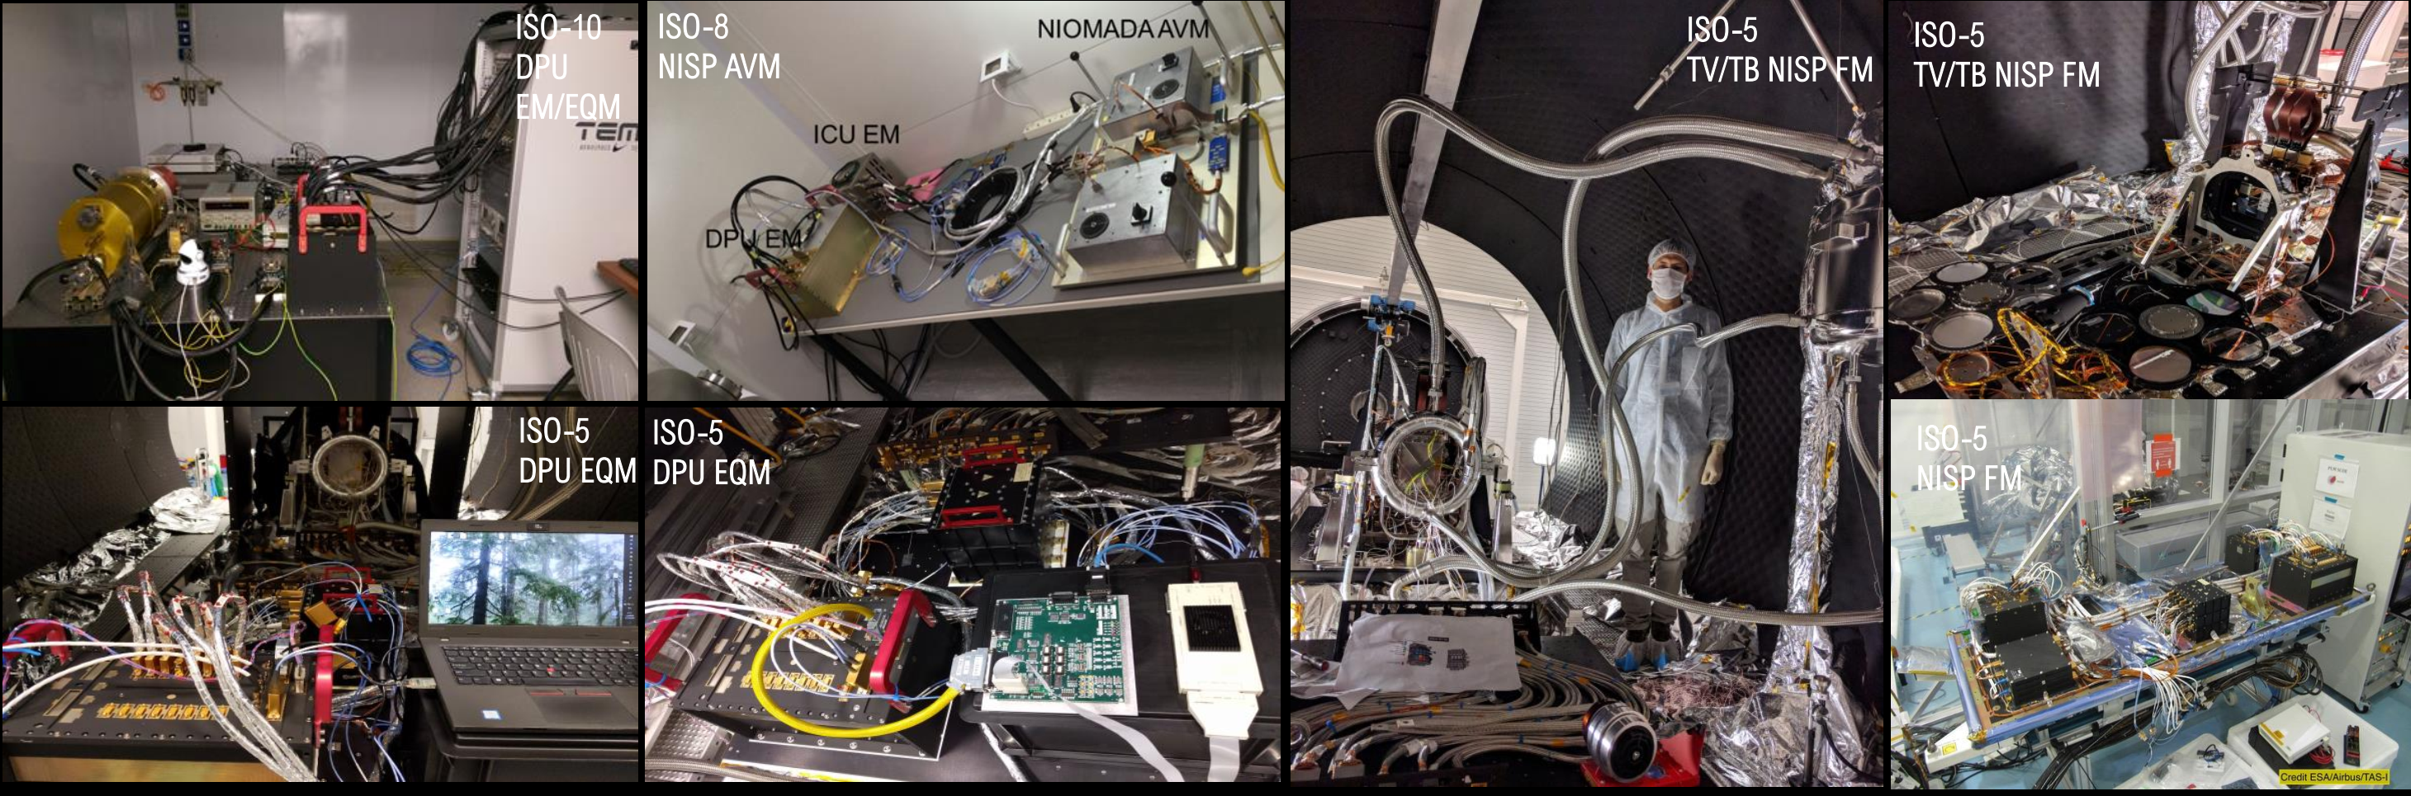
Space Instruments Control Software Validation and Testing: increasing complexity with mission phases Euclid’s NISP example

Slide 24
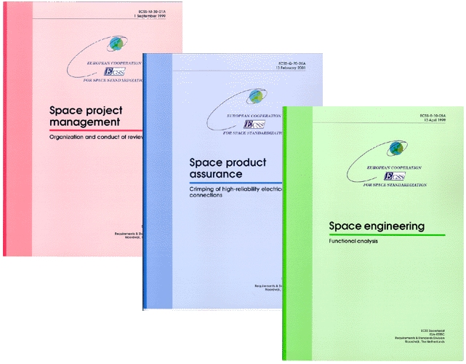
Space Instruments Control Software PA
Major Effort
Possible Collaborations

Slide 25
Plans for future developments
ESA Packet utilisation standard
homogeneize the library of PUS services already implemented at IAPS and OATO
+ use of new frameworks (e.g. Cordet)
Data compression:
develop a data compression functions library
An implementation of RTEMS OS and SpaceWire interface abstraction functions already available at IAPS.

Slide 26
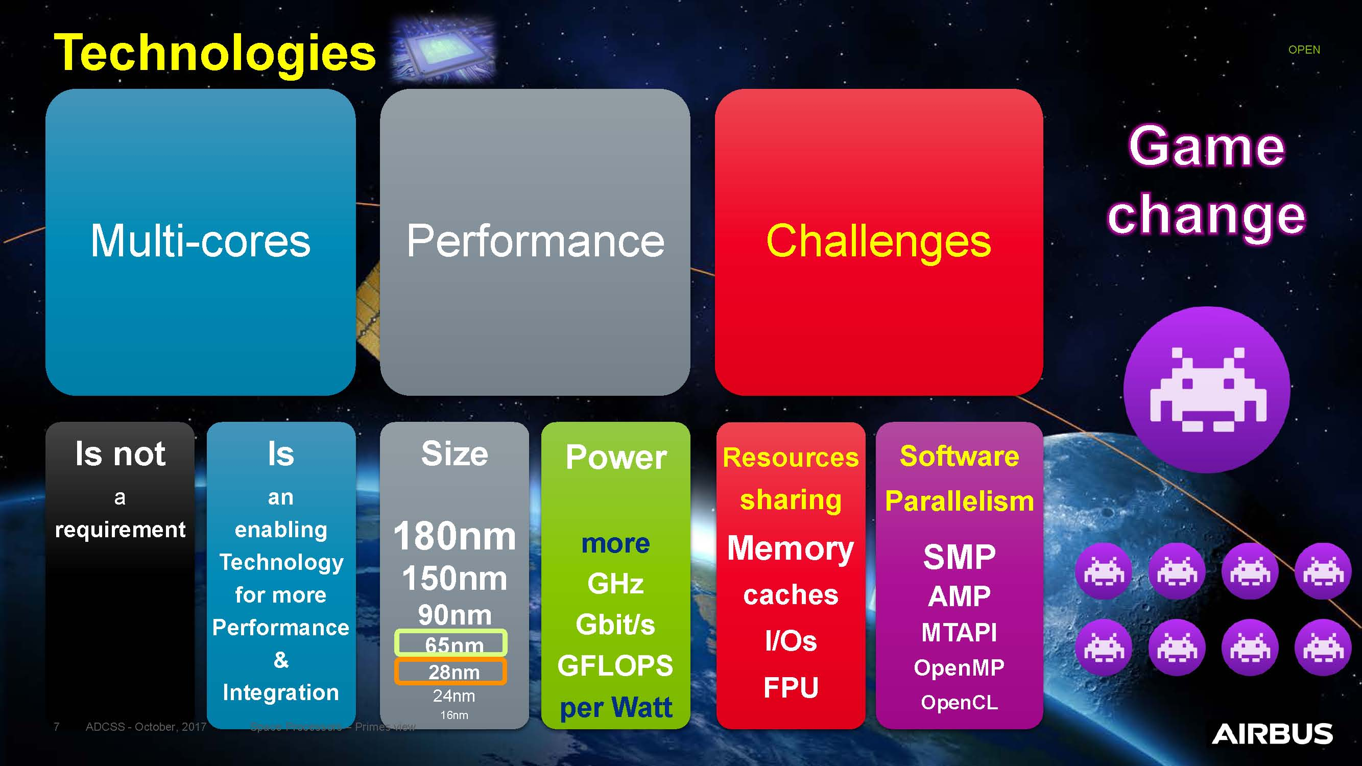

Plans for future developments
It will be not possible any more to face what technology is expected to provide within small INAF groups.
New collaborations with other INAF experts are necessary and welcome

