Slide 1

Italian Initiatives for
Open Science
Mario Locati
INGV Data Management Office

Slide 2
Index
Key elements of Open Science
European Union strategy on Open Science
Italian initiatives in Open Science
Open Science at INGV

Slide 3
Definition(s) of Open Science
Scientific knowledge of all kinds should be openly shared as early as is practical
in the discovery process. This includes making research data and results freely available to the public and encouraging collaboration among scientists and
with the public. Michael Nielsen, Reinventing Discovery, 2011
Practice of science in such a way that others can collaborate and contribute,
where research data, lab notes and other research processes are freely available, under terms that enable reuse, redistribution and reproduction of the research and its underlying data and methods. EC Project Foster, 2017-2019
Open science is a set of principles and practices that aim to make scientific research from all fields accessible to everyone for the benefit of scientists and society as a whole. Not only scientific knowledge should be accessible, but also the production
of that knowledge itself is inclusive, equitable and sustainable. UNESCO, 2021

Slide 4
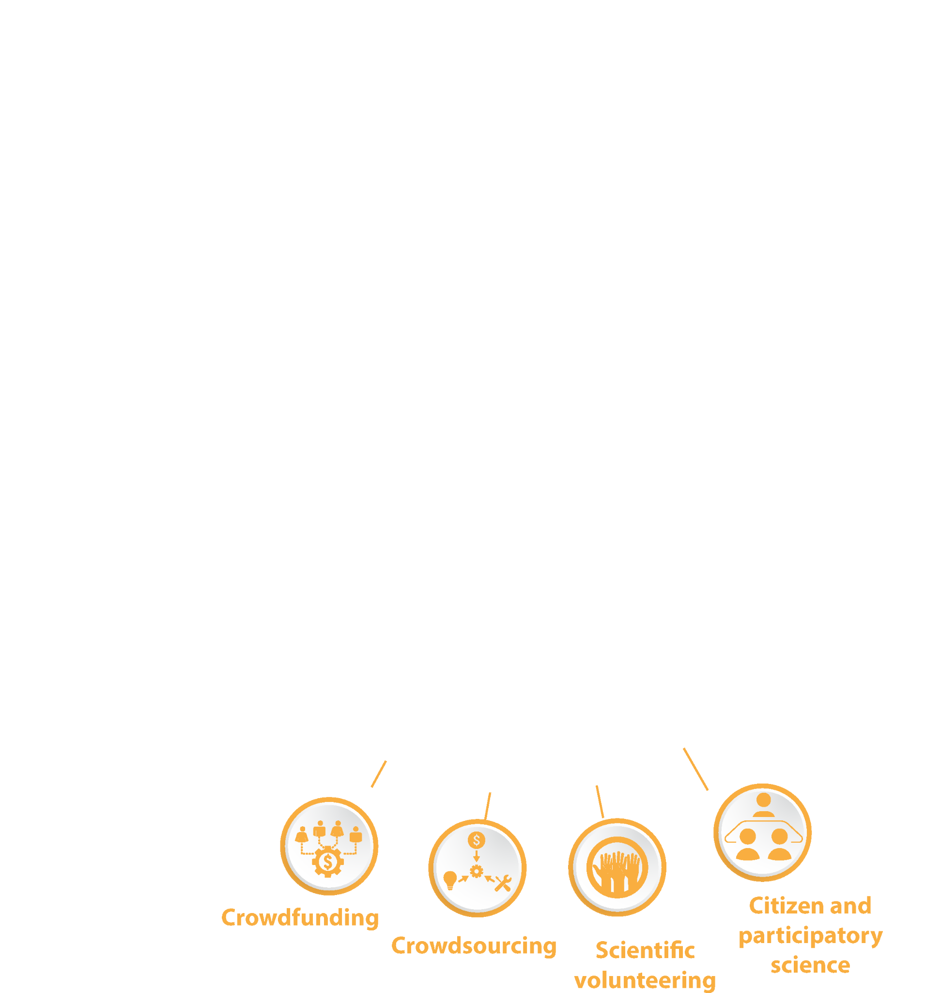

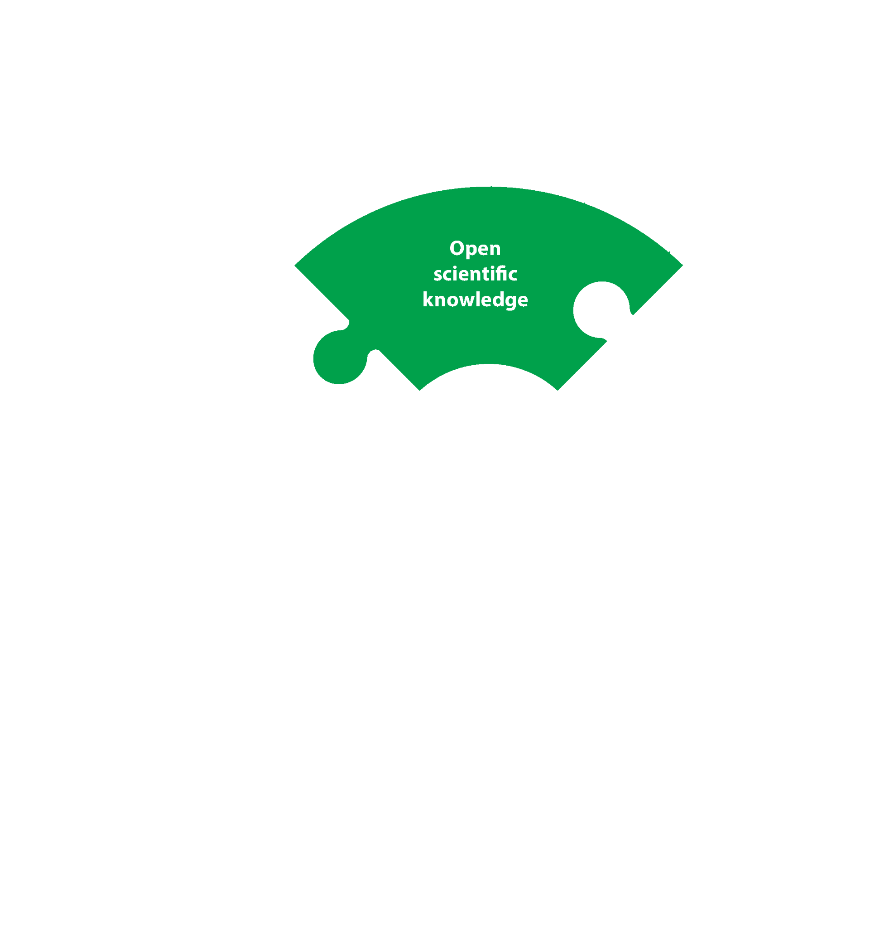



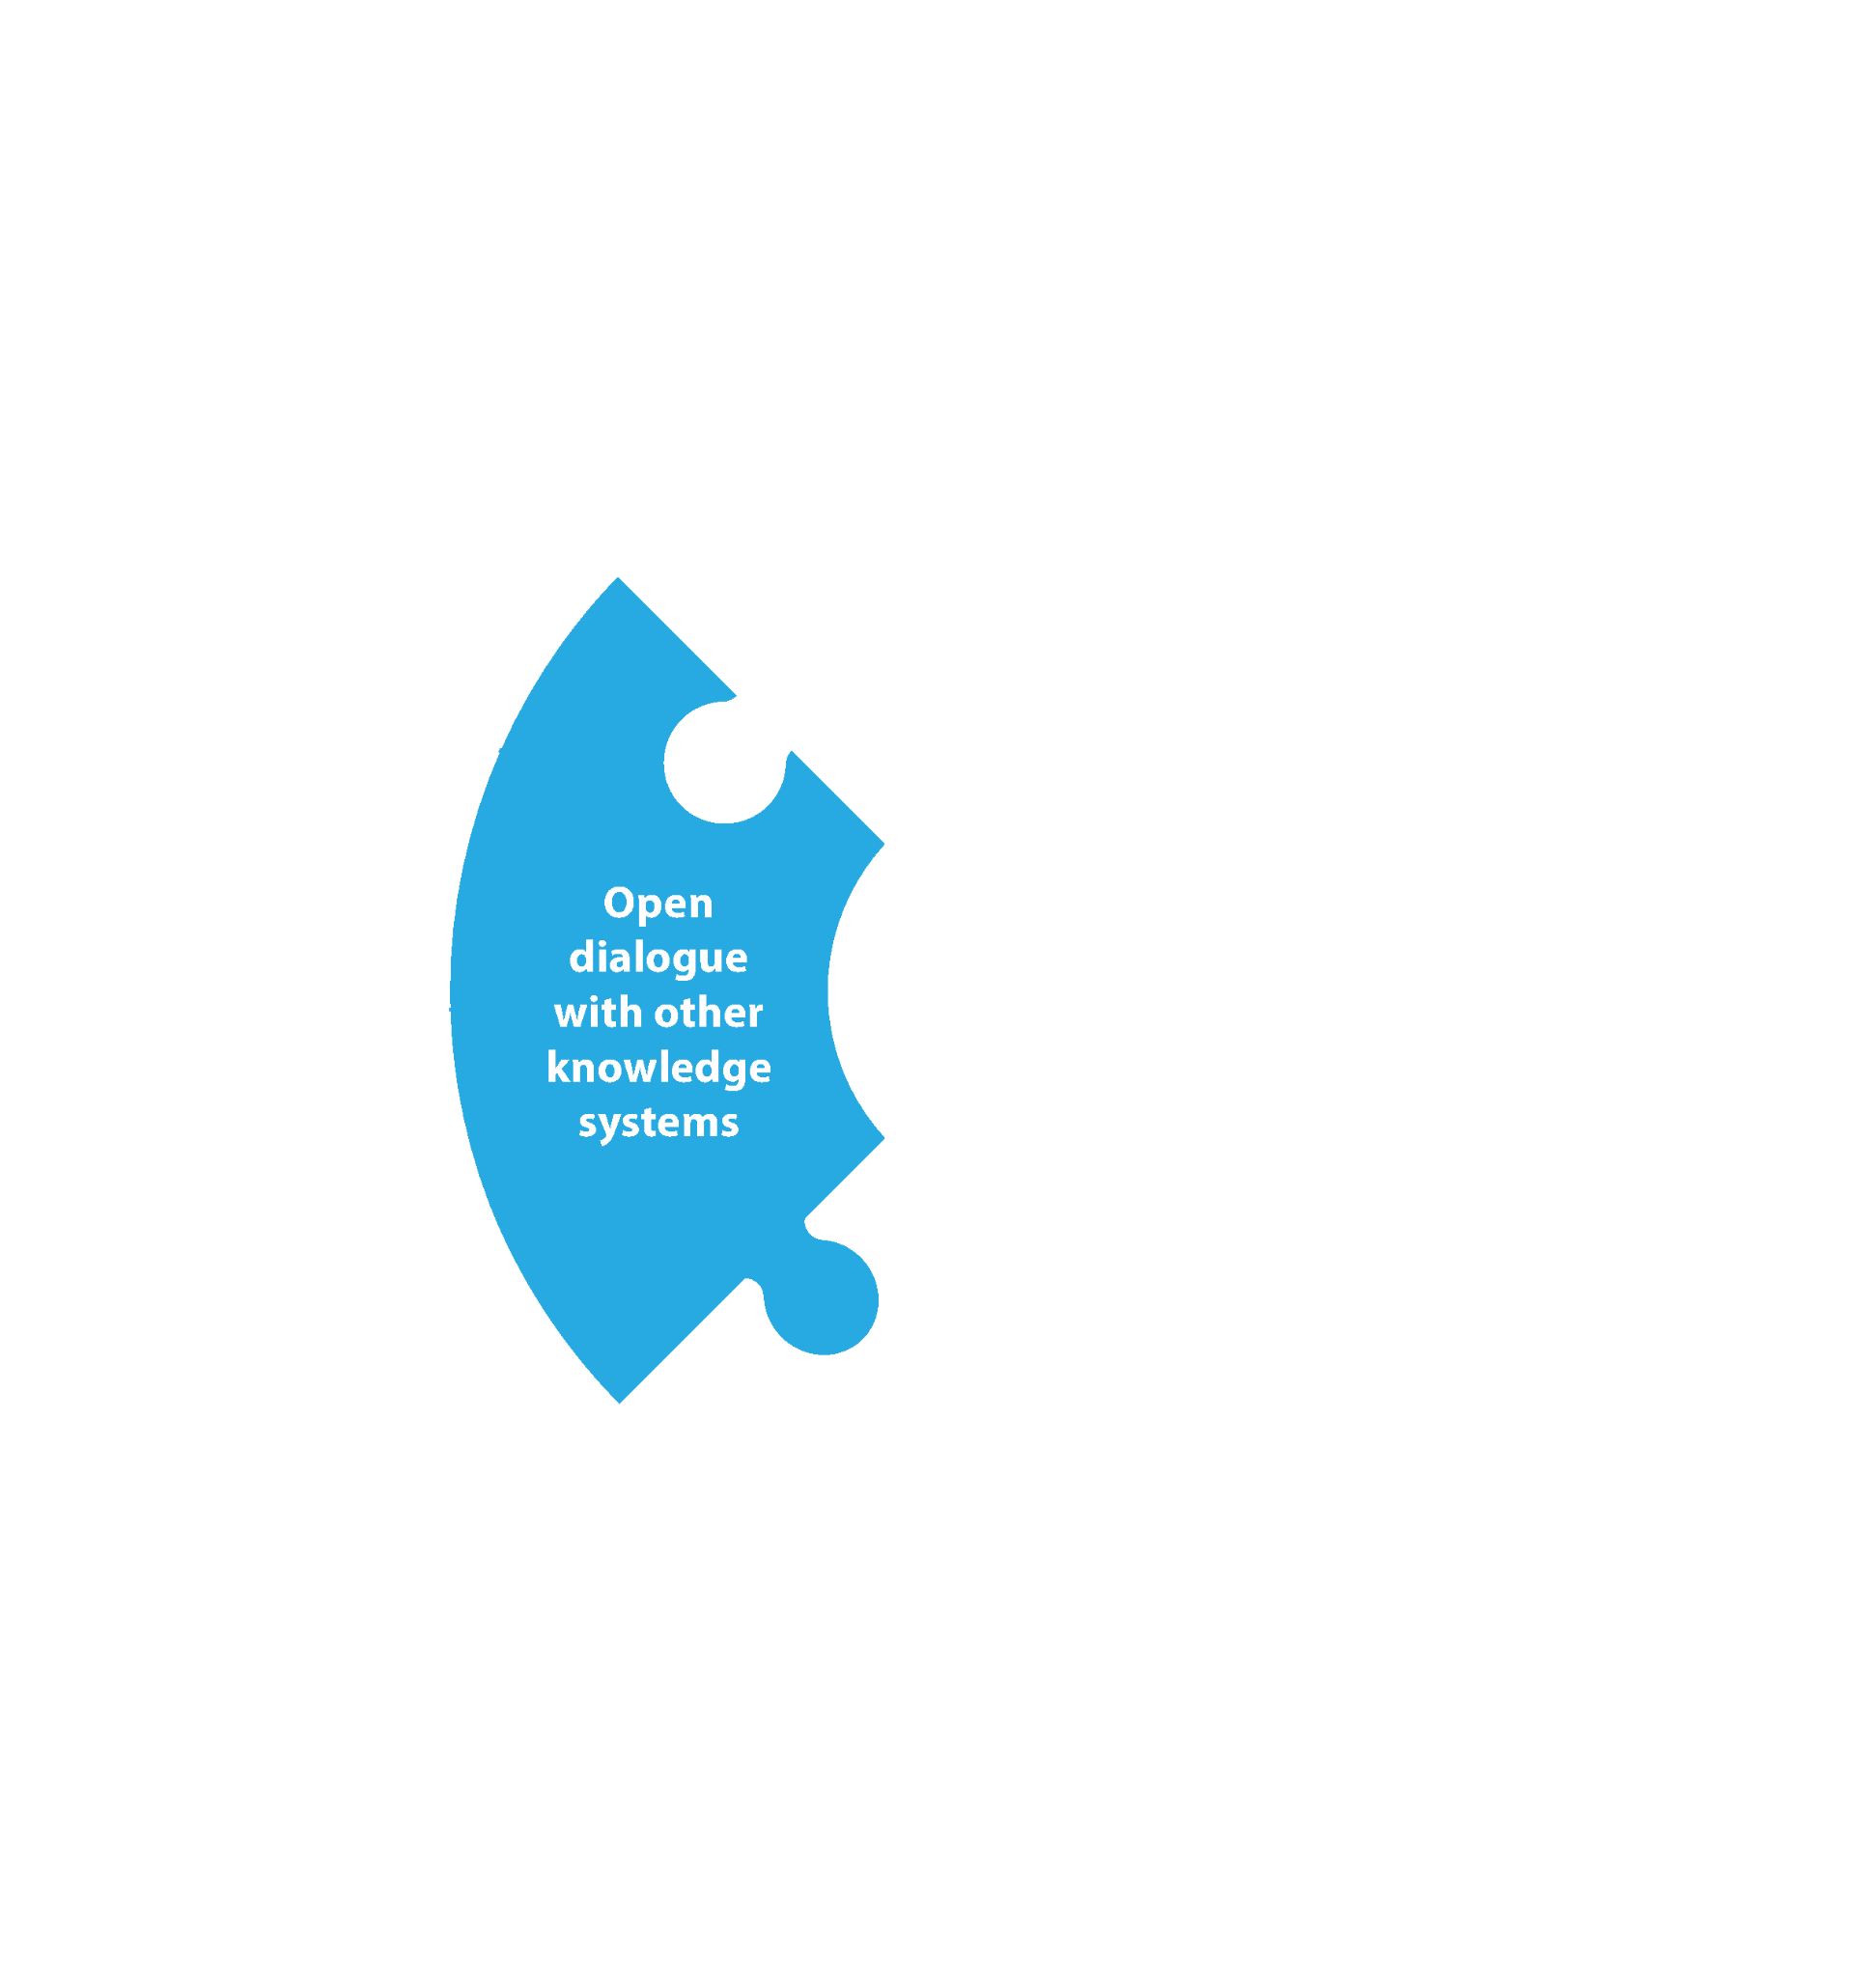
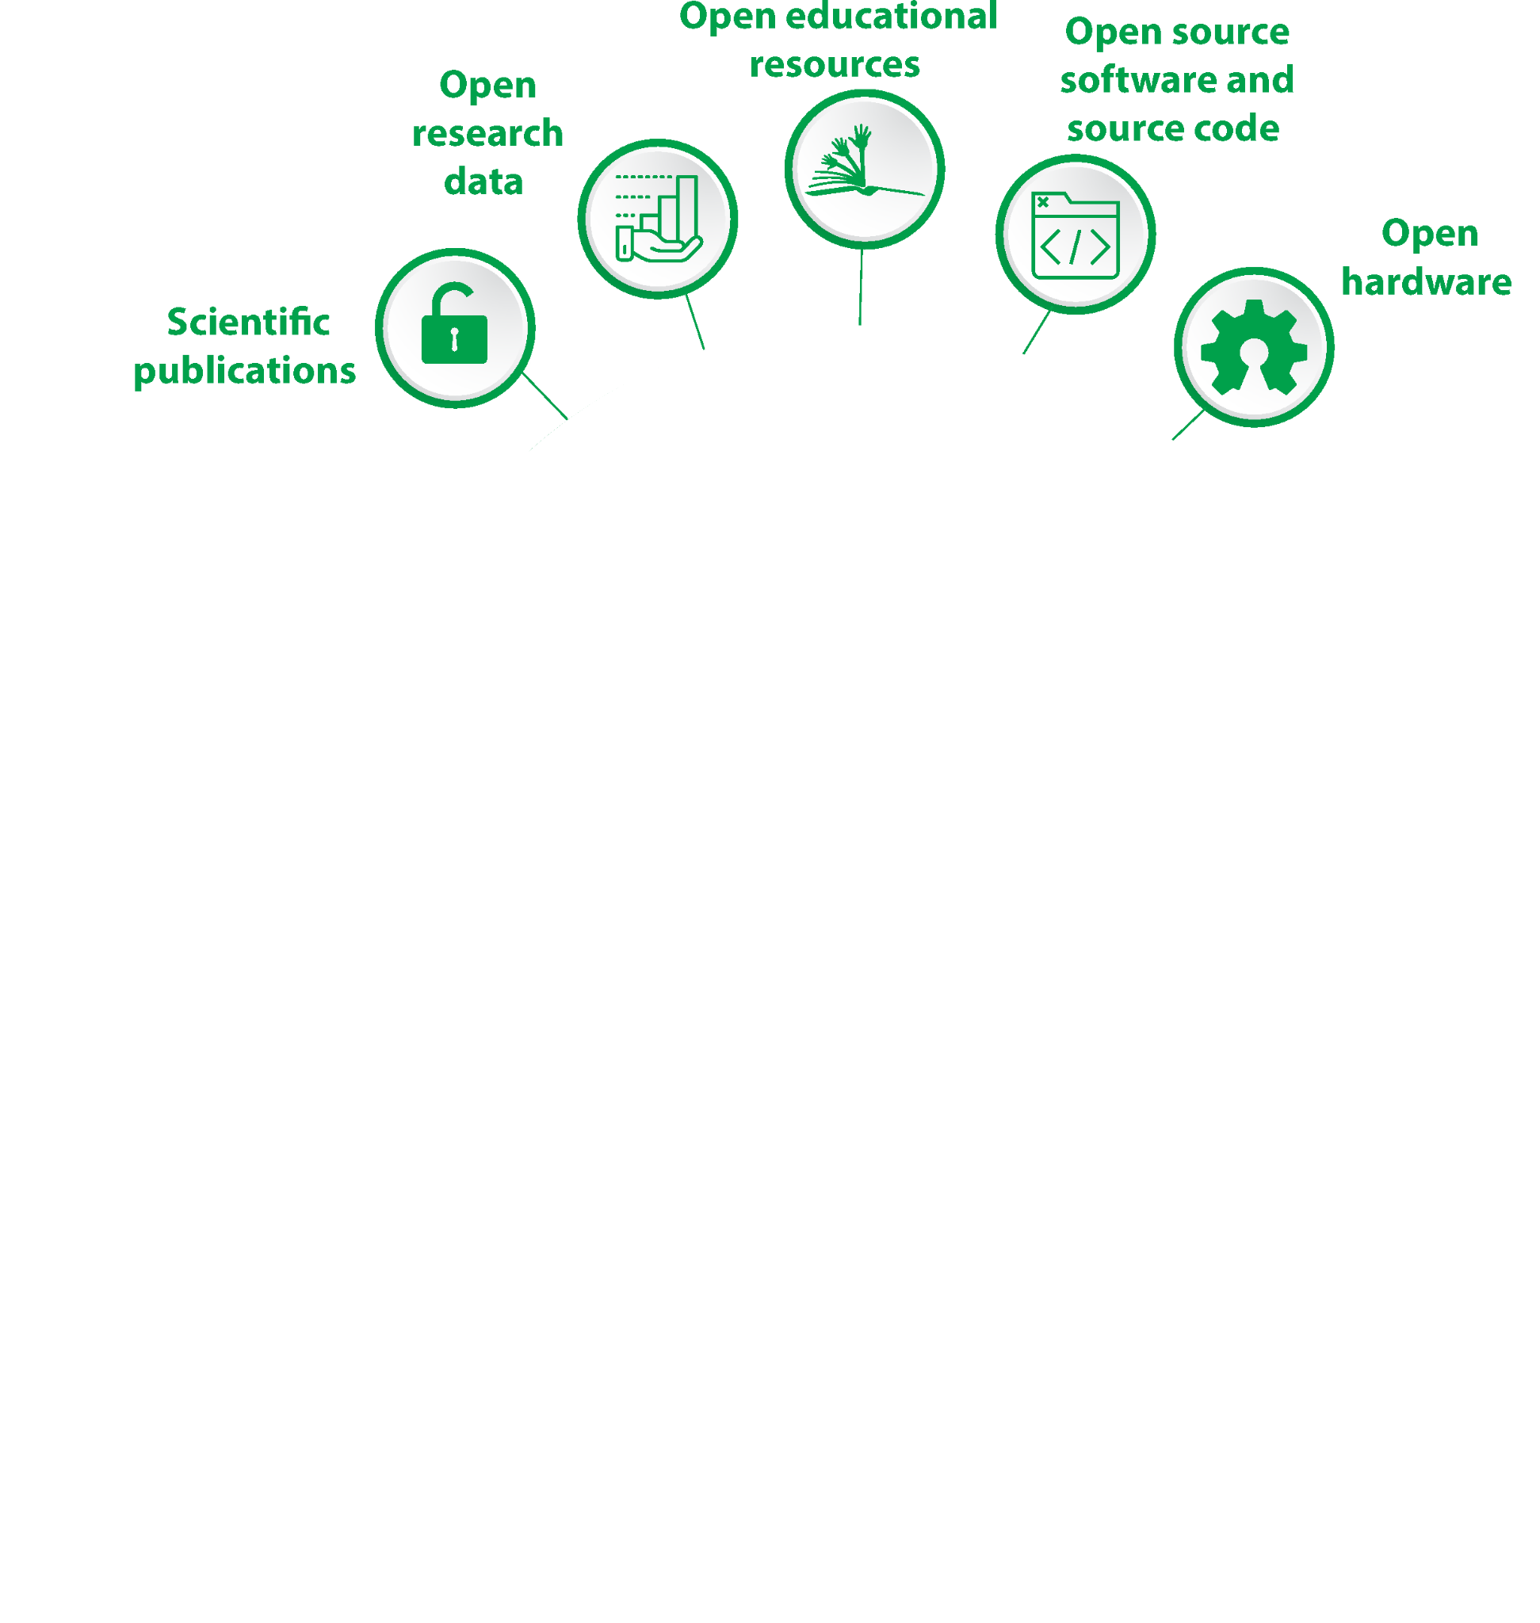
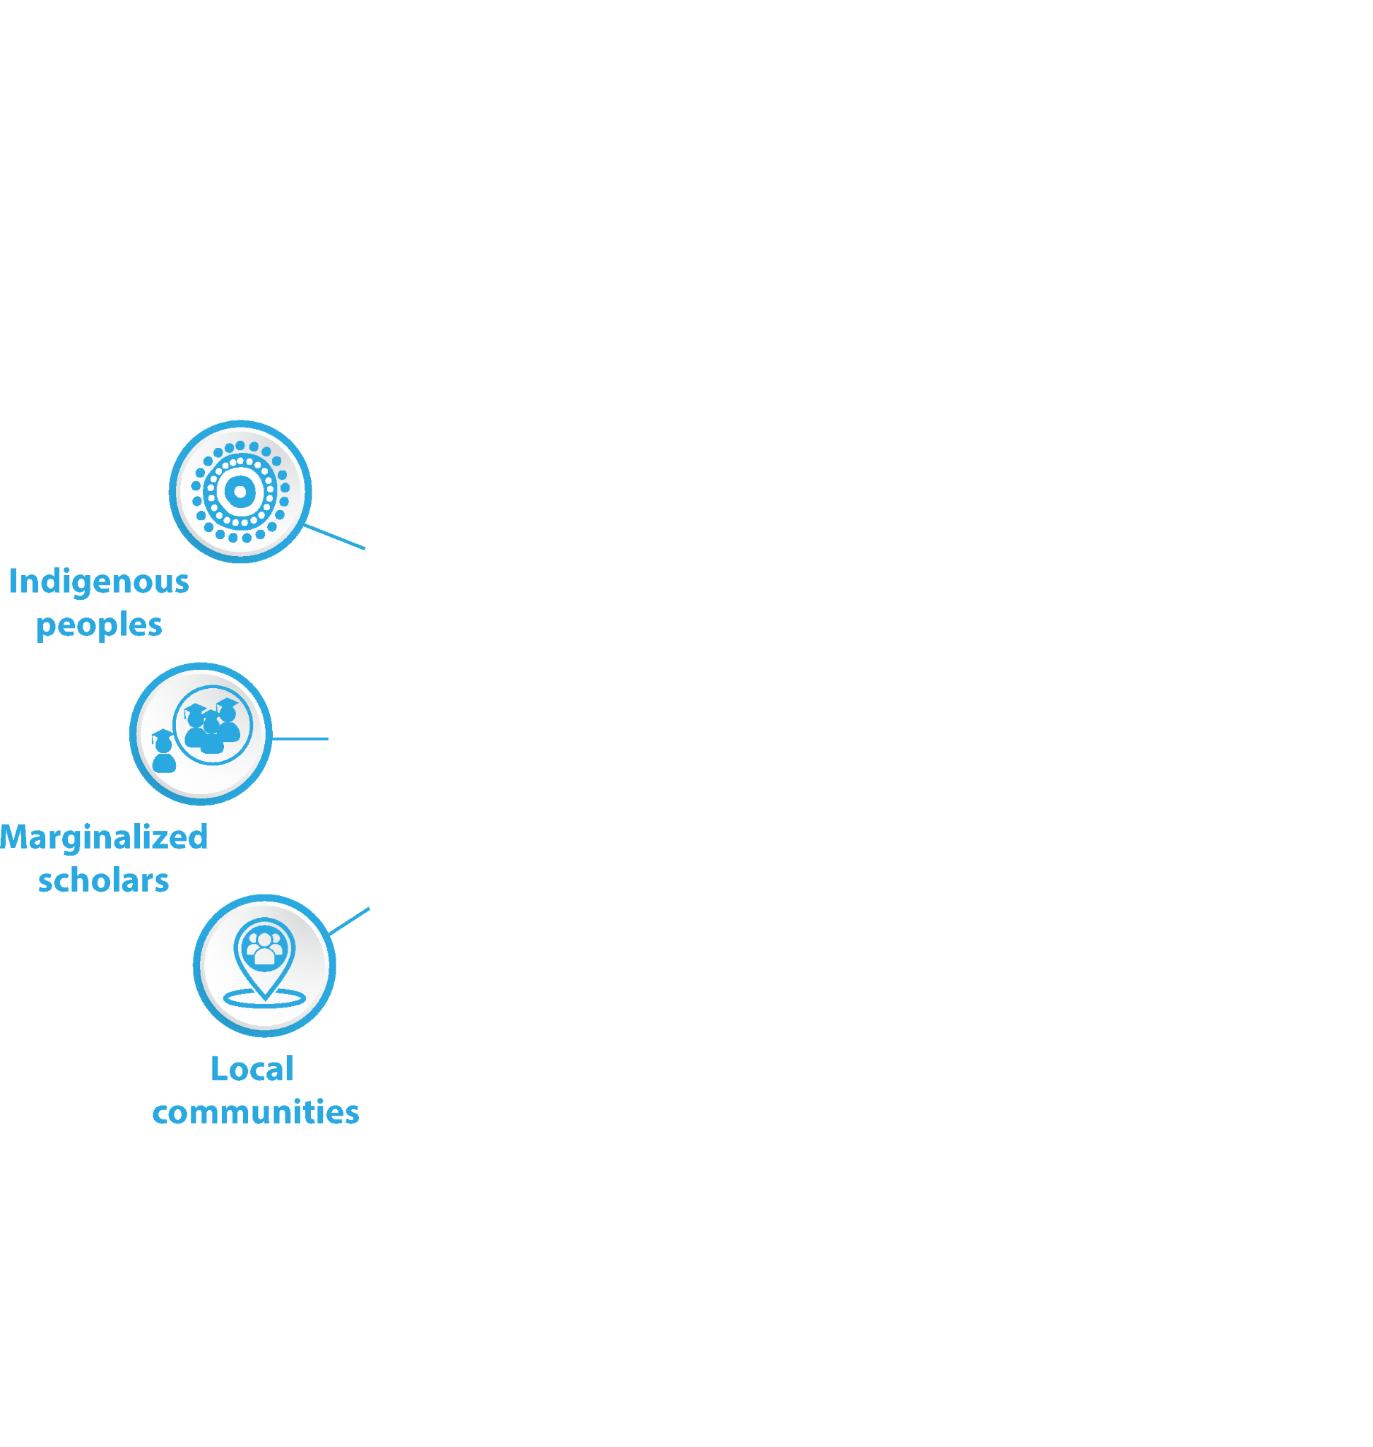
UNESCO Recommendation on Open Science
VALUES
PRINCIPLES
Transparency, scrutiny,
critique, reproducibility
Quality, integrity
Equality of opportunities
Collective benefit
Responsibility, respect,
accountability
Collaboration,
participation, inclusion
Equity, fairness
Flexibility
Diversity,
inclusiveness
Sustainability
https://www.unesco.org/en/open-science/toolkit

Slide 5

Components of Open Science
Open
Data
Open
Publications
Open
Policies
Open
Evaluation
Open
Platform
Open
Software
Open
Hardware
Open
Peer
Review
Open
Notebook
Open
Education
Open
License
Open
Infrastructure
Open Networks
Open
Protocols
Citizen Science
Open Reproducibility

Slide 6

CARE principles, society and value-driven data strategy
Collective benefit
Society should benefit from data and Research aligns with the needs and goals of the community.
Authority to control
Society must have the power to make decisions regarding data governance and
how they are represented in the data. Data must be accessible to society.
Responsibility
Researchers are accountable to society and must be able to demonstrate how their use of data produced by society benefits the society and their self-determination. Evidence of benefits must be shared and resources must be grounded supporting multiple languages and world-views.
Ethics
Society rights and well-being are central during all stages of the
data life-cycle. Risk assessments must be considered from the
society perspective.
Source: Carroll et al. 2020, https://doi.org/10.5334/dsj-2020-043
Carroll et al. 2021, https://doi.org/10.1038/s41597-021-00892-0

Slide 7
Research Data Life Cycle
Research Data Management involves:
Scientific Community for data generation and
curation (Data Providers and Data Curators)
Technological Community for making data
Interoperable (IT and Data Stewards)
Governance and DMP (Data Managers)
Financial Managers
REUSE
PLAN
SHARE
GENERATE
VISUALISE
ARCHIVE
INTERPRET
PROCESS
ANALYSIS

Slide 8
Open Science: efficient access and use of data
Adopting the Open Science paradigm should increase the efficiency in accessing and using Research outputs, taking advantage of modern communication and analysis technologies.
The less manual actions are required, the more efficient the overall system is.
MACHINE ACTIONABLE
SERVICES TO ACCESS DATA
MACHINE READABLE
DATA ENCODINGS
MACHINE INTERPRETABLE DATA
The goal can be achieved adopting the FAIR data principles.
Adapted from https://k-rns.github.io/workshop_data_reuse/

Slide 9

FAIR data principles
Findable: easy to find by humans and computers thanks to metadata and unique persistent identifiers
Accessible: stored for easy access and downloading
Interoperable: ready to be combined with other datasets by humans and computer systems
Re-usable: ready for reuse thanks to detailed, accurate documentation and clear usage license
Wilkinson et al., 2016

Slide 10

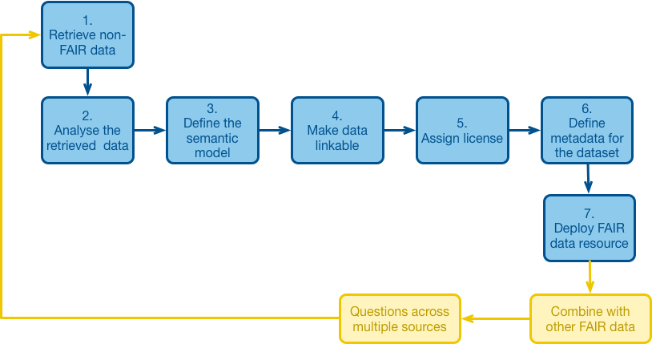
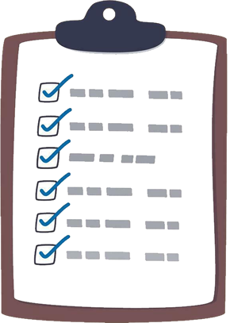


FAIR by design vs FAIRification
FAIR-by-design
FAIRification
Findable
REUSE
PLAN
Accessible
SHARE
GENERATE
VISUALISE
ARCHIVE
Interoperable
INTERPRET
PROCESS
Reusable
ANALYSIS

Slide 11
Effort to implement FAIR data
Interoperable
Harmonization,
Quality control,
Machine-readable
Reusable
Encoding formats,
Provenance,
Licensing
Value to Research Community
Accessible
Standard Access Protocols
Findable
Use of identifiers
Rich metadata
Data management effort
Adapted from https://k-rns.github.io/workshop_data_reuse/

Slide 12
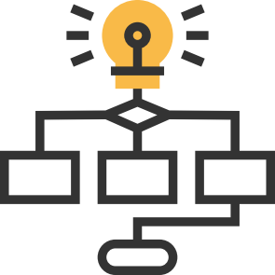

Web services facilitate end users in their work flow
Reliable machine actionable Web Services allows user to:
simplify their work flow, no need to build another data infrastructure
ensure output based on the latest data
Data Provider
Data User
Data & Metadata
Web Service
Output
internet

Slide 13
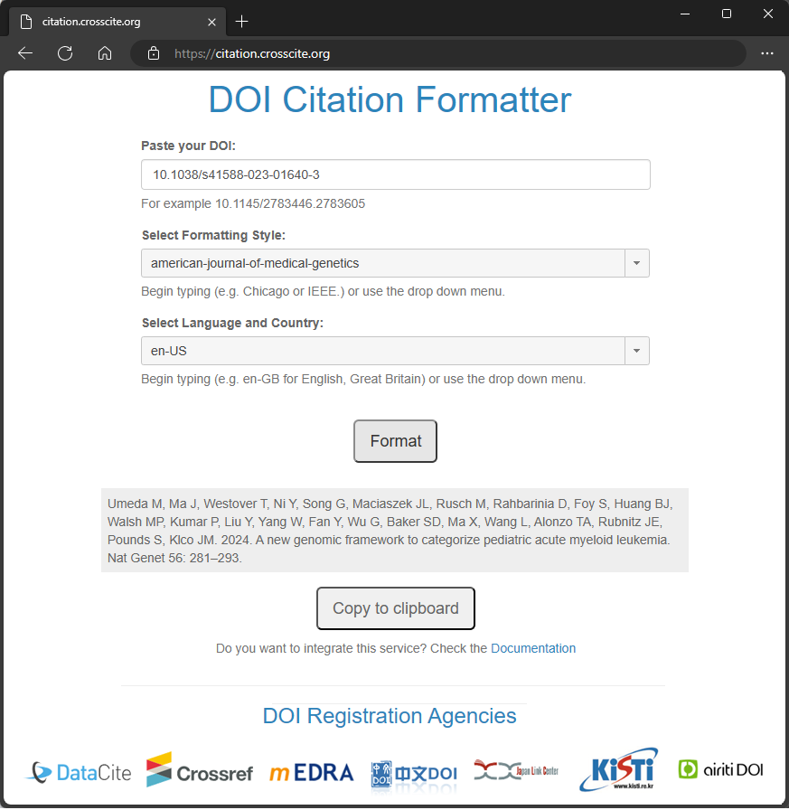

Citation of Research Outputs
Citing research outputs is a compulsory
requirement in Creative Commons licenses
(the “BY” component)
A bibliographic citation of any digital object associated to a DOI can be obtained
entering the code at
https://citation.crosscite.org/

Slide 14
Data Quality, a key to improve Machine Learning
Reduce the garbage in, garbage out for a
better training of Machine Learning algorithms.
COMPLETENESS
Is all the required
data present?
Train Data
Validation Data
& Test Data
UNIQUENESS
Are all features
unique?
ACCURACY
How well does
the data reflect
reality?
DATA
QUALITY
Normalisation
Training
VALIDITY
Is the data
valid?
TIMELESS
Is the data
up to date?
Validation
CONSISTENCY
Is all the required
data present?
Best model selection
Performance evaluation
Andy McDonald, Data Quality Considerations for Machine Learning Models, https://towardsdatascience.com/data-quality-considerations-for-machine-learning-models-dcbe9cab34cb
Source: adapted from Karapanagiotis & Krebber 2023, https://doi.org/10.3390/s23136187

Slide 15
Technology Sovereignty in practicing Open Science
Where your outputs
are published online?
How is your data
associated to metadata?
Infrastructure
directly managed by
your organisation
Infrastructure
managed by
another organisation
Metadata managed directly by
your organisation
Metadata managed by
another organisation
Direct control on
how outputs are made
(publicly) accessible
No direct control
on how outputs
are made accessible
Direct control
on the adopted
metadata standard(s)
No control
on metadata

Slide 16



European Union - Decisions
European Council
Represents the interests of National Governments
General political direction and priorities of the EU
DECISIONS
Council
Ministries of the EU Countries
Negotiate legislation in conjunction with
the EU Parliament
Parliament
Represents the interests of the Citizens
Legislative, Supervisory, Budgetary roles
Commission
Represents the interests of the Union
Legislative, Supervisory, Budgetary roles
European Research Area ERA
Directorate-General for
Research and Innovation (RTD)
Single Market
Digital Single Market

Slide 17













European Union - Strategy
European Research Area ERA
Directorate-General for
Research and Innovation (RTD)
Single Market
Digital Single Market
Digital Programme Europe
Common European Data Spaces
Directorate-General for Communications Networks, Content and Technology (CNECT)
Health
Industrial & Manufacturing
Agriculture
Culture
Mobility
Green Deal
Security
Public
Administration
Finance
Skills
Energy
Media
European Open Science Cloud (EOSC)
Directorate-General for Research and Innovation (RTD)
EOSC EU Node
Directorate-General for Communications Networks, Content and Technology (CNECT)

Slide 18
EOSC Federated “System of Systems”
USERS
EC Public
EOSC EU
Horizontal
European
Administration
Node
Services
Services
EOSC
Node X
EOSC
EOSC
National
Node A
Node B
Regional
Thematic Cluster
National
Resources
Thematic
Resources
Resources
Institutional
Institutional
Industry
Resources
Resources
from "L’opportunità di creare un nodo nazionale italiano per l’EOSC Federation elemento chiave della Scienza Aperta" by Rossi G. (2024).
https://agenda.infn.it/event/42629/contributions/239395/attachments/123838/181791/Presentazione%20NODO%20EOSC%20CoPER-CRUI.pdf

Slide 19
EU relevant legislation
Recommendation (EU) 2018/790 of the Commission 25/04/2018 on access to and preservation of scientific information.
Regulation (EU) 2018/1807 of the European Parliament and of the Council of 14/11/2018 on a framework for the free flow of non-personal data in the European Union.
Directive (EU) 2019/790 of the European Parliament and of the Council of 17/04/2019 on copyright and related rights in the Digital Single Market and amending Directives 96/9/EC and 2001/29/EC.
Directive (EU) 2019/1024 of the European Parliament and of the Council of 20/06/2019 on open data and the re-use of public sector information - Public Sector Information, PSI
Regulation (EU) 2022/868 of the European Parliament and of the Council of 30 May 2022 on European data governance and amending Regulation (EU) 2018/1724 - Data Governance Act
Regulation (EU) 2022/1925 of the European Parliament and of the Council of 14/09/2022 on contestable and fair markets in the digital sector - Digital Markets Act
Regulation (EU) 2022/2065 of the European Parliament and of the Council of 19/10/2022 on a Single Market For Digital Services and amending Directive 2000/31/EC - Digital Services Act
Council Recommendation (EU) 2022/2415 of 2/122022 on the guiding principles for knowledge valorisation.
Regulation (EU) 2023/138 of 21/12/2022 laying down a list of specific high-value datasets and the arrangements for their publication and re-use - High Value Datasets
Regulation (EU) 2023/2854 of the European Parliament and of the Council of 13 December 2023 on harmonised rules on fair access to and use of data - Data Act
Recommendation (EU) 2023/499 of the Commission 1/03/2023 on a Code of Practice on the management of intellectual assets for knowledge valorisation in the European Research Area.
Regulation (EU) 2024/903 of the European Parliament and of the Council of 13/03/2024 laying down measures for a high level of public sector interoperability - Interoperable Europe Act
Recommendation C/2024/3510 of Council 23/05/2024 on enhancing research security (ST/9097/2024/INIT).
Regulation (EU) 2024/1689 of the European Parliament and of the Council of 13/06/2024 laying down harmonised rules on artificial intelligence - Artificial Intelligence Act
(Currently being published) Horizontal cybersecurity requirements for products with digital elements - Cyber Resilience Act

Slide 20
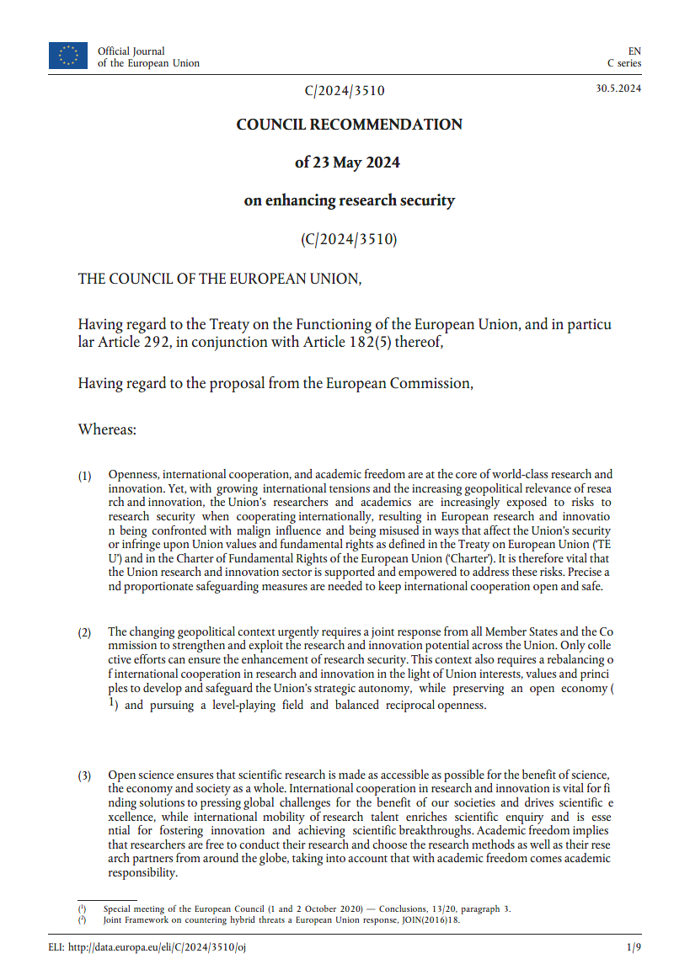
Data that must not, should be, and must be shared
As open as possible,
Council Recommendation of
23 May 2024 on
enhancing research security
[...] risk of undesirable transfer of critical knowledge and technology to third countries which might be used to strengthen these countries’ military capabilities and intelligence services, affecting the security of the Union and its Member States, or for purposes that are in violation of Union values and fundamental rights [...]
with academic freedom comes academic responsibility [...]
https://eur-lex.europa.eu/eli/C/2024/3510/oj
as closed as necessary
Sharing
limitations apply to:
Personal data
Data related to public security, defence and national security

Slide 21
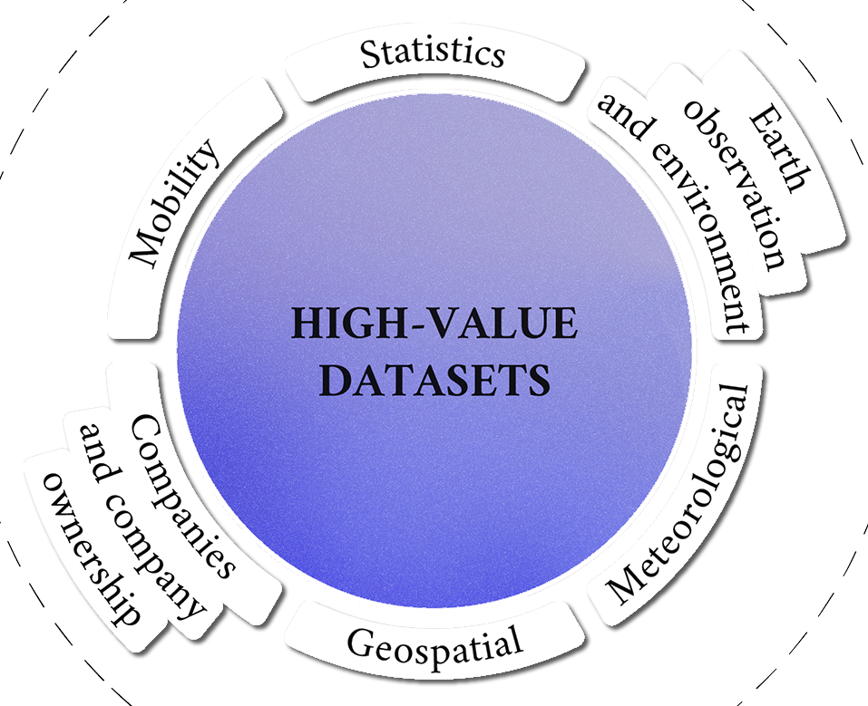
Data that must not, should be, and must be shared
As open as possible,
as closed as necessary
Sharing compulsory for:
High-value
Dataset
Sharing
limitations apply to:
Personal data
Data related to public security, defence and national security
Sharing recommendation for:
Data generated using
public fundings
No re-use limitations,
even for commercial purposes
Re-usable dataset that may generate important benefits for society, the environment and the economy, in particular because of their suitability for the creation of value-added services, applications and new, high-quality and
decent jobs for many potential beneficiaries.

Slide 22



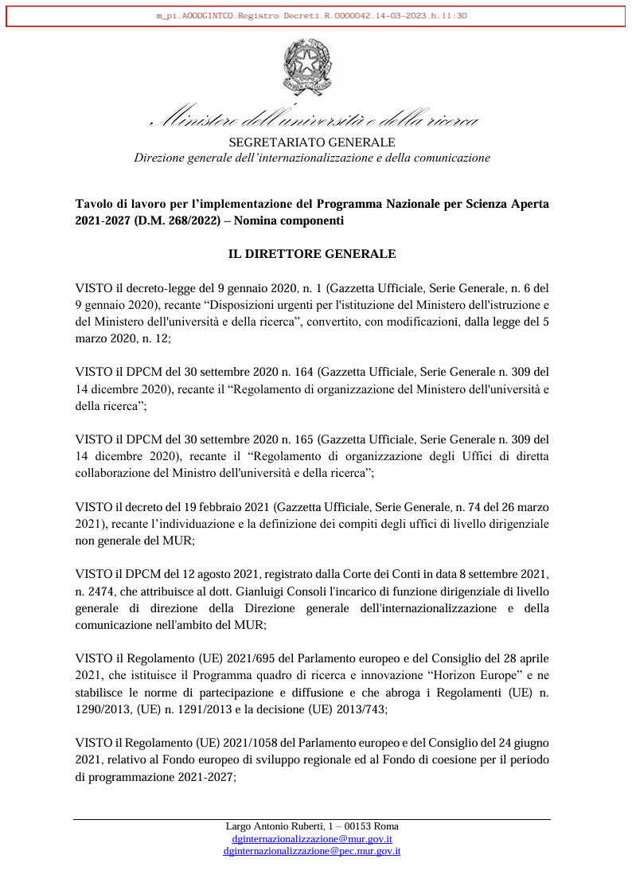
Italian plan for Open Science 2021-2027
The Ministry of University and Research (MUR)
selected 5 areas of intervention for the period 2021-2027:
Scientific publications
Scientific research data
Research evaluation
Open science, the community and European participation
Open data from research on SARS-CoV-2 and COVID-19
[...] strengthening rapid exchange of data between researchers, including access to results and evidence at no charge to the user and Open Science [...]
Working group for the implementation of the National Programme for Open Science:
Donatella Castelli
Emma Lazzeri
Giorgio Rossi
Francesca Di Donato
Roberto Cimino
https://www.mur.gov.it/sites/default/files/2023-04/Decreto%20Direttoriale%20n.%2042%20del%2014-03-2023.pdf

Slide 23

Italian participation in EOSC
European
Commission
on behalf of the EU
EOSC
Association
Involved in the
EOSC Steering Board
Roma, 5 giugno 2023, https://open-science.it/de/itaeosc2023
Mandated Organisation
Consortium GARR - ICDI, Italian Computing and Data Infrastructure
Members
Università del Piem. Orientale
Università della Tuscia
Università dell’Aquila
Università di Bologna
Università di Catania
Università di Ferrara
Università di Milano-Bicocca
Università di Padova
Università di Pisa
Università di Torino
Università S.O. Ben. di Napoli
Politecnico di Milano
Politecnico di Torino
EOSC
Tripartite
Governance
Area Science Park
Consiglio Nazionale delle Ricerche (CNR)
Istituto Nazionale di Fisica Nucleare (INFN)
Istituto Nazionale di Astrofisica (INAF)
Istituto Nazionale di Geof. e Vulc. (INGV)
Istituto Nazionale di Oce. e di Geo. Sp. (OGS)
Gran Sasso Science Institute (GSSI)
Elettra-Sincrotrone Trieste S.C.p.A.
Scuola Intern. Sup. di Studi Avanzati (SISSA)
Scuola Normale Superiore di Pisa
Consorzio per Va. Biologiche e Farm. (CVBF)
Trust IT Service provider for research
Member States
& Associated
Countries
Involved in the
EOSC Steering Board

Slide 24




ICDI, the Italian Computing and Data Infrastructure
Forum created by representatives of major
Italian Research Infrastructures and e-Infrastructures,
with the aim of promoting synergies at national level,
and optimising the Italian participation to
European and global challenges in this field,
including the European Open Science Cloud (EOSC),
the European Data Infrastructure (EDI) and HPC.
https://www.icdi.it
ICDI Competence Centre
https://www.skills4eosc.eu/
Italian Community of Data Stewards (CIDS)
https://open-science.it/
https://www.icdi.it/en/activities/competence-centre/open-science-cafe

Slide 25

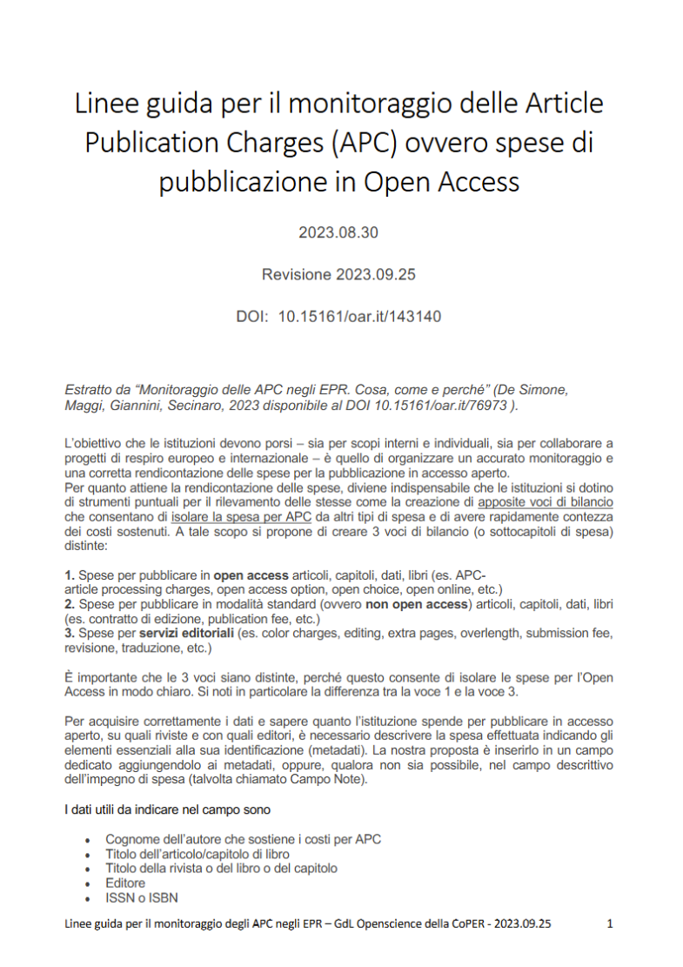
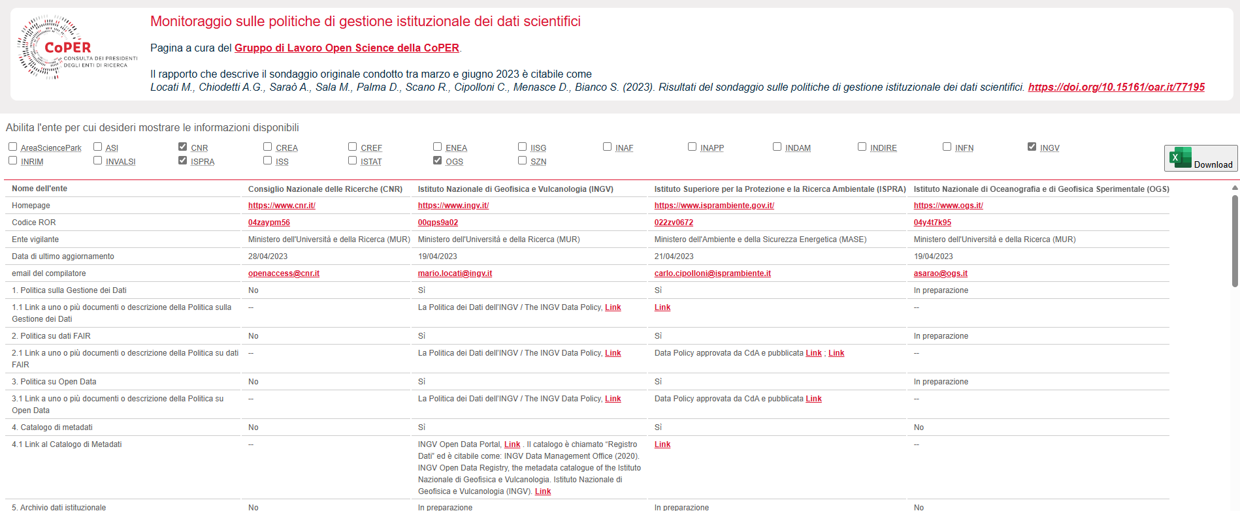
CoPER, Open Science Working Group
Facilitate the cooperation among Public Research Institutions in the production of documents and joint actions for the promotion and support of Open Science policies in Italy.
https://home.infn.it/coper/openscience.html
coper.openscience@lists.infn.it
Guidelines on the monitoring of
Article Publication Charges (APC)
Permanent monitoring of institutional Open Science policies
(e.g. open access to publications, open data, platforms, rewarding)
Next national conference [in Italian]
“A long way: the new challenges of Open Science”
27-28 November 2024, Frascati (RM)
https://agenda.infn.it/e/ConvegnoOpenscienceCoPER2024

Slide 26
AISA, Italian association for the promotion of Open Science
Encourage the values of open access to knowledge by:
disseminate a culture of Open Science;
publish studies on the implementation of its principles;
provide staff training programs;
organise conferences and seminars;
engage international cooperation;
promote participation in international projects;
raise awareness among decision makers.
https://aisa.sp.unipi.it/about-aisa/
AISA onlus
Next national conference [in Italian]
“The value of research:
open science between advertising and publication”
7-8 November 2024, Pisa
https://aisa.sp.unipi.it/il-valore-della-ricerca-scienza-aperta-fra-pubblicita-e-pubblicazione-pisa-7-9-novembre-2024/

Slide 27

COARA, Coalition for Advancing Research Assessment
70 Italian organisations signed the
Agreement on Reforming Research Assessment (ARRA).
50 Italian Research are member and participate
to the COARA National Chapter activities.
11 Italian organisations adopted and shared an action plan.
https://www.coara-italia.it/
Under discussion at INAF
optional
membership
SIGNATORY
MEMBER
ENDORSE PUBLICLY
Publicly signal the need and your willingness to reform the current ways of research assessment.
ACHIEVE CHANGE
Implement the
10 CoARA commitments in your organisation by implementing an action plan.
JOIN THE COMMUNITIES
Benefit from communities of practice; join Working Groups and National Chapters
HAVE A VOICE
Shape CoARA’s strategy by participating in governance and decision-making
NETWORK
AND LEARN
Interact and share best practices with the CoARA network of members
General Assembly of the Italian Chapter of CoARA
11 October 2024, online

Slide 28

AgID, the Agency for Digital Italy
Technical agency of the Presidency of the Council of Ministers
that guarantees the achievement of the objectives of the
Italian Digital Agenda, coordinating Italian Public Administrations.
https://www.agid.gov.it/
Areas of intervention:
Digital transition
Digital skills and education
Monitoring and Surveillance
Guidelines:
Accessibility of IT tools
Open data and re-use of Public Sector Information
Design websites and digital services
Management electronic documents
Management of the National Index of Digital Domiciles
e-procurement
Interoperability standards and technologies
Acquisition and reuse of software
Implementation of the eIDAS regulation
Cybersecurity
SPID, public digital identity system

Slide 29
Open Science at INGV
temporary actions
ongoing actions
Gruppo di lavoro informale
Adesione Berlin Declaration su Open Access
Accordo con CRUI per assegnare DOI DataCite
Adesione Position Statement su Open Access
Censimento Dati
GdL redazione Politica dei Dati
Principi della Politica dei Dati
Censimento dati
Regole Open Access per pubblicazioni
Adesione DORA
Attuazione della Politica dei dati
Ufficio Gestione Dati
Partecipazione a ICDI
Registro Dati
Conformità INSPIRE
GdL Open Science CoPER
Adesione a COARA
GdL agg. Politica Dati
2012
2013
2014
2015
2016
2017
2018
2019
2020
2021
2022
2023
2024

Slide 30
A differentiated path depending on the type of Research Output
Peer-review and
publication process
Paper
Published
(DOI paper + DOI data)
Paper
Research or Monitoring
Activities
may take a long time
(from months up to years)
Working
Group 1
Findings
short time
Data
Data & Metadata published
(DOI Data)
Paper
Working
Group 2
Research
Activity
Findings
Output Data

Slide 31

INGV Open Science policy
Principles + Open Access + Data Policy Implementation
2016
2017
2018
Adapts existing Data Regulations and Open Science paradigm and FAIR data principles
to its own environment and practices, providing its employees with:
A translation layer to the complex external legal framework related to data
A clear framework facilitating the adoption of Research Data Management
Guidelines for peculiarities not covered by any external framework
Identify roles, and responsibilities
Establish a Data Registry, a list describing all data shared
Practical rules on how to share data internally and externally
Predefined and ready-to-use solutions covering
Accountability, Provenance, Licensing, Preservation
https://hdl.handle.net/2122/14886

Slide 32
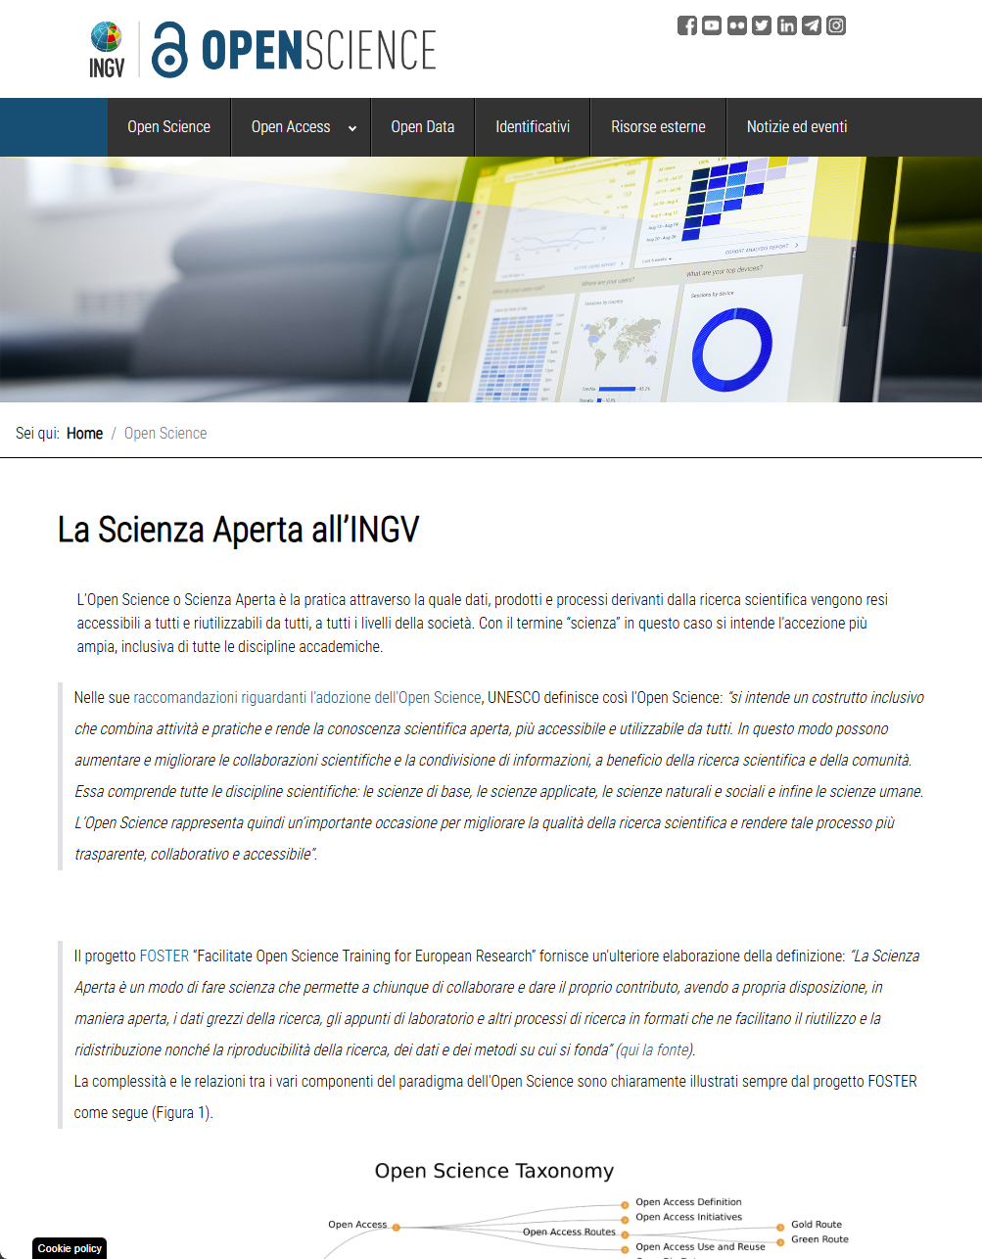
Institutional groups that put the policy into practice
Data Management Office, established in 2018
coordinate Open Data through the institutional metadata catalogue “INGV Data Registry”
https://data.ingv.it/
Open Access Commission, established in 2021
coordinate Open Access (OA) through the institutional repository "Earth-Prints" https://www.earth-prints.org/
Currently discussing new groups for:
Open Software
Open Research Infrastructures
https://istituto.ingv.it/it/open-science

Slide 33
Thank you for your attention!
datamanagementoffice@ingv.it
ufficiogestionedati@ingv.it
mario.locati@ingv.it
CC BY 4.0

