Slide 1

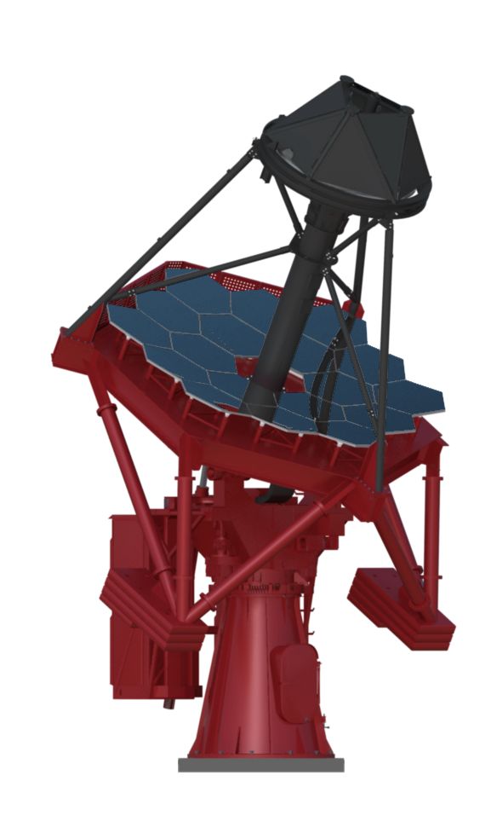
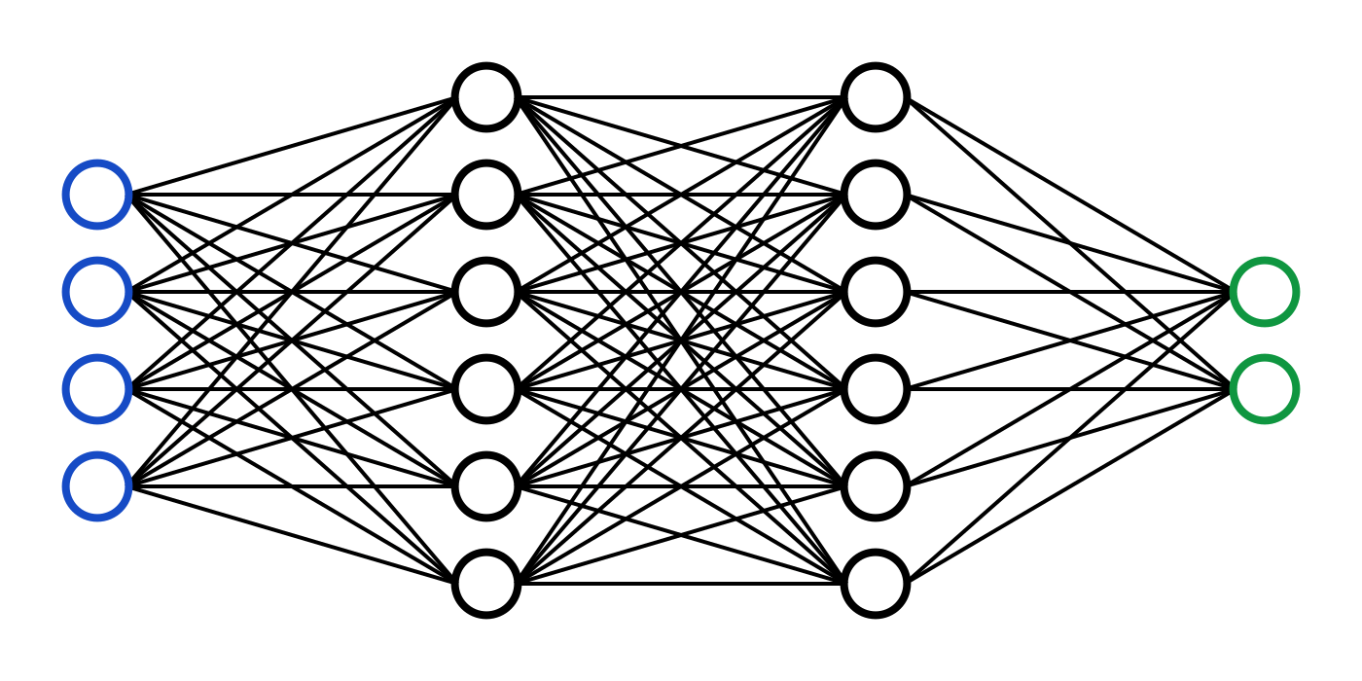
USCVIII – General Assembly
Multivariate Time Series Forecasting for the ASTRI-Horn Historical Monitoring Data
Federico Incardona*
Monday, 14 October 2024 - Friday, 18 October 2024 Galzignano Resort Terme & Golf
Notes:
Voglio ringraziare innanzitutto gli altri

Slide 2
*Authors
Federico Incardonaª, Alessandro Costaª, Farida Farsianª, Francesco Franchinaª, Giuseppe Letoª, Emilio Mastrianiª, Kevin Munariª, Giovanni Pareschi^{b}, Salvatore Scuderi^{c}, Sebastiano Spinelloª, and Gino Tosti^{d} for the ASTRI Project¹
ªINAF, Osservatorio Astrofisico di Catania
^{b}INAF, Osservatorio Astronomico di Brera
^{c}INAF, Istituto di Astrofisica Spaziale e Fisica Cosmica di Milano
^{d}Università di Perugia, Istituto di Astrofisica Spaziale e Fisica Cosmica
¹http://www.astri.inaf.it/en/library/
Federico Incardona, USCVIII – General Assembly, 14-18 October 2024, Galzignano Resort Terme & Golf

Slide 3
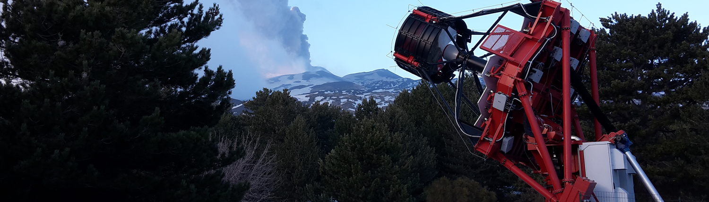
ASTRI-Horn for the Mini-Array
ASTRI Mini-Array will be 9 Cherenkov telescopes deployed at the Teide Observatory (Tenerife) of the SST class (~4 m) of the CTAO:
first light for the first telescope in Tenerife (ASTRI 1)
ASTRI-Horn prototype deployed and operated in Serra La Nave (Mt. Etna, Sicily) since late 2017
ASTRI Horn – Mt. Etna
Federico Incardona, USCVIII – General Assembly, 14-18 October 2024, Galzignano Resort Terme & Golf

Slide 4
ASTRI-Horn Database
+-----------------+------------------+
| Monitoring database |
+-----------------+------------------+
| Assembly | Number of tables |
+-----------------+------------------+
| ASC | 16 |
| CameraControl | 91 |
| ICT_ICMP | 37 |
| PMC | 50 |
| SQM | 11 |
| TCU | 110 |
| THCU | 85 |
| WS | 21 |
| WeatherStation | 29 |
| WeatherStation1 | 28 |
| logbook | 1 |
+-----------------+------------------+
479 tables each one corresponding to a time series of a monitored property (sampling rate corresponding to ~ 15 sec)
+---------+----------+
| Field | Type |
+---------+----------+
| timetag | bigint |
| value | char(30) |
+---------+----------+
Federico Incardona, USCVIII – General Assembly, 14-18 October 2024, Galzignano Resort Terme & Golf
Notes:
The CHAR data type stores character data in a fixed-length field. Data can be a string of single-byte or multibyte letters, numbers, and other characters that are supported by the code set of your database locale.

Slide 5
ASTRI-Horn Database
+-----------------+------------------+
| Monitoring database |
+-----------------+------------------+
| Assembly | Number of tables |
+-----------------+------------------+
| ASC | 16 |
| CameraControl | 91 |
| ICT_ICMP | 37 |
| PMC | 50 |
| SQM | 11 |
| TCU | 110 |
| THCU | 85 |
| WS | 21 |
| WeatherStation | 29 |
| WeatherStation1 | 28 |
| logbook | 1 |
+-----------------+------------------+
479 tables each one corresponding to a time series of a monitored property (sampling rate corresponding to ~ 15 sec)
+---------+----------+
| Field | Type |
+---------+----------+
| timetag | bigint |
| value | char(30) |
+---------+----------+
Federico Incardona, USCVIII – General Assembly, 14-18 October 2024, Galzignano Resort Terme & Golf
Notes:
The CHAR data type stores character data in a fixed-length field. Data can be a string of single-byte or multibyte letters, numbers, and other characters that are supported by the code set of your database locale.

Slide 6
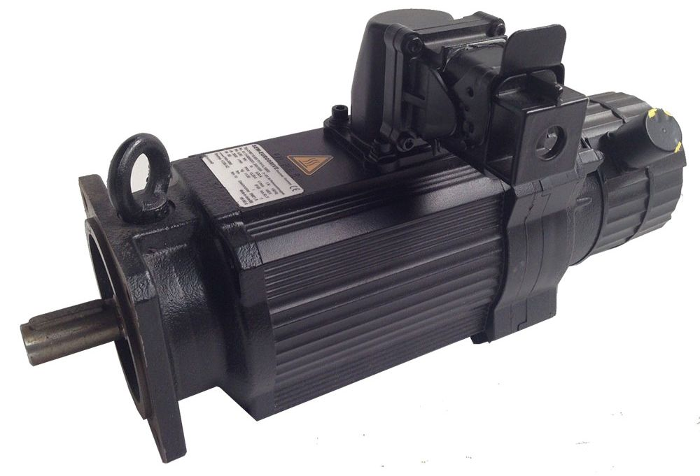
Feature selection
+-----------------+------------------+
| Monitoring database |
+-----------------+------------------+
| Assembly | Number of tables |
+-----------------+------------------+
| ASC | 16 |
| CameraControl | 91 |
| ICT_ICMP | 37 |
| PMC | 50 |
| SQM | 11 |
| TCU | 110 |
| THCU | 85 |
| WS | 21 |
| WeatherStation | 29 |
| WeatherStation1 | 28 |
| logbook | 1 |
+-----------------+------------------+
We focused on a subset of 47 features from TCU and THCU by selecting only those that were related to the motors
ASTRI-Horn is moved by three-phase motors:
one for elevation
two for Azimuth (master and slave)
Federico Incardona, USCVIII – General Assembly, 14-18 October 2024, Galzignano Resort Terme & Golf

Slide 7
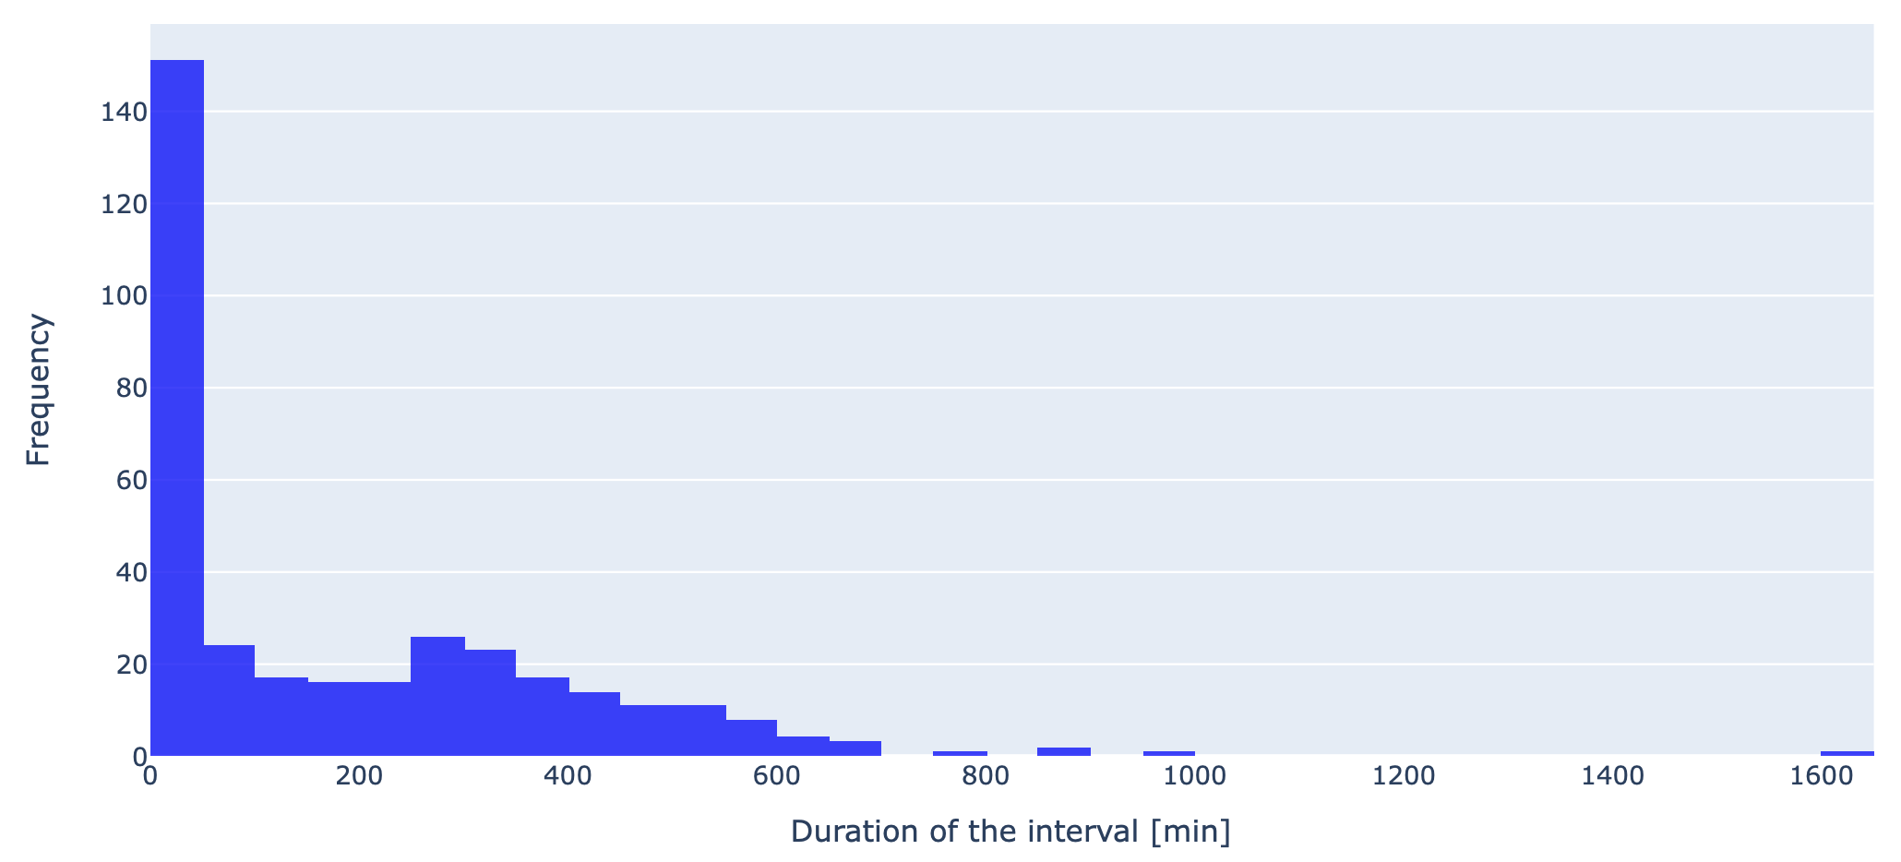
Active intervals selection
We selected only those time intervals when at least one of the motors was active
257609 rows × 47 columns; 346 intervals
Federico Incardona, USCVIII – General Assembly, 14-18 October 2024, Galzignano Resort Terme & Golf
Notes:
Questo grafico mostra un istogramma della distribuzione dell’ampiezza degli intervalli attivi in minuti,
Come si vede da questo picco abbiamo molti intervalli brevi (tra 1 e 50 minuti)
Poi degli altri tra i 50 minuti e 600 minuti (circa 10 ore)
Ci sono invece pocchissimi intervalli lunghi, diciamo con una durata superiore alle 10 ore

Slide 8
PdM Strategy
Since 2017 there have been three known faults involving the three-phase ASTRI motors:
May 2019: water infiltration caused a block in the Azimuth master motor
November 2021: slow degradation of the Azimuth encoder tape
February 2022: condensation caused a block in the elevation motor
There is not enough evidence of degradation in the time series corresponding to these three faults
There is instead a fair amount of normal data starting from September 2022
We aim to develop a Normal Behaviour Model for the telescope’s time series
In this way, it is possible to build a PdM application that constantly compares, for each target feature, the actual measured values and the predicted ones and raises an alarm every time there is a deviation from the model
Federico Incardona, USCVIII – General Assembly, 14-18 October 2024, Galzignano Resort Terme & Golf

Slide 9
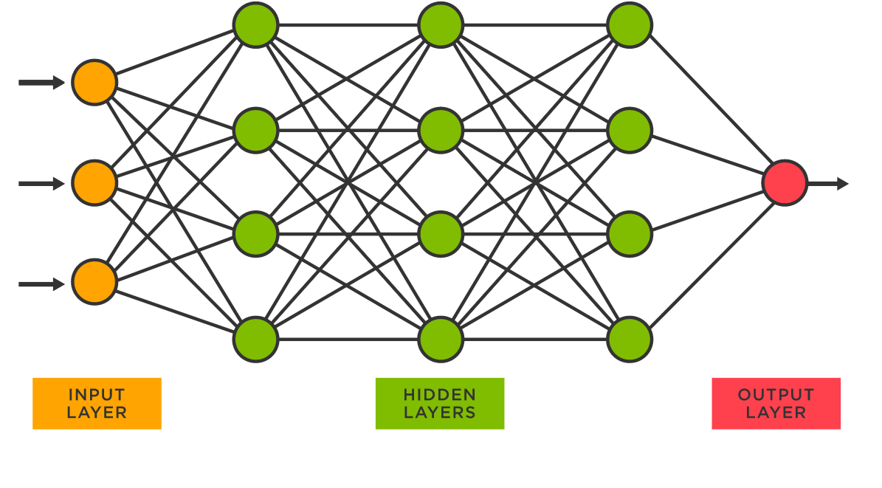
MLP Regressor
The Multi-Layer Perceptron (MLP) Regressor is a fully connected neural network (NN) used for regression tasks, designed to predict continuous values.
Feedforward Neural Network: data flows in one direction, from input to output
Hidden Layers: enable the model to capture complex patterns in data
Activation Functions: introduce non-linearity to the model by determining whether a neuron should be activated or not based on its input
Backpropagation: training method that adjusts weights based on prediction errors using gradient descent
Federico Incardona, USCVIII – General Assembly, 14-18 October 2024, Galzignano Resort Terme & Golf
Notes:
Each layer consists of neurons (nodes) connected by weights, using activation functions to introduce non-linearity.
2. Key Features:
• Feedforward Neural Network: Data flows in one direction, from input to output.
• Hidden Layers: Enable the model to capture complex patterns in data.
• Activation Functions: introduce non-linearity to the model, enabling it to learn and approximate complex patterns by determining whether a neuron should be activated or not based on its input.
Common choices include ReLU (Rectified Linear Unit) or tanh for hidden layers.
• Backpropagation: Training method that adjusts weights based on prediction errors using gradient descent.
Nel contesto delle reti neurali artificiali, il rettificatore è una funzione di attivazione definita come la parte positiva del suo argomento: f(x)=x+=max,
𝑓(𝑥)=𝑥+=max,
dove x è l'input a un neurone. È anche annoverata tra le funzioni rampa ed è l'analogo di un raddrizzatore in elettronica

Slide 10
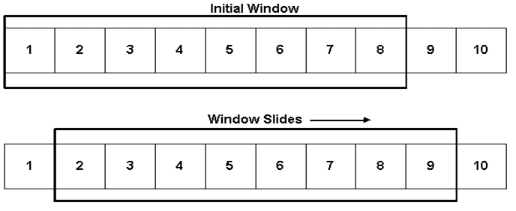
Multivariate Forecasting (MF)
Make predictions of all the time series at the same time within the so-defined data window:
total window length (L) = input samples (I) + offset samples (O)
O is the actual prediction window corresponding to the time prior to the system fault within which the maintainer must be alerted
Tried several combinations of I and O
Limited by the high number of short intervals
Used sliding window approach
Increase the number of intervals and samples for the NN training
Federico Incardona, USCVIII – General Assembly, 14-18 October 2024, Galzignano Resort Terme & Golf
Notes:
O deve tendere ad essere quanto più grande più possibile in modo che l’operatore sia informato quanto prima possibile

Slide 11
MLP architecture tuning
We tried several combinations of input (I) and offset (O) samples, in the two cases with and without outliers:
In each case, we tested the following NN architectures:
75 s + 15 s | 20 min + 5 min | 5h + 1h
hidden_layer_sizes:
[100, 50]
[320, 160, 80]
[1440, 720, 360]
[1440, 720, 720, 360]
[1440, 720, 360, 180, 90, 40]
[5760, 2880, 1440]
[5760, 11520, 2880]
Federico Incardona, USCVIII – General Assembly, 14-18 October 2024, Galzignano Resort Terme & Golf
Notes:
Ciascu

Slide 12
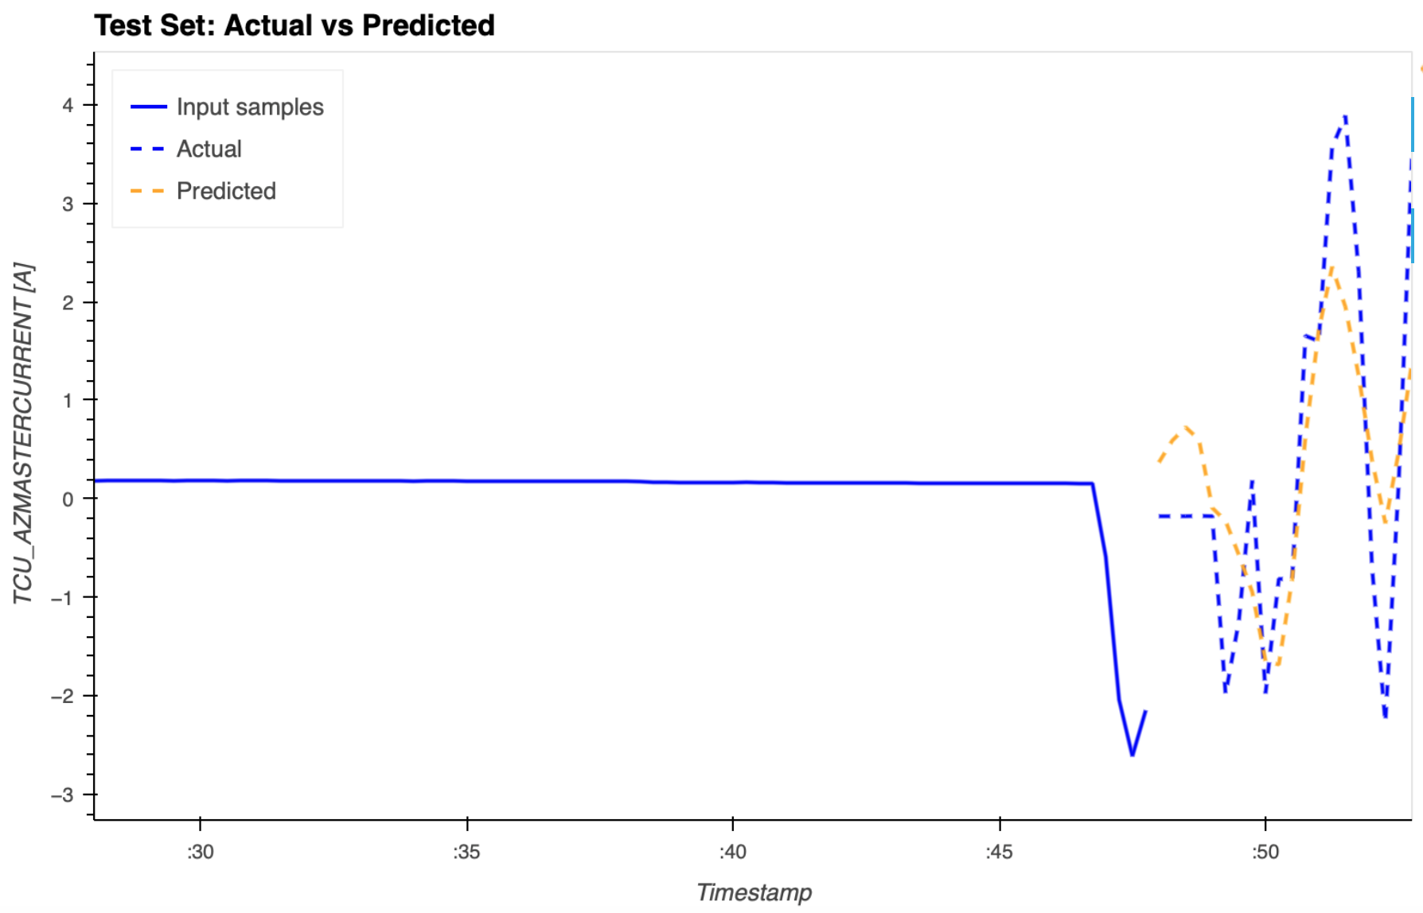
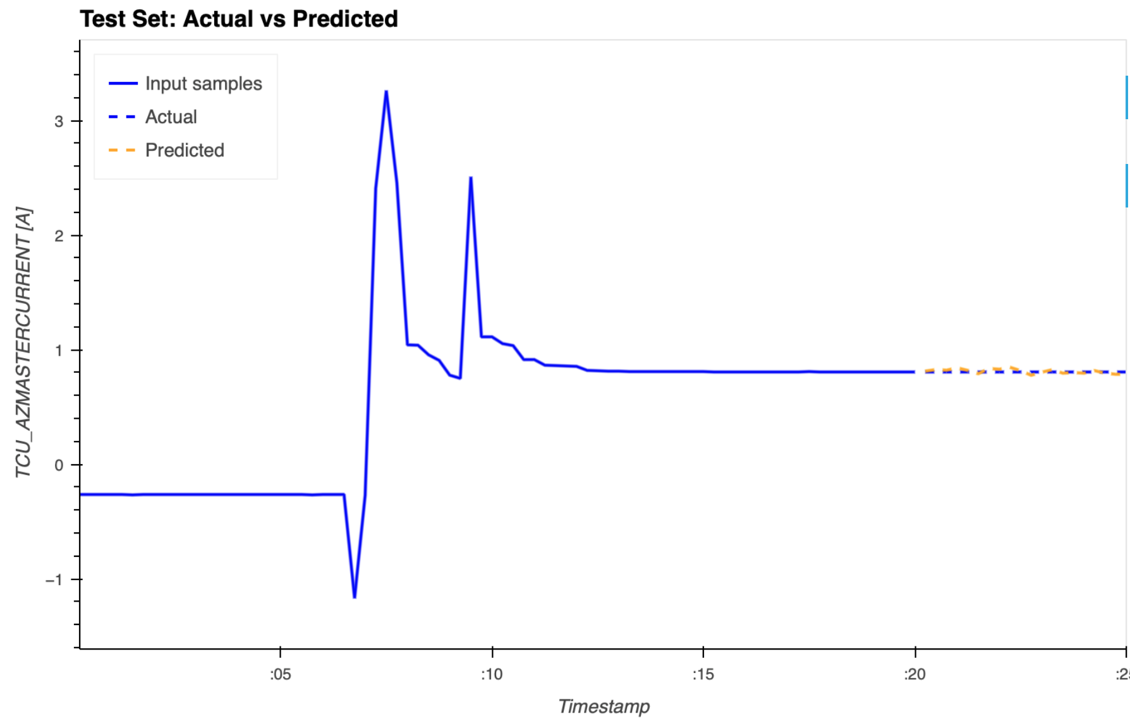
MF Plot
L = 20 min + 5 min
Federico Incardona, USCVIII – General Assembly, 14-18 October 2024, Galzignano Resort Terme & Golf

Slide 13
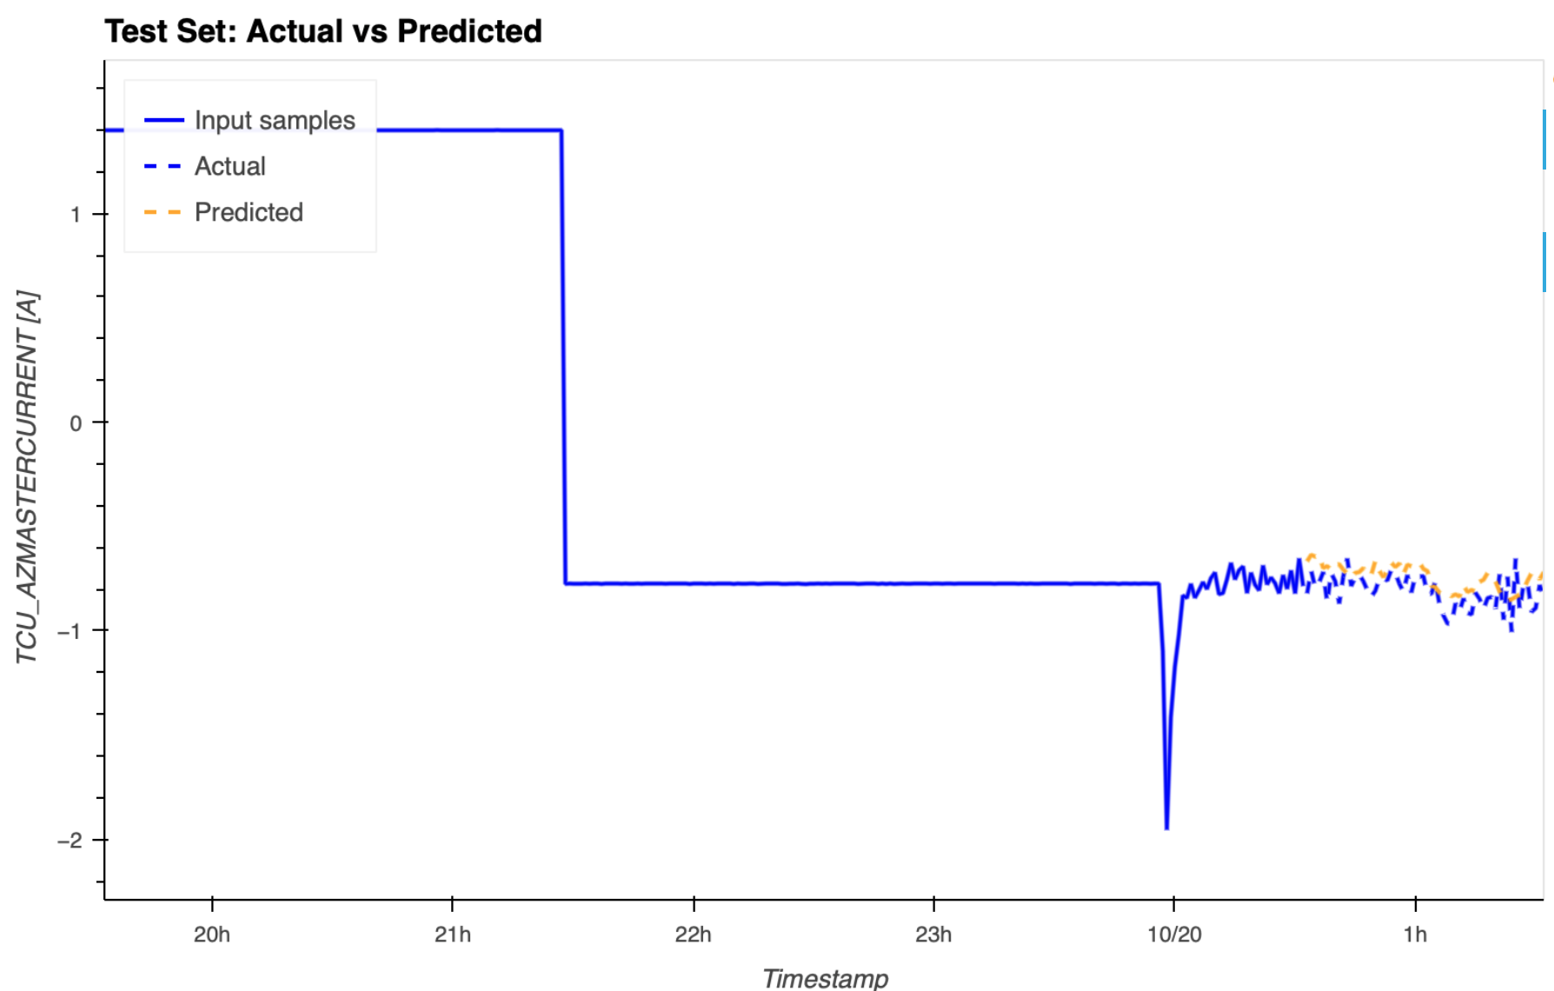
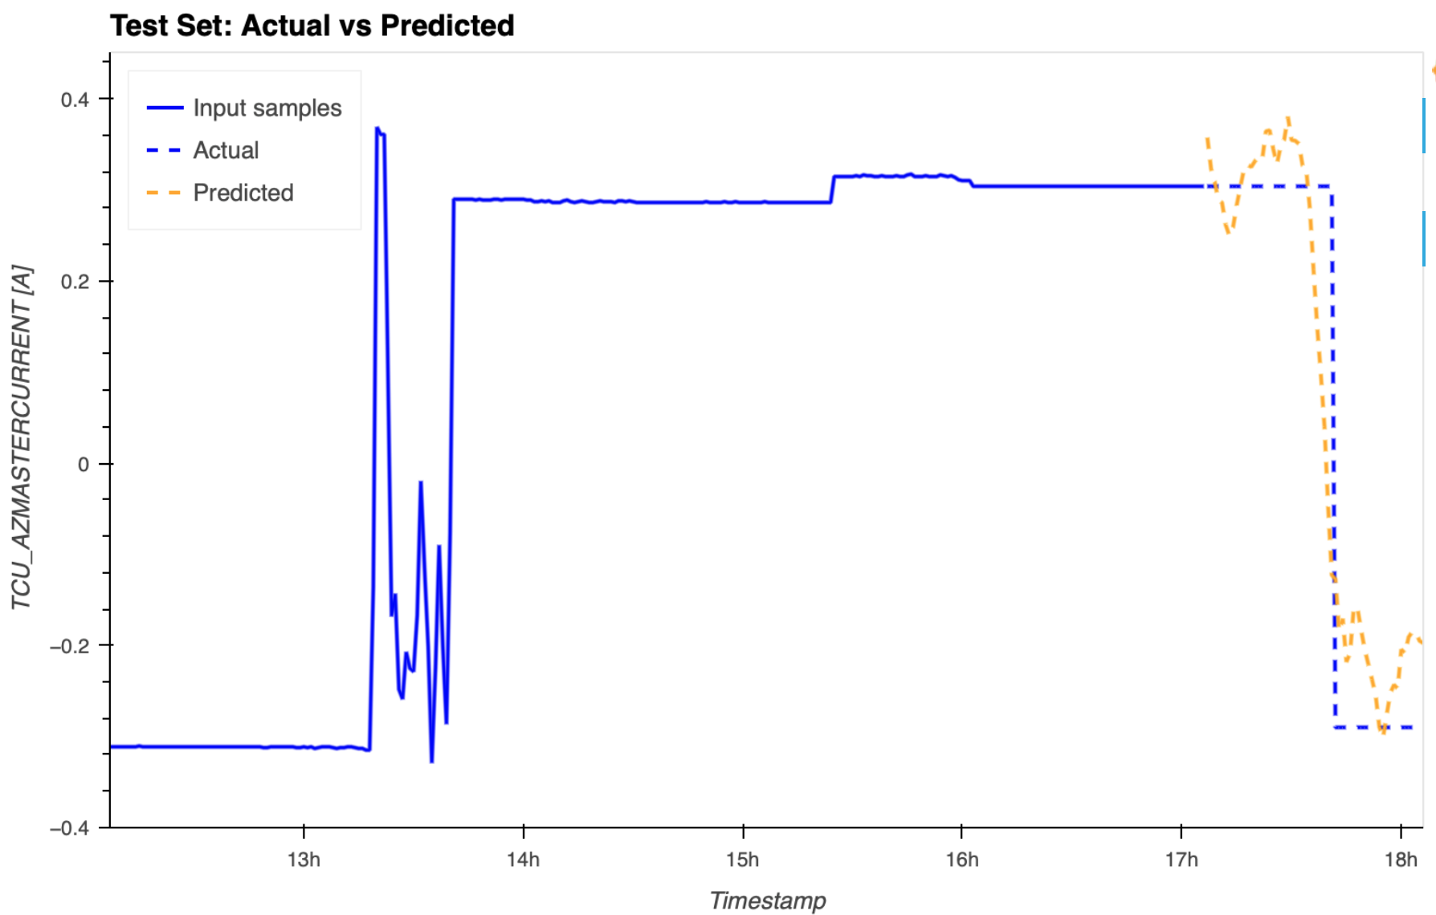
MF Plot
L = 5h + 1h
Federico Incardona, USCVIII – General Assembly, 14-18 October 2024, Galzignano Resort Terme & Golf

Slide 14
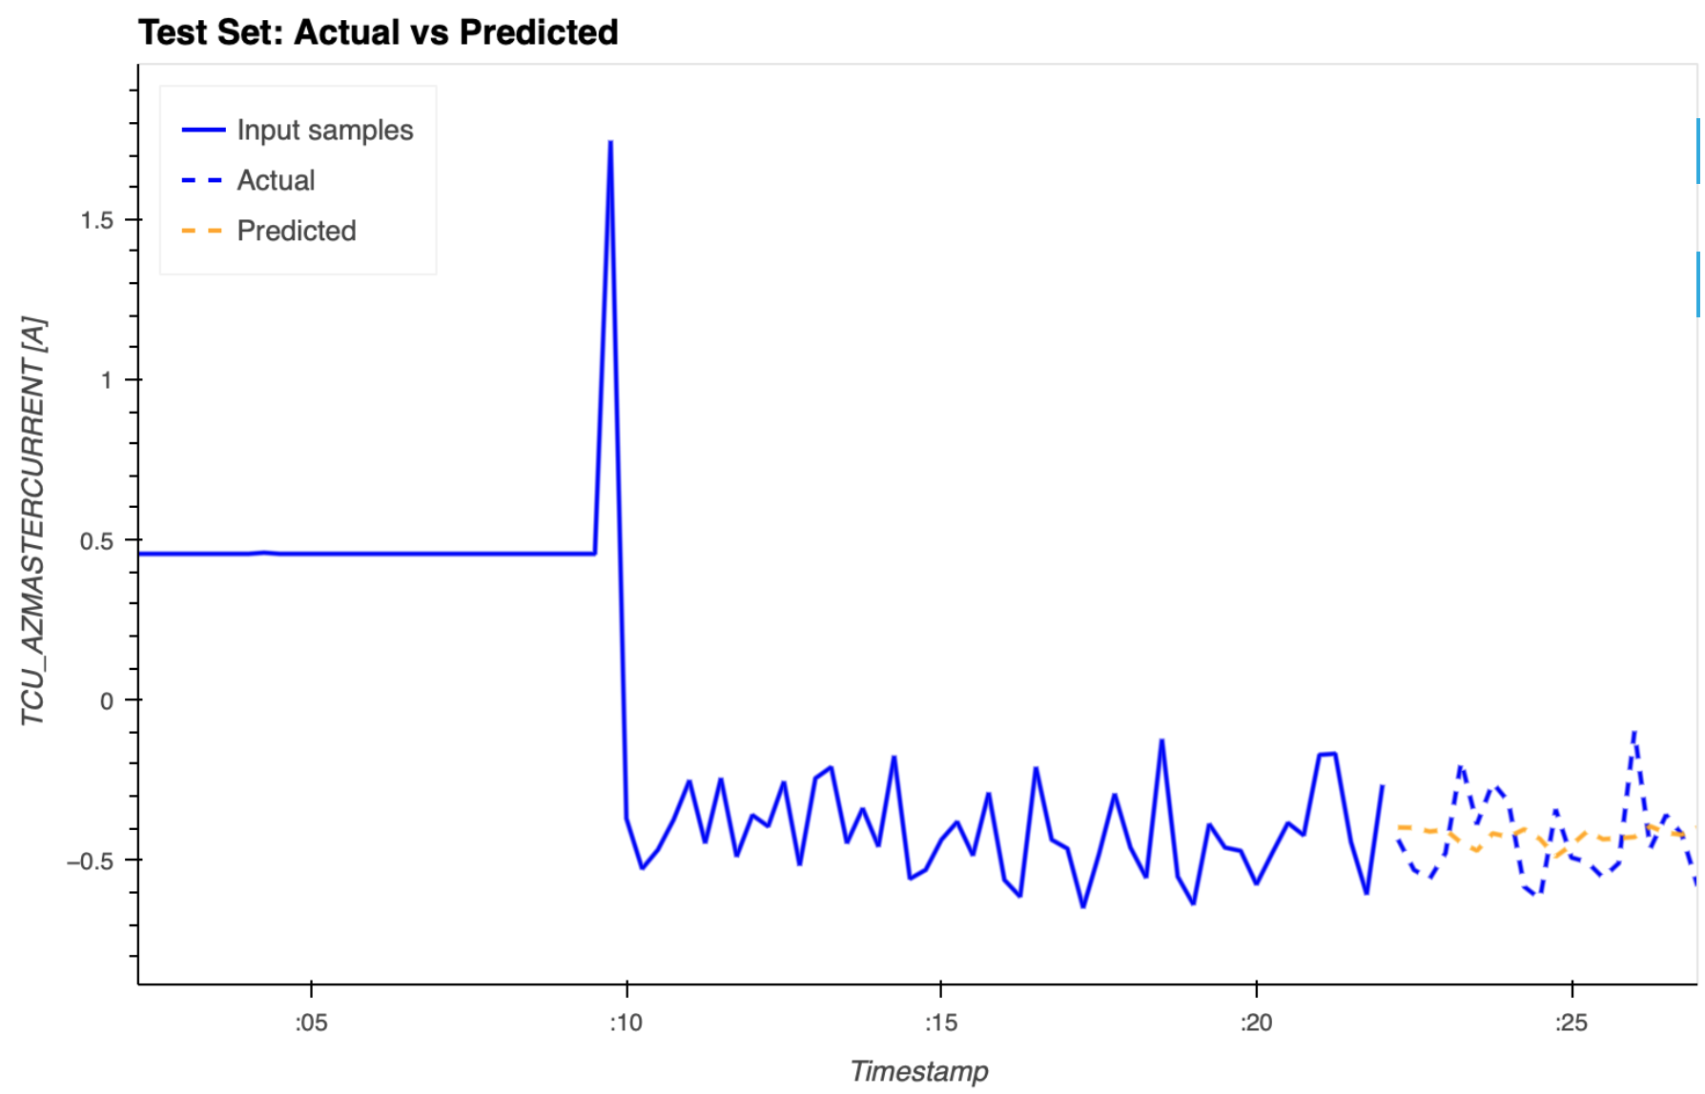
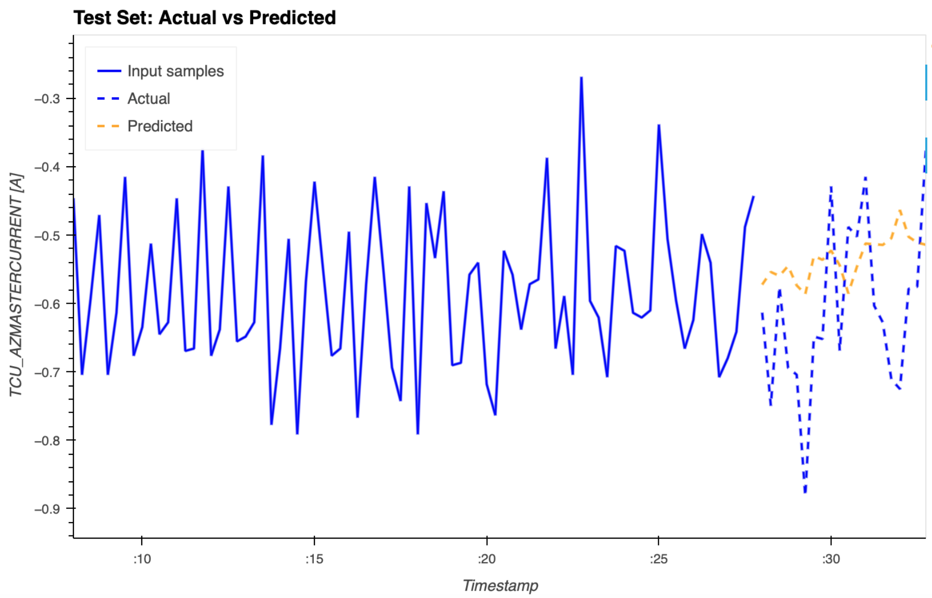
MF Plot
L = 20 min + 5 min
Federico Incardona, USCVIII – General Assembly, 14-18 October 2024, Galzignano Resort Terme & Golf

Slide 15
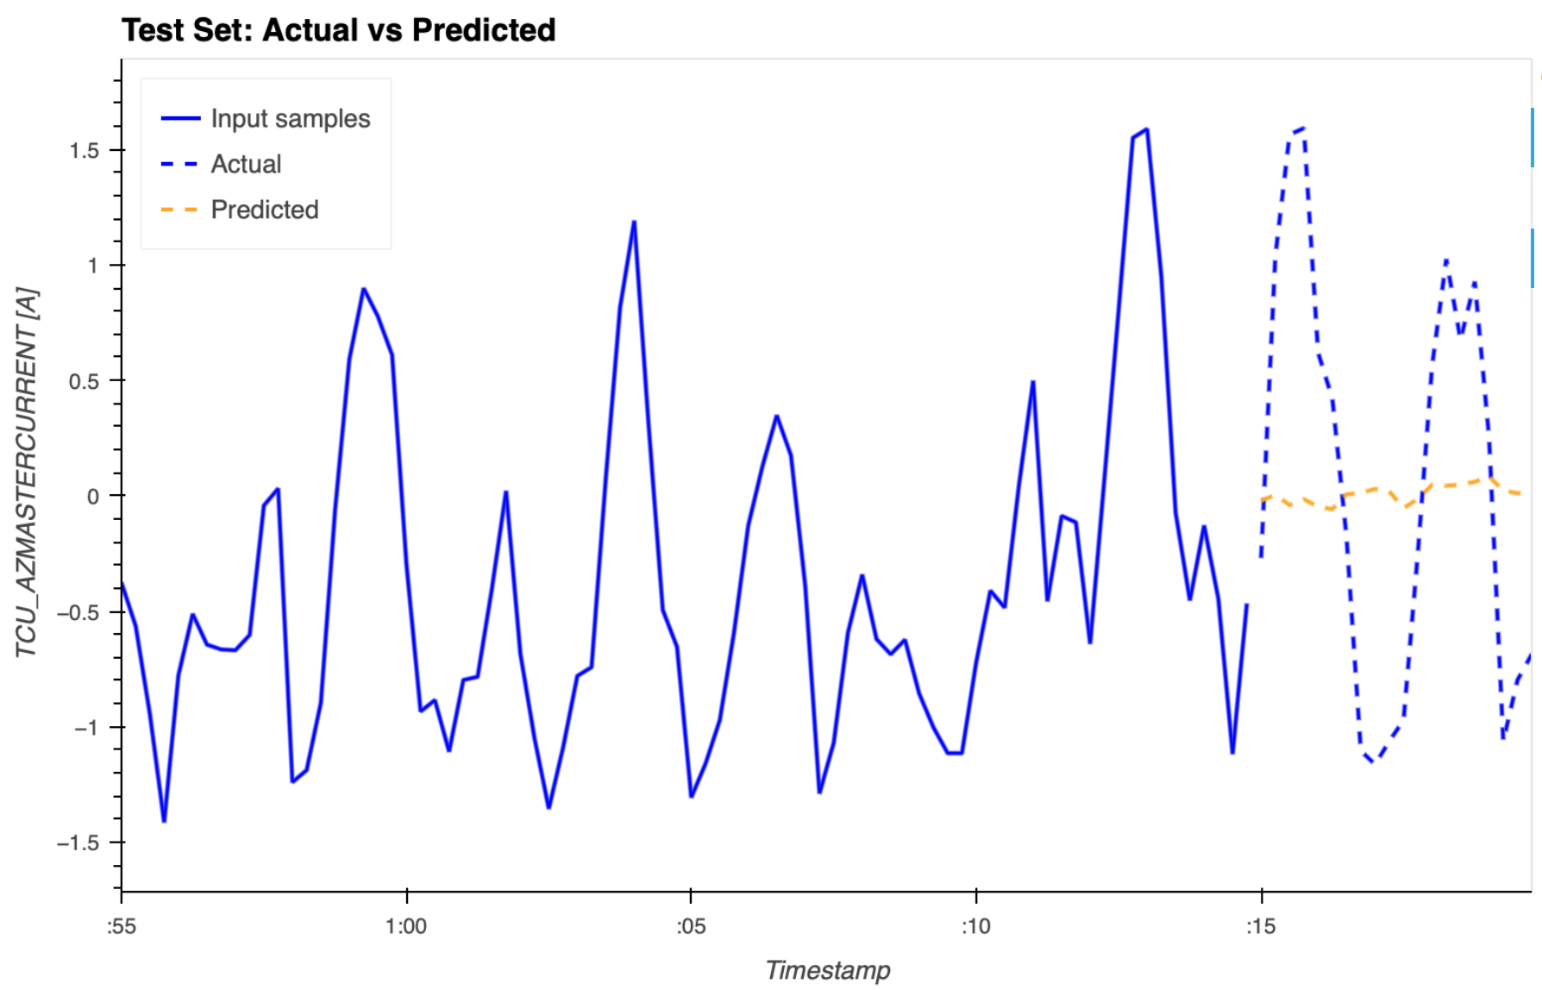
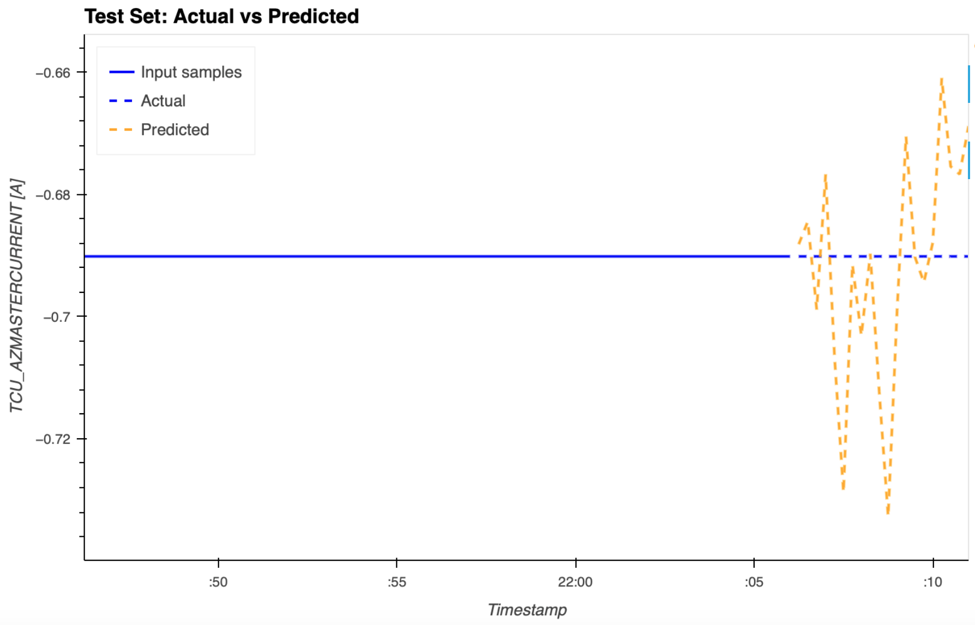
MF Plot
L = 20 min + 5 min
Federico Incardona, USCVIII – General Assembly, 14-18 October 2024, Galzignano Resort Terme & Golf

Slide 16
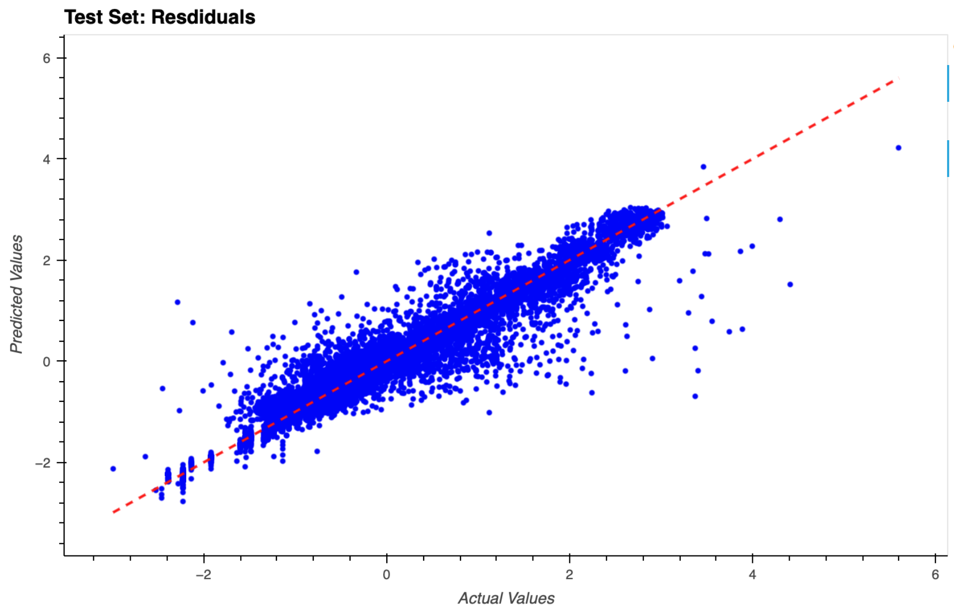
MF Residuals
L = 20 min + 5 min
Federico Incardona, USCVIII – General Assembly, 14-18 October 2024, Galzignano Resort Terme & Golf

Slide 17
MLP Results
 |  |  |  |  | Outliers remotion
 | Test MSE | Test MAPE | Train MSE | Train MAPE | Test MSE | Test MAPE | Train MSE | Train MAPE
L = 75 s + 15 s
(1440, 720, 360) | 0.218 | 6.737 | 0.191 | 4.920 | 0.198 | 2.810 | 0.133 | 2.470
L = 20 min + 5 min
(320, 160, 60) | 0.218 | 5.419 | 0.195 | 5.942 | 0.187 | 3.338 | 0.169 | 3.432
L = 5 h + 1 h
(1440, 720, 360) | 0.124 | 4.026 | 0.109 | 4.208 | 0.113 | 1.144 | 0.104 | 1.123
L = 5 h 50 min + 10 min
(1440, 720, 360, 180, 90, 40) | 0.146 | 3.852 | 0.134 | 3.983 | 0.124 | 1.394 | 0.114 | 1.127
Longer intervals improve the metrics
Outliers remotion improve the metrics
Federico Incardona, USCVIII – General Assembly, 14-18 October 2024, Galzignano Resort Terme & Golf
Notes:
Riportiamo in questa tabella l’architettura che ha dato i risultati migliori
Notiamo che
otteniamo migliori predizioni con input samples lunghi ma abbiamo visto che il risultato non migliora aumentando ancora l’input samples a scapito dell’offeset samples
La rimozione degli outliers migliora il modello

Slide 18
MLP Results
 |  |  |  |  | Outliers remotion
 | Test MSE | Test MAPE | Train MSE | Train MAPE | Test MSE | Test MAPE | Train MSE | Train MAPE
L = 75 s + 15 s
(1440, 720, 360) | 0.218 | 6.737 | 0.191 | 4.920 | 0.198 | 2.810 | 0.133 | 2.470
L = 20 min + 5 min
(320, 160, 60) | 0.218 | 5.419 | 0.195 | 5.942 | 0.187 | 3.338 | 0.169 | 3.432
L = 5 h + 1 h
(1440, 720, 360) | 0.124 | 4.026 | 0.109 | 4.208 | 0.113 | 1.144 | 0.104 | 1.123
L = 5 h 50 min + 10 min
(1440, 720, 360, 180, 90, 40) | 0.146 | 3.852 | 0.134 | 3.983 | 0.124 | 1.394 | 0.114 | 1.127
Longer intervals improve the metrics
Outliers remotion improve the metrics
Federico Incardona, USCVIII – General Assembly, 14-18 October 2024, Galzignano Resort Terme & Golf
Notes:
Riportiamo in questa tabella l’architettura che ha dato i risultati migliori
Notiamo che
otteniamo migliori predizioni con input samples lunghi ma abbiamo visto che il risultato non migliora aumentando ancora l’input samples a scapito dell’offeset samples
La rimozione degli outliers migliora il modello

Slide 19
MLP Results
 |  |  |  |  | Outliers remotion
 | Test MSE | Test MAPE | Train MSE | Train MAPE | Test MSE | Test MAPE | Train MSE | Train MAPE
L = 75 s + 15 s
(1440, 720, 360) | 0.218 | 6.737 | 0.191 | 4.920 | 0.198 | 2.810 | 0.133 | 2.470
L = 20 min + 5 min
(320, 160, 60) | 0.218 | 5.419 | 0.195 | 5.942 | 0.187 | 3.338 | 0.169 | 3.432
L = 5 h + 1 h
(1440, 720, 360) | 0.124 | 4.026 | 0.109 | 4.208 | 0.113 | 1.144 | 0.104 | 1.123
L = 5 h 50 min + 10 min
(1440, 720, 360, 180, 90, 40) | 0.146 | 3.852 | 0.134 | 3.983 | 0.124 | 1.394 | 0.114 | 1.127
Longer intervals improve the metrics
Outliers remotion improve the metrics
Federico Incardona, USCVIII – General Assembly, 14-18 October 2024, Galzignano Resort Terme & Golf
Notes:
Riportiamo in questa tabella l’architettura che ha dato i risultati migliori
Notiamo che
otteniamo migliori predizioni con input samples lunghi ma abbiamo visto che il risultato non migliora aumentando ancora l’input samples a scapito dell’offeset samples
La rimozione degli outliers migliora il modello

Slide 20
MLP Results
 |  |  |  |  | Outliers remotion
 | Test MSE | Test MAPE | Train MSE | Train MAPE | Test MSE | Test MAPE | Train MSE | Train MAPE
L = 75 s + 15 s
(1440, 720, 360) | 0.218 | 6.737 | 0.191 | 4.920 | 0.198 | 2.810 | 0.133 | 2.470
L = 20 min + 5 min
(320, 160, 60) | 0.218 | 5.419 | 0.195 | 5.942 | 0.187 | 3.338 | 0.169 | 3.432
L = 5 h + 1 h
(1440, 720, 360) | 0.124 | 4.026 | 0.109 | 4.208 | 0.113 | 1.144 | 0.104 | 1.123
L = 5 h 50 min + 10 min
(1440, 720, 360, 180, 90, 40) | 0.146 | 3.852 | 0.134 | 3.983 | 0.124 | 1.394 | 0.114 | 1.127
Longer intervals improve the metrics
Outliers remotion improve the metrics
Federico Incardona, USCVIII – General Assembly, 14-18 October 2024, Galzignano Resort Terme & Golf
Notes:
Riportiamo in questa tabella l’architettura che ha dato i risultati migliori
Notiamo che
otteniamo migliori predizioni con input samples lunghi ma abbiamo visto che il risultato non migliora aumentando ancora l’input samples a scapito dell’offeset samples
la rimozione degli outliers migliora il modello
Rimuovendo gli outleiers otteniamoin un buon agreement nel caso di un intervallo di predizione di un’ora

Slide 21
MLP Results
 |  |  |  |  | Outliers remotion
 | Test MSE | Test MAPE | Train MSE | Train MAPE | Test MSE | Test MAPE | Train MSE | Train MAPE
L = 75 s + 15 s
(1440, 720, 360) | 0.218 | 6.737 | 0.191 | 4.920 | 0.198 | 2.810 | 0.133 | 2.470
L = 20 min + 5 min
(320, 160, 60) | 0.218 | 5.419 | 0.195 | 5.942 | 0.187 | 3.338 | 0.169 | 3.432
L = 5 h + 1 h
(1440, 720, 360) | 0.124 | 4.026 | 0.109 | 4.208 | 0.113 | 1.144 | 0.104 | 1.123
L = 5 h 50 min + 10 min
(1440, 720, 360, 180, 90, 40) | 0.146 | 3.852 | 0.134 | 3.983 | 0.124 | 1.394 | 0.114 | 1.127
Longer intervals improve the metrics
Outliers remotion improve the metrics
Federico Incardona, USCVIII – General Assembly, 14-18 October 2024, Galzignano Resort Terme & Golf
Notes:
Riportiamo in questa tabella l’architettura che ha dato i risultati migliori
Notiamo che
otteniamo migliori predizioni con input samples lunghi ma abbiamo visto che il risultato non migliora aumentando ancora l’input samples a scapito dell’offeset samples
la rimozione degli outliers migliora il modello
Rimuovendo gli outleiers otteniamoin un buon agreement nel caso di un intervallo di predizione di un’ora

Slide 22
MLP Results
 |  |  |  |  | Outliers remotion
 | Test MSE | Test MAPE | Train MSE | Train MAPE | Test MSE | Test MAPE | Train MSE | Train MAPE
L = 75 s + 15 s
(1440, 720, 360) | 0.218 | 6.737 | 0.191 | 4.920 | 0.198 | 2.810 | 0.133 | 2.470
L = 20 min + 5 min
(320, 160, 60) | 0.218 | 5.419 | 0.195 | 5.942 | 0.187 | 3.338 | 0.169 | 3.432
L = 5 h + 1 h
(1440, 720, 360) | 0.124 | 4.026 | 0.109 | 4.208 | 0.113 | 1.144 | 0.104 | 1.123
L = 5 h 50 min + 10 min
(1440, 720, 360, 180, 90, 40) | 0.146 | 3.852 | 0.134 | 3.983 | 0.124 | 1.394 | 0.114 | 1.127
Best results in the case of 5h + 1h with no outliers
Federico Incardona, USCVIII – General Assembly, 14-18 October 2024, Galzignano Resort Terme & Golf
Notes:
Riportiamo in questa tabella l’architettura che ha dato i risultati migliori
Notiamo che
otteniamo migliori predizioni con input samples lunghi ma abbiamo visto che il risultato non migliora aumentando ancora l’input samples a scapito dell’offeset samples
La rimozione degli outliers migliora il modello

Slide 23
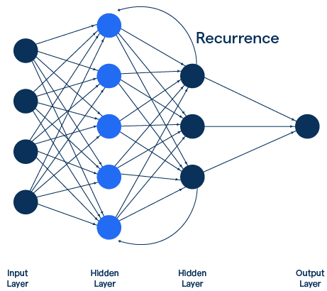
LSTM model
The Long short-term memory (LSTM) is a type of recurrent neural network (RNN)
Connections exploit feedback loops to process sequential data, allowing information to be retained between time steps
Uses memory cells and gates (input, forget, output) to decide what information to keep, update, or forget
Able to capture long-term dependencies
Federico Incardona, USCVIII – General Assembly, 14-18 October 2024, Galzignano Resort Terme & Golf
Notes:
Una rete neurale ricorrente o RNN (recurrent neural network) è una classe di rete neurale artificiale che include neuroni collegati tra loro in un ciclo. Tipicamente i valori di uscita di uno strato di un livello superiore sono utilizzati in ingresso di uno strato di livello inferiore.

Slide 24
LSTM architecture tuning
For each combination of input (I) and offset (O) samples, in the two cases with and without outliers, we tested the following NN architectures:
hidden_layer_sizes:
- [50]
- [100]
- [360]
- [720]
[1440]
num_layers:
- 1
- 2
- 3
- 4
- 5
Federico Incardona, USCVIII – General Assembly, 14-18 October 2024, Galzignano Resort Terme & Golf

Slide 25
LSTM results
 |  |  |  |  | Outliers remotion
 | Test MSE | Test MAPE | Train MSE | Train MAPE | Test MSE | Test MAPE | Train MSE | Train MAPE
L = 75 s + 15 s
(360, 360) | 0.248 | 6.816 | 0.096 | 2.940 | 0.226 | 3.691 | 0.107 | 2.691
L = 20 min + 5 min
(320, 360) | 0.383 | 8.764 | 0.386 | 8.386 | 0.162 | 2.803 | 0.155 | 2.864
L = 5 h + 1 h
(360, 360) | 0.114 | 5.585 | 0.090 | 4.820 | 0.096 | 1.167 | 0.081 | 1.055
Almost the same results as in the previous case
Federico Incardona, USCVIII – General Assembly, 14-18 October 2024, Galzignano Resort Terme & Golf
Notes:
Ciascu

Slide 26

Next steps
Improve the outliers removal process
Try other algorithms, e.g., autoencoders
Develop the PdM software application
Test it on ASTRI-Horn
Use the new ASTRI 1 Monitoring Data
Federico Incardona, USCVIII – General Assembly, 14-18 October 2024, Galzignano Resort Terme & Golf
Notes:
Rimozione delle variabili correlate per la riduzione del database

Slide 27
Thank you
Federico Incardona, USCVIII – General Assembly, 14-18 October 2024, Galzignano Resort Terme & Golf

Slide 28
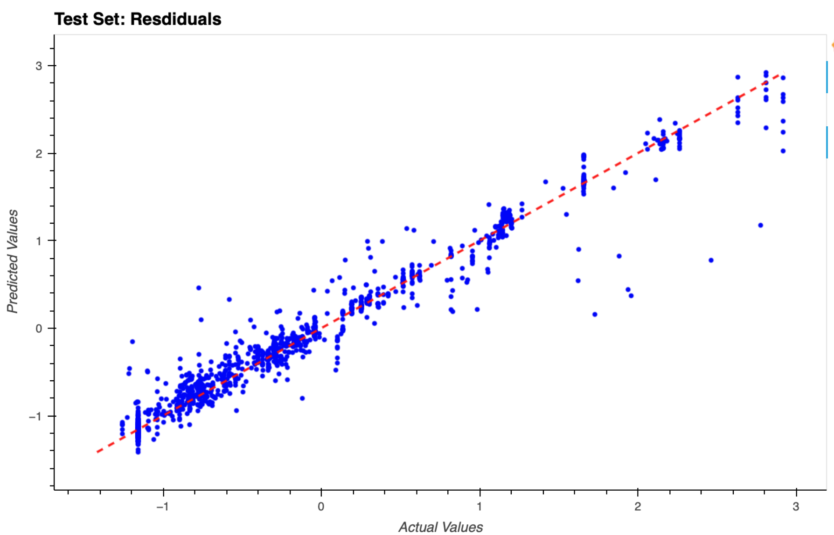
MF Residuals
L = 5h + 1h
Federico Incardona, USCVIII – General Assembly, 14-18 October 2024, Galzignano Resort Terme & Golf

Slide 29
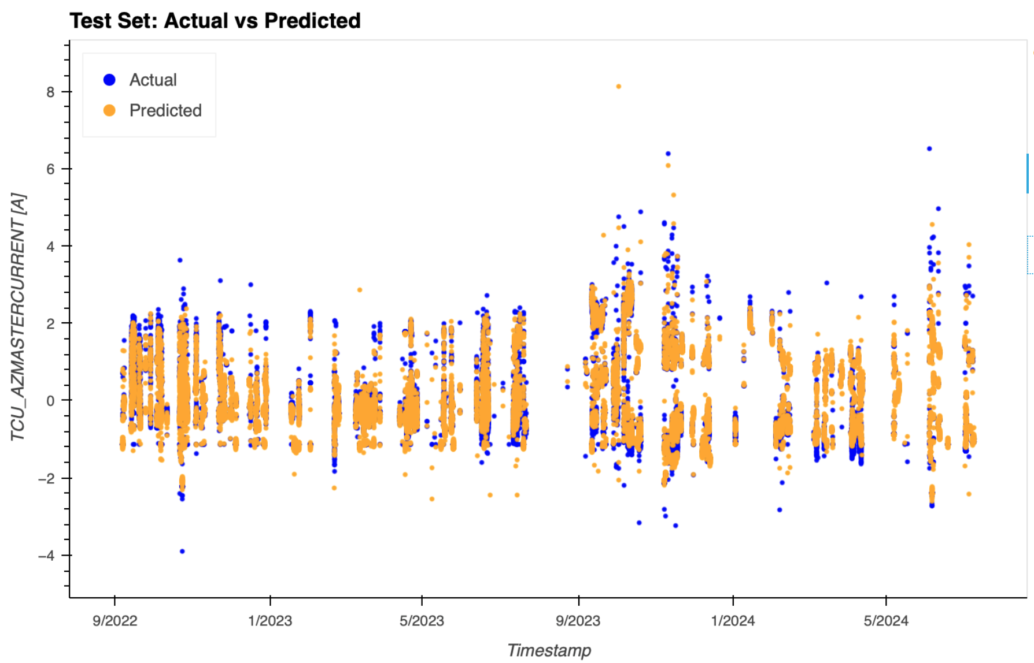
MF Plot
L = 75 s + 15 s
Federico Incardona, USCVIII – General Assembly, 14-18 October 2024, Galzignano Resort Terme & Golf

Slide 30
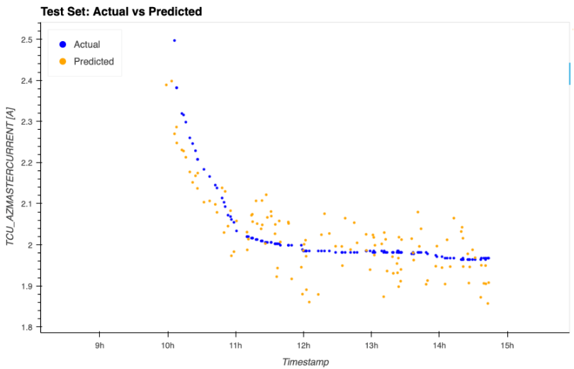
MF Plot
L = 75 s + 15 s
Federico Incardona, USCVIII – General Assembly, 14-18 October 2024, Galzignano Resort Terme & Golf

Slide 31
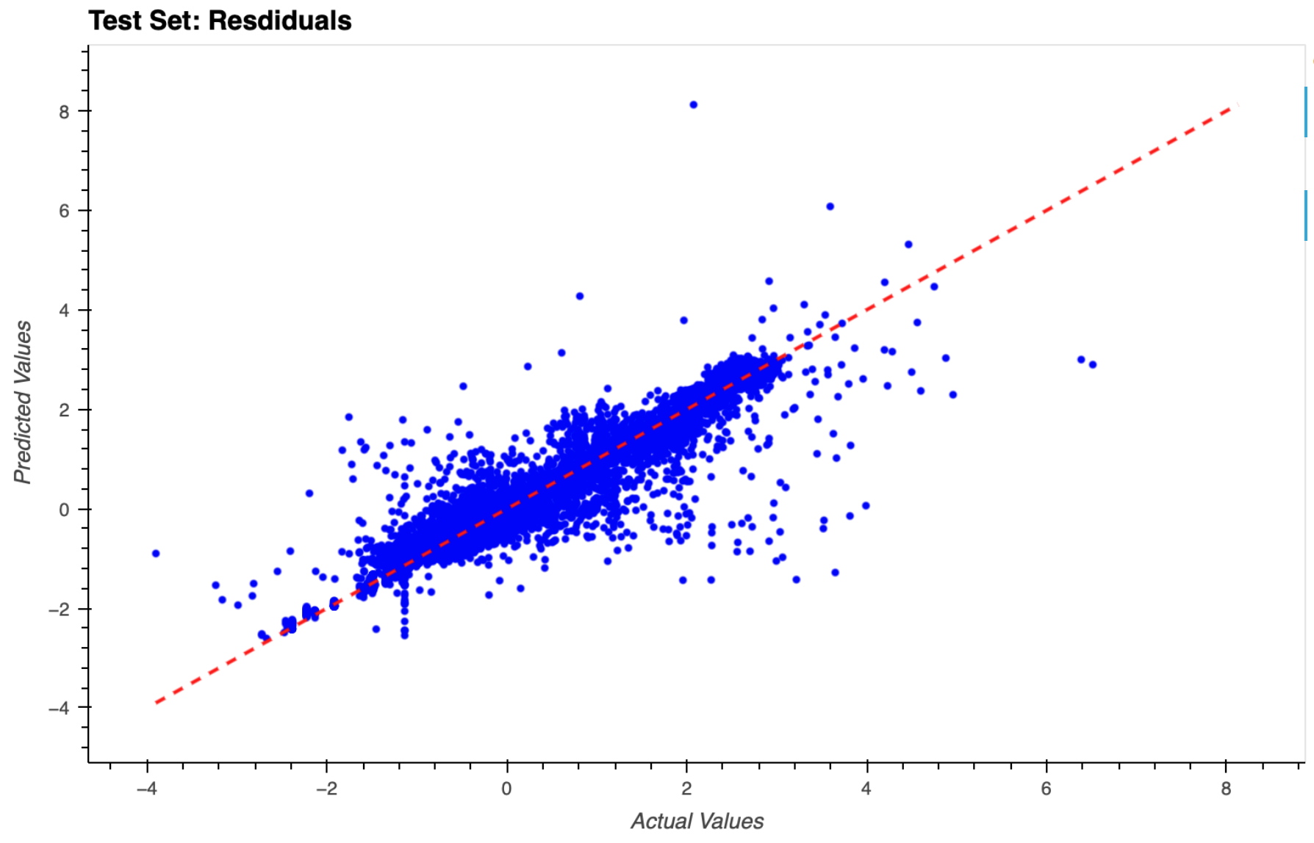
MF Residuals
L = 75 s + 15 s
Federico Incardona, USCVIII – General Assembly, 14-18 October 2024, Galzignano Resort Terme & Golf

Slide 32
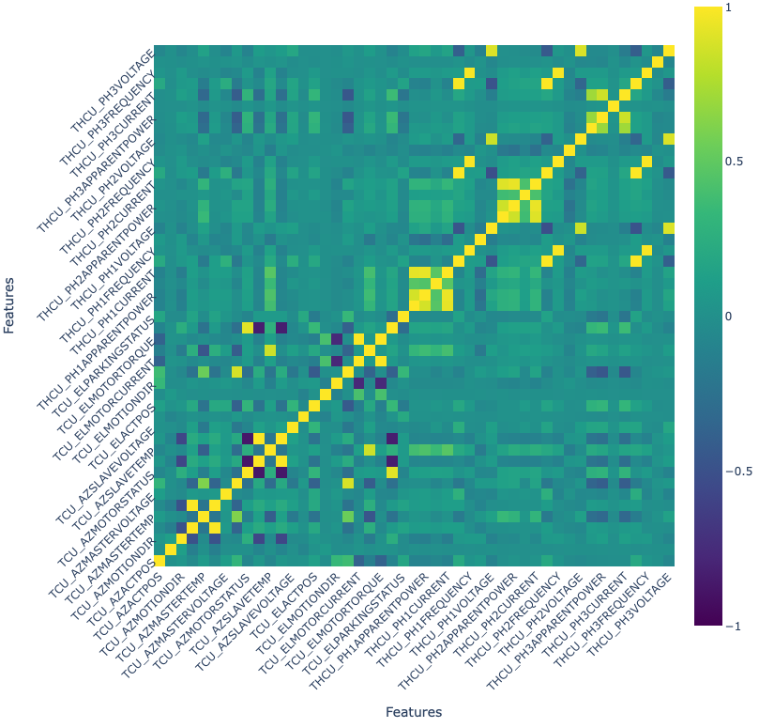
Feature correlation
Pearson coefficient
2-sigma correlated features
 | Feature_1 | Feature_2 | Pearson
0 | TCU_AZSLAVETORQUE | TCU_AZSLAVECURRENT | 0.998421
1 | TCU_AZMASTERTORQUE | TCU_AZMASTERCURRENT | 0.997397
2 | THCU_PH3ENERGY | THCU_PH2ENERGY | 0.996919
3 | TCU_ELMOTORTORQUE | TCU_ELMOTORCURRENT | 0.994627
4 | THCU_PH2ENERGY | THCU_PH1ENERGY | 0.993376
5 | THCU_PH3ENERGY | THCU_PH1ENERGY | 0.991244
6 | THCU_PH3FREQUENCY | THCU_PH1FREQUENCY | 0.985690
7 | THCU_PH3FREQUENCY | THCU_PH2FREQUENCY | 0.985656
8 | THCU_PH2FREQUENCY | THCU_PH1FREQUENCY | 0.985536
Federico Incardona, USCVIII – General Assembly, 14-18 October 2024, Galzignano Resort Terme & Golf
Notes:
Example: 1 sigma -> 0.6827, 2 sigma -> 0.9545, 3 sigma -> 0.9973.

Slide 33
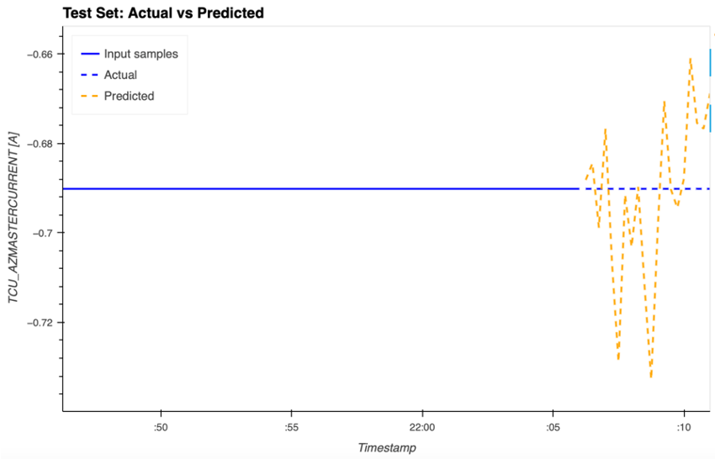
Residual Plot Explanation
Federico Incardona, USCVIII – General Assembly, 14-18 October 2024, Galzignano Resort Terme & Golf

Slide 34
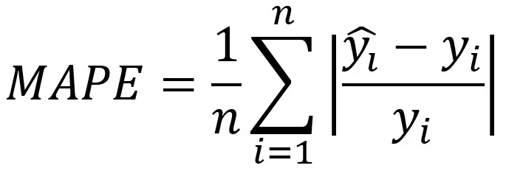
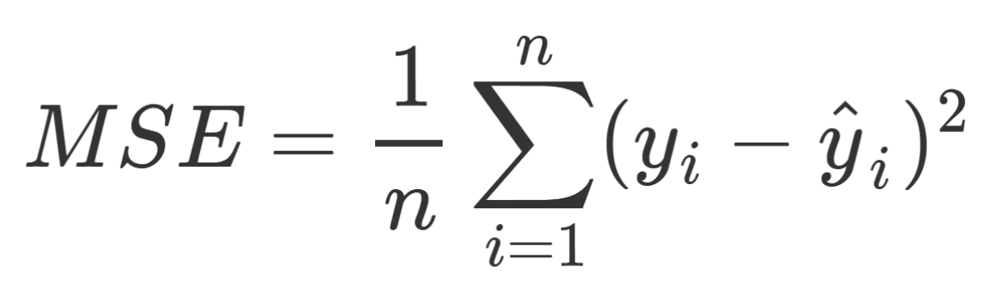
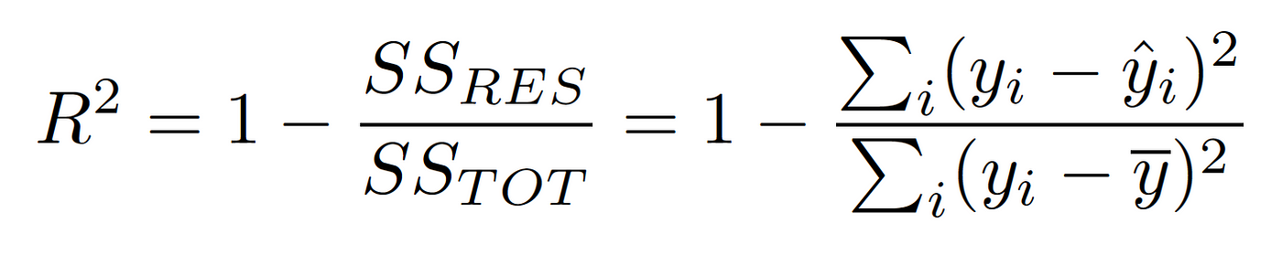
Evalutaion metrics
Federico Incardona, USCVIII – General Assembly, 14-18 October 2024, Galzignano Resort Terme & Golf
Notes:
Mean squared error
R2 score

Slide 35
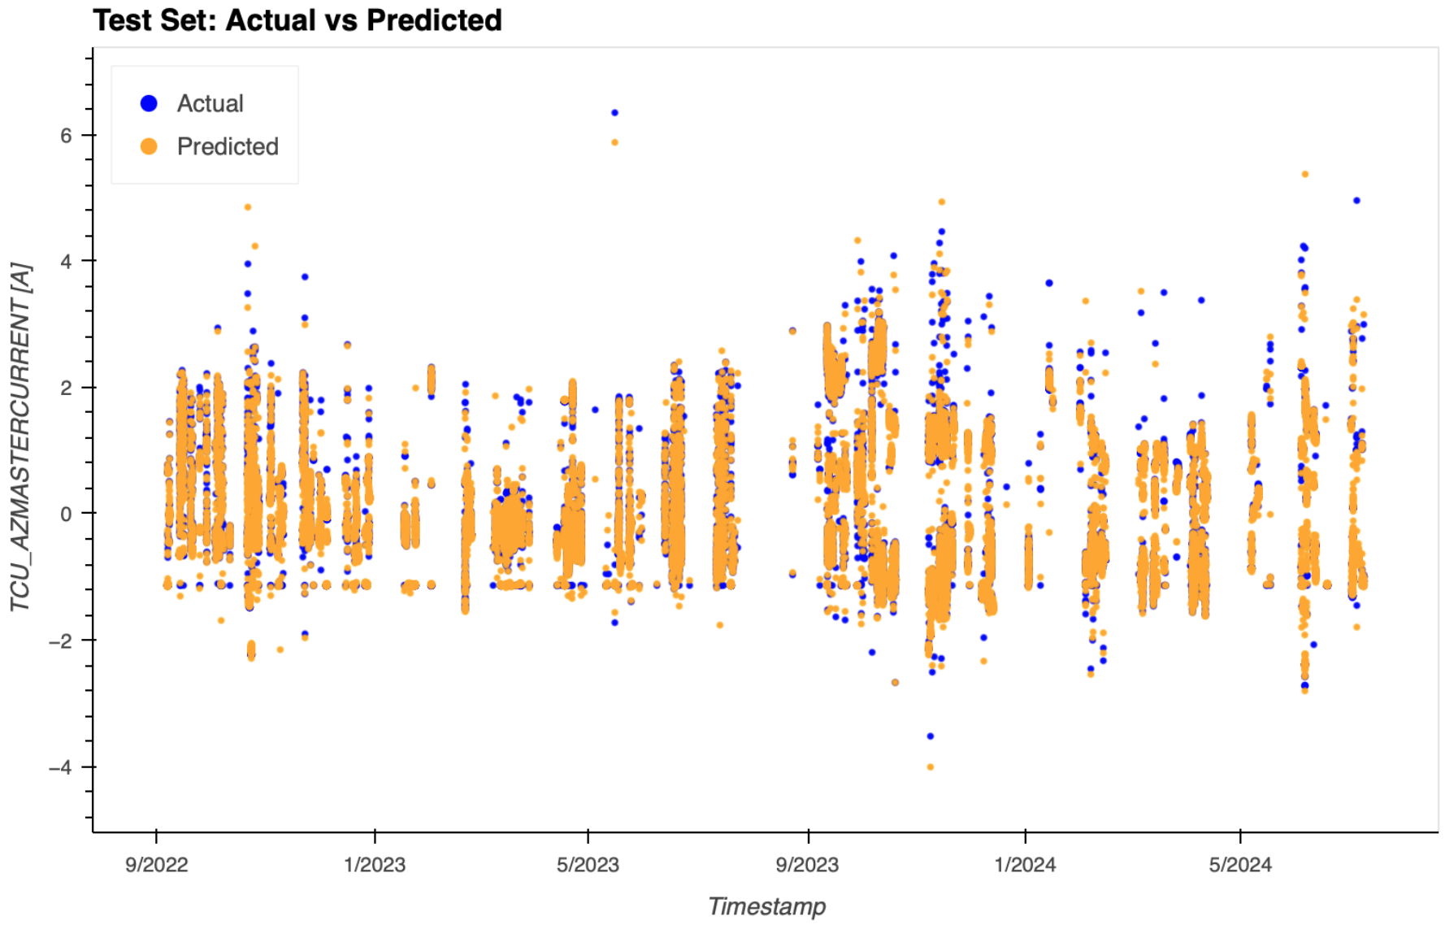
Single Points Model (SPM)
Treat each point as independent from the others
Hyperparameter optimization over different shapes of the NN (hidden layers)
Federico Incardona, USCVIII – General Assembly, 14-18 October 2024, Galzignano Resort Terme & Golf

Slide 36
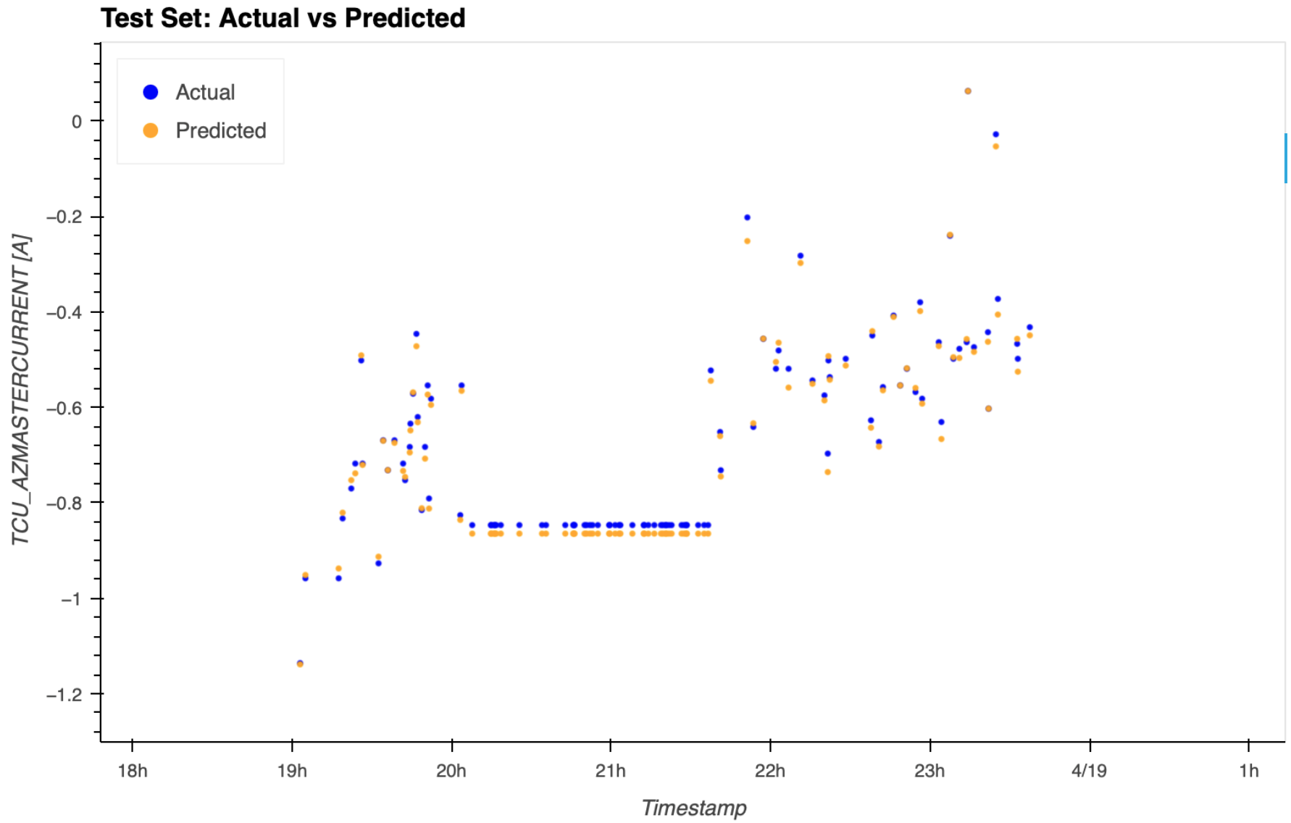
SPM Forecast Plot
Federico Incardona, USCVIII – General Assembly, 14-18 October 2024, Galzignano Resort Terme & Golf

Slide 37
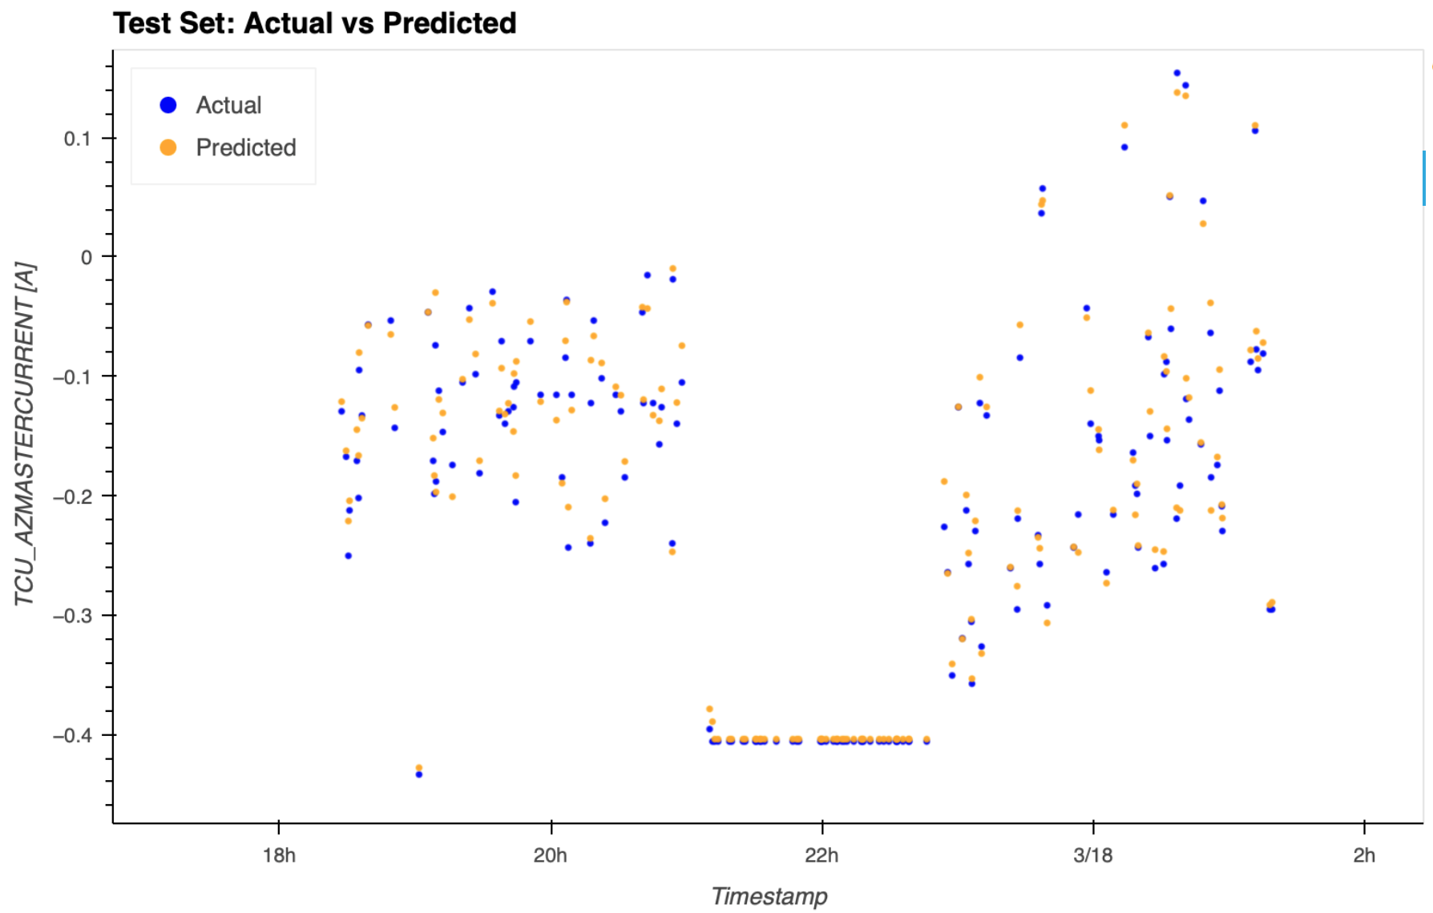
SPM Forecast Plot
Federico Incardona, USCVIII – General Assembly, 14-18 October 2024, Galzignano Resort Terme & Golf

Slide 38
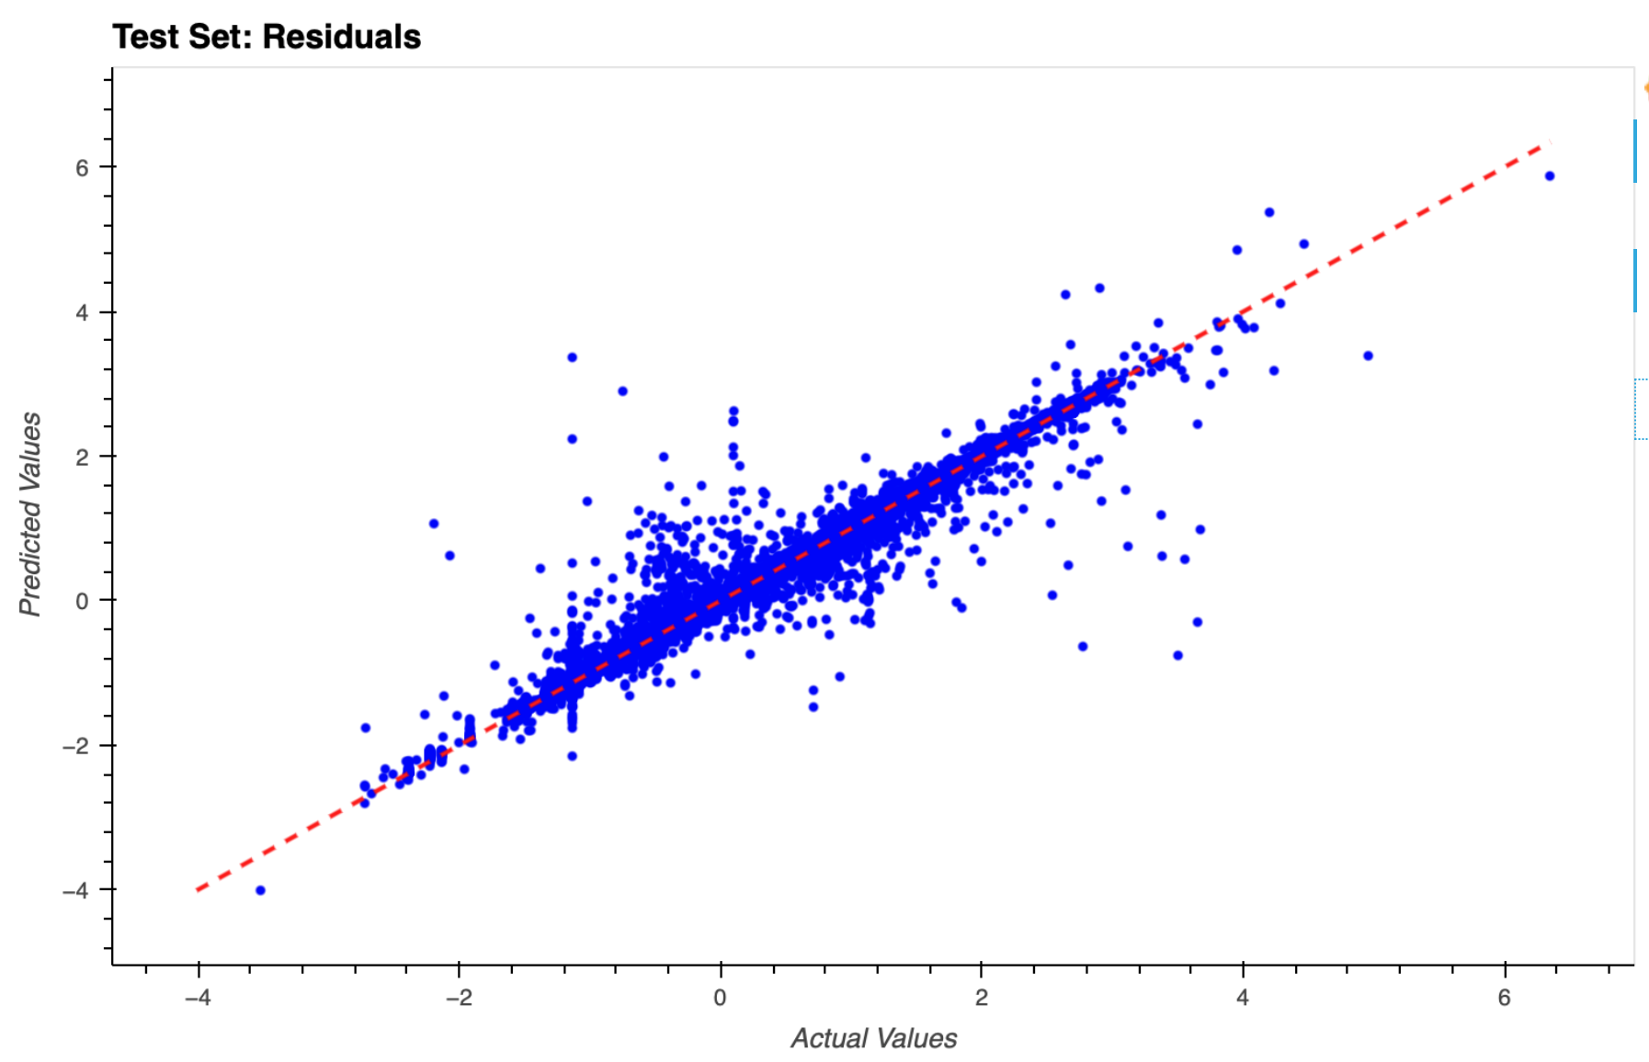
SPM Residuals Plot
Federico Incardona, USCVIII – General Assembly, 14-18 October 2024, Galzignano Resort Terme & Golf

Slide 39
SPM Results
 | Test MSE | Test R2 | Train MSE | Train R2
TCU_AZ_MASTERCURRENT
(160, 320, 80) | 0.0018 | 0.998 | 0.0017 | 0.998
5 Sigma outliers remotion
(160, 320, 80) | 0.0038 | 0.996 | 0.0011 | 0.999
2 Sigma correlated variables remotion
(160, 320, 80) | 0.0142 | 0.986 | 0.0059 | 0.994
5 Sigma outliers remotion; 2 Sigma correlated variables remotion
(160, 320, 80) | 0.0235 | 0.978 | 0.0074 | 0.993
Slight worsening due to outliers remotion
Slight worsening due to the remotion of the correlated features
Federico Incardona, USCVIII – General Assembly, 14-18 October 2024, Galzignano Resort Terme & Golf

Slide 40
SPM Results
 | Test MSE | Test R2 | Train MSE | Train R2
TCU_AZ_MASTERCURRENT
(160, 320, 80) | 0.0018 | 0.998 | 0.0017 | 0.998
5 Sigma outliers remotion
(160, 320, 80) | 0.0038 | 0.996 | 0.0011 | 0.999
2 Sigma correlated variables remotion
(160, 320, 80) | 0.0142 | 0.986 | 0.0059 | 0.994
5 Sigma outliers remotion; 2 Sigma correlated variables remotion
(160, 320, 80) | 0.0235 | 0.978 | 0.0074 | 0.993
Slight worsening due to outliers remotion
Slight worsening due to the remotion of the correlated features
Federico Incardona, USCVIII – General Assembly, 14-18 October 2024, Galzignano Resort Terme & Golf

Slide 41
SPM Results
 | Test MSE | Test R2 | Train MSE | Train R2
TCU_AZ_MASTERCURRENT
(160, 320, 80) | 0.0018 | 0.998 | 0.0017 | 0.998
5 Sigma outliers remotion
(160, 320, 80) | 0.0038 | 0.996 | 0.0011 | 0.999
2 Sigma correlated variables remotion
(160, 320, 80) | 0.0142 | 0.986 | 0.0059 | 0.994
5 Sigma outliers remotion; 2 Sigma correlated variables remotion
(160, 320, 80) | 0.0235 | 0.978 | 0.0074 | 0.993
Slight worsening due to outliers remotion
Slight worsening due to the remotion of the correlated features
Federico Incardona, USCVIII – General Assembly, 14-18 October 2024, Galzignano Resort Terme & Golf

Slide 42
SPM Results
 | Test MSE | Test R2 | Train MSE | Train R2
TCU_AZ_MASTERCURRENT
(160, 320, 80) | 0.0018 | 0.998 | 0.0017 | 0.998
5 Sigma outliers remotion
(160, 320, 80) | 0.0038 | 0.996 | 0.0011 | 0.999
2 Sigma correlated variables remotion
(160, 320, 80) | 0.0142 | 0.986 | 0.0059 | 0.994
5 Sigma outliers remotion; 2 Sigma correlated variables remotion
(160, 320, 80) | 0.0235 | 0.978 | 0.0074 | 0.993
Slight worsening due to outliers remotion
Slight worsening due to the remotion of the correlated features
Federico Incardona, USCVIII – General Assembly, 14-18 October 2024, Galzignano Resort Terme & Golf
Notes:
Questo comportamento non è atteso

Slide 43
SPM Results
 | Test MSE | Test R2 | Train MSE | Train R2
TCU_AZ_MASTERCURRENT
(160, 320, 80) | 0.0018 | 0.998 | 0.0017 | 0.998
5 Sigma outliers remotion
(160, 320, 80) | 0.0038 | 0.996 | 0.0011 | 0.999
2 Sigma correlated variables remotion
(160, 320, 80) | 0.0142 | 0.986 | 0.0059 | 0.994
5 Sigma outliers remotion; 2 Sigma correlated variables remotion
(160, 320, 80) | 0.0235 | 0.978 | 0.0074 | 0.993
Slight worsening due to outliers remotion
Slight worsening due to the remotion of the correlated features
Federico Incardona, USCVIII – General Assembly, 14-18 October 2024, Galzignano Resort Terme & Golf
Notes:
I valori per il train set sono molto migliori rispetto al test set

Slide 44
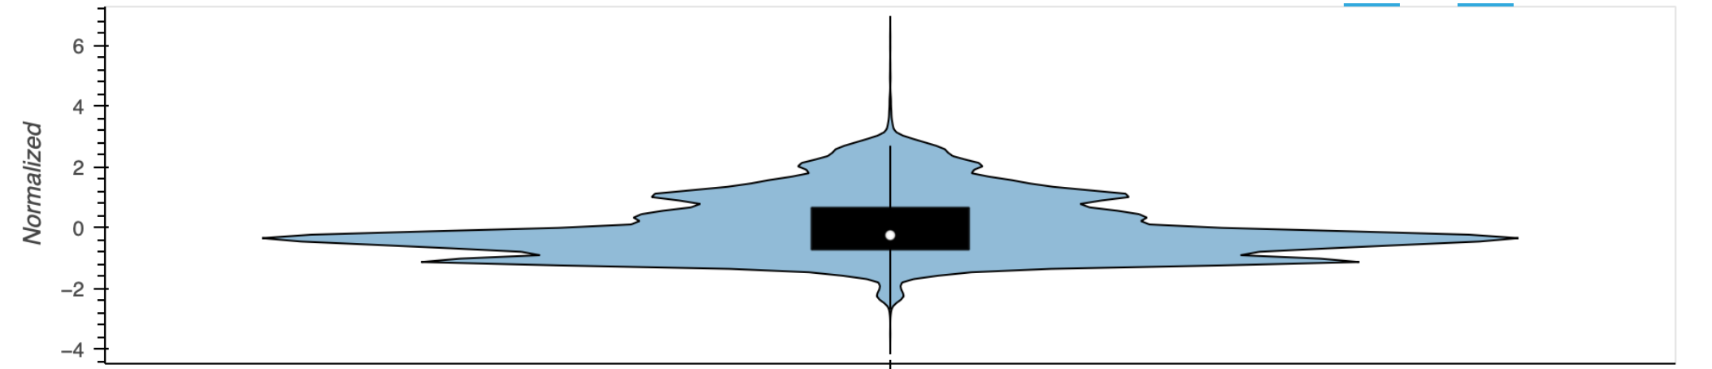
TCU_AZMASTERCURRENT
Federico Incardona, USCVIII – General Assembly, 14-18 October 2024, Galzignano Resort Terme & Golf

