Slide 1






Theory Grant –Astrometry of GWs, INAF RF 2023
The OPS4/DPCT HTC and HPC infrastructure. A whole-sky
INAF-ASI facility empowered by the Gaia mission legacy
Mario G. Lattanzi
for Team INAF@DPCT ( D. Busonero, E. Licata, A. Riva, A. Vecchiato, L. Filipello, S. Gelsumini, U. Abbas, B. Bucciarelli, R. Buzzi, M. Crosta)
& Team ALTEC@DPCT (R. Messineo, L. Tolomei, L. Squillnate, L. Bramante)
ICSC Italian Research Center on High-Performance Computing, Big Data and Quantum Computing
Missione 4 • Istruzione e Ricerca
GRAPE General Relativistic Astrometry and Pulsar Experiment Finanziato dell’UE – NextGenerationEU – Missione 4, Componente 2, Investimento 1.1

Slide 2
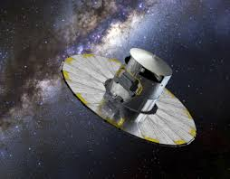
The Gaia mission is nearing the end of its operational life: after 10.5 years of continuous science operations (more than twice the initial lifetime), from the second half of Jan 2025, data taken with focal plane instruments will no longer be considered part of the scientific data stream (>> reconfiguration of Level-0 -1 and -2 pipelines at primary Data Processing Centers -DPCs- like the Italian DPCT).
However, in-orbit operations will continue for a few more months for testing end-of-life performances of digital detectors and other satellite subsystems in an effort to exploit Gaia's exceptional longevity despite its orbiting in the L2 environment (this activity is also strategic for Europe’s Scientific (including INAF) and Industrial Communities providing the necessary know-how to foster and improve leadership role in future projects; INAF is PI – A. Riva- of one of such post science operation experiments).
Courtesy of ASI
AS for the next Gaia data deliveries to the scientific community worldwide:
GDR4: 2nd quarter of 2026 (5.5 years of satellite science data)
GDR5: not before the end of 2030 (10.5 years of satellite data)

Slide 3
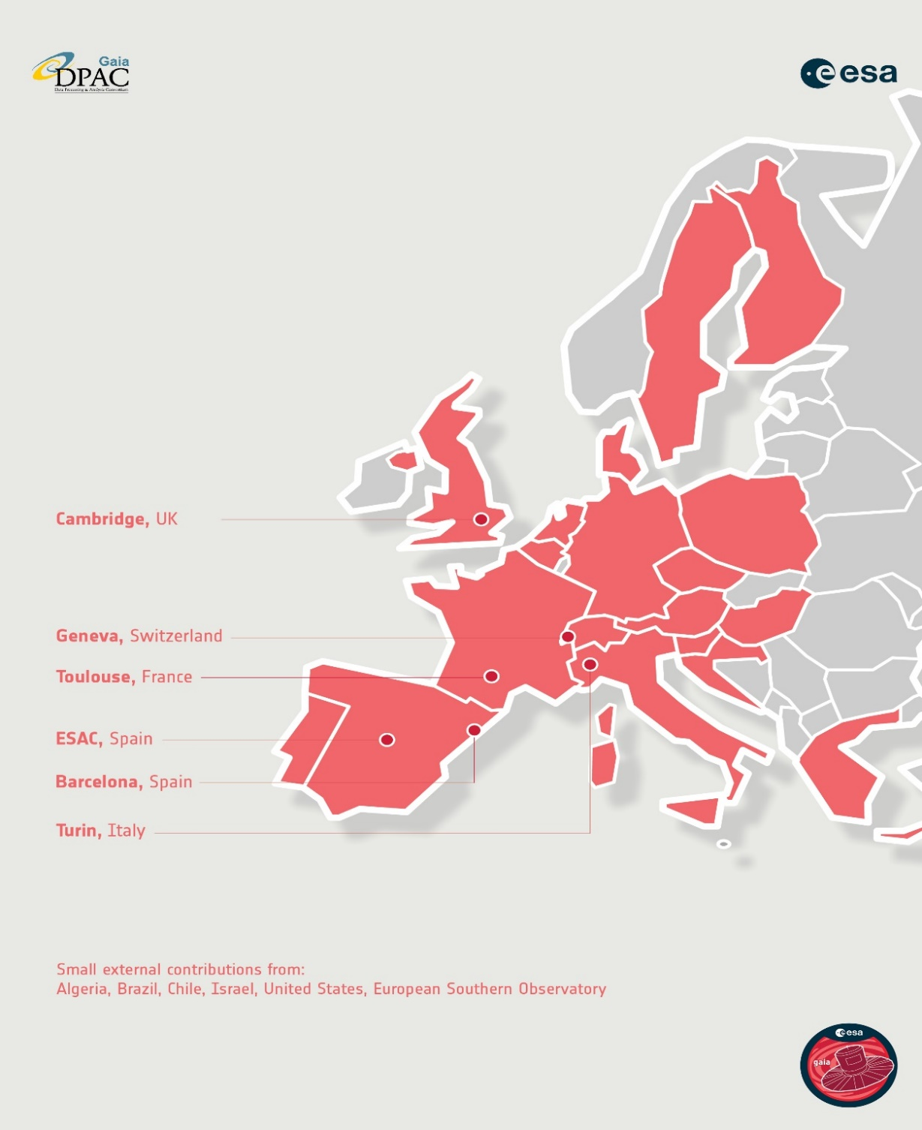
Il DPCT è uno dei 6 centri di processamento dati (DPC) del Gaia Science Ground Segment, ubicato in ALTEC a Torino. La sua realizzazione ed operatività è il risultato del lavoro di un team integrato INAF-OATo/ALTEC. Uno dei 3 primary DPC’s (core, Level-0 & Level-1 pipelines)
Ideazione e progettazione del DPCT e dei sistemi AVU iniziata nel lontano 2005 con in mente il concetto di ‘crescita e manutenzione evolutiva’.
INAF in DPCT: Catania (HPC@Cineca) e Torino (BIG DATA, HTC, HPC)

Slide 4
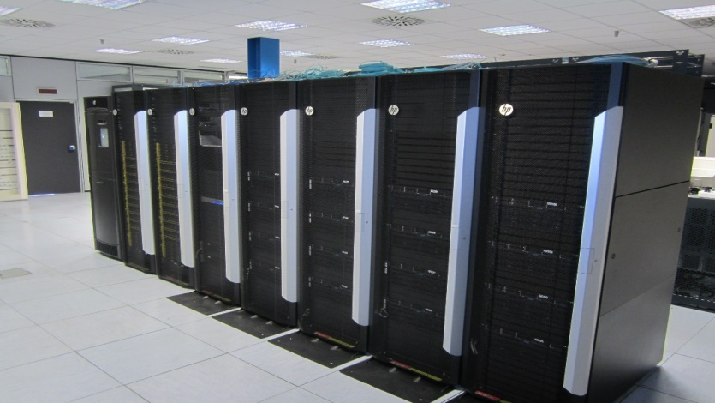
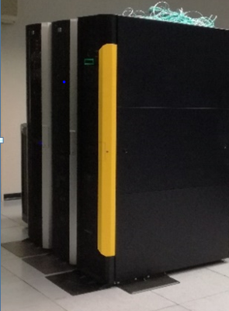
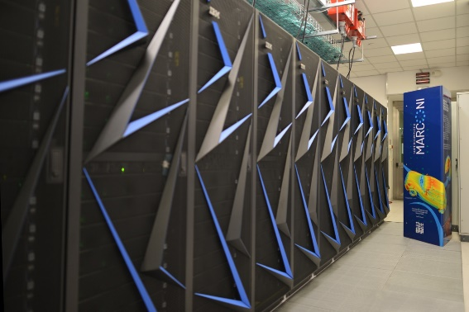
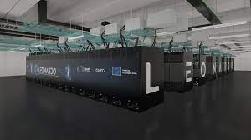
The DPCT- A Big Data/ HTC Facility
Operations and Test and development Platforms
Procurement paradigm: performed incrementally according to mission needs
INTERNET LINK : from 1 to 10 Gbps via GARR
HOT STORAGE SYSTEM CAPACITY: 2.5+ PB overall raw disk space distributed between two HP P7400 storage units and one P8400.
COMPUTING : 14 servers HP DL580 G7/G9 with a total of about 600 CPU cores and 4.5TB RAM.
DEV & TEST: 7 servers HP
DB SERVERS: 3 servers HP DL580 G7 (32 cores, 256MB RAM each) based on Oracle RAC technology (DBMS Oracle).
NETWORK CONNECTION: LAN network up to 10 Gbps. SAN network redundant at 8 Gbps.
SECURITY SERVICE: redundant firewall based on pfSense, enabling secure remote access via VPN.
INFRA MONITORING AND MANAGEMENT: services based on VMWare virtual environment configured with two HP DL 580 G7 servers clustered and managed by vCenter Server.
BACKUP SERVERS: HP DL580 G7 dedicated to DB and filesystem backups from data volume snaphots.
3 LEVELS BACKUP : L1 on primary storage array, L2 on disks (StoreOnce 6600) and L3 on tape libraries (HP ESL G3).
HPC INTERCONNECTION: access to HPC super computer at CINECA for dedicated processing.
Operation Platform
Dev&Test
L2
back-up
(See talk by E. Licata)
Direct link to HPC systems at CINECA via dedicated MOU
(See talk by V. Cesare)

Slide 5
Entering the post-operations phase and Gaia’ legacy era, i.e., from data acquisition, reduction, analysis and scientific quality validation for the given Project/mission, to Big Data data management (including long term preservation) and (deep: HTC and HPC) exploitation (including re-processing/calibration pipelines).
Team INAF, with the support of Team ALTEC and additional resources procured via more recent initiatives funded by PNRR, Univeristy and INAF Grants, is working at our Data Processing facility (DPCT@ALTEC) to face the challenges of the mission legacy, as advocated and prototyped in the framework of The Living Sky Project (WP4 of the MITIC special project, 2018-2022):
Data Management and Computational issues
New paradigms in data science (ML and AI)
Infrastructural aspects (based on economic and environmental sustainability
>> All implied by the deep exploitation of the first Big Data system of the faint astronomical sky built only from space-borne data.

Slide 6
Operations vs Legacy

Slide 7
Gaia’s Operations
In Operations direct use of parallel queries (via Oracle RAC technology) on DB to meet stringent DPAC requirements on processing time of Daily and Cyclic pipelines. Up to ~1000 simultaneous workflows estimated: however, limited time for code optimization and firmware limitations (HPE infrastructure vs Oracle DBMS) allowed us to achieve ~ 250 at peak performances.
Daily Pipelines use data in the time domain (objects transits on focal plane) and DB occupancy depends on cadence and tables are naturally organized/accessed by time:
AstroObservations Table = the actual Data Lake made of the 16 bit ADU pixels registered on focal plane digital detectors and sent to ground: 0.3 PBy.
IDU – AstroElemetaries Table = Intermediate Data 0.4 PBy containing the actual measurements
The computational complexity is driven by the number observations taken on average per day by Gaia.

Slide 8
Cyclic Pipeline (General Relativistic Sphere Reconstruction, GSR) utilize data per source (n~2 billions sources found by Gaia) and for each of the n sources all of the measurements (the IDU – AstroElemetaries Table) are processed in a whole big astrometric reconstruction of the whole celestial sphere.
GSR is a unique INAF full-GenRel model to 0.1 μas, where both observables (photons) and receiving Observers are relativistic (only two existing worldwide)
[As sources are discovered they are naturally placed on the celestial sphere utilisizing a HEALPix sphere partioning schema we implemented in Orcacle via their Spatial product.]
Therefore the n Gaia sources must be accessed spatially as well, and intermediate relation tables must be constructed to efficiently build a 2D indexing (time and position). Relation tables that can be huge are partitioned using Oracle specific methods.
Thus, computationl complexity > n times that of the Daily pipelines
Processing requirements on the Gaia Science Ground Segment led to the use of massive (0.5 PBy) DB’s, the largest ever handled by the Oracle DBMS. <<<<< a non-standard use for the creators!
For the massive HPC aspects to reconstruct the celestial sphere with GSR, and the need for the facilities @Cineca, see V. Cesare’s contribution.

Slide 9
Gaia’s Legacy
Legacy (strategic) functions: legacy requirements
Establish & maintain deep/dense Reference Frame at different wavelength
Development of new mission concepts, their design and profiling >> business line
Support mission operations (Euclid, CSST, LISA,….) >> business line (ex. 1, next slide)
Support of operations of large ground-based facilities
Support and operate deep exploitation and interoperability with ‘external’ data
Support the development of innovative reduction and analysis methods by
operating partial or full (from raw data) re-calibration/processing functions (ex. 2
and 3, following slides)
SCIENCE
Supporting thousands of simultaneous complex queries/ transactions
SPACE SCIENCE
& TECHNOLOGY
Combining data from the science telemetry channel and that of the housekeeping data >> Potential business line

Slide 10
Absolute and relative pointing of the Euclid telescope.
A special catalog for Euclid: by tailoring the Gaia extended catalog to the requirements and capabilities of the Euclid pointing and attitude acquisition system.
(OATo Team,led by R. Drimmel, and Bucciarelli, Lattanzi, Perina, Smart, Spagna)

Slide 11
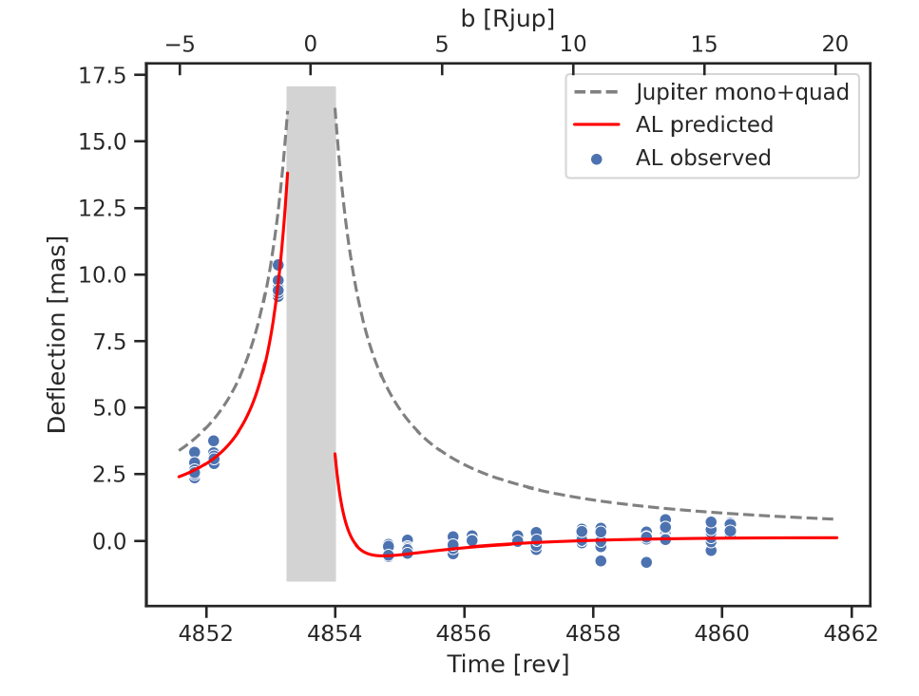
The GAREQ experiment and the LB1 comparison field
Jupiter does bend light!
Max deflection at 02h 54m 56.45s TUC, Feb 23, 2017
(Abbas, Bucciarelli, MGL, Crosta et. al 2022)
All of the 15 transits
The last 1o transits
Ground-based RV’s
Gaia’s transits
The LB1 field
Relative
Astrometry

Slide 12
From my presentation of last year in Catania
A change of Paradigm in Data Management was a must!!
Feasibility
Demonstrated in 2021
100 TBy NAS + small ODA (ODA x4) from OATs (Smareglia) Fully integrated at DPCT
&
Generic Data
Requests
(See talk by E. Licata)

Slide 13
New Data Paradigm
From DBMS-based pipelines to:
Smart File System
+
Meta Dati DB
(this was the key)
From “gbin” files → FITS, HDF5
- based pipelines
Hot vs Cold Data
Green Computing

Slide 14
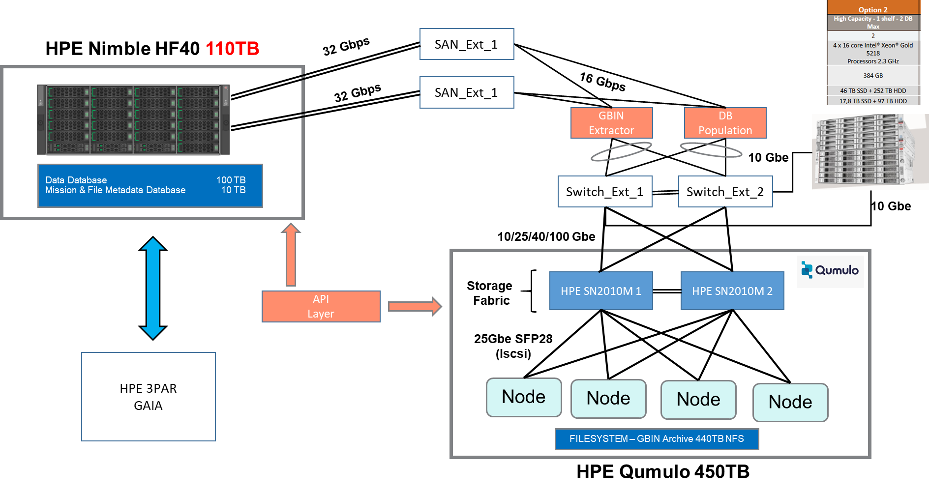
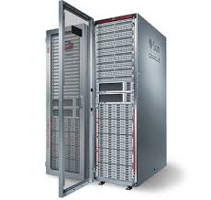
Full scale realisation: OPS4 expansion of DPCT (with INAF resources via ASI contract)
ODA-X8-2-HA
ODA-X8-2-HA
64 CPU
18 TBy SSD
97 TBy HHD
ZFS ZS9-2
480 TBy (RAID2)
(Current DPCT, next slide)
Oracle ZFS file system compatibile con DPCT.

Slide 15
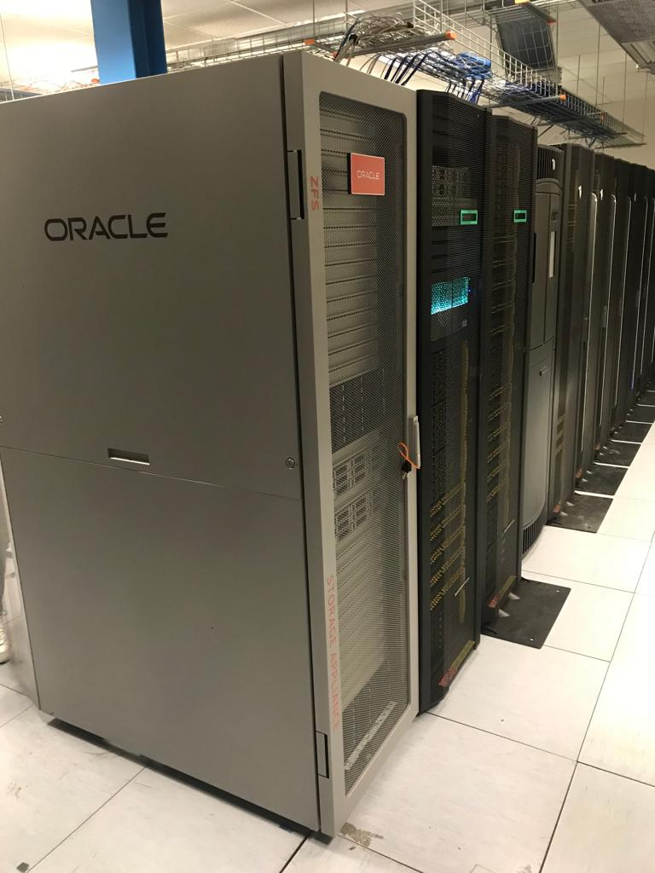
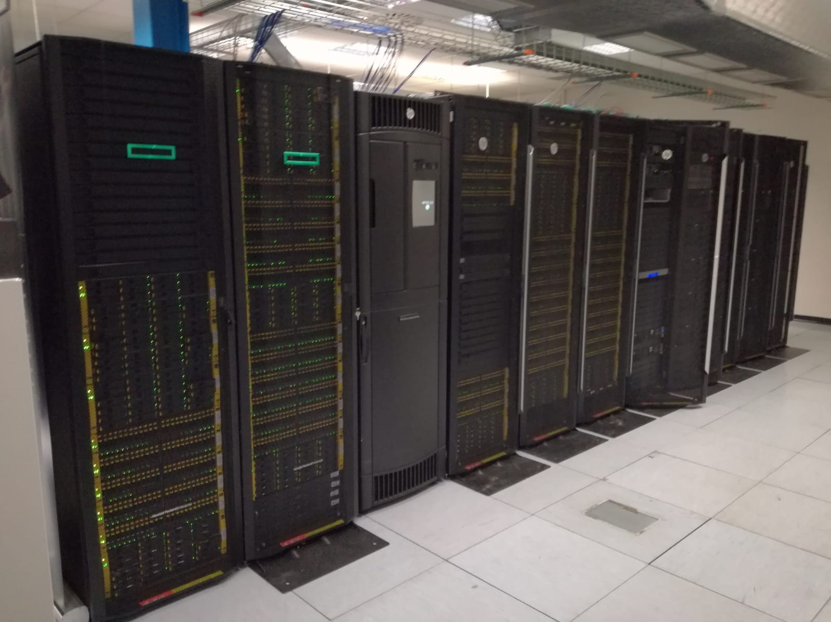
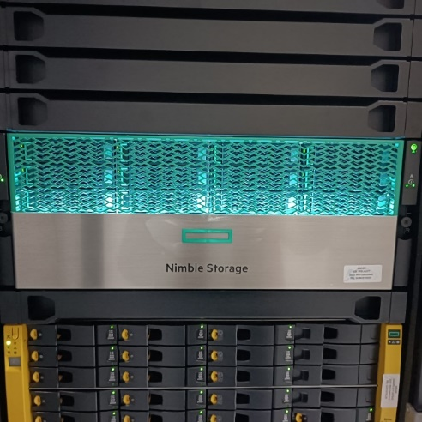
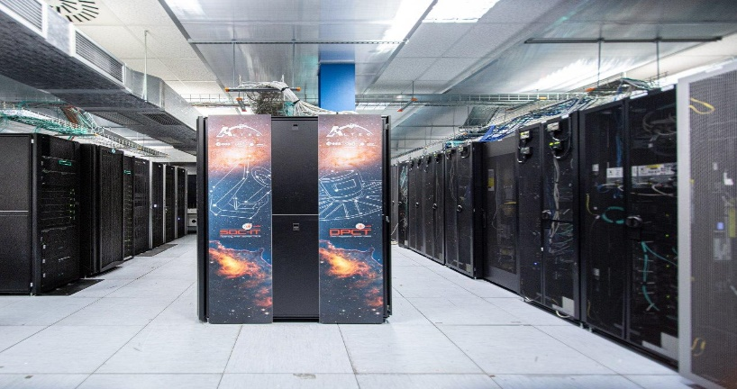
ODA X8 + ZFS
INAF OPS4 today: Facility IN PLACE!
(See Licata’s contribution)

Slide 16
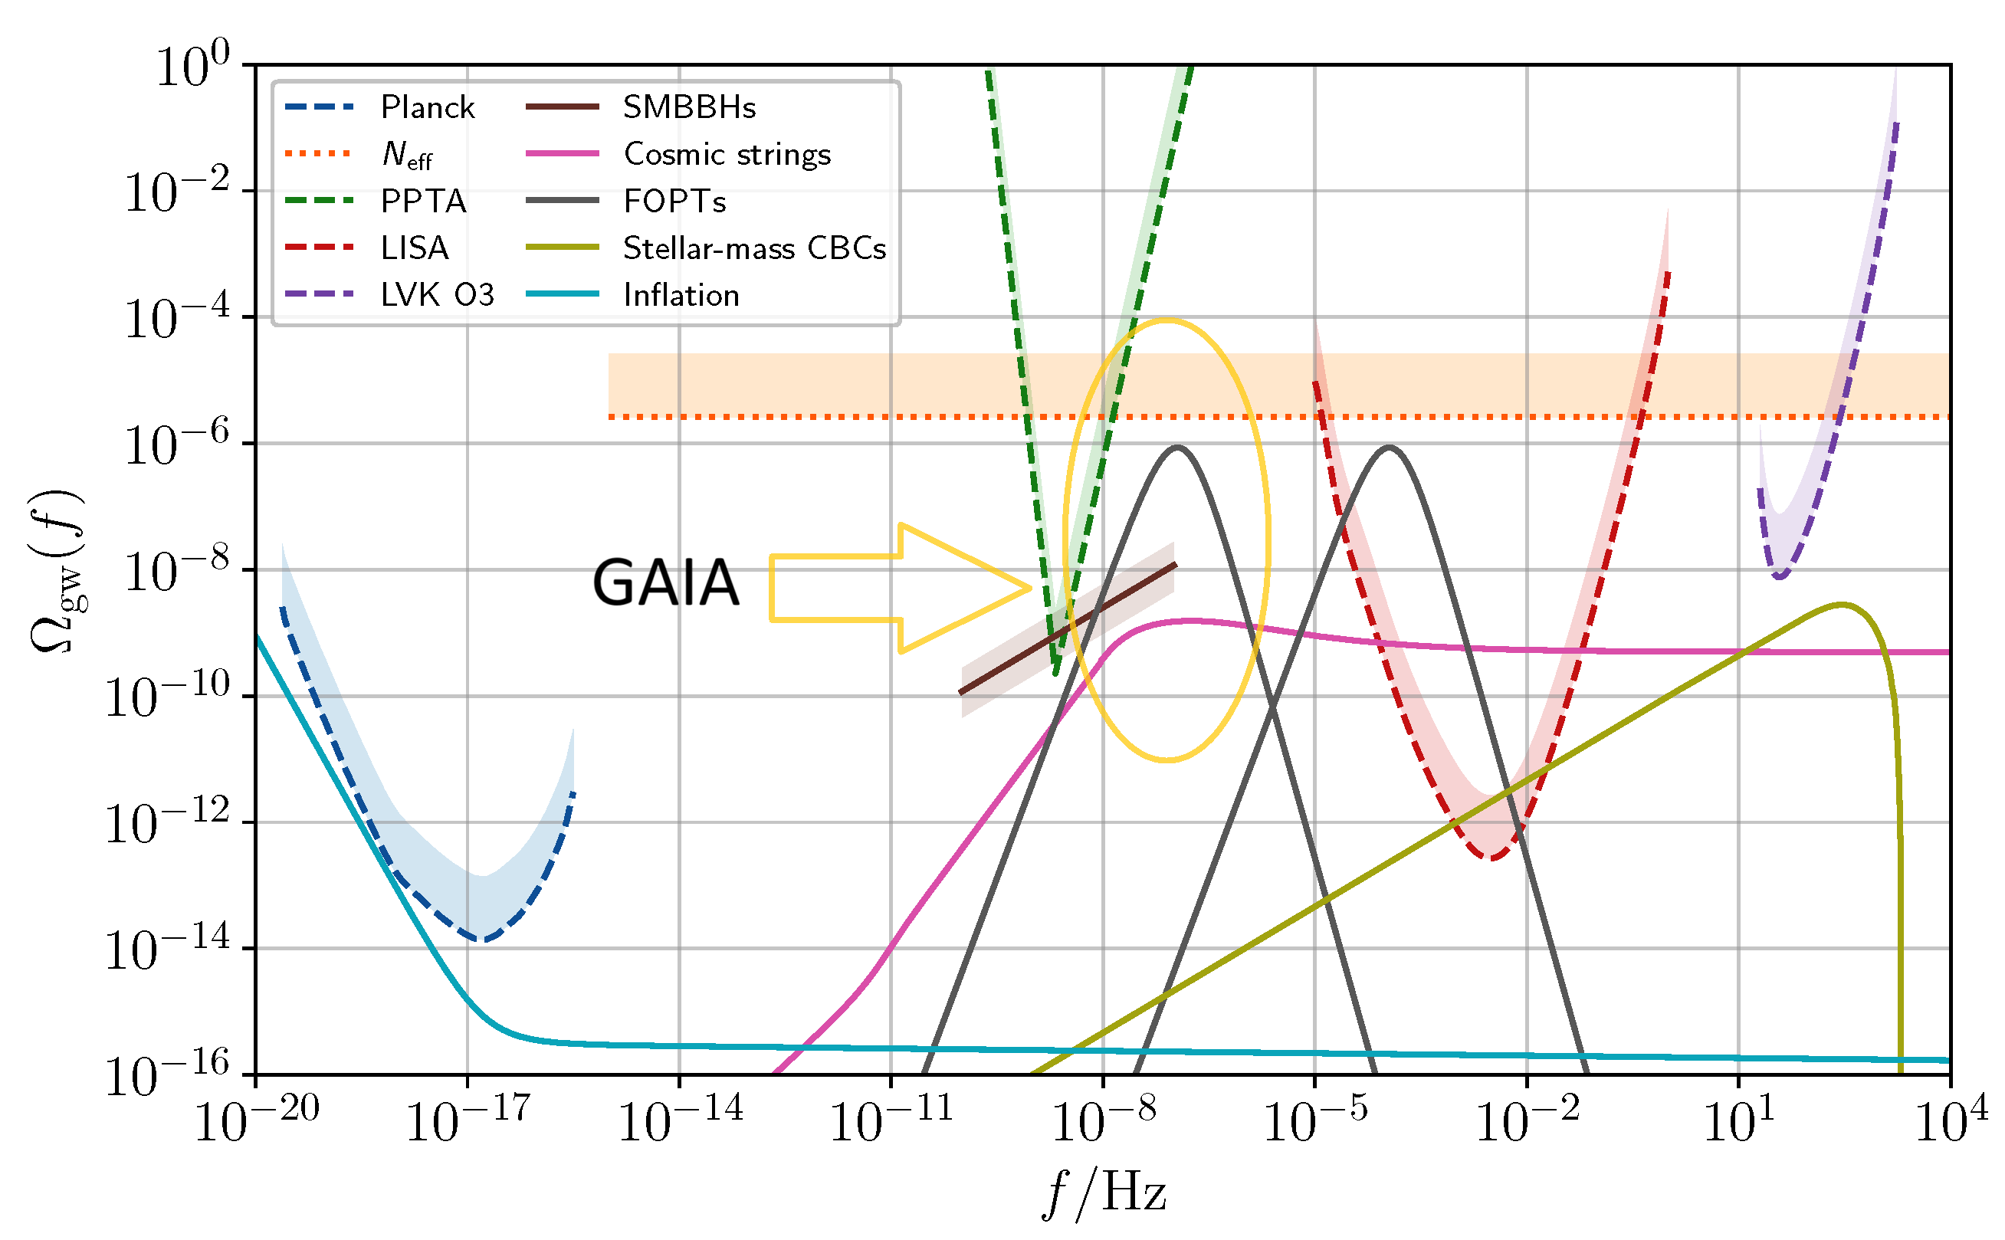
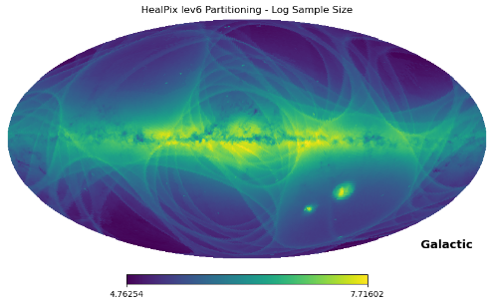
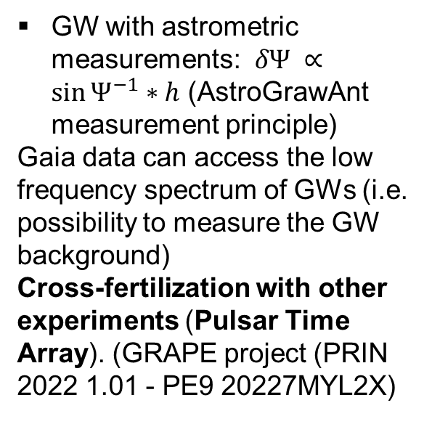
Digital Astrometric GW Antenna with Gaia: the cosmological GW Background
GW with astrometric measurements: $δΨ ∝{\sin{Ψ}}^{−1}∗h$ (AstroGrawAnt measurement principle)
Gaia data can access the low frequency spectrum of GWs (i.e. possibility to measure the GW background)
Cross-fertilization with other experiments (Pulsar Time Array). (GRAPE project (PRIN 2022 1.01 - PE9 20227MYL2X)
USC VIII GA - 18 ott 2024, Galzignano Terme (PD) - MGL
GRAPE General Relativistic Astrometry and Pulsar Experiment Finanziato dell’UE – NextGenerationEU – Missione 4, Componente 2, Investimento 1.1
Notes:
Template e guide lines

Slide 17
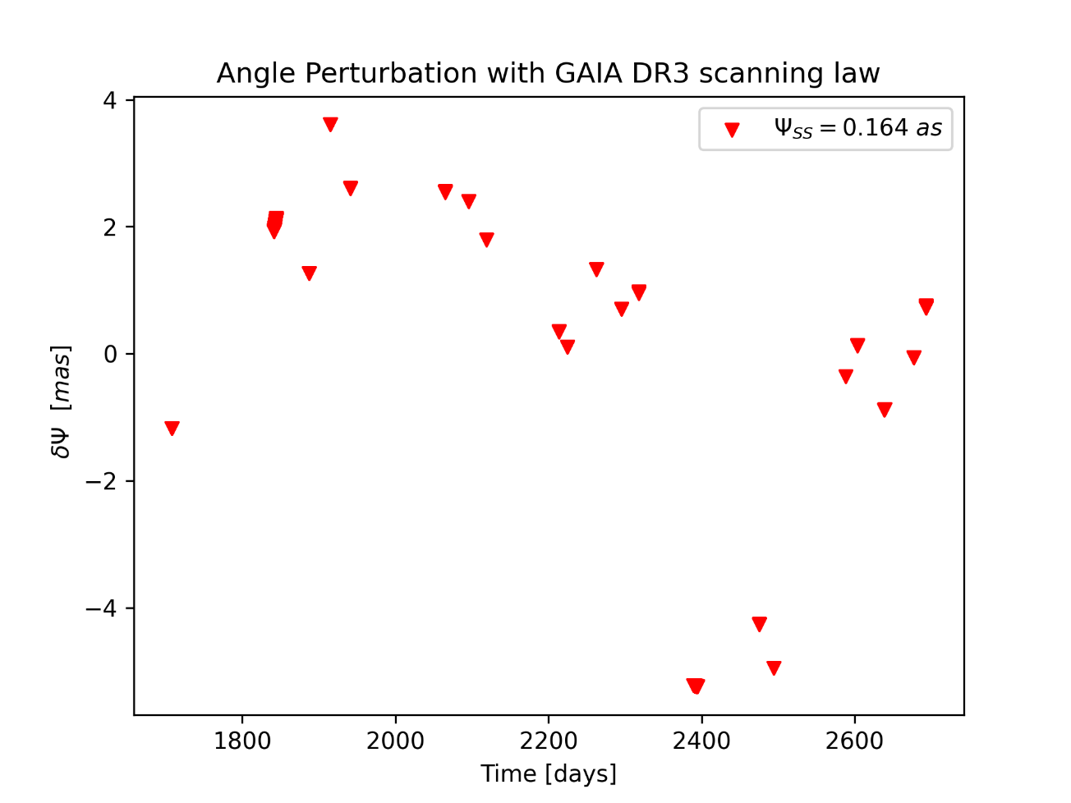
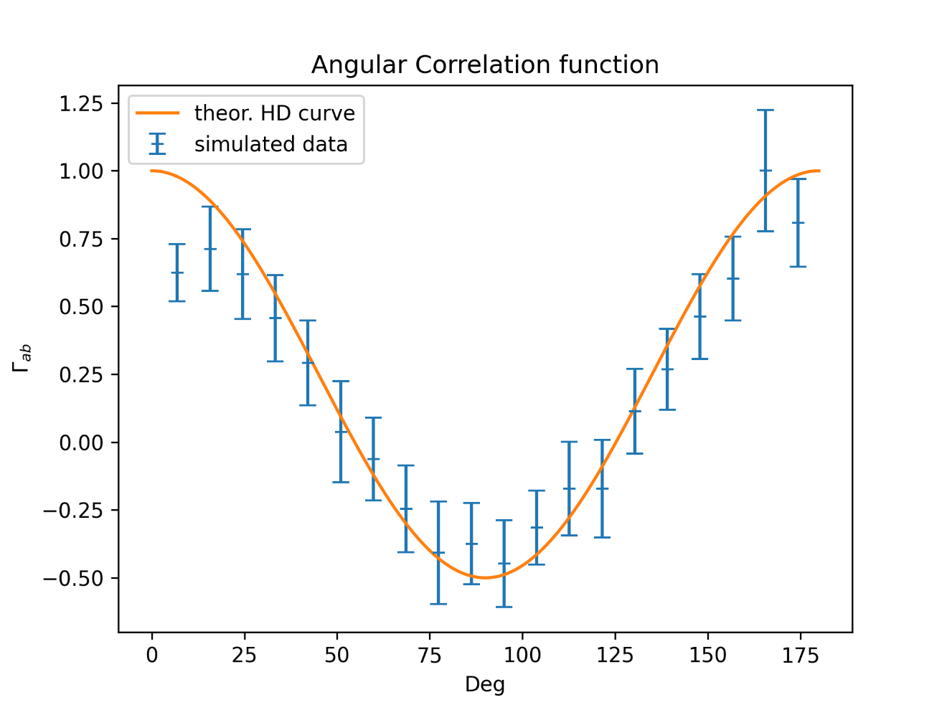
First steps: models and simulations
Using ePTA (Sesana et al’ article) synthetic data we created a stochastic background from a population of SMBH binaries
The astrometric effect is probably too optimistic (satellite attitude neglected) but feasibility encouraging!
USC VIII GA - 18 ott 2024, Galzignano Terme (PD) - MGL
GRAPE General Relativistic Astrometry and Pulsar Experiment Finanziato dell’UE – NextGenerationEU – Missione 4, Componente 2, Investimento 1.1
Notes:
Template e guide lines

Slide 18
Implementation of the digital Astrometric Gravitational Wave Antenna with Gaia elementary astrometry for GWB.
Interoperability Data Lake for Gaia Use Case (IGUC) Requirements (WP3)
For any sky direction of interest:
Identify Sources (SourceId, S) on the celestial sphere in cone toward direction of presumed incoming GW and in the corresponding meridian band (see figure);
Pairing, in given regions, of all of suitable sources (i.e., with angular distances >0.2 ‘’, appropriate magnitudes and color ranges, photometric stability, etc…) (as shown in figure);
Extract all of the elementary, or epoch, observations (AstroElementaries,Obs) for each pair:
  Astrometrically calibrate angular separations
  Build separation time series for analysis
USC VIII GA - 18 ott 2024, Galzignano Terme (PD) - MGL
Analyze according to multi-direction fundamental equations (Crosta, MGL et al. 2024)
ICSC Italian Research Center on High-Performance Computing, Big Data and Quantum Computing
Missione 4 • Istruzione e Ricerca
Notes:
Template e guide lines

Slide 19
IGUC: Sizing the effort- dimensions and computational complexity
Gaia mission: natural, i.e. observation-driven, data archiving schema (see Figure)
Requirements 1 and 2 (in previous slide) use SourceId table which is sky referenced, indexed, via HEALPix : estimated 10⁶ suitable pairs to G < 17 for each GW direction;
Req. 3 is the current challenge: Extract from AstroElementary Table all of the observations of each pair formed in steps 1 and 2. This means that the relation in Figure must be inverted. Given the dimensions of the AstroElementary table this operation requires proper partitioning of the CrossMatch table (shown in Figure as connections from obs-i to s-j)
Oracle DB Tables
Current results: 0.15 sec for the retrieval of all obs of a given source (pair) for 5.5 years of Gaia observations (DR4), i.e., 800 observations per source as sky average (actual numbers depend on ecliptic latitude). Therefore, 0.15 x 10⁶ sec for each trial GW direction, or, 42 h of extraction time!!
Unrealistic processing time to analyse GW sky at a resolution of, say, 1 square degree . HTC breakthrough required, and\or resort to mitigation strategies (reduce no. of pairs)!!
This is the relation table to implement the ‘inversion’!!
USC VIII GA - 18 ott 2024, Galzignano Terme (PD) - MGL
ICSC Italian Research Center on High-Performance Computing, Big Data and Quantum Computing
Missione 4 • Istruzione e Ricerca
Notes:
Template e guide lines

Slide 20
Legacy (strategic) functions: requirements
Establish & maintain deep/dense Reference Frame at different wavelength
Development of new mission concepts, their design and profiling >> business line
Support mission operations (Euclid, CSST, LISA,….) >> business line (ex. 1, next slide)
Support of operations of large ground-based facilities
Support and operate deep exploitation and interoperability with ‘external’ data
Support the development of innovative reduction and analysis methods by
operating partial or full (from raw data) re-calibration/processing functions (ex. 2
and 3, following slides)
SCIENCE
Supporting thousands of simultaneous complex queries/ transactions
SPACE SCIENCE
& TECHNOLOGY
Combining data from the science telemetry channel and that of the housekeeping data >> Potential business line
Oracle ODAX8

Slide 21
Conclusions
(On the assumption that the reasons provided for the Gaia legacy are overwhelming and pressing)
The OPS4 concept, design and initial implementation is capable of dealing with INAF growing ICT needs and ready to tackle more space data (e.g. Euclid, Lisa, JWT, CSST,…) and the suite of ground based (optical/radio) monitoring and survey projects (LSST, VST, ELT, PTA, VLBI, ALMA, SKA,..) for a multi-wavelength view of the deep sky, providing our scientific communities with the infrastructure to exploit them on a variety of outstanding problems in observational physics and the physics of space instrumentation.
With OPS4 up to the scientific and technological challenges it has set forth on itself, it is poised to become a world-class HTC and HPC facility capable to compete with and/or be the lead of possible other similar facilities on the international scene.
All this must be implemented by a dedicated team with the talent of mutlidisciplinarity and the figure of Data Scientists formed and “owned” by INAF. Within an infrastructure that CAN SCALE UP, yet it has to be economically and environmentally sustainable (from my presentation of last year at the USC VIII in Catania)
Set up appropriate organizational and legal framework(s) (MOU’s, Agreements, strategic partnerships with public and private players,..) to warrant resources (human and financial) for long term (legacy) operation of the infrastructure

Slide 22
Acknowledging two special Colleagues
Roberto Morbidelli, that retired on July 1st, for being the inspiring force behind a ‘digital sky’ and the ‘prototype’ of a figure that is today recognized as crucial in our research: the data scientist. He has been, more than 20 years ago, experimenting and comparing different data archiving strategies and DBMS (OBJECTIVITY vs Oracle: object oriented vs relational DB schemes) while building the second generation of the Guide Star Catalog for the new generation of instruments on HST.
Bianca Garilli, the PI of MITIC (a science special project funded by special funds awarded directly by the Italian Parliament -2018-2022) for believing in, and fully funding, my WP4 (The Living Sky -TLS) of that quite successful proposal that proved the feasibility of OPS4.
I met Bianca at the INSF ICT meetings over the years and it is just unfortunate that she is not here with us at this first GA of USCVIII.

