Slide 1
Computing in Euclid-IT Science (Cosmology)
Carmelita Carbone (on behalf of many people)
Meeting “INAF USCVIII – General Assembly”, Galzignano, 14-18 Oct 2024

Slide 2
Motivations for HPC computing in Euclid
Computing resources for SWGs (Melita’s talk) and SGS (Daniele’s talk):
different needs for different data analyses of upcoming big data
Different cosmological probes (GC, WL, Galaxy Clusters, CMBX, …):
computational resources for cosmological N-body simulations/mock catalogues, parameter inference, modelling, and single/joint-probe analyses

Slide 3
Computing for Euclid Galaxy Clustering
(P. Monaco, E. Sefusatti, M. Lepinzan, T. Castro, L. Tornatore, E. Sarpa, G. Parimbelli ++)
Computing resources to run PINOCCHIO simulations for the GC covariance (3500 smaller simulations + 1000 big simulations that cover half of the sky): INFN computing time (euclid project), Galileo100@CINECA and ISCRA-B grant, Galileo100@CINECA and UniTS-CINECA agreement -> total of ~5M core-hr. + Pleiadi system for smaller runs (700,000 core-h).
Development: ICSC/Spoke3, 700,000 gpu-hr on Leonardo@CINECA.
Postprocessing (creation of galaxy catalogs, application of systematics, mixing matrix, power spectrum measurement): -> Pleiadi system.
The 1000 EuclidLargeMocks are the largest collection of DM halos on the past light cone ever produced! (paper + press release in preparation).
Notes:
PINOCCHIO is a fast code to generate catalogues of cosmological dark matter halos with known mass, position, velocity and merger history. It is able to reproduce, with very good accuracy, the hierarchical formation of dark matter halos from a realization of an initial (linear) density perturbation field, given on a 3D grid. It is based on the Lagrangian Perturbation Theory. It runs in just a small fraction of the computing time taken by an equivalent N-body simulation, producing promptly the merging histories of all halos in the catalog.
PINOCCHIO is distributed under a gnu-gpl v2 license.

Slide 4
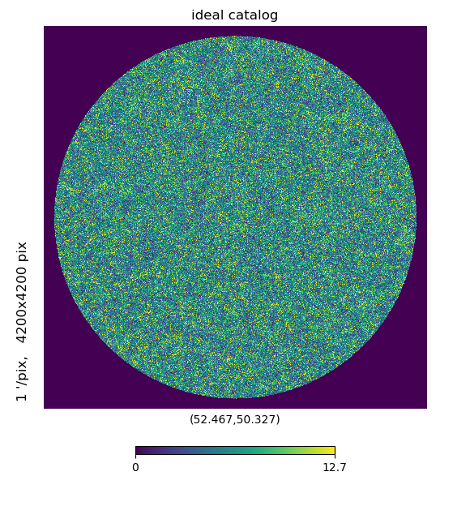
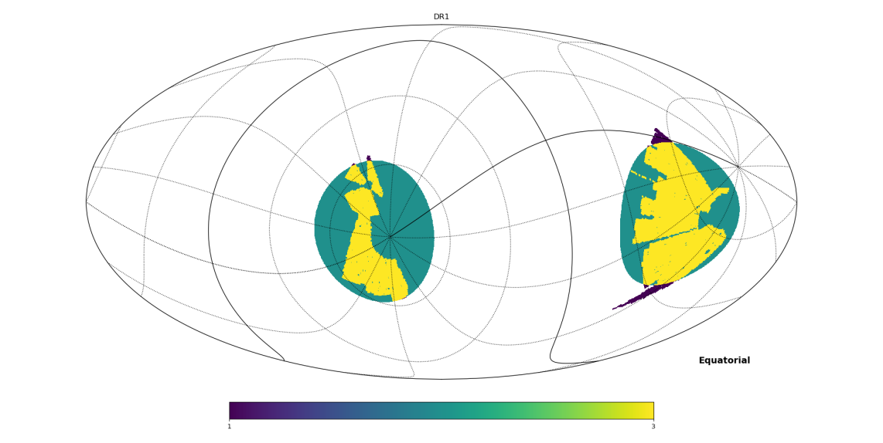
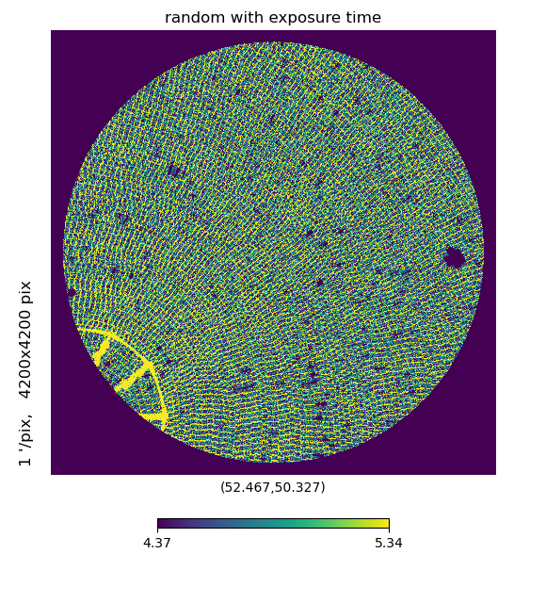
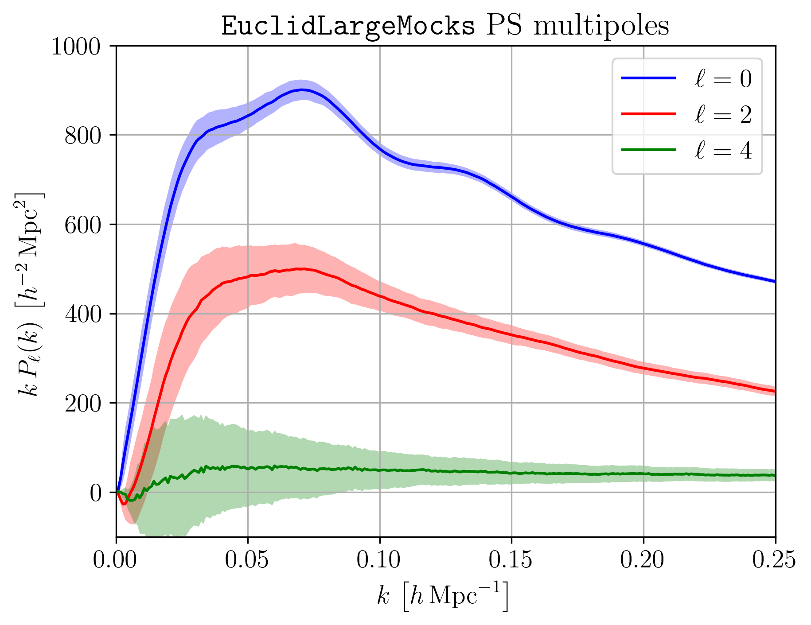
PINOCCHIO Mocks: adding systematics to ideal catalogs
30deg circle is ~ the same area of DR1 (pre-launch)
ideal catalogs, average P(k) over 1000 mocks
angular systematics: random catalog with varying exposure time due to survey strategy

Slide 5
Computing for Euclid Cluster Cosmology
(S. Borgani, T. Castro, M. Costanzi, R. Ingrao, A. Saro)
The needed resources for the activities inside the SWG-CL WP-9 for Galaxy Cluster Simulations has been covered in the past by:
Leonardo@CINECA Early Access Project (~20M core-hr)
ISCRA-B/CINECA project (~2M core-hr) on cineca
Couple of small ISCRA-C/CINECA projects for code development (~100k core-hr)
DRES storage on CINECA (80TB)
INAF-IA2 Storage (50TB)
⇒ Future activities are covered at the moment by a EuroHPC recently approved project on Leonardo-DCGP (+20M core/h; PI: T. Castro)
Resources to run chains for cosmological posteriors
So far based on the use of local clusters (AMONRA@INAF-OATs)
For DR1 data analysis: expected ~2M core-hr; ISCRA-B@CINECA sufficient in principle, but dedicated and flexible INAF resources would be welcome.

Slide 6
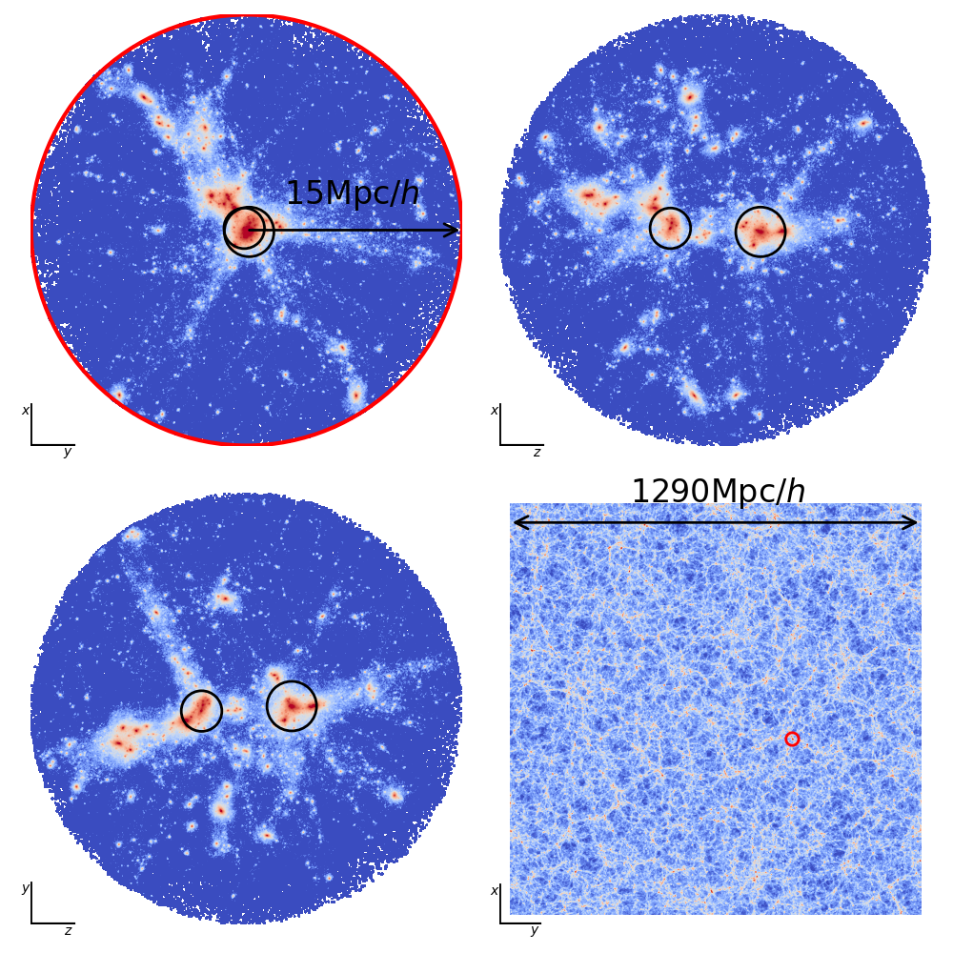
Galaxy clusters and line-of-sight projection effects
credits: Tiago Castro (OATS)

Slide 7
Cosmological simulations for beyond-LCDM models in Euclid
(M. Baldi)
Simulations of cosmologies beyond LCDM are necessary to achieve Euclid goals on constraining Dark Sector models and have been used in activities of SWG-TH, SWG-CS-WP8, PL-KP-JP6, using computational resources from:
PRACE Multi-year Access: 15 Mio CPU hrs on MareNostrum4 (DUSTGRAIN simulations, P.I. M. Baldi)
ISCRA-B projects SIMCODE2 and DZSH: ~2 Mio CPU hrs on Marconi (DUSTGRAIN-pathfinder and DAKAR2 simulations, P.I. M. Baldi)
ISCRA-C projects DZS, EuNuComp, EuKey, PANDAG4: ~150k CPU hrs on Marconi, Marconi-100, Galileo-100 (MassiveNu Code Comparison simulations, DUSTGRAIN-pathfinder extension for HOWLS project)
INFN-InDark resources at Cineca: ~200k CPU hrs on Marconi-100, Galileo-100 (CIDER simulations)
INFN-Euclid resources at Cineca: ~600k CPU hrs on Galileo-100, Leonardo (CIDER simulations)
Storage resources have been provided by:
INFN-CNAF data center under Euclid-INFN agreement: ~400TB on disk → storing all raw data and processed data
Local Bologna cluster: ~20 TB on disk purchased on personal research fundings (M. Baldi) → temporary storage of data for analysis
PIC data center (Spain): few TB → final products presented in Euclid Publication (for data availability policies)

Slide 8
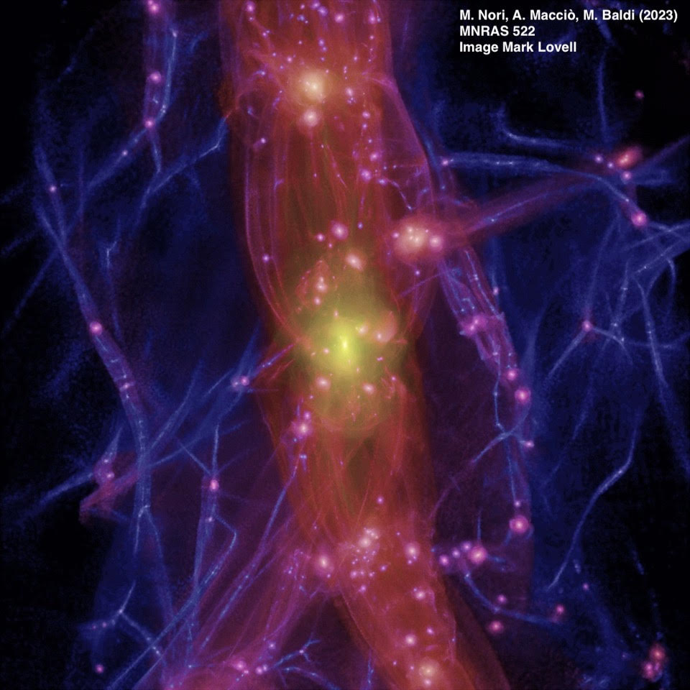
Matter density distribution around an Aquarius halo (Milky-Way like) obtained via AX-Gadget in a Fuzzy dark Matter scenario. Credits: Marco Baldi (UniBO)

Slide 9
Cosmological simulations for beyond-LCDM cosmology in Euclid
Carmelita Carbone: DEMNUni campaign
Total of 26M cpu-hr and 400TB storage
@CINECA/INAF/IA2

Slide 10
DEMNUni applications to Euclid
KP-CL-3 pre-launch paper-4 “Halo mass function and bias in non-standard models” of the Galaxy-Clusters SWG.
KP-CL-3 pre-launch paper-1 “Calibration of the halo mass function in Λ(ν) cosmologies” Castro et al. A&A 671, A100 (2023)
KP-CMBX-2 pre-launch paper2 “CMBX Mock Simulations” in CMBX SWG.
KP-JC-6 pre-launch paper-3 “Simulations & non-linearities beyond ΛCDM” joint Theory and Cosmo-SIM SWGs.
KP-TH-1 pre-launch paper-6 “Euclid: Nonlinear spectroscopic clustering in beyond-ΛCDM scenarios with Euclid”, Theory SWG.
KP-CMBX-2 pre-launch paper-6 “Numerical covariances for CMB cross Euclid” (calibration of FLASK lognormal mocks against DEMNUni-CoV mocks)
KP-CL-2 “Euclid preparation: Determining the weak lensing mass accuracy and precision for galaxy clusters”, arXiv:2409.02783

Slide 11
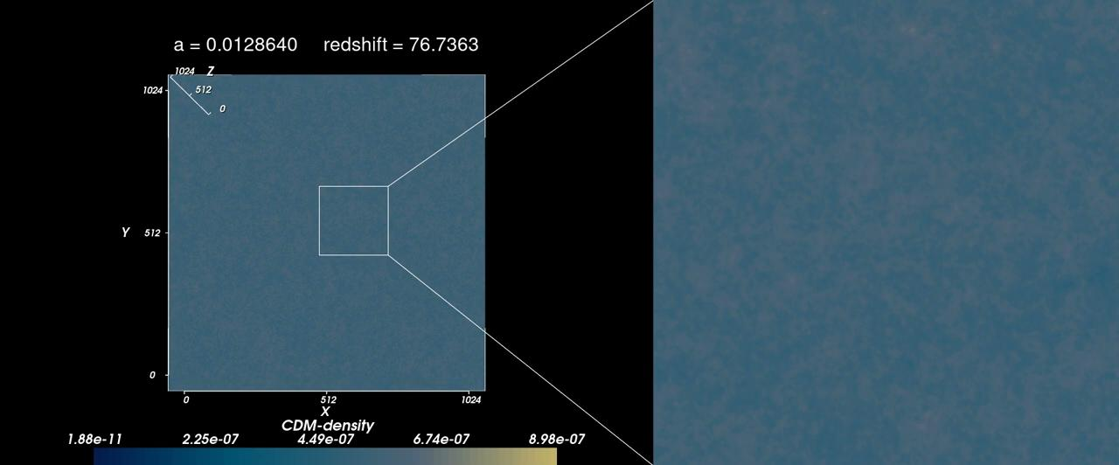
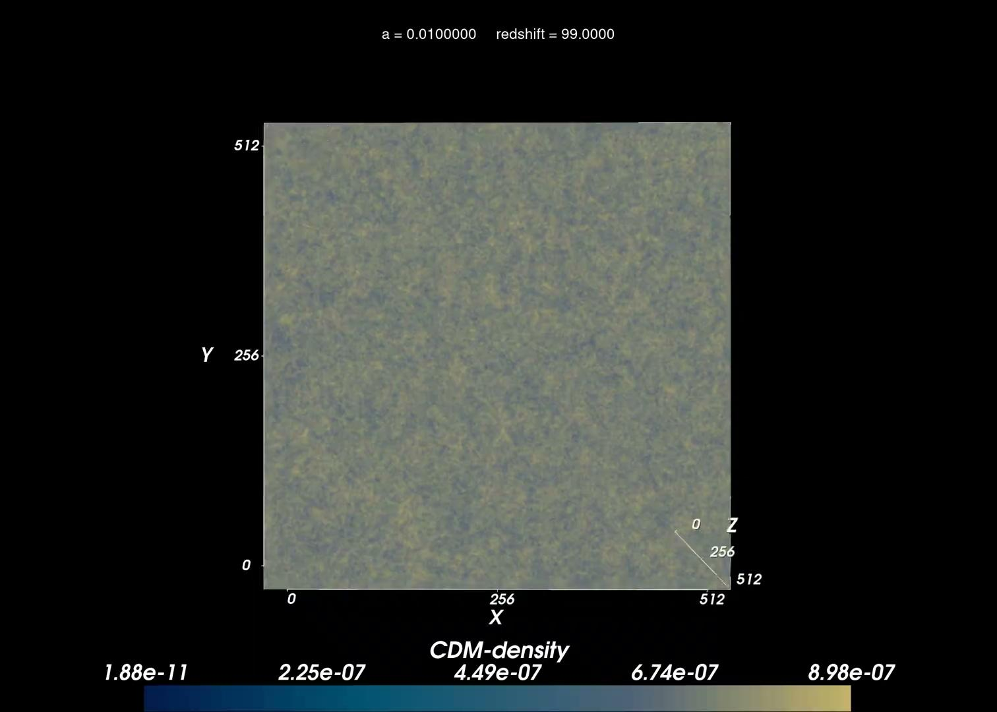
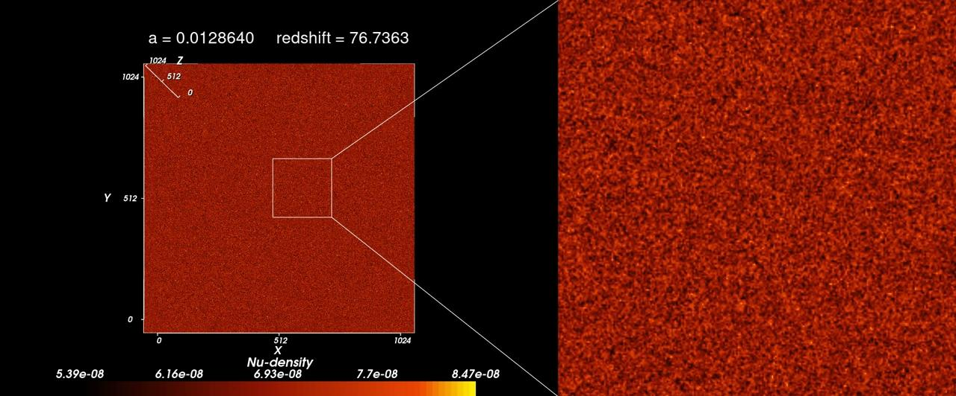
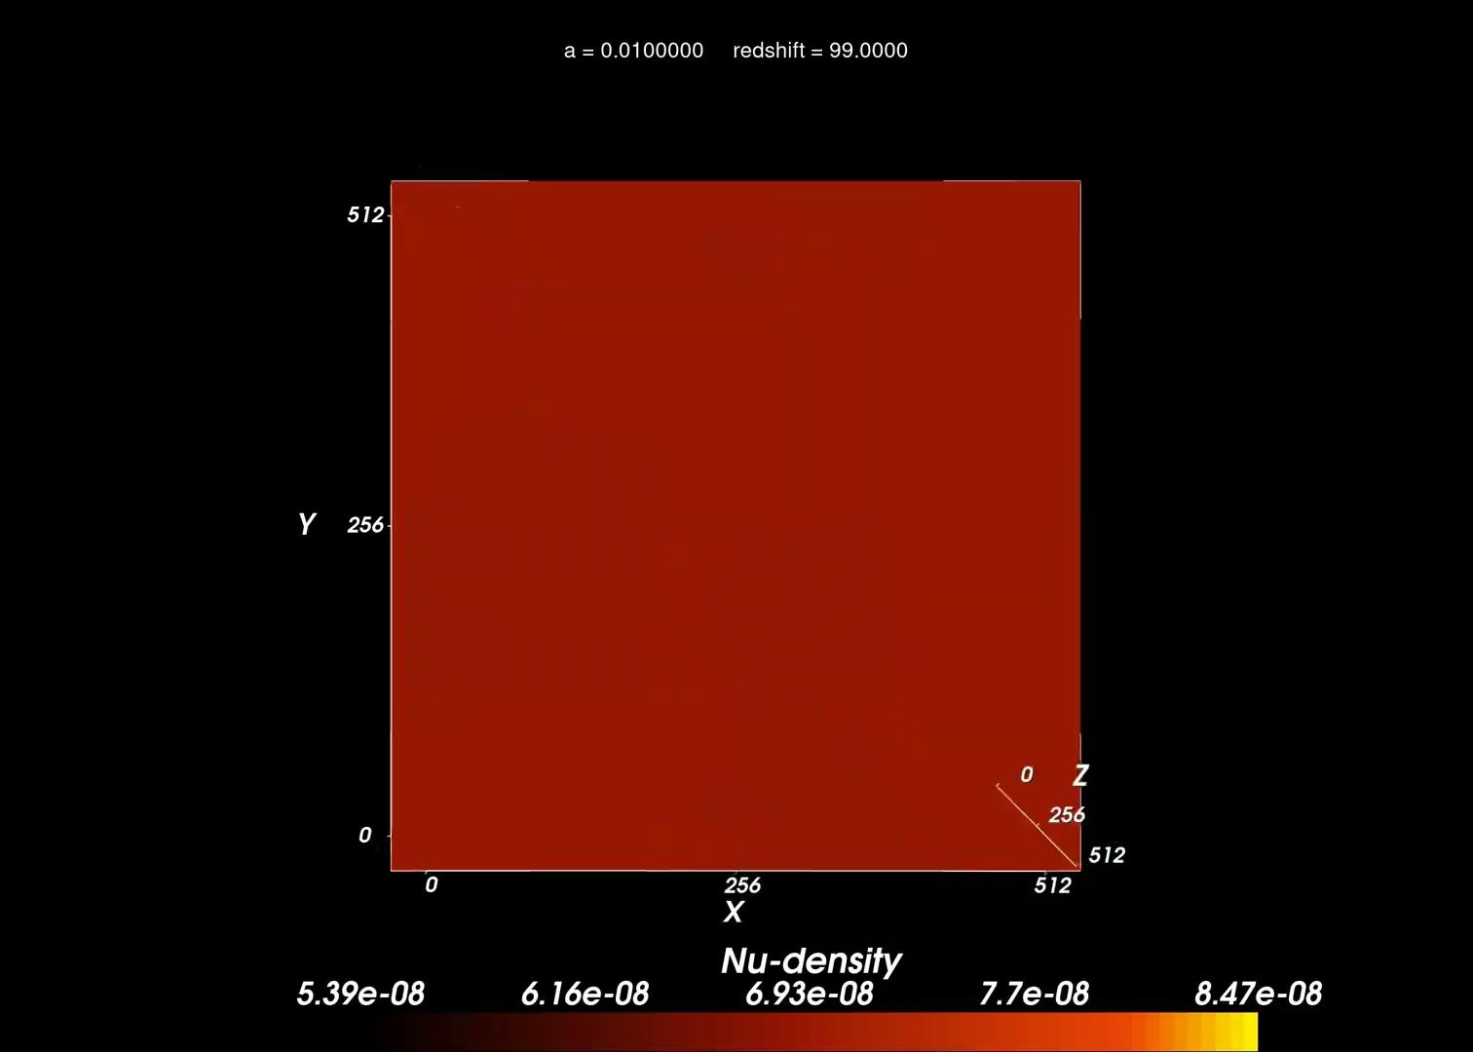
DEMNUni simulations: structure formation in 𝝂w₀w_{a}CDM scenarios
Credits: Tuccari, Sciacca, Vitello (Spoke1&Spoke3)

Slide 12
Analytical Covariances and future likelihood activities
(C. Carbone, S. Camera, M. Baldi, M. Calabrese, C. Giocoli, V. Cardone, D. Sciotti et al.)
Resources to run chains for 3x2pt (weak lensing, photo-gc and the cross) cosmological posteriors:
Runs performed on KiDS infrastructures (NL), france computers (F) and UK facilities
Resources to compute the 3x2pt X CMB covariance matrices with FLASK Simulations: Marseille cluster available
Future activities for DR1 KPs (e.g. DR1-JC1, DR1-JC2, DR1-TH1) not yet covered by sufficient computational resources.
Estimated resources to compute the 3x2pt covariance matrix terms and accounting for survey masks & GLASS Simulations: ~ 2M cpu-hr and up to 1TB of data
Ongoing applications for cosmological parameter inference:
EuroHPC call for Euclid DR1 KPs (coordinated by B. Joachimi)
DiRAC call for computational time in UK (coordinated by K. Koyama and Pedro Carrilho)

Slide 13
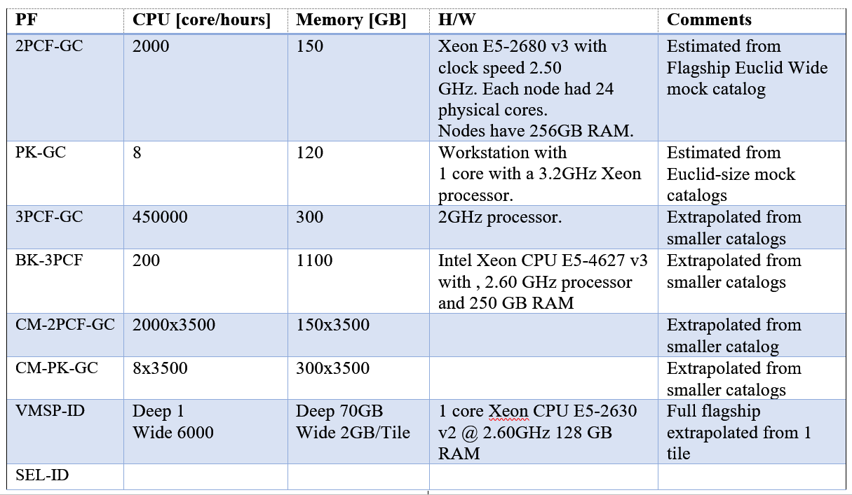
Computing resources in Euclid
Computing resources for SGS (see table below for OULE3 dated 2020)
No guaranteed computing resources for science (simulations, covariances, likelihood): only applying to public calls

Slide 15
Euclid
Science Ground Segment data processing
INAF USCVIII General Assembly, Galzignano, 14–18 Oct 2024 Daniele Tavagnacco on behalf of SDC-IT
(A.Zacchei, M.Frailis, E.Romelli, S.Galeotta, T.Gasparetto, G.Maggio, D.Maino, F.Rizzo, T.Vassallo, R.Giusteri)

Slide 16
SGS role in Euclid
Define, Organize and Maintain the data analysis infrastructure (ST)
Manage and monitor the instrument and the sky survey progression (IOT)
Process raw data into final science products (OT)

Slide 17
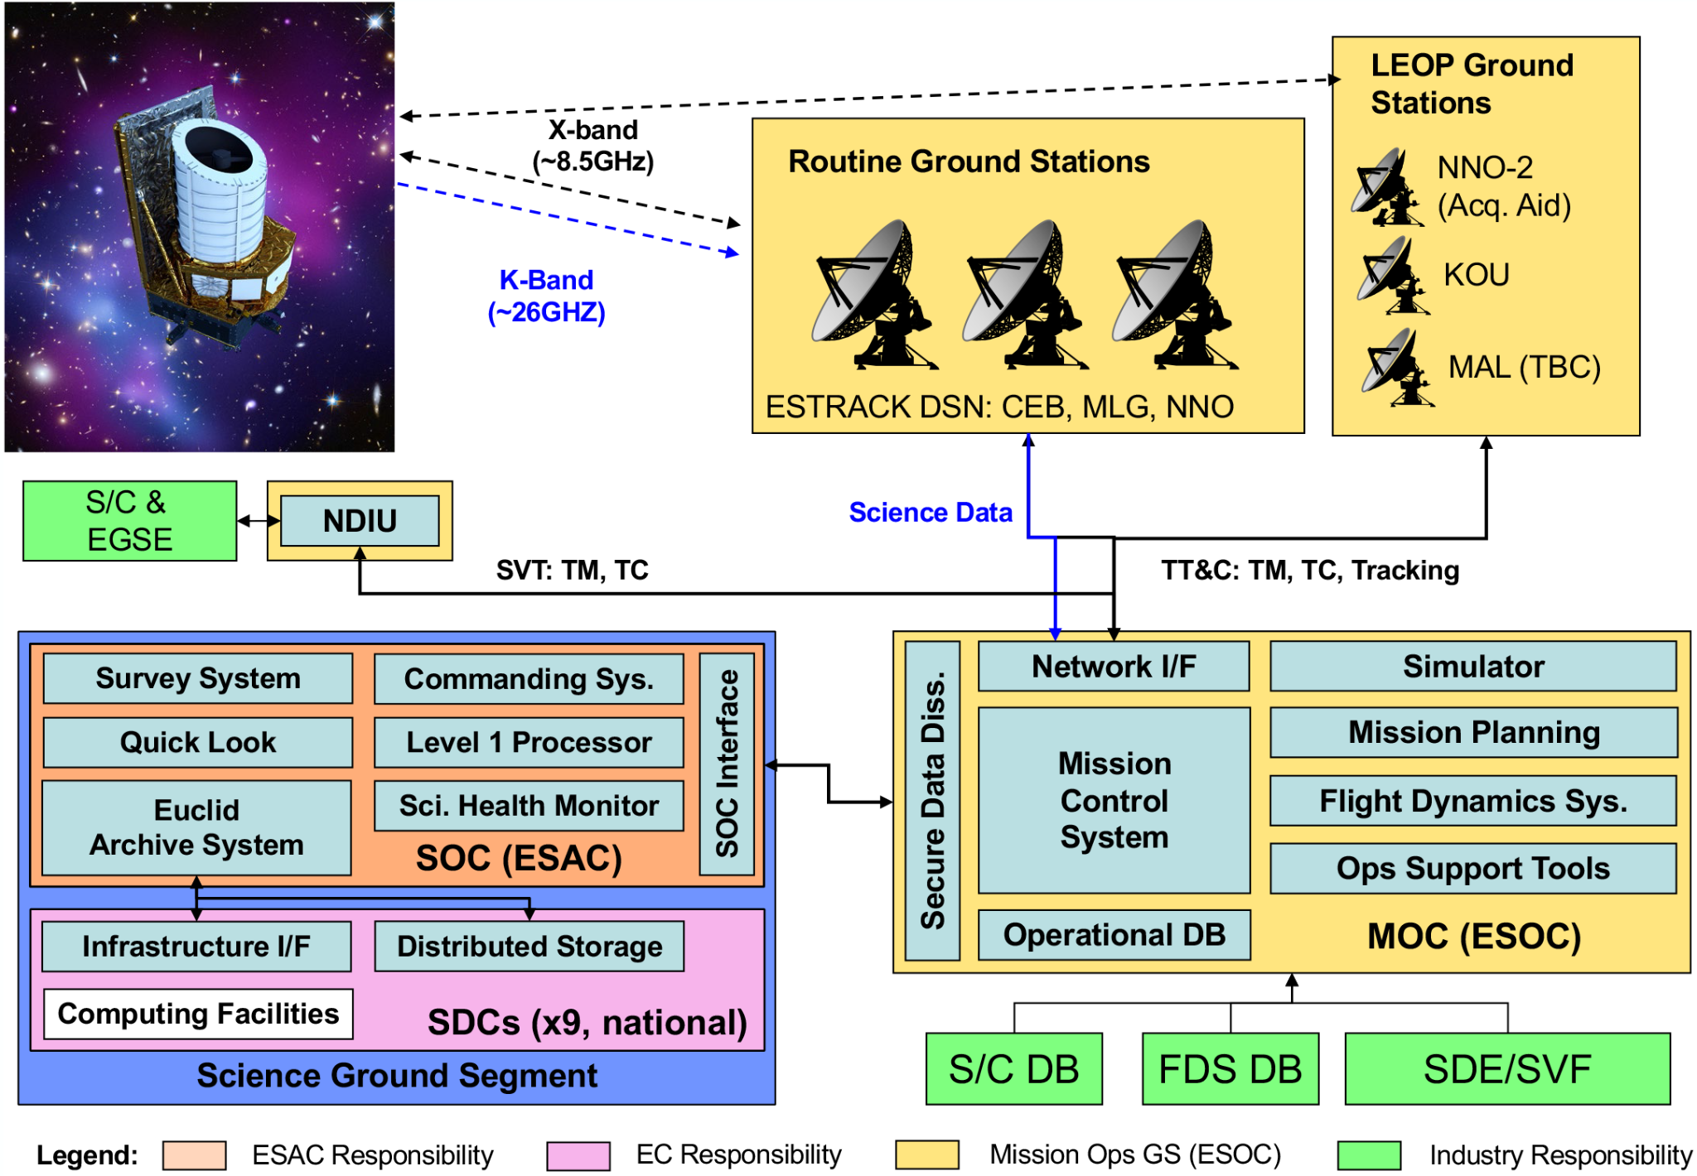
Credits: EC consortium]

Slide 18
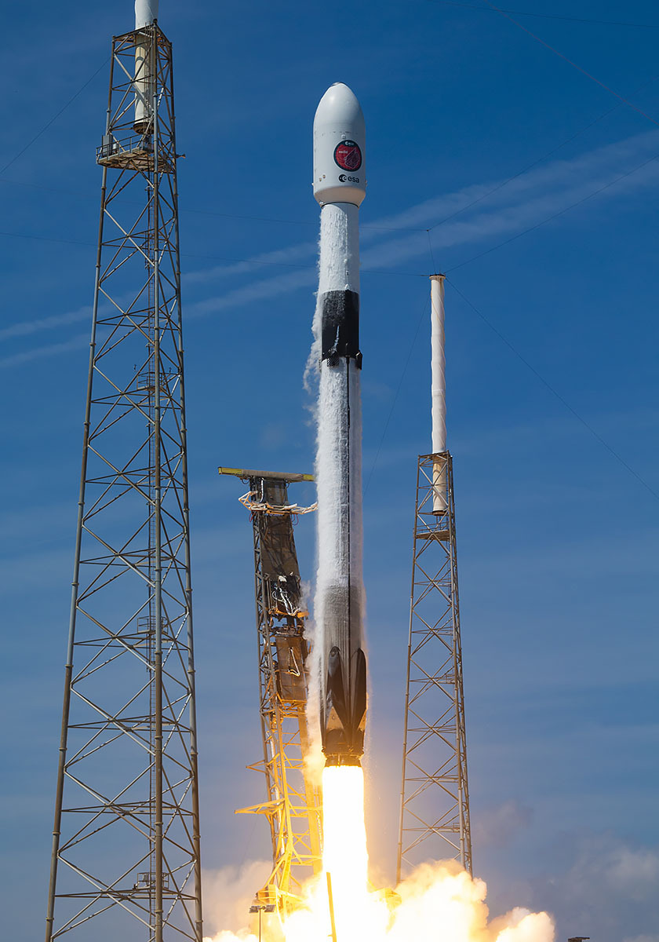
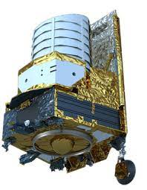
1 July 2023
Sun-Earth Lagrange point 2 (L2)
6yr nominal mission
1.20m primary mirror
VISible instrument
Near InfraRead/Spectro instrument

Slide 19
“Euclid is designed to explore the evolution of the dark Universe. It will make a 3D-map of the Universe [...] across more than a third of the sky”
[https://www.esa.int/Science_Exploration/Space_Science/Euclid_overview]

Slide 20
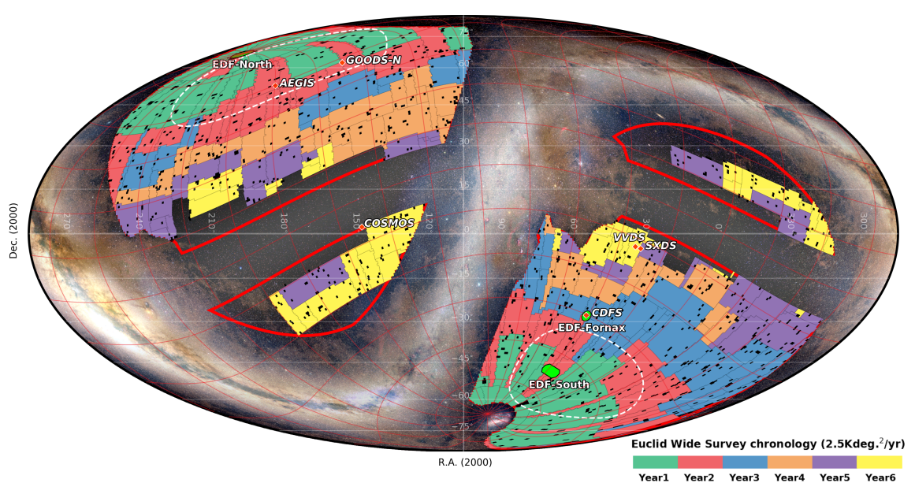
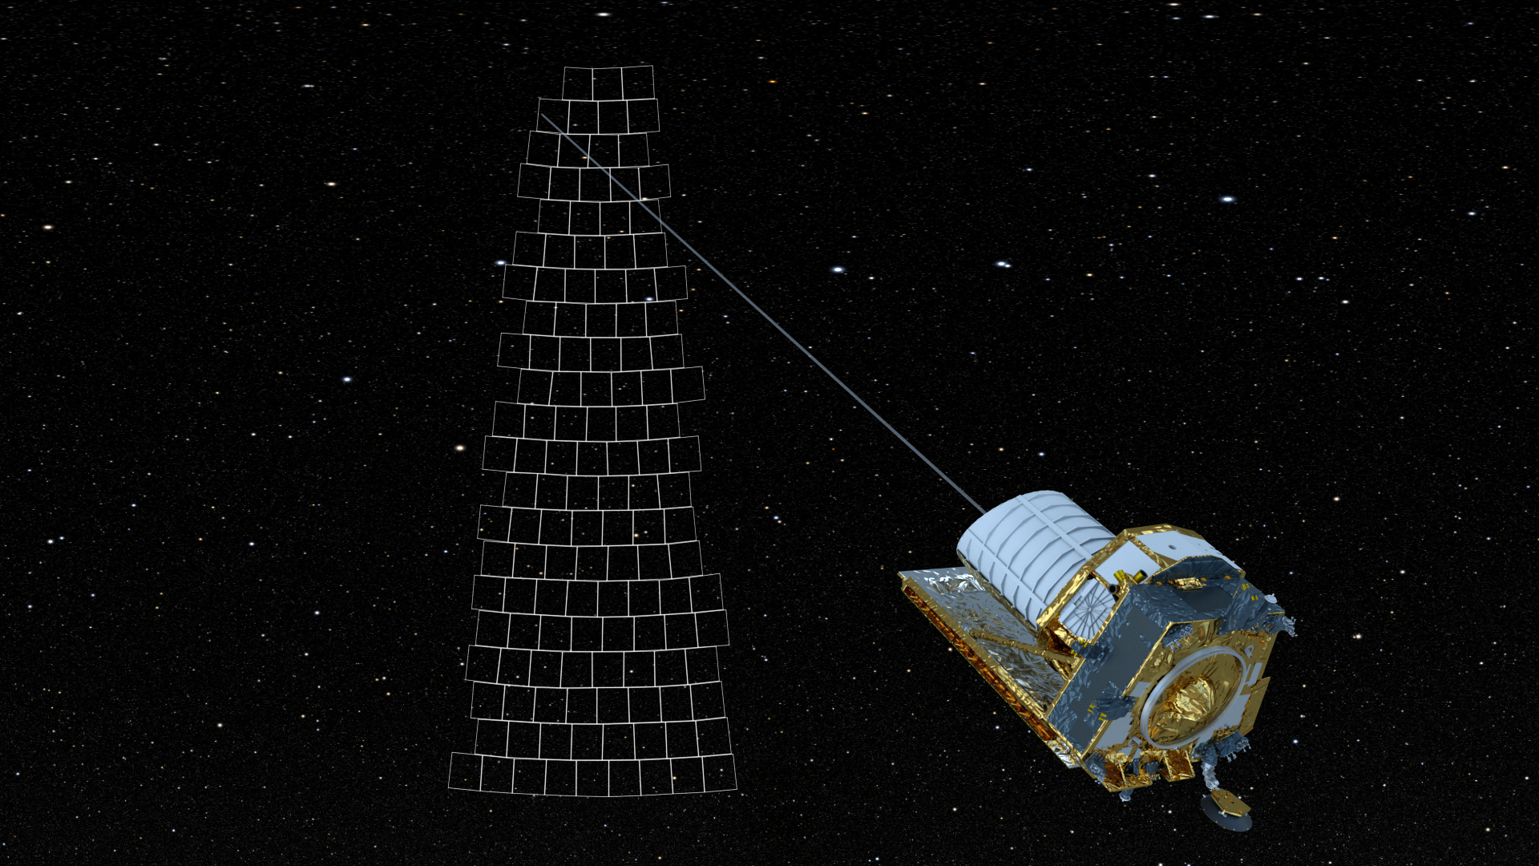
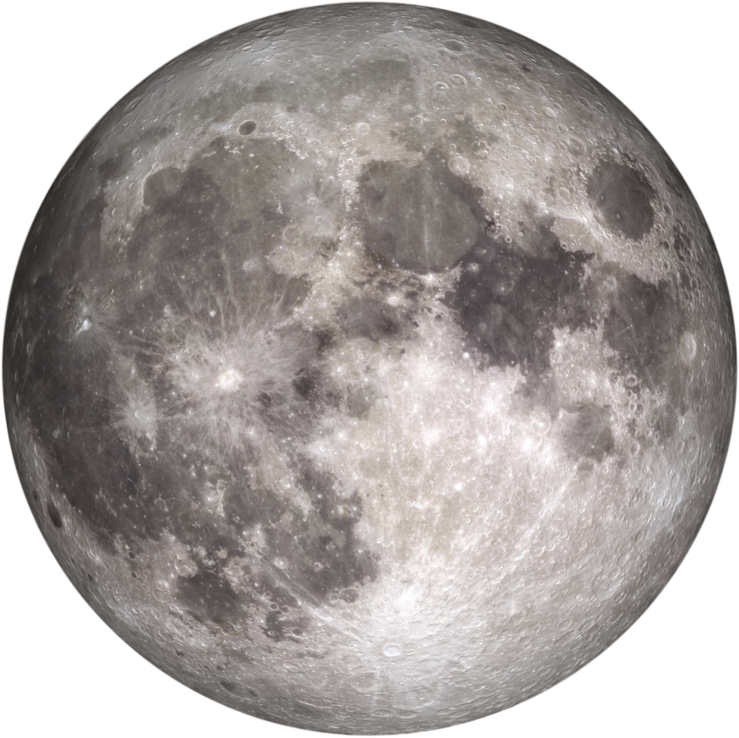
15000 deg² in 6yr
FoV ~0.5deg → +500k images
Process: 22 frames/day
Credits: EC consortium
Euclid FoV
Credits: ESA

Slide 21
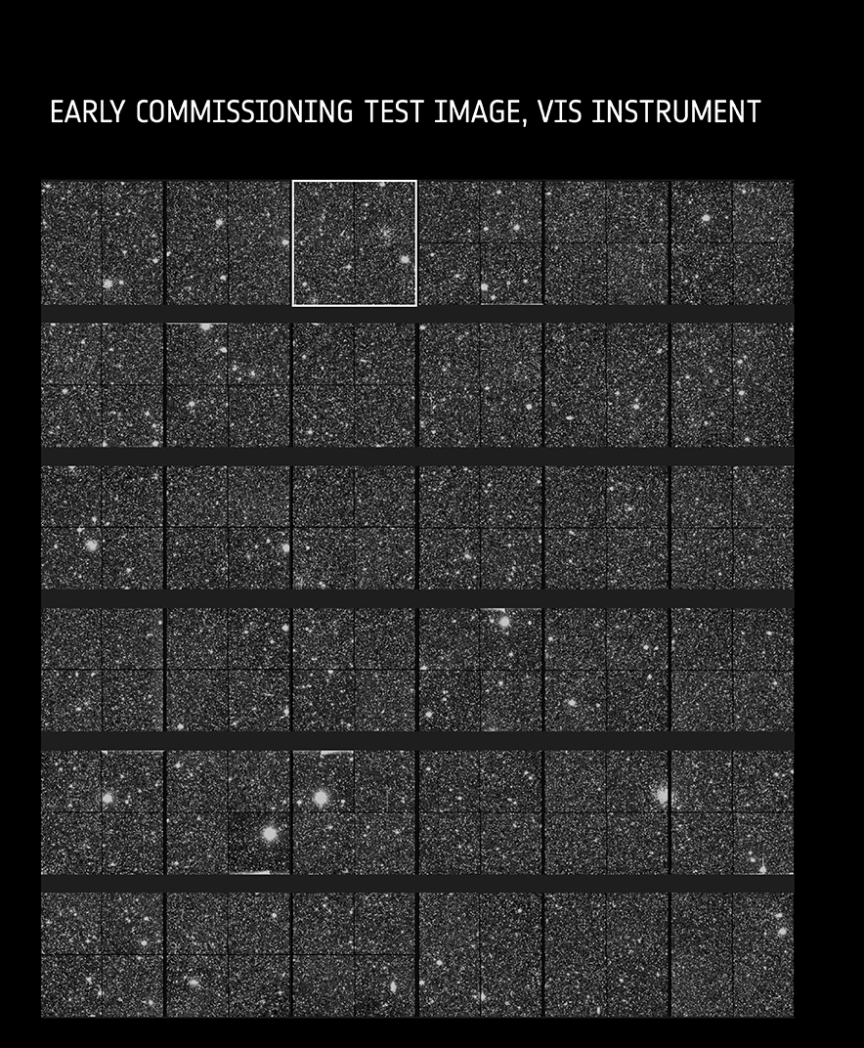
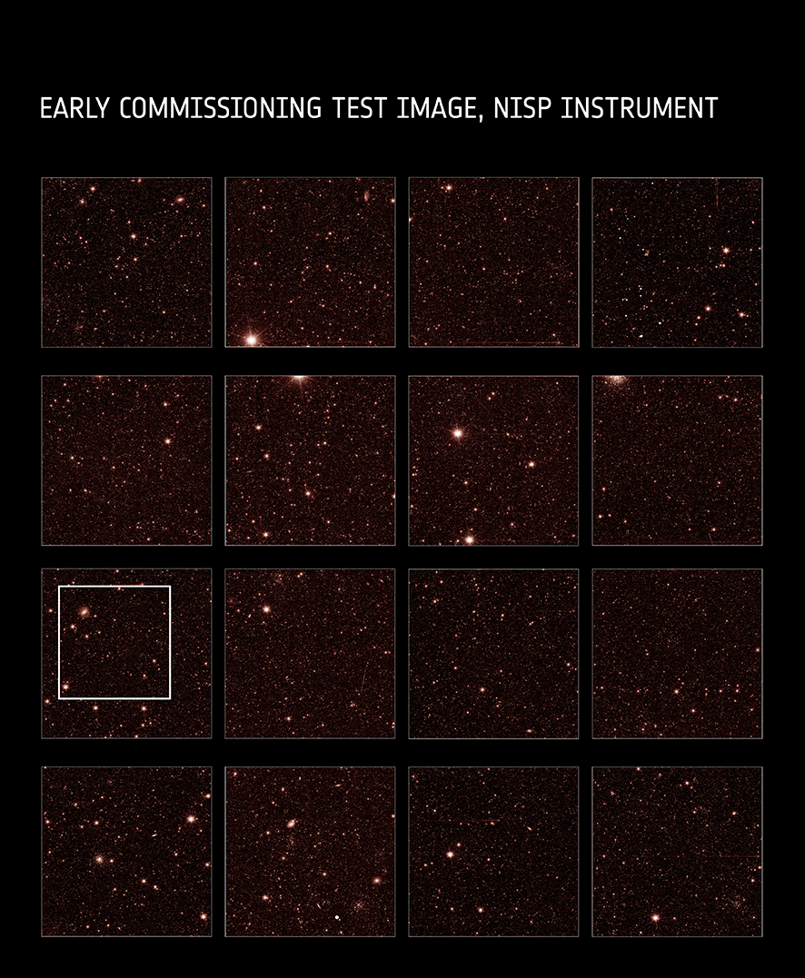
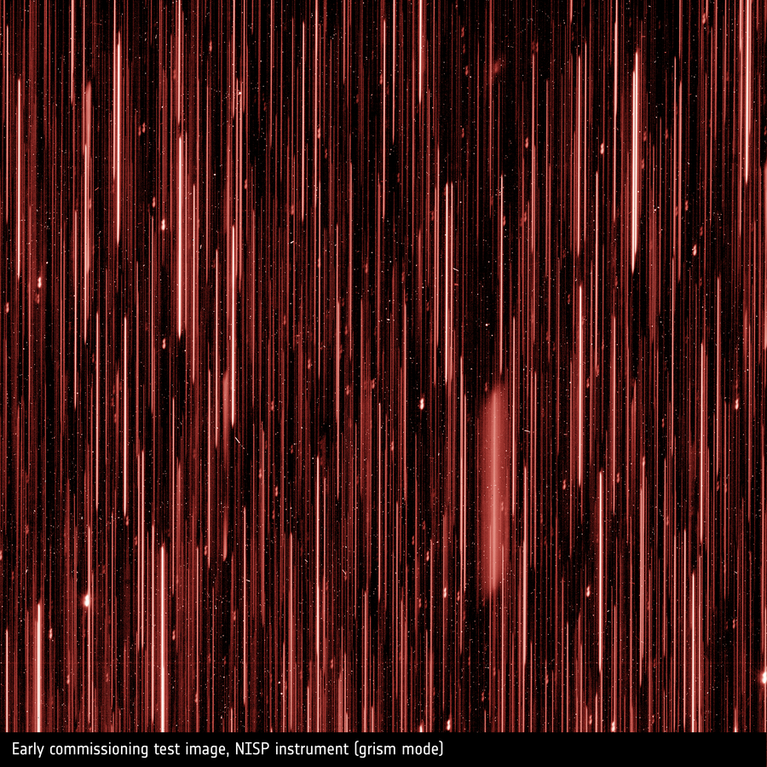
raw data images
+ NISP spectro mode
VIS 6x6x 16Mpix ~ 600Mpix
NISP 4x4x 4Mpix ~ 64Mpix
@download: 100GB/day
@ground: 1TB/day
plus external data
total mission 20-30PB
Credits: EC consortium/ESA

Slide 22
constraints
Large Data Volume (500+k raw images, external data)
Varied dataset on the processing flow (images → catalogs → science data)
Continuously evolving Software (data → instrument knowledge → better algorithms)
Notes:
Dataset vario → processing in step (PF) focalizzati ad un task specifico

Slide 23
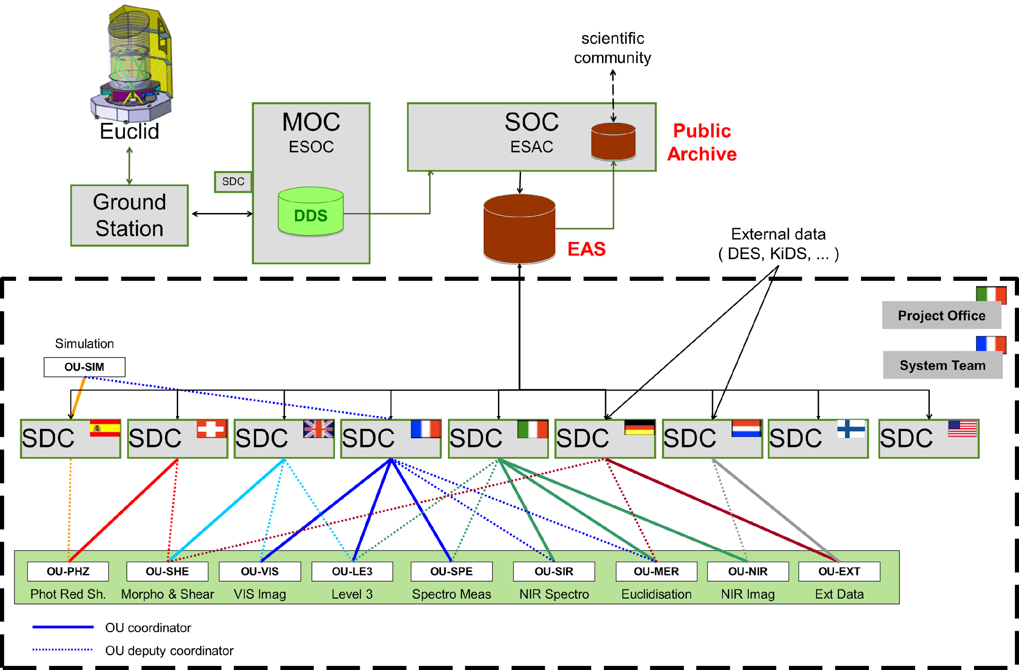
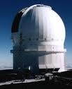
Euclid SGS as a distributed system
Science Data Centers
national HPC facilities (run)
develop. expertise (integration)
Organization Units
processing definition (algorithms)
science expertise (requirements)
SDC + OU SW pipelines development/optimization/test/integration/maintenance
Credits: EC consortium]
… 9 SDCs… 9 OUs… ~1500 persons

Slide 24
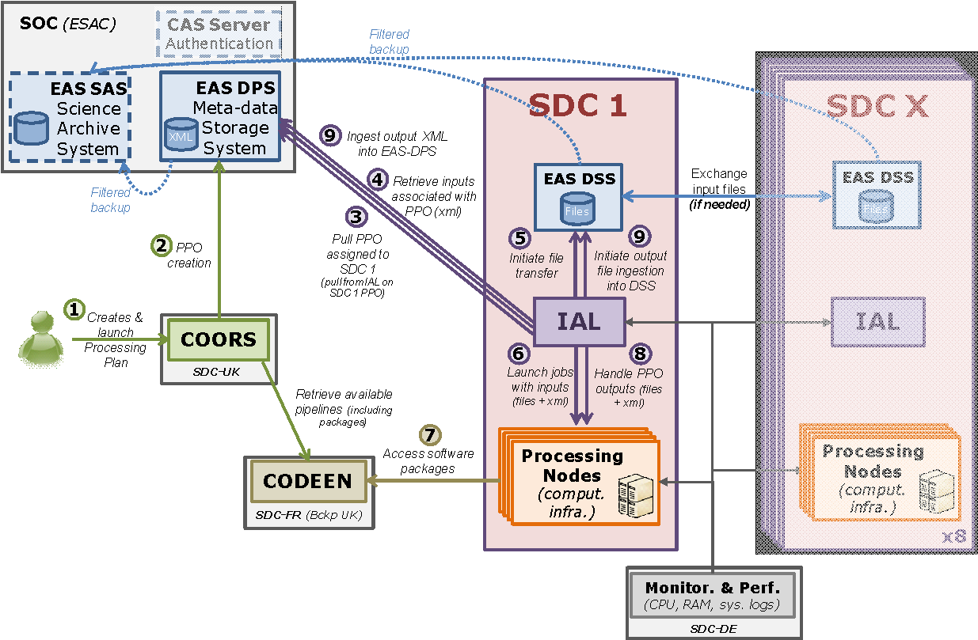
SDC(s)
EAS - Distributed Storage System (DSS)
Object Storage, SDC
http data transfer -transparent
mainly FITS and HDF5 formats
EAS - Data Processing System
central metadata archive
Object-to-relational mapping
Custom query language (REST)
data product oriented db
Products as XML files
Credits: EC consortium]
Notes:
Sistema distribuito implica degli “standard” di operazione/comunicazione

Slide 25
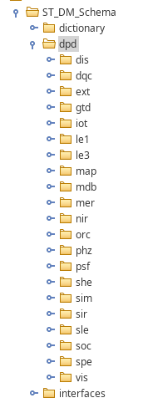
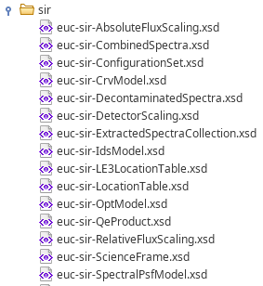
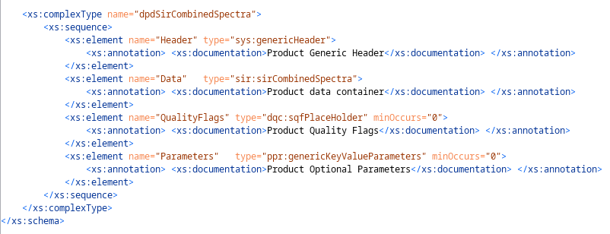
Euclid common data model
EAS - Data and Metadata
XSD to formalize products
description of metadata and data
evolution via Change Control Board

Slide 26
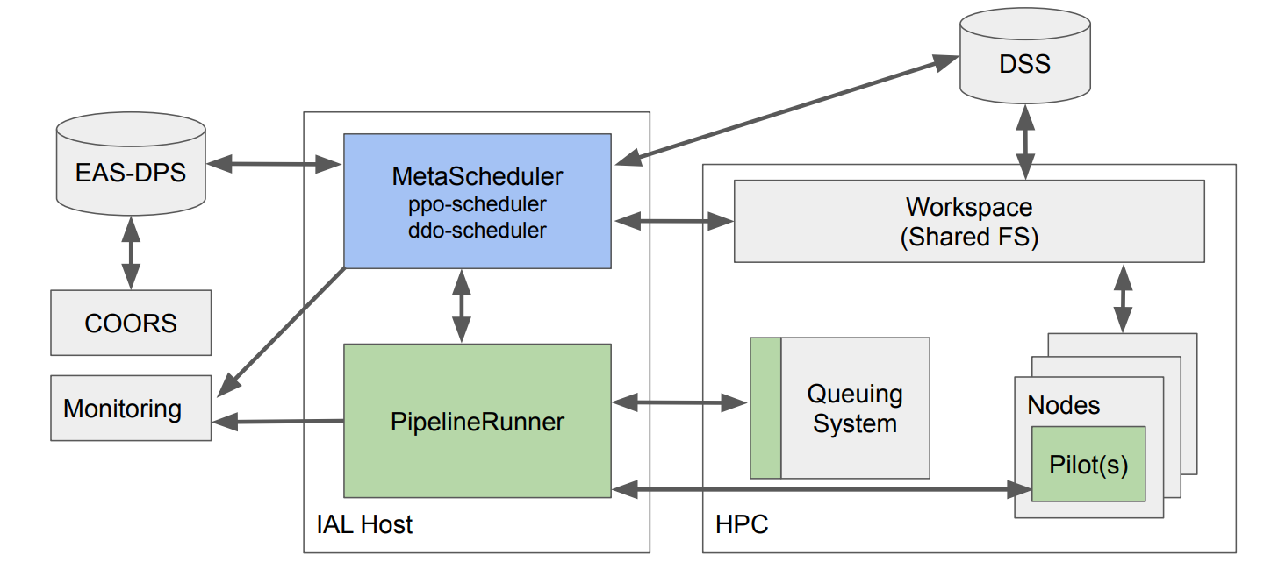
Infrastructure Abstraction Layer
national HPC facilities → possible different HW
common meta-scheduler
workflow manager
common queuing systems
Workflow (pipelines) definition
Python scripts specifying relations and requirements of each (PF)
enforced PF I/O description
stateless processing
Processing: payload job as common “pilot jobs”, profiling of jobs
Credits: EC consortium]

Slide 27
Infrastructure Abstraction Layer
national HPC facilities → possible different HW
common meta-scheduler
workflow manager
common queuing systems
Workflow (pipelines) definition
Python scripts specifying relations and requirements of each (PF)
enforced PF I/O description
stateless processing
Processing as payload job on common “pilot jobs”, profiling of jobs

Slide 28
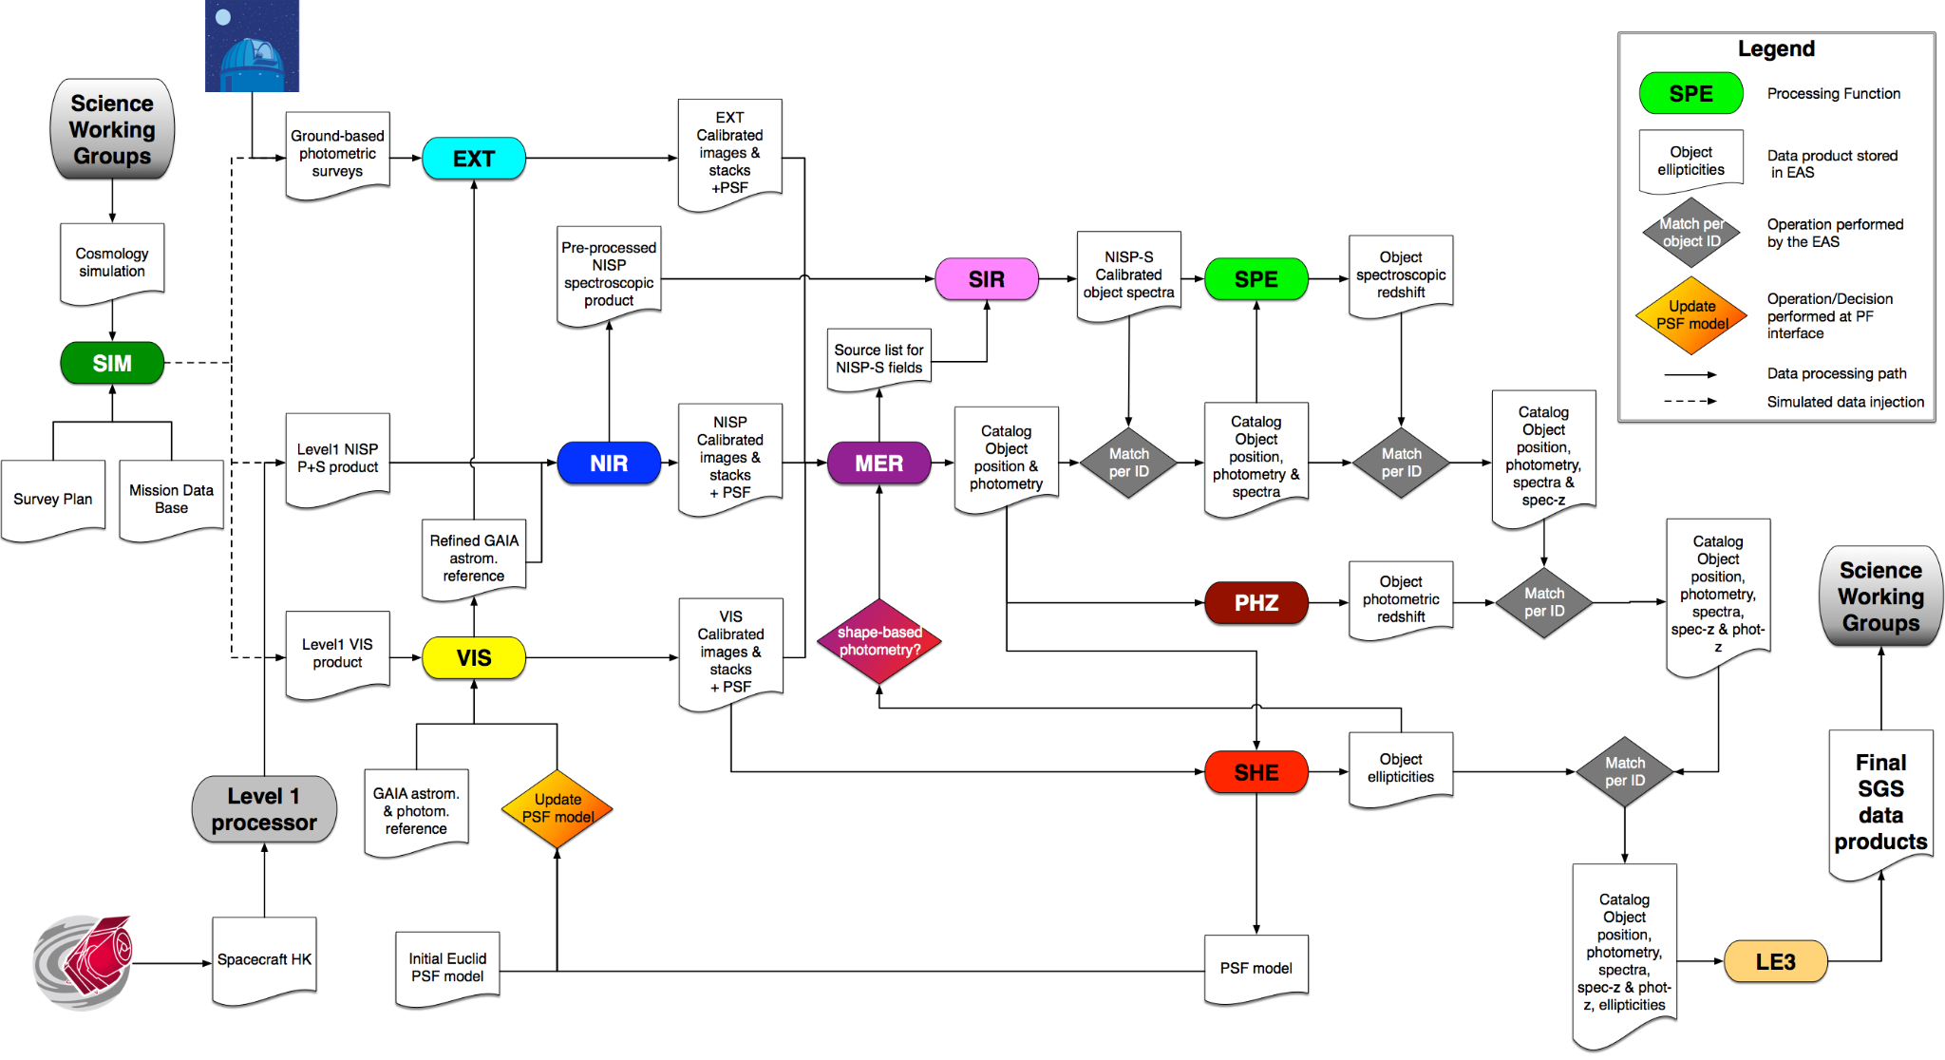
Euclid processing workflow
Credits: EC consortium]

Slide 29
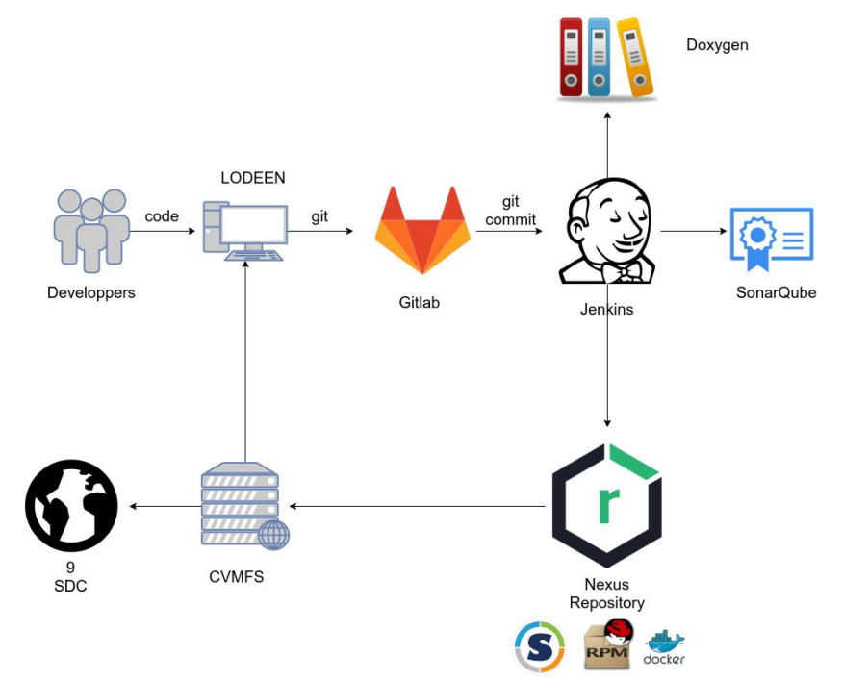
Software lifecycle in Euclid SGS
Data processing organized in steps (Processing Functions)
several software projects
different life cycle timings
Different requirements/granularity
minimal set of infrastructure req.
common environment
Multiple datacenters (SDCs)
synchronization of SW
different infrastructures
Gitflow workflow + Jenkins CI/CD + CVMFS packages distribution
Credits: EC consortium]

Slide 30
SDC-IT* computing infrastructure
development “SDC-IT-DEV” → OATs
15 nodes: 40 phys cores (no HT), 256GB RAM each node
1 node: 32 cores, 180GB RAM, 4x NVIDIA V100 16GB
650 TB of parallel storage (BeeGFS)
InfiniBand
integration/testing “SDC-IT-INT” → ALTEC (Turin)
8 nodes: 48 cores (24 phys), 256 GB RAM
4 nodes: 64 cores (32 phys), 1 TB RAM
730TB fast storage (Lustre) and Tier 2 storage shared with OPS
production “SDC-IT-OPS” → ALTEC (Turin)
12 nodes: 128 cores (64 phys), 1 TB RAM
9 nodes: 192 cores (96 phys), 768 GB RAM
2 nodes: 192 cores (96 phys); 1.5 TB RAM
1.4 PB fast storage (Lustre) + 4.4 PB Tier 2 general storage + 6 PB Tier 3 Tape Lib.
InfiniBand

Slide 31
…few takeaway notes
within a project, SGS is one of the longest-lived elements
technologies evolve during SGS lifecycle
SGS design/implementation and project design/development are entangled
SGS activities require various expertise to cover all operational fields
The Euclid, similarly to other mission like GAIA, Planck, and others, formed a community of experts, that is now an asset for INAF in perspective of future large missions and projects

