Slide 1
Deep learning for spectral perfectionism
Dinko Milaković, OATs; 1st USC VIII meeting; 15.10.2024

Slide 2
Brainstorming
Dinko Milaković, dinko.milakovic@inaf.it

Slide 3
Context
ANDES will be installed on the ELT in ~10 years.
The most demanding science goals are:
    Detecting Earth-Sun analogues and characterising exoplanet atmospheres
    Testing theories in which fundamental physical constants vary in time and/or space
    Measuring the small cosmological change in the redshift of distant objects (universal expansion)
Measurement uncertainties will be systematics limited — instrumental effects, spectral modelling, astrophysical uncertainties.
Advances in understanding instrument systematics will bring advances in other aspects
Dinko Milaković, dinko.milakovic@inaf.it

Slide 4
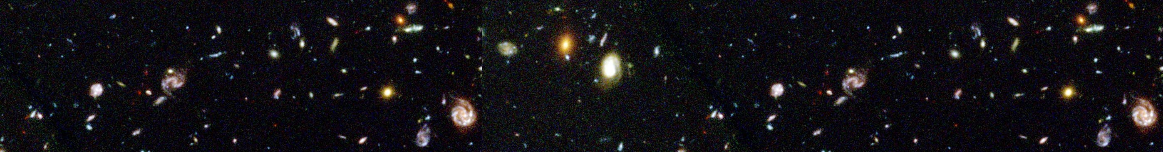

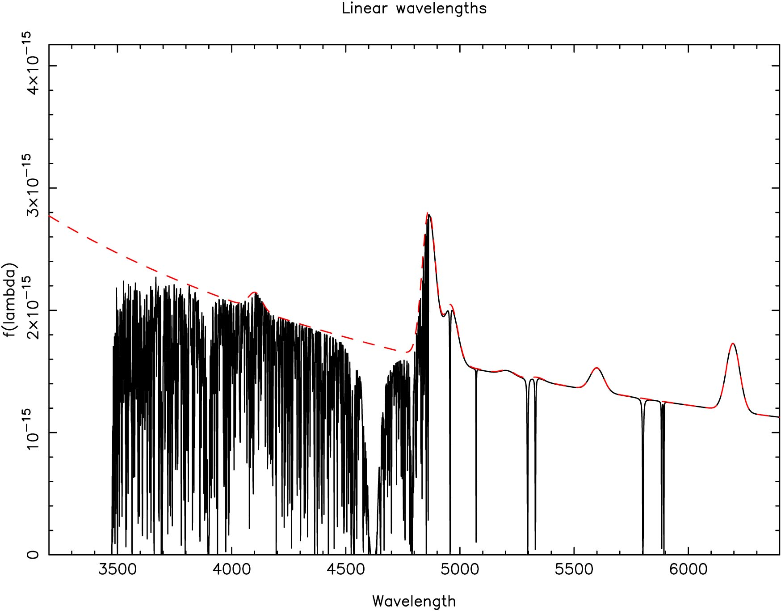
Quasar
To Earth
Hydrogen absorption due to galaxy
Emission lines from the Quasar
Heavy element absorption
DLA
Lyman alpha forest
Observed wavelength (Å)
Dinko Milaković, dinko.milakovic@inaf.it

Slide 5
Quasar
To Earth
Hydrogen absorption due to galaxy
Emission lines from the Quasar
Heavy element absorption
DLA
Redshift drift
Fundamental constants
Lyman alpha forest
Observed wavelength (Å)
Dinko Milaković, dinko.milakovic@inaf.it

Slide 6
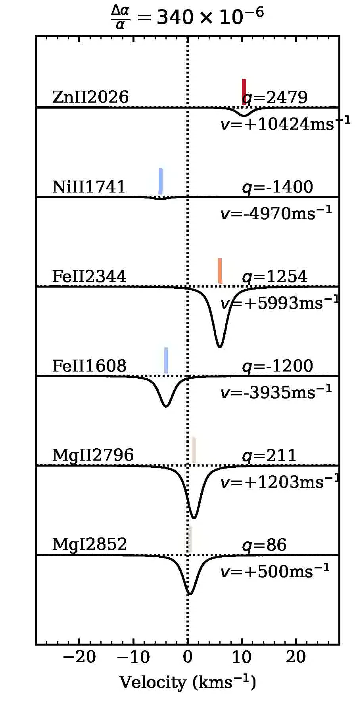
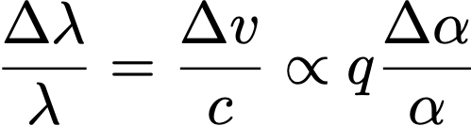
The effect of varying alpha
Any change in the value of the fine structure constant (alpha) perturbs energy levels of atoms and molecules
Wavelength shifts, velocity shifts,
and change in 𝛼 are related by:
The broad range in q coefficients means that
shift directions and amplitudes are
very different for different transitions
Dinko Milaković, dinko.milakovic@inaf.it

Slide 7
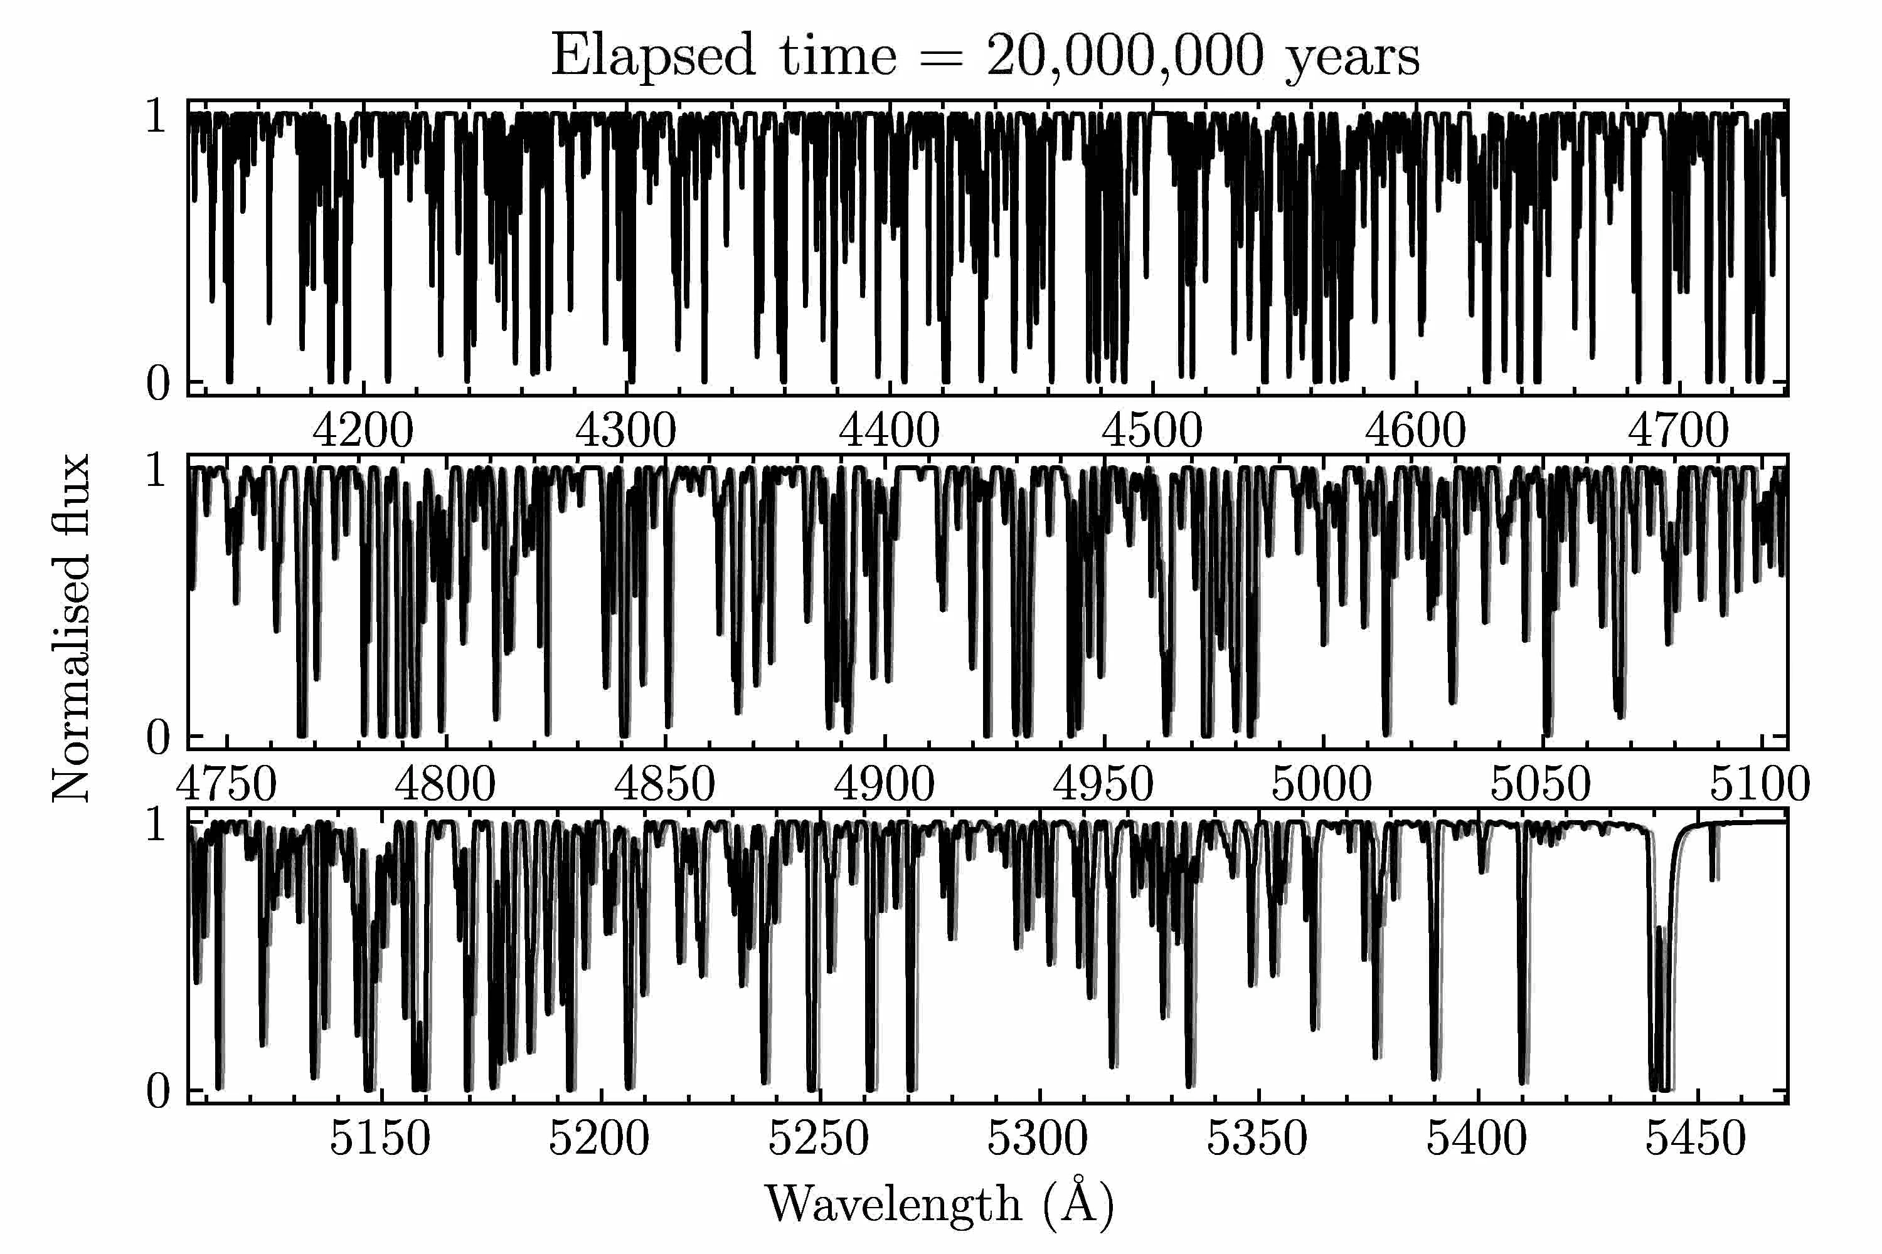
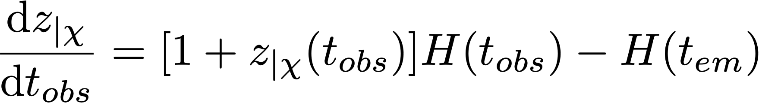
Simulation in ΛCDM
Dinko Milaković, dinko.milakovic@inaf.it
Notes:
\frac{{\rm d}z_{|\chi}}{{\rm d}t} = \left[ 1 + z_{|\chi} (t_{obs} \right ] H (t_{obs}) - H (t_{em})
\frac{\Delta v}{c} = \int_{t_0}^{t_1} \frac{{\rm d}z_{|\chi}}{{\rm d}t} \, {\rm d}t

Slide 8
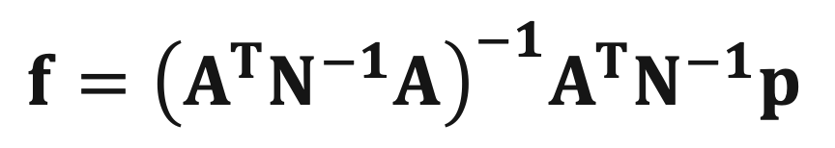
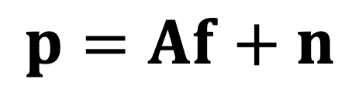
Spectral perfectionism
Data reduction procedures must be updated to fully benefit from high-quality ANDES data
“Optimal extraction” (Horne 1986, ) works fine and is suitable for many science cases but makes simplifying assumptions
“Spectral perfectionism” (Bolton & Schlegel 2010) goes beyond the limitations of previous approaches
Input spectrum
Observed CCD
count vector
Noise
$$p=Af+n$$
Calibration matrix
(wavelength calibration, spectrum trace position, PSF shape and its dependence on position, flat-fielding effects, spectrophotometry, exposure time)
$$f={\left(A^{T}N^{−1}A\right)}^{−1}A^{T}N^{−1}p$$
Dinko Milaković, dinko.milakovic@inaf.it

Slide 9
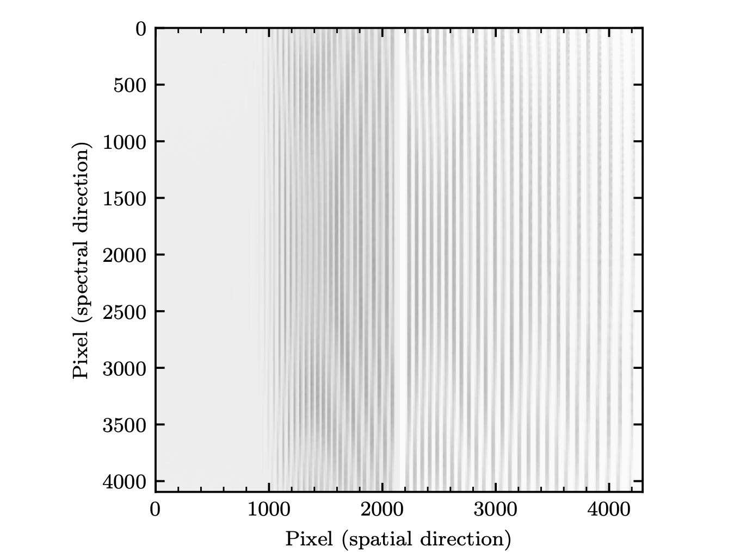
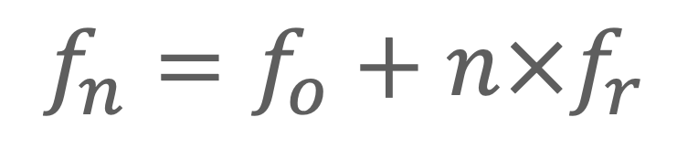
Project at OATs
INAF Techno grant to implement Spectral Perfectionism on HARPS – the first such pipeline for an extremely precise spectrograph
My responsibility: provide PSF models for the calibration matrix
Use the laser frequency comb (LFC) to reconstruct the instrument point-spread function (PSF)
Line frequency
Offset frequency
Repetition frequency
$$f_{n}=f_{o}+n×f_{r}$$
Supercontinuum

Slide 10
Wishlist
LFC samples the PSF
I want to reconstruct the PSF shape at any position of the detector (for spectral-perfectionism)
I want to fit those PSF shapes to data to centroid LFC lines (for wavelength calibration)
Dinko Milaković, dinko.milakovic@inaf.it

Slide 11
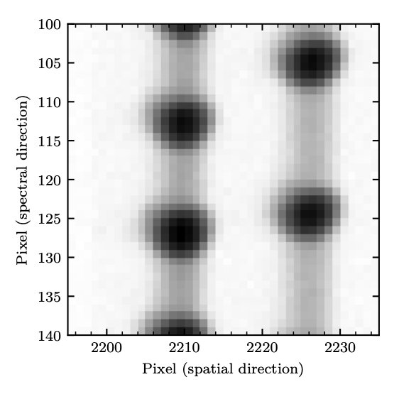
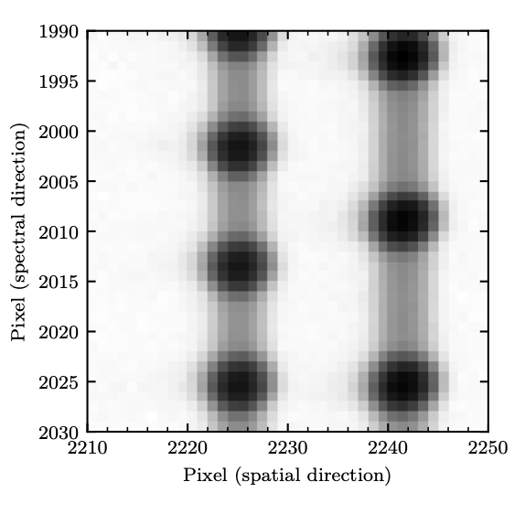
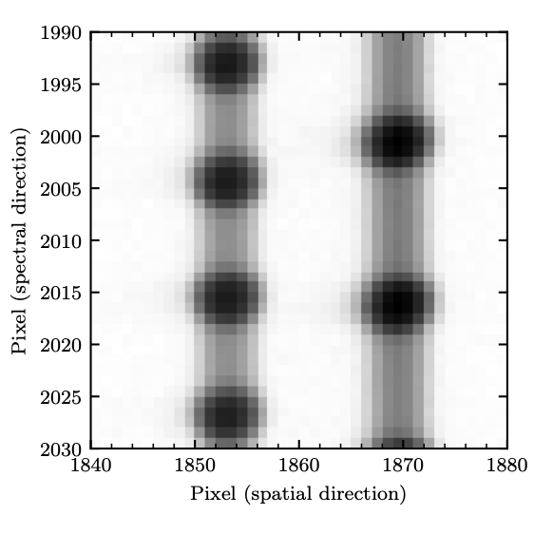
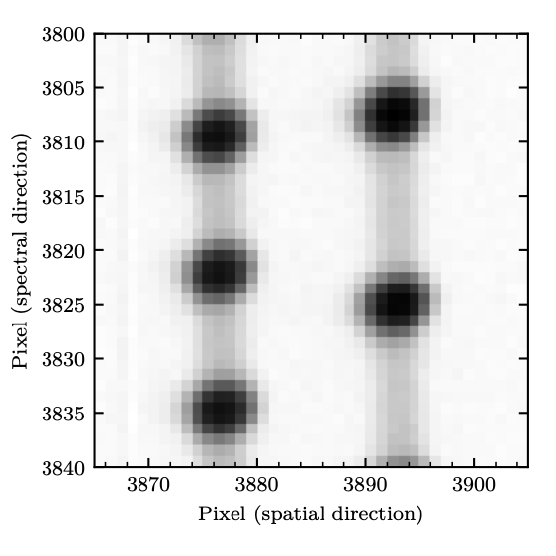
LFC samples the PSF, which changes across the detector
Dinko Milaković, dinko.milakovic@inaf.it

Slide 12
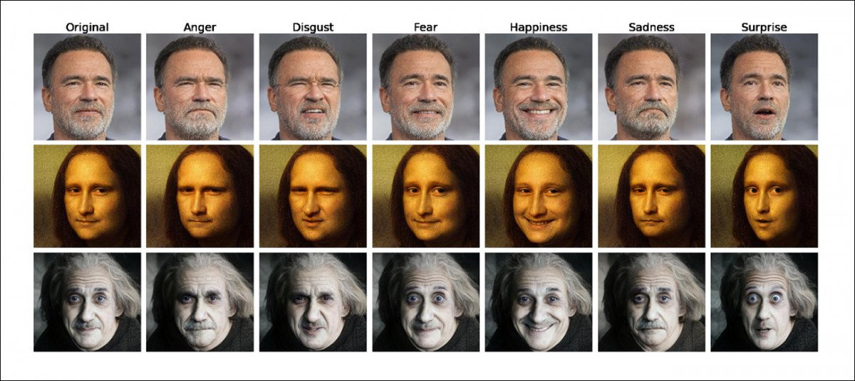
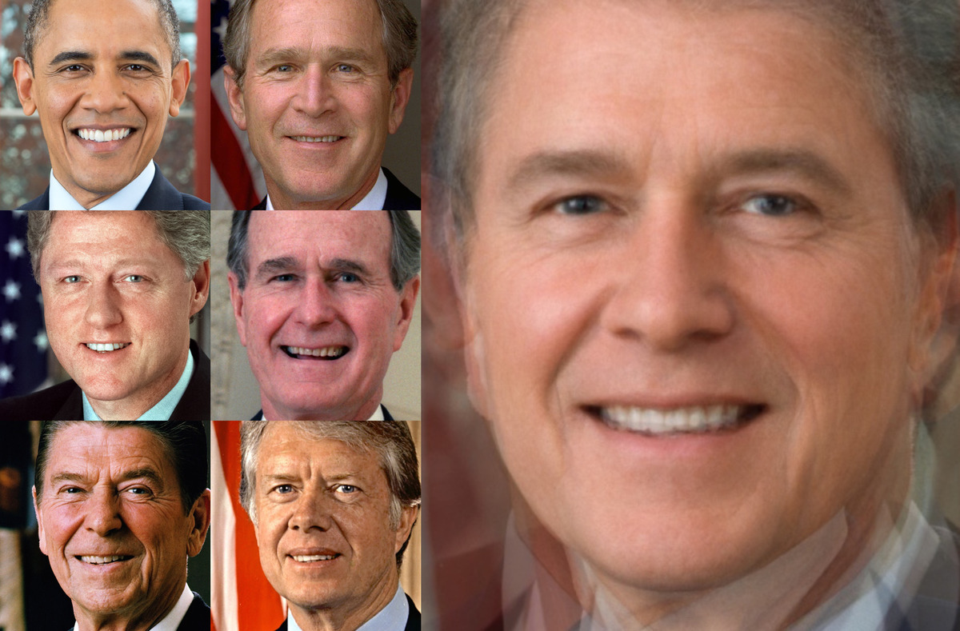
I want super-resolution PSF at any relevant coordinate
(position, intensity, time, …)
… without losing important differences
Figures from unite.ai/gan-as-a-face-renderer-for-traditional-cgi/
Dinko Milaković, dinko.milakovic@inaf.it

Slide 13
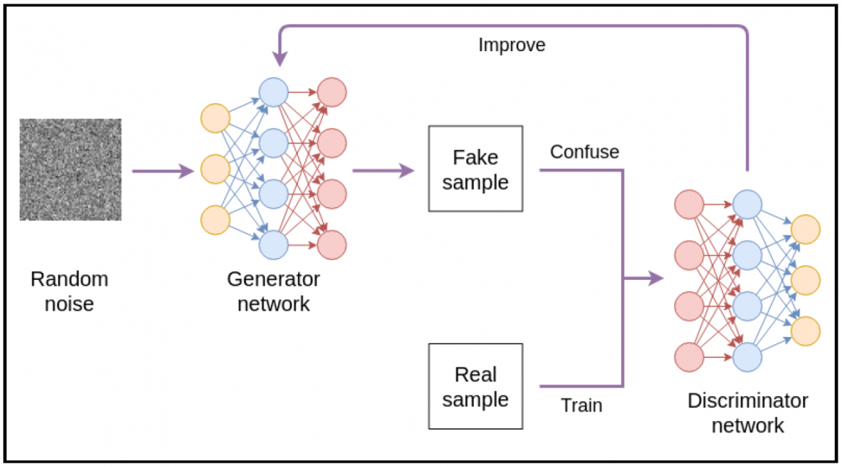
Deep learning
Generative adversarial neural network
Fake LFC
Real LFC
Taken from Heny & Walters “Hands-On Generative Adversarial Networks with PyTorch 1.x”
Dinko Milaković, dinko.milakovic@inaf.it

Slide 14
Curiosities I would like to get input on
Is the architecture suitable?
What could be a showstopper?
The PSF is approximately Gaussian in shape. Can this be used as a prior?
The PSF varies slowly. Neighbouring lines are pixelized versions of a very similar PSF: is it possible to “stack” them? If PSF shapes must be fitted to do this, can it be incorporated into the architecture?
The frequency spacing between LFC lines is constant and well known. Is it possible to incorporate that knowledge into the reconstruction process? Get the wavelength calibration simultaneously?
How about using wavelets or their 2d equivalents – starlets?
A technical point: the LFC spectrum contains a supercontinuum background that modulates the recorded spectrum. Would the network pick it up? Should it be fitted?
Dinko Milaković, dinko.milakovic@inaf.it

Slide 15
Contacts
Me, dinko.milakovic@inaf.it
Guido Cupani, guido.cupani@inaf.it

Slide 16
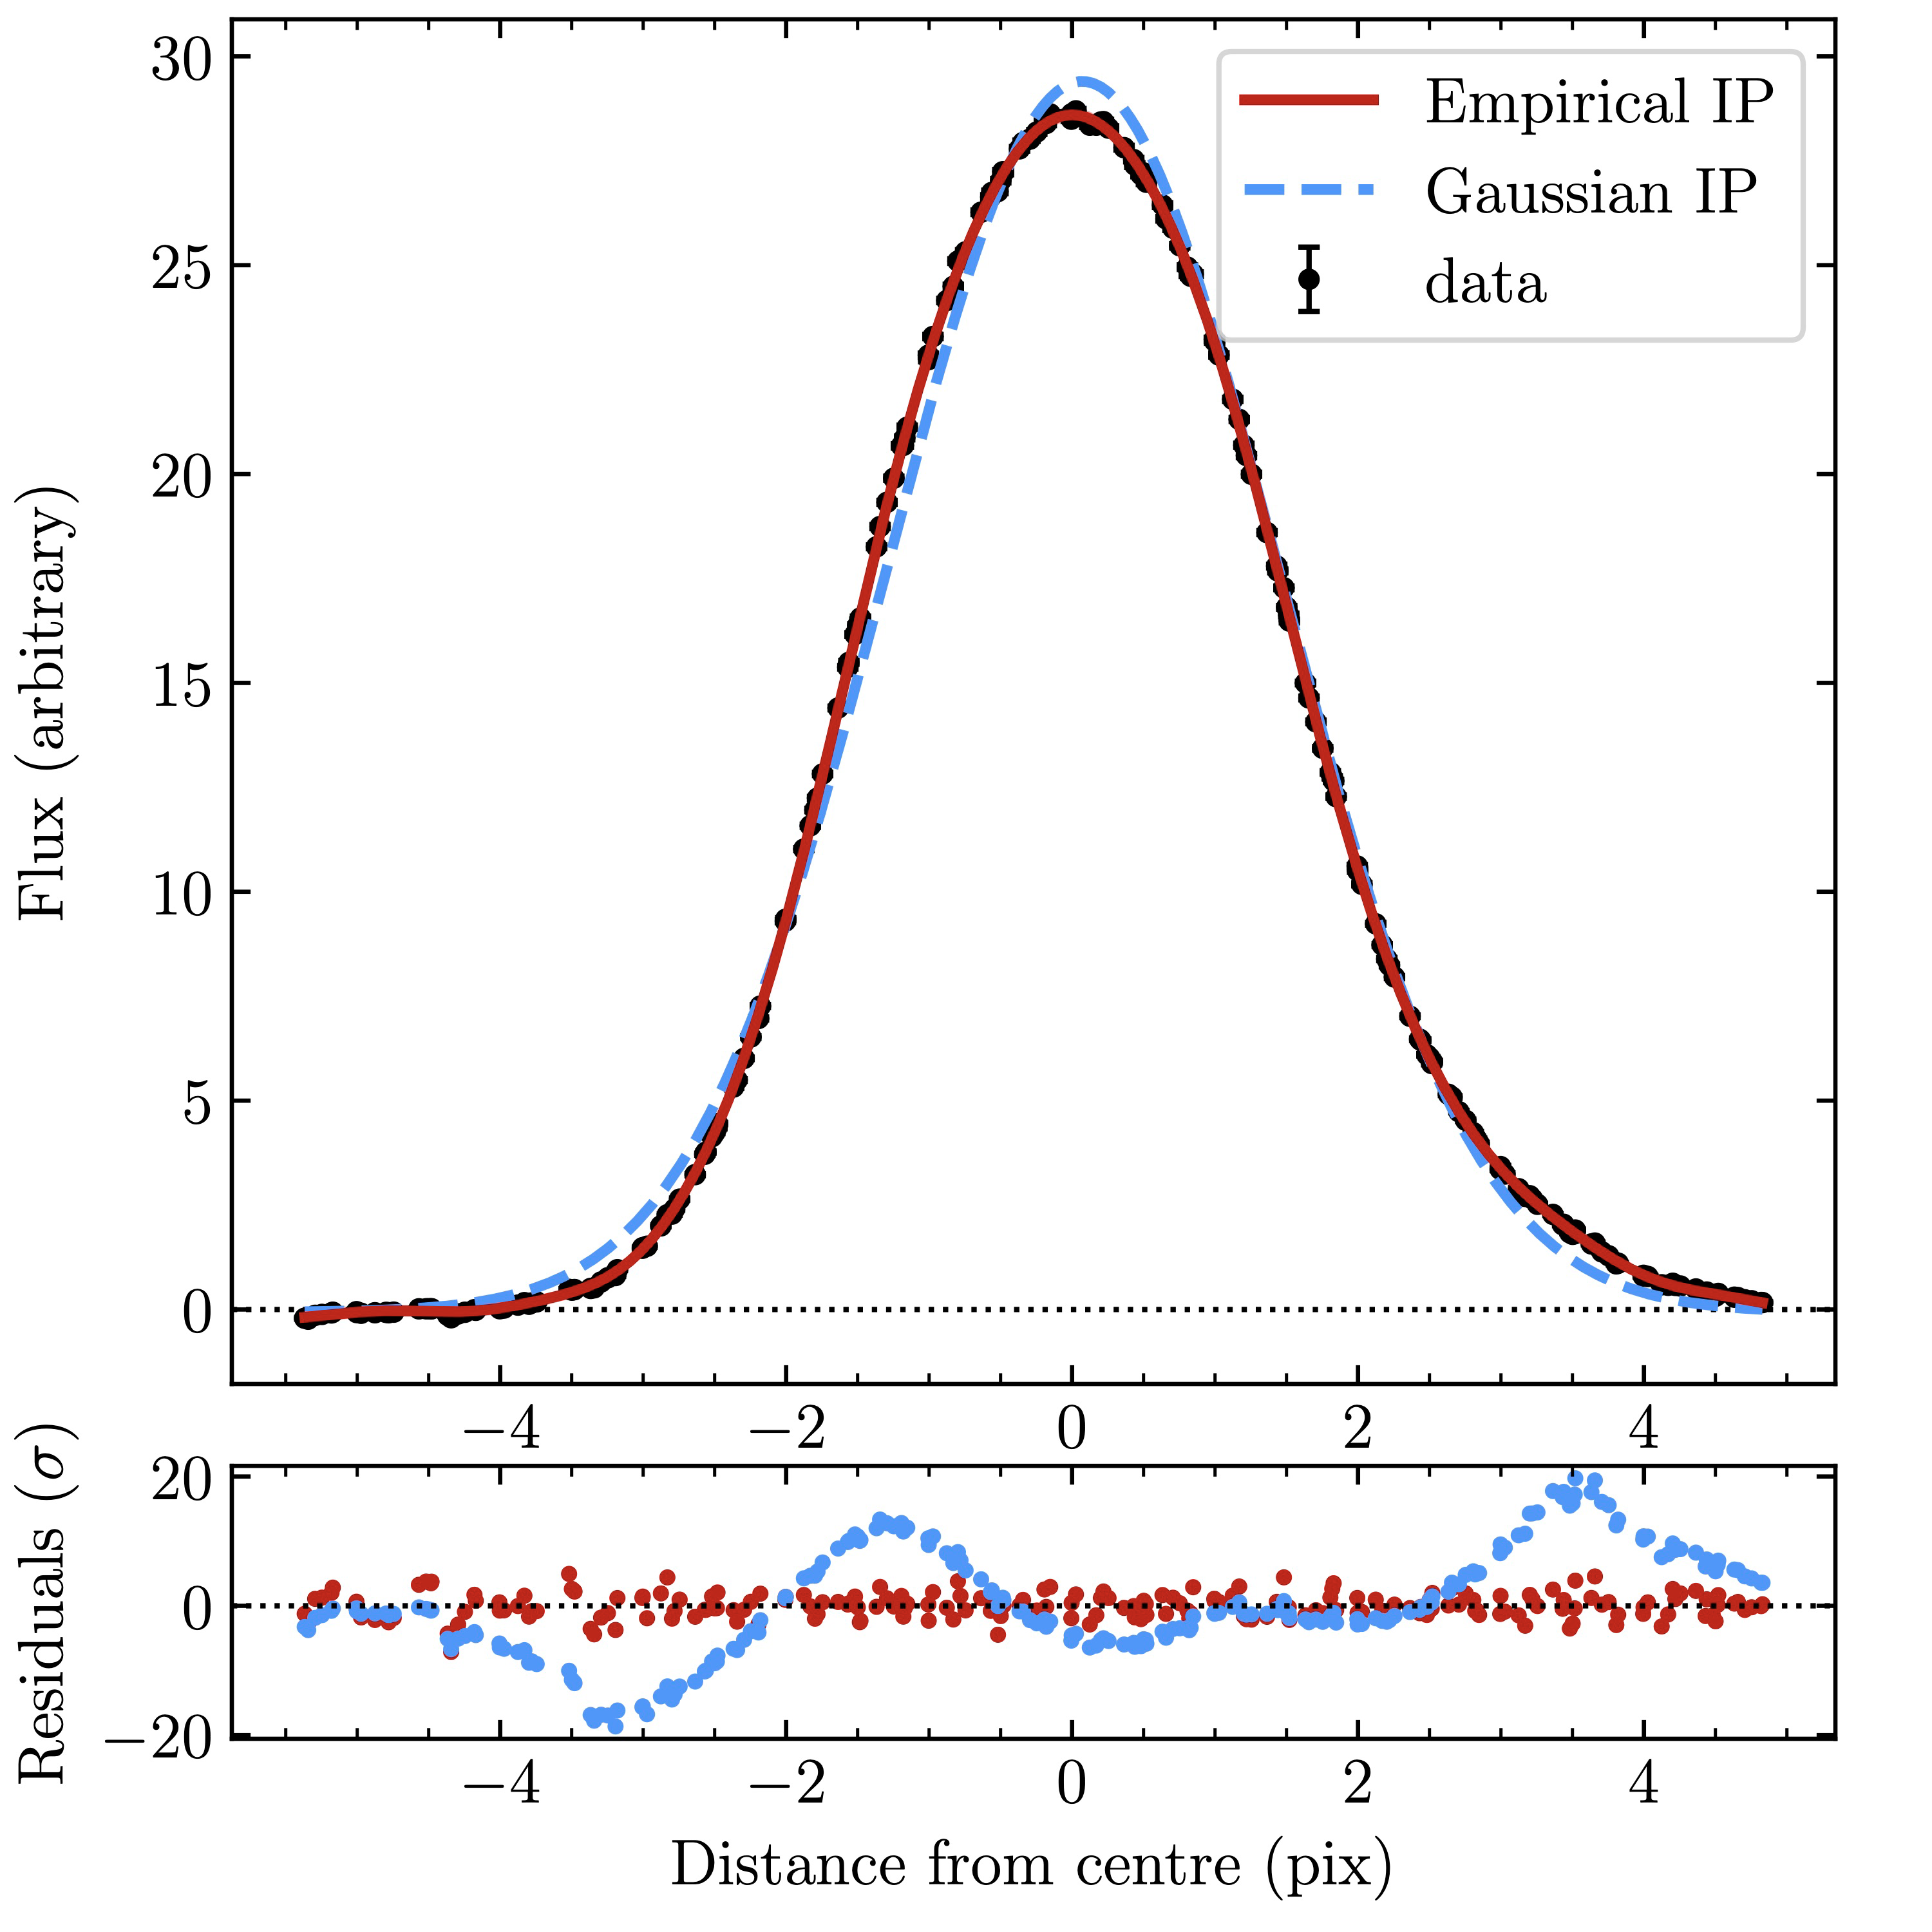
Some previous work on 1d
Gaussian process to model the line-spread function of HARPS
Dinko Milaković, dinko.milakovic@inaf.it

