Slide 1
Developing an INAF infrastructure for Software Quality Assurance
A. Balestra, R. Sordo, E. Costa – INAF OAPD

Slide 2
Context: Software Quality Assurance
The purpose of Software Quality Assurance (SQA) is to provide adequate confidence that:
the software satisfies its requirements throughout the system lifetime
the SW performs properly and safely in its operational environment
the SW meets the quality objectives agreed for the project.
This is usually achieved by verification of the SW compliance on a pre-agreed set of standards, using quality metrics
Given the increasing evidence that lack of quality implies hidden costs, through loss of observing time, a higher level of SQA is requested from stakeholders
SQA is increasingly important also in ground-based astronomical projects, as they become bigger and more complex

Slide 3
Working in INAF
Space and optical/IR ground-based INAF projects have only a couple of main committers:
ESA
Flight software usually contracted to industry, even if recently there have been some deeper INAF involvement
Based on ECSS (meta) standards
ESO
Internal ESO standards, evolving in time (new telescopes, new technologies…)
INAF’s involvement with ESO is multi-faced, developing many different astronomical instruments through different self-contained Consortia
Currently active projects include, where INAF is developing SW: MORFEO, MAVIS, CUBES, ANDES, SOXS…
Very few INAF personnel exists with expertise in SQA …

Slide 4
Working with ESO
ESO imposes an environment for SW development (DevEnv), including:
Operating system
Languages
Compilers & build system
GUI tools
…
Last but not least, an Instrument framework (IFW) & RTC toolkit
ESO imposes also its own guidelines and standards for coding
ESO requires a SQA Plan

Slide 5
Factoring similarities
Several projects, but the same set of standards
Natural to think about commonalities and how to take advantage of this
In the different project in which we are involved, we implement a standardization of:
Management plan
Quality metrics
Tools use to verify those metrics
Internal guidelines
Reporting
Configuration Control
Some level of tailoring is anyway needed to adapt to each project (e.g. RTC yes or no)

Slide 6
Current status
Starting from what already available in INAF (Mathworks Polyspace, Understand, GitLab infrastructure…) plus a set of freely available tools (cpptest, clang, Prospector), we adapted them to ESO requirements/standards.
We also added additional standards like the «Hersteller Initiative Software» (HIS) metrics
We glued them together in a CI/CD environment, with GitLab, using DevEnv in a virtual machine runner
SQA CI is triggered whenever developers issue a code release for ESO (every 3 months as required by ESO)
We are developing in Cameo a Verification Matrix of ESO requirements
This framework is currently working/planned for MORFEO, MAVIS, CUBES, ANDES

Slide 7
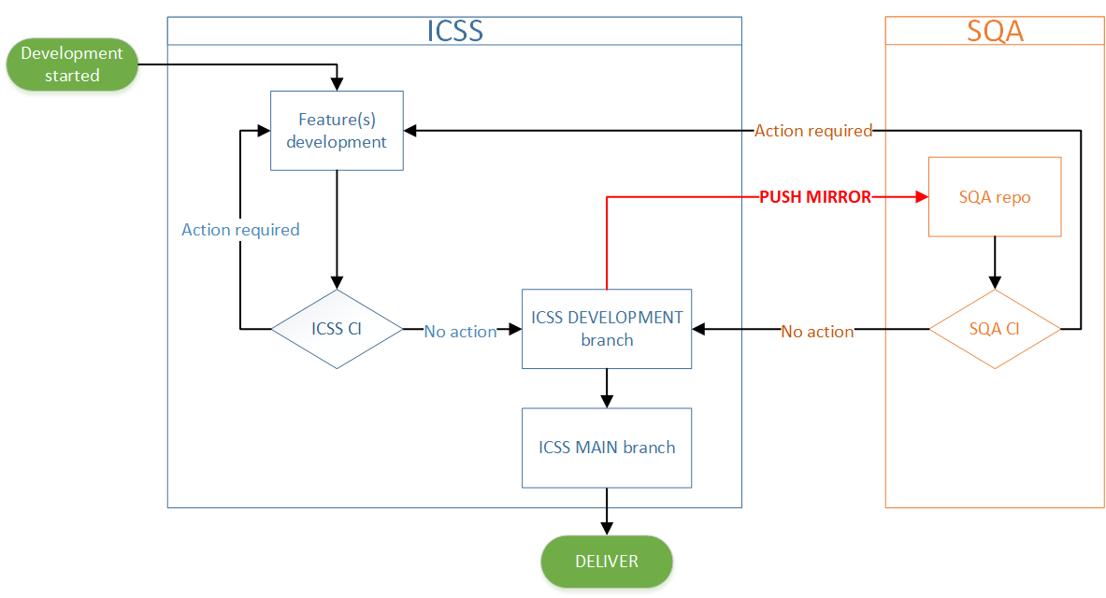
Developer repo has a stable branch. When a merge request is accepted and changes are integrated in the development branch, SQA repo automatically retrieves the changes, triggering the SQA pipeline. A failure in the SQA tests will trigger a message to the development team (action required), blocking the release. A success in the pipeline run will instead give green light to the delivery of the software.
On a regular basis, ICSS submits a merge request of the development branch into the main branch, which is tagged with a version number.

Slide 8
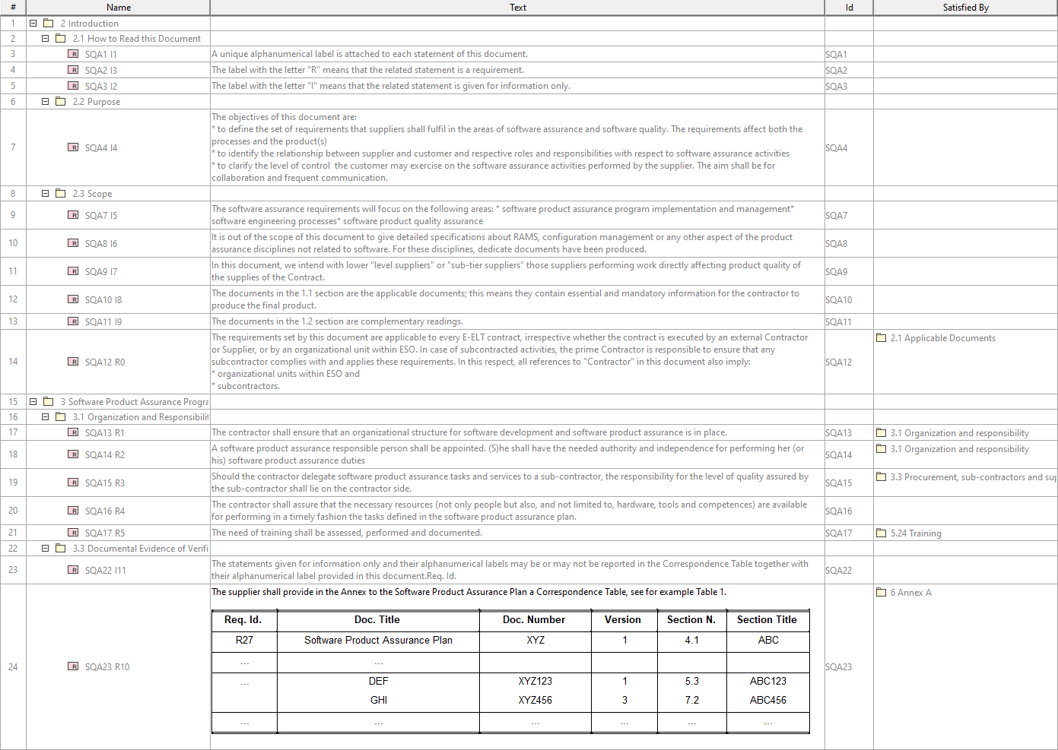

Slide 9
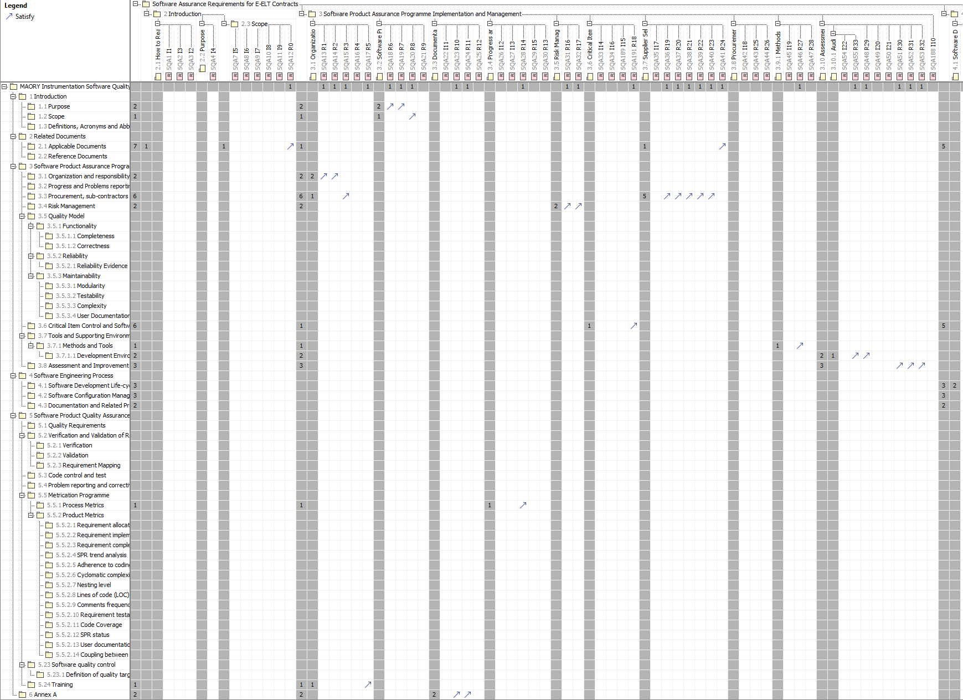

Slide 10
The goal: INAF infrastructure
Working in Consortia imposes the set of tools that can be used, e.g sharing licences among Consortia is difficult/impossible
Time/possibility for R&D is limited by the lifecycle of the instrument
We applied for INAF funding, to overcome these limitations and create a flexible infrastructure to be used by INAF consortia for future ESO projects
Of course, this could be easily adapted to non-ESO specific projects

Slide 11
Future development
Automatization of requirement checking:
Also quality of requirements needs to be checked
For this purpose, we are experimenting with AI using (as a starting point)
Gemini
Notebooklm
To overcome proprietary and lock-in issues with Polyspace we plan to explore other freely available tools like Frama-C
Use of AI and DigitalTwins for visionary V&V

