Slide 1
High Performance Visualization in the
SPACE Center of Excellence
Eva Sciacca, Valentina Cesare, Nicola Tuccari, Fabio Vitello,
Carmelita Carbone, Ugo Becciani

Slide 2
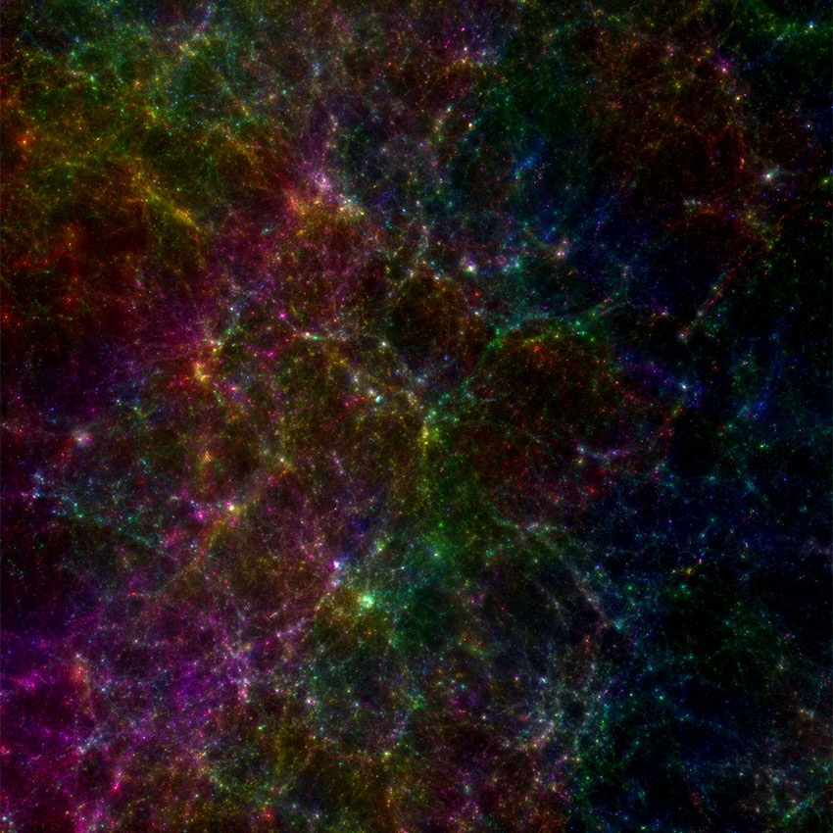
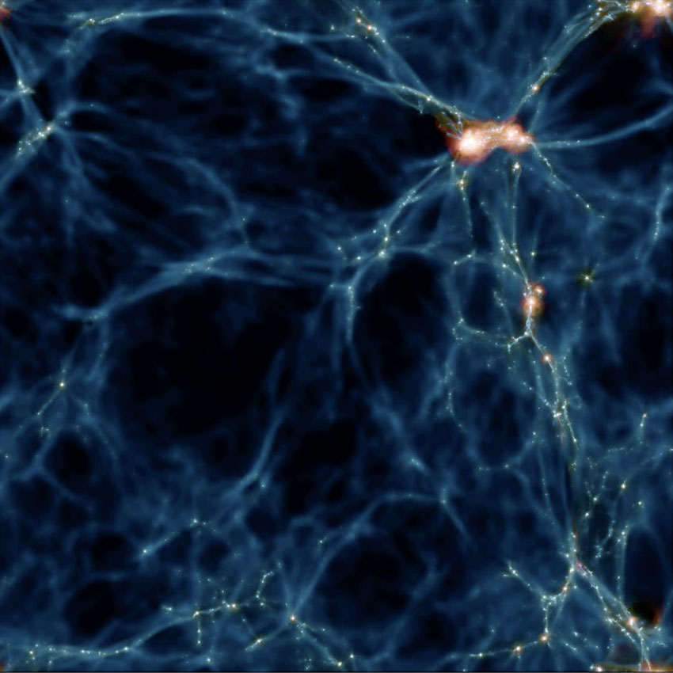
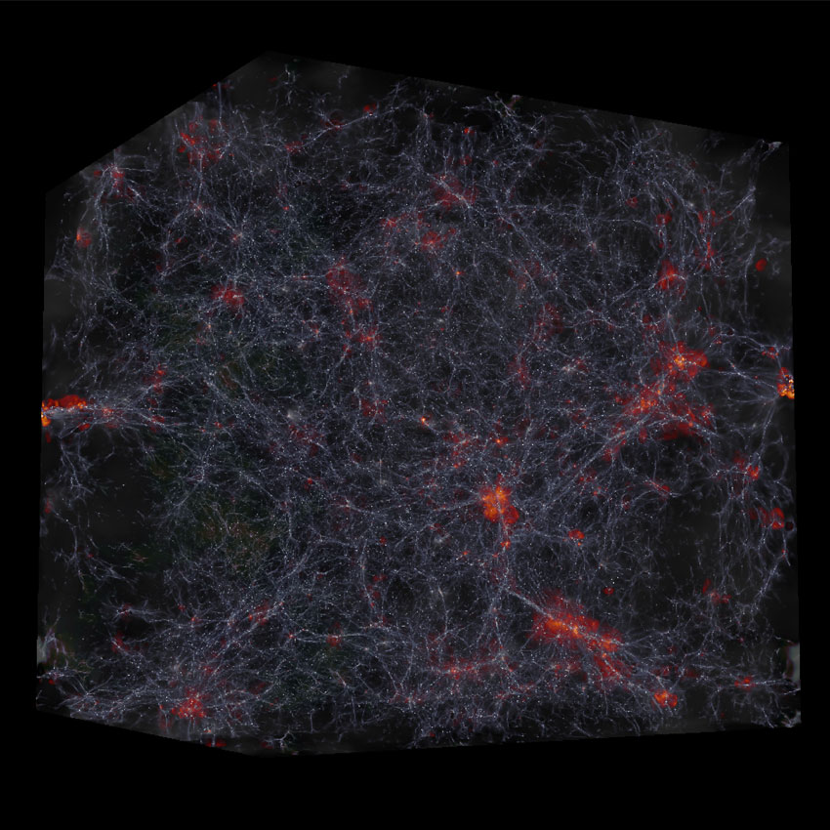
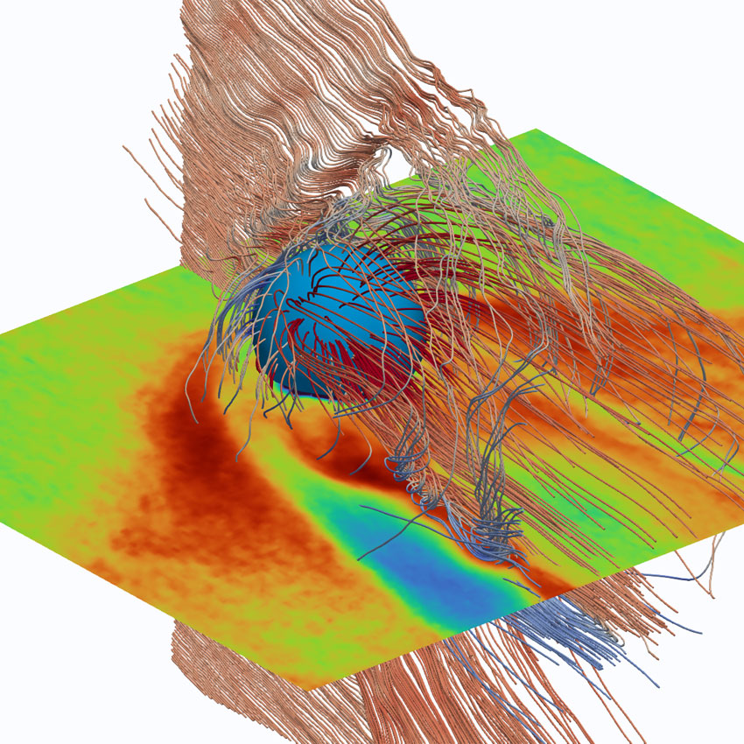
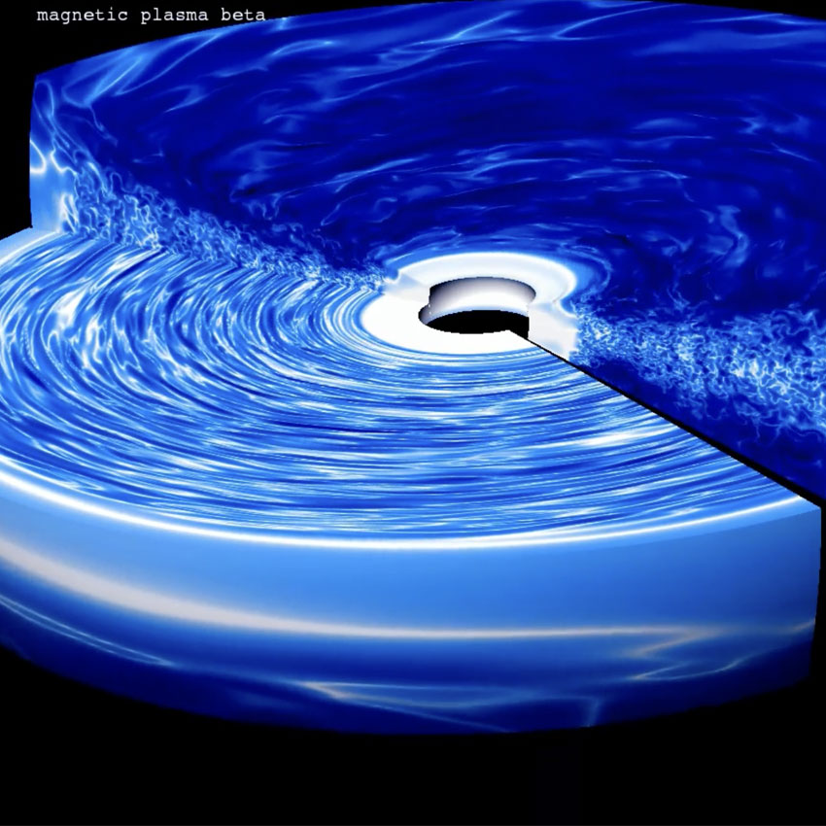
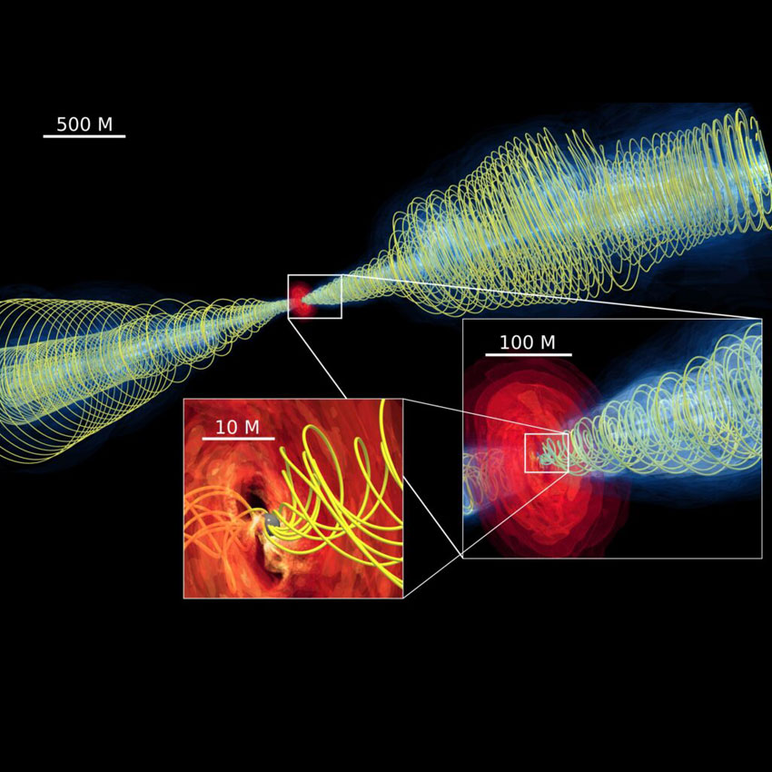
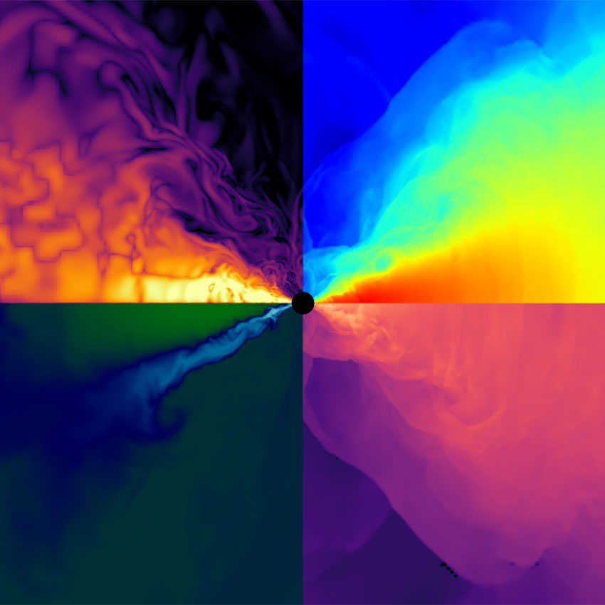
The SPACE Centre of Excellence
Scalable Parallel Astrophysical Codes for Exascale (SPACE)
EU Centre of Excellence focused on Astrophysical and Cosmological (A&C) applications
Extensively re-engineer A&C codes for the efficient and effective exploitation of exascale computing capabilities
High-performance data analysis of the data torrent produced by exascale A&C simulation applications with machine-learning and visualization tools.
See talk from L. Tornatore The SPACE project on October 15th
OpenGADGET CHANGA RAMSES iPic3D PLUTO BHAC FIL
cosmological simulations
magneto hydro dynamics code
AMR cosmological simulations
plasma physics
astrophysical plasma simulations
Black Hole accretion
general-relativistic MHD

Slide 3
Visualization Requirements
Over the years, the A&C domain has developed a set of ad-hoc tools and software modules to tackle data processing.
Some of these components become candidates to be replaced by either faster, more accurate, or more efficient data-driven technologies based on high-performance visualization.
Collected requirements in SPACE CoE include:
load directly from simulations’ computing infrastructure to reduce data-movement overheads
load directly from the simulation to avoid data duplication (in-situ)
interactive multi-dimensional visualisation
handling of different specific data formats
Notes:
Over the years, the A&C domain has developed a set of ad-hoc tools and software modules to tackle the challenging particularities of the field.
With the emergence of ML, high-performance visualization, and Visual Analytics (VA) as enabling technologies, some of these components become candidates to be replaced by either faster, more accurate, or more efficient data-driven technologies.
In the SPACE CoE, experts in visualization and AI techniques belonging to “Extreme data processing and analysis” (WP3) have performed a review of the existing software of interest, and identified components of specific interest in the SPACE exascale codes to be integrated with visualization and ML technique.
We gathered use case requirements and software specifications related to better exploitation of post-processing analysis products and of run- time modules suitable for coupling the applications with visualization and ML.

Slide 4
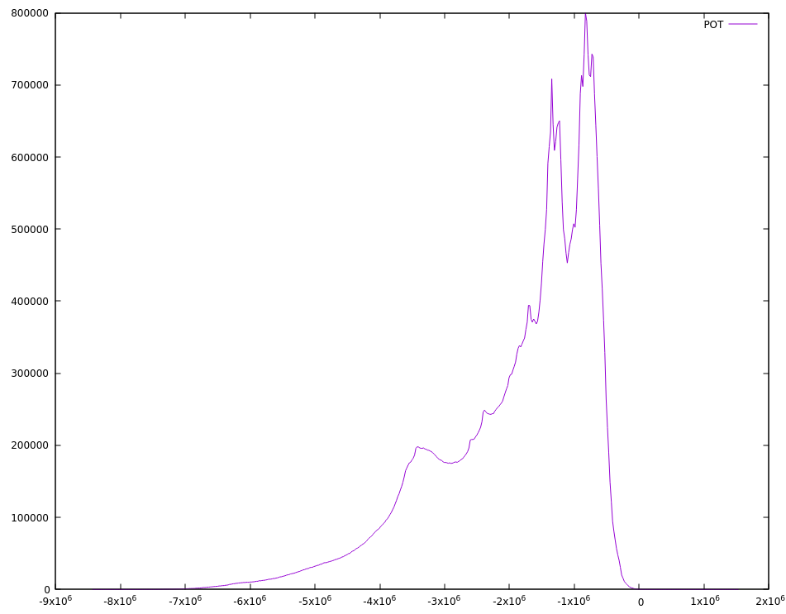
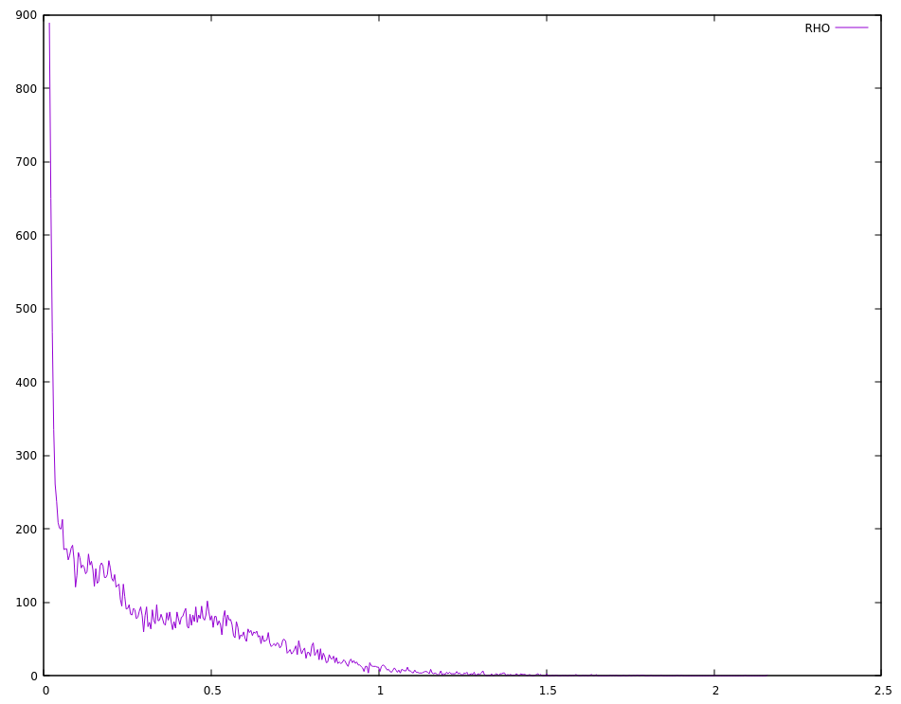
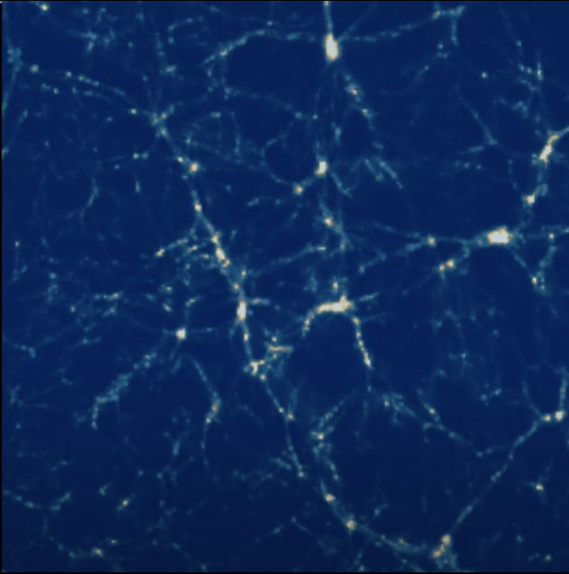
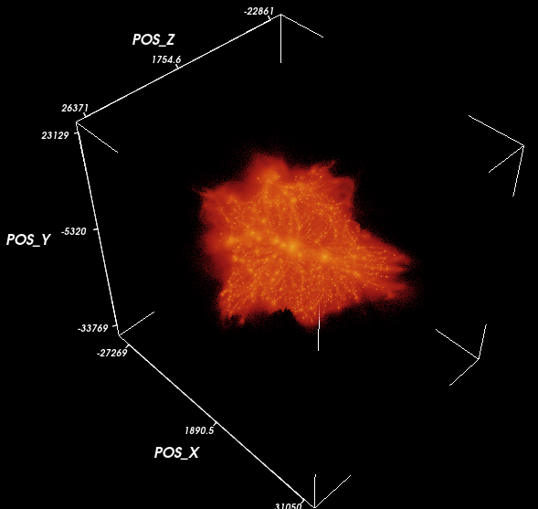
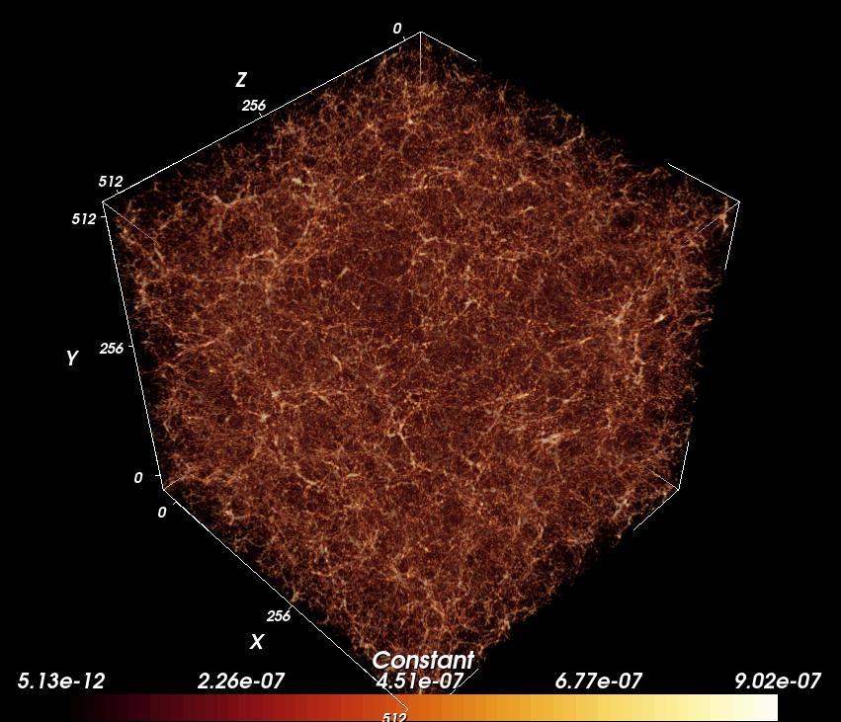
VisIVO
The Visualization Interface for the Virtual Observatory
Developed and maintained by INAF OACT
Part of the suite of tools for “Extreme data processing and analysis” (SPACE WP3)
Perform multidimensional data analysis and knowledge discovery.
Has been deployed using Science Gateways to access DCIs using containerization and virtualization technologies.
Has been deployed on EOSC, efficiently exploiting Cloud infrastructures and interactive notebooks applications.

Slide 5
Roadmap
The final aim of the VisIVO evolution are tailored to be exploited and adapted for high performance visualisation of data generated on the (pre-)Exascale systems by the SPACE user-community and other A&C applications:
Main objectives include:
Optimize and parallelize VisIVO modules to efficiently handle and process A&C data on Exascale computing resources,
Enhance the portability of the VisIVO modular applications and their resource requirements,
Foster reproducibility and maintainability,
Take advantage of a more flexible resource exploitation over heterogeneous HPC facilities (including also mixed HPC-Cloud resources),
Minimise data-movement overheads and improve I/O performances.

Slide 6
HPC enabling
Importing modules parallelized for multi node/multi thread platforms using MPI and OpenMP.
Filtering modules extended to exploit also multi GPU platforms investigating CUDA and OpenACC.
Viewer modules, based on VTK, already optimized for emerging processor architectures, will be tailored to support the extreme scale computing.

Slide 7
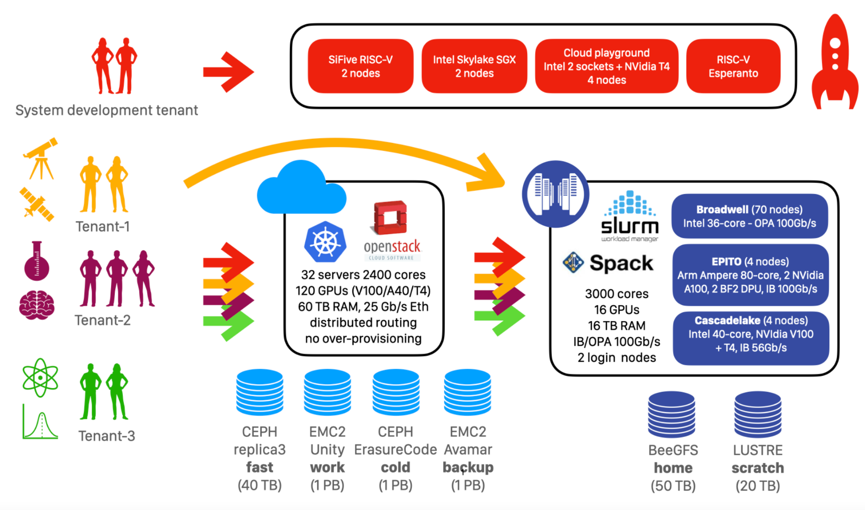
Computing Request @
VM instances: 2
VCPU: 8 each
RAM: 128
HD space: 500GB
GPU: 4
Access by Openstack
Access to HPC resources

Slide 8
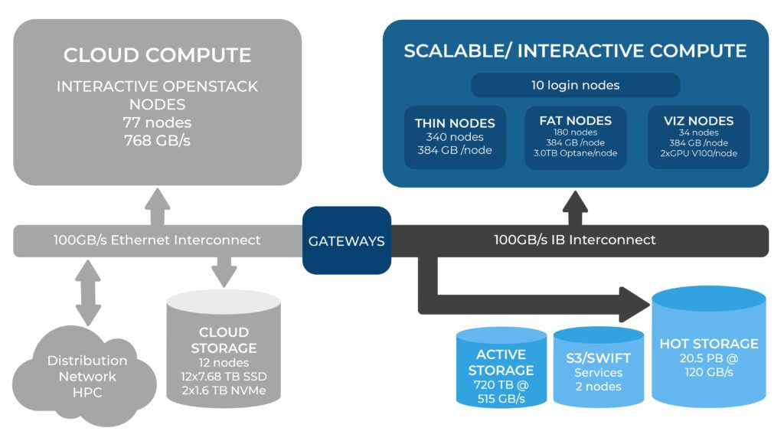
Computing Request @ Cineca Galileo100
Max Number of Nodes: 8
Assigned budget: 16.667 core/h
RAM per Node: 384GB
HD space: 1TB

Slide 9
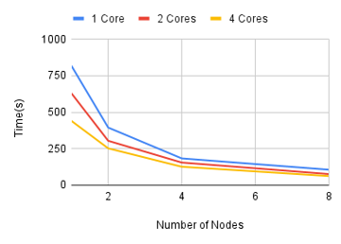
Preliminary scalability test @ Galileo100
Preliminary tests on the VisIVO Importer module were performed on the Cineca's Galileo100 platform using a 512GB GADGET snapshot .
With the use of multiple nodes the importer scales linearly using up to 8 nodes
Multi-core execution scales using up to 4 cores depending on the blocks present in the snapshot

Slide 10
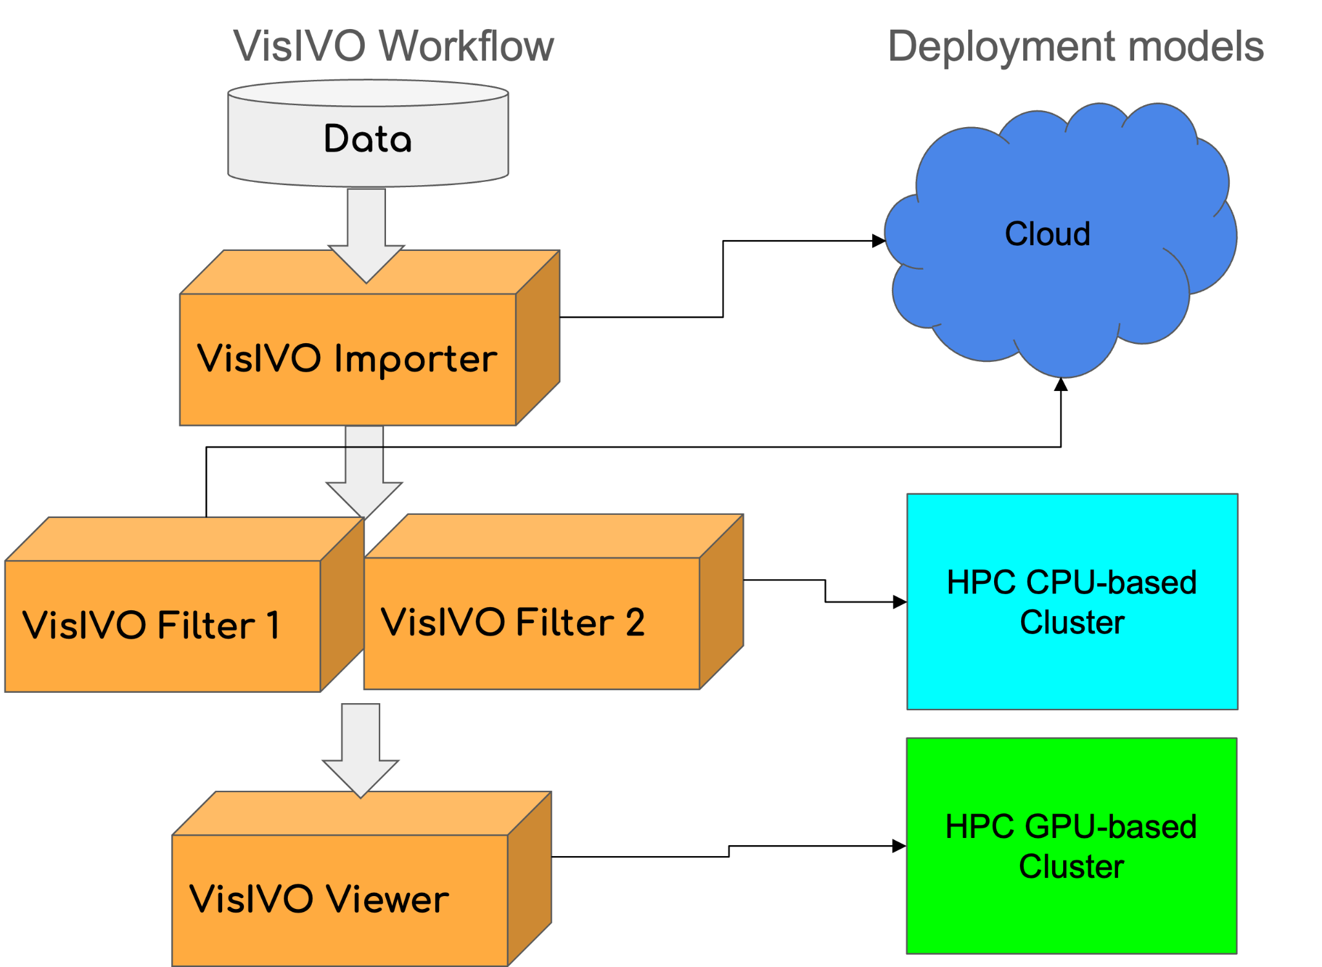
Hybrid Workflow Model
The main motivations for integrating VisIVO with a Hybrid Workflow Model are:
Enabling execution across various computing infrastructures for high-performance visualization of large-scale HPC application outcomes in A&C.
Enhancing the portability of VisIVO's modular applications and the related resource requirements.
Independent workflow steps can be executed in a concurrent fashion on top of multi-agent ecosystems (Cloud/HPC)

Slide 11
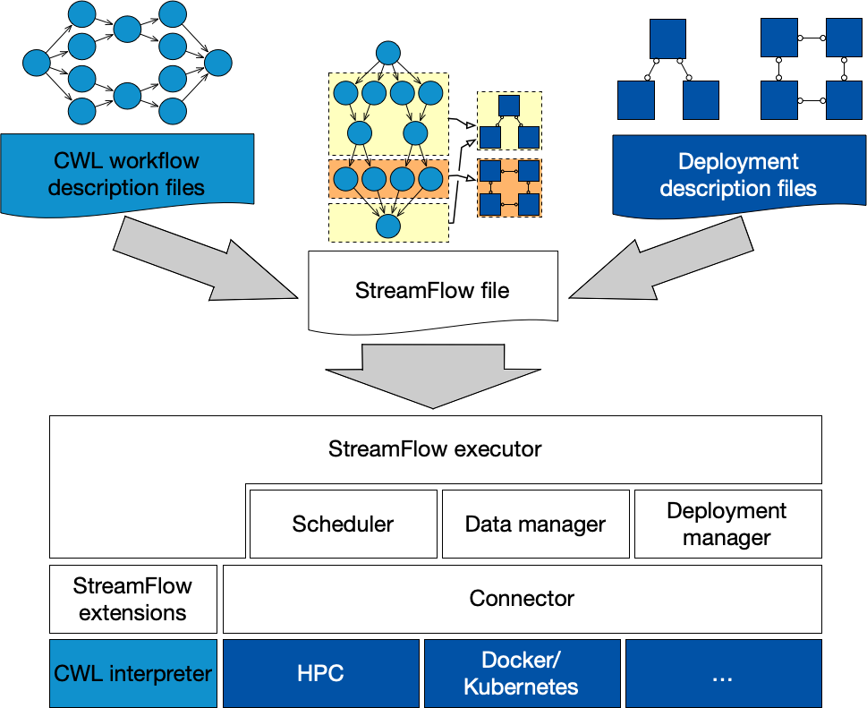
StreamFlow
A container-native Workflow Management System based on the Common Workflow Language (CWL) standard and designed around two main principles:
allowing the execution of tasks in multi-container environments, in order to support also concurrent execution of multiple tasks;
allow for hybrid workflow executions on top of hybrid cloud/HPC infrastructures.

Slide 12
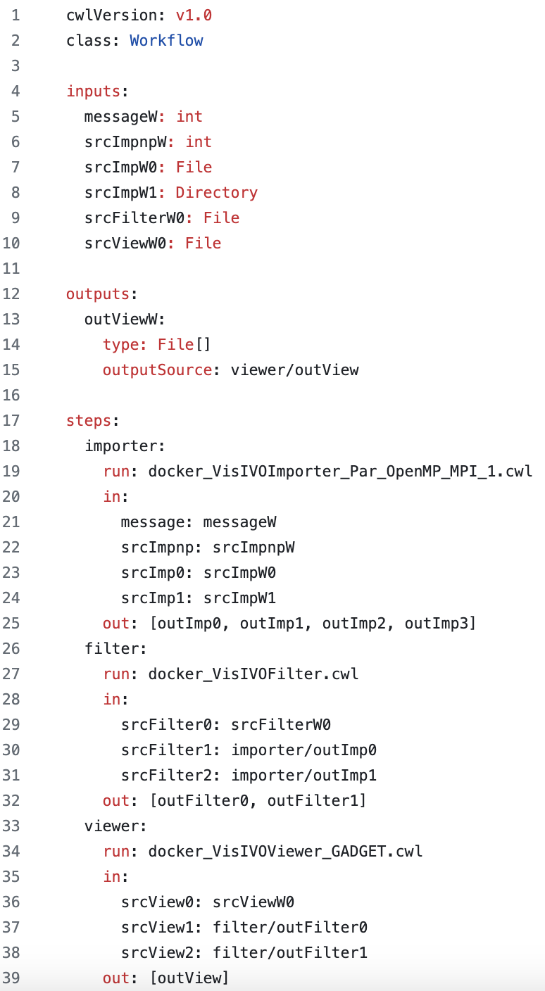
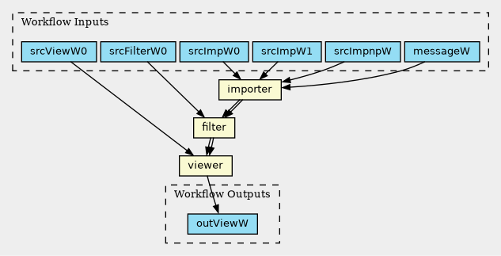
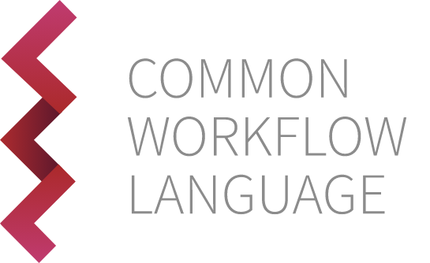
The Common Workflow Language (CWL)

Slide 13
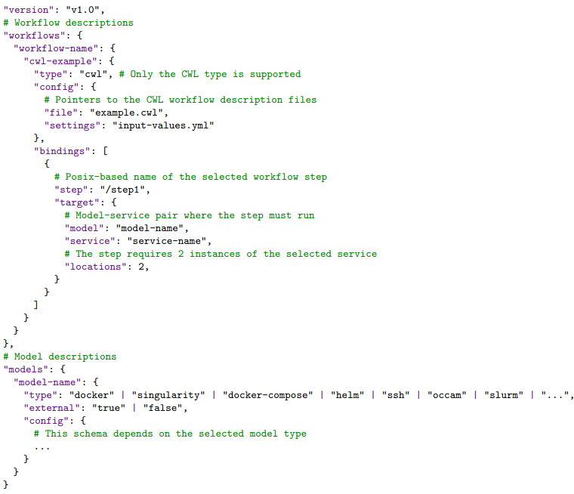
Workflow deployment
StreamFlow uses a .yml file as the entry point for workflow execution, performing these tasks:
representing pointers to workflows and models descriptions and specifies the way they should relate to each other.
relating each workflow step with the best suitable execution environment.

Slide 14
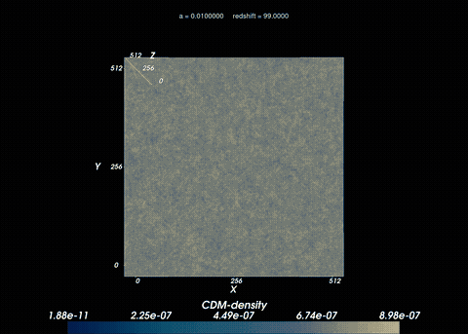
Rendering Results
The presented workflows have been developed to support the studies of the effects of massive neutrinos on the large scale structure of the Universe (DEMNUni simulations) through visualization.
See talk from C. Carbone The "Dark Energy and Massive Neutrino Universe" campaign on Oct 15th
Visualization with rotation and evolution of CDM particles over time
Visualization of GADGET-3 simulation following the Evolution of Cold Dark Matter(CDM) particles over time in presence of massive neutrinos

Slide 15
On going activities
Integration with IAC
The InterActive Computing (IAC) service provided by
brings notebook technology to the HPC environment,
provides Web access to computational resources for interactive use and
seamlessly integrates with Slurm to handle all requests efficiently.
Integration with CAPIO
The Cross-Application Programmable I/O (CAPIO) provided by
is a middleware file system that boosts the performance of workflows that communicate through files
allows users to coordinate the I/O and
inject streaming capabilities into a workflow.

Slide 16
Toward in-situ visualization
Post-processing visualization involves saving the data generated by simulation codes to permanent storage, so visualization and analysis tools need to load this data after it is stored.
The primary source of performance and scalability challenges lies in parallel file systems.
Working with files imposes rigid application workflows that require synchronization.
In-situ visualization involves visualizing and analyzing data as it is generated, allowing the user to create graphical output while the simulation executes.
Key-Value (KV) databases are widely used in data analytics and represent a realistic alternative.
Well-suited for scientific applications such as time-series or spatial data.
Allow analyzing partial results and react, for instance, by discarding a cosmological simulation as soon as a certain event occurs.

Slide 17
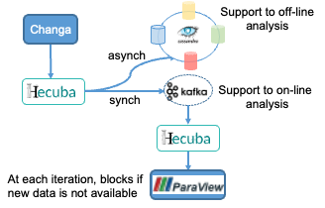
Hecuba
Hecuba allows in-transit visualization
analysis and visualization is run on I/O nodes that receive the simulation results and write information from analysis or provide run-time visualization.
We focus on the Hecuba platform integration with the Changa high performant cosmological simulator and the visualization of its N-body results with the ParaView and VisIVO tools.

Slide 18
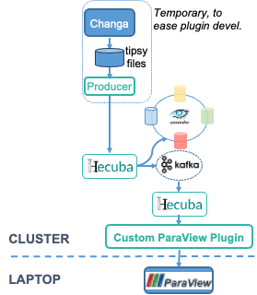
Preliminary results
Defined Hecuba data model for Changa output
Implemented a reader of tipsy format (output files of Changa) to test the plugin → producer
Extended Hecuba to support stream-out / stream-in of that data model
Implemented a ParaView plugin to receive Hecuba data
Implemented VisIVO Importer to read from Hecuba
Next Steps
Complete testing (bigger data set)
Performance evaluation
Integrate Hecuba with Changa

Slide 19
Conclusions
In this project we expect to further evolve VisIVO toward the following directions:
Including the following key results:
Exascale
(code parallelization & optimization)
Modular portability/ reproducibility
Fast I/O
In-situ visualization
VisIVO GPU
Filter
VisIVO Workflows
VisIVO interactive notebooks
VisIVO MPI Importer
VisIVO GPU Viewer
VisIVO Python
Wrappers

Slide 20
Acknowledgements
This work is funded by the European High Performance Computing Joint Undertaking (JU) and Belgium, Czech Republic, France, Germany, Greece, Italy, Norway, and Spain under grant agreement No 101093441
The aforementioned activities are also supported by the spoke 1 and spoke 3 of the ICSC – Centro Nazionale di Ricerca in High Performance Computing, Big Data and Quantum Computing – and hosting entity, funded by European Union – NextGenerationEU”

