Slide 1
Impatti e opportunità della AI Generativa dall'osservatorio Microsoft Italia
Andrea D’Onofrio
Data&AI Lead
Andrea D'Onofrio | LinkedIn

Slide 2
AI will reinvent every industry
AI will reinvent everything
Notes:
AI innovation like what we’ve seen today is poised to reinvent every industry.

Slide 3
is reinventing
AI will reinvent everything
Notes:
AI innovation like what we’ve seen today is poised to reinvent every industry.

Slide 4
… and we are seeing the opportunity
AI for Good
Responsible AI
AI for Industries
Notes:
AI for Good:
Better Research results in all fields, like Healthcare, Pharmaceutical discovery, Climate change, Food waist
Better inclusive world for all of us
Responsible AI
We are committed to a practice of responsible AI by design, guided by a core set of principles: fairness, reliability and safety, privacy and security, inclusiveness, transparency and accountability.
With the right guardrails, cutting-edge technology can be safely introduced to the world to help people be more productive and go on to solve some of our most pressing societal problems
AI for Industries
Put AI into action across the enterprise to turn meaningful innovation into actionable business results in a reliable and trusted way
All companies, from Big to small ones, in all industries can benefit from this technology. We saw it in last 12 months of adoption

Slide 5
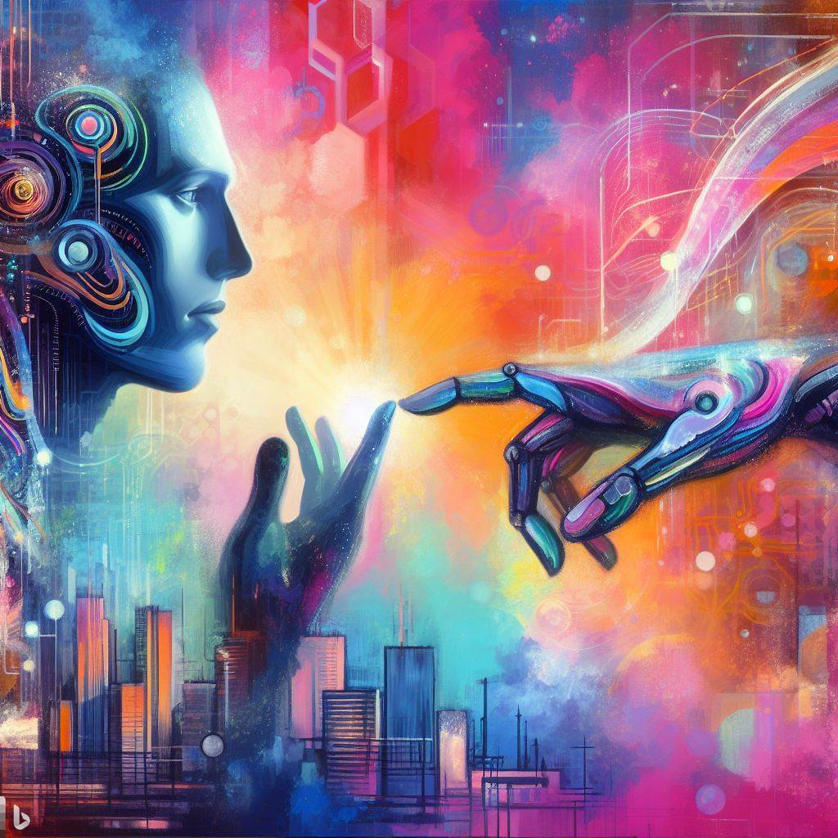
Human-AI relationship
Notes:
We had to learn the machine’s language
Now, it has learned our languages
Gartner Predicts: «By 2023, 80% of humans will engage with smart robots on a daily basis»

Slide 6
AI as teammate
Human-AI
relationship

Slide 7
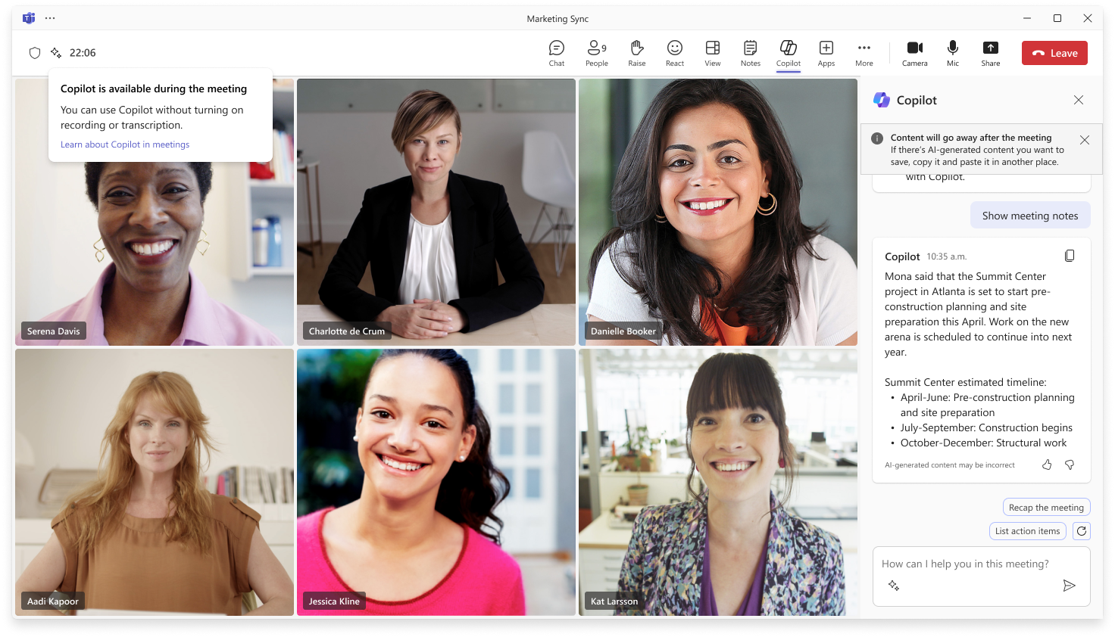
AI as teammate

Slide 8
AI started since 1957, why we are now talking about new technology transformation
Notes:
AI innovation like what we’ve seen today is poised to reinvent every industry.

Slide 9
What is a Custom Model?
Prompt Engineering is a technique that involves designing prompts for natural language processing models. This process improves accuracy and relevancy in responses, optimizing the performance of the model
Retrieval Augmented Generation (RAG) improves LLM performance by retrieving data from external sources and incorporating it into a prompt. RAG allows businesses to achieve customized solutions while maintaining data relevance and optimizing costs.
Fine-tuning adapts an existing LLM using example data, resulting in a new "custom" LLM that has been optimized for the provided examples.
Training a new model create a new LLM or SML from scratch, using data, resulting in a new custom model that has been optimized for a specific scenario

Slide 10
How can I use GenAI in business if there are allucinations?
Notes:
AI innovation like what we’ve seen today is poised to reinvent every industry.

Slide 11
Is my data used to train and evolve AI models?
Notes:
AI innovation like what we’ve seen today is poised to reinvent every industry.

Slide 12
LLM is a simple «language calculator»
Notes:
AI innovation like what we’ve seen today is poised to reinvent every industry.

Slide 13
it’s like a… Language Calculator

Slide 14
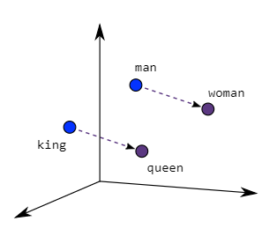
Next Best Word
…
Città
Foresta
Cascina
Campagna
Esselunga
Fattoria
Spiaggia
…
In the training set, statistically, in this proportion of occurrences the next word was Campagna.
La Donzelletta Vien Dalla
LLMs think fast and tend to respond in an automatic way, as we did by reading this sentence.

Slide 15
Pre-training a Large Language Model
Pretraining
Supervised Finetuning
Reward Modelling
Reinforcement Learning
Raw Internet
Demonstrations
Comparisons
Prompts
Dataset
Language Modeling
Language Modeling
Binary classification
Reinforcement learning
Algorithm
Base model
SFT
RM model
RL model
Model

Slide 16
How Microsoft is leading this new technology transformation
Notes:
AI innovation like what we’ve seen today is poised to reinvent every industry.

Slide 18
"The future belongs to those who prepare for it today." - Malcolm X

Slide 19
Work Trend Index 2024
http://aka.ms/wti24
31,000 people across 31 countries
Labor, hiring trends from LinkedIn
Productivity patterns of Microsoft 365
Notes:
One year into AI at work we are at a pivotal moment in time. In order to understand how its going, We surveyed 31,000 people across 31 countries, analyzed labor and hiring trends from LinkedIn and productivity patterns of Microsoft 365 customers globally.

Slide 20
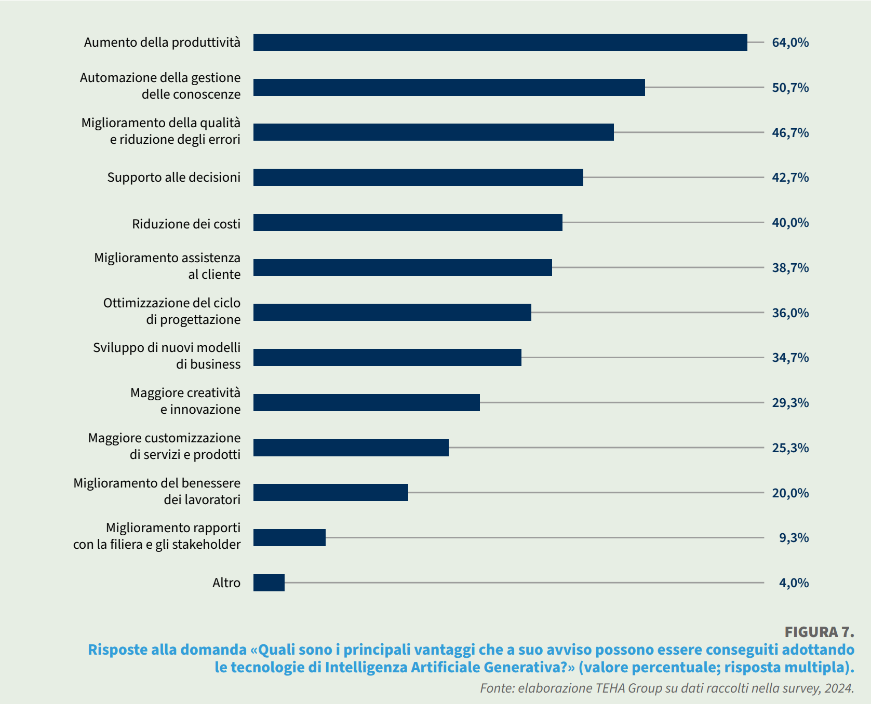
Professional productivity

Slide 21
Three findings stood out
1
2
3
Employees want AI at work—and won’t wait for companies to catch up.
The rise of the AI power user—and what they reveal about the future.
For employees, AI raises the bar and breaks the career ceiling.
Notes:
First, employees want AI at work, and they’re not waiting for their company to catch up.
Second, AI power users are reshaping the workday and show what’s possible when organizations empower people to use AI.
For employees, AI raises the bar and breaks the career ceiling.

Slide 22
BYOAI Is Not Just for Gen Z
Employees across every age group are bringing their own AI tools to work
Gen Z 85%
Millennials 78%
Gen X 76%
Boomers 73%
Share of survey respondents who have used AI tools at work not provided by their organization
Notes:
This BYOAI phenomenon is not just Gen Z, it spans all age groups.
The data suggests two things may be driving this:
Employees see AI as the key to getting through their overwhelming workloads;
And employees lack guidance from their organization about AI use at work. They need a vision and plan from the top.

Slide 23
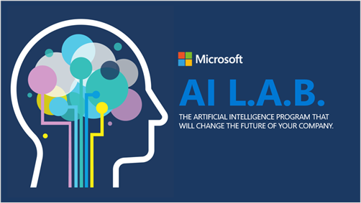
Facts by numbers
Companies adoption rate in Italy
320
Companies
450
Projects
81%
Partner driven
6.000+
Skilled Professionals

Slide 24
Top use cases for
Information & Product Discovery
“Enterprise ChatGPT”, chat with your own data, knowledge mining, product catalog search
Customer Service & Experience
Intelligent contact center (e.g., virtual agent, agent assistance, call analytics), voice assistant
Your Copilot
Build your own Multi-Agent
Augment LLMs with your organization data and industry expertise
Content Creation & Personalization
Marketing copy and visual creation, personalization
Business Process Optimization
Invoice processing, claim handling, anomaly detection, fraud detection
Notes:
Utilizzi orizzontali
Digitalizzazione della documentazione (testi, immagini, CAD, …). Es.. della constatazione amichevole
Categorizzazione delle mail (per poter fare routing intelligente e definire le priorità) oppure degli ordini
Analizzare le formule chimiche
Creare scenari di simulazione (es. Campagna marketing)
Creazione di articoli (sia testo che immagini) per il sito web, social o marketing
Personalizzazione delle comunicazioni verso i clienti
Localizzazione multi lingua dei contenuti

Slide 25
AFMR: Scientific Discovery and Innovation - Microsoft Research
Harvard University: Alyssa Goodman (PI)
We aim to enhance human interaction with astronomy literature by utilizing the capabilities of the Large Language Models, particularly GPT-4. We employ in-context prompting techniques to expose the model to astronomy papers to build an astronomy-focused chat application to engage the broader community. On the research track, we want to explore the potential foundation models have to generate novel scientific hypotheses. Specifically, we use GPT-4 to construct an instruction set of scientific ideas to fine-tune smaller models on this astronomy-specific downstream task. To assess their output’s accuracy, feasibility and creativity, we employ a hybrid evaluation strategy consisting of human experts and judge GPT-4 instances. Our research will illuminate a novel and unique way of applying LLMs in the scientific arena.

Slide 26
Thanks

