Slide 1
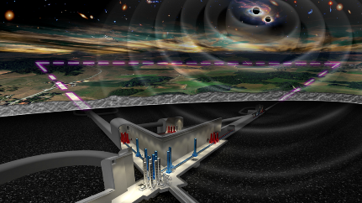
ETIC INAF-ADONI
Presented by: R. Briguglio
on behalf of the ETIC-ADONI group

Slide 2
ETIC
Einstein Telescope Infrastructure Consortium PNRR MISSIONE 4, COMPONENTE 2, INVESTIMENTO 3.1
Applicant: INFN, INAF: Co-applicant
ET Collaboration
Operative Unit (OU) for ETIC:
INAF-ADONI
(Scheda INAF: ETIC-ADONI)
Co-applicant (INAF) PI: E. Cappellaro (AOPd)
OU contact point: S. Esposito (OAA/ADONI)
ISB (instrument Science Board):
INAF-OAA
Total funds for INAF-ADONI in ETIC: 407 k€
INAF-OAPd
INAF-OAAb
WP2:
Optics, Electronics and Photonics
Optics > Wave-front sensing and control
INAF-OABr
WP3:
Vacuum and Cryogenics
Vacuum and Cryogenics > Pipe-arm vacuum
INAF-OAC

Slide 3
INAF PI: E. Cappellaro (AOPd)
OU contact point: S. Esposito (OAA-ADONI)
Team – INAF-ADONI
WP2_T043: ADONI-actpath
WP2_T044: ADONI-visPath
WP2_T045: ADONI-mainAIV
INAF-OAA:
Armando Riccardi
Runa Briguglio
Ciro Del Vecchio
Fabio Rossi
Tommaso Lapucci (TD OAA: ETIC-funded)
Simone Lombardi (PhD UniPD: ETIC-funded)
INAF-OAPd:
Jacopo Farinato
INAF-OABr:
Andrea Bianco
INAF-OAAb:
Gianluca Di Rico
Ivan Di Antonio
Angelo Valentini
WP3_T018: CALATIA-hydrocarbon_analysis
INAF-OANa:
Vito Mennella
Aniello Grado
Francesca Giudice (PhD Univ. Federico II Napoli: ETIC-funded)
Total of 16 persons in 5 INAF-Observatories
(including 1 TD + 2 PhD ETIC-funded full-time)

Slide 4
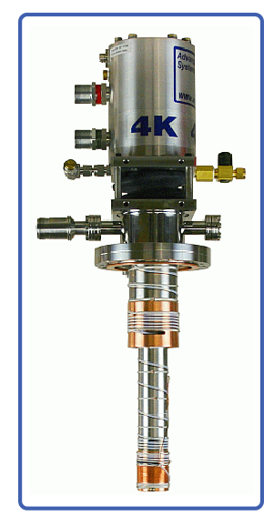
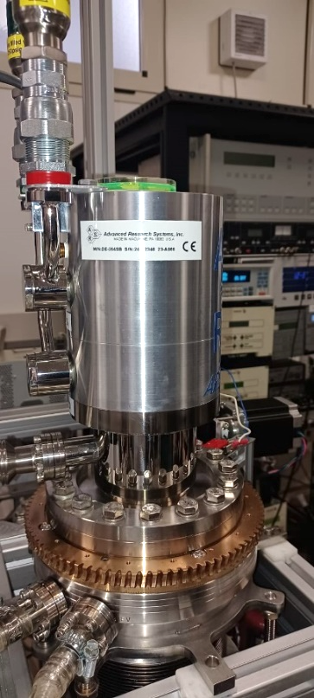
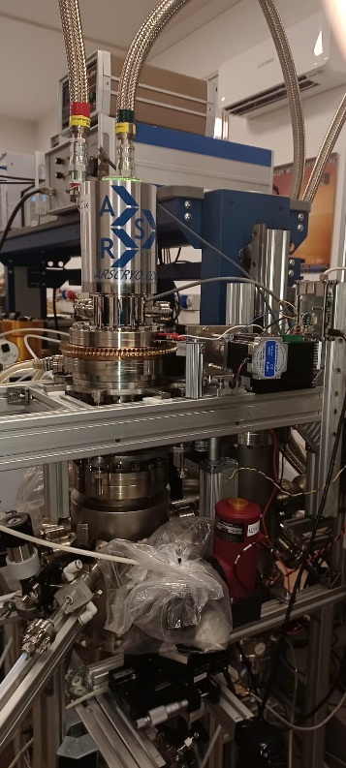
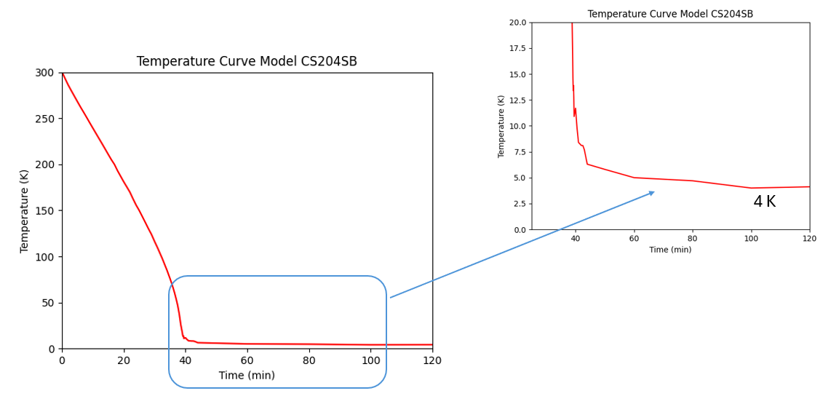
WP3 – T018 Studio dei processi di condensazione di idrocarburi in ultra alto vuoto (UHV) aspettate per le ottiche di ET Low Frequency
Criostato a Ciclo chiuso
Criostato integrato e collaudato nel sistema UHV pre-esistente
Consegnato Marzo 2024
(Task deliverable: CLOSED)

Slide 5
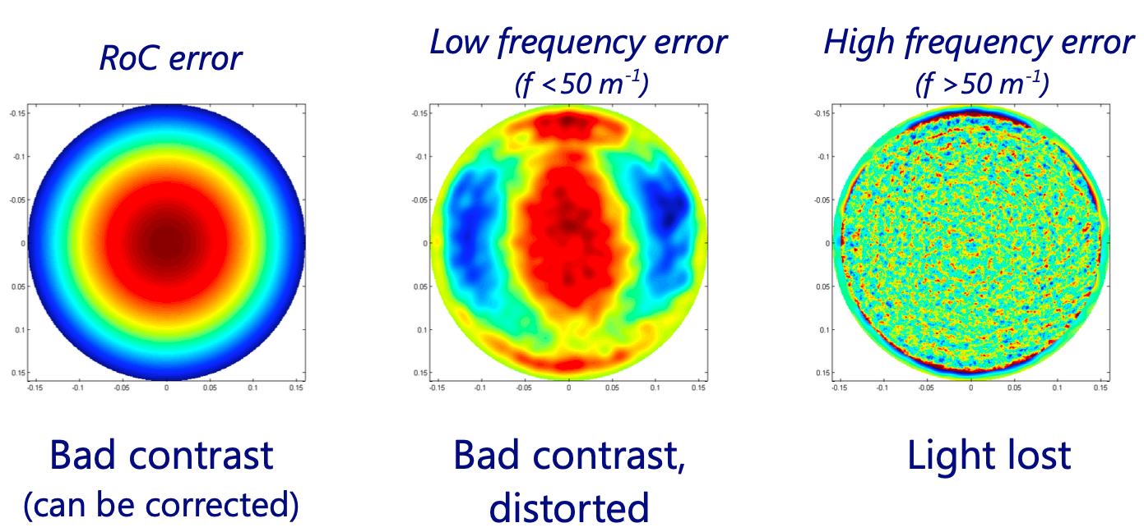
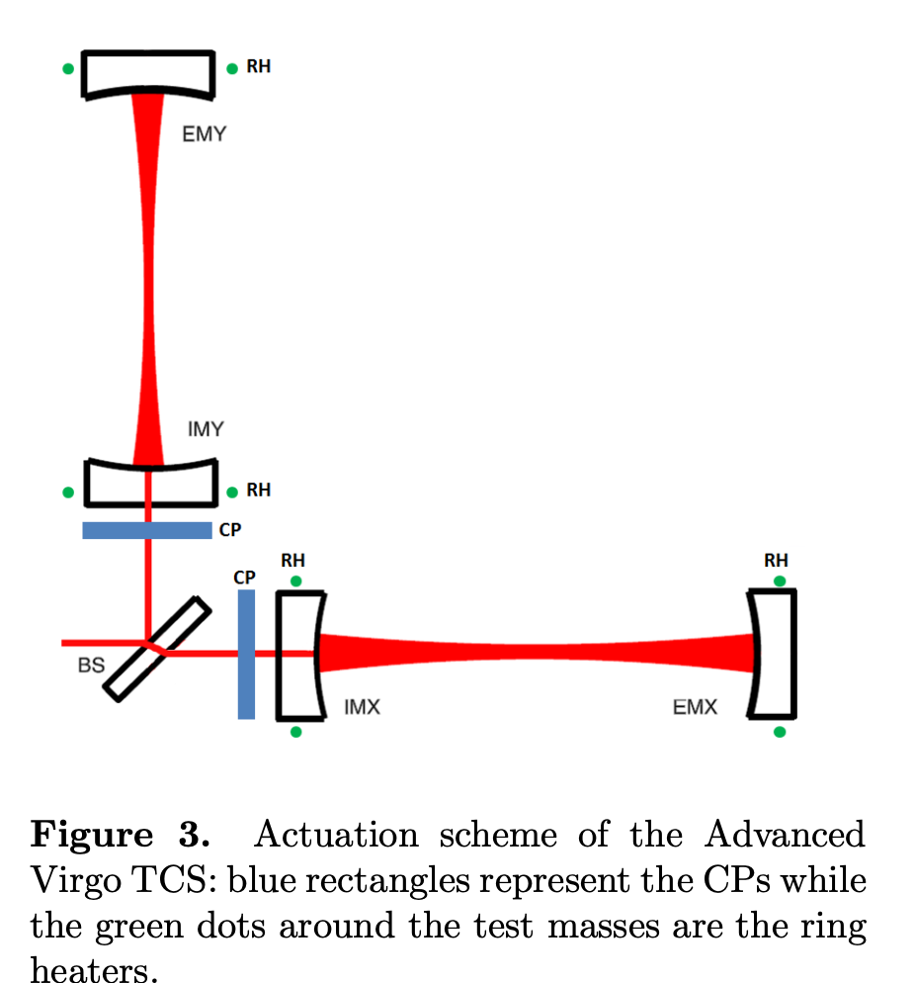
WP2 – T043/T044/T045
Lab for the test of Adaptive Optics techniques for the WF control of the ET
Test-bench using a DM to spatially modulate a power laser on the CP
Aberrations in the interferometer optics reduces the detection SNR of GWs
G. Degallaix, 2013
CP=Correction Plates

Slide 6
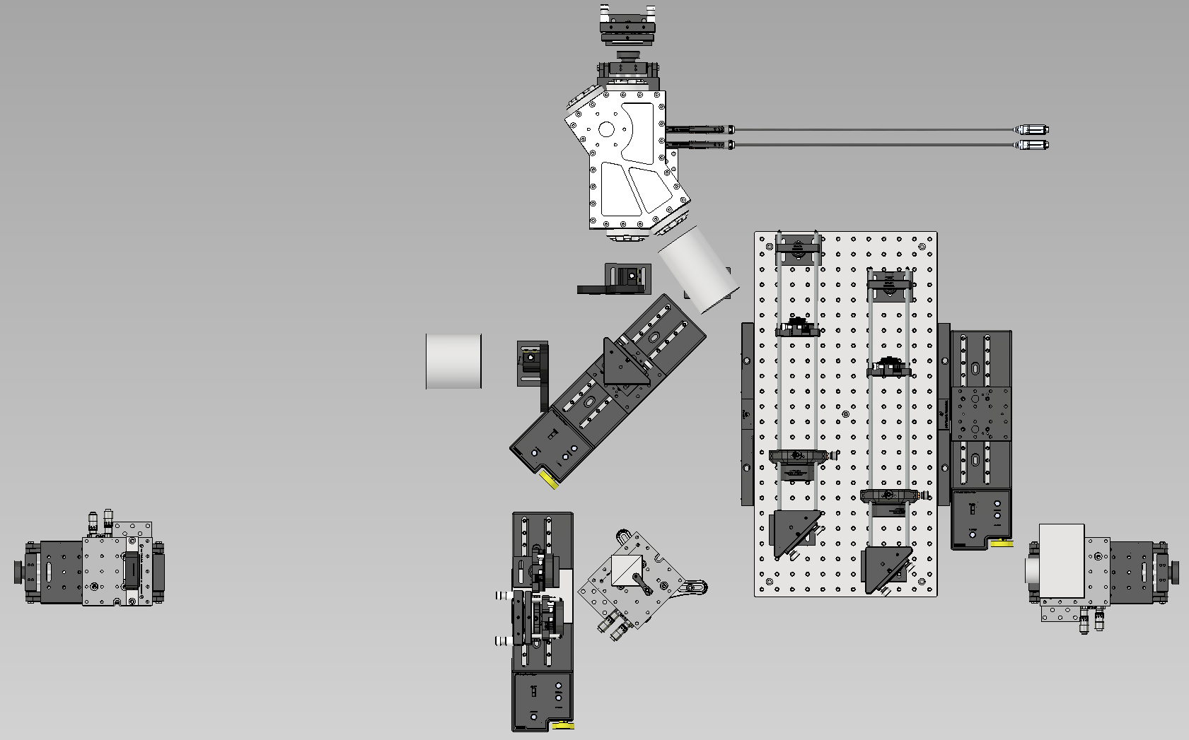
WP2 – T043/T044/T045
Test-bench using a DM to spatially modulate a power laser on a Correction Plate and verify the induced OPD variation
Heating Laser (1W@1064nm)
Sample test Unit (STU)
Visible test laser (660nm)
Pick-off for laser shape check (660/1064nm)
DM measurement path (HeNe interferometer)
Sample meas. path in transmission (HeNe interf.)
Sample meas. path in reflection (HeNe interf.)
Thermo-camera measurement path (sample)
Beam Test
Unit (BTU)
Deformable Mirror Unit (DMU)
Polarization Beam
Splitter Unit (PBU)
Source Unit (SOU)
Interferometer Unit
(INU)

Slide 7
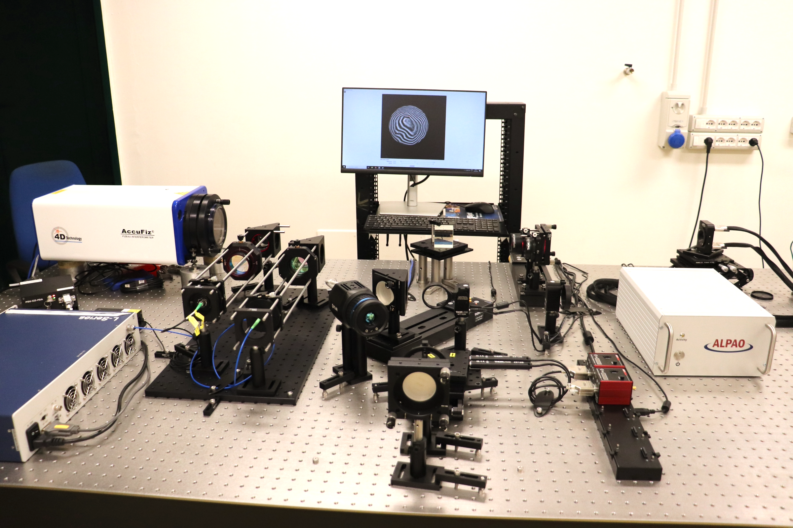
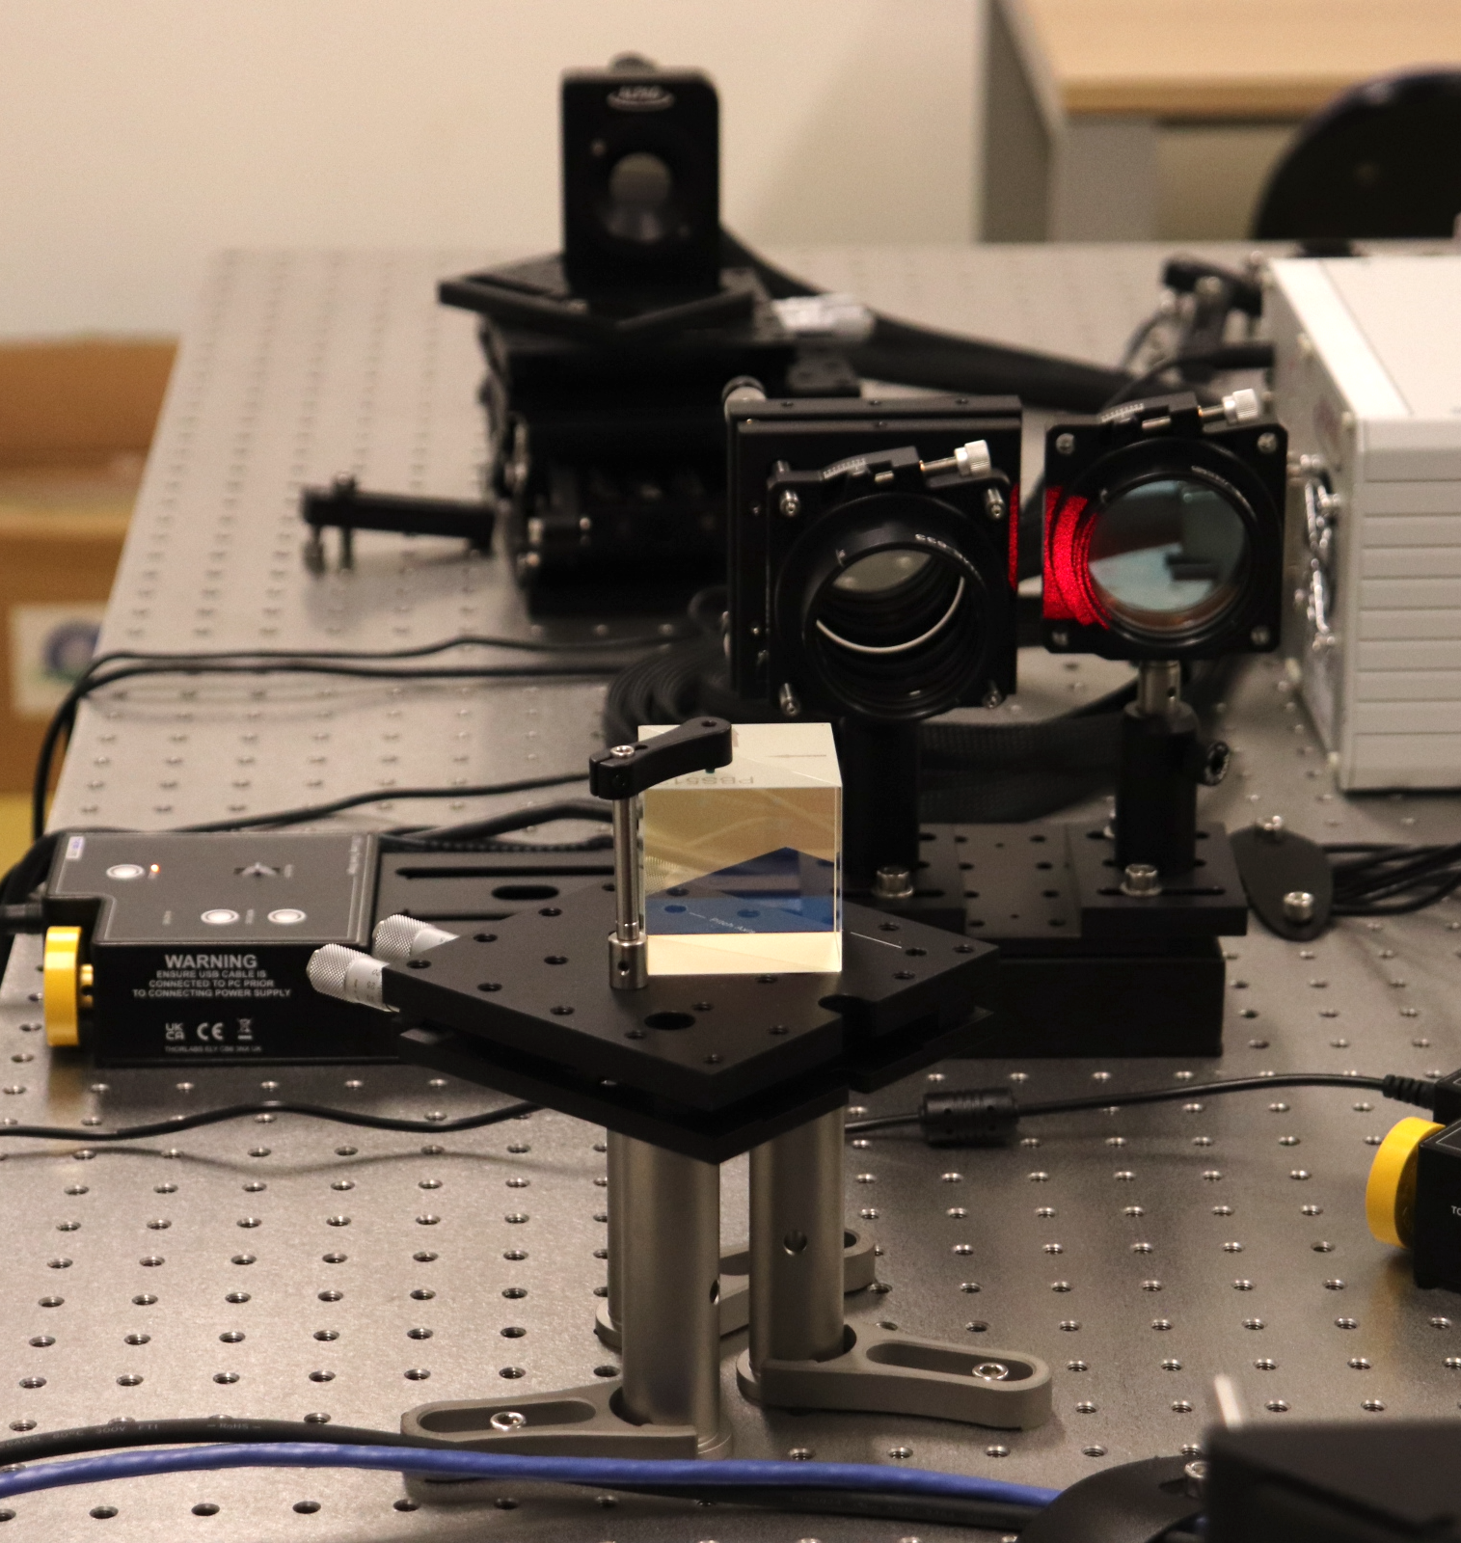
SwitchPos
Conf1:
No optics
Conf1: Measurement of the DM surface deformation with the interferometer

Slide 8
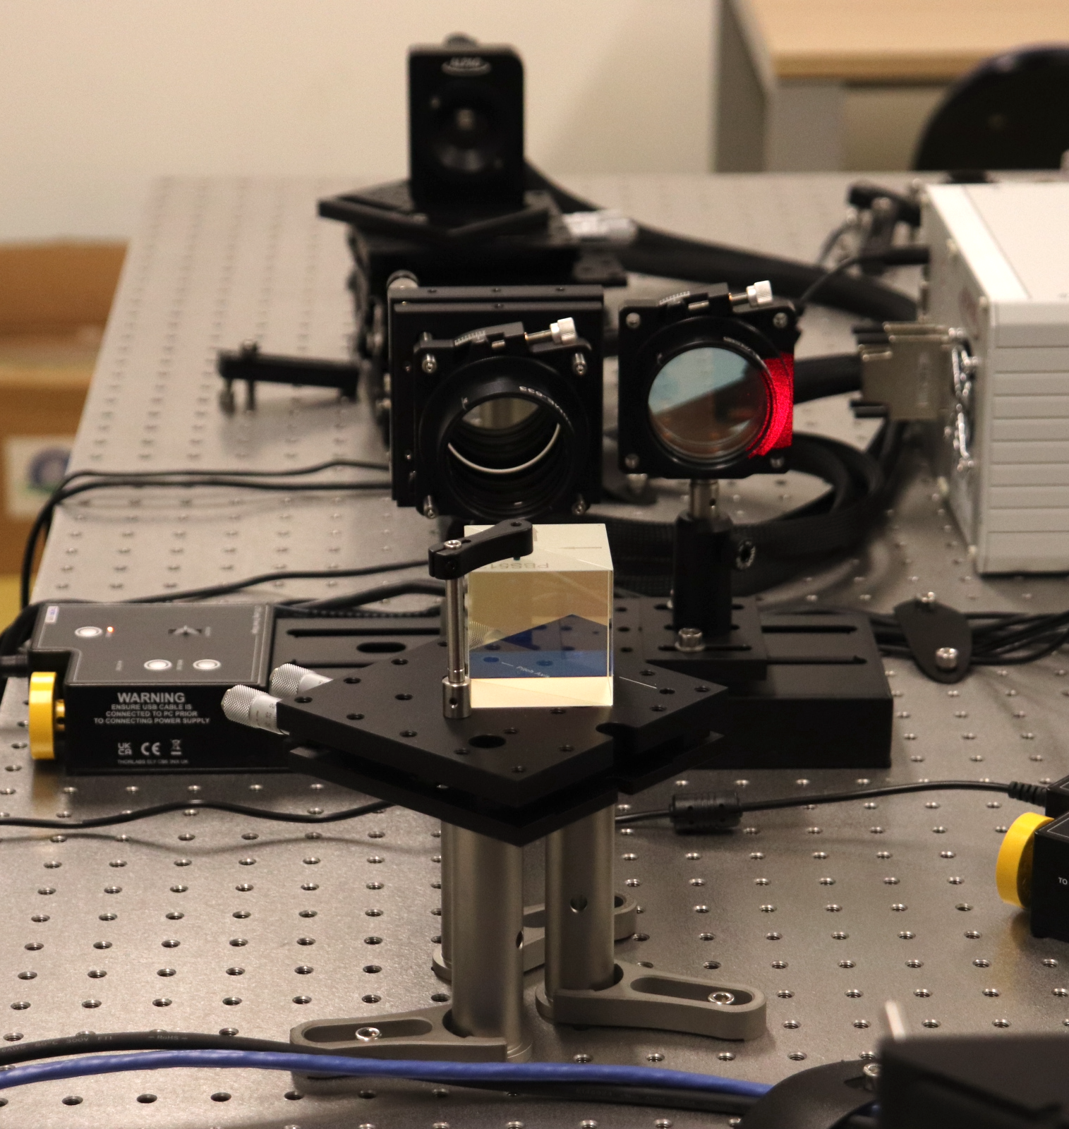
SwitchPos
Conf2:
QWL plate @633nm +
mirror
Conf2: Measurement of the glass sample in transmission with the interferometer.
Transparent sample @633nm

Slide 9
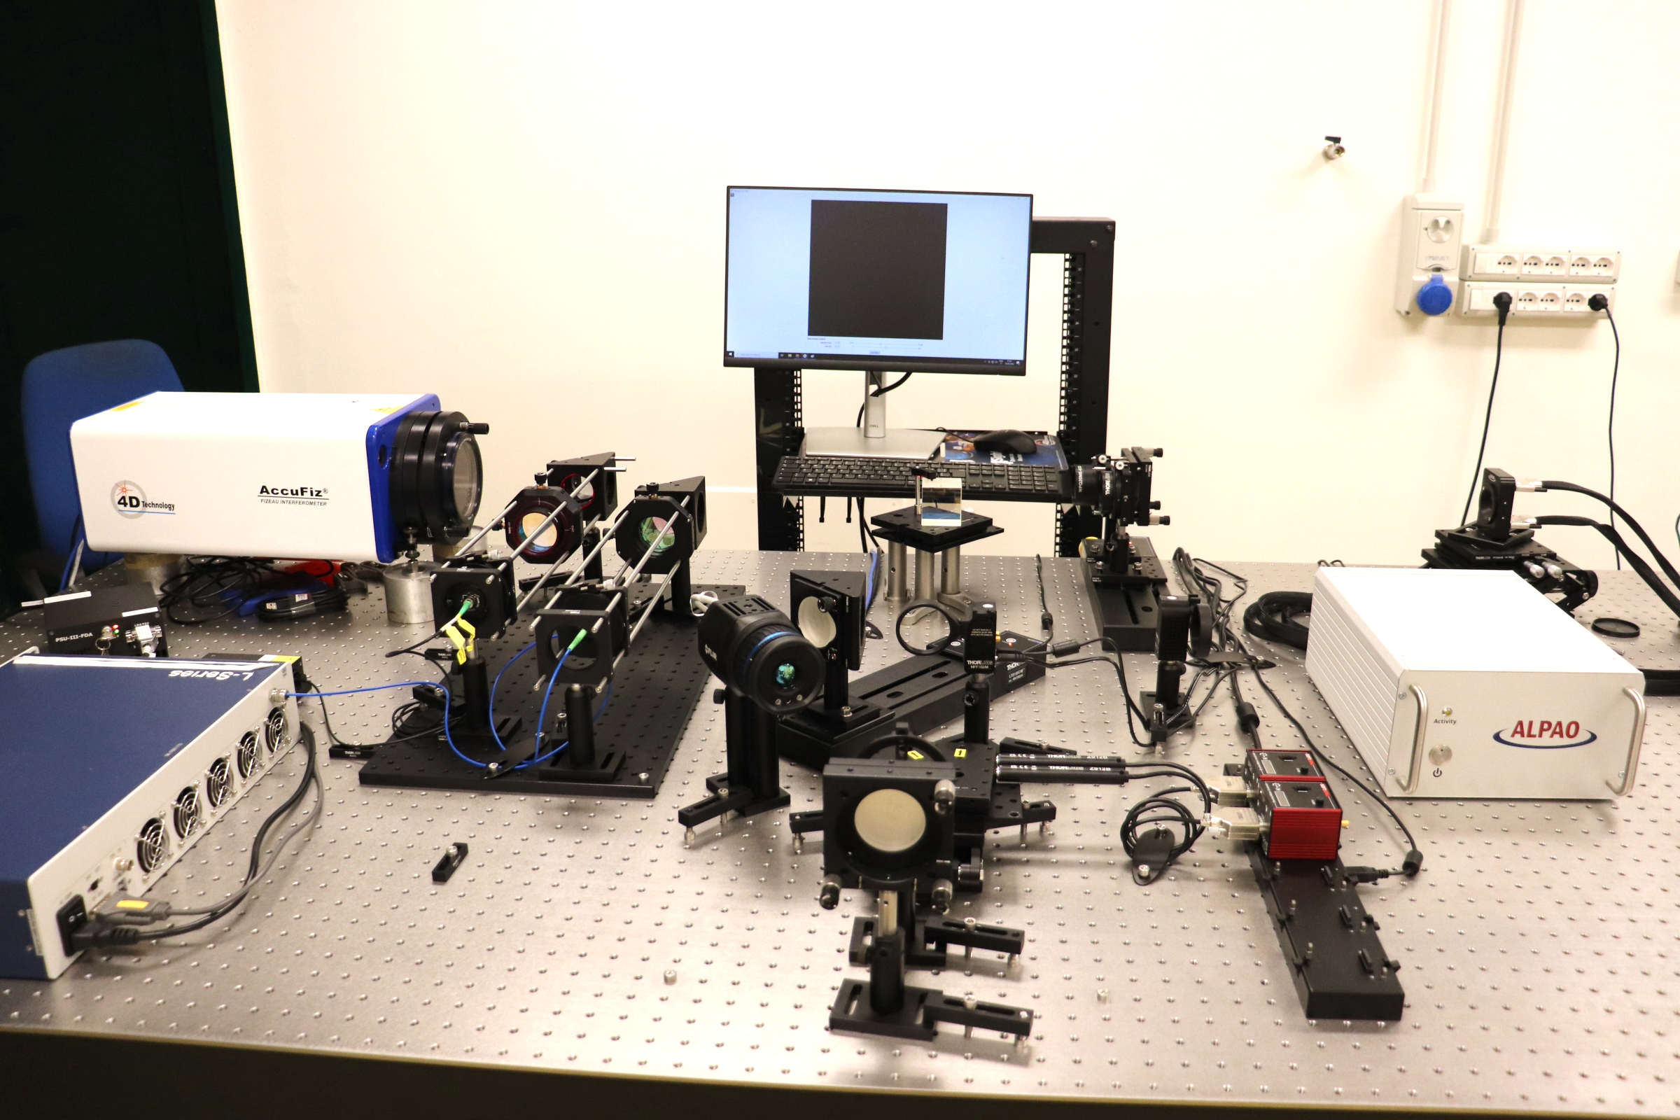
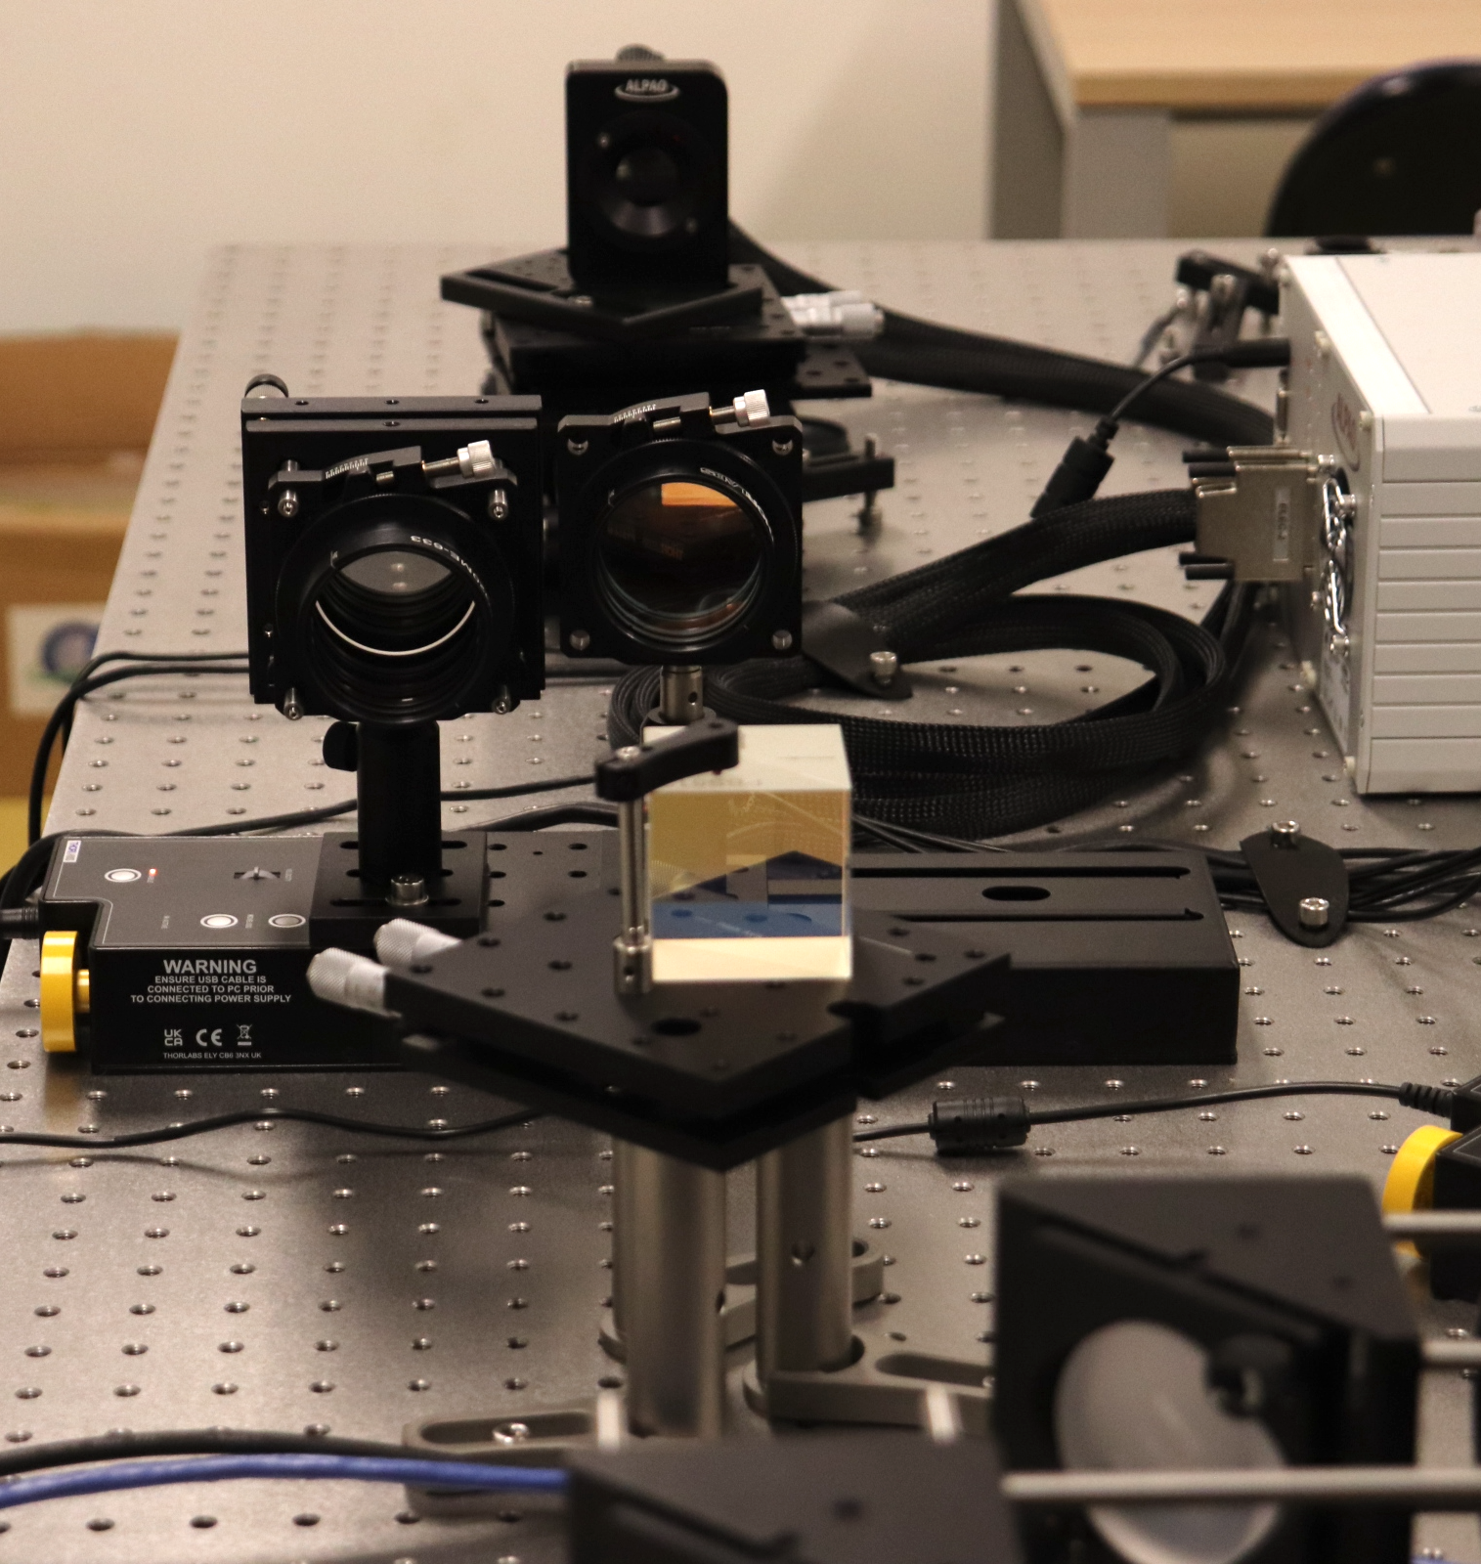
SwitchPos
Conf3:
QWL plate @1064nm
Conf3: Heating the glass sample with a 1W-laser @1064. The laser intensity distribution is spatially modulated by the DM deformation.
Absorbing sample @1064nm

Slide 10
Deliverable T043: Procurement of Actuation Channel
CLOSED: Jan24 (ALPAO DM-97)
OAPd
Stato delle attività
OAA
Deliverable T044: Lab acceptance of purchased interferometer
CLOSED: Apr24 (4” AccuFiz Interferometer)
WP2-T043 – ADONI-ActPath
procurement of DM
Test bench AIV
WP2-T044 – ADONI-VisPath
Deliverable T045: Test of functionality of full system
Plan: Jun25, no delay foreseen
procurement of interferometer
WP2-T045 – ADONI-MainAIV
OAA
procurement of optics, mech and tools
Procurement of optomech and lab tools:
CLOSED Mar24: VIS/IR camera + Lasers + Samples
CLOSED Feb24: Thermal Camera (FLIR)
CLOSED Apr24: Optomech (Thorlabs)
OABr
OABr
OAA
WP3-T018 – CALATIA-hydrocarbon_analysis
OCA
Deliverable T018: Delivery parcels and Tech Report
CLOSED: Mar24
Procurement of Cryostat
10

Slide 11
Conclusioni
OAC: Criostato acquistato, integrato e collaudato
ADONI: I componenti del laboratorio dedicato allo studio della correzione adattiva sono stati acquisiti, collaudati ed integrati sul banco ad Arcetri.
Ad Arcetri: Il banco è attualmente in fase di integrazione/allineamento/verifica secondo i tempi previsti dal proposal PNRR (06/2025).

