Slide 1
The EARTH MOON MARS (EMM) NRRP project
LABORATORY OF MOLECULAR SPECTROSCOPY IN PLANETARY ATMOSPHERES (ACTIVITY 1500.13)
Autori G. Piccioni, M. Snels, S. Stefani

Slide 2
Task WP1500-13
innovative laboratory infrastructure with instrumentation devoted to measurements for optical properties of atmospheric gases;
support to the radiative transfer calculation for molecules lacking crucial information in the actual spectral databases;
direct measurements of cross sections or absorption coefficients for mixtures of atmospheric gases;
direct measurements of self and foreign broadening at different physical conditions;
accurate measurements of optical transmission for atmospheric gases in particular within the so called “atmospheric windows”;
accurate measurements of CIA (Collision Induced Absorption) for various gases, e.g. for carbon dioxide (CO2).

Slide 3
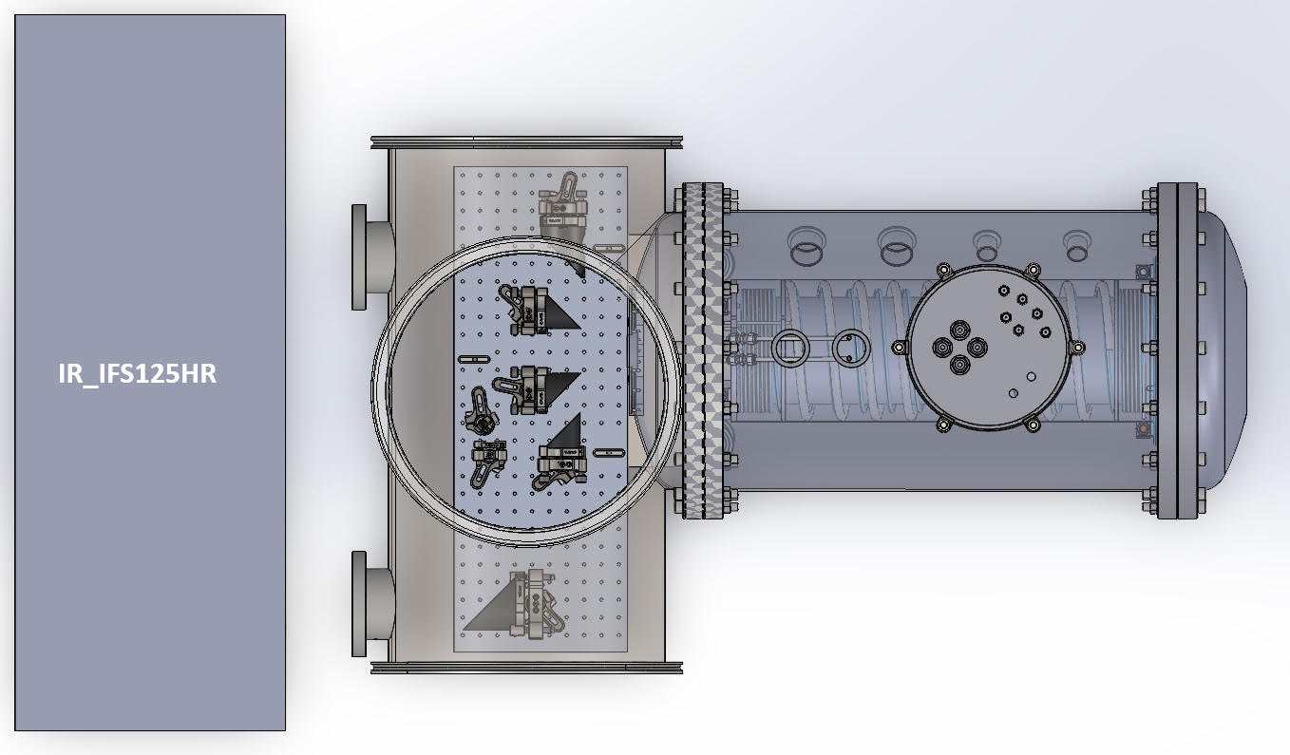
Sketch of the laboratory setup
Transfer optics
High resolution FT spectrometer
Transfer optics in vacuum
Multipath absorption cell
Planetary Atmosphere Simulation System for Spectroscopy (PASSxS) already available from other projects
PASSxS

Slide 4
Procurement and progress
We have two major procurements:
1) a high performance FTIR spectrometer (Bruker IFS125HR); (budget 547k€)
2) a custom vacuum optical box interface with vacuum optics and supports (budget 19.5k€)
1) The IFS125HR has been ordered after a «bando europeo» issued on November 10 2023 and closed on February 29 2024. The delivery is planned for mid November 2024
2) The optical box design is finalized. The delivery is expected in parallel with respect to (1)

Slide 5
Main performance parameters of the full setup
Spectral range: 2000-25000 cm⁻¹, limited by the present sapphire windows (new materials are under study in order to extend the lowest frequency as much as possible closer to the theoretical limit of the IFS125HR which is 600 cm⁻¹)
Spectral resolution : 0.0019 cm⁻¹
Pressure range : up to 50 bar
Temperature range: 100 – 550 K
Temperature stability: +-0.5 within the acquisition time (<30’)
Optical path length: 3.20 m
Gas mixture is possible

Slide 6
Science
Study of Collision Induced Absorption, self or foreign (CO₂, H₂O, H₂, N₂, O₂, etc.)
Spectroscopic studies of gas mixtures

Slide 7
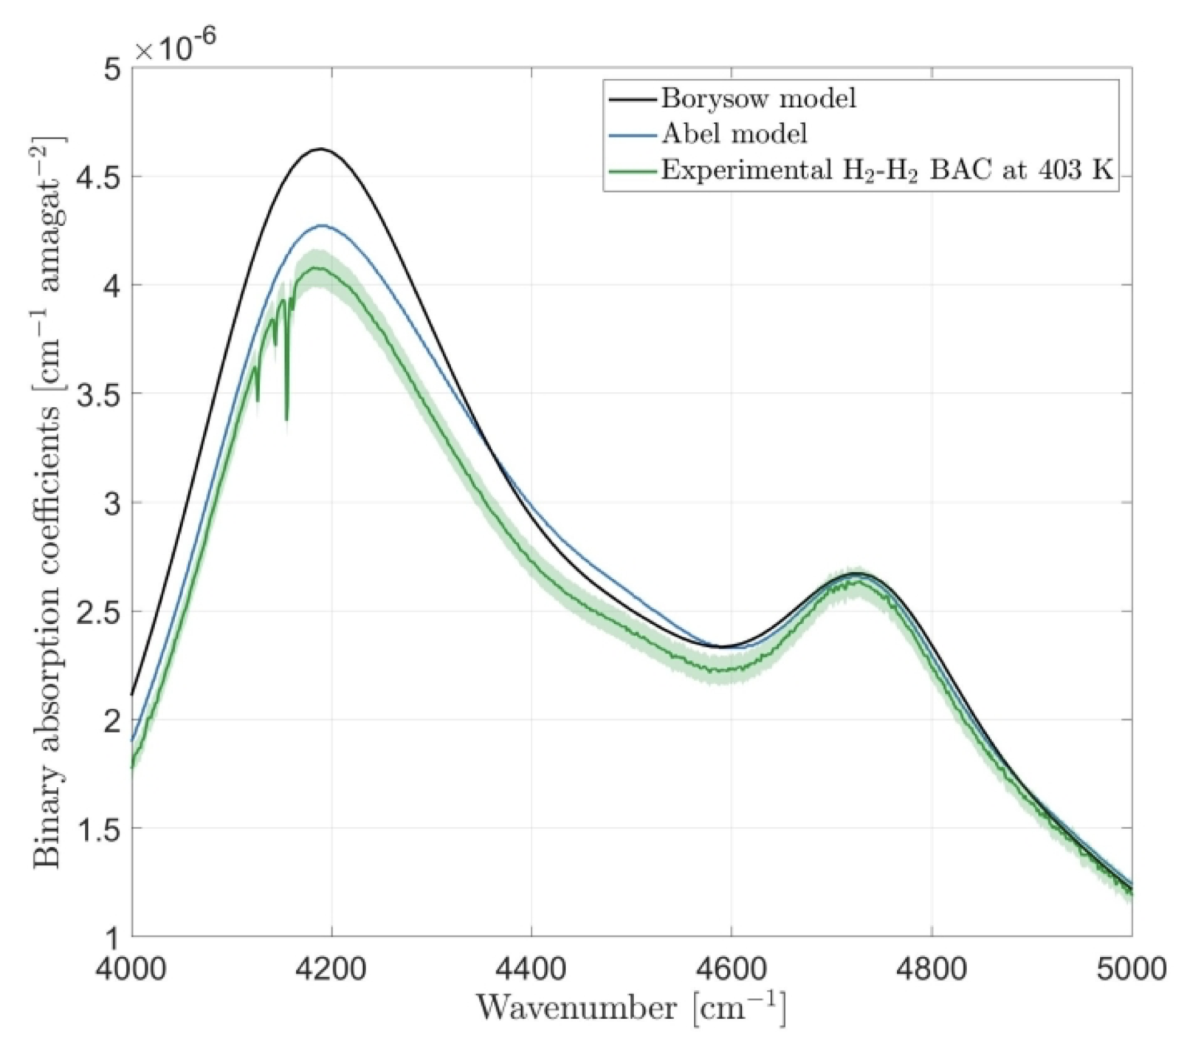
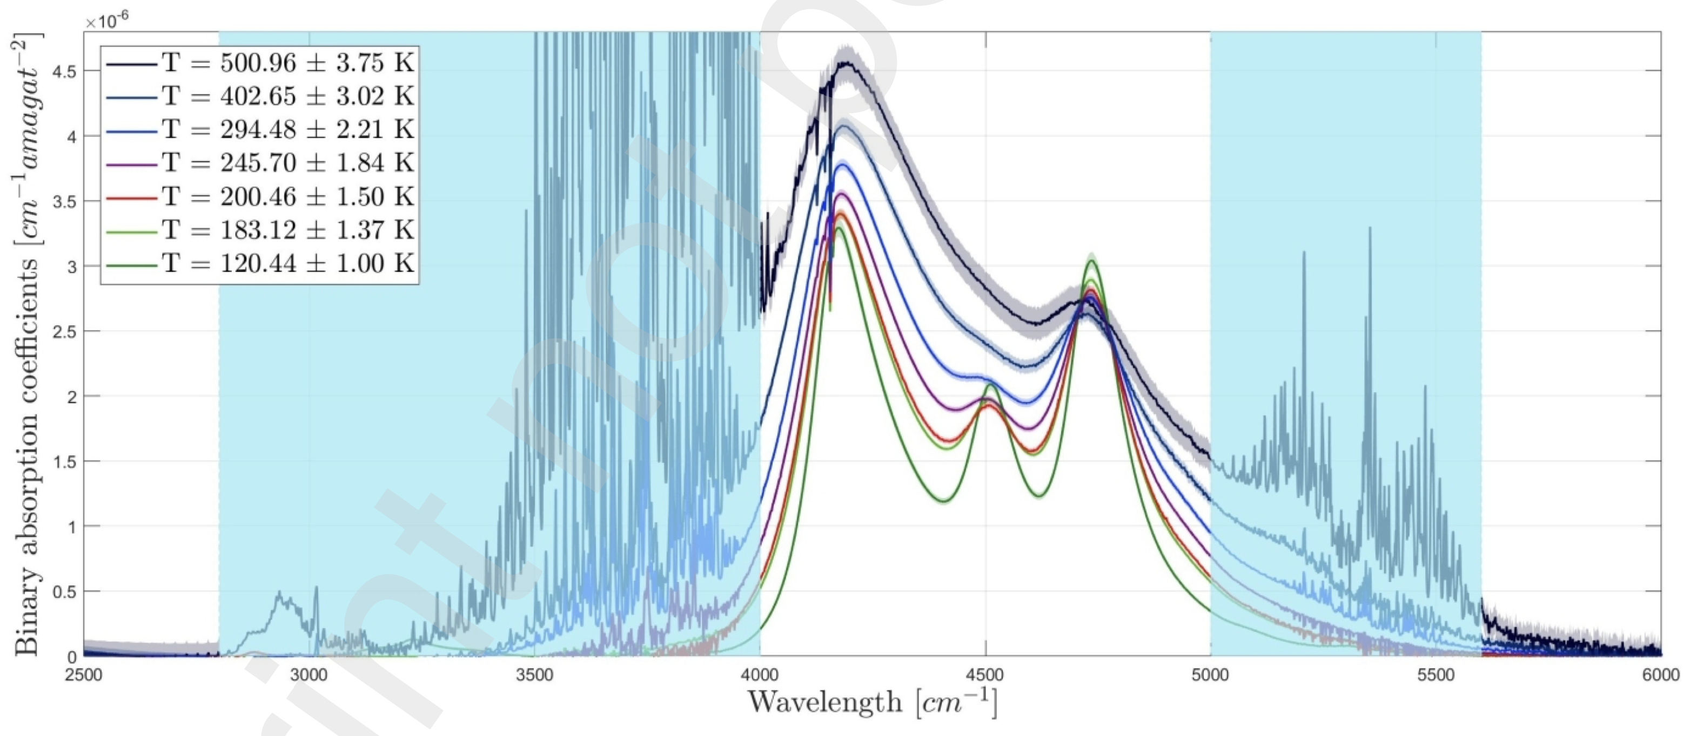
This is just an example acquired with the available cell for CIA of H₂-H₂
Water vapour contamination
From F. Vitali (PhD), submitted to JQSRT
* A. Borysow et al., (2002), A&A , volume 390 , issue 2
* M. Abel et al., (2012), The Journal of Chemical Physics, 136

Slide 8
Critical aspects
logistics (6m x 3m is the outline of the setup only, without pipes, vacuum pumps, etc.), in particular the room allocation in the present lab (PLAB) and the number of people attending the lab for other parallel activities
minor potential risk of delay in the procurement (presently there is no issue)

Slide 9
Summary
The EMM project provided us with a unique opportunity of investment to build up an innovative laboratory infrastructure devoted to measurements for optical properties of atmospheric gases
once completed, this infrastructure will support not only the EMM project needs but also at a larger extent the scientific return of INAF from the laboratory activities

