Slide 1
The EARTH MOON MARS (EMM) PNRR project
Lunar and Martian
Simulation Chambers
INAF - OACN
Giuseppe Mongelluzzo, Carmen Porto, Gabriele Franzese, Francesca Esposito, Ciprian Popa, Simone Silvestro.

Slide 2
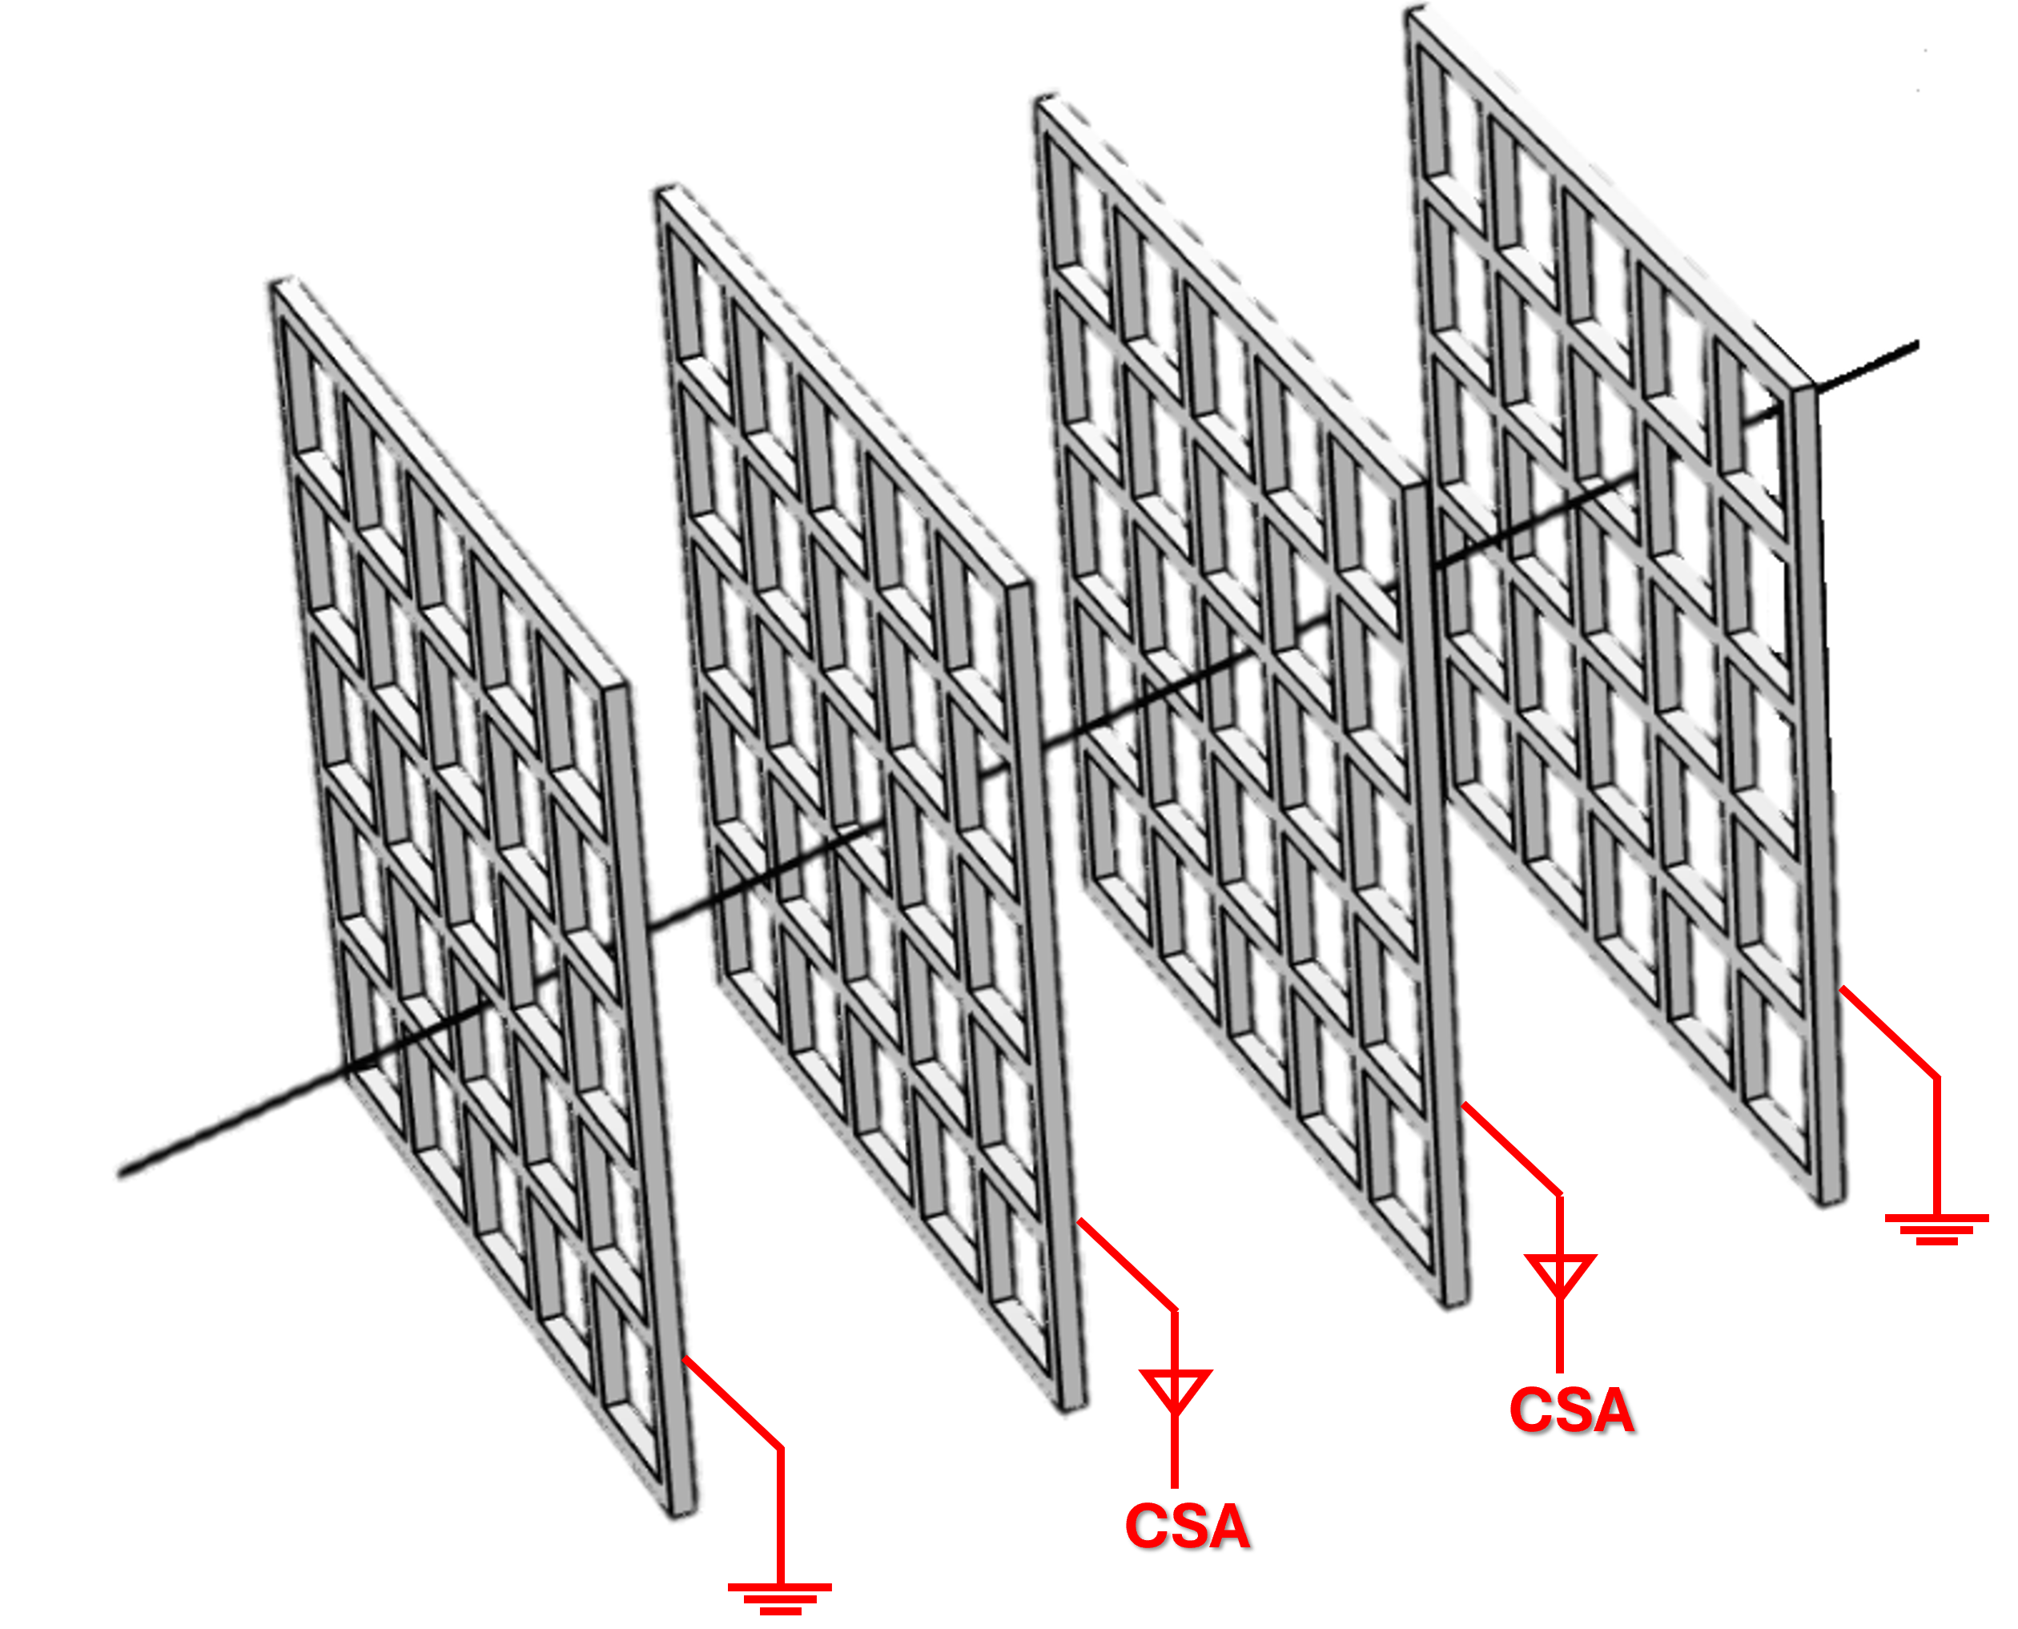
EMM-PNRR project:
Lunar Simulation Chamber
to test the sensor LD GRIDS
to study the electrostatic dust transport
under development to characterize
the electrostatically levitating dust grains,
measuring their charge (Q > 1 fC)
and velocity (1-100 m/s)
Charging and transport of dust particles on dusty surface
exposed to plasmas and/or UV sources
[Wang et al., 2009-2016]
Giuseppe Mongelluzzo, Carmen Porto, Gabriele Franzese, Francesca Esposito, Ciprian Popa, Simone Silvestro.

Slide 3
Motivation
Dust deposition on spacecraft poses a considerable threat to spacecraft
Electrostatic dust motion is a process that may influence the properties and the evolution of the Moon's surface
Open Questions
Does electrostatic levitation occur on the Moon? When? Where? At what rate?
What is the charge on a dust grain on the lunar surface? What is its velocity? What is its dynamics?
Giuseppe Mongelluzzo, Carmen Porto, Gabriele Franzese, Francesca Esposito, Ciprian Popa, Simone Silvestro.

Slide 4
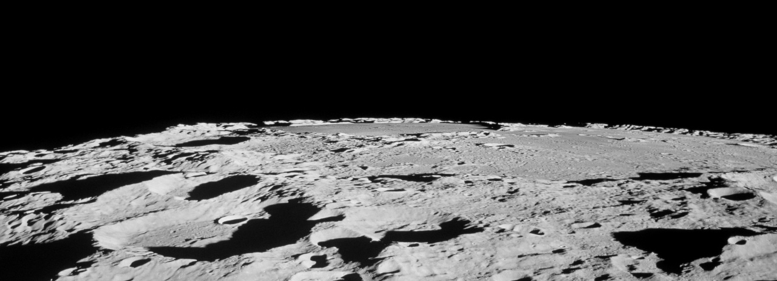
+
q
_
_
_
+

Slide 5
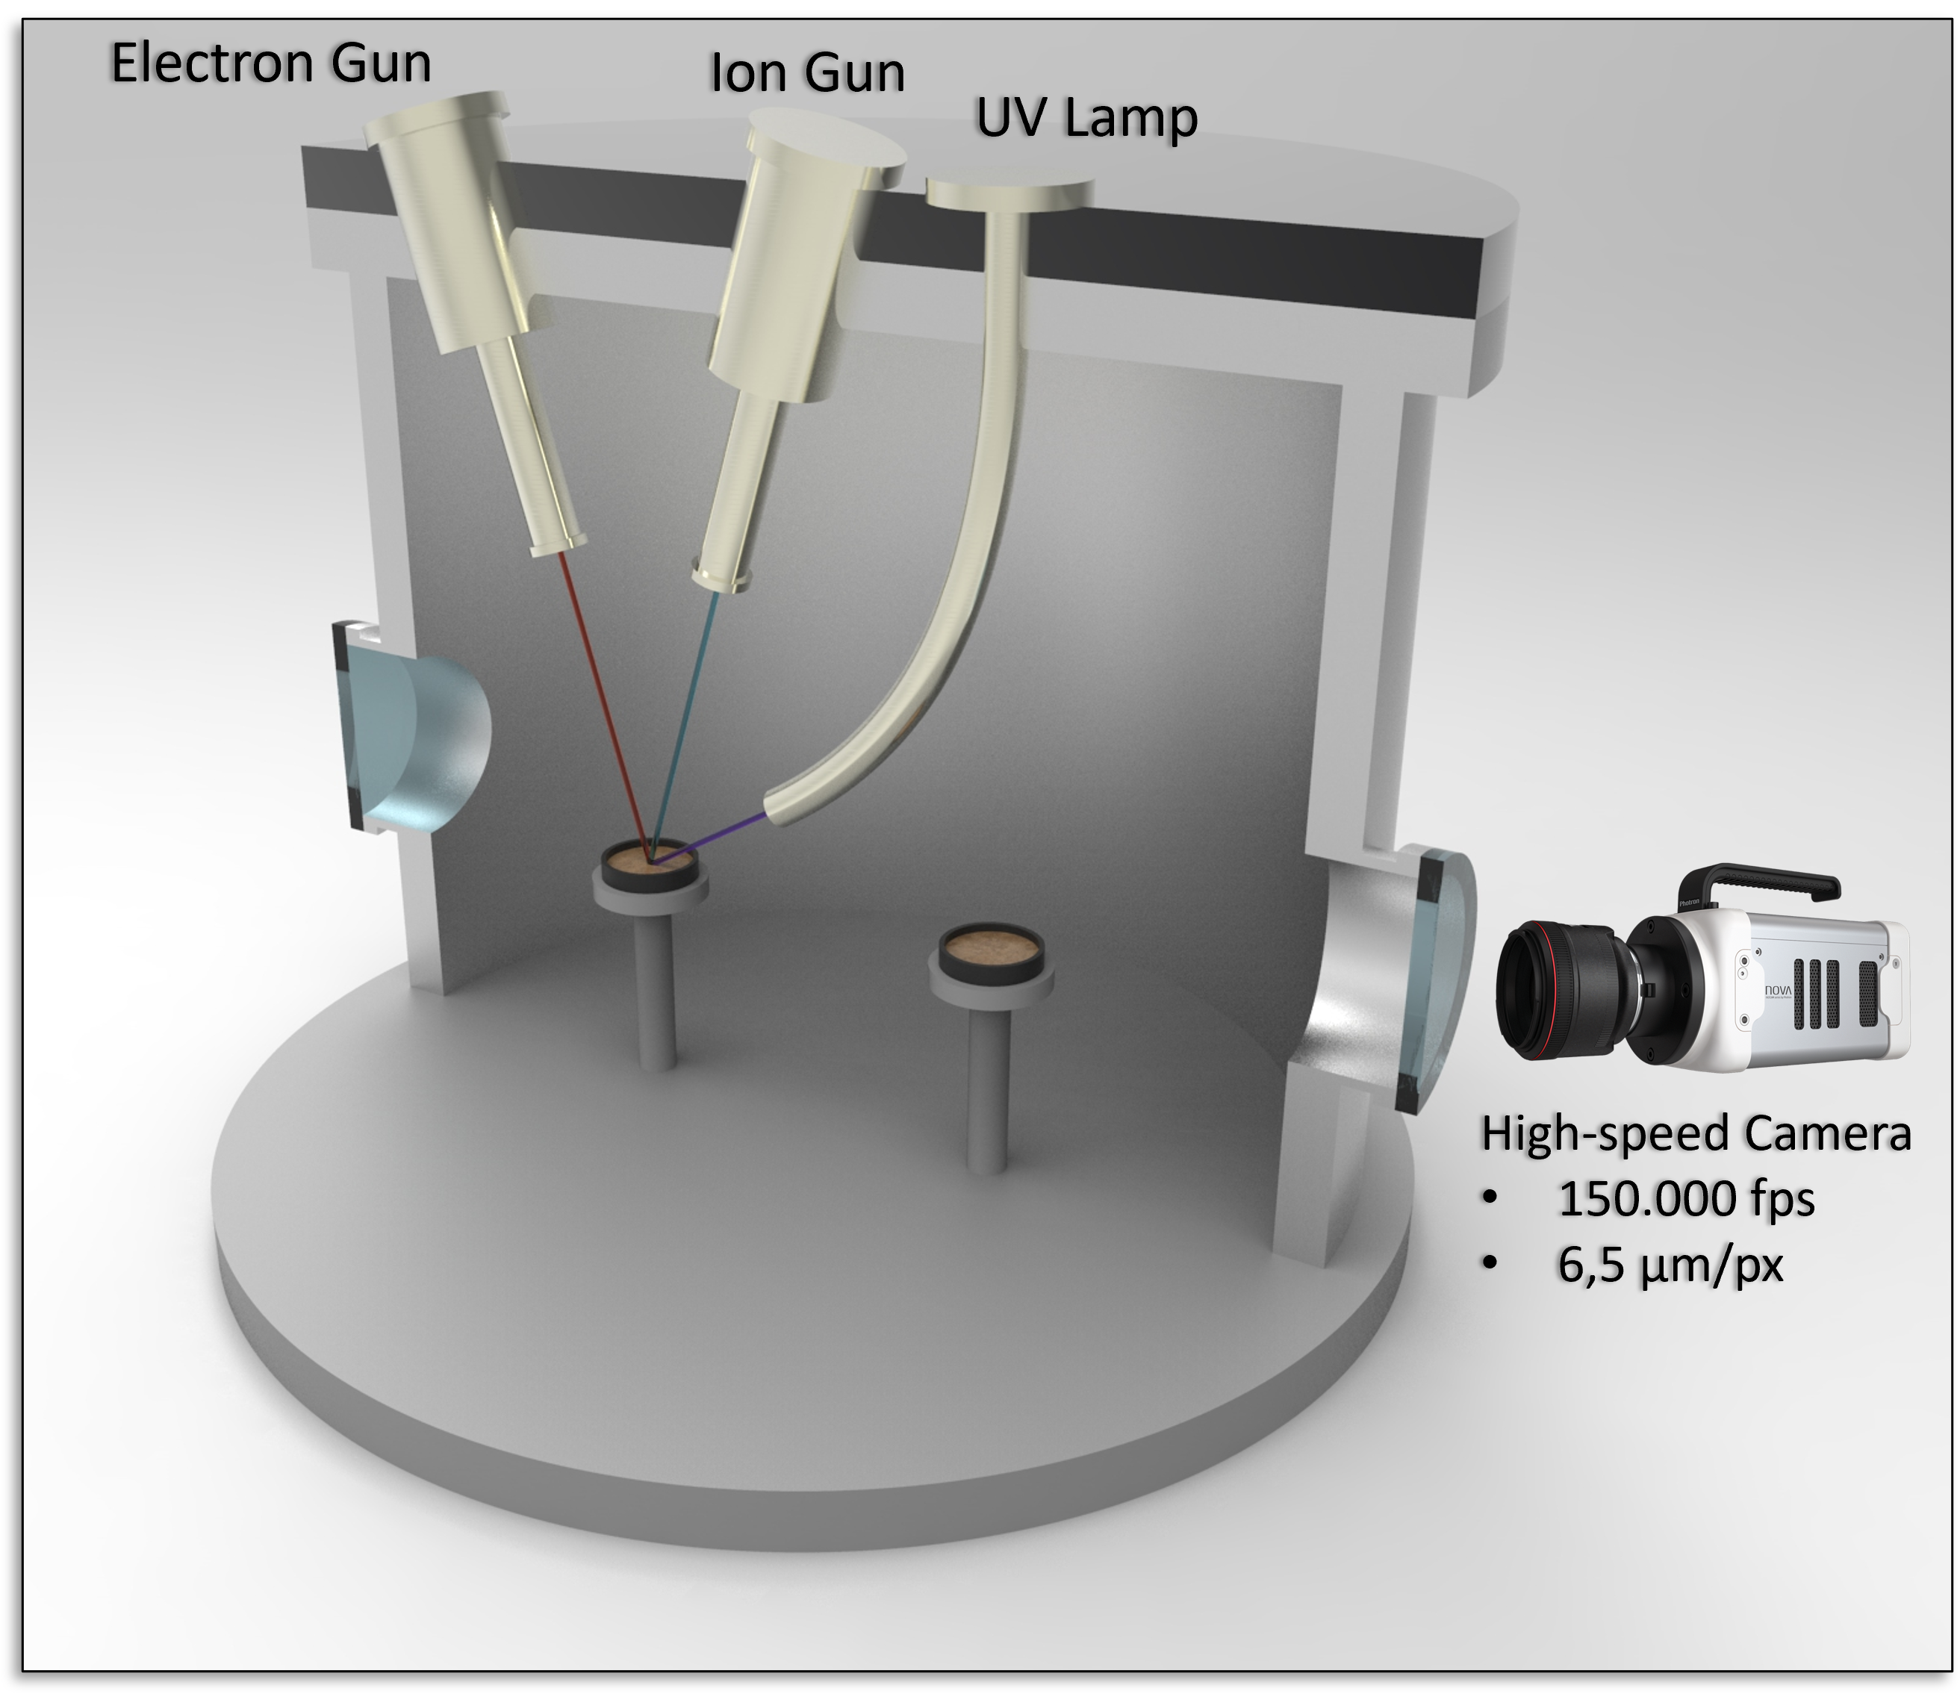
Testing facility: Lunar Simulation Chamber
Electrostatic levitation
To simulate the UV-induced photoemission
dust grains will be illuminated by an UV Lamp,
with λ = 172 nm,
i.e. E_{ph} = 7.2 eV > the work function of the dusty surface (~ 5.5 eV)
To simulate the Solar wind effect
dust grains will be exposed to
an Electron Gun
Beam energy: 10 - 1500 eV
Beam diameter: 1 - 100 mm
an Ion Gun
Beam energy: 0 - 3000 eV
Beam diameter: 5 - 25 mm
Giuseppe Mongelluzzo, Carmen Porto, Gabriele Franzese, Francesca Esposito, Ciprian Popa, Simone Silvestro.

Slide 6
Testing facility: Lunar Simulation Chamber
LD GRIDS testing
A high-voltage (up to ± 8 kV) gridded electrode
will be placed ~ 5 mm above the dusty surface to attract charged grains.
LD GRIDS
A system based on electrostatic lenses is being developed to accelerate the dust grains towards LDGRIDS under controlled conditions.
Giuseppe Mongelluzzo, Carmen Porto, Gabriele Franzese, Francesca Esposito, Ciprian Popa, Simone Silvestro.

Slide 7
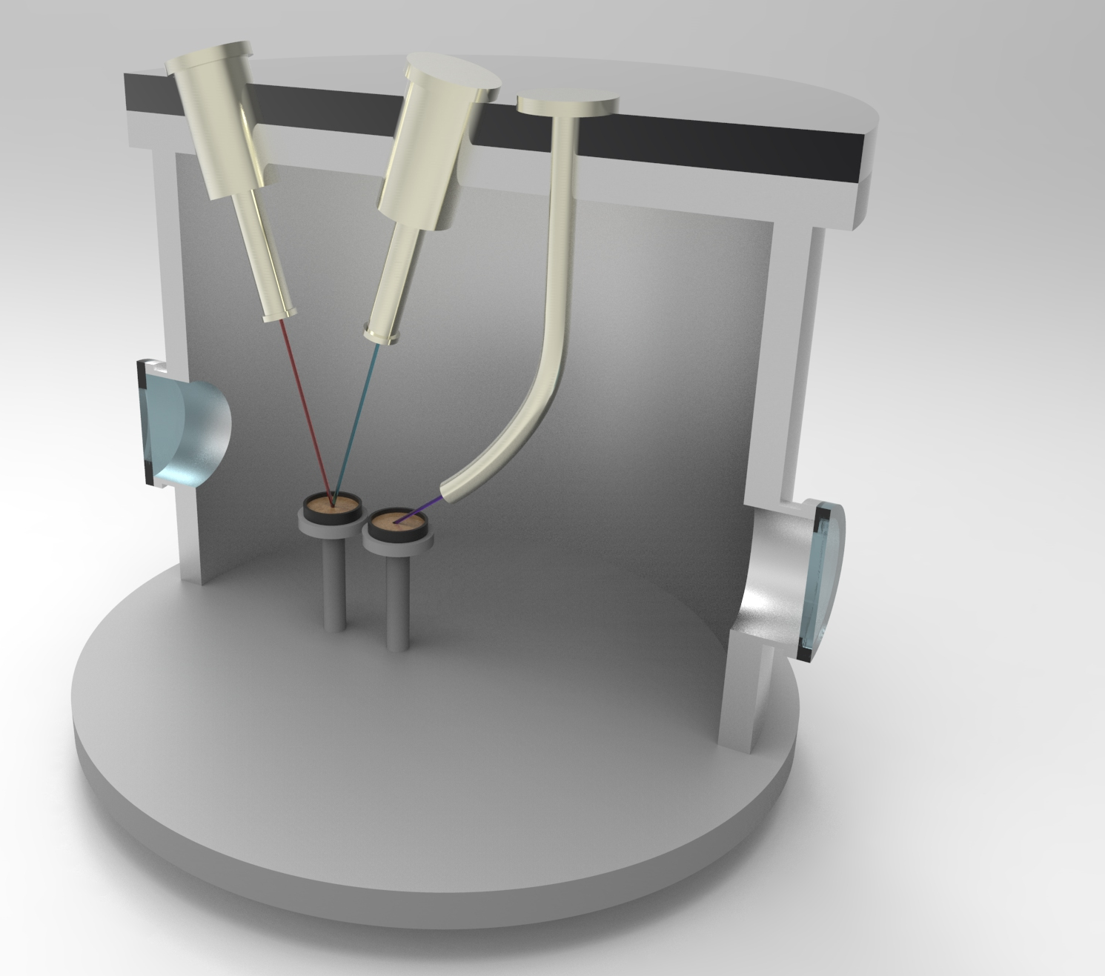
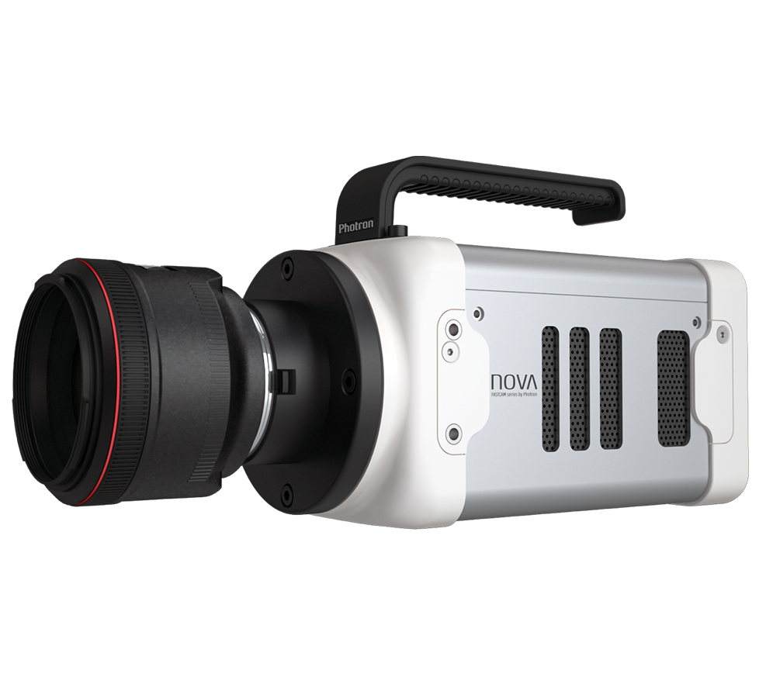
Testing facility: Lunar Simulation Chamber
Electron Gun
Ion Gun
UV Lamp
Electrostatic transport
To simulate the UV-induced photoemission
dust grains will be illuminated by an UV Lamp,
with λ = 172 nm,
i.e. E_{ph} = 7.2 eV > the work function of the dusty surface (~ 5.5 eV)
To simulate the Solar wind effect
dust grains will be exposed to
Sample 2
Sample 1
an Electron Gun
Beam energy: 10 - 1500 eV
Beam diameter: 1 - 100 mm
an Ion Gun
Beam energy: 0 - 3000 eV
Beam diameter: 5 - 25 mm
High-speed Camera
150.000 fps
6,5 µm/px
Giuseppe Mongelluzzo, Carmen Porto, Gabriele Franzese, Francesca Esposito, Ciprian Popa, Simone Silvestro.

Slide 8
Electron Gun
Ion Gun
UV Lamp
Testing facility: Lunar Simulation Chamber
Subsystems
Dust Charging System: UV lamps, Electron and Ion Gun.
Environmental sensors: Langmuir probe, Faraday Cup.
Gas injection system.
Sample holders.
High-voltage gridded electrode.
High-speed camera
Sample 2
Sample 1
High-speed Camera
150.000 fps
6,5 µm/px
Giuseppe Mongelluzzo, Carmen Porto, Gabriele Franzese, Francesca Esposito, Ciprian Popa, Simone Silvestro.

Slide 9
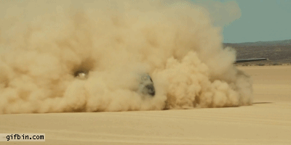
Why dust?

Slide 10
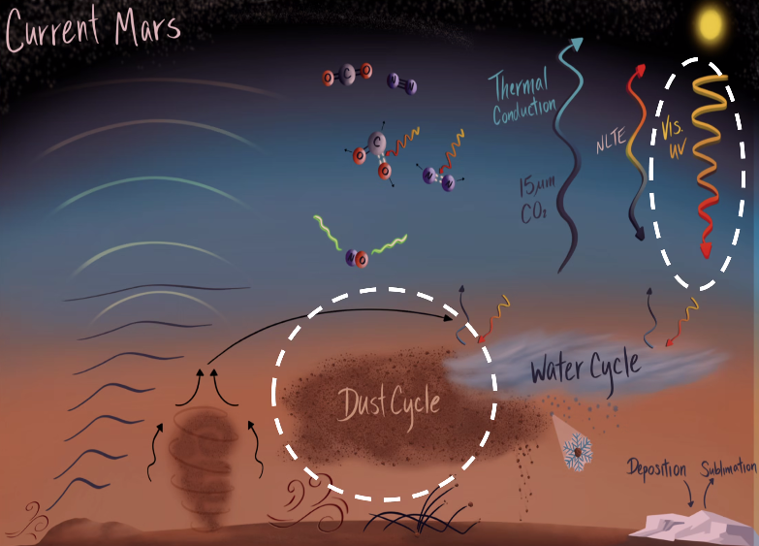
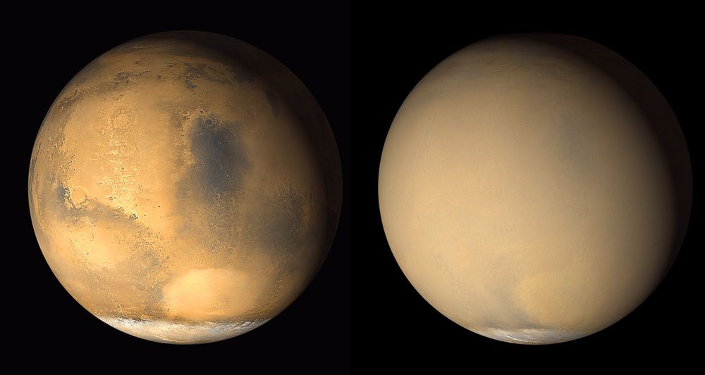
Why dust?
Strong influence on Mars global climate
Global dust cycle
Dust storms, dust devils are relevant phenomena (also on Earth); dust storms can become global
Influence on instrumentation (and on human explorers?)
Why dust?

Slide 11
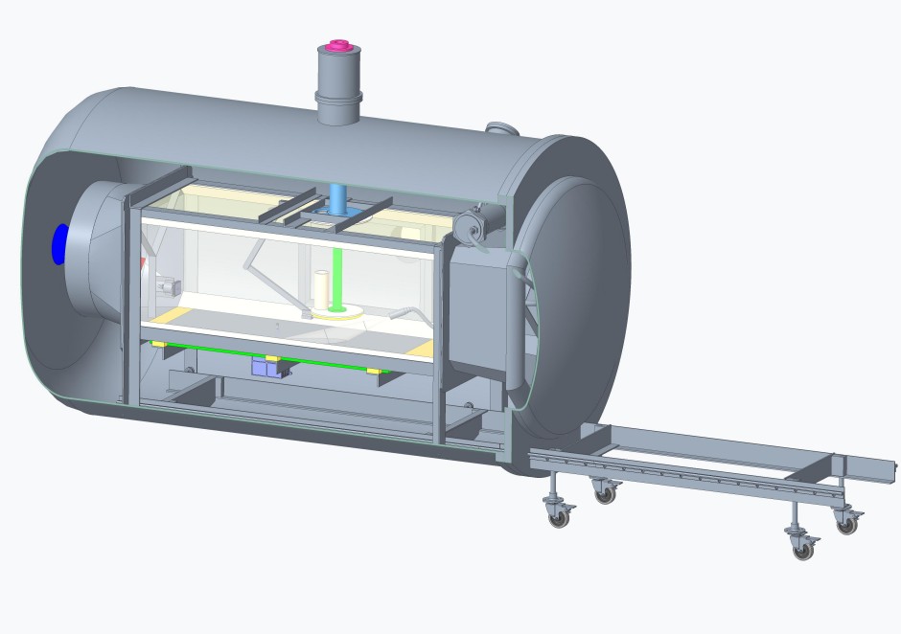
New subsystems
Wind Tunnel: logaritmic wind profile up to ~15 m/s
Thermal plate and sand bed: down to -80 °C
Vertical Electrodes: up to ~150 kV/m
UV radiation
Environmental Sensors System: Faraday Cup and Langmuir probe
Camera System: resolution up to 10 µm
Controlled injection system
All the new subsystems are removable, hence the chamber can always return to the original condition
Fan
Electrodes
Grain Injection
UV
source
Faraday cup
MicroMED
Sandbed
Martian Simulation Facility

Slide 12
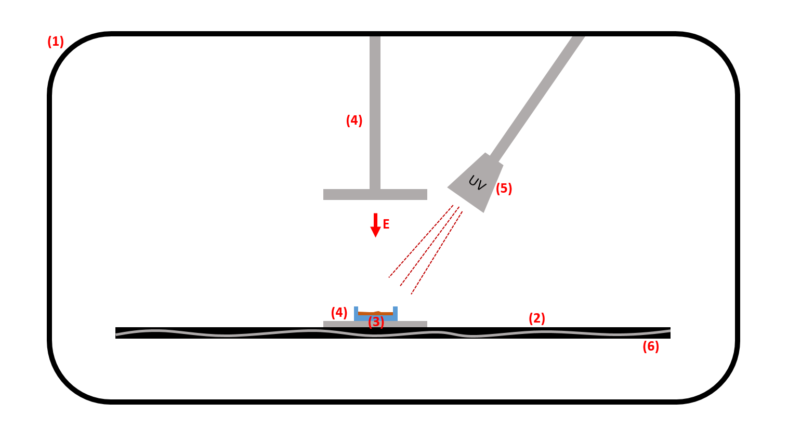
Possible test: Dust lifting due to electrification
Martian Simulation Facility
Notes:
su Marte la causa principale del sollevamento è sempre il vento quindi la causa principale della carica dei grani sono gli urti tra loro e col terreno noi vogliamo vedere se quel poco di carica che gli da l'UV può abbassare un poco la threshold necessaria al vento il campo vero si genera dopo che i grani sono in moto (dovuto ai grani appunto) e vogliamo vedere se una volta avviato il processo il campo E e l'interazione coi grani può aiutare a tenerlo attivo anche quando il vento cala

Slide 13
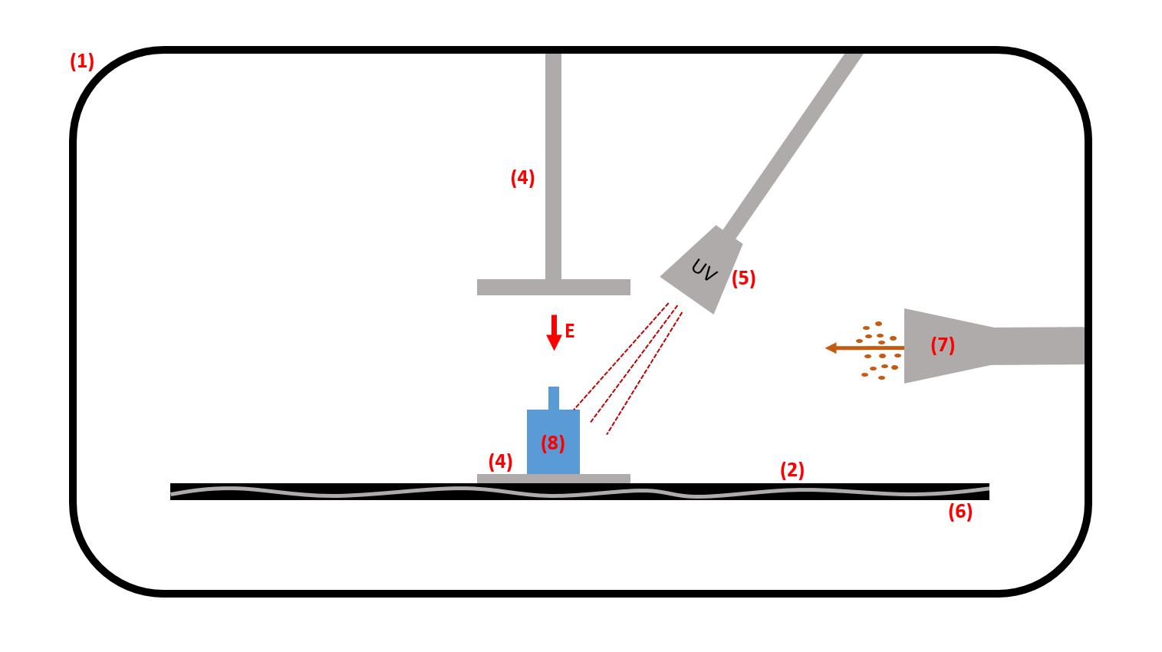
Possible test: Martian instrumentation testing
Martian Simulation Facility

Slide 14
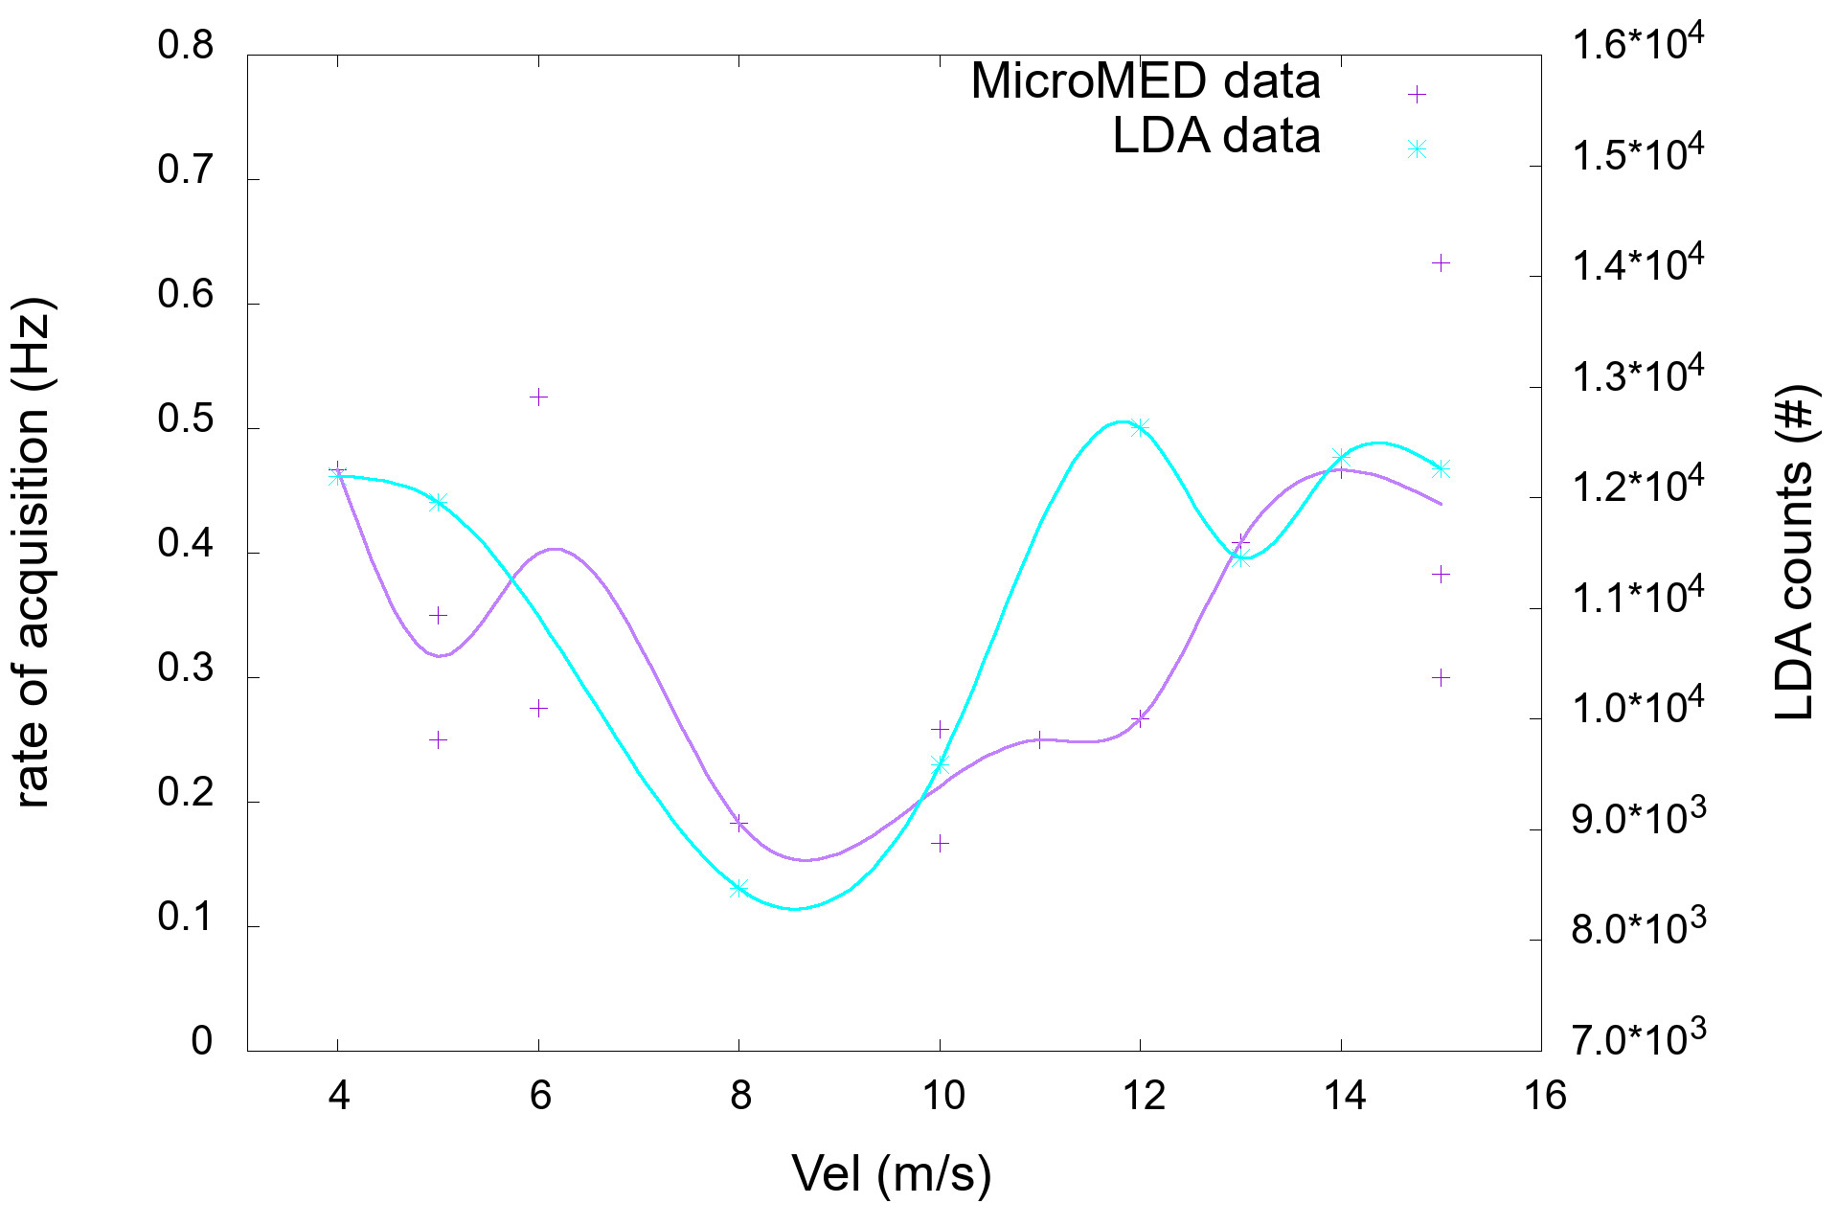
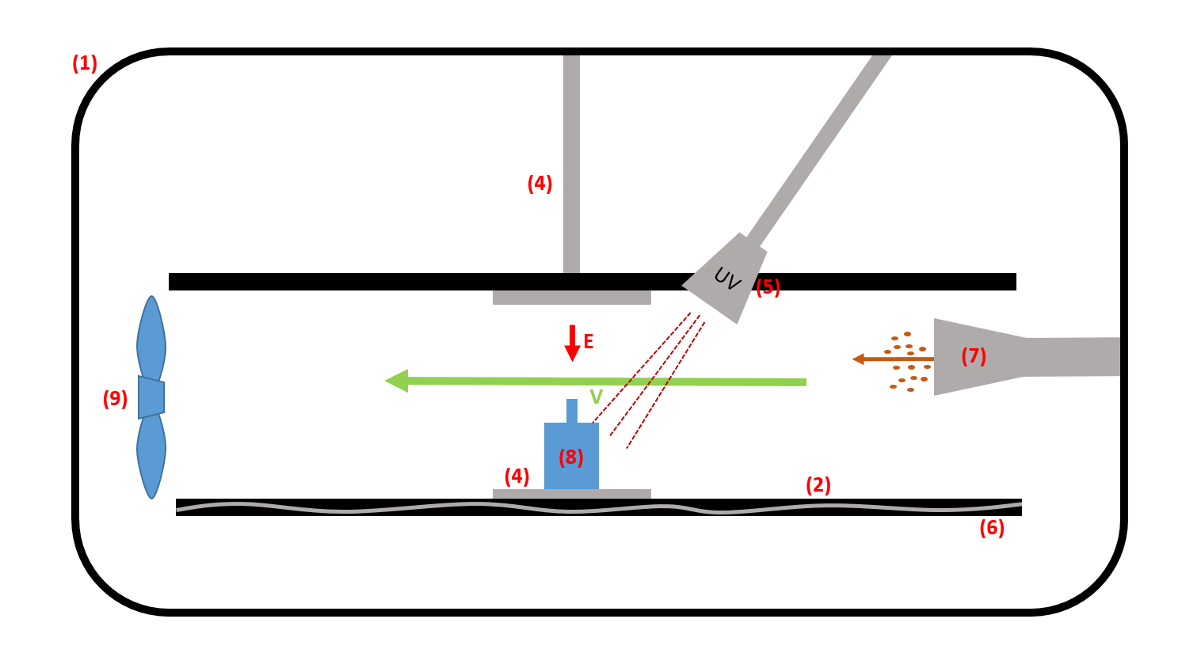
Possible test: Instrumentation testing in presence of wind
Martian Simulation Facility
Notes:
Vogliamo ottenere efficienza con velocità vento
Qui disuniformità quantità polvere con velocità, e picco minimo a metà che è strano

Slide 15
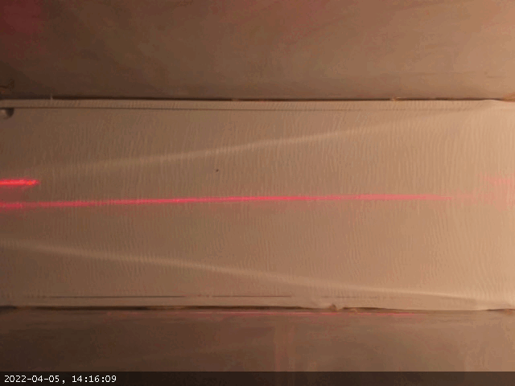
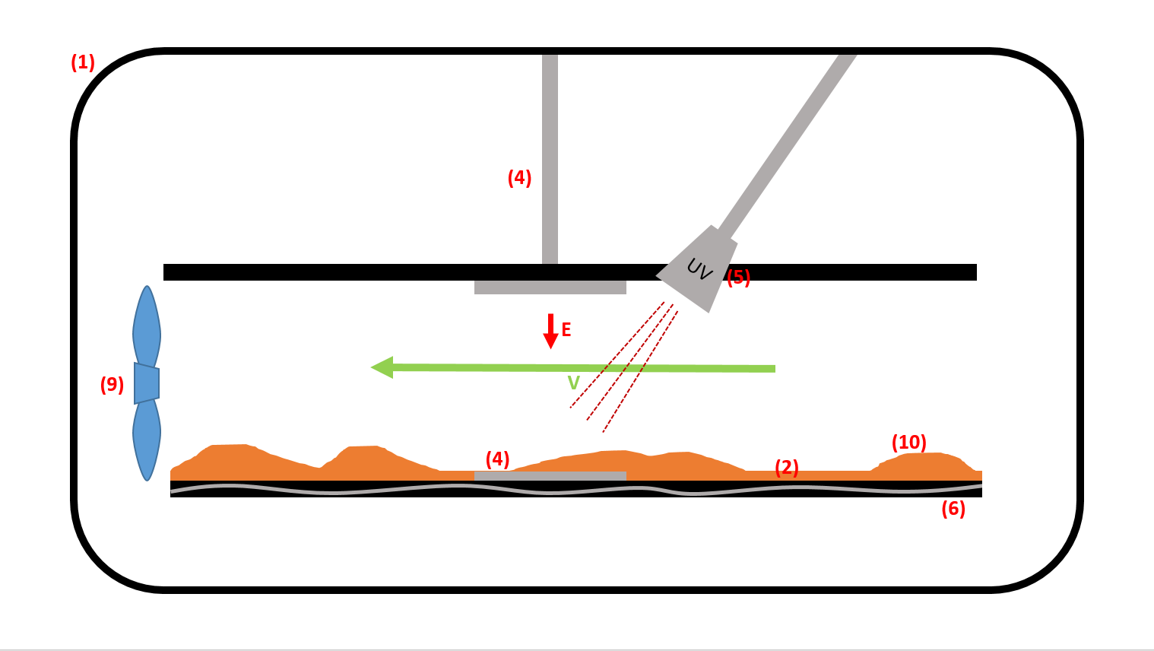
Possible test: Sandbed evolution in presence of wind
Martian Simulation Facility

Slide 16
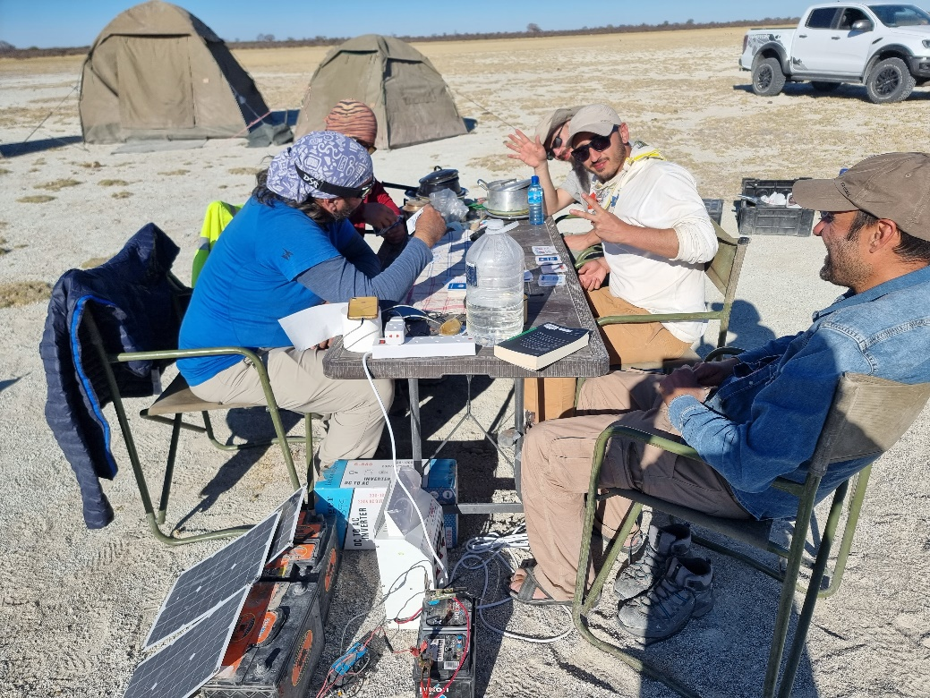
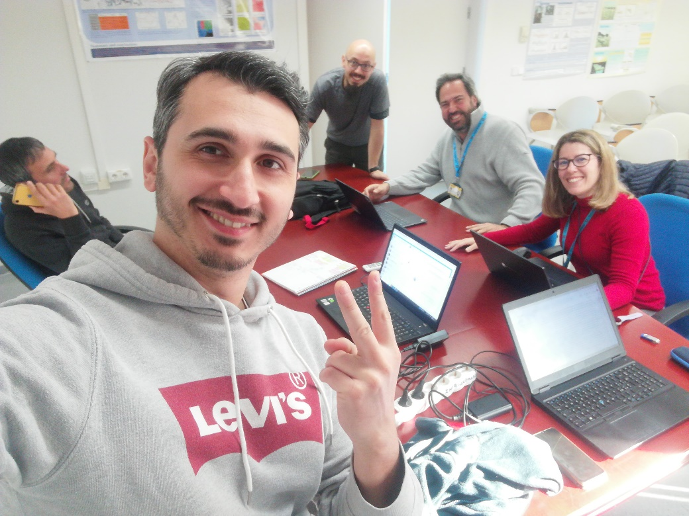
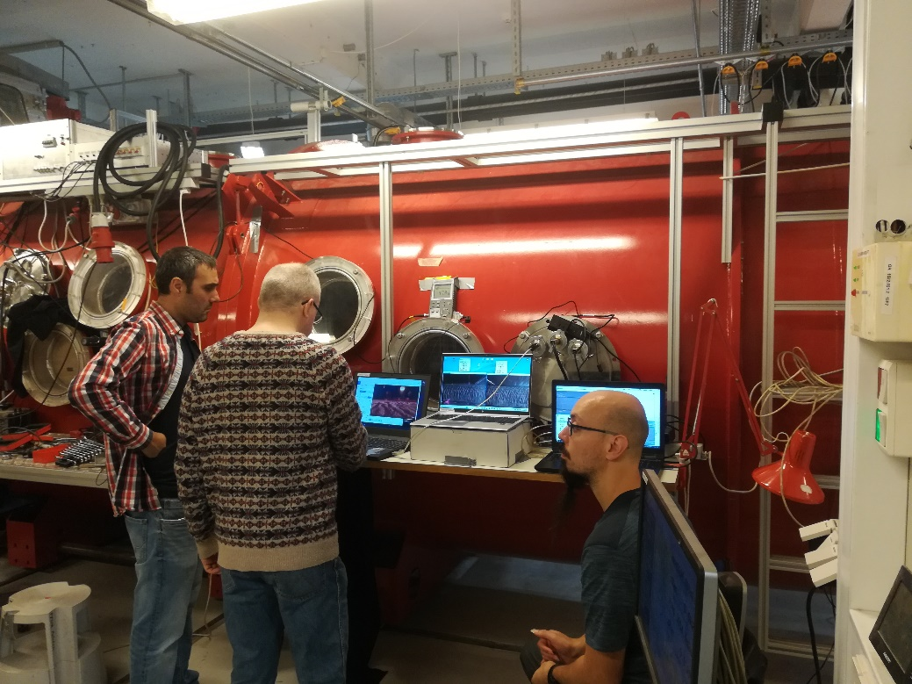
Thank you!
Giuseppe Mongelluzzo; Carmen Porto;
Osservatorio Astronomico di Capodimonte (INAF – OACN)
giuseppe.mongelluzzo@inaf.it; carmen.porto@inaf.it;
Contact us!
Thank you!

