Slide 1
STILES
Optical Astronomy Facilities / Laboratories
Valentina Viotto on behalf of the Activity leaders
October 1st, 2024

Slide 2
Act. 5101
Optical-IR & AO Lab @OAS
Objective: upgrade of OAS laboratories and facilities
Improvement of cleanliness level
OAS ISO7 Clean Room Financial coverage for maintenance finally secured by other funds, even though upgraded clean room will remain available for STILES activities 5101 and 2301
OAS Optics, Electronics & AO Lab Laminar flow enclosure to protect optical table for “visibly clean” cleanliness level
Equipment and instrumentation
General-purpose laboratory supplies for prototyping and AIV of optical-infrared instrumentation
Metrology and alignment instrumentation
Wavefront sensor
OAS large cryo-facility upgrade
Cryocooler to improve capabilities in terms of thermal cycling
Support table with fine adjustment mechanisms to support optical metrology instrumentation
Other tools
Computers, software licenses
Aim of the facility: development of Adaptive Optics (AO) technologies, optical and infrared instrumentation, cryogenic instrumentation including environmental testing
Location | INAF OAS Bologna
Related Projects | SPHERE+/SAXO+ for VLT (ELT PCS pathfinder) → see STILES Activity 2301. Other optical/IR instrumentation programmes @OAS.
Who can use it | Personnel involved in related projects. Other users compatibly with the planning of the related projects.
Responsible | Emiliano Diolaiti
STATUS: Procurement in progress
Notes:
2301: The activity starts to support the construction of the second-stage AO module (SAXO+) in the framework of the SPHERE+ upgrade.

Slide 3
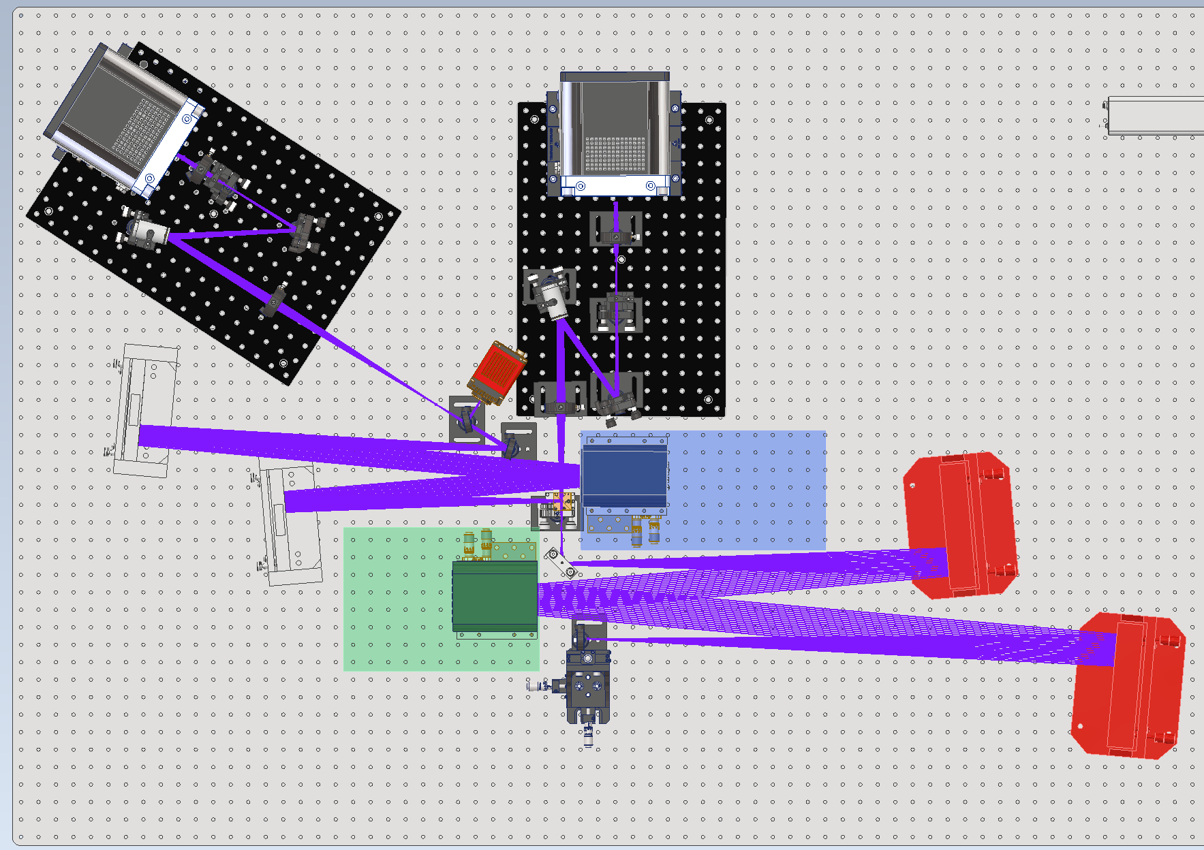
Act. 5102+5103:
ExtremeAoLab @ Arcetri
High contrast applications
Achromatic relay (OAPs) for vis to NIR operation
2 DMs (~450 and 800 acts) optically conjugated to telescope pupil
2 modulated Pyramid WFS with adaptable geometry and sampling (40 to 400 subaps on pup D)
Output F17.7 focal plane to host NIR imager
Aim of the facility: The aim of these 2 similar (but different!) test benches is to provide a lab-setup to test the key technologies required to fully exploit the capabilities of the ELTs (GMT and ELT) both in terms of contrast and resolution.
Location | INAF - Arcetri
Related Projects | 5102 -> ELT/Andes, LBT 5103 -> all instruments on ELT and GMT
Who can use it | INAF, Italian and international communities
Responsible | 5102 -> Marco Bonaglia 5103 -> Enrico Pinna
See also posters
Piston sensors characterization
Custom segmented DM
100 mm aperture
6 “petals” with independent PTT (and strain gauges)
Optical metrologies!
100 mm aperture Fizeau
Disperse fringe sensor
Laser displacement interferometer
STATUS of 5102: 90% of items are in house, but only 25% of budget has been spent (interferometer and DMs still to be procured).
SATUS of 5103: 90% of items are in house, 50% of budget spent (interferometer and segmented DM still to be procured).
Notes:
5102: versatile test bench to move the research activity on XAO from computer-assisted simulations to the laboratory.
Such facility will allow to deepen the knowledge in all the aspects of the implementation and control of 2 AO systems in cascade.
5103: realization of a testbed for sensors and techniques dedicated to ELT-M4 phasing (6 petals).

Slide 4
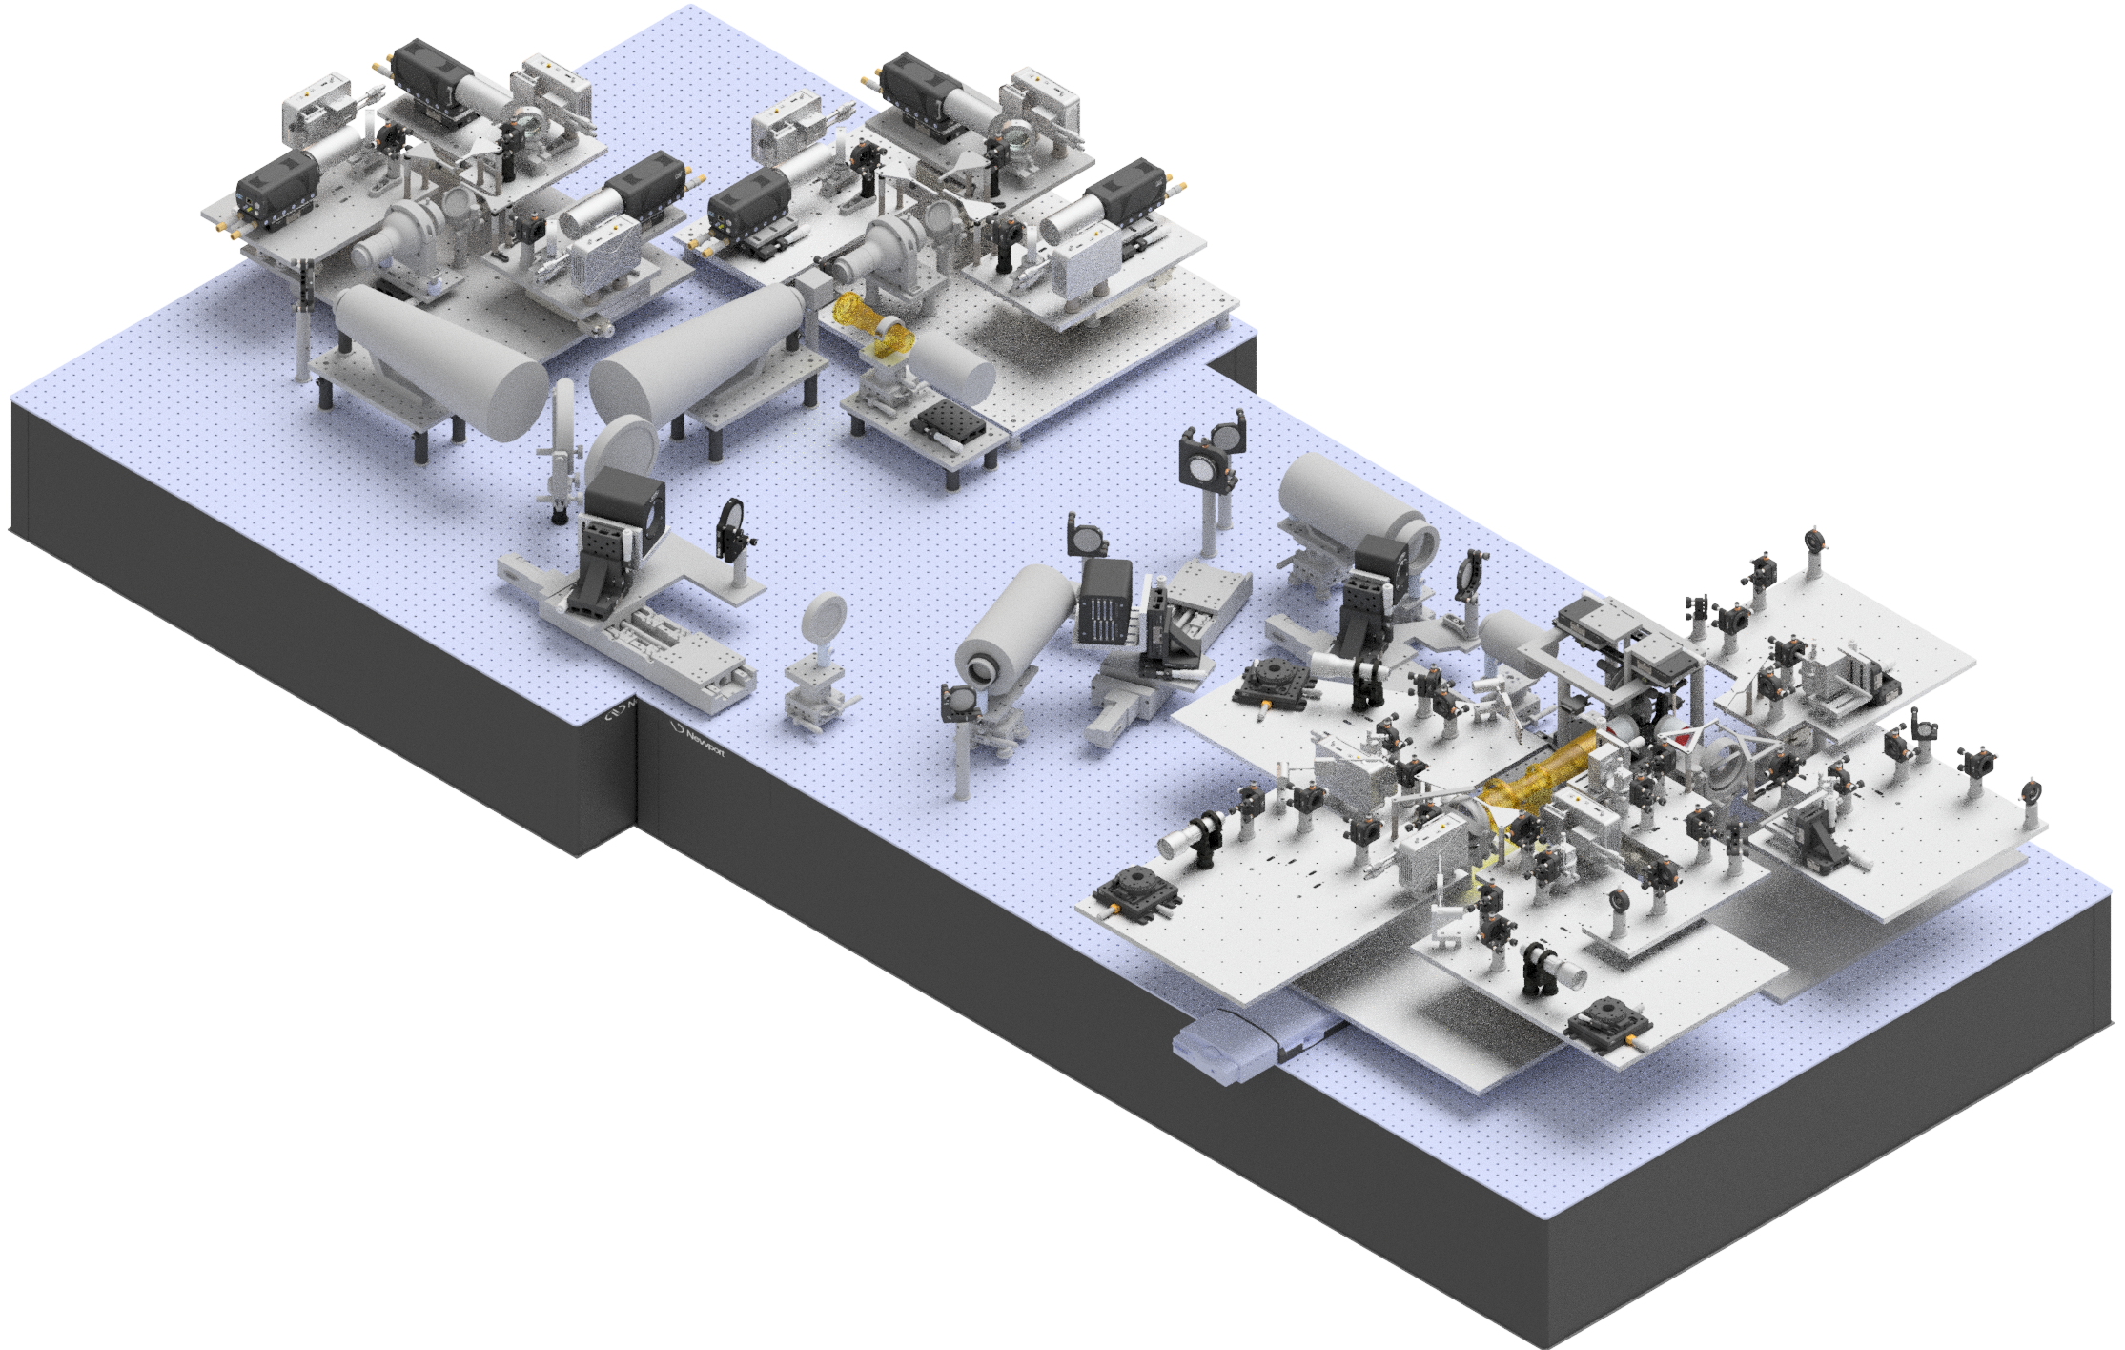
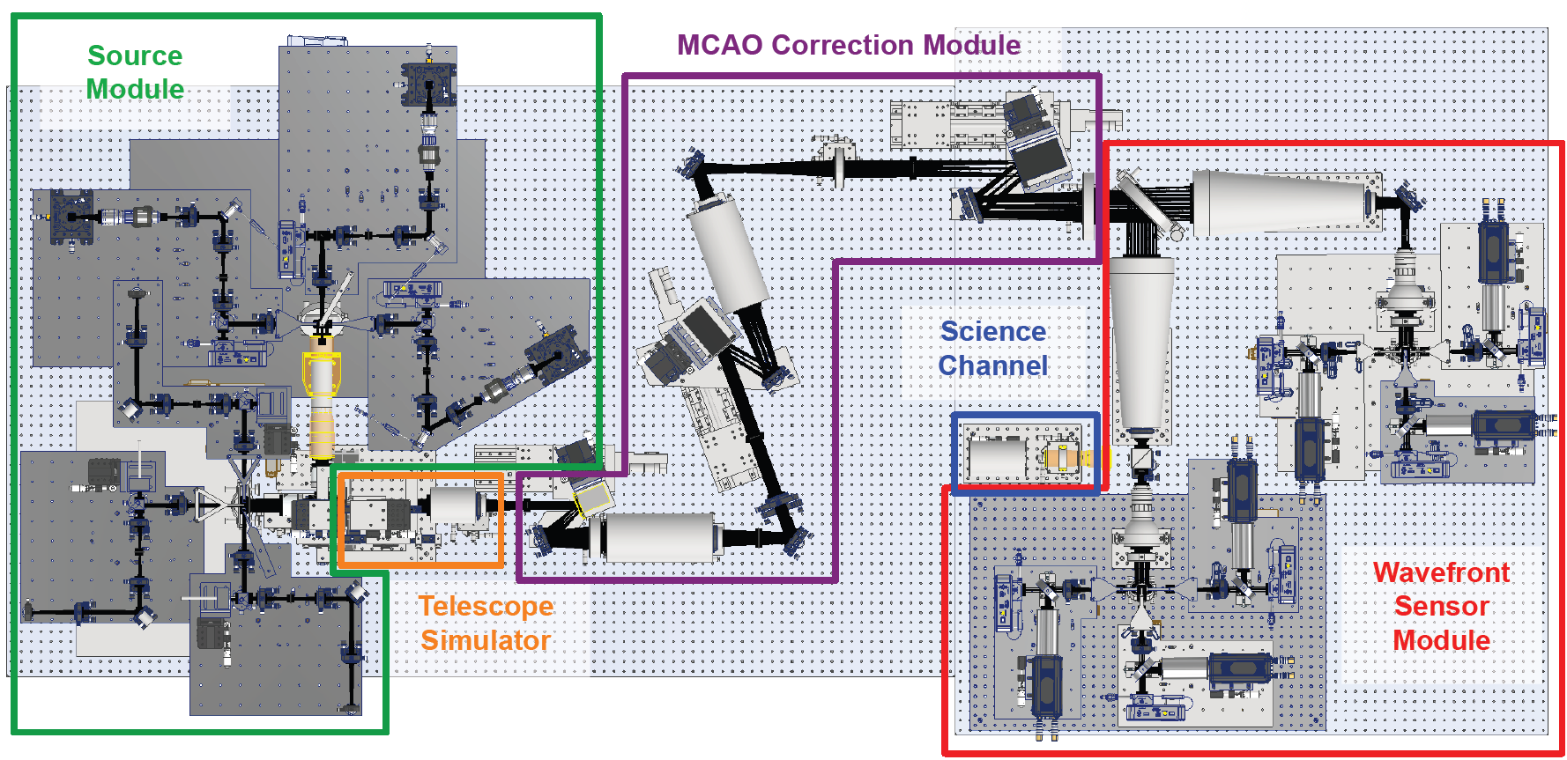
Act. 5301 MATTO: Multi-conjugate Adaptive Techniques Test Optics
MODULARITY!
up to 3NGS+3LGS-like sources
aberrations injected with:
DMs/SLMs @ sources level
Phase screens
MCAO module DMs
rescalable telescope geometry
MCAO module:
3 DMs ~200/450/800 act
3+3 WFSs: SLMs as phase masks
Aim of the facility: It is a wide field AO test bench for study and development of MCAO techniques, under a wide range of conditions. These include both NGS and LGS-like sources, different telescope geometries, compensation schemes and WFS types.
See also poster
RTC
HW:
3 x servers with 6 CPUs
1 x storage server
2 x workstations for additional interface
SW:
will be developed based on the DAO RTC package (collaboration with CfAI)
Location | INAF - OAPD
Related Projects | None
Who can use it | INAF, Italian and international communities
Responsible | Valentina Viotto
STATUS: The procurement is on going

Slide 5
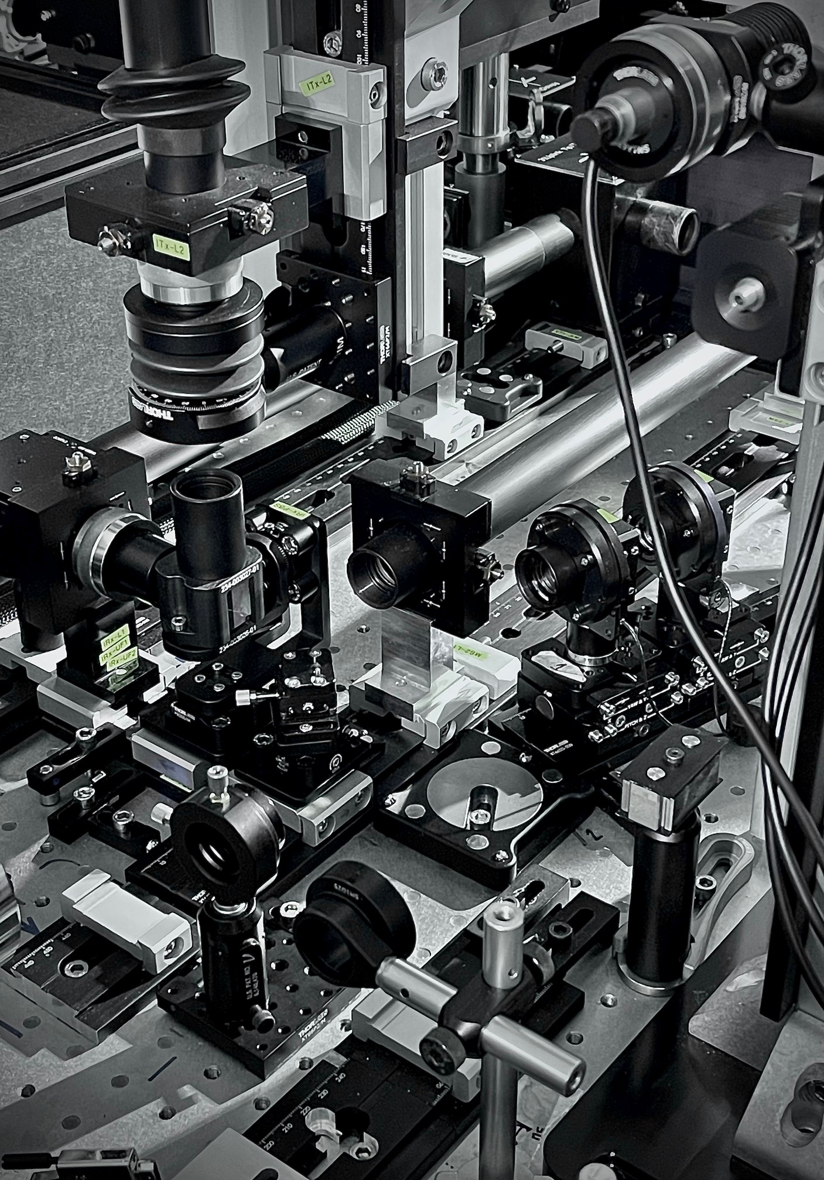
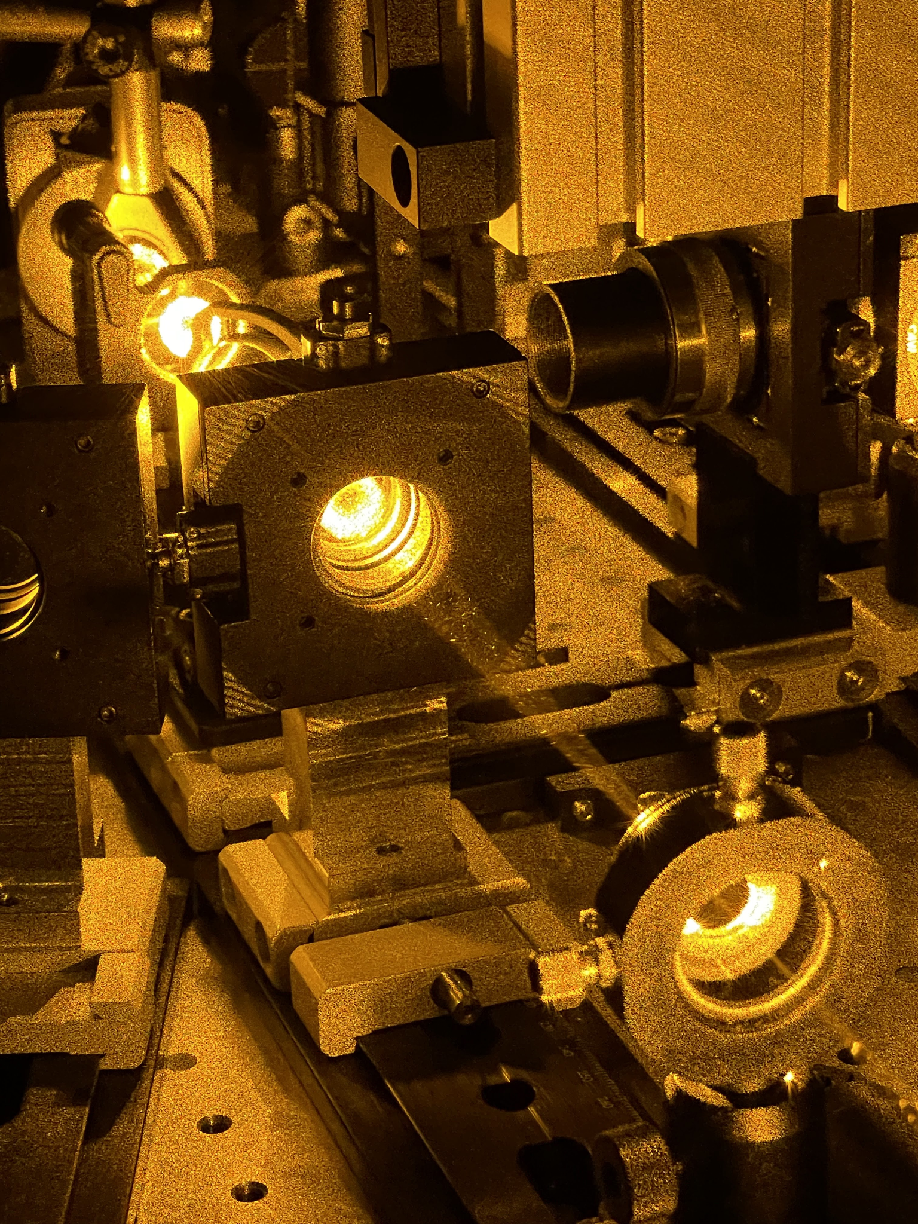
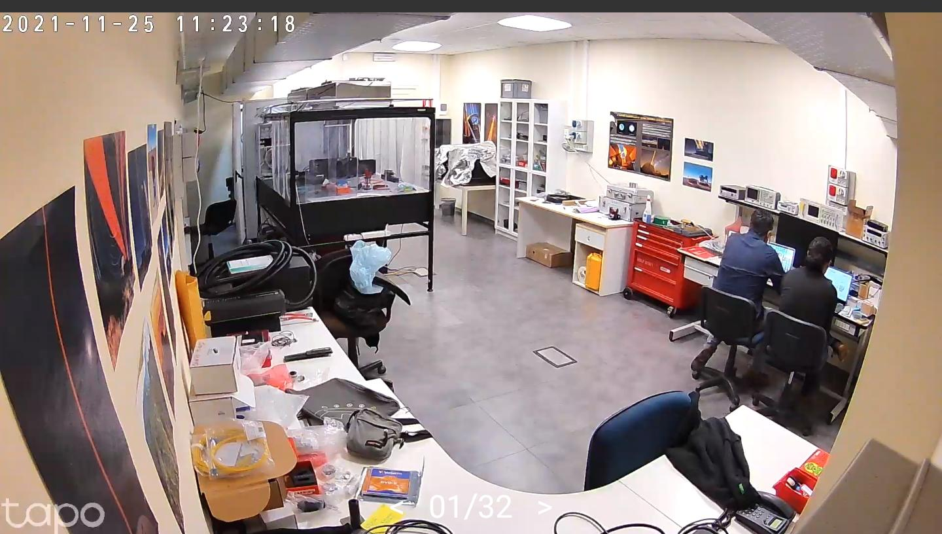
Act. 5201 Laser Guide Stars Lab Facility @ OAR
List of Procurements
Class IV laser safety and security tools
Laser 30 mW, single frequency, CW (low power laser)
Clear air laminar flow volume for the laboratory
Precision wavemeter with stabilized wavelength reference laser
Infrared interferometer
Polarimeters
Optical power measurement equipment
Class III Visible and infrared- lasers
Digitizers and signal generators
Detectors
Wave front sensors
Deformable Mirror
Turbulence simulator
Optical components
Field selector mirrors
Selector Dichroics and Filters
Mechanical laser shutters
Optomechanical tools
RTC Computer
Aim of the facility: Strengthen the competitiveness of INAF-OAR in LGS AO systems, by strengthening the existing LGS-AO laboratory at OAR, with particular reference to improving the role played by INAF-OAR in LGS-AO projects which is mainly that of being responsible for the activities of the AIV and the integration of precision instruments on an optical bench.
Location | INAF OAR
Related Projects | CaNaPy (ESO) - ALASCA (ESA) - SDLR (ASI)
Who can use it | INAF, Italian and international communities
Responsible | Mauro Centrone
STATUS: The procurement is on going
Notes:
Increase the capability of the laserlab fast optical and electronics metrology allowing full assembly, integration and verification of
LGS-AO systems, capable of serving INAF needs in projects with ESO, ESA and ASI.

Slide 6
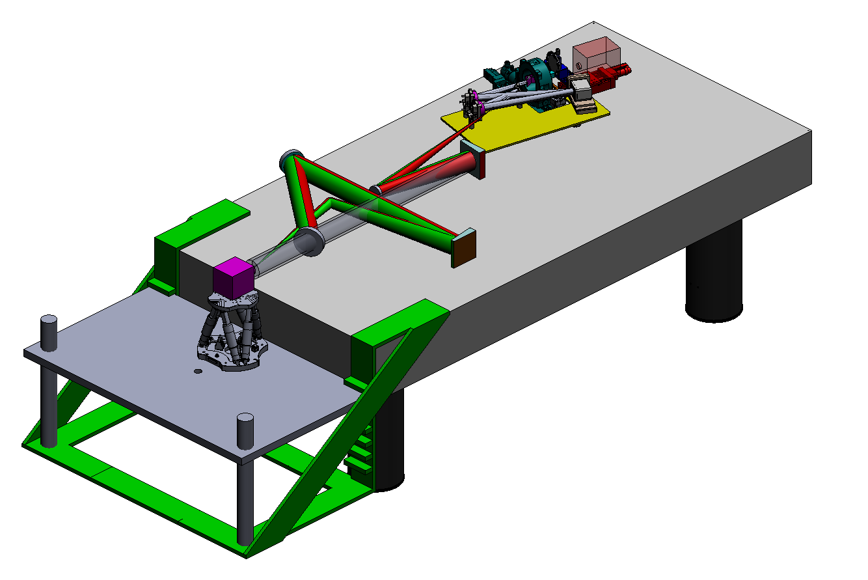
Act. 5401 DATT
Detector Advanced Test Track
Hexapod precision positioning for payloads up to 200kg
Turbulence injection by ALPAO DM with 300 modes
HAMAMATSU q-ORCA Reference detector
Aim of the facility: “Clean Room” based optical bench for test and characterization of VIS-NIR detectors and small optoelectronic instrumentation by projecting simulated astrophysical targets and test patterns at finite and infinite conjugation.
Location | INAF-OAR Monte Porzio Catone (RM)
Related Projects | SHARKs, ELVIS, MOSSCA, ROSIE, PSF reconstruction group, ADONI
Who can use it | INAF - PMI - Research institutes (remote controllable test session)
Responsible | Fernando Pedichini
8 x LED sources
Supercontinuum LASER
Black Body source
CROMATIQ spectral programmable source
Spectral lamps
STATUS: started clean room procurement and the procurement for 40% of the hardware
DELIVERED: control computers
Notes:
Activities 54XX: development and testing of detectors in different waveband regimes. 5401 is for testing of VIS-NIR detectors, including turbulence injection for fast imaging and WFSensing at high frame rate and low photon flux

Slide 7
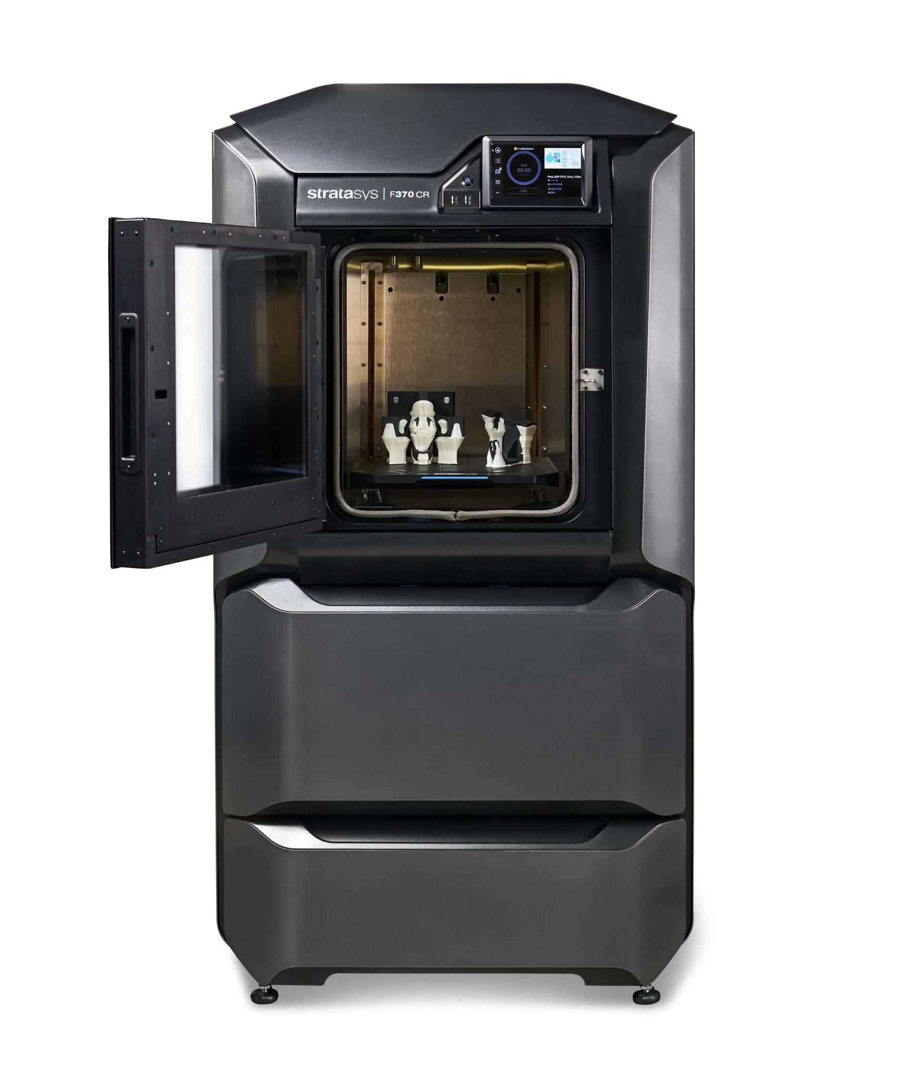
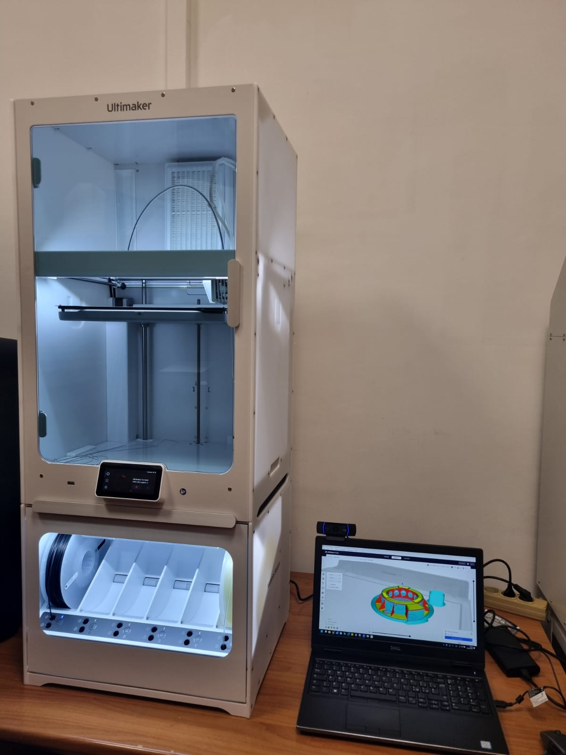
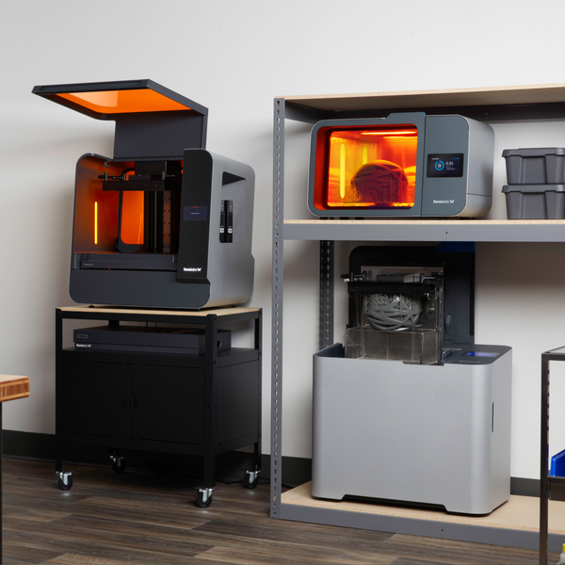
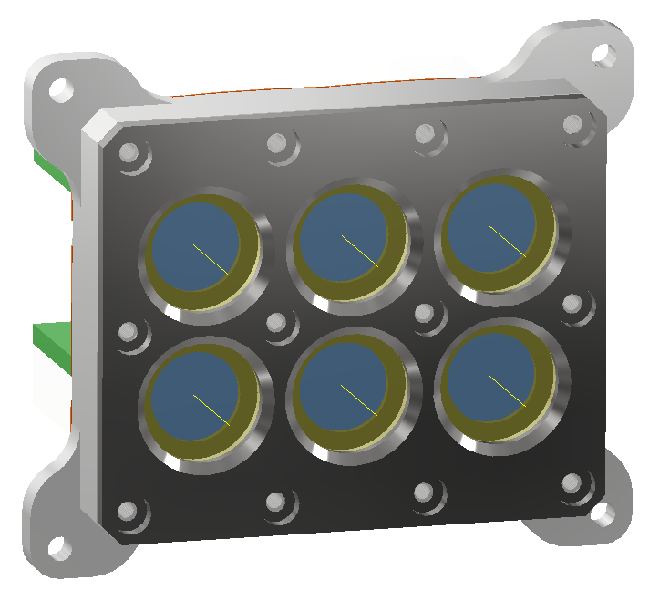
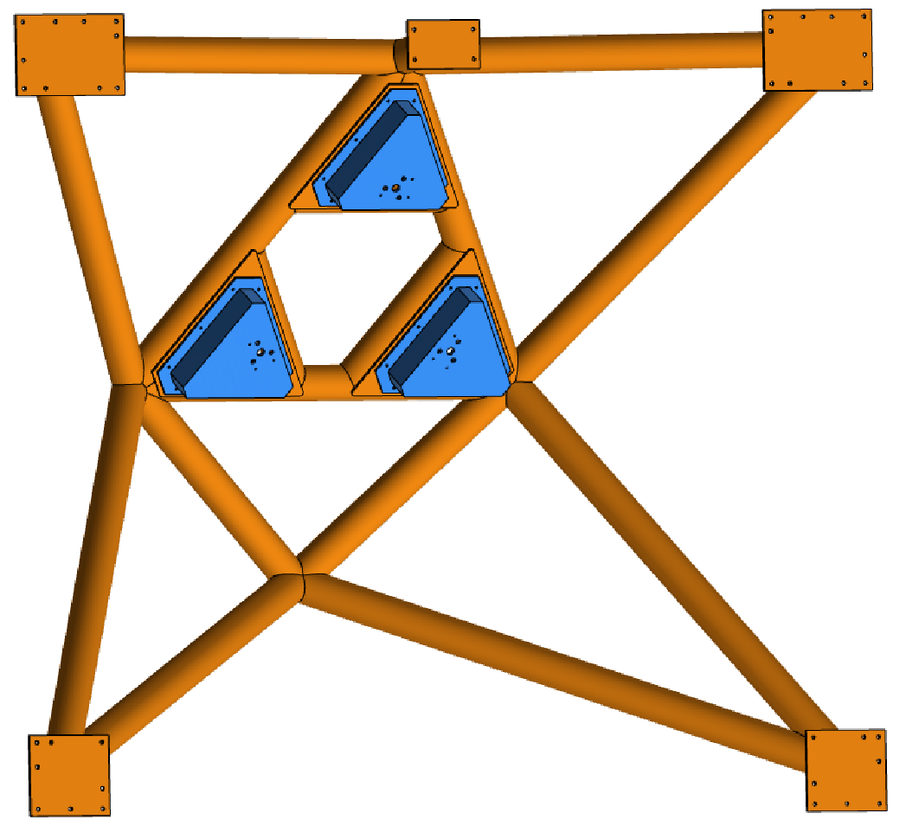
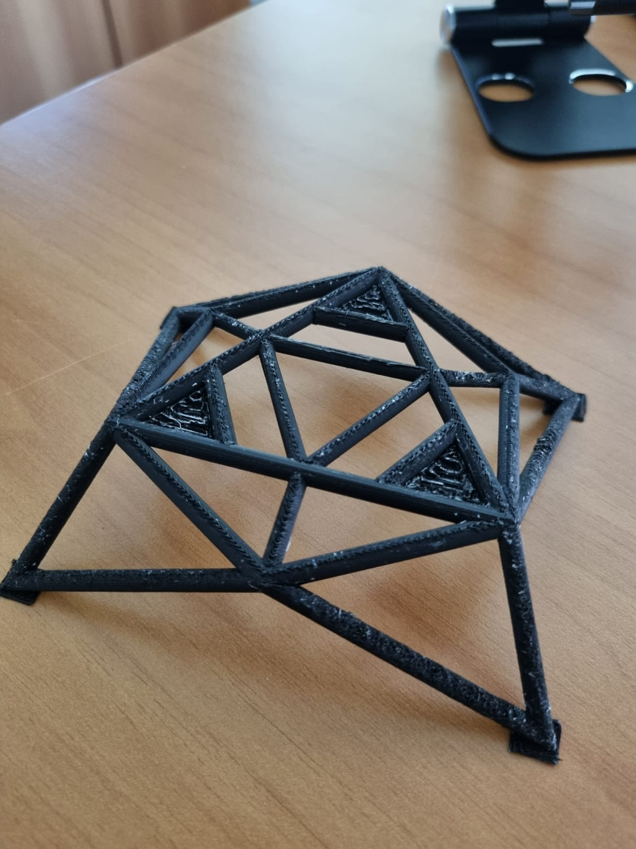
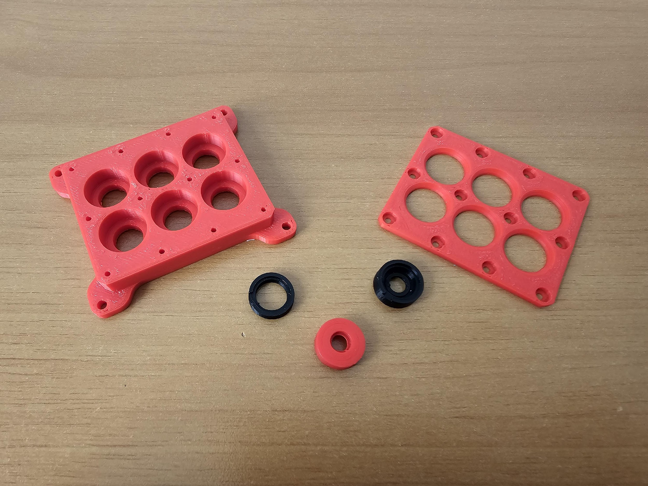
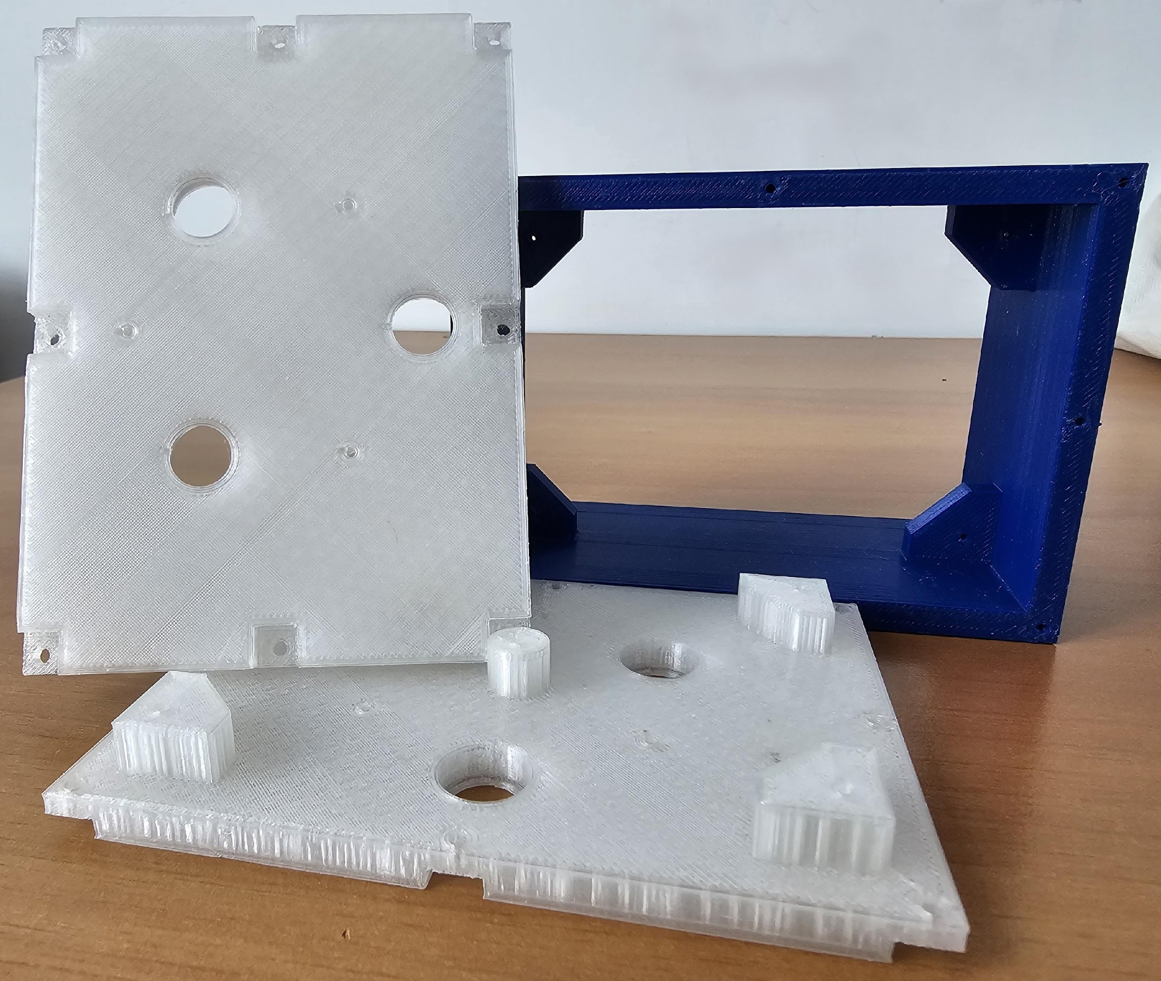
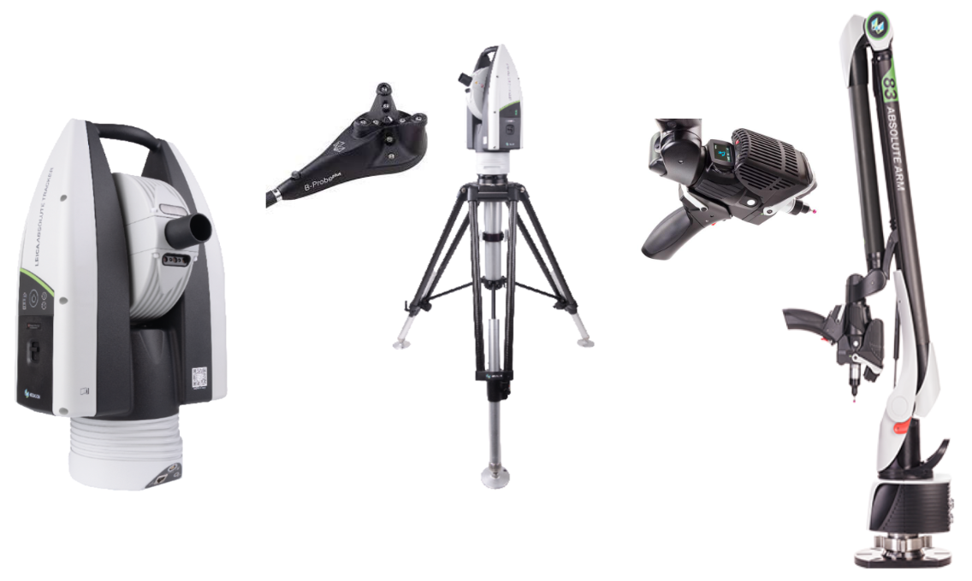
Act 5601 – Optomechanical Prototyping – New Material
The selected 3d printers:
Stratasys F370CR
Ultimaker S7-Pro
Formlabs Form 3L
cover two different technologies FDM (Fused Deposition Modeling) and SLA (Stereo Lithography Apparatus).
Aim of the facility:
setting up of a laboratory with a rapid prototyping stations using 3D printing technology with high-performance polymers, metrology and reverse engineering equipment.
First 3D “plastic” prototypes obtained
starting from our CADs: opto-mechanical mountings of MORFEO (ELT context), manufactured in scale 1:20 – MUAM (EMM/PNRR context) optomechanical support manufactured in scale 1:1
Location | INAF - Osservatorio Astronomico di Capodimonte (NA)
Related Projects | VLT/ELT instrumentation, Act 5602, Act 5603
Who can use it | INAF Institutes, Italian and international communities
Responsible | Vincenzo De Caprio
The metrology equipment available at the facility are:
Leica Absolute Tracker AT-500 + B-Probe Plus
Hexagon Absolute Arm 8320 + RS5 Laser Scanner
Software for data processing
These tools will be used to support the metrology activities related to the test and acceptance of the mechanical items designed and validated by FEA.
STATUS:
3D Printers & Metrology Equipment delivered.
The printing of the first 3D prototypes has been started.
See also poster

Slide 8
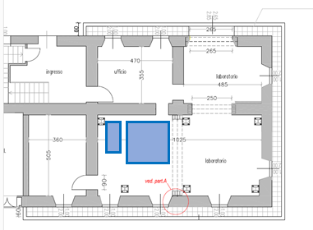
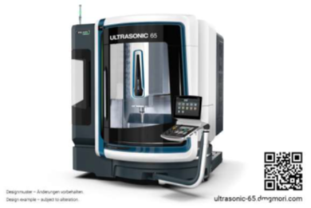
Act. 5602 - Optomechanical prototyping and precision manufacturing
ULTRASONIC 65
Technology-Integration:
ULTRASONIC-hard-machining of Advanced Materials and milling on one machine
Automation Ready - preparation of the automation interface for easy retrofitting
By CELOS simple operation and holistic integration in the business organization.
Strong speedMASTER®-Spindle with 20.000 rpm, 35 kW and 130 Nm (40% d.c.).
Ergonomic - Large door opening of 1,310 and unique access to the working area.
Precise - Comprehensive cooling measures, high-performance coolant unit and multi-sensor compensation as standard.
Range: X=735 mm Y=650 mm Z=560 mm
Max load: 600 kg
Direct Drive table (C axis) for continuous machining
Aim of the facility: acquisition of DMG Ultrasonic 65, a milling machine able to make the rough machining of big optic (~1m size), closing the loop of the capability to create free form and precise optomechanics
Location | INAF-OABrera @Merate
Related Projects | many VLT/ELT instruments
Who can use it | INAF community
Responsible | Stefano Basso
STATUS: contract signed and wait for delivery
See also poster
Notes:
centro di lavoro a 5 assi a controllo numerico per la lavorazione di materiali metallici e vetrosi

Slide 9
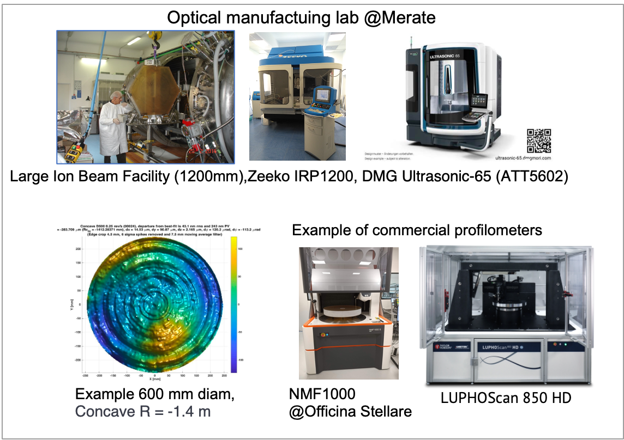
Act. 6703 OptomechTesting Profilometer
Aim of the facility: Expanding our capabilities in the field of metrology for optics manufacturing
Location | INAF-OABrera @Merate
Related Projects | MORFEO, NRT, Quvik, Ariel, Andes
Who can use it | INAF, Italian and International communities
Responsible | M.M.Civitani
STATUS: procurement ready to start with the additional budget from Bando Spazio.

Slide 10
Act. 5603
Optomechanical Metrology
Alignment system - Optical Perspectives Group
based on a Point Source Microscope and axicon grating
Laser Tracker - Leica AT930 SA
Articulated Arm CMM - Quantum S MAX 2.5m with 8 axes
Laser Line System - Attocube, 12 channels with PLC interface
Software for data processing - Spatial Analyzer
Aim of the facility: Expanding our capabilities in the field of optical metrology for alignment
Location | INAF-OABrera @Merate
Related Projects | CUBEs, MORFEO, ANDES…
Who can use it | INAF, Italian and International communities
Responsible | Giorgio Pariani
STATUS: procurement concluded for the available budget, material delivered. Waiting for budget redistribution to start the remaining procurements (20% of the total)

Slide 11
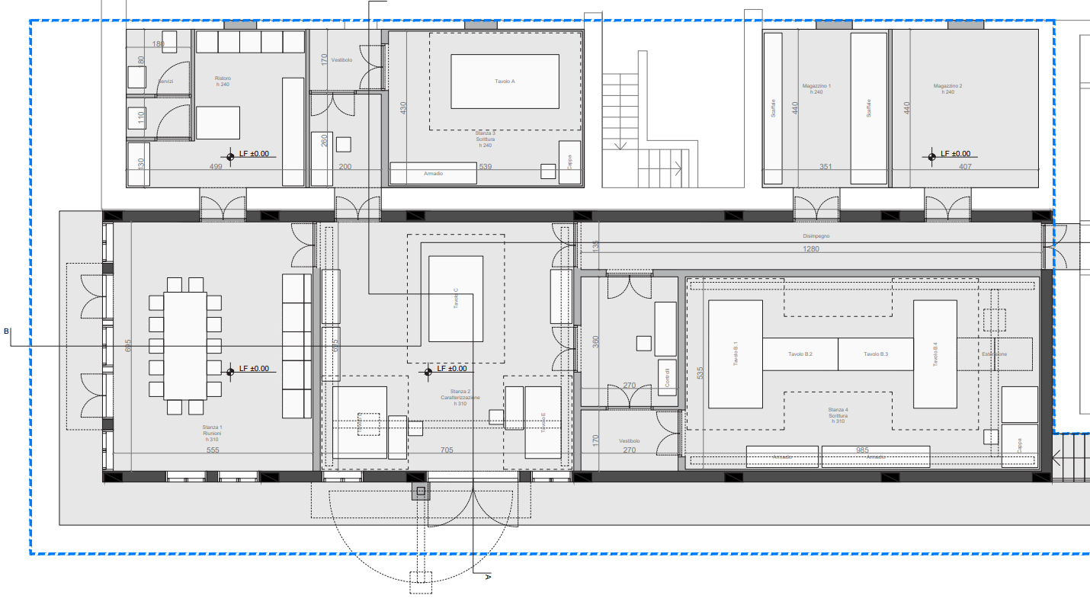
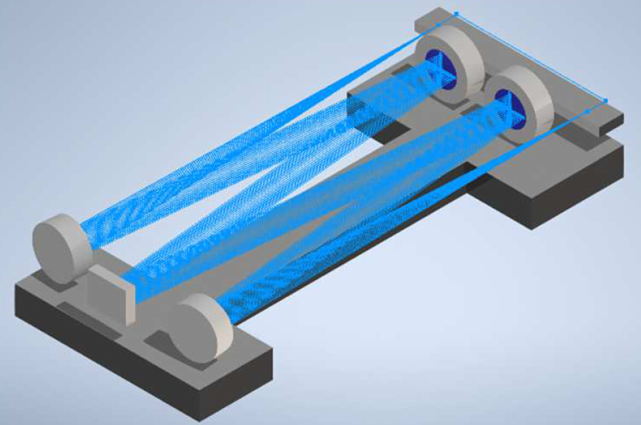
Act. 5701 Large size holo lab
Aim of the facility: production of the largest Volume Phase Holographic Gratings (VPHGs) as dispersing elements for astronomical spectrographs.
Location | INAF-OABr Merate
Related Projects | it would be used to produce VPHGs for different projects (ANDES, MOSAIC, HARMONI)
Who can use it | internal use the lab, the products for any interested group.
Responsible | Andrea Bianco
Brand new building for the holographic set-up.
Capabilities: VPHGs up to 450 mm in diameter operating from UV to K band.
STATUS: procurement of the main components on going (some of them already delivered).
See also posters
Notes:
The capability of design and optimization of these devices is a uniquum of INAF in the World’s Astronomical field. Improving this skill including manufacturing capabilities is a strategic driver for spectroscopy leadership of INAF in the European context

Slide 12
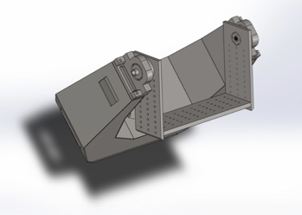
Act. 6301 TestingWFInstrumentOnSky
Inertial Platform Provider:
First draft of the fork concept:
The facility will come equipped with all necessary HW/SW (PLC/TCS) control system
Aim of the facility: Facility for on-sky test of wide field instrument concepts
Location | INAF OACT/Serra la Nave Observatory
Related Projects | None
Who can use it | INAF, Italian and international communities
Responsible | Giuseppe Leto
STATUS: 2 TDs hired; inertial platform (the main instrument) tender ok, winner ASTROALLIANCE, contract done, delivery expected April 2025; “open access” hardware procurement ongoing.

Slide 13
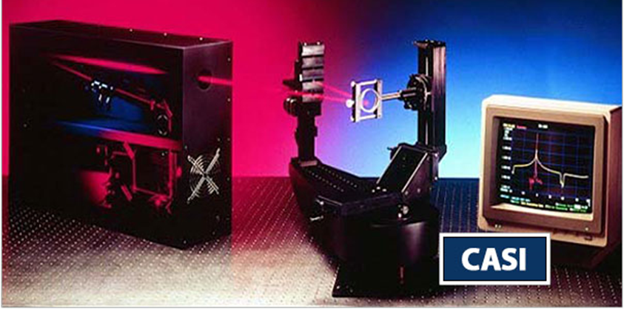
Act. 6601 Scatterometer
Aim of the facility: Measurement of scattering properties (BRDF, TIS) of samples of optical and mechanical surfaces
Location | INAF - OACT
Related Projects | None
Who can use it | INAF, Italian and international communities
Responsible | Matteo Munari
CASI scatterometer
•Turnkey system
•@HeNe wavelength (possible to upgrade 0.2-10.6um)
•Needs a 1.5x3m optical table, not included
•Measures BRDF, Transmittance and Reflectance (5% Accuracy)
•AoI from 0 to 85°
•Sample up to 15 cm and 2kg
STATUS: procurement procedure are nearly closed. Time for delivery 3-4 months
Notes:
Total Integrating Scattering (TIS)
Bi-directional Reflectance Distribution Function (BRDF)

Slide 14
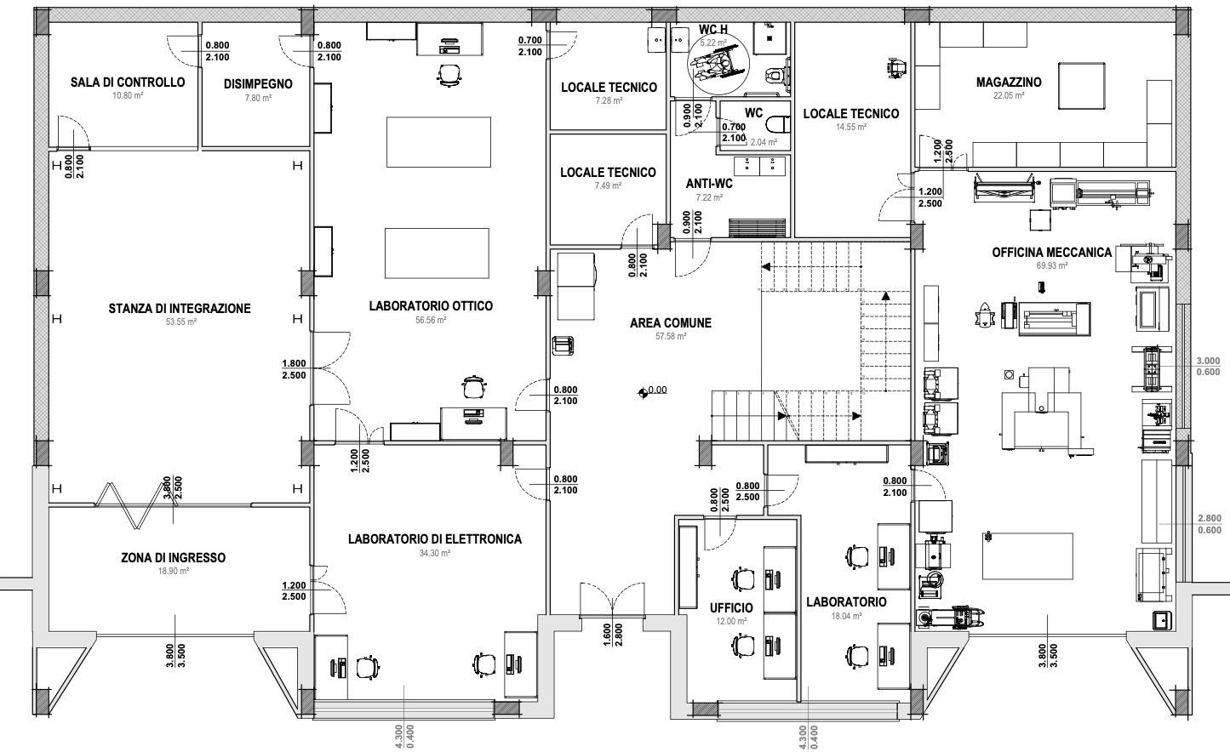
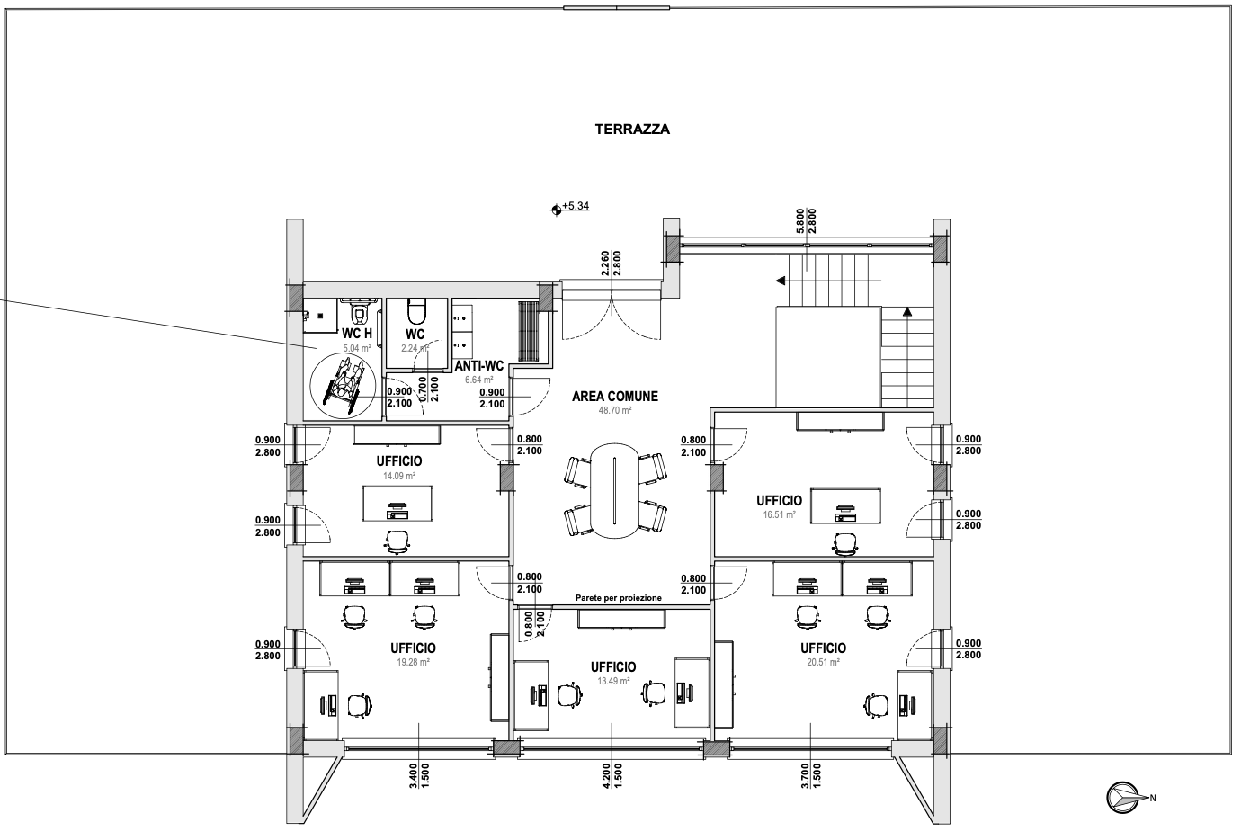
Act.6401 AOCalibrationFacility_Building A new laboratory for Adaptive Optics
EAST view
WEST view
See also poster
Aim of the facility:
establishing a new national facility to support INAF leadership in international AO projects for the development and calibration of ELT instrumentation within the ADONI National Lab framework.
Location | INAF–Osservatorio Astronomico d’Abruzzo
Related Projects | MORFEO, Act.6402 AOCalibrationFacility_Equipment
Who can use it | INAF, Italian and international communities
Responsible | Gianluca Di Rico
Integration Room clean room (ISO-7) for large instruments integration, test and verification | Electronics Lab and Fab Lab control electronics, models and prototypes | Optics Lab high-accuracy metrology equipment, experimental test benches | Mechanical Workshop Manufacturing & high precision CNC Machining | Office Floor workstations and meeting room on the first floor
STATUS: the start of work is pending the validation and approval of the executive project, with construction expected to begin in October 2024

Slide 15
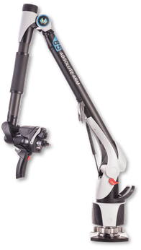
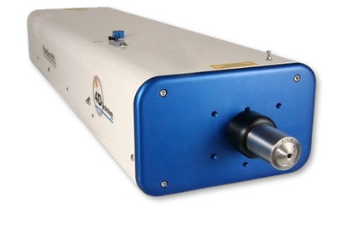
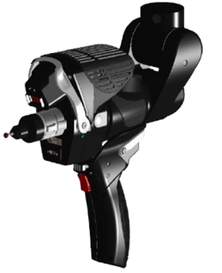
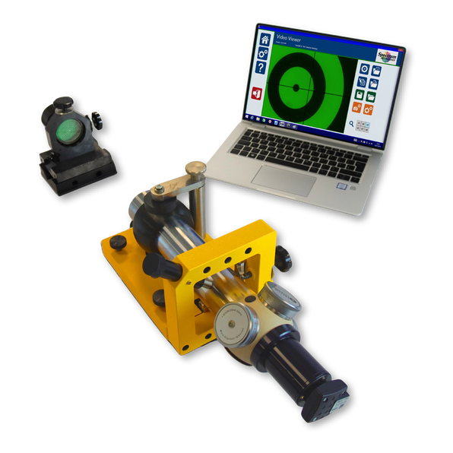
Act.6402 AOCalibrationFacility_Equipment
Advanced instrumentation for AO projects
See also poster
Metrology Instruments and tools for the
New Adaptive Optics Facility @ INAF-Abruzzo (Teramo)
Aim of the facility:
strengthen the development, integration, testing and calibration of AO instrumentation through the acquisition of advanced metrology systems and tools
Dynamic Laser Interferometer
PHASECAM 4030
Portable Measuring Arm
HEXAGON 8525
Micro-Alignment Telescope
TAYLOR HOBSON M112-2582UC
Location | INAF–Osservatorio Astronomico d’Abruzzo
Related Projects | MORFEO, Act.6401 AOCalibrationFacility_Building
Who can use it | INAF, Italian and international communities
Responsible | GIANLUCA DI RICO
+
testing setup with large aspherical Beam Expander (Ø 20 cm)
MAIN APPLICATIONS:
measure both surface form and transmitted wavefront quality.
Measure dynamic performances of deformable lens and mirrors
Testing flats, large focal optics and optical systems.
MAIN APPLICATIONS:
Reverse Engineering, Rapid Prototyping, Assembly & Integration Verification, Surface Analysis, GD&T, Manufacturing Process Check (CNC) and Optimization
MAIN APPLICATIONS:
High accuracy alignment of optical components, assembly & integration of complex systems, test & verification of low-throughput instrumentation, metrology and calibration
STATUS:
The procurement procedures are at an advanced stage, delivery of the final supply by Q1-2025.

Slide 16
Acknowledgements
(Part of) The research activities described in this presentation were carried out with contribution of the Next Generation EU funds within the National Recovery and Resilience Plan (PNRR), Mission 4 - Education and Research, Component 2 - From Research to Business (M4C2), Investment Line 3.1 - Strengthening and creation of Research Infrastructures, Project IR0000034 – “STILES - Strengthening the Italian Leadership in ELT and SKA”.

