Slide 1
STILES
Radio Astronomy:
Testing Facilities / R&D Laboratories
P. Bolli, INAF-OAA
October 1st, 2024

Slide 2
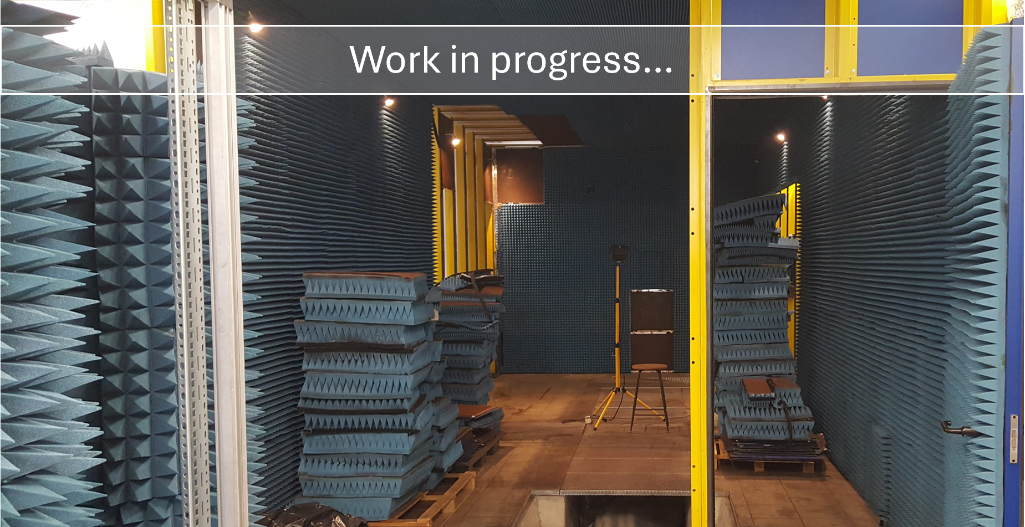
Att.6202

Slide 3
WP5000 & WP6000
WP5000: Labs for R&D
Laboratories explicitly aimed at enabling specific investigations on new technologies with high gain/high risk.
Labs designed to test and develop specific new transformational technologies in view of ELT and SKA.
In the radio domain, we aim to create a network of laboratories focused on developing new radio receivers and components (e.g. PAF).
WP6000: National Testing Facilities
Multi-purpose facilities meant to be of wider fruition, i.e. testing facilities and general services that will be available to the entire Italian astronomical community to routinely test instruments.
Radio facilities examples are a set of anechoic chambers that will be able to test radio receivers over a wide spectral range, and radio calibration facilities.
Activities in these WPs are primarily procurement of instruments and laboratory equipment (also civil work in WP6000)

Slide 4
List of radio-related activities
ID | Attività | Leader | Istituto
5501 | RadioDetectorDevelopment_CryogenicFacilityF orMultiFrequencyCharacterization | Francesco Cuttaia | INAF-OAS
5511 | RadioDetectorDevelopment_CryoRXIntegrationLab_equipment | Jader Monari | INAF-IRA
5521 | RadioDetectorDevelopment_OAC_ElectronicsLab | Tonino Pisanu | INAF-OAC
5531 | RadioDetectorDevelopment_CharacterizationFacilityCOLD+ | Francesco Schillirò | INAF-OACT
5532 | RadioDetectorDevelopment_ICdesign | Giuseppe Palmisano | UNICT
6201 | AnechoicChamber_AnechoicChamber | Renzo Nesti | INAF-OAA
6202 | AnechoicChamber_HighFrequencyTestRanges | Cristian Franceschet | UNIMI
6801 | LowFreqAcceptanceLab_Building-renovation | Jader Monari | INAF-IRA
6802 | LowFreqAcceptanceLab_equipment | Jader Monari | INAF-IRA

Slide 5
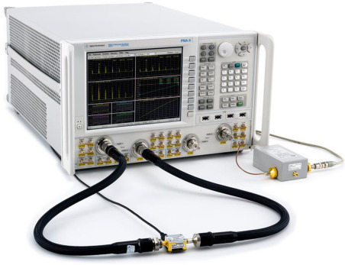
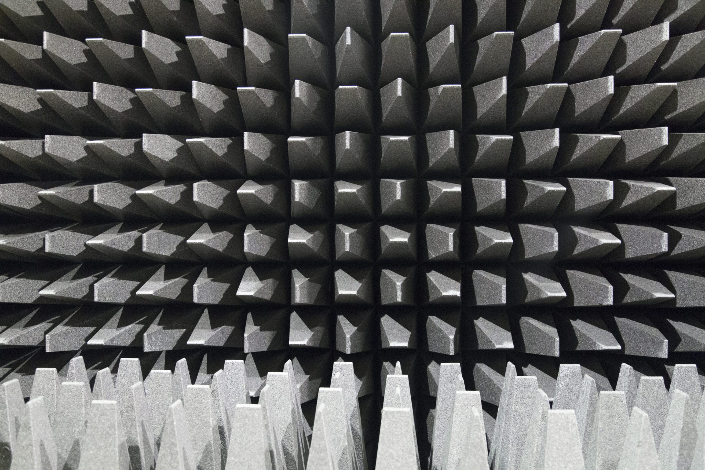
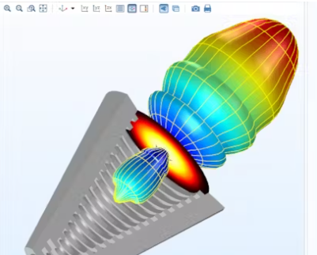
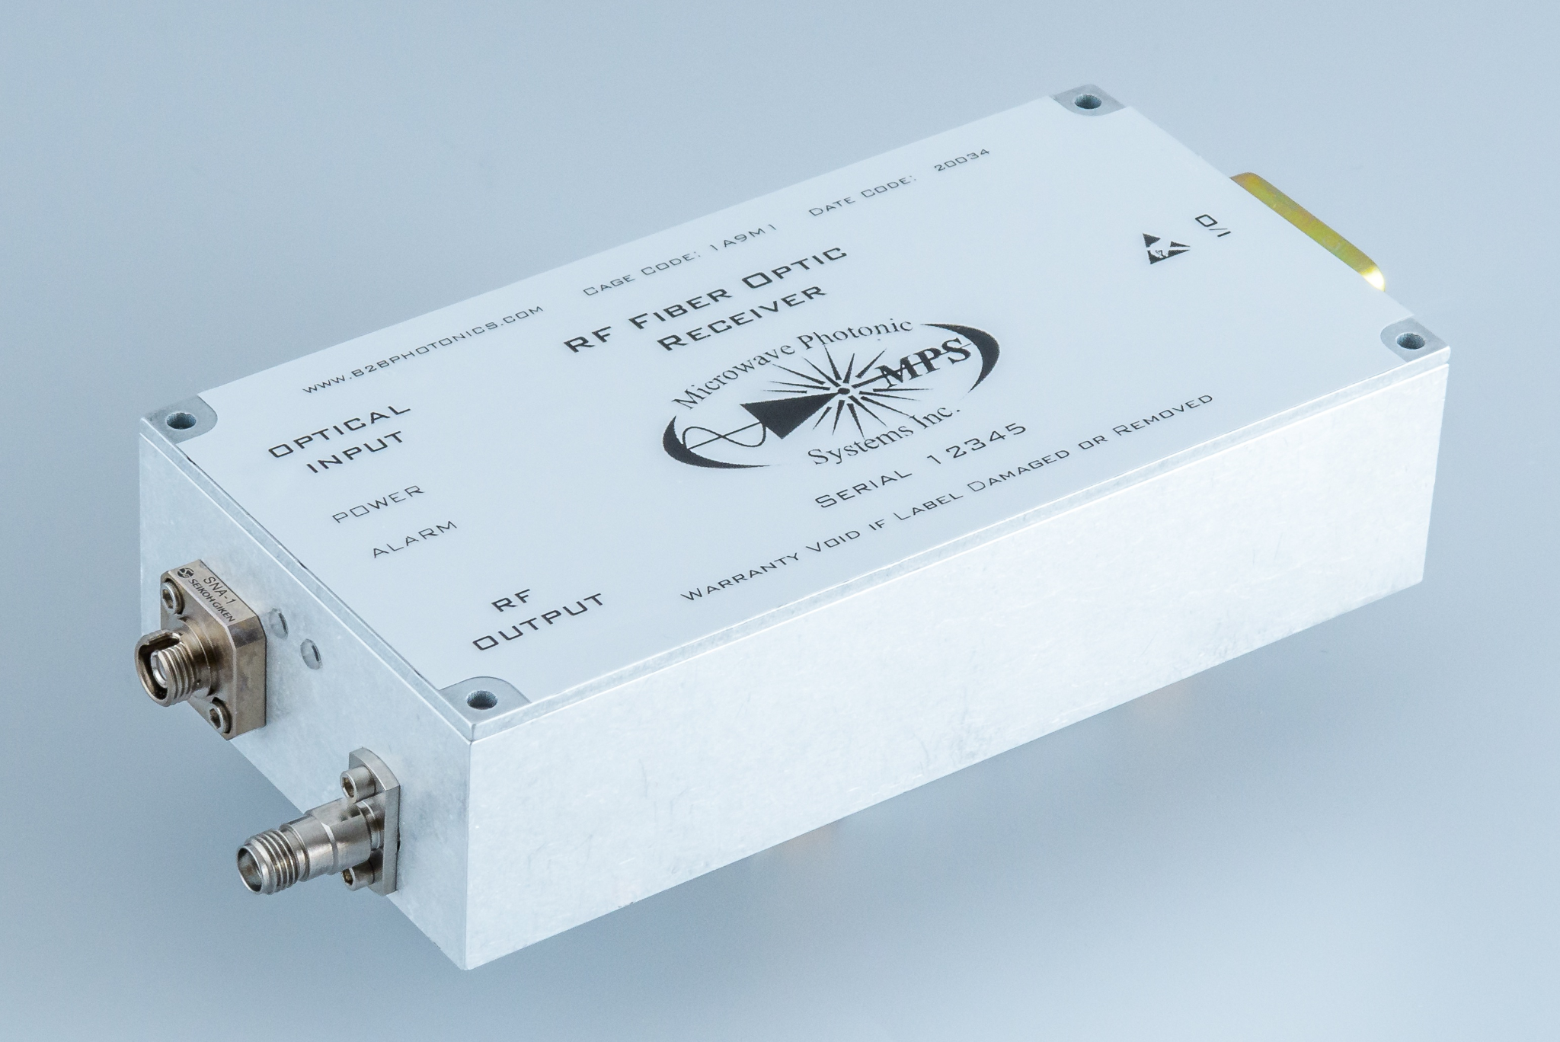
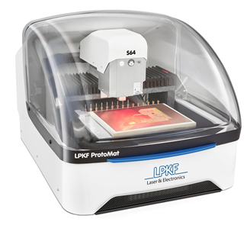
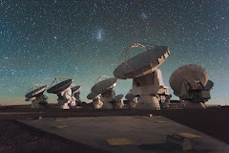
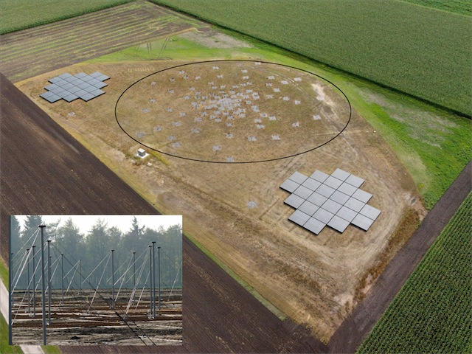
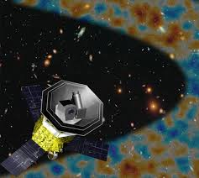
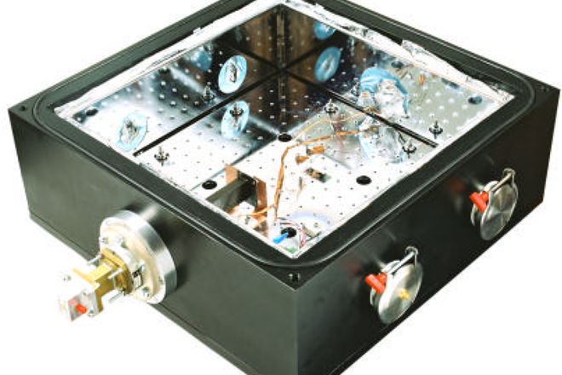
mw instrum.
antennas
rf software
photonics
electronics
cryogenics
Notes:
LiteBIRD “Lite satellite for the study of B-mode polarization and Inflation from cosmic background Radiation Detection” è una missione spaziale dedicata allo studio della radiazione di fondo cosmico a microonde (CMB).

Slide 7
Act. 5501 – RF Facility for cryo-multifreq. characterization
#PR | ITEM | Cost | Type | Status (E / C)
01 | RF measurements accessories (shelves and technical cabinets) | 2.5 K€ | Dir | 30/09/2024 (E)
02 | Auxiliary components for RF measurements (optical device alignment stages, step motors) | 24.5 K€ | Dir | 30/11/2024 (E)
03 | RF passive components (from 10 to 400 GHz) | 51.9 K€ | Dir | 30/10/2024 (E)
04 | Integrated platforms for the characterization of EM parameters of materials between 26-60 GHz and 140 - 330 GHz | 133,0 K€ | Dir | 21/03/2024 (C)
05 | electronic instrumentation for the characterization of microwave receivers, including control SW | 24,0 K€ | Dir | 02/02/2024 (C)
06 | Calibration kit and microwave components for the vector network analyzer (8 - 330 GHz) | 90,2 K€ | Dir | 02/02/2024 (C)
07 | TX/RX Extension heads for the Vector Network Analyzer (90 to 330 GHz) | 380.6 K€ | EU Tender | 02/02/2025 (E)
Aim of the facility: Enhancement of OAS RF laboratory instrumentation, aimed at characterizing receivers, microwave blackbody calibrators, even at cryogenic temperatures. Frequency extension (from 10 GHz up to 330 GHz) of testing capabilities to intercept the needs of ongoing large projects and increase competitiveness in future proposals.
Location | OAS Bologna
Related Projects | Tenerife MW Spectrometer, Strip-LSPE, Alma B2 and B4-5, LiteBird, CosmoCal, Solaris
Who can use it | OAS Cryowaves Laboratory, Radio – MW community, CMB/ Remote Sensing / Space weather
Responsible | F. Cuttaia
Status: In progress (3 of 7 procedures completed )

Slide 8
Act. 5511/6801/6802 - Low frequency laboratory
Aim of the facility: Laboratory of acceptance and qualification for analog (fiber and coax) and digital electronics for low frequency RF systems and integration laboratory for cryogenic high frequency receivers.
Location | Medicina (Bologna)
Related Projects | SKA - Cryogenics Radio receivers
Who can use it | INAF - SKAO - SKAO prime industry
Responsible | Jader Monari
Status: All activities started, construction works contracted and in preparation, purchasing in progress.

Slide 9
Act. 5521 - OAC Electronics Lab
Status of the Supply
TD 1,5 years - Contract started in December 2023
Aim of the facility: To create a new facility for the realization and testing of electronic and microwave circuit board prototypes at the Electronic and Microwave laboratory of the OAC. The facility will be available also for the realization of the prototypes developed by other INAF Institutes.
#1 Laser PCB Machine (Protolaser S4) | Order Closed
#2 Thourgh Hole Electroplater (Contact S4) | Order Closed
#3 Press Machine PCB Multilayer (Multipress S4) | Order Closed
#4 FDM 3D Printer (Raise 3D Pro3 Plus) | Device Delivered
#5 Mechanical PCB milling Machine (Protomat S64) | Order Closed
#6 SMT Stancil Printer SMD (Photoprint S4) | Order Closed
#7 Reflow for SMD Soldering (Protoflow S4) | Order Closed
#8 Accessory Equipment | Order Closed
Location | Cagliari Astronomical Observatory
Related Projects | Sardinia Radio Telescope
Who can use it | INAF – National Industries
Responsible | Tonino Pisanu
Status: Contracts closed, purchasing in progress.

Slide 10
Act. 5531 - Characterization Facility
Procedura Aperta – Lotto Unico – Accorpamento con bando di gara 5511 (Totale 1460 K€)
1 | Vector Network Analyzer, max 67 GHz | 355K€ | Stipula del contratto
2 | Signal and Spectrum Analyzer dotato di power sensors (termico e a diodi), max 40 GHz | 200K€
3 | Signal Generator, max 67 GHz | 150K€
Acquisto diretto (Unicità)
4 | Signal and Spectrum Analyzer portatile 26 GHz | 45 K€ | Acquistato
5 | Cryocooler System | 135 K€ | Capitolato definito / fase di negoziazione
6 | Microwave components and Tools | 98 K€ | Capitolato definito / fase di negoziazione
Aim of the facility: Il laboratorio sarà dotato della strumentazione necessaria per effettuare le misurazioni e le caratterizzazioni dei ricevitori sviluppati in ambiente criogenico, e sarà di supporto alle attività di sviluppo del progetto Banda 5B.
Location | Osservatorio Astrofisico di Catania
Related Projects | Band 5B receivers for Meerkat
Who can use it | SKAO
Responsible | F. Schillirò
Status: In progress

Slide 11
Act. 5532 - IC design
Aim of the facility: UniCT intends to strengthen its Microelectronics Lab to effectively contribute to a National Lab Network for the research in astronomy by enabling the design and characterization of high-performance dedicated IC solutions (ASICs).
Location | University of Catania
Related Projects
Who can use it
Responsible | Giuseppe Palmisano
Status:
Anticipation of 50% of funds by UniCT is available (about 800 k€ out of 1.6 M€);
RUP appointed in July;
Tender notice publication by mid-Nov. 2024.

Slide 12
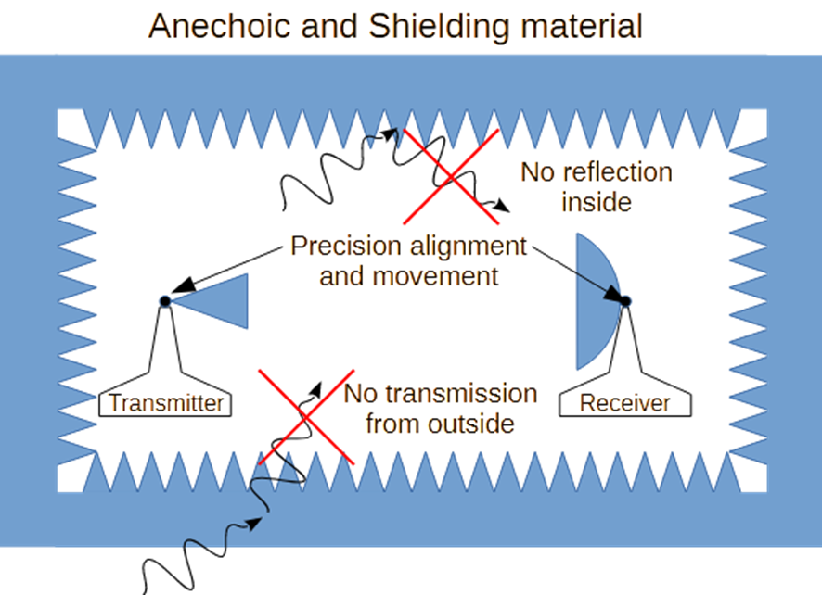
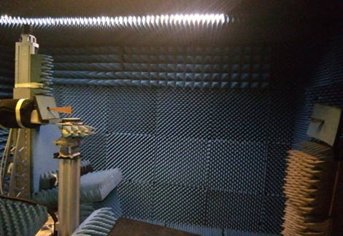
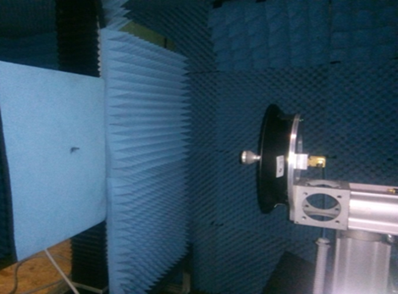
Act. 6201 - Anechoic Chamber
Aim of the facility: Characterization of antenna radiation in the microwave frequency range with lower limit at hundreds of MHz, using far-field and near-field measurement techniques.
What is an anechoic chamber?
Location | Arcetri, Firenze
Related Projects | On demand, SKA, ALMA, SRT
Who can use it | INAF community
Responsible | Renzo Nesti, INAF-OAA
Far-Field Measurement
The AUT rotates in azimuth
The test antenna is fixed
Measurement: amplitude
Near-Field Measurement
The AUT is fixed
The test antenna probes the field on a plane
Measurement: amplitude and phase
AUT
Transmitter
AUT
Probe
Status:
Open Tender ongoing, two applicants
Contract: December 2024
Delivery and testing: Jun./Sep. 2025

Slide 13
Act. 6202 - High Frequency Test Ranges
Contracts
2 years TD contract started in May 2023
1.5 years TD contract started in January 2024
Instrumentation
Compact Antenna Test Range
Optical design complete
Delivery and installation on February 2025
Temperature and relative humidity control (anechoic chamber)
Complete and operating
Near field scanner
Upgrade with polarization and “phase” linear axes in progress
Optical table installation within September
Temperature and relative humidity control (climatic chamber)
Complete and under testing
VNA, spectrum analyzer (up to 54 GHz) & extender modules (75 - 750 GHz)
Purchase complete
Civil infrastructures and related systems
Anechoic chamber renovation
Complete within begin of October
Aim of the facility: Characterization of antennas and optical systems in the frequency range above a few GHz up to about 750 GHz, by means of far-field (Compact Antenna Test Range and traditional) and near-field (planar scanner) measurement techniques.
Location | Milano
Related Projects | LiteBIRD, LSPE/Strip, QUBIC, Simons Array, CMB-S4
Who can use it | UniMi, scientific and industrial collaborators
Responsible | Cristian Franceschet
Status: All purchases complete. Lab thermal controls complete, CATR construction begins in October, anechoic chamber maintenance complete within September

Slide 14
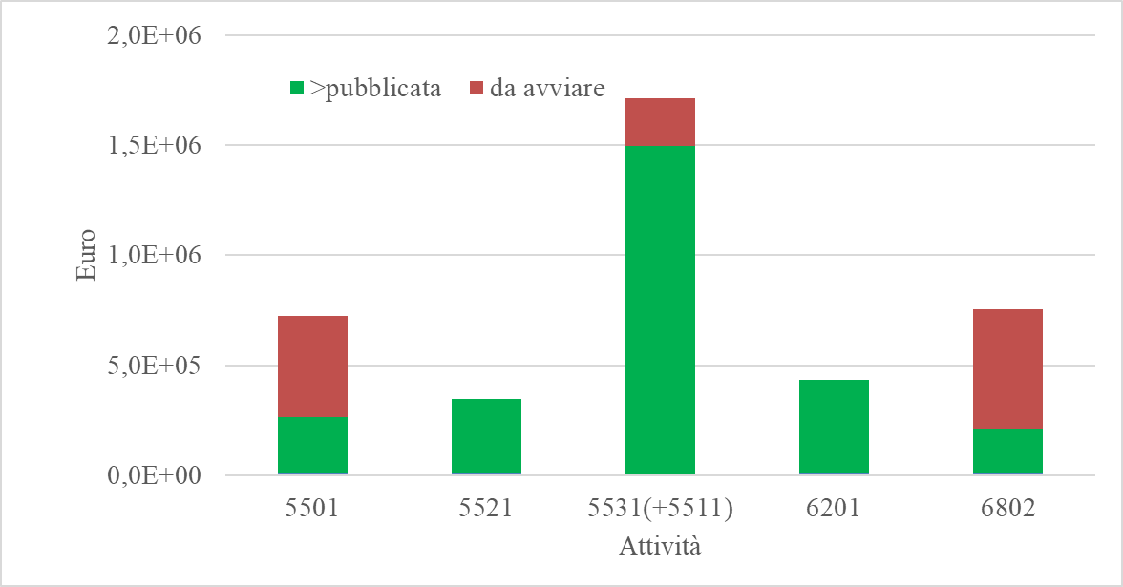
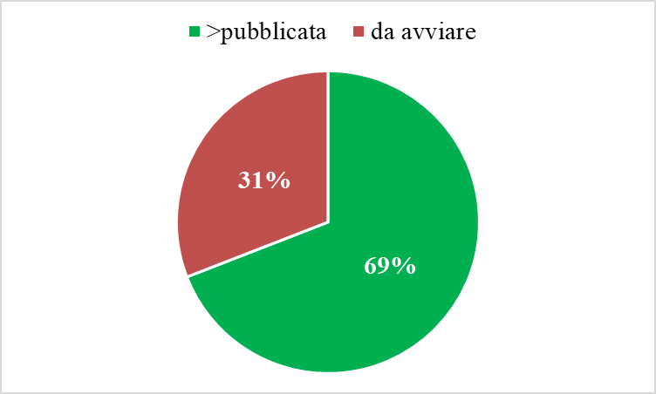
Status of the procedures
Escluse 5532, 6202, 6801
>Pubblicata → pubblicata, aggiudicata, contrattualizzata, rendicontabile proceduralm., in rendicontazione finanziaria, rendicontata finanziariam., procedura completata.
4 procedure
7 procedure
9 procedure
1 procedura
1 procedura

Slide 15
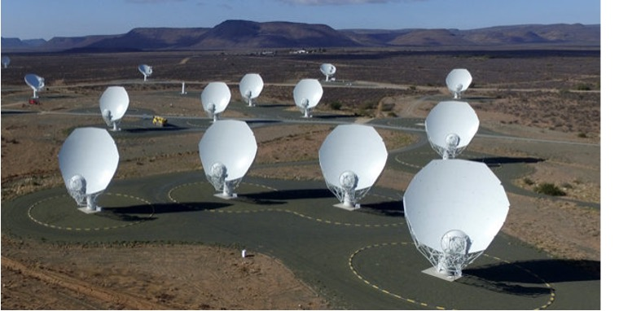
Act. 2401 - MeerKAT band5B
1 Contract for System Engineering (TD - I Lev) assigned -10 months
The band5B receiver prototype @Karoo for testing by the end of 2024
Aim of the facility: We intend to enable high-frequency capability of MeerKAT by retrofitting 64 Band 5B (8.3-15.4 GHz) receivers on MeerKAT dishes. The 64 extra receivers will significantly increase the sensitivity of SKA in Band 5B; the additional short spacings provided by MeerKAT will substantially enhance the image fidelity of extended emission.
Location | INAF-OACT
Related Projects | MeerKATplus, SKA
Who can use it | Scientific community
Responsible | Grazia Umana
Status: All the contracts assigned

Slide 16
Acknowledgment
Special thanks to the Activity Leaders for timely and comprehensively providing the information and to the STILES Project Office for the general overview on the status of the purchase procedures.
(Part of) The research activities described in this paper were carried out with contribution of the Next Generation EU funds within the National Recovery and Resilience Plan (PNRR), Mission 4 - Education and Research, Component 2 - From Research to Business (M4C2), Investment Line 3.1 - Strengthening and creation of Research Infrastructures, Project IR0000034 – “STILES - Strengthening the Italian Leadership in ELT and SKA”.

