Slide 1
ExoAtmoLab
A. Ciaravella INAF-OAPA
Study the chemical and physical evolution of a gas mixture “ exo-atmosphere” under energetic events
ExoAtmoLab
Pre-BioticLab_SurfLab Pre-BioticLab_OptSpectrLab
C. Goletti UNITV. D. Fulvio INAF-OACT
Study the interactions between complex organic molecules of astrobiological interest and minerals.
using the experimental methods of surface physics analysis and characterization by UV-VIS-NIR and NIR-MIR
Pre-BioticLab_SurfLab
Laboratory Plasma Spectroscopy
F. Leone INAF-OACT
Spectroscopic identification and characterization of emission lines from highly ionized atoms in the UV, VIS and NIR ranges
Laboratory Plasma Spectroscopy
Secondo Forum della ricerca sperimentale e tecnologica in INAF

Slide 2
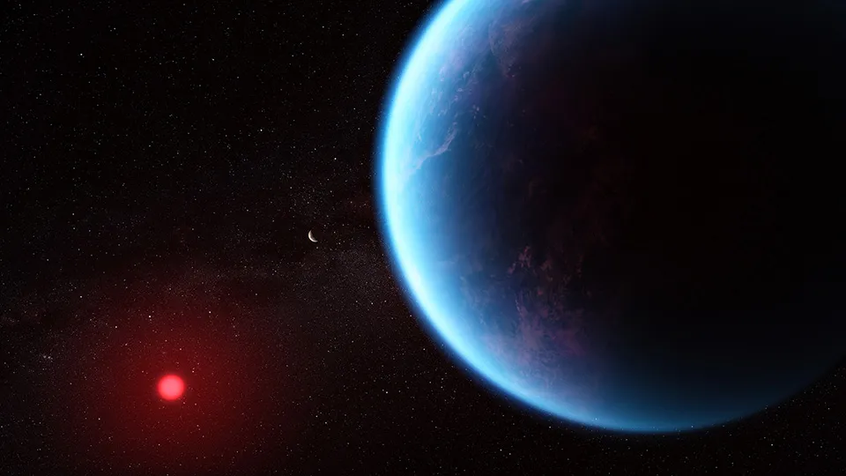
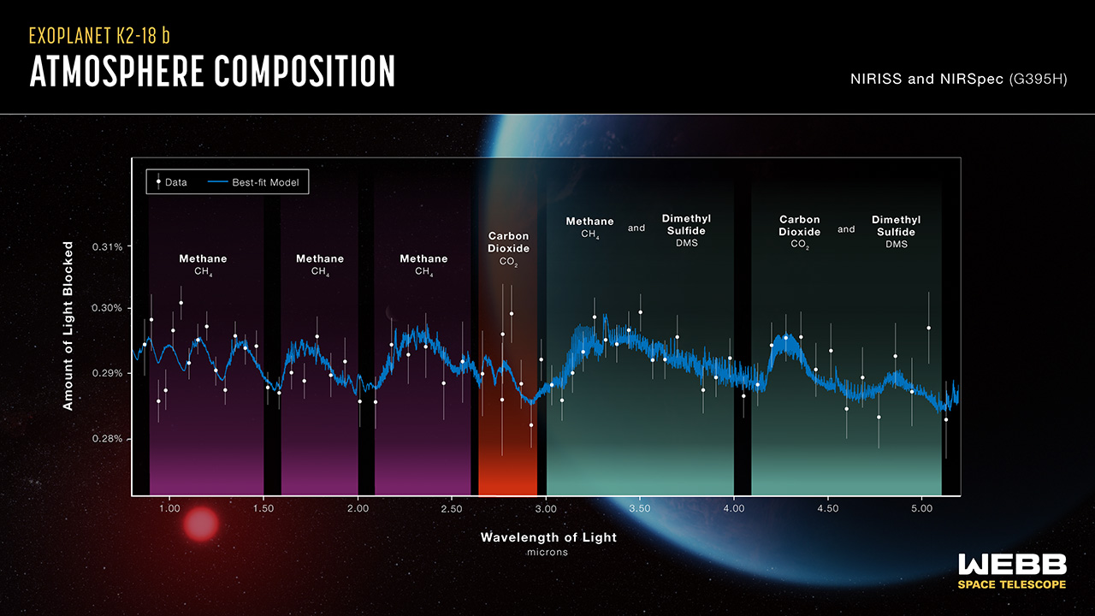
ExoAtmoLab
A. Ciaravella INAF-OAPA
Observations of exoplanet atmospheres open a window on the indicators of habitability and life. While the chemical composition is at the equilibrium in deep atmospheric layers, kinetic processes dominated by photochemical reactions drive drastic departures in the upper regions of an atmosphere.
Spectroscopic detection of atmospheric composition is one of the major tasks in present (JWST) and future (ARIEL) space and (ELT) ground based telescopes.
Objective: Design and construction of an atmosphere simulator facility, to study the chemical and physical evolution of a gas mixture under copious irradiation with high energy radiation (UV, X-rays) and electrical phenomena

Slide 3
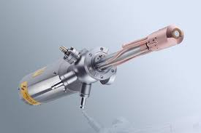
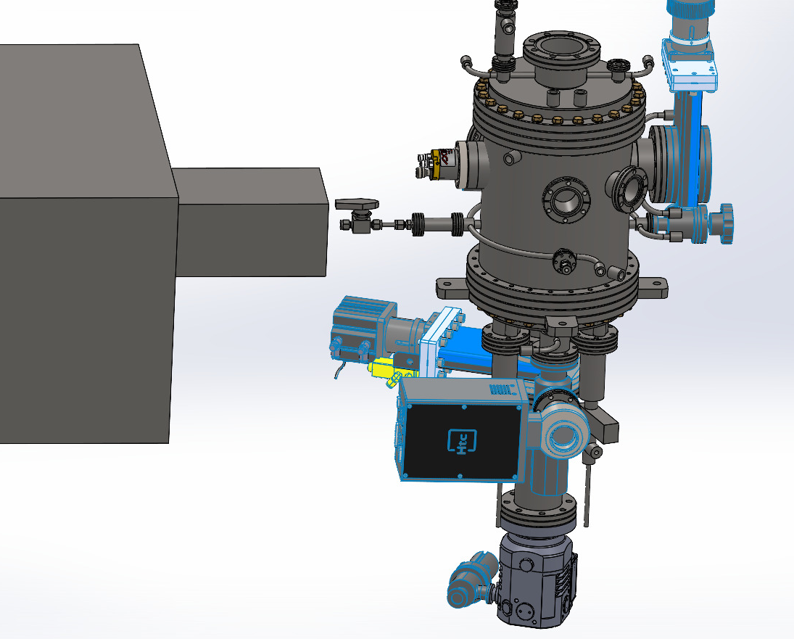
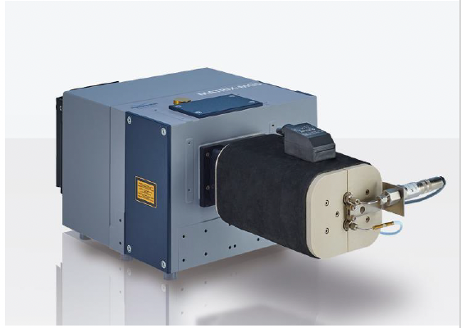
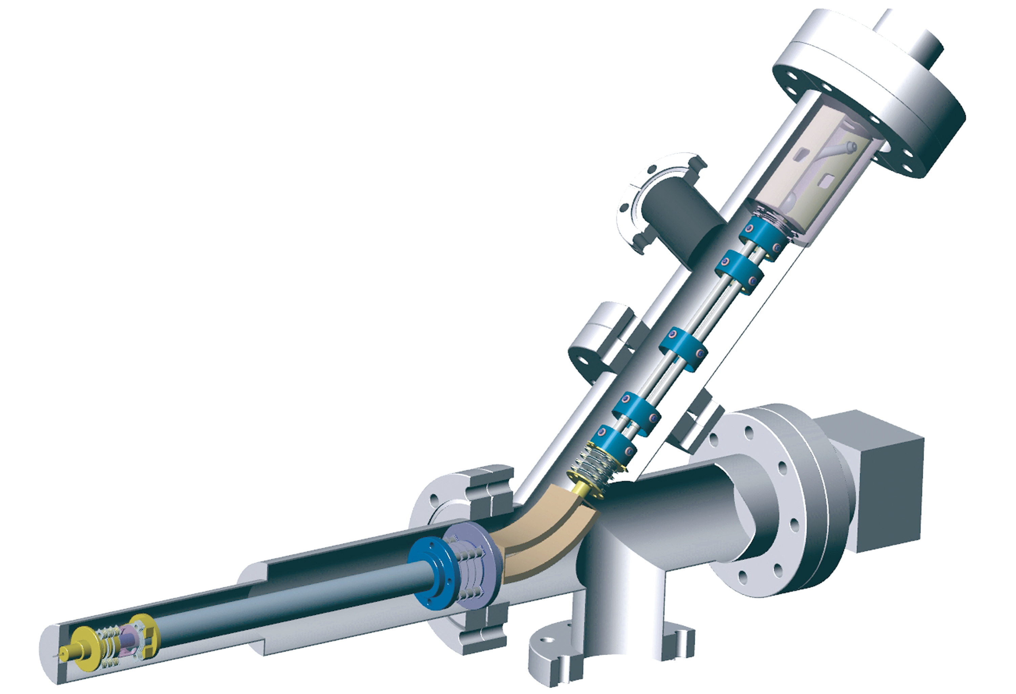
LIFE+ (Light Irradiation Facility for Exochemistry: PLanetary Atmosphere System)
Radiation Sources:
X-ray source Specs XR-50 X ~ 10¹⁰ ph/s
dual Anode Al/Cu 1.5/9 keV
UV microwave-discharge hydrogen-flow lamp. ~4 × 10¹⁰ ph/cm²/s (no STILES funds)
Sources of lightening :
- arc-discharge generator
- plasma generator
Dignostic Instruments
- NIR-MIR InfraRed spectrometer with a 5m multi reflection gas cell
- mass spectrometer (up to 300 amu) for of neutrals, radicals and ions.
- VUV spectrometer 100 - 400 nm (no STILES funds)
Gas -20 to 300 °C ; ≦ 1 bar
Mixing chamber to prepare the “atmosphere”
What’s new with LIFE+: high energy processing of the “atmospheres”, multiple and simultaneous diagnostics of the atmosphere
fingerprints (UV, mass and IR spectroscopy) . starting calib. beginning 2025

Slide 4
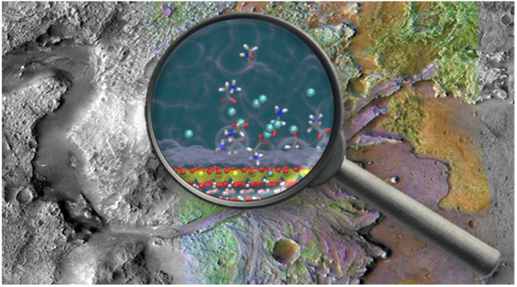
Mineral – organic interfacial processes: potential roles in the origins of life
Among the possible processes that led to the origin of life on Earth, minerals in aqueous environments could have played a decisive role. These surfaces, by significantly altering the concentration of molecules and favoring heterogeneous catalysis, induce complexification processes of prebiotic organic compounds
Objective: Setting up laboratories to investigate the interactions between complex organic molecules of astrobiological interest and minerals, using the experimental methods of surface physics. In particular, the interactions of amino acids with specific mineral surfaces to verify whether and under which conditions the peptide bond forms.

Slide 5
XPS technique to investigate the formation of peptide bond between molecules (N1s core level)
and the eventual development of molecular bands after bonding
Reaction between two molecules adsorbed on a gold surface [Au(111)]
in solution with different pH values: amine (ASB) and aldehyde (TPA).
N1s (in green) indicates the formation of the bond between the two molecules
N1s core level,deconvoluted into different components
(Di Giovannantonio et al., J. Phys. Chem C , 2015)

Slide 6
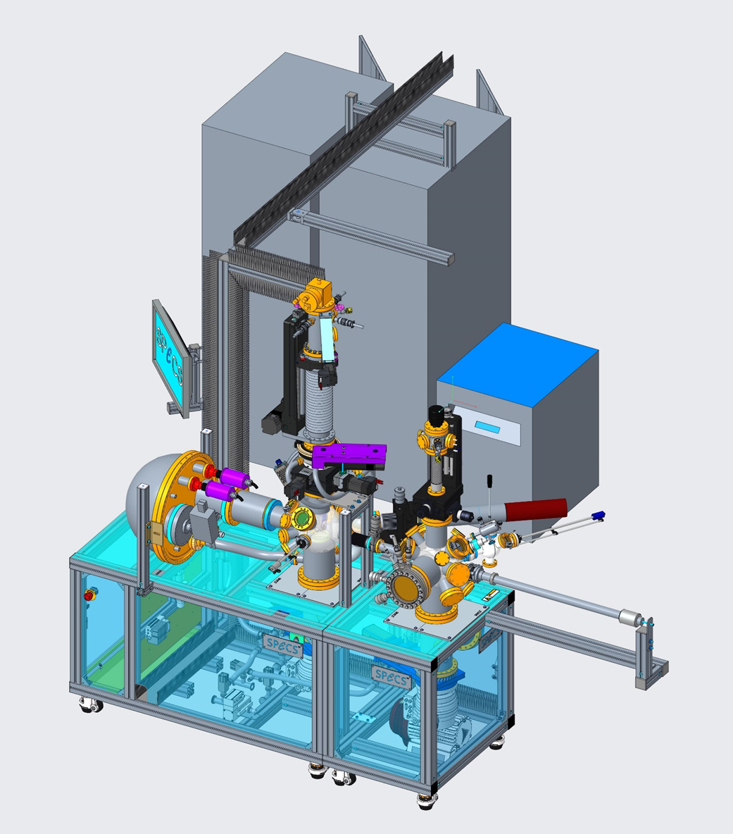
Pre-BioticLab_SurfLab
C. Goletti - Tor Vergata
Precamera UHV per
i) preparazione dei substrati;
ii) evaporazione di film organici e biologici;
iii) caratterizzazione ottica
ed elettronica (LEED, Auger, RAS)
UHV chamber (< 10⁻¹⁰mbar) for sample characterization with high
resolution XPS
variable temperature manipulator,
to prepare the substrate and mimic
a broad range of environments of
astrophysical interest, from the Earth’
surface down to 15 K;
Starting at the beginning 2025

Slide 7
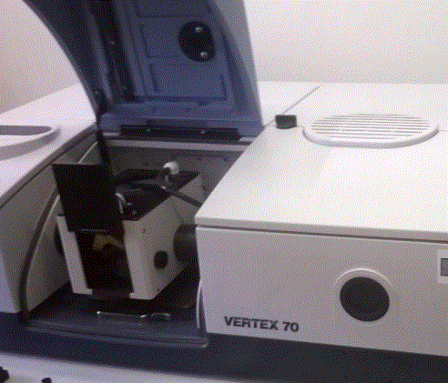
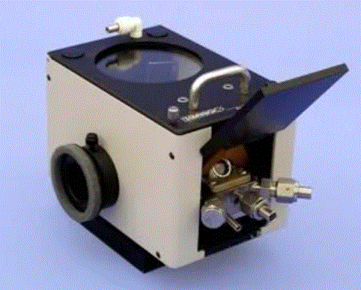
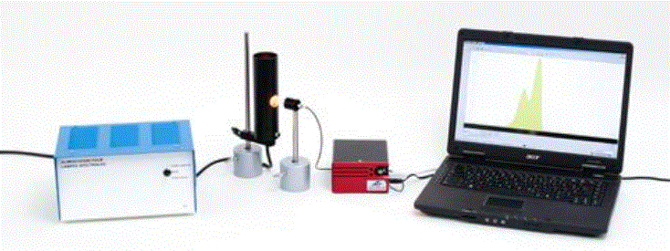
Pre-BioticLab_OptSpectrLab
D. Fulvio INAF-OACT
In trying to understand the origin of life, a promising scientific approach regards the possible role of substrates (e.g. minerals and clays on Earth, meteorites, and cosmic dust grains) which may have favored the formation of biomolecules starting from simpler species.
Objective: upgrading the facilities @OACT, to allow the UV-VIS-NIR and. NIR-MIR analysis and characterization of minerals of astrophysical interest and their interactions with amino acids.
NIR-MIR module
(reaction chamber + accessories + pumping units) to acquire
spectra in reflectance and at temperatures above room-T.
UV-VIS-NIR fiber optic module
(spectrometer + integrating sphere + accessories) to
acquire reflectance spectra in this spectral range.
High-T reaction
chamber
Praying Mantis™
Diffuse Reflection Accessory
inlet/outlet ports (3) for evacuating or introducing selected gases

Slide 8
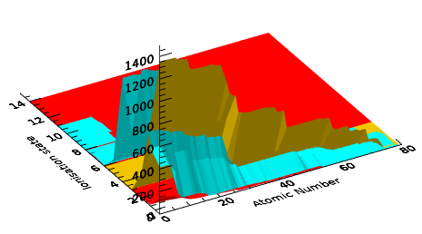
Laboratory Plasma Spectroscopy
F. Leone INAF-OACT
Experimentally observed lines
100 - 200 nm
500 - 600 nm
1100 - 1200 nm
reasonably known for neutrals or low ionisation in the 200-1000 nm
poorely known for high-Z elements
at any wavelengths
missing for highly-ionised-species
Objective: Astrophysical laboratory for spectroscopic identification and characterization of emission lines from highly ionized atoms in the UV, VIS and NIR ranges. The ultimate goal is an atomic database for past and future data (ELT high resolution spectroscopy)

Slide 9
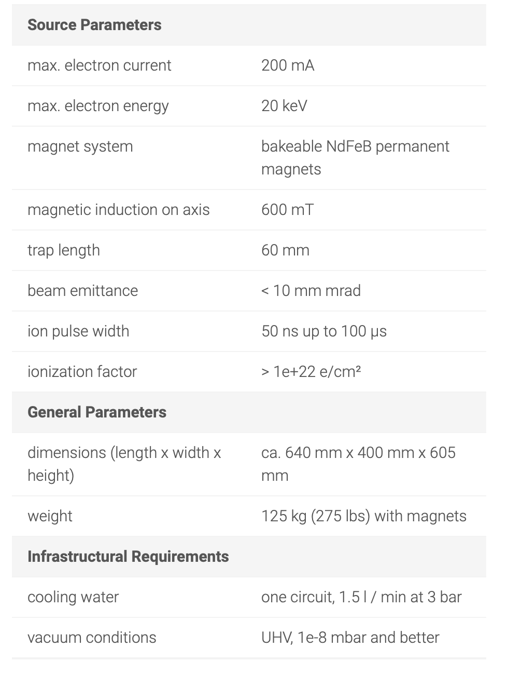
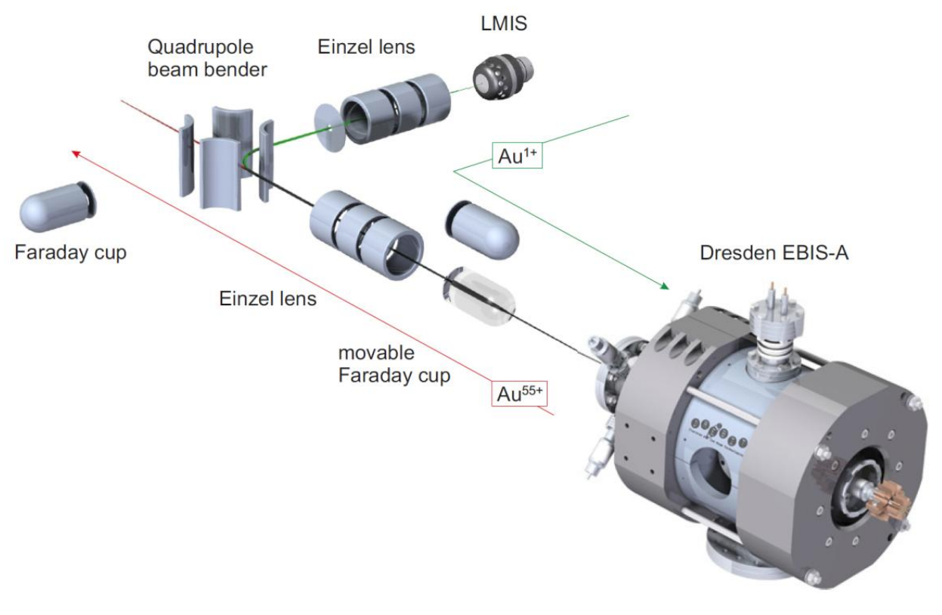
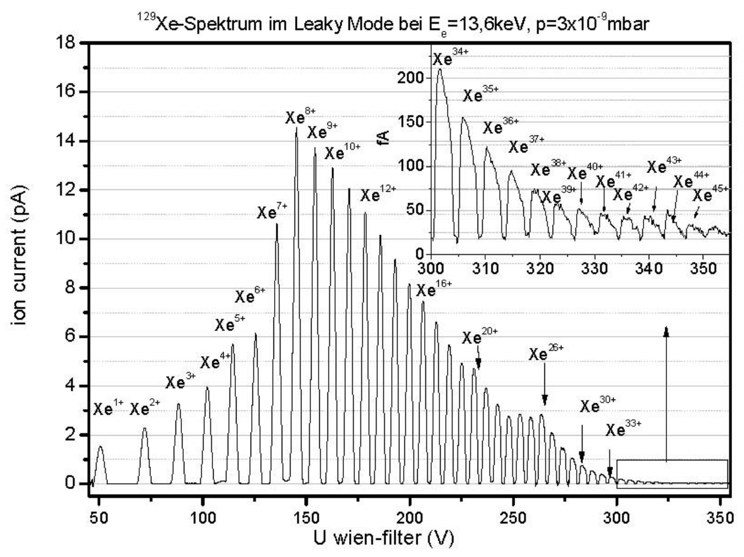
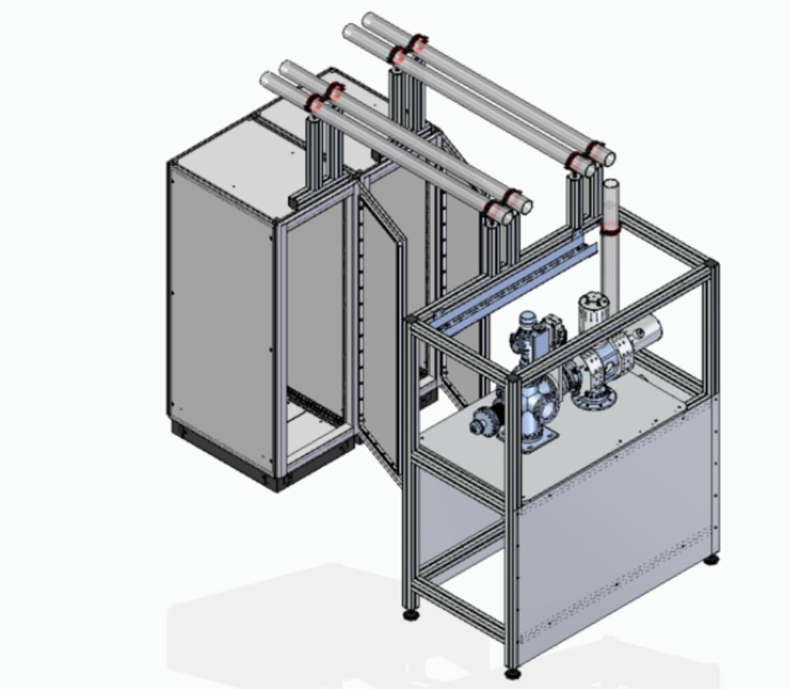
DREEBIT Electron Beam Ion Source
up to 8ke V (=FeXXV)
cross-check:
charge state distribution from mass spectroscopy

Slide 10
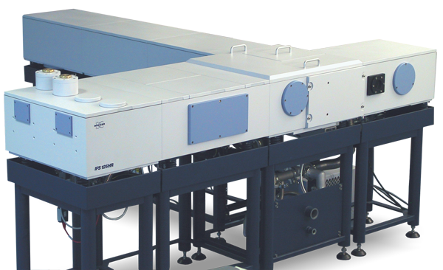
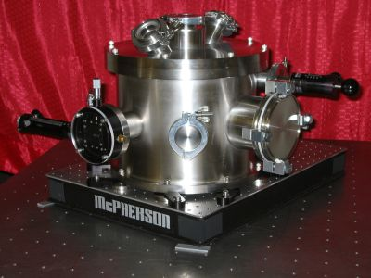
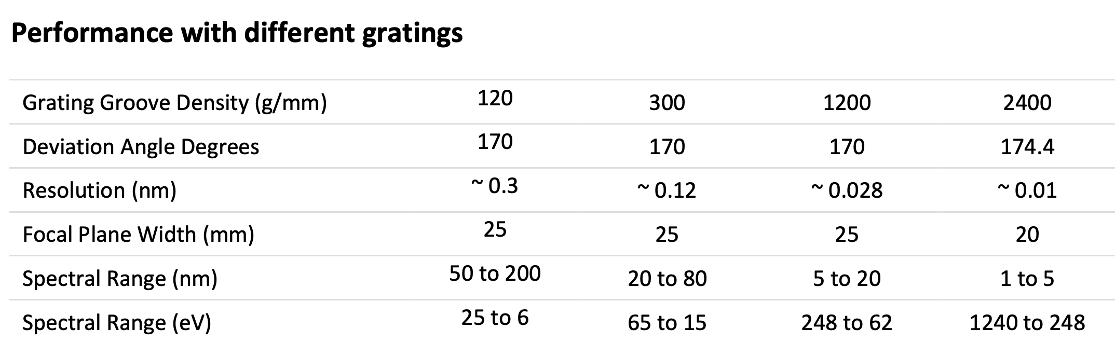
Spectroscopy
McPherson 251MX
High Resolution (R > 10⁶)
Fourier Spectrograph in the
0.2- 5 μm range
Completed Oct 2025

