Slide 1

﻿-- ELFORMS --
???
M.Civitani ( INAF-Brera)

Slide 2
﻿-- ELFORMS --
Extremely Large Free form Optics Metrology with Raster Scan profilometer
M.Civitani, M.Riva, M.Ghigo, G.Vecchi, V. Cotroneo, S.Basso, G. Sironi, D. Spiga, B. Salmaso, G.Pareschi ( INAF-Brera)

Slide 3
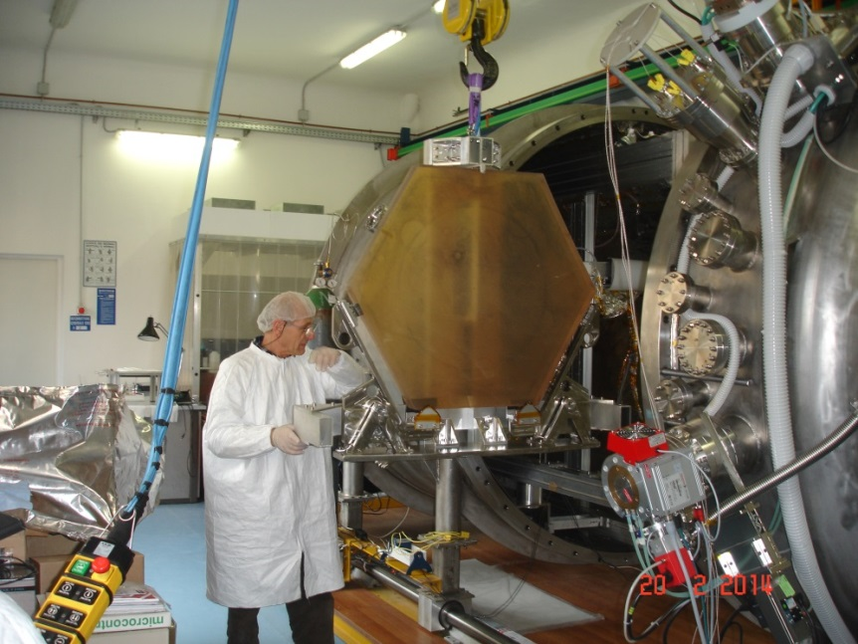
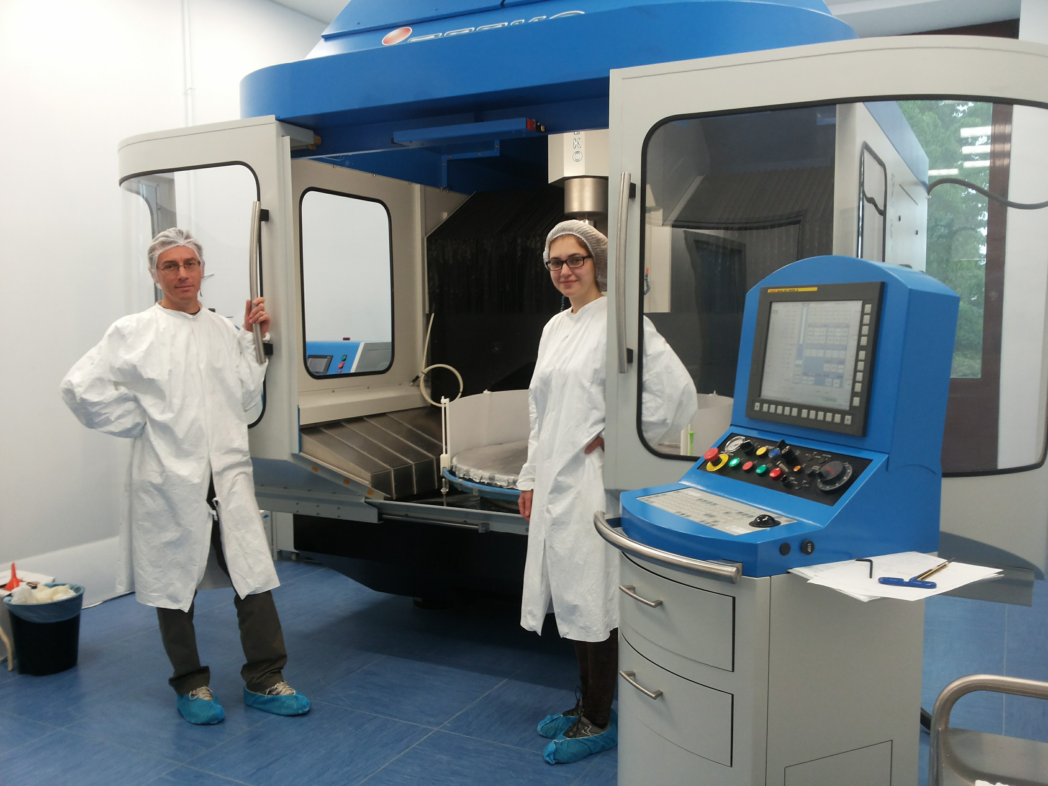
Optical manufactuing lab @Merate
Large Ion Beam Facility
(1200mm)
Zeeko IRP1200
DMG Ultrasonic-65 STILES (ATT5602)
Manufacturing < -- > metrology

Slide 4
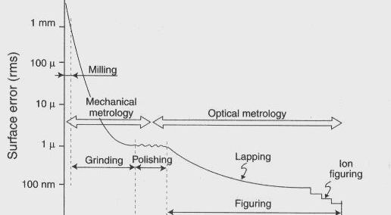
Typical manufacturing cycle
(Credits E-ELT costruction proposal)

Slide 5
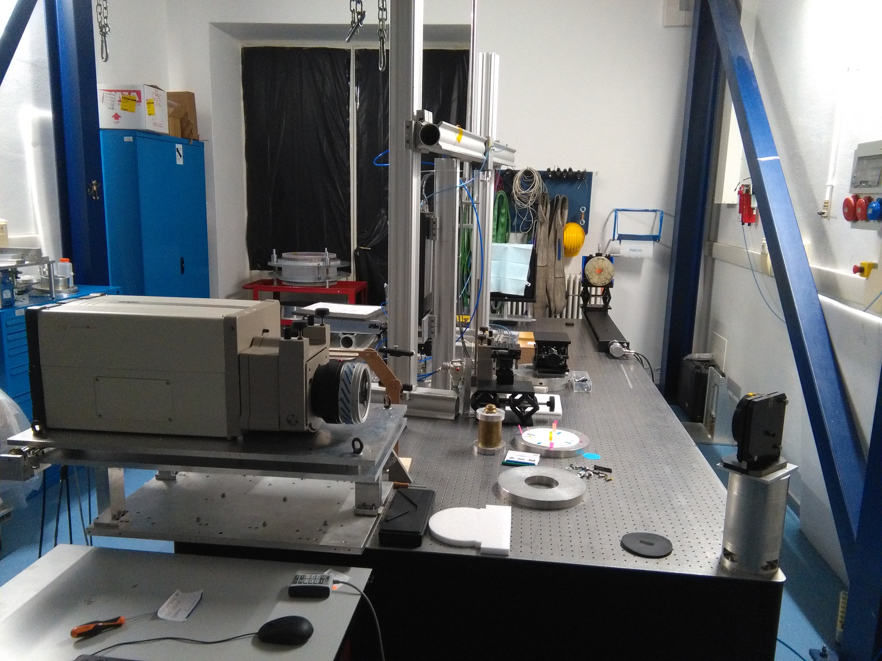
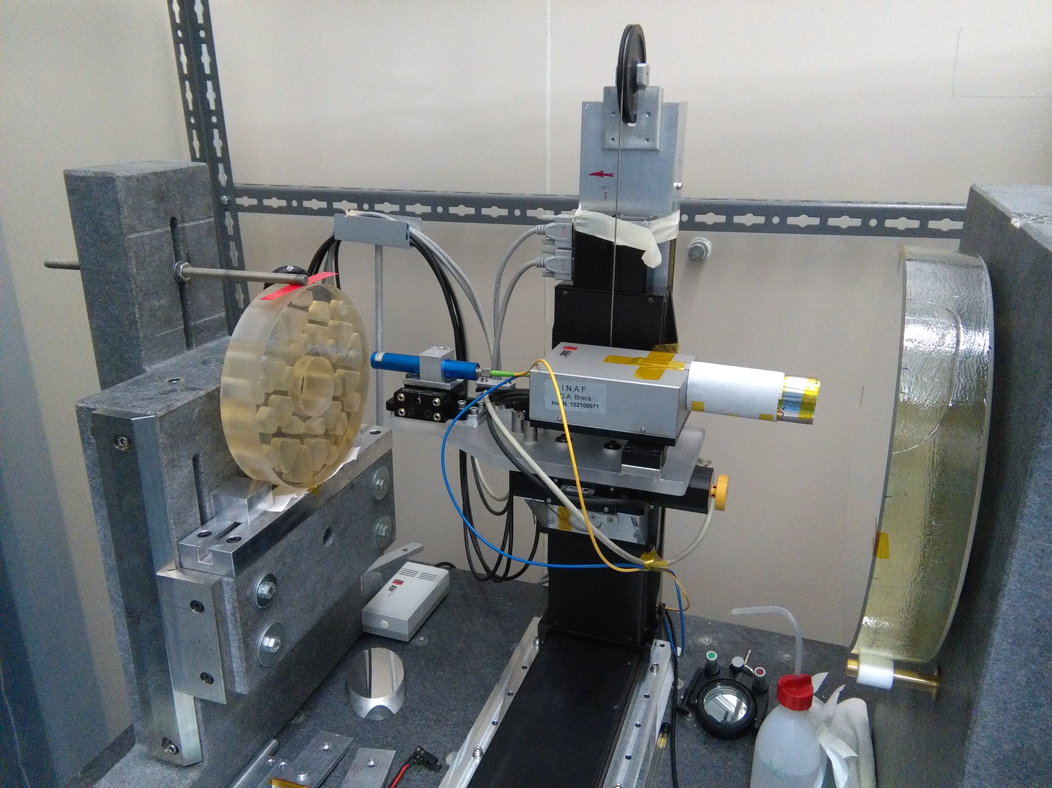
Current equipments
Example: MUSE Primary mirror under measurement
with Zygo set-up and Characterization Universal profilometer @Merate
CUP (Bando Innovazione 2019)

Slide 6
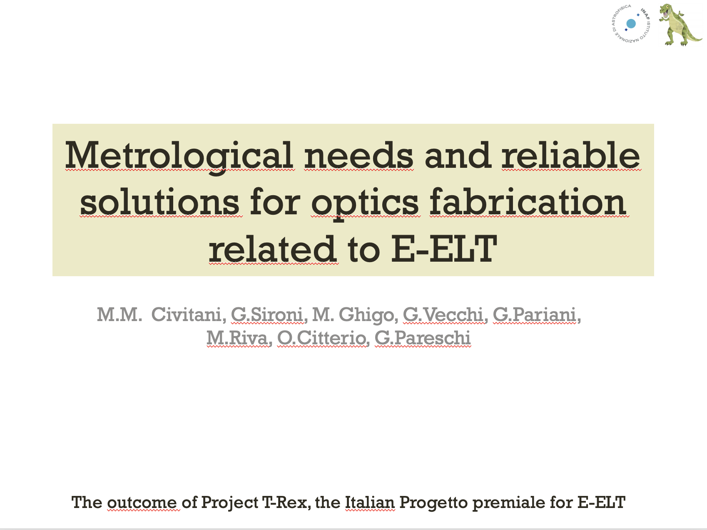
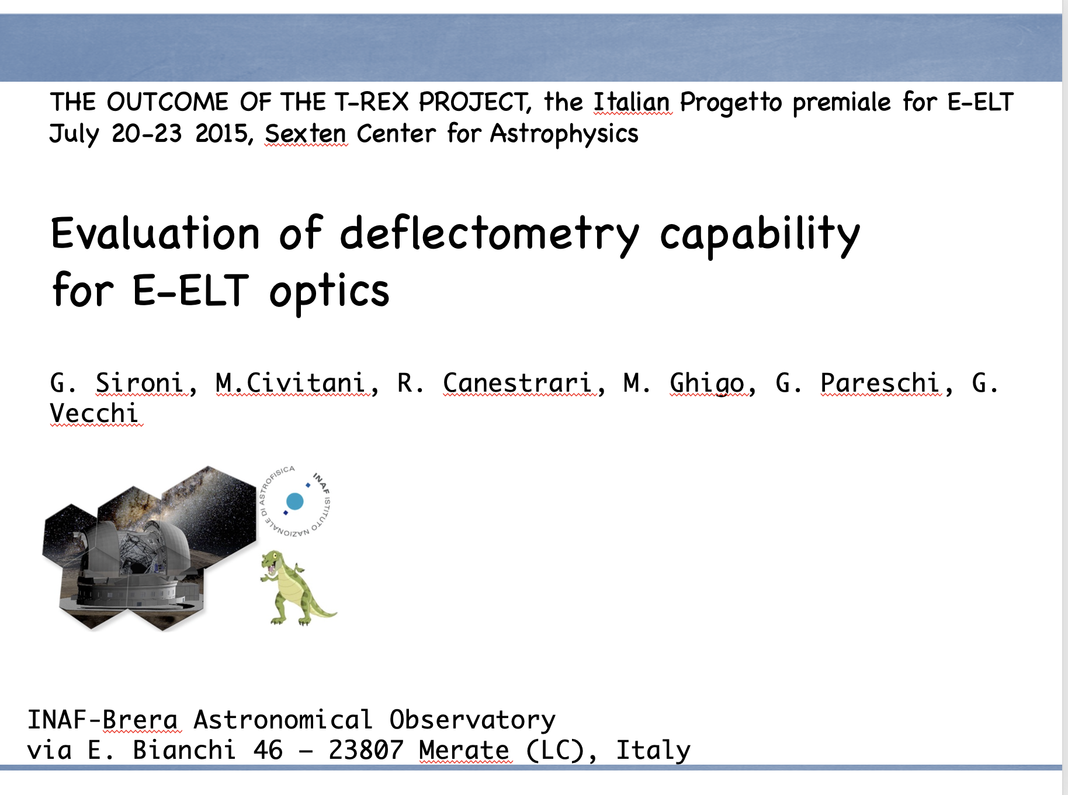
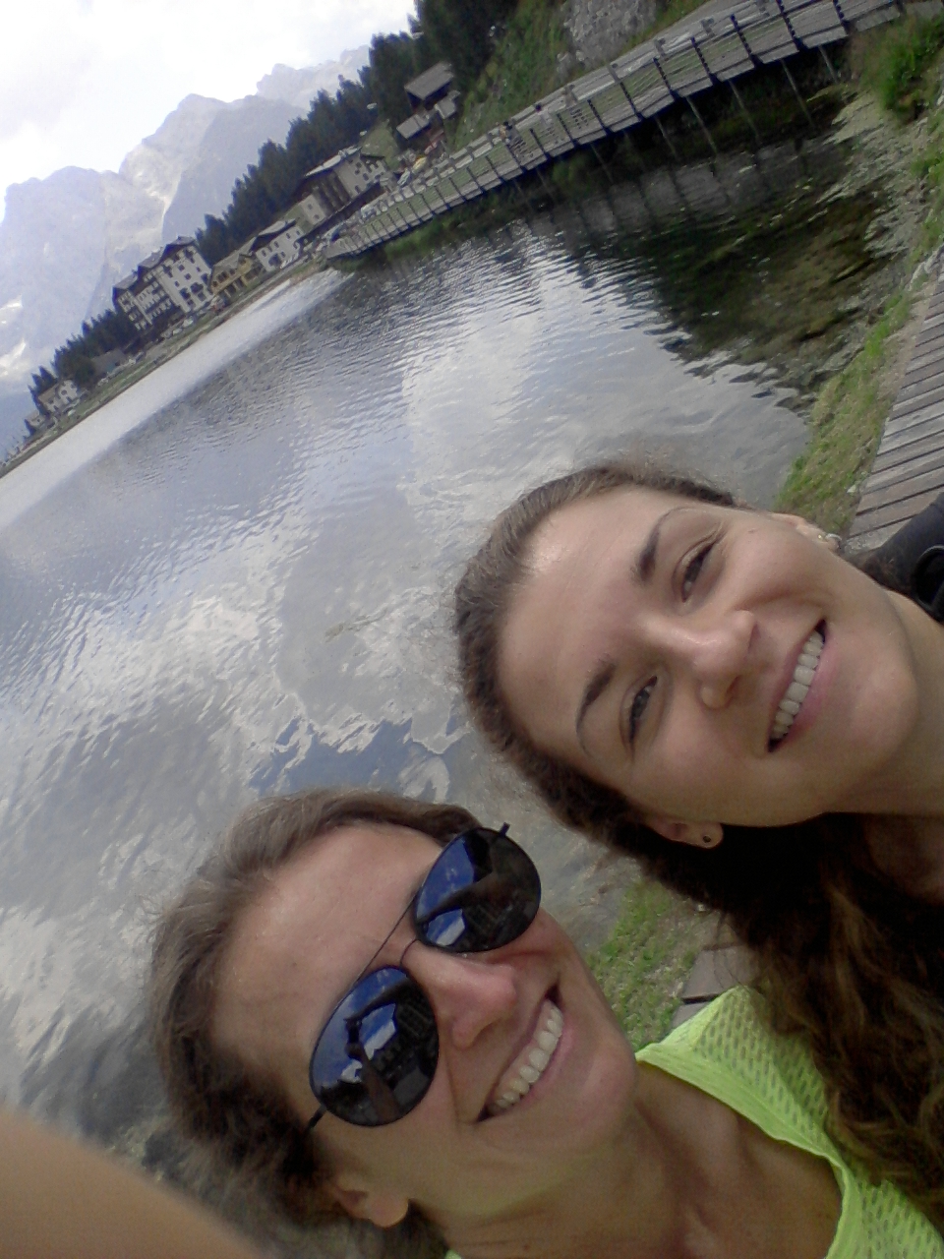
Hystorical background…. 2015!!
Strongly encouraged by O.Citterio

Slide 7
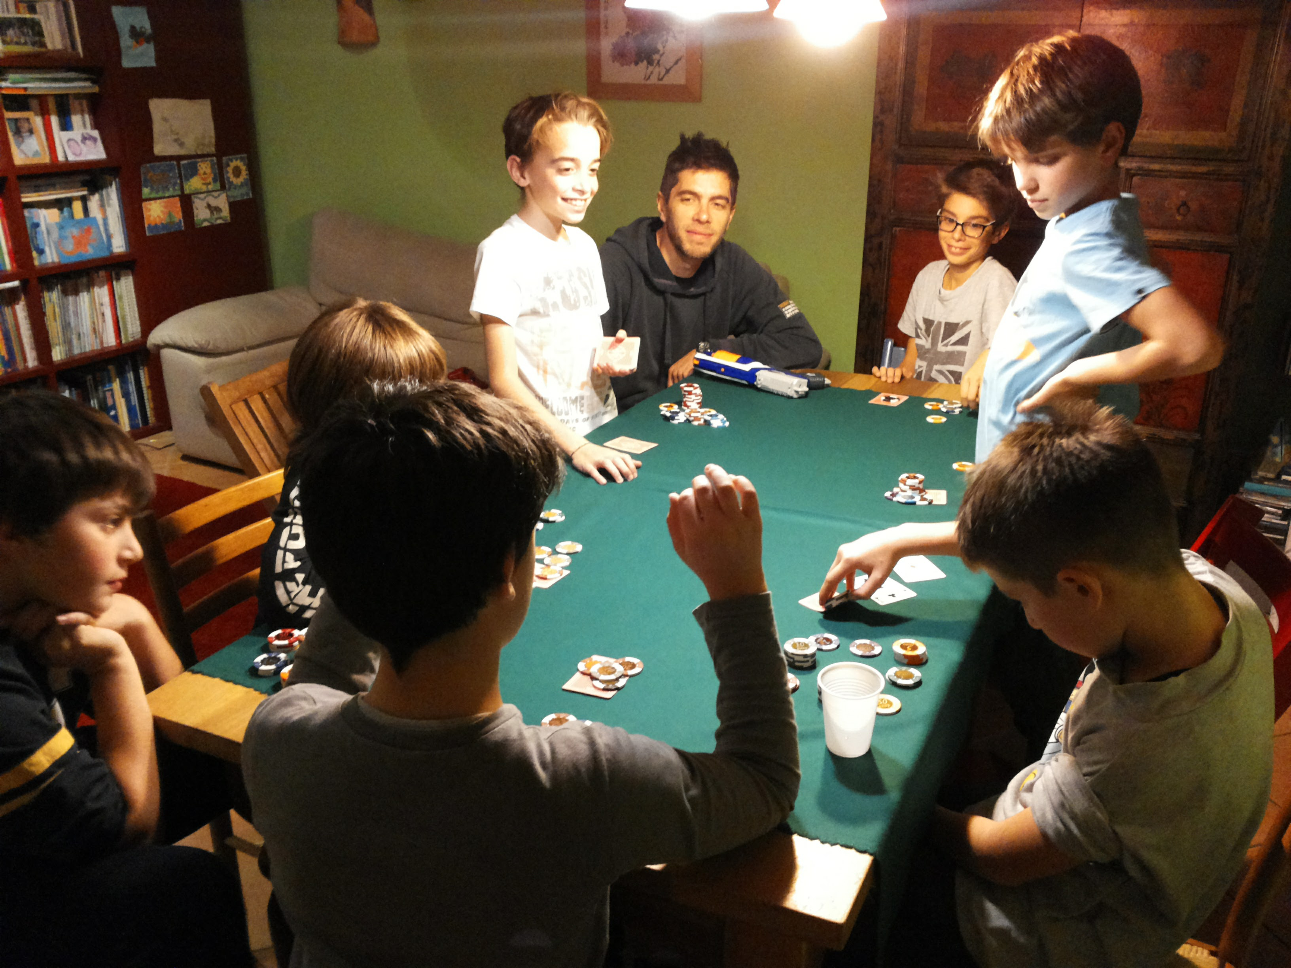
9 years ago = …

Slide 8
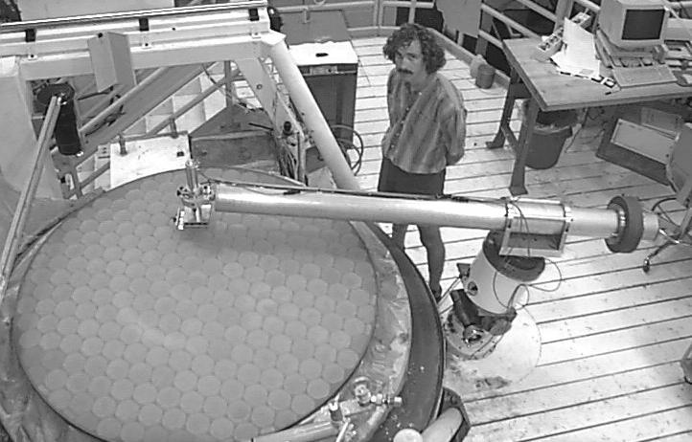
What is a profilometer?
Metrological equipment:
Great flexibility
Can measure concave/flat/ convex without specific optical components
Easy measurement set up
Nowadays with competitive accuracy with respect to interferometry measurerements
Very old version !!!

Slide 9
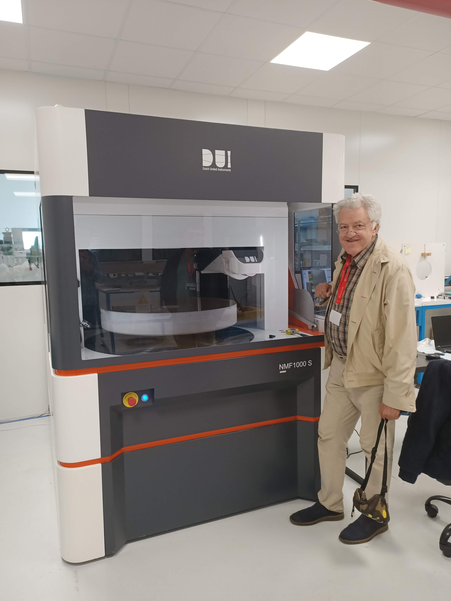
Now available also in modern version…
Well, we all know that Mauro is modern inside ☺
Largest in Italy @Officina Stellare (VI)
Max diam. 1m

Slide 10
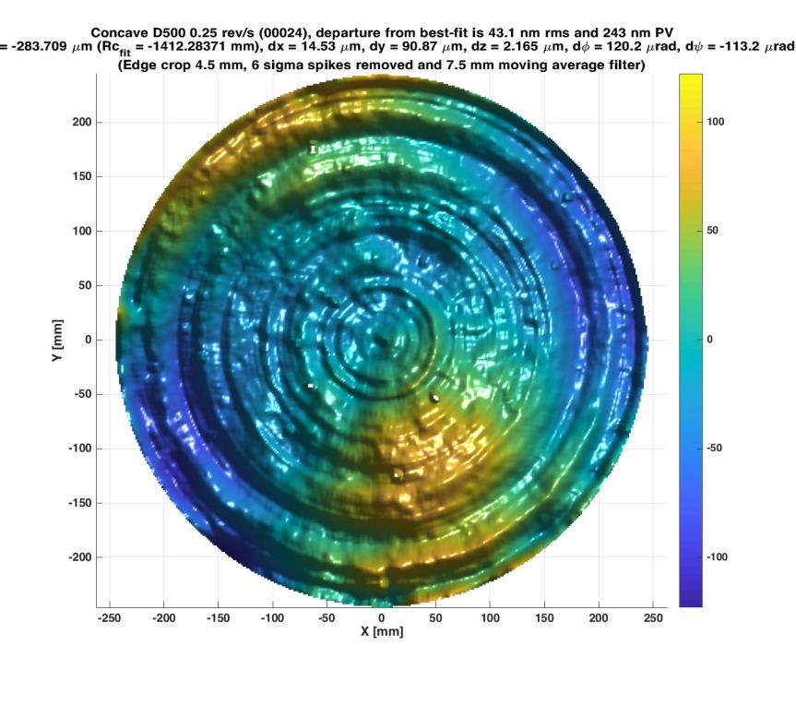
Example of output
Form error repeatability:
< 1 nm rms
Power repeatability:
< 5 nm rms
Point-by-point repeatability from average:
< 3 nm rms
Credits: DUI
Example 600 mm diam,
Concave R = -1.4 m

Slide 11
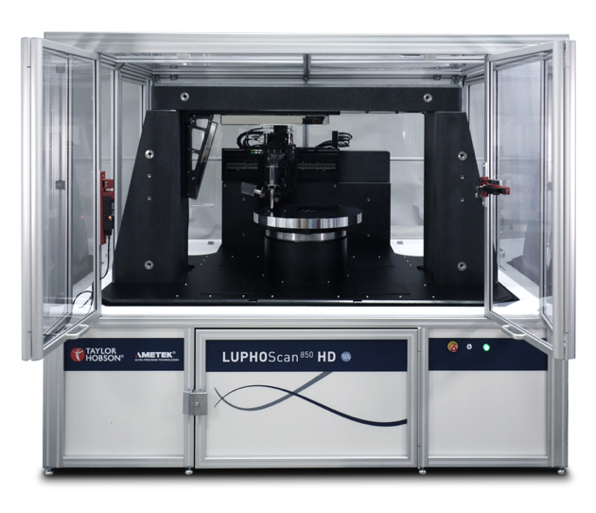
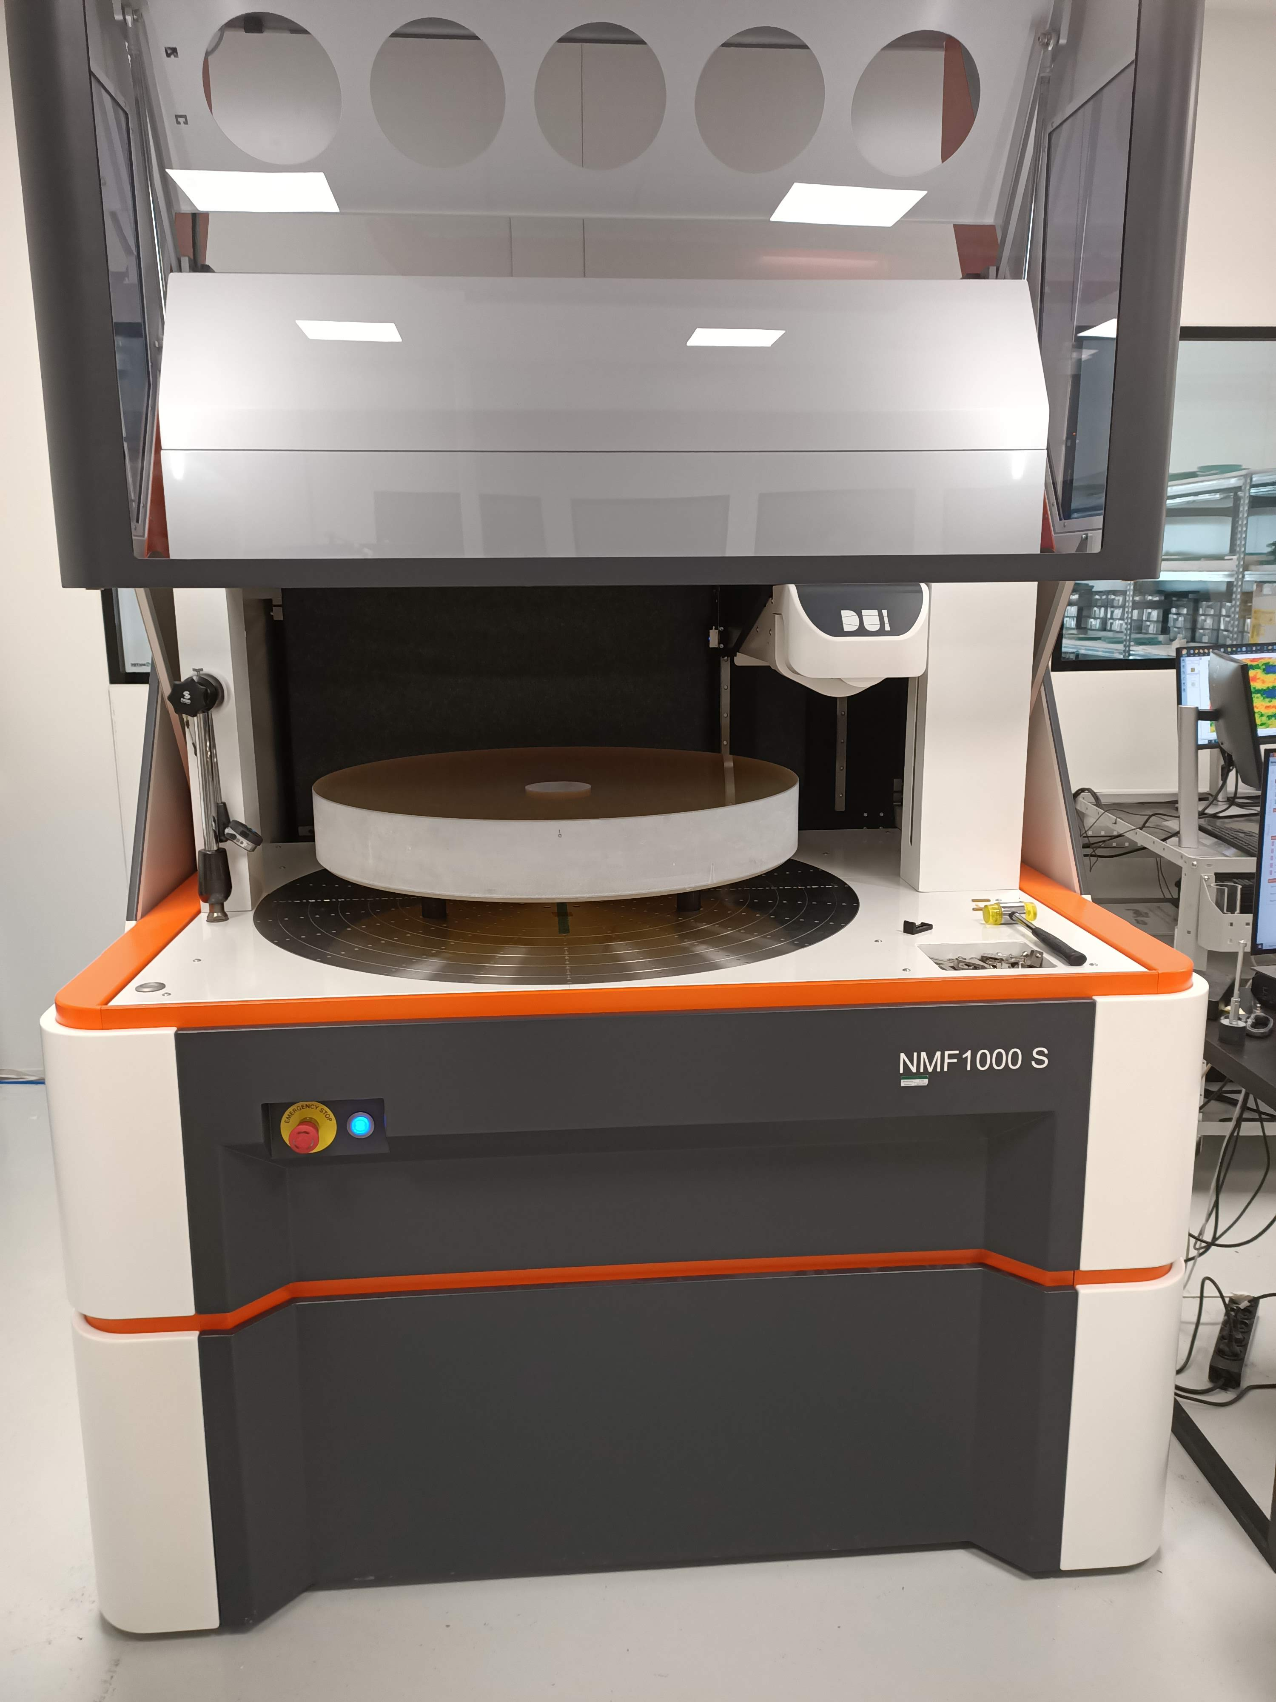
Examples of largest commercial products
LUPHOScan 850 HD
NMF1000
@Officina Stellare
Luphos scan 350
@Pecchioli +Research (FI)

Slide 12
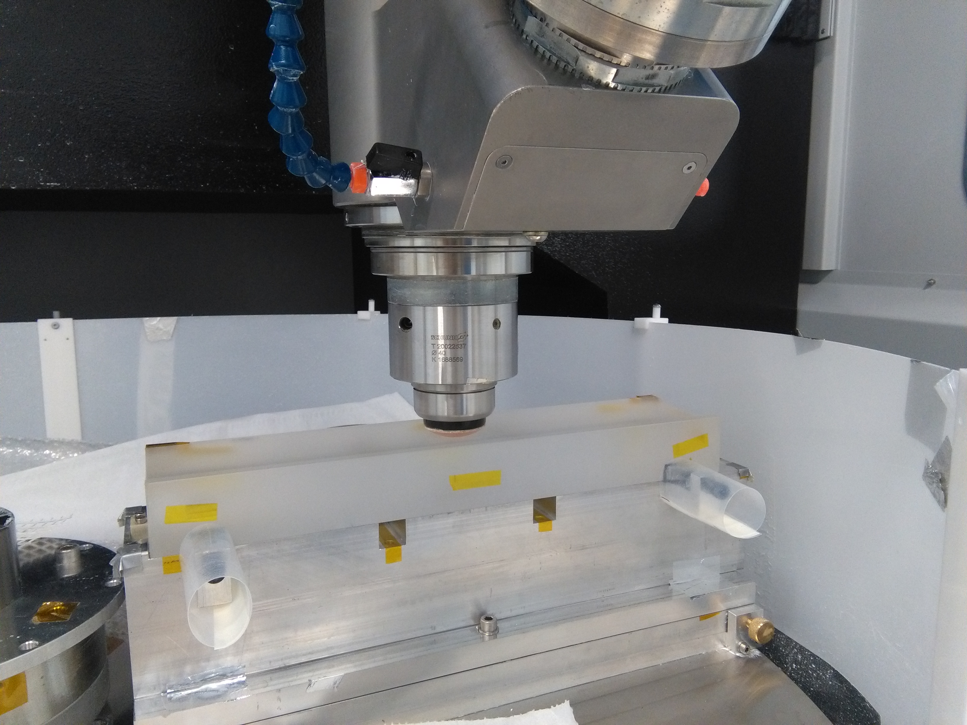
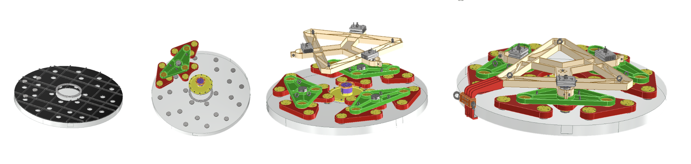
Proposed in STILES → Bando Spazio
Act. 6703 OptomechTesting Profilometer
Requested extra budget to get:
- Larger measurement area
- Custom design (Grazing incidence optics)
Aim of the facility: Expanding our capabilities in the field of metrology for optics manufacturing
750kEuro …
Beatrix parabolic mirror on Zeeko @Merate
Morpheo Mirrors

Slide 13
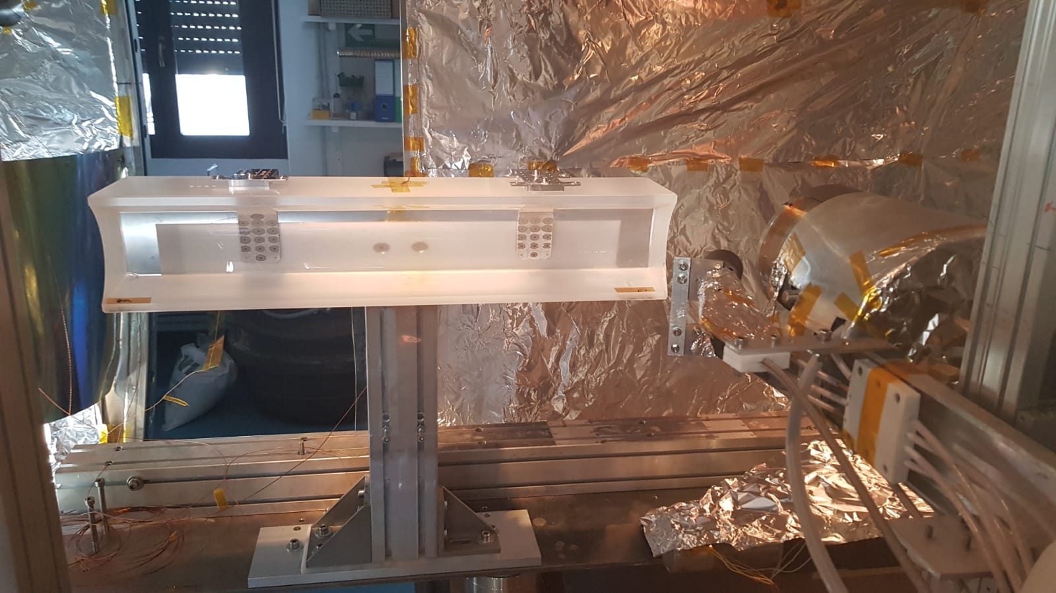
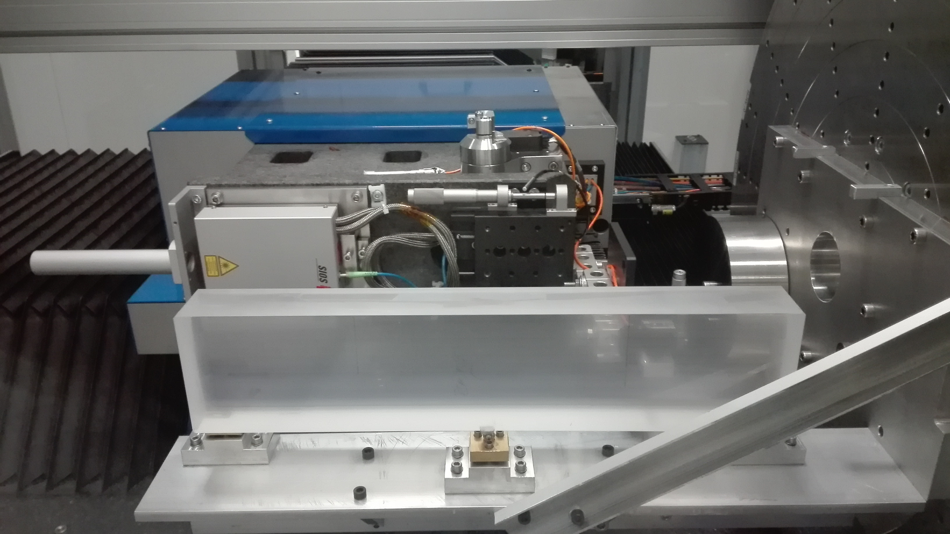
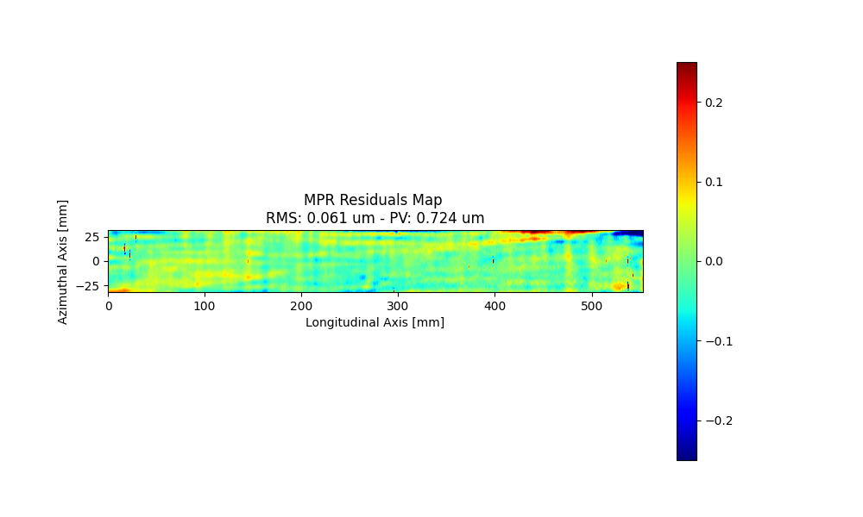
Custom design: raster scan
Beatrix on MPR @MLT
Vert-X parabolic mirror in IBF @Merate
Vert-X parabolic mirror measure from MPR @MLT

Slide 14
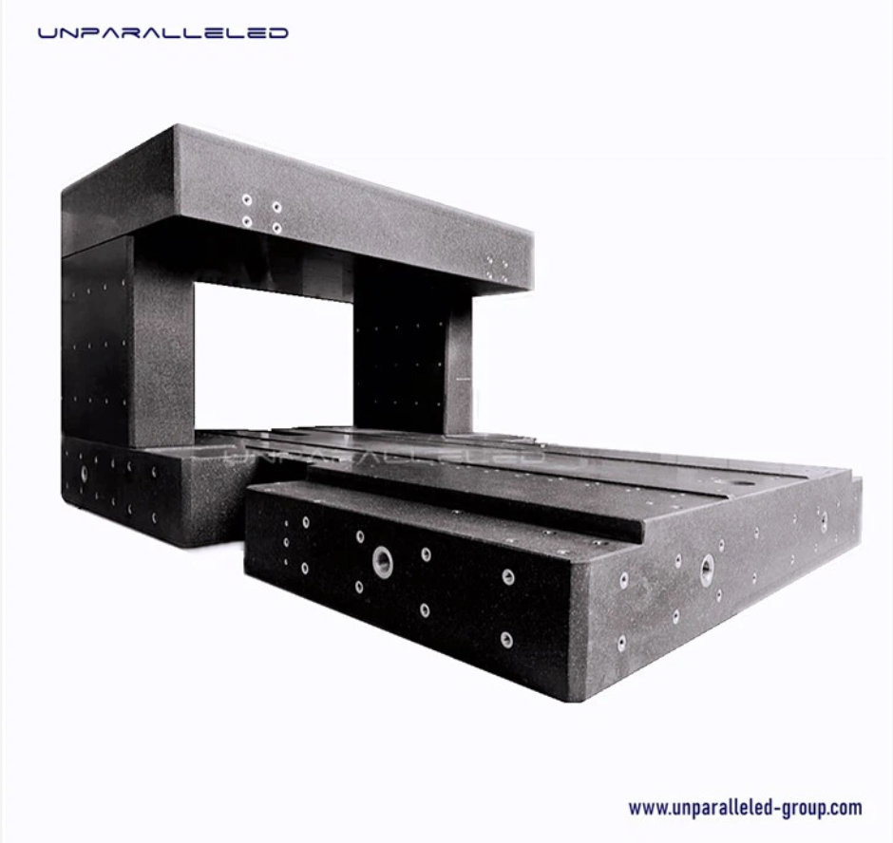
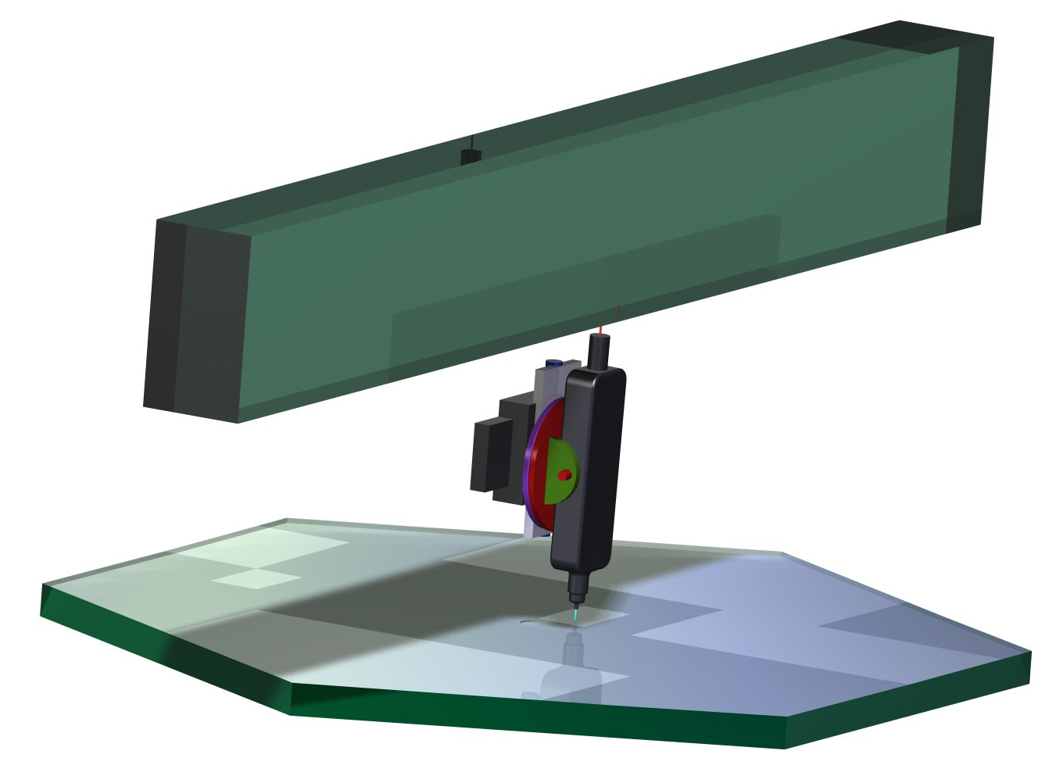
Req. & conceptual design
Zerodur
Reference bar
Laser
Geometry of the workpiece:
1,4 m x 1,4m
Maximum weight:
400 kg
Measurement area:
1,2 m x 1,2 m
Vertical movement range:
5 cm
Workpiece radius of curvature:
3 m
Accuracy:
< 10 nm RMS (goal 5 nm RMS)
Optical probe
Scanning
directions

Slide 15
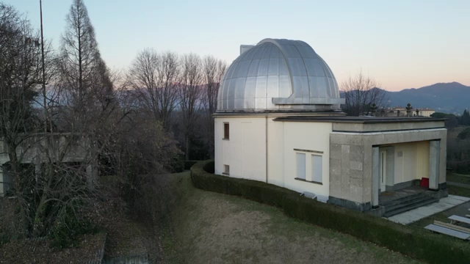
Looking up and far away
New metrological lab

