Slide 1
AGB stars and their importance in stellar population studies
Giada Pastorelli (she/her)
Department of Physics and Astronomy, University of Padova

Slide 2
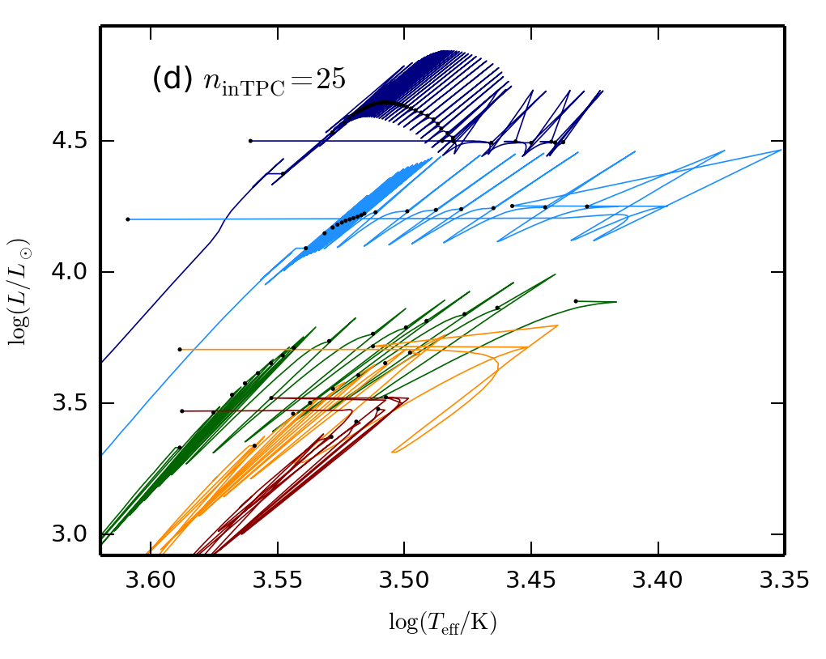
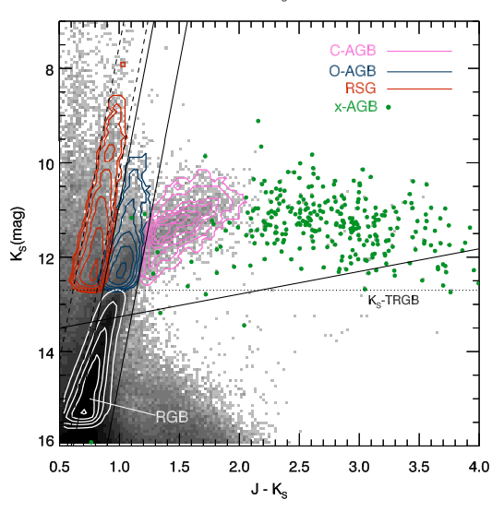
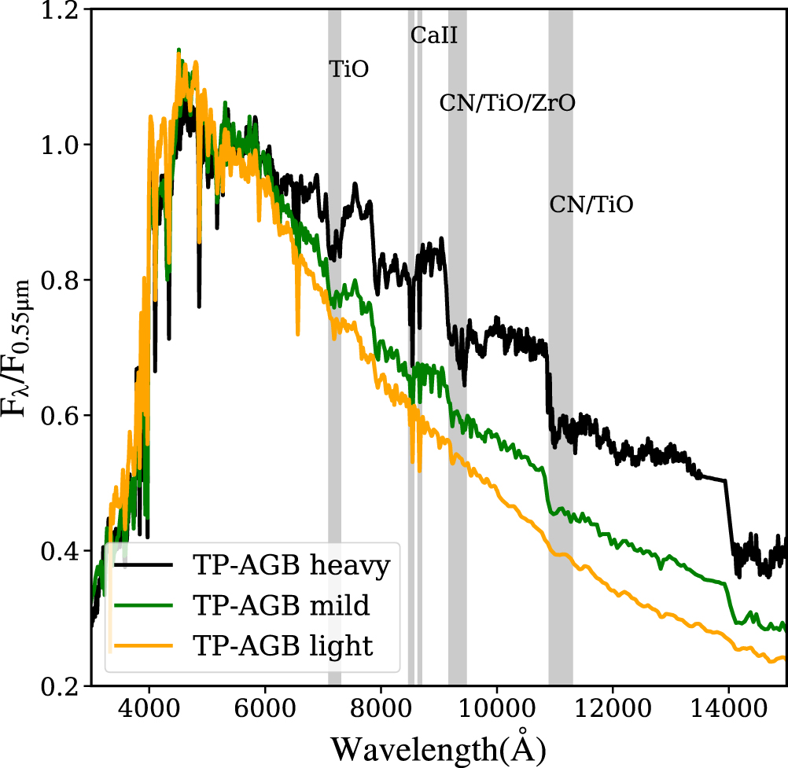
Topics:
Evolution of AGB stars & model uncertainties
The impact of AGB stars
Interpretation and calibration of models with resolved stellar populations
Main References
Herwig (2005) Review
Habing & Oloffson Book
Salaris, Cassisi (2005) Evolution of stars and stellar populations Book
Greggio, Renzini (2011) Stellar Populations. A User Guide From Low to High Redshift Book

Slide 3
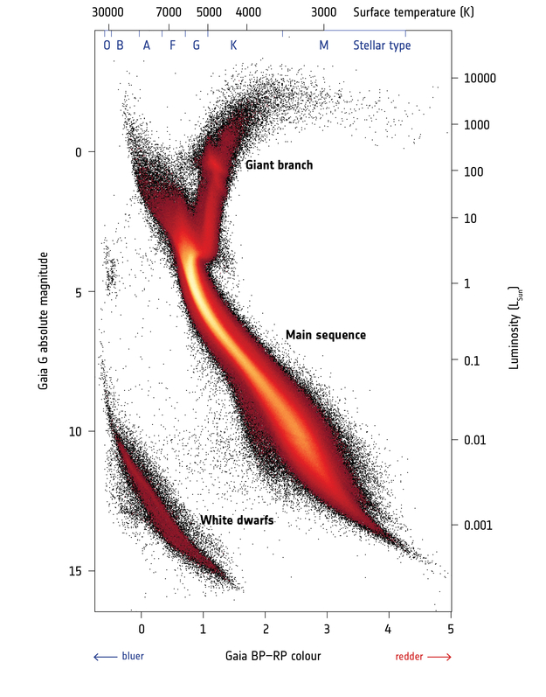
AGB stars in the HRD & CAMD

Slide 4
AGB stars in the HRD & CAMD

Slide 5
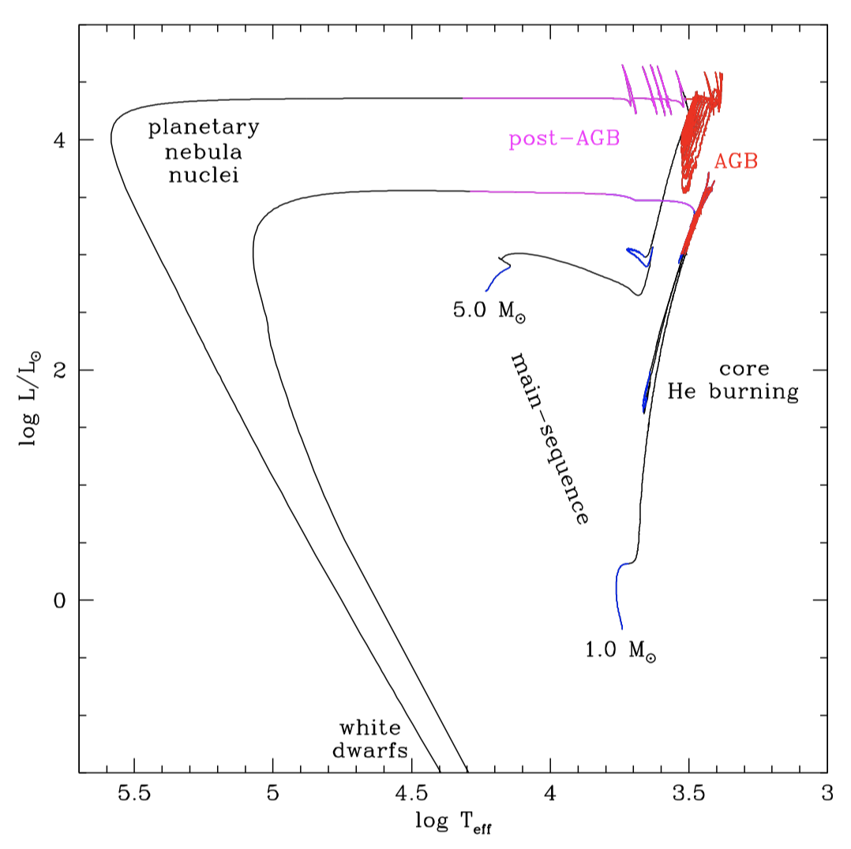
AGB stars in the HRD & CAMD

Slide 6
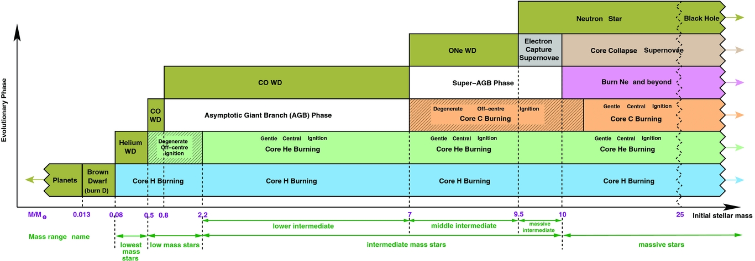
Initial mass range
From Karakas & Lattanzio (2014)

Slide 7
Initial mass range
From Karakas & Lattanzio (2014)
AGB stars →
~0.8 up to ~6-8 Msun
Model and composition dependent

Slide 8
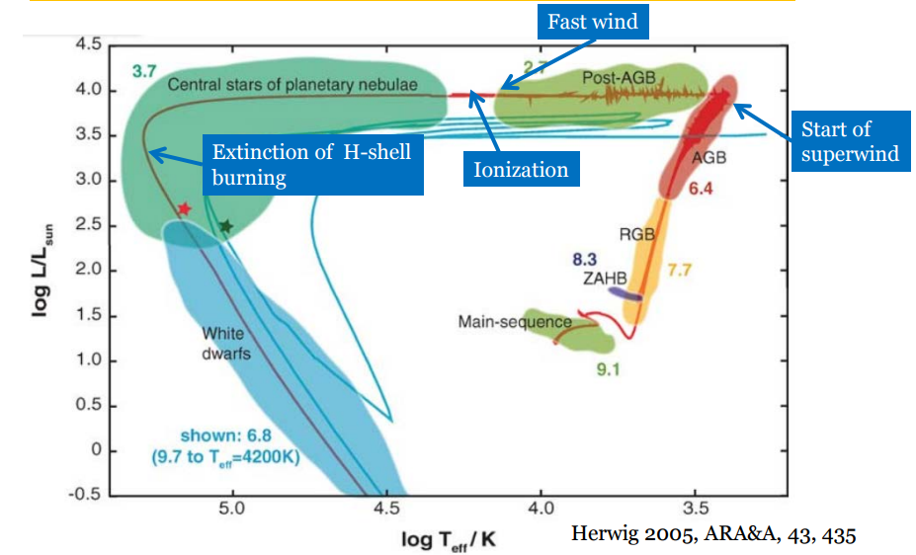
Evolution overview

Slide 9
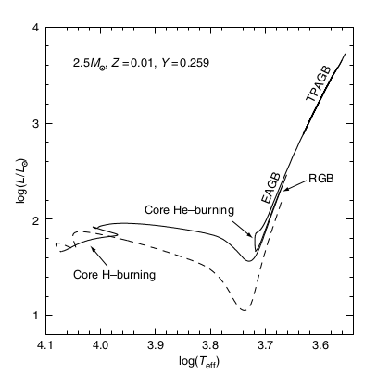
Early-AGB
Central He exhaustion: CO core contracts
He-shell burning
Short double shell burning (H, He)
H-shell extinguished (He-rich zone expansion)
Entire envelope expands
CO core becomes degenerate
Salaris & Cassisi

Slide 10
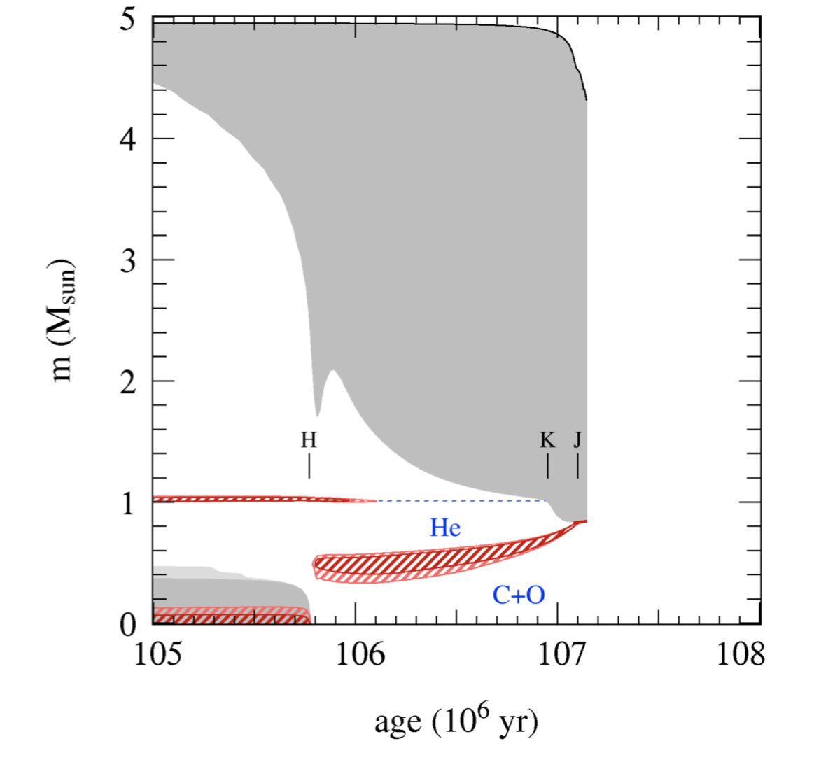
Early-AGB
Central He exhaustion: CO core contracts
He-shell burning
Short double shell burning (H, He)
H-shell extinguished (He-rich zone expansion)
Entire envelope expands
CO core becomes degenerate
O.R. Pols 2011 (Lect. Notes)

Slide 11
Early-AGB
M_{i} ≳ 4 M☉ : 2nd dredge-up
M_{i} ≲ 4 M☉ : H-shell is active → no 2nd DU
Effects of 2DU:
1. Increase of He- and N-rich surface abundance
2. Reduction of the mass of the H-exhausted core
→ Limits the mass of the WD remnant
O.R. Pols 2011 (Lect. Notes)

Slide 12
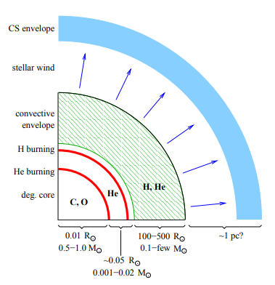
Thermally Pulsing AGB
Periodic thermal pulses
Stellar properties mainly depend on size of degenerate CO core: core mass - luminosity relation
Strong mass-loss
Molecules and dust form in the circumstellar envelope
O.R. Pols 2011 (Lect. Notes)

Slide 13
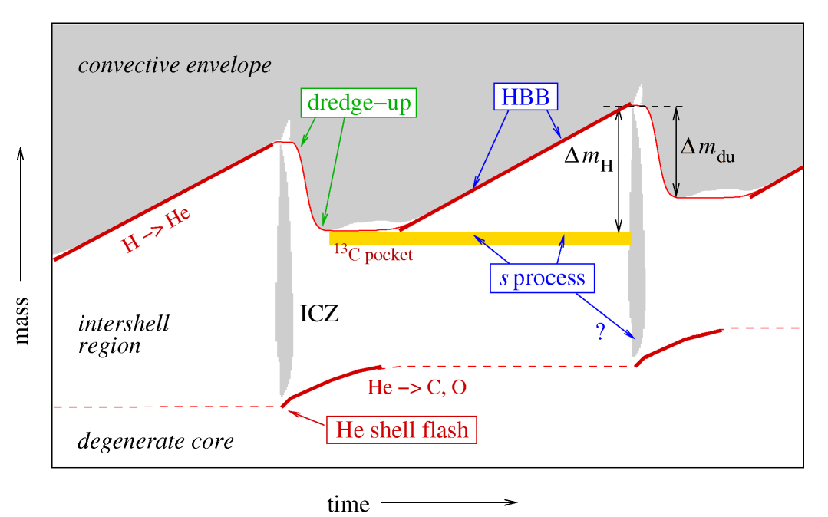
Thermal Pulses: He-shell instability
Degenerate CO core
He-shell instability
Intershell convection
H-shell extinguished
Penetration of CE
Adapted from N. Langer

Slide 14
Thermal Pulses: third dredge-up
Third Dredge-Up
(M_{i} > 1.5 M☉ depending on Zi)
He and H burning products reach the surface:
→ C ↗️
Series of 3DU events during the TP-AGB phase
→ # C atoms > # O atoms
C/O<1 → C/O>1
M-stars → C-stars
Adapted from N. Langer

Slide 15
Thermal Pulses: Hot Bottom Burning
Hot Bottom Burning
(M_{i} > 3 M☉ depending on Zi)
H-burning through
CNO cycle
1) CN cycle → C ↘
C/O>1 → C/O<1
C-stars → M-stars
2) ON cycle → O ↘
C/O<1 → C/O>1
M-stars → C-stars
HBB produces Nitrogen but also
⁷Li, ²³Na, and ^{25,26}Mg
Adapted from N. Langer

Slide 16
Thermal pulses: s-process
Slow-neutron capture reaction on Fe nuclei
Neutron sources:
²²Ne(⍺, n)²⁵Mg
¹⁴N → ²²Ne by He burning in
massive AGB stars ( ~ 3 Msun)
2. ¹³C(⍺, n)¹⁶O
formation of a ¹³C pocket in low
mass AGB stars
Elements heavier than Fe:
Zr, Y, Sr, Tc, Ba, La and Pb
observed in AGB spectra
Adapted from N. Langer

Slide 17
TP-AGB 3DU & HBB: stellar models
No 3DU
3DU
HBB
3DU
Models from Marigo+08

Slide 18
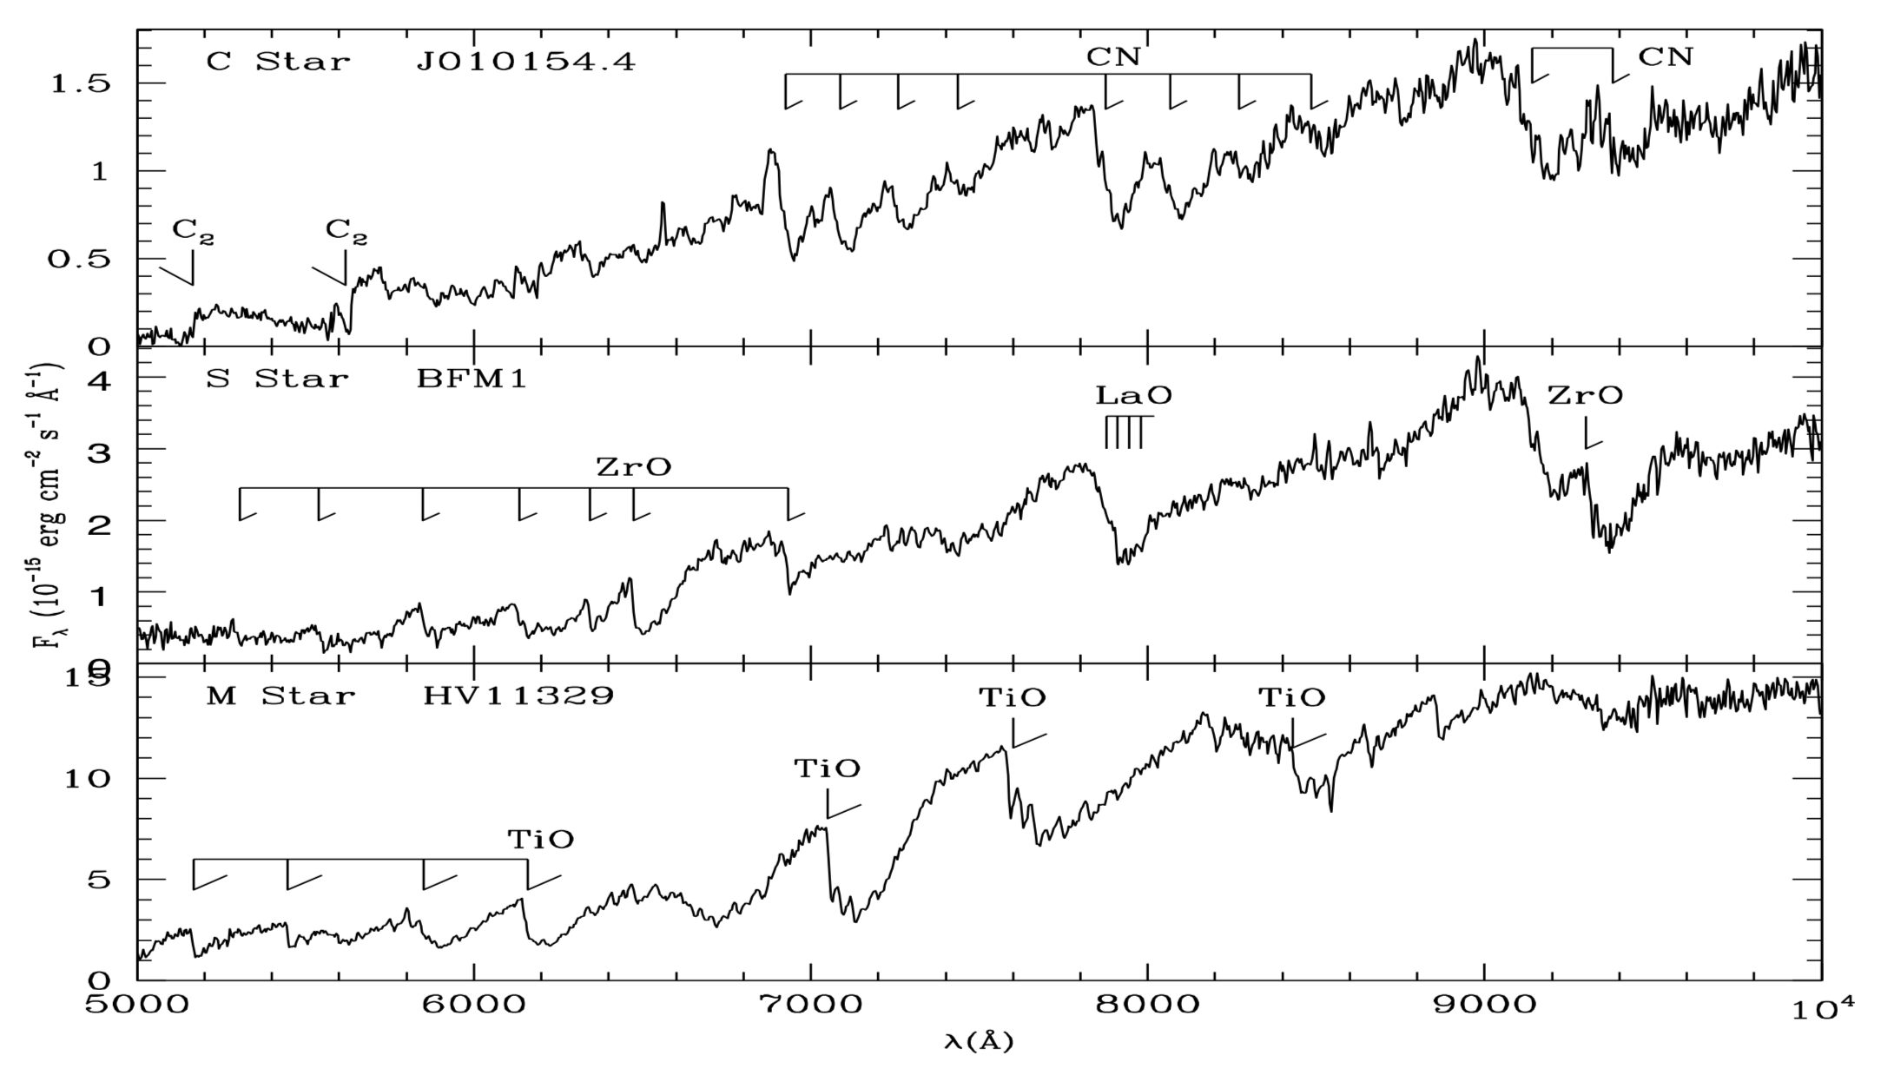
AGB stars spectra
C/O > 1
C/O< 1

Slide 19
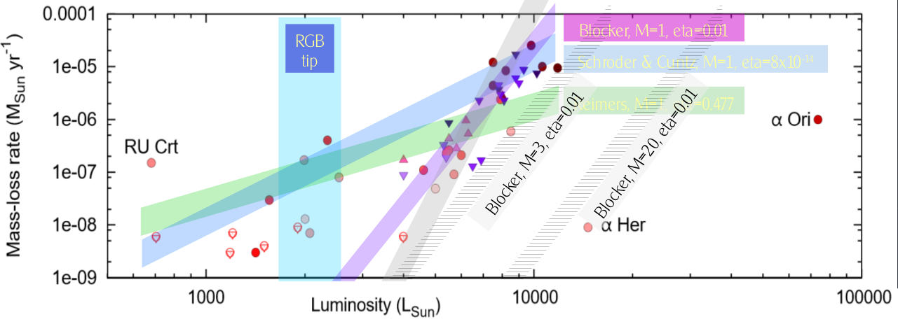
Mass-loss during the AGB
Credit: I. McDonald
Several empirical, semi-empirical relations as function of stellar parameters
Two distinct regime:
Pre-dust winds mechanism not fully understood:
magnetoacustic waves in the cool cromosphere of evolved giants? (Schröder & Cuntz +05, Cranmer & Saar+11)
Pulsation assisted dust driven winds based on dynamical model atmospheres (Höfner+15, Mattsson+10)

Slide 20
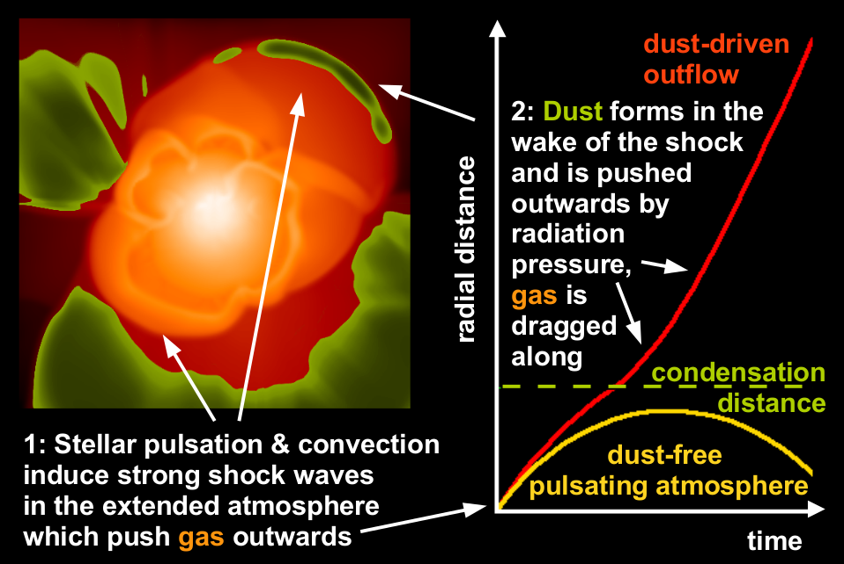
Mass-loss: dust-driven regime
(Hoefner 2016)
Credits: S. Hoefner

Slide 21
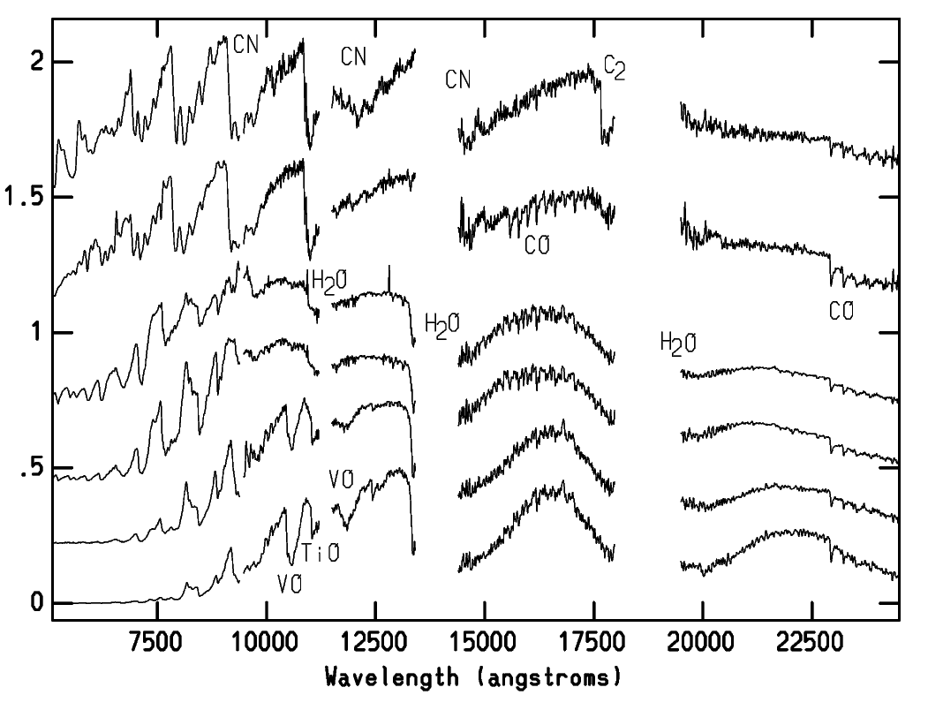
AGB spectra from the optical to the mid-IR
Gaia RP
J
H
Ks
2MASS
Optical/Near-IR Spectra
C-star
S/C
Molecular features
O-rich
Lancon & Wood (2000)

Slide 22
AGB spectra from the optical to the mid-IR
Mid-IR Spectra
M-stars
C-stars
Dust features
Spitzer IRAC
[3.6]
[5.8]
[3.6]
[5.8]
[4.5]
[8.0]
[4.5]
[8.0]

Slide 23
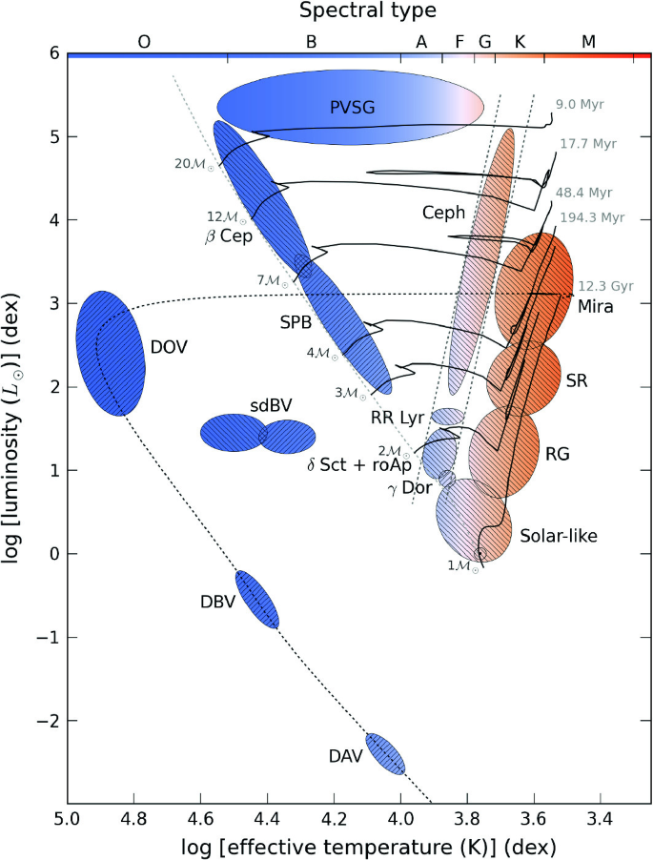
Pulsation in red giant stars
Long Period Variables:
Multiple radial modes
Periods: a few days – a few years
Amplitude: milli-magnitude up to several magnitudes
Classified according to period and variability amplitude
For example: Miras, Semi-regulars, Irregulars
Pulsation mechanism not fully understood: coupling between stellar oscillation and convection
Figure from Pápics (2013)

Slide 24
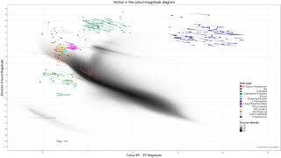
Variable stars with Gaia
Credit: ESA/Gaia/DPAC, CC BY-SA 3.0 IGO

Slide 25
Variable stars with Gaia
Variable stars in the Hertzsprung-Russell diagram
Description of the video
This video shows the way variable stars change their brightness and colour over time, as viewed by ESA's Gaia satellite using information from the mission's second data release. The stars are plotted on a Hertzsprung-Russell diagram, named after the astronomers who devised it in the early 20th century, which locates stars according to their colour and brightness.
More info
More about Gaia's second data release: http://sci.esa.int/gaia/60192-gaia-creates-richest-star-map-of-our-galaxy-and-beyond/
More information about this video and a download option can be found at http://sci.esa.int/gaia/60239-variable-stars-in-the-hertzsprung-russell-diagram/
Credit: ESA/Gaia/DPAC, CC BY-SA 3.0 IGO
http://creativecommons.org/licenses/by-sa/3.0/igo/
Acknowledgement: Gaia Data Processing and Analysis Consortium (DPAC); Gaia Coordination Unit 7; K. Nienartowicz / L. Eyer / L. Rimoldini / O. Marchal / F. Glass

Slide 26
Timescales
Dynamical oscillation of the envelope
→ Time required for a soundwave to traverse the envelope
Instability that triggers thermal pulses
→ Time required for nuclear energy to double the thermal energy in the He-burning region
Thermal relaxation timescale
→ the return to a quiescent phase after a thermal pulse
Building up of the conditions for the helium burning runway
hundreds of days - few years
less than a few years
a few 10^5 yr to 30 yr
depending on the core mass
Stellar pulsations (i.e. variability) and thermal pulses are two different phenomena

Slide 27
Stellar evolution models of AGB stars
1-D stellar models
Full evolutionary models (e.g. ATON, MONASH, FRUITY, PARSEC)
Physical accuracy and consistency but computationally demanding
Synthetic evolutionary models
Limited physical accuracy and rely on full models but
1) calculations are quick and 2) include parameters that can be constrained with observations
“Hybrid” models → COLIBRI
Envelope integration + Results of full models
Good compromise between full and synthetic models: can be effectively used to constrain specific uncertain parameters

Slide 28
Stellar evolution models of AGB stars
3D models and dynamical atmosphere models
Still not feasible to cover all the relevant initial masses and metallicities
Results can be incorporated into full/hybrid models
Grids of mass-loss for C-rich and M stars as a function of stellar parameters (L, Teff, C-O) are available (Mattsson+10, Eriksson+14, Bladh+19)
In COLIBRI (Pastorelli+19,+20,Marigo+20)
In PARSEC (Addari+24)
https://www.astro.uu.se/~bf/movie/AGBmovie.html

Slide 29
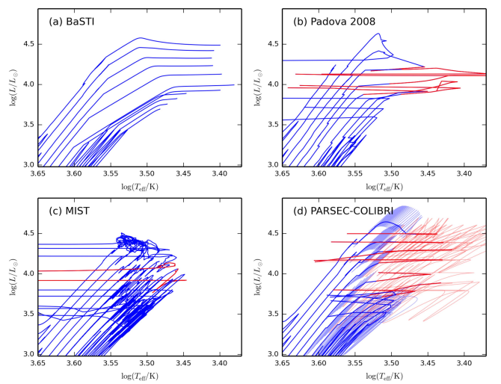
Stellar isochrones with TP-AGB
CMD web interface (isochrones)
& TRILEGAL based on PARSEC and COLIBRI models
Tutorial/overview on Tuesday afternoon
Marigo+17

Slide 30
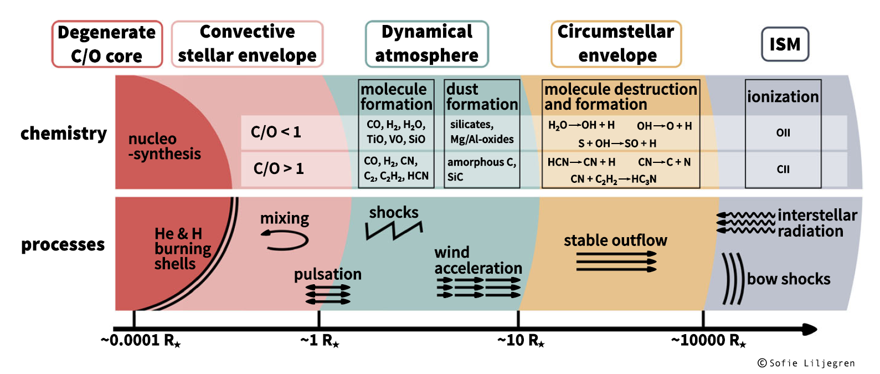
Recap and model uncertainties
Uncertainties of all previous evolutionary phases
Treatment of convection → HBB and 3DUP
Formation and growth of dust grains
No satisfactory theory for mass loss
Interplay between mass loss, 3DUP, HBB
Current models do not agree for:
Total TP-AGB lifetimes f(Zi)
Relative lifetimes of M and C stars
Initial mass range of C stars

Slide 31
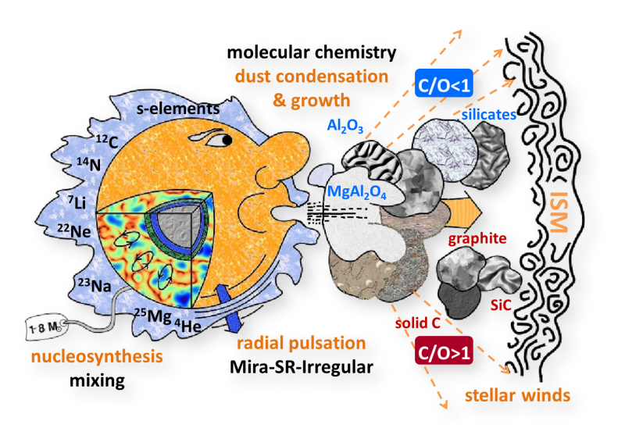
Why do we care about AGB stars?
ISM enrichment (gas & dust), chemical evolution models
Spectrophotometric properties of unresolved galaxies
TP-AGB high luminosity → SFH of distant galaxies
High L & Variability → Powerful distance indicators
Distant
unresolved
galaxies
Nearby
resolved galaxies
Stellar atmosphere

Slide 32
Why do we care about AGB stars?
ISM enrichment (gas & dust), chemical evolution models
Spectrophotometric properties of unresolved galaxies
TP-AGB high luminosity → SFH of distant galaxies
High L & Variability → Powerful distance indicators
Distant
unresolved
galaxies
Nearby
resolved galaxies
Stellar atmosphere

Slide 33
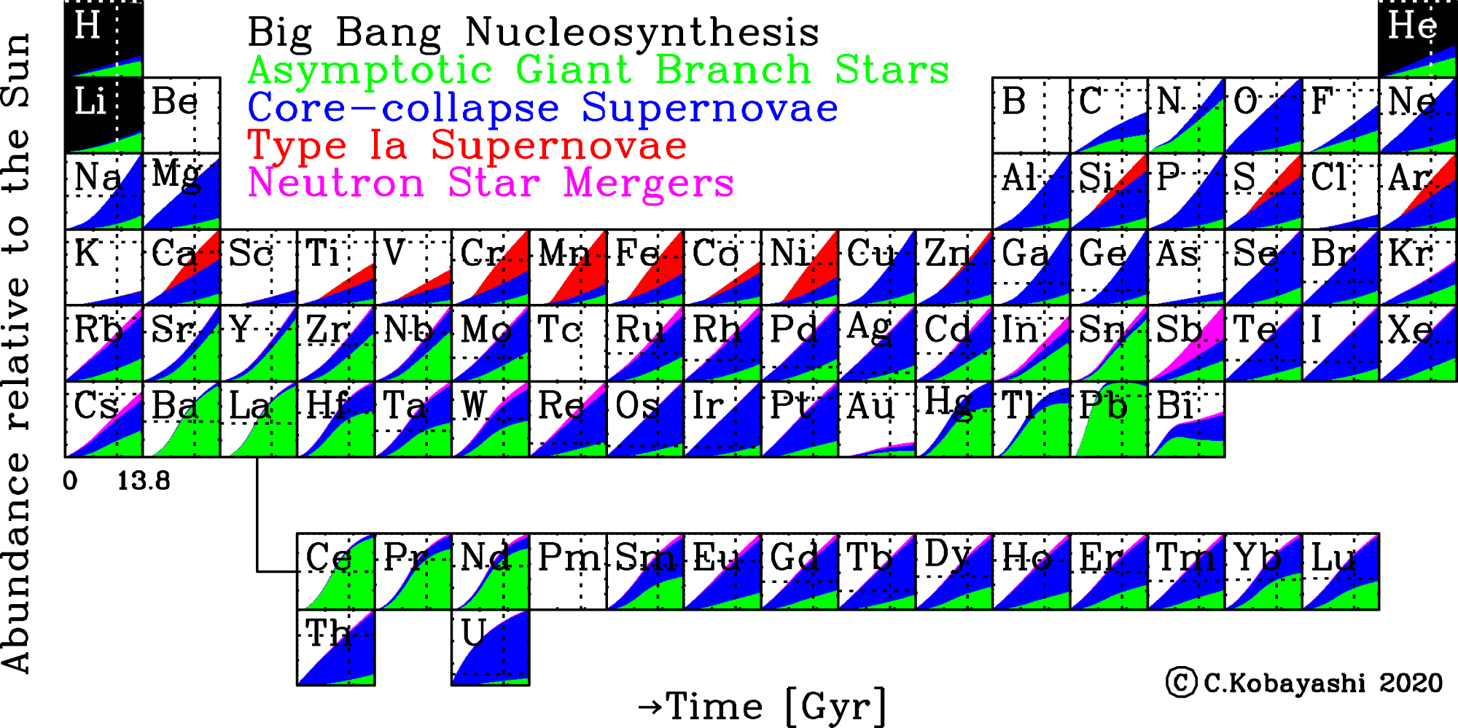
Time evolution of the origin of elements
From Kobayashi+2020

Slide 34
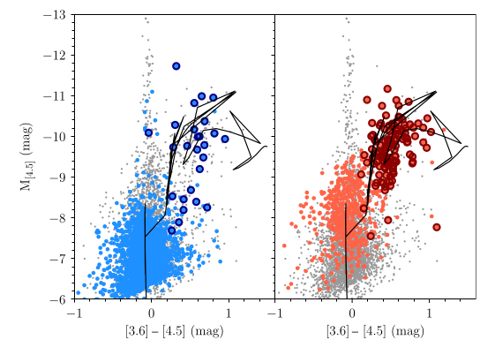
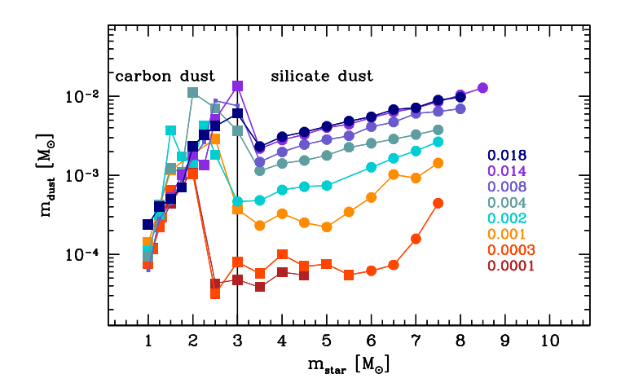
Dust production
Spitzer observations of metal-poor dwarf galaxies show dusty M- and C-type stars (Boyer+17)
Dust production of AGB stars from ATON models (fig. from Schneider, Maiolino+24)

Slide 35
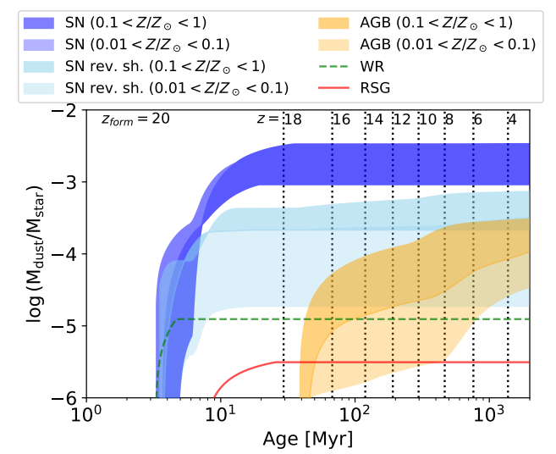
Dust production
Relative importance SNe & ABGs as sources of dust
Dust enrichment timescales
from Schneider, Maiolino+24

Slide 36
Why do we care about AGB stars?
ISM enrichment (gas & dust), chemical evolution models
Spectrophotometric properties of unresolved galaxies
TP-AGB high luminosity → SFH of distant galaxies
High L & Variability → Powerful distance indicators
Distant
unresolved
galaxies
Nearby
resolved galaxies
Stellar atmosphere

Slide 37
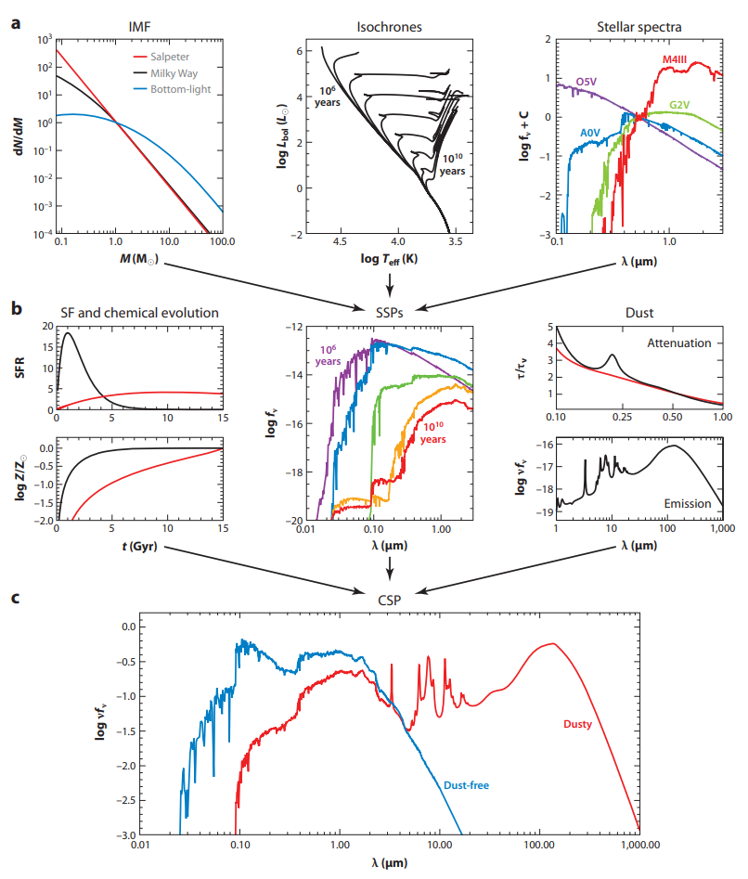
TP-AGB stars & unresolved galaxies
From stellar models
Conroy+09

Slide 38
TP-AGB stars & unresolved galaxies
From stellar models
Conroy+09

Slide 39
TP-AGB stars & unresolved galaxies
To Simple Stellar Population models
Conroy+09

Slide 40
TP-AGB stars & unresolved galaxies
To Composite Stellar Population models
Integrated fluxes to interpret distant unresolved galaxies
Conroy+09

Slide 41
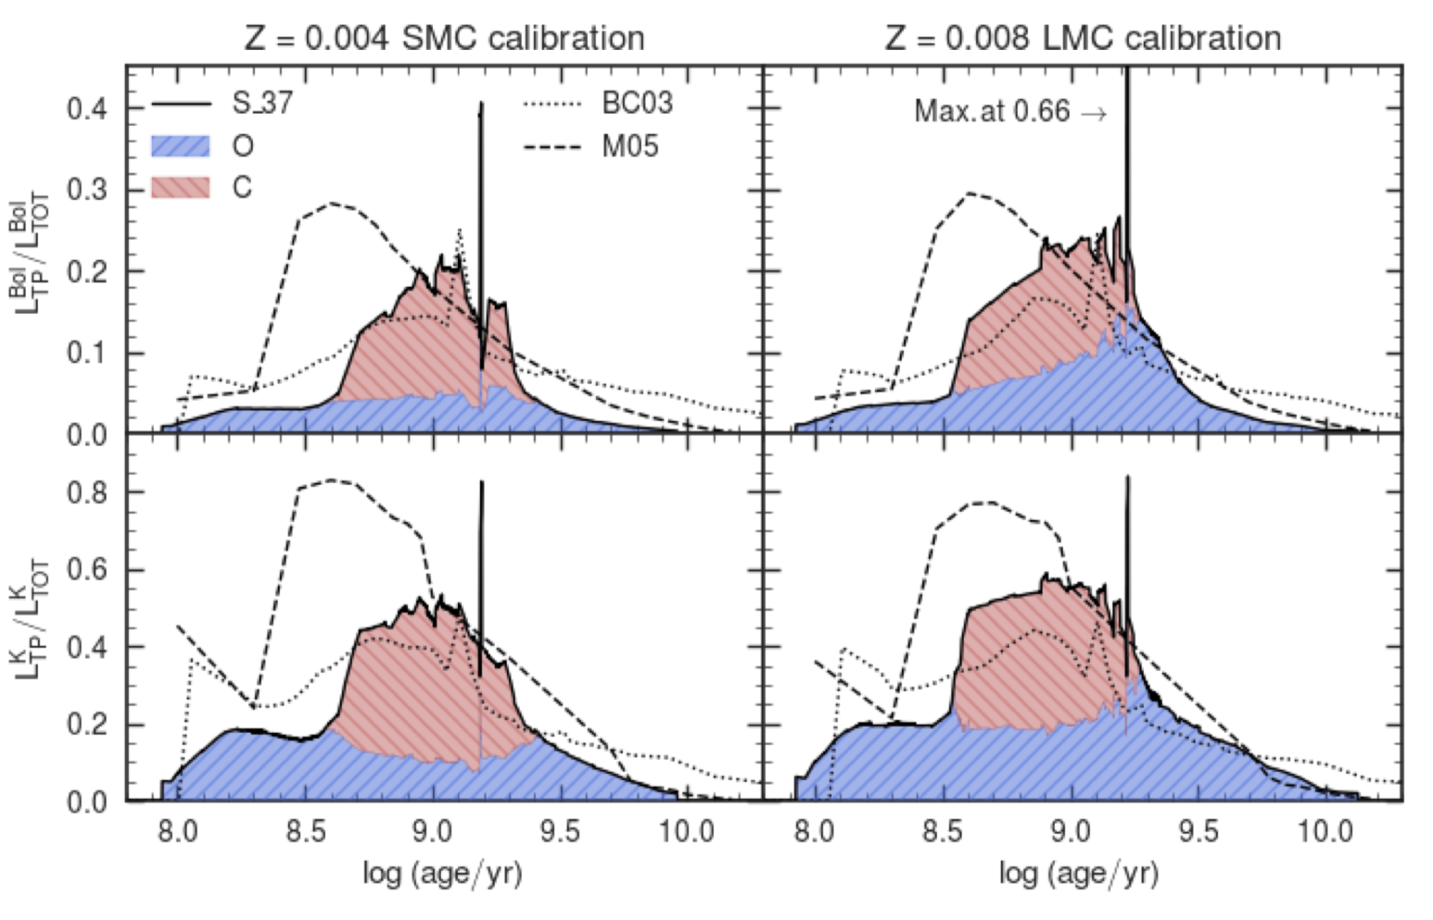
TP-AGB stars & unresolved galaxies
SEDs from models w/ different TP-AGB treatment
Pastorelli+20
From Liu & Luo (2023)

Slide 42
Why do we care about AGB stars?
ISM enrichment (gas & dust), chemical evolution models
Spectrophotometric properties of unresolved galaxies
TP-AGB high luminosity → SFH of distant galaxies
High L & Variability → Powerful distance indicators
Distant
unresolved
galaxies
Nearby
resolved galaxies
Stellar atmosphere

Slide 43
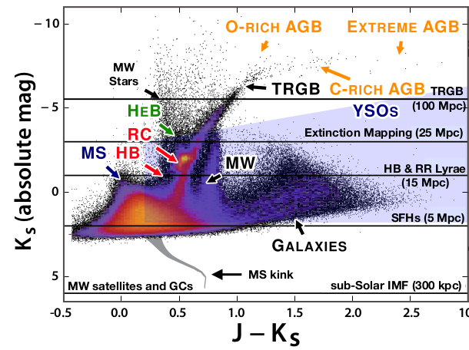
AGB stars & SFH of distant galaxies
(TP-) AGB stars can potentially be used to derive SFH at intermediate ages well beyond the Local Group
Main problems:
Models need to be refined as a function of Zi
Variability

Slide 44
Why do we care about AGB stars?
ISM enrichment (gas & dust), chemical evolution models
Spectrophotometric properties of unresolved galaxies
TP-AGB high luminosity → SFH of distant galaxies
High L & Variability → Powerful distance indicators
Distant
unresolved
galaxies
Nearby
resolved galaxies
Stellar atmosphere

Slide 45
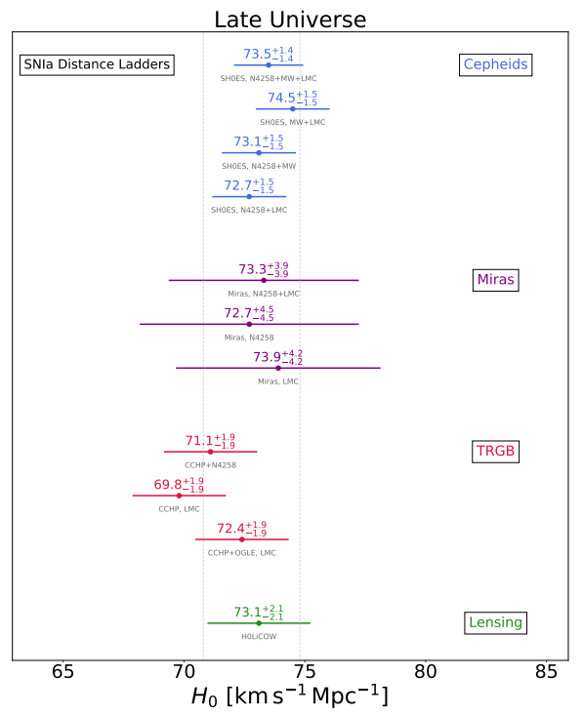
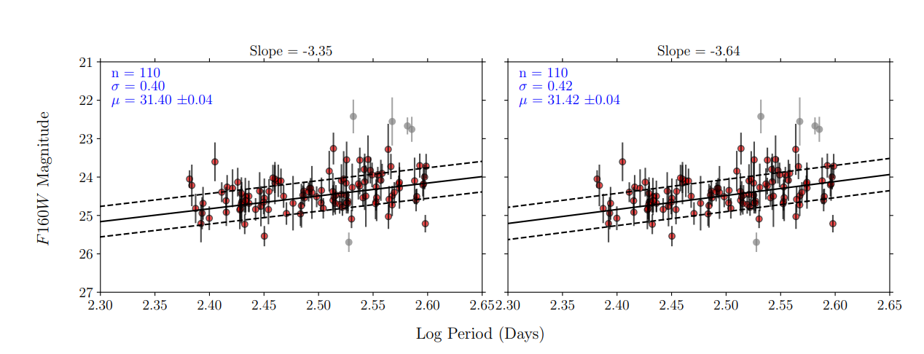
AGB stars as standard candles (?)
Mira variables follow period-luminosity relations
Relatively tight in the IR
O-rich stars (but no HBB!)
Metallicity dependence
Figures from Huang+19,+20

Slide 46
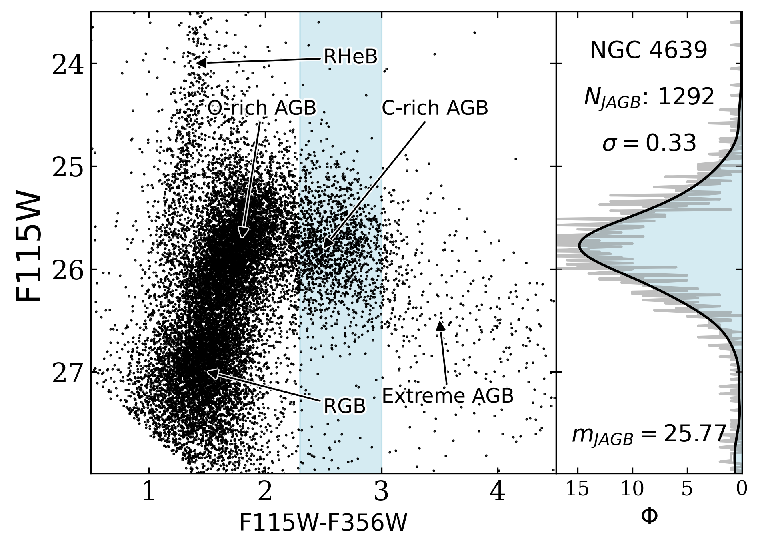
AGB stars as standard candles (?)
AGB stars in J-AGB region seem to have a constant J-band “peak” magnitude → Distances derived with J-AGB method agree with TRGB, Cepheids etc.
(see Madore & Freedman 2020; Freedman & Madore 2020; Ripoche +2020; Zgirski+2021; Parada+2021; Lee+2021b,2022,2021a; Parada+2023; Lee+2023,+2024)
However:
Dependencies on metallicity and other environmental factors to be fully explored
Method to be refined and standardized
(see Magnus+2024, Li+2024)
Lee+2024

Slide 47
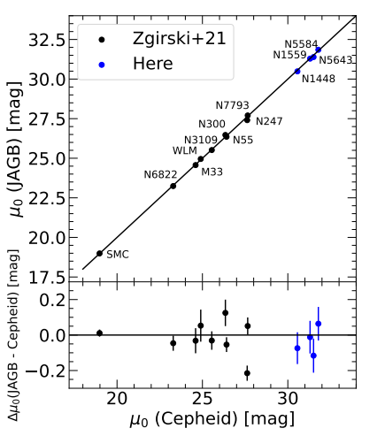
AGB stars as standard candles (?)
AGB stars in J-AGB region seem to have a constant J-band “peak” magnitude → Distances derived with J-AGB method agree with TRGB, Cepheids etc.
(see Madore & Freedman 2020; Freedman & Madore 2020; Ripoche +2020; Zgirski+2021; Parada+2021; Lee+2021b,2022,2021a; Parada+2023; Lee+2023,+2024)
However:
Dependencies on metallicity and other environmental factors to be fully explored
Method to be refined and standardized
(see Magnus+2024, Li+2024)
Li+2024

Slide 48
Why do we care about AGB stars?
ISM enrichment (gas & dust), chemical evolution models
Spectrophotometric properties of unresolved galaxies
TP-AGB high luminosity → SFH of distant galaxies
High L & Variability → Powerful distance indicators
Distant
unresolved
galaxies
Nearby
resolved galaxies
Stellar atmosphere

Slide 49
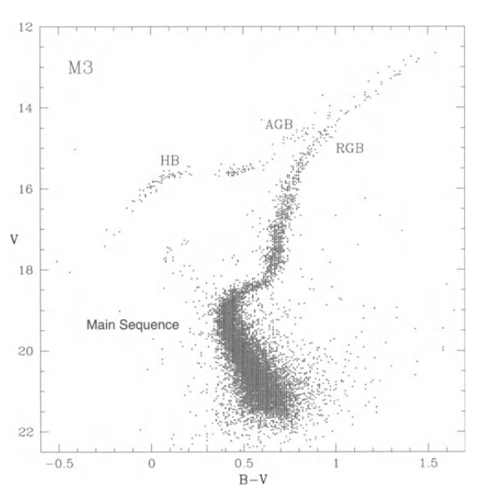
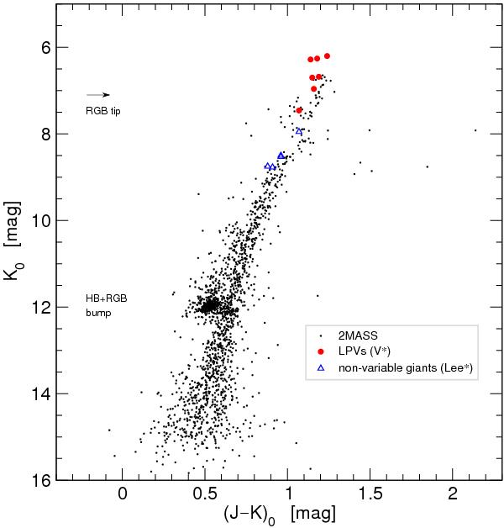
AGBs in stellar clusters
Optical
Infrared
47 Tuc
From Habing & Olofsson(2004)
Lebzelter+14

Slide 50
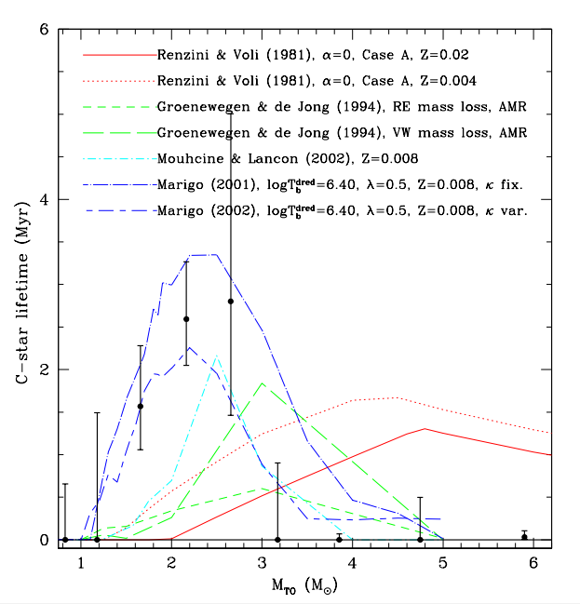
AGBs in stellar clusters
Magellanic Clouds’ clusters: excellent laboratories for testing stellar evolution in general, and AGB models
Main advantages:
“Simple” stellar populations: defined ages (initial masses) and metallicities
Main disadvantages
Small number of AGB stars per cluster
Limited to metallicities of Magellanic Clouds
Calibration of stellar lifetimes with star counts, e.g. C-star lifetime as a function of Mi
Girardi & Marigo 2007

Slide 51
AGBs in the field: Milky Way, MCs, nearby galaxies
Main Advantages
Large number of stars
Range of metallicities
Range of ages
Main disadvantages:
Composite stellar populations: need to know star formation history, (SFR(t), Zi(t))
Mix of ages and metallicities
Reliable photometric identification and classification of AGBs and their chemical type
Boyer+2011

Slide 52
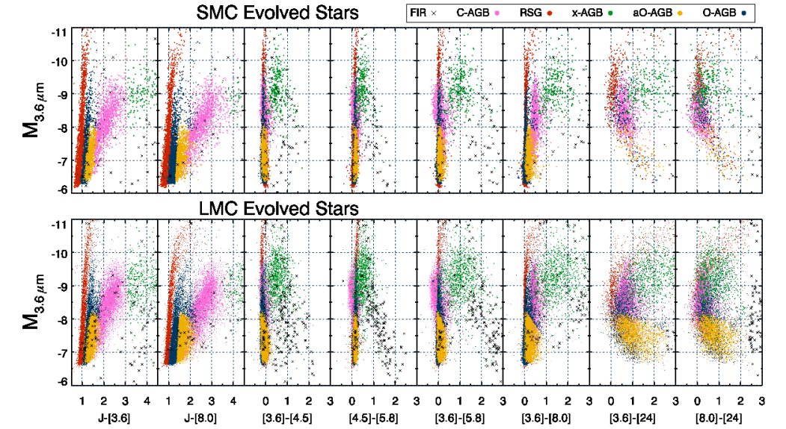
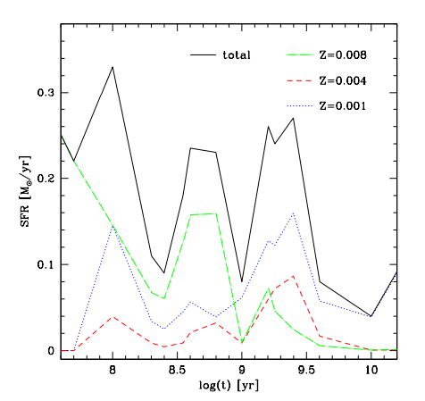
AGB populations in the Clouds
Boyer+2011
Fig. from Dell’Agli+2015, SFH from Harris & Zaritski 2009

Slide 53
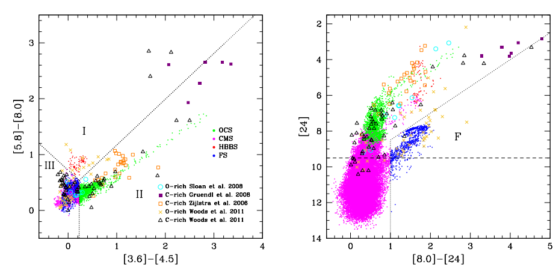
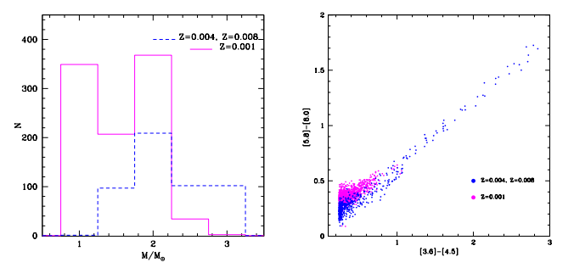
Interpreting AGB populations
Example for the LMC with evolutionary tracks from ATON code and Spitzer data
Figs. from Dell’Agli+2015
Position in CCDs strongly connected with mass, ev. phase, metallicity.
C- and O-rich (especially dusty ones) well separated
“Extreme” AGBs (dust obscured) mostly C-rich (~97%) plus O-rich in HBB phase
Dust production is ~ 85% from C stars, 15% from M stars (given by HBB)

Slide 54
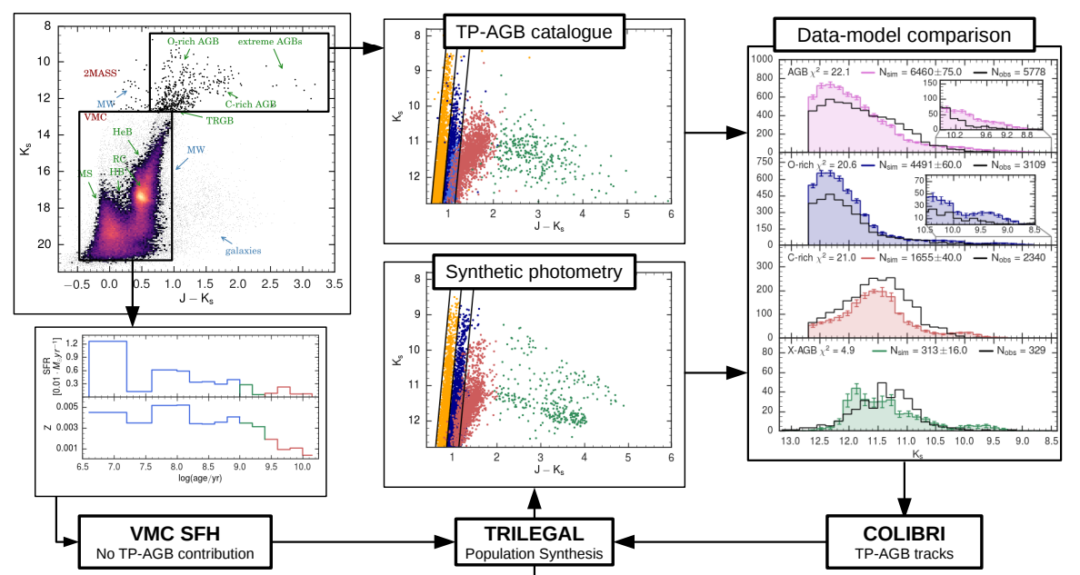
From interpretation to calibration of AGB models
From Pastorelli+19

Slide 55
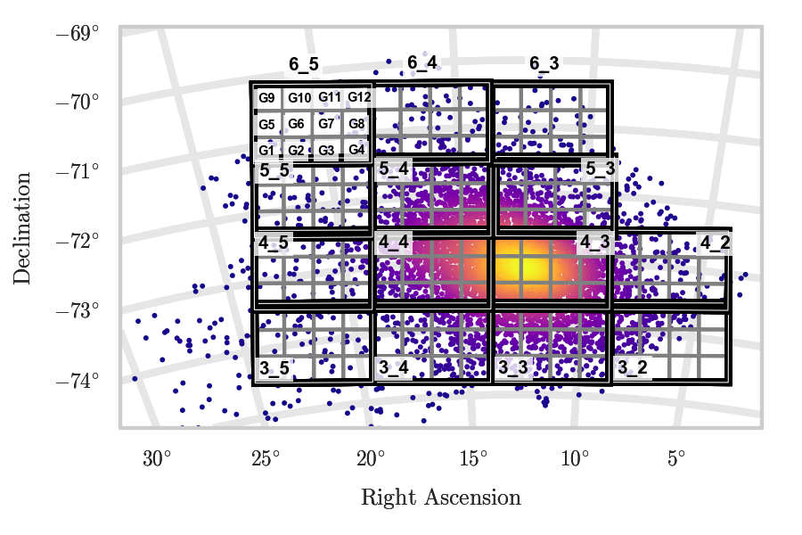
Calibration of AGB models with resolved populations
SAGE-SMC Survey Gordon+11
VMC Survey Cioni+11
(Pastorelli+19)

Slide 56
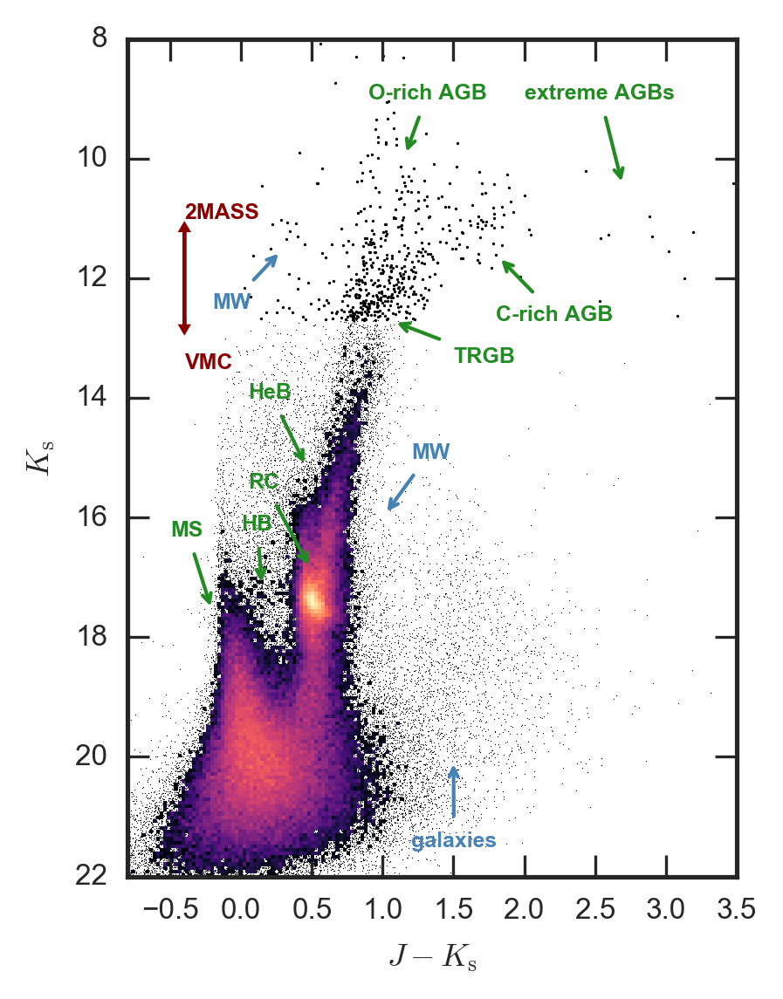
Calibration of AGB models with resolved populations
SAGE-SMC Survey Gordon+11
SAGE-SMC Survey Gordon+11
VMC Survey Cioni+11
VMC Survey Cioni+11
(Pastorelli+19)

Slide 57
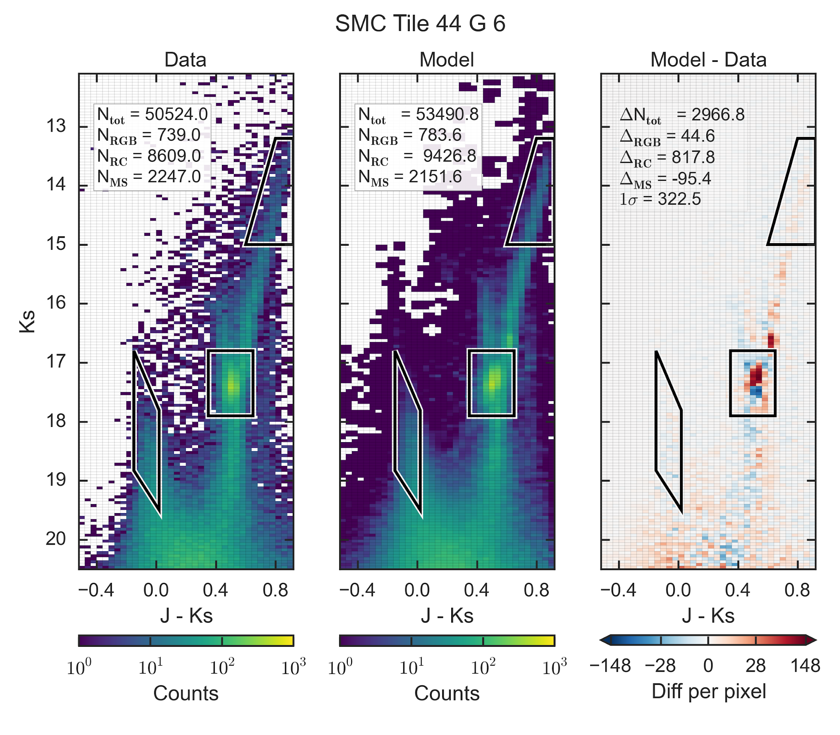
Calibration of AGB models with resolved populations
SAGE-SMC Survey Gordon+11
SAGE-SMC Survey Gordon+11
VMC Survey Cioni+11
VMC Survey Cioni+11
(Pastorelli+19)

Slide 58
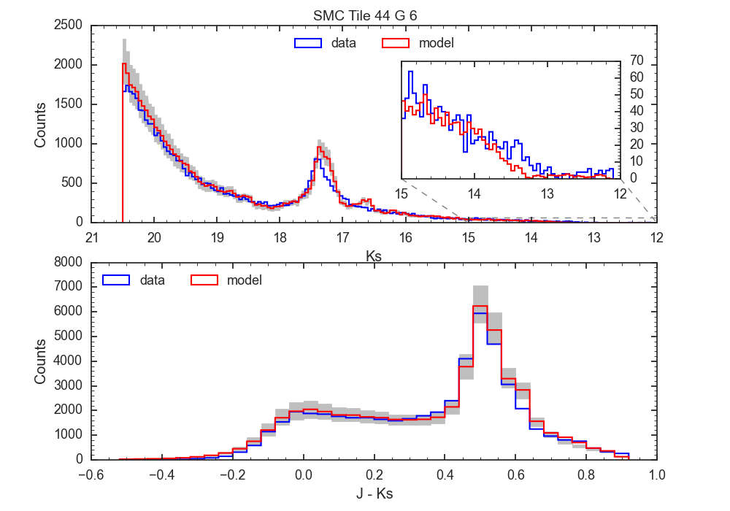
Calibration of AGB models with resolved populations
SAGE-SMC Survey Gordon+11
SAGE-SMC Survey Gordon+11
VMC Survey Cioni+11
VMC Survey Cioni+11
(Pastorelli+19)

Slide 59
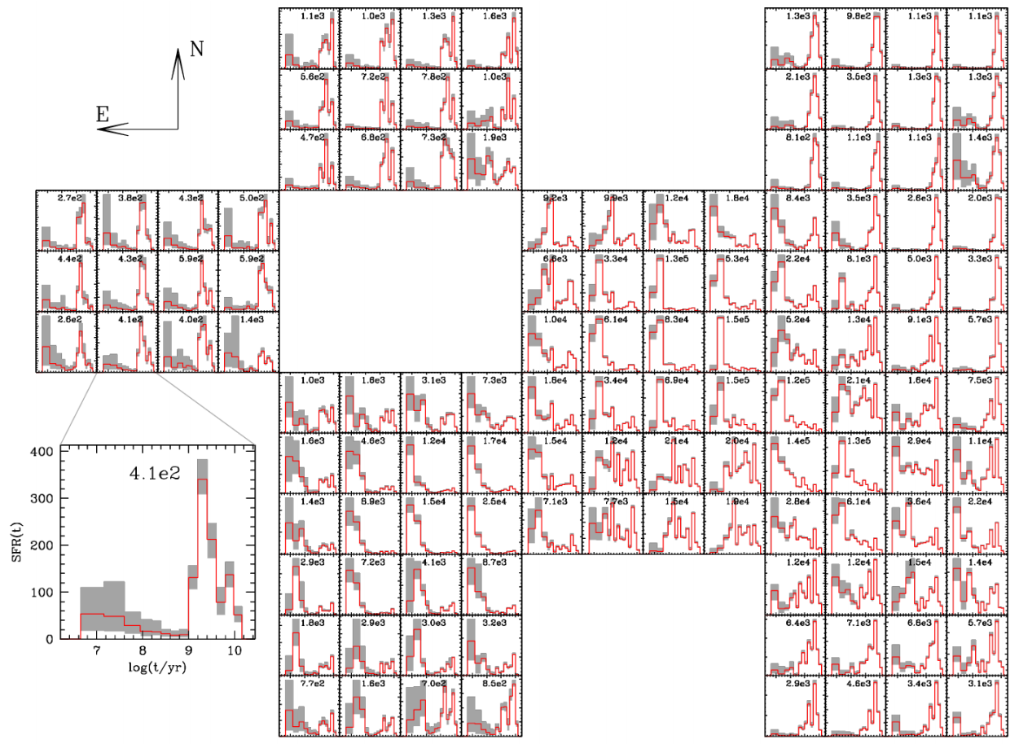
Calibration of AGB models with resolved populations
SAGE-SMC Survey Gordon+11
SAGE-SMC Survey Gordon+11
VMC Survey Cioni+11
VMC Survey Cioni+11
(Pastorelli+19)
Rubele+18

Slide 60
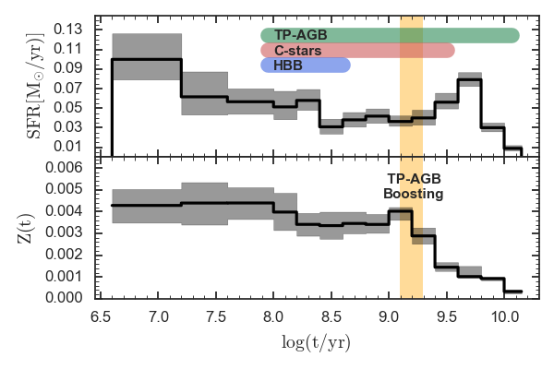
Calibration of AGB models with resolved populations
SAGE-SMC Survey Gordon+11
SFR(t) - Z(t) - DM - Av
Rubele+18
SAGE-SMC Survey Gordon+11
VMC Survey Cioni+11
VMC Survey Cioni+11
o Robust age estimate
down to old MSTO
o No TP-AGB contribution
o PARSEC v1.2s
o VMC-SAGE overlap ~ 87 %
147 sub-fields → 21 deg²
(Pastorelli+19)

Slide 61
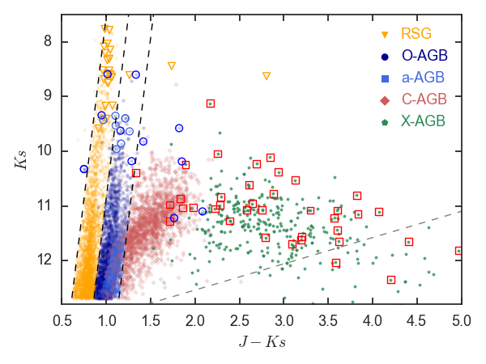
Calibration of AGB models with resolved populations
SAGE-SMC Survey Gordon+11
SFR(t) - Z(t) - DM - Av
Rubele+18
AGB catalogs
Boyer+11, Srinivasan+16
SAGE-SMC Survey Gordon+11
VMC Survey Cioni+11
VMC Survey Cioni+11
o Robust age estimate
down to old MSTO
o No TP-AGB contribution
o PARSEC v1.2s
o VMC-SAGE overlap ~ 87 %
147 sub-fields → 21 deg²
AGB = 5 792
C-rich = 2 340
O-rich = 3 109
X-AGB = 343
(Pastorelli+19)

Slide 62
Third dredge-up & Mass loss
Onset of 3DU
Minimum initial mass for C-star formation
Efficiency of 3DU
Amount of dredged-up material → chemical enrichment of the photosphere
Core-mass growth → Initial-to-final mass relation (IFMR)
Maximum initial mass for C-star formation
Efficiency of mass loss
AGB lifetime and number of thermal pulses
→ Number of 3DU episodes and the duration of HBB
Level of chemical enrichment
Remnant mass (IFMR)

Slide 63
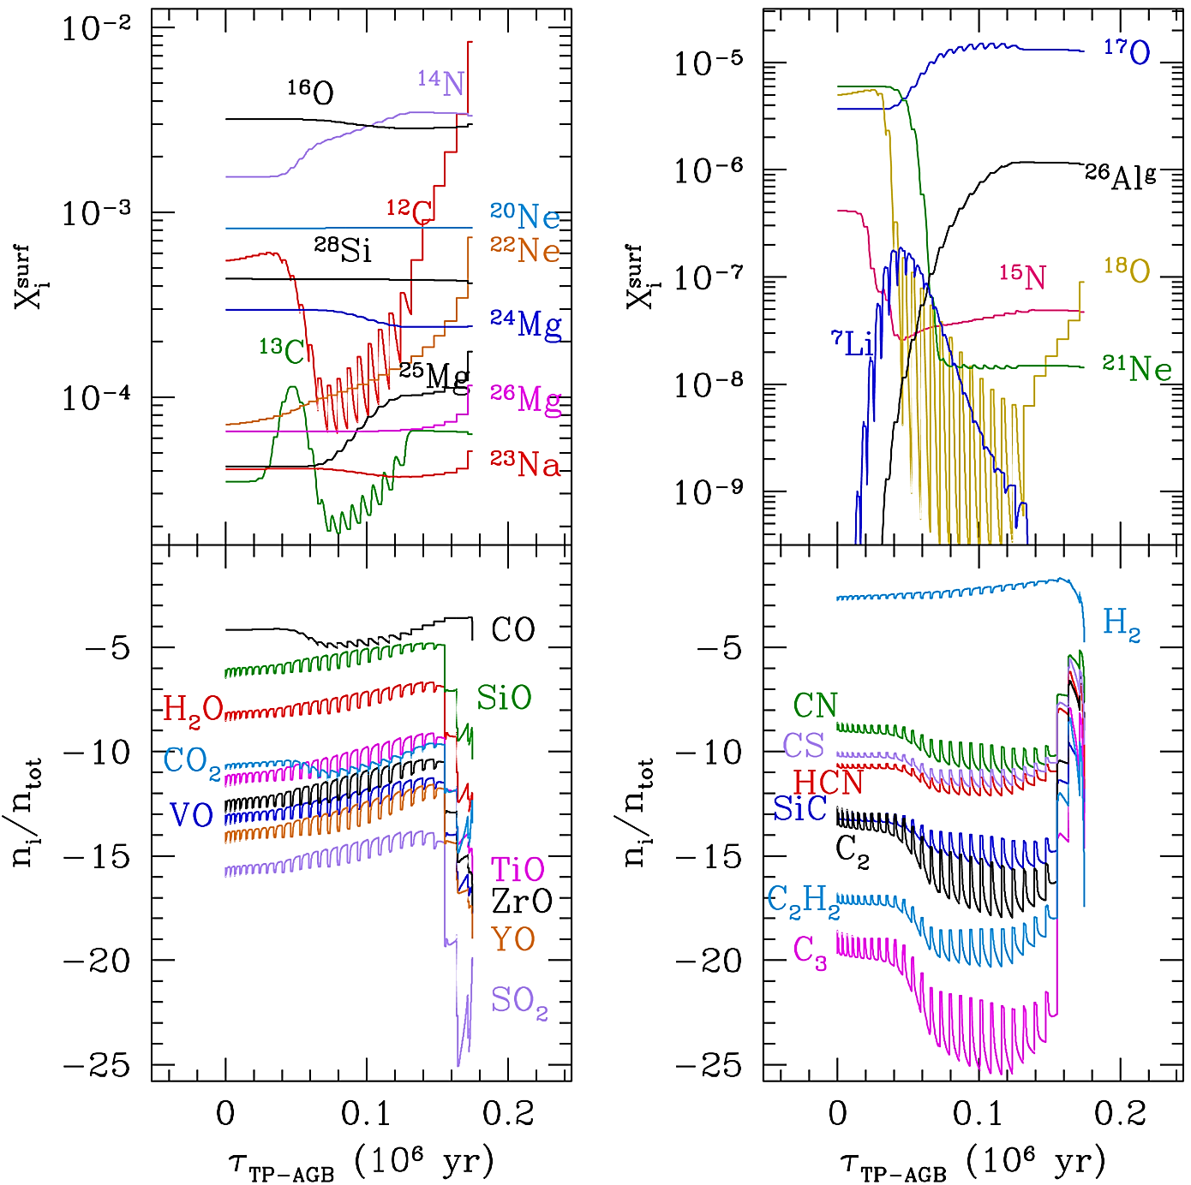
TP-AGB evolution with COLIBRI
Physical Accuracy:
On-the-fly computation of molecular chemistry and opacities (Marigo & Aringer+09)
HBB nucleosynthesis: CNO cycle, NeNa, MgAl chains
Quick calculations of large grids of models:
11 Zi x ~ 70 Mi values: 770 TP-AGB tracks
100X faster than full TP-AGB models
Parametrized description of:
Third dredge-up
Mass loss
log
log
COLIBRI Code Marigo+13

Slide 64
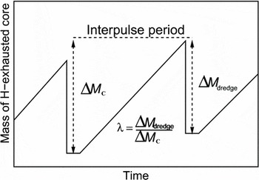
TP-AGB evolution with COLIBRI
1) Onset
→ M_{c,min}: minimum core mass for the onset of the
sequence of 3DUP events
2) Efficiency λ

Slide 65
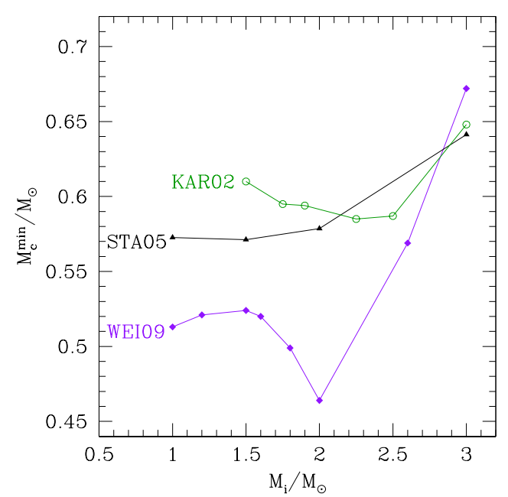
TP-AGB evolution with COLIBRI
1) Onset
→ M_{c,min}: minimum core mass for the onset of the
sequence of 3DUP events
2) Efficiency λ
→ mass dredged up into the envelope over the mass by which the H-exhausted core has grown during the preceding interpulse period
Marigo+13

Slide 66
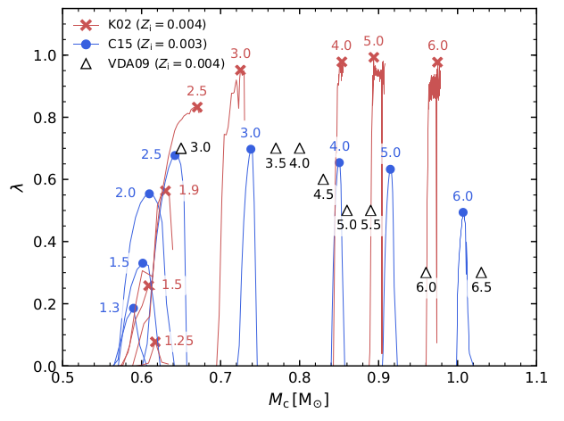
TP-AGB evolution with COLIBRI
1) Onset
→ M_{c,min}: minimum core mass for the onset of the
sequence of 3DUP events
2) Efficiency λ
Marigo+13
Pastorelli+19

Slide 67
TP-AGB evolution with COLIBRI
1) Pre-dust regime
Formalisms based on Alfven waves and turbulence in the cool extended chromosphere (Schröder & Cuntz 2005, Cranmer & Saar 2011)
Efficiency parameter η_{pre-dust}
Active before the 1TP (upper early-AGB phase)
2) Dust-driven regime
O-rich: empirical mass-loss prescriptions (Mi, Zi, L, Teff), efficiency parameter η_{dust} (Blöcker 1995, Vassiliadis & Wood, 1993)
C-rich: dynamical model atmospheres “CDYN” (Mi, Zi, L, Teff, C-O) (Eriksson+14, Mattson+10)

Slide 68
Reproducing Ks-band LFs for all AGB classes
AGB + 11.8 %
O-rich + 44.4 %
LF faint-end dominated by low-mass (1 M☉) low-metallicity (Z_{i}=0.001) stars
C-rich - 33.2 %
X-AGB + 23.4 %
C-rich and X-AGB:
1.8 - 2 M☉ & Zi ~ 0.004
Pastorelli+19

Slide 69
Reproducing Ks-band LFs for all AGB classes

Slide 70
Reproducing Ks-band LFs for all AGB classes
AGB
O-rich
C-rich
X-AGB

Slide 71
Reproducing Ks-band LFs for all AGB classes
Pastorelli+19

Slide 72
Reproducing Ks-band LFs for all AGB classes
TP-AGB COLIBRI models’ calibration
Less efficient 3DUP (M_{i}>3M☉) + lower mass-loss efficiency
Pre-dust mass-loss important for low-mass O-rich stars
Mass-loss based on C-star dynamical models
C-stars Mi ~ [1.4 - 2.8☉]
Pastorelli+19

Slide 73
Metallicity dependence: the LMC
SMC best-fit ~ Zi=0.004
does not work well in LMC with Zi ~0.008
Pastorelli+20

Slide 74
Metallicity dependence: the LMC
SMC best-fit ~ Zi=0.004
does not work well in LMC with Zi ~0.008
New COLIBRI models computed with a delayed onset of the 3DU
Pastorelli+20

Slide 75
Metallicity dependence: the LMC
SMC best-fit ~ Zi=0.004
LMC best-fit Zi ~0.008
New COLIBRI models computed with a delayed onset of the 3DU and a lower 3DU efficiency
Pastorelli+20

Slide 76
Metallicity dependence: the LMC
Pastorelli+2020

Slide 77
Beyond the magellanic Clouds
LG dwarfs SMC LMC M33 M31
(Marigo+13, Boyer+13)
Adapted from Boyer+19

Slide 78
Dwarf galaxies (metal-poor regime)
WFC3/IR on HST: F127M, F139M, F153M to separate C- and O-rich stars
(Boyer+13,17)
(Boyer+13,17)

Slide 79
Dwarf galaxies (metal-poor regime)
Pastorelli in prep.

Slide 80
Dwarf galaxies (metal-poor regime)
More metal-poor → → → More metal-rich
Pastorelli in prep.

Slide 81
Dwarf galaxies with JWST
Boyer+24

Slide 82
M33 and M31 (solar, super-solar regime)
(Dalcanton+12)

Slide 83
M33 and M31 (solar, super-solar regime)
HST broad-band optical + IR & HST medium-band
HST Cycle 23 - GO 14072 (PI Boyer) & HST Cycle 27 - GO 15932 (PI Boyer)

Slide 84
M33 and M31 (solar, super-solar regime)
~21 400
(Boyer+19)
(Chen in prep.)

Slide 85
Constraints from the IFMR
→ Shallow 3DU efficiency for Mi ~ 1.65 - 2 Msun
→ Mass-loss formulation that depends on the C abundance
Too efficient 3DU λ ~ 0.5
Mass-loss insensitive to
C abundance (Blocker,95)
Less efficient 3DU &
Mass loss depends on C-O
(Marigo+20 NatAstro)

Slide 86
AGB stars in the Gaia-2MASS diagram
Adapted from Lebzelter+18
Evolutionary stage, initial masses, chemical type from photometry alone

Slide 87
AGB stars in the Gaia-2MASS diagram
AGB stars with Mi <1.3 do not become C-stars → Evolve in the left part of the diagram in the lower luminosity branch
When AGBs with 1.2 < Mi < 3 become C-star → Jump to the right part of the diagram
AGBs with Mi>3 do not become C-stars, might experience HBB
Evolve in the left part at higher luminosities, can evolve to the right thanks to mass-loss
Lebzelter+18

Slide 88
Gaia and AGB stars in the Milky Way
Stellar parameters and dynamics of AGB stars with Gaia parallaxes and 3D Hydrodynamics simulations of convection (Chiavassa+2024)

Slide 89
Gaia and AGB stars in the Milky Way
Stellar parameters and dynamics of AGB stars with Gaia parallaxes and 3D Hydrodynamics simulations of convection (Chiavassa+2024)
Correlations between:
Photocentre displacement and pulsation period
Pulsation period and stellar parameters

Slide 90
Gaia and AGB stars in the Milky Way
Stellar parameters and dynamics of AGB stars with Gaia parallaxes and 3D Hydrodynamics simulations of convection (Chiavassa+2024)
Correlations between:
Photocentre displacement and pulsation period
Pulsation period and stellar parameters
Parallax uncertainties
Stellar parameters

Slide 91
AGB stars with interferometry
Images of the stellar surface of π¹ Gruis reconstructed from the interferometric data from PIONIER mounted at the Very Large Telescope Interferometer (VLTI; Cerro Paranal, Chile). From Paladini+2018
The bright spots are associated with convective patterns
π1 Gruis is an S-type AGB star

Slide 92
Conclusion
TP-AGB models qualitatively reproduce many observables
TP-AGB models uncertainties mainly due to mass-loss and convection
Models in the literature conflict in many key predictions
Complementarity between full-model calculations and hybrid models
Recent advancements in observations (e.g. Gaia, JWST, interferometry) and 3D hydrodynamic models are very promising
Given the impact of the TP-AGB phase, models can and should be constrained as a function of mass and metallicity with many observables (from stellar clusters to nearby galaxies)

