Slide 1
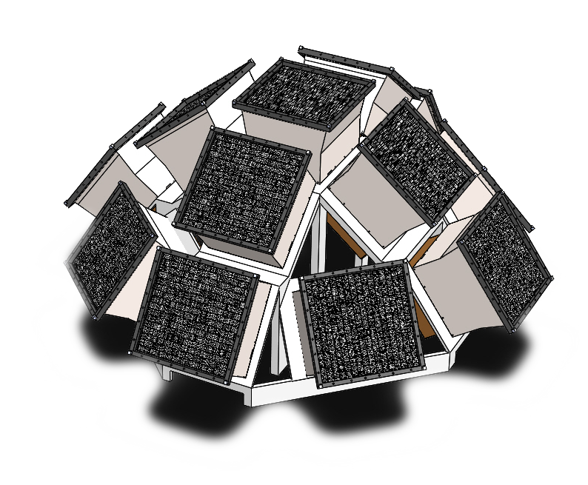
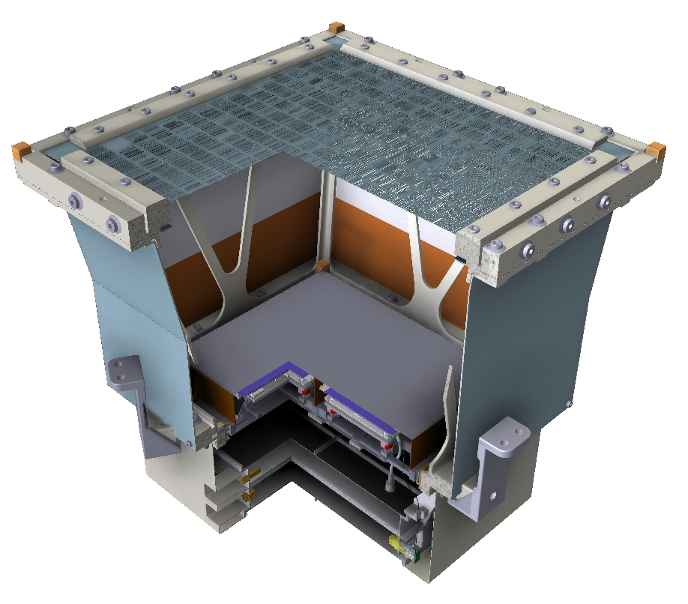
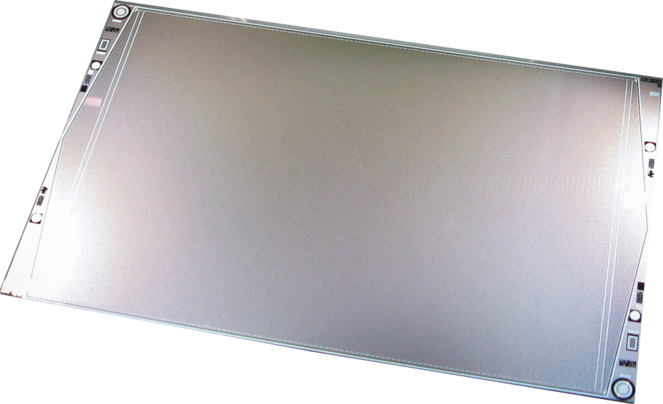
LEM-X Lunar Electromagnetic Monitor in X-rays
Y. Evangelista INAF-IAPS
on behalf of the EMM/LEM-X Team
LGWA Workshop – 8 October 2024

Slide 2
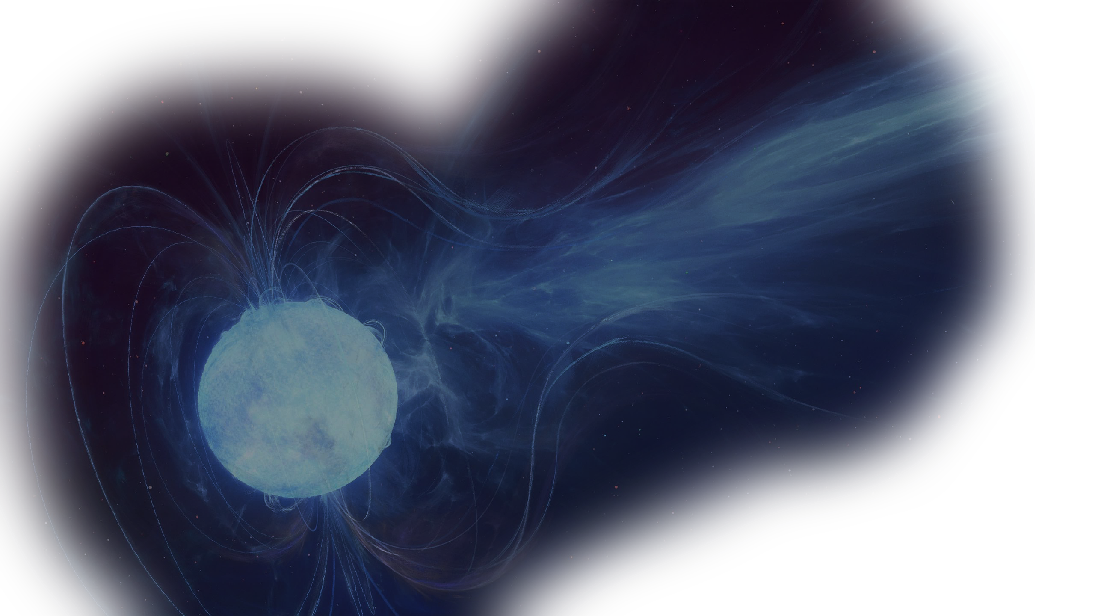
Photon-based Astronomy is now integrated into the broader multi-messenger framework, together with GWs, neutrinos and cosmic-rays
Interesting phenomena for multi-messenger Astronomy are produced in transient events and variable sources, thus require the simultaneous observation of all the sky
The Moon offers an interesting platform for an all-sky X-ray monitor since we can install larger and heavier instruments than on a satellite. The all-sky coverage can be obtained by exploiting the rotation of the Moon itself
A high performance, wide FoV, X-ray monitor is essential to provide prime observation
of the violent high-energy sky

Slide 3
What we need:
High energy (10⁰ keV – 10² keV)
Large instantaneous FoV (goal π/2π steradians)
All sky coverage/long continuous observations
Arcmin-level angular res.
Sub-arcmin level PSLA
Moderate/large effective area (10² cm²)
Good sensitivity (1 Crab in 1s)
Photon-by-photon capability
Good energy resolution (better than 500eV @ 6 keV)
High time resolution (better 10 µs)
Low (~negligible) dead time
What does our MOON offer?

Slide 4
What we need:
High energy (10⁰ keV – 10² keV)
Large instantaneous FoV (goal π/2π steradians)
All sky coverage/long continuous observations
Arcmin-level angular res.
Sub-arcmin level PSLA
Moderate/large effective area (10² cm²)
Good sensitivity (1 Crab in 1s)
Photon-by-photon capability
Good energy resolution (better than 500eV @ 6 keV)
High time resolution (better 10 µs)
Low (~negligible) dead time
What does our MOON offer?
No atmosphere

Slide 5
What we need:
High energy (10⁰ keV – 10² keV)
Large instantaneous FoV (goal π/2π steradians)
All sky coverage/long continuous observations
Arcmin-level angular res.
Sub-arcmin level PSLA
Moderate/large effective area (10² cm²)
Good sensitivity (1 Crab in 1s)
Photon-by-photon capability
Good energy resolution (better than 500eV @ 6 keV)
High time resolution (better 10 µs)
Low (~negligible) dead time
What does our MOON offer?
No atmosphere
Full-sky (equator)/half sky (poles) accessibility
Stable environment
~Continuous operation

Slide 6
What we need:
High energy (10⁰ keV – 10² keV)
Large instantaneous FoV (goal π/2π steradians)
All sky coverage/long continuous observations
Arcmin-level angular res.
Sub-arcmin level PSLA
Moderate/large effective area (10² cm²)
Good sensitivity (1 Crab in 1s)
Photon-by-photon capability
Good energy resolution (better than 500eV @ 6 keV)
High time resolution (better 10 µs)
Low (~negligible) dead time
What does our MOON offer?
No atmosphere
Full-sky (equator)/half sky (poles) accessibility
Stable environment
~Continuous operation
Resources (volume, power, telemetry)
Modular assembly capability
Instrument serviceability

Slide 7
What we need:
High energy (10⁰ keV – 10² keV)
Large instantaneous FoV (goal π/2π steradians)
All sky coverage/long continuous observations
Arcmin-level angular res.
Sub-arcmin level PSLA
Moderate/large effective area (10² cm²)
Good sensitivity (1 Crab in 1s)
Photon-by-photon capability
Good energy resolution (better than 500eV @ 6 keV)
High time resolution (better 10 µs)
Low (~negligible) dead time
What does our MOON offer?
No atmosphere
Full-sky (equator)/half sky (poles) accessibility
Stable environment
~Continuous operation
Resources (volume, power, telemetry)
Modular assembly capability
Instrument serviceability
“Mild” radiation environment (wrt high elliptical orbits) and/or possibly stable low temperature

Slide 8
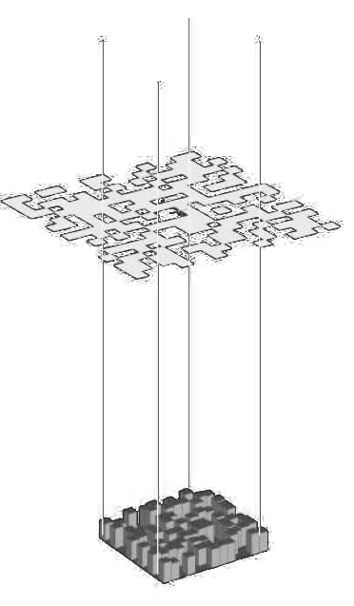
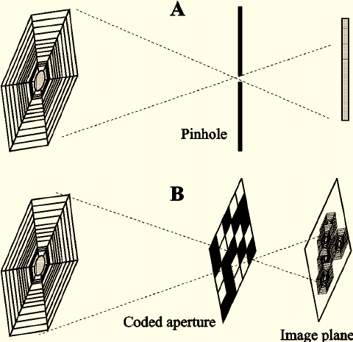
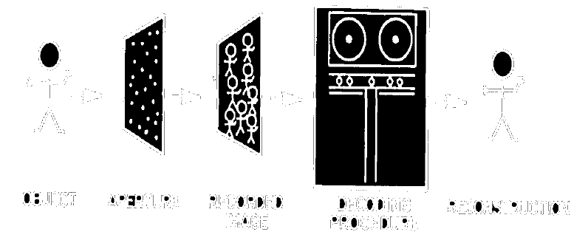
How?
Each detector pixel detects photons from the whole FoV. Coded-mask camera requires that every sky position is uniquely encoded on the detector
→ The coded-mask technique is not yet surpassed for wide FoV imaging with large E_{ff}

Slide 9
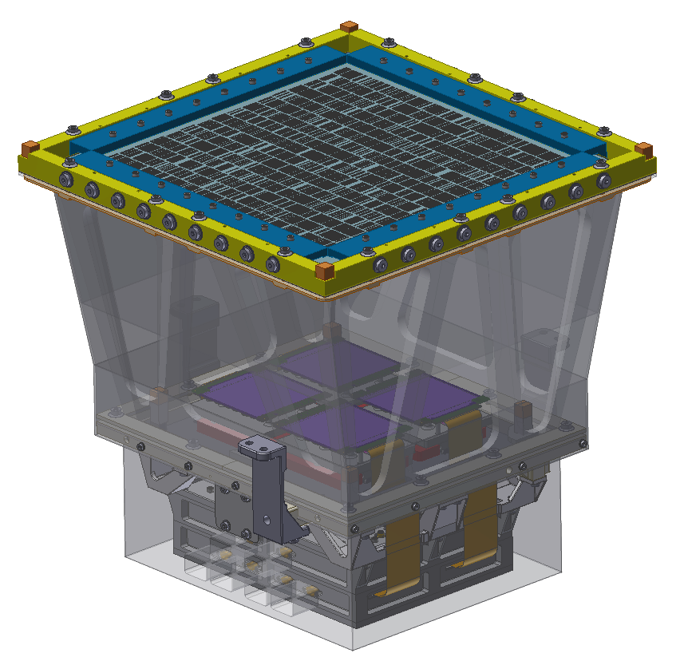
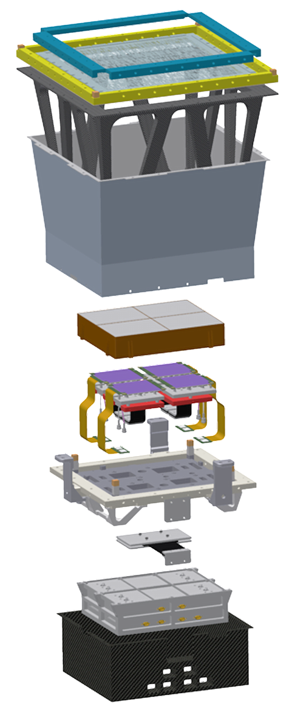
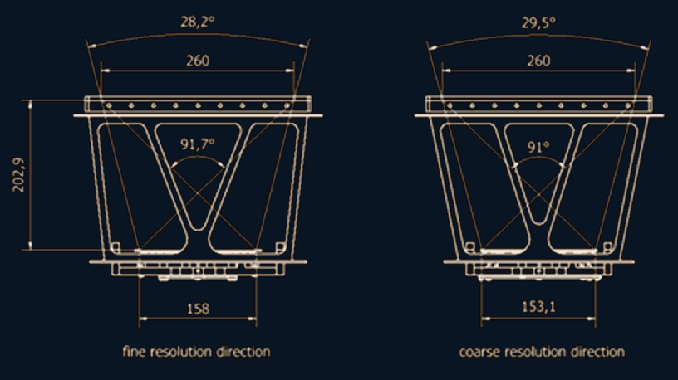
Coded-mask assembly
Collimator assembly
Micrometeoroid filter
Detector tray assembly
Digital electronics/PSU

Slide 10
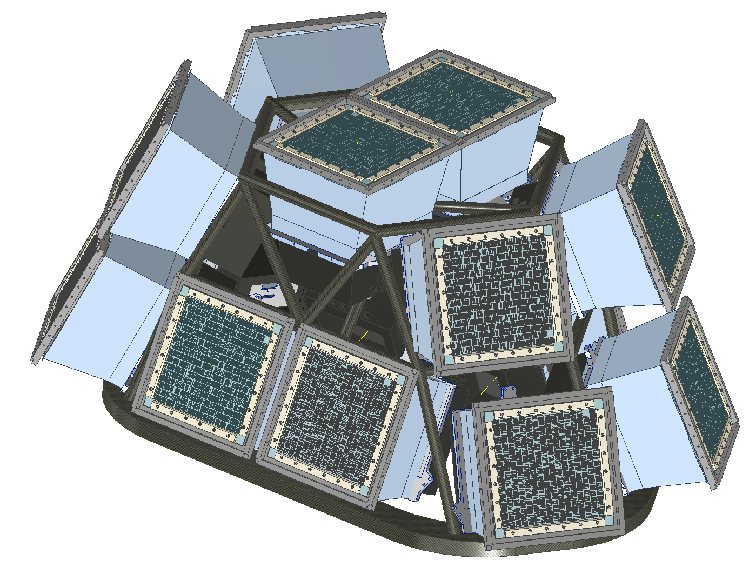
The Lunar Electromagnetic Monitor in X-rays (LEM-X) project aims at developing a large, permanent X-ray observatory.
The instrument is a coded-aperture all-sky monitor, operating in the X-ray energy band (2–50 keV).
Each LEM-X camera is equipped with four large-area Silicon Drift Detectors (SDDs) and is capable of monitoring and imaging the high-energy sky in a 1sr field-of-view

Slide 11
The high-resolution SDD detection plane will allow for a source localization accuracy of ~1 arcmin and a spectral resolution better than 350 eV FWHM at 6 keV, with a sensitivity better than 5 mCrab in 50 ks and 1 Crab in 1 s.
Each LEM-X module is:
Autonomous (with integrated BEE and PSU electronics)
Compact (about 35×35×35 cm³)
Light-weight (~15 kg)
With low power consumption (15 W).

Slide 12
LEM-X in the context of EMM
LEM-X is an Italian R&D project aiming to build the foundation for an Astrophysics instrument on the surface of the Moon
LEM-X belongs to the Earth-Moon-Mars (EMM) project funded by MUR and lead by INAF under PNRR (Next Generation EU)
The project relies on the heritage and technology readiness of the WFM aboard eXTP

Slide 13
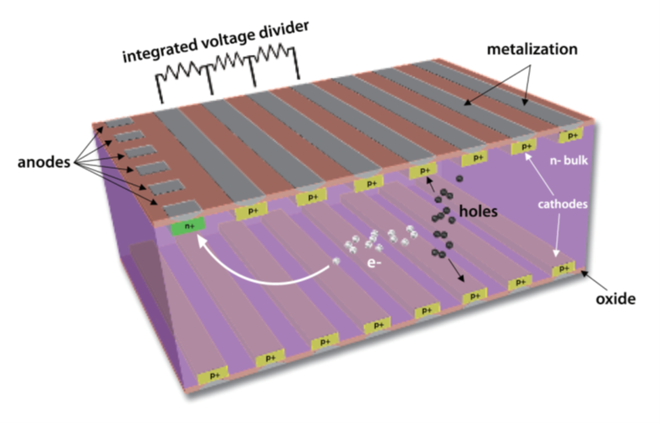
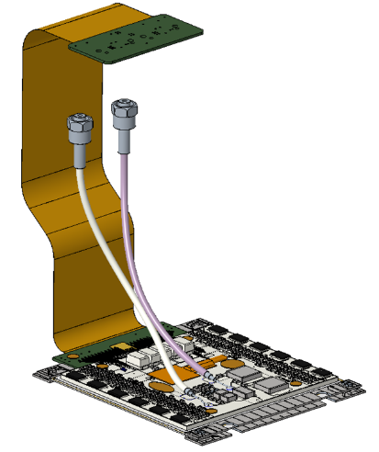
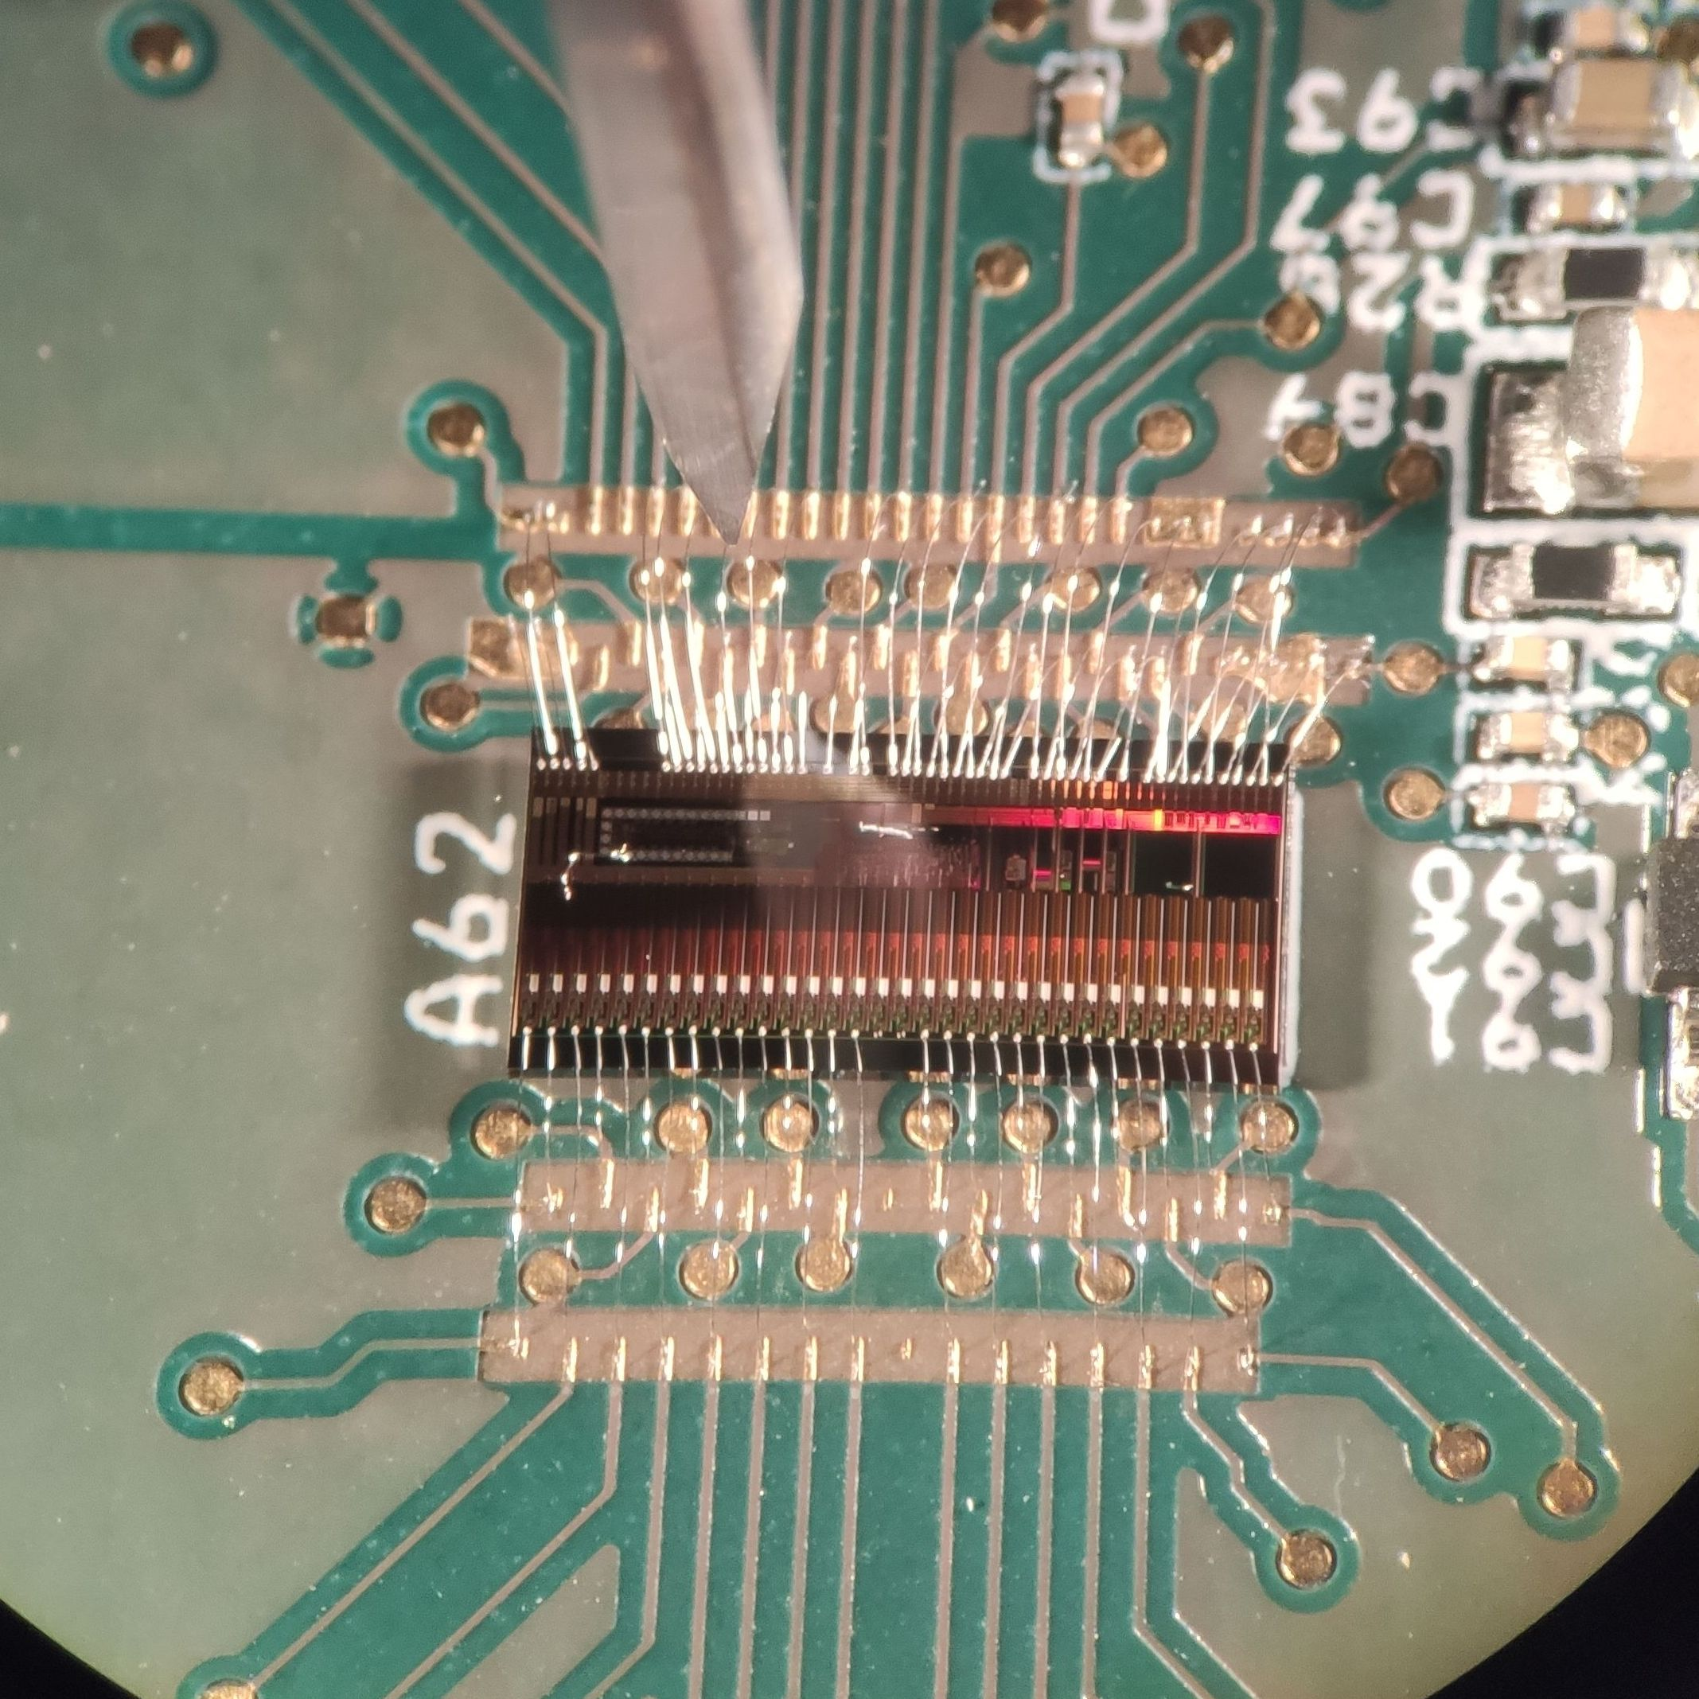
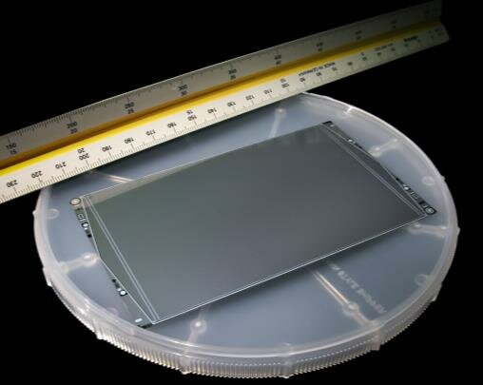
In the contest of the Italian National Recovery and Resilience Plan (PNRR/NRRP), INAF is now developing the LEM-X detector tray, composed by 4× Detector Assemblies (DA) based on the heritage of the WFM designed for the Sino-European mission eXTP.
Project will be completed by 0612/2025.
The DA is based on the Large-Area Silicon Drift Detectors (monolithic 7x7 cm² sensors) designed & developed by a collaboration involving INFN, INAF and FBK
The read-out (AFE) and ADC (DFE) ASICs design rely on the heritage of the VEGA, LYRA and ORION ASICs developed by PoliMi and UniPV in the framework of the ReDSoX collaboration (+HERMES, +THESEUS)
The AlO₂ thick-film FEE PCB is being developed to ensure electrical and thermoelastic (i.e. alignment) performance

Slide 14
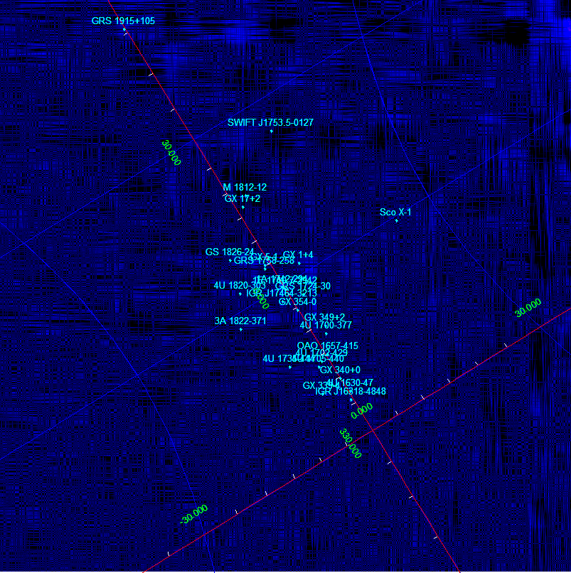
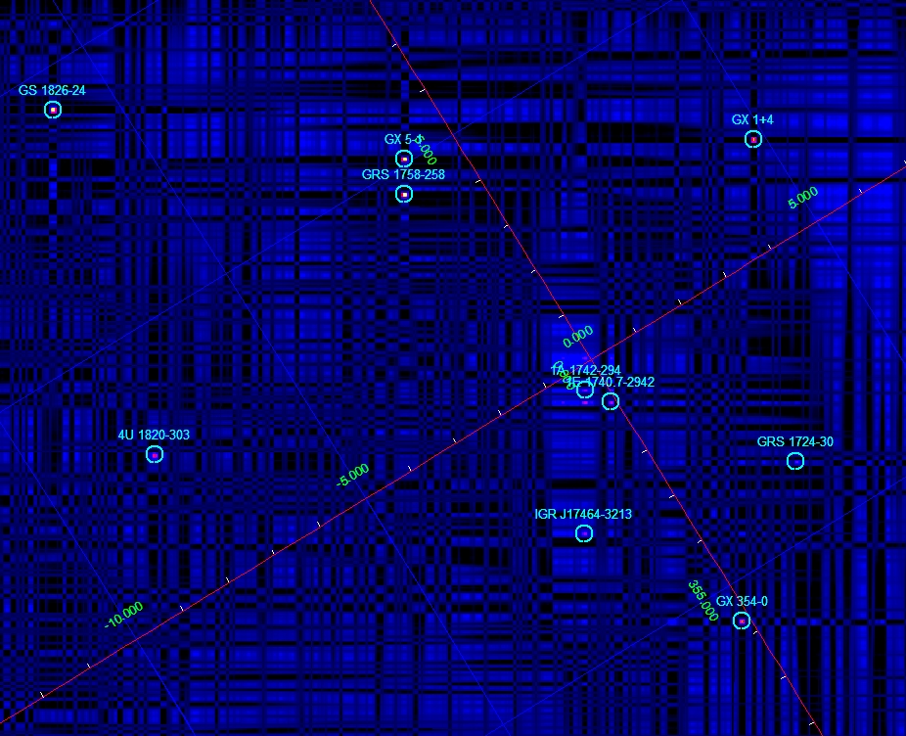
LEM-X camera anticipated performance
Field of View: 1.0 sr (50% effective area)
Angular res. < 4.7 arcmin
PSLA: < 1 arcmin PSLA
Sensitivity: 1 Crab/1s, 4.5 mCrab/50 ks
Energy band: 2-50 keV
Energy res.: <350 eV FWHM @ 6 keV
Eff. area: 80 cm² @ 6 keV (on-axis)
Time resolution: < 7 µs
Dead time: < 1% @ 10 Crab

Slide 15
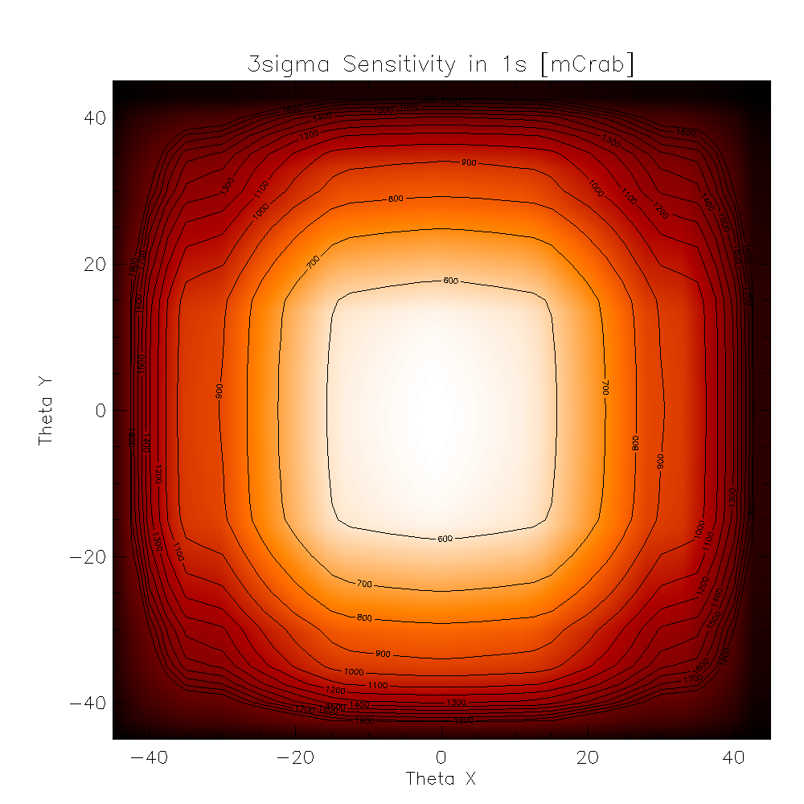
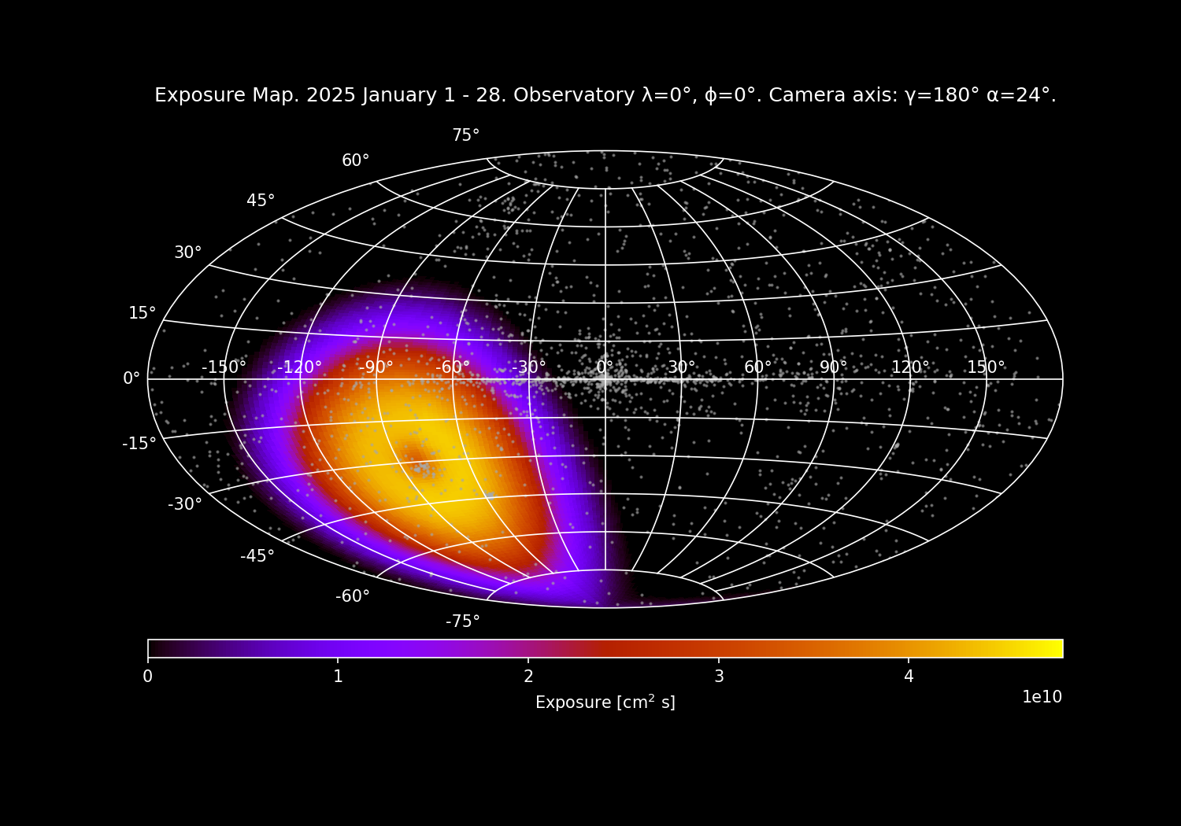
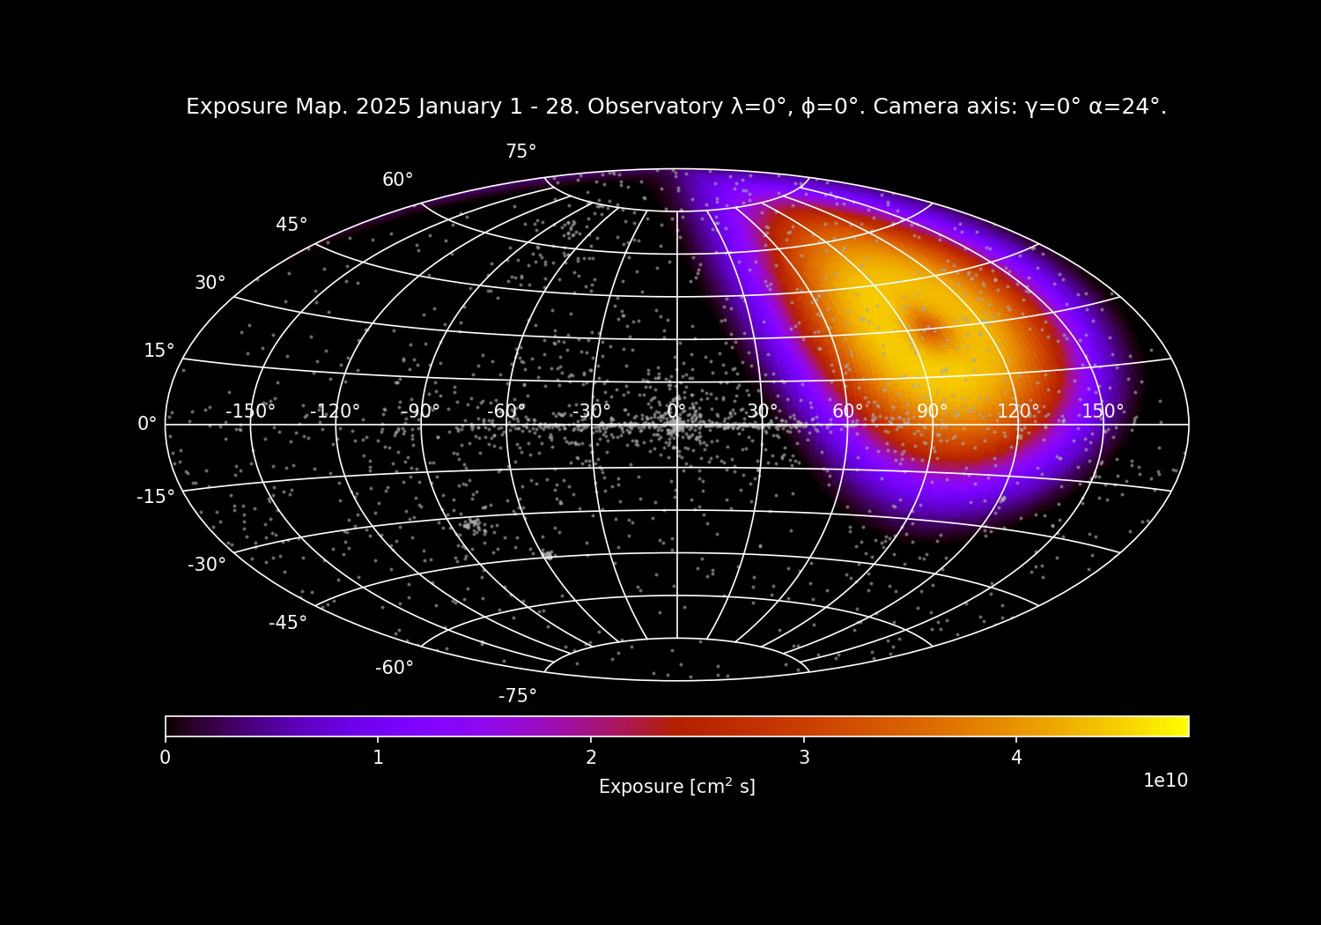
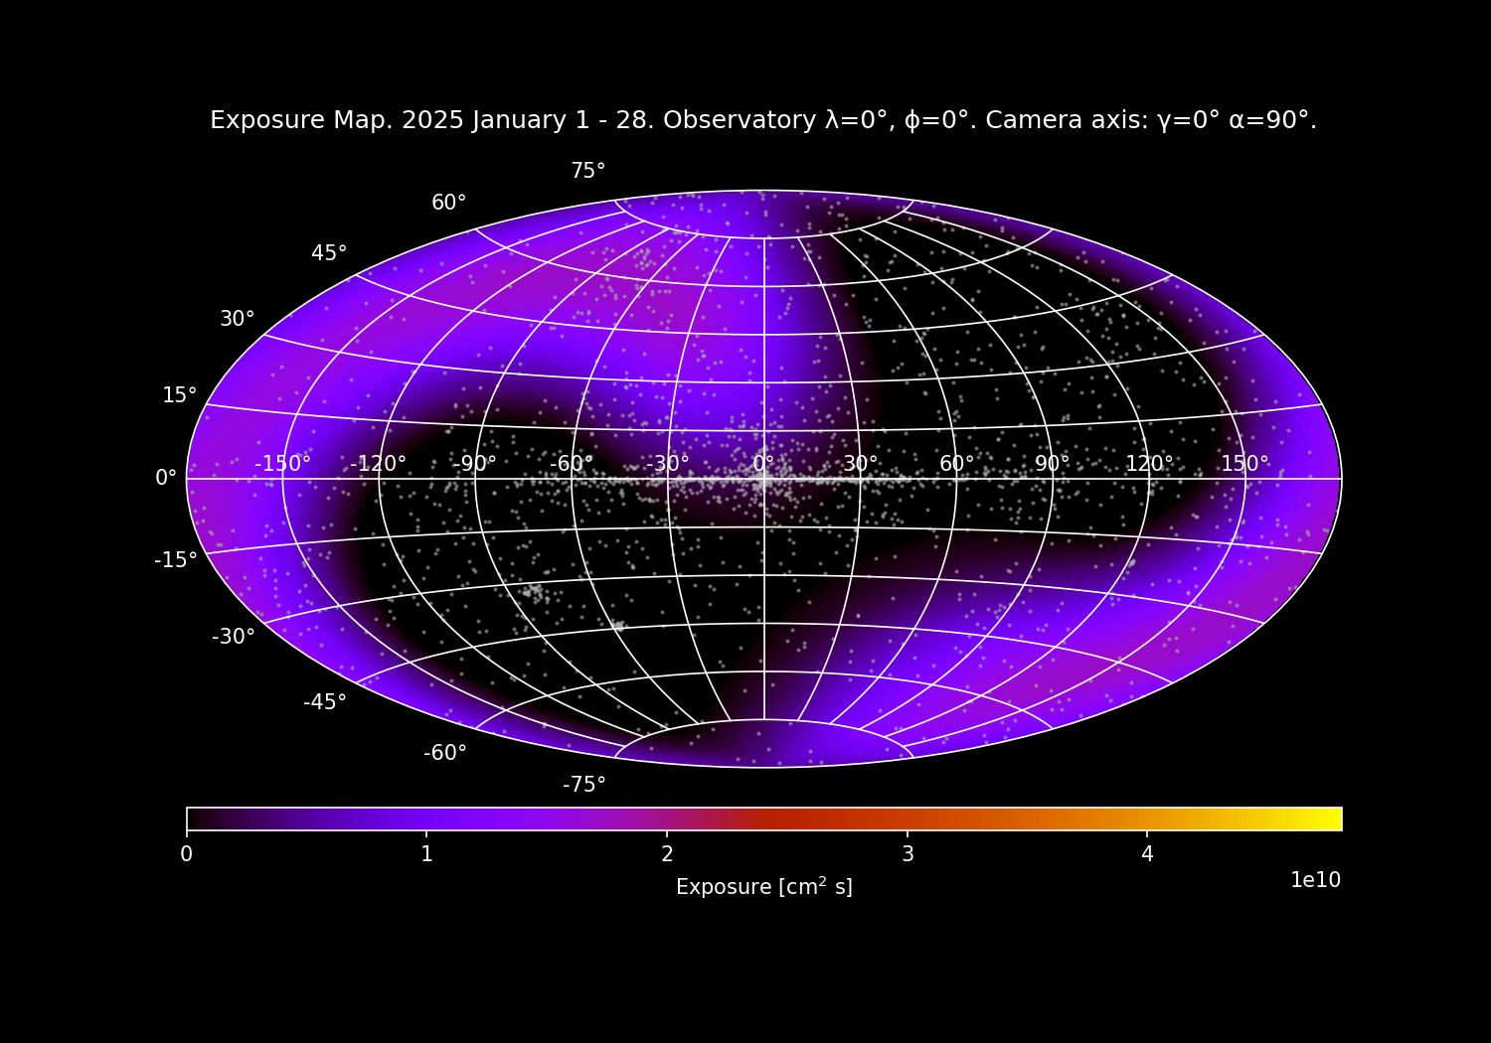
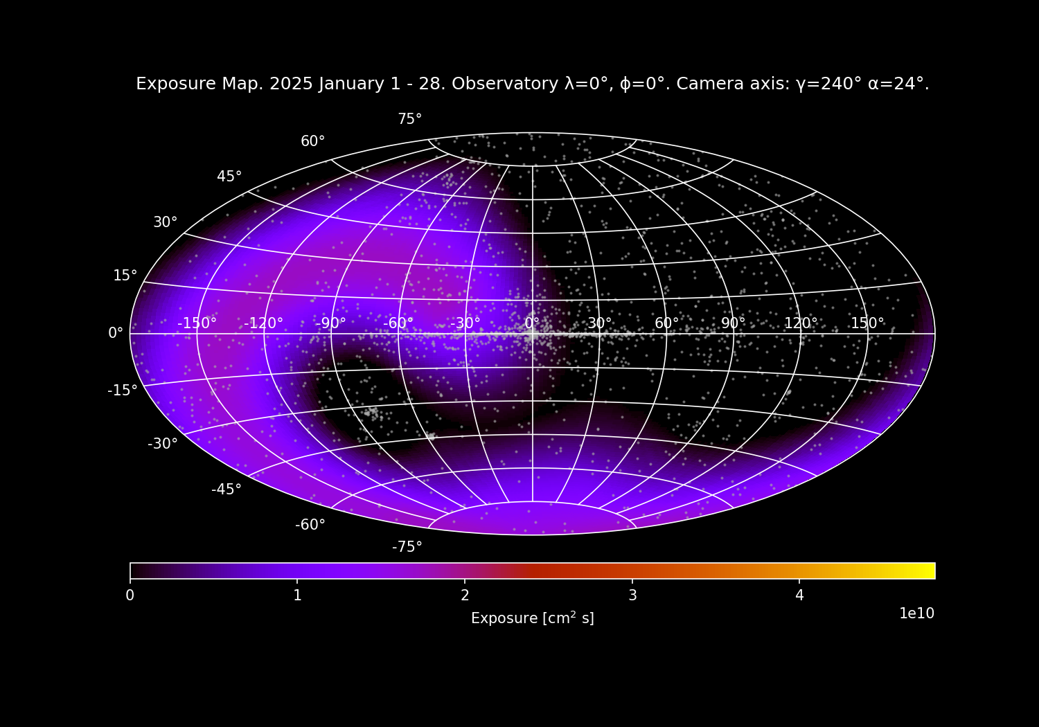
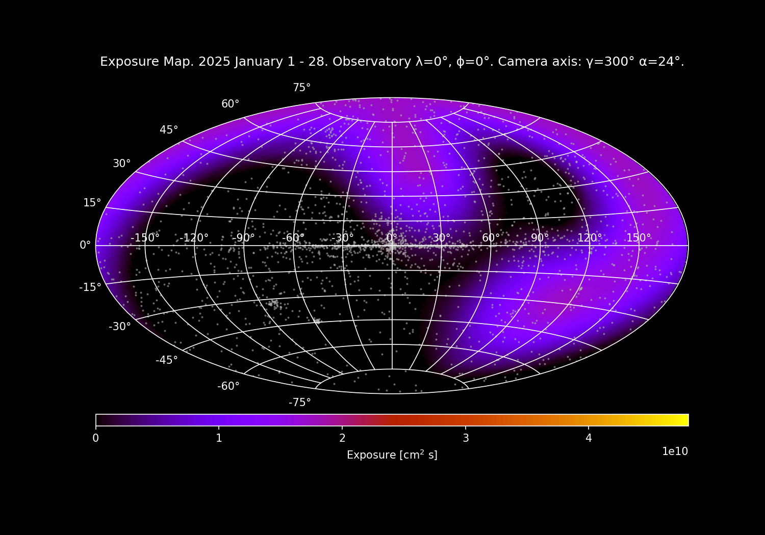
Camera pair sensitivity – 1s
Single camera monthly exposure

Slide 16
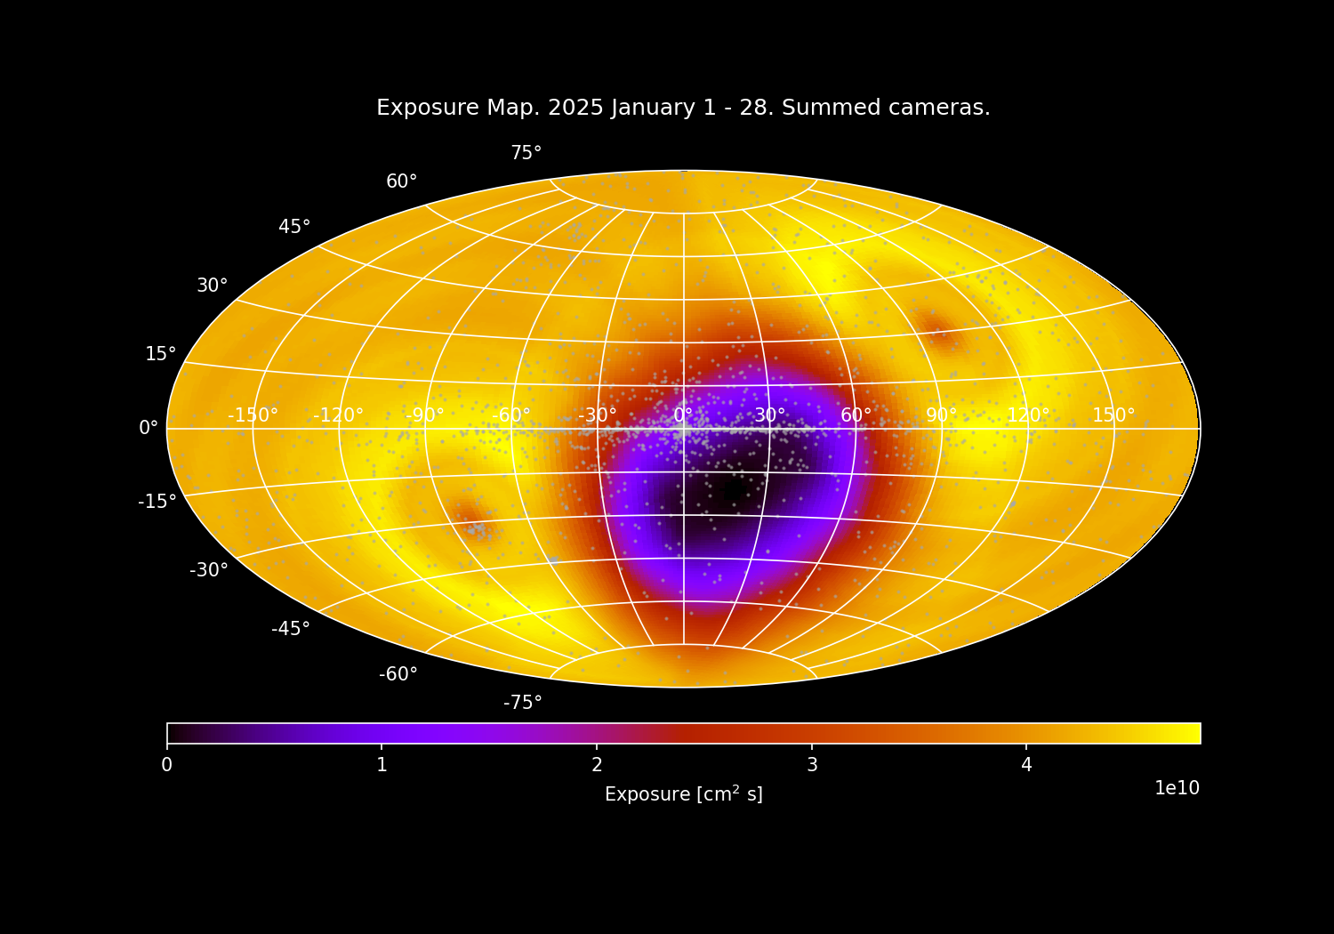
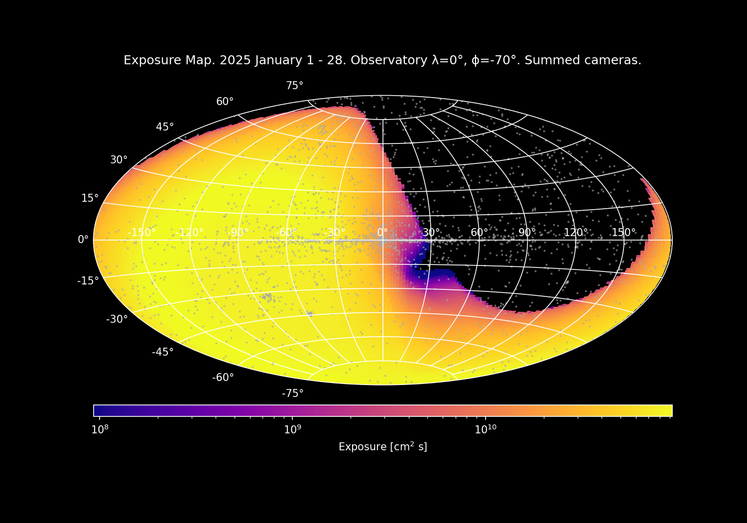
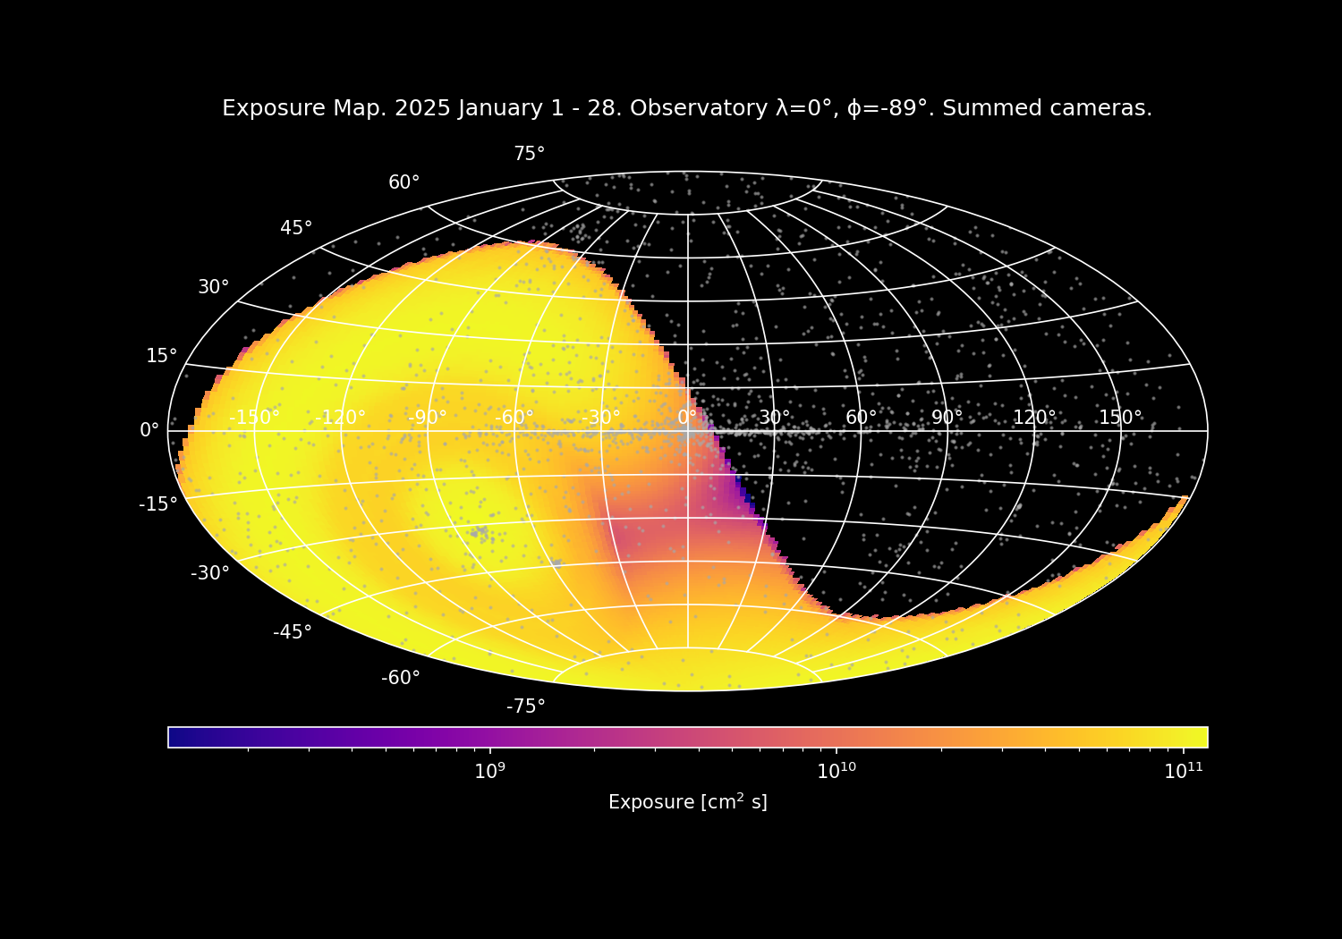
Instrument monthly exposure vs observation latitude (0°, -70°, -90°)

Slide 17
Comparison between THESEUS and LEM-X
 | THESEUS | LEM-X
Payload | 2 Soft X-ray Imagers 2 X/Gamma Imaging Spectrometers InfraRed Telescope | 7 camera pairs
Energy band(s) | SXI: 0.3 – 5 keV XGIS: 2 keV – 10 MeV IRT: 0.7 – 1.8 μm | 2 – 30 keV
Field of View | SXI: 0.5 sr – 31x61 degrees² XGIS: 2 sr (2 – 150 keV) – 117x77 degrees² 4 sr (>150 keV) | ∼1 sr per camera 2π sr overall
Source Location Accuracy | SXI: ≤ 2 arcminutes (99 % c.l.) XGIS: ≤ 7 arcminutes (90 % c.l.) | ∼1 arcmin
Sensitivity (XGIS) | 10⁻⁸ erg/cm²/s (2 – 30 keV) 3x10⁻⁸ erg/cm²/s (30 – 150 keV) 2.7x10⁻⁷ erg/cm²/s (150 keV – 1 MeV) | 2.1x10⁻⁸ erg/cm²/s (2 – 50 keV, 1 s at 3σ) 9.4x10⁻¹¹ erg/cm²/s (2 – 50 keV, 50 ks at 3σ)

Slide 18
Expected transient rates in LEM-X
 | Expected rate
X-ray Bursts | ∼5000 events/year
X-ray Flashes | 50 – 60 events/year
Gamma Ray Bursts | ∼190 events/year
Gamma Ray Bursts at z > 6 | 2 – 3 events/year

Slide 19
Thank you

Slide 20
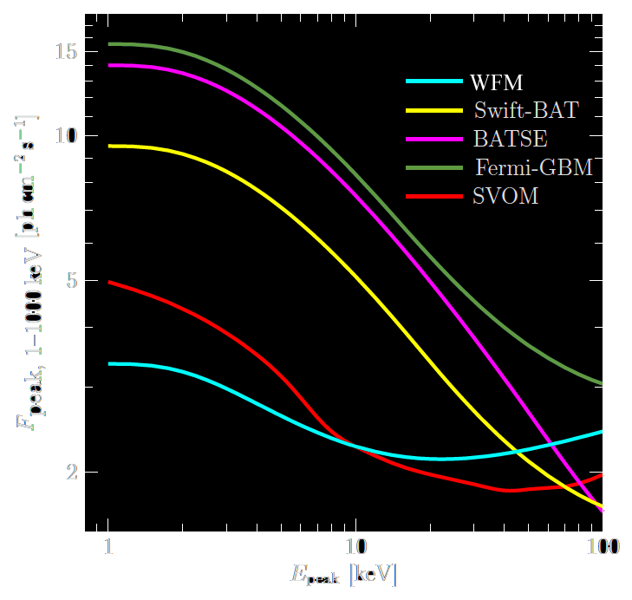
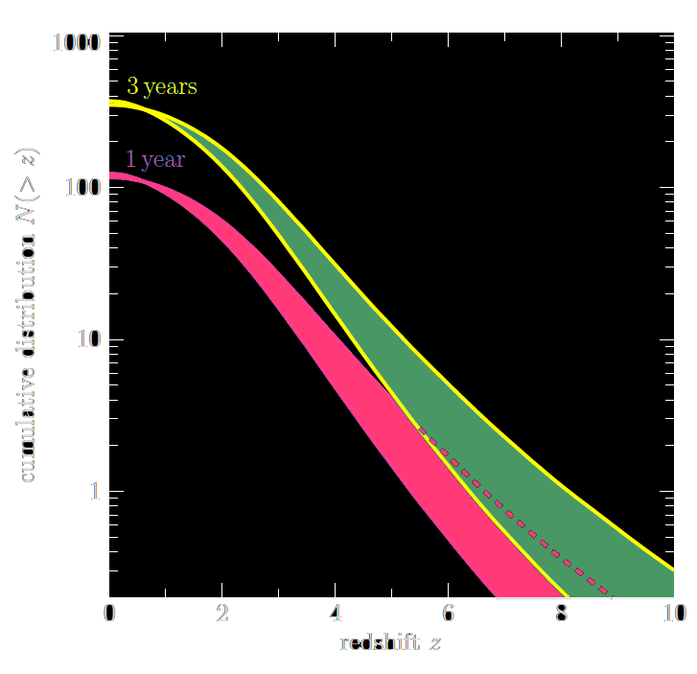
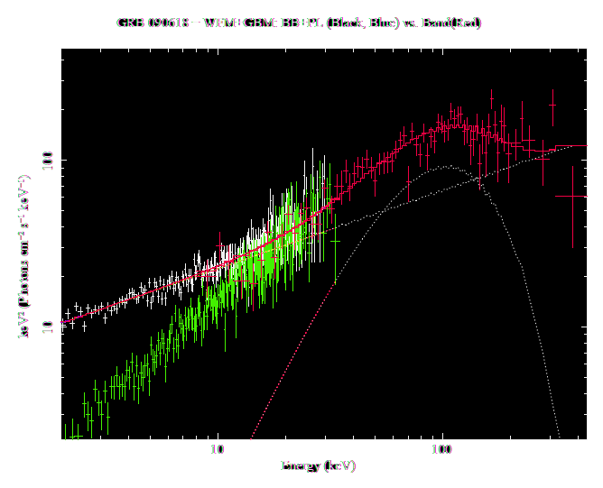
Amati et al., 2015
GRB detection sensitivity in terms of peak flux sensitivity as a function of the spectral peak energy Ep (Band, 2003) and cumulative Z distribution of long GRBs computed assuming a broken power-law luminosity function and a pure density evolution
GRB 090618 - BB+PL vs Band
GRB 090618 prompt spectrum (50s, FERMI/GBM)
Both
Band function (white)
Power-law plus black-body model (green)
equally fit the Fermi/GBM measured spectrum (red).
WFM observation (sim) allows to disentangle between the two spectral model

Slide 21
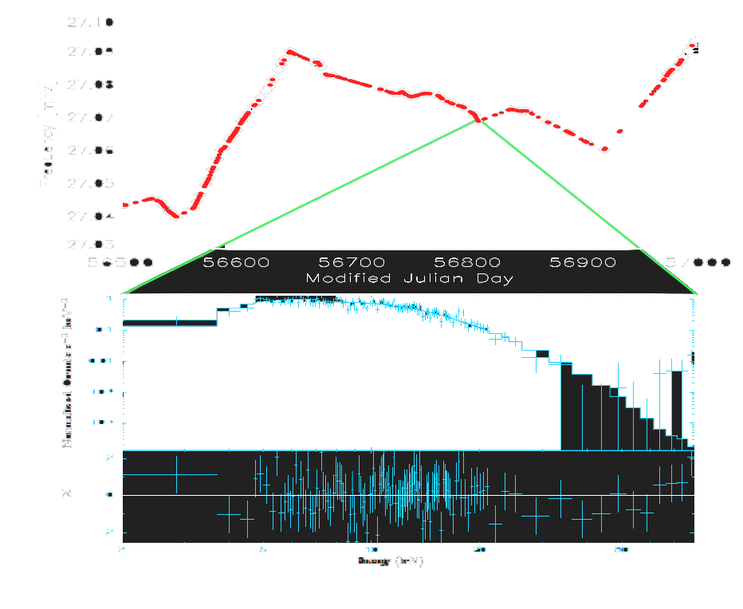
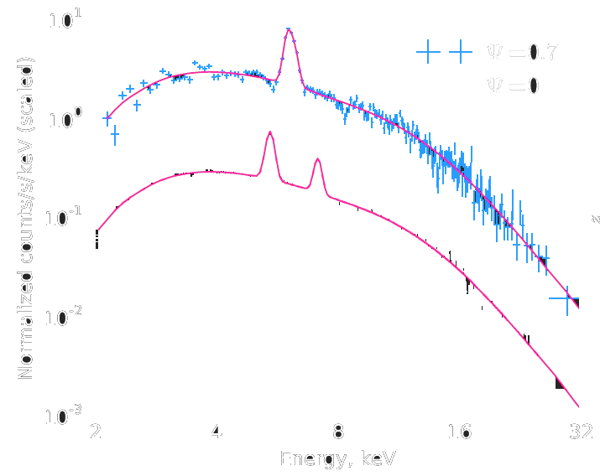
Spin history
Super-orbital spectra
Orlandini et al., 2015
Long term continuous spin monitoring and single observation spectrum of the HMXB OAO 1657-415
Red/blue shifted Fe K_{α} fluorescence lines from the SS 433 precessing jets. in two different superorbital phases (p ~ 160d)

Slide 22
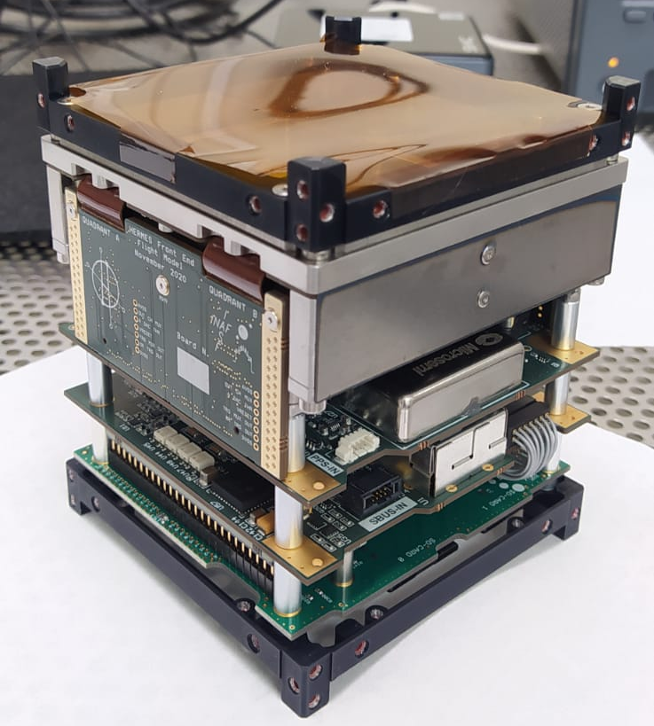
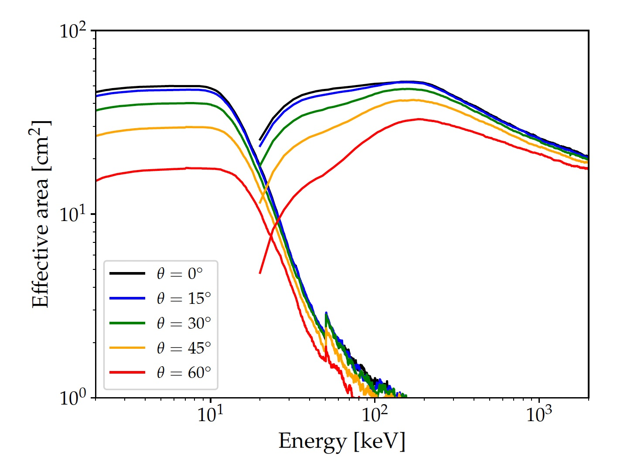
High-energy (MeV) extension – HERMES-like?
Long
Short
GBM
HERMES
HERMES-X
GBM
HERMES
HERMES-X
Ghirlanda, Nava, Fiore 2023
Ghirlanda, Nava, Fiore 2023
Low-energy/high-sensitivity extension – Lobster-eye?

