Slide 1
Actuators and Optical Camera control SW
Pietro Bruno – INAF OACatania
AIV SW Meeting, 19-20 feb 2024

Slide 2
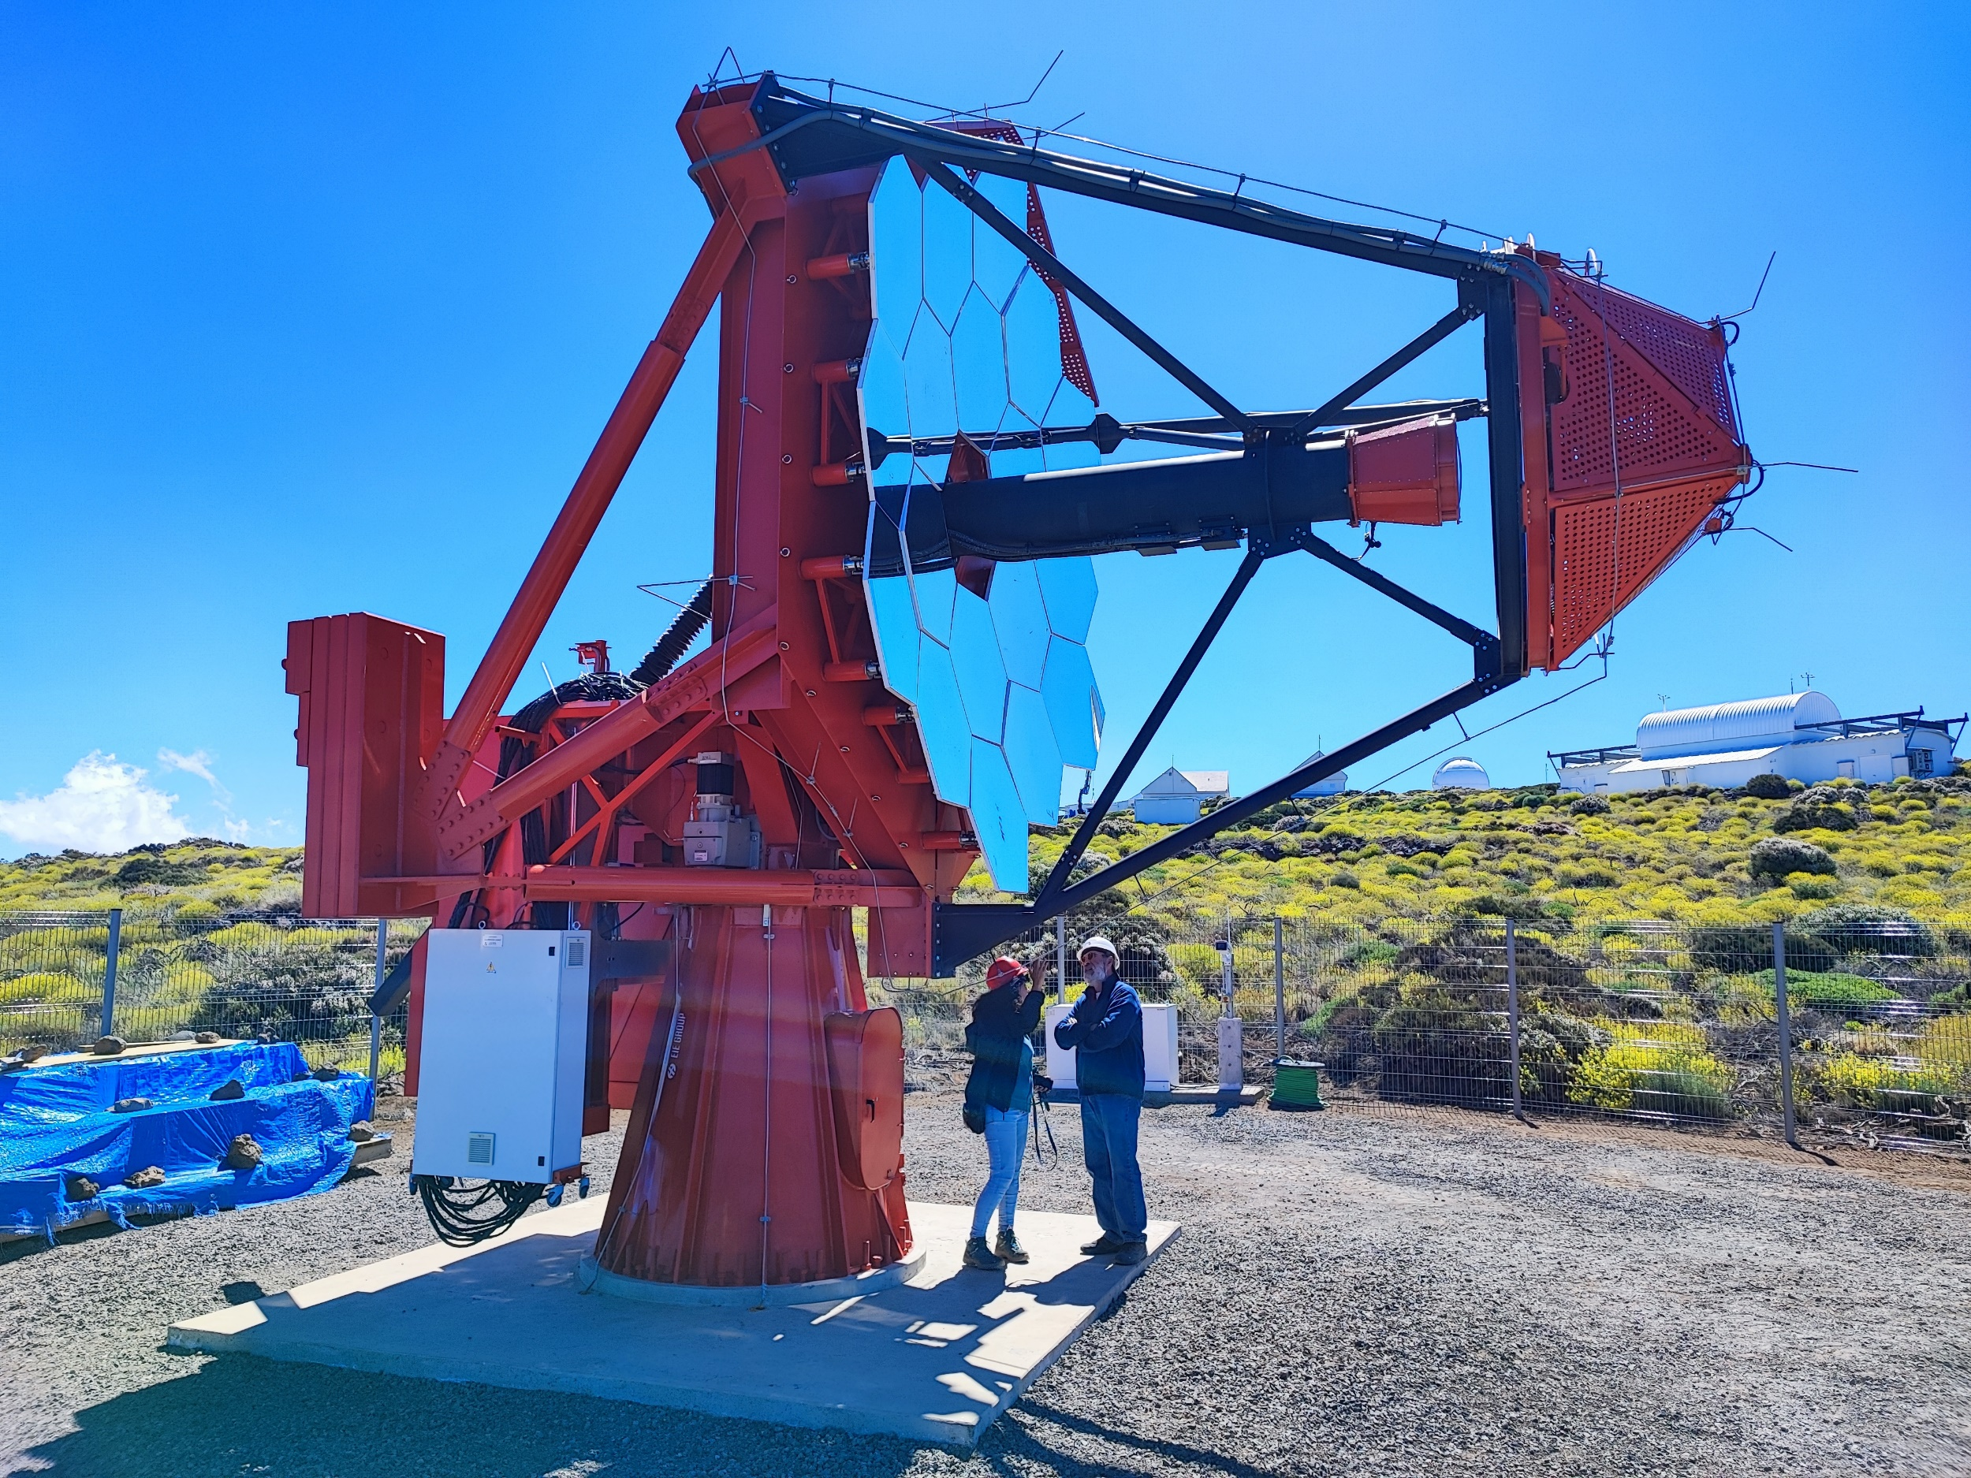
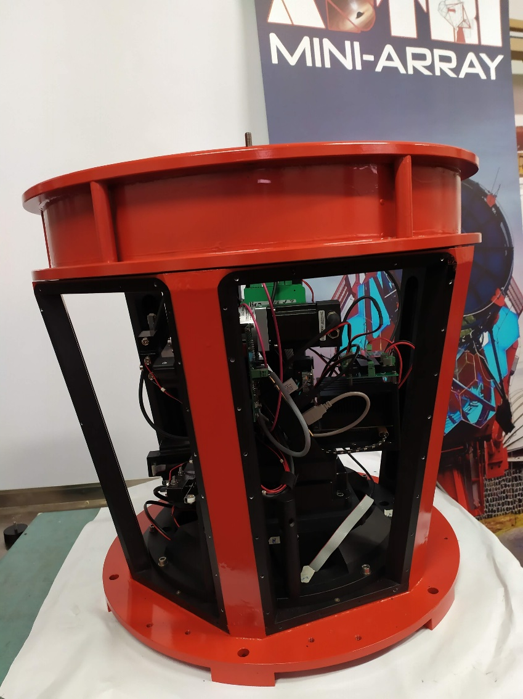
HW description
The Optical Camera (OC) is part of the auxiliary instrumentation of the ASTRI-MiniArray project, the OC is part of the devices for the alignment of the telescopes mirrors.
Principal purpose of the OC is to acquire images of the telescope focal plane both in axis and out of the optical axis
The OC was realized and assembled at the mechanical laboratory of INAF-IASF-Milan.
P.Bruno, AIV SW Meeting, Milan 19-20/02/2024

Slide 3
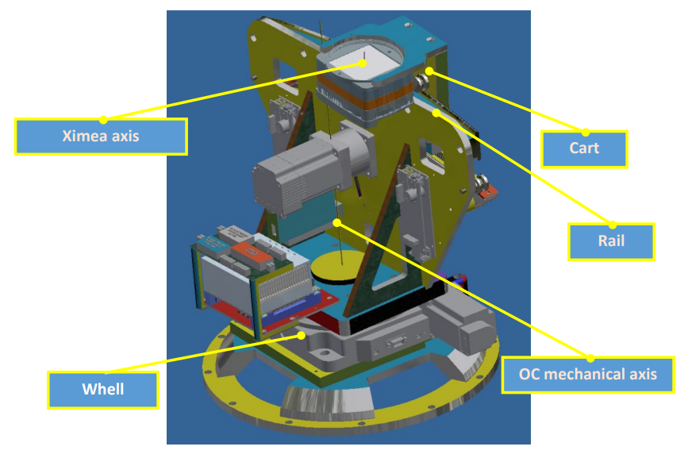
HW description
From a point of view of the control software the part to manage are:
A Ximea CMOS camera;
A rotary stage to rotate the Ximea around the telescope axis;
A moviment to move the Ximea on a curved rail, equipped by an absolute encoder by Lika;
An environmental sensor to read internal temperature, umidity, noise and light.
P.Bruno, SST – AIV SW Meeting, Milan 19-20/02/2024

Slide 4
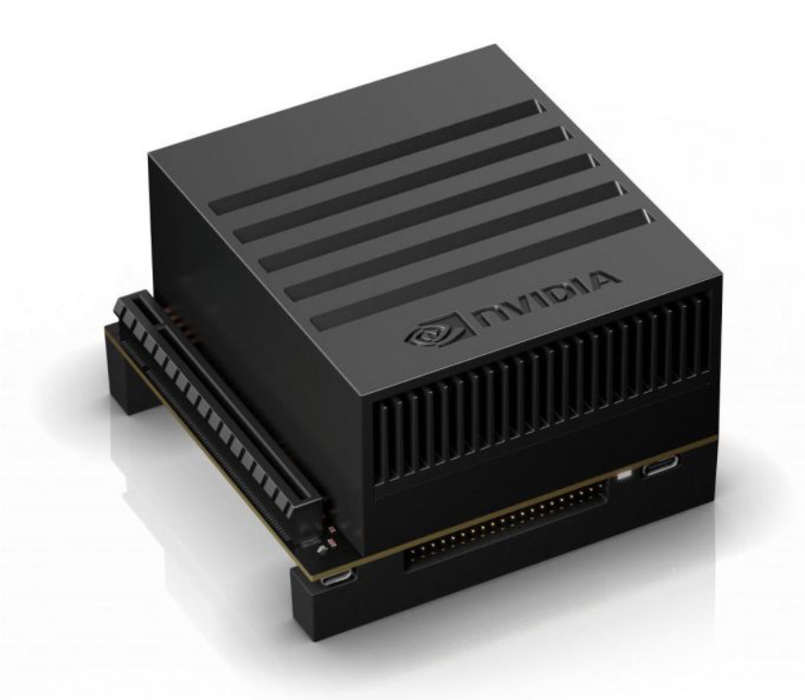
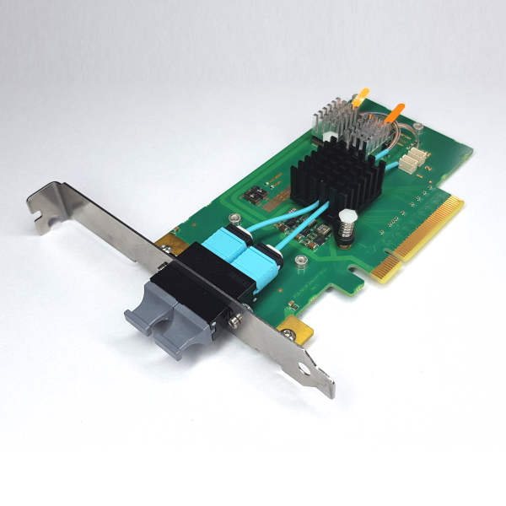
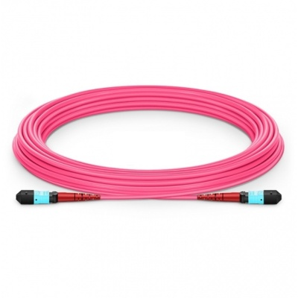
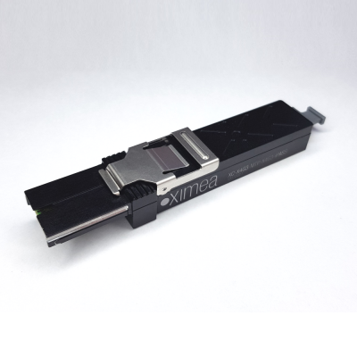
HW description
The Local Control Software (LCS) runs on a Local-PC (LPC) model Jetson AGX Xavier from NVIDIA
The OS on the LPC is Ubuntu 18.4
The connection to te Ximea camera happen by mean a MTP-connector PCIe 4x Gen3 at 32Gb/s
P.Bruno, SST – AIV SW Meeting, Milan 19-20/02/2024

Slide 5
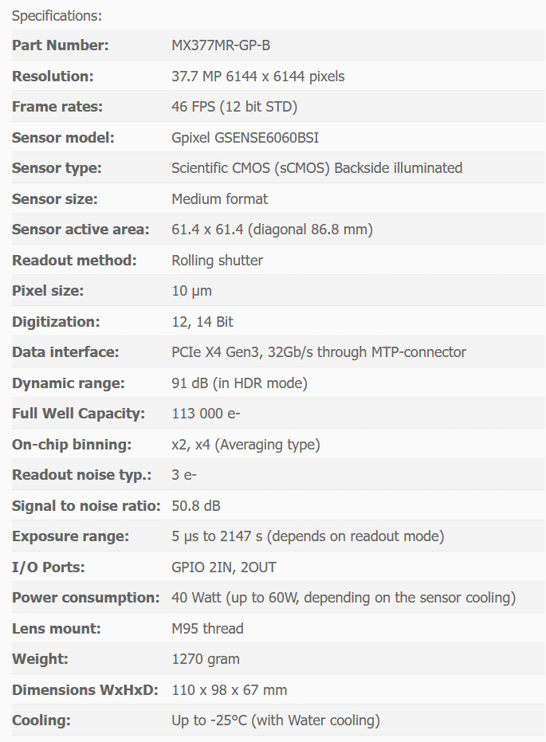
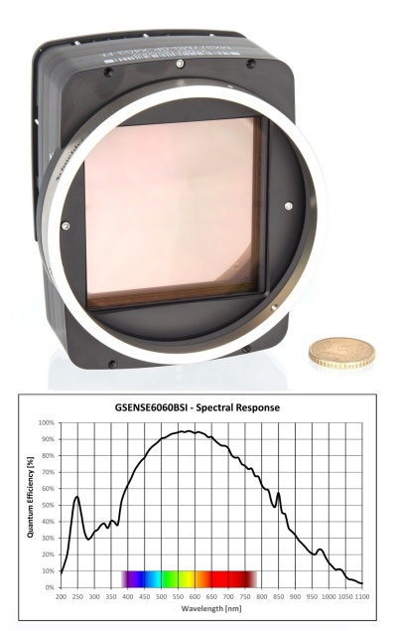
HW description
The plate scale is 37.6mm/deg
Field of view = 1.63 deg
61.4 mm
1.63 deg
P.Bruno, SST – AIV SW Meeting, Milan 19-20/02/2024

Slide 6
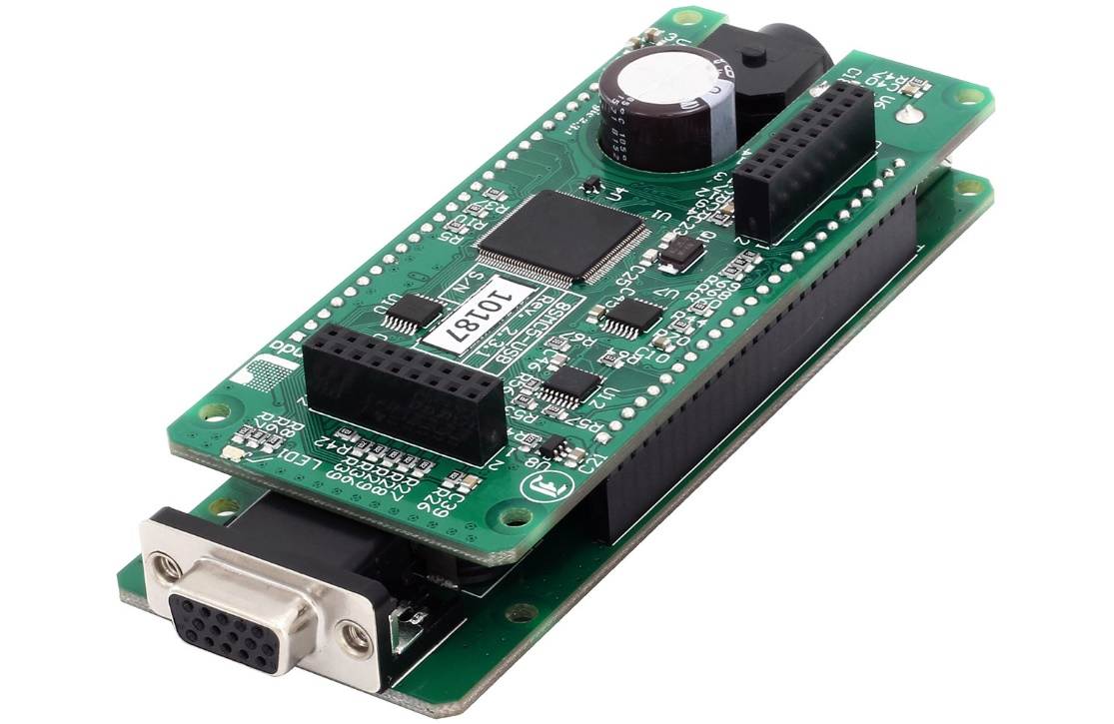
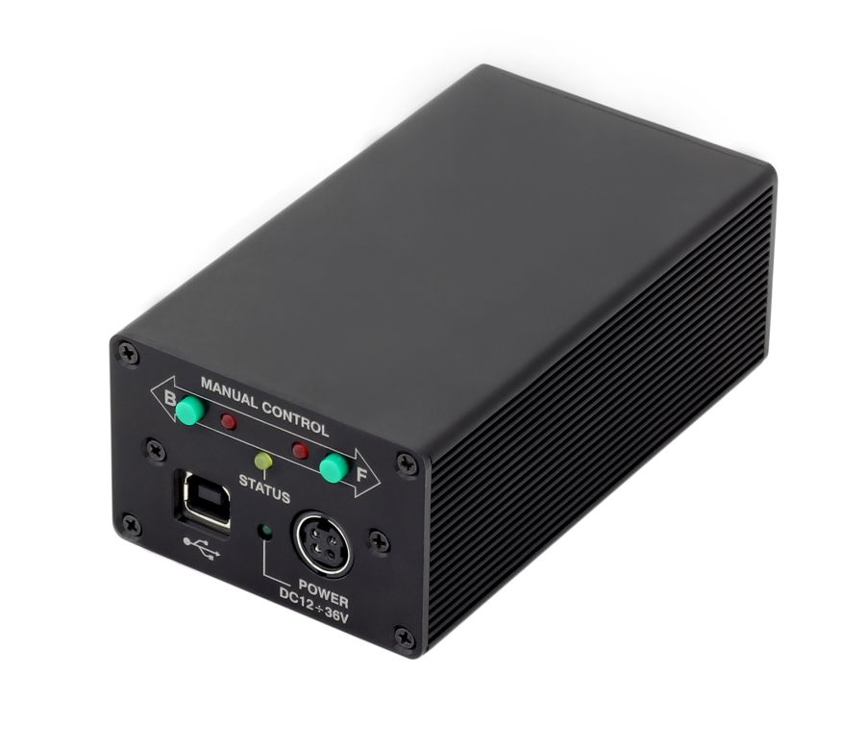
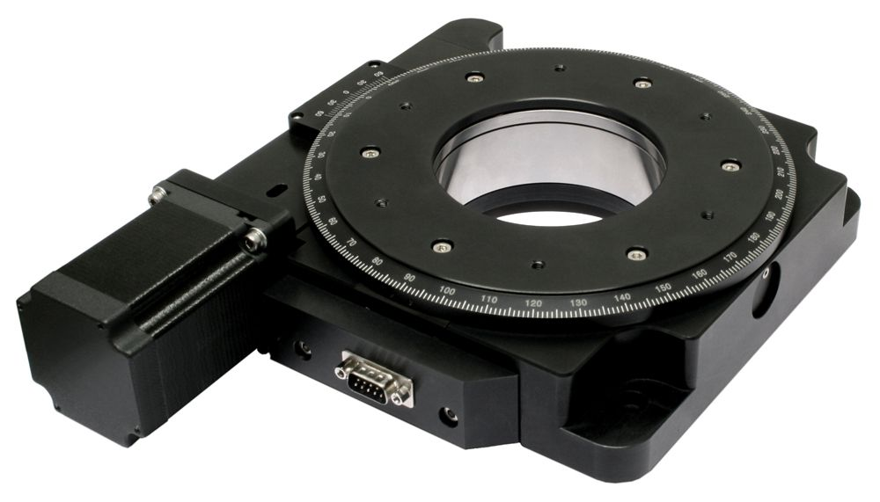
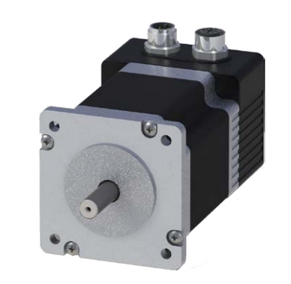
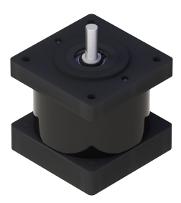
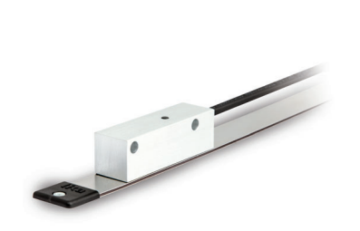
HW description
The motorized positioners are driver by two Standa Lituania controller model 8SMC5-USB
To rotate the structure that hold the Ximea camera has been used a large motorized rotation stage model 8MR190 by Standa
To move the Ximea camera along the rail has beeh used a Step motor equipped with an electro-magnetic brake (mod. NEMA24), and an absolute linear encoder by Lika with a resolution of 5um
P.Bruno, SST – AIV SW Meeting, Milan 19-20/02/2024

Slide 7
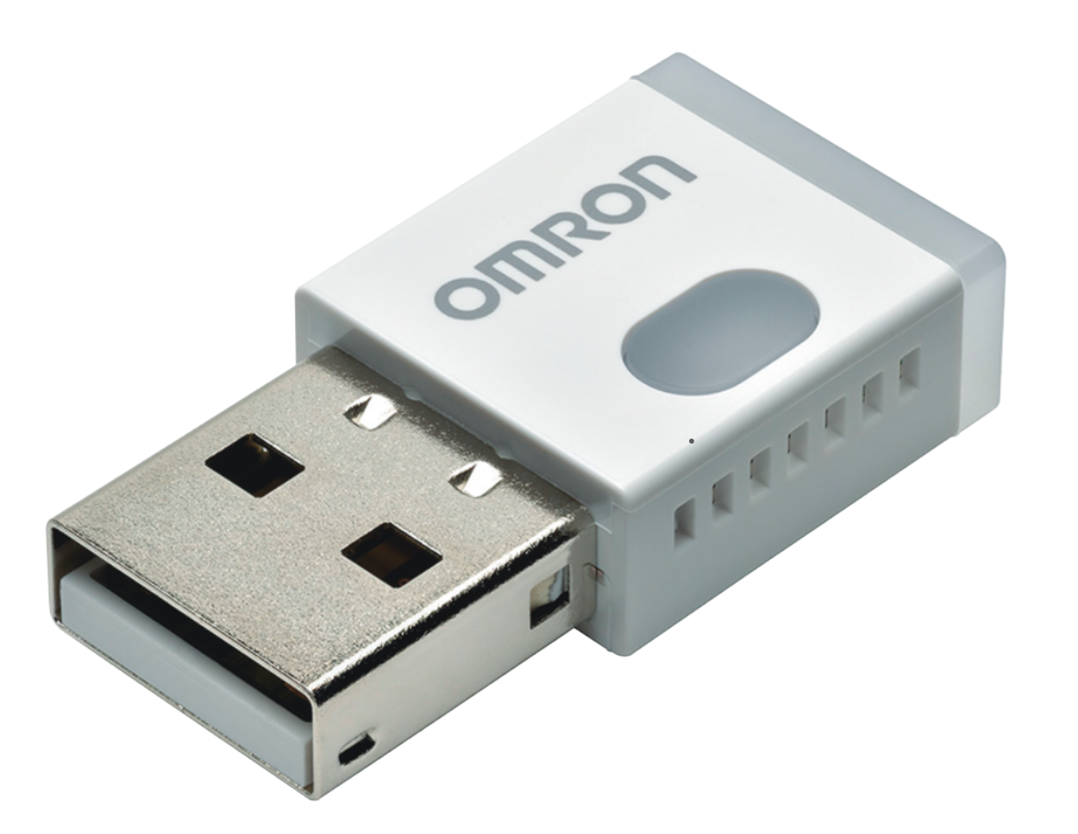
HW description
Environmental sensor made by Omron Mod. 2JCIE-BU USB type used to acquire the OC internal temperature, umidity, noise and light.
P.Bruno, SST – AIV SW Meeting, Milan 19-20/02/2024

Slide 8
HW description
The Ximea may move in the range of ±4.5 degree of sky angle with an accuracy of ±2 encoder counts (±10um) is equivalent to about 0.6x10⁻³ degree.
The rotary stage may cover a range of ±90 degree with an accuracy of 0.01 degree.
P.Bruno, SST–AIV SW Meeting, Milan 19-20/02/2024

Slide 9
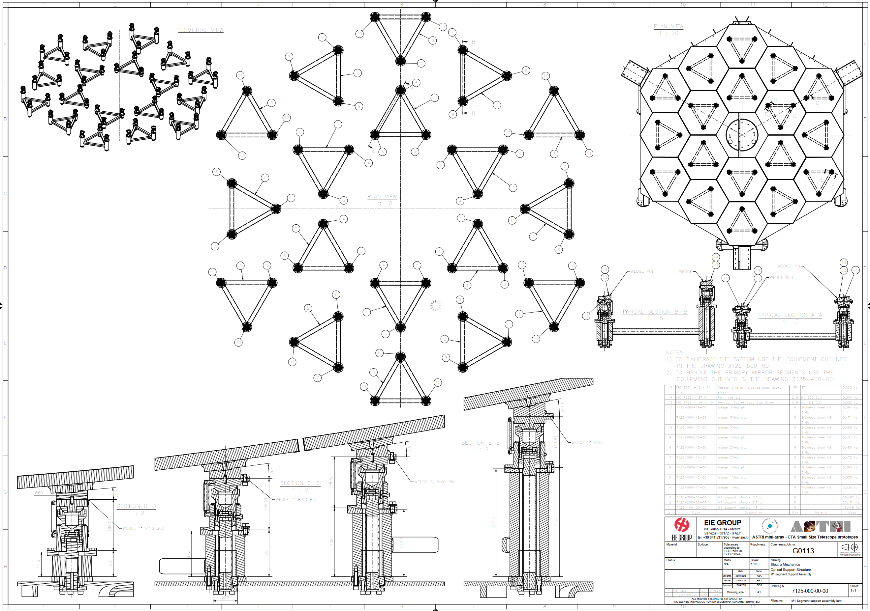
HW description
For the ASTRi-MA telescopes the Active Mirrors Controller (AMC) system manages 54 (18x3) linear actuators to move the segments of M1, and 3 linear actuators to move M2.
The LCS of the actuators runs on the same PLC where run the Mount Controller Software (MCS).
The actuators and the electronic of M1 have been designed to be installed only during the AIV phase or for maintenance (redo PSF).
While the motor controls of M2 stay always online.
P.Bruno, SST – AIV SW Meeting, Milan 19-20/02/2024

Slide 10
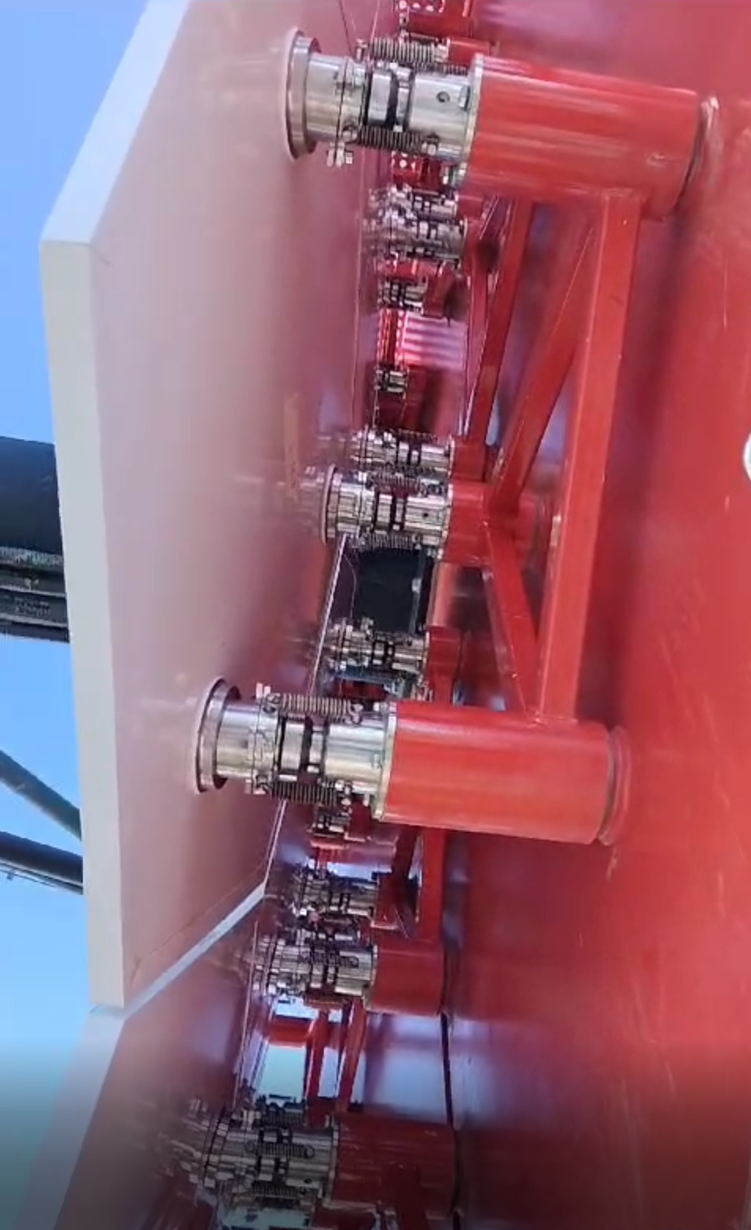
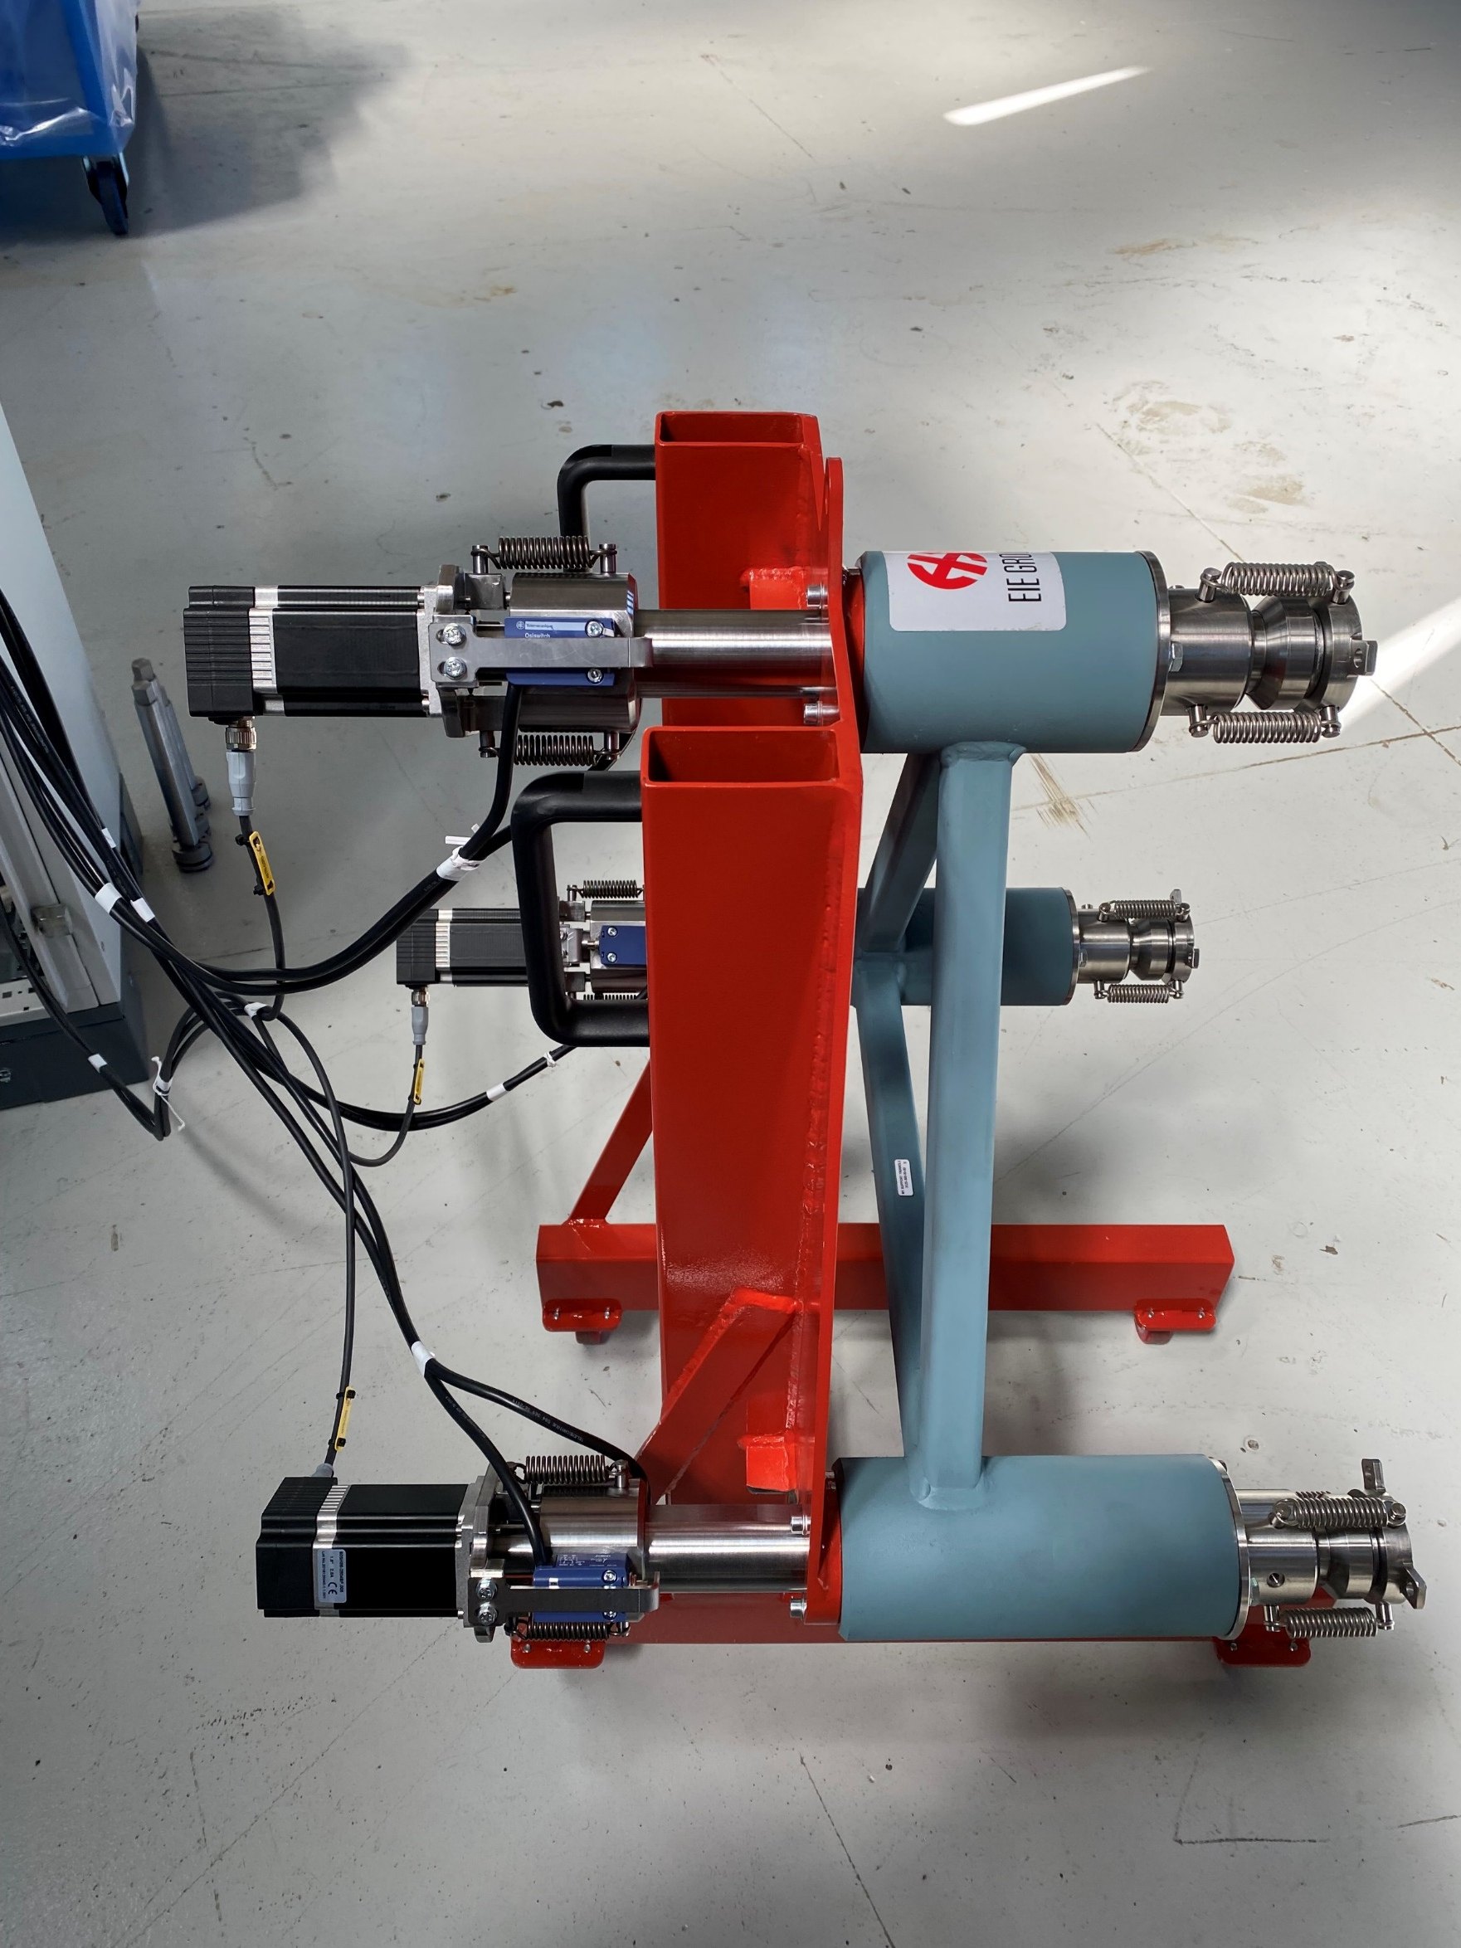
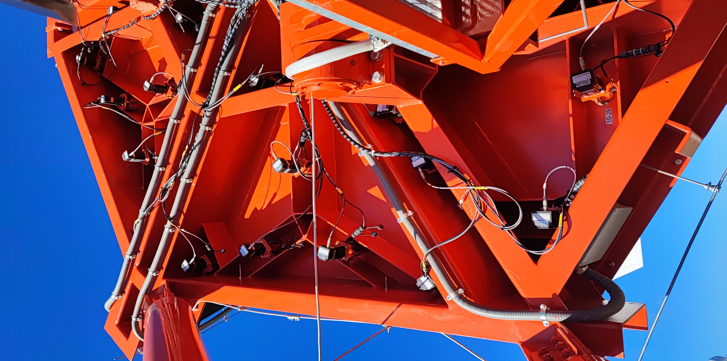
HW description
P.Bruno, SST – AIV SW Meeting, Milan 19-20/02/2024

Slide 11
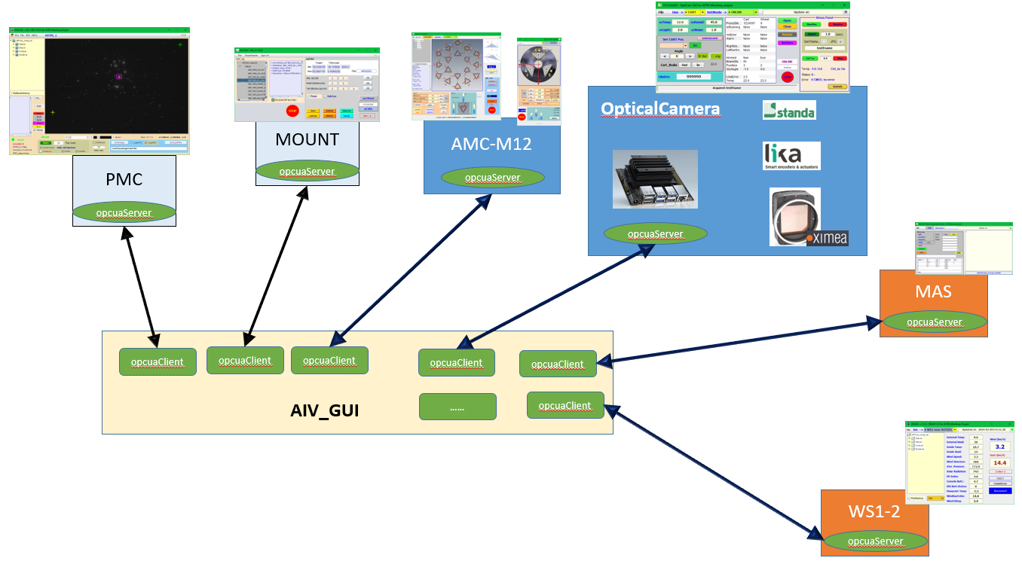
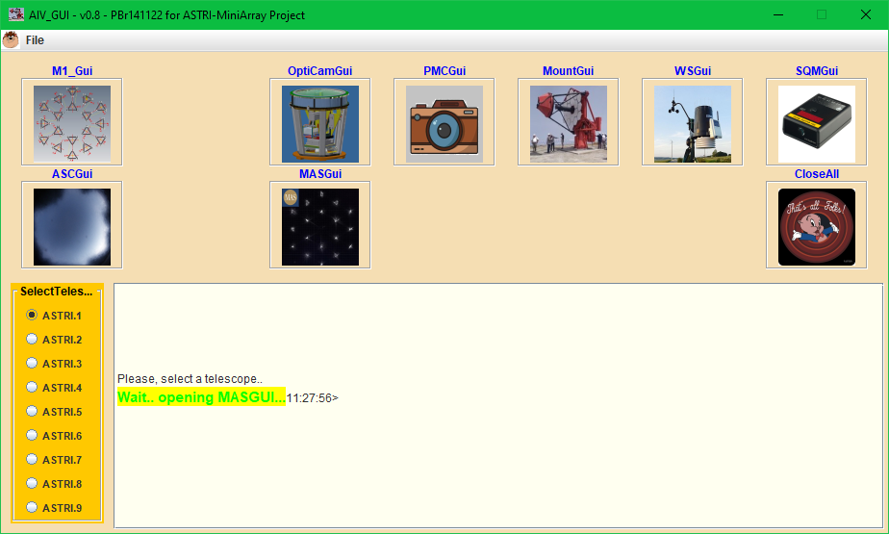
SW general schema
The AIV software for the mirrors alignment, named AIVGUI, was made in Java Swing.
For each device controlled was realized an engeneering GUI; for each subsystem was made an instance of an OPC-UA client that comminicates with the OPC-UA server in accord to the ASTRI-MA software standard
P.Bruno, AIV SW Meeting, Milan 19-20/02/2024

Slide 12
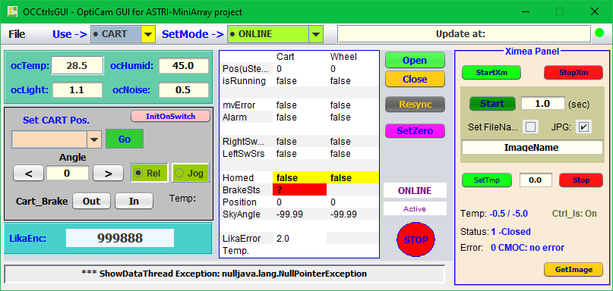
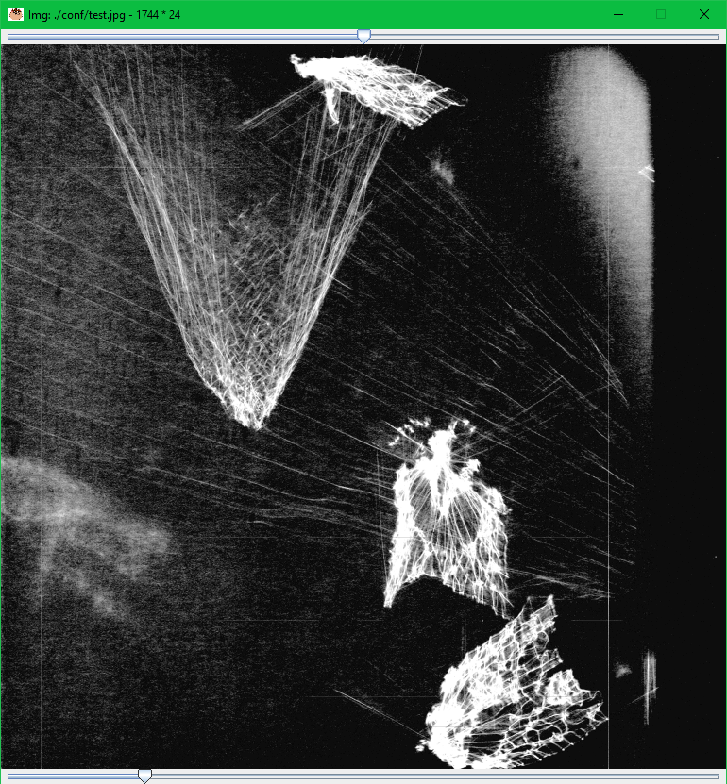
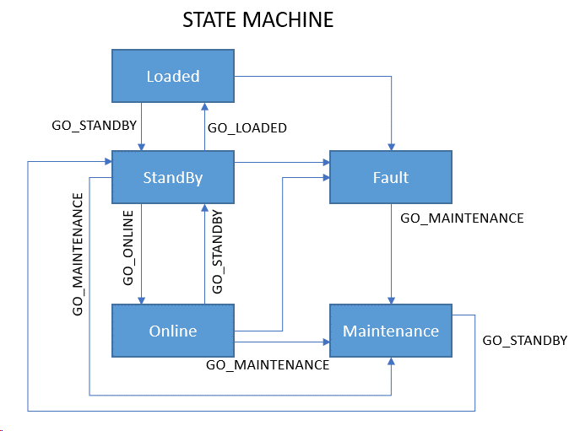
OCCtrlsGui
Tcp/Ip
OpcuaOC
pyXimea
OC LocalPC
opcua
fits/jpg
P.Bruno, SST – AIV SW Meeting, Milan 19-20/02/2024

Slide 13
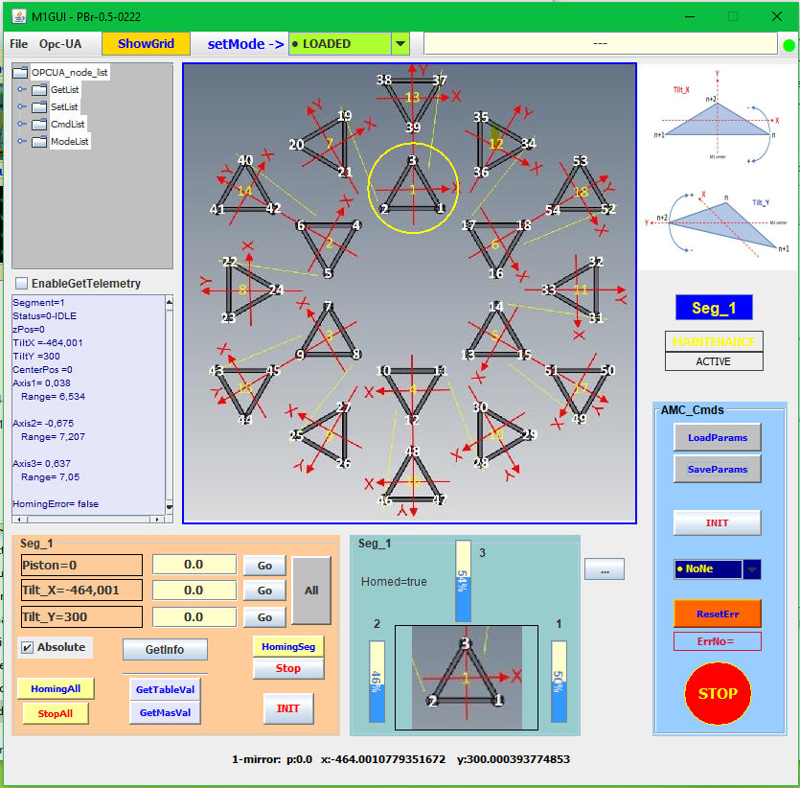
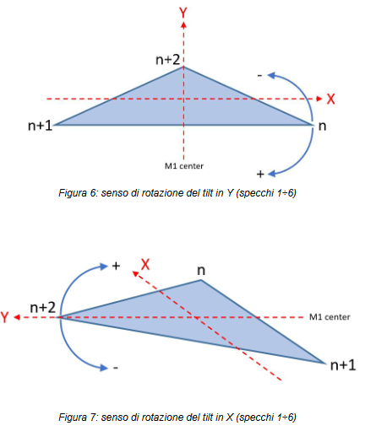
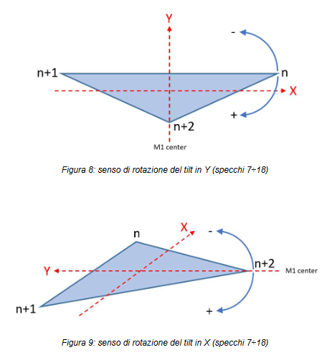
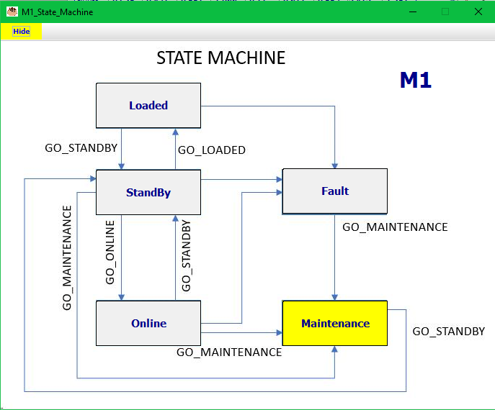
M1Gui
P.Bruno, SST – AIV SW Meeting, Milan 19-20/02/2024

Slide 14
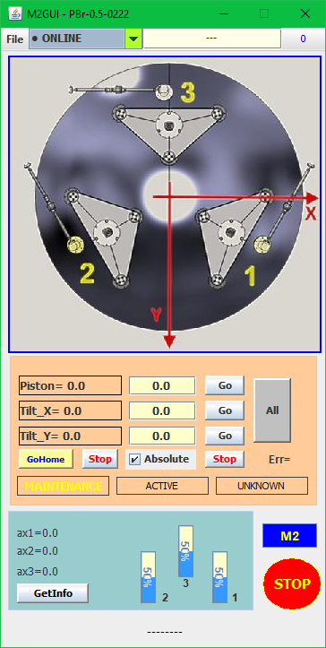
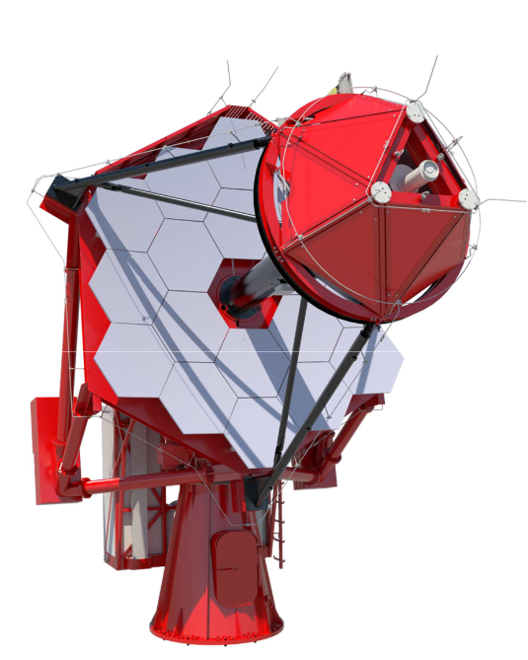
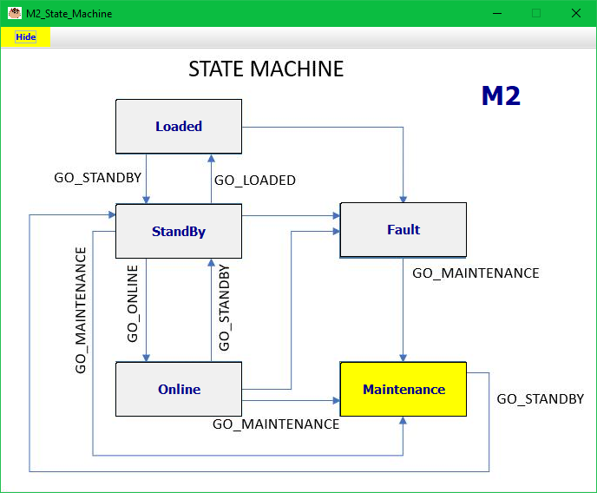
M2Gui
P.Bruno, SST – AIV SW Meeting, Milan 19-20/02/2024

Slide 15
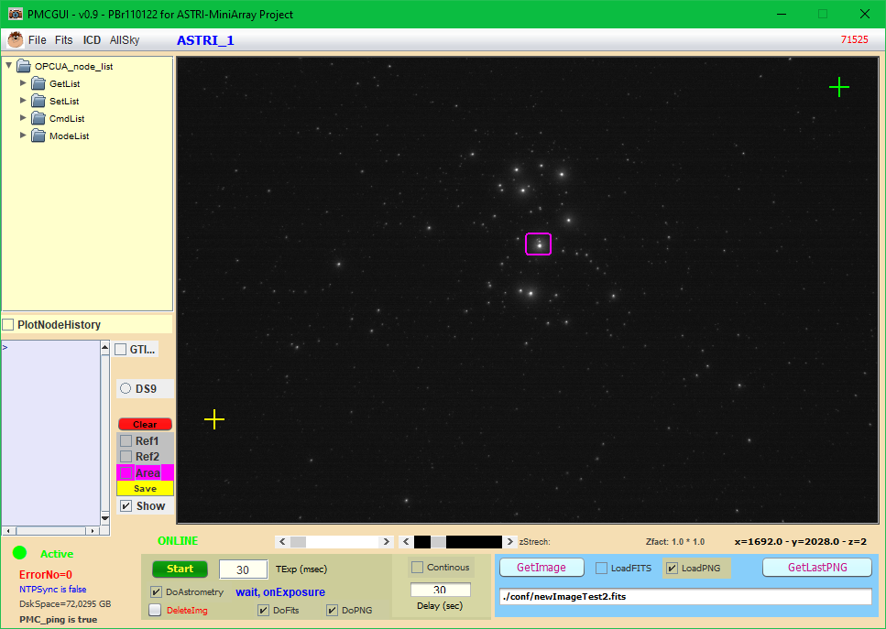
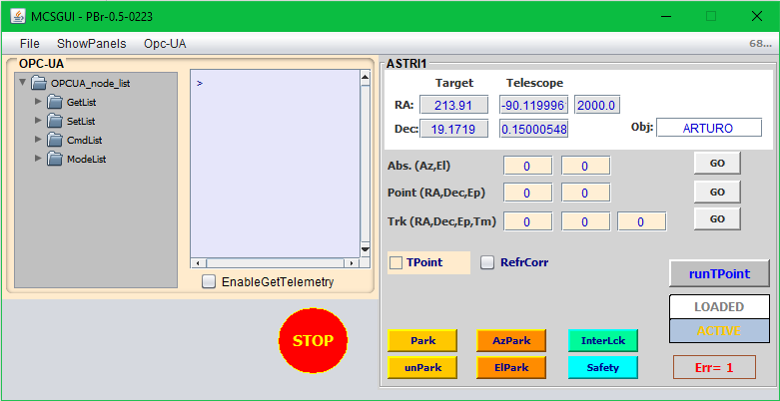
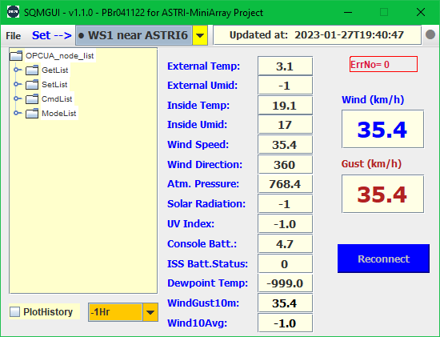
PMCGui – MCSGui - WSGui
5.61°
3,74°
P.Bruno, SST – AIV SW Meeting, Milan 19-20/02/2024

Slide 16
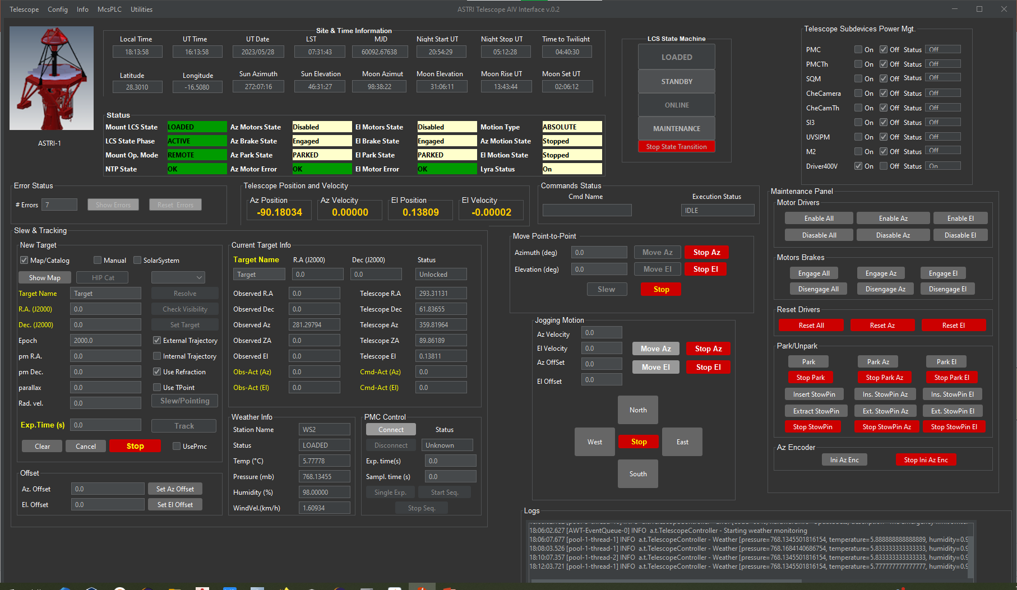
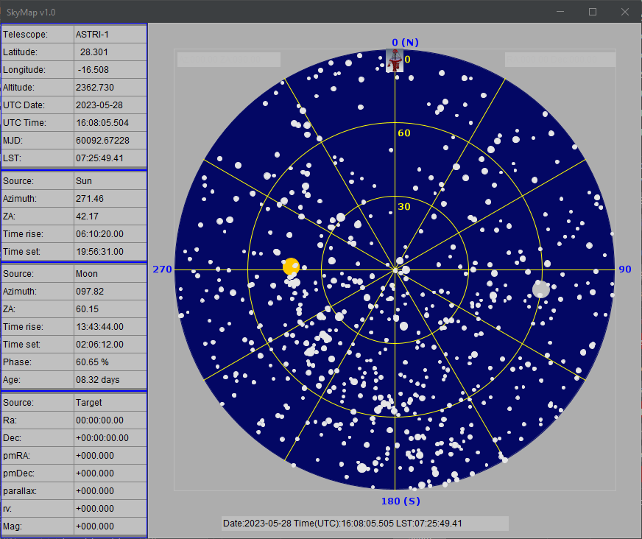
Telescope Gui
P.Bruno, SST – AIV SW Meeting, Milan 19-20/02/2024

Slide 17
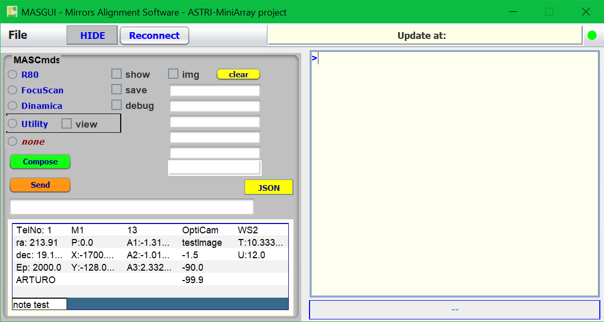
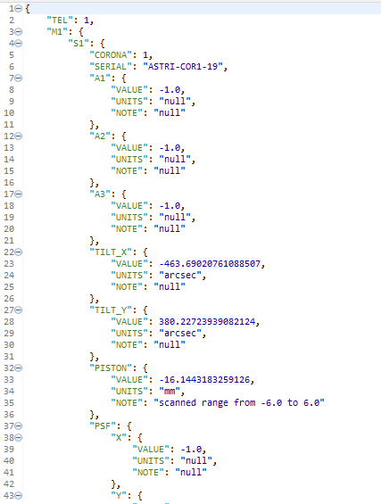
MASGui
Tcp/Ip
pyMAS
OpcuaMAS
OC LocalPC
opcua
In the MAS GUI we collect all data to send to a set of Python procedures for OC image processing.
These procedures resides on the OC LocalPC, and they have the task to calculate the R80 value, mirrors focus position, position of each M1 segment (tiltX, tiltY, Piston), etc.
The results are written on a JSON file named "telescope_x.json"
telescope_1.json
P.Bruno, SST – AIV SW Meeting, Milan 19-20/02/2024

Slide 18
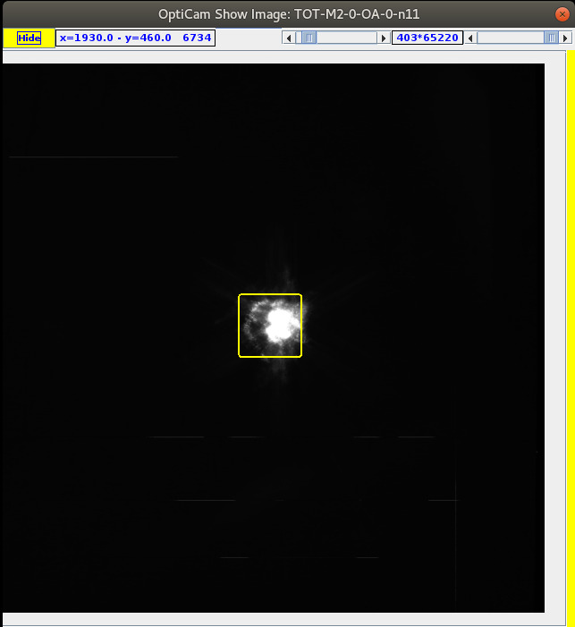
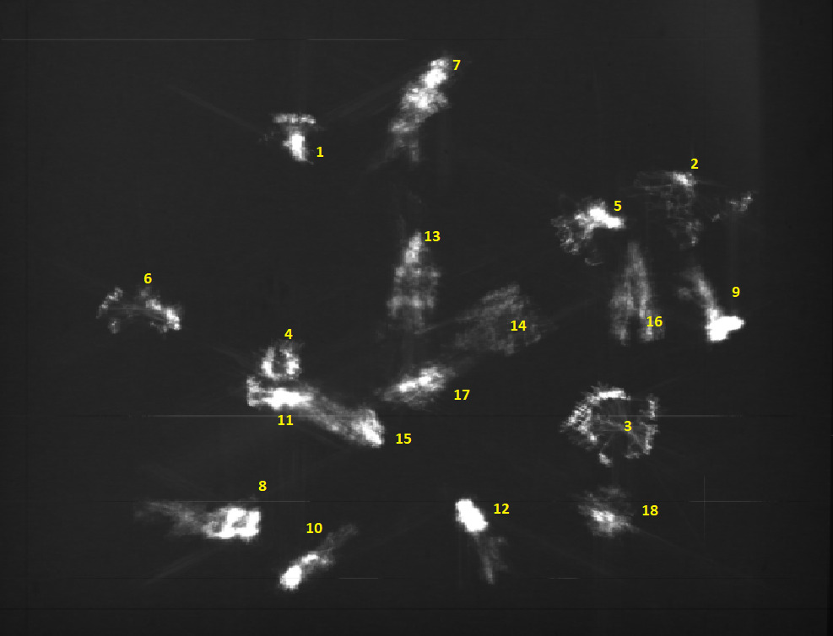
First result of alignment
P.Bruno, SST – AIV SW Meeting, Milan 19-20/02/2024

Slide 19
End
P.Bruno, SST – AIV SW Meeting, Milan 19-20/02/2024

Slide 20
Title
P.Bruno, SST – AIV SW Meeting, Milan 19-20/02/2024

