Slide 1
Exploring Vision Transformers in Remote Sensing for Building Feature Extraction
Nicoletta Sanvitale, Claudio Gheller (INAF)
Spoke 3 General Meeting, Elba 5-9 / 05, 2024
ICSC Italian Research Center on High-Performance Computing, Big Data and Quantum Computing
Missione 4 • Istruzione e Ricerca
Notes:
Cover

Slide 2
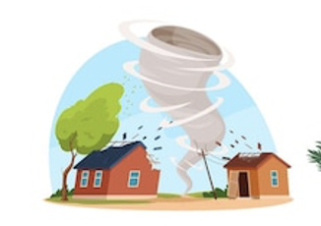
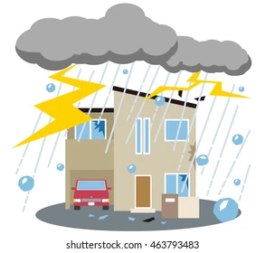
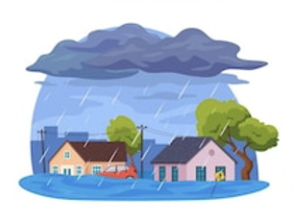
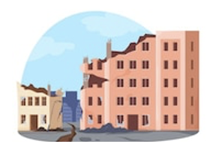
HaMMon (Hazard Mapping and vulnerability Monitoring) : WP 4
The project aims to develop tools and methodologies to be used in different industrial and academic contexts for the quantification of the impacts of extreme natural events on the Italian territory.
Buildings represent a major portion of the built environment.
WP4 objective:
Development of vulnerability curves for flood, windstorm, hail and seismic risk, based on the characteristics of the buildings automatically identifiable by the algorithms.
ICSC Italian Research Center on High-Performance Computing, Big Data and Quantum Computing
Missione 4 • Istruzione e Ricerca
Notes:
Template e guide lines

Slide 3
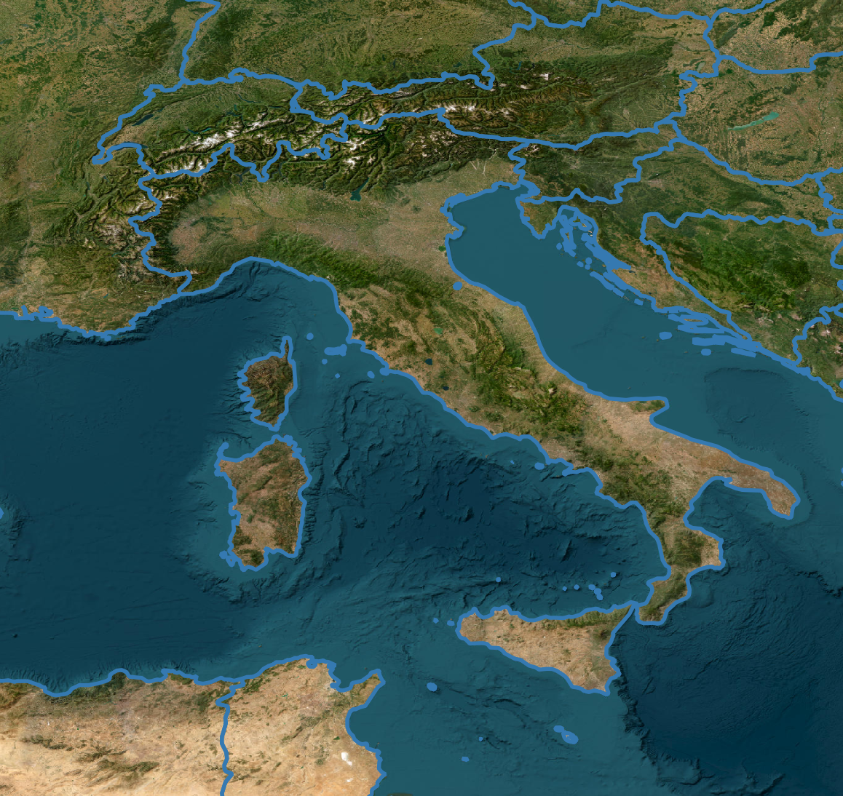
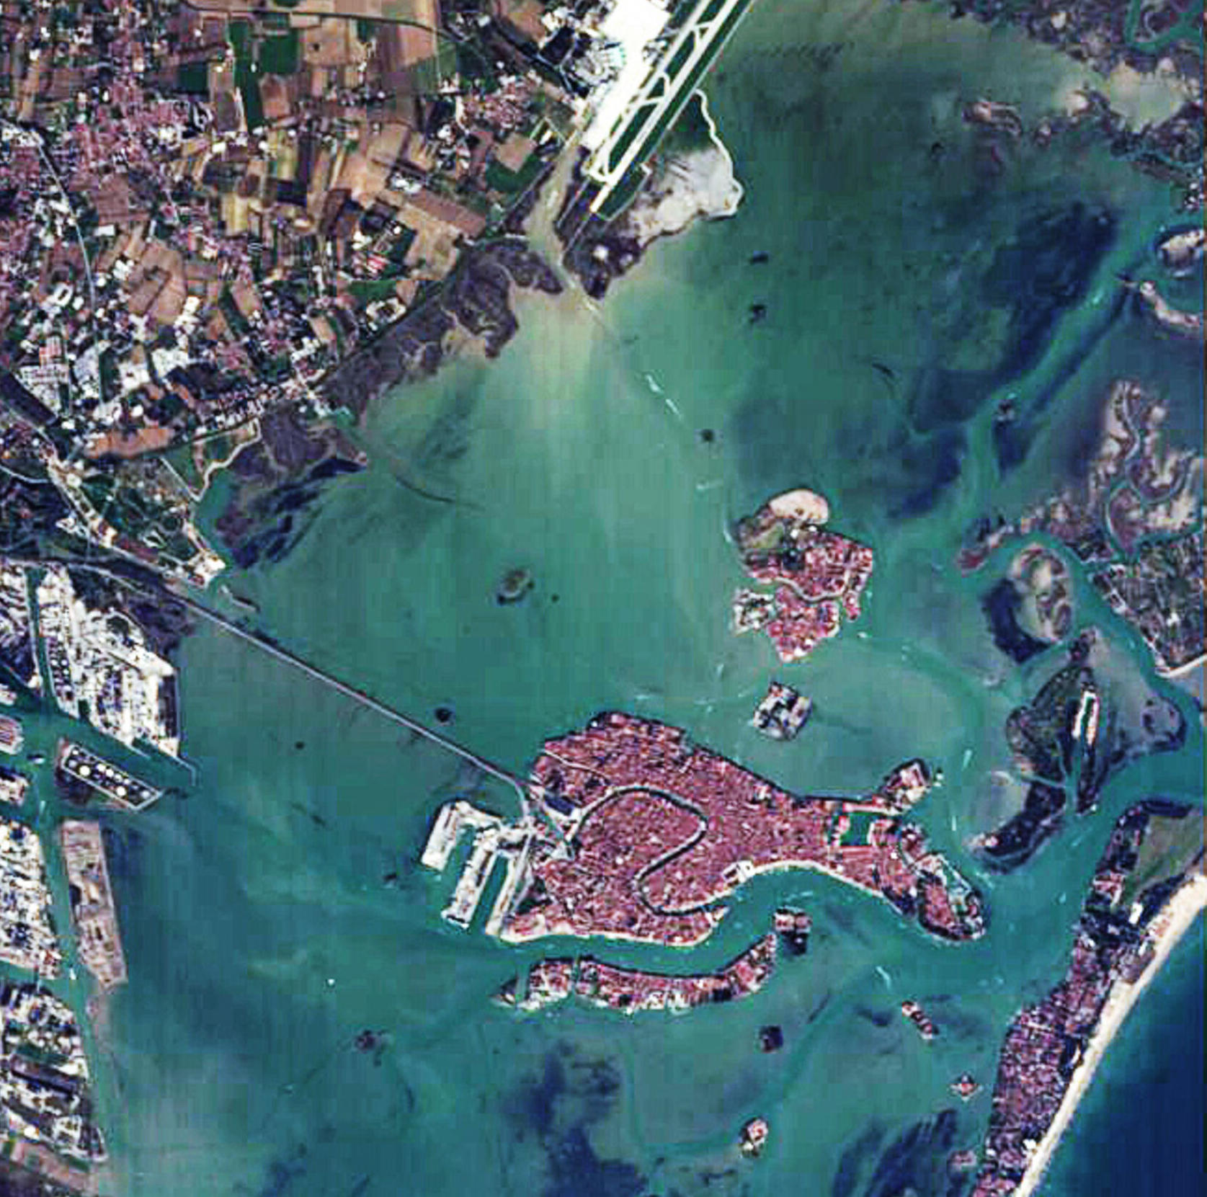
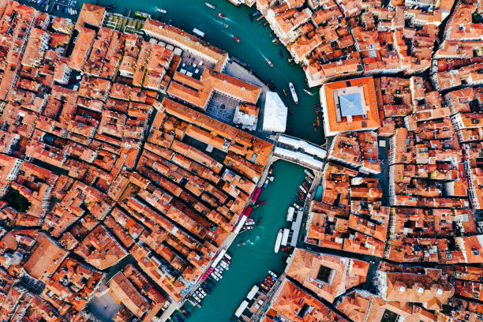
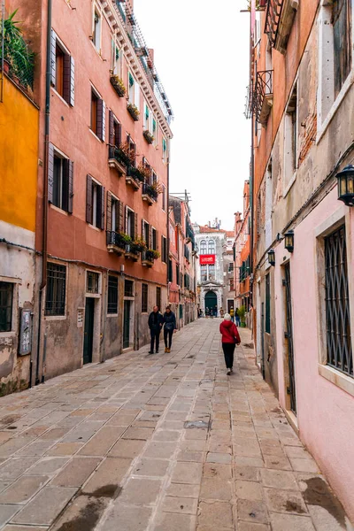
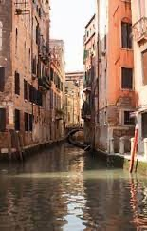
Technical Objectives: extraction and classification of building features
Artificial Intelligence solutions for automatic extraction of building features that determine their vulnerability (geometrical parameters; construction material; roof type, etc.) on the national territorial scale based on satellite, aerial, street view images .
satellite
airborne
Street view images
ICSC Italian Research Center on High-Performance Computing, Big Data and Quantum Computing
Missione 4 • Istruzione e Ricerca
Notes:
Template e guide lines

Slide 4
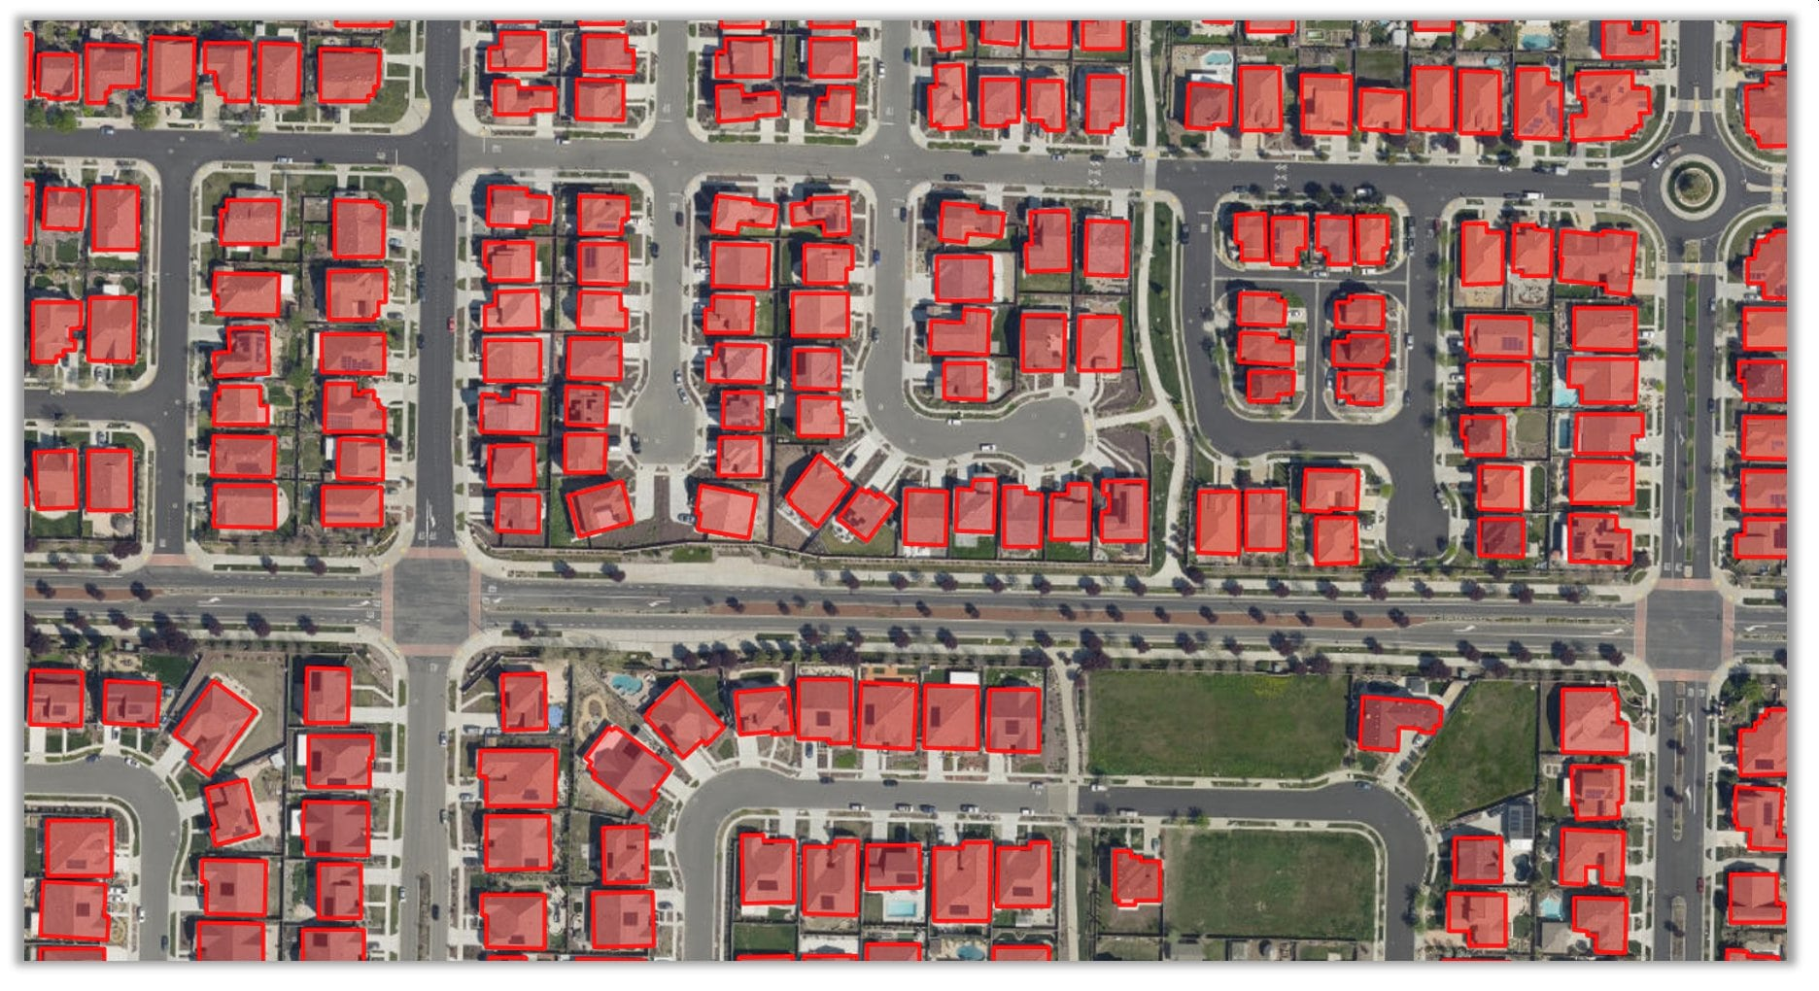
Technical Objectives: extraction and classification of building features
Artificial Intelligence solutions for automatic extraction of local building features that determine their vulnerability (geometrical parameters; construction material; roof type, etc.) on the national territorial scale based on satellite, aerial, street view images .
Building Footprint
satellite
airborne
Street view images
Machine Learning
ICSC Italian Research Center on High-Performance Computing, Big Data and Quantum Computing
Missione 4 • Istruzione e Ricerca
Notes:
Template e guide lines

Slide 5
Technical Objectives: extraction and classification of building features
Artificial Intelligence solutions for automatic extraction of local building features that determine their vulnerability (geometrical parameters; construction material; roof type, etc.) on the national territorial scale based on satellite, aerial, street view images .
Roof type
satellite
airborne
Street view images
Machine Learning
ICSC Italian Research Center on High-Performance Computing, Big Data and Quantum Computing
Missione 4 • Istruzione e Ricerca
Notes:
Template e guide lines

Slide 6
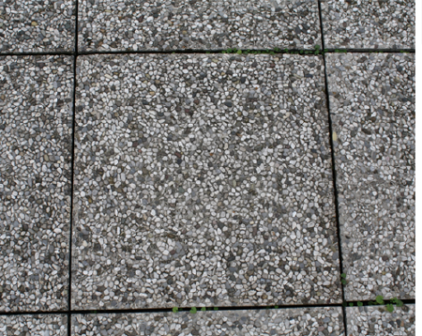
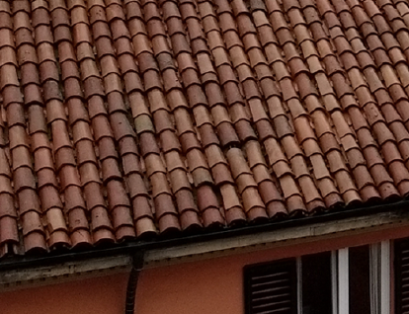
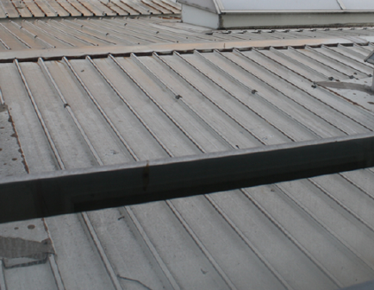
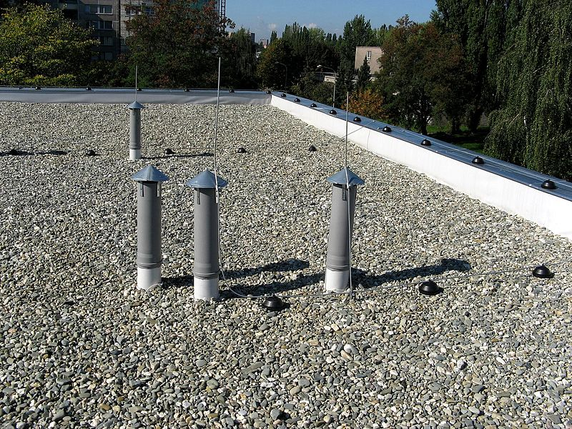
Technical Objectives: extraction and classification of building features
Artificial Intelligence solutions for automatic extraction of local building features that determine their vulnerability (geometrical parameters; construction material; roof type, etc.) on the national territorial scale based on satellite, aerial, street view images .
Roof material
Gravel tiles
Red clay tiles
satellite
airborne
Street view images
Machine Learning
Metal sheets
Loose gravel
ICSC Italian Research Center on High-Performance Computing, Big Data and Quantum Computing
Missione 4 • Istruzione e Ricerca
Notes:
Template e guide lines

Slide 7
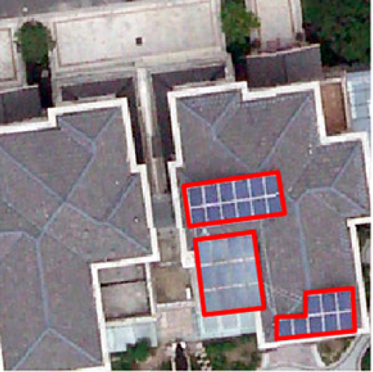
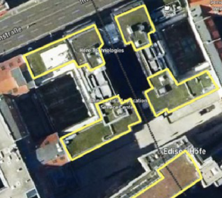
Technical Objectives: extraction and classification of building features
Artificial Intelligence solutions for automatic extraction of local building features that determine their vulnerability (geometrical parameters; construction material; roof type, etc.) on the national territorial scale based on satellite, aerial, street view images .
Sustainable Roof
Solar Rooftop
Green Rooftop
satellite
airborne
Street view images
Machine Learning
ICSC Italian Research Center on High-Performance Computing, Big Data and Quantum Computing
Missione 4 • Istruzione e Ricerca
Notes:
Template e guide lines

Slide 8
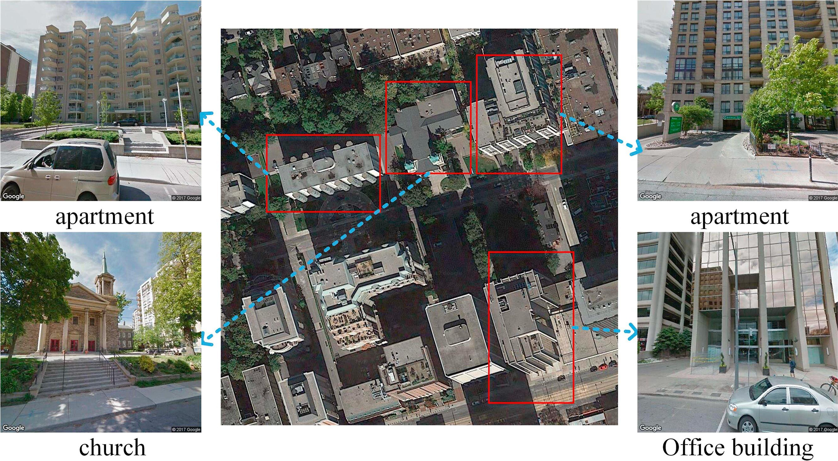
Technical Objectives: extraction and classification of building features
Artificial Intelligence solutions for automatic extraction of local building features that determine their vulnerability (geometrical parameters; construction material; roof type, etc.) on the national territorial scale based on satellite, aerial, street view images .
Building classification:
Building class: i.e. apartment, church, garage, house, industrial, office building,etc.
Construction material: Masonry, Reinforced concrete, other
Building height: Low 1-3, Medium 3-5, High >5
satellite
airborne
Street view images
Machine Learning
ICSC Italian Research Center on High-Performance Computing, Big Data and Quantum Computing
Missione 4 • Istruzione e Ricerca
Notes:
Template e guide lines

Slide 9
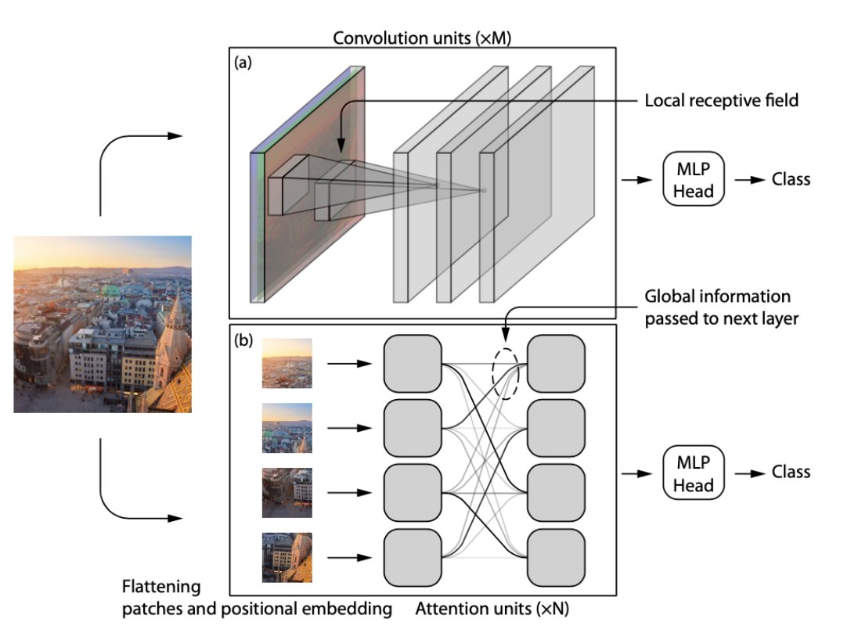
Methodologies : CNN and Vision Transformers (ViT) architectures
Convolution uses a kernel to apply sliding multiplication and addition to local data points.
Subsampling or pooling reduces feature map sizes.
The vectorized feature maps serve as inputs into a fully connected neural network (MPL) to provide a final result like segmentation or classification.
Vision Transformers treat images as sequences of image patches. Patches are embedded into vectors.
The embedded patches are passed through a Transformer encoder.
The Transformer encoder is a stack of Attention layers that allow the model to learn the relationships between the patches.
The output of the encoder is passed through a classification head (MLP) to provide a final result like segmentation or classification
(Tuli, Shikhar et al. “Are Convolutional Neural Networks or Transformers more like human vision?” ArXiv abs/2105.07197 (2021):
ICSC Italian Research Center on High-Performance Computing, Big Data and Quantum Computing
Missione 4 • Istruzione e Ricerca
Notes:
Template e guide lines

Slide 10
Methodologies : CNN and Vision Transformers
Strong ability to model local properties: CNNs primarily focus on local features due to the limited receptive field of convolutional filters. This can be a disadvantage for tasks requiring understanding global context or relationships between distant image elements
Less data for training
Scaling linearly with the datasize O(N)
Strong ability to model long-range dependencies: ViTs utilize self-attention mechanisms that allow them to learn relationships between any two patches in the image, regardless of their distance. This makes them well-suited for tasks where global context is important, such as image classification or scene understanding.
More data for training
Scaling quadratically with the datasize O(N²)
https://twitter.com/GuvercinGoktug/status/1749084802517553606/photo/1
ICSC Italian Research Center on High-Performance Computing, Big Data and Quantum Computing
Missione 4 • Istruzione e Ricerca
Notes:
In general, convolutional neural networks (CNNs) excel at learning local features, whereas vision transformers excel at learning global features. This is because CNNs employ convolutional layers to learn characteristics that are unique to small parts of the input picture. In contrast, vision transformers learn characteristics that are more global in scope by applying self-attention layers to the input picture.

Slide 11
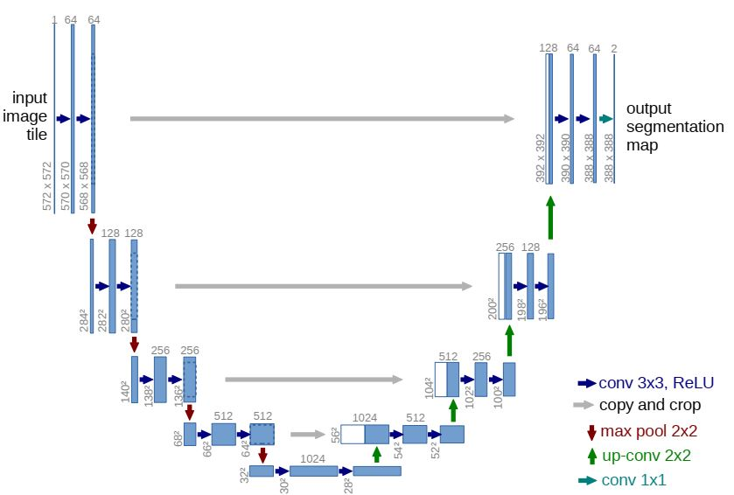
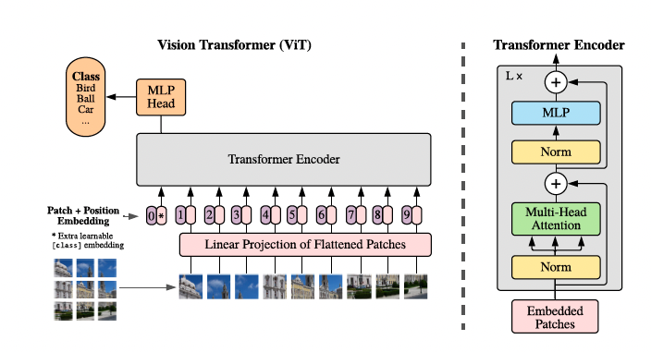
Semantic Segmentation: Hybrid ViTs with Convolutions
U-Net
Vision Transformer
ICSC Italian Research Center on High-Performance Computing, Big Data and Quantum Computing
Missione 4 • Istruzione e Ricerca
Notes:
Template e guide lines

Slide 12
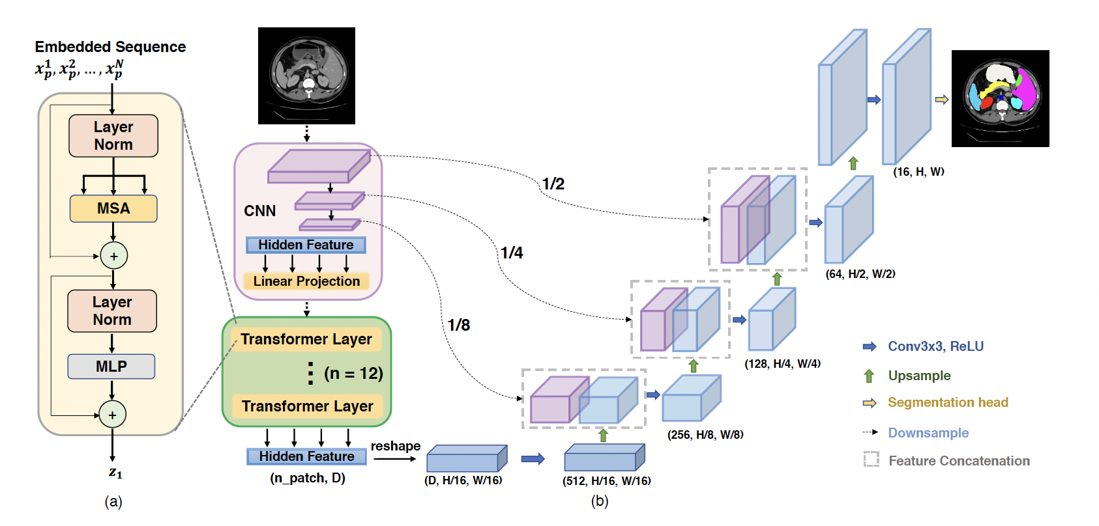
Hybrid ViTs with Convolutions: TransUnet (2021)
Chen, Jieneng, et al. "Transunet: Transformers make strong encoders for medical image segmentation."
arXiv preprint arXiv:2102.04306 (2021).
ICSC Italian Research Center on High-Performance Computing, Big Data and Quantum Computing
Missione 4 • Istruzione e Ricerca
Notes:
Template e guide lines

Slide 13
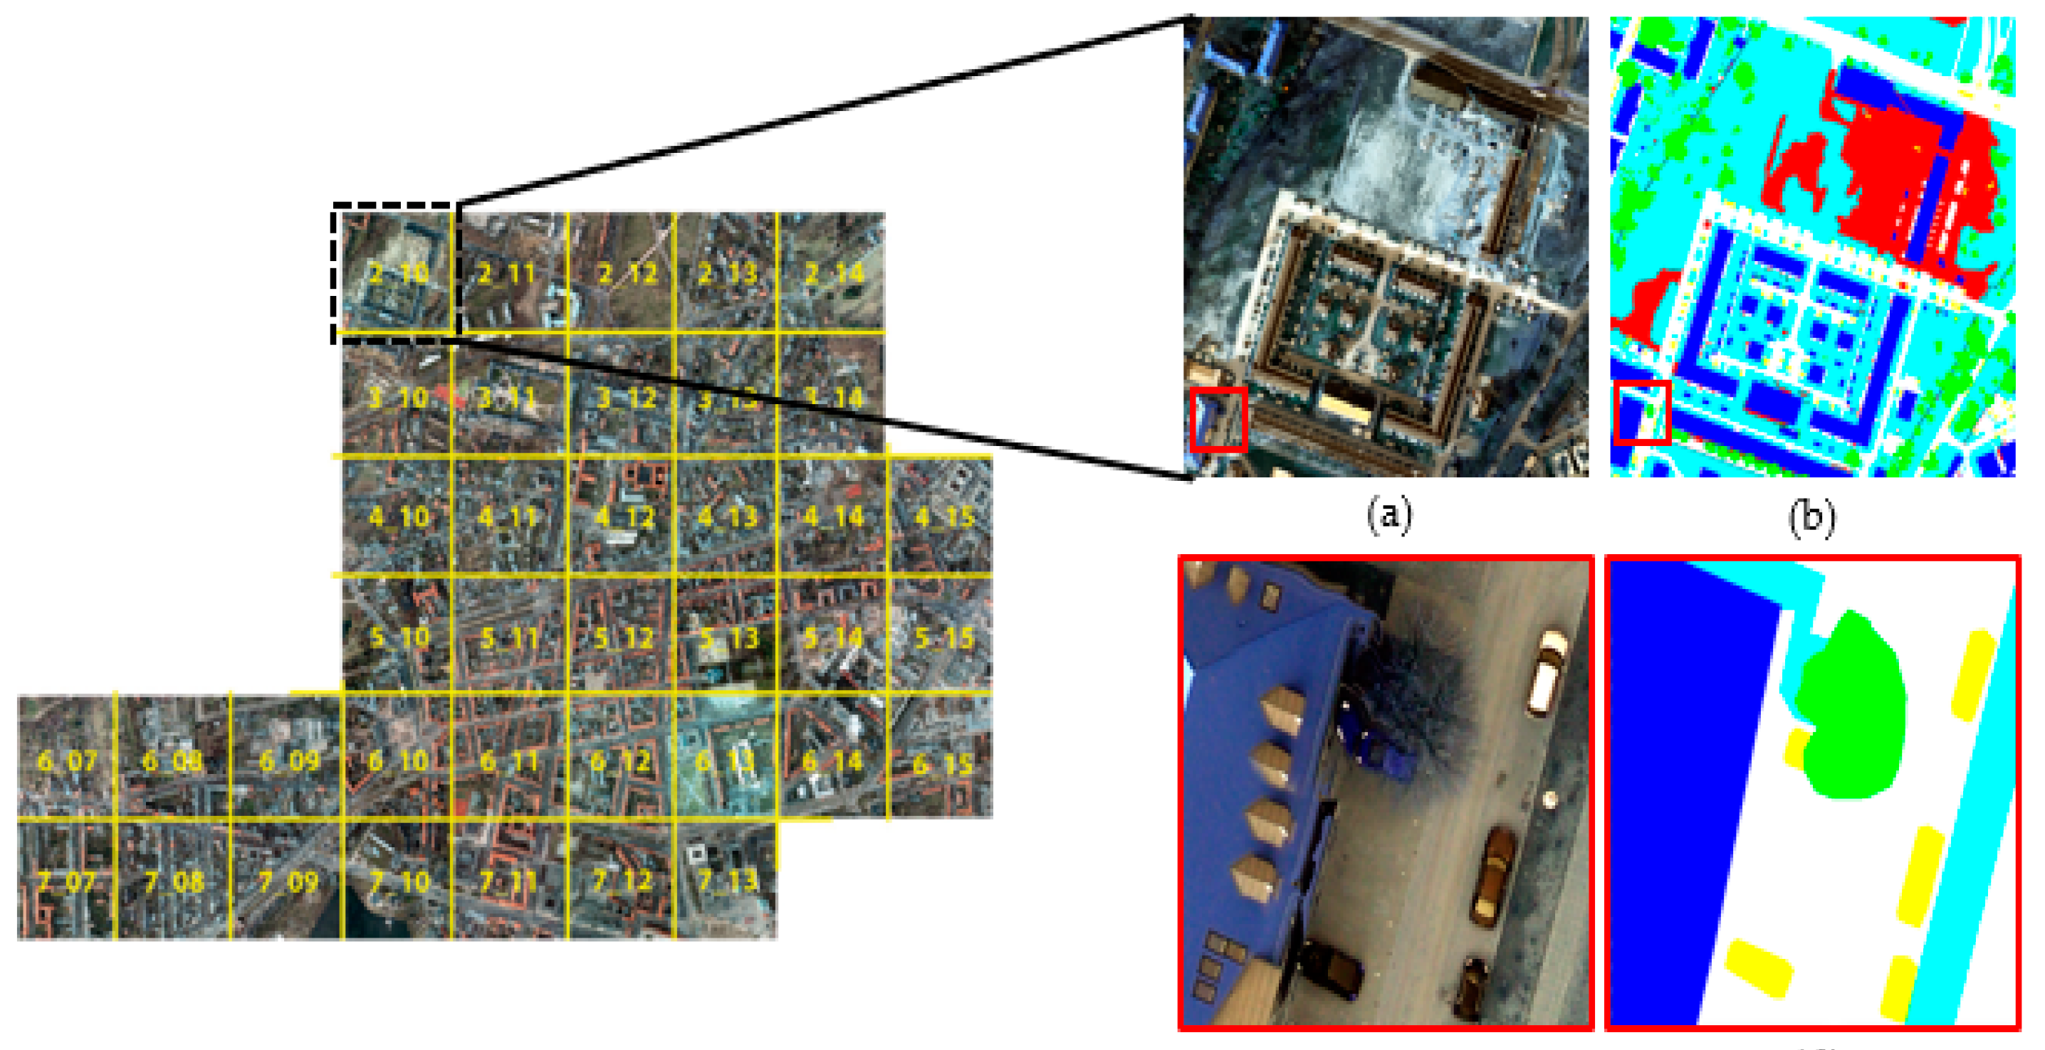
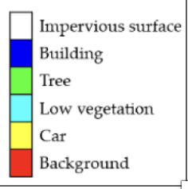
Accomplished work: Preliminary results on TransUnet
Open benchmark Potsdam/Germany dataset :
38 high-resolution airborne images (6000 ×6000 pixels)
spatial resolution of 5 cm.
Near-infrared (NIR), RGB, orthorectified imagery
ground-truth comprising 6 classes:
ICSC Italian Research Center on High-Performance Computing, Big Data and Quantum Computing
Missione 4 • Istruzione e Ricerca
Notes:
Template e guide lines

Slide 14
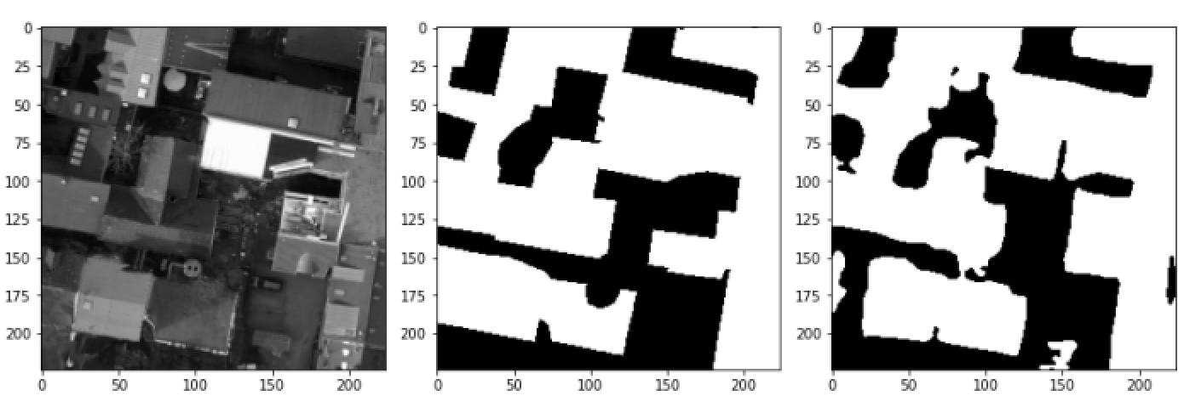
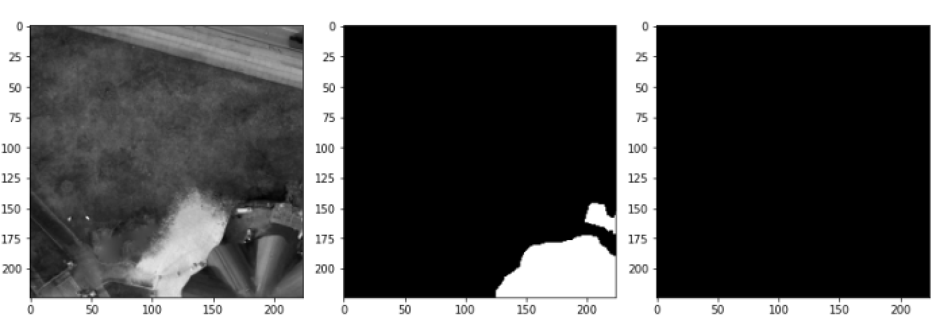
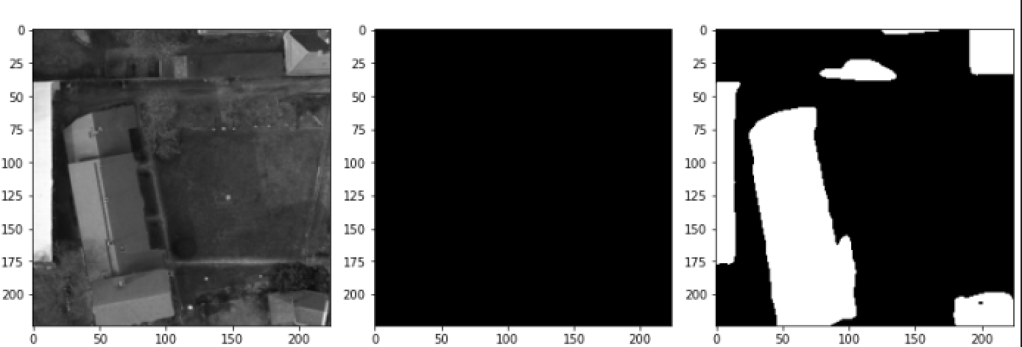
Accomplished work: preliminary results on TransUnet
Image preprocessing
6000x6000 pixel rescaled to 1344x1344 pixel
Split in 224x224 pixel tiles (inputs of the network)
Only one channel (green) used
Binary classification
Only one class used: buildings
Pretraining
ImageNet21K
Training
Epochs: 40; Batch size: 24; Initial Learning Rate: 0.01
Training Set: 1231 images Test Set: 137 images
Ground truth
Prediction
Network performance after 40 epochs:
Mean IoU 0.734
Accuracy 0.947
ICSC Italian Research Center on High-Performance Computing, Big Data and Quantum Computing
Missione 4 • Istruzione e Ricerca
Notes:
Template e guide lines

Slide 15
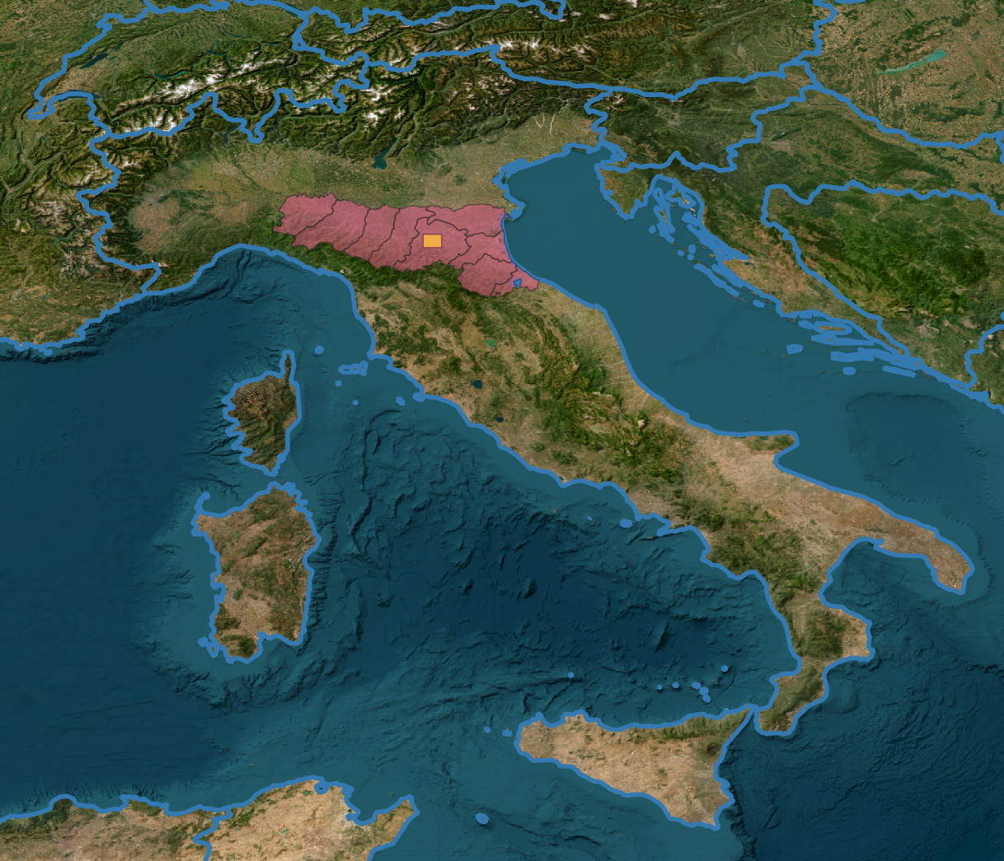
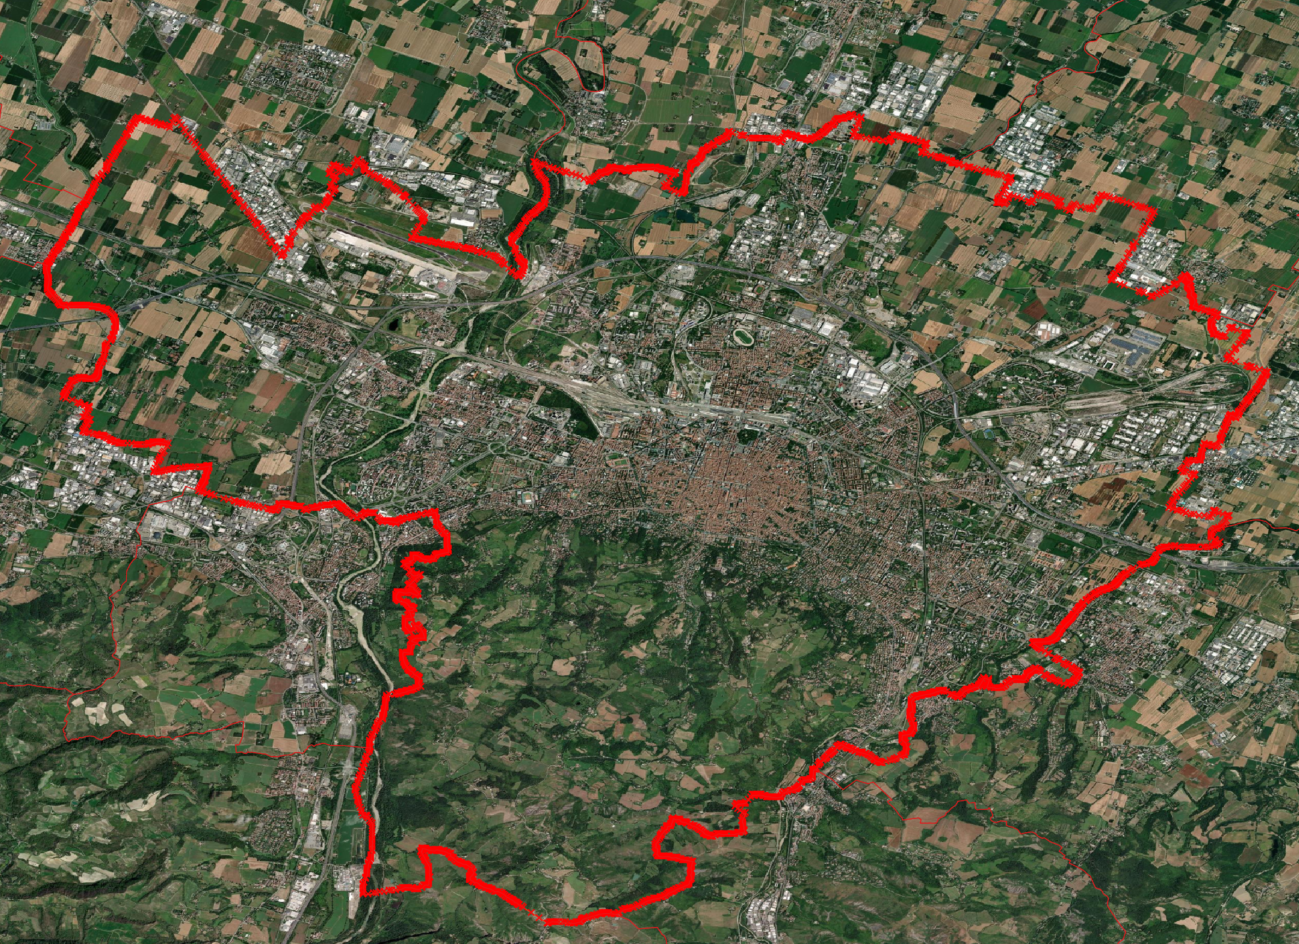
Further Accomplished work:
Analysis of the literature regarding ML solutions for image segmentation and classification
Selection of public labeled dataset for testing and benchmarking (Inria Aerial Image Labelling dataset, WHU building dataset, etc.)
On-going:
Access to satellite images from ASI (COSMO-SkyMed and Hyperspectral satellite Prisma) on the region of interest (Municipality of Bologna)
Access to orthophoto provided by Regione Emilia Romagna
Municipality of Bologna
ICSC Italian Research Center on High-Performance Computing, Big Data and Quantum Computing
Missione 4 • Istruzione e Ricerca
Notes:
Template e guide lines

Slide 16
Next Steps and Expected Results
Evaluation of alternative solutions for image segmentation: pure convolutional (U-Net), pure transformer (Swin-Unet), hybrid (TransUnet, Segment Anything Model and others)
Full acquisition of labeled dataset on the area of interests
Start investigating effective ML solutions for classification
December 2023
starting working on HaMMon
October 2024
Algorithm selection and dataset for ground truth
December 2024
Segmentation models implemented
June 2025
Classification models implemented
ICSC Italian Research Center on High-Performance Computing, Big Data and Quantum Computing
Missione 4 • Istruzione e Ricerca
Notes:
Template e guide lines

Slide 17
Thanks for your attention!
ICSC Italian Research Center on High-Performance Computing, Big Data and Quantum Computing
Missione 4 • Istruzione e Ricerca
Notes:
Template e guide lines

