Slide 1
Introduction to Data Models
Giacomo Coran - INAF OATs
Spoke 3 General Meeting, Elba 5-9 / 05, 2024
ICSC Italian Research Center on High-Performance Computing, Big Data and Quantum Computing
Missione 4 • Istruzione e Ricerca
Notes:
Cover

Slide 2
Status of the Importer development
The Importer devices are ready to be implemented: every aspect regarding the internal workflow is completed and tested.
We are ready to test the interconnectivity with the Rucio connector, which requires minimal adaptation to the connection part of the code.
The metadata extraction and the data model retrieval parts of the code are necessarily postponed, to be adapted to the specified file structure and data model described in the meetings with the groups producing the files.
Currently example devices are implemented for the Fermi and the Gaia use cases, working with a local database.
ICSC Italian Research Center on High-Performance Computing, Big Data and Quantum Computing
Missione 4 • Istruzione e Ricerca
Notes:
Template e guide lines

Slide 3
Data Models
Information gathered from A. Bignamini’s presentation at the 2024 School of Data management plan and Data Models
http://indico.ict.inaf.it/event/2668/contributions/17113/attachments/7867/16240/Data%20Model.pdf
What is a data model?
A description of how data is stored and accessed
It does not include details on how data is stored
Only uses logical concepts, such as objects, their properties and interrelationships
Different types of implementation
Conceptual: designed for high-level view, addresses entities and relationships
Logical: conceptual plus attributes and lesser entity types
Physical: logical applied to database design, describes tables, keys, indexes and constraint
Displayed with Entity-Relationship Diagrams
ICSC Italian Research Center on High-Performance Computing, Big Data and Quantum Computing
Missione 4 • Istruzione e Ricerca
Notes:
Template e guide lines

Slide 4
Data Models
Why using a data model?
Better interpretation of a problem
Representation of aspects of a problem
Helps to visualize the conceptual structure
Effective communication
Reduces misunderstanding
Promotes consensus
Improves data quality
Allows for weaving of additional constraints and tuning of the database
Leads to reliable storage
Improves performance in search
ICSC Italian Research Center on High-Performance Computing, Big Data and Quantum Computing
Missione 4 • Istruzione e Ricerca
Notes:
Template e guide lines

Slide 5
The FAIR principles
Findable:
(Meta)data are assigned a globally unique and persistent identifier;
Data are described with rich metadata;
Metadata clearly and explicitly include the identifier of the data it describes;
(Meta)data are registered or indexed in a searchable resource.
Accessible:
(Meta)data are retrievable by their identifier using a standardized communications protocol;
The protocol is open, free and universally implementable;
The protocol allows for an authentication and authorization procedure, where necessary;
Metadata are accessible, even when the data are no longer available.
Interoperable:
(Meta)data use formal, accessible, shared and broadly applicable language for knowledge representation;
(Meta)data use vocabularies that follow FAIR principles;
(Meta)data include qualified references to other (meta)data.
Reusable:
Meta(data) are richly described with a plurality of accurate and relevant attributes;
(Meta)data are released with a clear and accessible data usage license;
(Meta)data are associated with detailed provenance;
(Meta)data meet domain-relevant community standards.
ICSC Italian Research Center on High-Performance Computing, Big Data and Quantum Computing
Missione 4 • Istruzione e Ricerca
Notes:
Template e guide lines

Slide 6
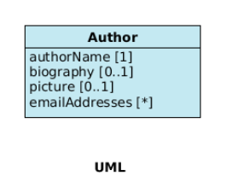
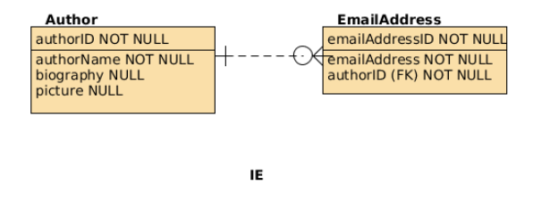
Datasets, collections and the relationships between objects
Data grouping
Collection: grouping of data homogeneous or inhomogeneous in format and content;
Dataset: atomic unit of a collection.
Entity-Relationship Diagrams
Display relationships between entities of a dataset
Different notation: main used UML and IE
UML (Unified Modeling Language)
Conceptual description of a data model
Groups entity types in classes
Associations describe relationships between classes
Properties of a class are defined as attributes with multiplicity that specifies the number of possible values that attribute can assume
IE (Information Engineering)
Closer to physical description
Distinguishes between independent and dependent entity types
Distinguishes between identifying and non-identifying relationships
Exposes separately the primary key among the attributes
Displays clearly when an attribute is a foreign key for a class
Shows multiplicity in relationship
Can explicit nullability of an attribute
ICSC Italian Research Center on High-Performance Computing, Big Data and Quantum Computing
Missione 4 • Istruzione e Ricerca
Notes:
Template e guide lines

Slide 7
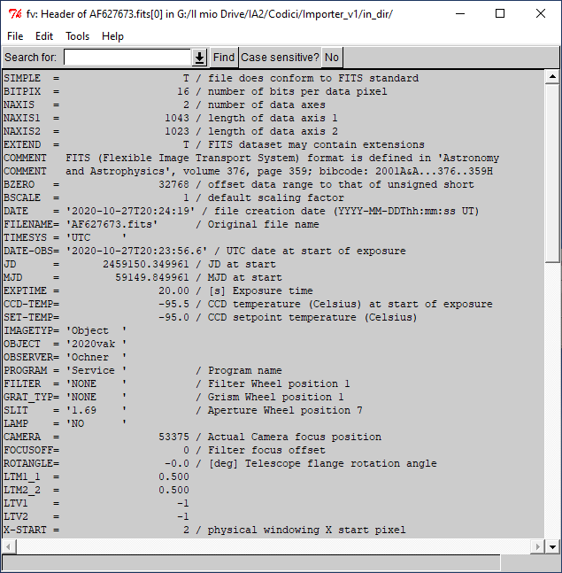
Formats and Data Models
File format ≠ data model
The format of a file is not a valid data model construction.
A data model is a broader description of the structure of the data as stored in a database, it can span throughout the structure of the file.
Standardized structures are definitely helpful for a data model.
Possible features of a file format:
Human-readable metadata availability;
Open format with public specifications maintained by a standard organization;
Machine independence;
Storage efficiency;
Data structures (images, tables, hierarchical structures,…)
Internal data compression;
Segmented data access.
FITS
Contains standardized headers describing content
Metadata displayed in keyword-value couples in the header
Fixed dictionary of keywords and value types for spatial and temporal coordinate representations
Additional dictionaries defined by international astronomy organization
Useful comments describing the metadata
ICSC Italian Research Center on High-Performance Computing, Big Data and Quantum Computing
Missione 4 • Istruzione e Ricerca
Notes:
Template e guide lines

Slide 8
Metadata
Some metadata are mandatory to create a VO compliant database and services
Mandatory metadata described in IVOA data models documents:
Axis descriptive metadata in the CharacterizationDM https://www.ivoa.net/documents/cover/CharacterisationDM-20080325.html
Observative metadata in the ObsCoreDM https://www.ivoa.net/documents/ObsCore/20170509/index.html
Simulative metadata in the SimDM https://www.ivoa.net/documents/SimDM/20120503/index.html
Example of common metadata
“dataproduct_type”: describes the primary nature of the data product
“obs_id”: defines a unique identifier for the observation
“facility_name”: explains the name of the facility where the observation was done
On the side the list of mandatory metadata for the ObsCore, with expected units and data type and with a simple description.
Column Name | Unit | Type | Description
dataproduct_type | unitless | String | Logical data product type (image etc.)
calib_level | unitless | enum integer | Calibration level {0, 1, 2, 3, 4}
obs_collection | unitless | String | Name of the data collection
obs_id | unitless | String | Observation ID
obs_publisher_did | unitless | String | Dataset identifier given by the publisher
access_url | unitless | String | URL used to access (download) dataset
access_format | unitless | String | File content format (see in App. BB.5.2 )
access_estsize | kbyte | integer | Estimated size of dataset in kilo bytes
target_name | unitless | String | Astronomical object observed, if any
s_ra | deg | double | Central right ascension, ICRS
s_dec | deg | double | Central declination, ICRS
s_fov | deg | double | Diameter (bounds) of the covered region
s_region | unitless | String | Sky region covered by the data product (expressed in ICRS frame)
s_xel1 | unitless | integer | Number of elements along the first spatial axis
s_xel2 | unitless | integer | Number of elements along the second spatial axis
s_resolution | arcsec | double | Spatial resolution of data as FWHM
t_min | d | double | Start time in MJD
t_max | d | double | Stop time in MJD
t_exptime | s | double | Total exposure time
t_resolution | s | double | Temporal resolution FWHM
t_xel | unitless | integer | Number of elements along the time axis
em_min | m | double | Start in spectral coordinates
em_max | m | double | Stop in spectral coordinates
em_res_power | unitless | double | Spectral resolving power
em_xel | unitless | integer | Number of elements along the spectral axis
o_ucd | unitless | String | UCD of observable (e.g. phot.flux.density, phot.count, etc.)
pol_states | unitless | String | List of polarization states or NULL if not applicable
pol_xel | unitless | integer | Number of polarization samples
facility_name | unitless | String | Name of the facility used for this observation
instrument_name | unitless | String | Name of the instrument used for this observation
ICSC Italian Research Center on High-Performance Computing, Big Data and Quantum Computing
Missione 4 • Istruzione e Ricerca
Notes:
Template e guide lines

Slide 9
Metadata retrieval
A clear and defined structure of a file is important in metadata retrieval
Allows for easy human access
Allows for quick software extraction
Improves construction of databases and relative data models
We ask our data providers for
A list of metadata to be imported in the database
A list of metadata among the stored ones to be queried on
The structure of the file they provide
An easy access to a unique key among the metadata necessary for the software ingestion
ICSC Italian Research Center on High-Performance Computing, Big Data and Quantum Computing
Missione 4 • Istruzione e Ricerca
Notes:
Template e guide lines

Slide 10
Data Flow
Useful to meet necessities of data providers and end users and to check for file integrity
How data arrive to the archive
Single file containing all the content with metadata stored in the same file they refer to
Folder containing all the data files and the ancillary metadata files as a single package
Check for integrity
checksum function: a value for the checksum preceding the delivery must be calculated and saved in the metadata
open to discuss other means if necessary
How to expose data to the end users
One file per entry in the tabular response of a query
Composition of all the selected entries from different files in a single file
Creation of a compacted (.tar) file when selecting multiple files
Availability to expose data in a different format from that received an archived
A service will provide a file construction in the requested format
Developed if requested by the data providers
ICSC Italian Research Center on High-Performance Computing, Big Data and Quantum Computing
Missione 4 • Istruzione e Ricerca
Notes:
Template e guide lines

Slide 11
Queries
Provide typical example queries
Help in data model creation
Improve database organization
Match end users’ discovery issues
Typical queries are of the type:
SELECT authorName FROM Author WHERE biography NOT NULL
SELECT emailAddress FROM EmailAddress WHERE AuthorId = 156
Try to provide them in the round-tables we are going to have tomorrow.
ICSC Italian Research Center on High-Performance Computing, Big Data and Quantum Computing
Missione 4 • Istruzione e Ricerca
Notes:
Template e guide lines

Slide 12
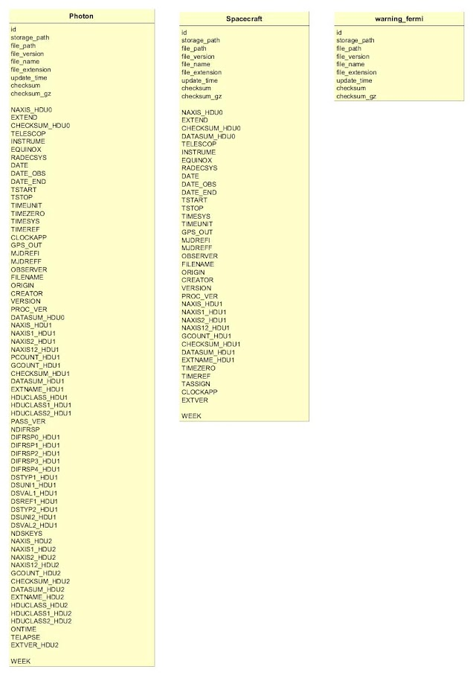
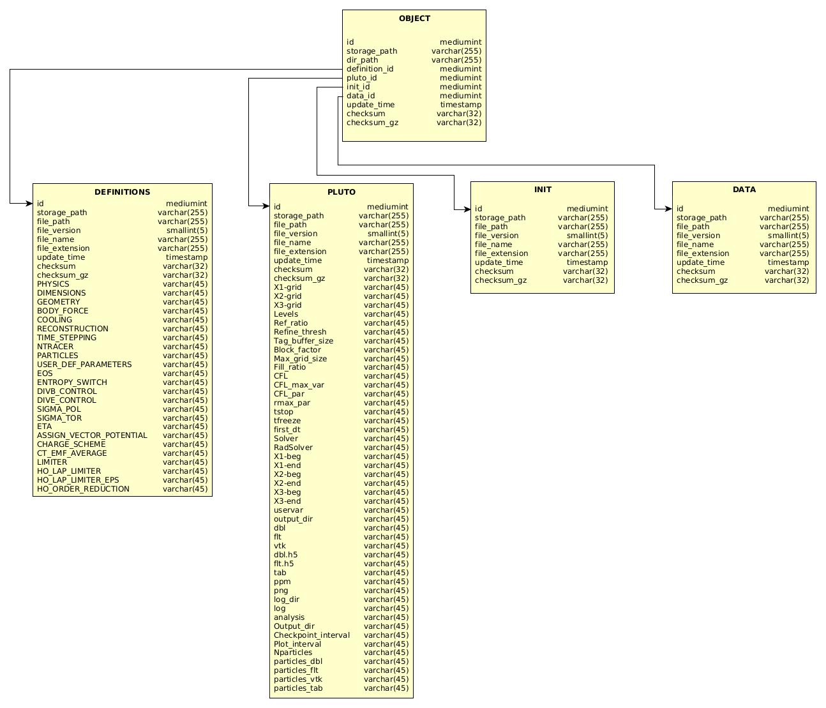
Current development
Data models developed for 3 use cases (Fermi, Gaia, Pluto)
Test implementation for 2 use cases (Fermi, Gaia) with local databases
Data models vary in complexity
Fermi is easy to implement, unique key in the file name and tables not related to one another
Pluto is more complex and may be subject to changes.
Fermi data model
Pluto data model
ICSC Italian Research Center on High-Performance Computing, Big Data and Quantum Computing
Missione 4 • Istruzione e Ricerca
Notes:
Template e guide lines

Slide 13
Conclusions
Round-table meeting tomorrow in the afternoon.
Definition of the list of metadata to archive and a prototype for the data model
Definition of typical queries you expect an end user would do
Metadata and portal interface - Massimo Costantini.
Fermi and Gaia examples - Andrea Adelfio and Sara Gelsumini
We are open to provide archive services to more use cases, if the requirements we set are met and within a limited number for testing purposes.
We are open to answer any question.
You can mail us all at cn1-spoke3-wp4@inaf.it or directly at giacomo.coran@inaf.it.
Please check out the great work done by Andrea Bignamini on the Data Models topic.
If interested, we invite you to the next School of Data Management Plan and Data Models.
ICSC Italian Research Center on High-Performance Computing, Big Data and Quantum Computing
Missione 4 • Istruzione e Ricerca
Notes:
Template e guide lines

