Slide 1
Search for orbital modulated periodic signals in radio timeseries
Andrea Possenti & Rouhin Nag
( INAF-Cagliari & Univ of Cagliari )
Spoke 3 General Meeting, Elba 5-9 / 05, 2024
ICSC Italian Research Center on High-Performance Computing, Big Data and Quantum Computing
Missione 4 • Istruzione e Ricerca
Notes:
Cover

Slide 2
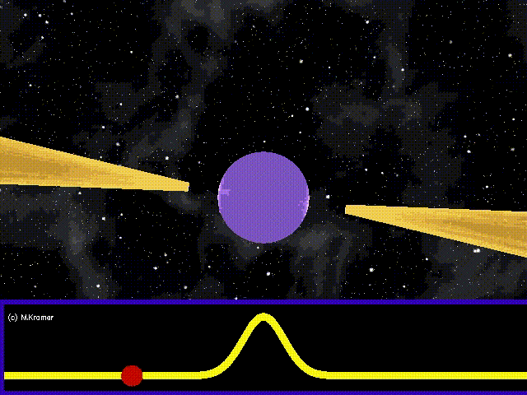
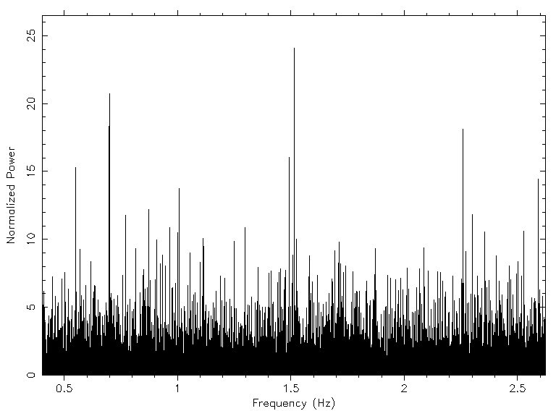
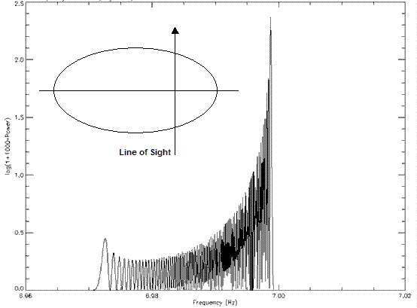
Scientific Rationale
Pulsars are great tools to investigate:
To be searched applying FFTs or Fast Folding Algorithms
Neutron star magnetosphere
Neutron star birth and population
Supernova explosion
Ionized Interstellar medium
Galactic magnetic field
Globular cluster potential well
Globular cluster internal dynamics
Ultralong period Gravitational Waves
Fourier
power is very Peaked
Binary pulsars in close orbital systems are magnificent tools to perform unique experiments in:
Direct FFTs is not possible due to the changing apparent spin period caused by the Doppler effect
Fourier power is
spread across many bins
Tests of General Relativity
Study of alternate Gravity Theories
Measuring the mass of a Neutron Star
Constraining nuclear Physics
Study of Plasma Physics
Giersch 2002
ICSC Italian Research Center on High-Performance Computing, Big Data and Quantum Computing
Missione 4 • Istruzione e Ricerca
Notes:
Template e guide lines

Slide 3
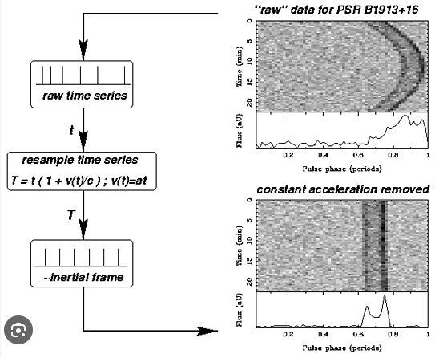
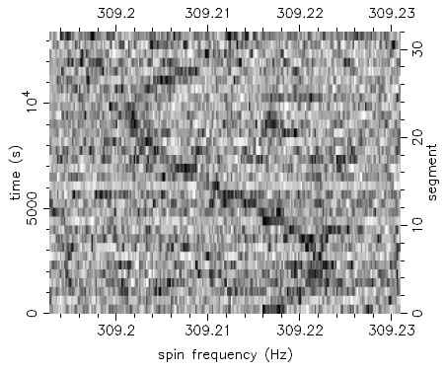
Technical Objectives, Methodologies and Solutions
Radio frequency Interference mitigation
Dedispersion
Periodicity searches using FFT
Preparation of pulsar candidate list and diagnostic plots
Inspection of the candidates by an Astronomer
Nag 2024
Chandler 2008
Several alternative approaches
Jerk search
Linear acceleration search
Very good for tight binaries
Computationally Very Expensive
Not very sensitive to tight systems
Template banking search
Potentially good, no discoveries so far
Needed accelerators … GPUs
ICSC Italian Research Center on High-Performance Computing, Big Data and Quantum Computing
Missione 4 • Istruzione e Ricerca
Notes:
Template e guide lines

Slide 4
Timescale, Milestones and KPIs (WP1, 1.13 )
Timeline | Description | Target | KPI
M7 (Sept 2023 – Feb 2024 ) | Acquisition of the basic knowledge of the most used existing codes to search for periodic signal in timeseries, as well as their usage in the astrophysical context. Implementation and test of these codes on CPU machines | Conceptual summary of the acquired knowledges | Presentation at doctorate first year review at University of Cagliari: https://www.openaccessrepository.it/record/143685 (also doi: 10.15161/oar.it/143685 )
M8 (Mar 2024 – June 2024) | Review and implementation of the latest CPU codes for searching for strongly modulated periodic signals in timeseries and investigation of their performance with respect to the codes examined in the previous milestone. In particular, this class of codes, usually dubbed as codes for "jerk" searches, have been developed in order to detect periodically emitting cosmic sources included in a very tight binary system. | Runnable version of the CPU based codes for performing "jerk" searches and application to some real data case. Comparison of the perfomance with respect to the code simply running "accelerated" searches | Presentation at a talk given at INAF
M9 (Jul 2024 – Oct 2024) | In-depth examination of the available CPU-based code for performing "jerk" searches and initial tests for replacing some of the tasks, by using GPUs | Early version of a code for performing "jerk" searches by using GPUs | Link to a gitlab repository
M10 (Nov 2024 – Aug 2025) | Development and implementation of a GPU-based code for running a "jerk" search of periodic signals generated by radio sources located in tight binary system | Runnable version of the GPU-based code for running a "jerk" search | Link to a gitlab repository
ICSC Italian Research Center on High-Performance Computing, Big Data and Quantum Computing
Missione 4 • Istruzione e Ricerca
Notes:
Template e guide lines

Slide 5
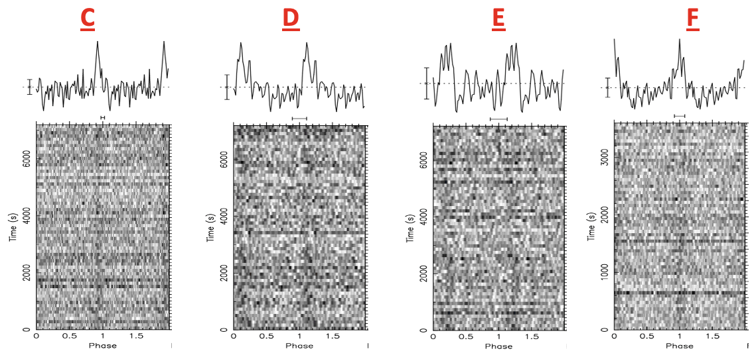
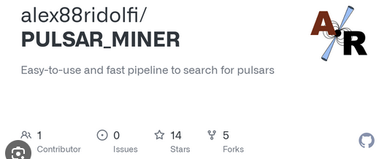
Rouhin Nag: Accomplished Work + Results
Acquisition of the basic knowledge of the most used existing codes to search for periodic signal in timeseries. Implementation and test of these codes on CPU machines
PRESTO : PulsaR Exploration and Search Toolkit developed by Scott Ransom (NRAO) is a large suite of pulsar search and analysis software.
Pulsar Miner developed by Alessandro Ridolfi (OAC,INAF) is pipeline that acts as a wrapper for various routines of PRESTO with additional benefits of configurating and parallelizing various steps.
Nag 2024
Four discovered pulsars in GLIMPSE-C01
Learned to use
ICSC Italian Research Center on High-Performance Computing, Big Data and Quantum Computing
Missione 4 • Istruzione e Ricerca
Notes:
Template e guide lines

Slide 6
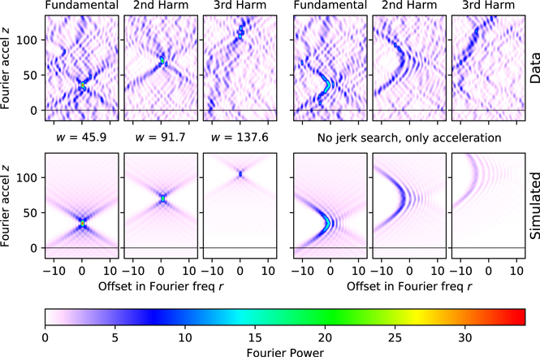
Next Steps and Expected Results
Andersen & Ransom 2018
Porting the “Jerk” search code to GPU and characterizing it
Learning the working and how to use the “Jerk” search code (for CPU only nowadays)
ICSC Italian Research Center on High-Performance Computing, Big Data and Quantum Computing
Missione 4 • Istruzione e Ricerca
Notes:
Template e guide lines

