Slide 1

ISTEDDAS: current status and
key-science project
Mario Spera + others @ SISSA
Spoke 3 General Meeting, Elba 5-9 / 05, 2024
ICSC Italian Research Center on High-Performance Computing, Big Data and Quantum Computing
Missione 4 • Istruzione e Ricerca

Slide 2
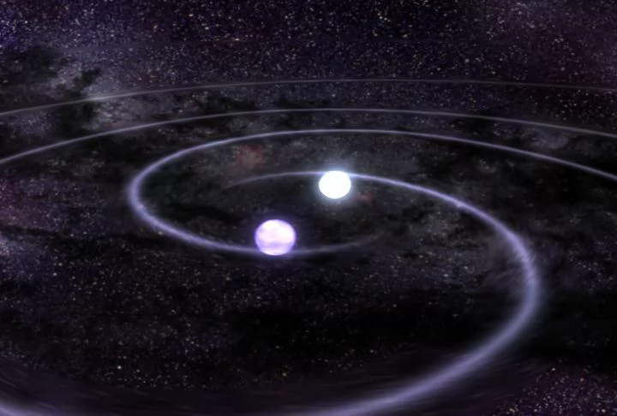
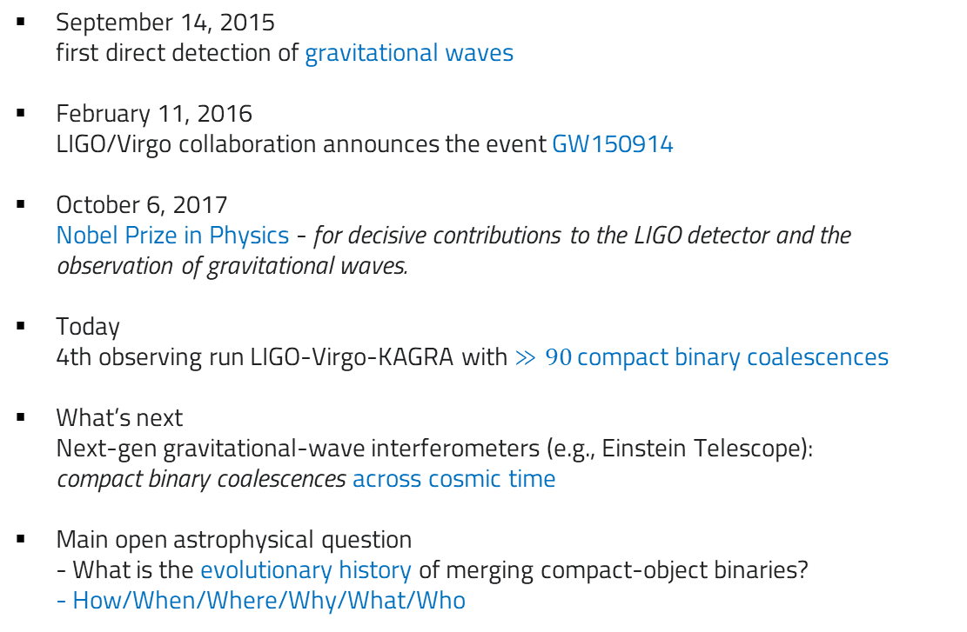
Scientific Rationale: gravitational-wave astrophysics
September 14, 2015
first direct detection of gravitational waves
February 11, 2016
LIGO/Virgo collaboration announces the event GW150914
October 6, 2017
Nobel Prize in Physics - for decisive contributions to the LIGO detector and the observation of gravitational waves.
Today
4th observing run LIGO-Virgo-KAGRA with $≫90$ compact binary coalescences
What’s next
Next-gen gravitational-wave interferometers (e.g., Einstein Telescope):
compact binary coalescences across cosmic time
Main open astrophysical question
- What is the evolutionary history of merging compact-object binaries?
- How/When/Where/Why/What/Who
https://www.ligo.caltech.edu/page/what-are-gw
ICSC Italian Research Center on High-Performance Computing, Big Data and Quantum Computing
Missione 4 • Istruzione e Ricerca

Slide 3
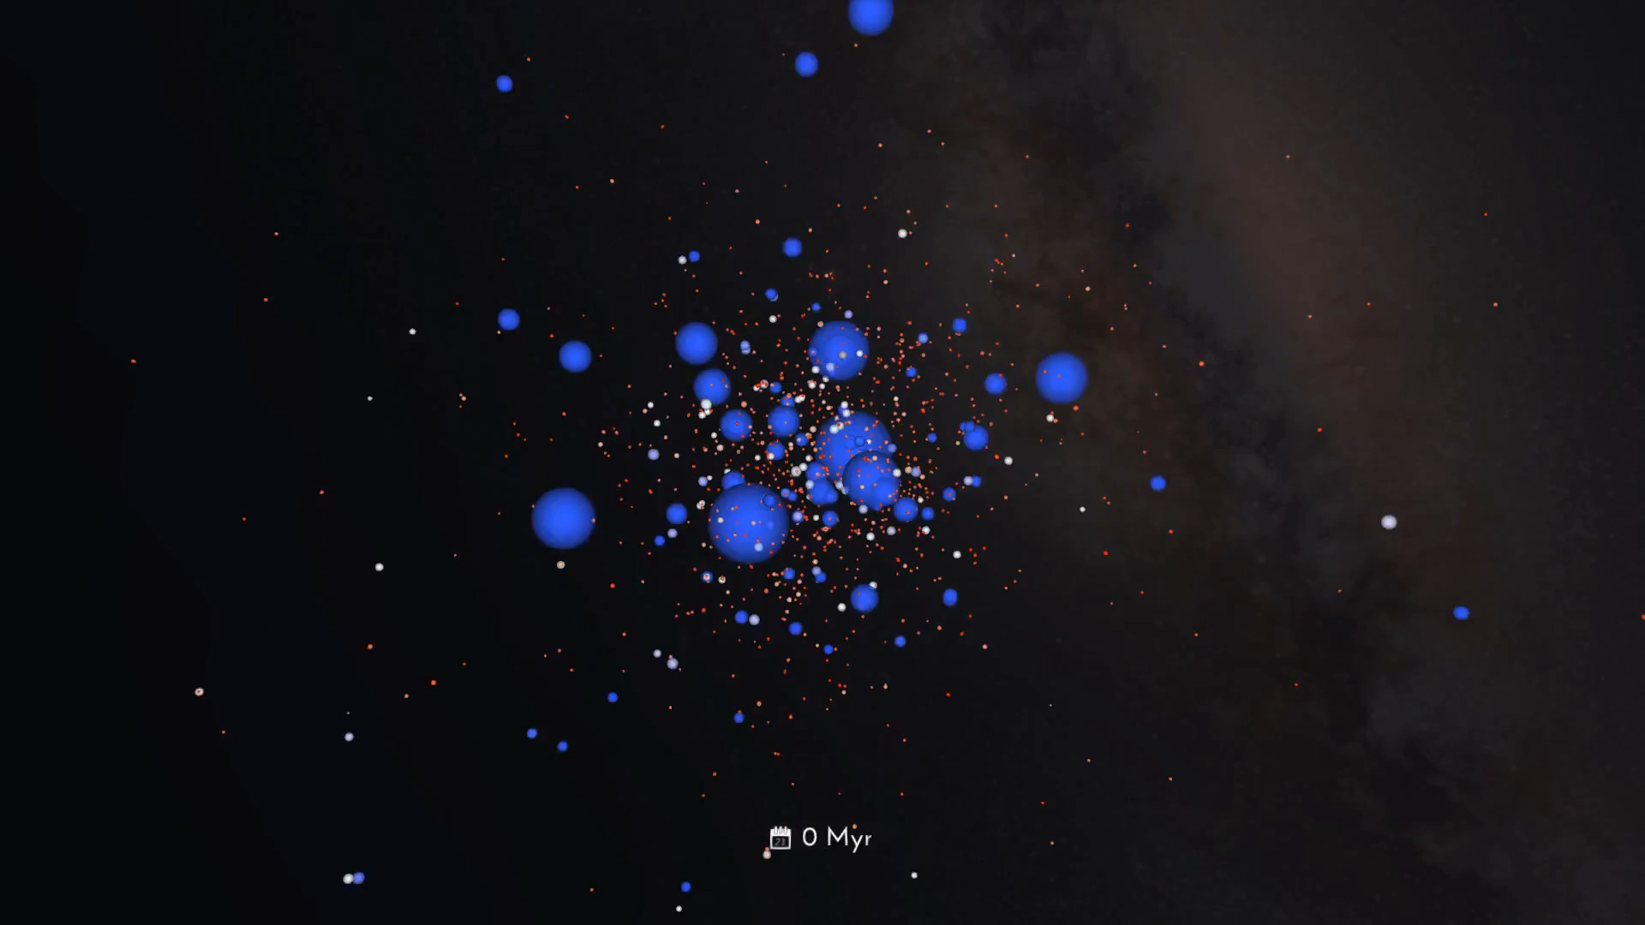
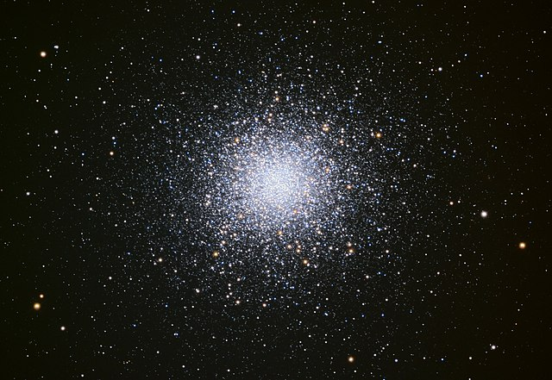
Scientific Rationale
Most stars form in dense stellar environments → star clusters are natural places to look for merging compact-binary coalescences
https://www.youtube.com/watch?v=AKzPCdZKX2I
ICSC Italian Research Center on High-Performance Computing, Big Data and Quantum Computing
Missione 4 • Istruzione e Ricerca

Slide 4
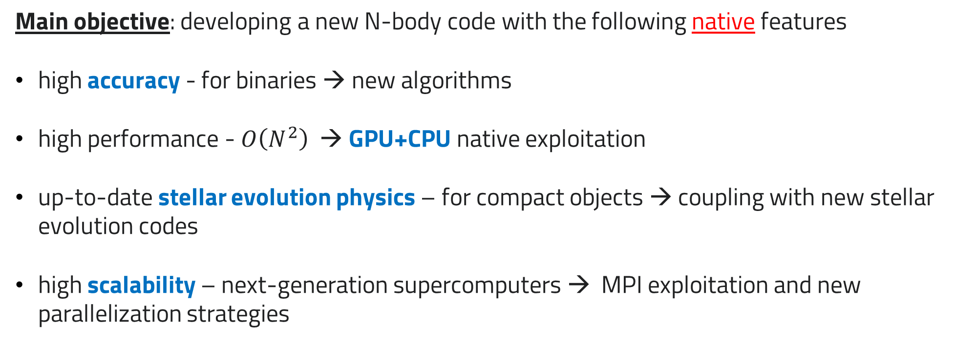
Technical Objectives, Methodologies and Solutions
Main objective: developing a new N-body code with the following native features
high accuracy - for binaries → new algorithms
high performance - $O\left(N^{2}\right)$→ GPU+CPU native exploitation
up-to-date stellar evolution physics – for compact objects → coupling with new stellar evolution codes
high scalability – next-generation supercomputers → MPI exploitation and new parallelization strategies
ICSC Italian Research Center on High-Performance Computing, Big Data and Quantum Computing
Missione 4 • Istruzione e Ricerca

Slide 5
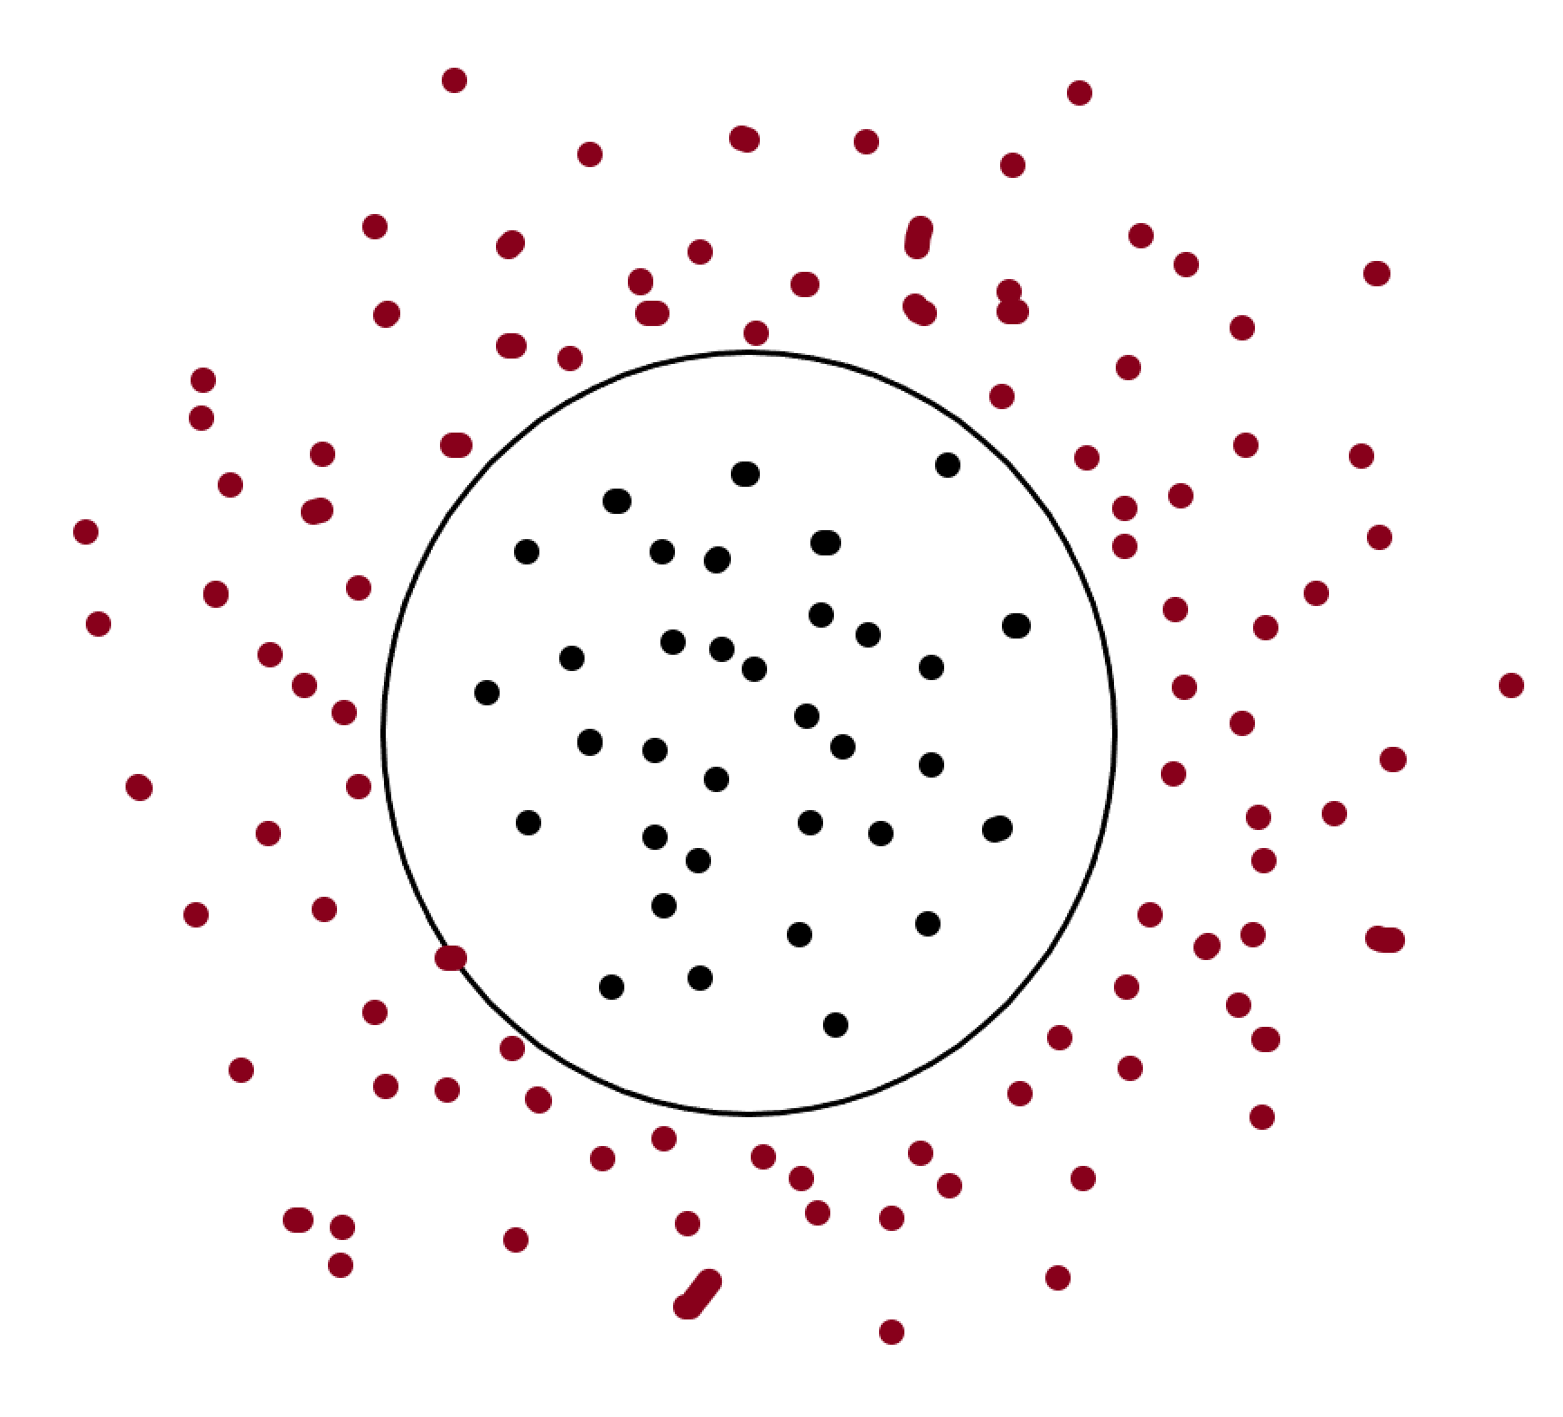
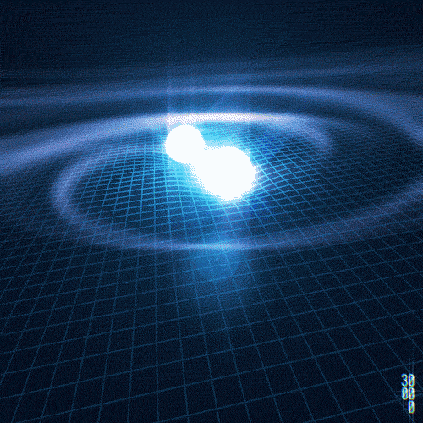
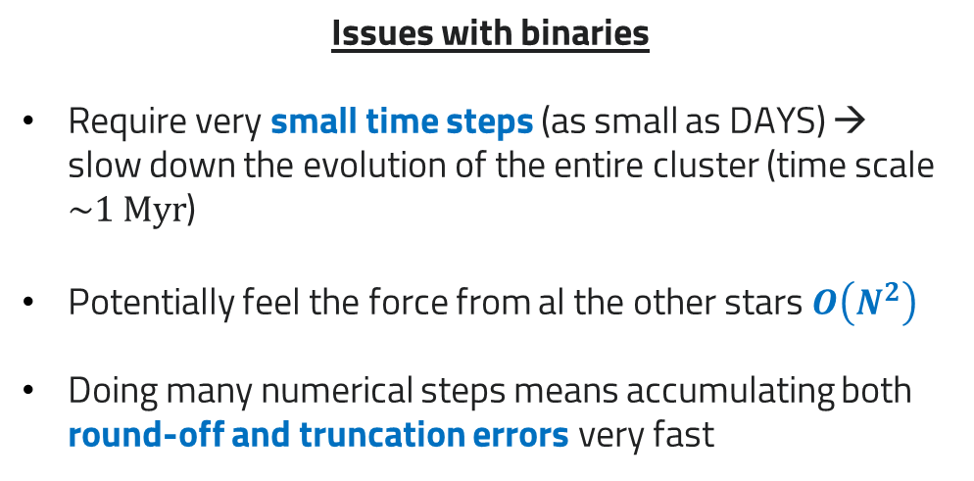
Technical Objectives, Methodologies and Solutions
Brute-force approach is not feasible – not because of $O(N^{2})$ complexity, but mainly for BINARIES
Issues with binaries
Require very small time steps (as small as DAYS) →
slow down the evolution of the entire cluster (time scale $\sim 1 Myr$)
Potentially feel the force from al the other stars $O\left(N^{2}\right)$
Doing many numerical steps means accumulating both
round-off and truncation errors very fast
ICSC Italian Research Center on High-Performance Computing, Big Data and Quantum Computing
Missione 4 • Istruzione e Ricerca

Slide 6
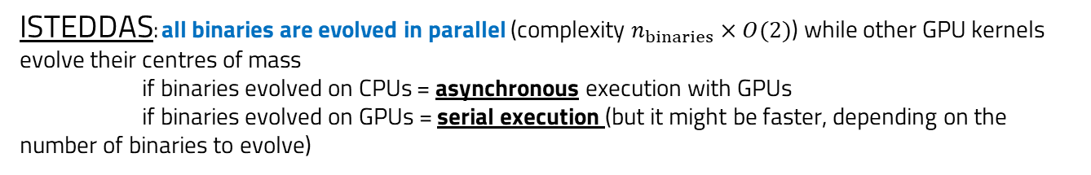
Technical Objectives, Methodologies and Solutions
Neighbors scheme implemented on GPUs + BINARIES
3-level splitting
Total force on 1 star =
very fast-varying contribution (from the companion star(s)) +
fast-varying contribution (from perturbers/neighbours) +
slow-varying contribution (from other stars)
Very fast-varying contribution: dedicated high-accuracy algorithm for perturbed binary systems - (regularization: time coordinate transformation)
ISTEDDAS: all binaries are evolved in parallel (complexity $n_{binaries}×O(2)$) while other GPU kernels evolve their centres of mass
if binaries evolved on CPUs = asynchronous execution with GPUs
if binaries evolved on GPUs = serial execution (but it might be faster, depending on the number of binaries to evolve)
ICSC Italian Research Center on High-Performance Computing, Big Data and Quantum Computing
Missione 4 • Istruzione e Ricerca

Slide 7
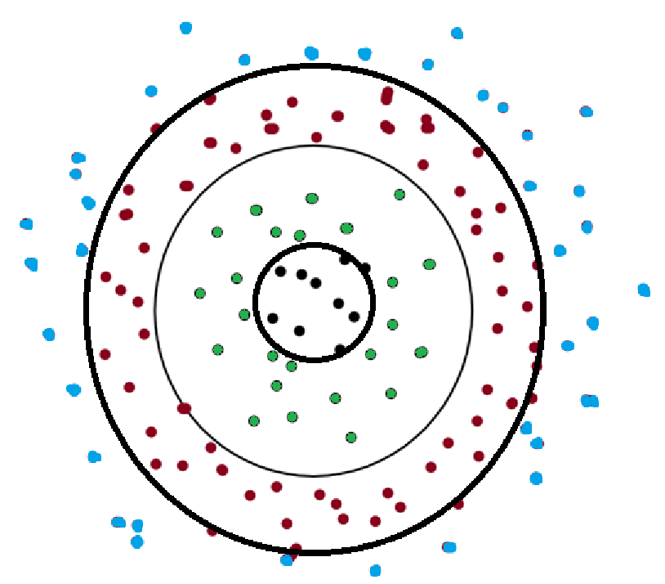
Technical Objectives, Methodologies and Solutions - NEW
Neighbors scheme implemented on GPUs + BINARIES
multi-level splitting
Total force on 1 star = several contribution from various levels (5+ - depending
on the position of the star inside the cluster)
integrator splitting
Integration method
arbitrary order and accuracy for tight few-body systems (e.g., binaries, triples, etc…)
6th order Hermite for neighbor particles
4th order for I-level particles
2nd order for other particles
ICSC Italian Research Center on High-Performance Computing, Big Data and Quantum Computing
Missione 4 • Istruzione e Ricerca

Slide 8
Timescale, Milestones and KPIs
Paper 1: evolutionary history of compact objects in star clusters (e.g., pulsars) – with the first set of preliminary runs
Paper 2: end of project – presentation of the ISTEDDAS code – technical paper
Catalog I: data release of the simulations used to produce Paper 1
KPI-0: implement zero-level neighbors scheme on GPU and interface with stellar evolution – GIT repo with code
KPI-1: perform at least 10 runs of star clusters – needed for Paper 1 – associated catalog and git with results
KPI-2: perform and report on scalability tests up to 64 GPUs (more, if available) – GIT with plots → towards paper 2
ICSC Italian Research Center on High-Performance Computing, Big Data and Quantum Computing
Missione 4 • Istruzione e Ricerca

Slide 9
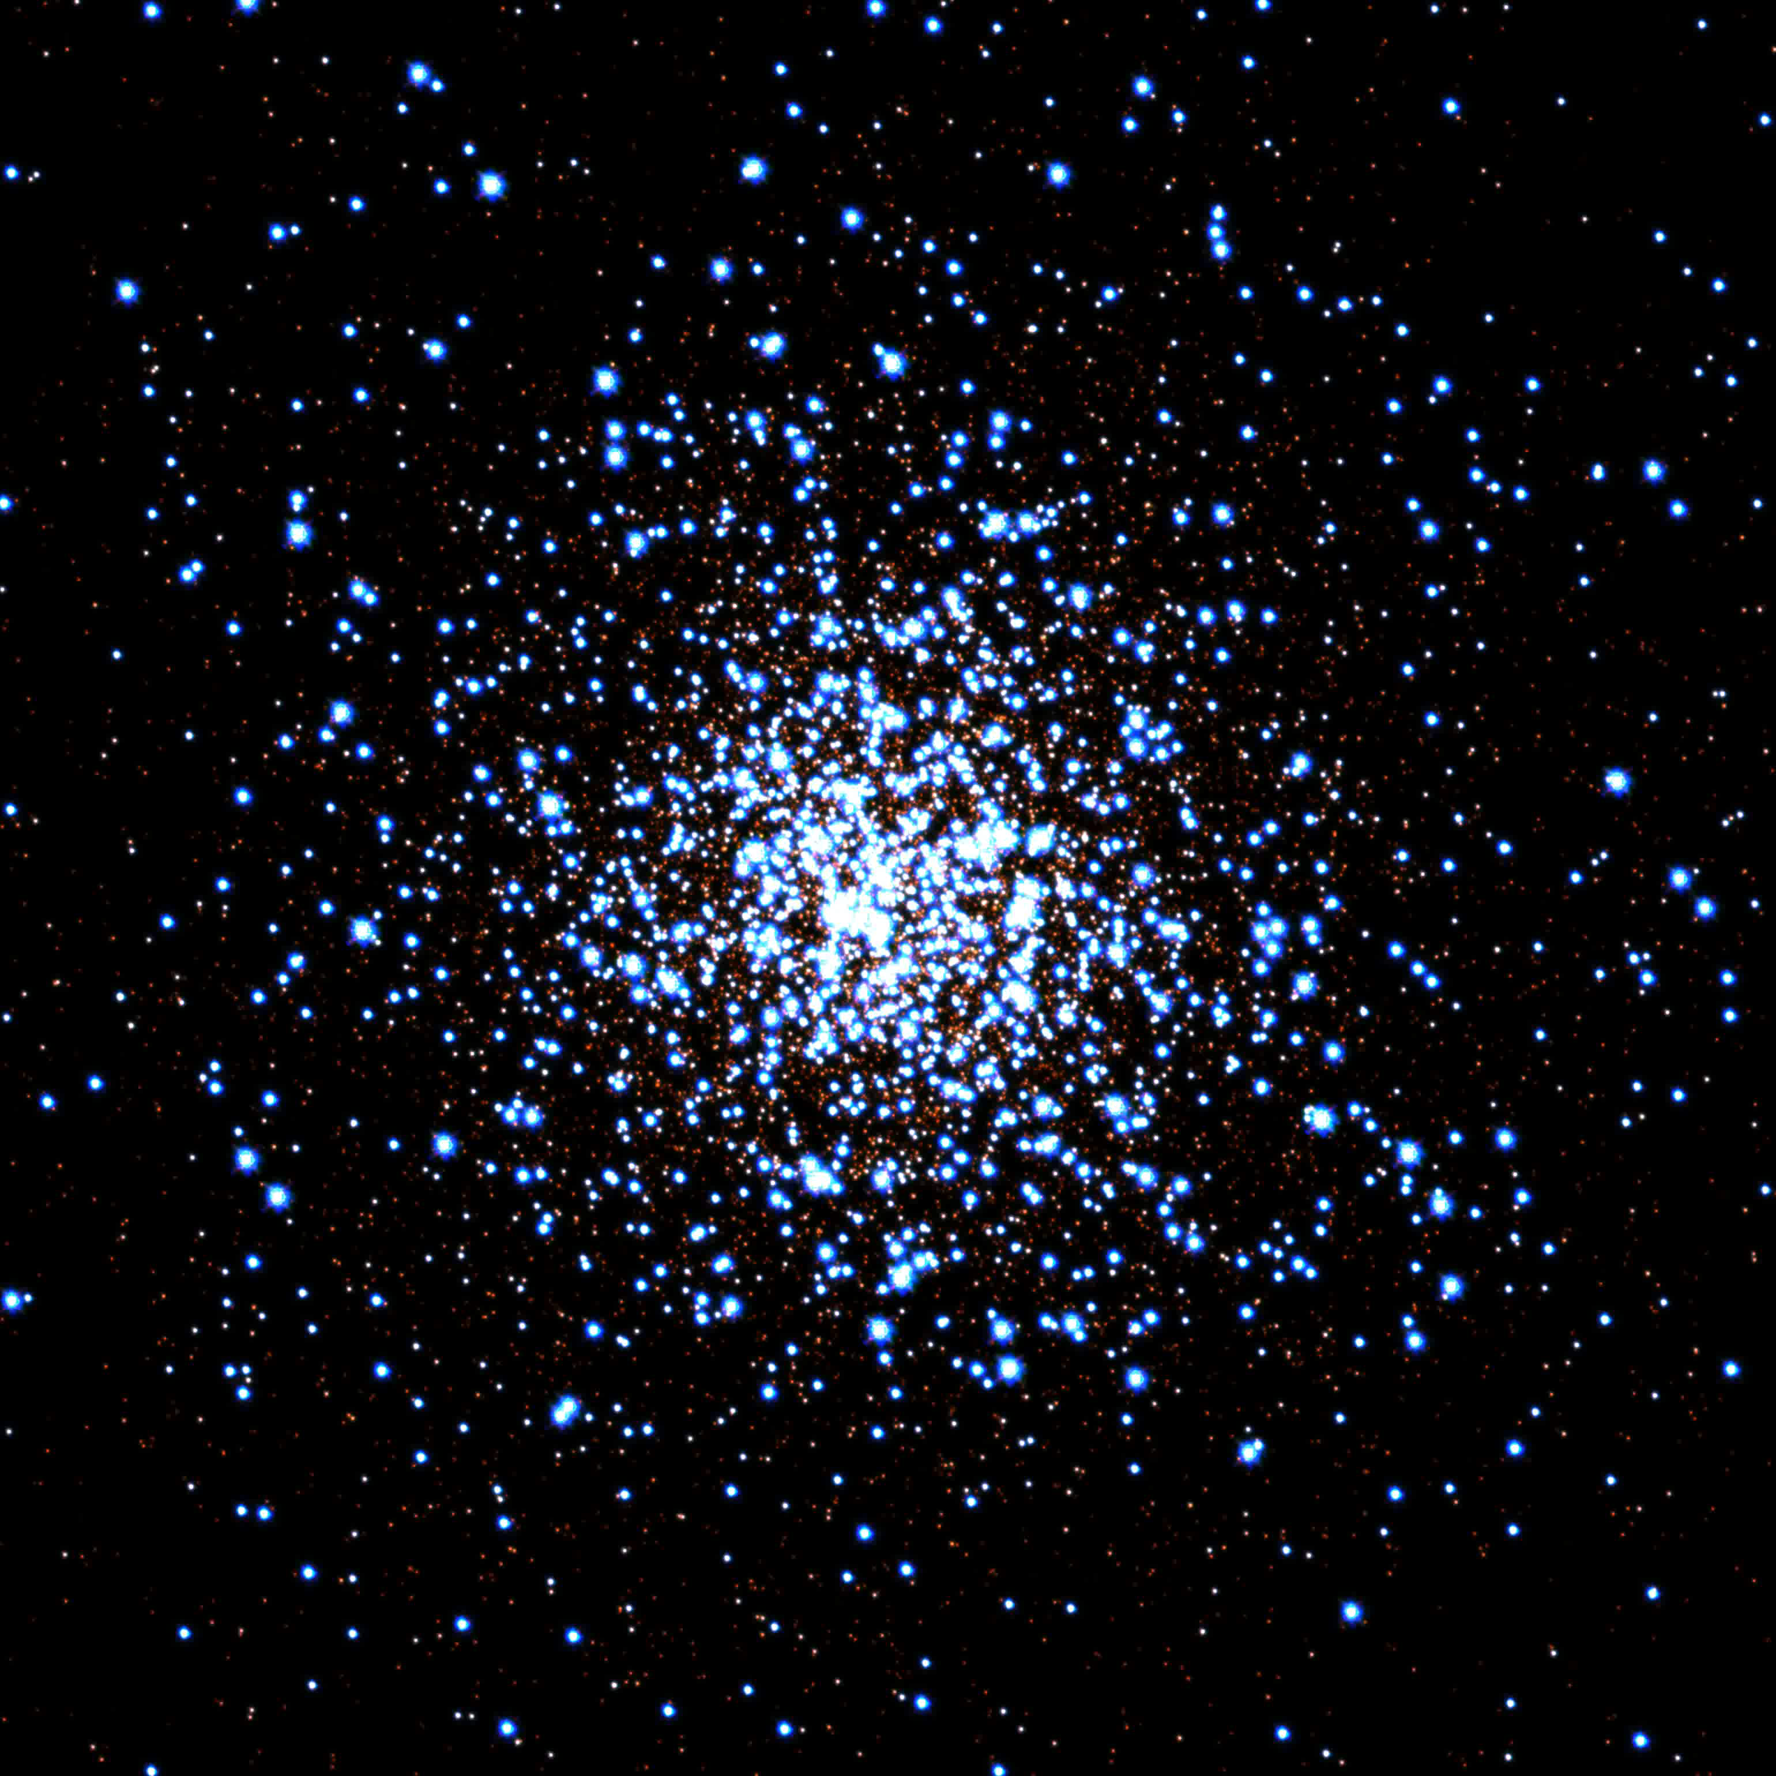
Accomplished Work, Results
First version of ISTEDDAS is ready (preliminary production – see KSP)
KPI-0: all zero-level implementations are in place and working + simple visualization (GIT repo) + stellar evolution (debugged)
ICSC Italian Research Center on High-Performance Computing, Big Data and Quantum Computing
Missione 4 • Istruzione e Ricerca

Slide 10
Next Steps and Expected Results
debug MPI parallelization
improve the decision making for the 2- and 3-level splitting -> turn into multi-level splitting
submit first paper with at least 10 runs and release catalog (KPI-1) -> by end of year
start testing on scalability and understand bottlenecks/how to improve
move towards scalability tests KPI-2 ( > 64 GPUs and new runs)
End of project (main goal – 2025/2026): public (final) release of ISTEDDAS
ICSC Italian Research Center on High-Performance Computing, Big Data and Quantum Computing
Missione 4 • Istruzione e Ricerca

