Slide 1
HPC&co @ OATs
Giuliano Taffoni
Giammarco Maggio

Slide 2
Why are we talking about HPC in OATs?
Notes:
Non e’ sol oHPC ma anche computing

Slide 3
DISCLAMER
HPC resources and Services are an integrated part of the OATs Computing Center.
1
None of the services discussed below will be possible wothout OATs infrastructure and support.
2

Slide 4
OATs computing ecosystem
Resource – HW e Services
People – support and knowhow
Projects – European projects, PRIN, National
Science – Numerical Simulations and data analysys

Slide 5
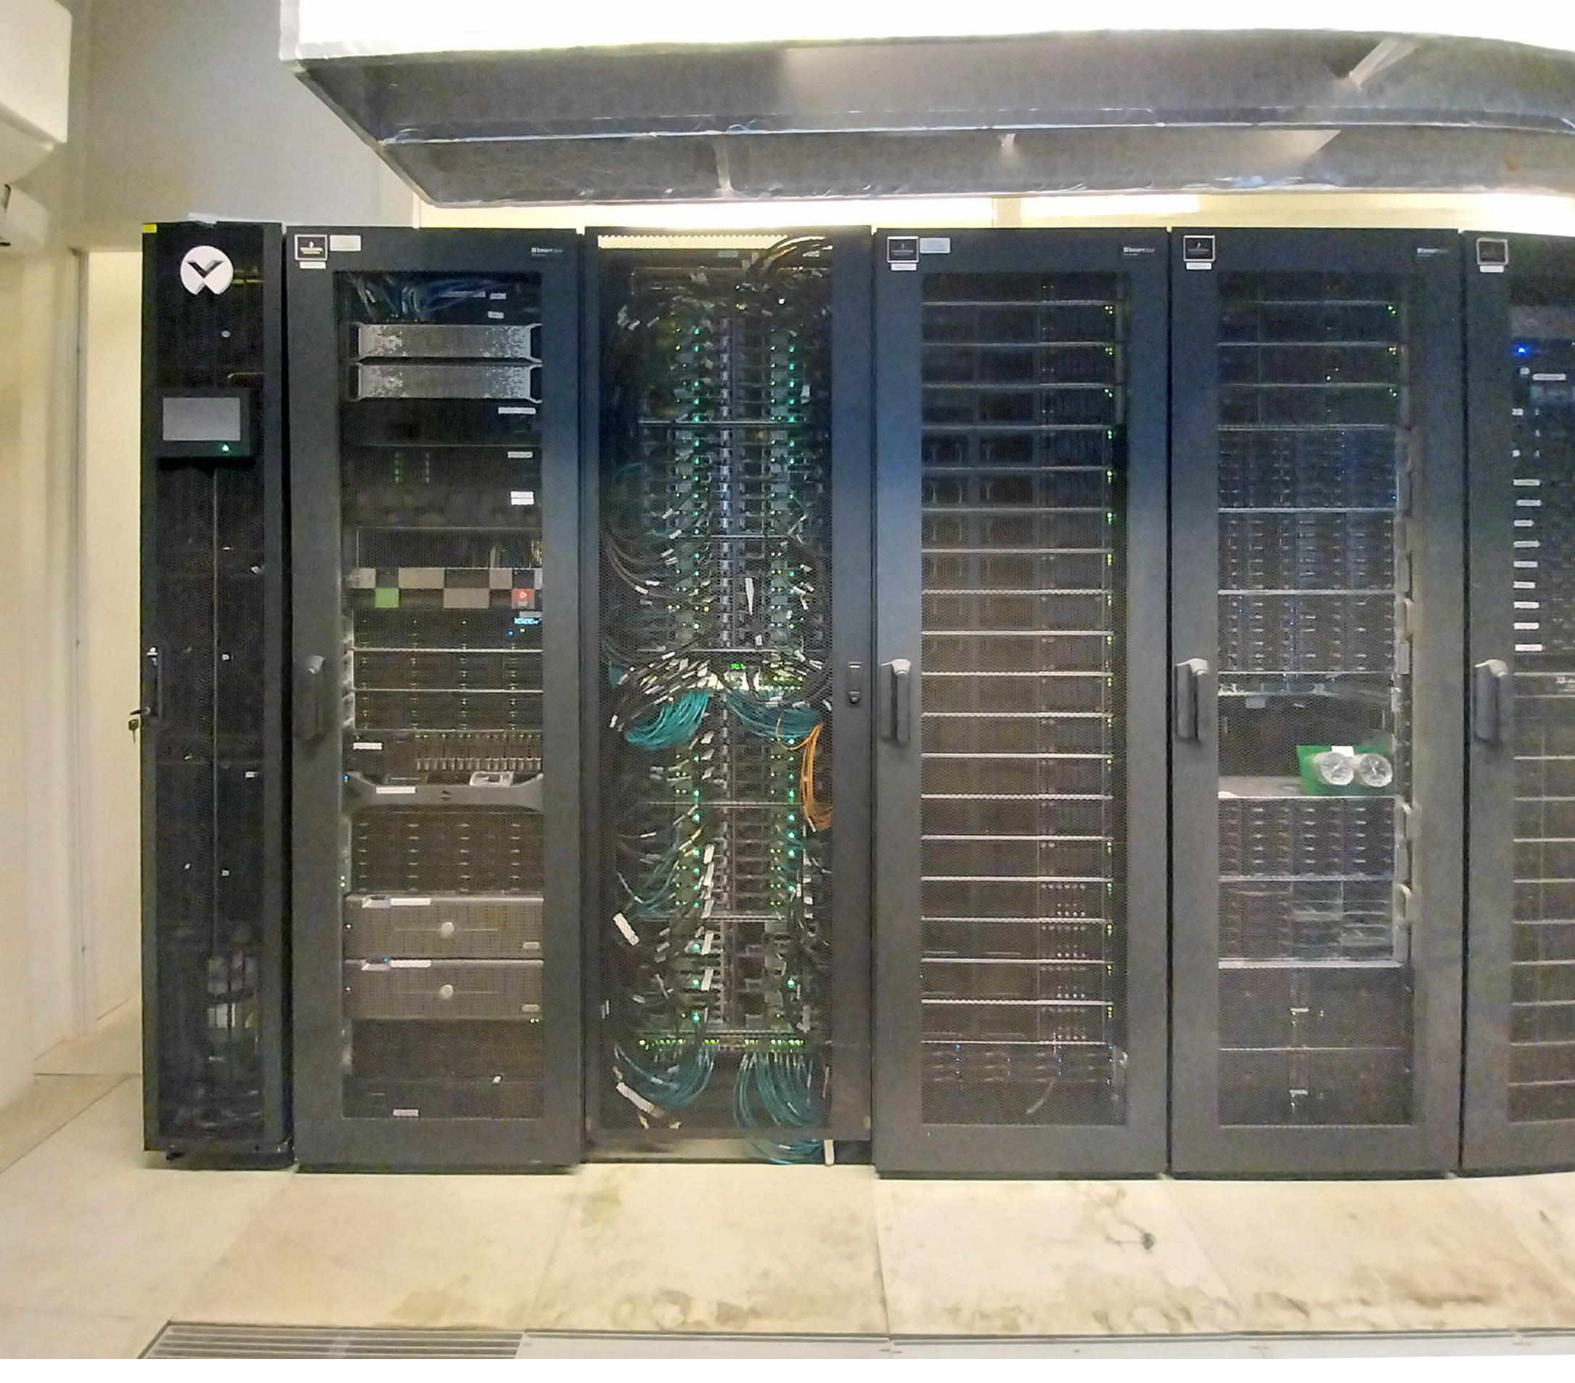
Computing resources
Login node
Scheduling/monitoring
Euclid
Local Cluster
Pleiadi
LOFAR
Almagal
SKA
Calls…
Notes:
Viviamo in un ecosistema dove risorse locali e remote si intersecano

Slide 6
Local Cluster
Type: 15+10 Nodes quad CPU Linux cluster
Node (15) : HPE DL380 Intel(R) Xeon(R) Gold 5118 CPU @ 2.30GHz – 48 cores - 512 GB RAM
Node (10): HPE DL380 Intel(R) Xeon(R) CPU E5-4627 v3 @ 2.60GHz – 40 cores – 256 GB RAM
Performance: 21 Tflop/s
OS: Centos 7
Interconnect: Infiniband 54gbits HPC network + ethernet management network
Accelerators: none.

Slide 7
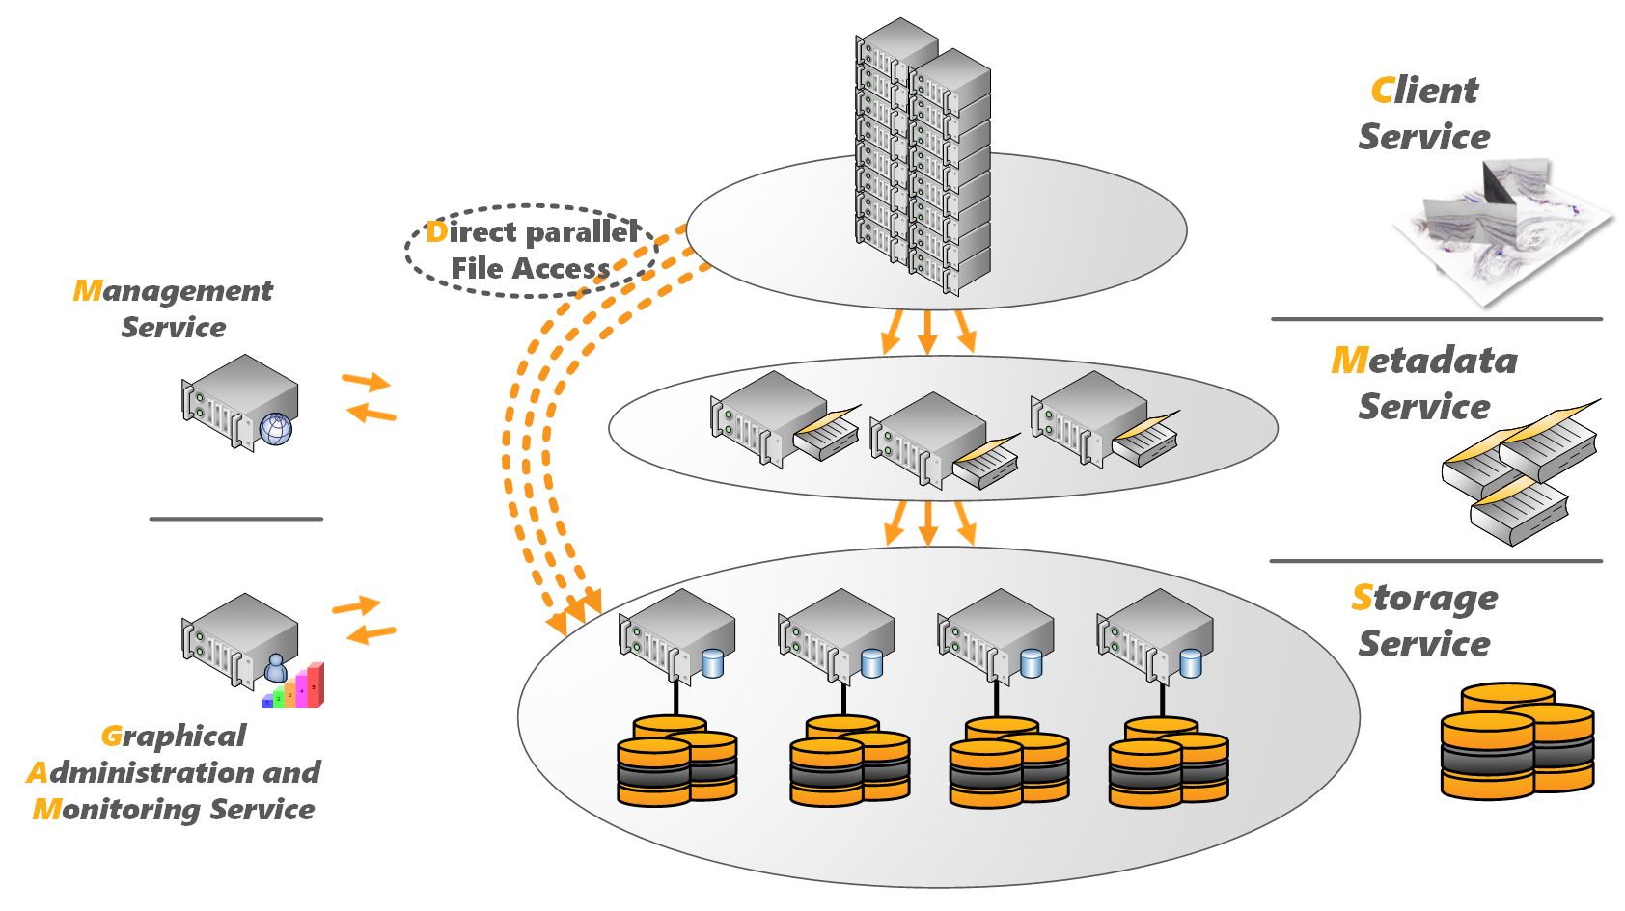
Cluster Storage
Type: SCRATCH 4 Nodes BeeGFS parallel filesystem
Performance: 4 gigabyte/s
Total Storage: ~500TB
Type: HOME (50TB RAID 6) NFS shared
Performance: ~100 megabyte/s
Total Storage: ~50TB
This is a scratch filesystem, it is nota a permanent Data Storage so remove data as soon as work is
completed.
All data will be lost in case of crash.
Secure but not so much

Slide 8
Software and services
Enviroment modules – The Modules package is a tool that simplifies shell initialization and lets users easily modify their environment during a session using modulefiles. Managing compilers, libraries, tools
Container computing – The containers are basically a fully functional and portable computing environment surrounding the application and keeping it independent of local environment running in parallel. Singularity based application packages.
Science platform - Rosetta is a science platform for resource-intensive, interactive data analysis which runs user tasks as software containers, it allows to manage files and computing tasks (including Python Noteboooks) (https://rosetta.oats.inaf.it)

Slide 9
Support
Who we are – Giammarco Maggio, Giuliano Taffoni and… OATs CED
What we do – Maintain and update clusters; manage users and queue; basic support for software.
What we do not do - Debugging, porting, and validating scientific software; Installation, configuration, and management of unsupported software and services.

Slide 10
Spack – manage sw in user space
Spack is a package manager for supercomputers, Linux, and macOS. It makes installing scientific software easy. Spack isn’t tied to a particular language; you can build a software stack in Python or R, link to libraries written in C, C++, or Fortran, and easily swap compilers or target specific microarchitectures.
$ spack install fftw

Slide 11
Enviroment modules
Pre-installed package manager
$ module available
$ module load default-gcc-11.2.0
$ module list
Currently Loaded Modulefiles:
1) gcc-11.2.0-gcc-4.8.5-yqydapx 5) hdf5-1.12.2-gcc-11.2.0-f63xprm
2) openmpi-4.1.3-gcc-11.2.0-djxjqlm 6) cfitsio-4.0.0-gcc-11.2.0-n4aj5l4
3) fftw-3.3.10-gcc-11.2.0-bap3oot 7) default-gcc-11.2.0
4) gsl-2.7.1-gcc-11.2.0-uehbowa

Slide 12
Python virtual env
The venv module supports creating lightweight “virtual environments”, each with their own independent set of Python packages installed in their site directories. A virtual environment is created on top of an existing Python installation, known as the virtual environment’s “base” Python, and may optionally be isolated from the packages in the base environment, so only those explicitly installed in the virtual environment are available.
$ python -m venv /path/to/new/virtual/environment

Slide 13
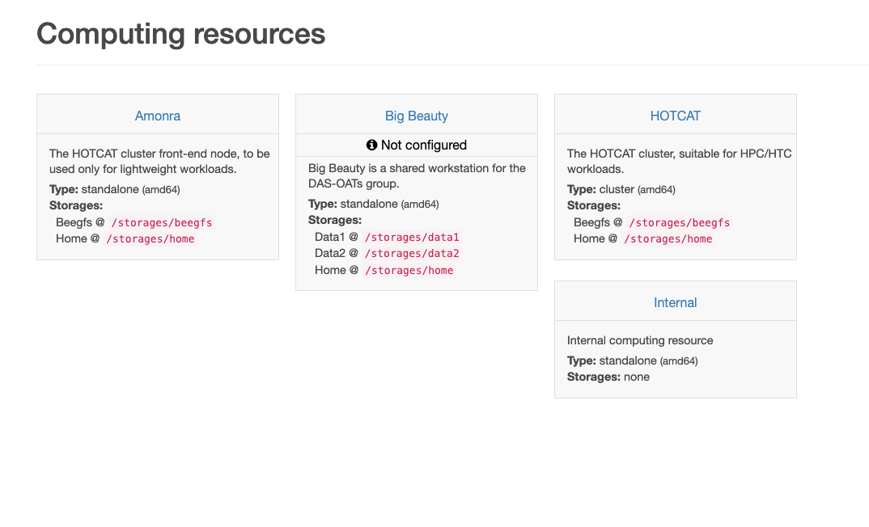
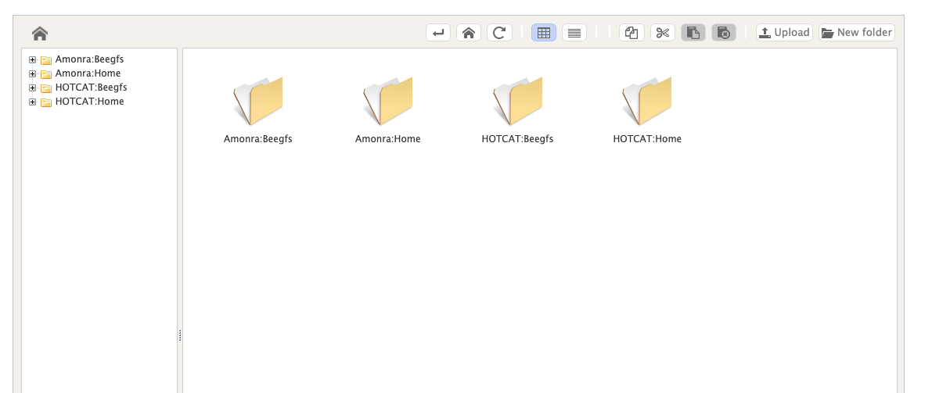
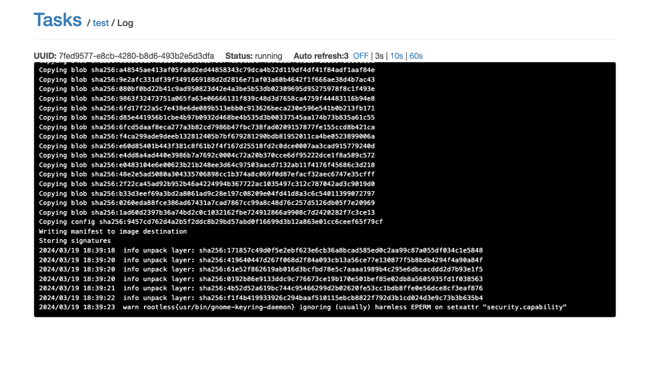
Rosetta

Slide 14
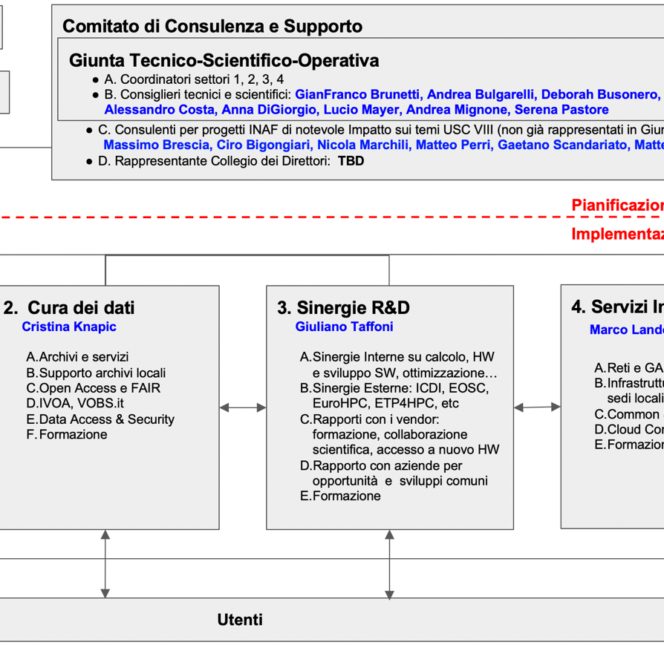
The Central Scientific Unit VIII - ”Computing”
“the main medium-long term objective of USC VIII-Computing is the creation of a computing ecosystem for INAF, capable of supporting, for the next few decades, the current very high competitiveness of the members of INAF in the international arena”

Slide 15
National Computing Resource: Pleiadi
Type: 72 Nodes dual CPU Linux cluster
Node: Lenovo Nextscale Intel(R) Xeon(R) CPU E5-2697 v4 @ 2.30GHz – 36 Cores - 128/256 GB RAM
Performance: 35 Tflop/s
OS: Centos 7
Interconnect: Omni path 100gbits HPC network + ethernet management network
Accelerators: Six "Kepler” K80 GPUs with 24 GB of memory with blazing fast memory bandwidth and up to 2.91 Tflops double precision performance.

Slide 16
We are waiting for MARCONI Nodes (6)
Architecture: IBM Power 9 AC922
Node: 2x16 cores IBM POWER9 AC922 at 2.6(3.1) GHz
Internal Network: Mellanox Infiniband EDR DragonFly+ 100 Gb/s
Accelerators: 4 x NVIDIA Volta V100 GPUs/node, Nvlink 2.0, 16GB
Performance: 32 TFlops per node
CPU (nominal/peak freq.) | 691/791 GFlops
GPU | 31.2 TFlops

Slide 17
CINECA MOU
MoU INAF-Cineca 2022-2023-2024. 2.5 Mcore/hours available on LEONARDO BOOSTER
1.5 M std-h, best before 1/8/2024

Slide 18
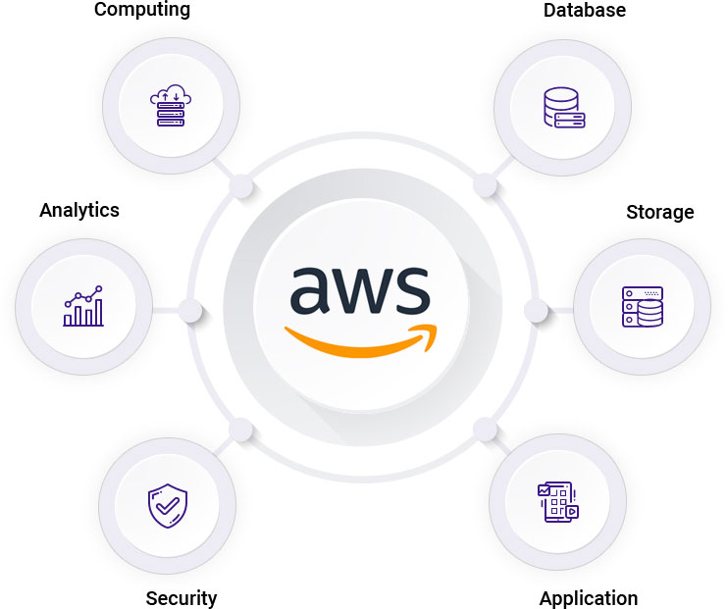
Cloud Computing
Amazon Cloud INAF agreement…
https://docs.google.com/forms/d/e/1FAIpQLSeXW0Rm20-FGYmU7JRzLEaVioK-fO4DERBUtTcqgC3QeYnoFQ/viewform

Slide 19
HOW TO APPLY
Periodic National Calls
On demand resources
Availble for all INAF staff
https://forms.gle/QD2gGZhmgbvW1ATi7

Slide 20
New Investments
Infrastructures available in the short/medium term at Tecnopolo-Bologna
TIER-3 sized storage+computational system
In the process of defining the call for tenders: Cineca – INAF joint action. System aimed at putting storage and hardware associated with it into operation for use in SKA-precursors, Pathfinders and relative development environments. STORAGE LONG TERM: Tape Library with LTO tapes ≈ 6 PB expandable up to 100 PB
Slow-medium speed STORAGE on disks: ≈ 4-5 PB
High speed STORAGE scratch on disks: ≈ 2 PB
Computational nodes. 40 FAT nodes: 2 CPU x86 (>= 48 cores) and 1TB RAM; 14 Accellerated nodes: 2 CPU x 86 (>=48 cores) and 512 GB RAM, 2 CPU x node with 80 GB memory, CUDA compatible
TIER-2 sized system integrated in a TIER-1 sized system
Investment of the CN-PNRR for the needs of INAF and CNR: 7 million euros in total purchase. Owned by CINECA, use guaranteed (although not exclusive) for INAF. Expected capabilities for INAF: about 4 Pflops (Data Centric Nodes and Booster Nodes) and about 2 PB high speed storage

Slide 21
Synergies in R&D
Bottom-up approach
Building an environment that facilitates the aggregation between RIC/TEC INAF who work on similar issues, for example by helping the establishment of distributed working groups, on the model of those that have already been formed (e.g. control software).
Enhance INAF's rich heritage of knowledge in the field of "scientific computing" by giving visibility to the groups and RIC/TECs working in the various fields.
The aim is to facilitate the identification of skills to be spent in different areas (e.g. European projects, large INAF projects, etc.)
Make sure that RIC/TEC have a point of reference on issues related to "calculus" to which they can refer.

Slide 22
Sinergies R&D
Schools:
HPC school for INAF - https://indico.ict.inaf.it/event/2785/
Research groups:
HPC
Machine Leaning
IDEAS?

Slide 23
Questions?
Thanks for your attention

